Slide 1


Word 2021 Proofing & Review
Intermediate Level

Slide 2
NITHA IT Helpdesk
helpdesk@nitha.com
1(306)953-5008

Slide 3

What will we be covering in this course?
Course Prerequisites
Checking the Quality of Your Document - Out for Review
Proofing Options – General
Viewing Two Documents Side by Side
Proofing Options – AutoCorrect Options
Merging Reviewer Documents into Your Original
Proofing Options – AutoCorrect Options Tabs
Comparing
Review Ribbon
Combining
Checking the Quality of Your Document - Proofing
Doing a Review of Another’s Document

Slide 4
Prerequisites for this course?
Assumption 1:
I will assume you have basic knowledge of Word: navigation, screen layout, etc.
Assumption 2:
You must know the following:
  What are ribbons, both regular and contextual?
  How to create new documents, both blank and from a template.
What is a dialog box and what is a window pane.
Our goal is to understand proofing methods:
how to send your document out for others to review
how to incorporate others’ suggested changes from others into your document.
To accomplish our goal we will have to:
Know the proofing settings in the options.
Understand the Review ribbon, its functions, and the review process.

Slide 5
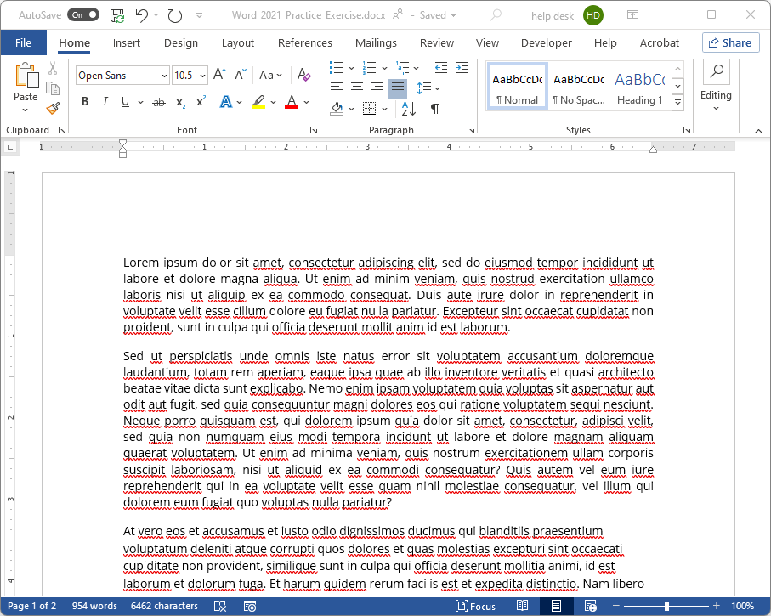
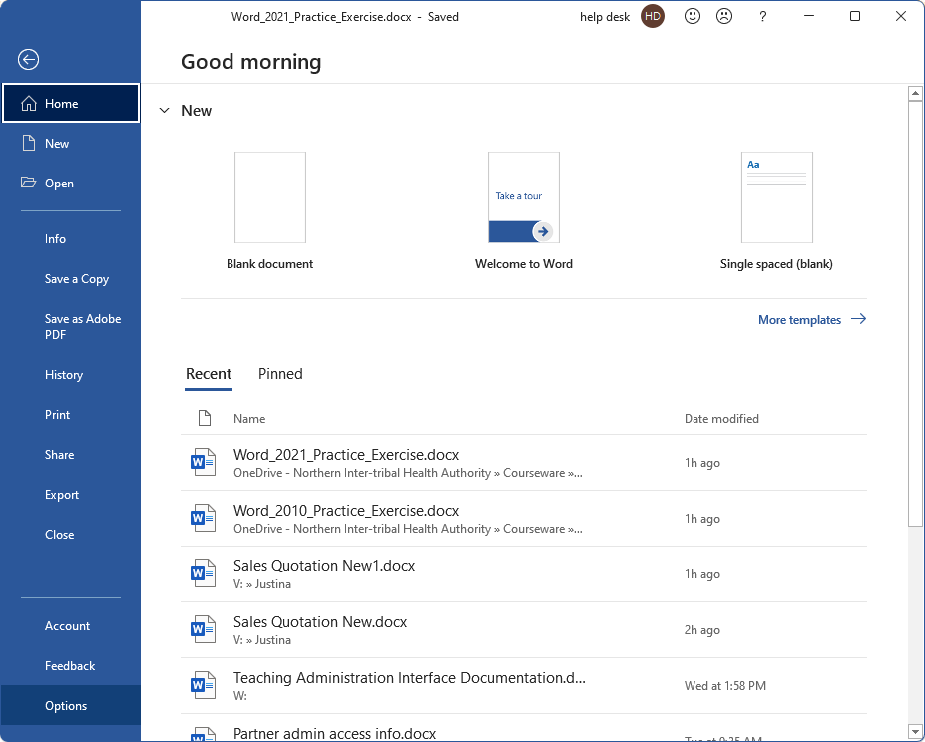
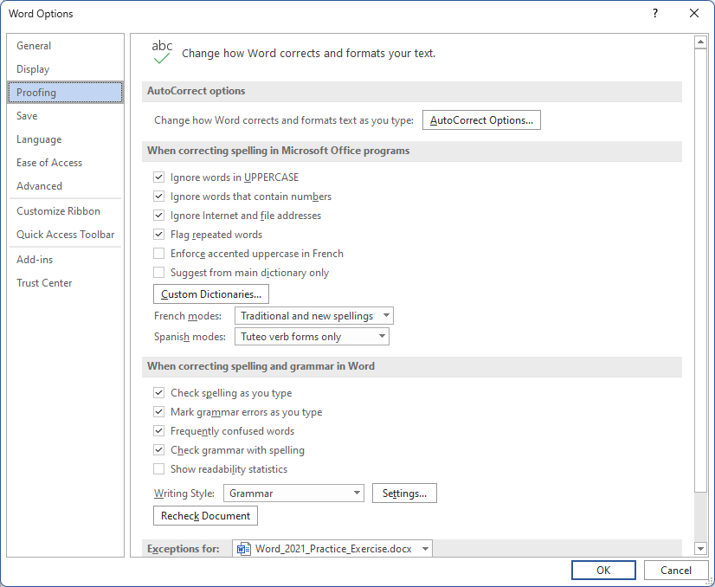
Proofing Options – General
Click on the File tab.
This is called the Backstage
Click on Proofing
AutoCorrect Options
Click on the Options

Slide 6
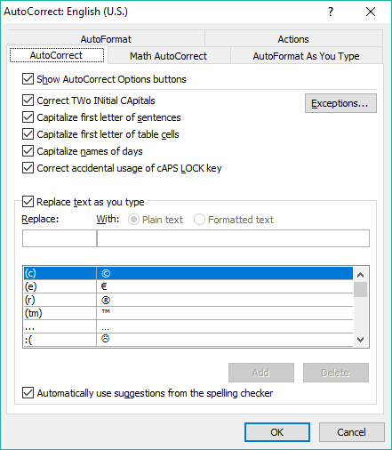
Proofing Options – AutoCorrect Dialog
Overview
AutoCorrect – Deals with the rules and conditions which define how Word is to auto-correct as you type. You can add your own auto-correct pairs. A pair is where one character is replaced with its’ paired symbol.
AutoFormat – Deals with the auto-correction rules and conditions of grammar styles.
Math AutoCorrect – Rules that deal with the auto-correction of math symbols as you type. You can add your own recognized math functions as well.
Actions – Add right-click context menu actions for specified words or phrases. You can add your own context menu options.
AutoFormat As You Type – Allows you to control in detail how auto-format is applied.

Slide 7
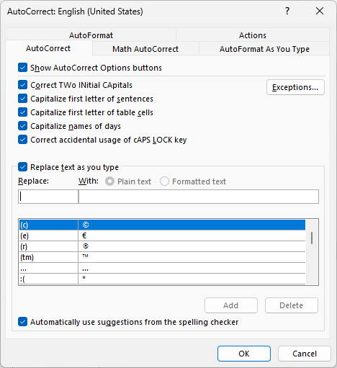
Proofing Options – AutoCorrect
AutoCorrect Options
AutoCorrect Tab
The AutoCorrect Options button appears at the bottom right when you paste. This option toggles that on or off.
If you hold down the Shift key just a millisecond too long while typing, you get the first two characters uppercased. This corrects that.
Automatically capitalizes the first letter of a sentence.
The first letter in the first word in a table cell is automatically uppercased.
Capitalize the first letter of names of days

Slide 8
Proofing Options – AutoCorrect
If the caps lock is on when you type, uppercase and lowercase are flipped.
This option fixes that for you when you end the sentence.
Replace words as you type if spelled wrong.
To add to this list: enter what incorrectly spelled word you want to replace with the proper spelling.

Slide 9
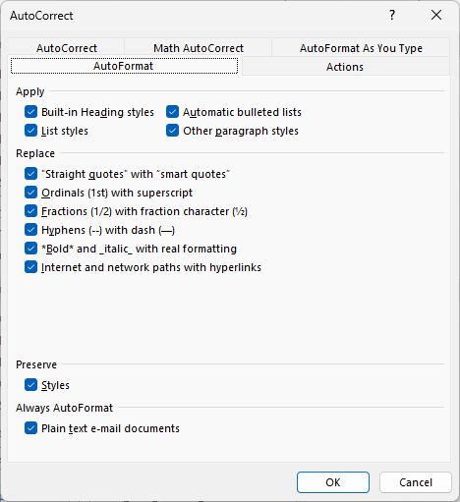
Proofing Options – AutoFormat
Apply some styles automatically.
Replace various characters with alternate characters.
Preserve styles or not.
Always AutoFormat plain text in email documents.

Slide 10
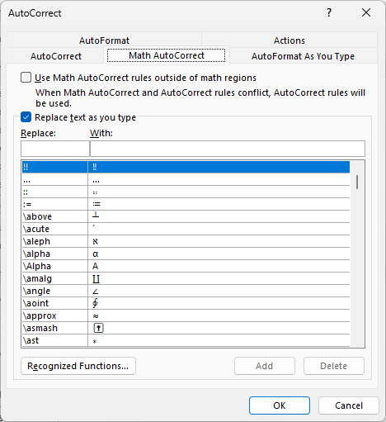
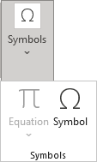
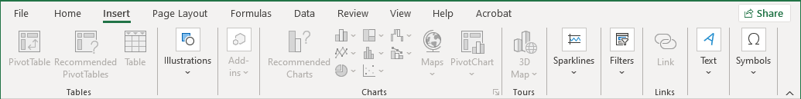
Auto-correction – Math AutoCorrect
Math Auto-Correction is similar to AutoCorrect in that you have a list of text items that, when typed into the cell or text box, are then replaced with other text.
The difference is that in this case you can insert math symbols that you would otherwise have to go to the Equations dialog to insert.
These math symbols can also be accessed through the Equation dialog found in the Insert ribbon and in the Symbols group.

Slide 11
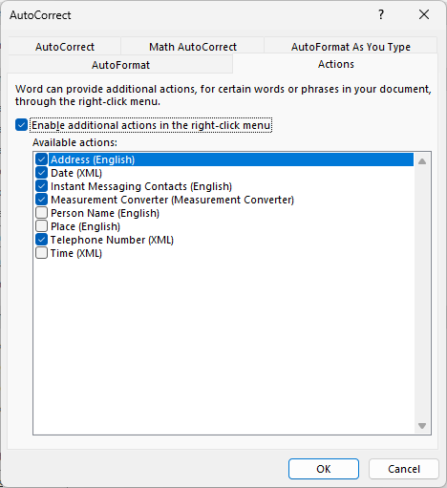
Auto-correction – Actions
Word provides a mechanism for adding additional actions to the right-click context menu.
Click on this checkbox to enable additional actions.
Each of these items will be added to the right-click context menu.

Slide 12
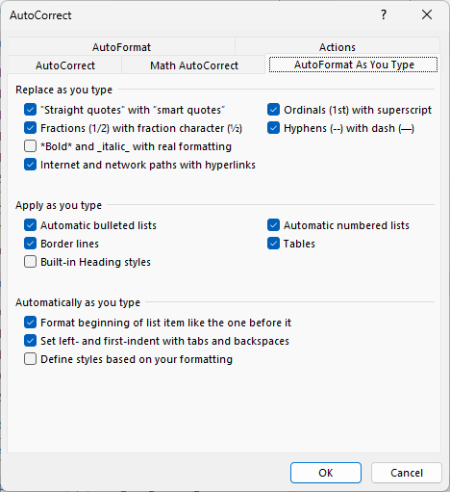
Auto-correction – AutoFormat as You Type
These options replace the text you typed with characters difficult to add to your document.
Applies formatting as you type, but does not replace the text you type as “Replace as you type” does.
Some more options to replace text as you type.

Slide 13
Proofing Options – General Options
Most uppercase words are usually meant as a visual style or contextual emphasis, such as to represent shouting.
Some words contain numbers. Check to ignore words with numbers embedded.
Any links to files and/or hyperlinks are ignored.
When two identical words appear one after the other, do you want them flagged?
If so, check this option.
Note that any words you add go into your custom dictionary. The Microsoft default dictionary cannot be modified.

Slide 14
Proofing Options – General Options
If you want the proper accent marks, such as; é –acute, ê –circumflex, è –grave, and ë – the Trema.
Where such accents are required, do you want them flagged as spelling errors when not present? Check the box if yes.
When you add words to your dictionary, those words are stored in a separate file from the main word file. You can force the use of this dictionary only.
This is where you manage the other dictionaries added.
You can choose from two other modes, French & Spanish.

Slide 15
Proofing Options – General Options
When two identical words appear one after the other, do you want them flagged? If so, check this option.
Marking grammar errors while you type is the same as spelling mistakes, except the line under the text is green, not red

Slide 16
Proofing Options – General Options
Check for those works that can get confused with each other, such as when to use “then” as opposed to “than”.
This option simply delays the grammar check until you manually perform a spell check. The check is done at that time.
Discover your grammar mistakes as you type, but be aware that this can lead to laziness in learning the correct grammar when it fixes it for you automatically.

Slide 17
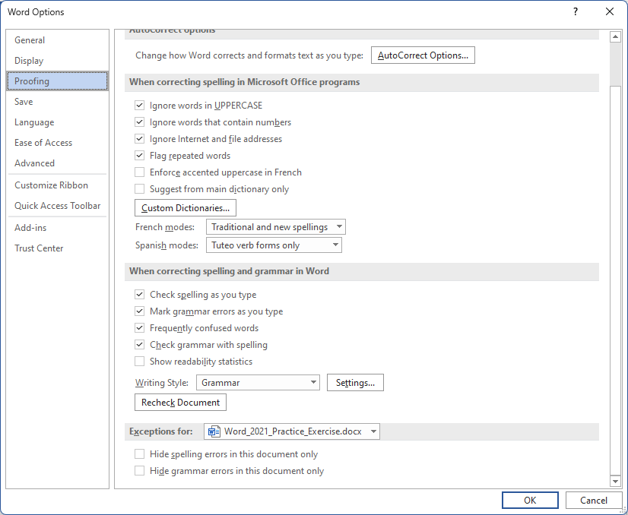
Proofing Options – General Options
Exceptions can be made to the rules above when checking for spelling and grammar mistakes in each document you have open.
Hide spelling mistakes
Hide Grammar mistakes

Slide 18
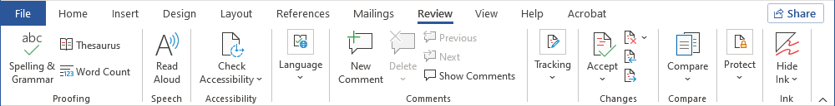
Review Ribbon
Start a Spelling & Grammar check.
Check for disabled accessibility.
Set the preferred language.
The Tracking group handles changes to your document that occur through the review process.
When initiating a review on your own or another’s document, click on the Track Changes button first.
The Markup menus provide options for marking the document for review.
Pull up the Research pane or check the Thesaurus for bigger, loftier-sounding words.
The research pane includes the Thesaurus. It appears on the right side.
Adding comments is usually done by others when they review your document or when you review another’s document.
Then, in the review process, you can choose to accept or reject the changes submitted by those who reviewed your document.
When reviewing the recommended changes to a document, the comments appear beside the document in a balloon box but do not change the document structure or pagination.

Slide 19
Review Ribbon
Accept or reject a proposed change to your document from your reviewers or cycle through the recommended changes.
Compare two documents, your original with a reviewed document, then combine from one or more documents.
The Compare command starts the review process.
The Combine command in this same menu finalizes the review process.
Protect your document with a password.
If you have your document saved in a shared location, you can block any specific text or all text from being changed by specified authors while allowing controlled access.
The author(s) you can block or allow to modify certain text are those on your domain.
On devices that have a touch screen, you can draw on the screen in Word. This option hides your drawings.

Slide 20
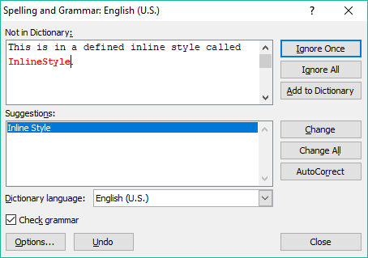

Start the proofing and review process by checking the quality of your document by proofing.
The first step is for you to use the tools built into Word:
  Check the spelling & grammar
Place the cursor in the document where you want to start a spelling check, usually at the beginning, and click on the button on the Review tab.
The top box lists the word it did not find in either the Microsoft-provided dictionary or your custom dictionary.
If it has any suggested spellings of the word, they will be listed here.
Of course, you can always choose the language dictionary.
Choose to check the grammar at the same time, or not.
The Options button displays the proofing options, which are also accessible from the backstage Options button that we have already covered.
Undo last change
Close the Spell and Grammar check dialog.

Slide 21
Checking the quality of your document – Proofing
Ignore the spelling or grammar error just this one time…
… or every time it finds the error in the entire document.
You can tell Word that you know better than it does and that you want it to add the word to the dictionary.
It goes into your custom dictionary. If you have it disabled in the options, you will not be able to add the word to the dictionary.
Here is where you can change the word with the one highlighted, or all that it finds in the document
AutoCorrect will change it to the suggestion at the top of the list.

Slide 22
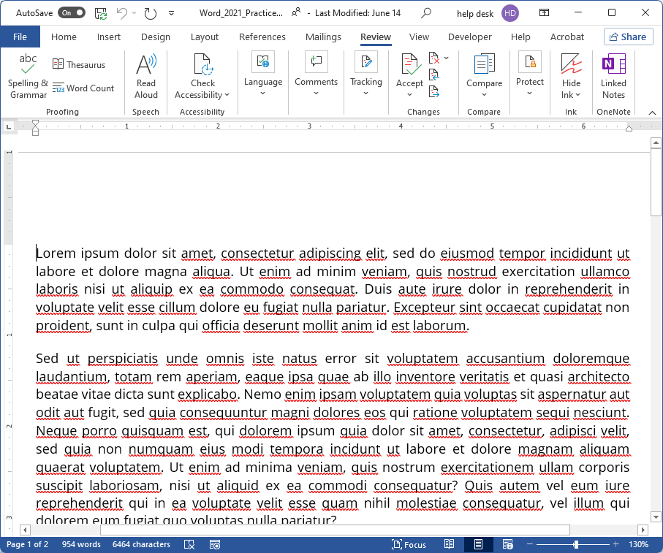
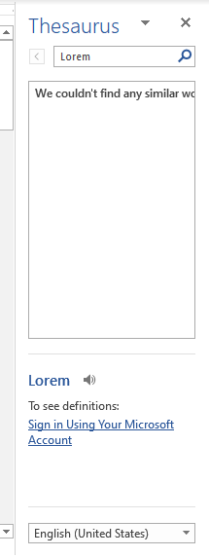
Checking the quality of your document – Proofing
The second step is for you to use the tools built into Word:
With the Thesaurus, you can add those words that best describe your document.

Slide 23
Third: Send your document out for review.
Once you have completed proofing, the next step is to send your document for others to review.
The first part, sending out/sharing your document, is the easiest part.
Send it by email
Save it to a shared drive
Upload it to Dropbox or Microsoft’s OneDrive
Checking the Returned Documents
The second part is for you to accept or reject the suggested changes for each returned document.
When you receive back the reviewed document(s) …
Start by going through each document separately and accepting or rejecting each change, save each one.
How do you go about viewing, comparing, and merging the documents you sent and just received back?
For just viewing two documents, you can set them for viewing using the View Side by Side function on the View Ribbon.
For viewing two places on one document at the same time, you can use the Split screen function on the View Ribbon.
You can use the Compare function found on the Review ribbon. The Compare function starts the merging process.
You can also use the Combine function found on the Review ribbon. The Combine function performs the merge.

Slide 24
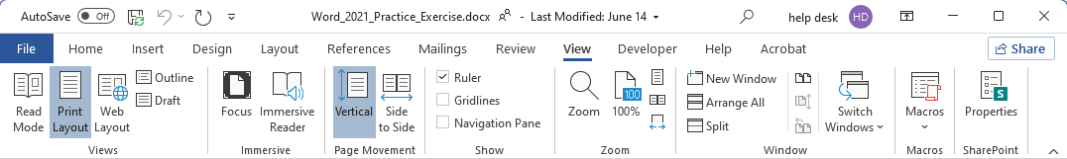
Viewing two documents side by side:
Your original document
The reviewer’s document
Open the second document you want to compare with the first.
Then click on the View tab …
The View Side By Side button will tile the two documents side by side and enable Synchronized Scrolling.
You can check the Switch Windows menu to see if both documents are open.
If you find that they are not aligned side by side, you can click on the bottom button in this set of three and the two document windows reset to be side by side.
You can also split a single document so you can view two parts of the same document by clicking on the Split command.
When you split the screen, the mouse cursor is connected to the split bar until you choose where to place the split. Do this by clicking one more time to place the split bar.

Slide 25
Viewing two documents side by side:
Your original document
The reviewer’s document
Open the second document you want to compare with the first.
Then click on the View tab …
The View Side By Side button will tile the two documents side by side and enable Synchronized Scrolling.
If you find that they are not aligned side by side, you can click on the bottom button in this set of three, and the two document windows reset to be side by side.
You can check the Switch Windows menu to see if both documents are open.
When you split the screen, the mouse cursor is connected to the split bar until you choose where to place the split.
Do this by clicking one more time to place the split bar.
You can also split a single document so you can view two parts of the same document by clicking on the Split command.

Slide 26
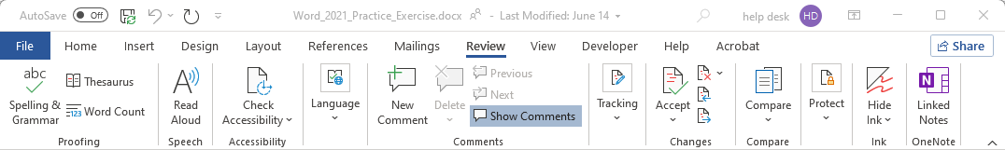
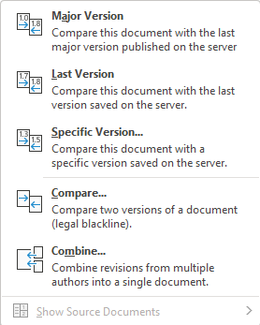
Merging two documents using Compare or Combine
Difference between Comparing documents vs. Combining documents
Use Compare with two documents that do not have revisions marked with Track Changes.
Use Combine with two documents that do have revisions marked with Track Changes.

Slide 27
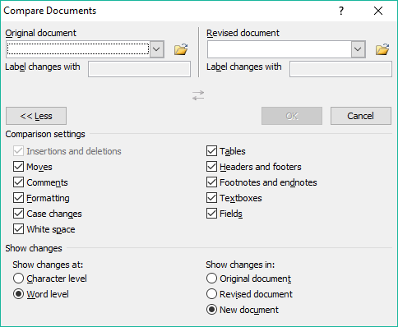
Comparing the reviewer document to your original using the Compare command.
On the Review ribbon, in the Compare group, click on the Compare menu
Even though we will be using the Combine command to merge the documents, we will start with the Compare command to understand the differences, as they look much the same.
Selecting that command will display the Compare Documents dialog.

Slide 28
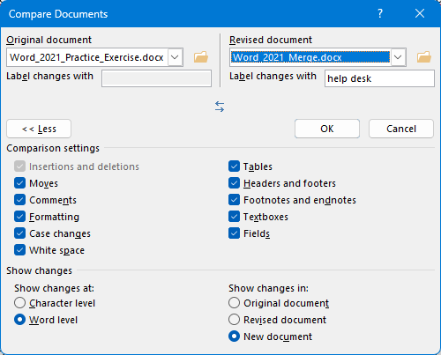
Comparing the reviewer document to your original using the Compare command.
Browse and select one of the returned documents.
Comparing documents enables what is called the legal blackline option, which displays what has changed between the two documents.
The legal blackline is only displayed in the third panel, the compared document.
Browse & select your original document.
These checkboxes allow you to refine the comparison process.
Select or deselect the options as you require.
In most cases, comparing at the word level is sufficient.
Set the location into which the changes are to appear. A new document is usually best, so as not to change the other two documents.
Click on OK

Slide 29
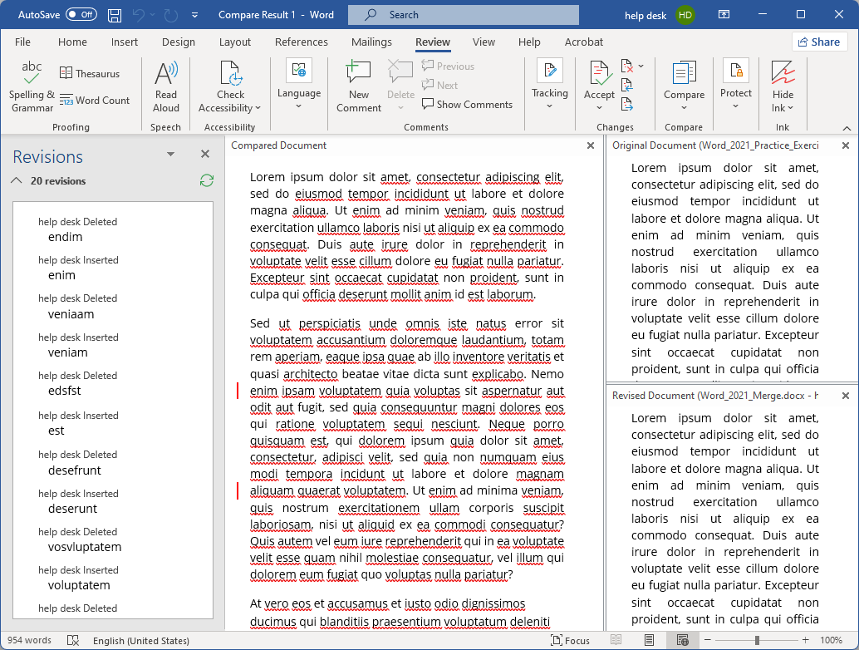
Comparing the reviewer document to your original using the Compare command.
Revisions panel contains a list of all the suggested revisions to your document by the reviewer.
Compared Document panel contains the mixed compared changes.
Original Document panel contains your document as it was before you sent it out for review.
Revised Document panel contains the reviewer document..
Scrolling of these panels is synchronized.

Slide 30
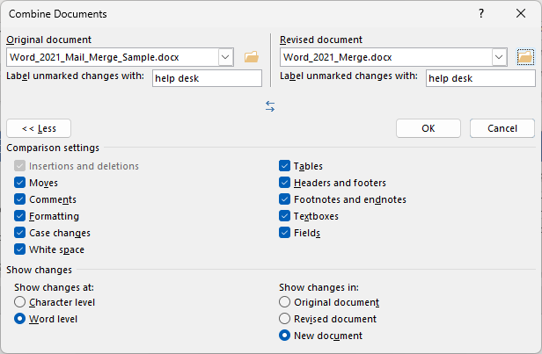
Comparing the reviewer document to your original using the Combine command.
These settings are the same for Combining as it is for Comparing.

Slide 31
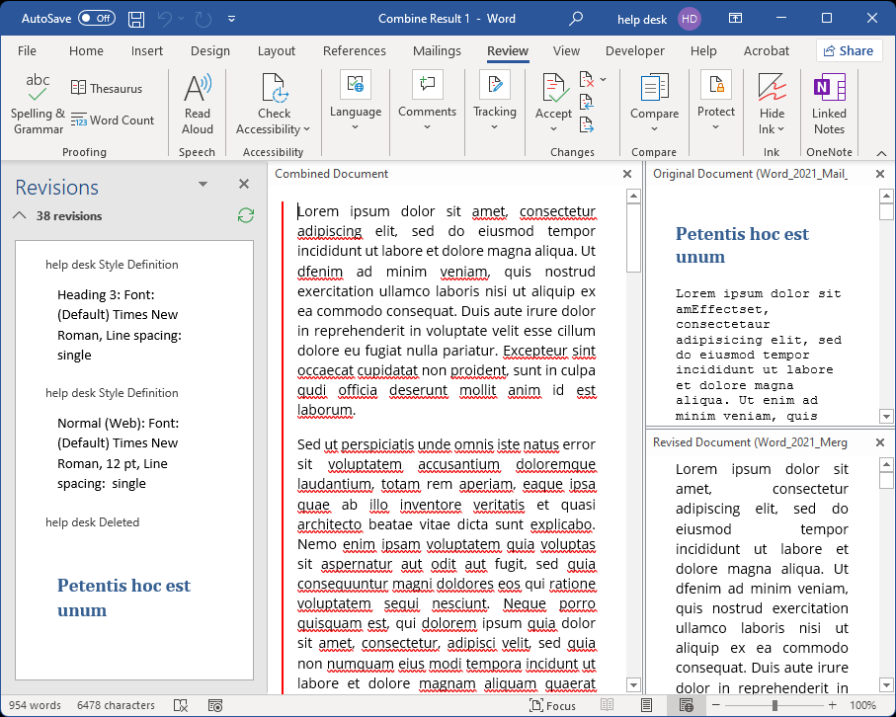
Comparing the reviewer document to your original using the Combine command.
The Revisions panel shows all changes the reviewer has created.
The Combine Document panel shows all changes merged with a new document.
The Original Document panel shows all changes merged with a new document.
The Revised Document panel contains the reviewer’s changes.

Slide 32
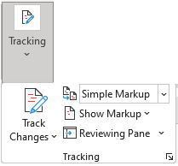

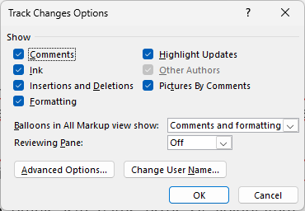
Doing a Review of Another’s Document
First thing to do is turn on the Tracking.
Lock Tracking uses a password to prevent other users from turning Track Changes off.
Second, click on the dialog box launcher and go through the Tracking Options to make sure they are as you want them.
Click on Advanced Options…

Slide 33
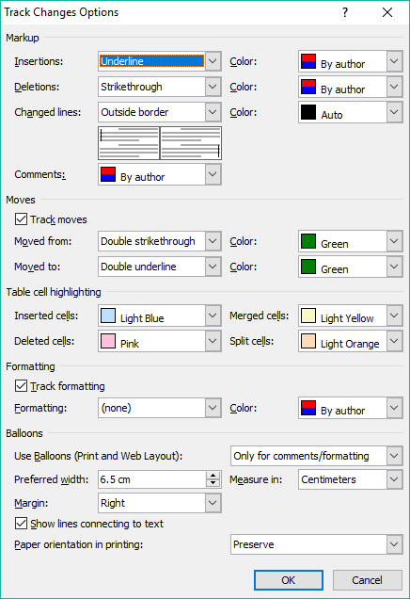

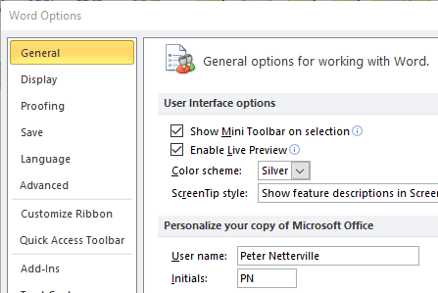
When you make alterations to another’s document, you want to make sure that person knows who made those changes and comments.
That is why this Change User Name menu link is here: to make sure your name is correct.
You can also change the colors, underline, strikethrough and more by changing the tracking options.
Markups
Moves
Change the …
Formatting
Balloons
Third, after setting the options, go through the document.

Slide 34

We have covered here in this course …
Course Prerequisites
Checking the Quality of Your Document - Out for Review
Proofing Options – General
Viewing Two Documents Side by Side
Proofing Options – AutoCorrect Options
Merging Reviewer Documents into Your Original
Proofing Options – AutoCorrect Options Tabs
Comparing
Review Ribbon
Combining
Checking the Quality of Your Document - Proofing
Doing a Review of Another’s Document

Slide 35
NITHA IT Helpdesk
helpdesk@nitha.com
1(306)953-5008

Slide 36

Thank you

