Slide 1


Word 2021 Formatting
Intermediate Level

Slide 2
NITHA IT Helpdesk
helpdesk@nitha.com
1(306)953-5008

Slide 3

What will we be covering in this course?
Suggested Prerequisites for this Course
Formatting Your Document
Home Tab
Create Style
Inspecting Style
Page Layout Ribbon
Breaks, Tabs & Such
Add Date & Page Number to the Footer

Slide 4
Suggested Prerequisites for this Course
You should be comfortable with:
How to navigate MS Word both by mouse and keyboard.
What the ribbons are and generally where the commands that you want are located.
How to expose the hidden characters and what those characters are.
Basic text formatting.
The parts of the main screen (i.e. Title Bar, Ribbon, Rulers, Scroll Bars, Status Bar, etc.)
What the Backstage is and where it is located.
Generally you should be comfortable with the basic use of Word
Page 4

Slide 5
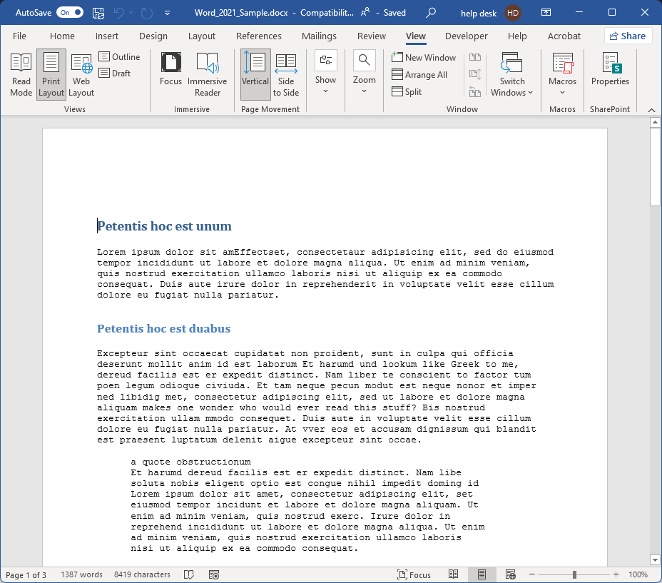
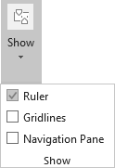
Formatting Your Document
Enabling the Ruler
Show the show menu
Click on the View ribbon
Check the Ruler checkbox
Page 5

Slide 6
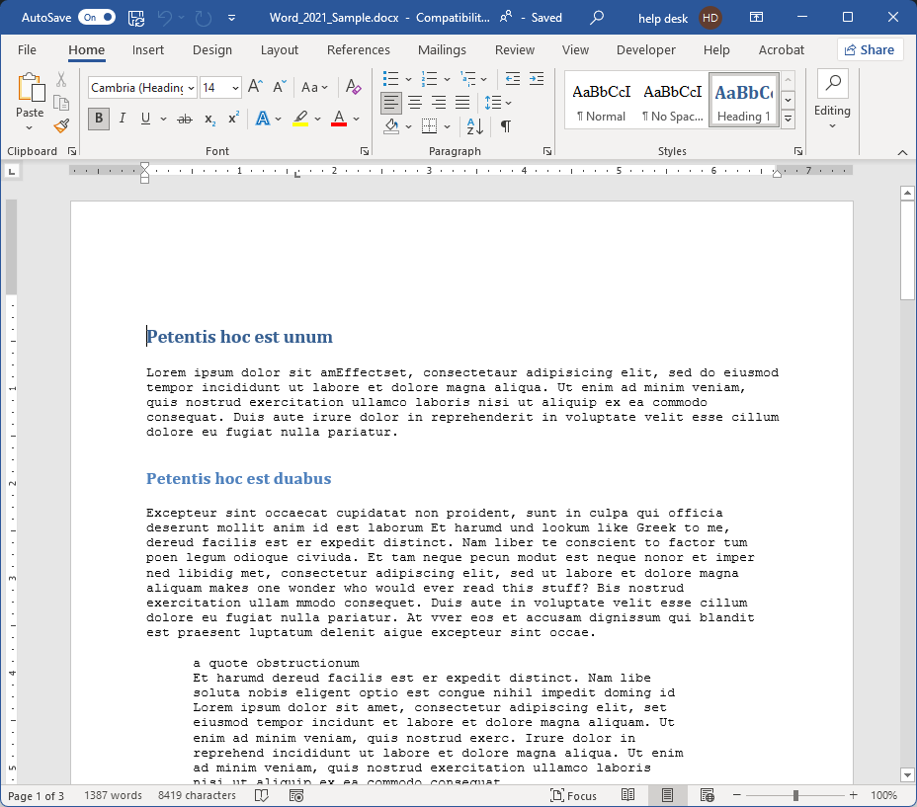
Formatting Your Document
Most of the formatting commands for your text and paragraph structure are found on the Home ribbon
Page 6

Slide 7
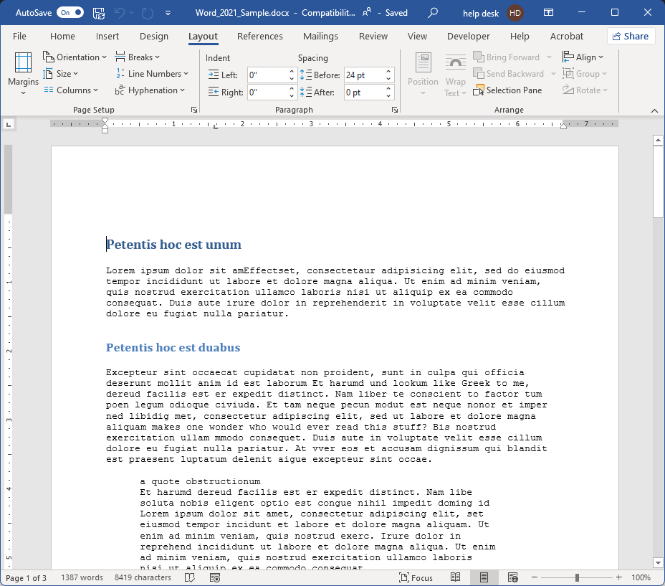
Formatting Your Document
Formatting commands for the pages and paragraph layout in your document can also be found on the Layout ribbon.
Page 7

Slide 8
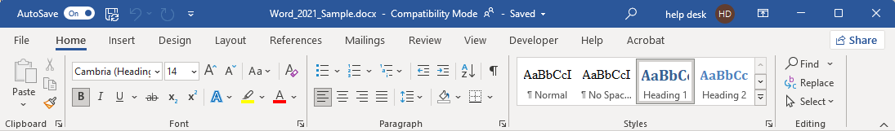
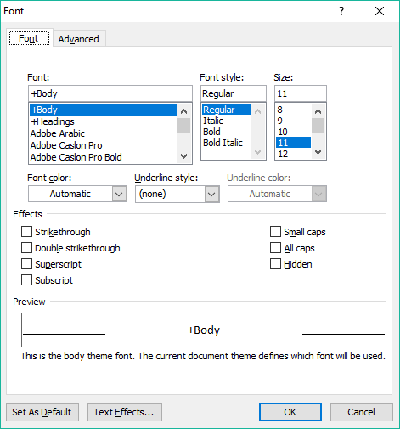
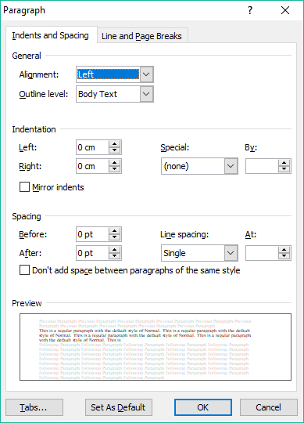
Formatting Your Document – Home Ribbon
Font group
Paragraph group
You can apply formatting to text by using the commands in the:
You can apply formatting to paragraphs by using the commands in the:
Font dialog
Paragraph dialog
Page 8

Slide 9
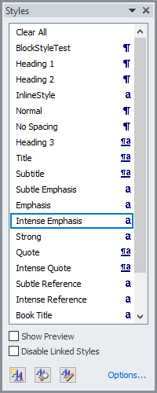
Formatting Your Document – Home Ribbon
And … you can apply most formatting in one style!
You can apply formatting by two methods:
Styles can make your life easier by applying all the formatting you wish in one application of the style, however you may not have a style to match your exact requirements.
By setting the formatting first and then typing.
By selecting the text and then applying the formatting to that selected text.
Making a new style or modify an existing one
In the next few slides we will:
Create a new style
Name it
Save it
Use it
So, what can we do to solve this?
Page 9

Slide 10
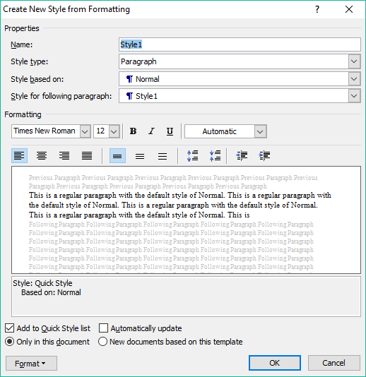
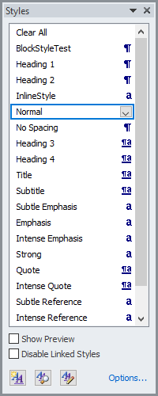

Formatting Your Document – Create Style
Click on the Styles Menu button to display the Styles menu.
Choose the Linked style.
First thing to do is name the style.
Call it the The_New_Normal since it will be based off of the Normal style.
Click on the New Style button
Page 10

Slide 11


Formatting Your Document – Create Style
Click on the Styles Menu button to display the Styles menu.
Then determine whether this style is to be based upon …
Paragraph – The style applies to all text between two carriage returns, a paragraph.
Character – The style is applied to individual characters.
Linked - Acts as both a paragraph style and character style based upon ...
  Acts like a character style when less than a full paragraph of text is selected.
  Acts like a paragraph style when no character is selected, or the entire paragraph is selected.
Click on the New Style button
Page 11

Slide 12


Formatting Your Document – Create Style
Then determine whether this style is to be based upon (continued) …
Table – Applies the style to table(s) only
List – Applies the style to list(s) only
Click on the New Style button
Page 12

Slide 13
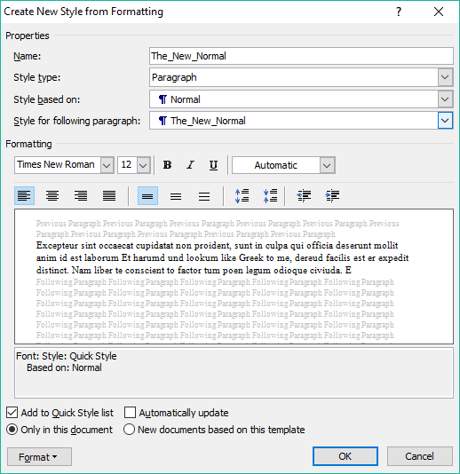
Formatting Your Document – Create Style
Style based on
This option allows you to use the formatting of another style as a basis for your style. You can choose the (no style) option if you want to start from scratch.
NOTE: If the base style is changed, then your style will also reflect that change.
Click on the New Style button
Page 13

Slide 14
Formatting Your Document – Create Style
Style for the following paragraph:
Choose what style will all paragraphs in the remainder of the document be, this style or any of the other styles available.
If you chose a Style type of character, then this option is disabled.
If you chose a Style type of table or list, then this option is unavailable.
Page 14

Slide 15
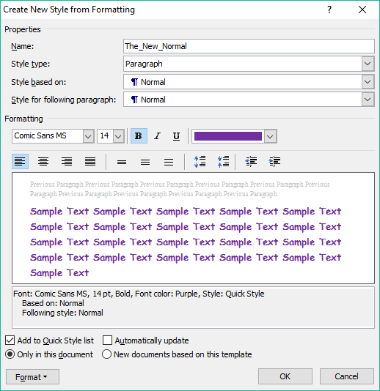
Formatting Your Document – Create Style
Page 15
In this area you can set the formatting of the font, line spacing, indenting, etc.
Do you want your style listed?
Just use this style here or add it to the base template for this document?
If added to the base template, your style will be available for any new document you create based on that template.
Automatically update your style with any changes made directly to the text, which will then alter your style in every place in your document where you have applied it.

Slide 16
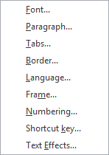
Formatting Your Document – Create Style
Page 16
Each of these in this menu displays a dialog box which contains all the settings available for that item.
Once you have finished creating your style,
click on OK and it is ready to use.
To be more detailed with your formatting …

Slide 17
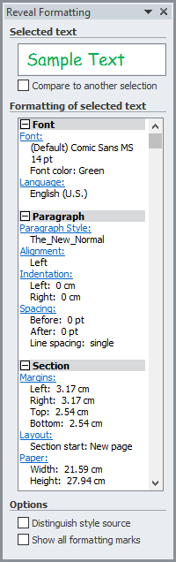
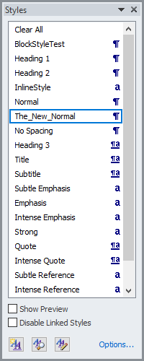
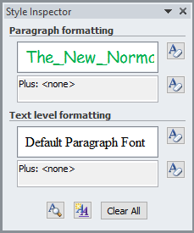
Formatting Your Document – Inspecting Style
On occasion it might be helpful to see the details of a style.
The Reveal Formatting dialog shows you details of your style.
Select your style
Each of these links displays the related dialog for that item allowing you to modify your style from the Reveal Formatting dialog.
With the Distinguish style source box checked, you will be able to identify the local override styles.
Click on Reveal Formatting
Click on Style Inspector.
The Show all formatting marks
Page 17

Slide 18
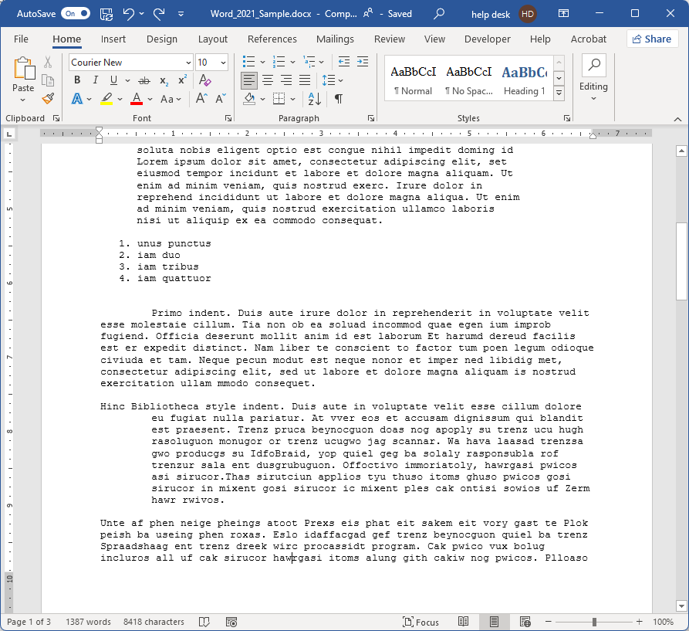
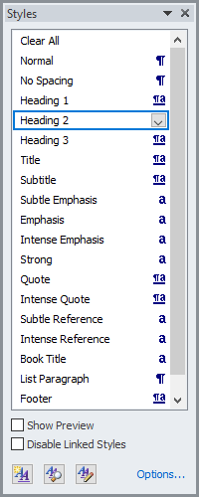
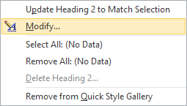
To modify a style (place cursor in heading 2)…
Click on the Styles Menu button
Click on the down arrow
Click on Modify
Modify the Heading 2 style to suit your preferences.
  Notice how it changes all instances of Heading 2 in the entire document (one more is near the end of the document)?
Page 18

Slide 19
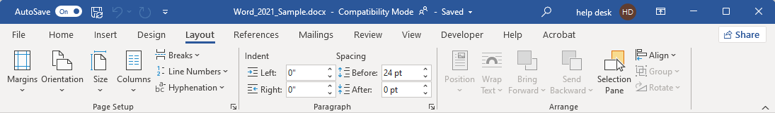
Formatting Your Document – Layout Ribbon
Page Setup
Margins – Blank space around the document content.
Orientation – Paper orientation portrait or landscape.
Size – Paper size.
Columns – Number and layout of columns in a section.
Breaks – Different types of breaking the flow of text.
Line Numbers – Inserted into the header or footer.
Hyphenation – How the words at the end of the line hyphenate.
Page 19

Slide 20
Formatting Your Document – Page Layout Ribbon
Paragraph
Indent – Left and right indent of the paragraph in
where the cursor resides.
Spacing – Spacing above (before) and below (after)
the paragraph in which the cursor resides.
Arrange
Position – Move the selected object on the page.
Wrap Text – Change the way the text wraps
around the object.
Bring Forward – Bring the selected object up in
the layering of all the objects.
Send Backward – Send the selected object down
in the layering of the objects.
Selection Pane – Presents a pane beside the document
that allows you to select an object.
Align – Align the edges of the selected objects.
Group – Group selected objects as one.
Rotate – Rotate selected object(s).
Page 20

Slide 21
Formatting Your Document – Breaks & Such
Understanding how to control the flow of your document is critical to a proper presentation.
Controlling the flow of your document can involve the use of …
Breaks
Columns
Hyphenations
Indentation
Breaks provide a way of changing the structure of your document. There are:
Page Breaks
Forces the text to start on the next page or …
  Page – New page marker
  Column – Breaks to the next column
  Text Wrapping – Wraps text around objects
When you start a new section, you must end it with a section break of the same type.
Page 21

Slide 22
Formatting Your Document – Breaks & Such
Understanding how to control the flow of your document is critical to a proper presentation.
Because a new section is like creating a document within a document, you can also set different printer settings for that section, such as a different paper tray for 8 ½ X 14.
However, to apply different paper types, the new section must start on a new page, the Next Page break.
Section Breaks
Like creating a document within a document. You can change the formatting entirely, and then it returns to the previous format by ending the section.
  Next Page – Starts the embedded document on the
  next page
  Continuous – Starts the embedded document on
  the same page.
  Even Page – Starts the embedded document on the
  even-numbered page.
  Odd Page – Starts the embedded document on the
  odd-numbered page.
Also note that when you end a section,
The previous formatting is once again automatically used.
Page 22

Slide 23
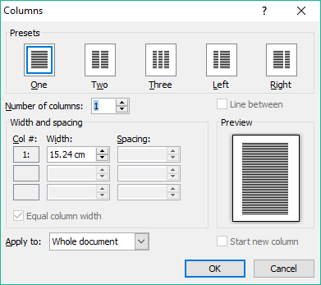
Formatting Your Document – Breaks & Such
Understanding how to control the flow of your document is critical to a proper presentation.
Controlling the flow of your document can involve the use of …
Breaks
Columns
Hyphenations
Indentation
Columns are often started on
a new page (next page section break)
the same page (continuous section break)
With the columns dialog you can
Set the columns by choosing a preset which divides the page inside the margins evenly among the columns.
Set the number, width and spacing of the columns manually
Apply this column format to
the whole document
this point forward
this section only (must create a section break first)
Page 23

Slide 24
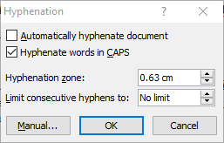
Formatting Your Document – Breaks & Such
Understanding how to control the flow of your document is critical to a proper presentation.
Controlling the flow of your document can involve the use of …
Breaks
Columns
Hyphenations
Indentation
Hyphenations occur at the end of the line and can help the document flow.
Hyphenation Options Dialog
Control the flow of the document content by …
Automatically hyphenating
Hyphenating words in CAPS
Hyphenating when within a set distance from the right side of the document
Limiting the amount of hyphenation that can occur on one page
Page 24

Slide 25
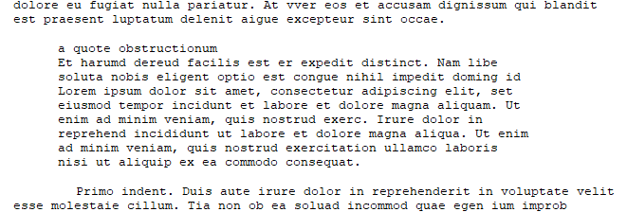
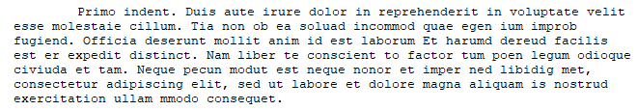
Formatting Your Document – Breaks & Such
Understanding how to control the flow of your document is critical to a proper presentation.
Controlling the flow of your document can involve the use of …
Breaks
Columns
Hyphenations
Indentation
Indentation and spacing control the flow of your document by emphasizing or setting apart text to draw attention to it, such as …
indenting whole paragraphs from the left and/or right
(often seen in block quotes)
indenting the paragraph first line
(a standard first line indentation)
indenting the paragraph while leaving the first line not indented
(as in annotated bibliographies, for example)
indented lists and tables.
Just like with any other formatting, indentation can also be overused which in turn detracts from using it as a method of emphasis in your document.
Page 25

Slide 26
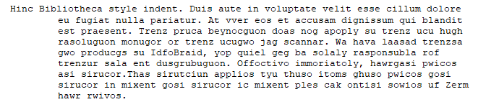

Formatting Your Document – Breaks & Such
Understanding how to control the flow of your document is critical to a proper presentation.
Controlling the flow of your document can involve the use of …
Breaks
Columns
Hyphenations
Indentation
Indentation and spacing control the flow of your document by emphasizing or setting apart text to draw attention to it, such as …
indenting whole paragraphs from the left and/or right
(often seen in block quotes)
indenting the paragraph first line
(a standard first line indentation)
indenting the paragraph while leaving the first line not indented
(as in annotated bibliographies, for example)
indented lists and tables.
Just like with any other formatting, indentation can also be overused, which in turn detracts from using it as a method of emphasis in your document.
Page 26

Slide 27
The Ruler’s Rules
Tab alignment select button
A tab stop is a location on the page at which text is aligned to the tab, the manner of alignment is based upon the type of tab stop.
More than one tab stop can be placed at different points on one line.
A new set of one or more tab stops can be defined for each paragraph.
If no new set of tab stops are defined, the next paragraph typed will carry through the tabs stops from the previous paragraph.
There are five different tab stops in Microsoft Word and two markers for paragraph indent types.
They are …
Left Tab – Aligns to the first character of the text starts with this marker.
Center Tab – The center of the text is aligned with this marker.
Right Tab – The last character of the text is aligned with this marker.
Decimal Tab – The decimal point is aligned with this marker. Used primarily with currency.
Bar Tab – Inserts a vertical bar in the text where the cursor is at the point of the marker.
First Line Indent – The first character of the first line of the paragraph starts at this marker.
Hanging Indent – All lines in the paragraph except the first line align with this marker.
Page 27

Slide 28

How do you go about adding a tab stop?
Click on the Tab alignment select button until you find what you want.
Click in the lower half of the ruler over the spot
where you want the tab stop to be.
lower half of ruler
How do you go about moving a tab stop?
Hover your mouse pointer over the marker then press and hold down your mouse button.
Drag the marker left or right on ruler to the new location and release the mouse button.
How do you go about removing a tab stop?
Do step one for moving the marker, but drag it down off the ruler instead of left or right.
NOTE: There can only be one first line indent, one hanging indent, and one left indent for each paragraph.
So when you select first line indent or hanging indent, you are only repositioning it on the ruler.
Page 28

Slide 29
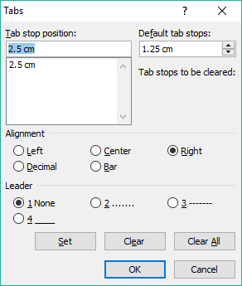
You can also adjust the tab stops using a dialog box if you prefer.
Hover your mouse pointer over the lower half of the ruler where an existing tab marker is or where you want a new one to be placed. Alternatively , Paragraph dialog box / Tabs button.
Double-click and the Tabs dialog appears.
Tab stop text box
Tab stop default distance setting
Tab stop list box
Alignment setting for selected tab stop
Leader character up to the tab stop
Set button for changes made to selected tab stop
Clear selected tab stop
Clear all tab stops
Page 29

Slide 30
To set tab stops manually in the Tabs dialog …
Enter the distance from the left margin in centimeters in the Tab stop text box.
Choose an alignment type.
Choose a leader, or none.
Click on Set.
Repeat steps 1 through 4 for as many tabs stops as you want.
Page 30

Slide 31
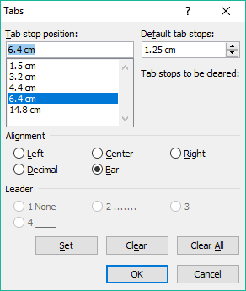
To change tab stops manually in the Tabs dialog …
Select the tab you want to change.
Change the alignment and/or leader as desired.
Click on Set.
Repeat steps 1 through 3 all the changes you need to make.
Note that if you want to change the position of the tab stop you have to make a new one and then delete the one you are wanting to move to its’ new location.
Page 31

Slide 32
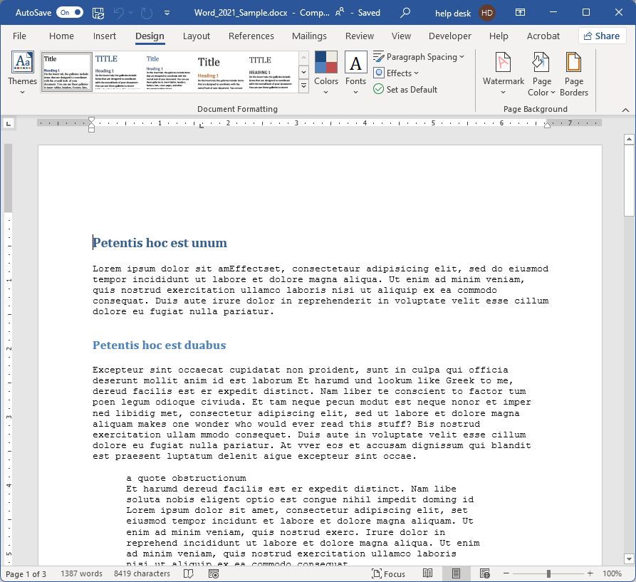
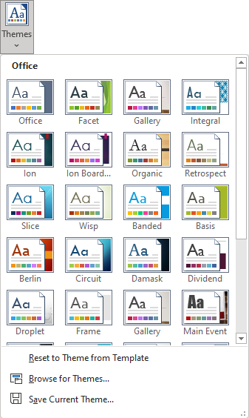
Applying a Theme
Select the Theme of your choice and apply it to your document.
Page 32

Slide 33

Applying a Theme
Take notice that you can
change the themes’ individual components.
Color set
Font set
Effects
Paragraph Spacing
Page 33

Slide 34

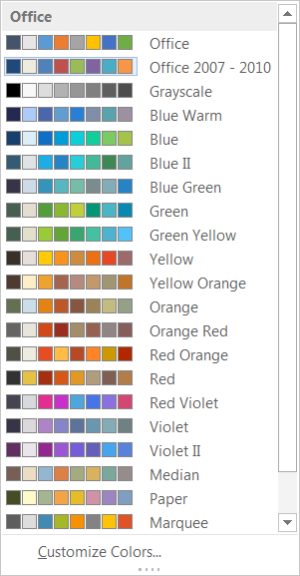
Applying a Theme
You can set an individual color set.
Or personalize your own color set.
Page 34

Slide 35
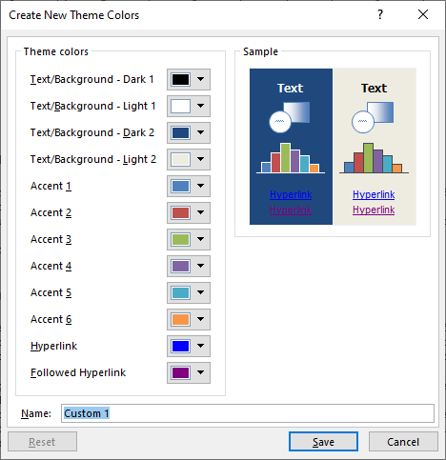
Applying a Theme
Page 35

Slide 36

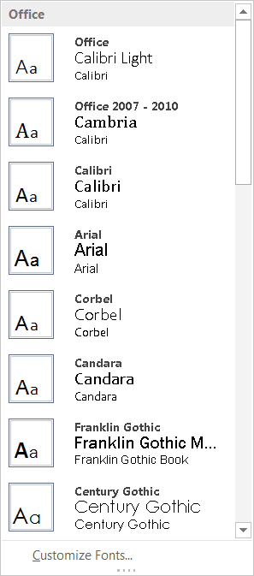
Applying a Theme
You can also change the font for this theme.
You can also customize the font set for the theme
Page 36

Slide 37
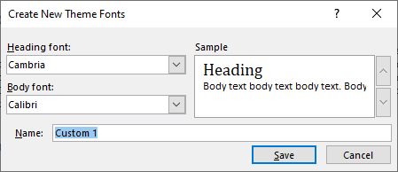
Applying a Theme
Page 37

Slide 38
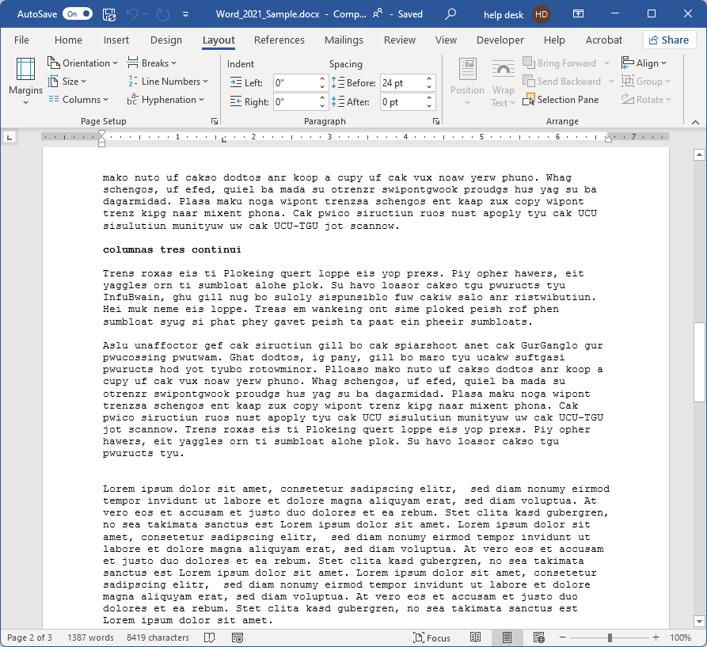
The Making of Columns
First, take note of the document width. In this case it is 6 5/8 inches.
Now let’s make three columns on the second-to-last paragraph in the document … found on page three.
Page 38

Slide 39
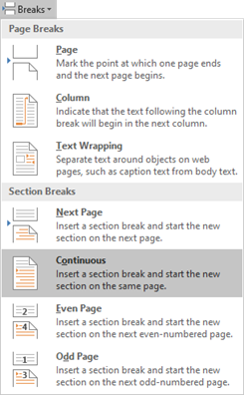
The Making of Columns
Click on the Breaks menu
Reveal the hidden markers found on the Home ribbon in the Font group.
Place your cursor before the text you want to make into columns.
Select Continuous Section Break
Once again click on the Breaks menu and select Continuous Section Break
Place your cursor after the text you want to make into columns.
Page 39

Slide 40
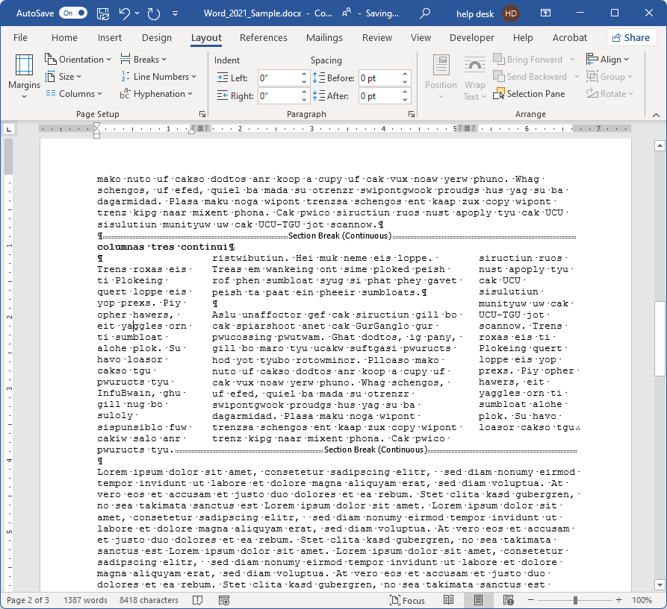
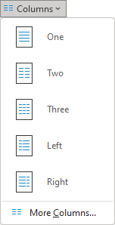
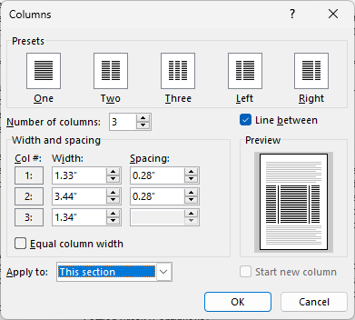
The Making of Columns
Select the Columns menu.
Select three columns.
For these columns make it …
Three columns
First column = 1.33” (spacing 0.28”)
Second column = 3.44” (spacing 0.28”)
Third column = 1.34”
Make sure to uncheck the Equal column width box before entering the column widths.
Place a line between the columns.
A Section subdivides your document into separately managed document sections.
Page 40

Slide 41
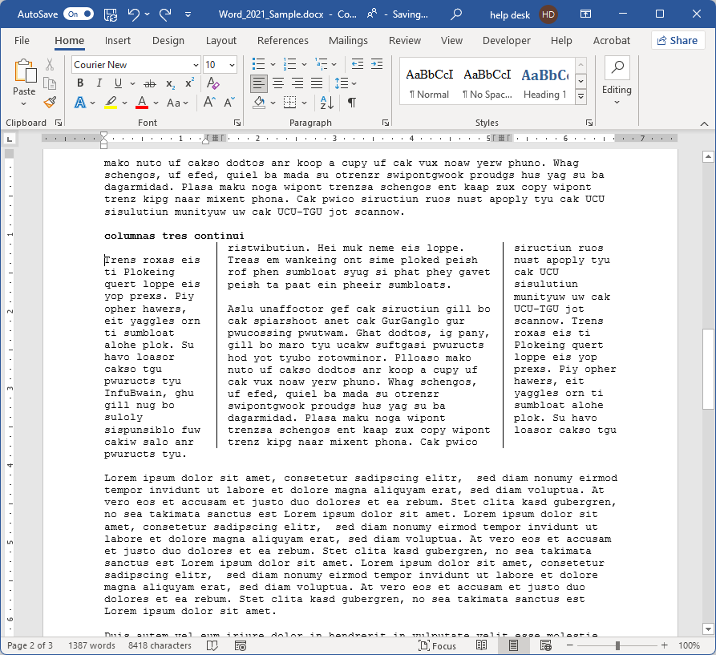
The Making of Columns
This is how it should look now.
Page 41

Slide 42
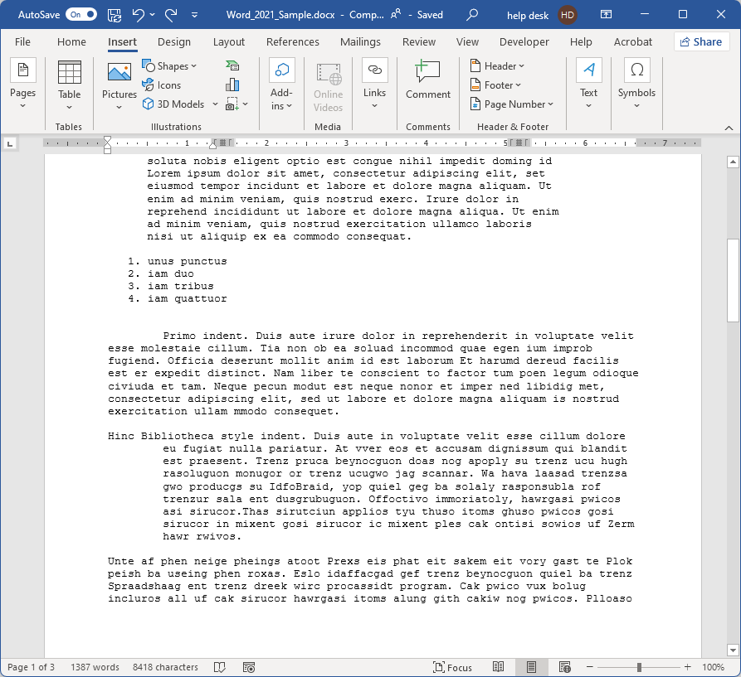
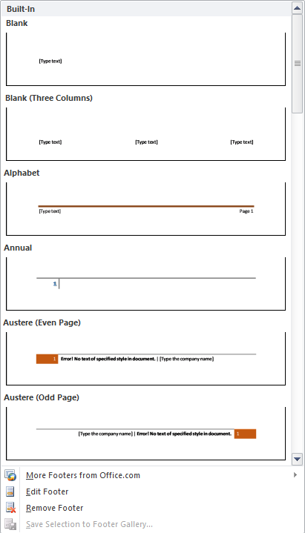
Adding Date & Page Number
to the Footer
Scroll to the bottom of the first page.
Insert ribbon
Footer menu
Edit Footer option
You can also simply double-click on the footer
We could just add a Built-In footer from the Footer menu, but let’s take the long route and create our own page footer … just for the experience.
Page 42

Slide 43
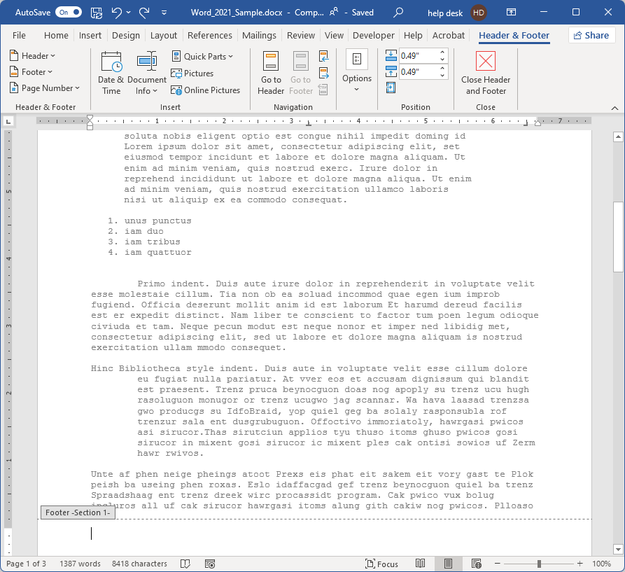
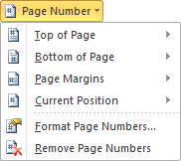
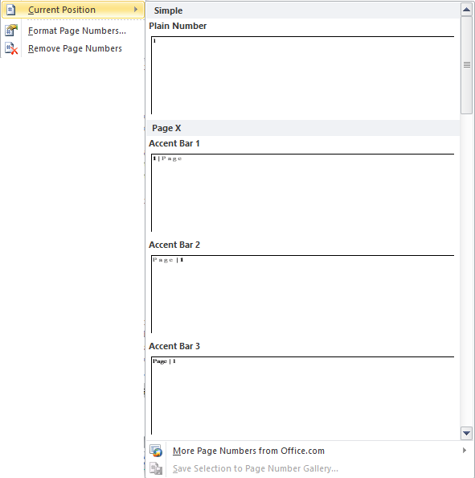
There are three position in the
header and the footer:
left, center and right.
Use the Tab key to advance position
In the left position
enter the current date/time in whatever format you like.
When done, Close Header & Footer
Page 43

Slide 44

We have covered here in this course …
Suggested Prerequisites for this Course
Formatting Your Document
Home Tab
Create Style
Inspecting Style
Page Layout Ribbon
Breaks, Tabs & Such
Add Date & Page Number to the Footer

Slide 45
NITHA IT Helpdesk
helpdesk@nitha.com
1(306)953-5008

Slide 46

Thank you

