Slide 1

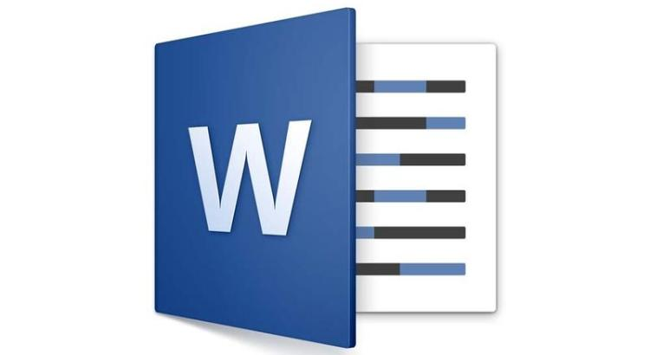
Word 2016/2019 Intro
Entry Level

Slide 2

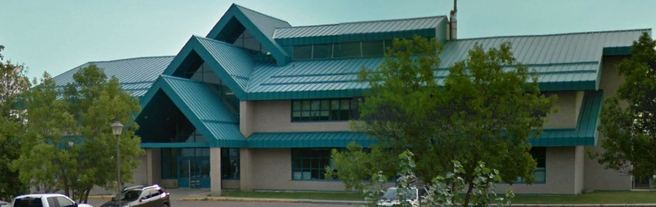

NITHA IT Helpdesk
helpdesk@nitha.com
1(306)953-5008

Slide 3

What will we be covering in this course?
Start Word 2016 & Open the Sample Document
Navigation & Selection Using the Mouse
The Parts of Word 2016
Formatting Text
The Ribbons
Insert Illustrations, Web Links, Text & More
Navigation & Selection Using the Keyboard
Working with Tables

Slide 4
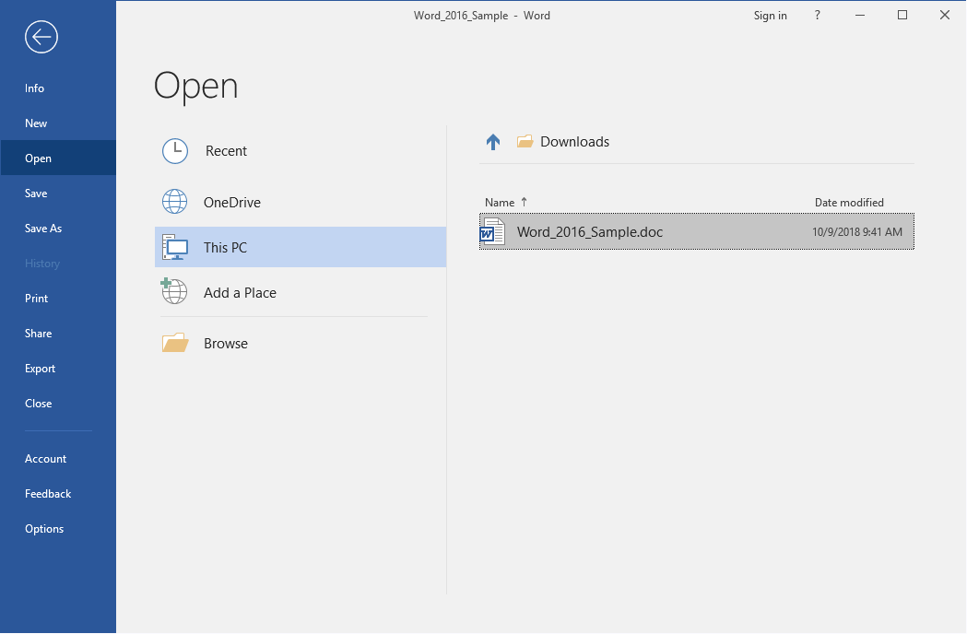
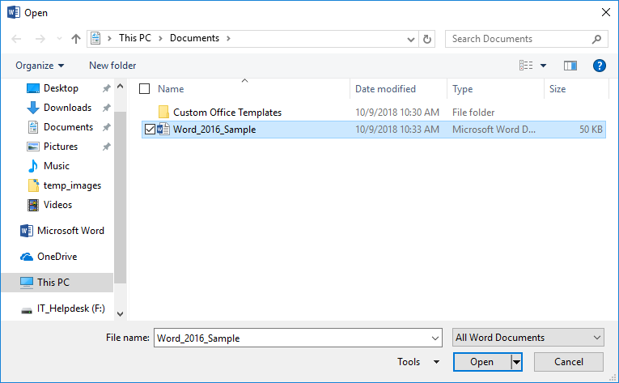
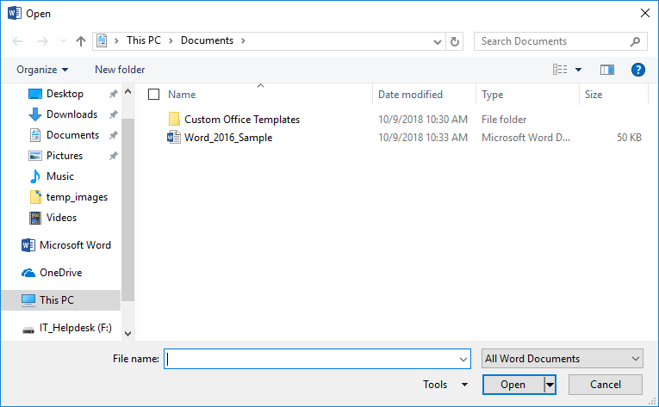
Open Sample Document in MS Word 2016
When you open MS Word 2016 from the Start Menu, the first screen you will see is the backstage Open screen.
Open a Recent document, on OneDrive, or on This PC.
Browse for a document at another location.
If you chose to open the program first then use the Open dialog, then …
Click on Browse
Click on Word_2016_Sample
Click on Open

Slide 5
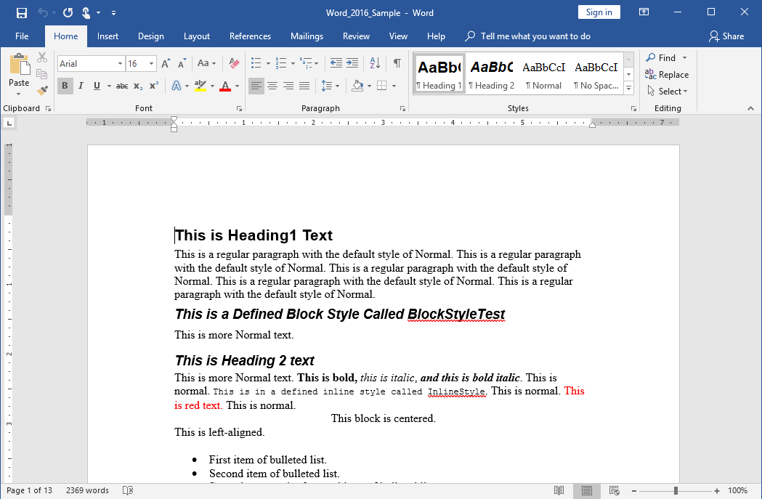
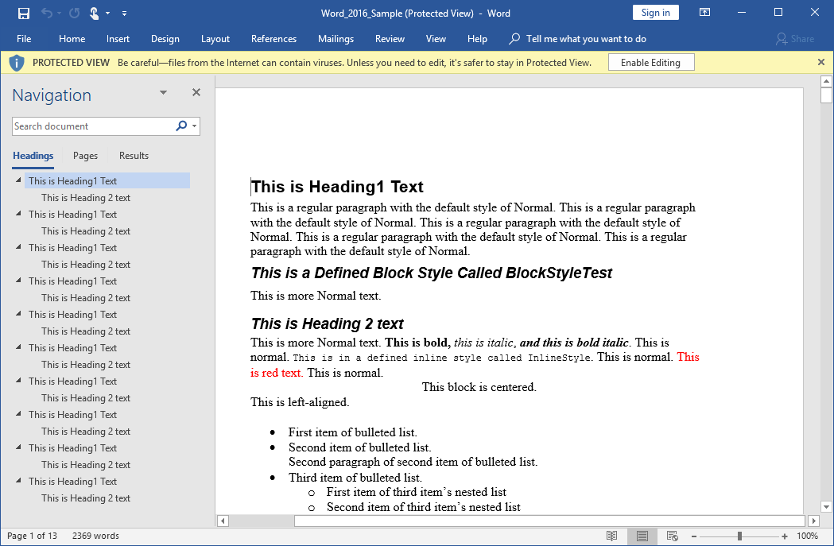
Open Sample Document in MS Word 2016
If you see bar under the ribbon that has a button on it that reads Enable Editing, then click on that button.
Our document is now ready for editing.

Slide 6
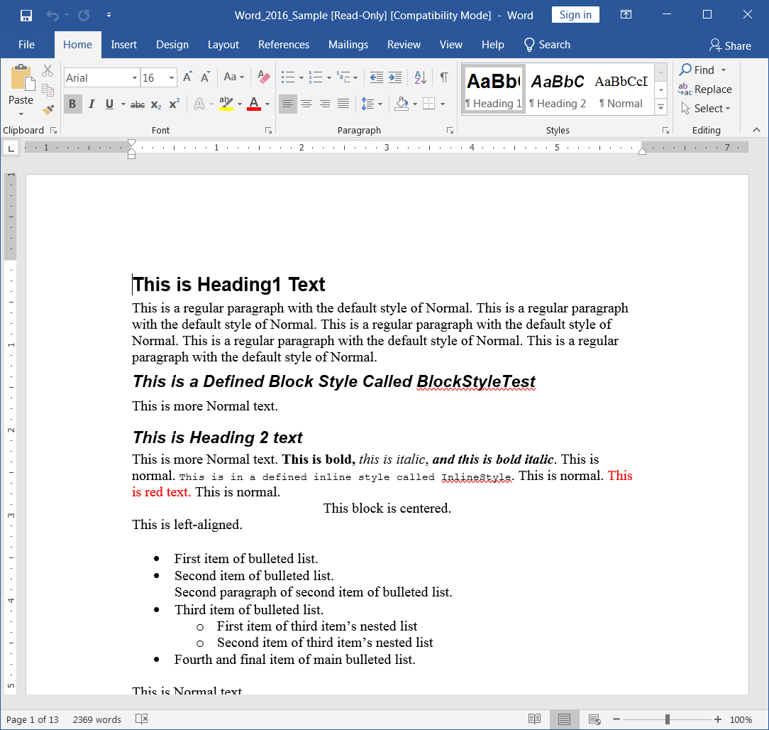
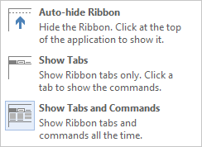
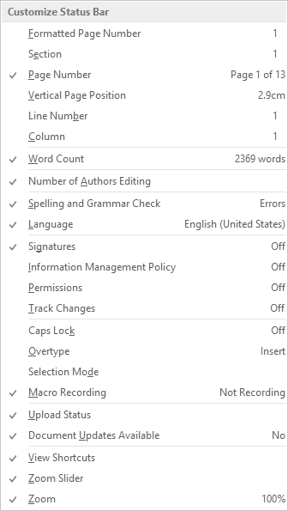
The Parts of Word 2016
Quick Access Toolbar
Ribbon Control Menu
The Ribbon – From where all the functions and commands of Word are accessed.
The Ribbon is similar to the older style toolbars found in MS Office 2003 and earlier.
Document Workspace – This area is where you create your document. It is WYSIWYG (What You See Is What You Get), which means that your document will appear on paper as you see it on the screen. It is not exact, but close.
Status Bar – Contains:
Zoom bar
Document view buttons
Current document information
Right-click on the status bar will present a menu from which you can personalize it.

Slide 7
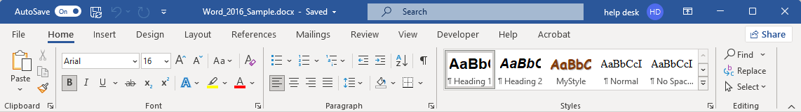
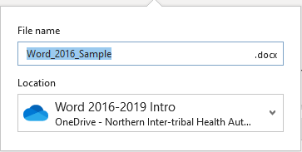
Parts of the Word 2021 Screen – Titlebar
Name of the opened file.
It will be named Document1 if you have not yet saved it.
New Feature: You can save your document to OneDrive from here by clicking on the drop arrow.
Slide

Slide 8
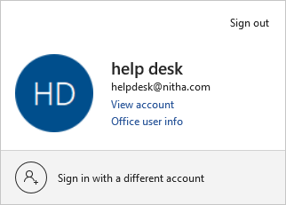
Parts of the Word 2021 Screen – Titlebar
Search the document.
This is one of the places you can log in and out of your Microsoft account.
Manage/view your account settings.
View additional account information.
Not you? Change the account to another.
You are not required to be signed in to a Microsoft account before you are able to use Word.
Slide

Slide 9
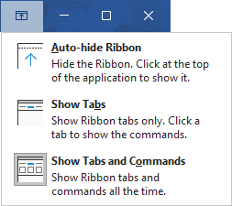
Parts of the Word 2021 Screen – Titlebar
These three buttons
Minimize Word to the taskbar
Maximize Word to full screen
Exit out of Word
This icon provides options for hiding or revealing the ribbon.
Auto-hide Ribbon gives you the maximum screen real estate.
Show Tabs reveals only the ribbon tabs.
Show Tabs and Commands shows the full ribbon

Slide 10
Parts of the Word 2021 Screen – Ribbon
2. The ribbon has four items of interest …
The ribbon tabs.
Group names.
The commands
Dialog box/panel launchers
Slide

Slide 11
Parts of the Word 2021 Screen – Home
The home ribbon has mostly formatting commands.
The Clipboard when displayed will hold up to 24 items.
Click on the dialog box launcher button and a panel will snap to the left side of the workspace area.
Note that when you close the clipboard panel, once again only one item can be held in the clipboard at one time.
Font, Paragraph, Styles & Editing & copy/cut/paste are all formatting commands.
Slide

Slide 12
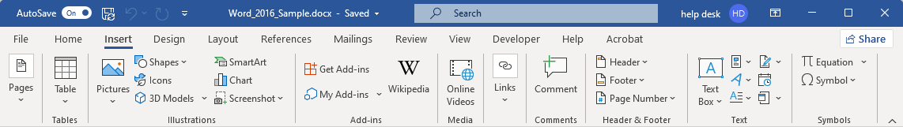
Parts of the Word 2021 Screen – Insert
The Insert ribbon has lots of stuff to add.
The Pictures menu in the Illustrations group lets you insert pictures from
This device
Stock images
Online pictures
The Pages menu offers to insert a
Cover Page
Blank Page
Page Break
The Tables menu offers several methods to create tables which will be covered later in the course.
Slide

Slide 13
Parts of the Word 2021 Screen – Insert
The Insert ribbon has lots of stuff to add.
The Pictures menu lets you insert pictures from
This device
Stock images
Online pictures
The Illustrations group menu provides options to insert
Shapes
Icons
3D Models
Charts
Screenshot
The Add-in menu provide a methods for adding software additions to Word, increasing Words’ functionality.
Slide

Slide 14
Parts of the Word 2021 Screen – Insert
The Insert ribbon has lots of stuff to add.
Online Videos – Connect to a video using a link (URL) or by embedded code to insert into a webpage.
Please be aware of the copywrite.
The Header & Footer group has three menus. Each has templates for quick insertion or a custom option so you can tailor the header or footer to your own design.
Header – has template & custom
Footer – has template & custom
Page Number – has template & custom
With the Links menu you can insert
Bookmarks
Cross-references
Hyperlinks
In the Comments group is the insert comment command.
Slide

Slide 15
Parts of the Word 2021 Screen – Insert
The Insert ribbon has lots of stuff to add.
With the Text menu the available objects to insert are
Text Box
Quick Parts
Word Art
Drop Cap
Signature line
Date & time
Object (Adobe, Flash & Postscript, Excel, PowerPoint, Word, OpenDocument objects, and more)
Insert the characters that are not on the keyboard.
This icon hides the commands on the ribbon but not the ribbon tabs giving you more screen real estate.
Slide

Slide 16
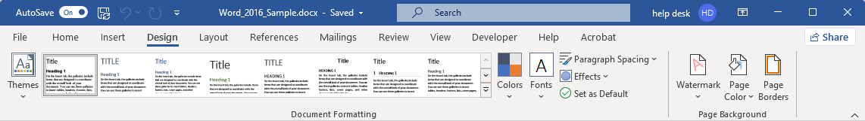
The Design ribbon has lots of methods for designing your document to your liking.
Parts of the Word 2021 Screen – Design
The Document Formatting group also allows you to change your chosen theme to tailor it to your specifications.
Add colors schemes, fonts, paragraph formatting, cool effects. Then set it as your default theme.
The Page background allows you to change
Watermark – text behind the document content.
Page color – Color ink waster.
Page Borders – Large variety of border from which to choose.
The Document Formatting group has a Themes menu, pre-set themes.
The Document Formatting group offers a live menu which allows you to see a preview as you mouse over the theme.
Slide

Slide 17
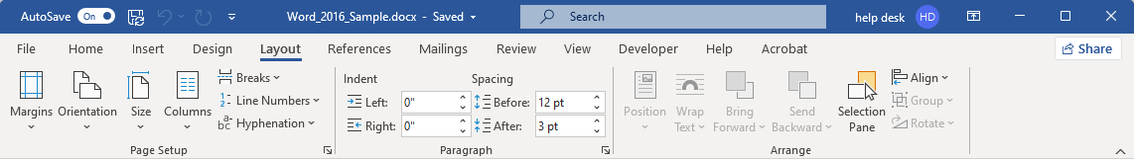
The Layout ribbon has many methods for structuring the content of your document as it appears on the printed page.
Parts of the Word 2021 Screen – Layout
The Page Setup group
Orientation – portrait or landscape
Size – define a paper size
Columns – Add column(s)
Breaks – Page, column, text wrapping; section breaks: next page, continuous, even page, odd page.
The Arrange group allows you to stack the objects you have inserted, like arranging playing cards on a table.
Positioning moves the selected object on to the same level as the document content, forcing the words to form around the object.
The Paragraph group lets you be very specific for settings indentation & spacing.
Margins allows you to set up document margins either custom or pre-defined.
These dialog box launchers will display a dialog with further commands with more formatting options.
Slide

Slide 18
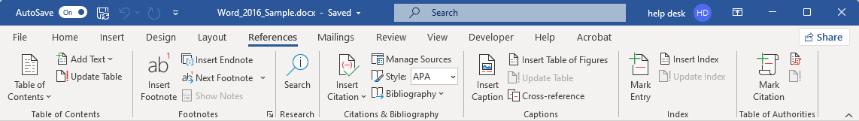
The References ribbon has many commands for research and further document formatting.
Parts of the Word 2021 Screen – References
Table of Authorities – is a list of all legal citations in your document along with every page on which has a reference to each authority that is made.
Add footnote to your document at the position of your cursor which then jumps your cursor to the bottom of the page where you type (or paste) in the footnote.
Citations & Bibliography provides methods for managing the content, style, and source of the bibliography.
Index – Create, manage, and mark entry points in an index.
Add a Table of Contents to your document. It will compile the TOC based upon your heading hierarchy.
Research provides suggestions based upon your content.
Captions – Insert, remove or edit Caption
Slide
18
Slide

Slide 19
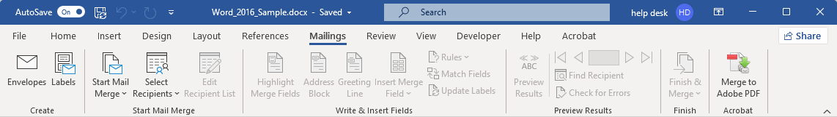
The Mailings ribbon is dedicated to merging dynamic data with mass mailing from Word.
Parts of the Word 2021 Screen – Mailings
Create – This is one point from where you can start a Mail Merge.
Envelopes
Labels
Start a Mail Merge – This is the second place you can start a Mail Merge.
Letters – Add mail merge fields to your document.
Emails – Add mail merge fields to your email.
Envelopes – Print address on envelopes
Labels – Create address labels
Directory – Create a merge from a directory of documents
Slide

Slide 20
The Mailings ribbon is dedicated to merging dynamic data with mass mailing from Word.
Parts of the Word 2021 Screen – Mailings
Write & Insert Fields – This is where you create custom fields or insert from template fields.
Preview Results – Allows you to step through the process without committing any changes so you can see if the procedure is inserting the fields as you require.
Slide

Slide 21
The Mailings ribbon is dedicated to merging dynamic data with mass mailing from Word.
Parts of the Word 2021 Screen – Mailings
Finish – Finalize the process by completing the merge.
Slide

Slide 22
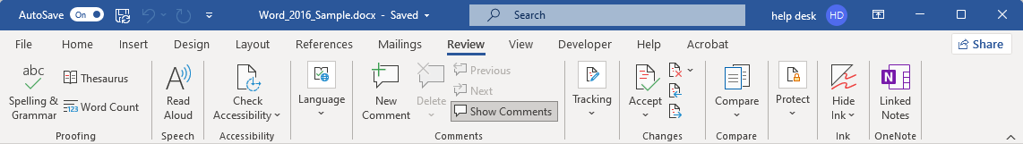
Check your document or allow others to check your document by using the Review ribbon.
Parts of the Word 2021 Screen – Review
Language – Change the language.
Read Aloud – Does what it says.
Accessibility – Deals with making your document accessible to people with various disabilities, mostly hearing and visual.
Proofing – Let Word check your document for spelling and grammar errors. Some of this is done as you type by underlining the word:
With a red squiggly line for spelling errors
With a green squiggly line for grammar errors
Slide

Slide 23
Check your document or allow others to check your document by using the Review ribbon.
Parts of the Word 2021 Screen – Review
Comments – Add a comment at the cursor location.
Hide Ink – Ink is where you draw on the document.
Tracking – Start here to track the changes you make in a document which you are reviewing for another.
Protect – Protect your document by blocking an author or by restricting content editing. Restrict by making
formatting restrictions
editing restrictions
Toggle to start the restrictions
Changes – Various methods of accepting the changes.
Compare – Here is where you initiate a comparison between documents, usually a document you received back that was reviewed by another.
Slide

Slide 24
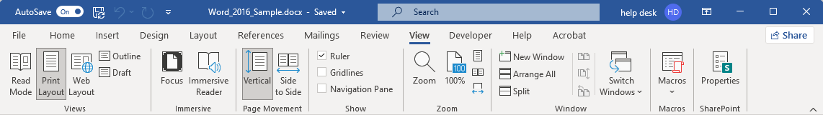
Parts of the Word 2021 Screen – View
The View ribbon deals specifically with the screen.
Views – Change the document view by
Reading Mode displays two pages like an open book.
Printed Layout is the default view.
Web Layout allows you to design as it will be seen on a webpage.
Outline Mode makes it easier to develop a document as an outline.
Draft Mode
Page Movement –
Vertical – This is the standard view, each page below the previous.
Side to Side – This causes the pages to move sideways, the previous page to the left, next page to the right.
Immersive (new) –
Focus makes all surrounding area around the document black and fills the screen.
Immersive Reader – breaks up words into syllables to aid in helping people pronounce the words.
Slide

Slide 25
Parts of the Word 2021 Screen – View
The View ribbon deals specifically with the screen.
Show – Change the document view by
Rule displays the ruler as we did earlier in the course.
Gridlines is the default view.
Navigations Pane snaps the Navigation pane on the left side.
Zoom – Self explanatory
Windows – Work with different views of your document.
New Window creates a second window on the same document so you can view different parts of the same document at the same time.
Arrange All & Split – arranges all open windows on the document as you like.
View Side-by-side, Synchronous scrolling, Reset window position are all available options.
Slide

Slide 26
Parts of the Word 2021 Screen – View
The View ribbon deals specifically with the screen.
Macros – Macros automate the things you do in Word verbatim so you can call them anytime.
View, record or pause recording a macro.
SharePoint – Connect with a SharePoint server
Slide

Slide 27
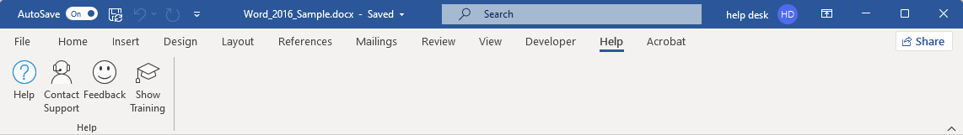
Parts of the Word 2021 Screen – Help
The Help ribbon deals specifically with the screen.
Contact Support – Allows you to start a ticketed support incident.
Feedback – Give Microsoft your opinion.
Show Training – Displays training videos for Word 2021.
Help – When you click on the help icon and do not have a connection to the Internet, Word will draw from the local installation of help files.
If you have a connection to the Internet, the help will be more extensive and up-to-date.
Slide

Slide 28
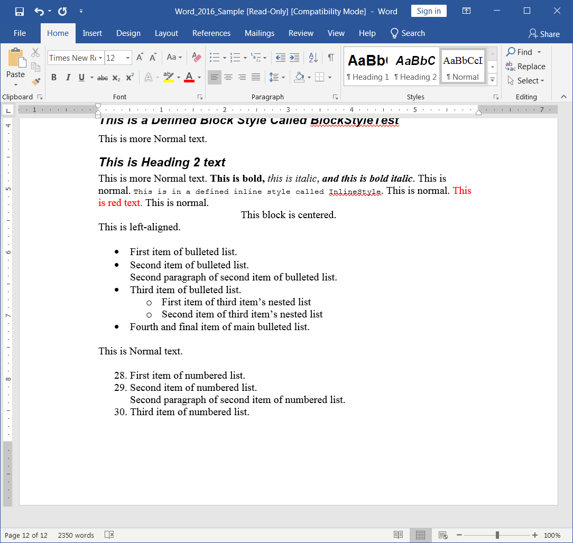
The Parts of Word 2016
Definition: A Section in Word is like a separate document with its’ own formatting, header & footer.
Top Margin – You can double-click here to enter the header for your document.
By default it will appear at the top of each page in that section of the document but that can be customized.
Left Margin – You can:
Single-click to select a single line
Double-click to select paragraph
Triple-click to select the entire document
Bottom Margin – You can double-click here to enter the footer for your document.
Like the header, by default you footer will appear at the bottom of each page in that section of the document but can be customized as you like.

Slide 29
The Parts of Word 2016
First Line Indent Marker
This indicated where the first line of each paragraph is positioned from the left margin.
Tab Stop Box
Click to cycle through the different types of Tab stops then click on the ruler to add that Tab Stop at that location on the page.
Hanging Indent Marker
First line in the paragraph is aligned with the left margin, all other lines in the paragraph are indented to where the Hanging Indent Marker is set.
Left Indent Marker
This is the distance from the left margin to where the whole paragraph is indented.
It is important to remember that the indents and tab stops can be different for each paragraph.
As you are typing along and press enter to start a new paragraph, the indents and tab stops are inherited from the previous paragraph, but can be changed independent of the previous paragraph if you choose.

Slide 30
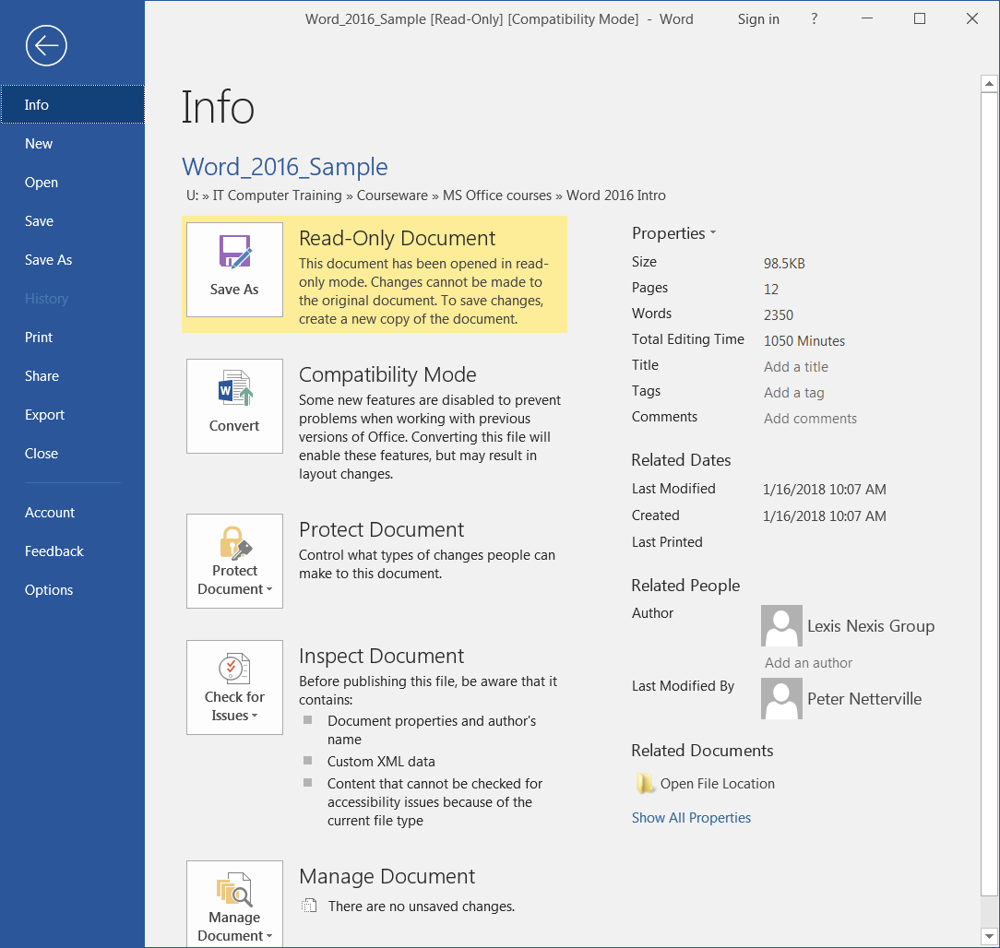
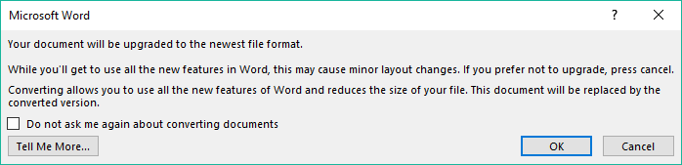
The Parts of Word 2016 - Backstage
The Backstage is where all things that happens to the document but not in the document occur.
The Backstage is accessed through the File tab on the left side of the ribbon.
If your document read only you will see this option.
The sample document for this course is not only a read only file but it is also an older format file, a .DOC file. We will convert it to the newer .DOCX format.
Exercise: Convert the current document to the new DOCX format using the Convert button, which displays this warning.
Once you save the document, the file will be saved in the new DOCX format.
Click on OK

Slide 31
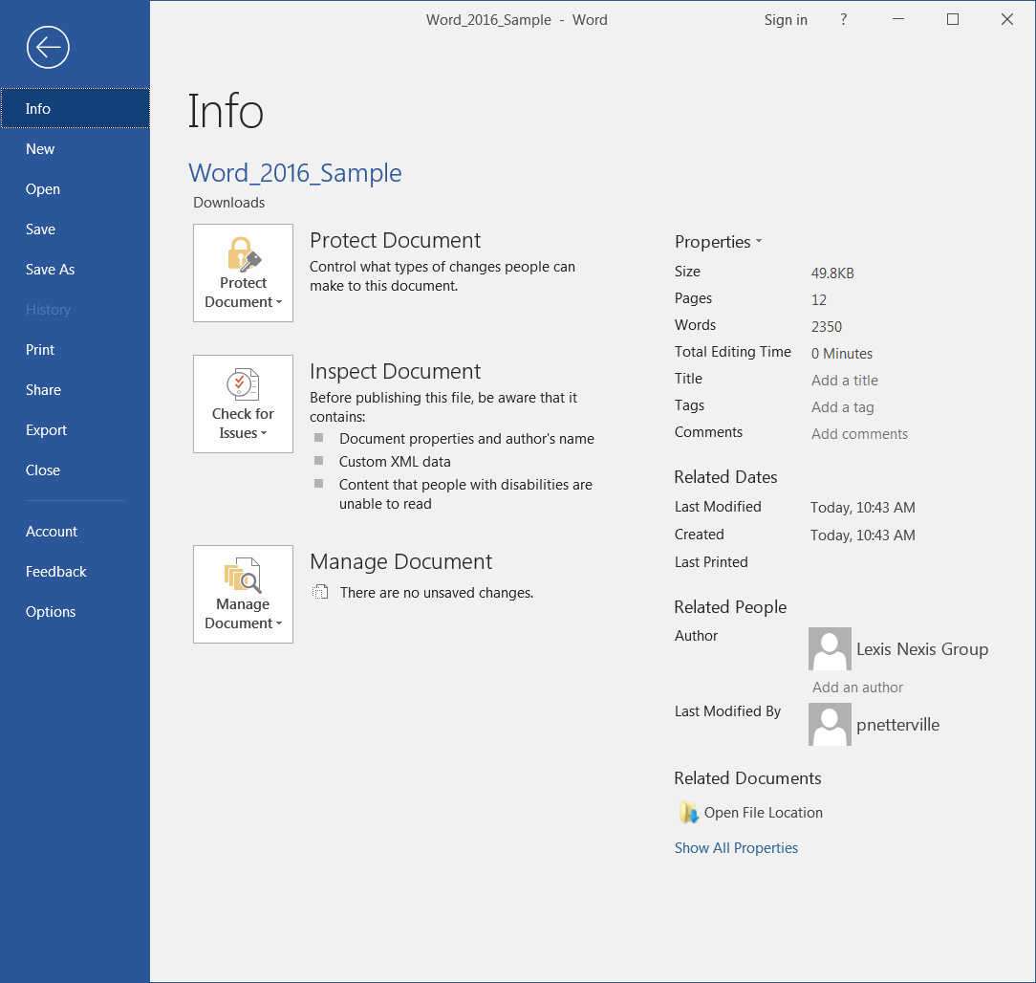
The Parts of Word 2016 - Backstage
The Backstage is where all things that happens to the document but not in the document occur.
Once you have converted and saved the older file format, the Info screen will change to the three options.
The first screen that appears is the Info screen. In here you can:
Apply permissions for others to access or not access your document.
Check your document before sharing it
Recover from earlier versions of your document

Slide 32
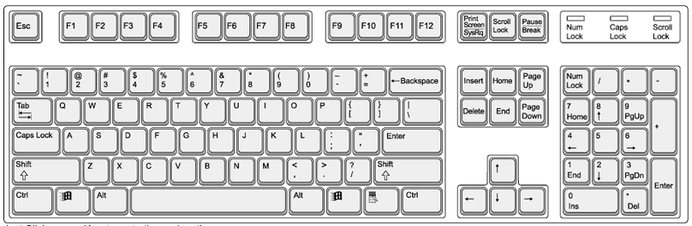
Navigation & Selection Using the Keyboard
Navigation Keys
Home – places the cursor at the beginning of the line
End – places the cursor at the end of the line
Ctrl-Home – moves cursor to the beginning of the document
Ctrl-End – moves cursor to the end of the document
Page-up – moves the cursor up the document the amount of lines displayed
Page-down – moves the cursor down the document the amount of lines displayed
Ctrl-Page-up – moves the cursor to the beginning of the previous page
Ctrl-Page-down – moves the cursor to the beginning of the next page

Slide 33
Navigation & Selection Using the Keyboard
Navigation Keys
Right Arrow – moves the cursor right one character
Left Arrow – moves the cursor left one character
Up Arrow – moves the cursor up one line
Down Arrow – moves the cursor down one line
Ctrl-Right Arrow – moves the cursor to the beginning of the next word
Ctrl-Left Arrow – moves the cursor to the beginning of the previous word
Ctrl-Up Arrow – moves the cursor to the beginning of the previous paragraph
Ctrl-Down Arrow – moves the cursor to the beginning of the next paragraph

Slide 34
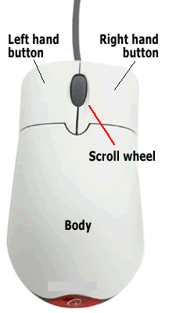
Navigation & Selection Using the Mouse
Select Contiguous Text Block (Option One):
Place mouse pointer at beginning of text you wish to select
Hold down the left mouse button
Drag the mouse pointer to the end of the desired text
Release the left mouse button
Select Contiguous Text Block (Option Two):
Click once at the beginning of the text you wish to select to place the cursor there
Scroll down to the end of the text you want to select using the mouse scroll button or the appropriate scroll bar but do not move the cursor
Hold down the Shift button and then click at the end of the text you wish to select
Select Non-contiguous Text Blocks
Select the first block of text just like Option One
Now to continue to select non-contiguous blocks of text to add to your selection
  Hold down the Ctrl button and then drag the mouse pointer to the end of the desired text
Keep repeating the previous step for each block of non-contiguous text you want

Slide 35
Navigation & Selection Using the Mouse
Select a single word:
Double click on the word. Be aware it also selects the space to the right of the word.
Select a paragraph:
Triple click on any word in that paragraph. Each new paragraph is started with a carriage-return (enter)
Select a line:
Left click once in the left margin beside the line
Select a paragraph (from the left margin):
Double click in the left margin beside the paragraph
Select the entire document (includes all sections)
Triple click in the left margin at any point in the document
Select a sentence
Ctrl + Left click over any word in the sentence

Slide 36
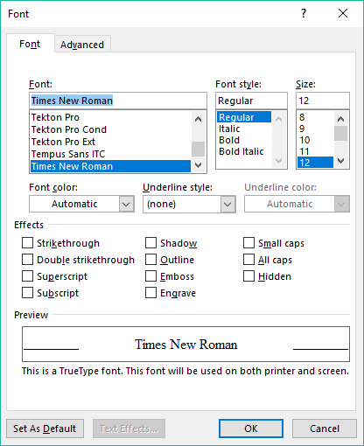
Formatting Text
The Home tab contains the formatting options
The Font group is where many of the options are located for formatting the text.
You can apply the formatting to either the selected text, or if no text is selected, then that formatting will be applied to any new text you type.
For more formatting options launch the Font Dialog Box by clicking on the Dialog Box Launcher

Slide 37
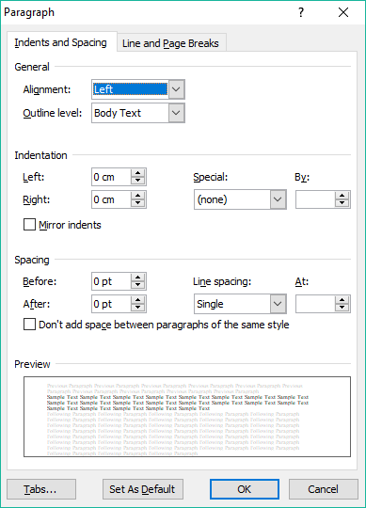
Formatting Text
The Home tab contains the formatting options
The Paragraph group has options for changing the paragraph in which the cursor is located.
If more than one paragraph is selected the formatting will be applied to all selected paragraphs.
The Paragraph Dialog launcher button displays the a dialog with more paragraph options.

Slide 38
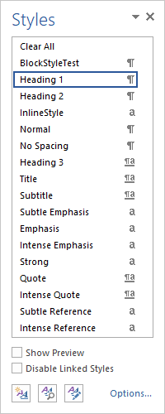
Formatting Text
The Home tab contains the formatting options
The Styles group contains pre-set styles you can apply to either the selected text, or if no text is selected, then that style will be applied to any new text you type.
The Styles menu launcher shows a menu on which you can choose to:
Select a style from a list
Choose options such as Show Preview and Disable Linked Styles
Create a New Style
Inspect style (applies to selected style)
Manage Style (applies to selected style)
More Options

Slide 39
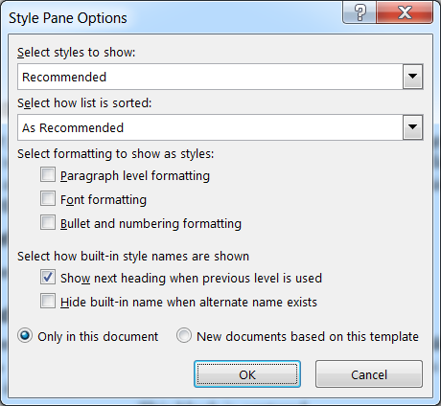
Formatting Text
The Home tab contains the formatting options
The Styles menu Options dialog box contains settings that affect the behavior of how styles are viewed in the menu.
The styles menu is also called a window pane.
You can choose what styles to display on the menu.
Set how the list of styles is sorted on the menu.
Formatting that is not a style can be included in the list for your convenience by checking any of these three options.
Display how the style names are listed.
Finally, will these display options be for this document only or will they be saved into the template upon which this document was created?
Click on the Options… button

Slide 40
Formatting Text
Apply formatting to the text in your document
Select some text and use the formatting from the Font group to change it as you like.
  Now open the Font Dialog Box and add some effects, such as Strikethrough or ^{Superscript} or Small Caps
Choose a paragraph, place your cursor anywhere in that paragraph and the modify it using the Paragraph group.
  Now open the Paragraph Dialog Box and change the spacing between the lines before and after by 2 points
Select some text and apply a character style type.
Click once to place your cursor in a paragraph and apply a paragraph style type.

Slide 41
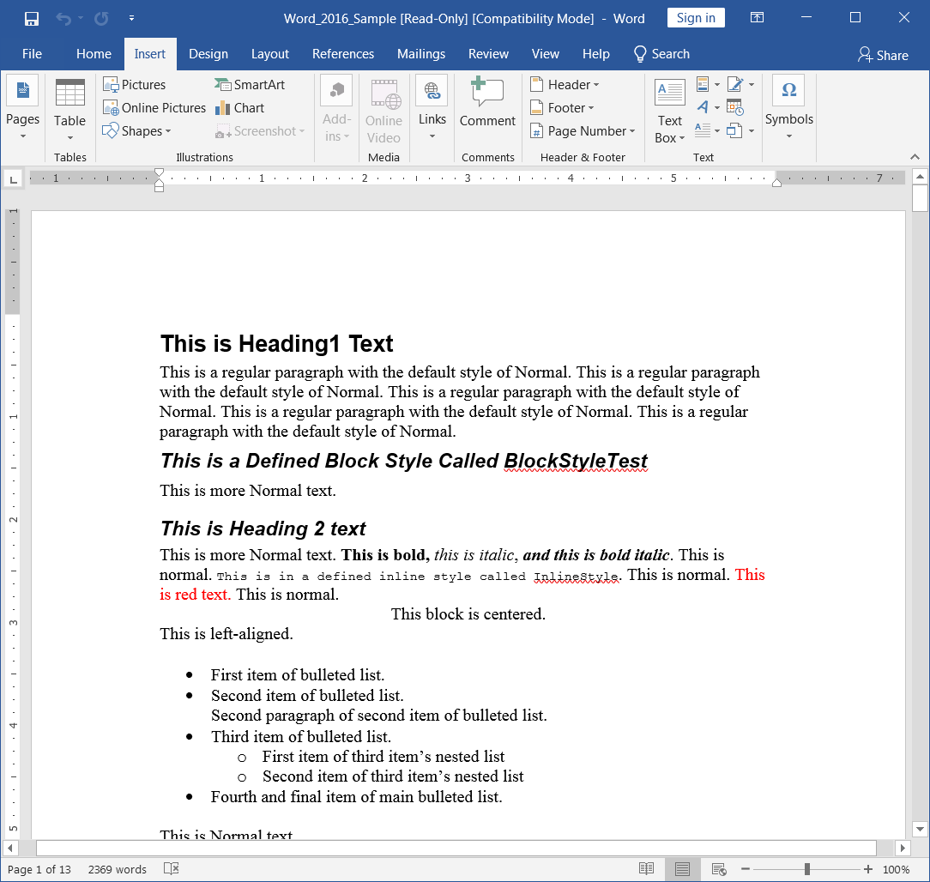
Insert Illustrations, Web Links, Text & More
The Insert tab contains many objects to add
You can insert into your document a plethora of cool things …
Pages group
Cover Page
Blank Pages
Page Breaks
Add-Ins group
Store
My Apps
Wikipedia
Symbols
Tables group
Insert
Draw
Embed
Quick
Media group
Online Videos
YouTube
Embedded Code
Illustration group
Pictures
Online
Shapes
Smart Art
Excel Charts
Screenshots
Links menu
Hyperlink
Bookmark
Cross-Reference
Comments
Insert Comment
Notes:
Show them how to add a PICTURE, SHAPE, HYPERLINK, TEXTBOX

Slide 42
Insert Illustrations, Web Links, Text & More
The Insert tab contains many objects to add
You can insert into your document a plethora of cool things …
Header & Footer group
Header
Footer
Page Number
Symbols
Text group
Text Box
Quick Parts
Word Art
Drop Cap
Signature Line
Date & Time
Objects
Symbols group
Equation
Symbol
Notes:
Show them how to add a PICTURE, SHAPE, HYPERLINK, TEXTBOX

Slide 43
Add to your document
Picture
  Make the text wrap around it.
Shape
  Give it a color
  Make it 60% transparent
  Make it overlay on top of the text
Hyperlink
  Link to your favorite website
  Format it to your liking
Text Box
  Format to you liking, but make the text wrap around it.
Insert one more item of your choice and format that.

Slide 44
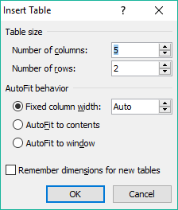
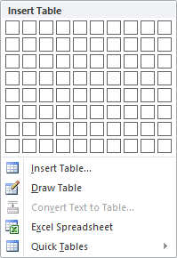
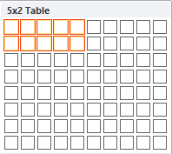
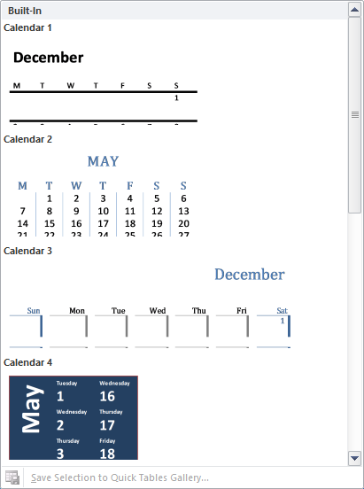
Working with Tables
To insert a table:
Click on the Insert tab
Click in the document where you want
the table to appear
Click on the Table button
You can choose to
  Select the number of rows and columns
  Insert a table by entering the number of columns and rows in a dialog box
  Draw a table using the mouse directly on the document
  Insert an Excel Spreadsheet
  Insert a Quick Table

Slide 45

We have covered here in this course …
Download a Sample Document from NITHA
Navigation & Selection Using the Mouse
Start Word 2016 & Open the Sample Document
Formatting Text
The Parts of Word 2016
Insert Illustrations, Web Links, Text & More
Navigation & Selection Using the Keyboard
Working with Tables

Slide 46


NITHA IT Helpdesk
helpdesk@nitha.com
1(306)953-5008
Notes:
Please do not hesitate to ask any question regarding this session, and I will make sure to answer your question as soon as possible.

Slide 47


