Slide 1


Word 2016/2019 Mail Merge
Intermediate

Slide 2



NITHA IT Helpdesk
helpdesk@nitha.com
1(306)953-5008

Slide 3

What will we be covering in this course?
What is our direction in this course?
Mail Merge Basics – Data Sources, Outlook Contacts
Mail Merge Basics – Definitions
Mail Merge Basics - Selecting an Existing Source, Excel
Mail Merge Basics – What’s what
Mail Merge Basics - Selecting an Existing Source, Advanced
Mail Merge Basics – Data Sources, Manual Entry
Mail Merge Basics – Step by Step Wizard (exercise)

Slide 4
What is our direction in this course?
Assumption 1:
I will be assuming you have a basic knowledge Word: navigation, screen layout, etc.
Assumption 2:
You must know the following:
  What are ribbons both regular and contextual.
  What is a dialog box and what is a window pane.
How to display the ruler, use the ruler and work with tabs and paragraph markers.
Our goal is to merge address data into a letter document from a couple of different data sources.
To accomplish our goal we will have to:
Learn how to create the data source and/or connect to the data source.
Understand how to insert merge fields into the document.
Disambiguation …
The term document and letter will be used interchangeably.
Data entry and merge field refer to the same thing for the purpose of this course, they are just different perspectives of the same concept which will be explained throughout the course.

Slide 5
Mail Merge Basics – Definitions
The data, no matter the source, is divided into two elements which together is called a data attribute or a name-value pair.
Data name – This label is used to reference the data value and is the column header.
Data value – Always a data type of text is the information associated with the data name.
Each data attribute is also referred to in Word as a mail merge field.
As an example of the data name and data value relationship as it is viewed in the different data sources…
On an Excel spreadsheet
  the data name is the column header
  the data value is each cell under the column header
  each row is a data record which can have any number of data attributes (name-value pairs).
With manual entry, some of the common data names are provided in a dialog box where you can …
add the values
add and/or remove data value in a text box under the data name, just like on an Excel spreadsheet.
  In a text file, such as a .CSV file, the data names are on the first row each separated by a comma. And each row (data record) which includes the data, is separated by a carriage return/line feed character.

Slide 6
Mail Merge Basics - – What’s What
There are two types of mail merge that you can do …
Merge data in to a letter to send out by postal mail.
Merge data in to a letter to send out by email.
Each of these two mail merge types require …
a letter to send, which is called the source document
addresses to which the document is sent, which is called the data source.
I use the term data source rather than addresses because you can merge more than just addresses into your letter.

Slide 7
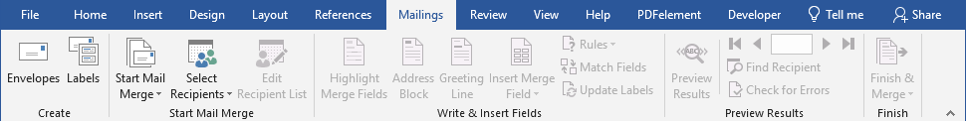

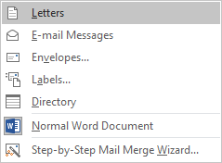
Mail Merge Basics
The data that can be merged to four different document types ...
on to letters.
You can merge data …

Slide 8
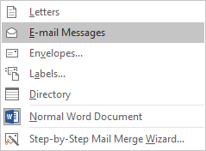
Mail Merge Basics
The data that can be merged to four different documents ...
on to email messages.
You can merge data …

Slide 9
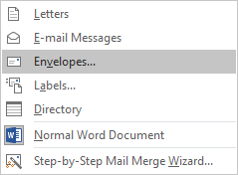
Mail Merge Basics
The data that can be merged to four different documents ...
on to envelopes.
You can merge data …

Slide 10
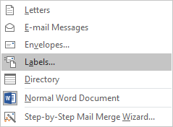
Mail Merge Basics
The data that can be merged to four different documents ...
on to labels.
You can merge data …

Slide 11
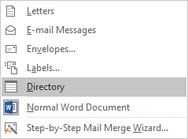
Mail Merge Basics
The data that can be merged to four different documents ...
from a directory.
You can merge data …

Slide 12
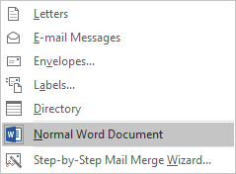
Mail Merge Basics
The data that can be merged to four different documents ...
This menu option starts a new mail merge on a blank document.

Slide 13
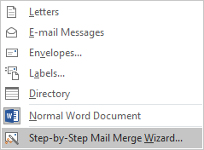
Mail Merge Basics
The data that can be merged to four different documents ...
by using the mail merge wizard.
You can merge data …
Though you can import source data on to the destination document manually,
using the Step-by-Step Mail Merge Wizard is much easier.
We will be going through the Step-by-Step Mail Merge Wizard.

Slide 14
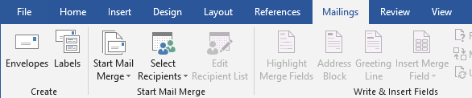


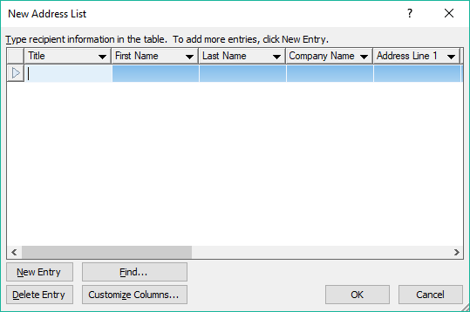
Mail Merge Basics
Data Sources Manual Entry
So now that we know what we can merge the data on to, what are the data sources?
Where do we get the data from?
The most common sources for the addresses come from …
Manual data entry
Click on the Select Recipients button…
… do manual entry by selecting the
Type New List option …
… which displays this dialog box.

Slide 15
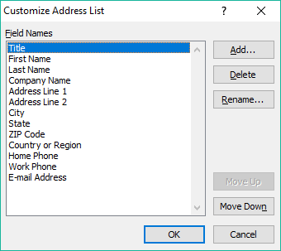
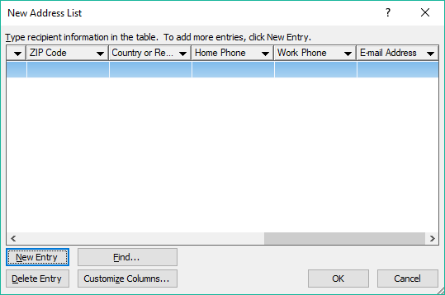
Mail Merge Basics
Data Sources Manual Entry
Just like in Excel, when you type in text you use the Tab key to move to the next cell to the right, or you can click on the cell with your mouse.
When you are on the last cell, E-mail Address, you can…
use the Tab key to start a new entry
From here you can Add, Delete, Rename, Move Up, or Move Down the columns in the list.
Or you can click on the New Entry button (or Alt-N) at any point while entering data.
When you are done, just click on OK.
Find, oddly enough, allows you to find some text searched through all the fields of every record in your list.
You can customize the columns by adding new fields (columns), removing fields, renaming them, or moving them left or right.
Delete Entry removes the row that is highlighted.

Slide 16

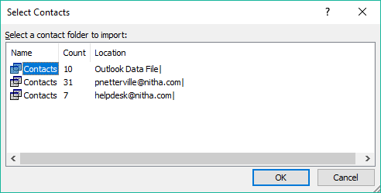
Mail Merge Basics
Data Sources Outlook Contacts
The second common data source
Another common source for the addresses comes from …
your Outlook Contacts …
… which displays this dialog box.
Microsoft Word may require you to enter in the password for your Outlook account(s) before it displays this dialog.
This list of Outlook contacts is, of course, from my own computer. Your list will appear different.

Slide 17
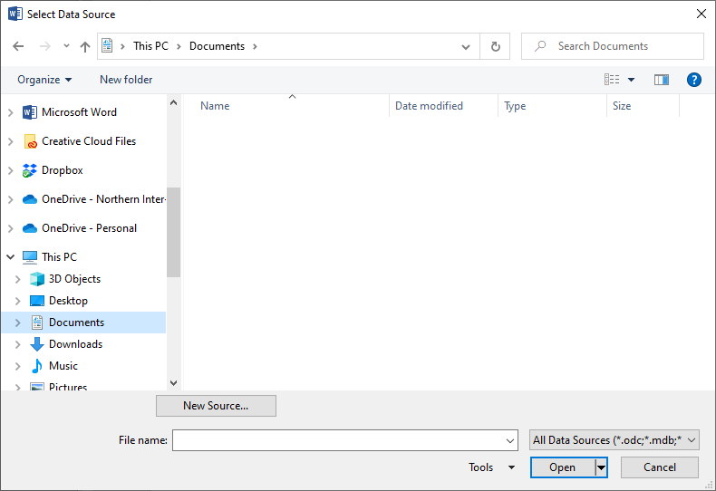

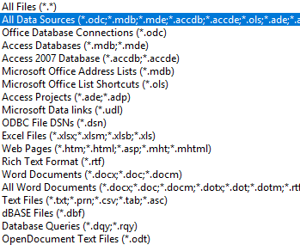
Mail Merge Basics – Selecting an existing source, Excel
The third common data source
The most common sources for your data; the addresses and even sentences, paragraphs, date/time stamps, come from …
Use an Existing List…
… which displays a Select Data Source dialog box.
The sheer number of different data sources is mind numbing.
Click on the All Data Sources list box …
Excel is also a common data source for addresses.

Slide 18
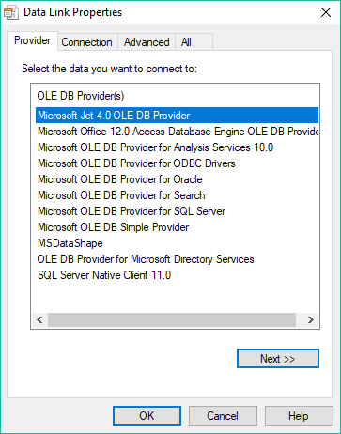
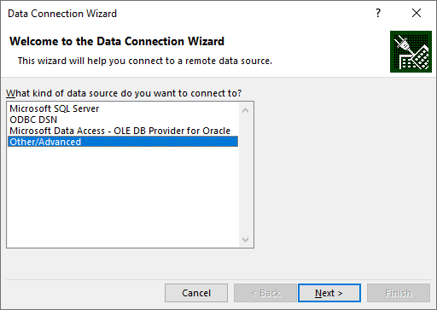

Mail Merge Basics – Selecting an existing source, advanced
The New Source… button opens a dialog box where you can make a new data source, the Data Connection Wizard.
Click on Other/Advanced
This Data Link Properties dialog is displayed by selecting the Other/Advanced option allows you to connect to live data at remote data sources.
The data is live in the sense that it is a source which is maintained by another agent and can change at any time.
These are the less common sources for data when doing a mail merge..

Slide 19
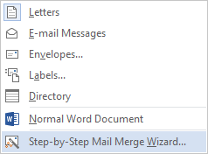
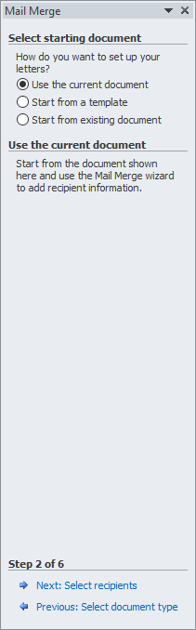
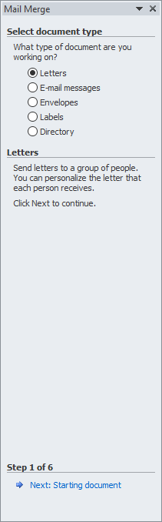
Mail Merge Basics – Step by Step Wizard (exercise)
Open the sample document, Word_2016-19_Mail_Merge_Sample in Word 2013.
From the Mailings ribbon / Start Mail Merge group
click on the Start Mail Merge menu
select Step by Step Mail Merge Wizard
Which displays a Mail Merge panel on the right side of the document work area.
We will use the current document, but we could start from a template
or from an existing saved file.
Select the Letters option.
Which displays a Mail Merge panel step 2 of 6, Selecting the document you want work with.
Click on Next: Select recipients
Click on Next: Starting document

Slide 20
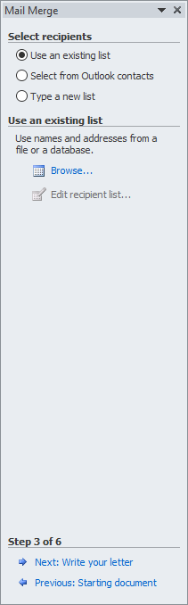
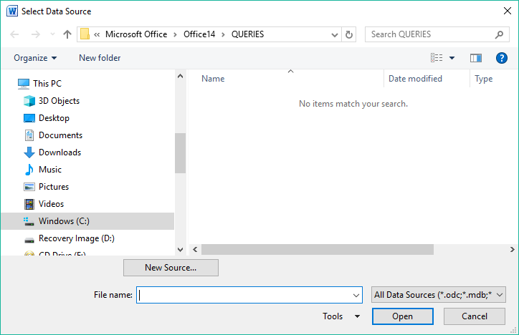
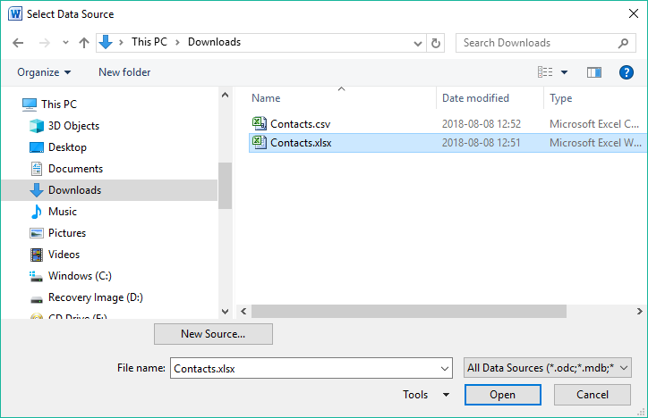
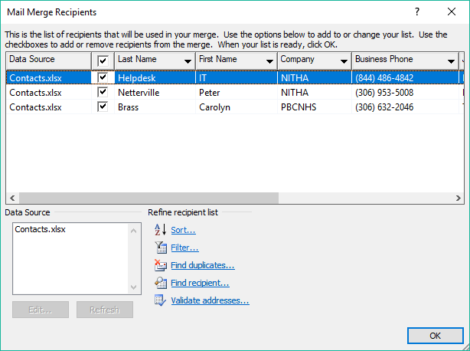
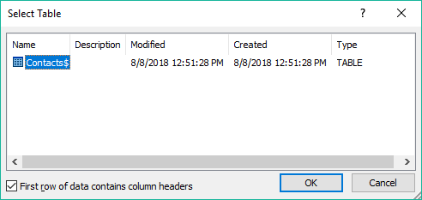
Mail Merge Basics – Step by Step Wizard (exercise)
We will import an existing list from an Excel workbook. Select the first option.
Select the Contacts.xlsx file and click on the Open button.
Click on Browse.
Since there is only one table in this workbook, there is only one listing. So with that one selected, click on the OK button.
These are the Excel Mail Merge Recipients we just imported.
Click on OK.
Click on the folder where the course files are located. I will assume the Downloads folder for this example.

Slide 21
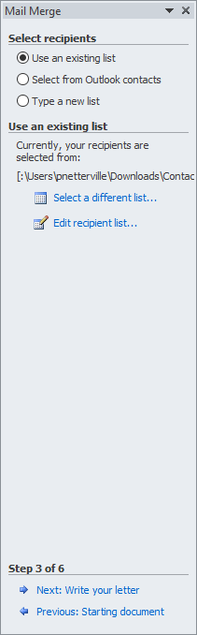
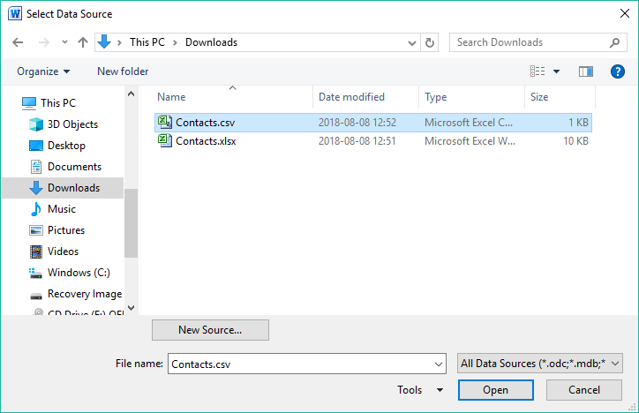
Mail Merge Basics – Step by Step Wizard (exercise)
There is no method in Excel 2016/19 to import a second contact list to merge it with the first one while doing a mail merge.
Select Use an existing list from the Mail Merge panel and click on Select a different list…
Browse to where you have saved your Contacts data files for this course.
We will open up the Contacts.csv file.
When you click on any of the options
Use an existing list
Select from Outlook contacts
Type a new list
after having imported a list already, you will end up replacing the previous list with the new one.
They will not be merged.
So the trick is to merge your address fields first. It is easiest to do this in Excel.
Click on Open
The Contacts.csv file provided is a merge I have created of three sources, some existing addresses, an Excel .xlsx file of addresses, and some Outlook contacts.

Slide 22
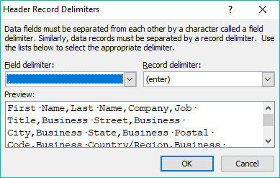
Mail Merge Basics – Step by Step Wizard (exercise)
Definition 1: CSV file – a .CSV file is a comma delimited text based file.
The purpose of a .CSV file is to move data from one program to another in a common format that both programs understand.
The .CSV file is a text based file where the data fields are separated by a delimiter and the rows of data (records) are separated by the carriage return.
Definition 2: Delimiter - A delimiter can be any character that is not part of any of the data fields.
It is used to separate one data field from the others.
A comma is quite commonly used, but if there are commas in your data, another character must be used, such as a TAB character.
Word will usually properly recognize the character separating the data fields, but check to see that it is the comma that Word has chosen.
Then click on OK.
The first time you open the .CSV comma delimited file of addresses Word will ask you what character is separating the data fields.

Slide 23
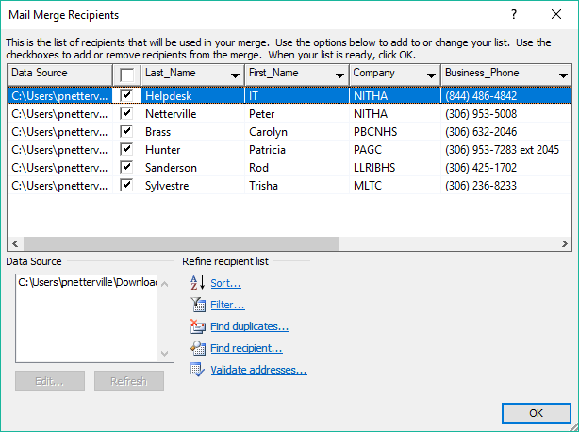
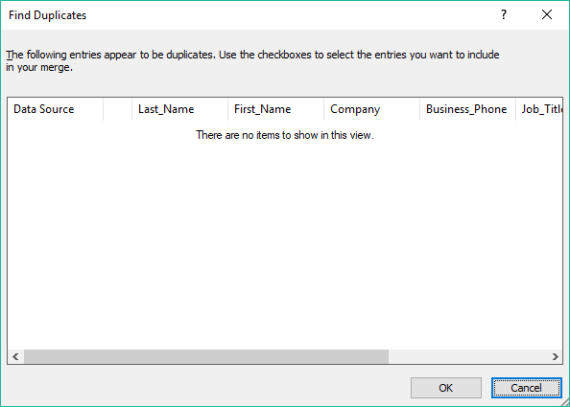
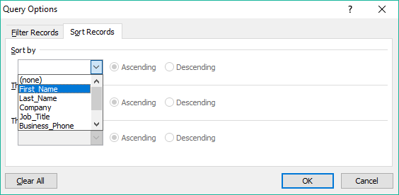
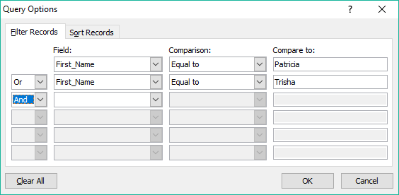
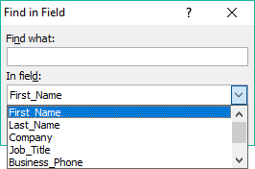
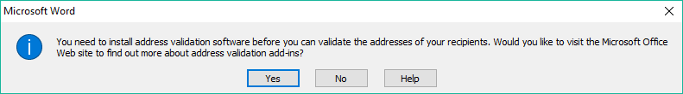
Mail Merge Basics – Step by Step Wizard (exercise)
You should have a dialog box that looks like this one.
You can further work with the list by …
Sorting the recipients list
Filtering the recipients list
Finding & Removing duplicates
Searching for a recipient
Validating addresses

Slide 24
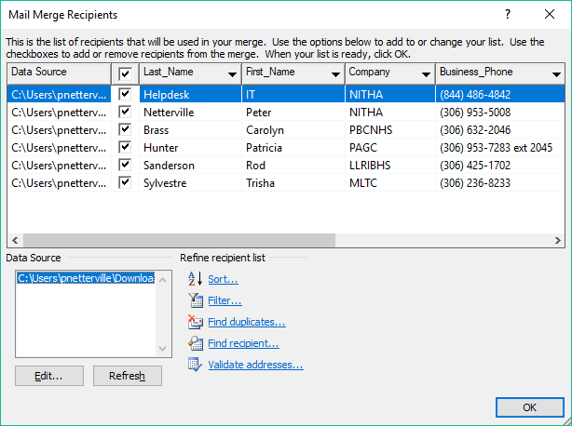
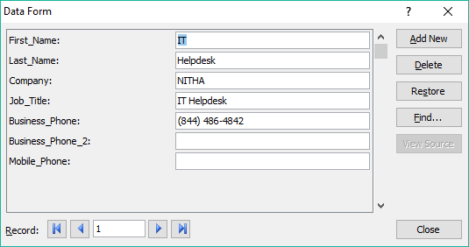
Mail Merge Basics – Step by Step Wizard (exercise)
Editing the list you just imported.
You can …
Delete the current selected record
Edit the selected record
Move through the records with these controls
Click on the Edit… button to edit the list you just imported.
Restore the current selected record
Once you have worked with the contacts list, click on OK.

Slide 25
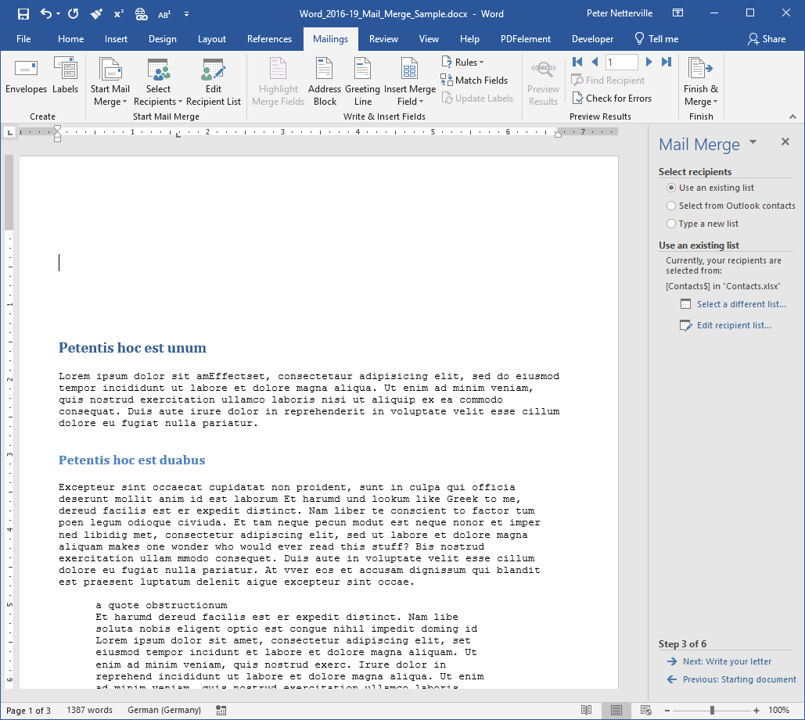
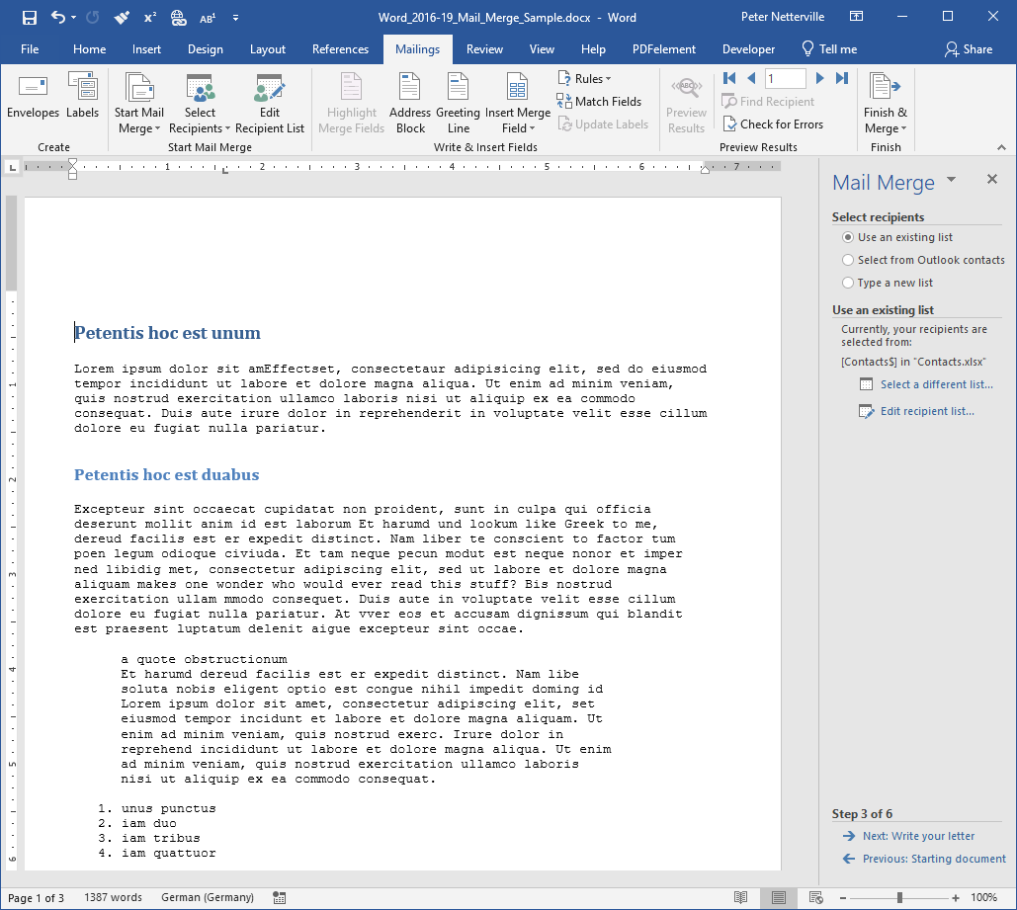
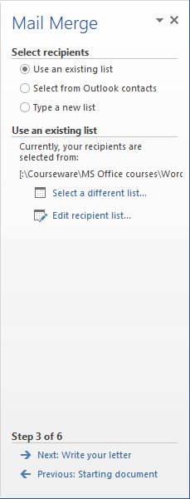
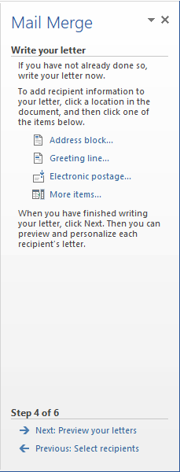
Mail Merge Basics – Step by Step Wizard (exercise)
Addresses imported, now write your letter.
Place the cursor on the first line beside the left most character.
Press Enter a couple of times to create space at the top of the document for the salutation line.
Place the cursor at the top of the page again.
Note: It may seem obvious to say, but the formatting at the location you insert the merge field is how that data will look when merged on to the document.
Click on
Next: Write your letter

Slide 26
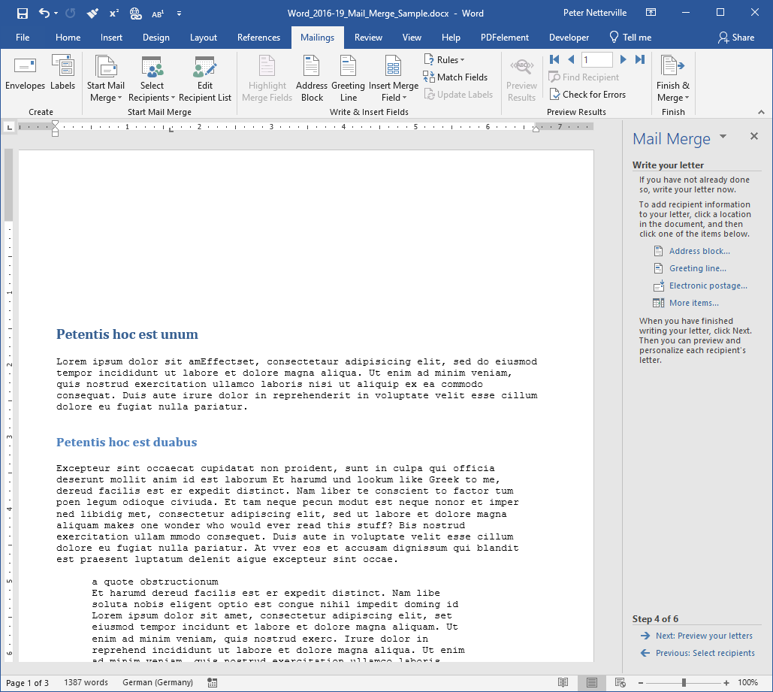
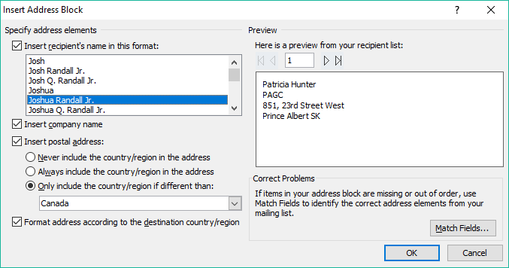
Mail Merge Basics – Step by Step Wizard (exercise)
Inserting fields into the document.
Address Block is a group of fields
First Name
Last Name
Company
Address
City
Province
Postal
Country
which define the full address.
S
By defining the Address Block, you can insert all the address lines at once.

Slide 27
Mail Merge Basics – Step by Step Wizard (exercise)
Inserting fields into the document.
You have some control over how the address is displayed by selecting the different options.
Choose the name format
Display the company name or not.
Include the postal address?
To refine even further the address display.

Slide 28
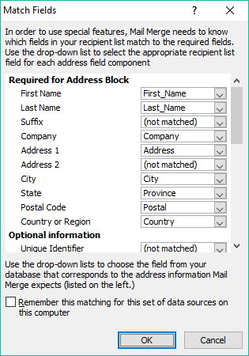
Mail Merge Basics – Step by Step Wizard (exercise)
Inserting fields into the document.
What Word expects …
What your merge file (database) has available …
This saves the fields you have matched for another similar mail merge.
If you have field names (the column header) that do not match what Word is expecting, then you can match your field name with Word by clicking on Match Fields.

Slide 29
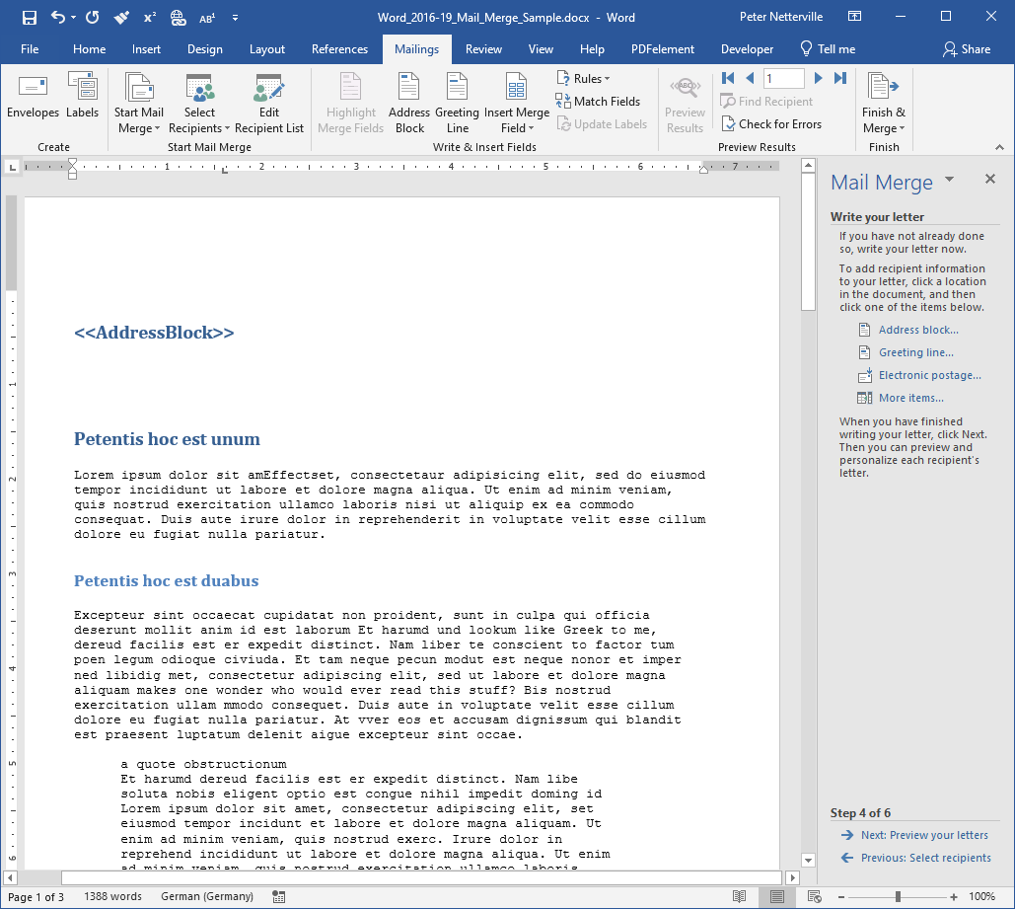
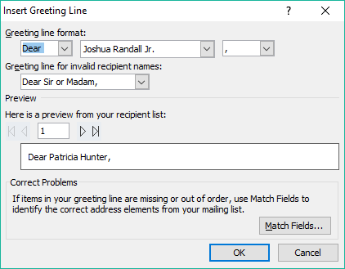
Mail Merge Basics – Step by Step Wizard (exercise)
Inserting fields into the document.
Now the Address Block is added to the document at the point where the cursor was located.
Click on Greeting line…
Greeting line format
Salutation
Name
Punctuation
Move the cursor down one.
If the address data you provided is invalid this is what Word will substitute.

Slide 30
Mail Merge Basics – Step by Step Wizard (exercise)
Inserting fields into the document.
Preview the greeting line for all your recipients.
This Match Fields button is the same as we examined earlier.
Click on OK when done.

Slide 31
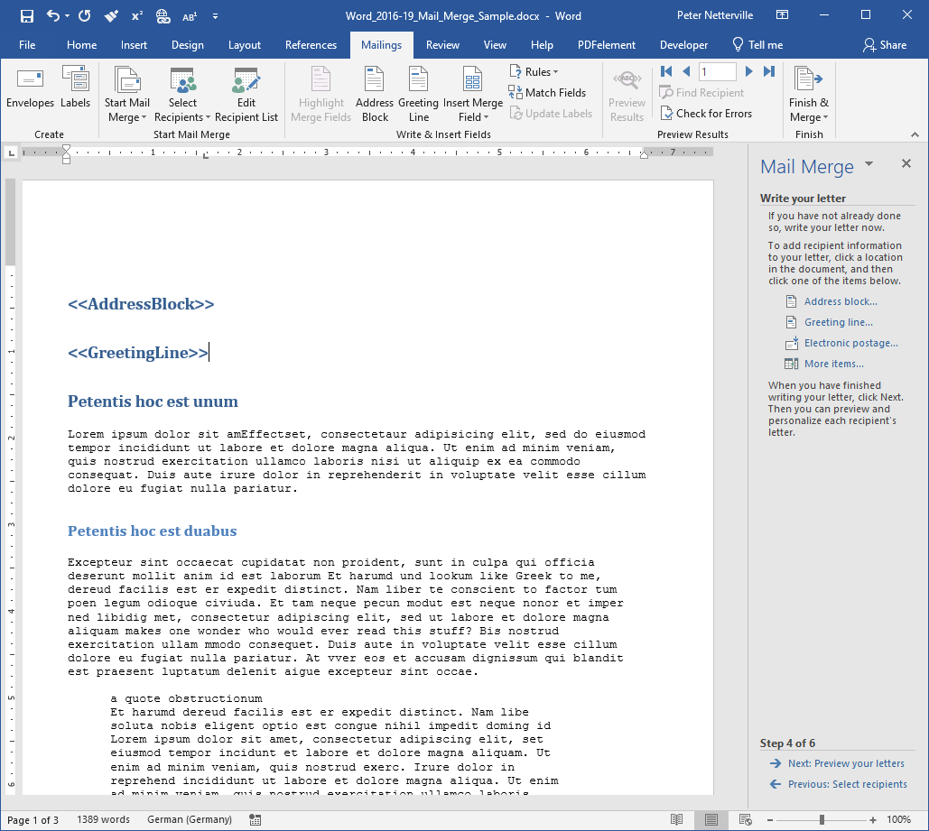
Mail Merge Basics – Step by Step Wizard (exercise)
Inserting fields into the document.
Now that the Address Block and the Greeting Line are inserted, we can insert a custom line.
Scroll down to the bottom of the document and put in a P.S., Post Script, and place the cursor just below that.

Slide 32
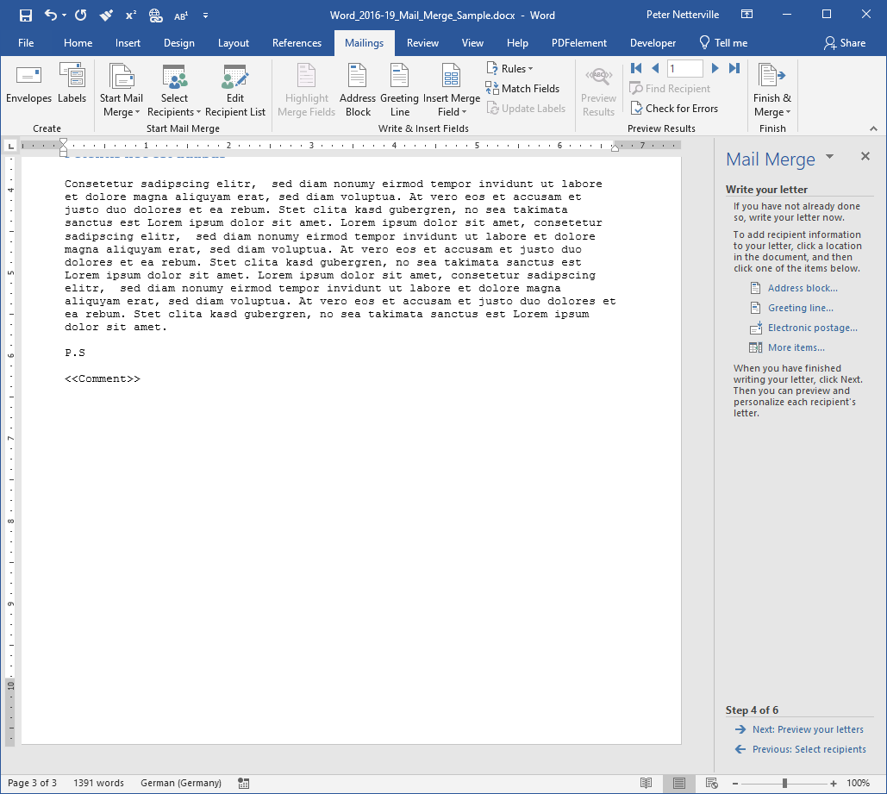
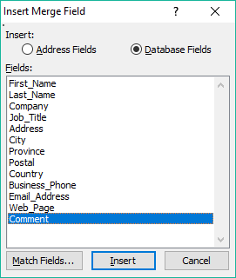
Mail Merge Basics – Step by Step Wizard (exercise)
Inserting fields into the document.
Click on the More Items… link.
Now we have the Comment line.
Database Fields – Will contain all the data fields, including the comment field we need to insert as the Post Script.
Click on the Comment field.
Address Fields – Only those fields which pertain to the address.
Click on Insert.

Slide 33
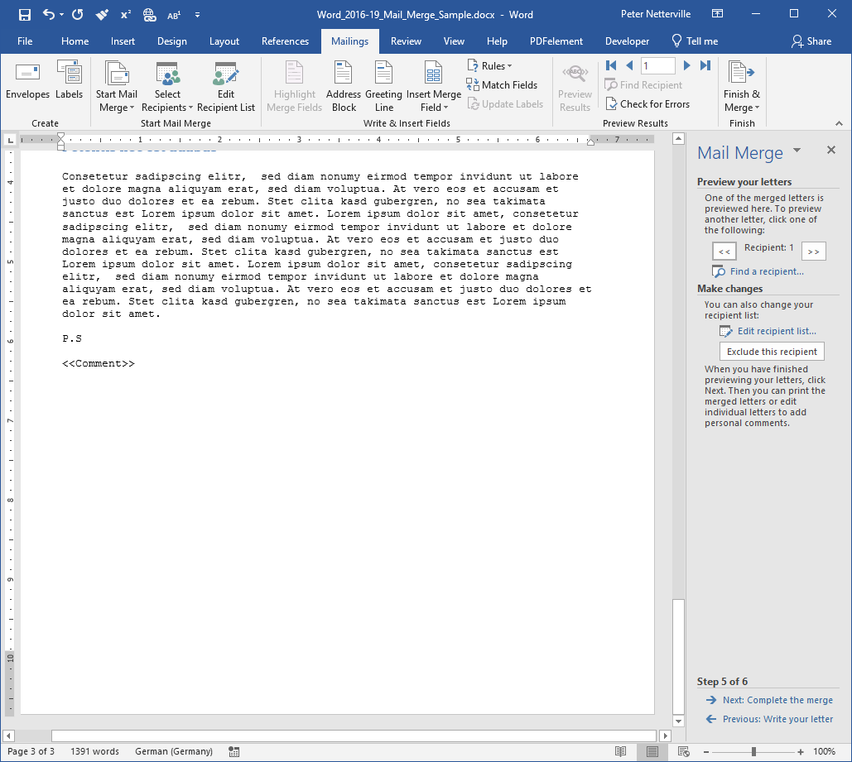
Mail Merge Basics – Step by Step Wizard (exercise)
Reviewing your merge.
You can cycle through the recipients list and do a preview of each document by clicking on the left and right arrow.
You can edit the recipient list.
If you click on Exclude this recipient, then the current recipient in removed from the current merge.
Finally, click on Next: Complete the merge

Slide 34

We have covered here in this course …
What is our direction in this course?
Mail Merge Basics – Data Sources, Outlook Contacts
Mail Merge Basics – Definitions
Mail Merge Basics - Selecting an Existing Source, Excel
Mail Merge Basics – What’s what
Mail Merge Basics - Selecting an Existing Source, Advanced
Mail Merge Basics – Data Sources, Manual Entry
Mail Merge Basics – Step by Step Wizard (exercise)

Slide 35


NITHA IT Helpdesk
helpdesk@nitha.com
1(306)953-5008
Notes:
Please do not hesitate to ask any question regarding this session, and I will make sure to answer your question as soon as possible.

Slide 36


