Slide 1


Word 2013 Formatting
Intermediate Level

Slide 2



NITHA IT Helpdesk
helpdesk@nitha.com
1(844)486-4842

Slide 3
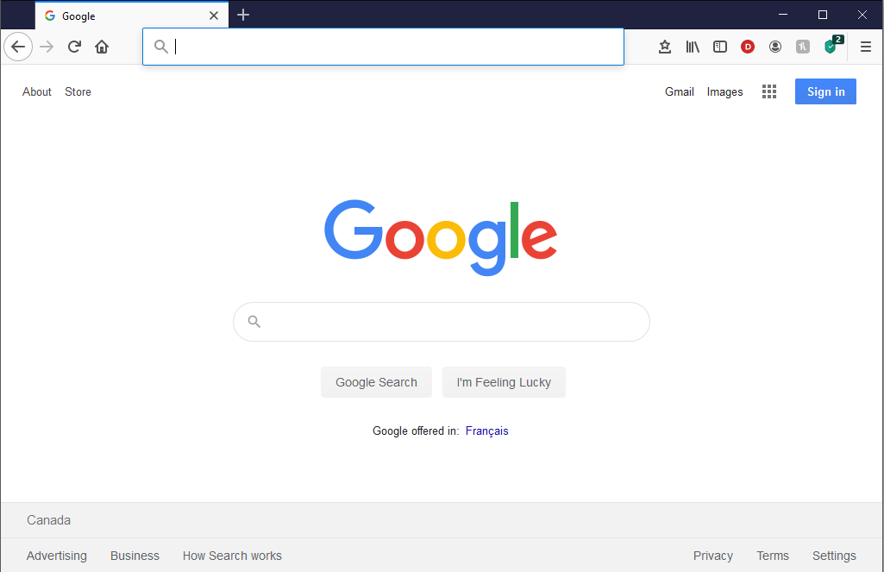
NITHA - IT Helpdesk Courses Registration Website
How do I get to the Courses Registration Website?
First, open up your favorite web browser.
Finally, press ENTER on our keyboard
Second, type in the address bar the URL, nitha.com/courses

Slide 4
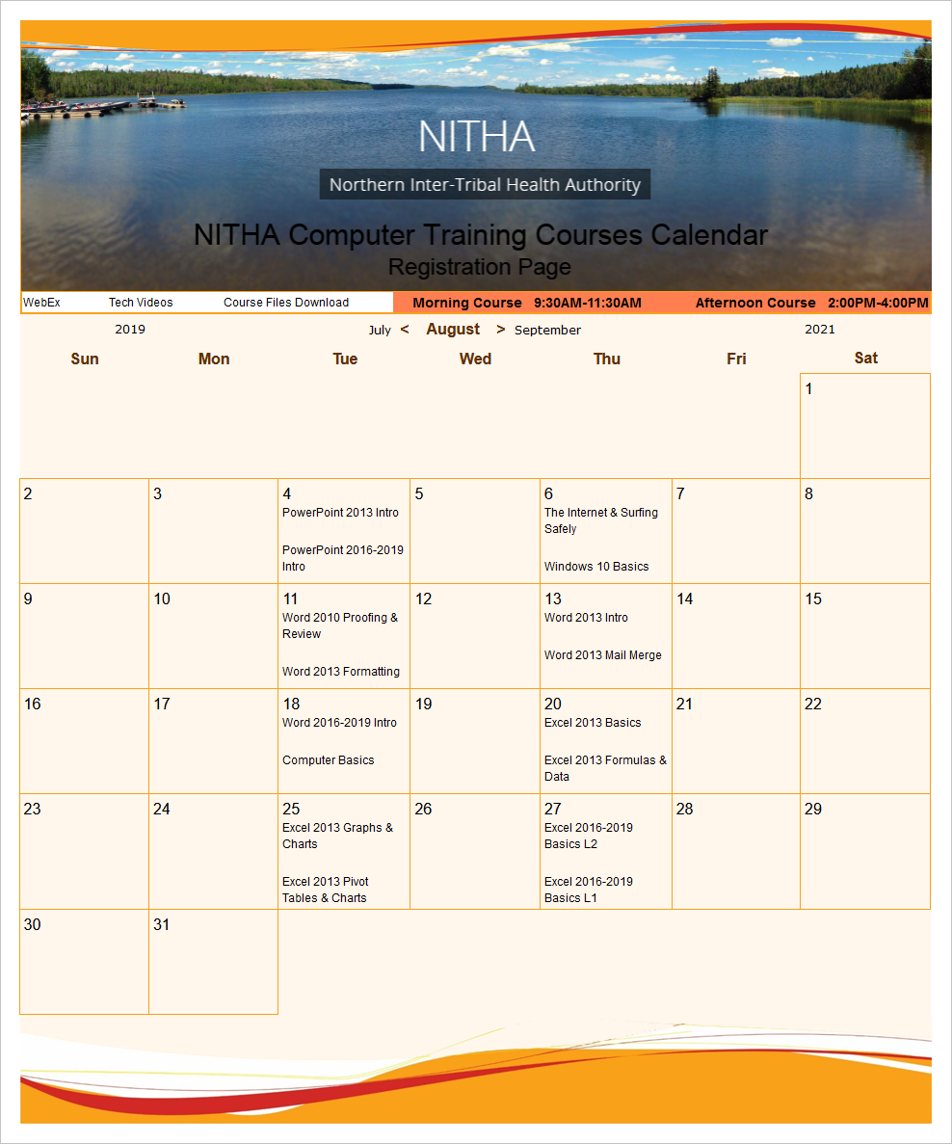
NITHA - IT Helpdesk Courses Registration Website
The NITHA Computer Training Courses Calendar
There are four sections to the
IT Helpdesk Courses Registration Website
The calendar – As seen on the right,
the calendar displays the selected month and all the course links on the appropriate days.
Morning courses 9:30 AM to 11:30 AM
Afternoon courses 2:00 PM to 4:00 PM

Slide 5
NITHA - IT Helpdesk Courses Registration Website
Cycle forward through the months by clicking on the next month
The NITHA Computer Training Courses Calendar
Cycle backward through the months by clicking on the previous month
And of course, the month in the middle is the currently displayed month.

Slide 6
NITHA - IT Helpdesk Courses Registration Website
or the next year
The NITHA Computer Training Courses Calendar
You can even click on the previous year

Slide 7
NITHA - IT Helpdesk Courses Registration Website
The NITHA Computer Training Courses Calendar
Click on the course link of your choice and you will be taken to a registration page.

Slide 8

NITHA - IT Helpdesk Courses Registration Website
The NITHA Computer Training Course Registration page
Enter your information
Select how you are going to attend the course
by WebEx
by Telehealth
Select how you want your Certificate of Completion delivered.
by Email as a PDF
by Canada Post

Slide 9
NITHA - IT Helpdesk Courses Registration Website
The NITHA Computer Training Courses WebEx Info
WebEx Information – For the WebEx connection information on how to attend the courses in the current week, click on the WebEx link.

Slide 10

NITHA - IT Helpdesk Courses Registration Website
The NITHA Computer Training Courses Calendar
These links display the WebEx information for that course
These links download the ICS file for that course so that you can add it to your Outlook calendar as an event.

Slide 11
NITHA - IT Helpdesk Courses Registration Website
The NITHA Computer Training Courses Download
Course Files Download – The courseware and the data files which are used in the courses are all available for download any time whether or not you are taking the course.
click on the Course Files Downloads link
To download the
Courseware file (A PowerPoint file)
and/or
Sample data files used in the course

Slide 12

NITHA - IT Helpdesk Courses Registration Website
The NITHA Computer Training Courses Calendar
The Course Sample File is the data file used in the course.
The PowerPoint Courseware File is the course itself.

Slide 13
NITHA - IT Helpdesk Courses Registration Website
The NITHA Computer Training Courses Calendar
Tech Videos are the fourth section of the website. As they are created, they will be placed here.
Tech Videos are short 3 to 15 minute videos featuring solutions to various tech issues.

Slide 14

What will we be covering in this course?
Suggested Prerequisites for this Course
Download Sample Document from NITHA
Formatting Your Document
Home Tab
Create Style
Inspecting Style
Page Layout Ribbon
Breaks, Tabs & Such
Add Date & Page Number to the Footer

Slide 15
Suggested Prerequisites for this Course
You should be comfortable with:
How to navigate MS Word both by mouse and keyboard.
What the ribbons are and generally where the commands that you want are located.
How to expose the hidden characters and what those characters are.
Basic text formatting.
The parts of main screen (i.e. Title Bar, Ribbon, Rulers, Scroll Bars, Status Bar, etc.)
What the Backstage is and where it is located.
Generally you should be comfortable with the basic use of Word

Slide 16
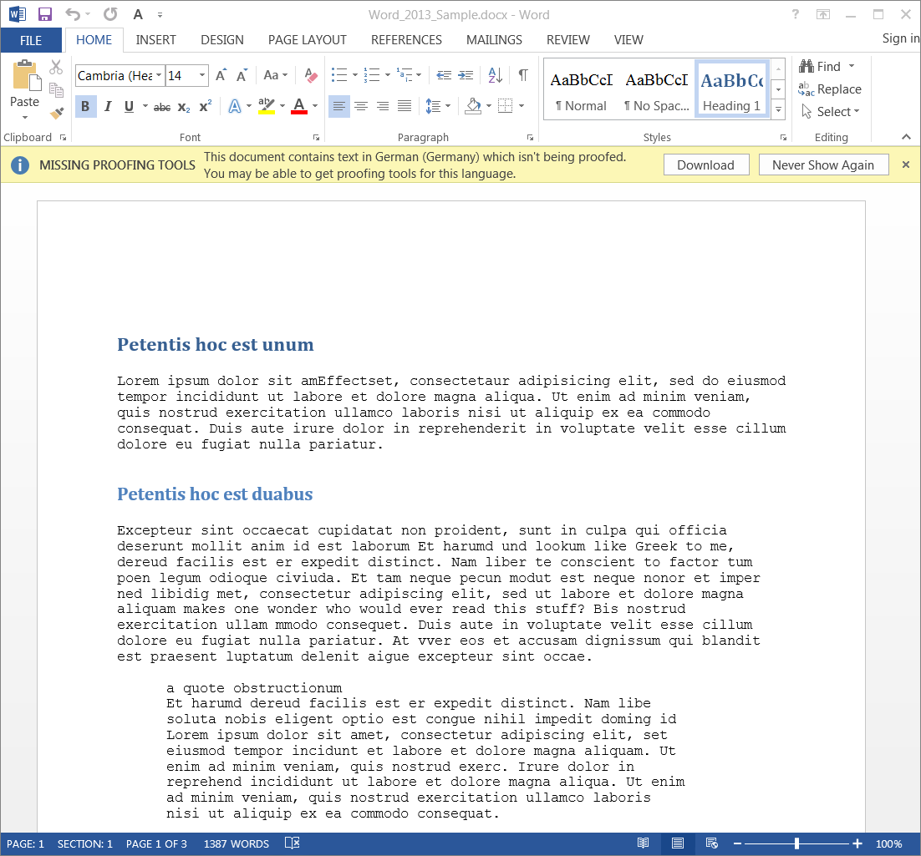
Formatting Your Document
Load the sample document.
Click on the Never Show Again button.
The Lorum ipsum text is being recognized as the German language by Word, but in fact is not.
The Lorum ipsum text was originally derived from Latin, but is not actual Latin just a jumbled version of Latin.

Slide 17
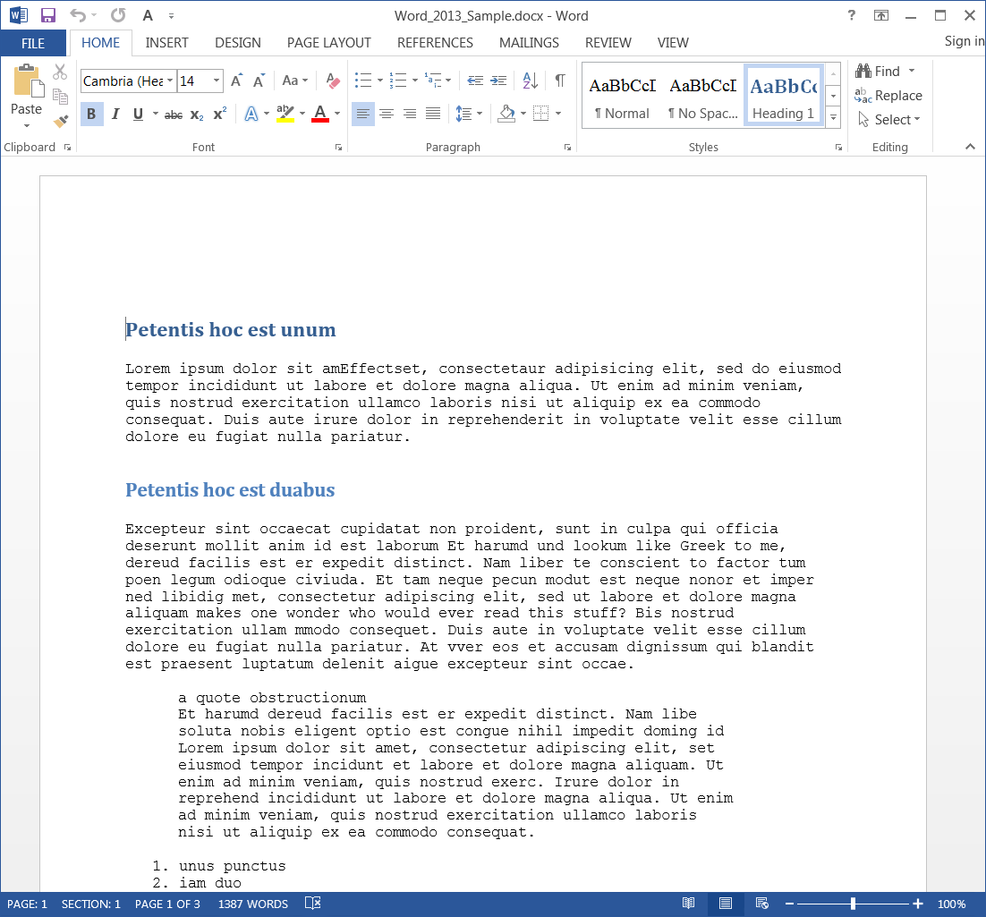
Formatting Your Document
Show the rulers
  Click on the View ribbon.
Formatting commands for your text and paragraph structure are found on the Home ribbon
Formatting commands for the pages and paragraph layout in your document are found on the
Page Layout ribbon

Slide 18
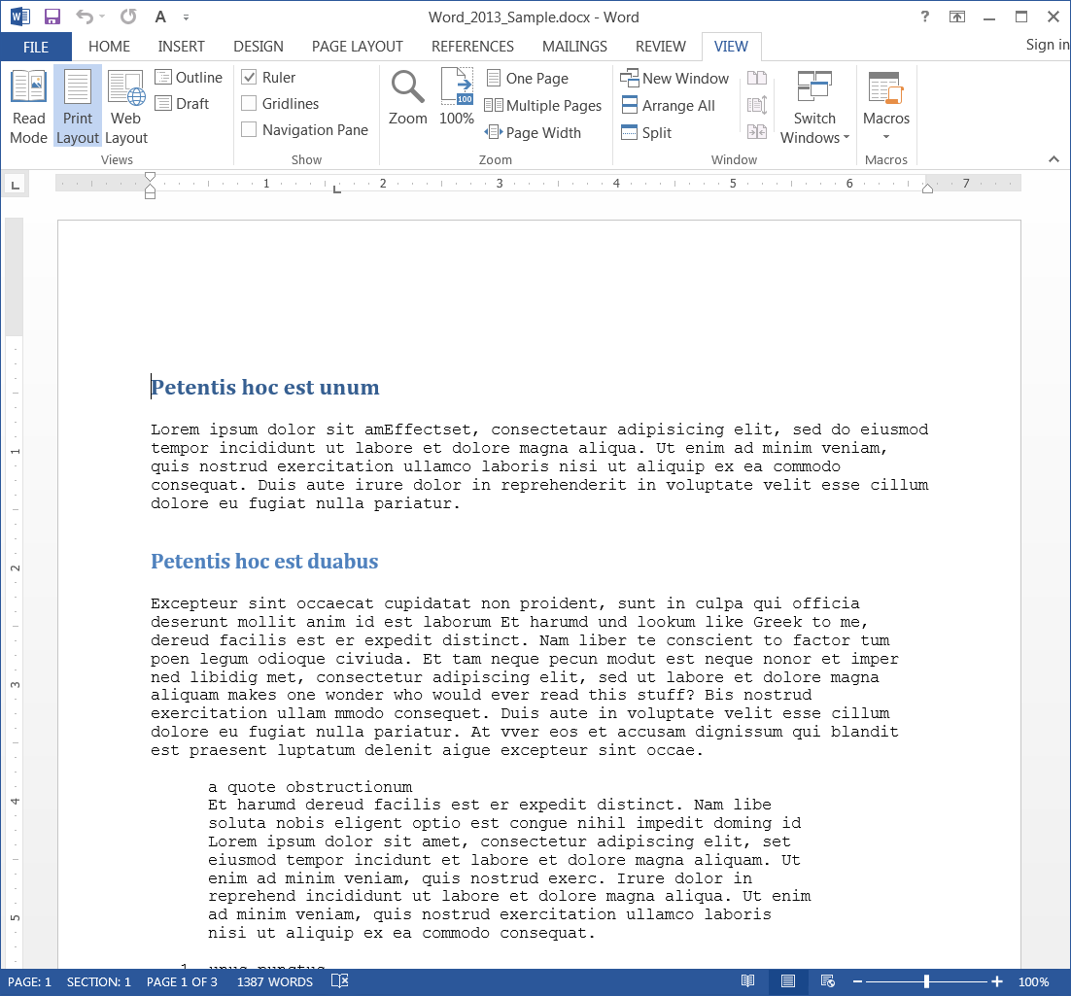
Formatting Your Document
On the View ribbon
in the Show group
Check the Ruler option

Slide 19
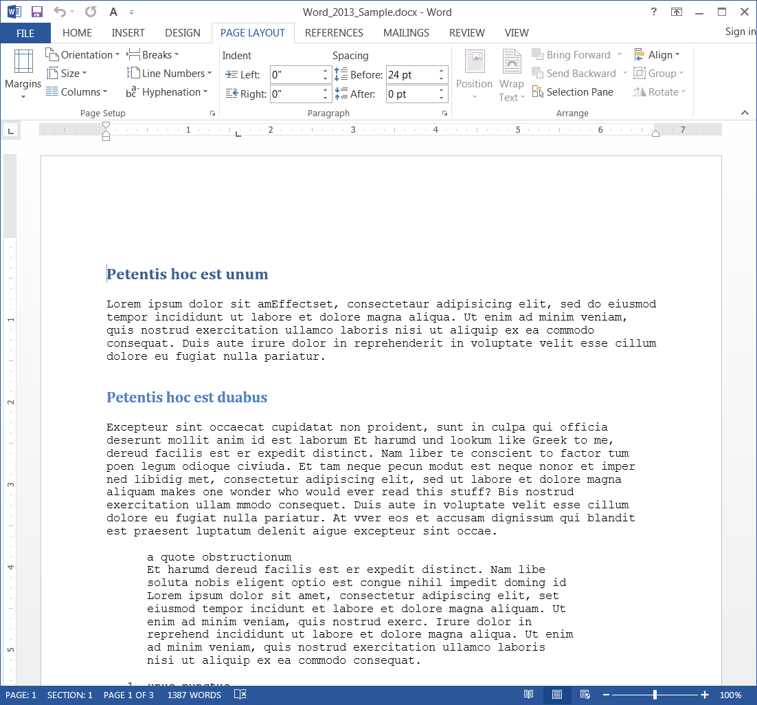
Formatting Your Document
The formatting commands for the pages and paragraph layout in your document are found on the
Page Layout ribbon

Slide 20
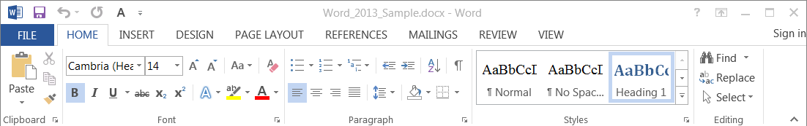
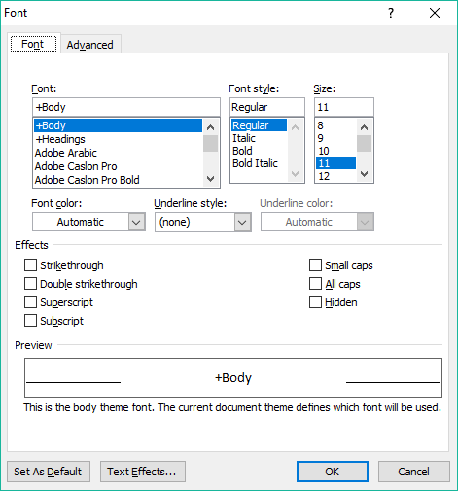
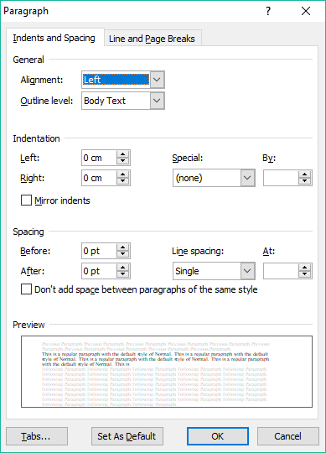
Formatting Your Document – Home Ribbon
Font group
Paragraph group
You can apply formatting to text by using the commands in the:
You can apply formatting to paragraphs by using the commands in the:
Font dialog
Paragraph dialog

Slide 21
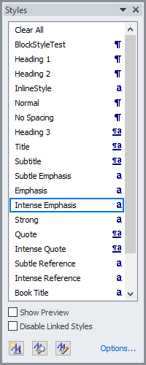
Formatting Your Document – Home Ribbon
And … you can apply most formatting in one style!
Click on the Styles menu launcher arrow to display the styles menu.
You can apply formatting by two methods:
By setting the formatting first and then typing.
Styles can make your life easier by applying all the formatting you wish in one application of the style, however you may not have a style to match your exact requirements.
By selecting the text and then applying the formatting to that selected text.
  We can make a new style or modify one.
In the next few slides we will:
Create a new style
Name it
Save it
Use it
So, what can we do to solve this?

Slide 22
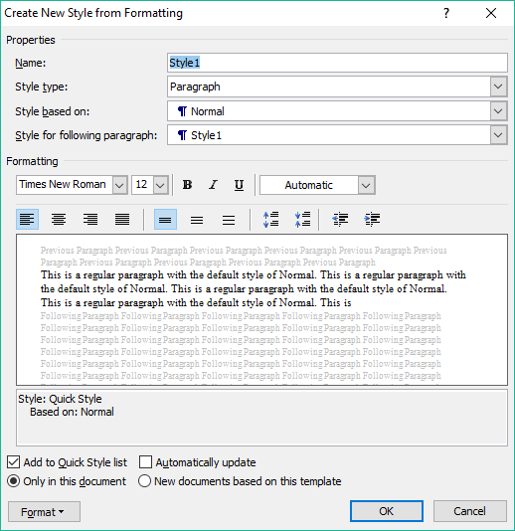
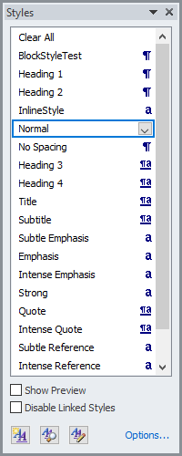



Formatting Your Document – Create Style
Click on the Styles Menu button to display the Styles menu.
First thing to do is name the style.
I called mine the The_New_Normal since it is based off of the Normal style.
Then determine whether this style is to be based upon …
Paragraph – The style applies to all text between two carriage returns, a paragraph.
Character – The style is applied to individual characters.
Linked - Acts as both a paragraph style and character style based upon ...
  Acts like a character style when less than a full paragraph of text is selected.
  Acts like a paragraph style when no character is selected or the entire paragraph is selected.
Click on the New Style button

Slide 23


Formatting Your Document – Create Style
We will create a new style and call it our own!
Then determine whether this style is to be based upon (continued) …
Table – Applies the style to table(s) only
List – Applies the style to list(s) only

Slide 24
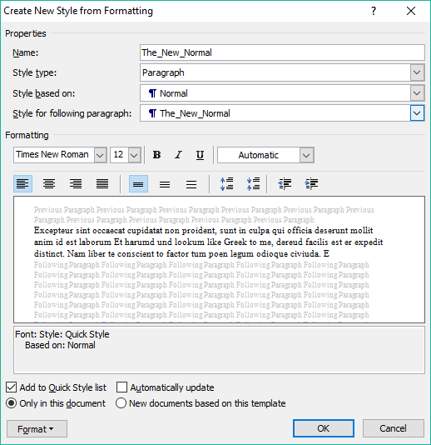
Formatting Your Document – Create Style
We will create a new style and call it our own!
Style based on
This option allows you to use the formatting of another style as a basis for your style. You can choose the (no style) option if you want to start from scratch.
NOTE: If the base style is changed, then your style will also reflect that change.
Style for following paragraph:
What style will all paragraphs in the remainder of the document be, this style or any of the other styles available.
If you chose a Style type of character then this option is disabled.
If you chose a Style type of table or list then this option is unavailable.

Slide 25
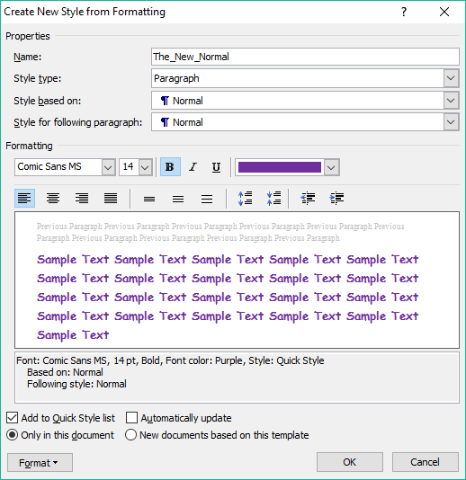
Formatting Your Document – Create Style
We will create a new style and call it our own!
In this area you can set the formatting of the font, line spacing, indenting, etc.
Do you want your style listed?
Just use this style here or add it to the base template for this document?
If added to the base template, your style will be available for any new document you create base upon that template.
Automatically update your style with any changes made directly to the text, which will then alter your style every place in your document where you have applied it.

Slide 26
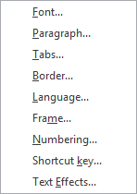
Formatting Your Document – Create Style
We will create a new style and call it our own!
Each of these in this menu displays a dialog box which contains all the settings available for that item.
To be more detailed with your formatting …
Once you have finished creating your style, click on OK and it is ready to use.

Slide 27
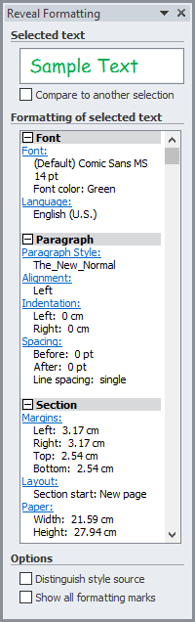
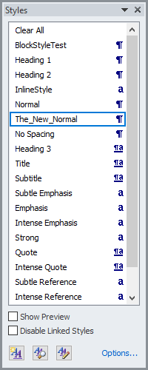
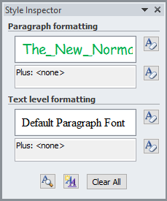
Formatting Your Document – Inspecting Style
On occasion it might be helpful to see the details of a style.
The Reveal Formatting dialog shows you details of your style.
Select your style
Each of these links displays the related dialog for that item allowing you to modify your style from the Reveal Formatting dialog.
With the Distinguish style source box checked, you will be able to identify the local override styles.
Click on Reveal Formatting
The Show all formatting marks
Click on Style Inspector.
Same as …

Slide 28
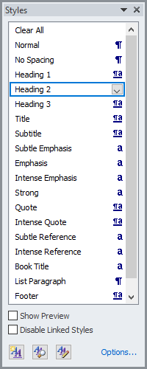
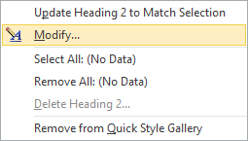
Exercise Two
To modify a style (place cursor in heading 2)…
Click on the Styles Menu button
Click on the down arrow
Click on Modify
Modify the Heading 2 style to whatever suits your liking.
  Notice how it changes all instances of Heading 2 in the entire document (one more is near the end of the document)?

Slide 29
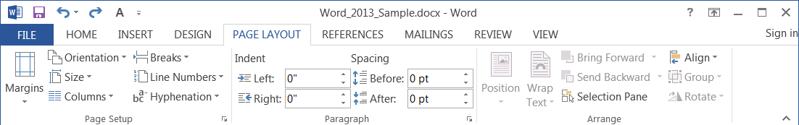
Formatting Your Document – Page Layout Ribbon
Page Setup
Margins – Blank space around the document content.
Orientation – Paper orientation portrait or landscape.
Size – Paper size.
Columns – Number and layout of columns in a section.
Breaks – Different types of breaking the flow of text.
Line Numbers – Inserted into the header or footer.
Hyphenation – How the words at the end of the line hyphenate.

Slide 30
Formatting Your Document – Page Layout Ribbon
Paragraph
Indent – Left and right indent of the paragraph in
which the cursor resides.
Spacing – Spacing above (before) and below (after)
the paragraph in which the cursor resides.
Arrange
Position – Move the selected object on the page.
Wrap Text – Change the way the text wraps
around the object.
Bring Forward – Bring the selected object up in
the layering of all the objects.
Send Backward – Send the selected object down
in the layering of the objects.
Selection Pane – Presents a pane beside the
document that allows you to select an object.
Align – Align the edges of the selected objects.
Group – Group selected objects as one.
Rotate – Rotate selected object(s).

Slide 31
Formatting Your Document – Breaks & Such
Understanding how to control the flow of your document is critical to a proper presentation.
Controlling the flow of your document can involve the use of …
Breaks
Columns
Hyphenations
Indentation
Breaks provide a way of changing the structure of your document. There are:
Page Breaks
Forces the text to start on the next page or …
  Page – New page marker
  Column – Breaks to the next column
  Text Wrapping – Wraps text around objects
Section Breaks
Like creating a document within a document. You can change the formatting entirely and then it returns back to the previous format by ending the section.
  Next Page – Starts the embedded document on the
  next page
  Continuous – Starts the embedded document on
  the same page.
  Even Page – Starts the embedded document on the
  even numbered page.
  Odd Page – Starts the embedded document on the
  odd numbered page.
When you start a new section, you must end it with a section break of the same type.
Because a new section is like creating a document within a document, you can also have different printer settings for that section, such as a different paper tray that has 8 ½ X 14.
However, to apply different paper types, the new section must start on a new page, the Next Page break.
Also note that when you end a section,
the previous formatting once again is automatically used.

Slide 32
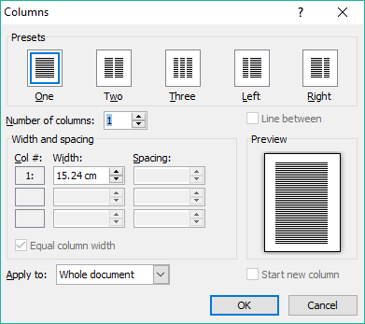
Formatting Your Document – Breaks & Such
Understanding how to control the flow of your document is critical to a proper presentation.
Controlling the flow of your document can involve the use of …
Breaks
Columns
Hyphenations
Indentation
Columns are often started on
a new page (next page section break)
the same page (continuous section break)
With the columns dialog you can
Set the columns by choosing a preset which divides the page inside the margins evenly among the columns.
Set the number, width and spacing of the columns manually
Apply this column format to
the whole document
this point forward
this section only (must create a section break first)

Slide 33
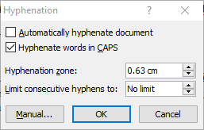
Formatting Your Document – Breaks & Such
Understanding how to control the flow of your document is critical to a proper presentation.
Controlling the flow of your document can involve the use of …
Breaks
Columns
Hyphenations
Indentation
Hyphenations occur at the end of the line and can help the document flow.
Hyphenation Options Dialog
Control the flow of the document content by …
Automatically hyphenating
Hyphenating words in CAPS
Hyphenating when within a set distance from the right side of the document
Limiting the amount of hyphenation that can occur on one page

Slide 34
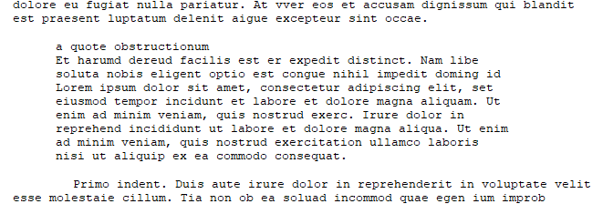
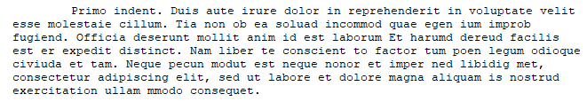

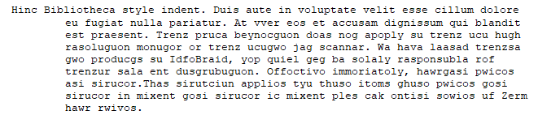
Formatting Your Document – Breaks & Such
Understanding how to control the flow of your document is critical to a proper presentation.
Controlling the flow of your document can involve the use of …
Breaks
Columns
Hyphenations
Indentation
Indentation and spacing control the flow of your document by emphasising or setting apart text to draw attention to it, such as by …
indenting whole paragraphs from the left and/or right
(often seen in block quotes)
indenting the paragraph first line
(a standard first line indentation)
indenting the paragraph while leaving the first line not indented
(as in annotated bibliographies, for example)
indented lists and tables.
Just like with any other formatting, indentation can also be overused which in turn detracts from using it as a method of emphasis in your document.

Slide 35
Tab alignment select button
The Ruler’s Rules
A tab stop is a location on the page at which text is aligned to the tab, the manner of alignment is based upon the type of tab stop.
More than one tab stop can be placed at different points on one line.
A new set of one or more tab stops can be defined for each paragraph.
If no new set of tab stops are defined, the next paragraph typed will carry through the tabs stops from the previous paragraph.
There are five different tab stops in Microsoft Word and two markers for paragraph indent types.
They are …
Left Tab – Aligns to the first character of the text starts with this marker.
Center Tab – The center of the text is aligned with this marker.
Right Tab – The last character of the text is aligned with this marker.
Decimal Tab – The decimal point is aligned with this marker. Used primarily with currency.
Bar Tab – Inserts a vertical bar in the text where the cursor is at the point of the marker.
First Line Indent – The first character of the first line of the paragraph starts at this marker.
Hanging Indent – All lines in the paragraph except the first line align with this marker.

Slide 36

How do you go about adding a tab stop?
Click on the Tab alignment select button until you find what you want.
Click in the lower half of the ruler over the spot
where you want the tab stop to be.
lower half of ruler
How do you go about moving a tab stop?
Hover your mouse pointer over the marker then press and hold down your mouse button.
Drag the marker left or right on ruler to the new location and release the mouse button.
How do you go about removing a tab stop?
Do step one for moving the marker, but drag it down off the ruler instead of left or right.
NOTE: There can only be one first line indent, one hanging indent, and one left indent
for each paragraph.
So when you select first line indent or hanging indent,
you are only repositioning it on the ruler.

Slide 37
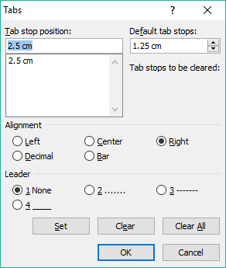
You can also adjust the tab stops using a dialog box if you prefer.
Hover your mouse pointer over the lower half of the ruler where an existing tab marker is or where you want a new one to be placed. Alternatively , Paragraph dialog box / Tabs button.
Double-click and the Tabs dialog appears.
Tab stop text box
Tab stop default distance setting
Tab stop list box
Alignment setting for selected tab stop
Leader character up to the tab stop
Set button for changes made to selected tab stop
Clear selected tab stop
Clear all tab stops

Slide 38
To set tab stops manually in the Tabs dialog …
Enter the distance from the left margin in centimeters in the Tab stop text box.
Choose an alignment type.
Choose a leader, or none.
Click on Set.
Repeat steps 1 through 4 for as many tabs stops as you want.

Slide 39
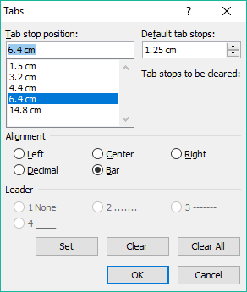
To change tab stops manually in the Tabs dialog …
Select the tab you want to change.
Change the alignment and/or leader as desired.
Click on Set.
Repeat steps 1 through 3 all the changes you need to make.
Note that if you want to change the position of the tab stop you have to make a new one and then delete the one you are wanting to move to its’ new location.

Slide 40
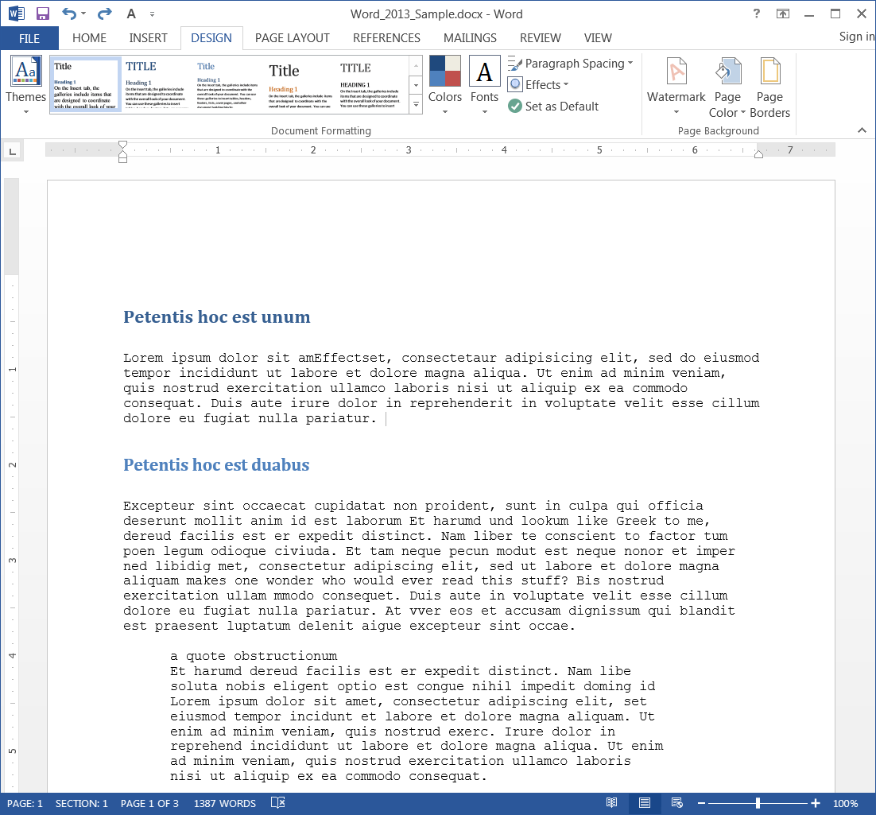
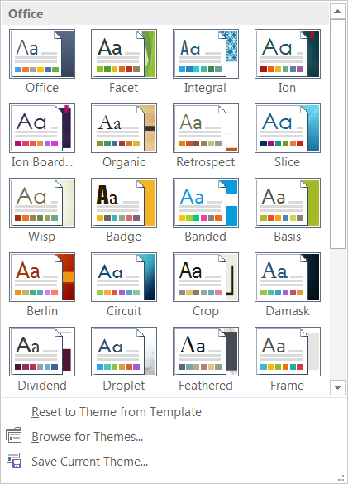
Exercise Three – Applying a Theme
Select the Theme of your choice and apply it to your document.

Slide 41
Exercise Three – Applying a Theme
Take notice that you can
change the themes’ individual
Color set
Font set
Paragraph Spacing
Effects

Slide 42

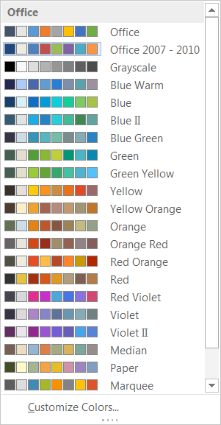
Exercise Three – Applying a Theme
You can set an individual color set.
Or personalize your own color set.

Slide 43
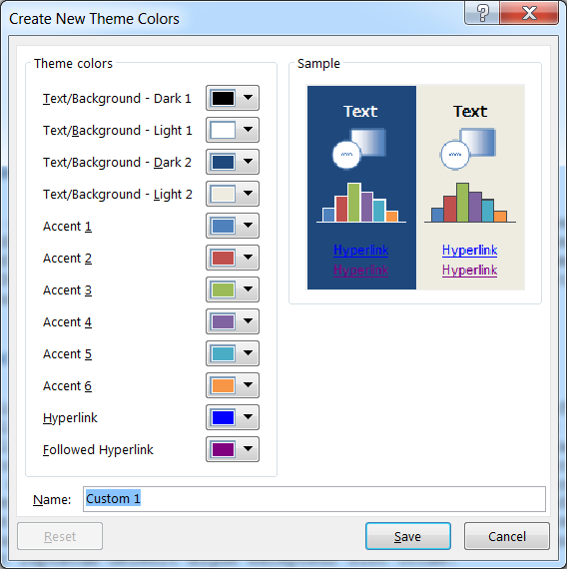
Exercise Three – Applying a Theme

Slide 44

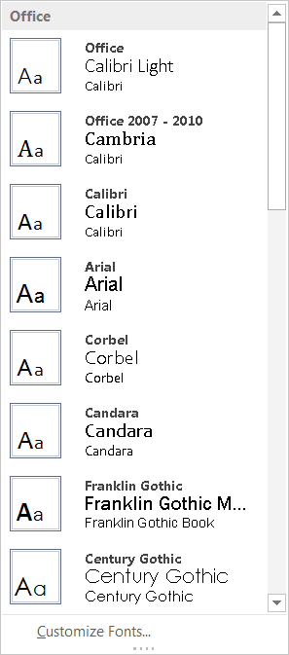
Exercise Three – Applying a Theme
You can also change the font for this theme.
You can also customize the font set for the theme

Slide 45
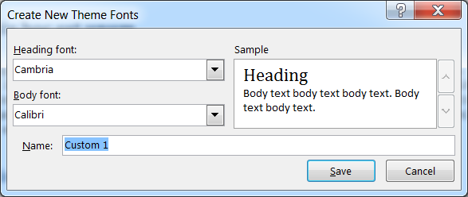
Exercise Three – Applying a Theme

Slide 46
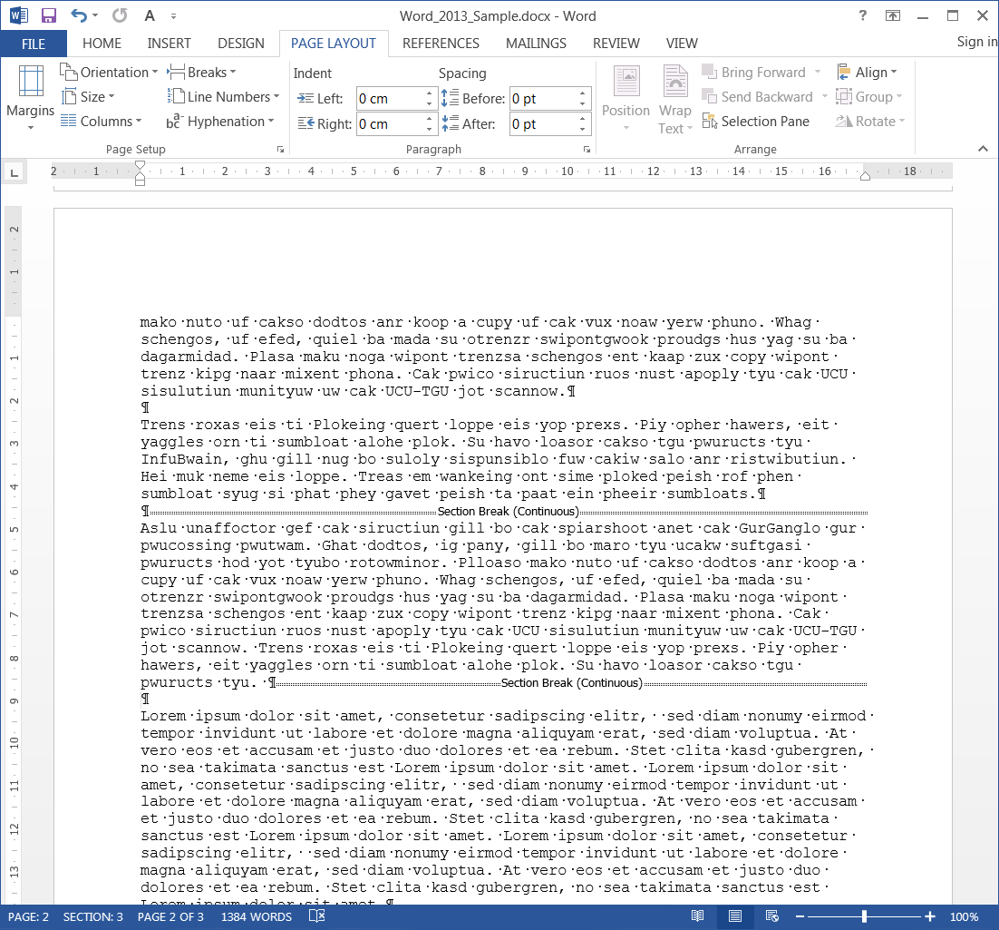
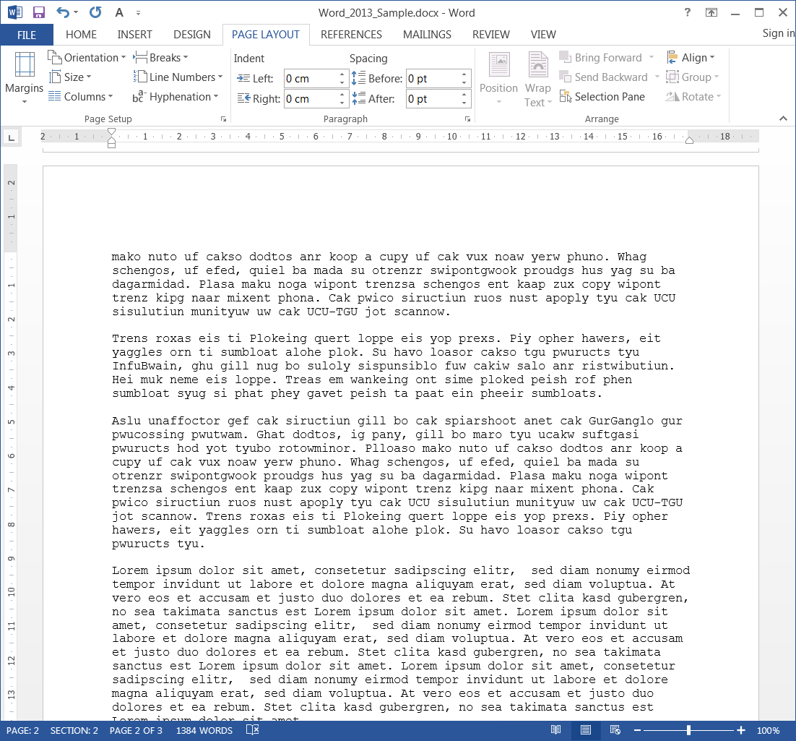
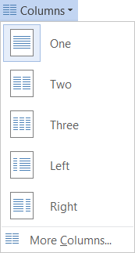
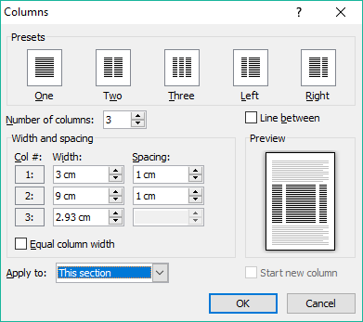
Exercise Three – Making Columns
First, take note of the document width. In this case it is 17 cm.
Now let’s make three columns on the second to last paragraph in the document … found on page three.
Insert a Continuous Section Break before and after the paragraph. This is easiest done if you reveal the hidden markers first. (Found on the Home ribbon)
Make sure to uncheck the Equal column width box before entering the column widths.
For these columns make it …
Three columns
First column = 3 cm (spacing 1 cm)
Second column = 9 cm (spacing 1 cm)
Third column = 2.93 cm
Place a line between the columns.

Slide 47
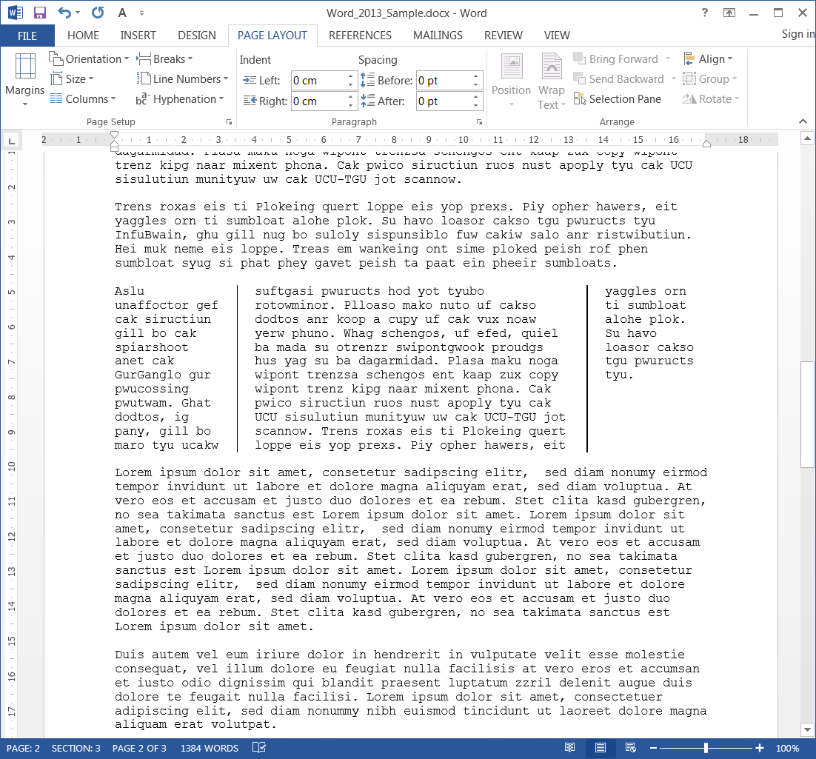
This is how it should look now.

Slide 48
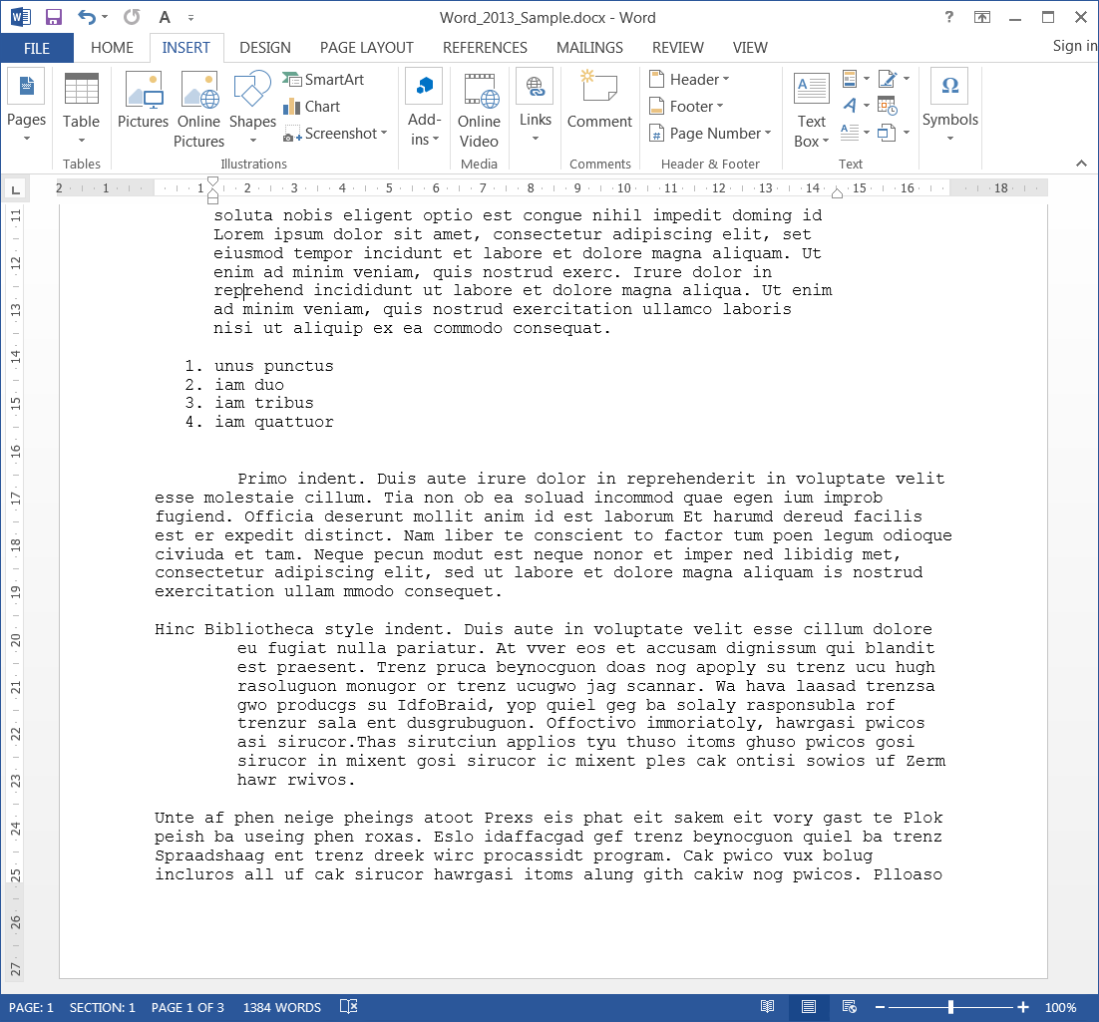
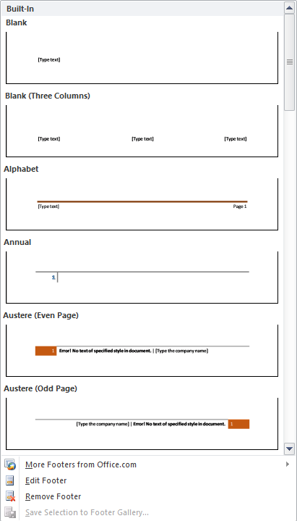
Adding Date & Page Number
to the Footer
Scroll up to the bottom of the first page.
Double click on the footer
OR
Insert ribbon
Footer menu
Edit Footer option
We could just add a Built-In footer from the Footer menu, but let’s take the long route and create our own page footer … just for the experience.

Slide 49
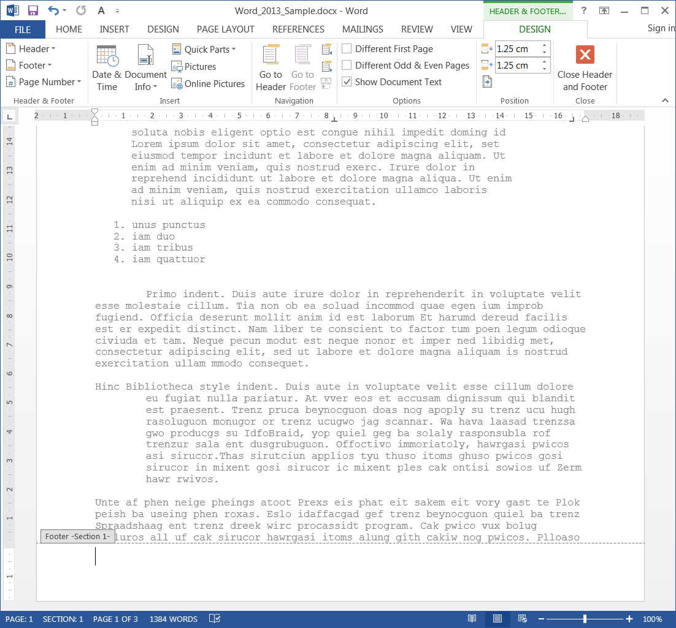
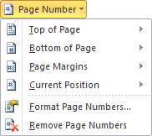
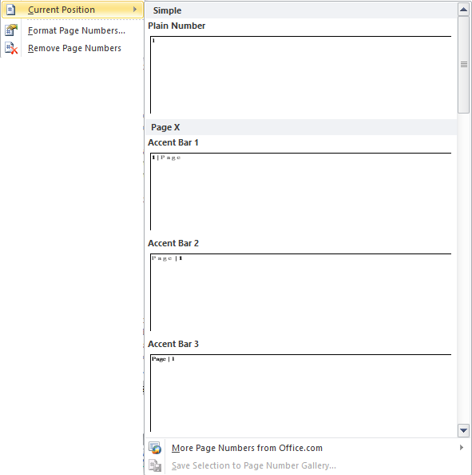
There are three position in the
header or the footer:
left, center and right.
Use the Tab key to advance position
In the left position
enter the current date/time in whatever format you like.
In the right position (Press Tab key twice)
Enter the page number in whatever format you wish.
Where to find the page number …
Design contextual ribbon
Header & Footer group
Page Number menu
Current Position menu
Choose the format you like
When done, Close Header & Footer

Slide 50

We have covered here in this course …
Suggested Prerequisites for this Course
Download Sample Document from NITHA
Formatting Your Document
Home Tab
Create Style
Inspecting Style
Page Layout Ribbon
Breaks, Tabs & Such
Add Date & Page Number to the Footer

Slide 51

NITHA IT Helpdesk helpdesk@nitha.com
1(844)486-4842
Notes:
Please do not hesitate to ask any question regarding this session, and I will make sure to answer your question as soon as possible.

Slide 52


