Slide 1


Word 2010 Proofing & Review
Intermediate Level

Slide 2

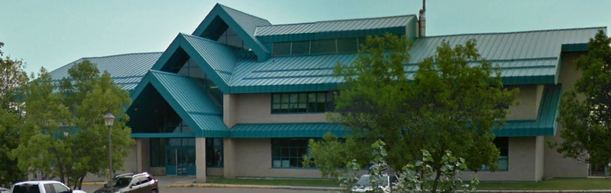

NITHA IT Helpdesk
helpdesk@nitha.com
1(844)486-4842

Slide 3
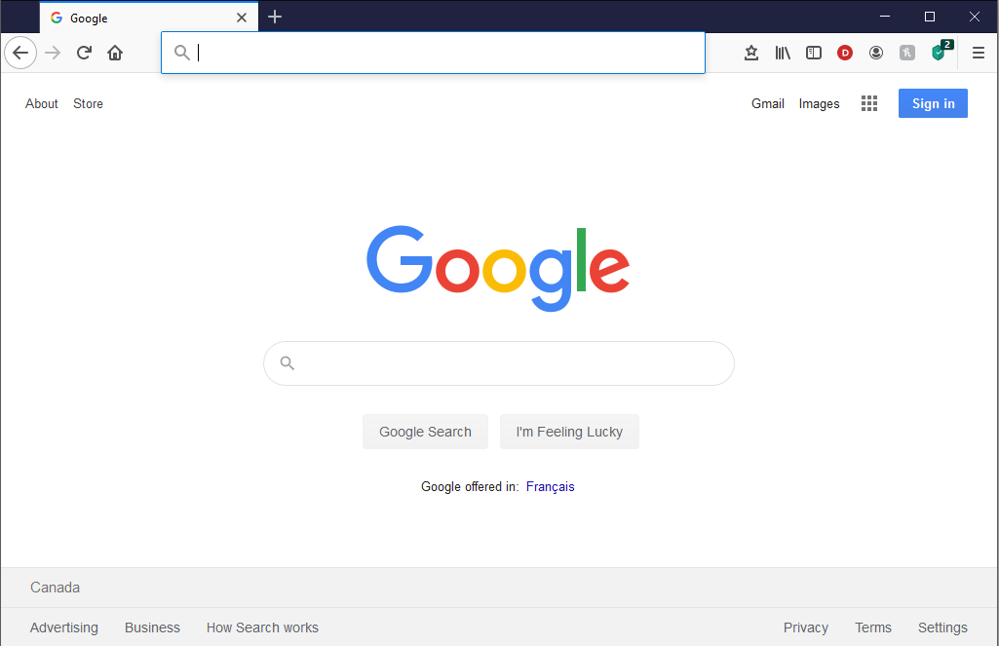
NITHA - IT Helpdesk Courses Registration Website
How do I get to the Courses Registration Website?
First, open up your favorite web browser.
Finally, press ENTER on our keyboard
Second, type in the address bar the URL, nitha.com/courses

Slide 4
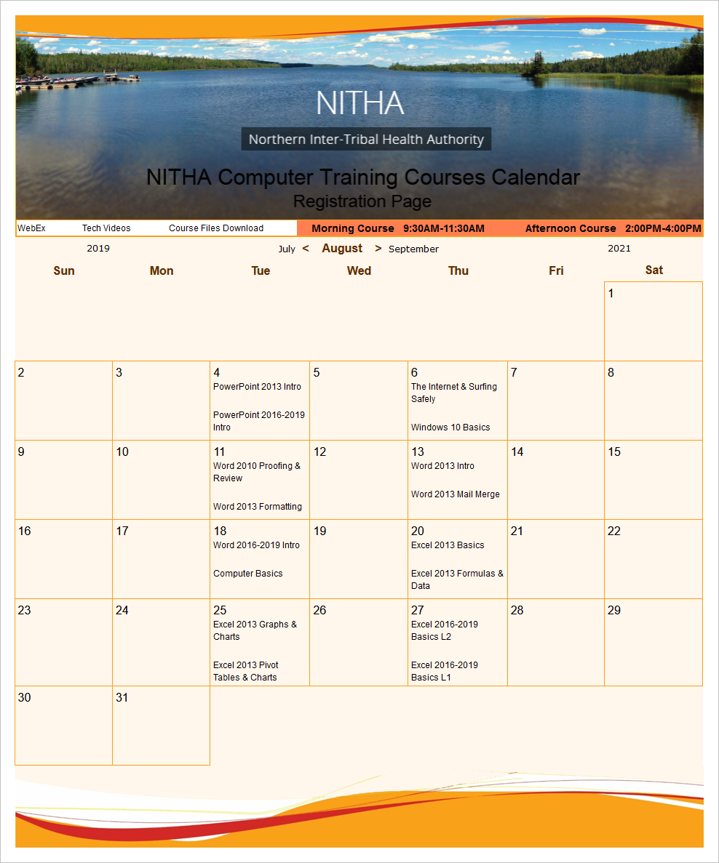
NITHA - IT Helpdesk Courses Registration Website
The NITHA Computer Training Courses Calendar
There are four sections to the
IT Helpdesk Courses Registration Website
The calendar – As seen on the right,
the calendar displays the selected month and all the course links on the appropriate days.
Morning courses 9:30 AM to 11:30 AM
Afternoon courses 2:00 PM to 4:00 PM

Slide 5
NITHA - IT Helpdesk Courses Registration Website
Cycle forward through the months by clicking on the next month
The NITHA Computer Training Courses Calendar
Cycle backward through the months by clicking on the previous month
And of course, the month in the middle is the currently displayed month.

Slide 6
NITHA - IT Helpdesk Courses Registration Website
or the next year
The NITHA Computer Training Courses Calendar
You can even click on the previous year

Slide 7
NITHA - IT Helpdesk Courses Registration Website
The NITHA Computer Training Courses Calendar
Click on the course link of your choice and you will be taken to a registration page.

Slide 8

NITHA - IT Helpdesk Courses Registration Website
The NITHA Computer Training Course Registration page
Enter your information
Select how you are going to attend the course
by WebEx
by Telehealth
Select how you want your Certificate of Completion delivered.
by Email as a PDF
by Canada Post

Slide 9
NITHA - IT Helpdesk Courses Registration Website
The NITHA Computer Training Courses WebEx Info
WebEx Information – For the WebEx connection information on how to attend the courses in the current week, click on the WebEx link.

Slide 10

NITHA - IT Helpdesk Courses Registration Website
The NITHA Computer Training Courses Calendar
These links display the WebEx information for that course
These links download the ICS file for that course so that you can add it to your Outlook calendar as an event.

Slide 11
NITHA - IT Helpdesk Courses Registration Website
The NITHA Computer Training Courses Download
Course Files Download – The courseware and the data files which are used in the courses are all available for download any time whether or not you are taking the course.
click on the Course Files Downloads link
To download the
Courseware file (A PowerPoint file)
and/or
Sample data files used in the course

Slide 12

NITHA - IT Helpdesk Courses Registration Website
The NITHA Computer Training Courses Calendar
The Course Sample File is the data file used in the course.
The PowerPoint Courseware File is the course itself.

Slide 13
NITHA - IT Helpdesk Courses Registration Website
The NITHA Computer Training Courses Calendar
Tech Videos are the fourth section of the website. As they are created, they will be placed here.
Tech Videos are short 3 to 15 minute videos featuring solutions to various tech issues.

Slide 14

What will we be covering in this course?
Course Prerequisites
Checking the Quality of Your Document - Out for Review
Proofing Options – General
Viewing Two Documents Side by Side
Proofing Options – AutoCorrect Options
Merging Reviewer Documents into Your Original
Proofing Options – AutoCorrect Options Tabs
Comparing
Review Ribbon
Combining
Checking the Quality of Your Document - Proofing
Doing a Review of Another’s Document

Slide 15
Prerequisites for this course?
Assumption 1:
I will be assuming you have a basic knowledge of Word: navigation, screen layout, etc.
Assumption 2:
You must know the following:
  What are ribbons both regular and contextual.
  How to create new documents both blank and from template.
What is a dialog box and what is a window pane.
Our goal is to understand the proofing methods and how to send your document out for others to review, then to incorporate the suggested changes from others into your document.
To accomplish our goal we will have to:
Know the proofing settings in the options.
Understand the Review ribbon, its functions, and the review process.

Slide 16
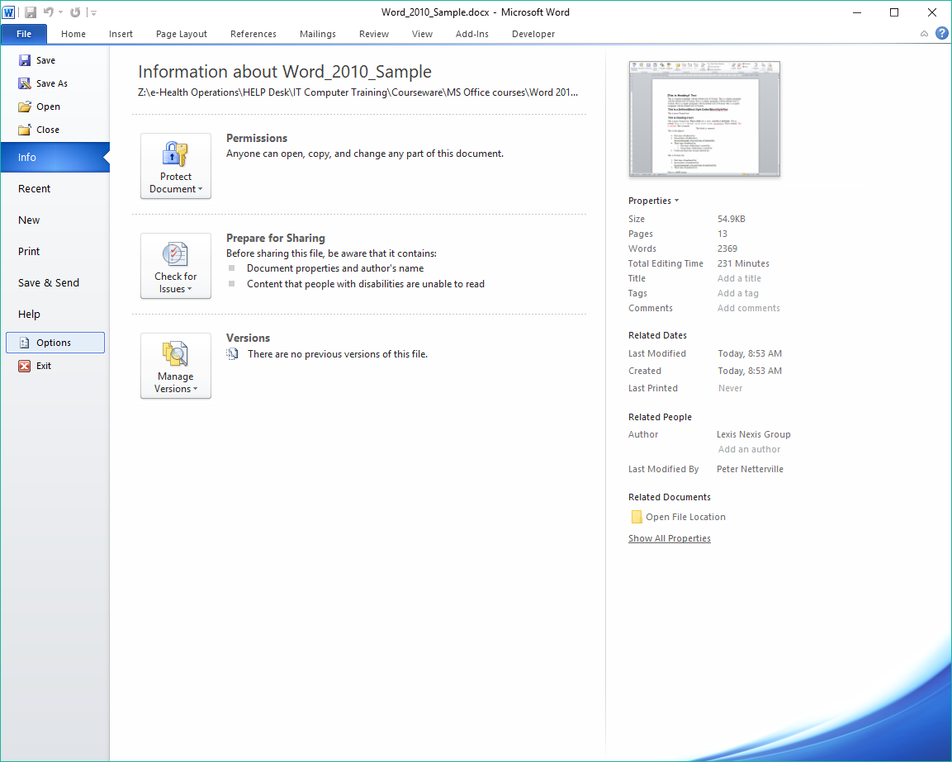
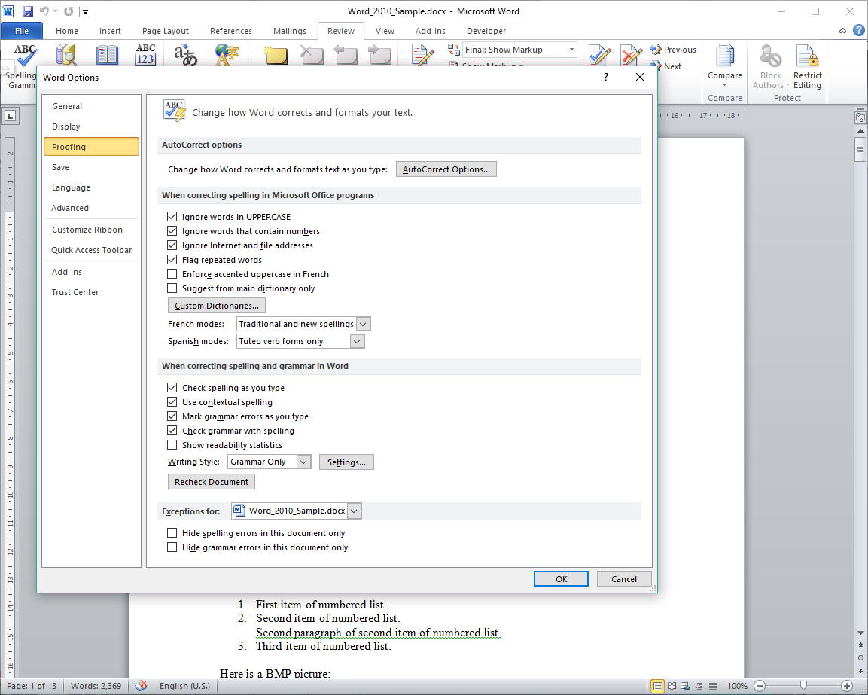
Proofing Options – General
How do you want Word to act when it encounters a spelling or grammar error?
Internet addresses (URLs) and file addresses (UNCs) are not normally spell or grammar checked. Check this option to ignore.
Click on the File tab. This is called the Backstage.
Most uppercase words are usually meant as a visual style or contextual emphasis, such as to represent shouting.
Spell checking such words is usually not desired. Check this option to ignore.
Click on the Options.
When two same words appear one after the other do you want them flagged? If so, check this option.
Click on Proofing.
When enabled, spell checking in the document appears as:
Spelling error – a red wavy underline
Grammar error – a blue wavy underline
If you want the proper accent marks, such as; é –acute, ê –circumflex,
è –grave, and ë – the trema.
Where such accents are required, do you want them flagged as a spelling error when not present?
A numeronym is a number-based word.
It is sometimes called alphanumeric acronyms, alphanumeric abbreviations, or numerical contractions.
Typically they are not part of a Word spelling dictionary, so checking this option is usually preferred.
These are setting for French and/or Spanish modes.
You can add your own words to the dictionary, but to force just the Microsoft supplied default dictionary, check this option.
Note that any words you add go into your custom dictionary. The Microsoft default dictionary cannot be modified.

Slide 17
Proofing Options – General
How do you want Word to behave when it encounters spelling and/or grammar errors?
Check spelling as you type option.
A word by itself may be spelled correctly, but in context a different word may be required. That is contextual spelling.
For example, “Deer Mr. Jones“ is incorrect, but without contextual spelling enabled this would pass by the checker as okay since “Deer” is a valid word.
Mark grammar errors as you type.
Check grammar at the same time when checking for spelling errors.

Slide 18
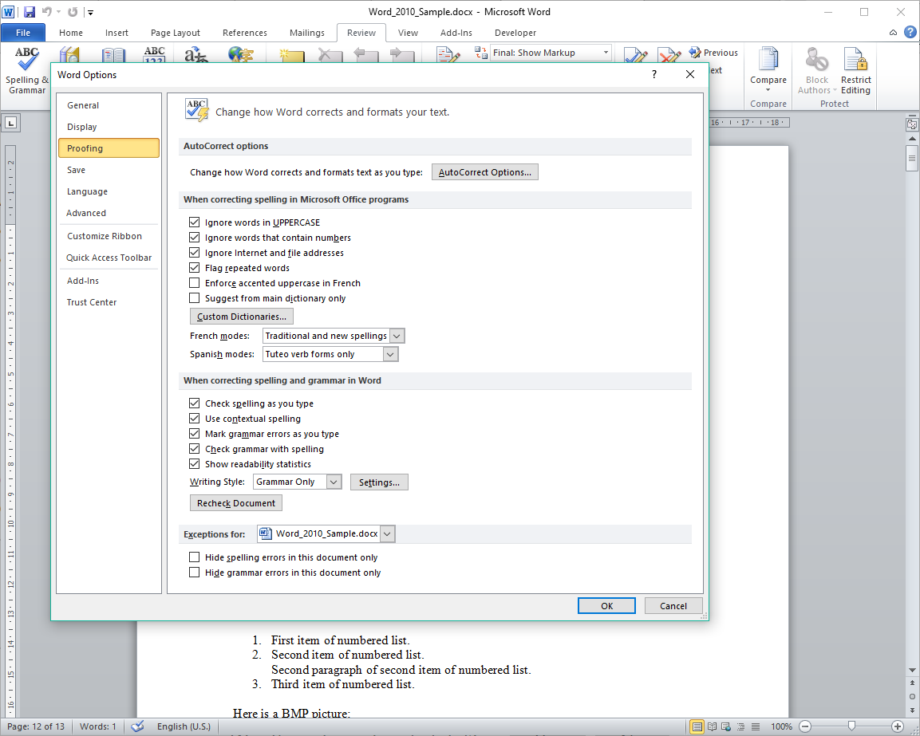
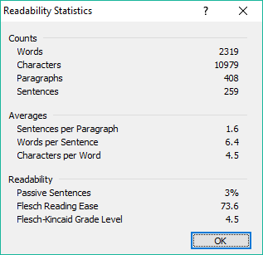
Proofing Options – General
Show readability statistics displays a dialog
check is performed.
after a Spelling & Grammar
Here you can set up exceptions for the current document or any new documents derived from the document template.

Slide 19
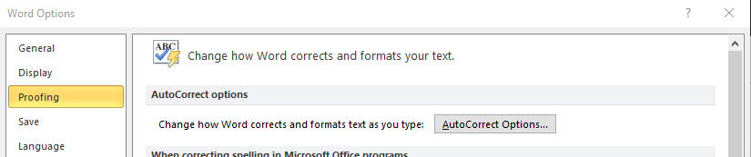

Proofing Options – AutoCorrect Options
The number of AutoCorrect Options is too much to cover here, but we will go through the basics.
On the backstage (File tab) click on Options, then on Proofing and then click on the AutoCorrect Options button
Which displays the Autocorrect Options dialog that has five tabs.

Slide 20
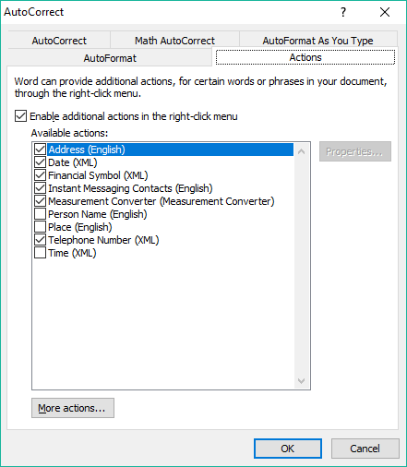
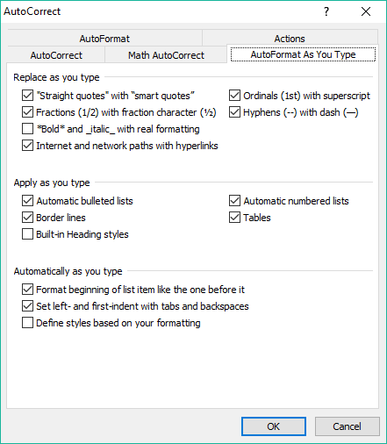
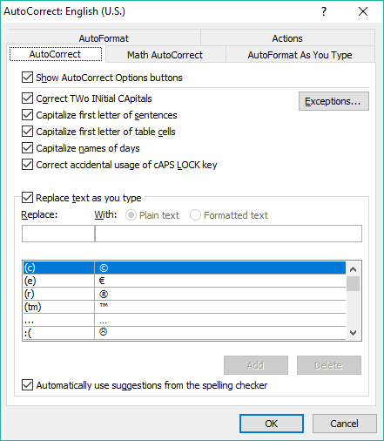
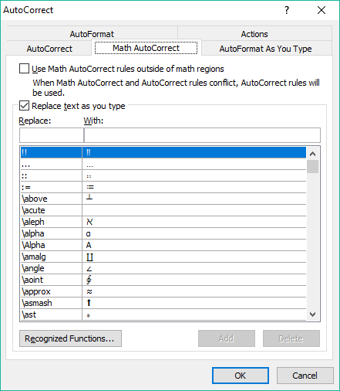
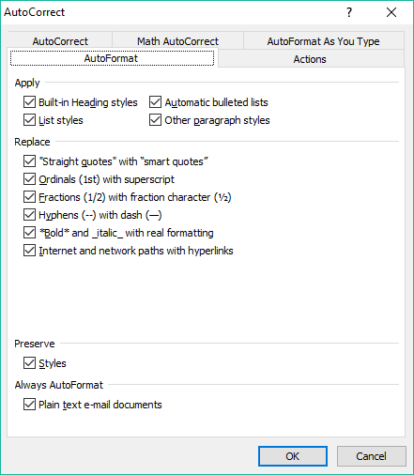
Proofing Options – AutoCorrect Options Tabs
The tabs …
AutoCorrect – Deals with the rules and conditions which define how Word is to auto-correct as you type.
  You can add your own auto-correct pairs. A pair is where one character is replaced with its’ paired symbol.
AutoFormat – Deals with the auto-correction rules and conditions of grammar styles.
Math AutoCorrect – Rules that deal the auto-correction of math symbols as you type.
  You can add your own recognized math functions as well
Actions – Add right-click context menu actions for specified words or phrases.
  You can add your own context menu options.
AutoFormat As You Type – Allows you to control in detail how auto-format is applied.

Slide 21
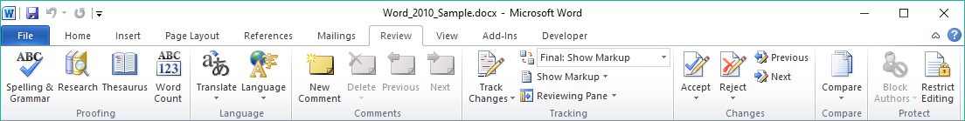
Review Ribbon
Start a Spelling & Grammar check.
Do translation & change language.
The Tracking group deals with tracking changes to your document that occur through the review process.
When initiating a review on yours or another’s document, click on the Track Changes button first.
The Markup menus provide options for marking the document for review.
Pull up the Research pane or check the Thesaurus for bigger loftier sounding words.
The research pane includes the Thesaurus. It appears on the right side.
Adding comments is usually done by others when they review your document or when you review another’s document.
Then in the review process you can choose to accept or reject the changes submitted by those who reviewed your document.
When reviewing the recommended changes to a document, the comments appear beside the document in a balloon box but does not change the document structure or pagination.

Slide 22
Review Ribbon
Accept or Reject a proposed change to your document from your reviewers or cycle through the recommended changes.
Compare two documents, your original with a reviewed document, then combine from one or more documents.
The Compare command starts the review process.
The Combine command in this same menu finalizes the review process.

Slide 23
Review Ribbon
If you have your document saved in a shared location, you can block any specific or all text from being changed by specific authors while allowing controlled access.
The author(s) you can block or allow to modify certain text are those on your domain.
There are three general steps to proofing your document …
To check the quality of your document using the tools provided by Word.
To send it out for review to one or more people and/or reviewing another’s document.
With the returned documents, merge them into one, accepting or rejecting the recommended changes.

Slide 24
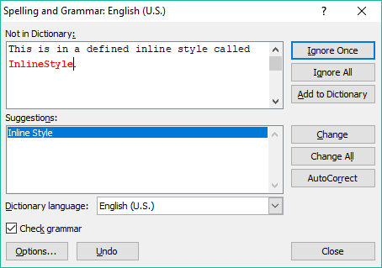

Start the proofing and review process by checking the quality of your document by proofing.
The first step is for you to use the tools built into Word:
  Check the spelling & grammar
Place the cursor in the document where you want to start a spelling check, usually at the beginning, and click on the button on the Review tab.
The top box lists the word it did not find in either the Microsoft provided dictionary or your custom dictionary.
If it has any suggested spellings of the word, they will be listed here.
Of course, you can always choose the language dictionary.
Choose to check the grammar at the same time, or not.
The Options button displays the proofing options, which is also accessible from the backstage Options button that we have already covered.
Undo last change
Close the Spell and Grammar check dialog.

Slide 25
Checking the quality of your document – Proofing
Ignore the spelling or grammar error just this one time …
… or every time it finds the error in the entire document.
You can tell Word that you know better than it does and to add the word to the dictionary.
It goes into your custom dictionary. If in the options you have it disabled, you will not be able to add the word to the dictionary.
Here is where you can change the word with the one highlighted, or all that it finds in the document
AutoCorrect will change it for you with the suggestion at the top of the list of suggestions.

Slide 26
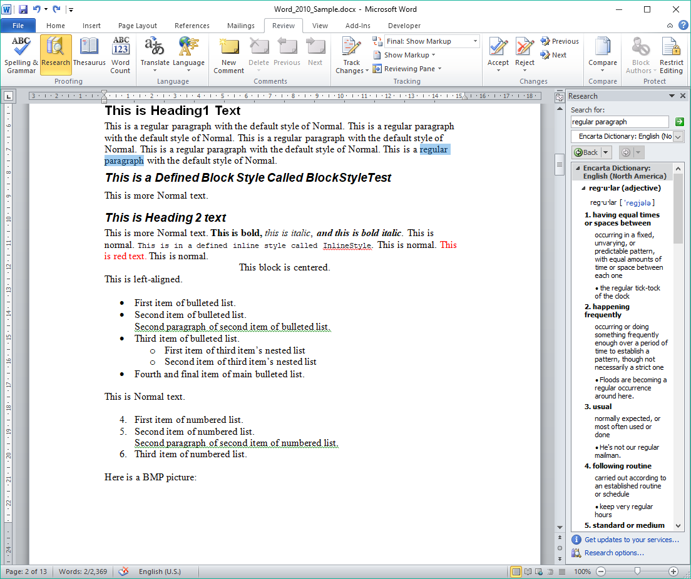

Checking the quality of your document – Proofing
The second step is for you to use the tools built into Word:
  Use the Encarta dictionary, thesaurus, or language translation to enhance your document.

Slide 27
Third: Send your document out for
review.
Once you have done the proofing, the second step is to send out your document for others to review.
The first part, sending out/sharing your document, is the easiest part.
Send it by email
Save it to a shared drive
Upload it to Dropbox or Microsoft’s Onedrive
Checking the Returned Documents
The second part is for you to accept or reject the suggested changes of each of the returned documents.
When you receive back the reviewed document(s) …
Start by going through each document separately and accepting or rejecting each change, save each one.
How do you go about viewing, comparing, and merging the documents you sent and just received back?
For just viewing two documents, you can set viewing them using the View Side by Side function on the View Ribbon.
For viewing two places on one document at the same time, you can use Split screen function on the View Ribbon.
You can use the Compare function found on the Review ribbon. The Compare function starts the merging process.
You can also use the Combine function found on the Review ribbon. The Combine function does the merge process.

Slide 28
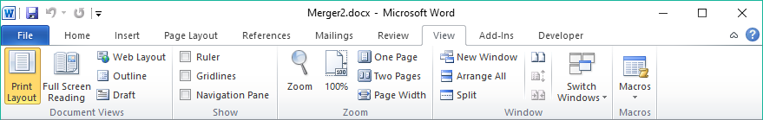
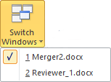
Viewing two documents side by side:
Your original document
The reviewer’s document
Open a the second document you want to compare with the first.
Then click on the View ribbon …
The View Side By Side button will tile the two documents side by each and enable Synchronized Scrolling.
You can check the Switch Windows menu to see if both documents are open.
If you find that they are not aligning side by side, you can click on the bottom button in this set of three and the two document windows reset to be side by side.
You can also split the screen on a single document so you can view two parts of the same document by clicking on the Split command.
When you split the screen, the mouse cursor becomes connected to the split bar until you choose where to place the split.
Do this by clicking one more time to place the split bar.

Slide 29
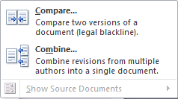
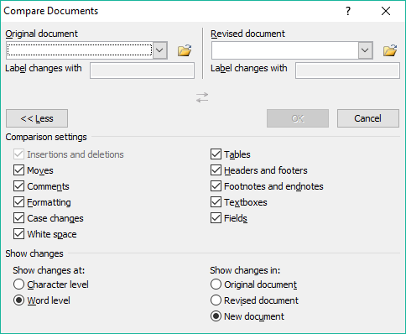
Comparing the Reviewer Documents with Your Original via the Compare command.
On the Review ribbon, in the Compare group, click on the Compare menu
Even though we will be using the Combine command to merge the documents, we will start with the Compare command to understand the difference because they look much the same.
Selecting that command will display the Compare Documents dialog.

Slide 30
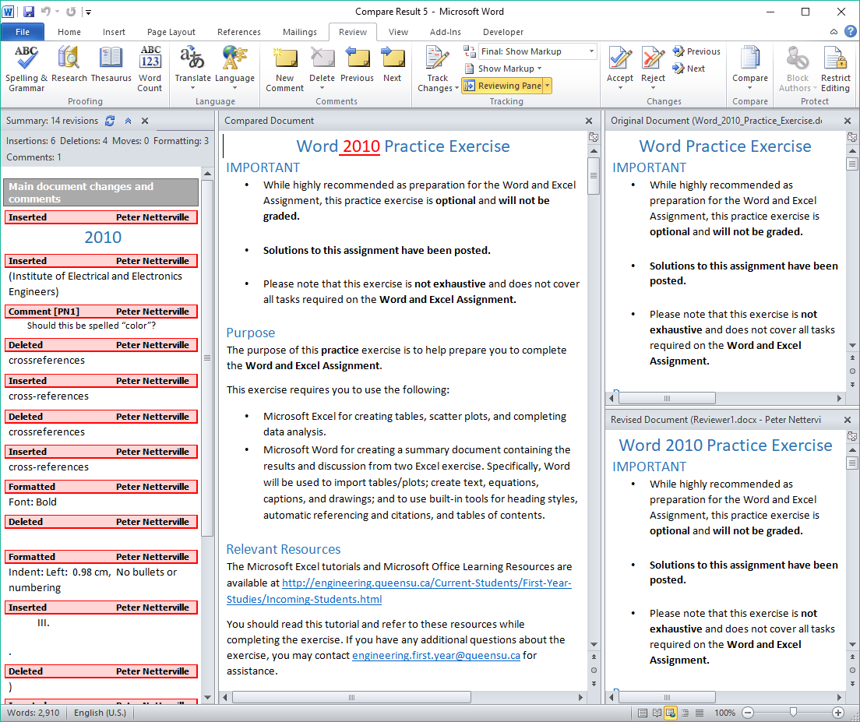
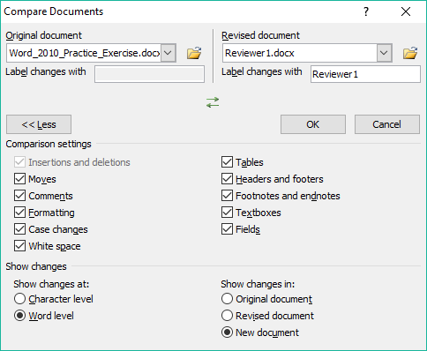
Comparing the Reviewer Documents into Your Original Using the Compare Documents command.
Browse and select your original document on the left “Original” side.
Browse and select one of the returned documents that you already went through and accepted or rejected the changes on the right “Revised” side.
Which displays a window like the one below.
Click on OK

Slide 31
Comparing
The panel on the left side displays the reviewer’s suggested changes to your document, the Review Panel.
This top document is where your original document will appear.
Comparing documents enables what is called the legal blackline option which displays what is changed between the two documents.
The legal blackline is only displayed in the third, the compared document, panel.
The bottom document is the reviewer’s document.
Note that you cannot change either document on the right side, only the Compared Document in the large window pane.
This center panel is the third document, the compared document.

Slide 32
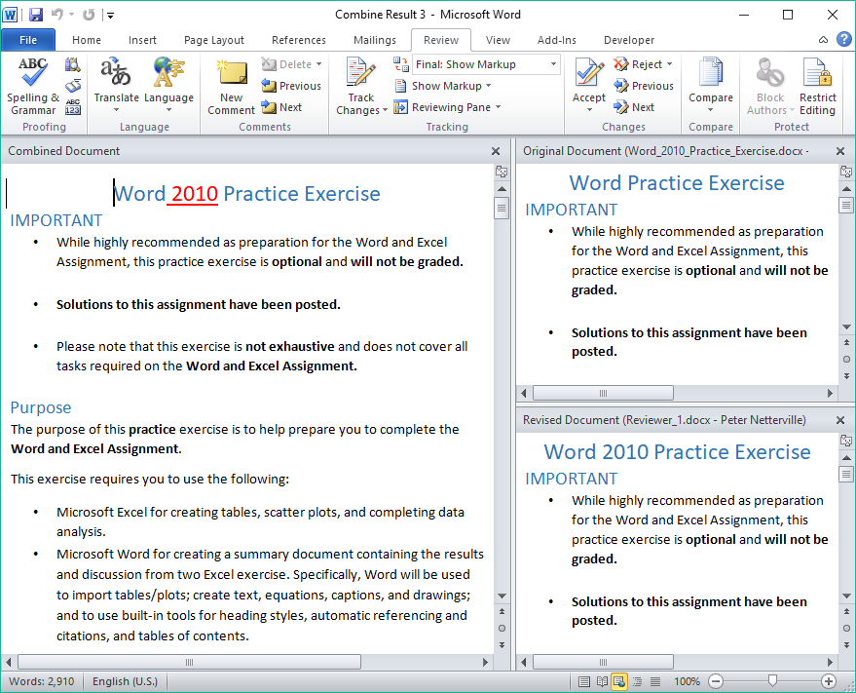
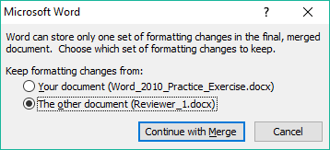
Combining
So finally, after you have accepted or rejected the changes and the merge of the two primary documents is done in to the combined document, you can now save that document.
First thing that appears is the dialog that asks which document has the changes you want to keep.
Typically you would want to keep the reviewer’s document changes.
But what if you did not want to include all the reviewer’s changes? You will have the choice to accept or reject each change later in this process.
Do this procedure for each reviewer document you received back.
The reviewer pane may not appear like it did in the compare option until all the changes are accepted or rejected.
If not, and you want to see the reviewer pane, you can force its’ display by clicking on the Reviewer Pane menu and selecting how you want it to appear, horizontally or vertically.

Slide 33
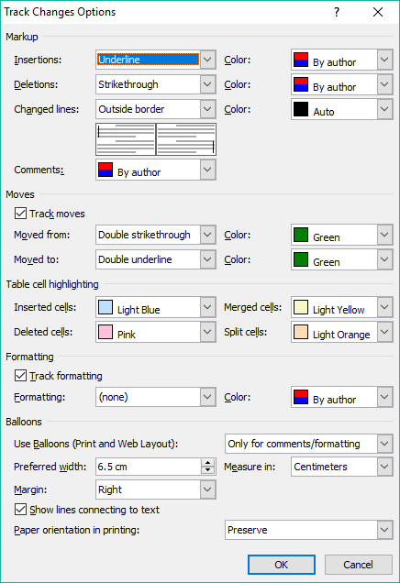

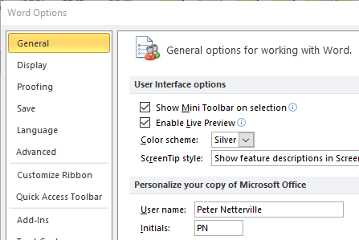
When doing a review of another’s document, follow these procedures..
You can also change the colors, underline, strike-through and more by changing the tracking options.
When you make alterations to another’s document, you want to make sure that person knows who made those changes and comments.
That is why this Change User Name menu link is here, so you can make sure your name is correct.
Markups
Moves
Change the …
Formatting
Balloons
Once you are done, save it and send it back to the owner.

Slide 34
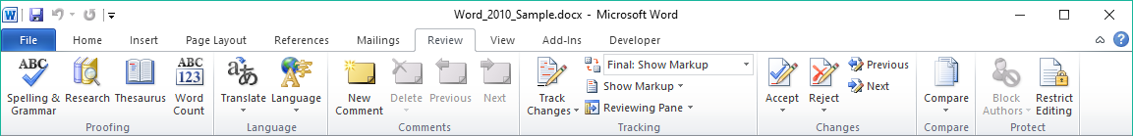


When doing a review of another’s document, follow these procedures..
Once you open the document, start by clicking on the Track Changes option in the Tracking group on the Review ribbon.
Then go through the document and make your changes. Edit like normal. To add a comment click on the button.
Text you delete becomes red with a strike through.
All changes to the text you have made will have a black vertical line, called a legal blackline, in the left margin parallel to the place in the text where you made the change.
The selected text for the comment is in brackets and has by default a pink background.
A comment appears on the right side with a dashed line pointing to where the comment applies.
Any text you added is displayed in red with a red underline.

Slide 35

We have covered here in this course …
Course Prerequisites
Checking the Quality of Your Document - Out for Review
Proofing Options – General
Viewing Two Documents Side by Side
Proofing Options – AutoCorrect Options
Merging Reviewer Documents into Your Original
Proofing Options – AutoCorrect Options Tabs
Comparing
Review Ribbon
Combining
Checking the Quality of Your Document - Proofing
Doing a Review of Another’s Document

Slide 36

NITHA IT Helpdesk helpdesk@nitha.com
1(844)486-4842
Notes:
Please do not hesitate to ask any question regarding this session, and I will make sure to answer your question as soon as possible.

Slide 37


