Slide 1


Word 2010 Intro
Entry Level

Slide 2

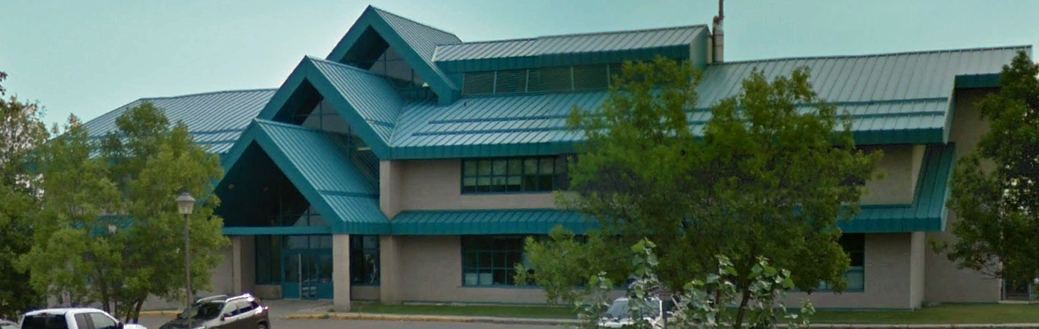

NITHA IT Helpdesk
helpdesk@nitha.com
1(844)486-4842

Slide 3
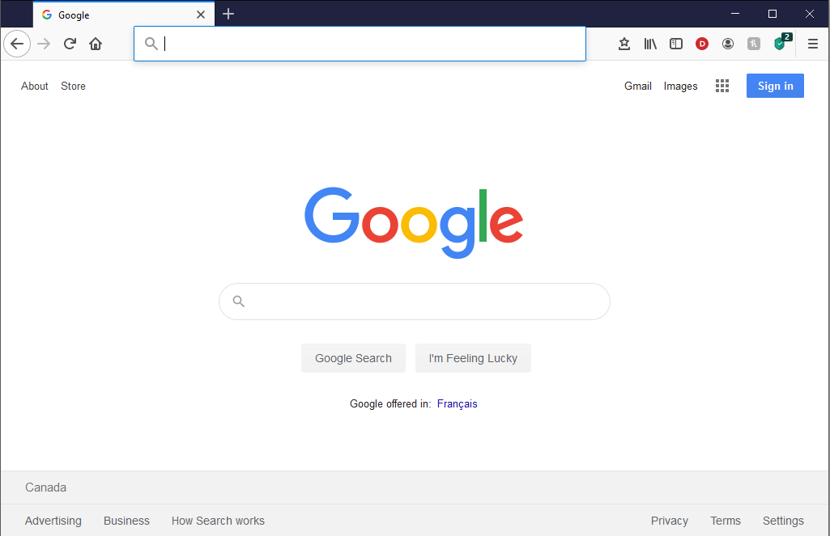
NITHA - IT Helpdesk Courses Registration Website
How do I get to the Courses Registration Website?
First, open up your favorite web browser.
Finally, press ENTER on our keyboard
Second, type in the address bar the URL, nitha.com/courses

Slide 4

NITHA - IT Helpdesk Courses Registration Website
The NITHA Computer Training Courses Calendar
There are four sections to the
IT Helpdesk Courses Registration Website
The calendar – As seen on the right,
the calendar displays the selected month and all the course links on the appropriate days.
Morning courses 9:30 AM to 11:30 AM
Afternoon courses 2:00 PM to 4:00 PM

Slide 5
NITHA - IT Helpdesk Courses Registration Website
Cycle forward through the months by clicking on the next month
The NITHA Computer Training Courses Calendar
Cycle backward through the months by clicking on the previous month
And of course, the month in the middle is the currently displayed month.

Slide 6
NITHA - IT Helpdesk Courses Registration Website
or the next year
The NITHA Computer Training Courses Calendar
You can even click on the previous year

Slide 7
NITHA - IT Helpdesk Courses Registration Website
The NITHA Computer Training Courses Calendar
Click on the course link of your choice and you will be taken to a registration page.

Slide 8

NITHA - IT Helpdesk Courses Registration Website
The NITHA Computer Training Course Registration page
Enter your information
Select how you are going to attend the course
by WebEx
by Telehealth
Select how you want your Certificate of Completion delivered.
by Email as a PDF
by Canada Post

Slide 9
NITHA - IT Helpdesk Courses Registration Website
The NITHA Computer Training Courses WebEx Info
WebEx Information – For the WebEx connection information on how to attend the courses in the current week, click on the WebEx link.

Slide 10

NITHA - IT Helpdesk Courses Registration Website
The NITHA Computer Training Courses Calendar
These links display the WebEx information for that course
These links download the ICS file for that course so that you can add it to your Outlook calendar as an event.

Slide 11
NITHA - IT Helpdesk Courses Registration Website
The NITHA Computer Training Courses Download
Course Files Download – The courseware and the data files which are used in the courses are all available for download any time whether or not you are taking the course.
click on the Course Files Downloads link
To download the
Courseware file (A PowerPoint file)
and/or
Sample data files used in the course

Slide 12

NITHA - IT Helpdesk Courses Registration Website
The NITHA Computer Training Courses Calendar
The Course Sample File is the data file used in the course.
The PowerPoint Courseware File is the course itself.

Slide 13
NITHA - IT Helpdesk Courses Registration Website
The NITHA Computer Training Courses Calendar
Tech Videos are the fourth section of the website. As they are created, they will be placed here.
Tech Videos are short 3 to 15 minute videos featuring solutions to various tech issues.

Slide 14

What will we be covering in this course?
Download a Sample Document from NITHA
Navigation & Selection Using the Mouse
Start Word 2010 & Open the Sample Document
Formatting Text
The Parts of Word 2010
Insert Illustrations, Web Links, Text & More
Navigation & Selection Using the Keyboard
Working with Tables

Slide 15
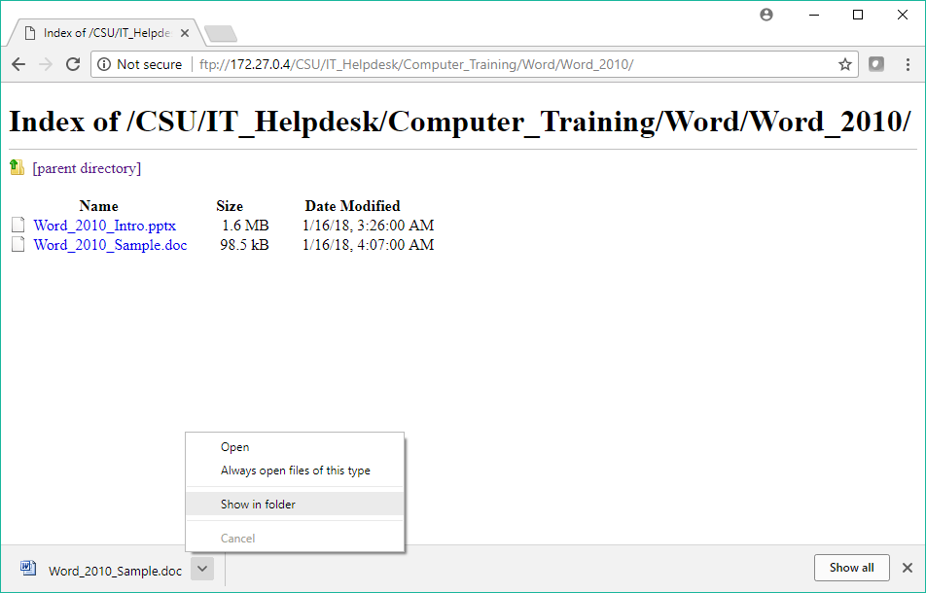
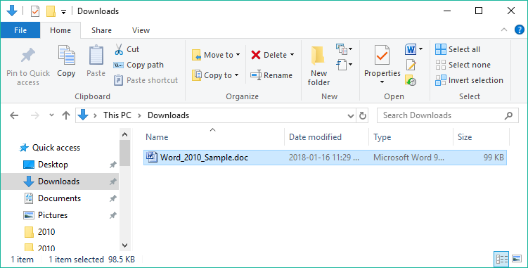
Exercise One
Download a sample document from NITHA
Browsing for the File
Open the folder which contains the Word_2010_Sample.doc file. This will be the Downloads folder.
Now to start the MS Word 2010 program and open that file.

Slide 16
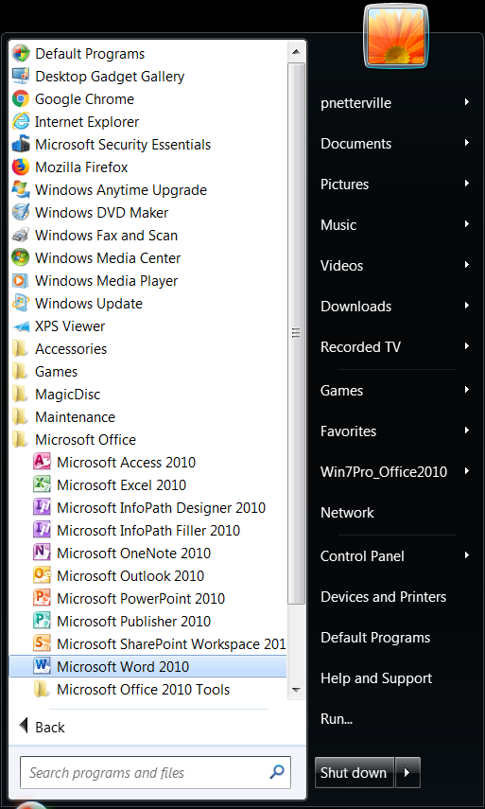

Exercise Two
Let’s open the Word 2010 program
If you are using a computer in this course, then follow along with what I do.
Goal: To start Word 2010 and to open the sample document. (Windows 7)
Click on your Start Button (Windows 7)
  Click on All Programs
Scroll down the program list and find MS Office 2010
  Then click on Word 2010
Windows 7 start button

Slide 17
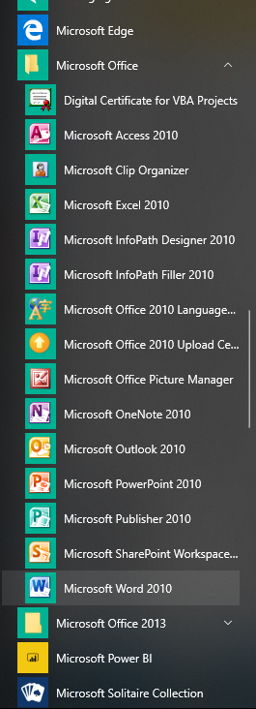
Exercise Two
Let’s open the Word 2010 program
If you are using a computer in this course, then follow along with what I do.
Goal: To start Word 2010 and to open the sample document. (Windows 10)
Click on your Start Button (Windows 10)
Scroll down the program list and find MS Office 2010
  Then click on Word 2010
Windows 10 start button

Slide 18
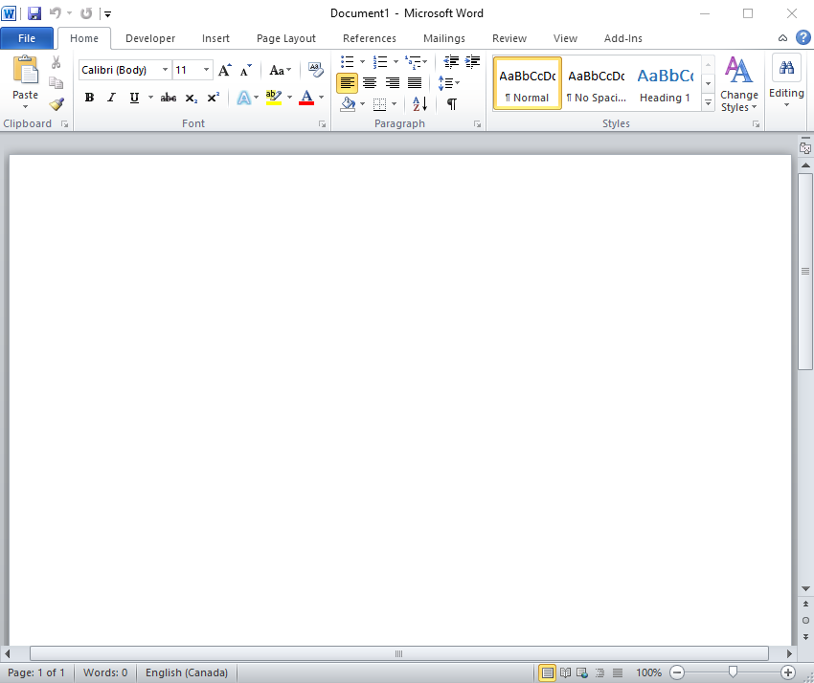
Open Sample Document in MS Word 2010
When you open MS Word 2010 from the Start Menu, the first screen you will see is the document screen, ready to get to work!
Notice the Home ribbon tab.
Notice Document1 in the title bar.
Next we need to open the sample document that we downloaded from the NITHA server (or was given to you by your Telehealth Coordinator)
Click on the File tab along the top left of the program (the blue tab)
  OR
Press the Ctrl-O keyboard sequence.

Slide 19
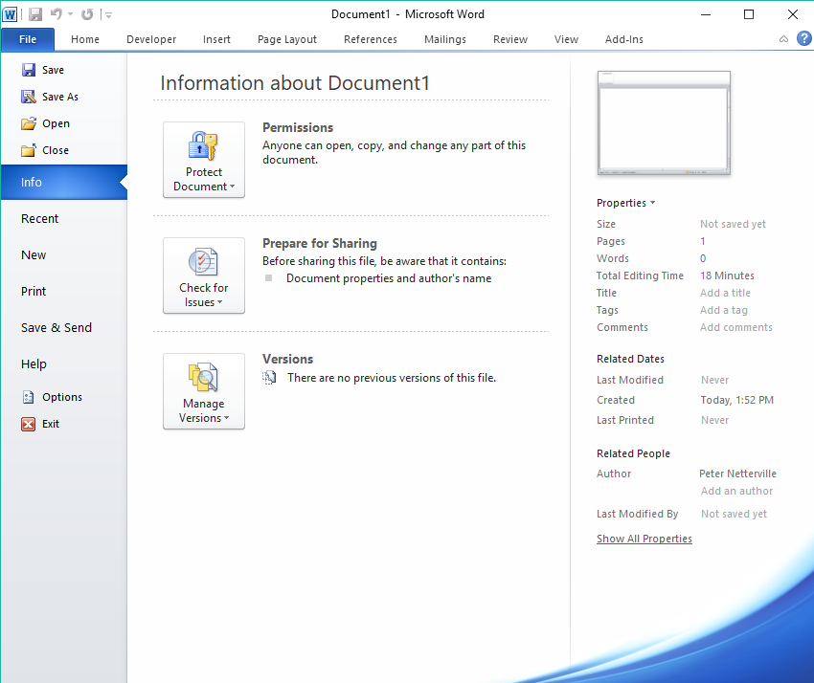
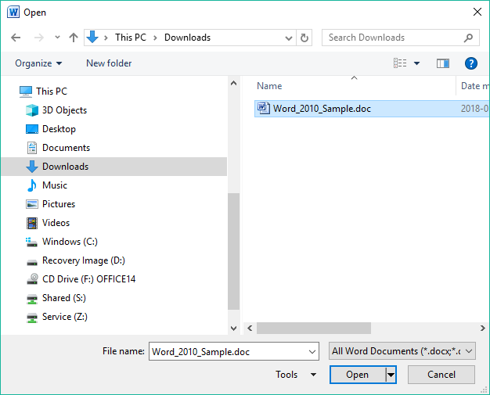
Open Sample Document in MS Word 2010
If you clicked on the File tab, you should see a screen like this. Now click on the Open option.
Click on the Downloads folder in the Navigation pane.
Click on the Word_2010_Sample.doc file.
Click on the Open button.

Slide 20
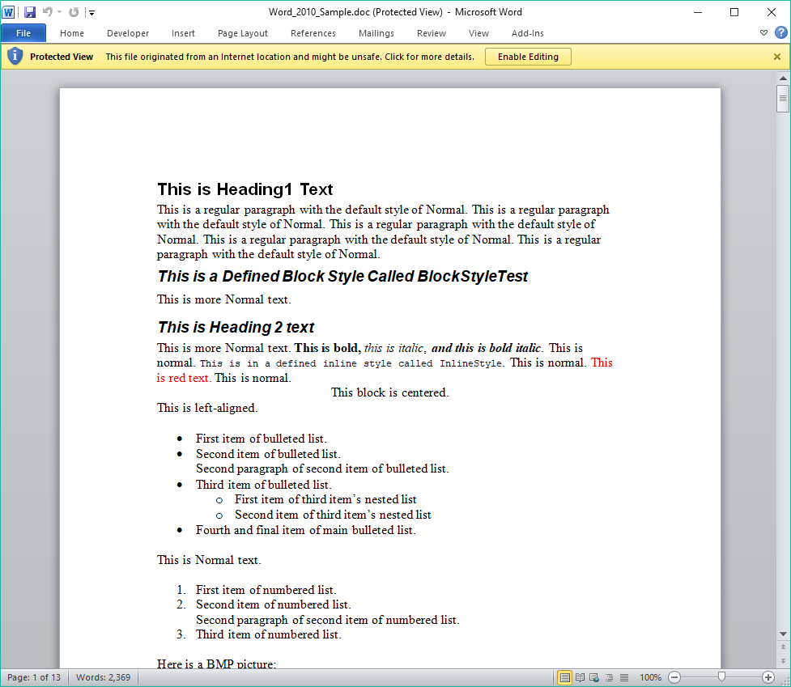
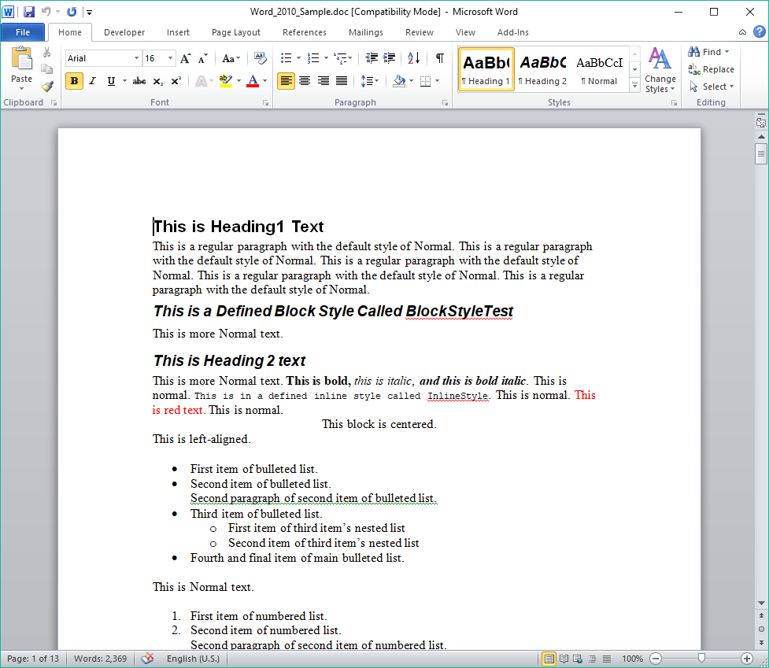
Open Sample Document in MS Word 2010
Click on the Enable Editing button
Our document is now ready for editing.

Slide 21
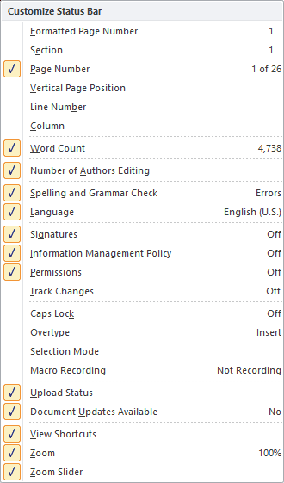
The Parts of Word 2010
Quick Access Toolbar
Help
Minimize Ribbon
The Ribbon – From where all the functions and commands of Word are accessed.
The Ribbon is similar to the older style toolbars found in MS Office 2003 and earlier.
Document Workspace – This area is where you create your document. It is WYSIWYG (What You See Is What You Get), which means that your document will appear on paper as you see it on the screen. It is not exact, but close.
Status Bar – Contains:
Zoom bar
Document view buttons
Current document information
Right-click on the status bar will present a menu from which you can personalize it.

Slide 22
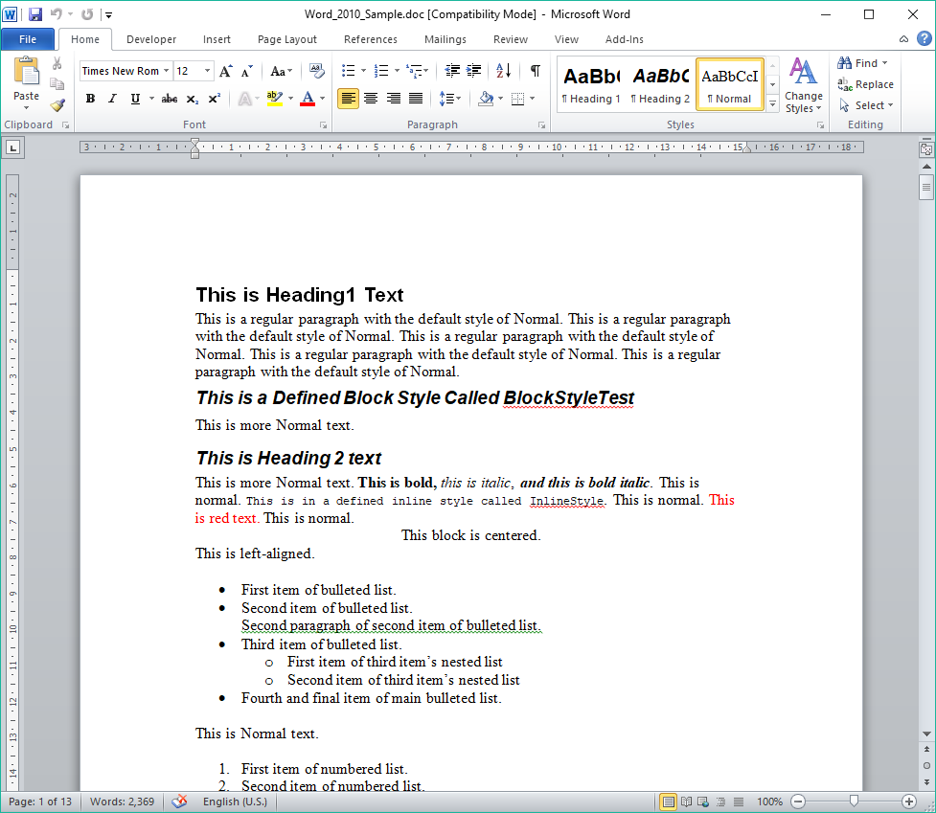
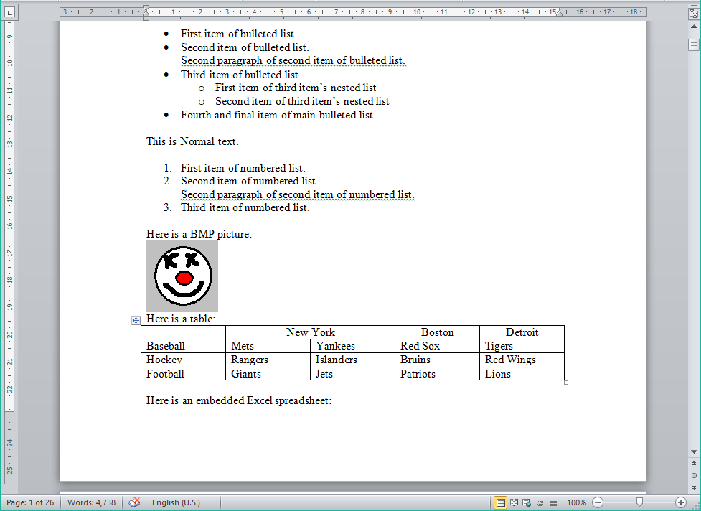
The Parts of Word 2010
Definition: A Section in Word is like a separate document
with its’ own formatting, header & footer.
Document Ruler button adds both horizontal and vertical rulers
Top Margin – You can double-click here to enter the header for your document.
By default it will appear at the top of each page in that section of the document but that can be customized.
Left Margin – You can:
Single-click to select a single line
Double-click to select paragraph
Triple-click to select the entire document
Bottom Margin – You can double-click here to enter the footer for your document.
Like the header, by default you footer will appear at the bottom of each page in that section of the document but can be customized as you like.

Slide 23

The Parts of Word 2010
First Line Indent Marker
This indicated where the first line of each paragraph is positioned from the left margin.
Tab Stop Box
Click to cycle through the different types of Tab stops then click on the ruler to add that Tab Stop at that location on the page.
Hanging Indent Marker
First line in the paragraph is aligned with the left margin, all other lines in the paragraph are indented to where the Hanging Indent Marker is set.
Left Indent Marker
This is the distance from the left margin to where the whole paragraph is indented.
Previous Page (Ctrl + Page Up)
Object Browser (Ctrl + Alt + Home)
Next Page (Ctrl + Page Down)

Slide 24
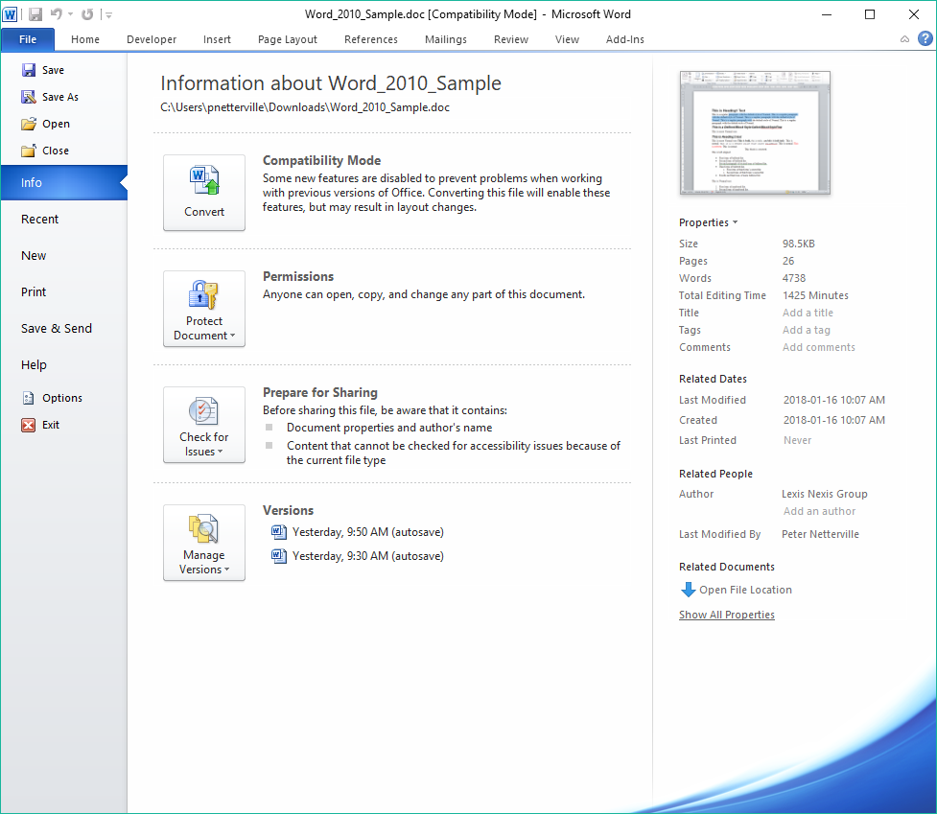
The Parts of Word 2010 - Backstage
The Backstage is where all things that happens to the document but not in the document occur.
The Backstage is accessed through the File tab on the left side of the ribbon.
The first screen that appears is the Info screen. In here you can:
Convert older document file formats (such as .doc) to the most current format (.docx)
Apply permissions for others to access or not access your document
Check your document before sharing it
Recover from earlier versions of your document
More about the Backstage later.
Next, keyboard and mouse navigation

Slide 25
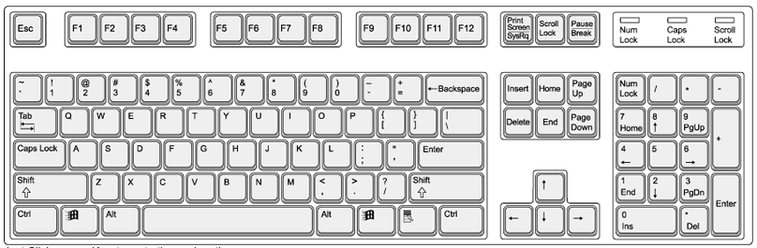
Navigation & Selection Using the Keyboard
Navigation Keys
Home – places the cursor at the beginning of the line
End – places the cursor at the end of the line
Ctrl-Home – moves cursor to the beginning of the document
Ctrl-End – moves cursor to the end of the document
Page-up – moves the cursor up the document the amount of lines displayed
Page-down – moves the cursor down the document the amount of lines displayed
Ctrl-Page-up – moves the cursor to the beginning of the previous page
Ctrl-Page-down – moves the cursor to the beginning of the next page

Slide 26
Navigation & Selection Using the Keyboard
Navigation Keys
Right Arrow – moves the cursor right one character
Left Arrow – moves the cursor left one character
Up Arrow – moves the cursor up one line
Down Arrow – moves the cursor down one line
Ctrl-Right Arrow – moves the cursor to the beginning of the next word
Ctrl-Left Arrow – moves the cursor to the beginning of the previous word
Ctrl-Up Arrow – moves the cursor to the beginning of the previous paragraph
Ctrl-Down Arrow – moves the cursor to the beginning of the next paragraph

Slide 27
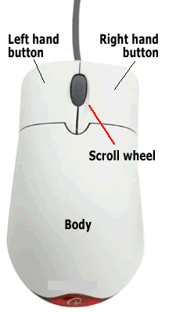
Navigation & Selection Using the Mouse
Select Contiguous Text Block (Option One):
Place mouse pointer at beginning of text you wish to select
Hold down the left mouse button
Drag the mouse pointer to the end of the desired text
Release the left mouse button
Select Contiguous Text Block (Option Two):
Click once at the beginning of the text you wish to select to place the cursor there
Scroll down to the end of the text you want to select using the mouse scroll button or the appropriate scroll bar but do not move the cursor
Hold down the Shift button and then click at the end of the text you wish to select
Select Non-contiguous Text Blocks
Select the first block of text just like Option One
Now to continue to select non-contiguous blocks of text to add to your selection
  Hold down the Ctrl button and then drag the mouse pointer to the end of the desired text
Keep repeating the previous step for each block of non-contiguous text you want

Slide 28
Navigation & Selection Using the Mouse
Select a single word:
Double click on the word. Be aware it also selects the space to the right of the word.
Select a paragraph:
Triple click on any word in that paragraph. Each new paragraph is started with a carriage-return (enter)
Select a line:
Left click once in the left margin beside the line
Select a paragraph (from the left margin):
Double click in the left margin beside the paragraph
Select the entire document (includes all sections)
Triple click in the left margin at any point in the document
Select a sentence
Ctrl + Left click over any word in the sentence

Slide 29
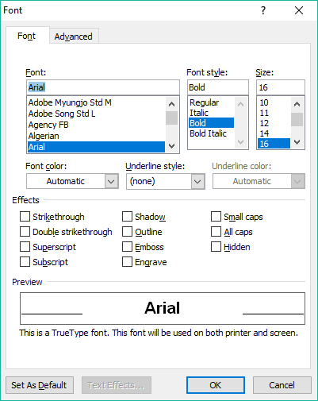
Formatting Text
The Home tab contains the formatting options
The Font group is where many of the options are located for formatting the text.
You can apply the formatting to either the selected text, or if no text is selected, then that formatting will be applied to any new text you type.
For more formatting options launch the Font Dialog Box by clicking on the Dialog Box Launcher

Slide 30
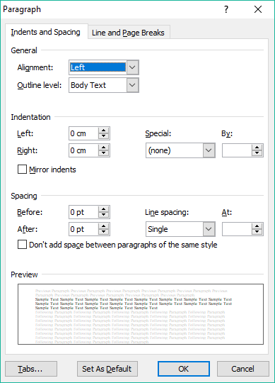
Formatting Text
The Home tab contains the formatting options
The Paragraph group has options for changing the paragraph in which the cursor is located.
If more than one paragraph is selected the formatting will be applied to all selected paragraphs.
The Paragraph Dialog launcher button displays the a dialog with more paragraph options.

Slide 31
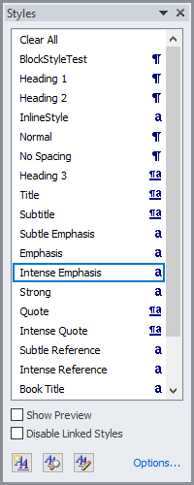
Formatting Text
The Home tab contains the formatting options
The Styles group contains pre-set styles you can apply to either the selected text, or if no text is selected, then that style will be applied to any new text you type.
The Styles menu launcher shows a menu on which you can choose to:
Select a style from a list
Choose options such as Show Preview and Disable Linked Styles
Create a New Style
Inspect style (applies to selected style)
Manage Style (applies to selected style)
More Options

Slide 32
Exercise Three
Formatting Text
Apply formatting to the text in your document
Select some text and use the formatting from the Font group to change it as you like.
  Now open the Font Dialog Box and add some effects, such as Strikethrough or ^{Superscript} or Small Caps
Choose a paragraph, place your cursor anywhere in that paragraph and the modify it using the Paragraph group.
  Now open the Paragraph Dialog Box and change the spacing between the lines before and after by 2 points
Select some text and apply a style.

Slide 33
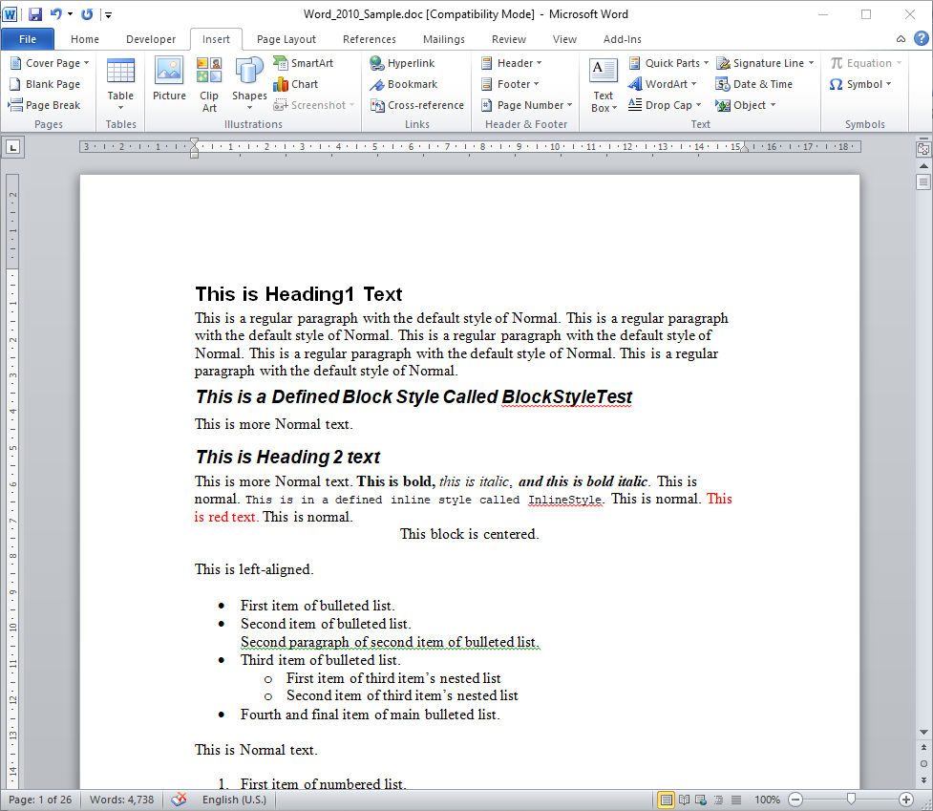
Insert Illustrations, Web Links, Text & More
The Insert tab contains many objects to add
You can insert into your document a plethora of cool things …
Pages group
Cover Page
Blank Pages
Page Breaks
Header & Footer group
Header
Footer
Page Number
Symbols
Tables group
Tables
Text group
Text Box
Quick Parts
Word Art
Drop Cap
Signature Line
Date & Time
Objects
Illustration group
Pictures
Clip Art
Shapes
Smart Art
Excel Charts
Screenshots
Symbols group
Equation
Symbol
Links group
Hyperlinks
Bookmarks
Cross-references
Notes:
Show them how to add a PICTURE, SHAPE, HYPERLINK, TEXTBOX

Slide 34
Exercise Four
Add to your document
Picture
  Make the text wrap around it.
Shape
  Give it a color
  Make it 60% transparent
  Make it overlay on top of the text
Hyperlink
  Link to your favorite website
  Format it to your liking
Text Box
  Format to you liking, but make the text wrap around it.
Insert one more item of your choice and format that.

Slide 35
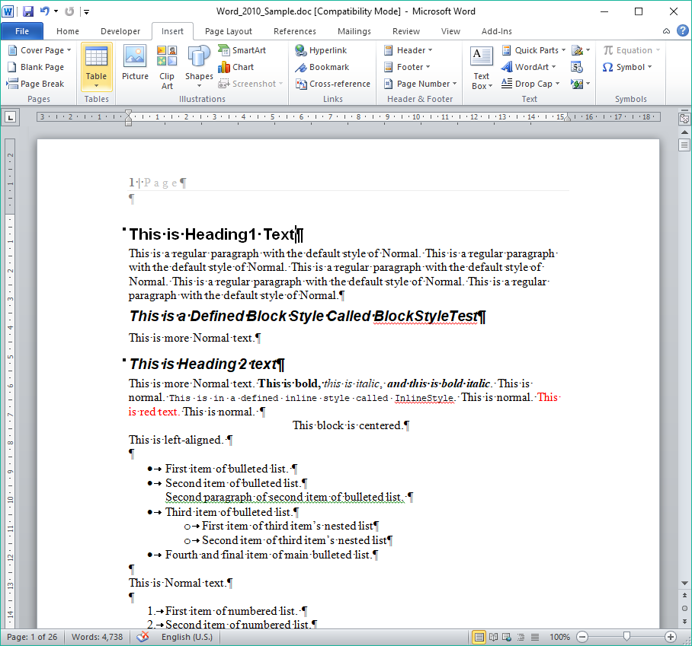
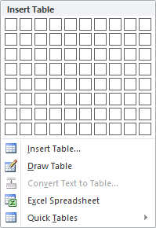
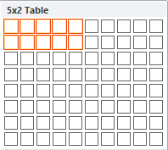
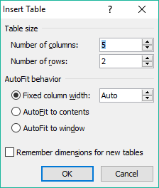
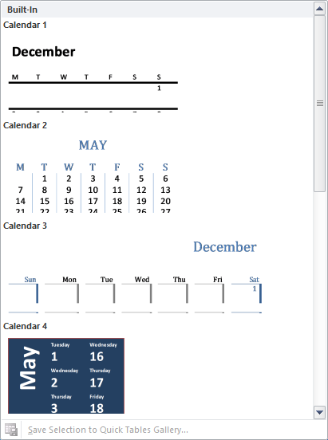
Working with Tables
To insert a table:
Click on the Insert tab
Click in the document where you want the table to appear
Click on the Table button
You can choose to
  Select the number of rows and columns
  Insert a table by entering the number of columns and rows in a dialog box
  Draw a table using the mouse directly on the document
  Insert an Excel Spreadsheet
  Insert a Quick Table

Slide 36
Exercise Five
Add to your document
Click in the document where you want the table to appear
Insert a document using each of the five methods.

Slide 37

We have covered here in this course …
Download a Sample Document from NITHA
Navigation & Selection Using the Mouse
Start Word 2010 & Open the Sample Document
Formatting Text
The Parts of Word 2010
Insert Illustrations, Web Links, Text & More
Navigation & Selection Using the Keyboard
Working with Tables

Slide 38

NITHA IT HelpDesk helpdesk@nitha.com
1(844)486-4842
Notes:
Please do not hesitate to ask any question regarding this session, and I will make sure to answer your question as soon as possible.

Slide 39


