Slide 1

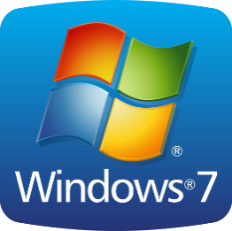
Windows 7 Basics
Entry Level

Slide 2

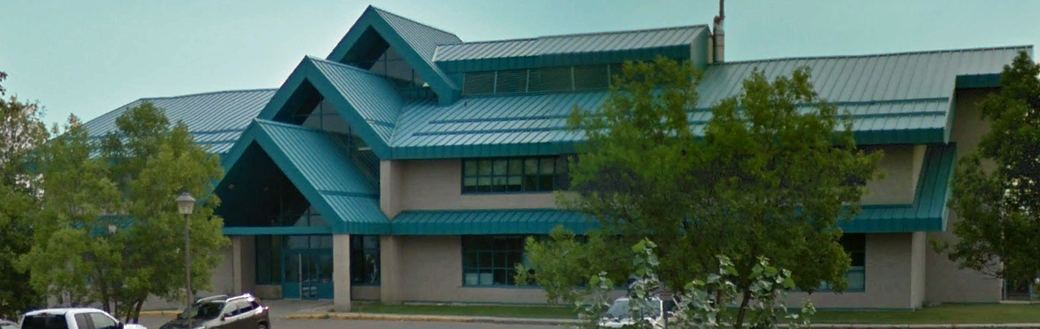

NITHA IT Helpdesk
helpdesk@nitha.com
1(844)486-4842

Slide 3
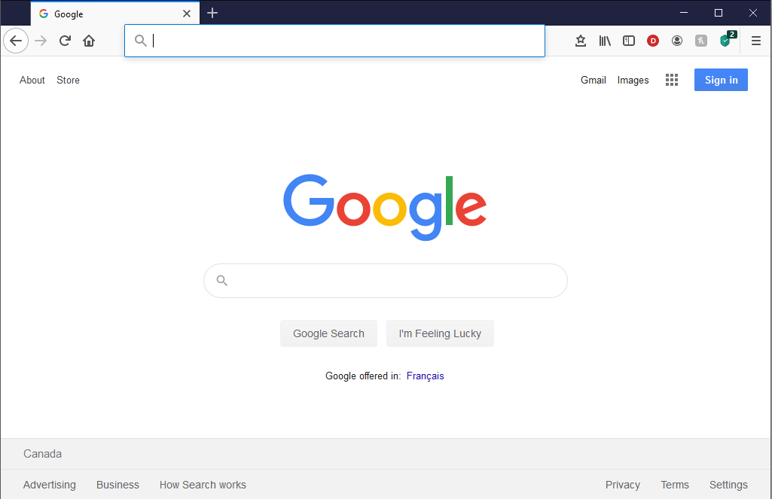
NITHA - IT Helpdesk Courses Registration Website
How do I get to the Courses Registration Website?
First, open up your favorite web browser.
Finally, press ENTER on our keyboard
Second, type in the address bar the URL, nitha.com/courses

Slide 4
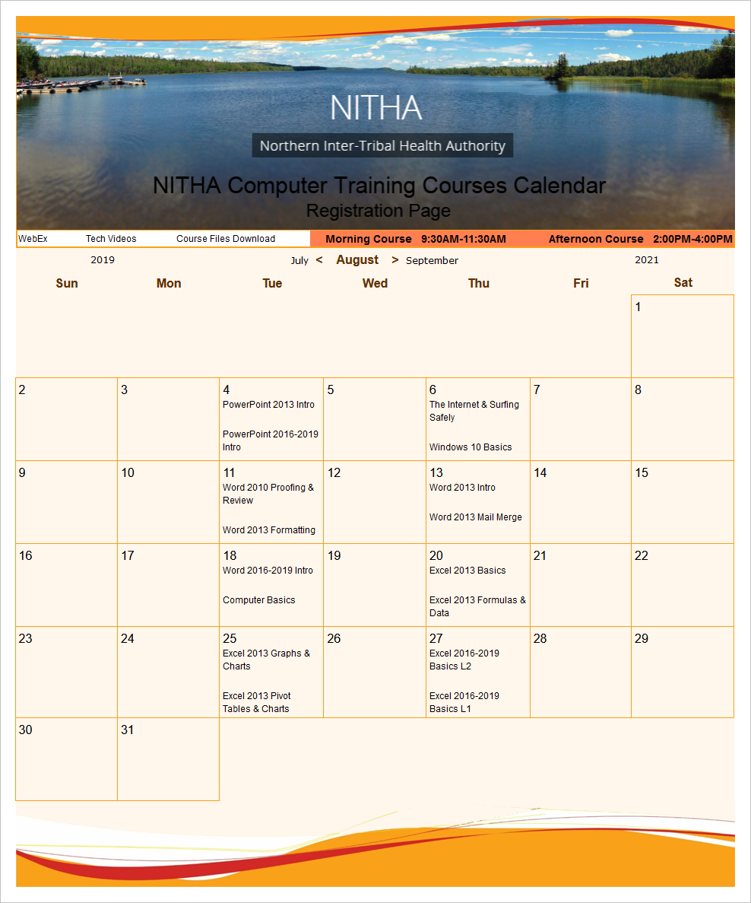
NITHA - IT Helpdesk Courses Registration Website
The NITHA Computer Training Courses Calendar
There are four sections to the
IT Helpdesk Courses Registration Website
The calendar – As seen on the right,
the calendar displays the selected month and all the course links on the appropriate days.
Morning courses 9:30 AM to 11:30 AM
Afternoon courses 2:00 PM to 4:00 PM

Slide 5
NITHA - IT Helpdesk Courses Registration Website
Cycle forward through the months by clicking on the next month
The NITHA Computer Training Courses Calendar
Cycle backward through the months by clicking on the previous month
And of course, the month in the middle is the currently displayed month.

Slide 6
NITHA - IT Helpdesk Courses Registration Website
or the next year
The NITHA Computer Training Courses Calendar
You can even click on the previous year

Slide 7
NITHA - IT Helpdesk Courses Registration Website
The NITHA Computer Training Courses Calendar
Click on the course link of your choice and you will be taken to a registration page.

Slide 8

NITHA - IT Helpdesk Courses Registration Website
The NITHA Computer Training Course Registration page
Enter your information
Select how you are going to attend the course
by WebEx
by Telehealth
Select how you want your Certificate of Completion delivered.
by Email as a PDF
by Canada Post

Slide 9
NITHA - IT Helpdesk Courses Registration Website
The NITHA Computer Training Courses WebEx Info
WebEx Information – For the WebEx connection information on how to attend the courses in the current week, click on the WebEx link.

Slide 10

NITHA - IT Helpdesk Courses Registration Website
The NITHA Computer Training Courses Calendar
These links display the WebEx information for that course
These links download the ICS file for that course so that you can add it to your Outlook calendar as an event.

Slide 11
NITHA - IT Helpdesk Courses Registration Website
The NITHA Computer Training Courses Download
Course Files Download – The courseware and the data files which are used in the courses are all available for download any time whether or not you are taking the course.
click on the Course Files Downloads link
To download the
Courseware file (A PowerPoint file)
and/or
Sample data files used in the course

Slide 12

NITHA - IT Helpdesk Courses Registration Website
The NITHA Computer Training Courses Calendar
The Course Sample File is the data file used in the course.
The PowerPoint Courseware File is the course itself.

Slide 13
NITHA - IT Helpdesk Courses Registration Website
The NITHA Computer Training Courses Calendar
Tech Videos are the fourth section of the website. As they are created, they will be placed here.
Tech Videos are short 3 to 15 minute videos featuring solutions to various tech issues.

Slide 14
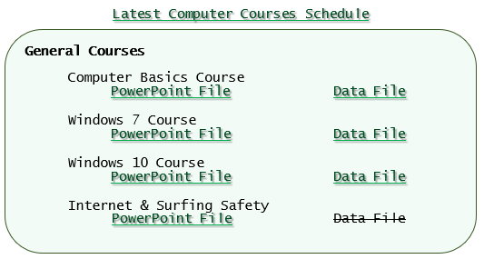
Where to find to the course files
The course files are located in a DropBox account.
Hyperlinks to those files are located in an Adobe PDF document called Course_Downloads.
There are two files for most of the courses:
The PowerPoint course file.
The Data File (some may not have a data file).
Simply click on the one you want to download.
It will download automatically into your downloads folder.
Some of the data files are archived into a ZIP format. You will need to extract those files.
To extract those files:
Right click on the file once you have downloaded it. You will see a menu.
Left click on the Extract all… option.

Slide 15
What will we be covering in this course?
Intro to Windows
The Graphical User Interface (GUI)
Windows Versions
Windows Desktop
  Personalization
  Taskbar
  Start Menu
The Control Panel
The Anatomy of a Windows Window
Why is Windows Called Windows
A Typical Program Window
Controlling a Window by Keyboard
File and Folders
Getting Around in Windows
Working with Files and Folders
File Association
File Extension Types
File Explorer Parts
File Explorer Command Bar
Using the Keyboard and Mouse
Using Menus
Computer Software
Program Flow
What Can Programs Do?
Information Security
Backup Security
Powering Down a Windows Computer

Slide 16

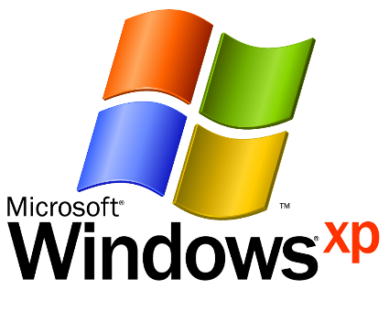
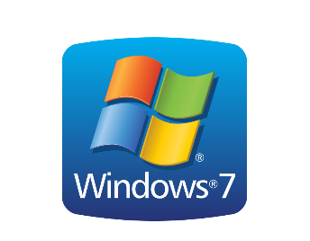


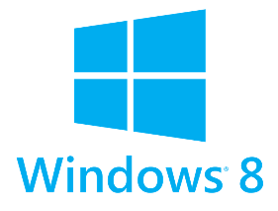
Intro to Windows
Windows Versions
Windows is the operating system.
Without Windows nothing would work. It manages the hardware and controls the environment in which the software runs.
The versions that you might come across are listed here.
Windows Vista is also deprecated. Most software will run under Vista. The way you get around in Vista changed significantly from XP. This OS was somewhat of a failure, but still works fine.
Windows 8, 8.1 is still support until January 2023. The user interface in 8 changed from the menu system to an entirely flat touch screen panel style. The change did not go over well with Windows users so they made 8.1 which had a small menu again.
Windows 10 was the next version to come out. Windows 9 never existed.
With the introduction of 10, Windows updates became mandatory for all but servers.
The OS is stable and has both the panel navigation and the older style menu system.
Windows XP is deprecate. Microsoft is no longer supporting it, however it is a very good operating system and some people still use it.
Note that most software does not support XP anymore.
Windows 7 is still support until January 2020. This OS is quite stable and a favorite of many. It has some of the older familiar navigation while incorporating the newer technology.
Notes:
Operating system is managing hardware and programs
require OS or operating system to work
Windows most used operating system in the world, 1.25 billion.
windows runs on approximately %75 of computers in world.
If you have computer, more than likely you have one of this 4 recent version of windows running on your computer.
Every three years, Microsoft will introduce new version of Windows
Latest version is Windows 10 which was released in 2015
Before that Windows 8 (and short after that Windows 8.1 with slight difference) in 2012
Windows 7 released in 2009 and probably most popular version of Windows until Windows 10 release date
Windows Vista released in 2006 and least popular version of windows, very unstable and very slow operating system

Slide 17
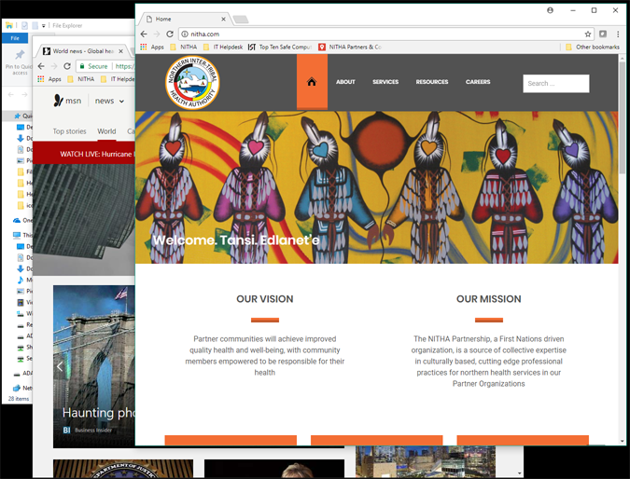



Why is Windows called Windows?
Windows is called Windows because each program you have open resides in a separate space called a “window object”.
The window object is responsible for displaying the program and being able to be moved, resized and stacked.
To move a window using your mouse:
Position your mouse pointer over the title bar at the top of the window
Press and hold down your left mouse button
Move your mouse over the surface of the desk until the window is where you want it to be
Release the mouse button
To resize a window using your mouse:
Position your mouse over the edge of the window when it changes to one of the following mouse pointer types:
Left click and hold down the mouse button
Move the mouse over the surface of the desk to move the edge of the window to where you want it to be
Release the mouse button.
The picture to the left shows three stacked windows.
To bring a window to the top of the stack:
Left click on one of the windows to select it. It is best practice to left click on the title bar at the top of the window.
When you select one, it is brought in whole to the foreground. It now has “focus”.
When a window has focus, it means that all input from the mouse, keyboard and other input devices will go to that window. Think of it as where the computer’s attention is focused. In the picture to the left the NITHA Internet browser window has focus.

Slide 18
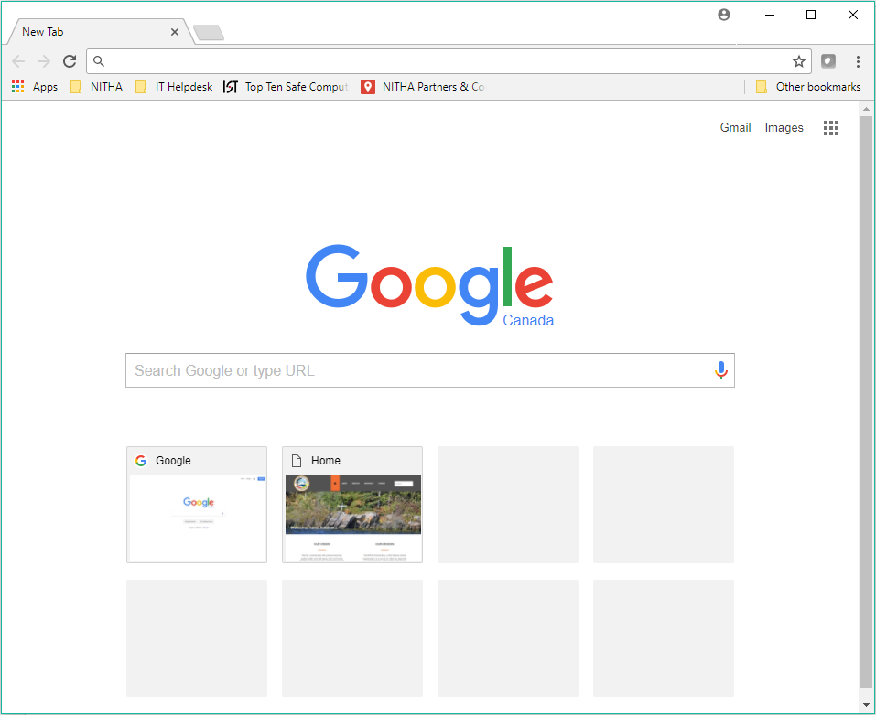
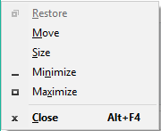
The Anatomy of a Windows Window
The minimize button shrinks the window off the screen. You can get it back by
Left clicking on the icon on the taskbar. If you have more than one instance of the program running (such as more than one Google Chrome running), then you will be presented with the option to choose which one you want.
Left clicking on the Task View icon on the taskbar and then left click on the window you want to view.
The exit button closes the window.
If you have unsaved data in the program that is running in that window, then a dialog box asking you to save your document will appear. You must deal with that dialog before the window will be shut down.
The maximize button increases the size of the window to fill the entire screen.
The window control menu is accessed by the Alt + Spacebar key sequence.
It allows you to control the window’s restore, move, size, minimize, maximize and close functions using the keyboard instead of the mouse.

Slide 19

How do I move, resize or select a window using the keyboard and why would I want to when I have a mouse?
To select a window by keyboard:
Hold down the Windows key and press and release the Tab key once. Now release the Windows key. This is the Task View.
Use the arrow keys to highlight a window and press Enter to select.
These are good questions and I am glad you asked!
It is actually faster and easier to use the keyboard once you know how.
There is the occasional time a window is completely off your monitor, so your mouse would not be any help.
To resize the selected window:
Press and hold down your Alt key, press and release the spacebar, release the Alt key. The window control menu will appear in the top left corner of that window.
Press the s key once on the keyboard (case insensitive)
Press the arrow key on the keyboard in the direction you want to resize the window.
When you have the window sized the way you want it, then press Enter on the keyboard.
To move a selected window that has focus do the following:
Press and hold down your Alt key, press then release the spacebar, release the Alt key. The window control menu will appear in the top left corner of that window.
Press the m key once on the keyboard (case insensitive)
Press the arrow key on the keyboard in the direction you want to move the window.
When you have the window where you want it, then press Enter on the keyboard.
As you have probably noticed, you can also minimize, maximize and close the window with this menu.
Just press the appropriate key.

Slide 20
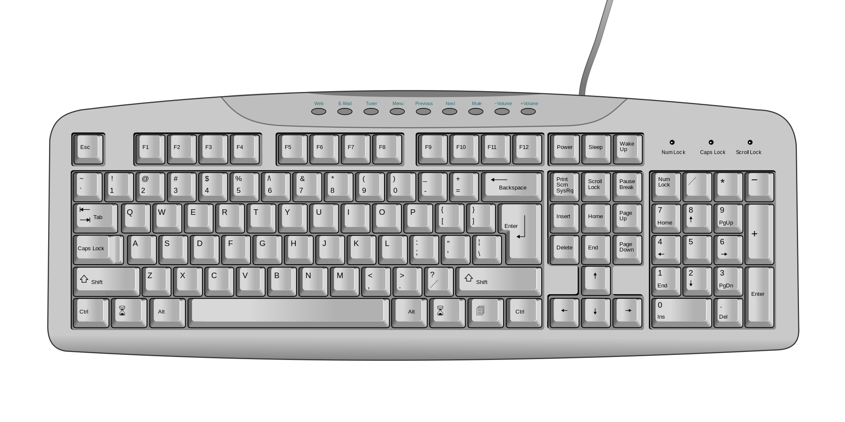
Getting Around in Windows
Using the Keyboard
Insert/Delete
Home/End
Page Up/Page Down
Print Screen
Scroll Lock
Pause
Escape key
Programmable Function Keys
Standard typewriter
keyboard
Numeric Key Pad
Arrow Keys
Standard keyboard

Slide 21
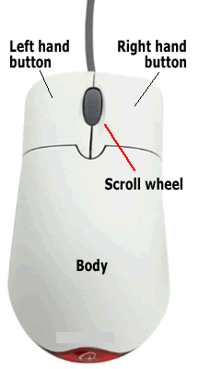
The typical mouse has two larger buttons that can be configured either:
left / right
right / left
The scroll wheel is also a button.
Getting Around in Windows
Using the Mouse - Clicking
Some basic rules
1. Don't double click in a Web browser.
Links, buttons, tabs, toolbar icons, and everything else you will find in your web browser usually require only one click.
2. Don't double click the quick launch program icons on your Taskbar
3. Do double click program icons on your desktop and files / folders you want to open.
4. You can right click almost any item (icon, link, desktop, taskbar, etc.) and get a context menu of things you can do with that item.
Rule of thumb – If you are unsure when to single or double click, then click once. If it does not work, double click.
When do you left click, right click or double click, you ask?
You left click to:
Select an object such as a desktop icon,
a file or a file folder.
Start a program or open a document link.
When you right click something, you quickly press and release the button that is configured as the right mouse button.
When you left click something you do the same as a “right click” except using the left button.
When you “double click” you press and release the left mouse button two times in rapid succession.

Slide 22







Getting Around in Windows
Using the Mouse - Pointers
Common Mouse Icons
Link pointer - Click once on to open the link.
Regular pointer - Click once to select.
Horizontal resize pointer – Click, hold, and drag to resize.
Vertical resize pointer – Click, hold, and drag to resize.
Move pointer – Click, hold, and drag to move.
Wait pointer – Indicates the program is busy.
Help Select pointer – Next object clicked displays help

Slide 23
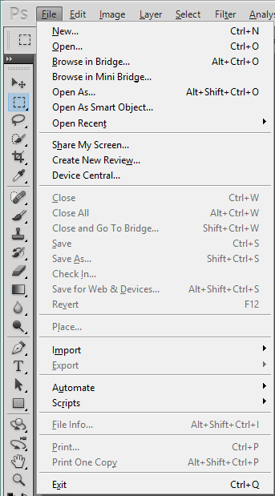
Menus are not part of Windows itself, but are still found in programs built before Microsoft went to the ribbon navigation method.
This is a menu bar from Adobe Photoshop CS5, created before ribbons were the norm.
Getting Around in Windows
Menus and Ribbons
I touched the Alt key to access this menu. Since the File menu is the first on the left, the Alt pulls it up first.
Just as a note, not all programs pull up the far left menu (usually the File menu) when you touch the Alt key. Some programs just highlight the first menu name when you touch the Alt key.
I could have also held down the Alt key and touched the “f” key (then released both keys) to accomplish the same thing.
Alt-E brings up the edit menu, Alt-I the image menu, etc.
In addition, any of the shortcuts I would touch the underlined letter to do that function, such as “New” is underlined. I would then touch the “n” key to start a new canvas or “o” to open a file.
I can mix and match keyboard and mouse, just like I can with the ribbon.
This older style navigation is quite common still and you should know how to use it as the change over to ribbon navigation occurs.
Note that the icons to the left of the File menu are not part of the menu. That is Photoshop’s toolbar.
Navigation in the menus
Arrow keys up and down.
Then press Enter to do that function.
Arrow keys right and left on sub-menus
Right arrow expands the sub-menu.
Shortcut keys (the underlined letters)
Hotkeys (e.g. Ctrl-N, Alt+Ctrl+O, etc.) Hotkeys are also available without using the menu.
And finally, you can just left click once with your mouse on the function you want.

Slide 24
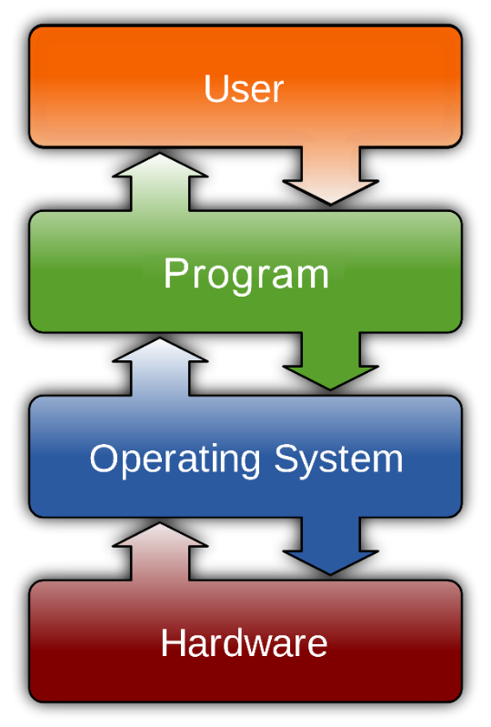


Computer Software
Program Flow
The diagram below shows the flow of activity between the user and the computer and back again.
The user is you
The program can be anything; from Excel to Word, Internet to Email, to fancy stuff like photo editing and albums.
You can run many programs at once, such as browse the Internet while writing up an email to your friend. In fact, even if you do not start any program, Windows still runs many programs in the background, and all of them simultaneously.
There are several operating system: Windows, Mac, Linux, and UNIX are the most common.
We will focus on Windows as it is the most widely used operating system and is the one you are most likely to use.
The hardware we have already covered in general in the Computer Basic course.
Windows runs on the desktop, tower, tablet and Surface PCs.
The operating system Android and Apple IOS runs on the smaller sNote, iPad, iPhone and Android phones.

Slide 25






















Computer Software
What can programs do?
Here is a small few popular programs of the many thousands available to do just about any function you can imagine.
Productivity:
- Microsoft Word, Excel and PowerPoint
- PhotoShop, Premiere, Corel Draw, Sound Forge, Amadeus Pro
Entertainment:
- Media Player, VLC Media Player, Real Player, iTunes
- Games such as Guild Wars, World of Warcraft, SIMs
Internet:
- Web browsers such as Chrome, Firefox, MSIE, Safari, Edge
- Email software such as Microsoft Outlook and GMail

Slide 26
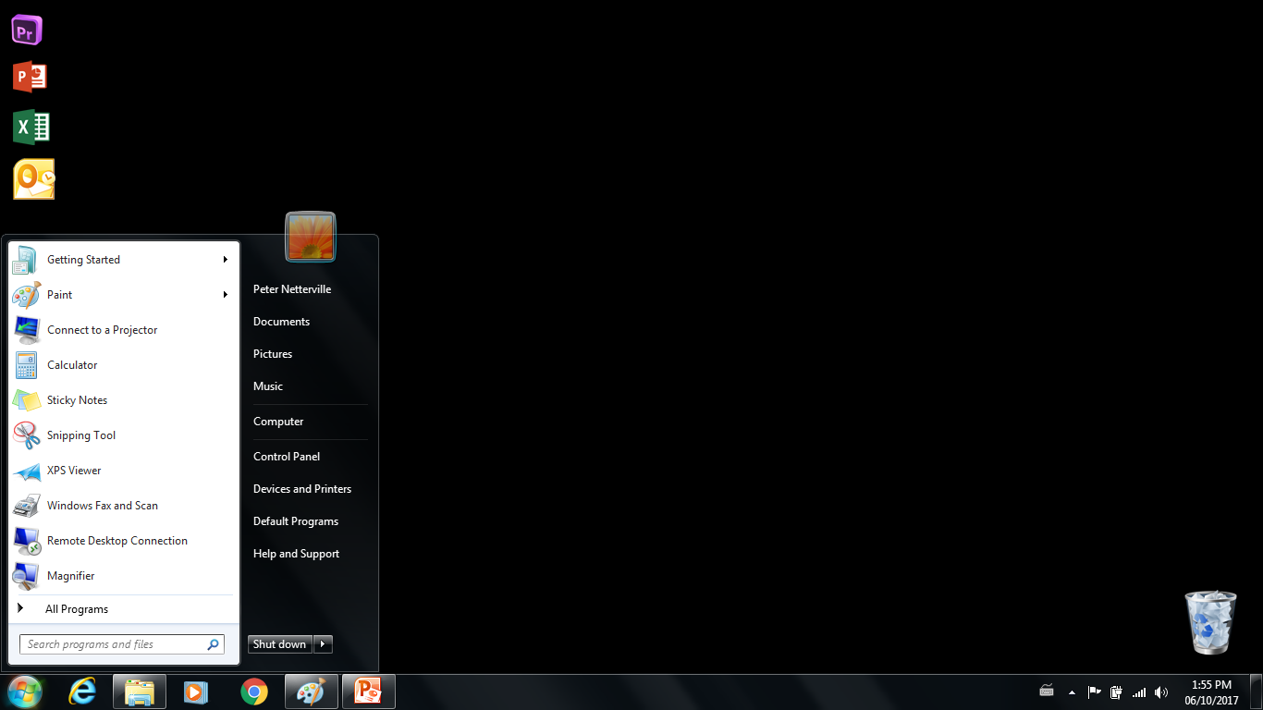
The Graphical User Interface (GUI)
Windows Desktop
Windows Desktop
Desktop Icons
The Windows Desktop is the entire visible area, which includes the Taskbar, the Start Menu, and all the Desktop Icons.
Microsoft patterned the Windows Desktop after the desktop of the a physical desk.
The Start Menu is accessed from the Taskbar. It is the place you go to access your programs, documents and much more. We will cover the start menu in detail later in this course.
Taskbar
Start Menu
The Taskbar is the main launching point from where all your programs and documents can be accessed.
The Taskbar contains the Start Menu, Search Bar, Quickstart icons, and the System Notification Tray. We will get into these later in this course.
Notes:
Interface of operating system is what you see and they way you interact with your computer.
Every area of your Windows operating system called in specific name.
We will talk about each of those area one by one in more details.
We will show you Windows 7 interface, as most office computers are running on Windows 7 now.
Newer version of windows like Windows 10 may have different look, but areas of the computer and interface is always same

Slide 27
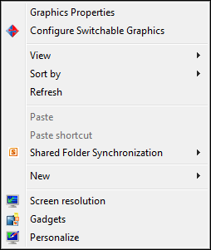
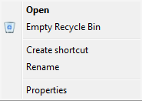
The Graphical User Interface (GUI)
Windows Desktop (continued)
The Windows Desktop is the entire visible area, which includes the Taskbar, the Start Menu, and all the Desktop Icons.
The desktop is a container only, meaning that you cannot write up a document directly on the desktop, but it contains icons to your programs and documents and it contains the Taskbar.
The desktop can be customize to your liking.
The easiest way to do that is to right-click anywhere on the desktop where there is no icon and select (left-click) Personalize.
We will cover those features in the next several slides.
The Recycle Bin is where everything that you delete goes. Occasionally you may want to empty your recycle bin, but make sure you do not want to recover anything from it first.
Emptying the Recycle Bin is as easy as right-clicking on it and then left-clicking on
Empty Recycle Bin in the Context Menu that appears.
A dialog-box will appear asking for you to confirm. Click on Yes.
Also notice Open will display a dialog box that will allow you to delete or recover items in the trash.
Notes:
Why name of Windows operating system is Windows? Because you can open different folders and programs in separate window!
Every single windows can be hover around the screen and you may close them separately without having interference with others.

Slide 28
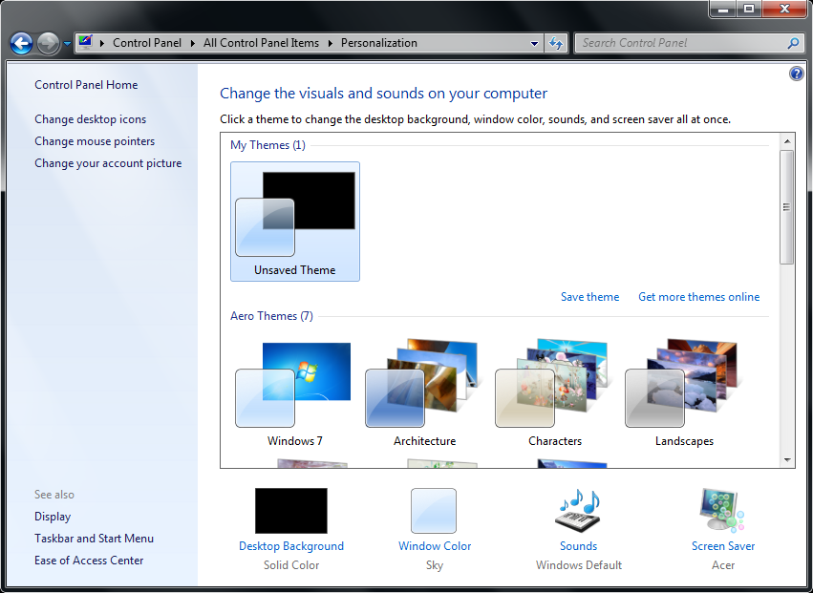
When you personalize your desktop you see a screen that looks like the picture below.
The first screen is the Theme.
The Graphical User Interface (GUI)
Windows Desktop – Personalization
This is the Navigation pane with relevant links.
This section of the right side pane displays the current theme and whether it is saved or not.
The link to click to save the current theme is here.
To get more free themes from a Microsoft repository, click here.
Select a theme from the installed themes here. Any themes you download are also added to this list.
You can modify any theme you choose by clicking on the appropriate button here.
Make sure to save the theme after you modify it.
The Themes is a combination of visual and audio elements including the desktop background, colors scheme, sounds scheme, and mouse cursor scheme. Each item in the theme can be individually modified to your taste or left as is. You can even get more Themes from the Microsoft store, most are free to download and use, royalty free.
Notes:
What you see after you are logged into your computer, is Desktop
Desktop is the root of your access to computer, you can start browsing into your files and computer after you see the desktop.
Usually when you install a program, there will be an icon in your desktop of that program, so you can have access and open it.
In the Windows, we only have “Recycle Bin” and nothing else for the first time we run the computer.

Slide 29
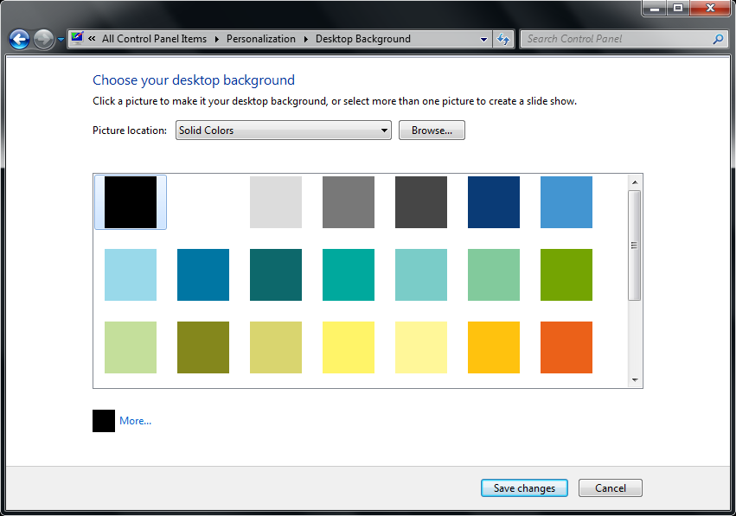
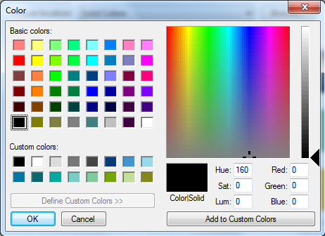
The Graphical User Interface (GUI)
Windows Desktop – Personalization / Solid Colors Background
The background, as covered in the last slide can be modified for your chosen theme. The choices are:
Solid Colors
Windows Desktop Backgrounds (upcoming slides)
Pictures Library (upcoming slides)
Top Rated Photos (upcoming slides)
Choose from a set of common colors for the background
OR …
Click on the More… button to bring up a dialog box that allows you to choose precisely the color you want.
Make sure to save your background when you are done modifying it.
Notes:
The ribbon or bar at the very bottom of desktop is Taskbar.
You will use taskbar a lot in daily bases work
having access to other main areas is possible from taskbar, such as Start Menu
Or you may see time and notification area in far right side of it.

Slide 30
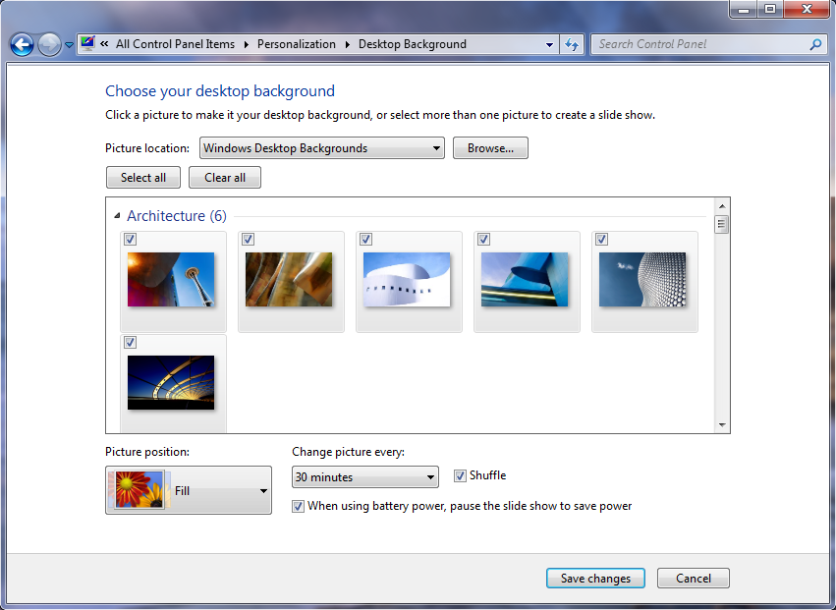
The Graphical User Interface (GUI)
Windows Desktop – Personalization / Desktop Background
The background, as covered in previous slides can be modified for your chosen theme. The choices are:
Solid Colors (covered in previous slide)
Windows Desktop Backgrounds
Pictures Library (covered in upcoming slides)
Top Rated Photos (covered in upcoming slides)
Choose from:
Set of common pictures from the for the background
Browse for a pictures saved on your computer
Choose:
Position of the picture
  Options are Fill, Fit, Stretch, Tile, and Center
How often it changes
  Second, minute and hour settings
Whether it is random or sequential
It pauses when the laptop is on battery operation
  Option does not appear if not on a laptop
Make sure to save your desktop theme when you are done modifying it.
Notes:
The ribbon or bar at the very bottom of desktop is Taskbar.
You will use taskbar a lot in daily bases work
having access to other main areas is possible from taskbar, such as Start Menu
Or you may see time and notification area in far right side of it.

Slide 31
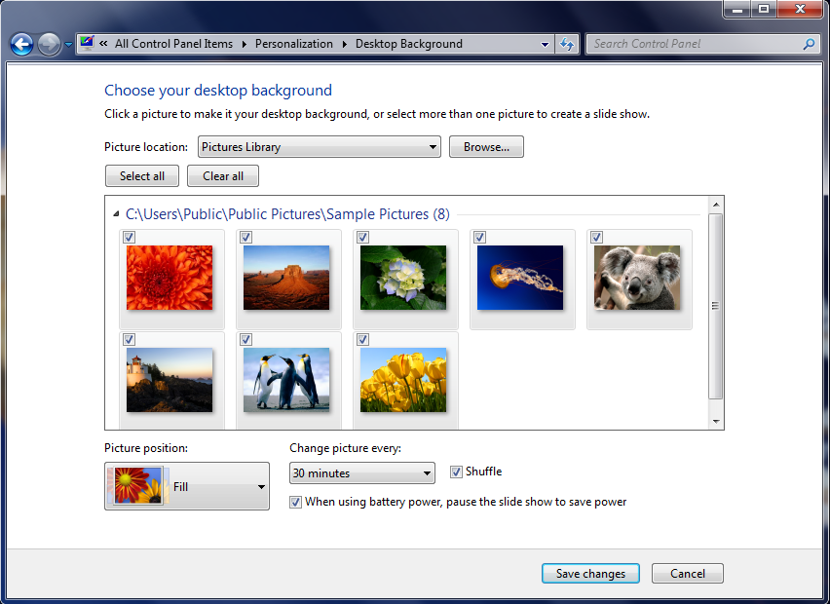
The Graphical User Interface (GUI)
Windows Desktop – Personalization / Picture Library Background
The background, as covered previous slides can be modified for your chosen theme. The choices are:
Solid Colors (covered in previous slide)
Windows Desktop Backgrounds (previous slide)
Pictures Library
Top Rated Photos (covered in upcoming slides)
Select:
From the current picture library
Browse for a folder which contains pictures suitable for background images
Choose:
Position of the picture
  Options are Fill, Fit, Stretch, Tile, and Center
How often it changes
  Second, minute and hour settings
Whether it is random or sequential
If pauses when the laptop is on battery operation
  Option does not appear if not on a laptop
Make sure to save your desktop theme when you are done modifying it.
Notes:
The ribbon or bar at the very bottom of desktop is Taskbar.
You will use taskbar a lot in daily bases work
having access to other main areas is possible from taskbar, such as Start Menu
Or you may see time and notification area in far right side of it.

Slide 32
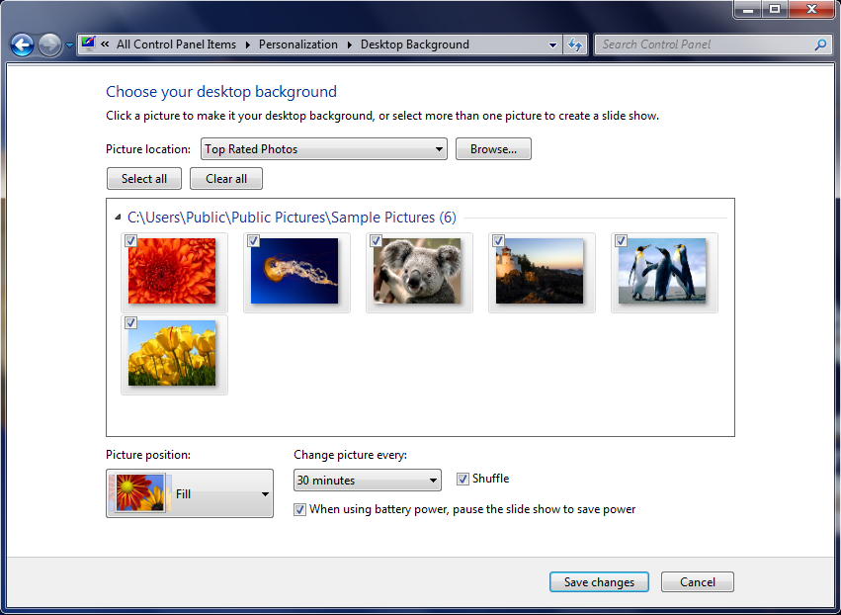
The Graphical User Interface (GUI)
Windows Desktop – Personalization / Top Rate Photos Background
The background, as covered previous slides can be modified for your chosen theme. The choices are:
Solid Colors (covered in previous slides)
Windows Desktop Backgrounds (previous slides)
Pictures Library (covered in previous slide)
Top Rated Photos
Select:
From the current picture library
Browse for a folder which contains pictures suitable for background images
Choose:
Position of the picture
  Options are Fill, Fit, Stretch, Tile, and Center
How often it changes
  Second, minute and hour settings
Whether it is random or sequential
If pauses when the laptop is on battery operation
  Option does not appear if not on a laptop
Make sure to save your desktop theme when you are done modifying it.
Notes:
The ribbon or bar at the very bottom of desktop is Taskbar.
You will use taskbar a lot in daily bases work
having access to other main areas is possible from taskbar, such as Start Menu
Or you may see time and notification area in far right side of it.

Slide 33
The Graphical User Interface (GUI)
Windows Desktop – Taskbar
This is the Time & Date.
Left clicking on this will pull up a calendar.
Right clicking on the time/date will display a context menu that among other options will allow you to adjust the time, date and time zone.
The taskbar runs along the bottom of the screen.
Power Control icon (Laptops)
This is the Start Menu button.
The start menu contains links to programs, personal user folders, computer storage, and settings options.
We will cover the start menu in later panels.
Action Center Icon
System Tray button
Contains hidden programs that do not need a window. These programs are started when the computer starts up.
Network Access Icon
Volume Control
Keyboard and Language Control
These are Pinned Icons of various programs.
You can add to or remove any of these icons. They are there for convenience.
If one of the programs is running, it is highlighted as are the two right hand programs here on this taskbar.
This whole area on the right side is called the Notification Area.
Above are listed some of the more common icons you will see on most computers.
The button on the far right side of the taskbar Minimize All button minimizes all windows on the screen to expose the desktop.
Click on it again to bring back all the program windows the same as they were before they were minimized.
Notes:
Action Center allows for four quick settings, and in Windows 10 users can expand the view to show all of the quick settings. Notifications are sorted into categories by app, and users can swipe right to clear notifications. Action Center also supports actionable notifications starting with Windows 10. In the mobile version, the user can swipe from the top to the bottom to invoke Action Center,^{[5]} and further features introduced in Windows Phone 8.1 include the ability to change simple settings such as volume controls. The new notifications area's design allows the user to for example change wireless networks, turn Bluetooth and Airplane Mode on or off, and access "Driving Mode" from four customisable boxes at the top of the screen, while beneath these four horizontally placed boxes include recent text messages and social integration.^{[6][7][8]} On the desktop version, the user can invoke Action Center by clicking on its icon on the taskbar, or by swiping from the right.

Slide 34
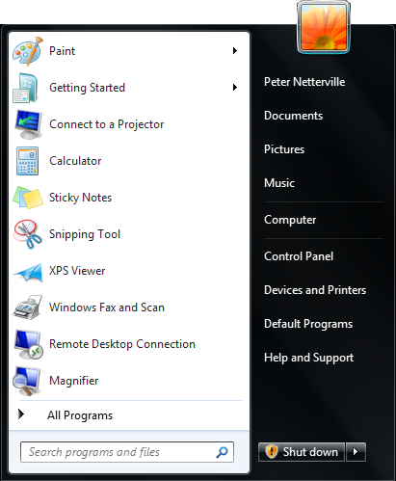
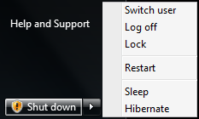
The Graphical User Interface (GUI)
Windows Desktop – Start Menu
The Shut down button shuts down the computer. In this case where the icon appears, the computer will do the downloaded updates first, then shut down.
The arrow icon when clicked will display the menu listed below instead of immediately shutting down:
Switch User – Leaves your programs running but logs you out for another user to log in. Be aware this can consume a lot of memory.
Log Off – Shuts down your programs and logs you out, leaving Windows at the log in prompt.
Lock – Leaves your account logged in with programs running but sets Windows to the log in prompt.
Restart – Logs off all users (including the Switched Users) and restarts the computer but does not re-run the BIOS initialization.
Sleep – Computer leaves programs and data in memory but goes into a low power state.
Hibernate – Saves the state of your computer to the hard drive and powers the system off.
User Account. Either local or network
The User’s personal folder access links.
The Computer link opens the File Explorer. We will be covering this later in the course.
These three links allow you to access settings for Windows.
Help and Support accesses the Microsoft online resource if Internet is available, otherwise it accesses the local installed help files
This left pane contains the list of recently opened programs and at the bottom, the All Programs sub menu which allows you access to most installed programs

Slide 35
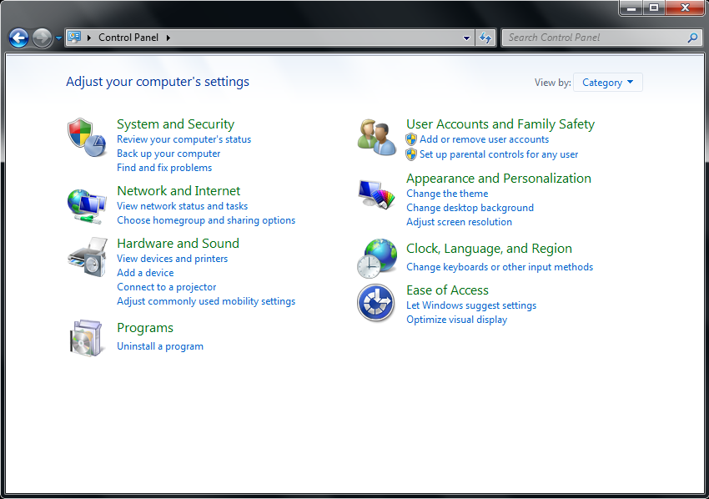
The Graphical User Interface (GUI)
Windows Desktop – Control Panel
System and Security
Action Center
Windows Firewall
System
Windows Update
Power Options
Backup and Restore
Windows Anytime Upgrade
Administrative Tools
User Accounts and Family Safety
User Accounts
Parental Controls
Windows CardSpace
Credential Manager
Mail
Category View
Appearance and Personalization
Personalization
Display
Desktop Gadgets
Taskbar and Start Menu
Ease of Access Center
Folder Options
Fonts
Network and Internet
Network and Sharing Center
HomeGroup
Internet Options
Hardware and Sound
Devices and Printers
AutoPlay
Power Options
Display
Windows Mobility Center
Clock, Language, and Region
Date and Time
Region and Language
Ease of Access
Ease of Access Center
Speech Recognition
Programs
Programs and Features
Default Programs
Desktop Gadgets

Slide 36
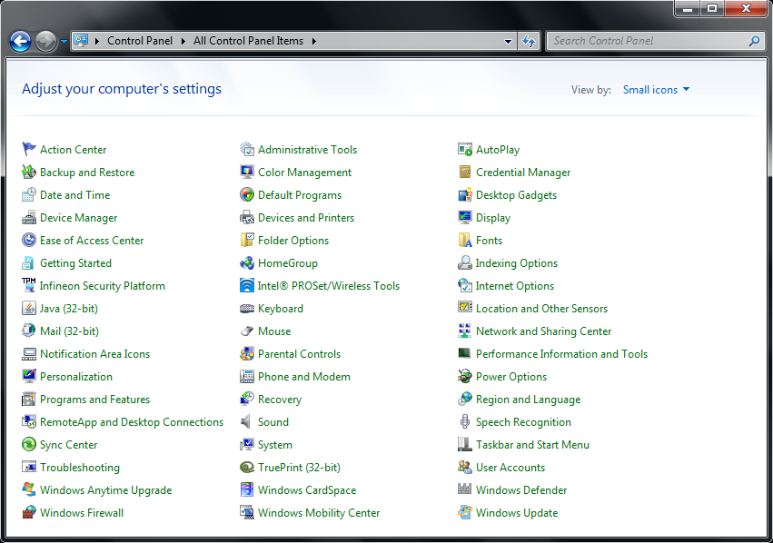
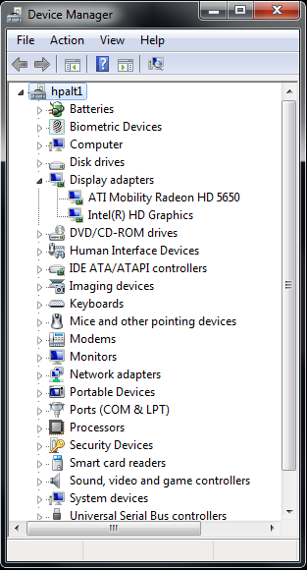
The Graphical User Interface (GUI)
Windows Desktop – Control Panel
The small icons view displays all control panel applets alphabetically across. There is also a large icons view.
Some applets are not part of Windows, but are added when various drivers are installed to the computer and other software, such as:
Infineon Security Platform
Java
Intel ProSet/Wireless Tools
Small Icons View
The Device Manager is where all the installed devices are listed.
Click on the small arrow beside the device category to expand the list of installed drivers.
We will not be covering the Device manager in this course to any greater degree.

Slide 37
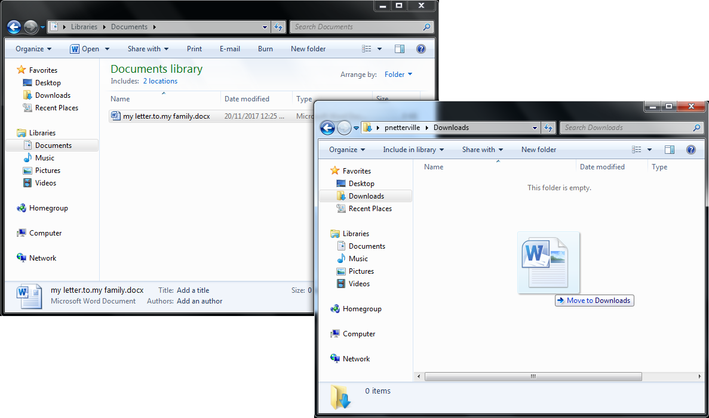
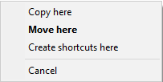
You can also drag and drop from one window to another by picking up a file from one folder and dropping it into another folder.
There are two ways to drag and drop
By pressing and holding down your left mouse button while dragging.
Pressing and holding down your right mouse button
Copying using your mouse
Dragging a file and dropping it allows you to use the mouse to copy or move the file
To drag and drop a file do the following:
Open two windows on your computer, one containing the file and the other to the destination folder. Both need to be visible, one cannot completely cover the other.
Position your mouse pointer over the file for which you wish to copy, move, or create a shortcut.
Left (or right click) and hold the button down.
Move your move over the surface of the desk until the mouse pointer is over the destination window
Release the mouse button.
Drag & Drop Rules
Using the left mouse button:
When you drag and drop to another folder on the same drive, it moves the file.
When you drag and drop to a folder on another drive then it copies the file.
Using the right mouse button:
When you drag and drop using the right mouse button, you always get a menu and you can choose what to do from that menu, regardless of the destination.

Slide 38


Where do I find the stuff I need?
Programs – File Association
File association is where Windows knows what file to open, because you double clicked on it, but has to check in its’ settings to determine what program it needs to use to open the document.
From the example in the previous box, Windows takes the docx and matches that to what program it knows to use to open that docx file.
Then Windows starts the program and then tells the program to open the document you double clicked on.
Important Techie Talk: File Association
There are two methods to open your documents.
By opening the program, such as MS Word, and then opening the document from the program.
By double clicking on the document itself.
The way the document is opened is quite
different by each of these methods.
Be aware that you do not need to worry about typing in the file extension when you name your document as you save it. The program will do that for you.
Windows determines what type of document you clicked on by the document’s file extension.
Definition: A file extension is composed of the characters after the last period in a file name.
Two things to note in that definition:
You can have as many periods in a file name as you like.
The characters after the last period in the file name is the file extension.
For example: “my letter.to.my family.docx”
“my letter.to.my family” is the file name and “docx” is the file extension.
So, in method 1 you are telling Windows what program to use by opening the program, and then you are telling the program what document to open.
In method 2, if Windows has the wrong information as to what program to use, or there is no information at all, then Windows will either open the file in the wrong program or not be able to open it at all.
If Windows has the wrong program associated to that file type or none at all, then the file association problem needs to be fixed. It is not difficult to do. I will show you on the next slide.
So how do I fix a file association problem?

Slide 39
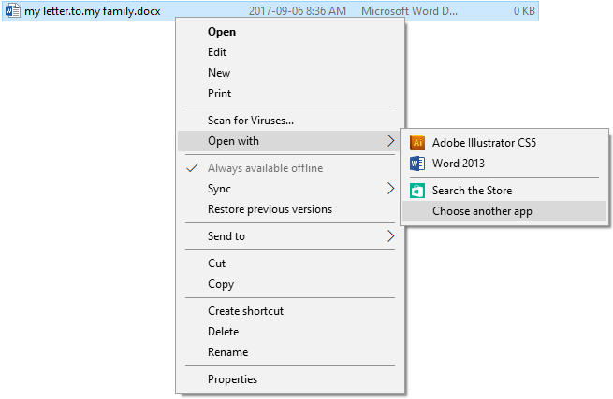
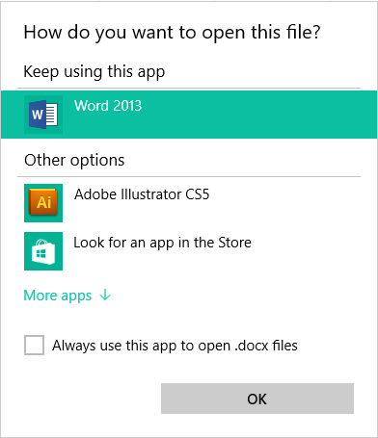
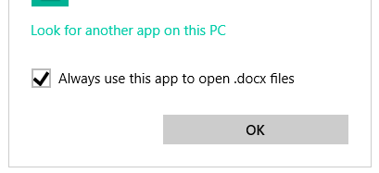
Where do I find the stuff I need?
Fixing A File Association Problem
From the previous panel we were using the example file name, “my letter.to.my family.docx”.
We have a problem with the file association for this document, so:
Left click once on the file name to select that file
Right click once on the file name to pull up the context menu.
Move your mouse pointer over the Open with sub-menu option to expand the sub-menu
Move the mouse pointer down to the Choose another app option and left click once. You only need to left click once in any menu in Windows to select an item.
Now select the check box beside Always use this app to open .docx files
You may have to click on More apps and scroll down to find the program you are looking for.
If you still cannot find the program, at the bottom of that list is a link that says, Look for another app on this PC. Left click on that link to browse your computer for the program.

Slide 40


























Files and Folders
File Extension Types
Below is a list of a few common file extension types from a list of many hundreds.
Pictures, Photos, Clipart | jpg, jpeg, png, gif, wmf
Video | avi, mpeg, mp4, m4v, mov
Audio and Music | mp3, wma, wav, aaif
Text and Word Processing | txt, odt, wpd, doc, docx
Excel and Quattro Pro | xls, xlsx, qpw
PowerPoint | ppt, pptx
Adobe Acrobat | pdf
There is no central authority that assigns file extensions. A software company chooses a file extension to represent the data that is created by using their software and that extension then becomes the de facto standard for that software.
Notes:
What are file extensions?
File extension help us to know which program we must use to open a each file.
This is usually done by computer itself, but if we have a file and can not be open, then we have to look into file extension and see which program we can use for it.
Here in this table you can see sample of each file, extension and their icon in Windows OS

Slide 41
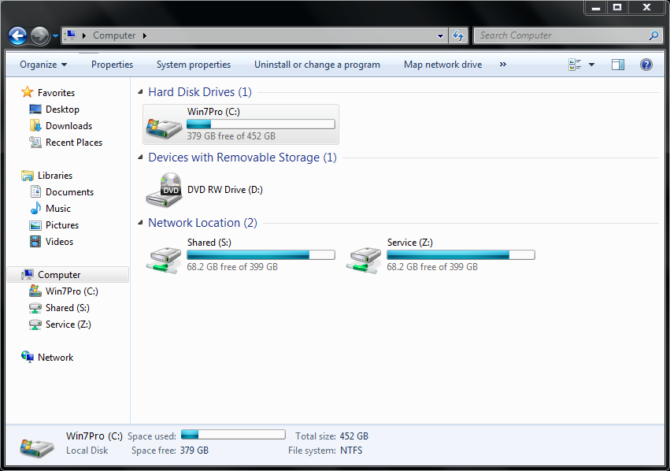
Files and Folders
File Explorer Parts
The Navigation buttons go forward and back moving the file explorer along the path of selected folders.
Address bar holds the path to the current folder represented as buttons to navigate to that folder. The arrow to the right side of the button drops a list of the contents of that folder. More on this next slide.
The refresh button is on the far right side of the Address bar.
If you want to find a file on your computer, the Search bar is where you enter either the full or part of the file name. You can use wildcards to replace some or all of the file name.
Asterisk * - substitutes for one or more characters
Question Mark ? - substitute for just one character
Click on the little magnifying glass icon to start the search.
The Command bar is similar to a context toolbar, it will display the commands available for the object that is selected in the Content pane. If nothing is selected, a default command bar is displayed.
The Content pane. The contents of whatever is selected in the Navigation pane is displayed here. Select an object here and the Command bar will display the commands associated with working with that object.
This is the Navigation pane. Use it to move up and down in the hierarchy of the Windows folder structure.

Slide 42
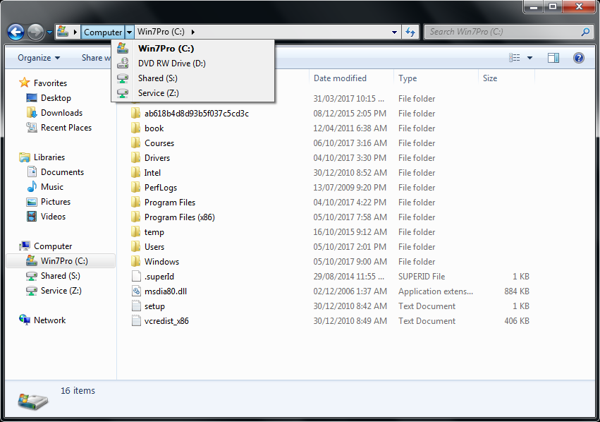
Files and Folders
File Explorer Parts (continued)
As mentioned in the last slide the file path is displayed in the Address bar as buttons. Each folder is a button that you can click on the take you directly to that folder.
The arrow right of the button when clicked upon drops a menu listing all the folders in that folder as shown in the image here.
You can click on one of those folders in the menu list and navigate to that folder.
To get back to the previous folder, just click on the back button.
When you click on the right side of the Address bar in a blank space, the buttons will change to show you the full path.
When you click upon the blank space, the Address bar with
Buttons became the Address bar with the folder path.
So, why does it show only C:\ when there was also the
button?
The Computer button is not a “physical” folder. It is a virtual folder that represents the root, a collection of all physical drives mounted in or connect to the computer that are available for use.
The C:\ folder is the root of that one drive only.
Important Note: Whenever you right-click on most any object in Window, you will get a context menu. The context menu provides a list of things you can do with that object.

Slide 43
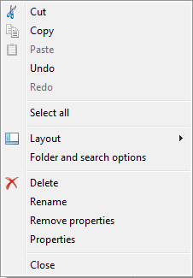
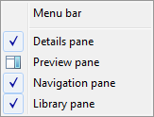
Files and Folders
File Explorer Parts – Command Bar
Below is a list of characters that cannot be used in a file or folder name.
* | Asterisk | < | Left angle bracket
? | Question mark | > | Right angle bracket
“ | Double quote | / | Forward slash
: | Colon | \ | Back slash
Cut – Cut does not immediately remove the file, but only when pasted to a new location.
Copy – Copy leaves the original file intact. A duplicate is made when pasted in the new location.
Paste – Paste copies or moves a file of folder to the new location.
Undo, Redo – Will undo or redo the last action, such as delete, paste, rename, etc.
Select All – Selects all objects in the Content Pane
Folder and search options – Will not be covered in this course
Delete – Deletes selected object, but displays a dialog box asking for confirmation.
Rename – Allows for the renaming of the selected object.
Remove Properties – Allows you to remove properties attached to the selected object.
Properties – Display the properties of the selected object in a dialog box.
Close – Closes the File Explorer window.
The Command Bar is context sensitive.
This means that it changes depending upon what is selected in the Content Pane.

Slide 44
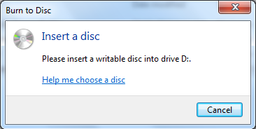



Files and Folders
File Explorer Parts – Command Bar (continued)
Burn – Will burn the selected object to a CD, DVD or Blu-ray optical disc without further dialog, but if there is no burnable optical disc in the drive, the dialog box show on the left appears.
If the drive is incapable of writing, a dialog appears indicating the error.
E-mail – attaches the object to an email using your default client email program.
The email program must be an installed program such as Outlook, not a web browser based email, such as Gmail.
Nobody – Pulls up a file sharing dialog box so you can stop an existing share on that object or change sharing permissions (i.e. who can access the file to read/write/change)
Specific people – Displays a dialog box so you can choose with which people to share the selected object.
This option is used for those computers connected to a User authenticated client/server network.
New Folder – Creates a new folder entry in the Content Pane. Keep in mind that the contents of the Content Pane is already the contents of a folder.
It places the typing cursor in the name box so you can type in label of your own. If you leave it as it is, the name will remain “New folder”.
The Open button displays a menu of the files that are registered capable of opening the selected file object.
If a folder is the selected object, the Open button simply opens the folder in the same window.

Slide 45

Information Security
In today’s world of computer technology, keeping your information safe is absolutely required!
With our information being recorded in government computers, on social networking, on banking, and while your information is conveniently available for you to use, it can also be available to anyone else if the proper steps are not taken to secure it.
Steps to Privacy
Please do not write your password on a slip of paper and leave it near your desk.
2. Never share your password
Create a complex password
  Use upper and lower case letters
  Use a symbol or two
  Use one or more number
  Do not use names or words
  Do not use your phone number or any number that would easily be associated with you
Notice how the keyboard can be used as a mnemonic?
The pattern on the keyboard, top left four keys, the 5 is near the “r”, the top right four keys all uppercase (so hold the Shift key while typing), the * is near the “u”.
Difficult to crack passwords can also be easy to remember when you
use something like the keyboard to help you remember.
An example might look like
qwer5POIU*
Whenever you walk away from your computer, lock it.
(Windows Key) + L

Slide 46


Information Security
4. Keep Windows updated
5. Always have installed an active Anti-Virus software package. Some common package names are:
Symantec’s Norton Anti-Virus
AVG Anti-Virus
McAfee Anti-Virus
Malwarebytes
BitDefender
Trend Micro
Windows Defender
Some of these companies have a free basic version you can download and install.
But it is still always better to buy the full anti-virus package.
6.
Do not reply to emails unless you know who the sender is or you are expecting the email. Spam emails ask for you to enter your information. Don’t. A legitimate organization will not solicit your information in that way.
Do not visit questionable websites.
Keep informed of security risks. Often your anti-virus software will inform you of threats.

Slide 47
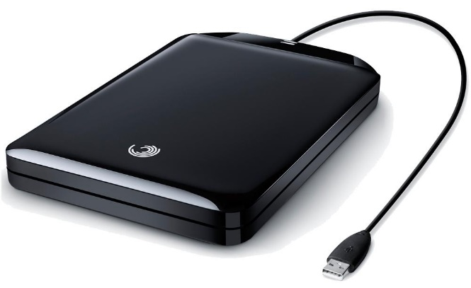
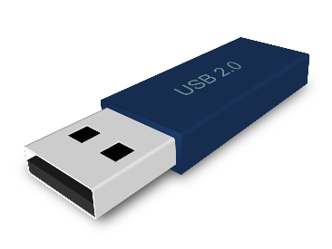

Backup Security
A USB drive is the most common method of backup today.
Though the physical size stays about the same (picture is full size), the data that it can hold ranges from 1 Gigabyte to 2,000 Gigabyte (2 Terabyte).
Backup your data!
Though this is technically not a security issue, it is an
“Oh No! Now what do I do?”
issue.
Few things are worse than losing of all your important documents.
The image above is a portable hard drive. This image is not full size.
They are about 4” X 5.5” X 0.75”
The largest capacity affordable portable hard drive (at the time of this writing) is about 2 Terabyte (2,000 Gigabyte).
Backup software
Acronis True image
Norton 360
Dropbox
This is not an exhaustive list by any means.
Methods for backup
Copy to USB drive or to a portable hard drive.
Use backup software

Slide 48
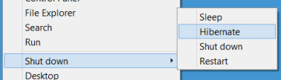
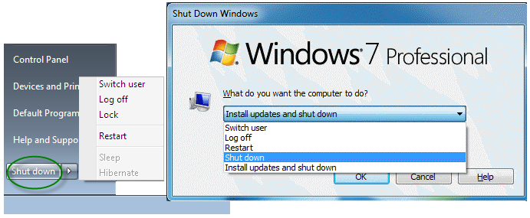
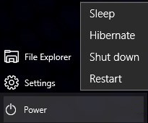
Turning off a Windows computer
Basic Power Down options:
Common to 7, 8, 8.1, 10
Shut Down
Restart
Log Off
Install updates and shut down
Switch User
Added Options on a laptop 7, 8, 8.1, 10
Sleep
Hibernate
Windows 8.1 Shut down menu
Windows 7 Shut down menu
Windows 10 Shut down menu
Windows 7 and earlier had a second dialog with a drop down box of options.

Slide 49
NITHA IT HelpDesk helpdesk@nitha.com
1(844)486-4842
Notes:
Please do not hesitate to ask any question regarding this session, and I will make sure to answer your question as soon as possible.

Slide 50


