Slide 1

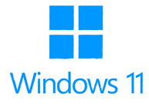
Windows 11
Entry Level

Slide 2
NITHA IT Helpdesk
helpdesk@nitha.com
1(306)953-5008

Slide 3

What will we be covering in this course?
Windows GUI – Identifying the Parts of Windows
Login Slide 15
Desktop Slide 21
Taskbar Slide 22
Start Menu Slide 23
Navigating Windows - Finding the Files You Need
File Explorer Slide 29
Keyboard & Mouse Slide 35
Menus & Ribbons Slide 38
Safety, Backups & Best Practices

Slide 4
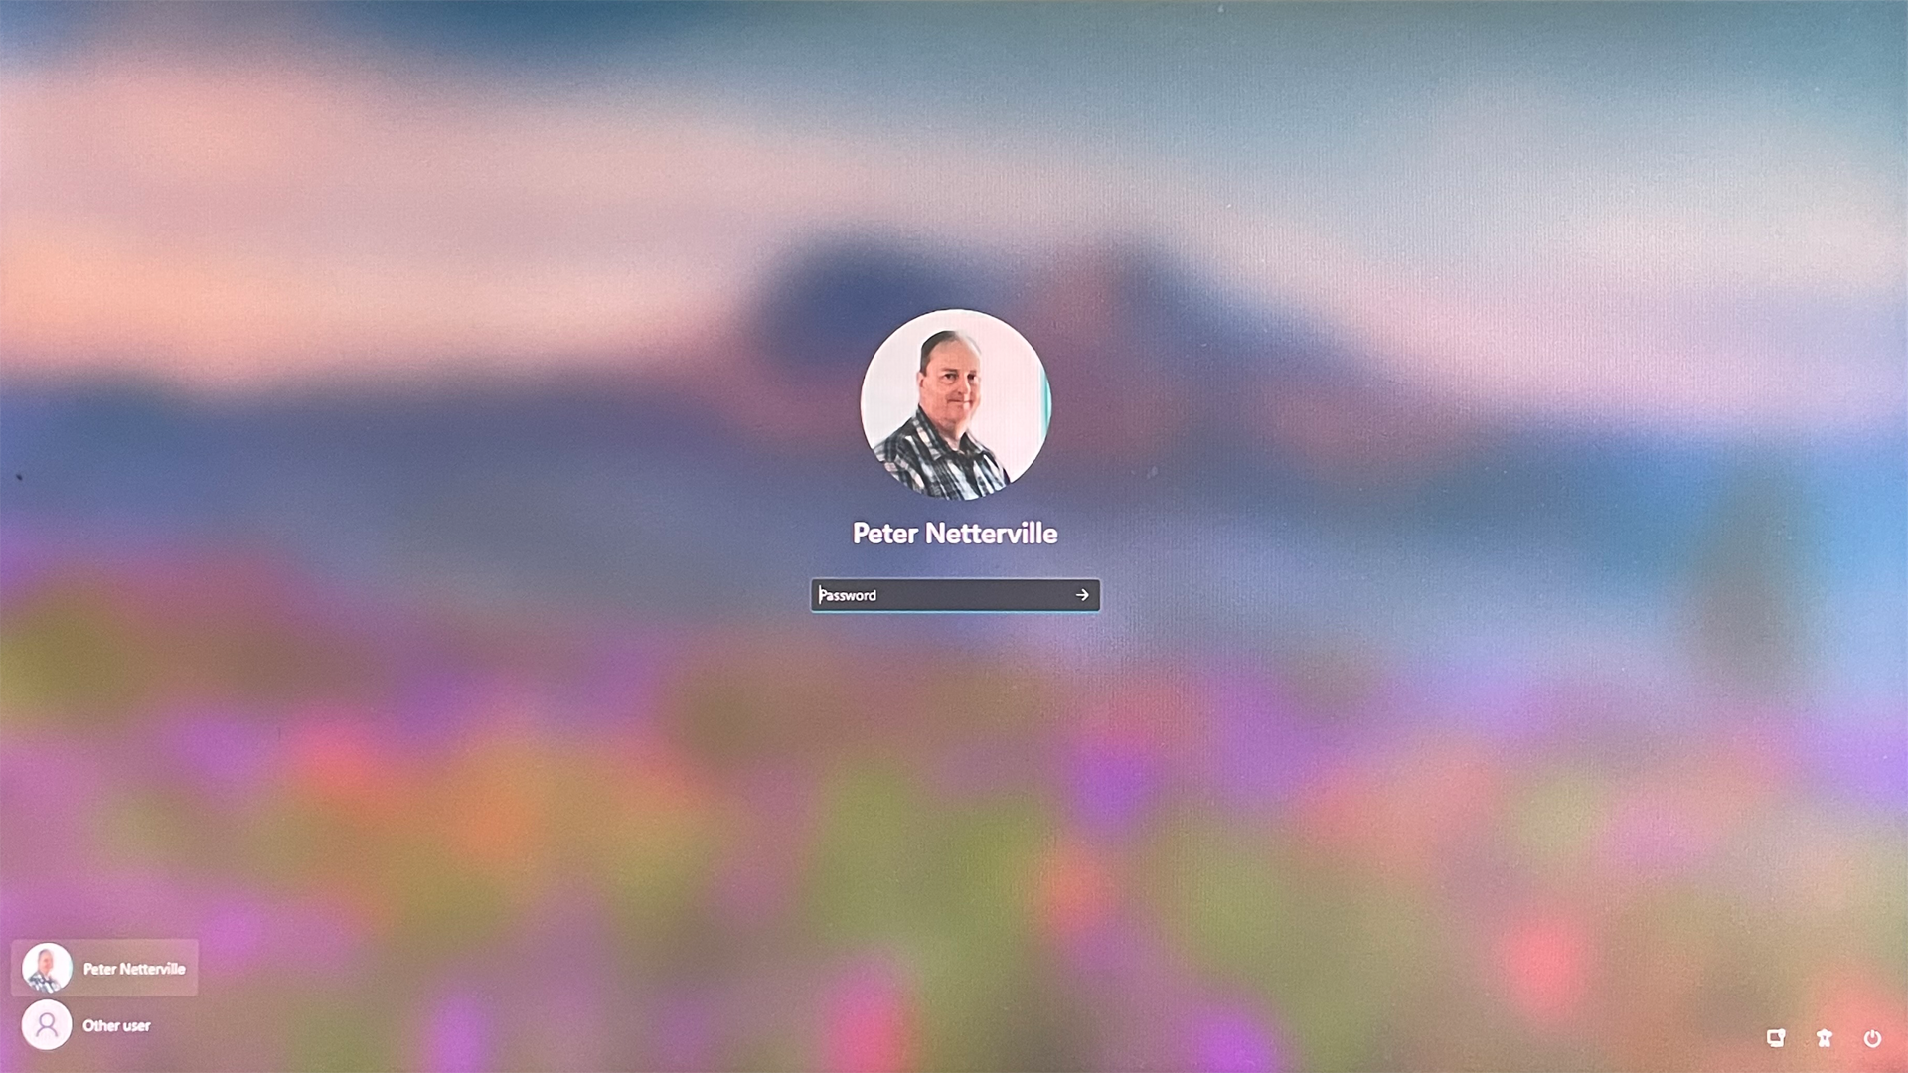


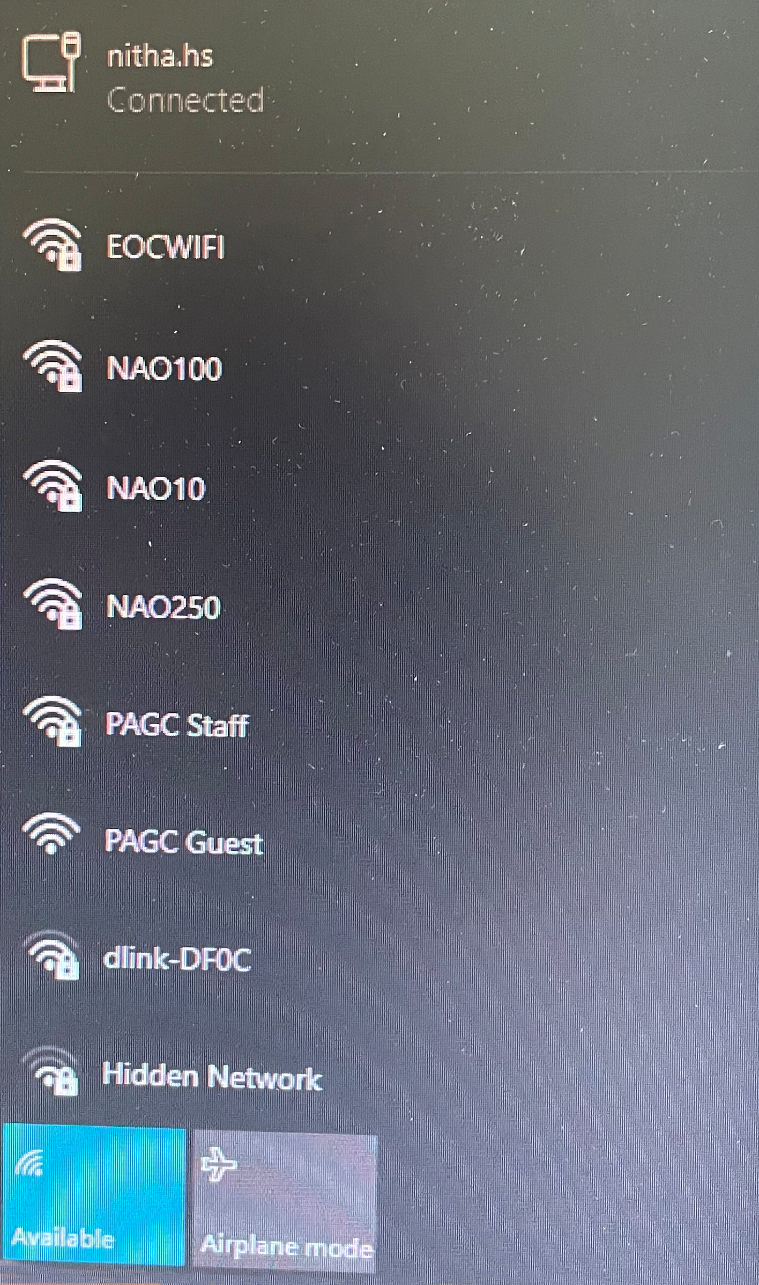
Windows GUI – Login
= Wired Network Connection
= Wireless Network Connection
If not connected, choose a network connection and, if needed (for a wireless connection), enter your username and password for the network connection, not your domain username and password. That comes next.
Before logging in to your domain profile, check your network connection to make sure you are connected.
Notes:
Question 1: Where on the Windows login screen is the network connection icon? (Slide 4)
b. Bottom right corner

Slide 5
Windows GUI – Login
When logging in to Windows, you select a user shown on the bottom left of the screen and type in your password.
If your user profile is not listed at the bottom left of the screen then …

Slide 6
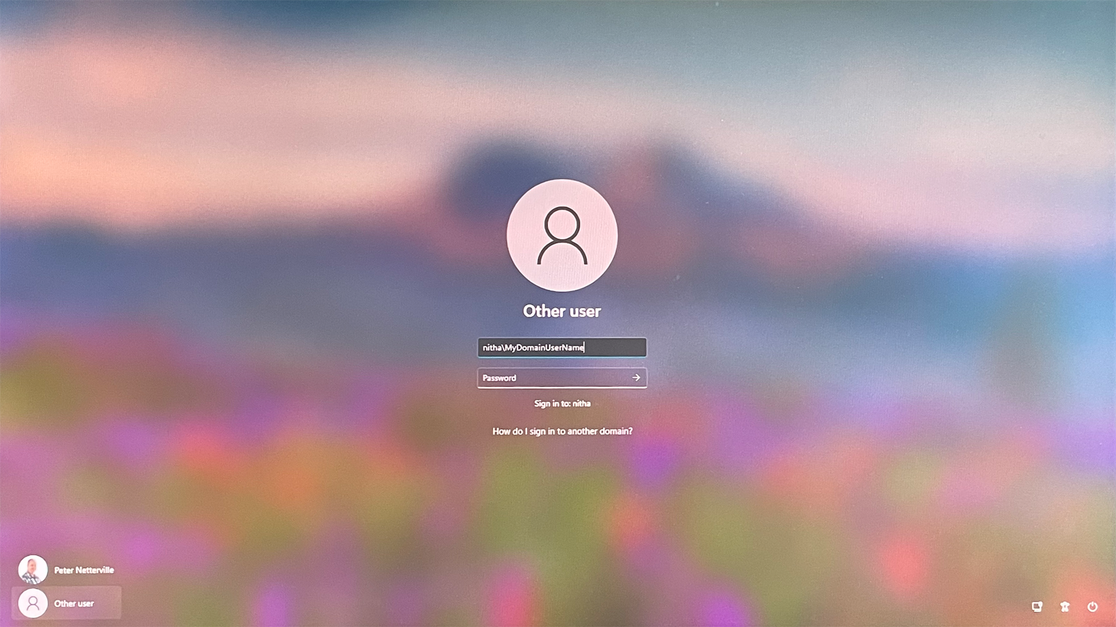
Windows GUI – Login
… then just enter your domain username in the field provided.
The username is the part before the @ sign of your email address.
However, if your domain is not displayed, then you must enter it before your username, as shown here.
nitha\
NITHA is our domain name. Your domain will be different.
… then select Other User which displays …
If your domain is shown here …

Slide 7
Windows GUI – Login
This icon represents accessibility options for people with disabilities.
This icon opens a menu that lets you shut down the computer.
This icon represents your connection to a network.

Slide 8
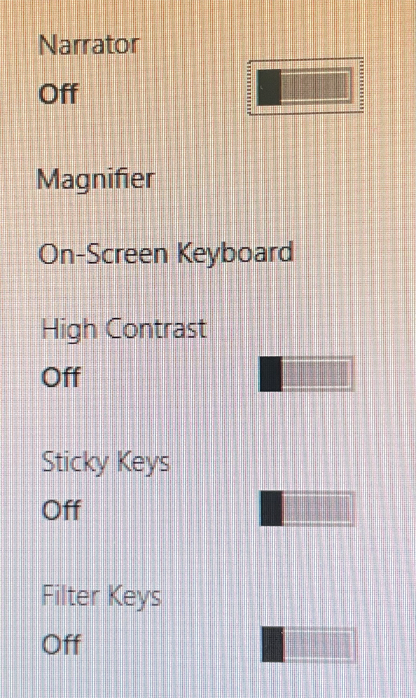
Windows GUI – Login
Disability options.

Slide 9
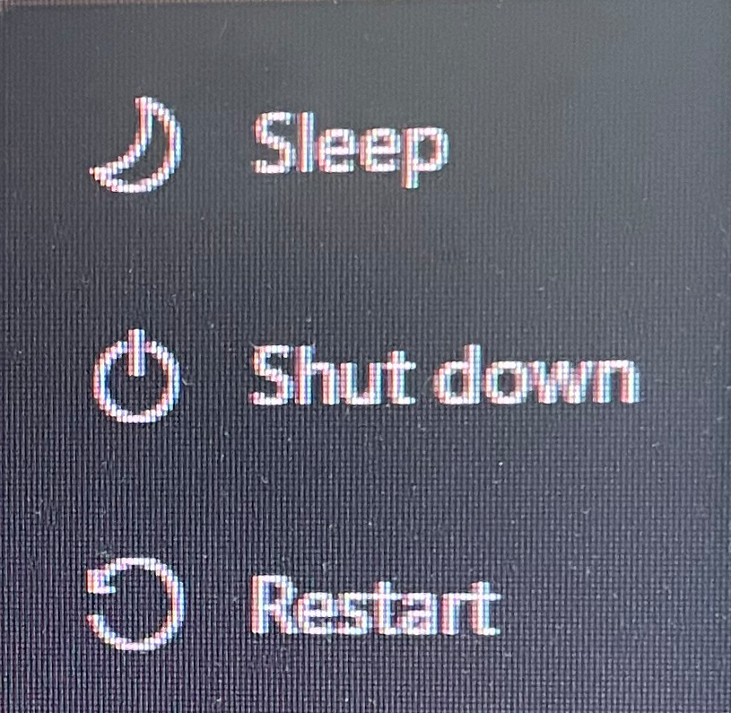
Windows GUI – Login
Power options.

Slide 10
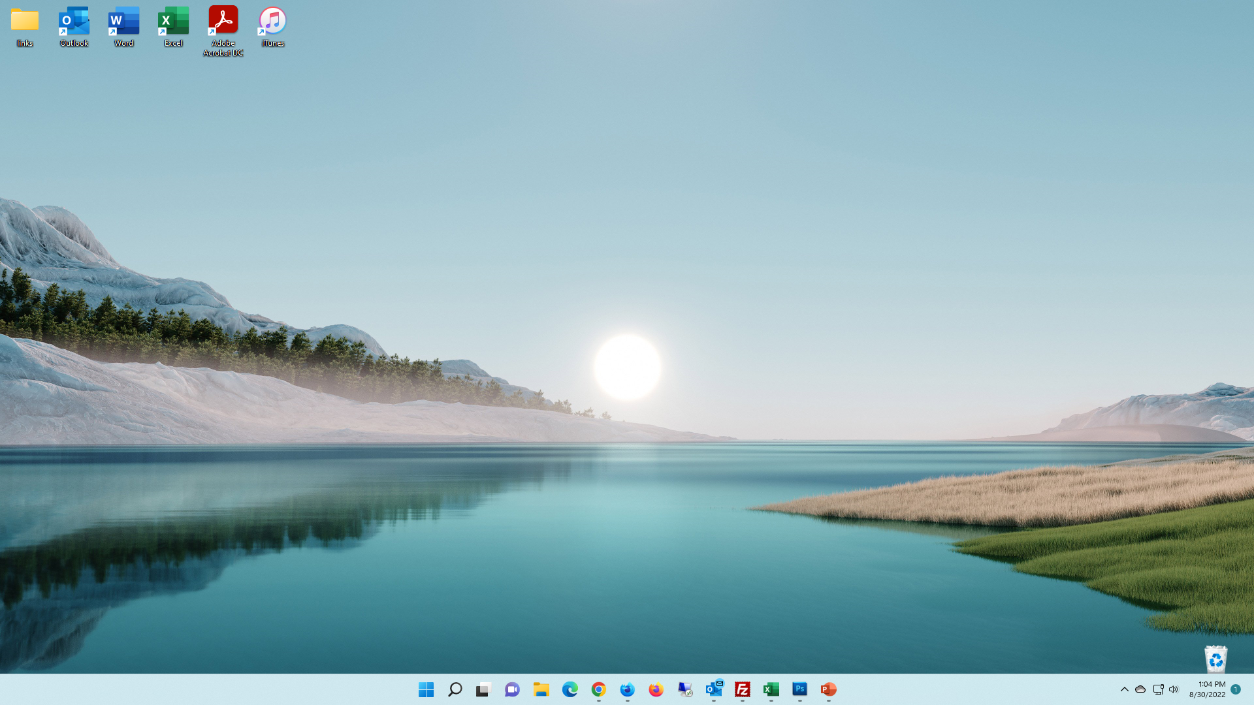
Windows GUI – Desktop
The desktop is what you see once you have logged in.
The desktop contains four item types:
The taskbar.
Shortcuts to various files and hyperlinks.
Trash can.
The background.
2. On the desktop you can place files, shortcuts, and hyperlinks.
1. The desktop is the entire screen with a taskbar.
3. Every desktop also has a trash can.
Files in the trash can still be recovered, but empty the trash and the file(s) are gone.

Slide 11
Windows GUI – Taskbar
The taskbar is by default along the bottom of the screen.
The taskbar contains
Start button
Search
Virtual Desktop
Shortcut icons / running programs
System Notification Area
3. Virtual Desktop
2. The Search icon
4. Shortcut icons / running programs
1. The Start button
When the application is running, you will see a short line under the app icon.
5. System Notification Area
Notes:
Question 2: Where is the System Notification area located? (Slide 11)
c. On the Taskbar

Slide 12
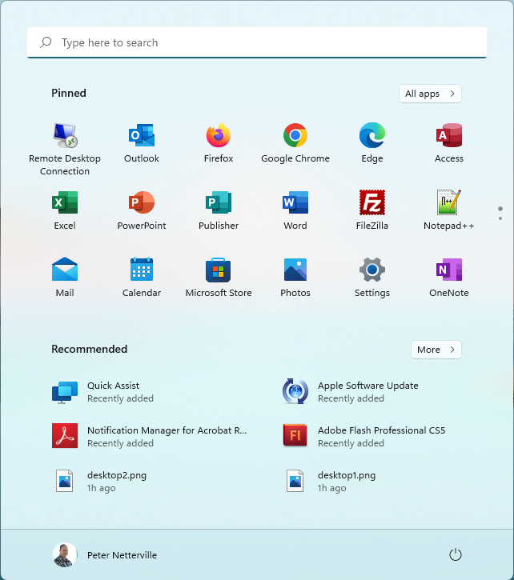
Windows GUI – Taskbar – Start Menu
The Start Button displays the Start Menu.
1. The Search bar looks for files and if unsuccessful searches the Internet.
Items of interest on the Start Menu include …
2. A list of all installed apps.
3. Pinned shortcuts to apps from the list of all installed apps. Some default apps are listed here, but mostly you add to this list yourself.
4. Shortcuts to documents you have opened and apps you have recently used.
Left click on the Start Button or the Windows key.

Slide 13
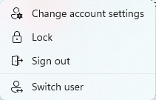
Windows GUI – Taskbar – Start Menu
The Start Button displays the Start Menu.
This option allows you to set or reset options in your account. The options will not be covered here.
Signing out will shut down your running apps and log you out of your profile.
Locking your profile returns the screen to the login screen but does not sign you out, so your programs will still be running when you sign in again. You can use the Win + L keyboard combination to lock your workstation instead if you prefer.
Switching users leaves your apps running as you left them, then loads the new user profile. This can consume much memory.
Your user profile.
Notes:
Question 3: Where do you go to log out? (Slide 13)
Answer 3: a. Start menu, your account

Slide 14
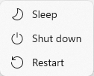
Windows GUI – Taskbar – Start Menu
The Start Button displays the Start Menu.
Sleep mode stores in memory and uses a small amount of constant power in the process, eventually draining your battery if left long enough in Sleep mode.
Just as a comparison to sleep mode, hibernation mode is basically the same as sleep mode, but it saves information to your hard drive instead, allowing your computer to be turned off entirely and uses no energy.
Shut down does exactly what is says.
Restart logs you out of your profile and restarts the computer.

Slide 15
Windows GUI – Taskbar
This icon is the Virtual Desktop button.
A Virtual Desktop creates another desktop that shows no open programs from any other desktop, so you can keep your desktop from getting too cluttered, and it helps you to organize yourself.
CTRL + Win + Right arrow or Left arrow switches between desktops.
The Search icon opens the Start menu and places the cursor in the Search field.
Shortcut icons/running programs.
When an app is running, a short underline appears under the icon. The line is a bit longer when that app has focus (i.e., the window you have selected).
Pinned items on the Taskbar remain even when not running, but the underline disappears.

Slide 16
Windows GUI – Taskbar
The System Notification Area contains
The sound icon allows you to change your sound device as well as set volume for all the apps you have running that have sound capability.
The System Notification Area contains
The network icon allows you to access the network connections menu.
The System Notification Area contains
The cloud icon represents your personal or business OneDrive.
The System Notification Area contains
The system tray contains apps that are running but typically has no user interface, but still are required apps.

Slide 17
Windows GUI – Taskbar
The System Notification Area contains
The Notification panel expands out from the right side of the screen and contains notices from running apps.
The System Notification Area contains
The date/time icon allows you to change your date, time, area code setting and much more.

Slide 18

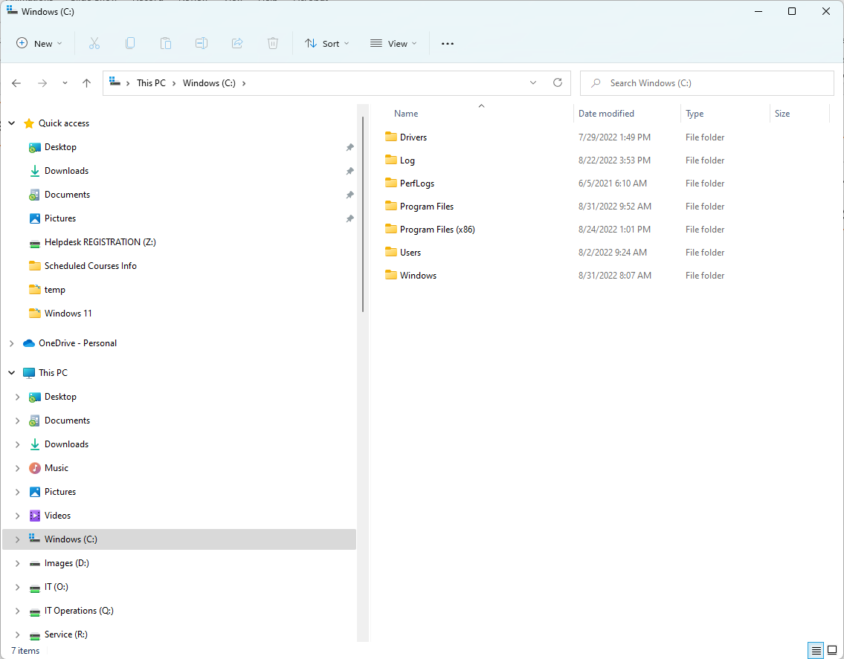
Navigating Windows – File Explorer - Parts
The Titlebar
File Explorer (Win + E)
The Ribbon
Drive & Folder Navigation
The Navigation Pane
The Files/Folders Pane
The File Explorer is the primary method Windows uses to display files & folders to which your computer has access; local hard drive files, network files, OneDrive files, external USB drive files and more.
Notes:
Question 4: What is the keyboard shortcut to open a File Explorer dialog? (Slide 18)
Answer 4: d. Windows Key + E

Slide 19
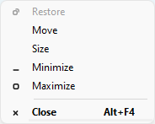
Navigating Windows – File Explorer - Titlebar
2. Current folder selected in the Navigation pane.
File Explorer (Win + E)
1. The window control (Alt + Spacebar)
The Titlebar has three items of interest …
3. Minimize, Maximize/Restore, Close

Slide 20
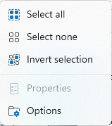
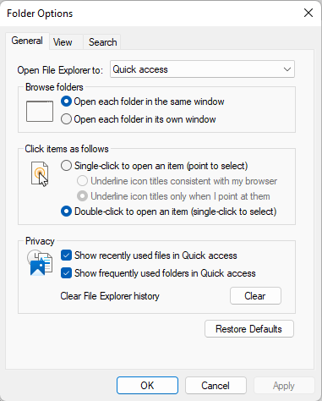
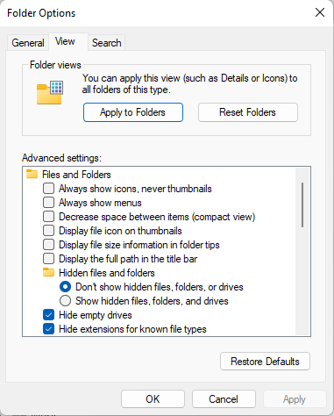
Navigating Windows – File Explorer - Ribbon
2. The Ribbon has
  Icons that perform functions such as …
  cut, copy, paste, rename, share, delete, sort, & view.
File Explorer (Win + E)
  1. The new icon lists items that can be created anew: a folder on the Navigation pane or a folder/file in the Folders/Files pane.

Slide 21
Navigating Windows – File Explorer – Navbars
Drive & folder navigation bar has three items of interest.
File Explorer (Win + E)
2. Address bar navigation.
Search bar. Searches the selected item’s folder and subfolders in the Navigation pane.
1. Folder history/recent locations/hierarchical navigation.

Slide 22
Navigating Windows – File Explorer – Navigation Pane
The Navigation pane has three general categories.
File Explorer (Win + E)
Quick Access links – These links are the common shortcuts.
You can add to these by dragging a folder & dropping it in the Quick Access area or delete it by right clicking on it.
OneDrive – This OneDrive link is most likely connected to your personal OneDrive but can also be a business OneDrive account.
This PC – First is listed the folders in your user profile, desktop,
documents, downloads, music, pictures & videos.
Second, the devices are listed: local storage drives.
Third, all physically attached drives, usually USB drives.
Fourth, all mapped network drives.
Fifth, the network link at the very bottom.

Slide 23
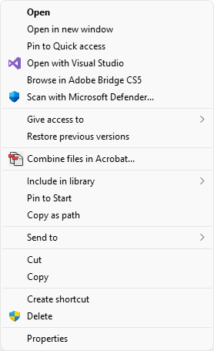
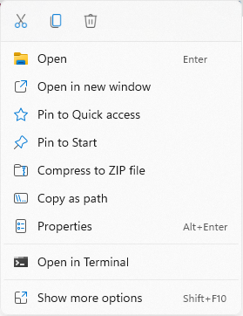
Navigating Windows – File Explorer – Navigation Pane
The File/Folder pane lists the contents of the drive/folder highlighted in the Navigation pane.
File Explorer (Win + E)
Right-clicking on a file or folder displays a context menu
… OR …
by pressing the
SHIFT-F10
keyboard combination

Slide 24
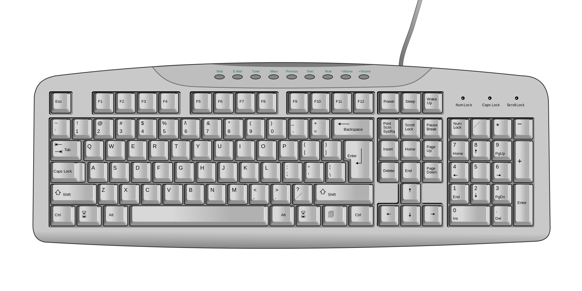
Navigating Windows – Using the Keyboard
Windows can be fully accessed solely by the keyboard alone.
A mouse is not required.
Insert/Delete
Home/End
Page Up/Page Down
Print Screen
Scroll Lock
Pause
Escape key
Programmable Function Keys
Standard typewriter
keyboard
Numeric Key Pad
Arrow Keys
The Standard keyboard

Slide 25

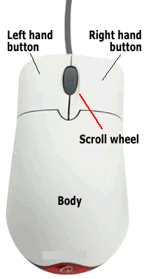





Navigating Windows – Using the Mouse
Even though you can navigate around in Windows without a mouse, it is much better to have a pointing device.
Link pointer - Click once on to open the link.
Regular pointer - Click once to select.
Horizontal resize pointer – Click, hold, and drag to resize.
Vertical resize pointer – Click, hold, and drag to resize.
Move pointer – Click, hold, and drag to move.
Wait pointer – This icon spins.
You can right-click on just about any object in Windows and get a context menu. Making use of those context menus can greatly increase your productivity when using the Windows operating system.

Slide 26
Navigating Windows – Using the Mouse
The basic rules with using a mouse.
1. Don’t double-click in a Web browser.
Links, buttons, tabs, toolbar icons,
and everything else you will find in
your web browser usually requires
only one click.
Rule of thumb – If you are unsure whether to single- or double-click, click once. Wait for a few seconds, and if it does not work, double-click.
2. Do double click program icons on your desktop and files / folders you want to open.
The hand icon means click once.
The arrow pointer means click once to select, twice to open/run.
3. You can right-click almost any item (icon, link, desktop, taskbar, etc.) and get a context menu of things you can do with that item.

Slide 27
Menus and Ribbons
Before 2007 menus were the method used by software that runs under Windows, but it was replaced with the Ribbon in 2007. However, much software still uses the menu system, which still works fine in Windows.
The first software that acquired ribbons was MS Office 2007.

Slide 28
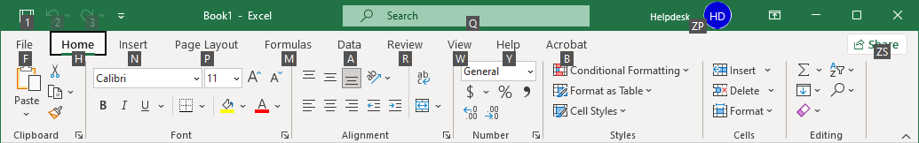
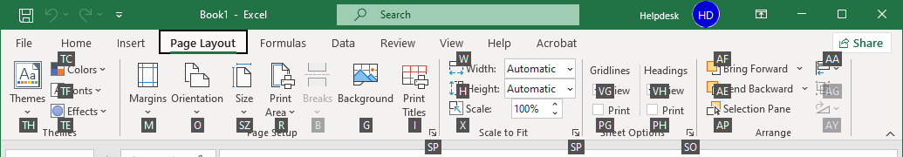
Menus and Ribbons - Navigating a Ribbon using the Keyboard
This ribbon is in Excel.
Alt – Touch the Alt key on the keyboard to gain access to the ribbon via the keyboard. You may have to press it twice depending on where the cursor is currently located.
Touch Esc on the keyboard to go back one level.
Notice the white letters in small black boxes.
Now touch the letter of the item you want.
P for the Page Layout ribbon, for example.
Now touch another letter (or two letters in some cases) to do that command or pull down a menu.
M for the Margins menu, for example.
Notes:
Question 5: Using the keyboard only, what key accesses the ribbon (select two)? (Slide 28)
Answer 5: b. ALT + R
c. ALT

Slide 29
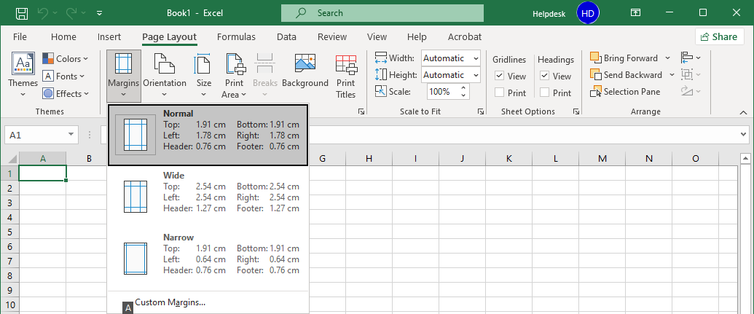
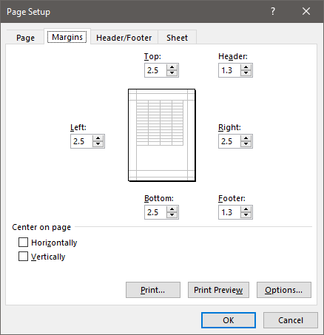
Menus and Ribbons - Navigating a Ribbon using the Keyboard
While in the menu, you can use the up/down arrow keys to select a command or touch the letter on the menu.
Touch Esc on the keyboard to go back one level.
In this example, press the letter A.
Which displays the Custom Margins dialog.

Slide 30
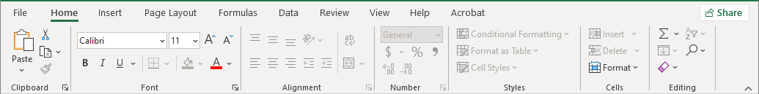
Menus and Ribbons - Navigating a Ribbon using the Mouse
A ribbon is a toolbar. It is ordered by labelled groups, such as “Clipboard”, “Font”, “Alignment”, “Number”, “Styles”, “Cells”, “Editing” as displayed on the Excel Home ribbon below.
Using the mouse is easier than the keyboard.
First click on the ribbon tab unless you are already in the ribbon.
Second, click on the command you require. That’s it.

Slide 31
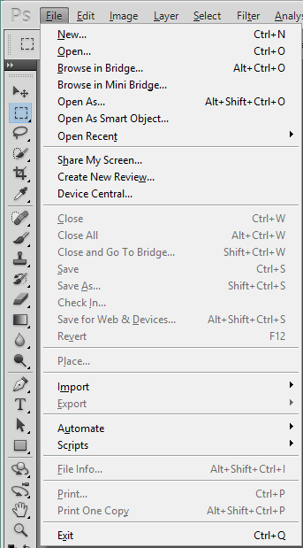
Menus and Ribbons - Navigating a Menu using the Keyboard or Mouse
Alt-E brings up the edit menu
Alt-I the image menu, etc.
Navigation in the menus
This is a menu bar from Adobe Photoshop CS5, created before ribbons were the norm; menus are still in use and are fully supported by Microsoft.
Arrow keys up and down.
Then press Enter to do that function.
Arrow keys right and left on sub-menus
Right arrow expands the sub-menu.
Shortcut keys (the underlined letters - New)
Press the Alt key to access this menu.
The File menu is the first on the left, so the Alt key pulls it up.
When viewing the menu, press the underlined key to do that command.
Hotkeys (e.g. Ctrl-N, Alt+Ctrl+O, etc.) Hotkeys are also available without using the menu.
And finally, you can just left click once with your mouse on the function you want.

Slide 32


Information Security
Safety, Backups & Best Practices
In today’s world of computer technology, keeping your information safe is
absolutely required!
With our information being recorded in government computers, by social networking apps, for banking, and much more, and while your information is conveniently available for you to use, it can also be available to anyone else if the proper steps are not taken to secure it.
Steps to take to maintain your privacy
Create a complex password
  Use upper and lower case letters
  Use a symbol or two
  Use one or more number
  Do not use names or words
  Do not use your phone number or any number that would easily be associated with you
Whenever you walk away from your computer, lock it.
(Windows Key) + L
2. Never share your password
An example might look like
qwer5POIU*
Notice how the keyboard can be used as a mnemonic?
The pattern on the keyboard, top left four keys, the 5 is near the “r”, the top right four keys all uppercase (so hold the Shift key while typing), the * is near the “u”.
Difficult to crack passwords can also be easy to remember when you
use something like the keyboard to help you remember.

Slide 33

Safety, Backups & Best Practices
Information Security
5. Always have installed an active Anti-Virus software package. Some common package names are:
Symantec’s Norton Anti-Virus
AVG Anti-Virus
McAfee Anti-Virus
Malwarebytes
BitDefender
Trend Micro
Windows Defender
Some of these companies have a free basic version you can download and install.
But it is still always better to buy the full anti-virus package.
4. Keep Windows updated
6.
Do not reply to emails unless you know who the sender is or you are expecting the email. Spam emails ask you to enter your information. Don’t. A legitimate organization will not solicit your information in that way.
Do not visit questionable websites.
Keep informed of security risks. Often your anti-virus software will inform you of threats.

Slide 34
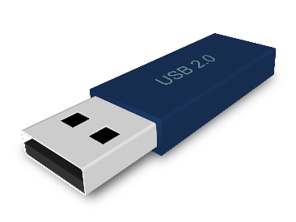
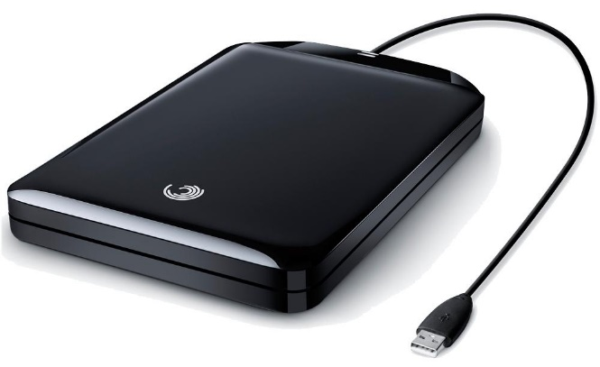

Backup Security
Safety, Backups & Best Practices
A USB drive is the most common method of backup today.
Though the physical size stays about the same (picture is full size), the data that it can hold is up to 16,000 Gigabyte (16 Terabyte).
Backup your data!
Though this is technically not a security issue, it is an
“Oh No! Now what do I do?”
issue.
Few things are worse than losing of all your important documents.
The image above is a portable hard drive. This image is not full size.
They are about 4” X 5.5” X 0.75”
The largest capacity affordable portable hard drive (at the time of this writing) is about 16 Terabyte (11,000 Gigabyte).
Some Backup software names
Acronis True image
Norton 360
Dropbox

Slide 35
Safety, Backups & Best Practices
Don’t open email that you are not expecting or are not sure about.
If you have a question about a supposed breach in an email about the security on a website you use, do not click on the link in the email. Go to the website by typing in the hyperlink into the browser address bar.
Don’t visit questionable websites.
Be careful about installing software downloaded from the Internet unless you are sure it does not contain a virus.
Scan downloaded software for viruses (Right-click the file, choose More Options, Scan for Viruses with Defender.)
Always backup your data on a regular basis.
Keep more than one complex password memorized and use them for different situations.

Slide 36
We have covered here in this course …
Windows GUI – Identifying the Parts of Windows
Login Slide 15
Desktop Slide 21
Taskbar Slide 22
Start Menu Slide 23
Navigating Windows - Finding the Files You Need
File Explorer Slide 29
Keyboard & Mouse Slide 35
Menus and Ribbons Slide 38
Safety, Backups & Best Practices

Slide 37
NITHA IT Helpdesk
helpdesk@nitha.com
1(306)953-5008

Slide 38

Thank you

