Slide 1


Windows 10 Basics
Entry Level

Slide 2

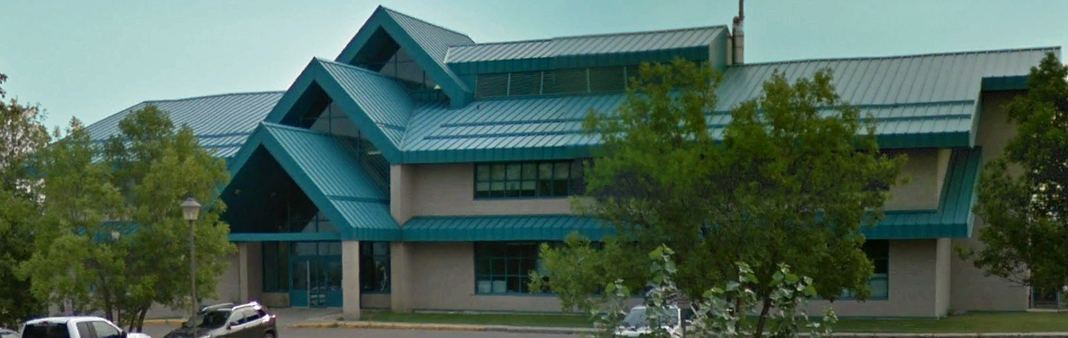

NITHA IT Helpdesk
helpdesk@nitha.com
1(844)486-4842

Slide 3
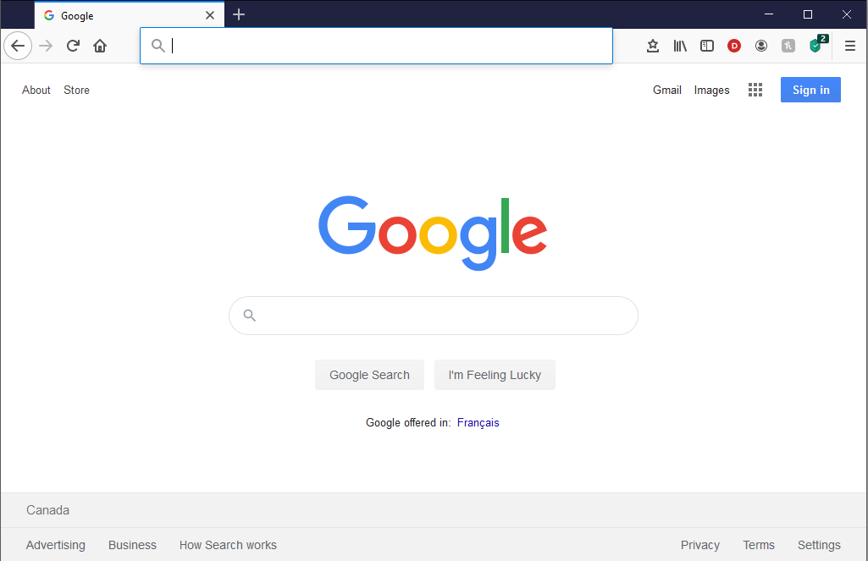
NITHA - IT Helpdesk Courses Registration Website
How do I get to the Courses Registration Website?
First, open up your favorite web browser.
Finally, press ENTER on our keyboard
Second, type in the address bar the URL, nitha.com/courses

Slide 4
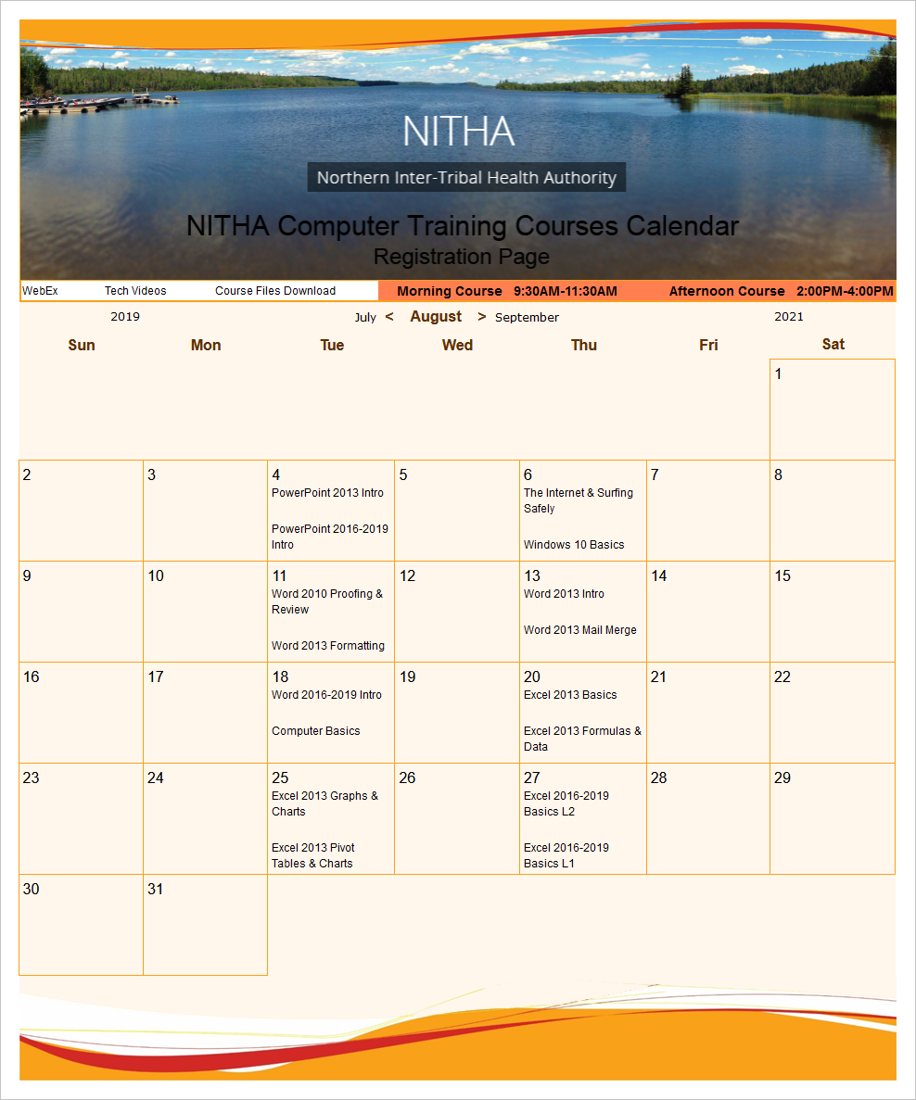
NITHA - IT Helpdesk Courses Registration Website
The NITHA Computer Training Courses Calendar
There are four sections to the
IT Helpdesk Courses Registration Website
The calendar – As seen on the right,
the calendar displays the selected month and all the course links on the appropriate days.
Morning courses 9:30 AM to 11:30 AM
Afternoon courses 2:00 PM to 4:00 PM

Slide 5
NITHA - IT Helpdesk Courses Registration Website
Cycle forward through the months by clicking on the next month
The NITHA Computer Training Courses Calendar
Cycle backward through the months by clicking on the previous month
And of course, the month in the middle is the currently displayed month.

Slide 6
NITHA - IT Helpdesk Courses Registration Website
or the next year
The NITHA Computer Training Courses Calendar
You can even click on the previous year

Slide 7
NITHA - IT Helpdesk Courses Registration Website
The NITHA Computer Training Courses Calendar
Click on the course link of your choice and you will be taken to a registration page.

Slide 8

NITHA - IT Helpdesk Courses Registration Website
The NITHA Computer Training Course Registration page
Enter your information
Select how you are going to attend the course
by WebEx
by Telehealth
Select how you want your Certificate of Completion delivered.
by Email as a PDF
by Canada Post

Slide 9
NITHA - IT Helpdesk Courses Registration Website
The NITHA Computer Training Courses WebEx Info
WebEx Information – For the WebEx connection information on how to attend the courses in the current week, click on the WebEx link.

Slide 10

NITHA - IT Helpdesk Courses Registration Website
The NITHA Computer Training Courses Calendar
These links display the WebEx information for that course
These links download the ICS file for that course so that you can add it to your Outlook calendar as an event.

Slide 11
NITHA - IT Helpdesk Courses Registration Website
The NITHA Computer Training Courses Download
Course Files Download – The courseware and the data files which are used in the courses are all available for download any time whether or not you are taking the course.
click on the Course Files Downloads link
To download the
Courseware file (A PowerPoint file)
and/or
Sample data files used in the course

Slide 12

NITHA - IT Helpdesk Courses Registration Website
The NITHA Computer Training Courses Calendar
The Course Sample File is the data file used in the course.
The PowerPoint Courseware File is the course itself.

Slide 13
NITHA - IT Helpdesk Courses Registration Website
The NITHA Computer Training Courses Calendar
Tech Videos are the fourth section of the website. As they are created, they will be placed here.
Tech Videos are short 3 to 15 minute videos featuring solutions to various tech issues.

Slide 14

What will we be covering in this course?
Windows GUI – Identifying the Parts of Windows
Login Slide 15
Desktop Slide 21
Taskbar Slide 22
Start Menu Slide 26
Navigating Windows – File Explorer - Parts
File Explorer Slide 29
Keyboard & Mouse Slide 37
Menus and Ribbons Slide 38
Safety, Backups & Best Practices Slide 42

Slide 15
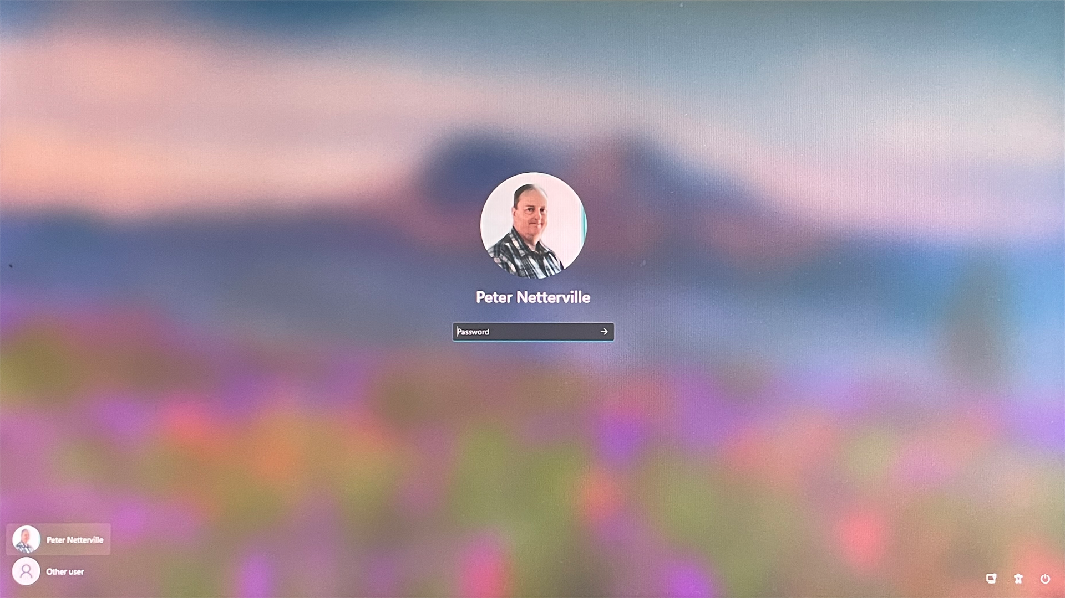


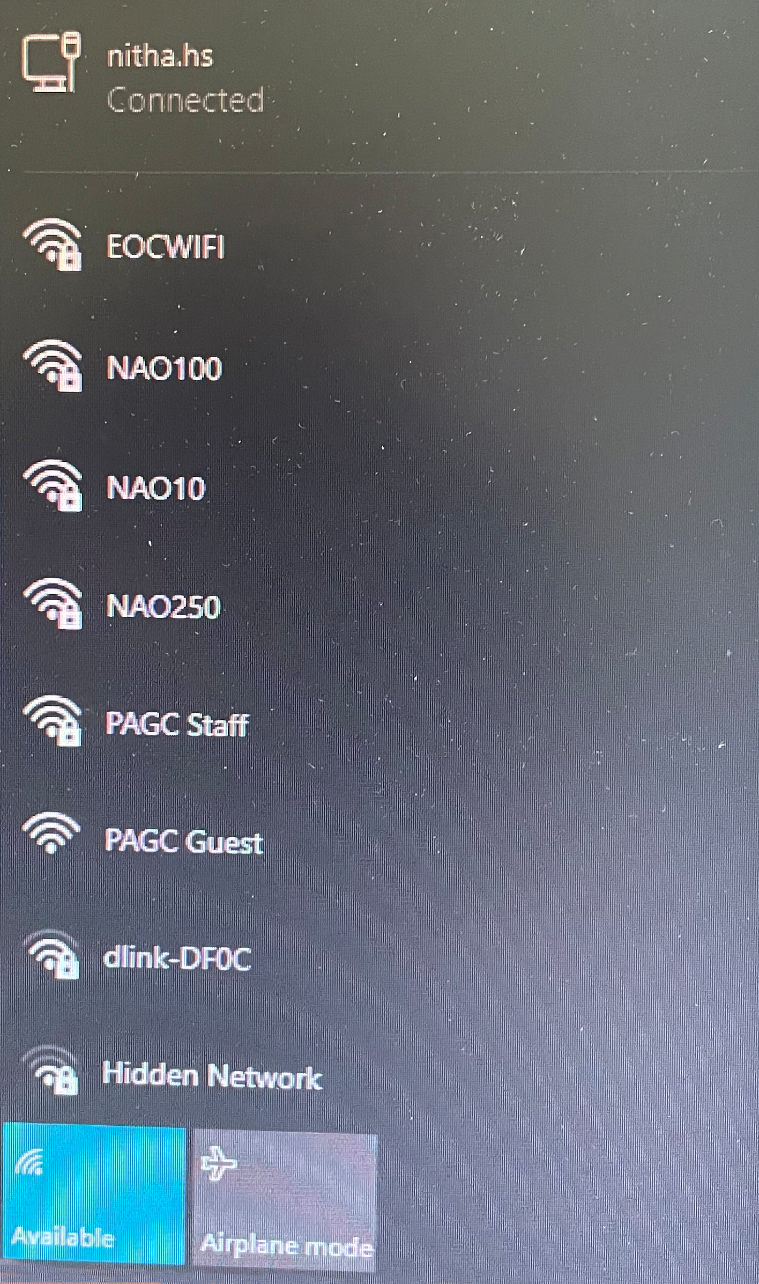
Windows GUI – Login
= Wired Network Connection
= Wireless Network Connection
If not connected, choose a network connection and, if needed (if it is a wireless connection), enter your username and password for the network connection, not your domain username and password. That comes next.
Before logging in to your domain profile, check your network connection to make sure you are connected.

Slide 16
Windows GUI – Login
When logging in to Windows you select a user shown on the bottom left of the screen and type in your password.
If your user profile is not listed at the bottom left of the screen then …

Slide 17
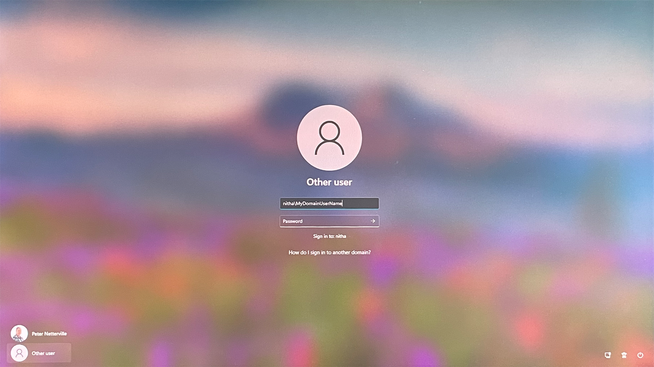
Windows GUI – Login
… then just enter your domain username in the field provided.
The user name is that part before the @ sign of your email address.
However, if your domain is not displayed then you must enter it before your username as shown here.
nitha\
NITHA is our domain name. Your domain will be different.
… then select Other User which displays …
If your domain is shown here …

Slide 18
Windows GUI – Login
This icon represents accessibility options for disabled people.
This icon presents a menu which allows you to shut down the computer.
This icon represents your connection to a network.

Slide 19
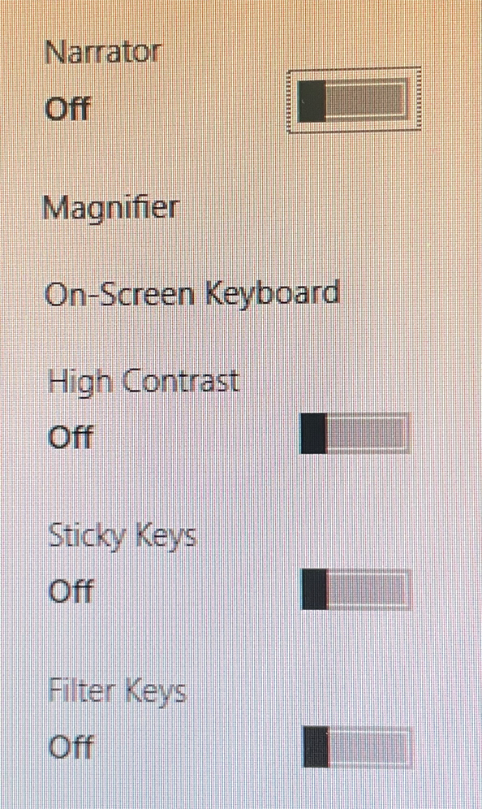
Windows GUI – Login
Disability options.

Slide 20
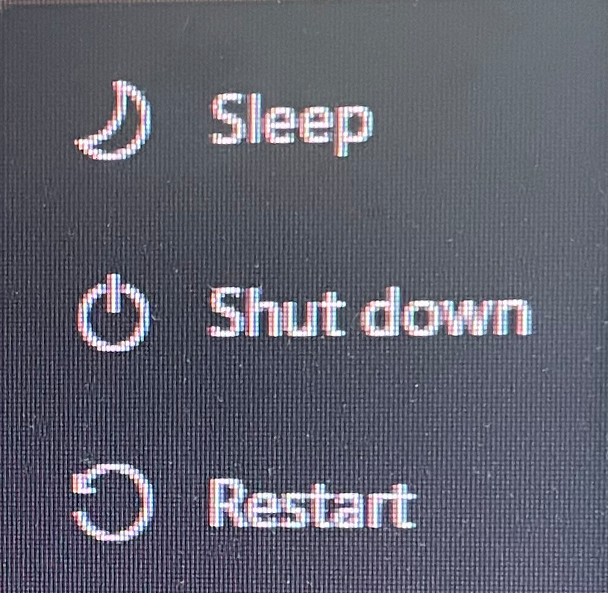
Windows GUI – Login
Power options.

Slide 21
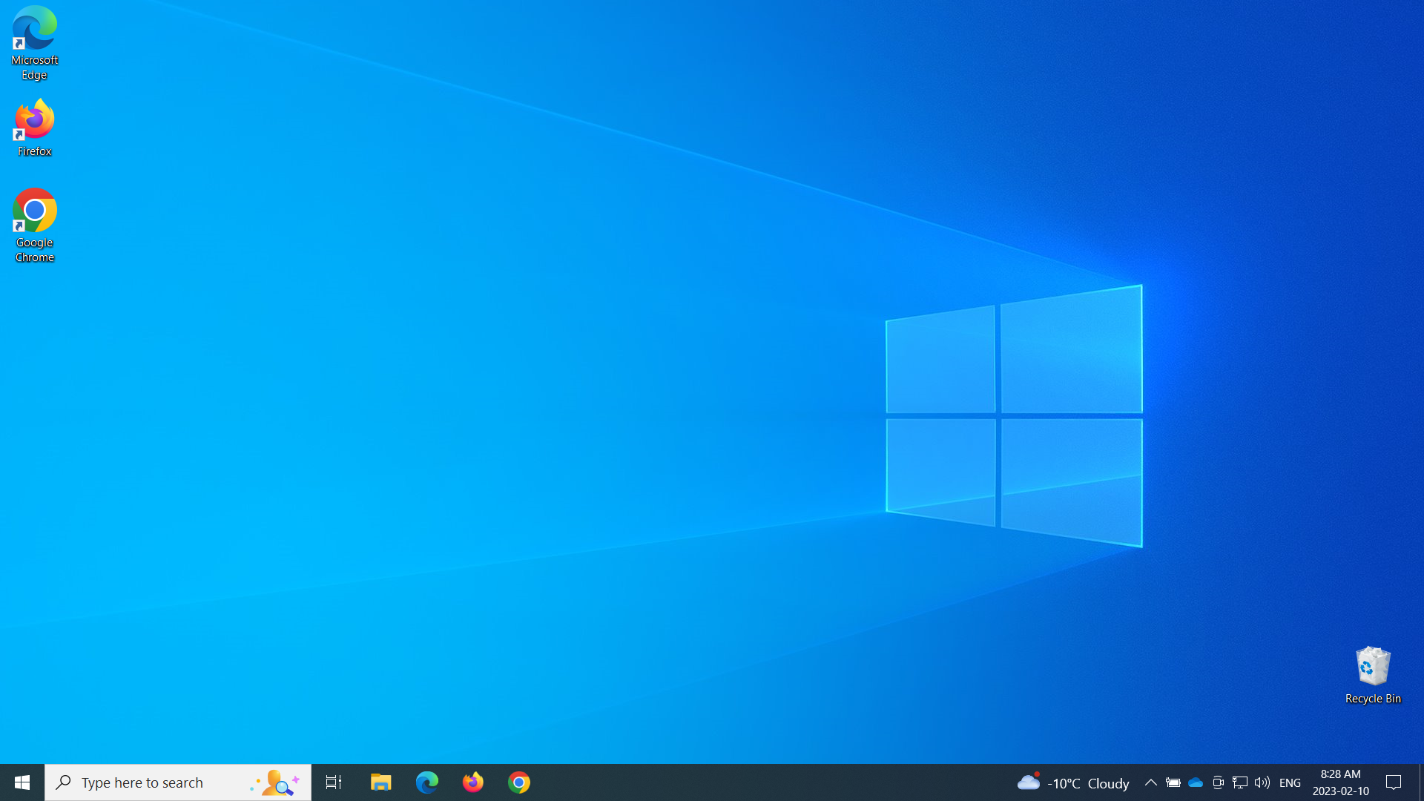
Windows GUI – Desktop
The desktop is what you see once you have logged in.
The desktop contains four item types:
The taskbar.
Shortcuts to various files and hyperlinks.
Trash can.
The background.
2. On the desktop you can place files, shortcuts, and hyperlinks.
1. The desktop, a folder in your profile, is the entire screen with a taskbar along the bottom.
3. Every desktop also has a trash can.
Files in the trash can still be recovered; but empty the trash and the file(s) are gone.

Slide 22

Windows GUI – Taskbar
The taskbar is by default along the bottom of the screen.
The taskbar contains
Start button
Search
Virtual Desktop
Shortcut icons / running programs
System Notification Area
3. Virtual Desktop
2. The Search box
4. Shortcut icons / running programs
1. The Start button
When the application is running you will see a line under the app icon.
5. System Notification Area

Slide 23
Windows GUI – Taskbar
This icon is the Virtual Desktop button.
A Virtual Desktop creates another desktop which shows no open programs from any other desktop so you can keep your desktop from getting too cluttered. It can help you to organize yourself.
CTRL + Win + Right arrow or Left arrow switches between desktops.
The Search icon pulls up the start menu and places the cursor in the Search field.
Shortcut icons / running programs.
When an app is running, there is a line under the icon.
Pinned items on the Taskbar remain even when not running, but the underline disappears.

Slide 24
Windows GUI – Taskbar
The Network icon opens the network connection dialog.
This is the Skype Meet Now app.
The cloud icon represents your personal or business OneDrive.
The battery icon lets you know the status of the battery.
The system tray contains icons of apps that are running but typically have no user interface, but still are required apps.
Current News applet.

Slide 25
Windows GUI – Taskbar
There is a small sliver of an icon on the far right hand side of the taskbar that minimizes all windows and then when clicked again restores the windows back to where they were before. This is handy if you want to view your desktop but not be required to minimize the windows to see the desktop.
The notifications icon allows you access the messages sent by apps or from Windows.
The date/time icon is where you change the time, time zone, and more.
The keyboard icon lets you change the keyboard character set to a different language.
The sound icon allows you change your sound device as well as set volume for all the apps you have running that have sound capability.

Slide 26
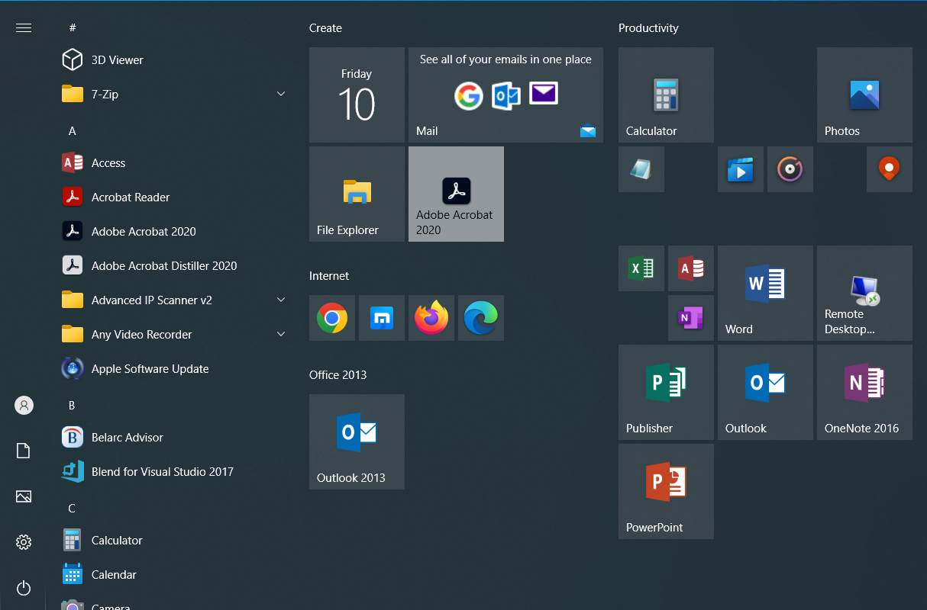
Windows GUI – Taskbar – Start Menu
The Start Button displays the Start Menu.
Left click on the Start Button or tap the Windows key. The CTRL-ESC button will also open the Start Menu.
Items of interest on the Start Menu include …
2. A list of all the installed apps.
3. Pinned shortcuts to apps from the list of all installed apps. Some default apps are listed here, but mostly you add to this list yourself.
1. The Search bar looks for files on the computer but if unsuccessful it then searches the Internet.

Slide 27
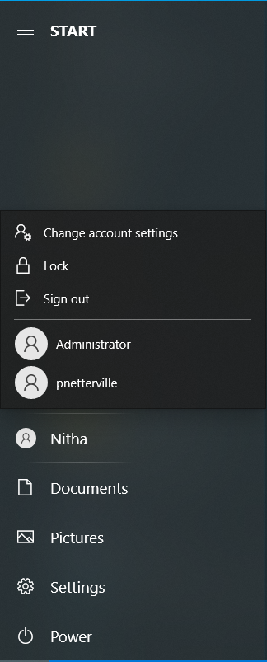
Windows GUI – Taskbar – Start Menu
The Start Button displays the Start Menu.
Signing out will shut down your running apps and log you out of your profile.
This option allows you to set or reset options in your account. The options will not be covered here.
Click to open your account profile.
Locking your profile sets the screen back to the login, but does not sign you out, so your programs will still be running when you sign in again. You can use the Win + L keyboard combination to lock your workstation instead if you prefer.
Switching user will leave your apps running as you left them, then loads the new user profile. This can consume much memory.
Your user profile folders.
All system settings are accessed from this link.

Slide 28
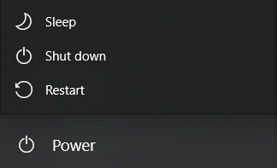
Windows GUI – Taskbar – Start Menu
The Start Button displays the Start Menu.
Sleep mode stores in memory and uses a small amount of constant power in the process, eventually draining your battery if left long enough in Sleep mode.
Just as a comparison to sleep mode, hibernation mode is basically the same as sleep mode but it saves the information to your hard drive instead, which allows your computer to be turned off entirely and uses no energy.
Shut down does exactly what is says.
Restart logs you out of your profile and restarts the computer, but does not reload the BIOS. The BIOS is what tells Windows what hardware is connected and what its’ settings are.

Slide 29

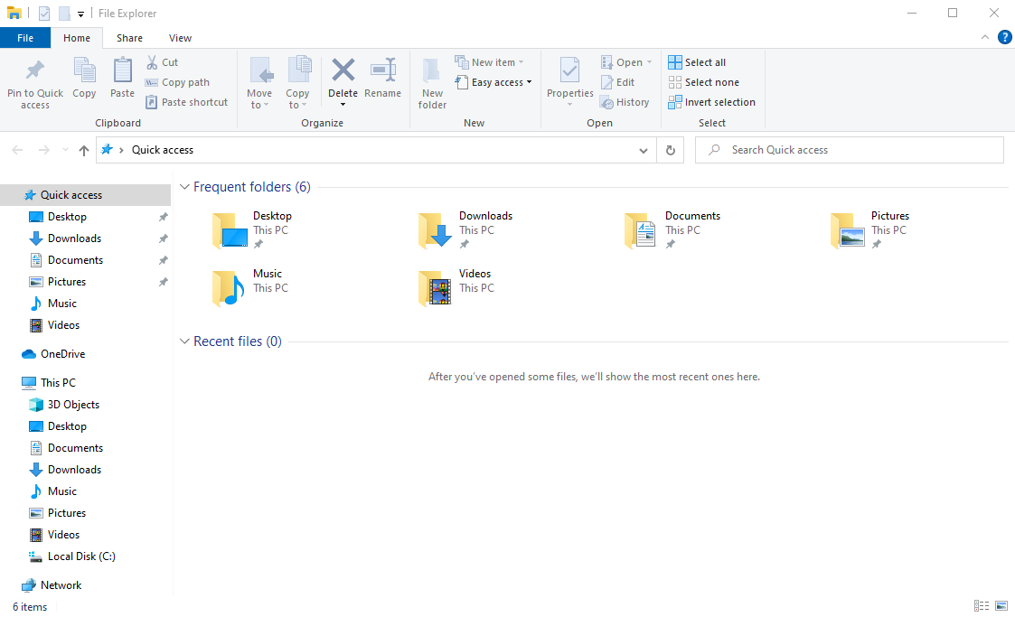
Navigating Windows – File Explorer - Parts
The Title Bar
File Explorer (Win + E)
The Ribbon
Drive/Folder Navigation
The Navigation Pane
The Files/Folders Pane
The File Explorer is the primary method Windows uses to display files & folders to which your computer has access; local hard drive files, network files, OneDrive files, external USB drive files and more.

Slide 30
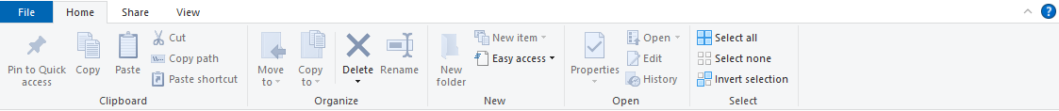
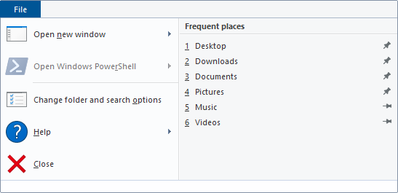
Navigating Windows – File Explorer – Home Ribbon
Groups are separated by a light gray vertical line
File Explorer (Win + E)
Home tab
Group names
Ribbon commands
File menu

Slide 31
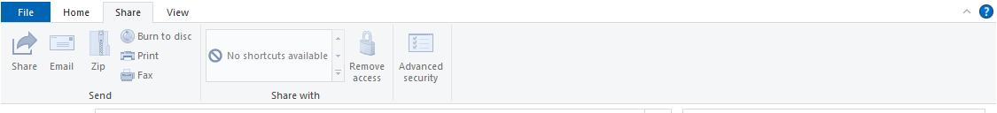
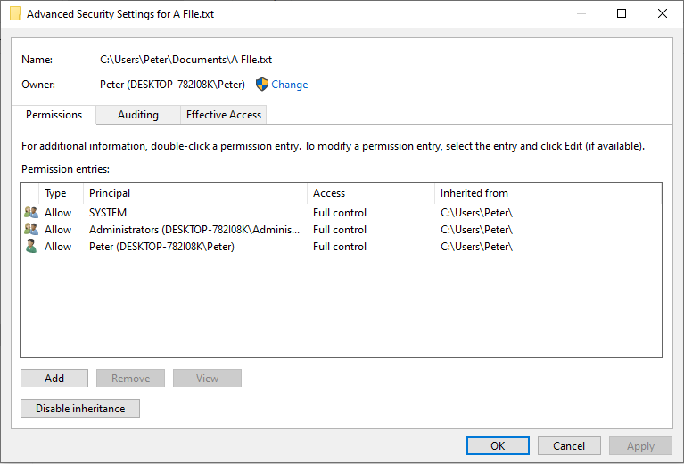
Navigating Windows – File Explorer – Share Ribbon
File Explorer (Win + E)
Share Tab
Send the currently selected file(s) by share to OneDrive, Email, Compress to Zip file, Burn to CD/DVD, Print, or Fax
Share the current selected file with those listed.
Advanced Security for selected file(s).

Slide 32
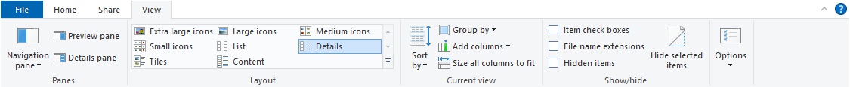
Navigating Windows – File Explorer – View Ribbon
File Explorer (Win + E)
View Tab
Set how the Navigation pane, Preview pane, and the Details pane are placed on the screen
Choose with what format you wish to view the files.
More option on the layout of the files.
Here are some of the more common options.
This drop down menu offers all the file explorer option.

Slide 33
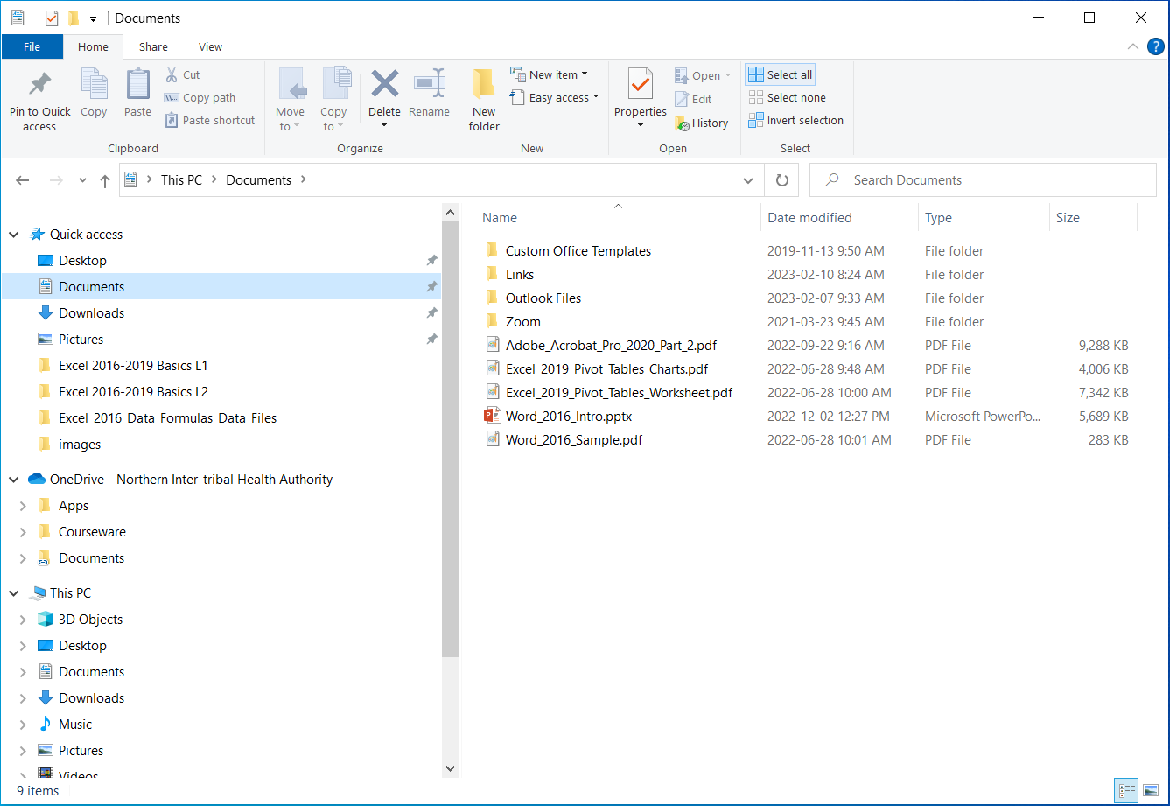
Navigating Windows – File Explorer – Navbars
Drive & folder navigation bar has seven items of interest.
File Explorer (Win + E)
1. Folder history, similar to web browser history
2. Recent locations
3. Hierarchical navigation
7. Search bar. Searches the folder and subfolders of the item(s) selected in the Navigation pane for your search string.
4. Address bar navigation
5. Previously visited history
6. Refresh File Explorer

Slide 34
Navigating Windows – File Explorer – Navigation Pane
The Navigation pane has three general categories.
File Explorer (Win + E)
Quick Access links – These links are the common shortcuts.
You can add to these by dragging a folder & dropping it in the Quick Access area or delete the shortcut by right clicking on it and selecting Delete from the Context menu. Keyboard “right click” is SHIFT-F10.
OneDrive – This OneDrive link is most likely connected to your business OneDrive but can also be a personal OneDrive account.
This PC – First is listed the folders in your user profile, desktop,
documents, downloads, music, pictures & videos.
Second, the devices are listed; local storage drives.
Third, all physically attached drives, usually USB drives.
Fourth, all mapped network drives.
Fifth, the network link at the very bottom.

Slide 35
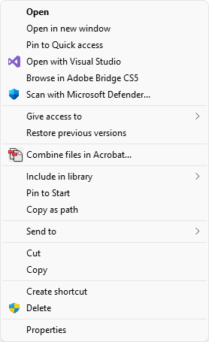
Navigating Windows – File Explorer – Files/Folders Pane
The File/Folder pane lists the contents of the drive/folder highlighted in the Navigation pane.
File Explorer (Win + E)
Right clicking on a file or folder displays a context menu
… OR …
by pressing the
SHIFT-F10
keyboard combination when the object is selected.
The context menu of the selected file/folder will be displayed.

Slide 36
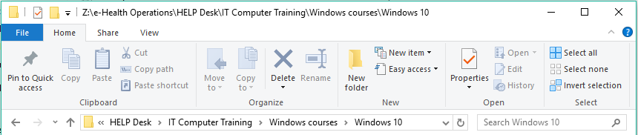
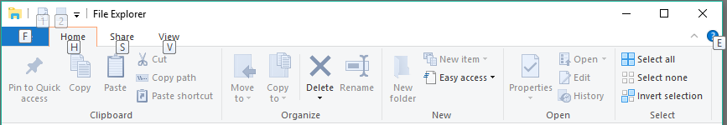
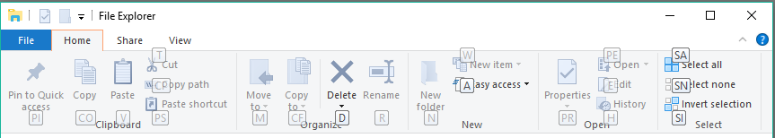
Navigating Windows – Using the Keyboard
A ribbon is a toolbar.
It is ordered by labelled groups, such as “Clipboard”, “Organize”, “New”, “Open”, and “Select” as displayed on the File Explorer ribbon below.
File Explorer Ribbon
To use the keyboard to access the menu, quickly press and release the Alt key.
Then you will see a letter in a little box for each available sub-ribbon item, such as for the Home tab. So press the H key on the keyboard and …
Now you have a letter box for each function on the Home tab. This pattern follows for further sub-functions. Where there are two letter boxes, such as ,
then touch S, then A. Easy keyboard navigation.
So, you can use the keyboard to navigate Windows if you wish, you do not require a mouse.

Slide 37
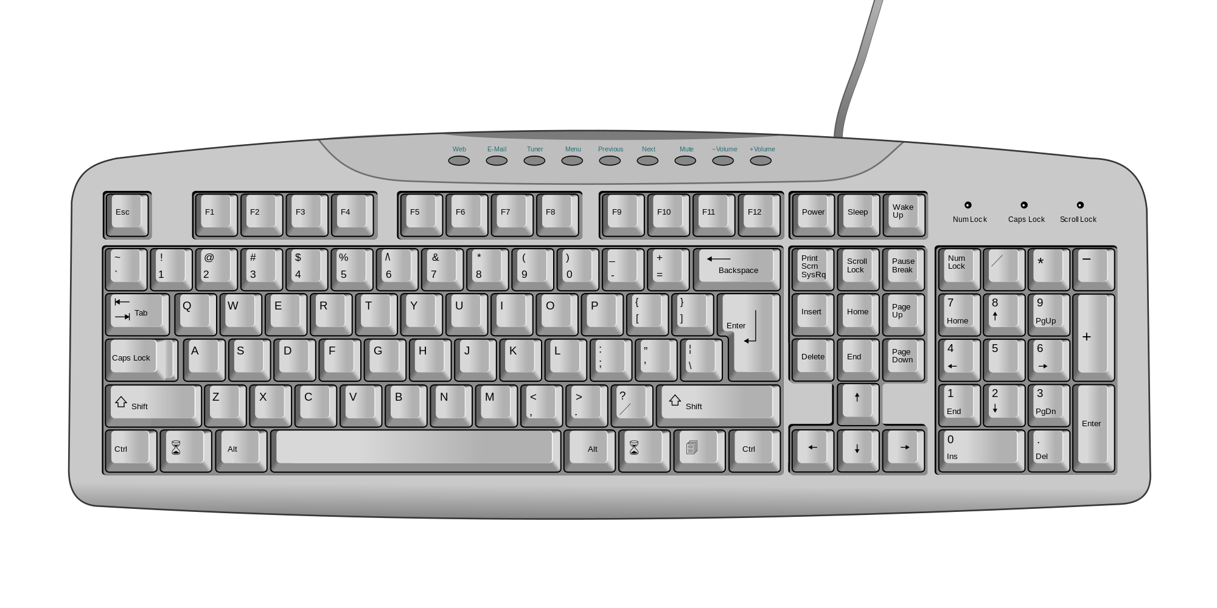
Navigating Windows – Using the Keyboard
Windows can be fully accessed solely by the keyboard alone.
A mouse is not required.
Insert/Delete
Home/End
Page Up/Page Down
Print Screen
Scroll Lock
Pause
Escape key
Programmable Function Keys
Standard typewriter
keyboard
Numeric Key Pad
Arrow Keys
The Standard keyboard

Slide 38

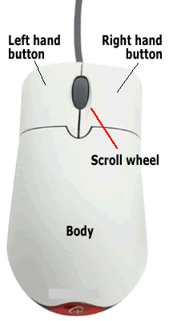





Navigating Windows – Using the Mouse
Even though you can navigate around in Windows without a mouse, it is much better to have a pointing device.
Link pointer - Click once on to open the link.
Regular pointer - Click once to select. Twice to open.
Horizontal resize pointer – Click, hold, and drag to resize.
Vertical resize pointer – Click, hold, and drag to resize.
Move pointer – Click, hold, and drag to move.
Wait pointer – This icon spins.
You can right click on just about any object in Windows and get a context menu. Making use of those context menus can greatly increase your productivity when using the Windows operating system.

Slide 39
Navigating Windows – Using the Mouse
The basic rules with using a mouse.
1. Don't double click in a Web browser.
Links, buttons, tabs, toolbar icons,
and everything else you will find in
your web browser usually requires
only one click.
Rule of thumb – If you are unsure when to single or double click, then click once. Wait for a few seconds, and if it does not work, double click.
2. Do double click program icons on your desktop and files / folders you want to open.
The hand icon means click once.
The arrow pointer means click once to select, twice to open/run.
3. You can right click almost any item (icon, link, desktop, taskbar, etc.) and get a context menu of things you can do with that item.

Slide 40
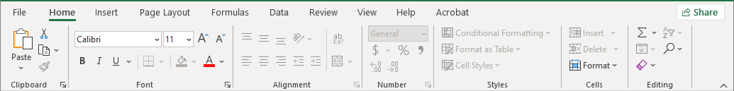
Menus and Ribbons - Navigating a Ribbon using the Mouse
A ribbon is a toolbar. It is ordered by labelled groups, such as “Clipboard”, “Font”, “Alignment”, “Number”, “Styles”, “Cells”, “Editing” as displayed on the Excel Home ribbon below.
Using the mouse is easier than the keyboard.
First click on the ribbon tab unless you are already in the ribbon.
Second, click on the command you require. That’s it.

Slide 41
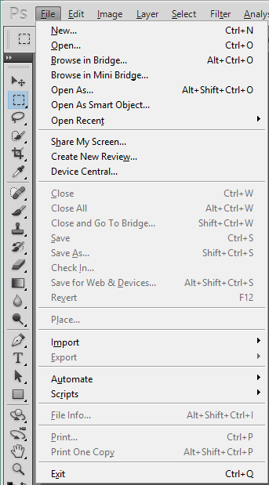
Menus and Ribbons - Navigating a Menu using the Keyboard
Alt-E brings up the edit menu
Alt-I the image menu, etc.
Navigation in the menus
This is a menu bar from Adobe Photoshop CS5, created before ribbons were the norm, however menus are still in use and are fully supported by Microsoft.
Arrow keys up and down.
Then press Enter to do that function.
Arrow keys right and left on sub-menus
Right arrow expands the sub-menu.
Shortcut keys (the underlined letters - New)
Press the Alt key to access this menu.
The File menu is the first on the left, so the Alt key pulls it up.
When viewing the menu, press the underlined key to do that command.
Hotkeys (e.g. Ctrl-N, Alt+Ctrl+O, etc.) Hotkeys are also available without using the menu.
And finally, you can just left click once with your mouse on the function you want.

Slide 42


Information Security
Safety, Backups & Best Practices
In today’s world of computer technology, keeping your information safe is
absolutely required!
With our information being recorded in government computers, by social networking apps, for banking, and much more, and while your information is conveniently available for you to use, it can also be available to anyone else if the proper steps are not taken to secure it.
Steps to take to maintain your privacy
Create a complex password
  Use upper and lower case letters
  Use a symbol or two
  Use one or more number
  Do not use names or words
  Do not use your phone number or any number that would easily be associated with you
Whenever you walk away from your computer, lock it.
(Windows Key) + L
2. Never share your password
An example might look like
qwer5POIU*
Notice how the keyboard can be used as a mnemonic?
The pattern on the keyboard, top left four keys, the 5 is near the “r”, the top right four keys all uppercase (so hold the Shift key while typing), the * is near the “u”.
Difficult to crack passwords can also be easy to remember when you
use something like the keyboard to help you remember.

Slide 43

Safety, Backups & Best Practices
Information Security
5. Always have installed an active Anti-Virus software package. Some common package names are:
Symantec’s Norton Anti-Virus
AVG Anti-Virus
McAfee Anti-Virus
Malwarebytes
BitDefender
Trend Micro
Windows Defender
Some of these companies have a free basic version you can download and install.
But it is still always better to buy the full anti-virus package.
4. Keep Windows updated
6.
Do not reply to emails unless you know who the sender is or you are expecting the email. Spam emails ask for you to enter your information. Don’t. A legitimate organization will not solicit your information in that way.
Do not visit questionable websites.
Keep informed of security risks. Often your anti-virus software will inform you of threats.

Slide 44
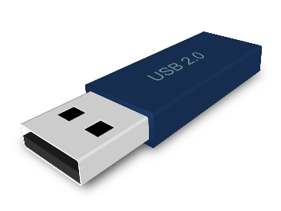
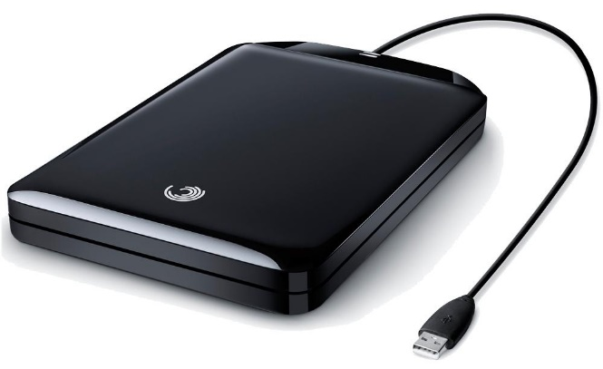

Backup Security
Safety, Backups & Best Practices
A USB drive is the most common method of backup today.
Though the physical size stays about the same (picture is full size), the data that it can hold is up to 8,000 Gigabyte (8 Terabyte), though they are ridiculously expensive.
Backup your data!
Though this is technically not a security issue, it is an
“Oh No! Now what do I do?”
issue should you lose your files.
Few things are worse than losing of all your important documents.
The image above is a portable hard drive. This image is not full size.
They are about 4” X 5.5” X 0.75”
The largest capacity affordable portable hard drive (at the time of this writing) is about 16 Terabyte (11,000 Gigabyte).
Some Backup software names
Acronis True image
Norton 360
Dropbox

Slide 45
Safety, Backups & Best Practices
Don’t open email that you are not expecting or are not sure about.
If you have a question about a supposed breach in an email about the security on a website you use, do not click on the link in the email. Go the website by typing in the hyperlink into the browser address bar.
Don’t visit questionable websites.
Be careful about installing software downloaded from the Internet unless you are sure it does not contain a virus.
Scan downloaded software for viruses (Right click the file, choose to scan for viruses with Defender.)
Always backup your data on a regular basis.
Keep more than one complex password memorized and use them for different situations.

Slide 46
We have covered here in this course …
Windows GUI – Identifying the Parts of Windows
Login Slide 15
Desktop Slide 21
Taskbar Slide 22
Start Menu Slide 26
Navigating Windows – File Explorer - Parts
File Explorer Slide 29
Keyboard & Mouse Slide 37
Menus and Ribbons Slide 38
Safety, Backups & Best Practices Slide 42

Slide 47
NITHA IT Helpdesk
helpdesk@nitha.com
1(844)486-4842

Slide 48


