Slide 1


PowerPoint 2021 Intro
Entry Level

Slide 2
NITHA IT Helpdesk
helpdesk@nitha.com
1(306)953-5008

Slide 3

What will we be covering in this course?
Opening a PowerPoint Project Slide 15
Parts of PowerPoint Slide 19
Objects Slide 34
Adding Content and Formatting Slide 49
Adding Animation Slide 52
Adding Transitions Slide 61
Slide Show Ribbon Slide 62
Slide

Slide 4
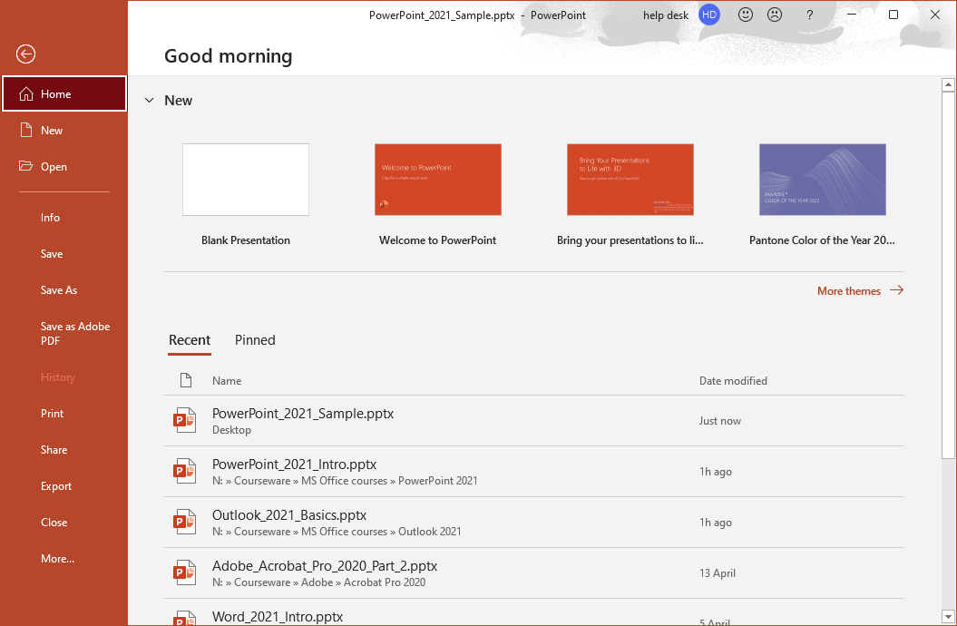
Opening a PowerPoint Project
This section is where you can choose a template theme with which to start your project.
When you first start PowerPoint this is the screen you will see.
To start a new presentation, click on Blank Presentation.
Since you have not opened this link then click on the Open the navigation panel link instead.
In this case open the PowerPoint_2021_Sample.pptx.
This link exists here, in the Recent list, because it was loaded it earlier.
Slide

Slide 5
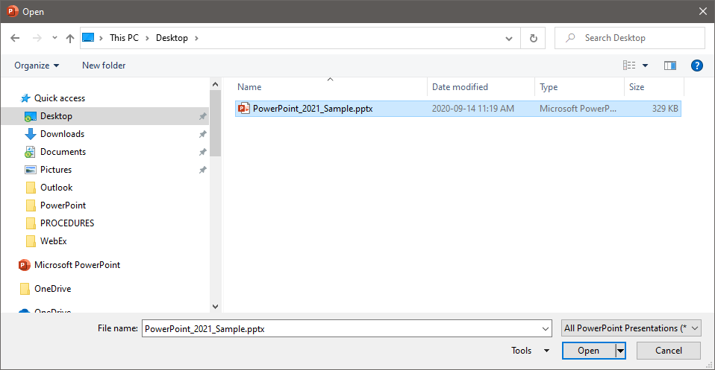
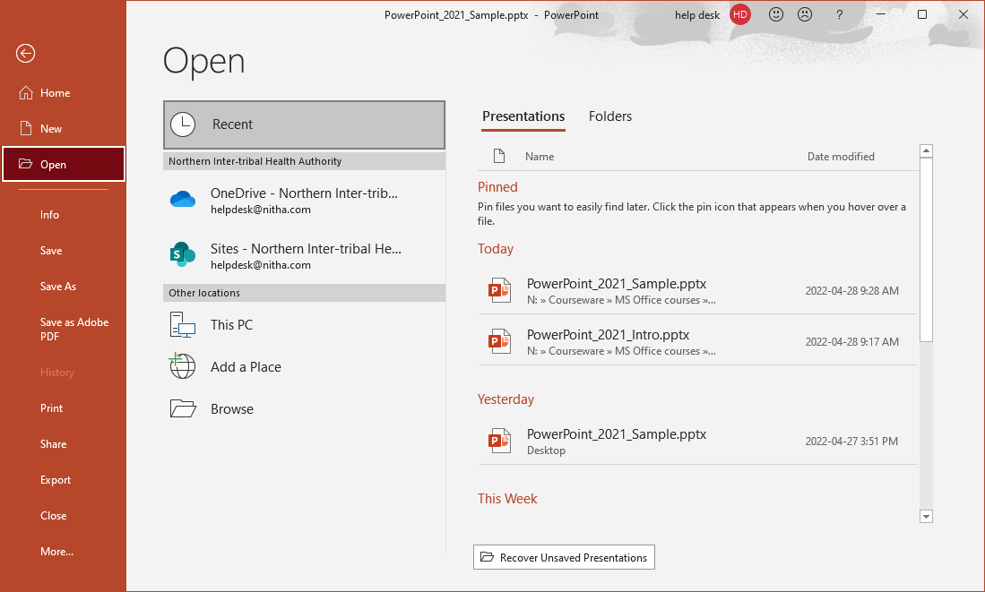
Opening a PowerPoint Project
Select the file and click on Open.
Click on Browse to view your storage devices or another location to find the file. In this case it is available on the desktop.
Slide

Slide 6
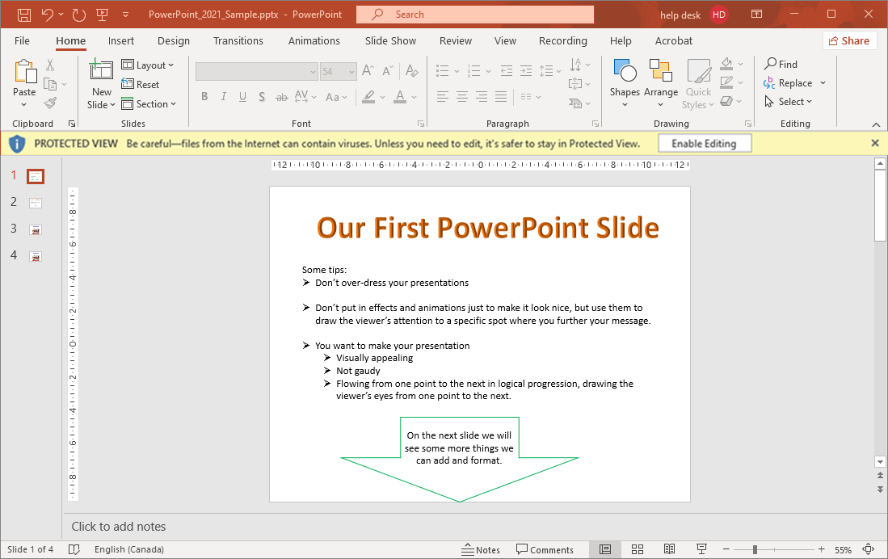
Opening a PowerPoint Project
If you see this Protected View bar, click on Enable Editing
Slide

Slide 7
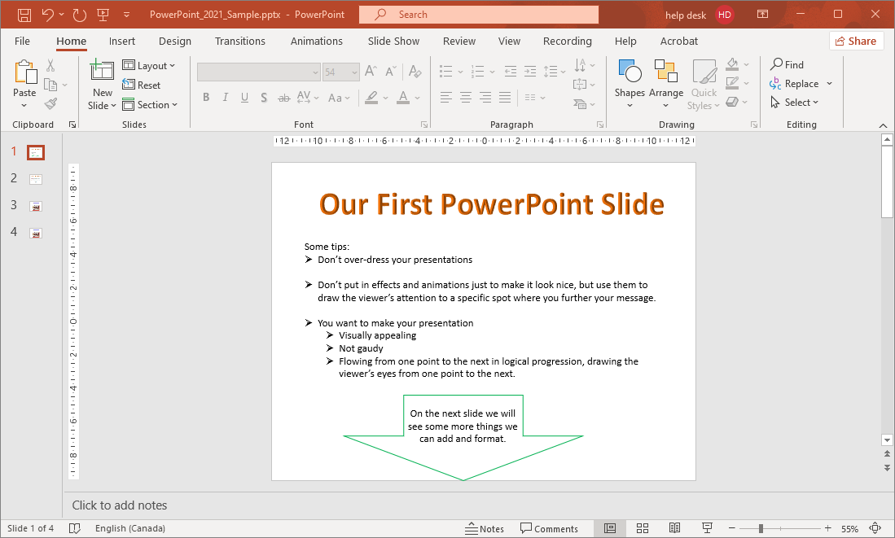
Opening a PowerPoint Project
This is what you should see.
Slide

Slide 8
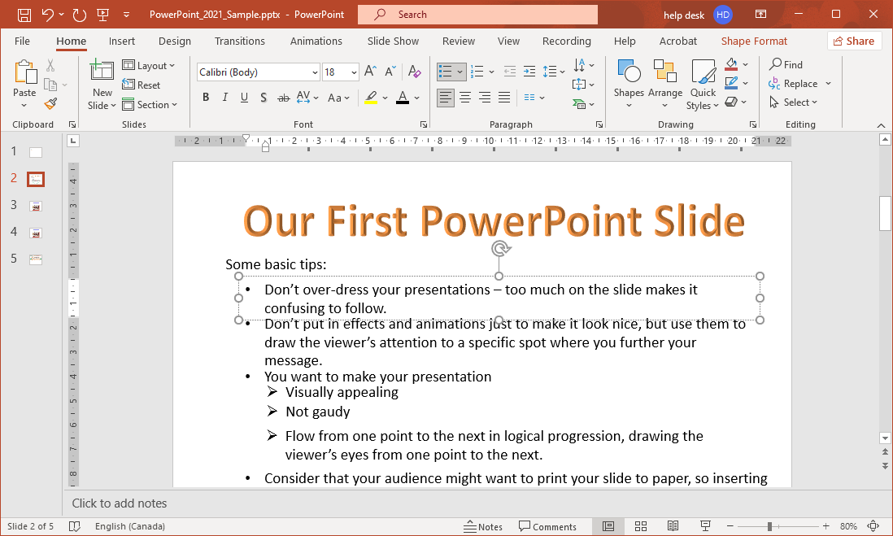
Parts of PowerPoint - Titlebar
There are six items on the Titlebar that are of interest.
1. The Quick Access Toolbar
2. The current file name.
3. Search bar.
4. Account Management.
5. Ribbon Control.
6. Minimize
Maximize/Restore
Exit
Slide

Slide 9
Parts of PowerPoint - Ribbon
There are four items of interest on the Ribbon.
1. Ribbon tabs
2. Commands
3. Group Names
4. Dialog Box Launcher
Slide

Slide 10
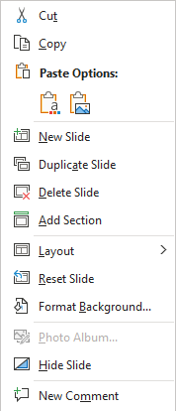
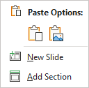
Parts of PowerPoint - Navigation Panel
There are three points of interest on the Navigation Panel.
1. The slides.
This is where you can select the slide upon which you craft your message.
Right-click
3. Right-clicking the panel where there is no slide icon displays this menu.
Right-click
2. Right-clicking a slide icon in the Slides Navigation Panel displays this menu.
Slide
Notes:
Question 1: On what ribbon and group do you start a new slide? (select two) (Slide 10)
Answer 1:
b. Home / Slides
c. Insert / Slides

Slide 11
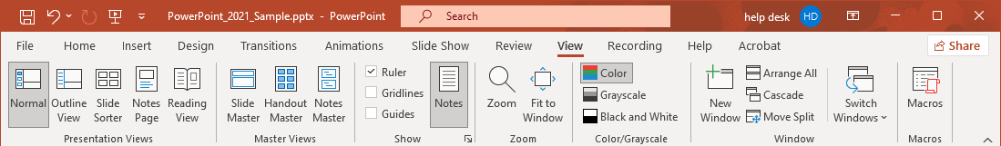
Parts of PowerPoint – Slide Panel – Ruler
The ruler is a useful tool when designing slides with your content.
This is how you add the ruler to the Slide Panel should it not currently be there.
2. Check the Ruler box.
1. Select the View ribbon.
Slide

Slide 12
Parts of PowerPoint – Slide Panel - Ruler
The Slide Panel, where the creativity happens!
When the cursor is located within an object that can contain text, such as a text box, the ruler becomes able to hold tab stops …
… the Tab Stop icon is displayed ...
… which allows you to set tab stops and paragraph markers in that object similar to the way you can in Word.
Slide
Notes:
You can use tab stops in your project, but only in certain types of object. What are those object types? (check all that apply) (slide 12)
Text box
An arrow line shape
Many of the shapes
Wordart

Slide 13
Parts of PowerPoint
The Ruler’s Rules
Tab alignment select button
A tab stop is a location on the page at which text is aligned to the tab, the manner of alignment is based upon the type of tab stop selected.
More than one tab stop can be placed at different points on one line.
A new set of one or more tab stops can be defined for each paragraph.
If no new set of tab stops are defined, the next paragraph you type will carry through the tabs stops from the previous paragraph.
There are five different tab stops in PowerPoint and two markers for paragraph indent types. They are …
Left Tab – Aligns to the first character of the text that starts with this marker.
Center Tab – The center of the text is aligned with this marker.
Right Tab – The last character of the text is aligned with this marker.
Decimal Tab – The decimal point is aligned with this marker. Used primarily with currency.
Bar Tab – Inserts a vertical bar in the text where the cursor is at the point of the marker.
First Line Indent – The first character of the first line of the paragraph starts at this marker.
Hanging Indent – All lines in the paragraph except the first line align with this marker.
Slide

Slide 14

Parts of PowerPoint
The Ruler’s Rules
How do you go about adding a tab stop using the mouse?
Click on the Tab alignment select button until you find the one you want.
Select an object, then click in the lower half of
the ruler over the spot where you want the tab stop to be.
lower half of ruler
How do you go about moving a tab stop?
Hover your mouse pointer over the marker then press and hold down your mouse button.
Drag the marker left or right on ruler to the new location and release the mouse button.
How do you go about removing a tab stop?
Do step one for moving the marker, but drag it down off the ruler instead of left or right.
NOTE: There can only be;
one first line indent,
one hanging indent,
and one left indent for each paragraph.
Slide

Slide 15

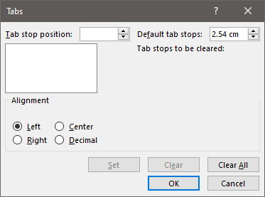
Parts of PowerPoint
The Ruler’s Rules
You can also adjust the tab stops using a dialog box if you prefer the keyboard method.
Launch the Paragraph dialog box from the Home ribbon.
Then click on the Tabs button to launch the Tabs dialog box.
Tab stop position
Tab stop default distance setting
Tab stop list box
Alignment setting for selected tab stop
Set button commits changes
Clear selected tab stop
Clear all tab stops
Slide

Slide 16
Parts of PowerPoint
The Ruler’s Rules
To set tab stops manually in the Tabs dialog …
Enter the distance from the left margin in centimeters in the Tab stop text box
OR
use the up/down scroll buttons.
Choose an alignment type.
Click on Set.
Repeat steps 1 through 3 for as many tabs stops as you want.
Slide

Slide 17
Parts of PowerPoint
The Ruler’s Rules
To change tab stops manually in the Tabs dialog …
Select the tab you want to change.
Change the alignment as desired.
Click on Set.
Repeat steps 1 through 3 all the changes you need to make.
Note that if you want to change the position of the tab stop, you have to make a new one and then delete the one you want to move to its’ new location.
Slide

Slide 18
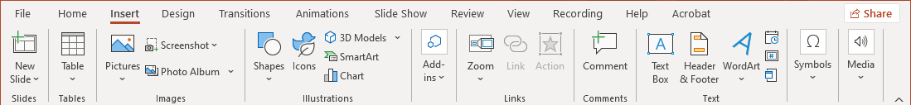
Parts of PowerPoint – Slide Panel
The Slide Panel, where the creativity happens!
Everything that goes on to the slide you are crafting must be an object.
The objects are located on the Insert ribbon.
Slide

Slide 19
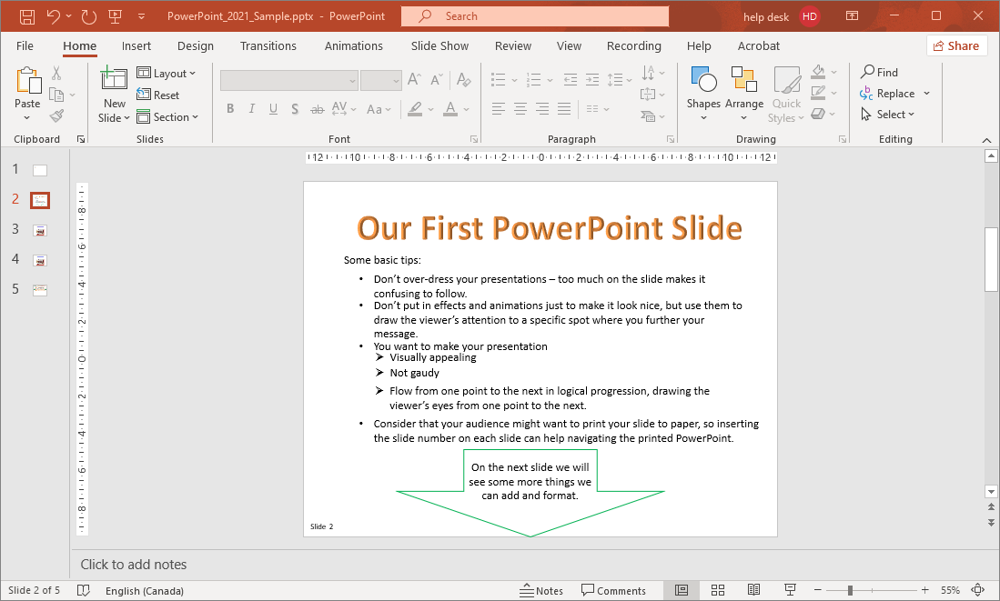
Parts of PowerPoint – New Slide
One method to make a new slide is to right-click on a slide in the Slides Navigation Panel.
… do the following …
Slide

Slide 20

Parts of PowerPoint – New Slide
Not part of the Navigation Panel, but you can also create a new PowerPoint project by clicking on the Home or Insert tab …
… then by clicking on the New Slide menu from the Clipboard group on the Home ribbon, or from the Slides group on the Insert ribbon.
Slide

Slide 21
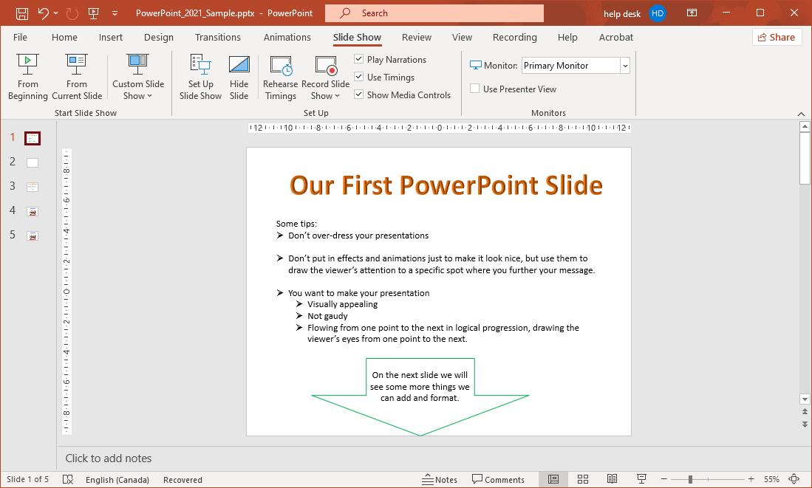
Parts of PowerPoint - Notes Panel
The Notes can be viewed while showing your presentation when the Presenter View is enabled.
Presenter View properties can be set from the Slide Show ribbon.
Click on the Use Presenter View checkbox.
Notes can be added to each slide to help you remember what you need to say.
And then select the Monitor you are sharing with others.
You need a minimum of two monitors to use the Presenter View.
As it happens, when you plug your laptop into a projector, you then have two monitors.
Select “Display Settings” (right-click the Desktop).
Click on the projector screen and the select from the drop menu, “Extend This Display”.
Slide

Slide 22
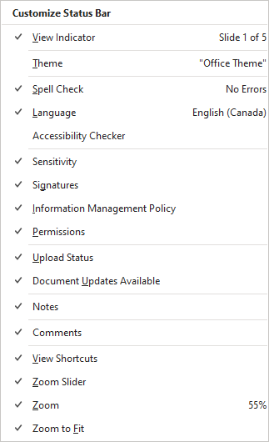
Parts of PowerPoint – Status Bar
The Status Bar displays current information.
The Status bar displays current information about your project.
When any one of these conditions becomes true, the data is displayed in the Status bar.
Right click on the Status bar to view the menu.
Slide

Slide 23





















Objects
In its’ most basic definition:
an Object (for our purpose) is a self contained software entity.
Most objects are (not an exhaustive list):
self contained software which contains its’ own data and is maintained by its’ own methods and procedures.
customizable using object formatting (Format panel).
stackable, one on top or below another object, just like cards laying on a table.
can have animation applied to it.
So, in practical terms an object is anything you add to your slide from the Insert ribbon.
You can work with the arrangement of objects, stacking, alignment, etc. from the Home ribbon, Drawing group.
Slide

Slide 24
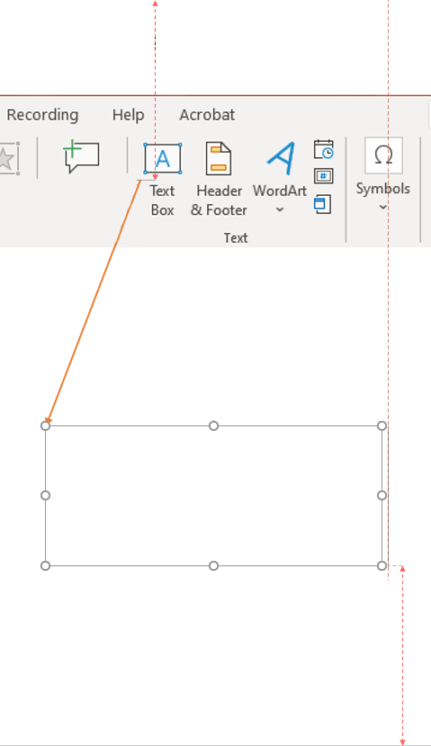
Objects: Placing on the Slide
To Insert an object on the slide is as easy as …
… for example, a textbox …
1. Click on the Insert tab to expose the Insert ribbon.
2. Select the object you wish to add to your project.
3. Draw it on the slide at the location you want it to appear.
Slide

Slide 25
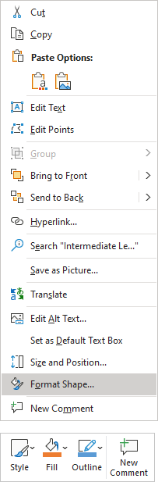
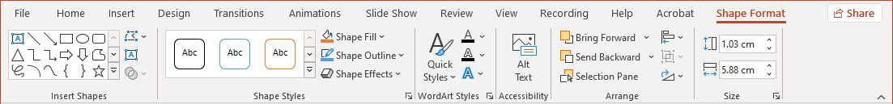
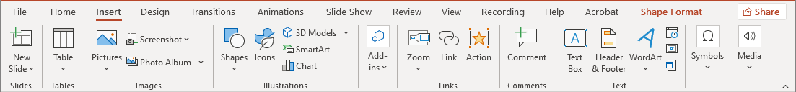
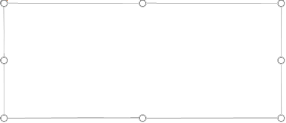
Objects: Placing on the Slide
To Insert an object on the slide is as easy as …
Now to open the Shape Format ribbon …
1. by using the context ribbon, Shape Format, to format the text box
OR
2. By right-clicking on the edge of the textbox
It has these points around the textbox because the textbox (the container object) is selected.
This is the textbox just added.
Now to format the textbox
Slide

Slide 26
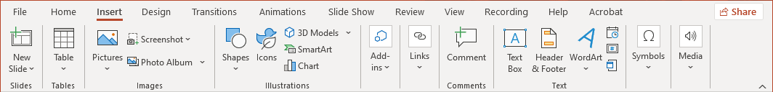


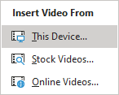
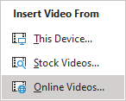
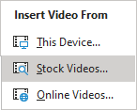
Objects
Placing on the slide Multimedia
It is always better to download a video and play it from your computer than to stream it over the Internet.
Why, you ask?
1. Bandwidth – From where you are connected to the Internet is it fast enough for smooth streaming?
Try this!
speedtest.net
10 Mbps might suffice if you are on the connection alone.
25 Mbps or greater is best if you are sharing the Internet with just a few other people.
Of course, the faster speeds are always preferred.
2. Reliability – The fewer variables that have a chance to change
to crash your polished presentation, the better.
Options for streaming using one of the three available sources are:
Opens an Insert Video file dialog. Present from your PC.
Opens an Insert Video window displaying stock media.
Opens an Insert Video window. Type in the URL (link).
Slide
26

Slide 27



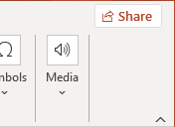
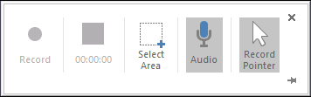
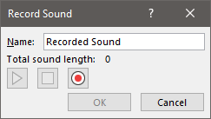

Objects - Placing Multimedia on the slide
Opens an Insert Audio file dialog. Listen from your PC.
Opens a Record Sound dialog. Save to your PC.
First set the Select Area, then set the Audio, then Record all the changes on the screen with audio from whatever sources you have set up, microphone, streaming video, online chatting services, and much more. The list is extensive.
Slide
Notes:
Question 3: Where do you go to add a video to your project? (Slide 27)
Answer 3: d. Insert / media

Slide 28
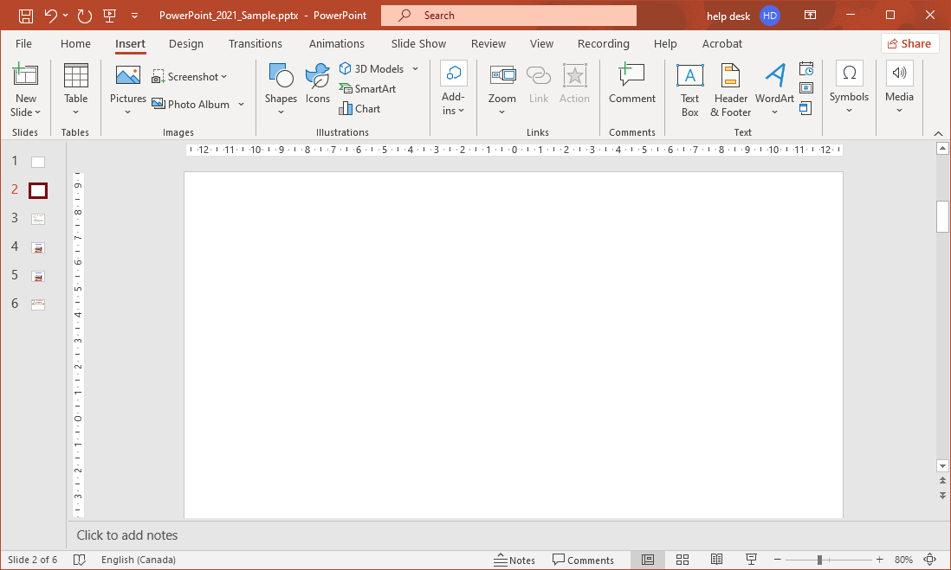


Objects - Placing Multimedia on the slide
2. Click on the Insert tab
1. Create a blank slide …
3. Now make a WordArt title. Click on WordArt.
Select the WordArt that appeals to you.
Once selected, the box appears on the slide so you can work with it.
Slide

Slide 29
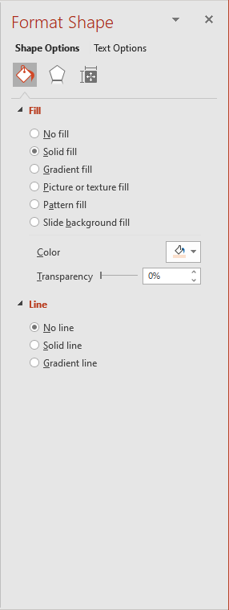
Objects - Formatting
What is it that you are formatting?
When formatting objects, keep in mind that there are two things to format in any object that can contain content. the container
          the contents
Not all objects are containers or content. An arrow or line is a basic object.
It cannot contain content, so it is not a container object.
It is not inside another object as content, so it is not content.
Therefore, the arrow, line, or similar objects are basic objects only.
  Format Shape (Formatting options for arrow, lines and other similar objects)
  Shape Options
  Fill & Line
  Effects
  Size & Properties
However, a Textbox, most Shapes, WordArt, or SmartArt, or other such object can contain content, so they are container objects.
Slide

Slide 30
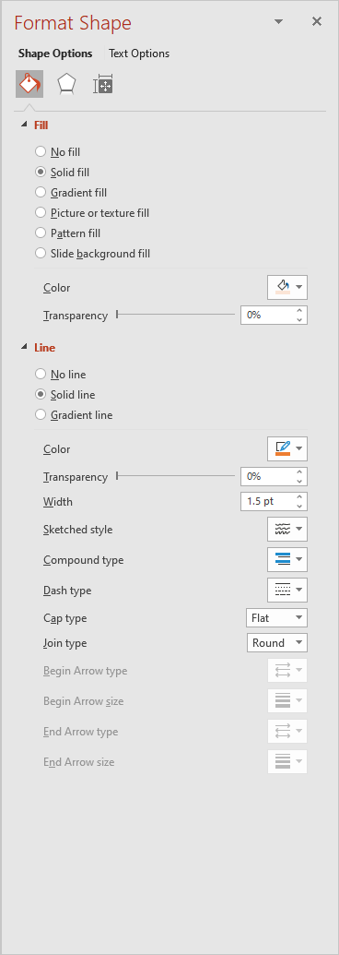
Objects - Formatting
Starting from the top, notice the name of the type of selected object(s). Format Shape for this example.
Formatting commands allow you to customize each and every object you insert to your heart’s content.
Shape Options – Format the container in which the
content resides.
Most objects are container objects, some are data objects, and still others are basic objects.
Fill – Fill formats the container background.
Line – Line formats the border line around the container
Slide
Notes:
Question 4: On the Formatting panel that snaps in to the right side of the slide work area has three lines along the top of the panel. What are they? (Select all that apply) (Slide 30)
ALL four are correct.
The name of the type of object being formatted
Select to which the options be applied; to the shape, or to the text
Select the type of options you wish to apply to the object
Adjust the settings available to the selected type of option

Slide 31
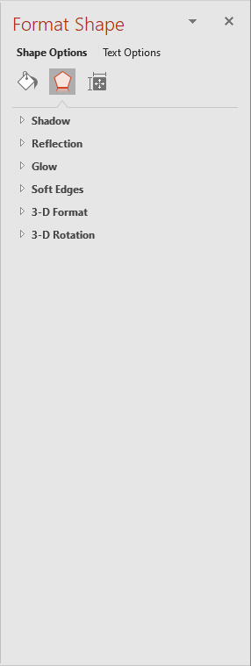
Objects - Formatting
Starting from the top, notice the name of the type of selected object(s). Format Shape for this example.
Formatting commands allow you to customize each and every object you insert to your heart’s content.
Shape Options – Format the container in which the
content resides.
Most objects are container objects, some are data objects, and still others are basic objects.
Effects – Add a Shadow, Reflection, Glow, and/or Soft Edge.
3-D Format & Rotation - Work with formatting 3D data objects; bevels, contours, material, lighting, rotation (x, y, & z).
Slide

Slide 32
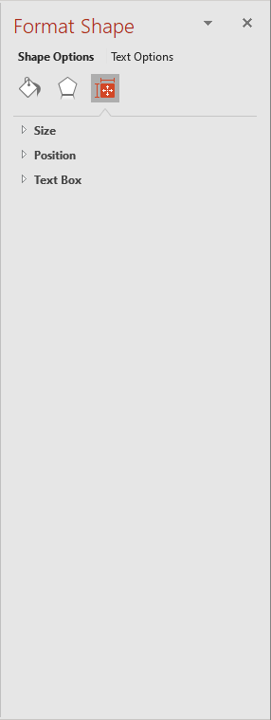
Objects - Formatting
Starting from the top, notice the name of the type of selected object(s). Format Shape for this example.
Formatting commands allow you to customize each and every object you insert to your heart’s content.
Shape Options – Format the container in which the
content resides.
Most objects are container objects, some are data objects, and still others are basic objects.
Size & Properties – Size, position, alignment, margins.
Text Box – Text alignment, direction, autofit/shrink/resize, margins & more!
Slide

Slide 33
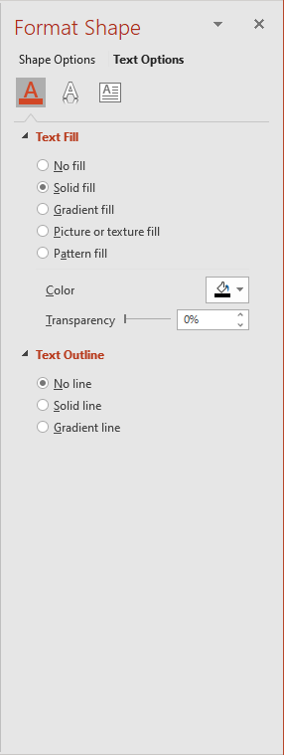
Objects - Formatting
Starting from the top, notice the name of the type of selected object(s). Format Shape for this example.
Formatting commands allow you to customize each and every object you insert to your heart’s content.
Text Options – Format the contents of the container.
Text Fill – Fill the text with a color, gradient fill, picture, texture, or pattern fill. Set transparency.
Most objects are container objects, some are data objects, and still others are basic objects.
Text Outline – set the border around the text as a solid line (choose your line type), or as a gradient.
Slide

Slide 34
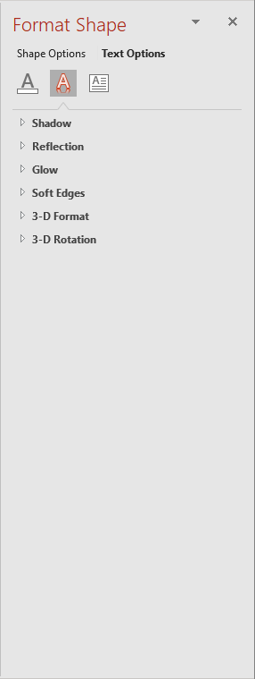
Objects - Formatting
Starting from the top, notice the name of the type of selected object(s). Format Shape for this example.
Formatting commands allow you to customize each and every object you insert to your heart’s content.
Text Options – Format the contents of the container.
Effects – Add a Shadow, Reflection, Glow, and/or Soft Edge.
Most objects are container objects, some are data objects, and still others are basic objects.
3-D Format & Rotation - Work with formatting 3D data objects; bevels, contours, material, lighting, rotation (x, y, & z).
Slide

Slide 35
Objects - Formatting
Starting from the top, notice the name of the type of selected object(s). Format Shape for this example.
Formatting commands allow you to customize each and every object you insert to your heart’s content.
Text Options – Format the contents of the container.
Most objects are container objects, some are data objects, and still others are basic objects.
Size & Position – Change the size and/or position of the object you have selected.
Text Box – Text alignment, direction, autofit/shrink/resize, margins & more!
Slide

Slide 36
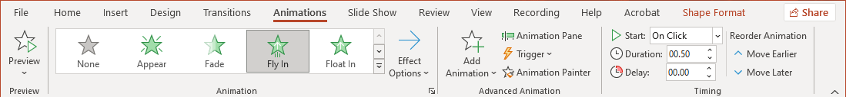
Objects - Animating
Now for the real fun in creating a PowerPoint presentation, adding animation to objects.
Keep in mind that adding animation is usually meant to further your presentation by directing the viewer’s attention to your next point.
Take a look at the animation for the current slide without running the presentation from the start.
These animations can exist in objects in four states;
No animation
Entrance Effects
Emphasis Effects
Exit Effects
Motion Paths are added to an existing animation.
Slide

Slide 37
Objects - Animating
The four states of animation are as follows …
Add Animation is divided into four sections:
None – No animation.
Entrance – Does not show on the slide until its’ animation time is cued.
Emphasis – Adds one or more animations to an object already
displayed on the slide (or will be displayed on the slide).
Exit – Performs the animation and then disappears from the screen.
Motion Paths – Not an animation type. Motion Paths are added to an
existing object.
Animation Pane
Displays a very helpful pane that shows all the animations on the page in the order in which they will occur when the page is run. It provides an easy method for editing the options for each animation.
Trigger – Change the trigger here or from the animations pane.
An example of a trigger would be if you click on an object, it will perform an action.
Animation Painter is like the Format Painter (on the Home tab under Clipboard) except the animation and its’ properties are painted instead of object formatting.
Slide

Slide 38
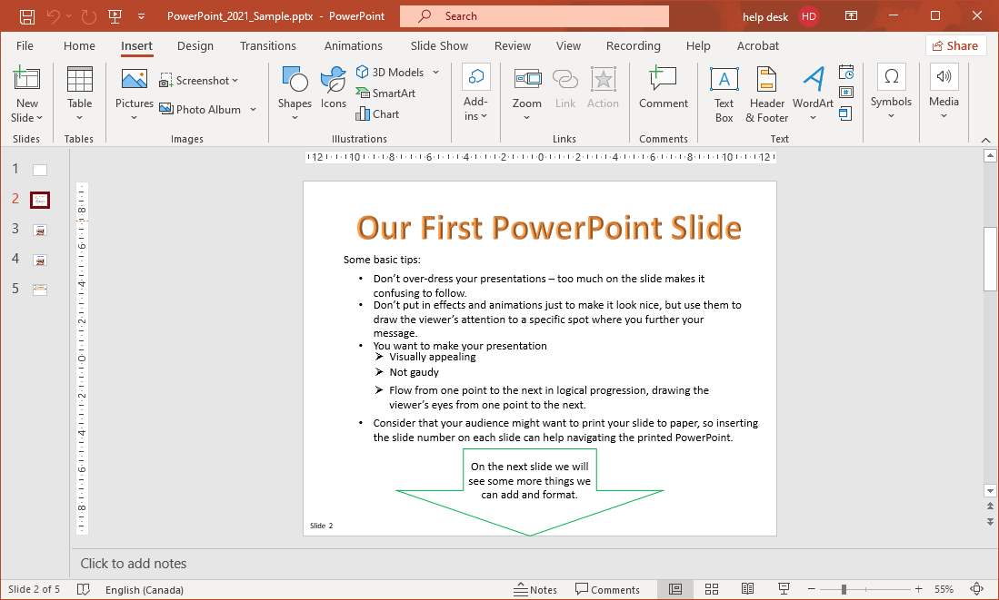
Adding Content and Formatting
1. Insert a WordArt as a title
3. Insert a Textbox.
2. Type in Our First PowerPoint Slide
4. Now add some content to the Textbox.
Slide

Slide 39
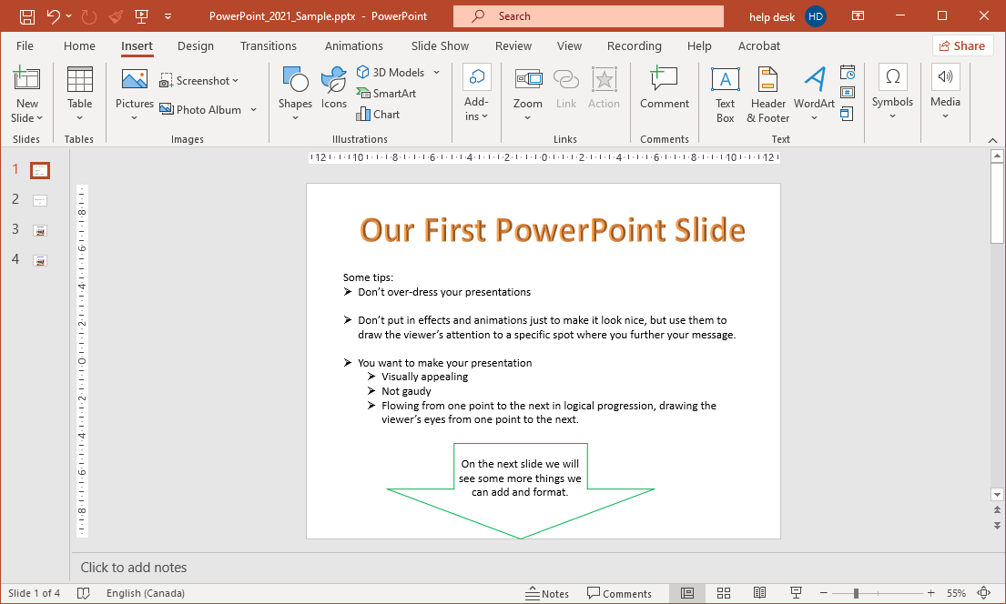
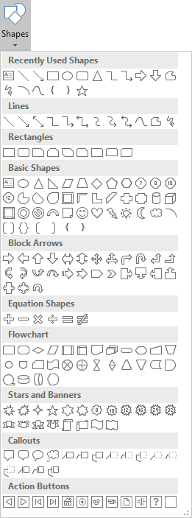
Adding Content and Formatting
Now that we have added content, let’s add a down arrow and animate it.
1. Click on the Insert tab.
2. Click on Shapes.
3. Select the large down arrow and draw it at the bottom of the slide under the text we just typed in.
Slide

Slide 40
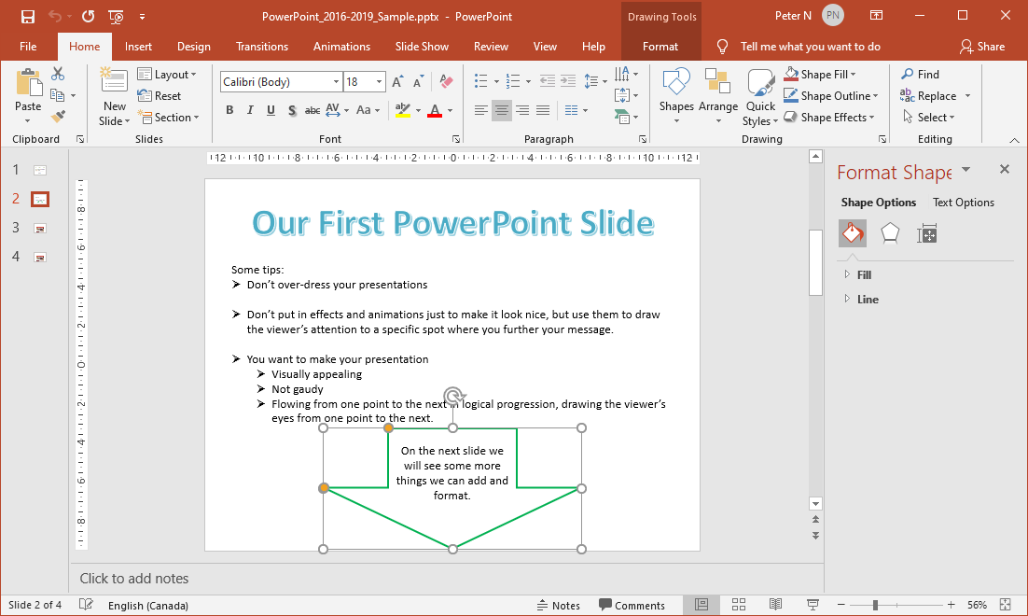
Adding Content and Formatting
Now to add some text and formatting to the arrow.
Now apply whatever formatting you wish to the arrow object.
  Note that if you type text in the arrow, it is white and centered. These things can be changed from the
  Home tab
  Font group
  Paragraph group
… select the arrow and click on the Drawing dialog box launcher.
Right-click on the arrow and select Format Shape, which displays the Format Shape pane …
OR
Slide

Slide 41
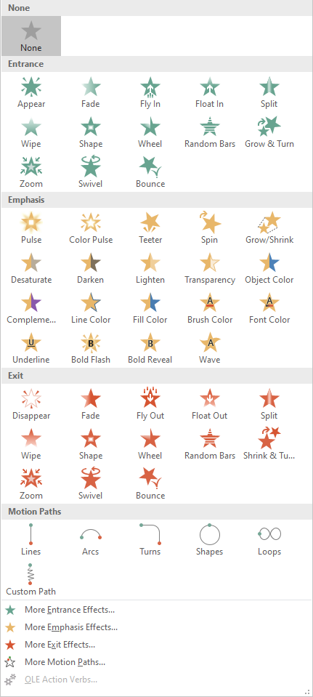
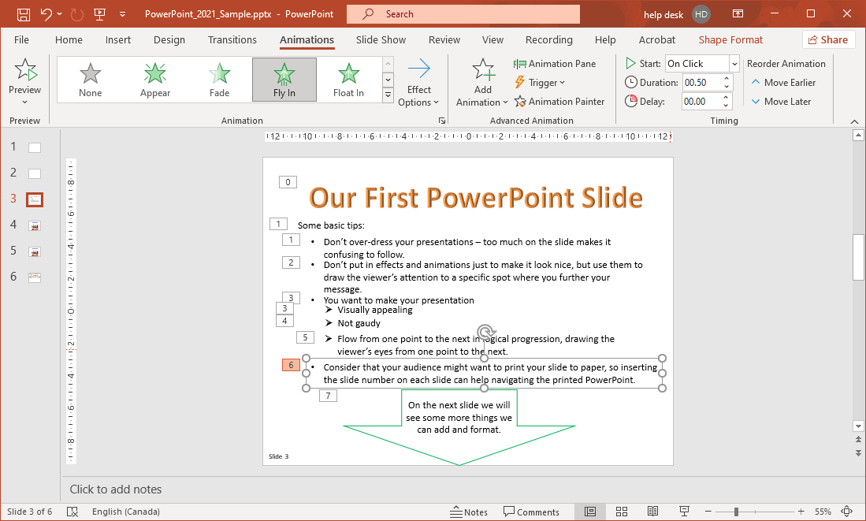
Adding Animation
Now that we have added a down arrow and formatted it, let’s animate it.
With the arrow selected
Click on the Animations tab
Click on the down more arrow.
which displays
Now select the Fly In animation from the Entrance animations.
The Entrance animations remain hidden until they appear in sequence.
Slide

Slide 42
Adding Animation
Just a review …
The Entrance animations remain “off screen” until its’ animation time appears in the sequence you have set for it.
The Emphasis animations are either:
applied to an object that does not have any previous animations attached to it, in which case you simply select it from this dialog,
OR
applied as a second (or subsequent) animation to an object by clicking on the Add Animation button. The Add Animation button opens the same dialogue and lets you add another animation to the same object.

Slide 43
Adding Animation
Just a review …
The Exit animations reverse the Entrance animations; the animation moves the object until it “disappears” off the slide.
You can apply a motion path movement to any animated object.
The top four options, when selected, will provide added effects not found in the options above.
Slide

Slide 44
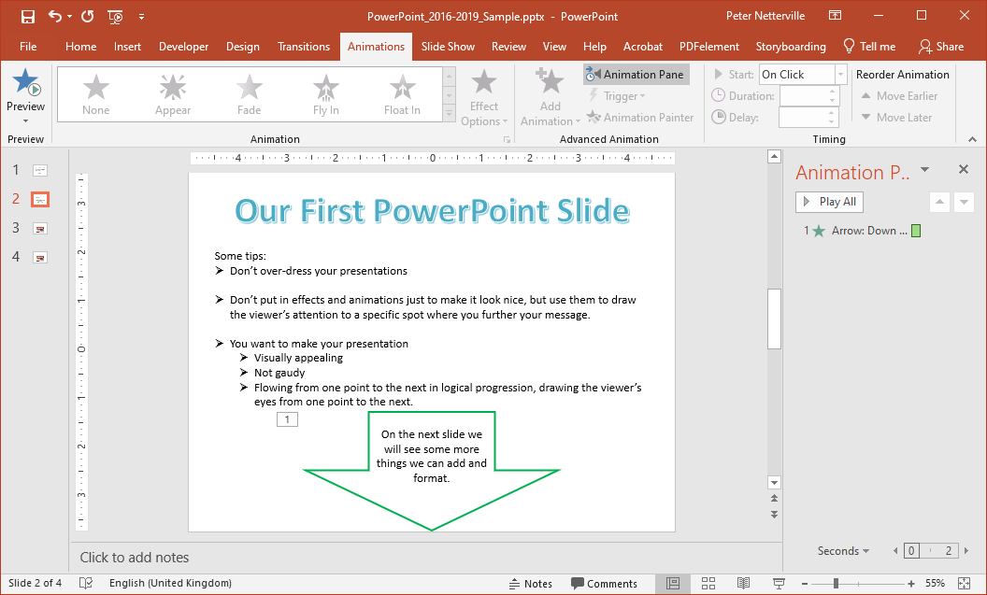
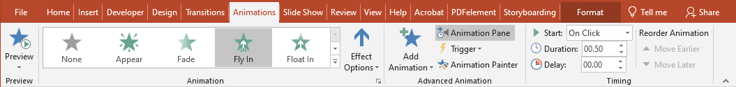
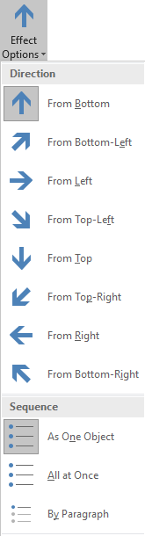
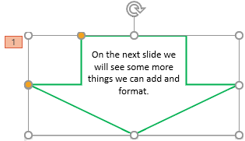
Adding Animation
How to add animation to the arrow.
You may have noticed that the arrow flew up from the bottom, which really does not make sense for an arrow that is pointing down, so let’s change that.
To make the arrow fly down from the top click on the Effect Options on the ribbon and select From Top.
Start by selecting the arrow to make it the object that has focus.
Slide

Slide 45
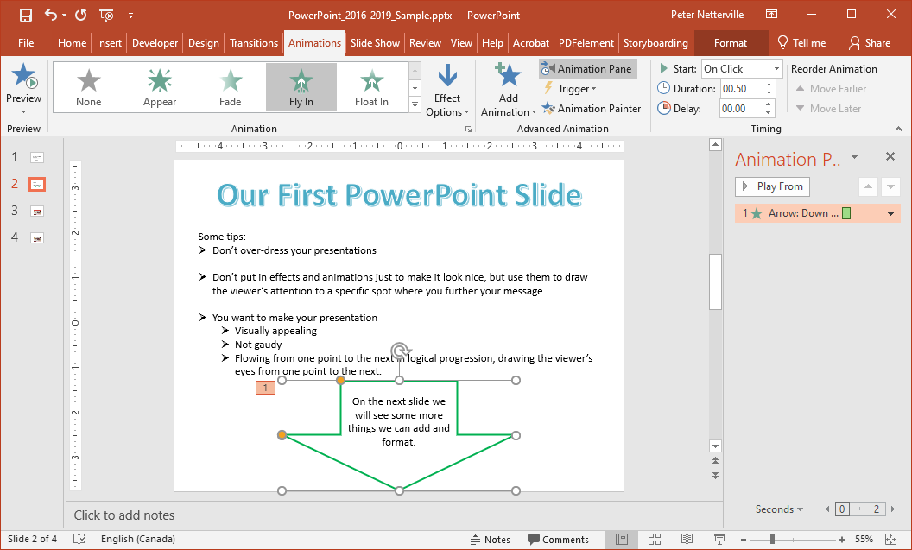
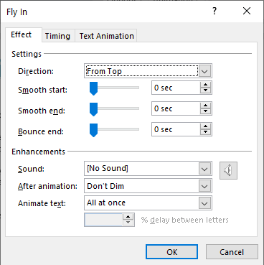
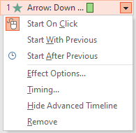
Adding Animation
Another method for changing the movement direction of the arrow is by clicking on the down arrow on the animation we just created from the Animation Pane, then click on Effects Options.
The direction of the animation can be changed from here as well.
Select the Effect Options menu
Smooth Start slows the start and increases in speed evenly, and vice versa for a Smooth End.
The bounce at the end of the animation can be up to 0.5 seconds in duration.
Slide

Slide 46
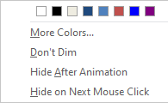
Adding Animation
Add a sound to the animation from the list or your own in .wav format.
After the animation has completed, you can have the object …
Change color
Don’t Dim
Hide
Hide on next mouse click
Slide
Notes:
Question 5: In order to further adjust options in an animation that is added to your project.
(Select all that apply) (Slide 46) ALL ARE CORRECT
Open the Animation pane
Select the animation from that panel or click on the animation number on the slide.
Right click on the animation from panel
Select the option of your choice and change it.

Slide 47
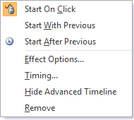
Adding Animation
Now that we have animated the arrow let’s adjust a few things.
Start On Click forces the animation to wait for a mouse click before being run.
Start With Previous causes the animation to occur at the same time as the previous animation.
Start After Previous runs the animation after the previous one has ended.
If you set to Start After Previous on the first animation then it starts immediately when the slide is displayed.
Slide
47

Slide 48
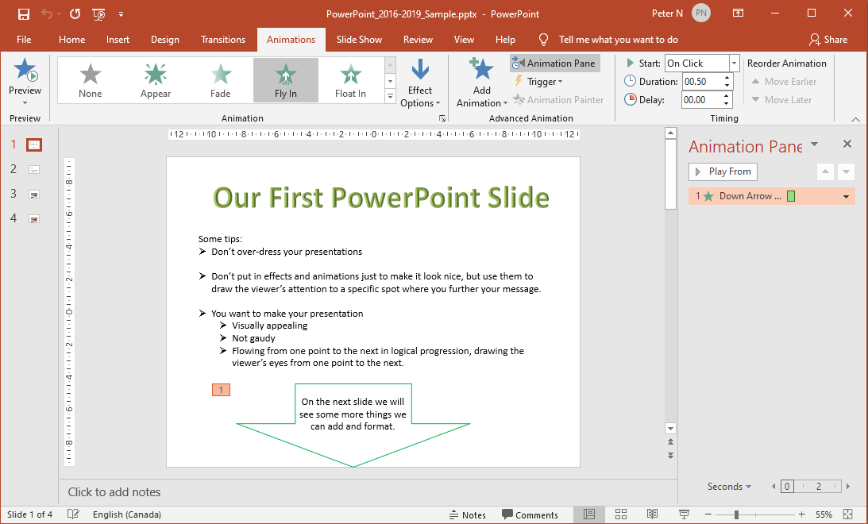

Adding Animation
Click on the Timing menu option.
On the Timing tab you can set …
How the animation starts
A delay before it starts
The duration (how long it takes to animate)
Whether it repeats
If the animation rewinds to the start when completed
Or add a trigger
Click on the Timing tab.
Slide

Slide 49

Adding Animation
Click on the Text Animation tab.
In the Animation Pane you can also change the animation execution order by picking it up with your mouse and moving it.
On the Text Animation tab you can set …
How you group text: as a group object or at a certain paragraph level.
When the text is to be automated
Control whether the attached shape is to be animated or not.
Reverse the order of animation events.
So we have seen how from the Animation Pane you can control specifically how the animation is to occur.
Slide

Slide 50


Adding Transitions
First, let’s change how the previous slide transitions into this slide.
Click on the Transitions tab.
You can choose from one of the slide transitions shown, but let’s display the menu.
Click on the More menu button.
Now click through the choices, and each one will preview and animate for you.
You will need to select the More menu after selecting each one.
Slide

Slide 51

Start Slide Show
From Beginning & From Current Slide – Self explanatory
Custom Slide Show – Choose specific slides to create a slide show.
Set Up
Set Up Slide Show – Settings for how to present the slide
show.
Hide Slide – Hide one or more slides from presentation.
Rehearse Timings – This times how long it takes for you
to do the presentation.
Record Slide Show – Record the presentation and save it as in AVI or MOV format.
Play Narrations – Play the recorded slide show.
Use Timings – Play timings
Show Media Controls – Displays the media controls when mouse-over the video.
Monitors
Monitor – If two or more monitors are present, choose
which monitor to display the presentation.
Use Presenter View – If two or more monitors are
present, presenter view display the presentation, notes, and upcoming events on three panels.
Slide
51

Slide 52
NITHA IT Helpdesk
helpdesk@nitha.com
1(306)953-5008

Slide 53

Thank you

