Slide 1


PowerPoint 2021 In-Depth
Entry Level

Slide 2
NITHA IT Helpdesk
helpdesk@nitha.com
1(306)953-5008

Slide 3

What will we be covering in this course?
Inserting Objects - Ribbon Slide 4
Review Ribbon Slide 30
Animation Ribbon Slide 6
View Ribbon Slide 31
Insert and Animate Content Slide 8
Recording Ribbon Slide 32
Designs Ribbon Slide 13
Slide Master Slide 35
Transitions Ribbon Slide 15
Audio & Video Slide 37
Slide Show Ribbon Slide 17
3D Models Slide 40
Presenter View Slide 20

Slide 4
Inserting Objects - Ribbon
Insert images from various sources.
Add-ins provide additional functionality for PowerPoint.
Add a comment, displayed as an icon, to your PowerPoint presentation.
Define Section - A section break groups slides into meaningful categories. You will need more than one section to do a Summary Zoom, which allows you to create a clickable overview slide of your presentation that you can use to navigate to different sections.
Section Zoom: Add links to specific sections in your presentation.
Slide Zoom: Lets you navigate to specific slides in any order, without interrupting the
flow of your presentation.
Insert a table by one of four methods.
New slides are inserted directly below the current selected slide.
You can insert:
- Shapes of various types
- Icons command opens a dialog which allows you to select stock images for
Images, Icons, Cutout People, Stickers, Videos, Illustrations, and Cartoon People.
- 3D Models command opens a dialog which allows you to insert a 3D Image from
your computer or from stock 3D models.
- SmartArt inserts non-sequential or grouped blocks of information.
Slide

Slide 5
Inserting Objects - Ribbon
Text Box – Standard text box.
Header & Footer – Divided into three sections; insert images, text, & date.
Word Art – Fancy styled text.
Date & Time – Insert the date and/or time into an object that can have text.
Slide Number – Insert the current slide number.
Object – Insert objects such as Adobe objects and/or Office objects.
Insert an equation or a symbol into your presentation. The symbol must go into a container that can hold text, but the Equation object creates its’ own container.
Insert a Video or Audio file:
From your computer – Best option because it provides a smooth video experience.
Stock Video – Premade video for your use.
Online Video – Streamed from the Internet. It is best to download the video and run it from your PC.
Screen Recording – Record the screen & any related audio before inserting as an object into your presentation.
Slide

Slide 6
Animation Ribbon
Animation options
These are the animations, explained in the next slide.
Run the animations you have created for this slide.
Add Animation – This menu allows you to add another animation to the same object.
Trigger – Select from a dynamic list of objects which you have already added to your presentation to act as a trigger to cause motion on the selected object when clicked. The object can be located anywhere in your presentation.
Timing – On the selected object, which also has animation applied to it, you can:
Start: Choices are On click, With previous, After previous
Duration: Delay adds the set time to wait before performing the animation.
Reorder Animation: Move the animation of the selected object to run
earlier or later in the sequence of animations you have on that slide.
Slide

Slide 7
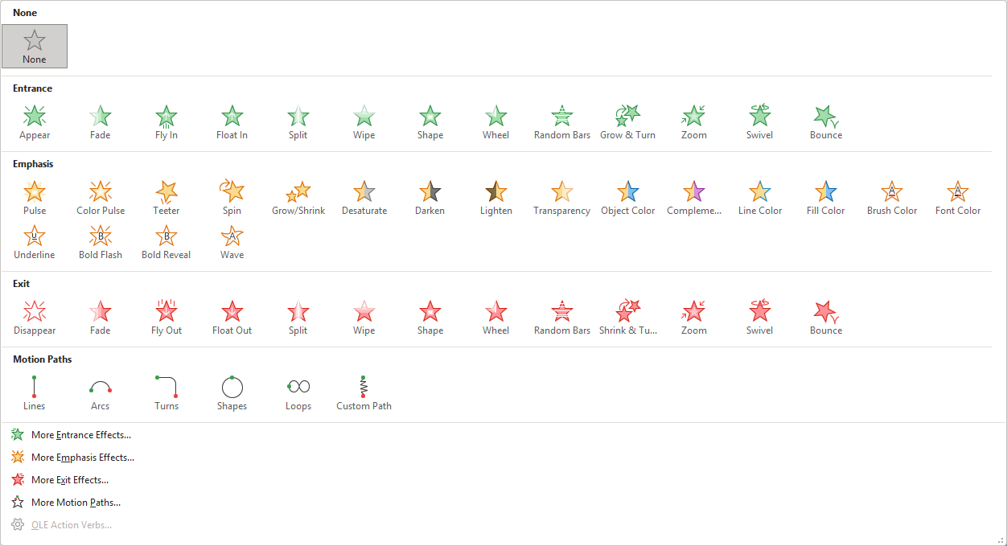
Animation Ribbon
Animation options
These animations are transparent until it comes up in order.
Add an animation to an object already visible on the screen.
These animations make a visible object transparent once the animation completes.
Add a motion path to any animation.
Need more animation and/or motion options?
Slide

Slide 8
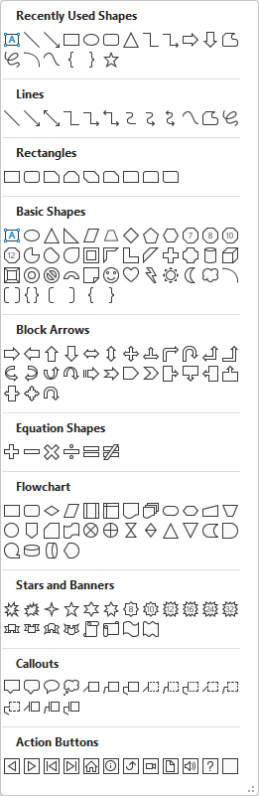

Insert and Animate Content
Add a common object, such as a shape.
Choose, format and animate the shape of your choice …
… then draw it on the slide by dragging your mouse pointer from one corner to the opposing corner.
Drag mouse pointer from corner to corner.
Slide

Slide 9

Insert and Animate Content
Animate a common object, such as a shape
Apply an entrance animation, such as Fly In.
This random motion is applied by clicking
Add Animation and then select the motion path of your choice.
In this case, it is a custom-drawn path.
You can add a custom path to an object either in addition to a previous animation
OR
on an object that has no previous animation applied.
Slide

Slide 10
Insert and Animate Content
Insert an uncommon object, such as an Excel spreadsheet, and animate it
Insert an Excel Spreadsheet into your presentation.
When not in Presentation Mode, double-click on the spreadsheet to edit the content of the spreadsheet.
Apply the Shape animation.
This random motion is applied by clicking
Add Animation and then select the Custom Path motion path.
This is an active Excel spreadsheet, not an image. This is called OLE, Object Linking and Embedding.
OLE embeds the necessary software functions from the source software, in this case, Excel, along with the data. The end result is that you edit this object with Excel while it is in your PowerPoint Project.
Slide
Notes:
Question 1: In order to insert an active Excel spreadsheet (OLE) go to: (Slide 10)
Answer 1: a. Insert / Object

Slide 11
Insert and Animate Content
Insert a chart and animate it
The chart is an active object rather than just an image. This is also called OLE, Object Linking and Embedding.
The figure eight motion applied to this chart is added by clicking on
Add Animation, then select the figure-eight motion path.
In addition, the figure 8 motion path was applied to this chart.
Slide
Notes:
Question 2: What is OLE? (Slides 10-11)
Object Linear Escalation
Object Line Etching
Object Linking and Embedding
Object Lineal Embedding

Slide 12
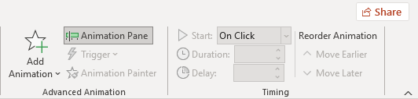
Insert and Animate Content
Reorder Animation
Choose to move the animation before or after
its’ current location
Timing
Start the object’s animation:
1. on left mouse button click
2. at the same time as previous animation (with previous)
3. after previous animation runs (after previous)
Duration – How long, in seconds, is the animation to run.
Delay – How long to wait before running the animation.
Add Animation – Click this button to apply an animation to the selected object.
Animation Pane – Displays the animation pane. It can be moved to another monitor, same as the format pane.
Trigger – On Click Of… Choose an object to click on to run the animation you are adding to the object.
This allows you to click on any object to run that animation.
Animation Painter – Same as a format painter, except it duplicates animations.

Slide 13
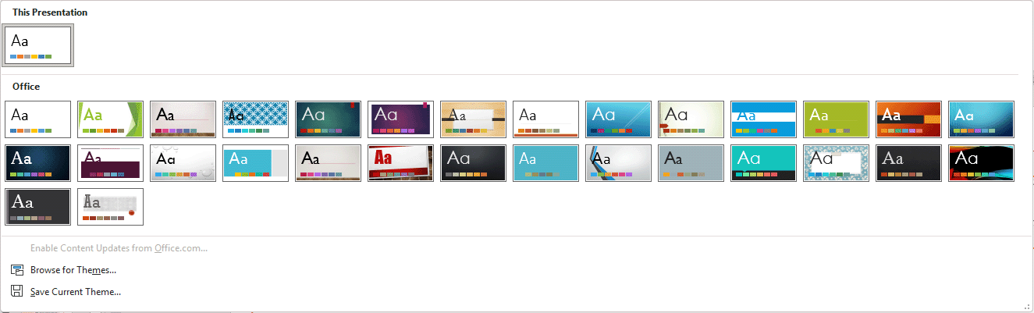
Designs Ribbon
expanded
Opens an Open file dialog. Themes have the .THMX file extension, but you can import themes from another slide and much more.
Designs Menu
Save the current theme.
Slide

Slide 14
Designs Ribbon
Variants – Changes the selected theme to different color scheme.
Customize
Slide Size – Choose from 4x3 or 16x9
Format Background – Apply a background to the slide
Slide

Slide 15
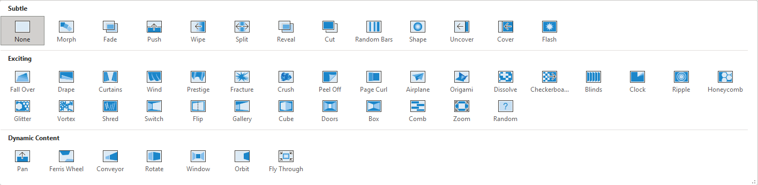
Transitions Ribbon
Transitions apply animation to slides as the progress in sequence
The transition is applied to the slide’s entrance animation.
Choose the transition you prefer from the full list.
The Fracture transition was applied to this slide, so we saw it as we entered.
View the transition applied to this slide.
The transition animations are applied before the animation(s) applied to the objects on the slide are run.
Slide

Slide 16
Transitions Ribbon
Timing:
Sound - Choose from the provided sounds, or select to browse your computer for a sound file.
Duration – How long to play the sound, measured in seconds.
Apply to All – Applies the current slide’s transition, effects, and timing to all slides in your project.
Advanced Slide – On Mouse Click and/or After a specified period of time.
The key thing to remember when applying a transition to a slide is that the slide to which you are applying the transition will take the previous slide’s graphics and apply the transition to it.
Slide

Slide 17
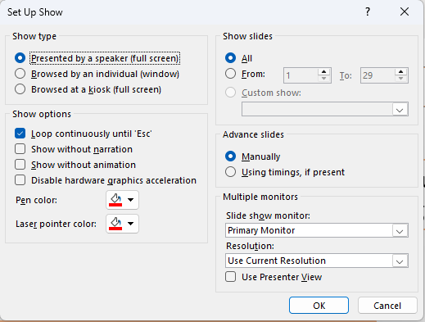
Slide Show Ribbon
Show Slides:
- Play all of the of slides
- Play a series of slides
- Or a custom show by name, one set
up in the Custom Slide Show menu.
Set up your slide show with specific settings as shown.
Show type:
- View full screen with presenter control of slides.
- View as a window, normal.
- View full screen and the presentation runs by itself.
Pick and choose random slides to create a presentation of just a few slides for the purpose of dividing or categorizing your slides into groups.
Show Options:
- Loop continuously –
Best for kiosk mode.
- Show without narration
- Show without animation
- Disable graphics acceleration hardware.
Start the presentation from the current slide (Shift-F5).
Advanced Slides:
Manually - means click to advanced the slides.
Use timings added to the presentation by you.
Start the presentation from the first slide (F5).
Multiple Monitors: Choose the primary and secondary monitors.
If Use Presenter View if checked a second monitor must be selected.
Slide

Slide 18
Slide Show Ribbon
Hide the current slide. The slide becomes shaded to represent its’ visibility state.
Monitor – Of the two monitors required for Presenter View, this monitor setting is the one the audience will see. In a conference scenario, this setting is the projector or large TV. The other monitor is the one you will see.
Use Presenter View – Toggles this mode on or off.
The next slide describes the Presenter View in detail.
Play Narrations – Play narrations you previously recorded via the Record Slide Show.
Use Timings – Use the timings recorded when recording the slide show.
Show Media Controls – Display the controls for all inserted audio and/or video files.
Records all narration, ink, laser pointers, gestures, and slide & animation settings for the purpose of replaying the sequence of slides, much like a macro in Excel or Word.
Switches to presentation mode and runs the slides from the first slide.
A timer appears in the top left corner of the screen, allowing you to do your presentation and keep track of the time it takes for you to go through each slide.
Slide

Slide 19
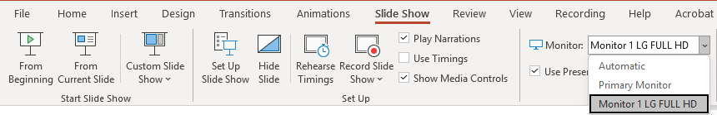
Slide Show Ribbon
In this example the Monitor 1 LG FULL HD is the display the audience will see. On the Primary Monitor is where you will see the Presenter View.
At a conference this monitor option will be the name of the projector/TV.
Using the Presenter View gives you the ability to see the upcoming slide before the audience sees it in addition to other helpful features.
Slide

Slide 20
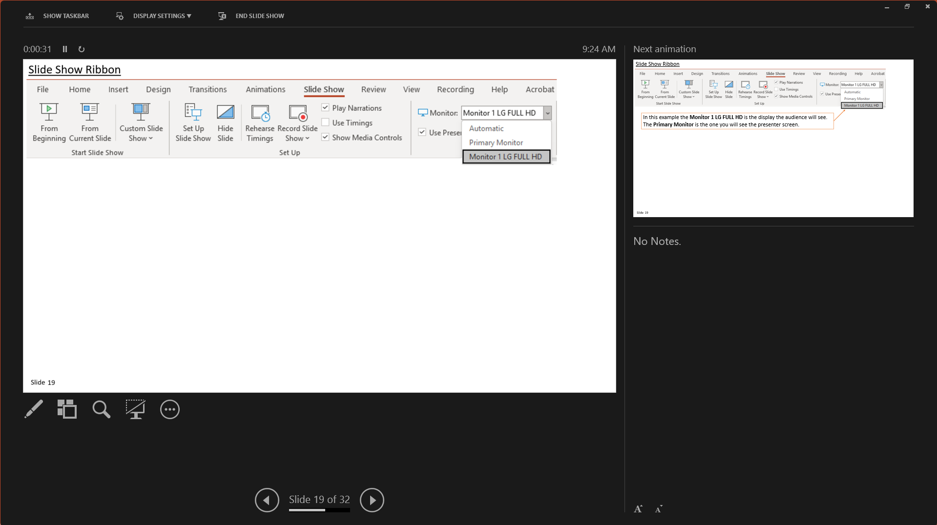
Show Taskbar – Shows the Taskbar on your monitor, not the display the audience sees. Clicking on it
again hides the Taskbar. This option is like a toggle switch for the Taskbar.
Display Settings – Swap Presenter View and the Slide Show displays.
Duplicate Slide Show sets both displays to the same slide show view.
End Slide Show – Stops the slideshow.
Notes:
Question 3: What is Presenter View? (Select three) (Slides 20 -29)
How the Presenter views the presentation
View upcoming slides before they are viewed by the audience.
Provides a method for the Presenter to use tools on the slide
d. Presenter view displays on a different monitor

Slide 21
This section shows you what the audience sees, fewer transitions, effects, and videos.

Slide 22
This panel shows you the upcoming animation, or if it the last animation on that slide is visible to your audience, then you will see the next slide.
This preview panel is so you know what is coming up next.

Slide 23
View your lecture notes for the slide you are presenting.

Slide 24
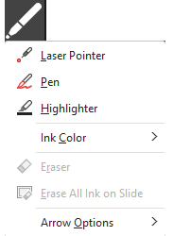
Tools: Drawing pen and laser pointer tools

Slide 25
Tools: See all slides - Displays all slides on your presenter screen so you can click on to choose a slide to jump to while remaining in slide show mode.

Slide 26
Tools: Clicking here allows you to zoom into a specific part of the slide to enlarge that section so you can draw your audience’s attention to a specific part of your presentation.

Slide 27
Tools: Blackens the screen. Clicking again on this tool will make visible the slide again.

Slide 28
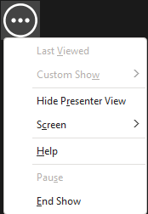
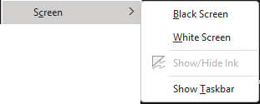
Last Viewed – Similar to using the back button while browsing the Internet.
Custom Show – If you had created a custom slideshow, you can select it from here so you do not have to break out of your presentation to start it running.
Tools: Screen & Taskbar settings
Hide Presenter View – Hides the Presenter View and cannot be switched back to Presenter View except by restarting the presentation.
Screen – Black Screen and White Screen
changes the screen as specified
Show/Hide Ink – Toggles any inking done
Show Taskbar – Shows the taskbar on
your Presenter screen only.

Slide 29
Tools: Scroll backwards and forwards through your slides.

Slide 30
Review Ribbon
Hide any inking you have done.
Inking is done by drawing on your
presentation using your PowerPoint pen.
Show all comments in a panel applied to the left side.
Cycle through the changes suggested by the reviewer.
View the reviewer pane.
End the review process.
Add, delete & cycle through your comments.
Do translations.
Search your presentation.
Reject the change made by the reviewer.
Check for visual and audio accessibility settings.
Accept the change made by the reviewer.
Check spelling and grammar throughout your presentation.
Start comparing two presentations, one that is returned from the reviewer.
Slide

Slide 31
View Ribbon
Set slides to color, Grayscale, and B&W.
Record and play macro(s) that you create. A macro replays the keys and mouse clicks you did while recording it.
Zoom by percentage
Fit to window
Ruler – Shows the ruler.
Gridlines – Shows the gridlines.
Guides – Set adjustable guidelines.
Notes – Add notes to presentation.
New Window – Create a duplicate window on same Arrange All, Cascade – Arranges the windows
Allows you to plan your presentation. This is covered in greater detail two slides ahead.
Normal View – The regular way to design the slides.
Outline View – Set out your presentation in an outline view first.
Slide Sorter View – Displays all the slides in your presentation in horizontally sequenced thumbnails.
Notes Page – Displays the notes for the current slide.
Slide

Slide 32
Recording Ribbon
Save your recording as a show.
Export your video to a file.
Export File types include: PDF, MP4, MOV, JPEG, TIFF, PNG, GIF, BMP, RTF, PPAM, PPA
Do a screen recording which records the entire slide.
Insert a video into your presentation.
Insert an audio file into your presentation.
Take a screenshot of open windows or make a screen clip.
Record either from the current slide or from the beginning.
Slide
Notes:
Question 4: Using what devices can you record video and/or audio? (Select all that apply) (Slide 32-34) All three
From the screen
From a video file
From an audio file

Slide 33
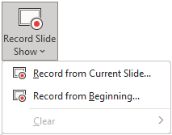
Recording Ribbon
Screenshot – Choose a clip from an existing window
or
Grab a “Screen Clipping”, which is simply doing cropping, taking a rectangular snapshot of the screen.
Record Slide Show – Record audio, video and ink gestures …
from the selected slide
or
from the beginning of the presentation.
Slide

Slide 34
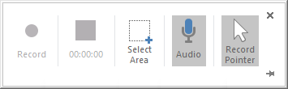
Recording Ribbon
Screen Recording – This command displays a control toolbar on the top of your screen.
Record – Start the recording.
Time/Stop – Stop the recording.
Select Area – Select the potion on the screen that is to be recorded.
Audio – Toggle on/mute audio recording.
Record Pointer – Makes your mouse pointer into a red laser dot while you hold down the CTRL.
Slide

Slide 35
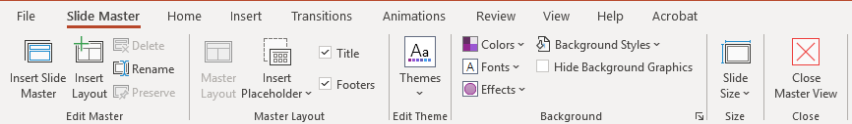
Slide Master (View Ribbon)
When the Slide Master is launched by clicking on the command from the View ribbon, the Slide Master ribbon appears.
Insert a new or template layout.
Themes – Select and edit a theme.
A Slide Master is the first slide in your presentation, which determines the template design for all subsequent slides.
Title & Footers – Defines the content for header & footer.
Insert Placeholder – Defines a rectangular spot on the screen which creates a box in to which you can place content.
Any design change made to the Slide Master appears in all other slides.
Each design element can be overridden on each slide without affecting the other slides.
Master Layout – Opens up the first slide from which all the other slides derive their default layout.
Slide

Slide 36
Slide Master (View Ribbon)
Change the colors, fonts and/or effects of your theme.
Background Styles opens a window where you can select a background style. It is applied to all slides if you have your slide master selected, or to just a single slide if you have any other slide selected.
Hide Background Graphics – This hide the background to the currently selected slide unless the currently selected slide is the slide master, in which case this hides the background graphics for all slides.
Slide Size – Set selected slide to either 4X3 (Standard) or 16X9 (widescreen)
Custom Size – Define your own size slide size and whether landscape or portrait
Slide

Slide 37
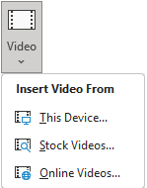
Audio & Video
Inserting audio and video into your project
Click on the Video menu in the Media group
This opens a file dialog box allowing you to choose to insert a video.
Of the some 42 file types, the more popular file types include:
avi, mov, mp4, mp4v, mpeg, mpg, wmv.
This menu option displays a window which allows you to search for stock images and/or videos.
Online videos option displays a window which allows you to type in or paste the URL to the web resource.
Slide
Notes:
On what ribbon do you find the command to insert a video? (Select 2) (Slide 37)
b. Insert Ribbon
d. Recording Ribbon

Slide 38
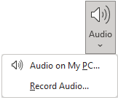
Audio & Video
Inserting audio and video into your project
Click on the Audio menu in the Media group
This opens a file dialog box allowing you to choose to insert an audio file.
Of the some 22 file types, the more popular file types include: adt, aiff, snd, mka, mp3, mp2, wav, wma.
This command starts an audio recording. Just enter the name of the audio file you want to create and then click on the record button, now record your content.
Slide

Slide 39

Audio & Video Presentations

Slide 40


3D Models
Insert 3D models from a file or from stock 3D models.
Slide

Slide 41
NITHA IT Helpdesk
helpdesk@nitha.com
1(306)953-5008

Slide 42

Thank you

