Slide 1


Outlook 2016/2019 Intro
Entry Level

Slide 2



NITHA IT Helpdesk
helpdesk@nitha.com
1(306)953-5008

Slide 3

What will we be covering in this course?
Open PowerPoint File from NITHA
Parts of PowerPoint
The Making of a PowerPoint Slides

Slide 4
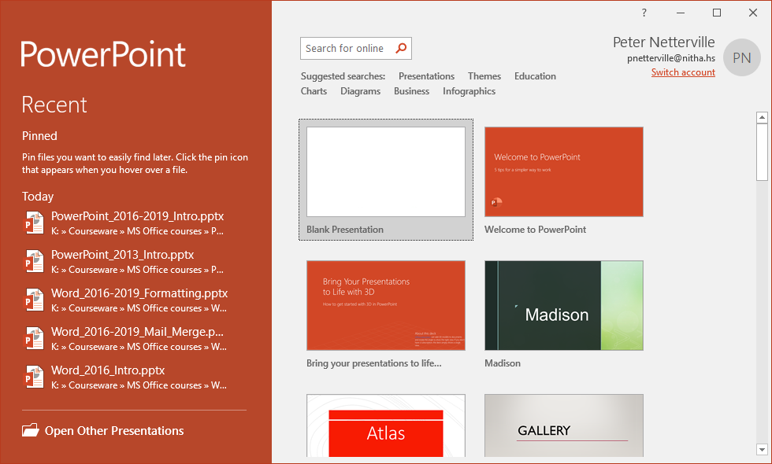
Open Sample Document in MS PowerPoint 2016/2019
When you first open the program, this is the screen you will see. From here you can open an existing presentation or start a new one from a template. Even the blank presentation is a template.
To start a new presentation, you would click on Blank Presentation, however …
… we will open the
PowerPoint_2016-2019_Sample.pptx
file.
Click on the Open Other Presentations link.

Slide 5
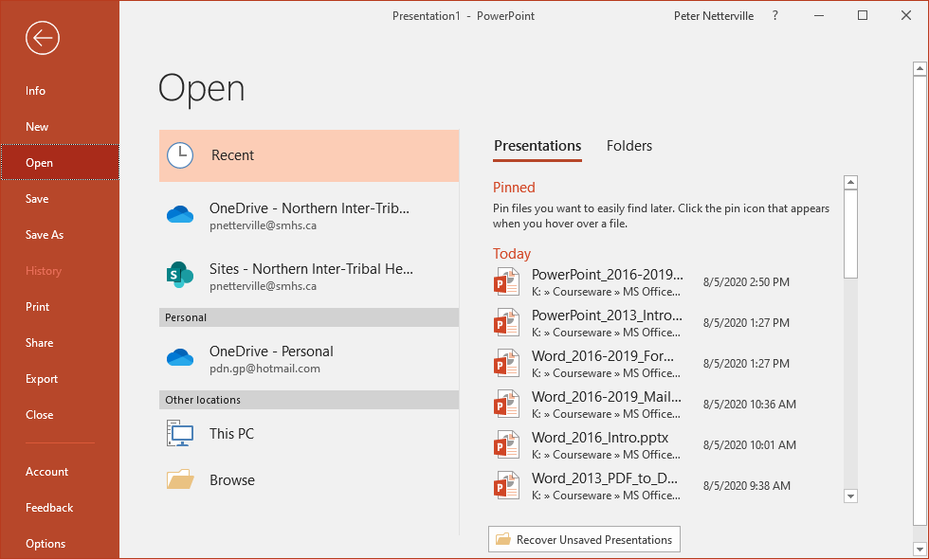
Open Sample Document in MS PowerPoint 2016/2019
Which displays the Open screen.
Now click on the Browse link.

Slide 6
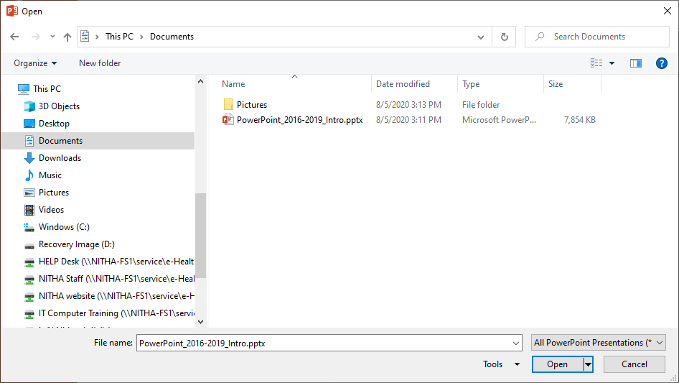
Open Sample Document in MS PowerPoint 2016/2019
Which displays the Open dialog.
Now select the folder in the Navigation pane where the course data file is saved.
Click on Open
Click on the file in the list pane.

Slide 7
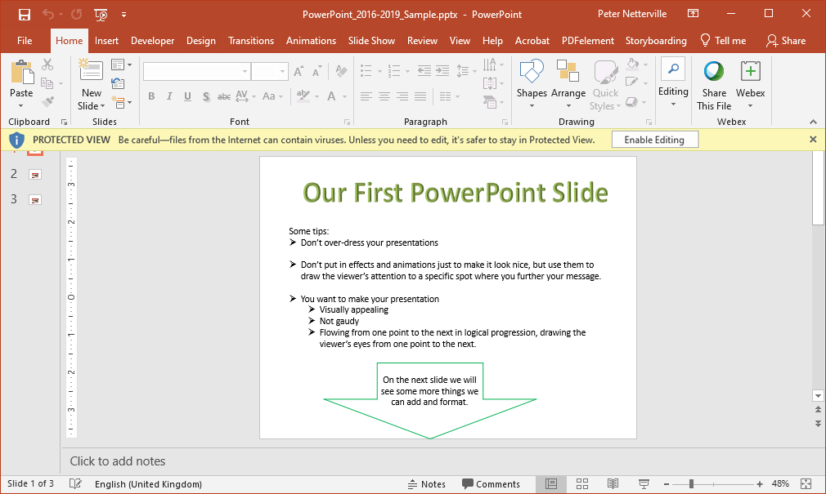
Parts of PowerPoint
If you see this Protected View bar, click on Enable Editing

Slide 8
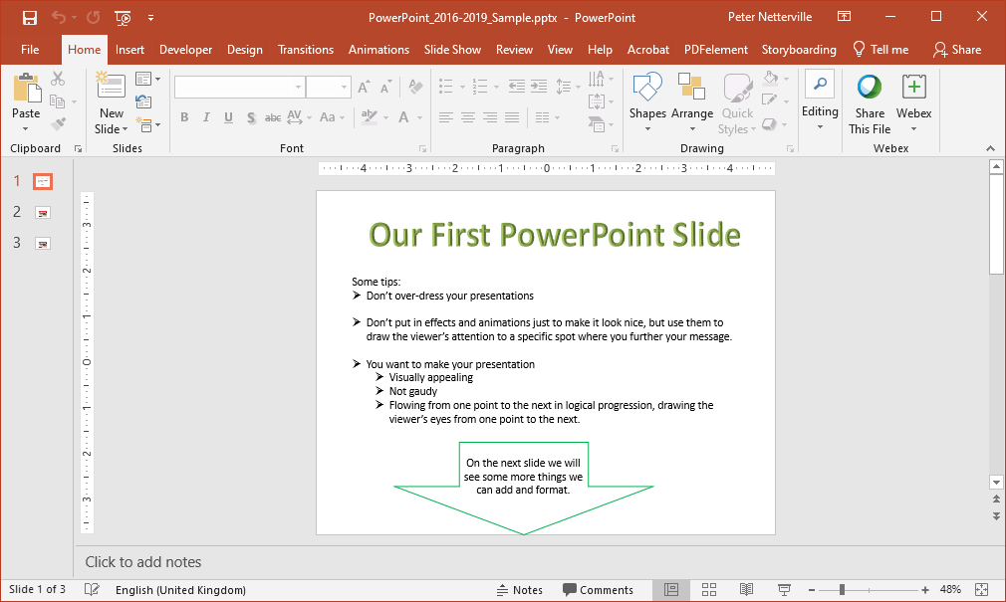
Parts of PowerPoint
Ribbon Minimize Button
Quick Access Toolbar
Ribbon
Slides Navigation Pane
Slide Pane
Notes Pane
Status Bar

Slide 9
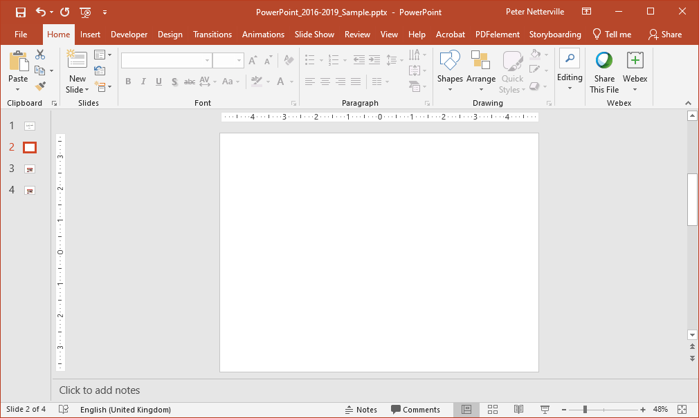
Exercise Two
The Making of a PowerPoint Slide
In order to make a new slide
… do the following …

Slide 10

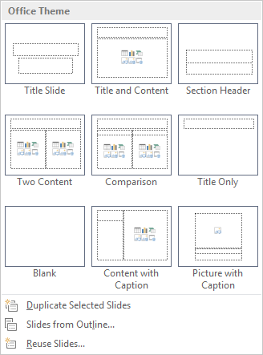
Exercise Two
The Making of a PowerPoint Slide
Click on the Home Tab
Click on the New Slide menu from the Slides group.
Select the slide Blank slide

Slide 11
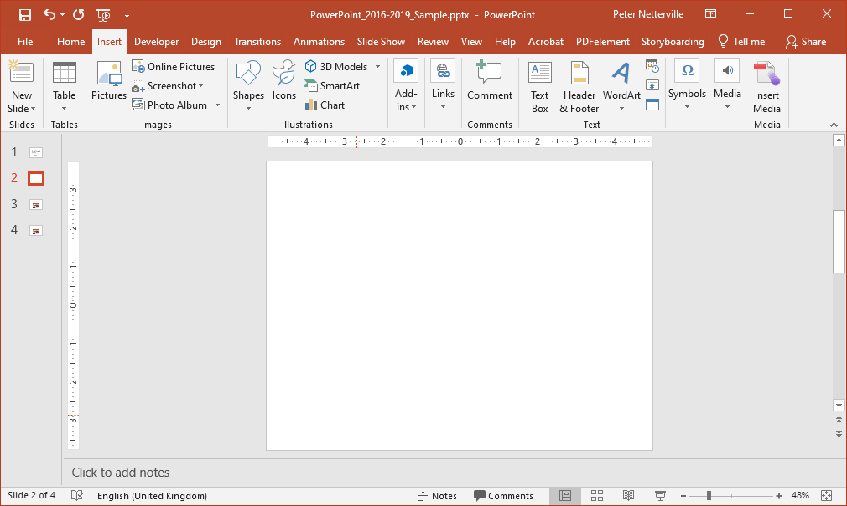


Exercise Two
The Making of a PowerPoint Slide
Click on the Insert tab
Notice the new slide was inserted below the slide you had selected
Let’s make a WordArt title.
Click on WordArt
Select the WordArt that appeals to you.

Slide 12
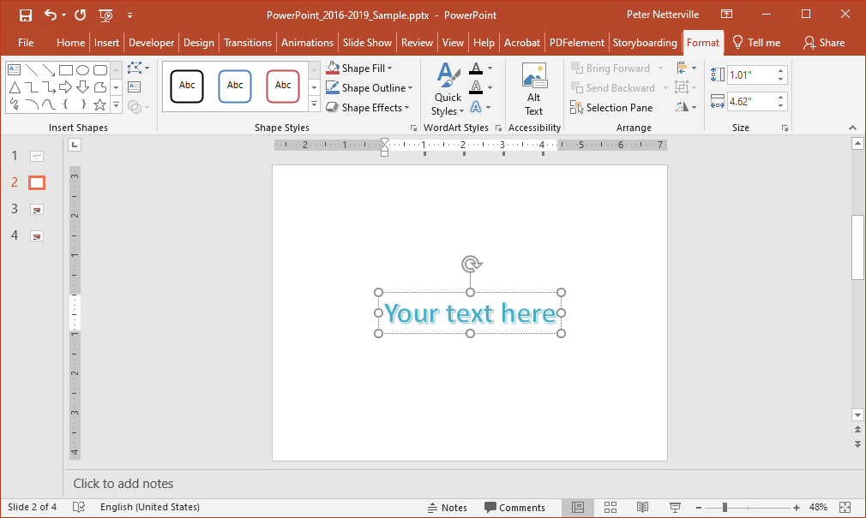
Exercise Two
Notice the context ribbon that appears, Format, which provides for you the commands to work with the WordArt object.
The Making of a PowerPoint Slide
Type into the new WordArt box you just created,
Our First PowerPoint Slide,
and move it to the top of the slide.

Slide 13
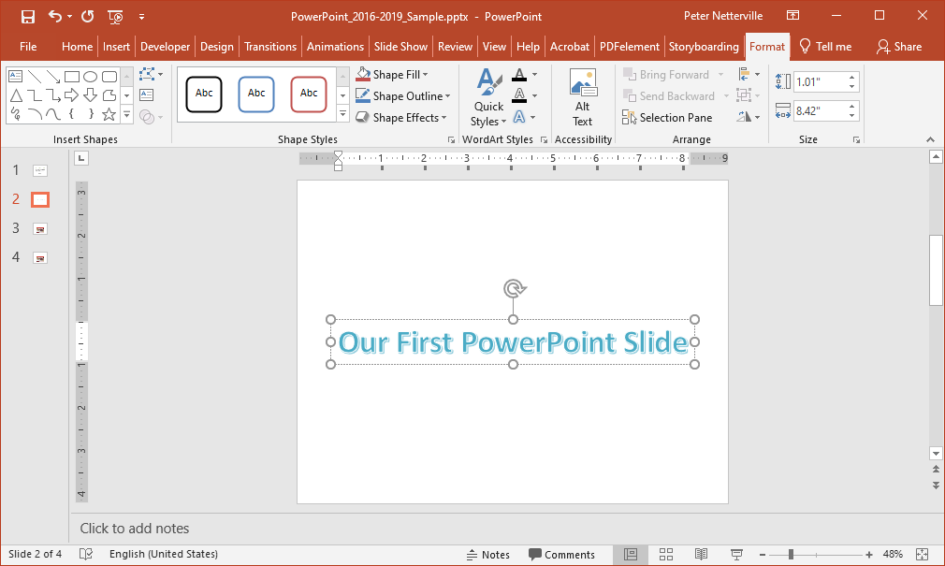
Exercise Two
The Making of a PowerPoint Slide
Now move the new Word Art up to the top of the slide.

Slide 14
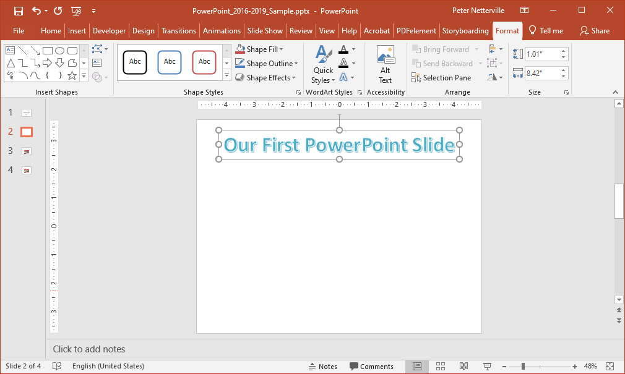
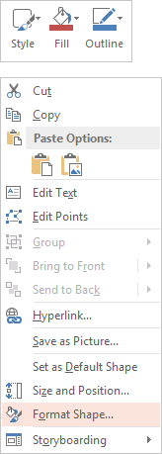
Exercise Two
Now that we have an object on the slide, a WordArt object, let’s do some formatting to it.
The Making of a PowerPoint Slide
Right click on the WordArt or the edge of the box, the dashed line.
… OR …
click on the launcher button to display the formatting panel.
If you Right clicked on the shape then select Format Shape… from the menu that appeared ...

Slide 15
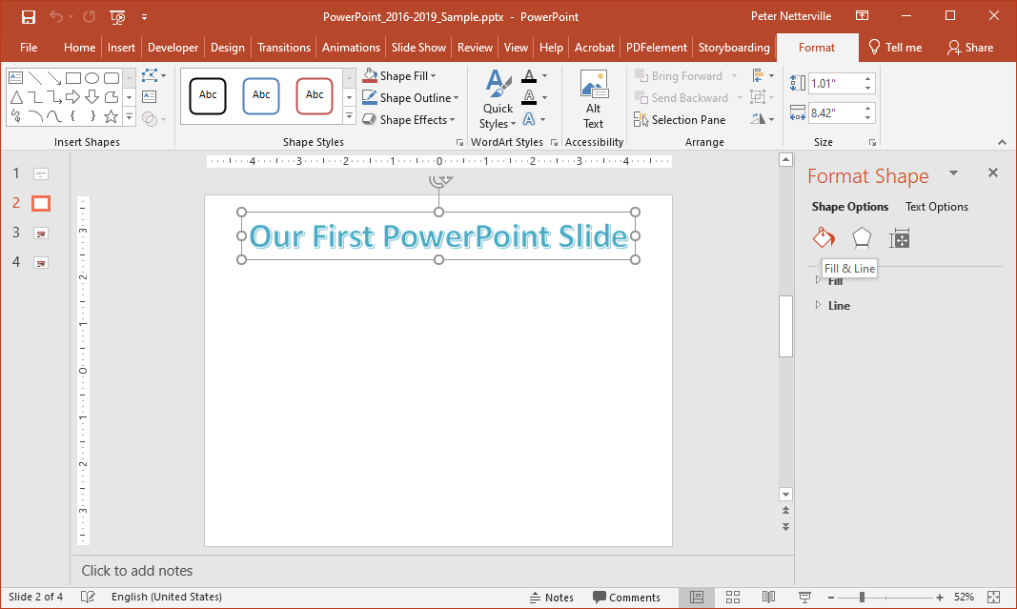
Exercise Two
When the WordArt container, not the text, is selected Shape Options is selected.
The shape is the container object.
The Making of a PowerPoint Slide
1. Fill & Line/Outline formatting
The Format Shape panel has three categories and ribbon has two categories:

Slide 16
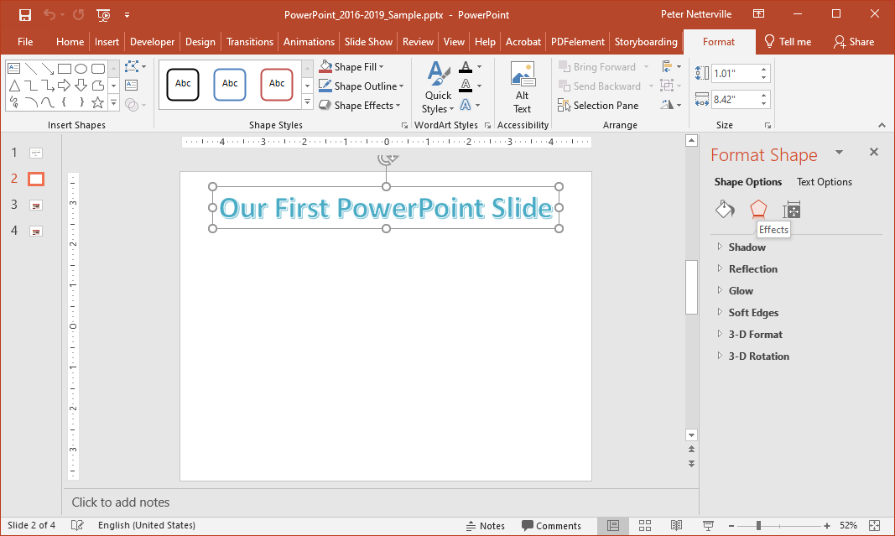
Exercise Two
When the WordArt container, not the text, is selected Shape Options is selected.
The shape is the container object.
The Making of a PowerPoint Slide
2. Effects formatting

Slide 17
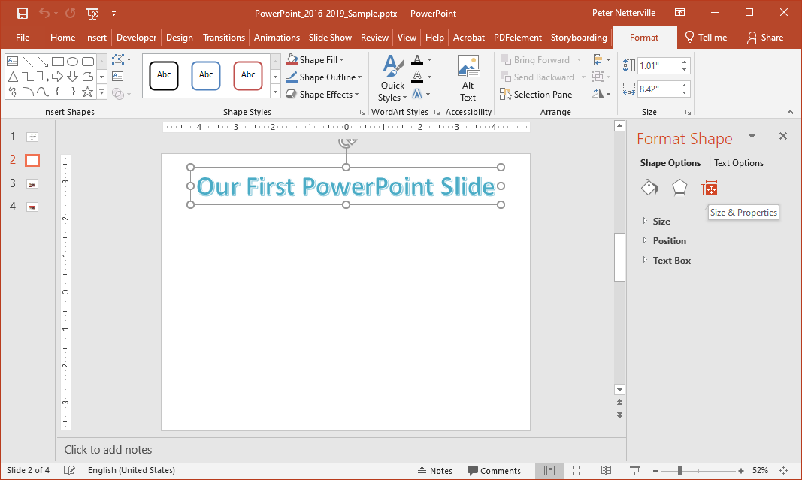
Exercise Two
When the WordArt container, not the text, is selected Shape Options is selected.
The shape is the container object.
The Making of a PowerPoint Slide
3. Size & Properties formatting

Slide 18
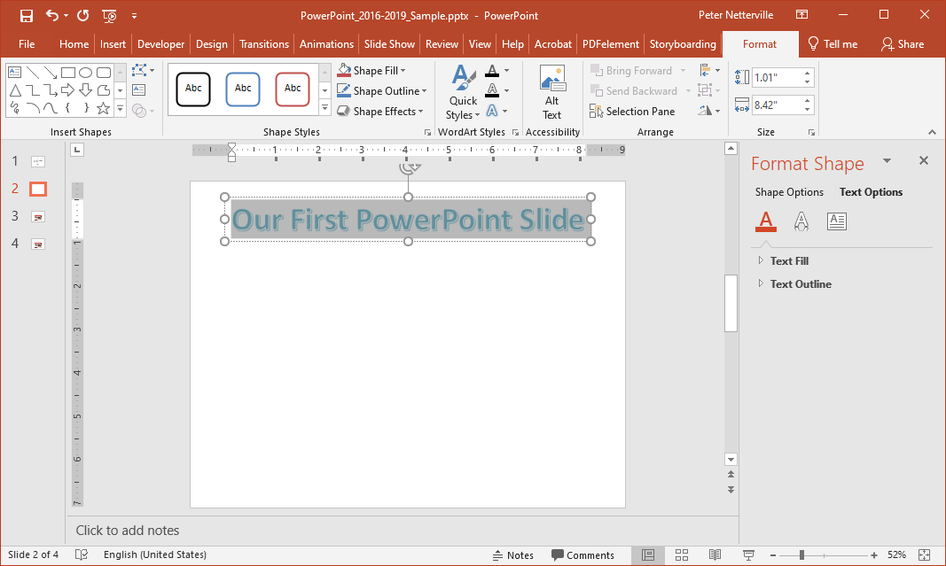
Exercise Two
When the WordArt text, not the container, is selected Text Options is selected.
The Making of a PowerPoint Slide
1. Fill & Outline formatting

Slide 19
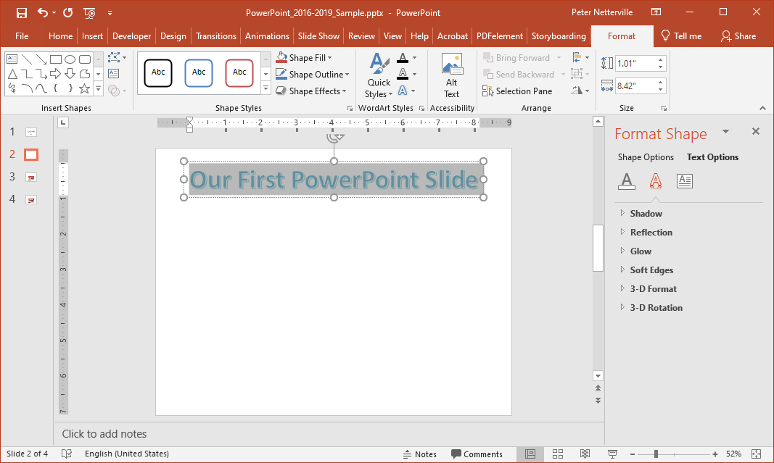
Exercise Two
When the WordArt text, not the container, is selected Text Options is selected.
The Making of a PowerPoint Slide
2. Text Effects formatting

Slide 20
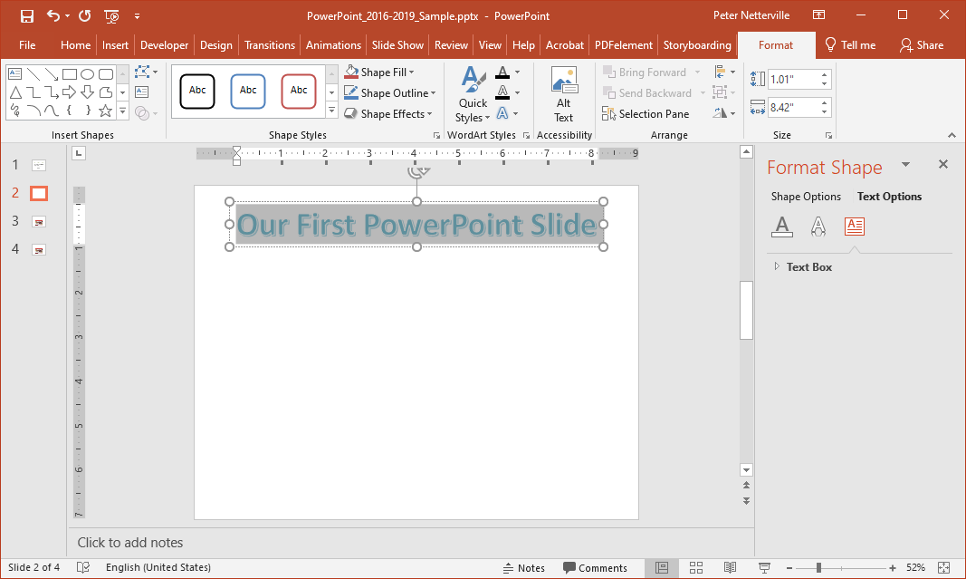
Exercise Two
When the WordArt text, not the container, is selected Text Options is selected.
The Making of a PowerPoint Slide
3. Text Box formatting

Slide 21
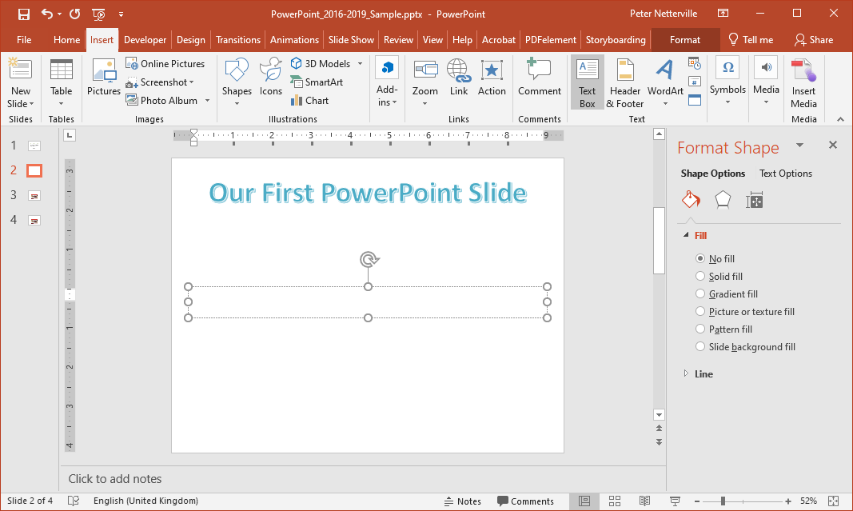
Exercise Two
Now that we have inserted our WordArt title, let’s insert some content in a Textbox..
Add a Text Box and place it below the title by …
  placing the pointer to the top left where you want the text box to start
dragging the mouse pointer to the bottom right where you want the text box to end
When you release the mouse button the Drawing Tools / Format also appears, though it may not be selected. If not, click on the ribbon tab.

Slide 22
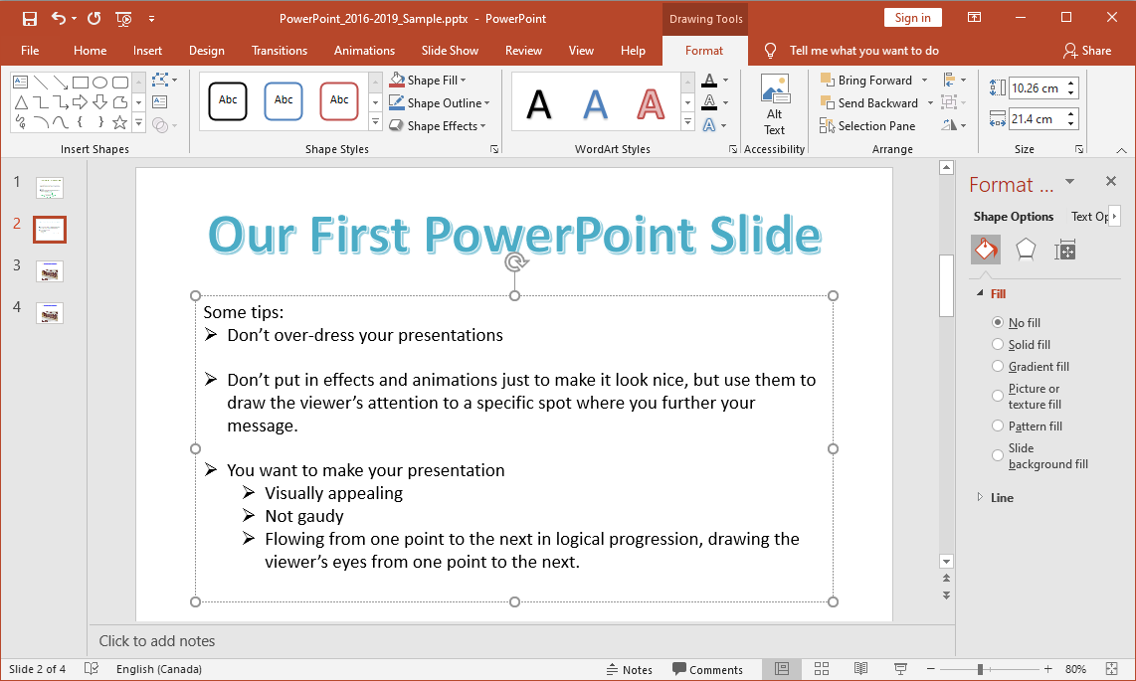
Exercise Two
Now that we have
inserted a WordArt title,
inserted a Textbox
Now type some content.
You can copy and paste the content from slide one, if you wish.

Slide 23
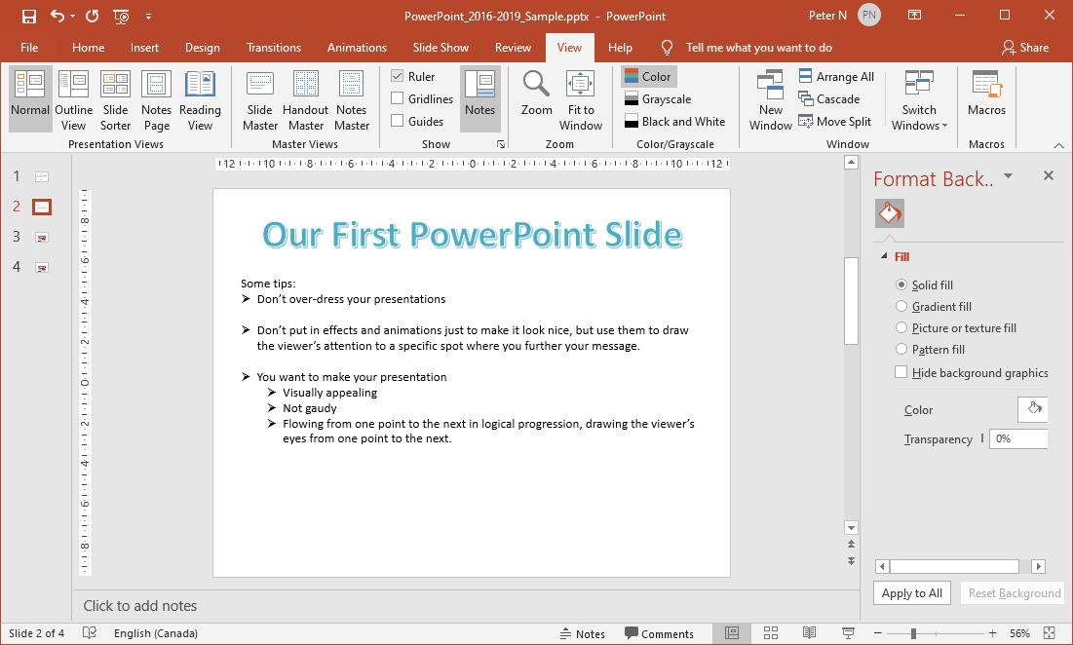
Exercise Two
At this point expose the ruler …
Click on the View tab to show the View ribbon …
Check the Ruler box

Slide 24
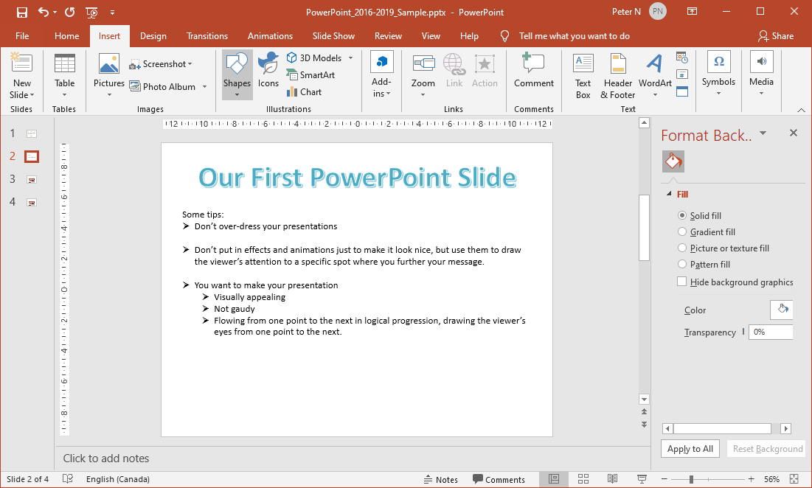
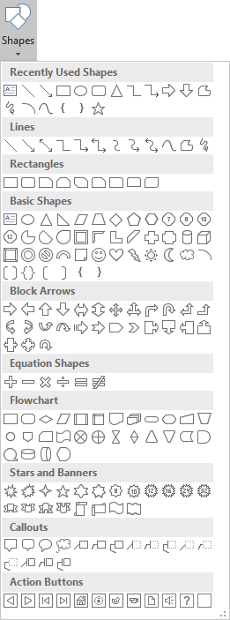
Exercise Two
Now that we have added content, let’s add a down-arrow and animate it.
Click on the Insert tab.
Click on Shapes.
Select the large down arrow and draw it at the bottom of the slide under the text we just typed in.

Slide 25
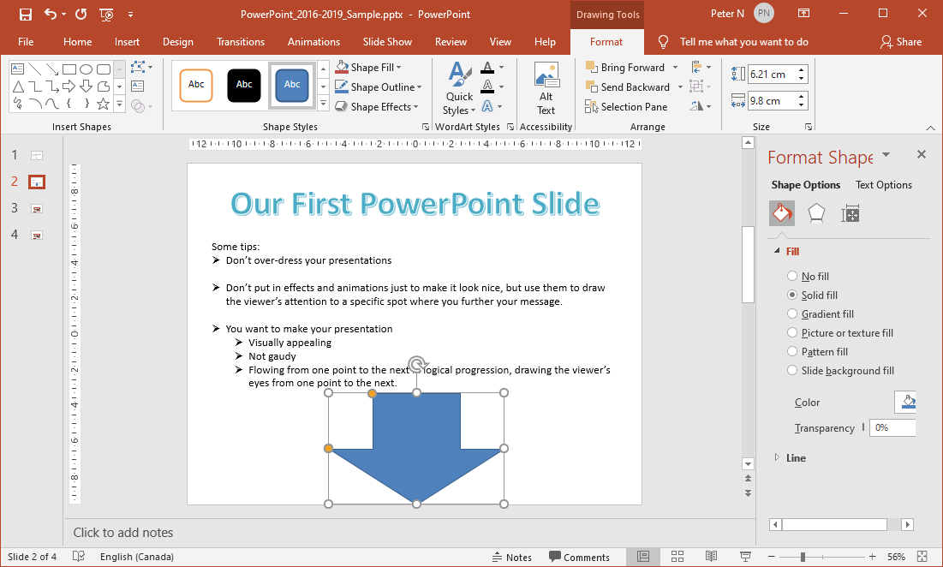
Exercise Two
Now to add some text and formatting to the arrow.
  Select the arrow and format as you like.

Slide 26
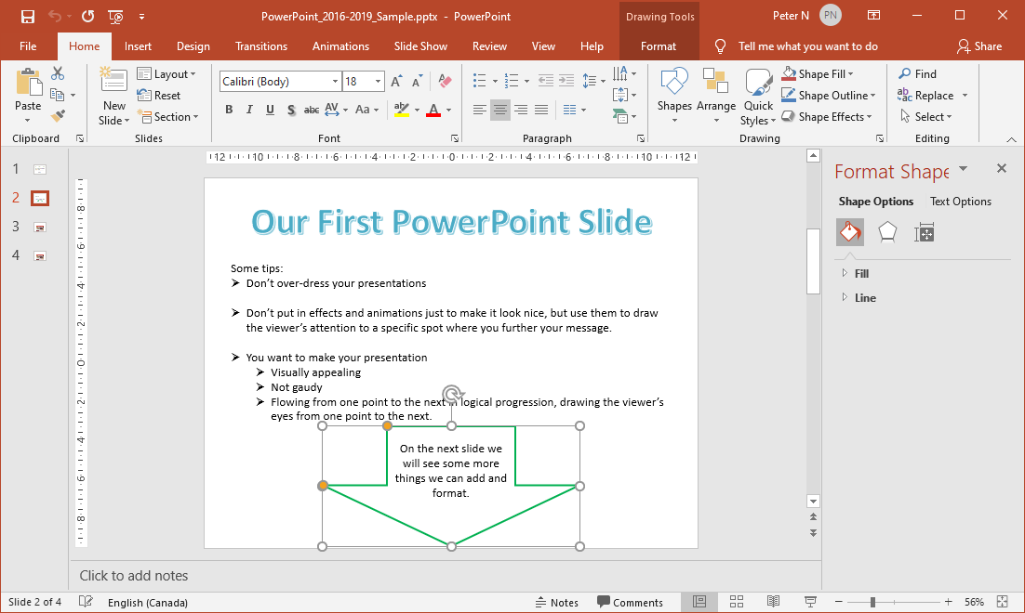
Exercise Two
Now apply whatever formatting you wish to the arrow object.
  Note that if you type text in the arrow, it is white and centered. These things can be changed from the
  Home tab
  Font group
  Paragraph group
Now to add some text and formatting to the arrow.
… select the arrow and click on the Drawing dialog box launcher.
Right-click on the arrow and select Format Shape, which displays the Format Shape pane …
OR

Slide 27
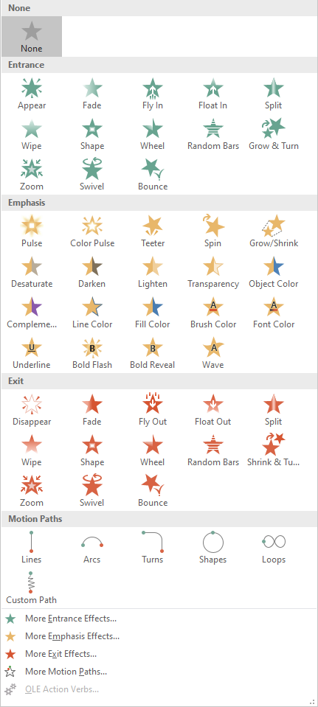
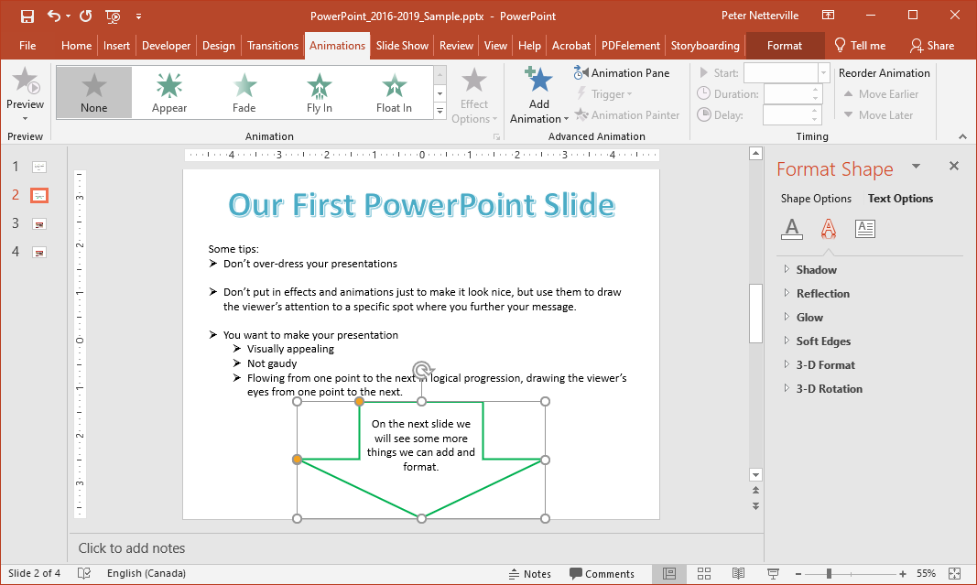
Exercise Two
Now that we have added a down-arrow and formatted it, let’s animate it.
with the arrow selected
Click on the Animations tab
Click on the down more arrow.
which displays
Now select the Fly In animation from the Entrance animations.
The Entrance animations remain hidden until its’ animation time comes up in sequence.

Slide 28
Exercise Two
The Entrance animations remain “off screen” until its’ animation time appears in the sequence you have set for it.
The Emphasis animations are either:
applied to an object that does not have any previous animations attached to it, in which case you simply select it from this dialog,
OR
applied as a second (or subsequent) animation to an object by clicking on the Add Animation button. The Add Animation button displays the same dialog but allows you to add another animation to the same object.

Slide 29
Exercise Two
The Exit animations reverse the Entrance animations; the animation moves the object until it “disappears” off the slide.
You can apply a motion path movement to any animated object.
The top four options when selected will provide added effects not found in the options above.

Slide 30
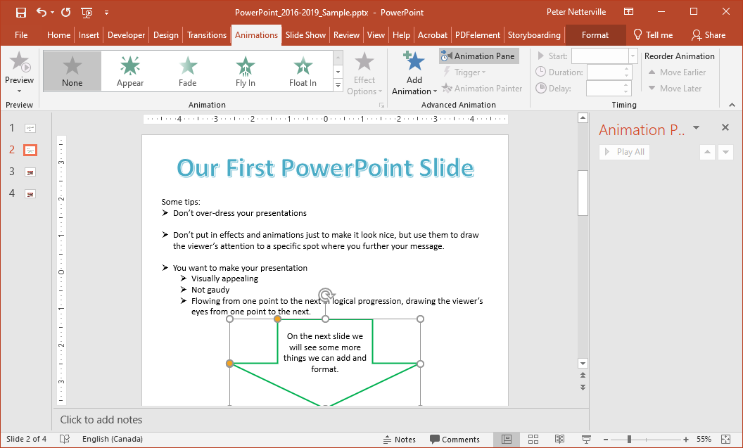
Exercise Two
Now to add some animation to the arrow.
First select the arrow …
… then select the Animations tab to expose the Animations ribbon.
Select Fly In from the Entrance animations on ribbon.

Slide 31
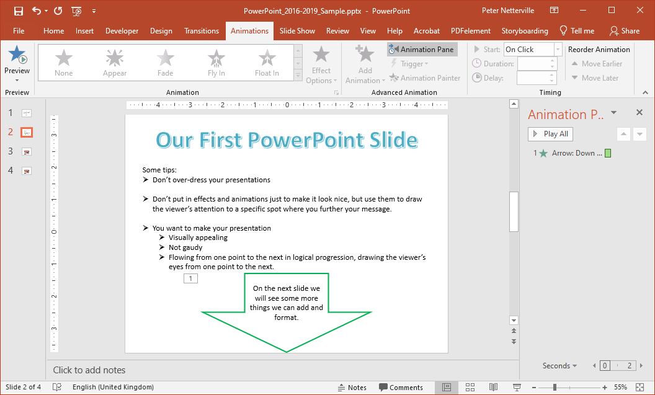
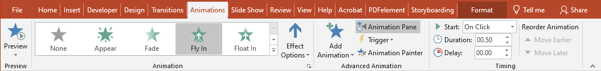
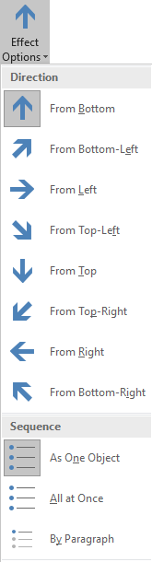
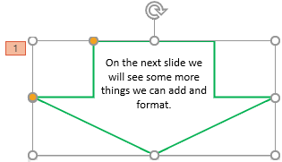
Exercise Two
You may have noticed that the arrow flew up from the bottom, which really does not make sense for an arrow that is pointing down, so let’s change that.
To make the arrow fly down from the top click on the Effect Options on the ribbon and select the From Top.
Start by selecting the arrow to make it the object that has focus.

Slide 32
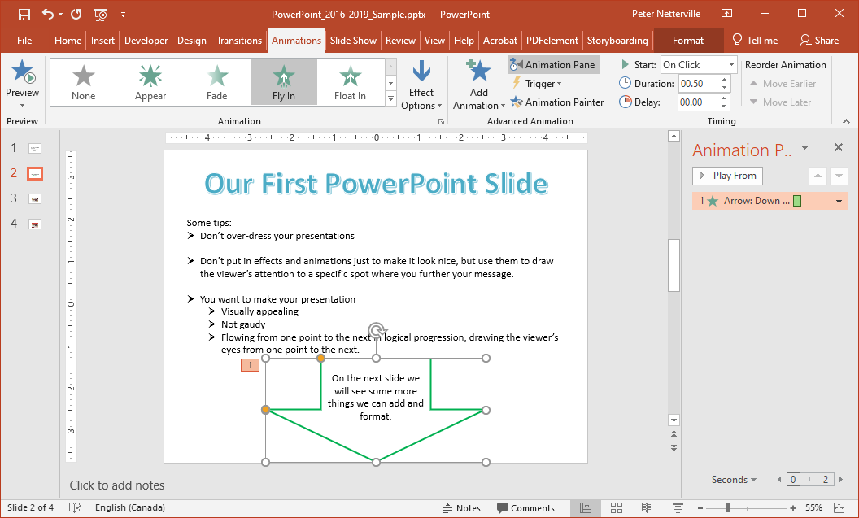
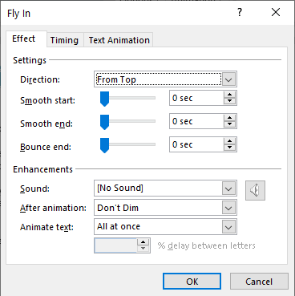
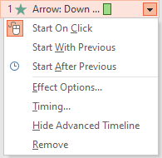
Exercise Two
Another method for changing the movement direction of the arrow is by clicking on the down arrow on the animation we just created from the Animation Pane.
The direction of the animation can be changed from here as well.
Select the Effect Options menu
Smooth Start slows the start and increases in speed evenly and vise-versa for Smooth End.
The bounce at the end of the animation can be not at all up to 0.5 seconds.

Slide 33
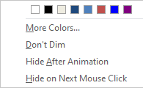
Exercise Two
Add a sound to the animation from the list or your own in .wav format.
After the animation has completed you can have the object …
Change color
Don’t Dim
Hide
Hide on next mouse click

Slide 34
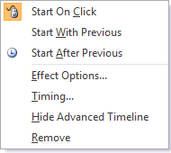
Exercise Two
Now that we have animated the arrow let’s adjust a few things.
Start On Click forces the animation to wait for a mouse click before being run.
Start With Previous causes the animation to occur at the same time as the previous animation.
Start After Previous runs the animation after the previous one has ended.
If you set to Start After Previous on the first animation then it starts immediately when the slide is displayed.

Slide 35
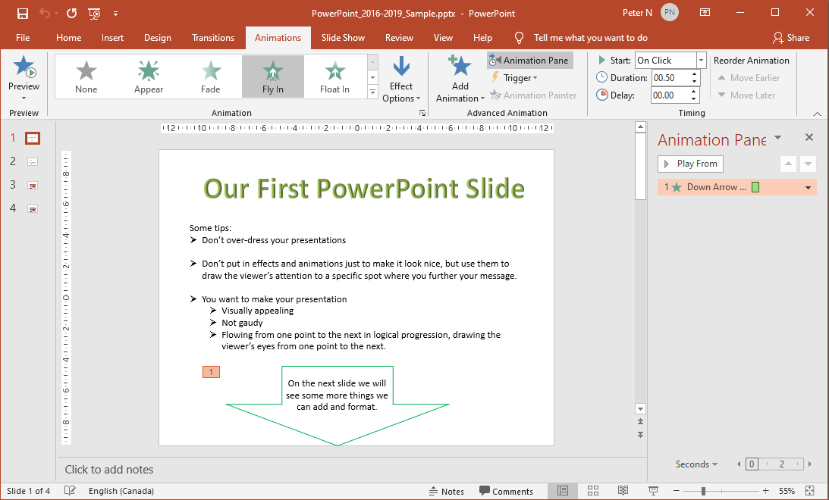
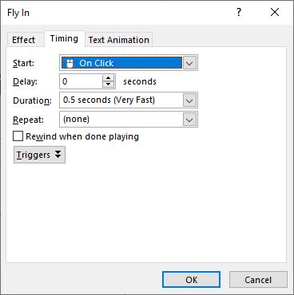
Exercise Two
Now that we have animated the arrow let’s adjust a few things.
1. Click on the Timing menu option.
On the Timing tab you can set …
How the animation starts
A delay before it starts
The duration (how long it takes to animate)
Whether it repeats
If the animation rewinds to the start when completed
Or add a trigger
Click on the Timing tab.

Slide 36
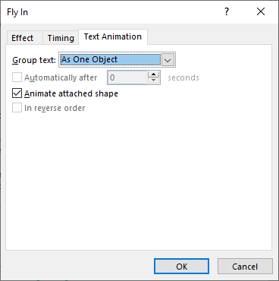
Exercise Two
Now that we have animated the arrow let’s adjust a few things.
Click on the Text Animation tab.
In the Animation Pane you can also change the animation execution order by picking it up with your mouse and moving it.
On the Text Animation tab you can set …
How you group text: as a group object or at a certain paragraph level.
When the text is to be automated
Control whether the attached shape is to be animated or not.
Reverse the order of animation events.
So we have seen how from the Animation Pane you can control specifically how the animation is to occur.

Slide 37
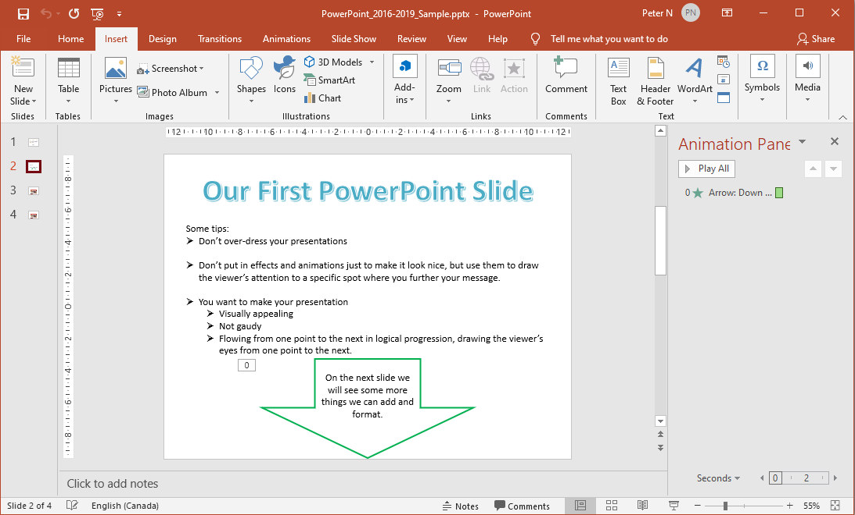
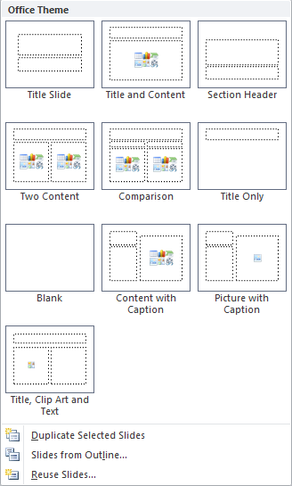
Exercise Two
Let’s move on to the next slide.
Next is to start a new slide.
Click on the Home or Insert tab.
Click on New Slide.
Notice that there are templates from which you can select to best suits your needs.
But in this case, choose Blank.

Slide 38
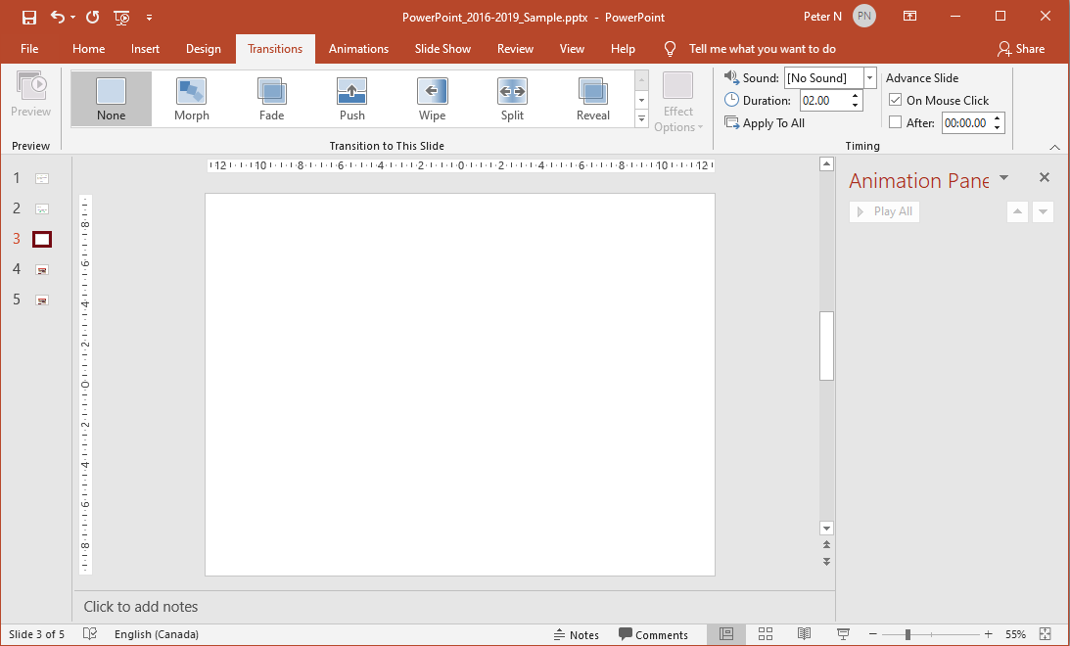
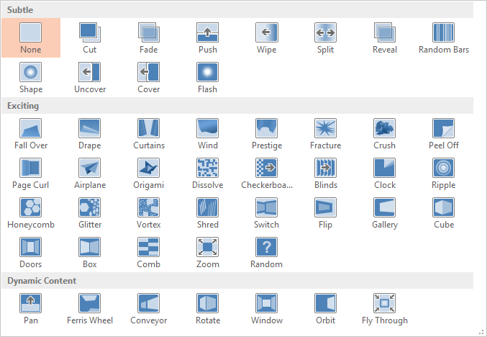
Exercise Two
With a new blank slide we can add more content and continue the presentation.
First let’s change how the previous slide transitions into this slide.
Click on the Transitions tab.
You can choose from one of the slide transitions shown, but let’s display the menu.
Click on the More menu button.
Now click through the choices and each one will preview animate for you.
You will need to select the More menu after selecting each one.

Slide 39
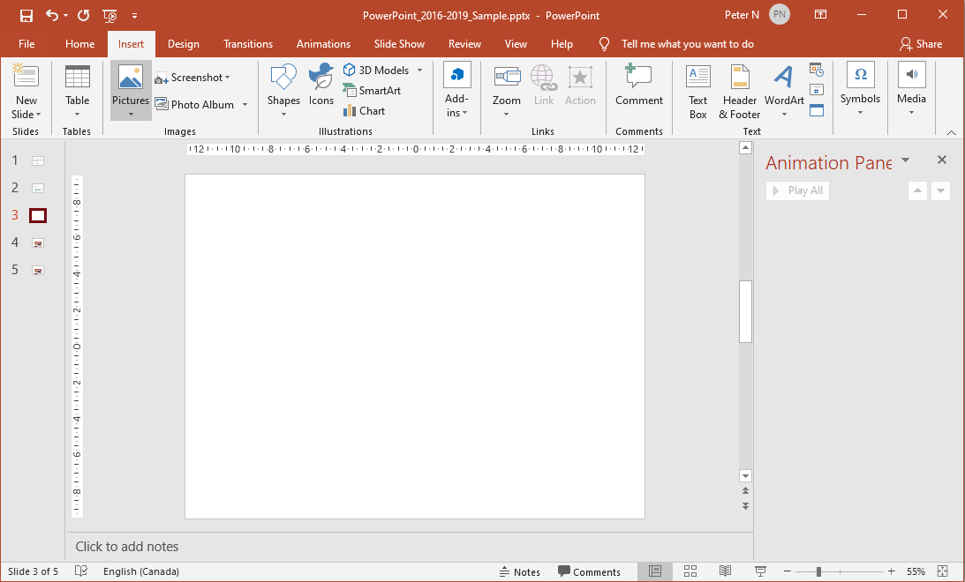
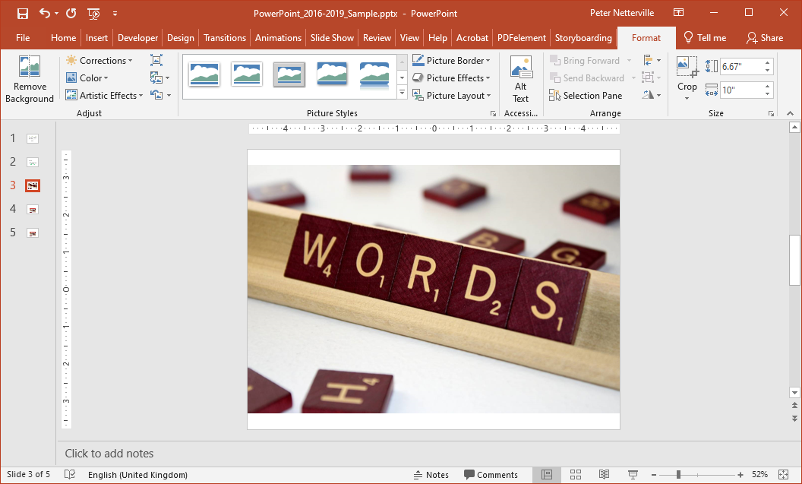
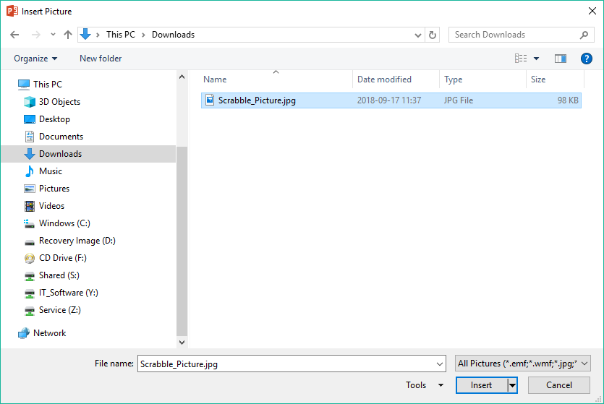

Exercise Two
Now you have added a slide transition to this slide from the previous slide.
Next, insert an image from file.
Click in the Insert tab.
Click on Scrabble_Picture.jpg
Click on Pictures in the Images group.
Which displays the Insert Picture dialog.
Navigate to where the picture lives, probably the Downloads folder.
… the small menu that appears will let you link to the file instead of inserting it into the PowerPoint presentation, or to link and insert both.
Click on the Insert button.
Note: If you click on the down arrow beside the Insert button …

Slide 40
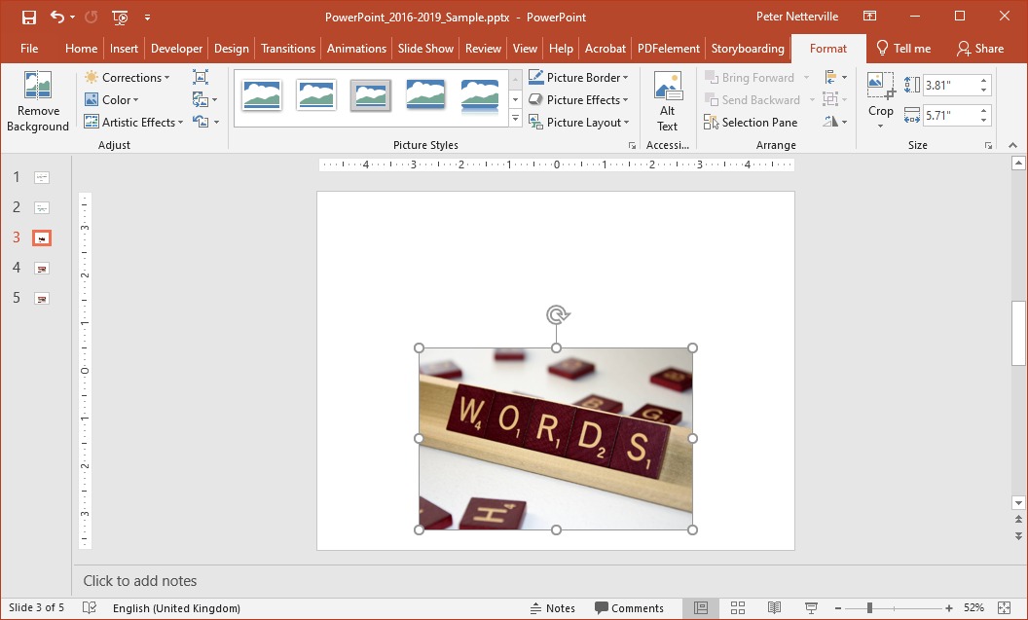
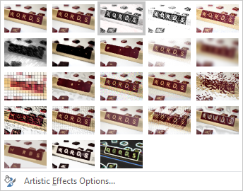
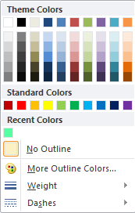


Exercise Two
Tip: Vector graphics can be resized without degradation of the image, but a raster graphics will pixelate as it is resized larger.
Resize and position the clip art as it is here.
The JPG graphic we just inserted is a lossy compression file type, a raster graphic, so making it larger will cause pixelation, but smaller will not.
With the image still selected, add
a Picture Border
a Picture Effect
an Artistic Effect
Now that you have added some styling to your clip art, let’s …
make a hyperlink above the clip art
make it like a web page link when you hover over it some effect occurs.

Slide 41



Exercise Two
There is no hyperlink hover function in PowerPoint 2016/2019 like there is for web pages, so we will have to make it.
Now that you have added some styling to your clip art, let’s …
make a hyperlink above the clip art
make it like a web page link when you hover over it some effect occurs.
Add a Text Box and then type in some text into that box.
Type or paste the web address into the Address box.
Make the text in the box (or part of the text) into a Hyperlink by:
Selecting the text for the Hyperlink
Clicking on Hyperlink in the Links group
Click on the OK button.

Slide 42



Exercise Two
… let’s decorate the text box.
With hyperlink now in a text box …
Decorate the text box as you like.
Once you have it decorated the way you like, copy the slide.
Right click on the current slide in the slide navigation pane.
Click on Duplicate Slide.
Now the navigation pane shows three slides we have made and the last one is the current slide which is the duplicated slide.
Tip: When you duplicate a slide, that slide is automatically selected.
Page 42

Slide 43


Exercise Two
Tip: When you duplicate a slide, that slide is automatically selected.
Let’s decorate the text box on the new slide by making a slight change.
Select the hyperlink text box if it is not already selected and click on Action from the Links menu on the Insert ribbon.
Make some type of change to the hyperlink.

Slide 44




Exercise Two
Make some type of subtle change. I changed the background color.
Let’s decorate the text box on the new slide by making a slight change.
Select the hyperlink text box if it is not already selected and click on Action in the Links group on the Insert ribbon.
On the Mouse Over tab click the Hyperlink to:
Now do the same to the previous slide except select Next Slide instead.
Select Previous Slide from the drop menu.
Click on OK.

Slide 45

Exercise Two
… we need to make the original slide hyperlink to the new slide.
With the original slide selected (slide 3) …
Select the hyperlink text box.
Click on Links.
Select Action from the menu.
Select the Mouse Over tab.
Click the Hyperlink to:
We are done!
Now run the second slide (shift-F5) from the Slide Show ribbon and step through the slides we just created.
Select Next Slide from the drop menu.
Click on OK.

Slide 46
Exercise Two
We are done!
Now run the second slide (shift-F5) from the Slide Show ribbon and step through the slides we just created.

Slide 47
We’ve learned so far …
How to start PowerPoint & load a file by using the Back Stage (File tab / Open).
The parts of the PowerPoint screen; the Home tab and the contextual Format tab.
How to create new slides both blank and from a template.
How to create WordArt and style it to your liking.
How to insert a Text Box, enter text and then format that Text Box to your style.
How to create a Shape and style it.
How to animate the Shape as you like, plus all the settings to customize the animation.
How to transition from one slide to the next and all the options for that.
How to insert a picture and to add some styling to it.
How to create a Hyperlink in a textbox and style it so it looks good.
How to create a mouse-over hyperlink using the Action command.
Finally, we will briefly cover the Slide Show ribbon.

Slide 48

Start Slide Show
From Beginning & From Current Slide – Self explanatory
Present Online – Online broadcasting that requires
a web service.
Custom Slide Show – Choose specific slides to create a
slide show.
Set Up
Set Up Slide Show – Settings for how to present the slide
show.
Hide Slide – Hide one or more slides from presentation.
Rehearse Timings – Times how long it takes for you to do
the presentation.
Record Slide Show – Record the presentation and save as
in AVI or MOV format.
Play Narrations – Play the recorded slide show.
Use Timings – Play timings
Show Media Controls – Displays the media controls when
mouse-over the video.
Monitors
Monitor – If two or more monitors are present, choose
which monitor to display the presentation.
Use Presenter View – If two or more monitors are
present, presenter view display the presentation, notes, and upcoming events on three panels.

Slide 49


NITHA IT Helpdesk
helpdesk@nitha.com
1(306)953-5008
Notes:
Please do not hesitate to ask any question regarding this session, and I will make sure to answer your question as soon as possible.

Slide 50


