Slide 1


PowerPoint 2013 Intro
Entry Level

Slide 2



NITHA IT Helpdesk
helpdesk@nitha.com
1(844)486-4842

Slide 3

NITHA - IT Helpdesk Courses Registration Website
How do I get to the Courses Registration Website?
First, open up your favorite web browser.
Finally, press ENTER on our keyboard
Second, type in the address bar the URL, nitha.com/courses

Slide 4

NITHA - IT Helpdesk Courses Registration Website
The NITHA Computer Training Courses Calendar
There are four sections to the
IT Helpdesk Courses Registration Website
The calendar – As seen on the right,
the calendar displays the selected month and all the course links on the appropriate days.
Morning courses 9:30 AM to 11:30 AM
Afternoon courses 2:00 PM to 4:00 PM

Slide 5
NITHA - IT Helpdesk Courses Registration Website
Cycle forward through the months by clicking on the next month
The NITHA Computer Training Courses Calendar
Cycle backward through the months by clicking on the previous month
And of course, the month in the middle is the currently displayed month.

Slide 6
NITHA - IT Helpdesk Courses Registration Website
or the next year
The NITHA Computer Training Courses Calendar
You can even click on the previous year

Slide 7
NITHA - IT Helpdesk Courses Registration Website
The NITHA Computer Training Courses Calendar
Click on the course link of your choice and you will be taken to a registration page.

Slide 8

NITHA - IT Helpdesk Courses Registration Website
The NITHA Computer Training Course Registration page
Enter your information
Select how you are going to attend the course
by WebEx
by Telehealth
Select how you want your Certificate of Completion delivered.
by Email as a PDF
by Canada Post

Slide 9
NITHA - IT Helpdesk Courses Registration Website
The NITHA Computer Training Courses WebEx Info
WebEx Information – For the WebEx connection information on how to attend the courses in the current week, click on the WebEx link.

Slide 10

NITHA - IT Helpdesk Courses Registration Website
The NITHA Computer Training Courses Calendar
These links display the WebEx information for that course
These links download the ICS file for that course so that you can add it to your Outlook calendar as an event.

Slide 11
NITHA - IT Helpdesk Courses Registration Website
The NITHA Computer Training Courses Download
Course Files Download – The courseware and the data files which are used in the courses are all available for download any time whether or not you are taking the course.
click on the Course Files Downloads link
To download the
Courseware file (A PowerPoint file)
and/or
Sample data files used in the course

Slide 12

NITHA - IT Helpdesk Courses Registration Website
The NITHA Computer Training Courses Calendar
The Course Sample File is the data file used in the course.
The PowerPoint Courseware File is the course itself.

Slide 13
NITHA - IT Helpdesk Courses Registration Website
The NITHA Computer Training Courses Calendar
Tech Videos are the fourth section of the website. As they are created, they will be placed here.
Tech Videos are short 3 to 15 minute videos featuring solutions to various tech issues.

Slide 14

What will we be covering in this course?
Download & Open PowerPoint File from NITHA
Parts of PowerPoint
The Making of a PowerPoint Slides

Slide 15
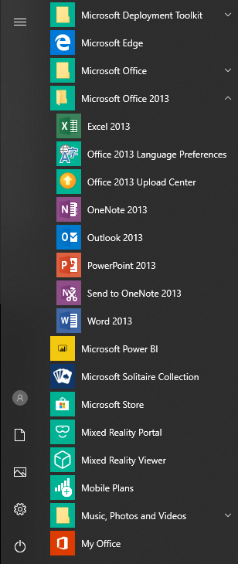
Exercise Two
Let’s open the PowerPoint 2013 program
If you are using a computer in this course, then follow along with what I do.
Goal: To start PowerPoint 2013. (Windows 10)
Click on your Start Button (Windows 10)
Scroll down the program list and find MS Office 2013
  Then click on PowerPoint 2013
Windows 10 start button

Slide 16
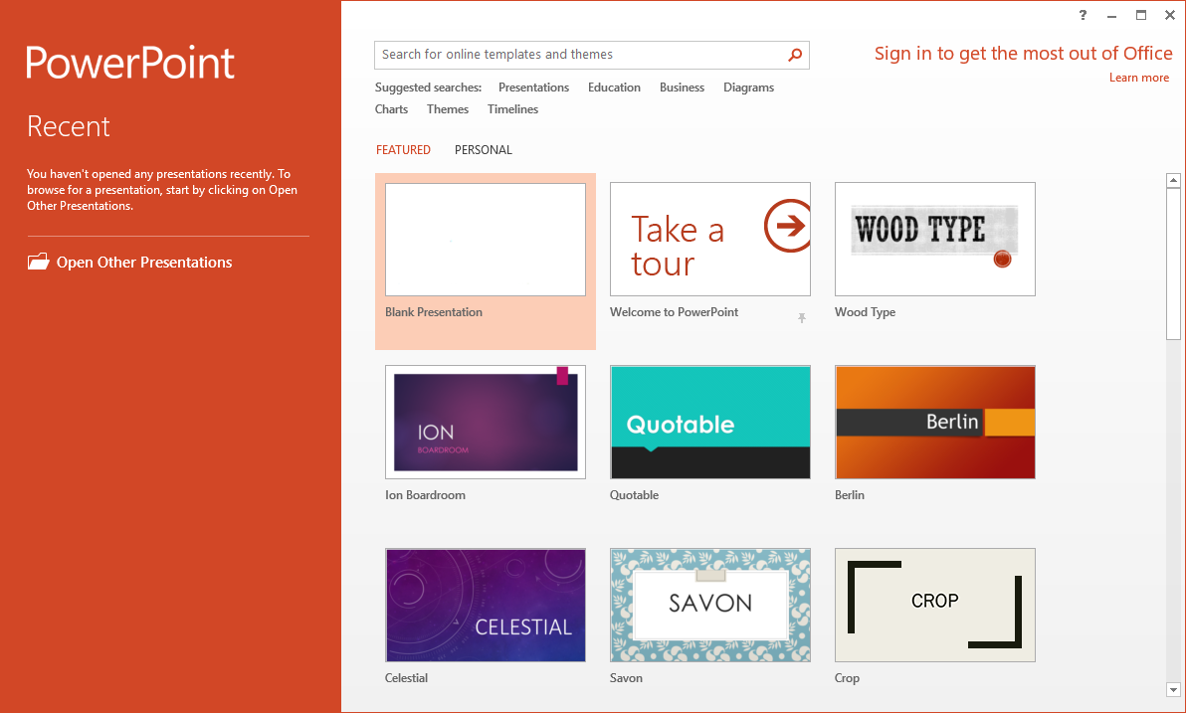
Open Sample Document in MS PowerPoint 2013
When you first open the program, this is the screen you will see. From here you can open an existing presentation or start a new one from a template. Even the blank presentation is a template.
To start a new presentation, you would click on Blank Presentation.
However, we are going to open the PowerPoint_2013_Sample.pptx file.
Click on the Open Other Presentations link.

Slide 17
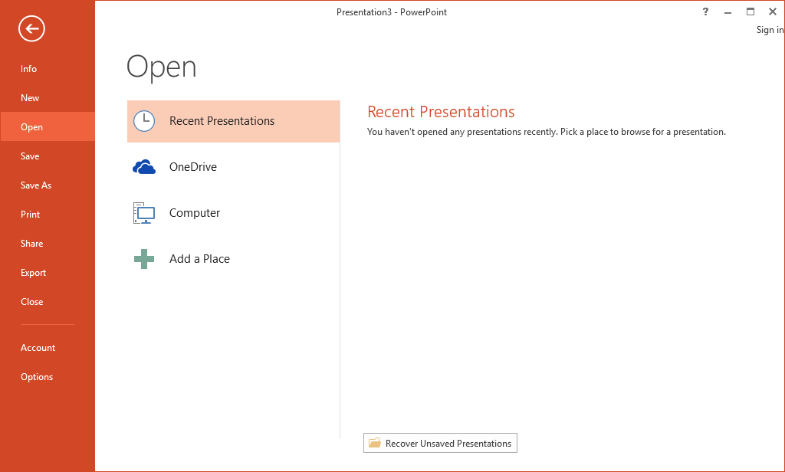
Open Sample Document in MS PowerPoint 2013
Which displays the Open screen.
Now click on the Computer link.

Slide 18
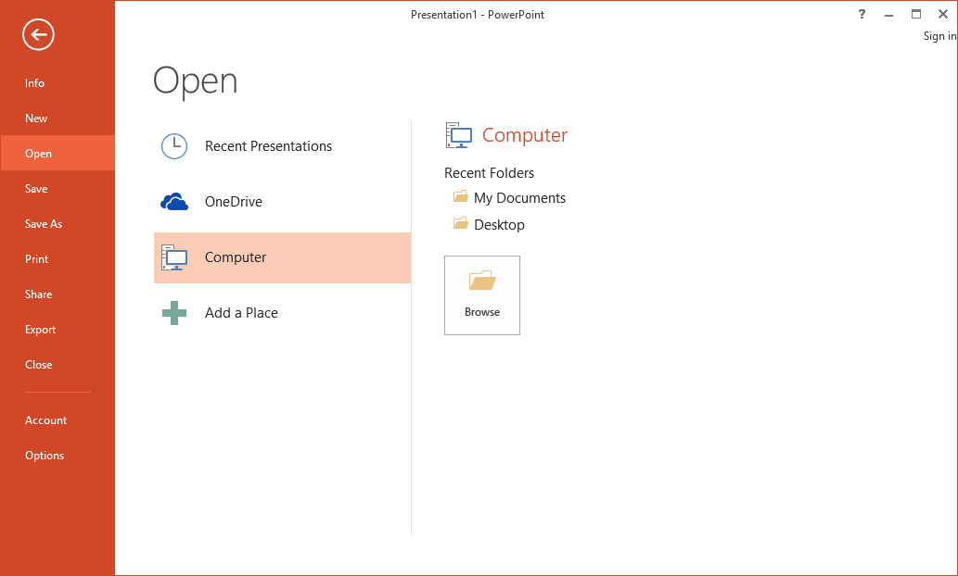
Open Sample Document in MS PowerPoint 2013
Which display the recent folders and recently opened files of which there are none in my example so it displays default folders.
Now click on the Browse button.

Slide 19
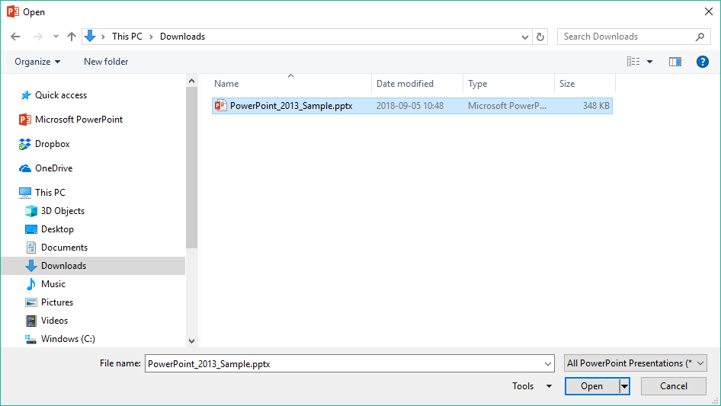
Open Sample Document in MS PowerPoint 2013
Which display the Open dialog.
Now click on the PowerPoint_2013_Sample file.
Select the folder where the PowerPoint_2013_Sample file is saved, probably the Downloads folder.
Which displays the file name in the file name box.
Click on the Open button.

Slide 20
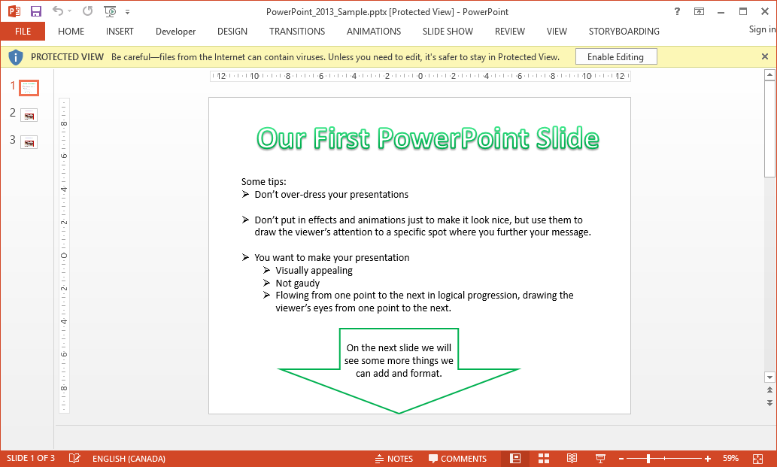
Parts of PowerPoint
If you see this Protected View bar, click on Enable Editing

Slide 21
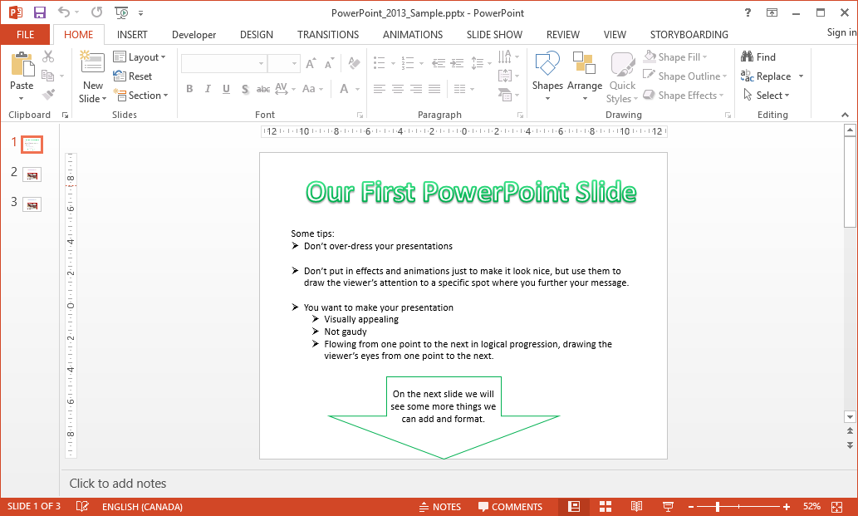
Parts of PowerPoint
Ribbon Minimize Button
Quick Access Toolbar
Ribbon
Help Button
Slides Navigation Pane
Slide Pane
Notes Pane
Status Bar

Slide 22

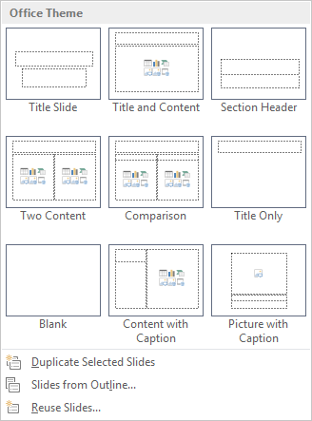
Exercise Two
The Making of a PowerPoint Slide
Click on the Home Tab
Click on the New Slide menu from the Slides group.
Select the slide Blank slide

Slide 23
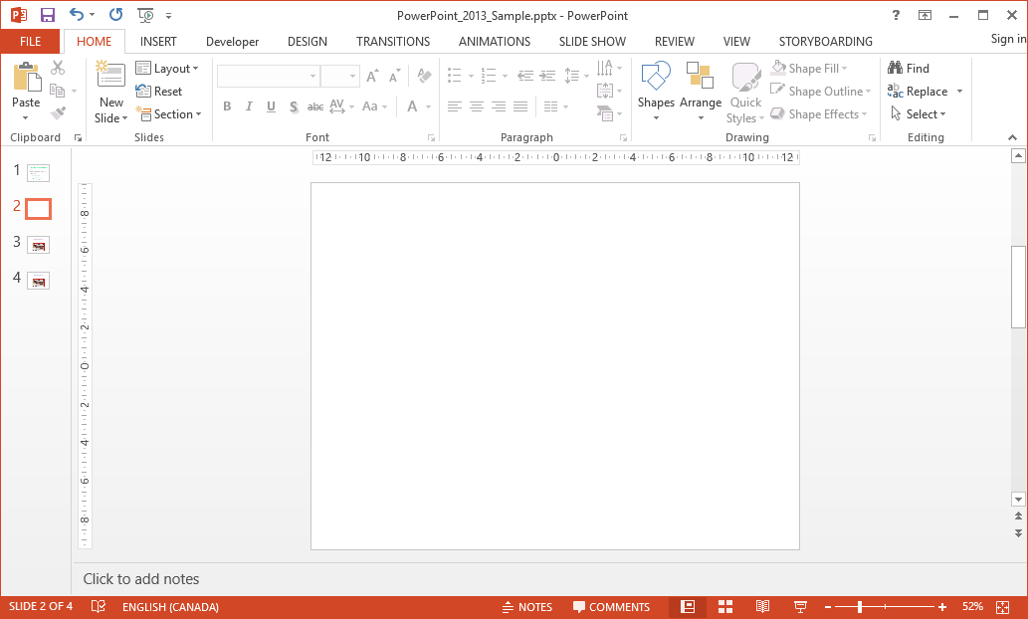
Exercise Two
The Making of a PowerPoint Slide

Slide 24
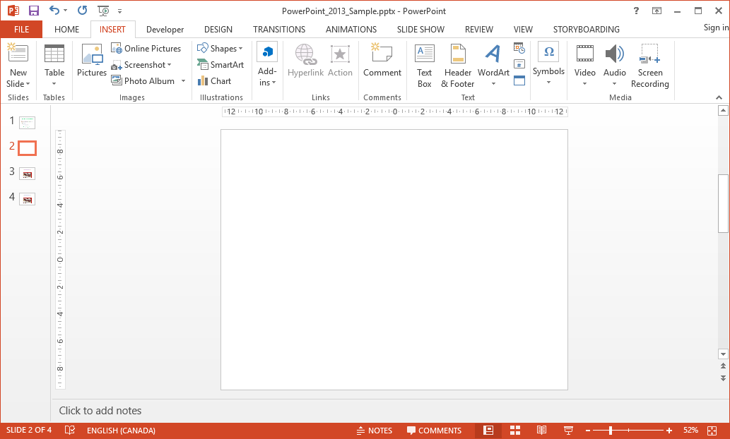


Exercise Two
The Making of a PowerPoint Slide
Click on the Insert tab
Notice the new slide was inserted below the slide you had selected
Let’s make a WordArt title.
Click on WordArt
Select the WordArt that appeals to you.

Slide 25
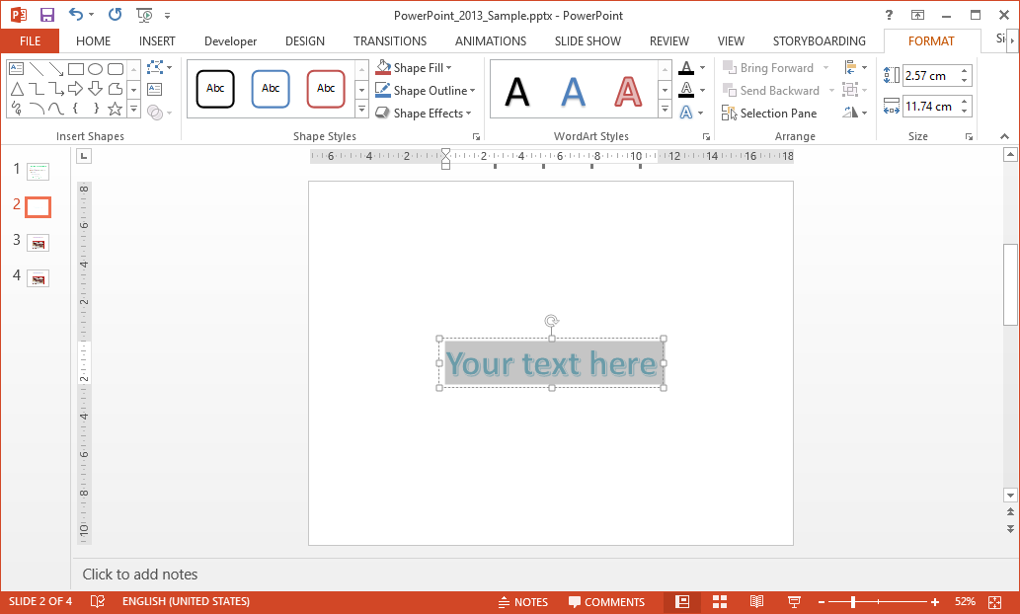


Exercise Two
The Making of a PowerPoint Slide
Type into the new WordArt box you just created,
Our First PowerPoint Slide,
and move it to the top of the slide.

Slide 26
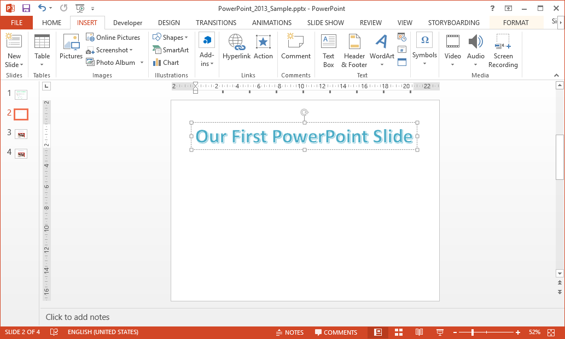
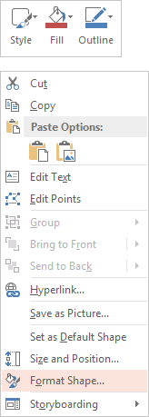
Exercise Two
Now that we have an object on the slide, a WordArt object, let’s do some formatting to it.
The Making of a PowerPoint Slide
Right click on the WordArt or the edge of the box, the dashed line.
Select Format Shape… from the list.
AND
Click on the Format tab.

Slide 27
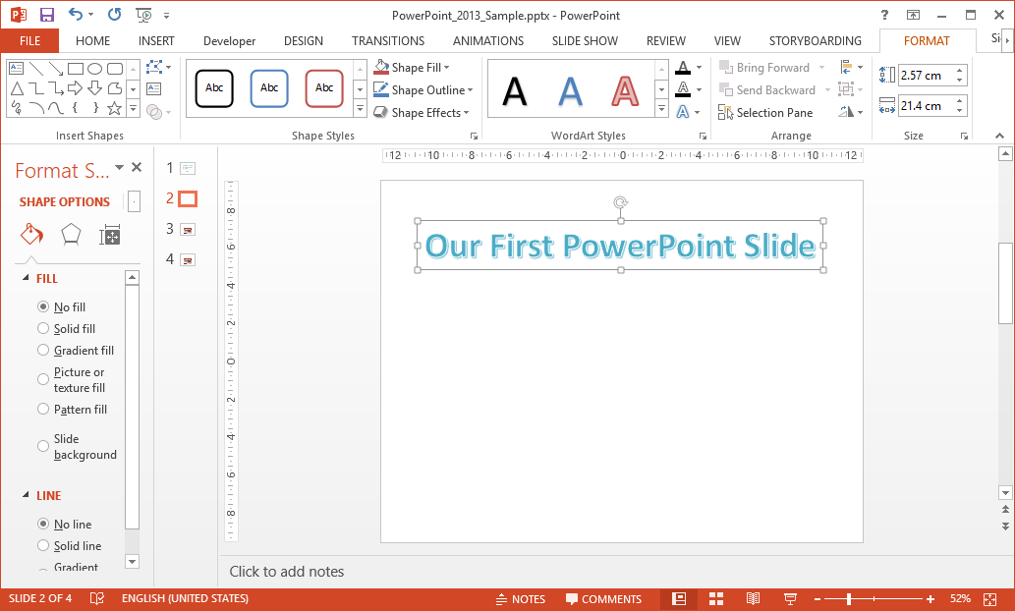
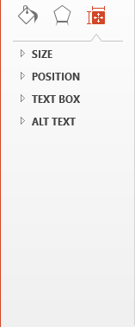
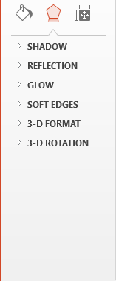
Exercise Two
Note: The Format tab will not appear until the WordArt object is selected.
The Making of a PowerPoint Slide
The Format Shape pane that was opened by right-clicking and selecting it from the menu appeared on the left side as seen here and the Format tab displays the Format object ribbon as seen here.
The Format Shape pane has three categories, two categories on the ribbon:
Fill & Line formatting
Effects formatting
Size & Properties
Note: The size & properties options are only available from the Format Shape pane, not from the ribbon.
Poke through the options and format the WordArt object we just made.

Slide 28
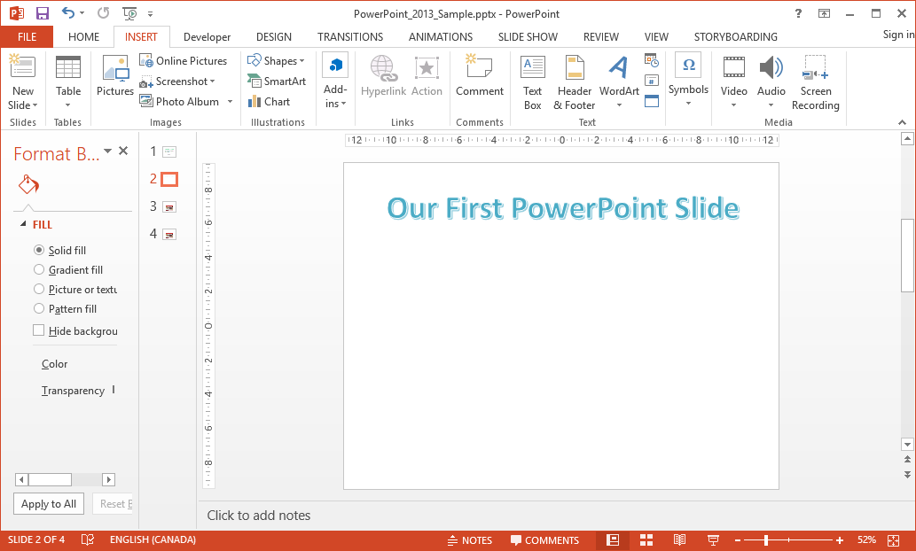
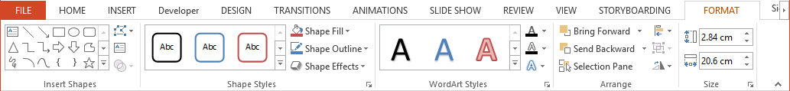

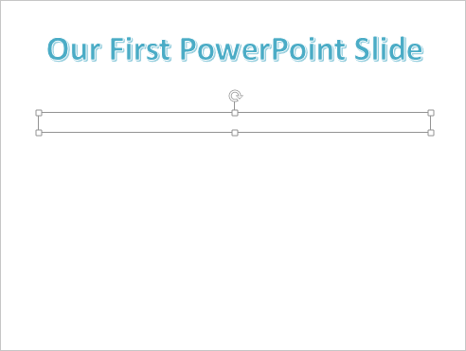

Exercise Two
Now that we have inserted our WordArt title, let’s insert some content in a Textbox..
Add a Text Box and place it below the title by
  Placing the pointer to the top left where you want the text box to start
  Dragging the mouse pointer to the bottom right where you want the text box to end
When you release the mouse button the Drawing Tools / Format also appears, though it may not be selected. If not, click on the ribbon tab.
Now type some content. You can copy and paste the content from slide one, if you wish.

Slide 29
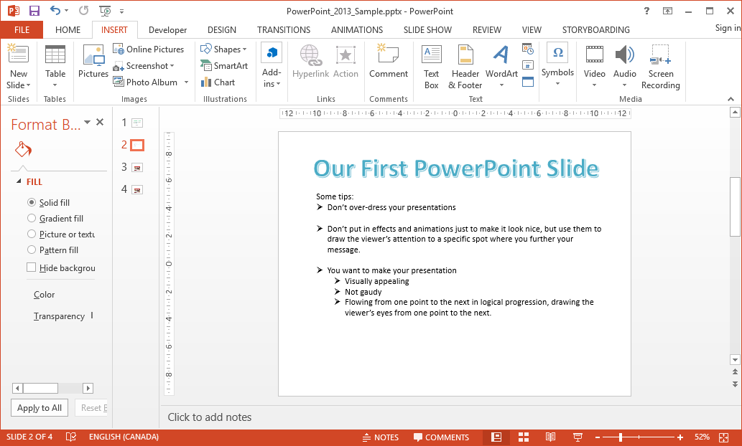
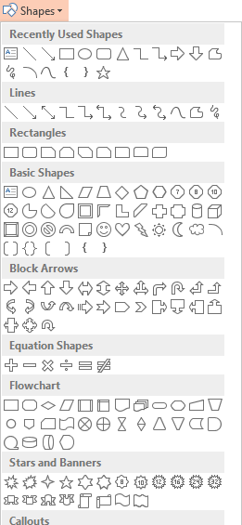
Exercise Two
Now that we have added content, let’s add a down-arrow and animate it.
Click on the Insert tab.
Click on Shapes.
Select the large down arrow and draw it at the bottom of the slide under the text we just typed in.

Slide 30
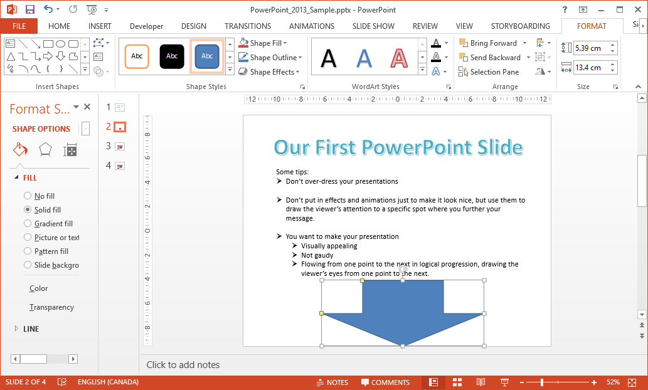
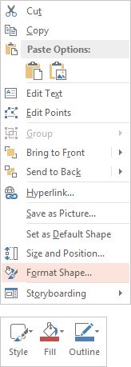
Exercise Two
Now to add some text and formatting to the arrow.
Right-click on the arrow and select Format Shape, which displays the Format Shape pane OR select the arrow and click on the Format context tab.

Slide 31
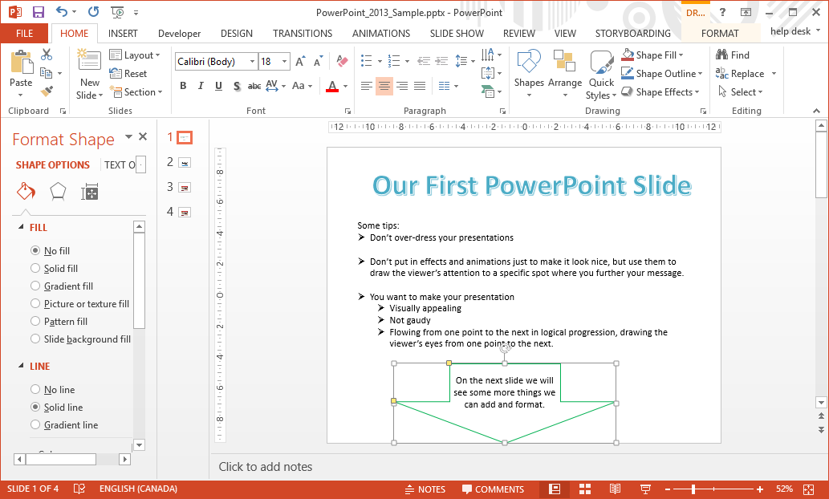
Exercise Two
Now to add some text and formatting to the arrow.
Right-click on the arrow and select Format Shape, which displays the Format Shape pane OR select the arrow and click on the Format context tab.
Now apply whatever formatting you wish to the arrow object.
  Note that if you type text in the arrow, it is white and centered. These things can be changed from the Home tab / Font and Paragraph groups.
  We will add animation in the next slide

Slide 32
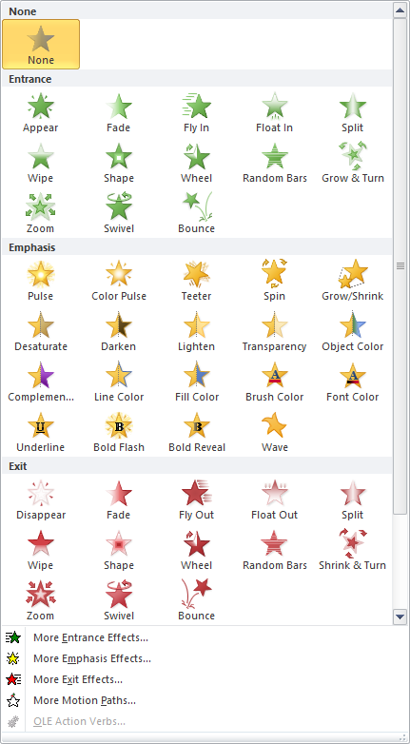
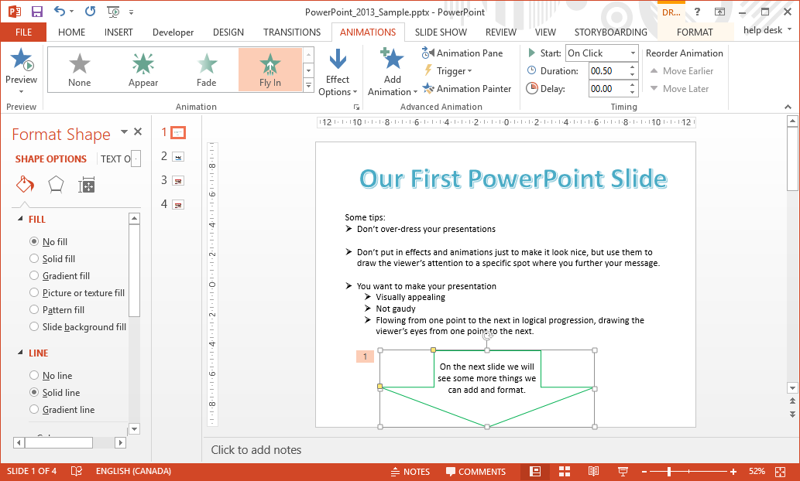
Exercise Two
Now that we have added a down-arrow and formatted it, let’s animate it.
Click on the Animations tab
Click on the down more arrow.
Now select the Fly In animation.
This first section called Entrance will hide the object until it is time to display it and then do the set animation.
Click on the Add Animation button in the Advance Animation group to add an Emphasis effect to the object after it is already displayed on the slide.
The Exit options will do the animation and then hide the object. You can also add Emphasis effects to an exiting object using the Add Animation button.

Slide 33
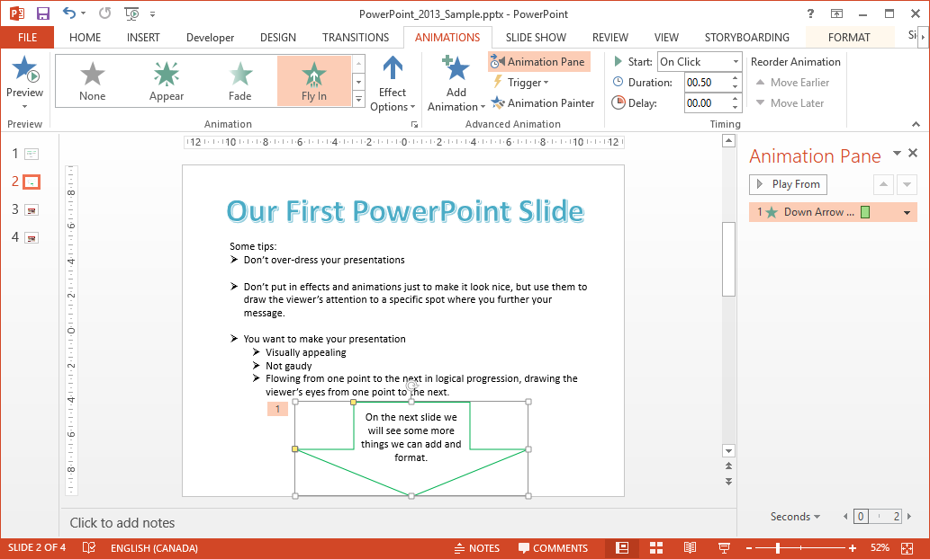
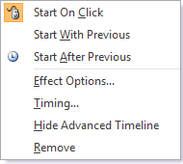
Exercise Two
In the Animation Pane that appears on the right side, click on the down arrow beside the animation.
You may have noticed that the arrow flew up from the bottom, which really does not make sense for an arrow that is pointing down, so let’s change that.
Click on the Animation Pane in the Advanced Animation group.
Select the arrow if it is not already.

Slide 34
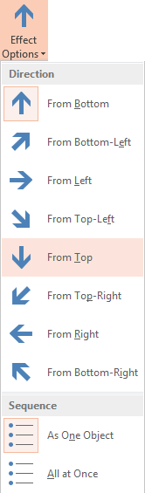
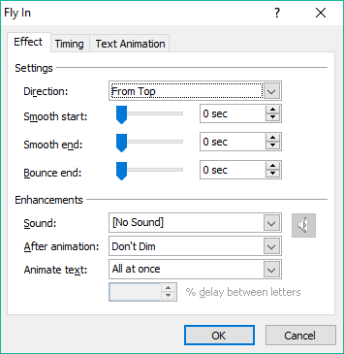
Exercise Two
OR select From Top from this Effects Option menu on the Animations ribbon
Start On Click forces the animation to wait for a mouse click before being run.
Start With Previous causes the animation to occur at the same time as the previous animation.
Start After Previous runs the animation after the previous one has ended.
Effects Options … displays a menu with further settings to customize your animation.
Select From Top from the Direction menu. Notice the other options you can apply in the Effect tab.

Slide 35
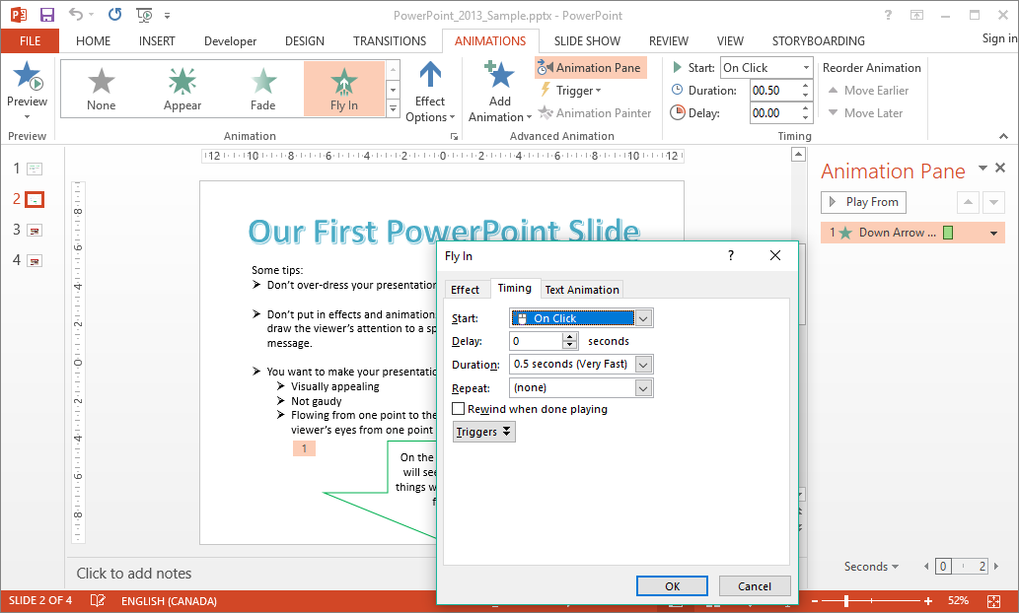
Exercise Two
Now that we have animated the arrow let’s adjust a few things.
Click on the Timing tab.
On the Timing tab you can set …
How the animation starts
A delay before it starts
The duration (how long it takes to animate)
Whether it repeats
If the animation rewinds to the start when completed
Or add a trigger

Slide 36
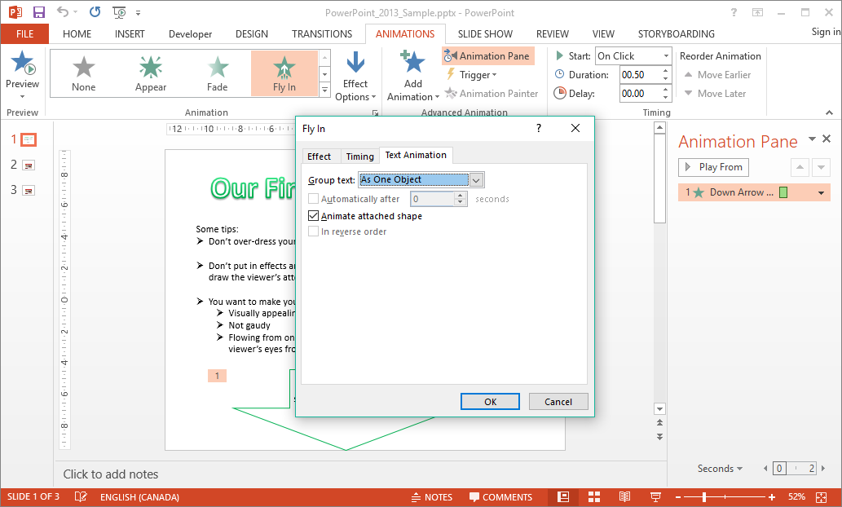
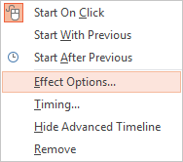
Exercise Two
Now that we have animated the arrow let’s adjust a few things.
Click on the Text Animation tab.
In the Animation Pane you can also change the animation execution order by picking it up with your mouse and moving it.
On the Text Animation tab you can set …
How you group text: as a group object or at a certain paragraph level.
When the text is to be automated
Control whether the attached shape is to be animated or not.
Reverse the order of animation events.
So we have seen how from the Animation Pane you can control specifically how the animation is to occur.

Slide 37
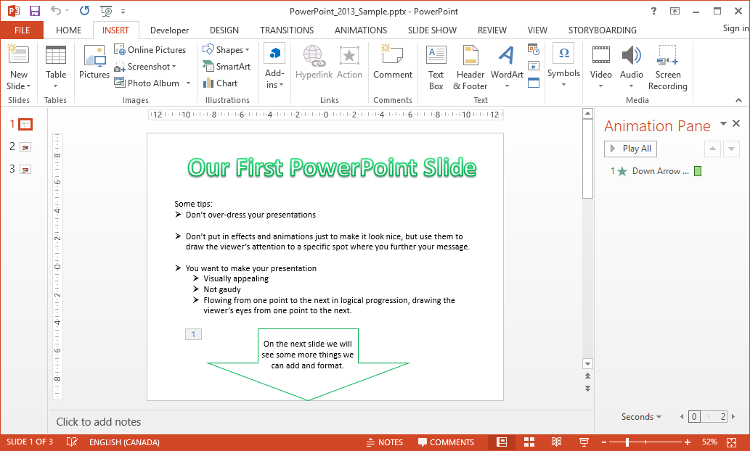
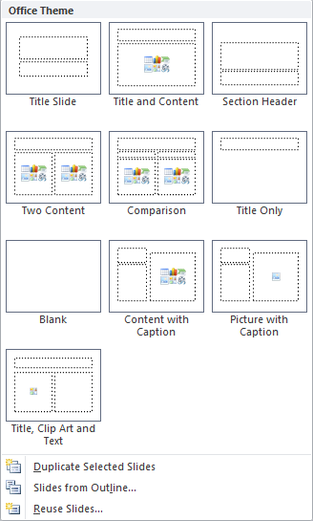
Exercise Two
Now we have an animated arrow which drops from the top to the bottom.
Next is to start a new slide.
Click on the Home or Insert tab.
Click on New Slide.
Notice that there are templates from which you can select to best suits your needs.
But in this case, choose Blank.

Slide 38
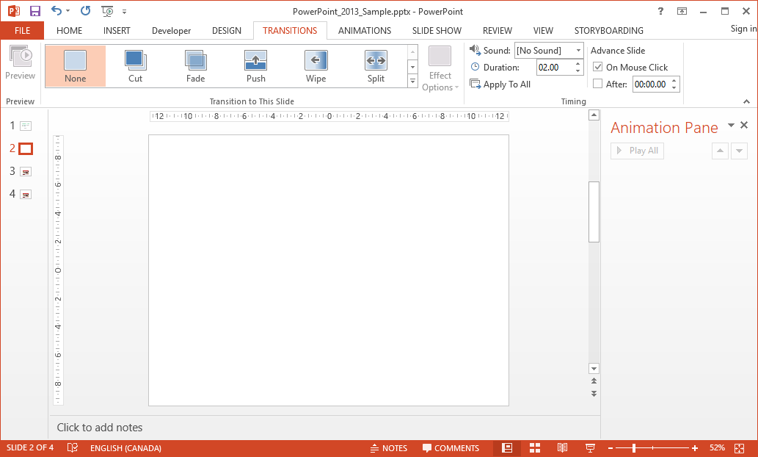
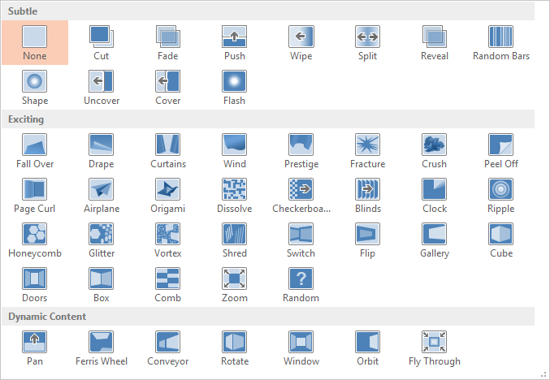
Exercise Two
With a new blank slide we can add more content and continue the presentation.
First let’s change how the previous slide transitions into this slide.
Click on the Transitions tab.
You can choose from one of the slide transitions shown, but let’s display the menu.
Click on the More menu button.
Now click through the choices and each one will preview animate for you.
You will need to select the More menu after selecting each one.

Slide 39
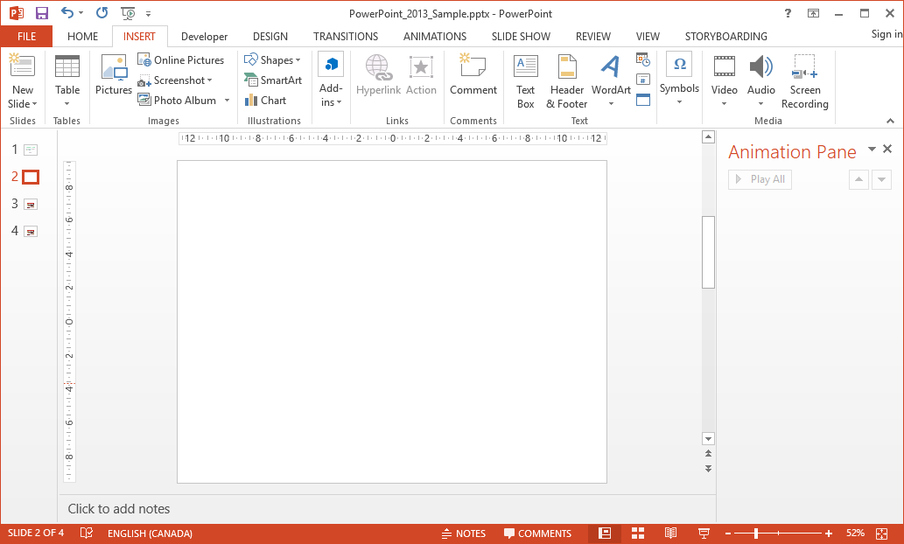
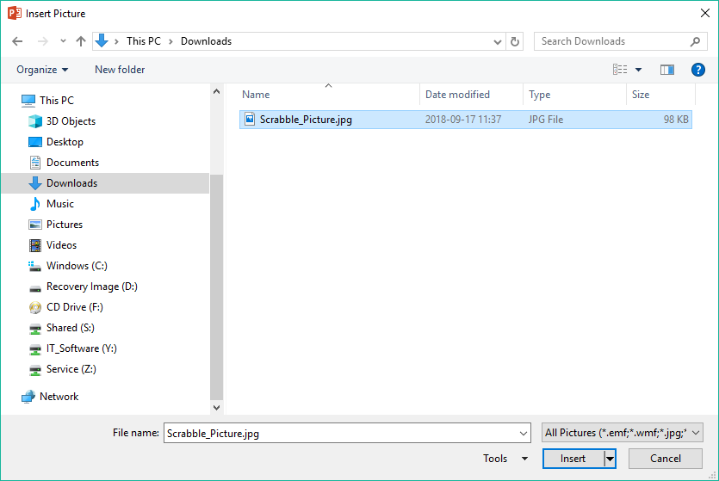

Exercise Two
Now you have added a slide transition to this slide from the previous slide.
Let’s insert an image from file.
Click in the Insert tab.
Click on Pictures in the Images group.
Which displays the Insert Picture dialog.
Navigate to where the picture lives, probably the Downloads folder.
… the small menu that appears will let you link to the file instead of inserting it into the PowerPoint presentation, or to link and insert both.
Click on Scrabble_Picture.jpg
Click on the Insert button.
Note: If you click on the down arrow beside the Insert button …

Slide 40
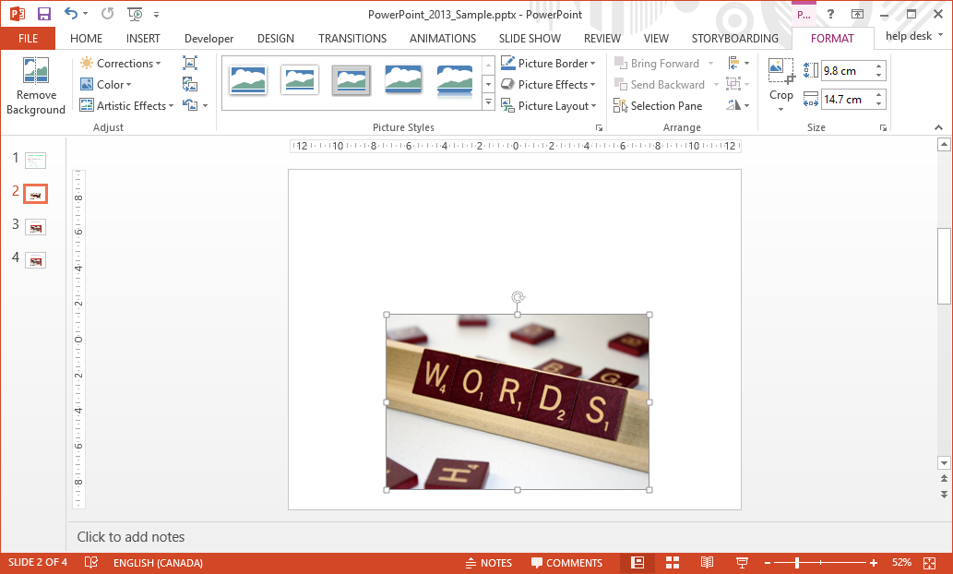
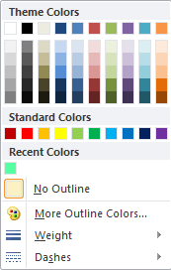
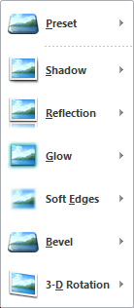
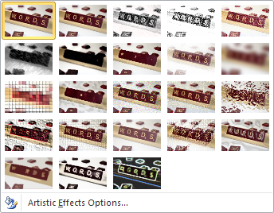
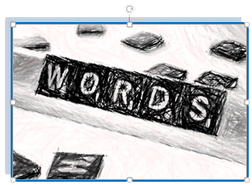

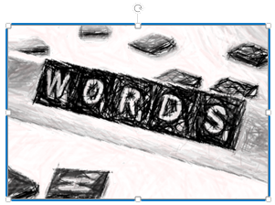
Exercise Two
Tip: Vector graphics can be resized without degradation of the image, but a raster graphic will
pixelate as it is resized larger than its’ intended size. The JPG graphic we just inserted is a lossy compression file type, and a raster graphic, so making it larger will pixelate, but smaller will not.
Resize and position the clip art as it is here.
With the image still selected, add
an Artistic Effect
a Picture Border
a Picture Effect
Now that you have added some styling to your clip art, let’s …
make a hyperlink above the clip art
make it like a web page link when you hover over it some effect occurs.

Slide 41
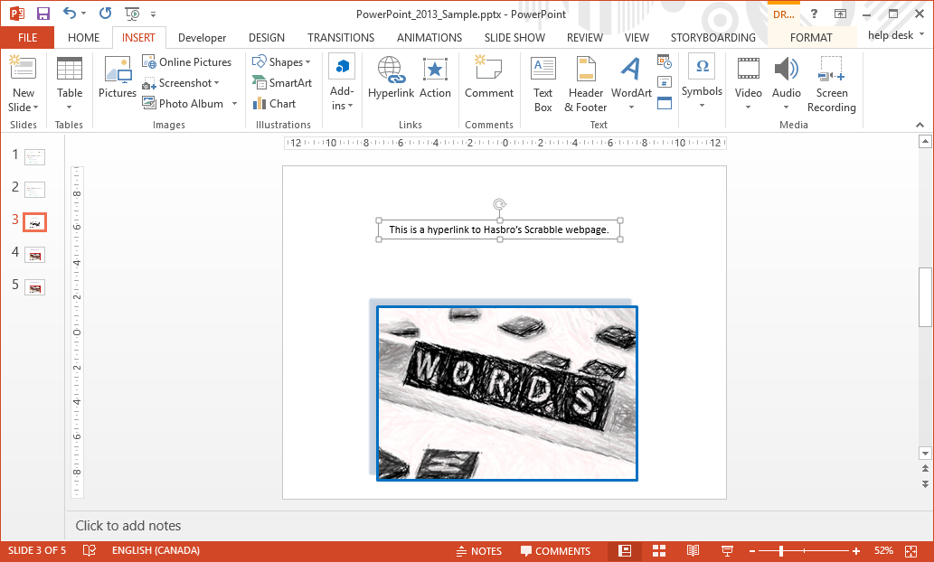
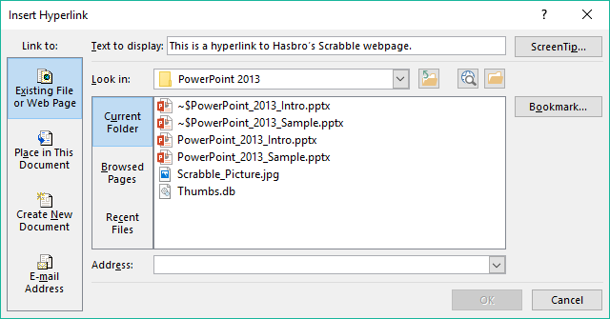

Exercise Two
There is no hover function in PowerPoint 2010 like there is for web pages, so we will have to make it.
Add a Text Box and then type in some text into that box.
Make the text in the box (or part of the text) into a Hyperlink by:
Selecting the text for the Hyperlink
Clicking on Hyperlink in the Links group
Type or paste the web address into the Address box.
Click on the OK button.

Slide 42
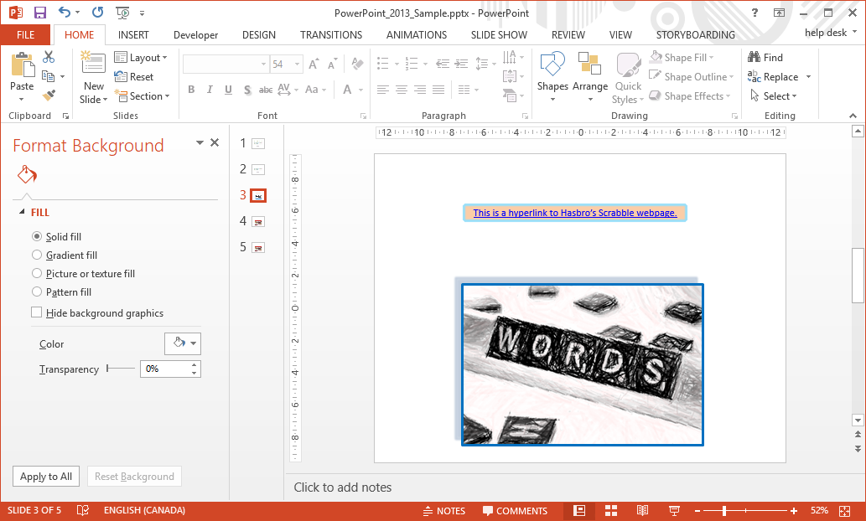

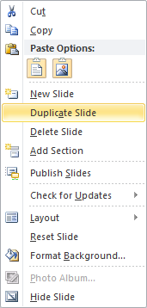
Exercise Two
Let’s decorate the text box.
With hyperlink now in a text box …
Decorate the text box as you like.
Once you have it decorated the way you like, copy the slide.
Right click on the current slide in the slide navigation pane.
Click on Duplicate Slide.
Now the navigation pane shows three slides we have made and the last one is the current slide which is the duplicated slide.

Slide 43
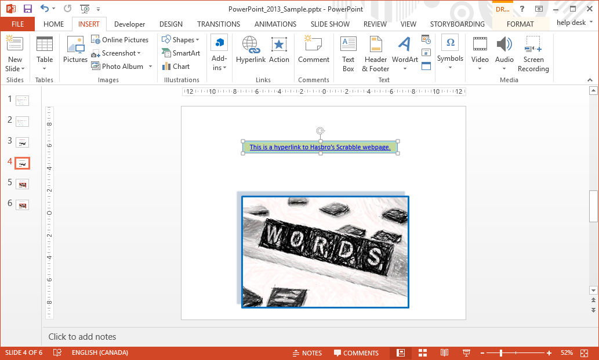


Exercise Two
Let’s decorate the text box on the new slide by making a slight change.
Make some type of subtle change. I changed the background color.
Select the hyperlink text box if it is not already selected and click on Action in the Links group on the Insert ribbon.

Slide 44




Exercise Two
Let’s decorate the text box on the new slide by making a slight change.
Make some type of subtle change. I changed the background color.
Select the hyperlink text box if it is not already selected and click on Action in the Links group on the Insert ribbon.
Now do the same to the previous slide except select Next Slide instead.
On the Mouse Over tab click the Hyperlink to:
Select Previous Slide from the drop menu.
Click on OK.

Slide 45

Exercise Two
We need to make the original slide hyperlink to the new slide.
With the original slide selected…
Select the hyperlink text box.
Click on Action.
Select the Mouse Over tab.
We are done!
Now run the Current Slide from the Slide Show ribbon and hover over your hyperlink to test it.
Click the Hyperlink to:
Select Next Slide from the drop menu.
Click on OK.

Slide 46
We’ve learned so far …
How to start PowerPoint & load a file by using the Back Stage (File tab / Open).
The parts of the PowerPoint screen; the Home tab and the contextual Format tab.
How to create new slides both blank and from a template.
How to create WordArt and style it to your liking.
How to insert a Text Box, enter text and then format that Text Box to your style.
How to create a Shape and style it.
How to animate the Shape as you like, plus all the settings to customize the animation.
How to transition from one slide to the next and all the options for that.
How to insert a picture and to add some styling to it.
How to create a Hyperlink in a textbox and style it so it looks good.
How to create a mouse-over hyperlink using the Action command.
Next, we will cover the Slide Show ribbon.

Slide 47

Start Slide Show
From Beginning & From Current Slide – Self explanatory
Broadcast Slide Show – Online broadcasting that requires
a web service.
Custom Slide Show – Choose specific slides to create a
slide show.
Set Up
Set Up Slide Show – Settings for how to present the slide
show.
Hide Slide – Hide one or more slides from presentation.
Rehearse Timings – Times how long it takes for you to do
the presentation.
Record Slide Show – Record the presentation and save as
in AVI or MOV format.
Play Narrations – Play the recorded slide show.
Use Timings – Play timings
Show Media Controls – Displays the media controls when
mouse-over the video.
Monitors
Resolution – Set the resolution up to the maximum for
the monitor
Show On – If two or more monitors are present, choose
which monitor to display the presentation.
Use Presenter View – If two or more monitors are
present, presenter view display the presentation, notes, and upcoming events on three panels.

Slide 48

NITHA IT Helpdesk helpdesk@nitha.com
1(844)486-4842
Notes:
Please do not hesitate to ask any question regarding this session, and I will make sure to answer your question as soon as possible.

Slide 49


