Slide 1


Outlook Webmail
Entry Level

Slide 2
NITHA IT Helpdesk
helpdesk@nitha.com
1(306)953-5008

Slide 3

What will we be covering in this course?
The Big Picture Slide 4
Contacts/People Slide 49
Signing in to your email account Slide 5
New Contact Slide 53
Opening Screen Slide 11
Groups Slide 55
New Outlook Email Slide 26
New Group Slide 56
Outlook Calendar Slide 31
Tasks Slide 57
New Outlook Calendar Event Slide 33
New Task Slide 58
New Outlook Calendar Slide 36
Using Rules Slide 60

Slide 4

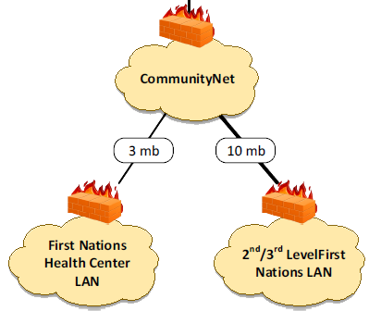



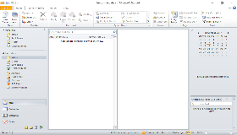
The Big Picture
Internet
Your email lives here.
Microsoft
25 mb
50 mb
Where Microsoft Exchange server lives
The Microsoft Server farm is probably located in Northern USA East coast, but it could be located anywhere in the world.
Slide

Slide 5
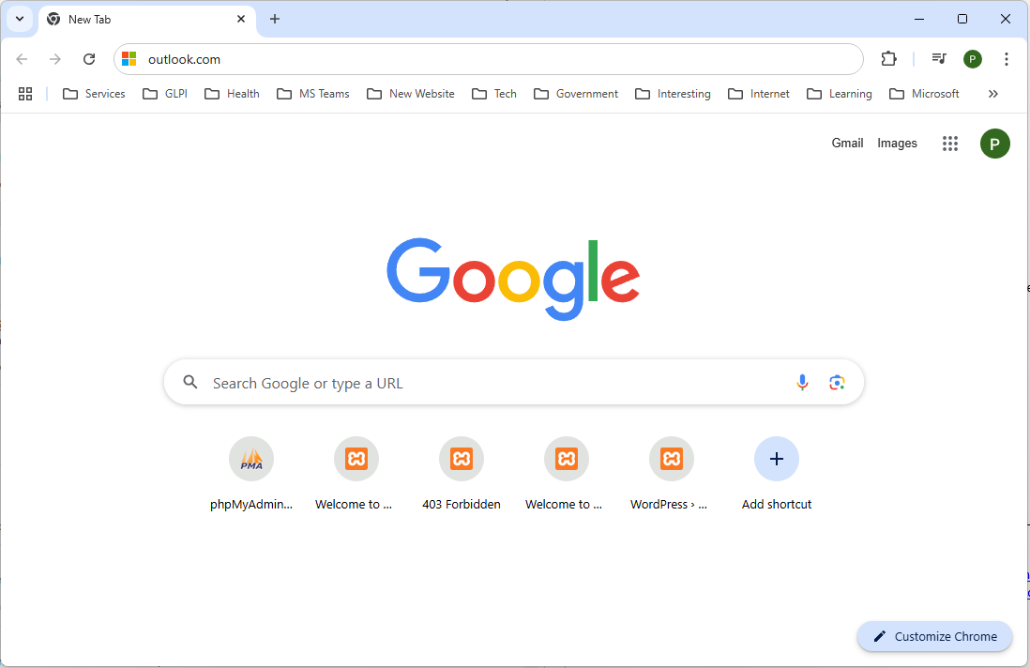
Signing in to your email account
Open your favorite web browser.
Type in to the address bar the URL, outlook.com, and press Enter.
Slide
5

Slide 6
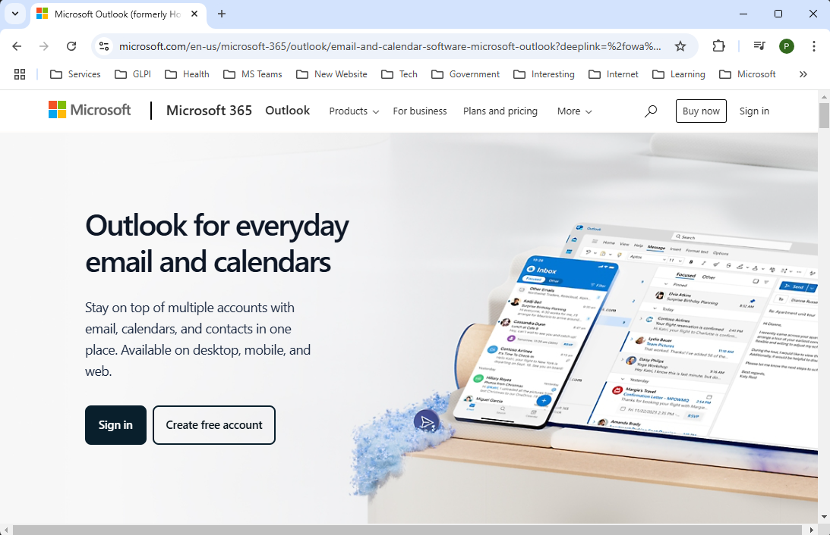
Signing in to your email account
After opening the website, Outlook.com, this is the landing page.
The content will probably be different than what is here, but the main item of interest on the page is here.
Click on Sign in .
Slide

Slide 7
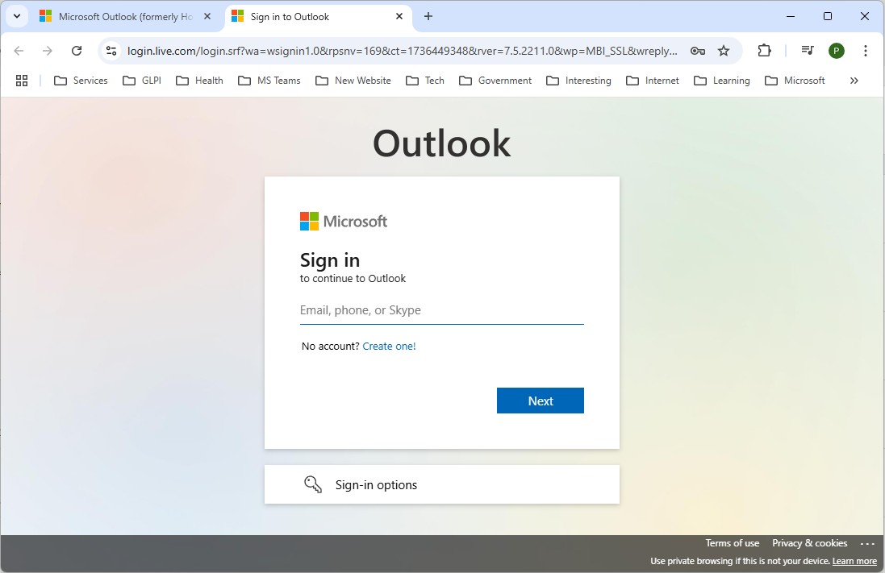
Signing in to your email account
Type in your email address here.
helpdesk@nitha.com
Click on Next
Slide

Slide 8
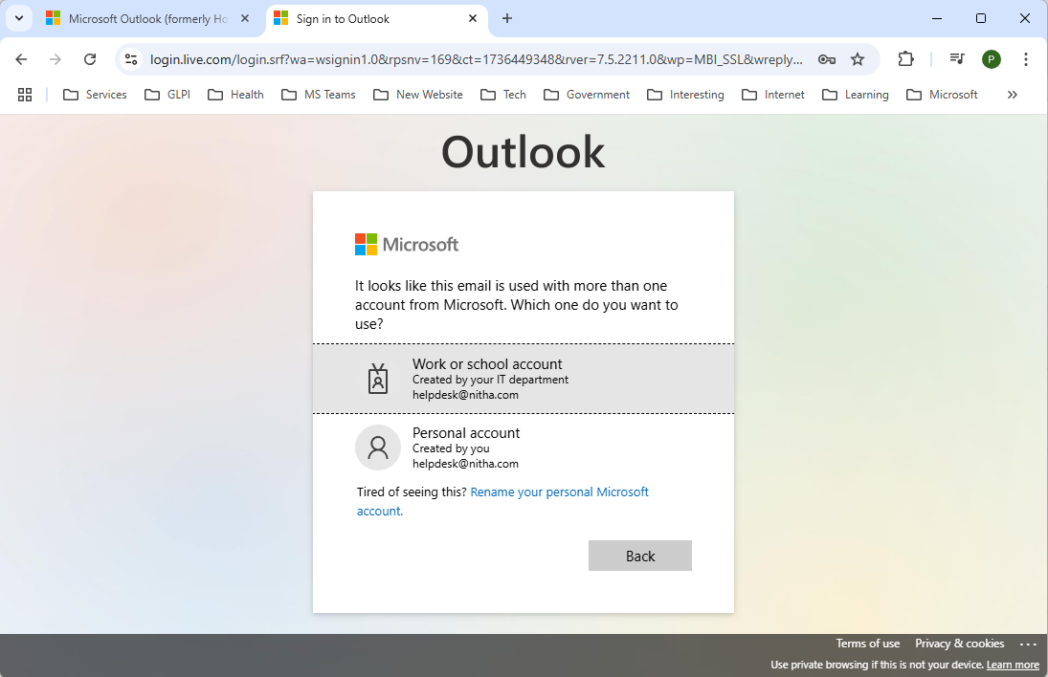
Signing in to your email account
Select the Work or school account and the login will advance to Outlook
Slide

Slide 9
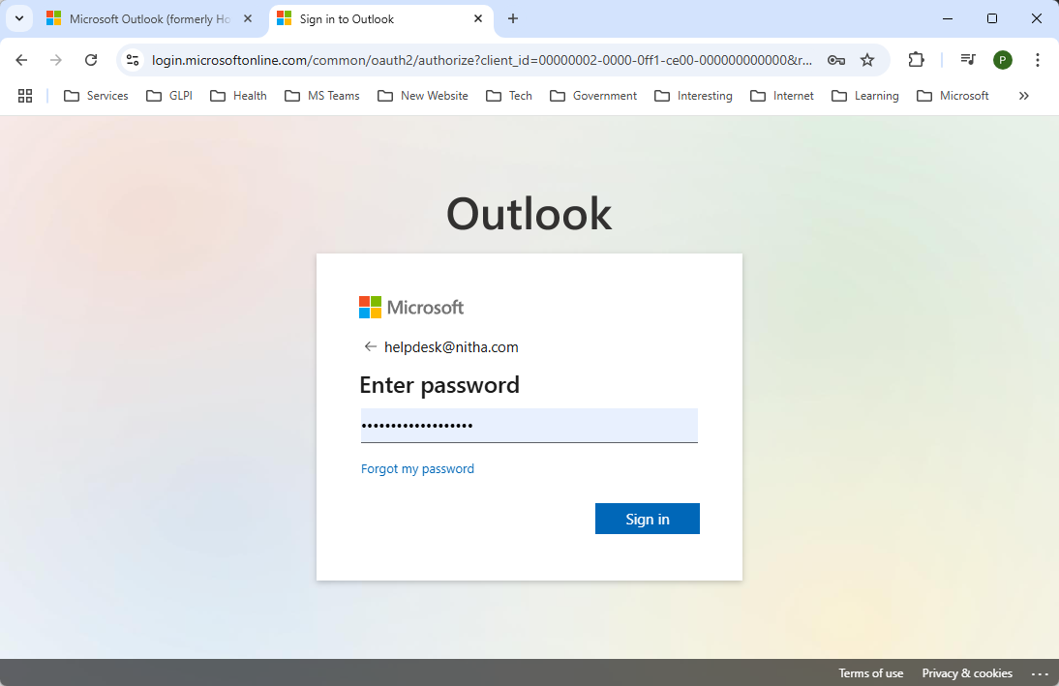
Signing in to your email account
Type in your password and click on Sign In
Slide

Slide 10
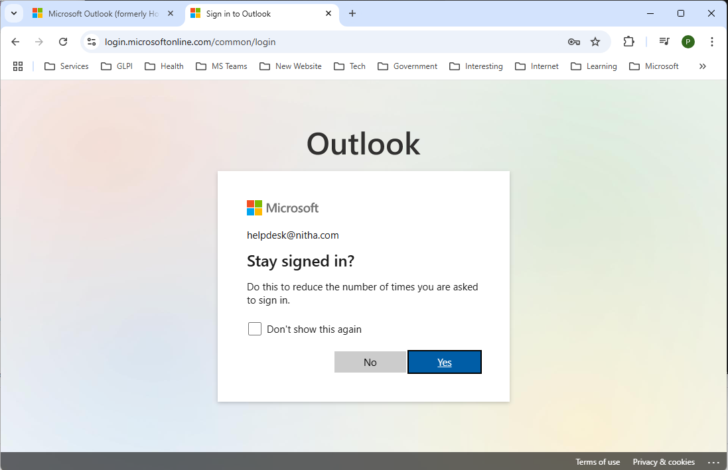
Signing in to your email account
Selecting No means you will need to enter your password each time you log in. This is more secure and is recommended.
Selecting Yes means that every time you open up a browser and go to Outlook.com from the same PC and the same web browser, it will automatically log you in. Use this if you are the only one to use your PC.
Slide

Slide 11
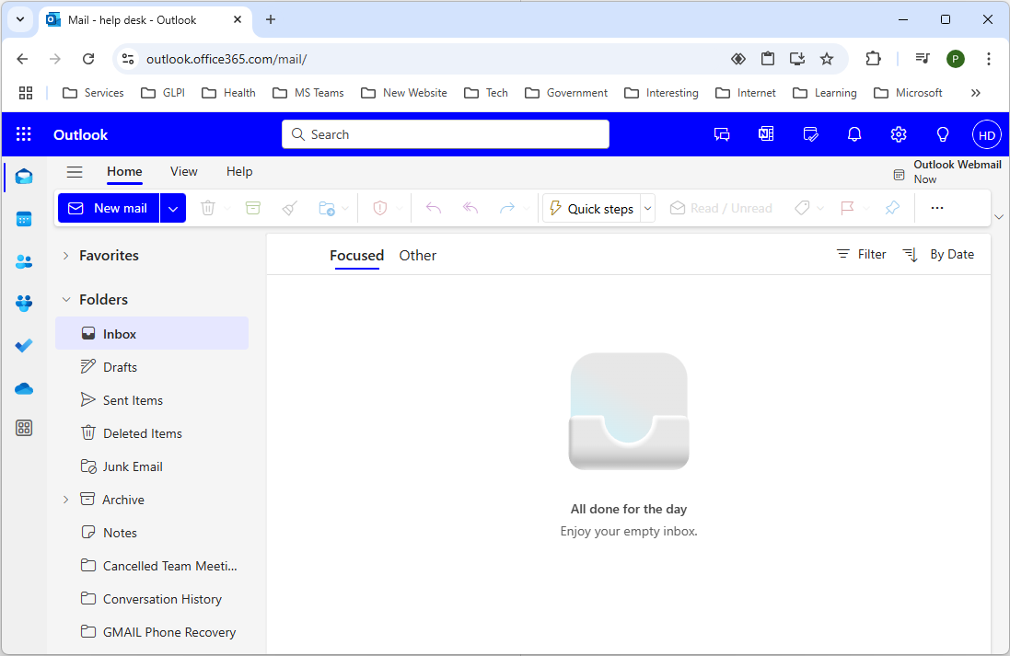
Opening Screen
If your email belongs to a full Office 365 account, then you will see all these icons on the left side menu bar; you will just see: email, calendar, contacts, & notes.
Launch Outlook mail
Launch Outlook calendar
Launch Outlook contacts
Launch Outlook groups
Launch Outlook to-do
Launch OneDrive
Launch More Apps dialog
Slide
11
Slide

Slide 12
Opening Screen
This is where your added favorites live.
These folders are where your email live.
Same as paper sticky notes.
Various folder links.
Slide

Slide 13
Opening Screen
Content pane
Slide

Slide 14
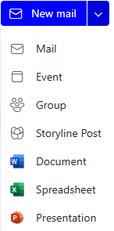
Opening Screen
You can create:
An email
A calendar event
A group of emails
A storyline post
A new Word doc
Create a Item.
A new Excel spreadsheet
A new PowerPoint
Slide

Slide 15
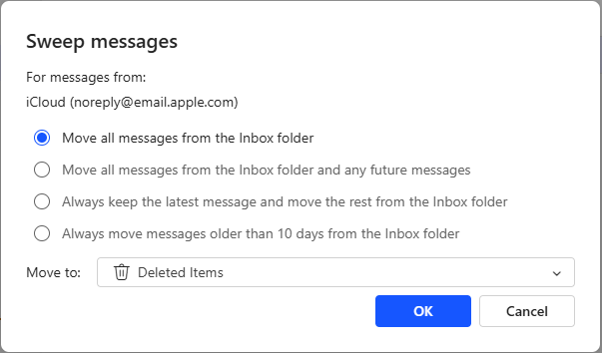
Opening Screen
Trash selected email(s)
Move selected email(s) to archive
Make a rule for the selected email
Slide

Slide 16
Opening Screen
Move selected email(s) to another folder.
Report message(s) as spam or junk email.
Reply to message.
Reply to all email addresses.
Forward email or forward as an attachment on other email.
Slide

Slide 17

Opening Screen
Quick steps allow you to perform multiple actions with one click, something like a macro.
Slide

Slide 18
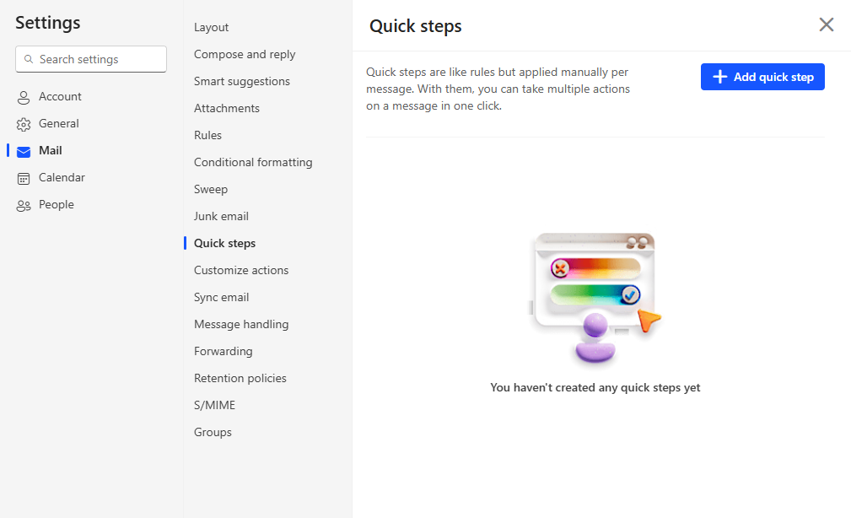
Opening Screen
With Quick steps selected …
Click on the Add quick step button.
Slide

Slide 19
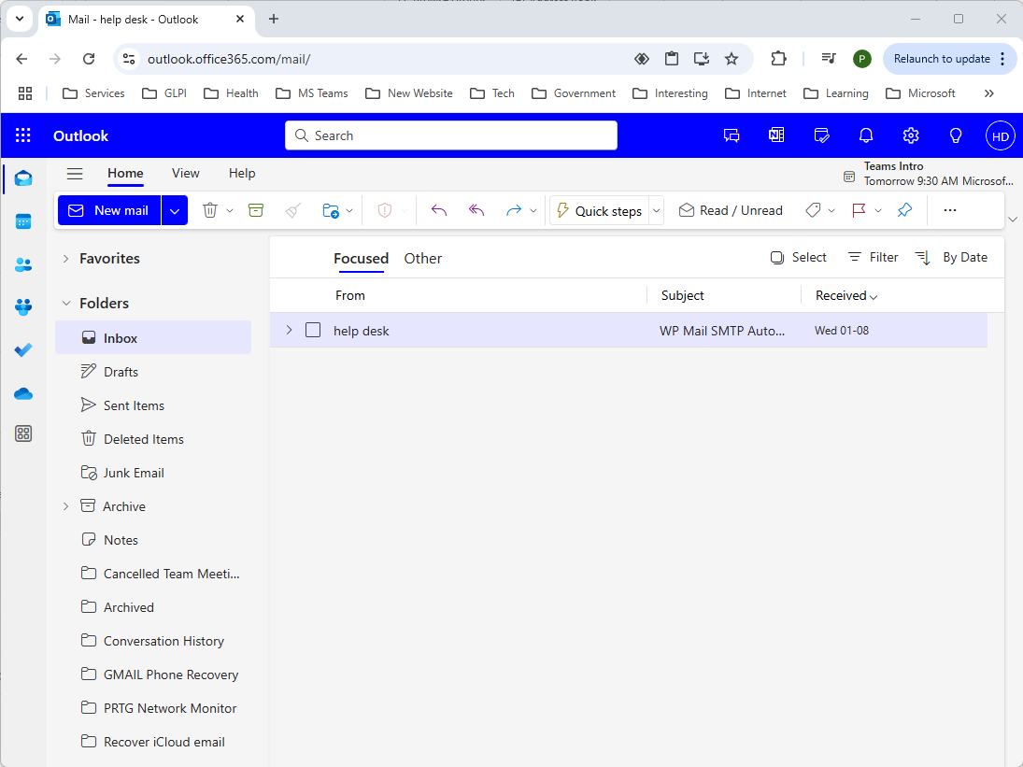
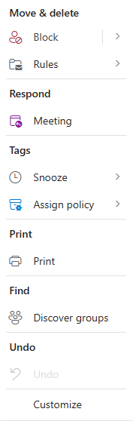
Opening Screen
Read / Unread – Toggle read/unread for the selected email(s).
Add a colour category to selected email(s).
Flag the email for later follow-up.
Toggle pin/unpin message in the Inbox.
Menu options
Slide

Slide 20
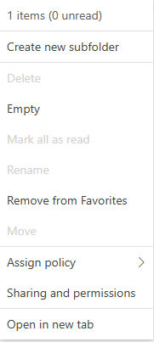
Opening Screen
Toggle blocked sender or set a blocked sender to unblocked.
Assign Policy
Create or Manage rules.
Create a meeting based on the sender and recipients of an email.
Add snooze tags. The email is displayed like new email is displayed when the date/time comes up, with a dialog box.
Retention properties of the selected email(s). i.e. when to delete it.
Yes, never is an option. If you do not choose a retention policy,
the retention policy of the folder in which the email is stored is used.
Slide

Slide 21
Opening Screen
Print your email, calendar events, notes and more to paper.
Search for groups.
Undo last action.
Customize the ribbon to suit your needs.
Slide

Slide 22
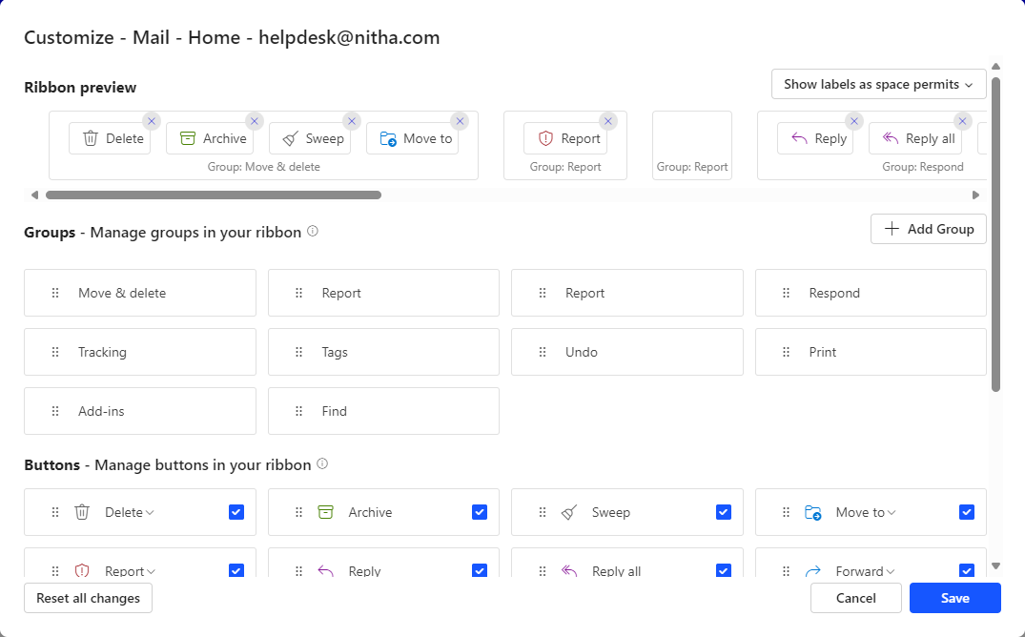
Opening Screen
Customize the ribbon to suit your needs.
Slide

Slide 23
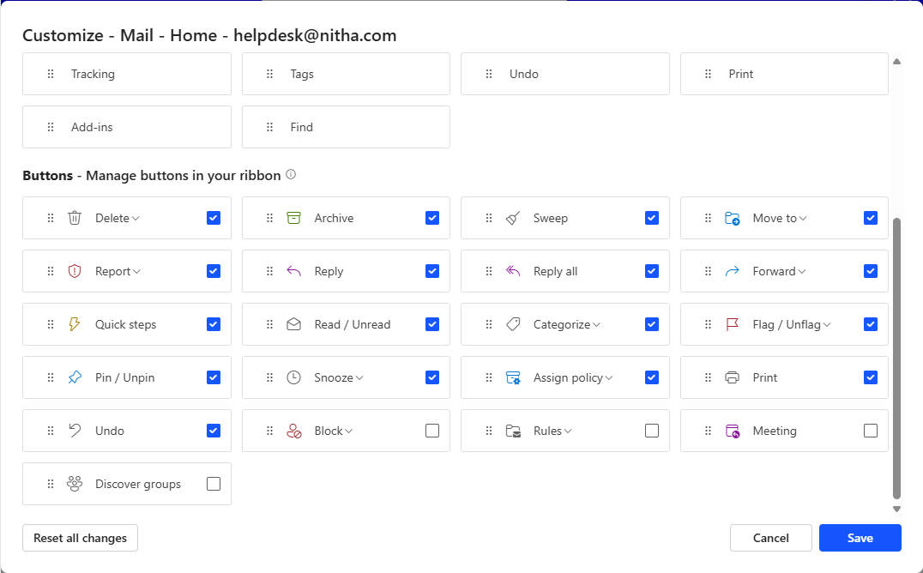
Opening Screen
Customize the ribbon to suit your needs.
Slide

Slide 24
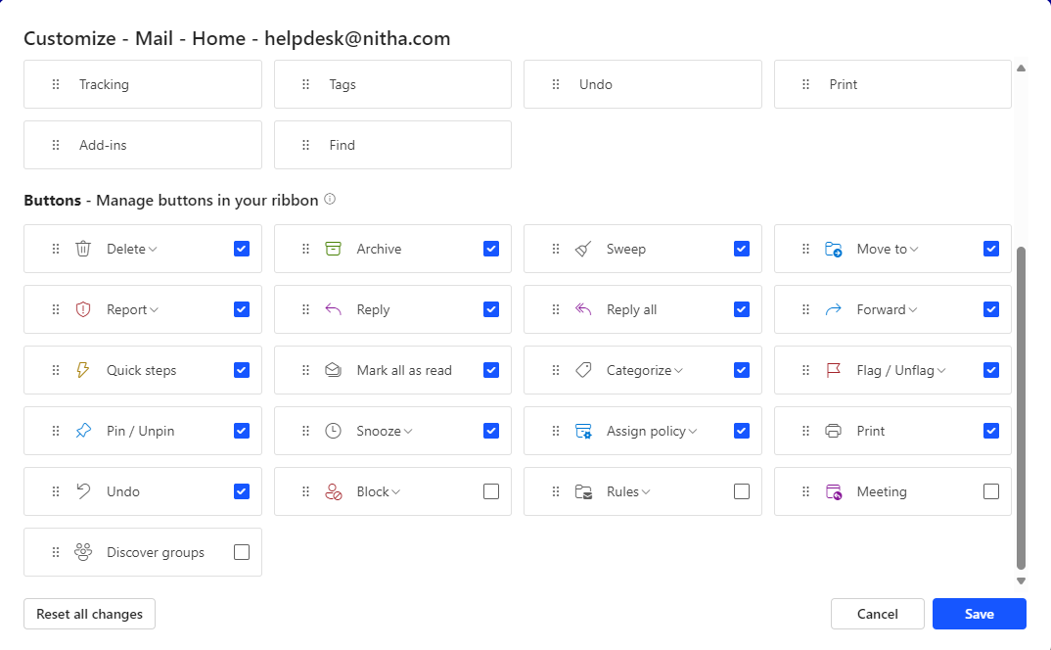
Opening Screen
Slide

Slide 25
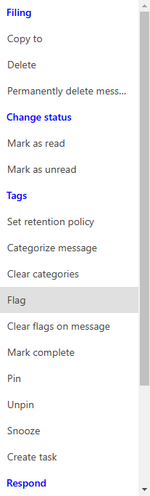
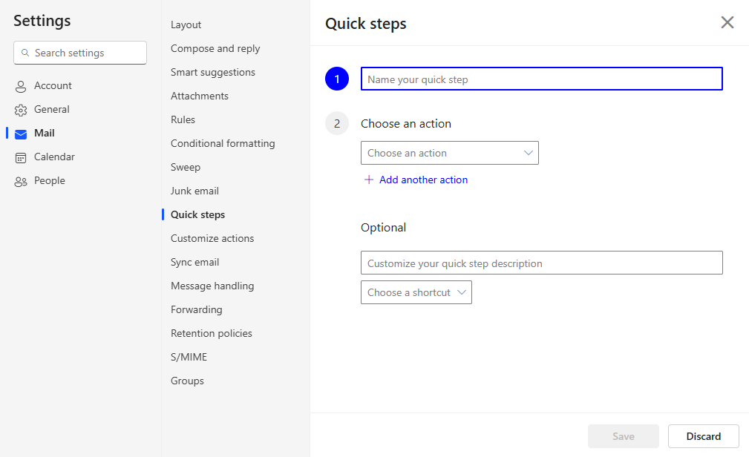
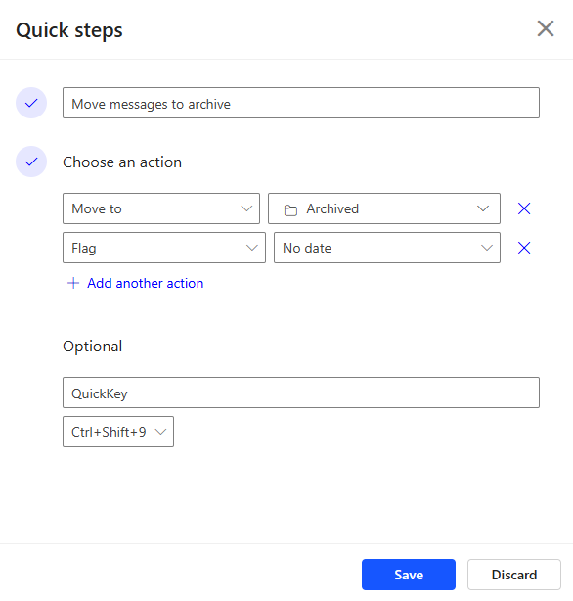
Opening Screen
Quick steps is a quicker way to make a rule.
Name the rule.
Move your messages to a location, in this case, archive is selected.
The second action in this rule is to set a flag; more actions are available.
If you wish to sign a key to this rule, then name it here.
Select the keys to use to run this rule.
Slide

Slide 26
New Outlook Email
When you first start a new email it will be embedded as part of the window. To detach it into a separate window, click on the Edit in a separate window button.
Create a New Outlook Email
Slide

Slide 27
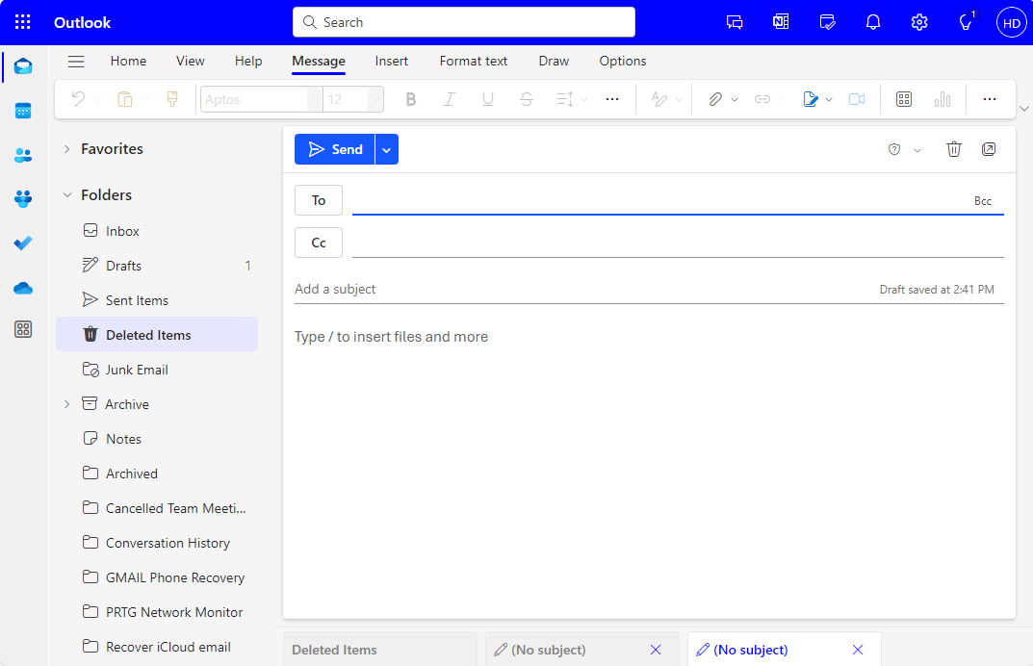
New Outlook Email
Click on the To in order to add a recipient.
pnetterville@nitha.com
Slide

Slide 28

New Outlook Email
pnetterville@nitha.com
Click on the Cc for carbon copy emails.
Click here and enter the subject.
How can I sign up for all the Helpdesk courses?
Click here and enter the text of the message.
You can sign up for courses by opening a web browser, such as Chrome or Firefox or Edge, and type into the address bar, “nitha.com/courses” (less the quotation marks.)
and press Enter.
OR
Go to nitha.com and select the IT Helpdesk Courses Registration link from the Quick Links.
Slide

Slide 29
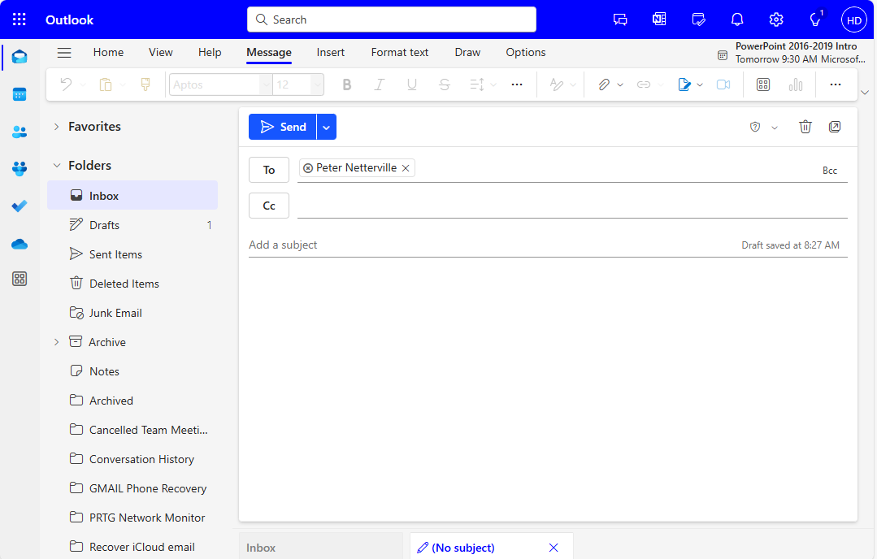
New Outlook Email
How can I sign up for all the Helpdesk courses?
You can sign up for courses by opening a web browser, such as Chrome or Firefox or Edge, and typing into the address bar, “nitha.com/courses” (less the quotation marks.)
and press Enter.
If there is anyone to whom you want to send an email in privacy, click on the Bcc link.
Slide

Slide 30
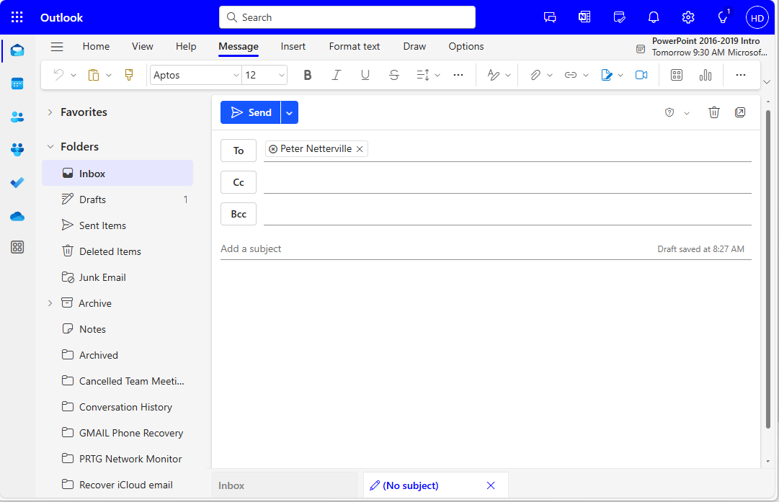
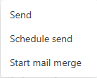
New Outlook Email
Send – Same as clicking on Send button
Schedule Send – Set up a time for it to go out.
Start mail merge – Displays a sub-menu bar
with Mail Merge commands.
How can I sign up for all the Helpdesk courses?
You can sign up for courses by opening a web browser, such as Chrome, Firefox or Edge, and typing into the address bar, “nitha.com/courses” (less the quotation marks.)
and press Enter.
Slide

Slide 31
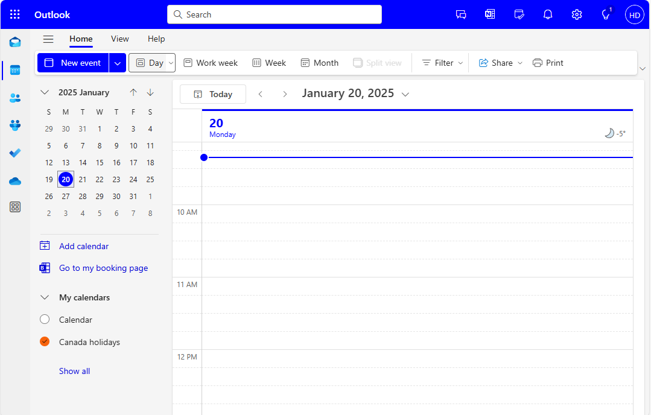
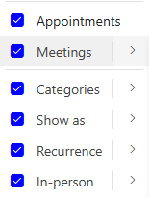
Outlook Calendar
Click on the Calendar icon in the nav panel to see the calendar displayed.
Create a new event or click on the drop arrow, which allows you to choose to make an email.
Choose to number of days to view.
As the button name implies, change the view to Work Week, Full Week, or Month.
Split view – Separates the view to two views.
Filter – Apply a search filter to restrict the view of the events.
Slide

Slide 32
Outlook Calendar
Share – Share one or more of your calendars with others in and out of your organization.
Print – Print your calendar. Click on this button to select and print a calendar, the view type, time range, show mini-month, and/or print a detailed agenda (if you have one made) for the date and time period you have selected.
Slide

Slide 33
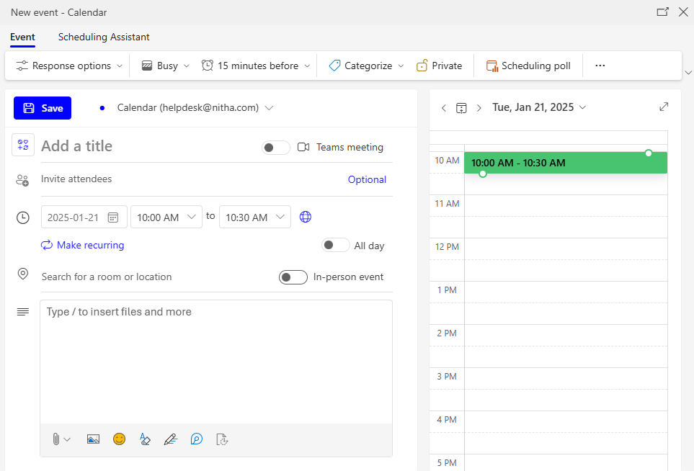
New Outlook Calendar Event
Click on New Event
Outlook Webmail
Type in an agenda here, and/or drag and drop one or more files into this area to attach to this event. When sent to the invited, they receive the file(s).
Slide

Slide 34
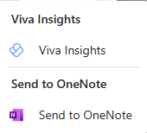
New Outlook Calendar Event
Response options:
Request responses from those invited
Allows contact to forward event info to others.
Set your busy status as:
Free
Working Elsewhere
Tentative
Busy
Out of office
Start a poll to determine the best time to schedule the event.
Make the event private.
Set the time ahead to remind you of the event & add an email reminder.
Set the category colour.
Slide

Slide 35
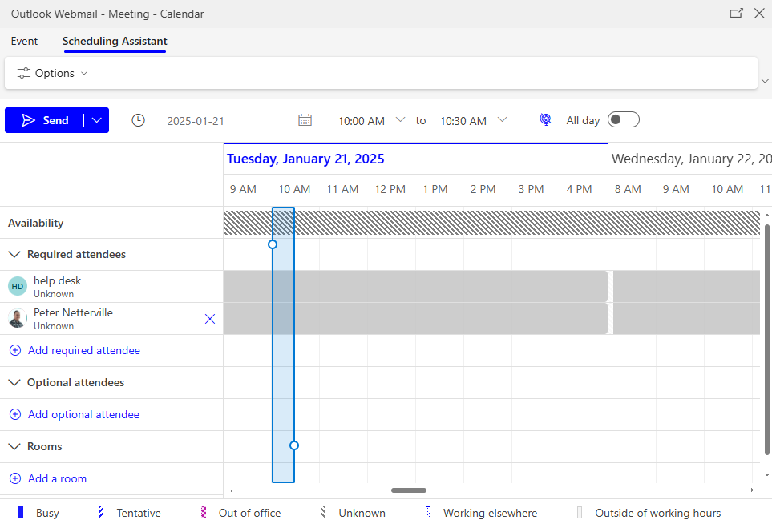
New Outlook Calendar Event
The Scheduling Assistant helps to take the free time of all those who are registered for the event, so you can work with them to make a viable date/time.
Slide

Slide 36
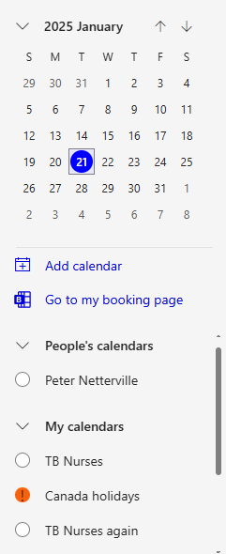
New Outlook Calendar
In this menu
Select the Calendar module.
Add a new calendar.
Slide

Slide 37
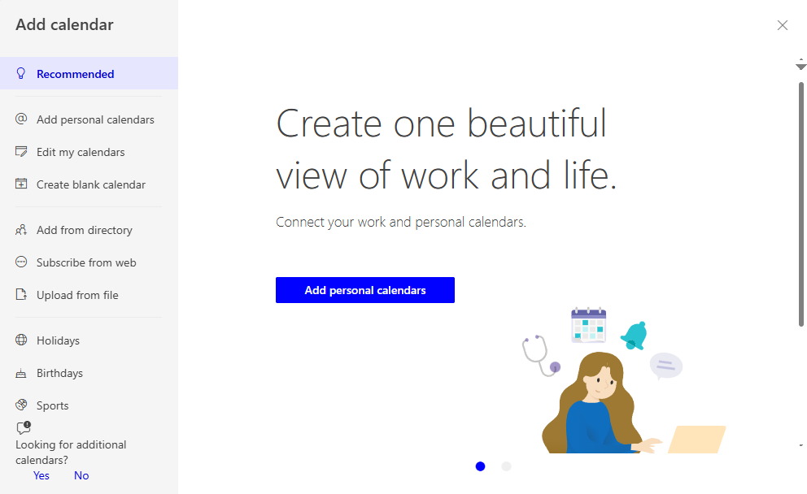
New Outlook Calendar
Add a new personal calendar, and assign permissions to others to view/change your calendar events.
Slide

Slide 38
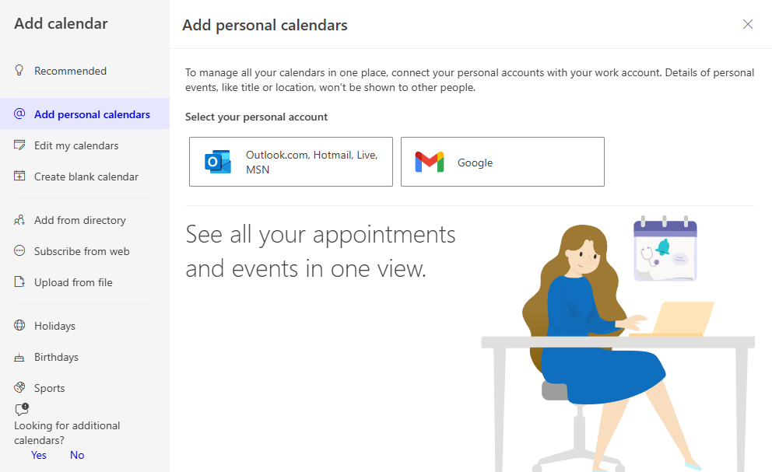
New Outlook Calendar
For the email, it can be created on Microsoft’s platform or Google’s.
Slide

Slide 39
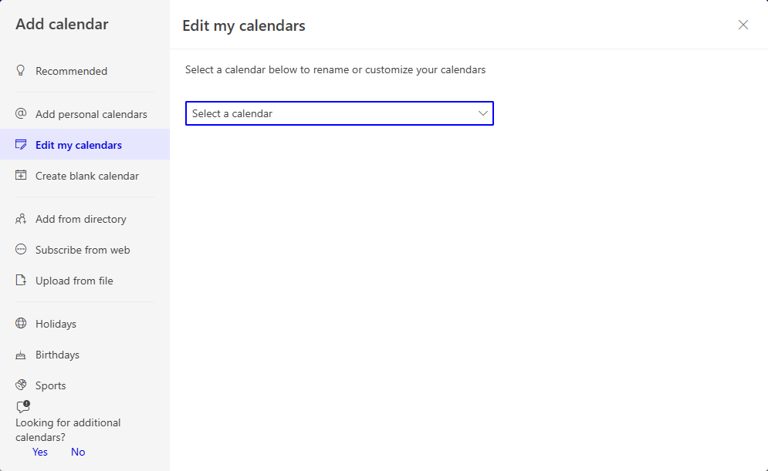
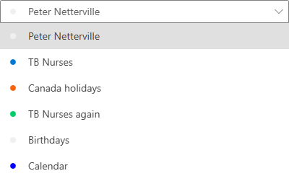
New Outlook Calendar
Once you select a calendar to edit, you will be able to change
Slide

Slide 40
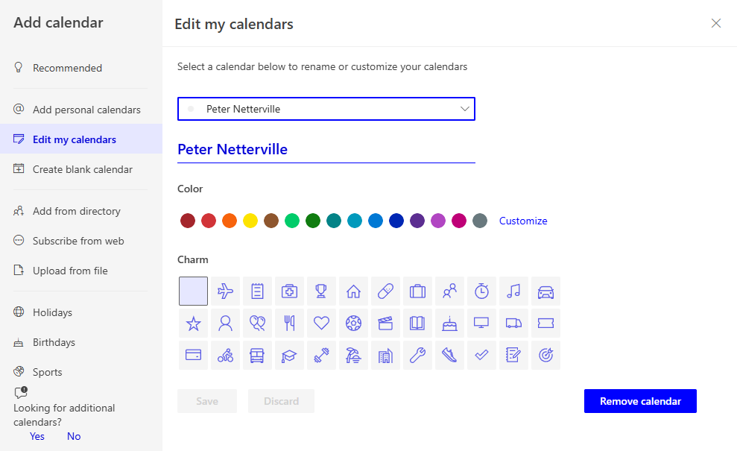
New Outlook Calendar
Once you select a calendar to edit, you will be able to change
Slide

Slide 41
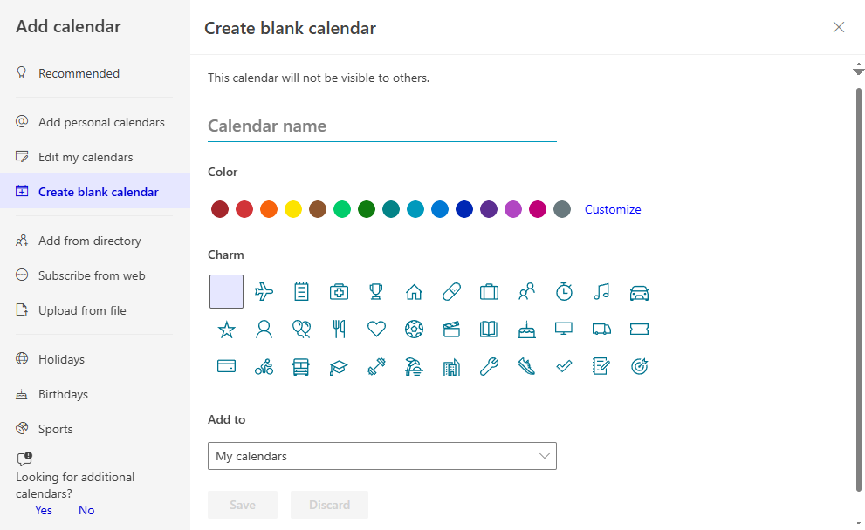
New Outlook Calendar
A New Calendar
Slide

Slide 42
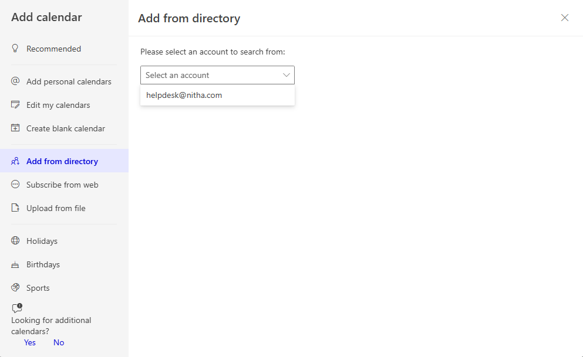
New Outlook Calendar
Slide

Slide 43
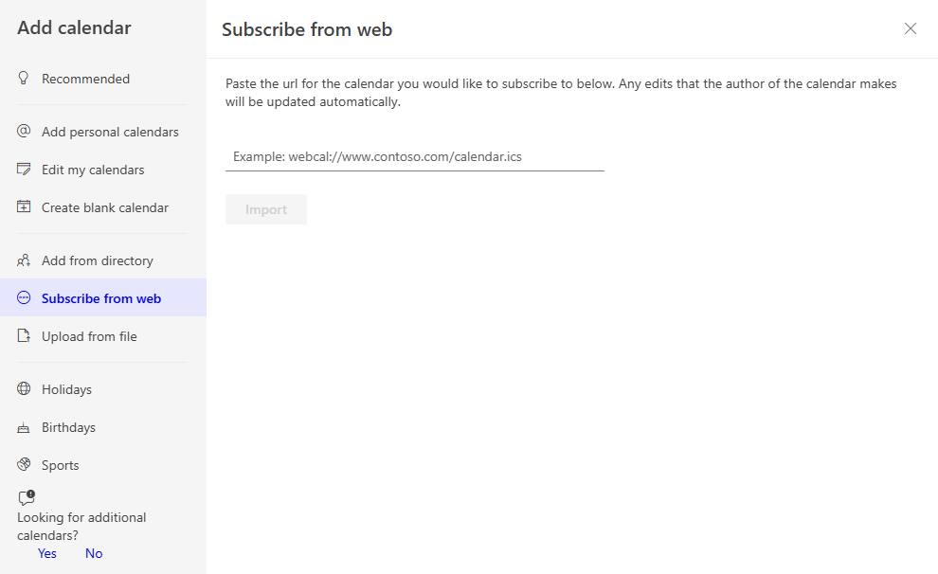
New Outlook Calendar
Slide

Slide 44
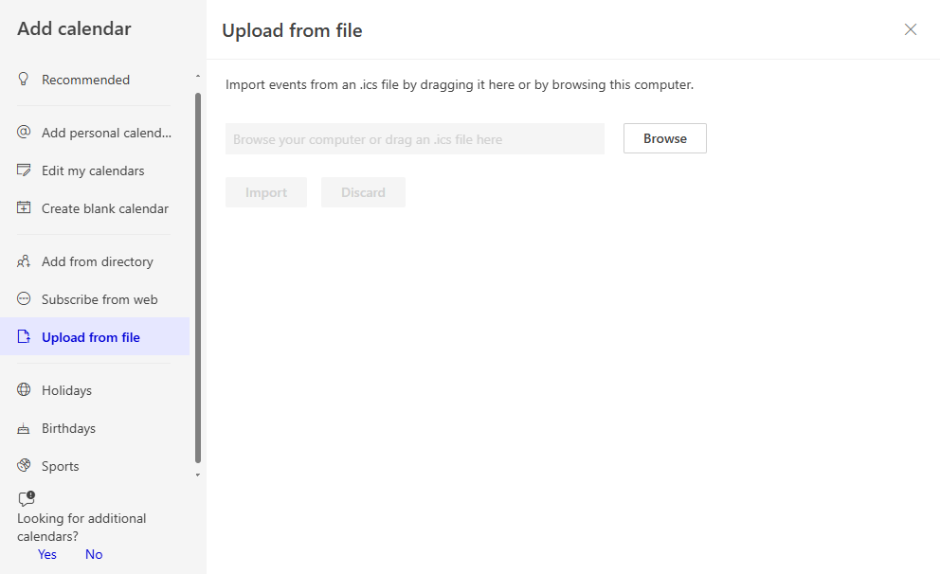
New Outlook Calendar
Slide

Slide 45
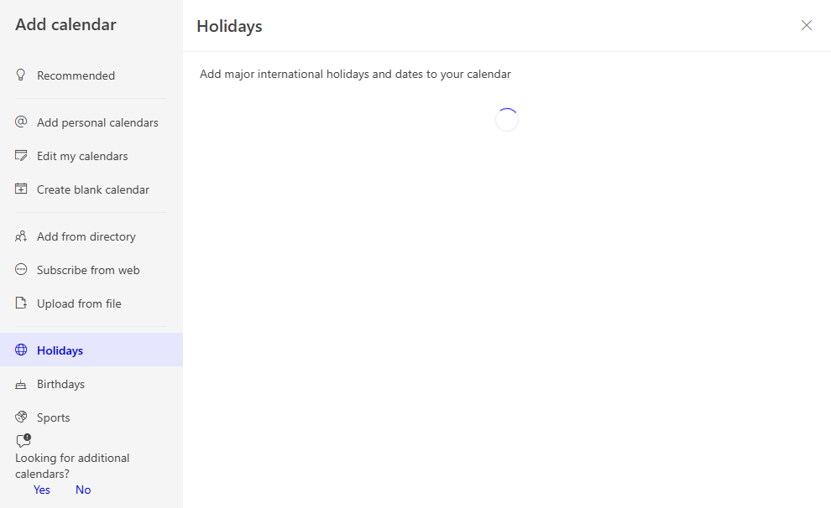
New Outlook Calendar
Slide

Slide 46
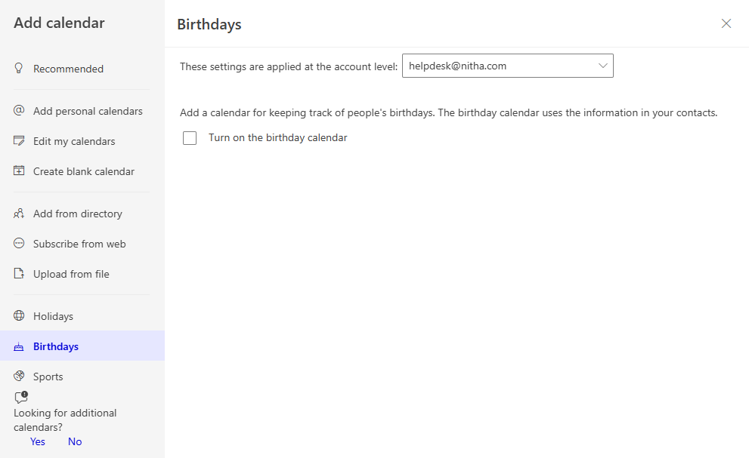
New Outlook Calendar
Slide

Slide 47
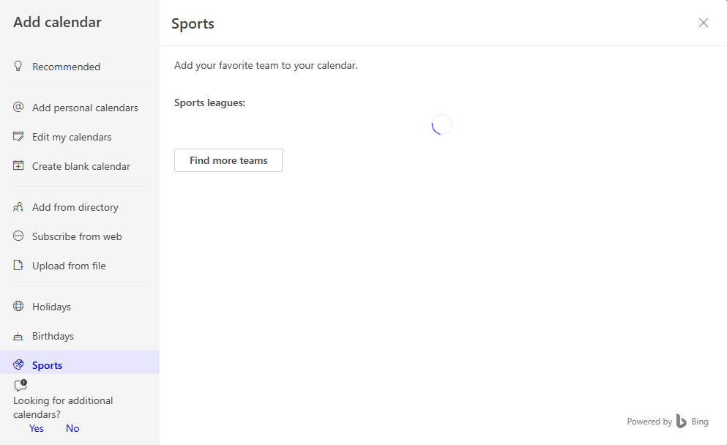
New Outlook Calendar
Slide

Slide 48
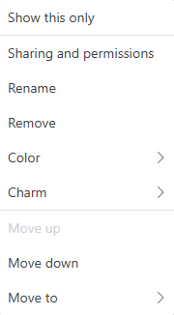
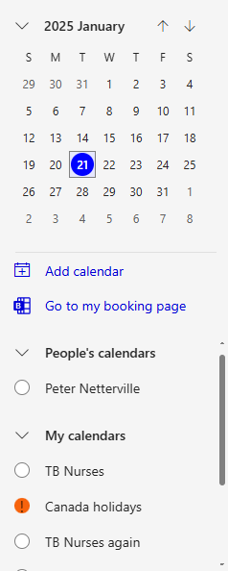
New Outlook Calendar
Select the calendar you wish to share with others by clicking on the ellipsis.
Slide

Slide 49
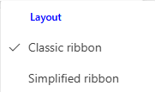

Contacts/People
Simplified People/Contacts Ribbon
Classic People/Contacts Ribbon
Definitions:
Group - A group is a collection of people/contacts who can share resources, such as a calendar, inbox, and files.
List – A people/contact list, also known as a distribution list, is a collection of email addresses used to send messages to one or more people.
Note:
If, when viewing a contact, you find you cannot see a method to navigate back to your Contact list, in order to select a different contact, click on the menu link, and select Your Contacts or Your Contacts List.
Slide

Slide 50
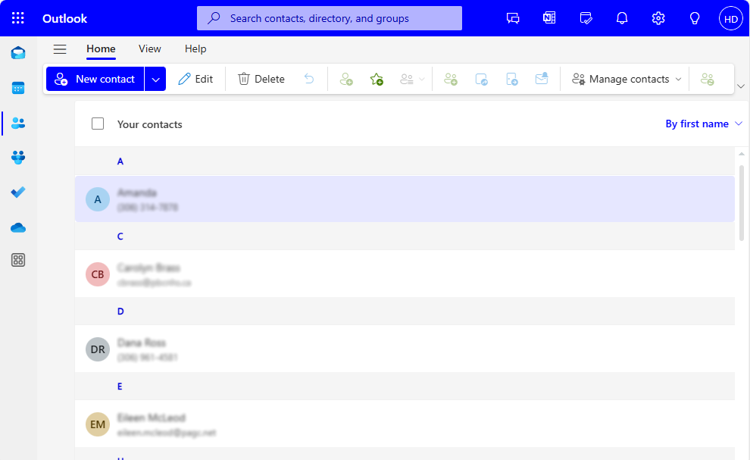
Contacts/People
Click here to make a new
contact or click on the drop arrow to make a:
New Contact
New Contact List
Edit the selected contact.
Delete the selected contact(s)
Undo the last action.
Add to contacts.
Add contact to Favorites.
Slide

Slide 51
Contacts/People
Add selected contact(s) to a contact list.
Add selected contact(s) to a group list.
Invite other contacts to join the selected group.
Leave the selected group.
Follow the selected group.
What does it mean to follow a group?
Following a group will copy all conversations and events from the group to your inbox.
Slide

Slide 52

Contacts/People
Manage Contacts
Import and/or Export your contacts to a CSV file. A CSV file is a comma delimited text file, used as a lowest common data type (text), for the transfer of data to other software.
Refreshes the contact by pulling the contact data from the Microsoft server.
Slide

Slide 53
New Contact
Make a new contact
Slide

Slide 54
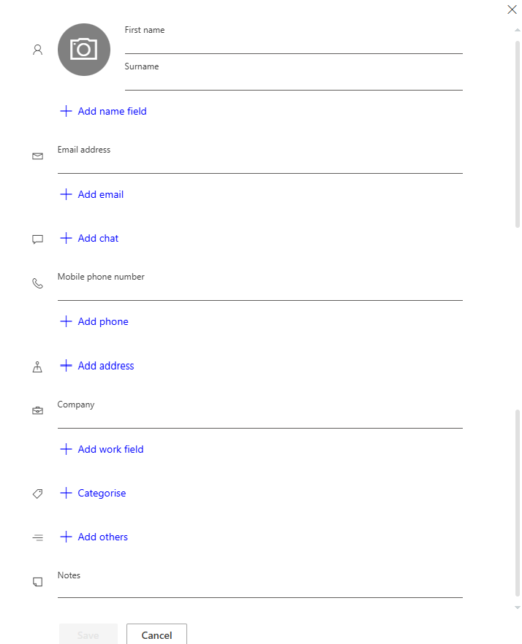
New Contact
First & Last Name
Add as many name fields as you need
Type in the email address
Add another email
Add a link to chat service
Type in phone number
Add another phone number
Add a link to chat service
Add a title, department, office location, or the pronunciation of the company name
Categorize the contact by name and colour
Add: A personal web page link
A significant other
A birthday
An anniversary
Slide

Slide 55
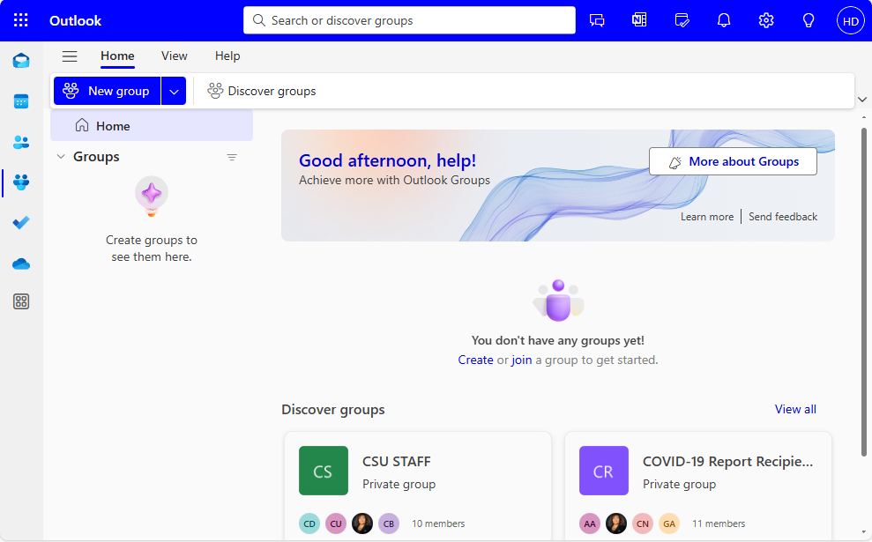
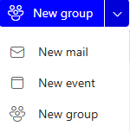
Groups
Create a new group
Slide

Slide 56


New Group
Name your group.
Describe your group.
Click on Edit to:
change privacy setting
change language setting
Subscription to group conversations and events
Slide

Slide 57

Tasks
Displays tasks for today.
Create a new task
Displays tasks marked as important.
Displays planned tasks.
Displays tasks assigned to you.
Displays all tasks.
Create new group and add contacts to the list.
Slide

Slide 58

New Task
Enter a title for the task.
Redo the Outlook Webmail course
Add a due date.
Add a notification for:
Later today
Tomorrow
Next week
Pick a date & time
Repeat the task:
Daily
Weekdays
Weekly
Monthly
Yearly
Once all the information is entered, click on the Add button.
Slide

Slide 59

New Task
The new task
Slide

Slide 60


Using Rules
Rules can be very handy to keep your email organized, for notification and much more.
Select the rules sub-menu
The Create Rule is available if you have an email selected.
Select Manage Rules to create a rule from blank.
Slide

Slide 61

Using Rules
Select Manage Rules to create a rule from blank.
Existing rules

Slide 62

Using Rules
A rule has 4 parts:
Its’ name.
One or more conditions that qualify the email for further processing.
The action(s) to be performed on the email should it pass the conditions.
Any exception(s) that cause the email to not be processed because of exceptions.
Name the rule, usually a name related to its’ function.
Add one or more condition(s) which will qualify the email.
Add one or more action(s) to perform on the qualifying email.
If the email is qualified based upon the initial conditions, but has an exception that must be applied to the email.

Slide 63


Using Rules
Conditions List

Slide 64

Using Rules
Actions List
The exceptions list
The exception list is the same as the condition list.

Slide 65

We have covered here in this course …
The Big Picture Slide 4
Contacts/People Slide 49
Signing in to your email account Slide 5
New Contact Slide 53
Opening Screen Slide 11
Groups Slide 55
New Outlook Email Slide 26
New Group Slide 56
Outlook Calendar Slide 31
Tasks Slide 57
New Outlook Calendar Event Slide 33
New Task Slide 58
New Outlook Calendar Slide 36
Using Rules Slide 60
Slide

Slide 66
NITHA IT Helpdesk
helpdesk@nitha.com
1(306)953-5008

Slide 67

Thank you

