Slide 1


Outlook 2021 Calendars
Intermediate Level

Slide 2
NITHA IT Helpdesk
helpdesk@nitha.com
1(306)953-5008

Slide 3

What will we be covering in this course?
Purpose of this Course
Setting up OneDrive
The Making of a Calendar
Logging in to OneDrive on the Cloud
Assigning Access Rights to Others
Managing OneDrive
Sharing Your Calendar with Others
Setting up a Shared Library
Using OneDrive to Enhance Collaboration
Managing the Shared Library

Slide 4

Page
Purpose of this Course
4
The purpose of this course is to cover working with Outlook calendars and OneDrive with a focus on using them to enhance collaboration inside and outside your organization.
Definitions:
Organization – In this usage, your organization comprises those members of your Exchange server. Usually, this includes those people whose email addresses have the same domain name as your email address.
For example: username@llribhs.ca, username@mltc.net, username@pbcnhs.ca, username@pagc.net
OneDrive – OneDrive is a file hosting service similar to Dropbox except that OneDrive is connected to an Exchange server which allows for easy document sharing with members within and without your organization.
Security for your documents can be assigned to others in your organization, from no access to full access.
When OneDrive is used in conjunction with shared Calendars, collaboration is made easy and flexible.

Slide 5
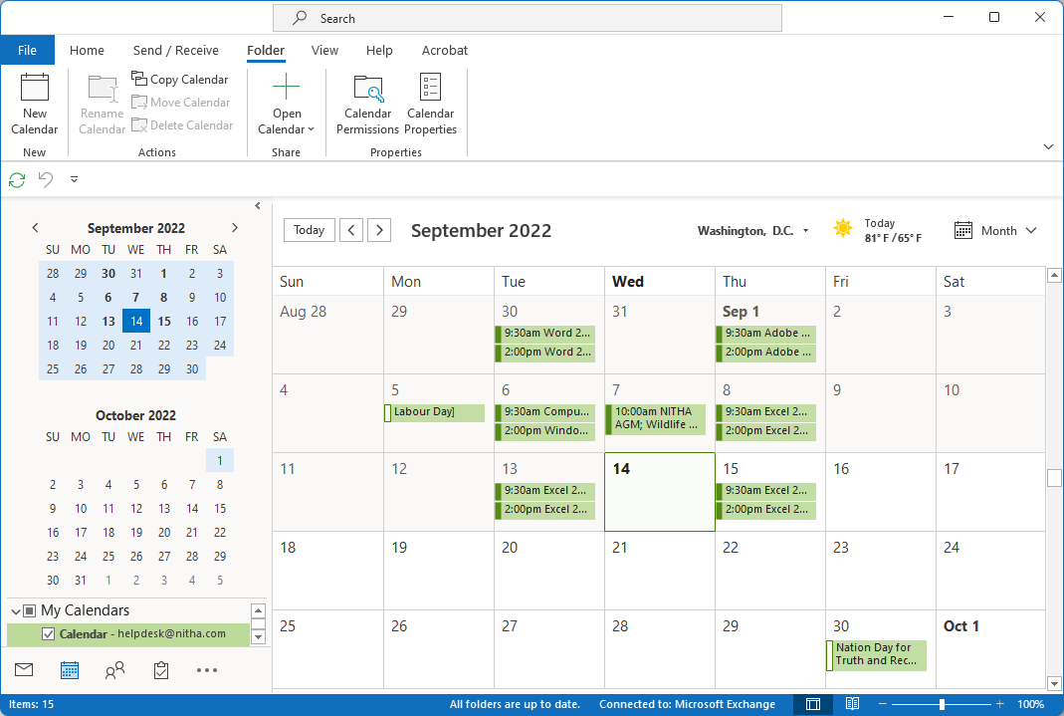
Page
The Making of a Calendar
5
If you see two calendars in the Navigation Pane …
… drag the separator handle up to display just the one calendar
Click on the Calendar module

Slide 6
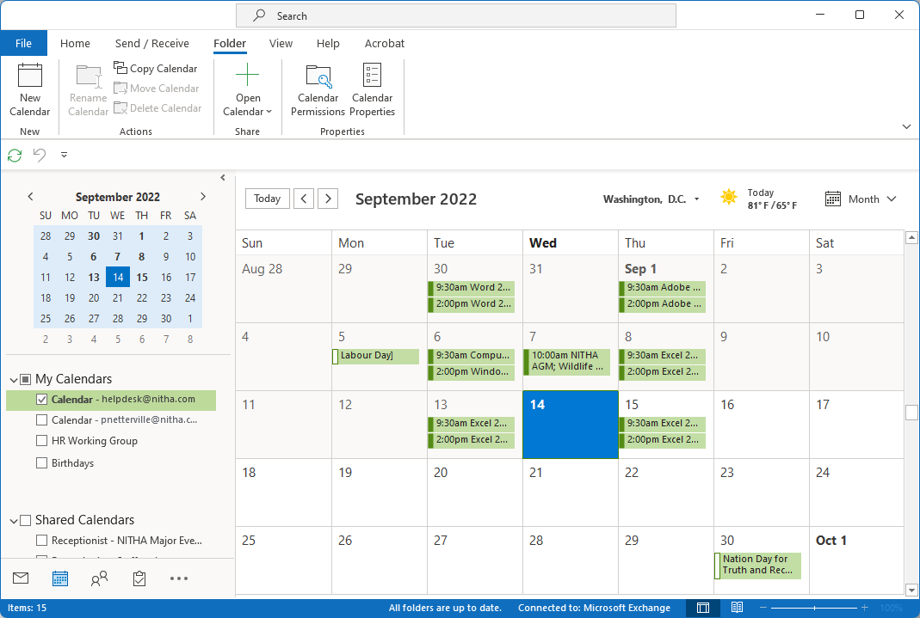
Page
The Making of a Calendar
Now it is easier to see the calendars
6
My Calendars lists one calendar for each of the following:
for each email account you have added to Outlook.
for each Outlook data file (.pst). e.g. Archive.pst
Calendars you have made to share or not share.
for each special calendar. e.g. Birthdays, Stat Holidays
When someone shares a calendar with you, you will see it in this group.

Slide 7
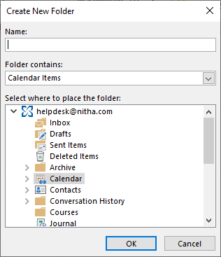
Page
The Making of a Calendar
Now to create a new calendar.
7
Click on the Folder tab.
Click on New Calendar.
Notes:
Question 1: What ribbon command do you click on to create a new calendar?
Answer: b. Calendar module / Folder Ribbon

Slide 8
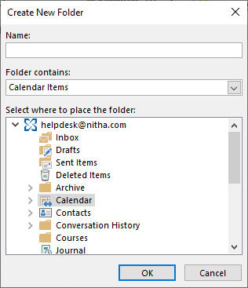
Page
The Making of a Calendar
Now to create a new calendar.
8
Enter in a meaningful name for the calendar.
Click on OK
Notes:
Question 1: What ribbon command do you click on to create a new calendar? (Slide 8)
Answer 1: c. Calendar module / Folder Ribbon

Slide 9
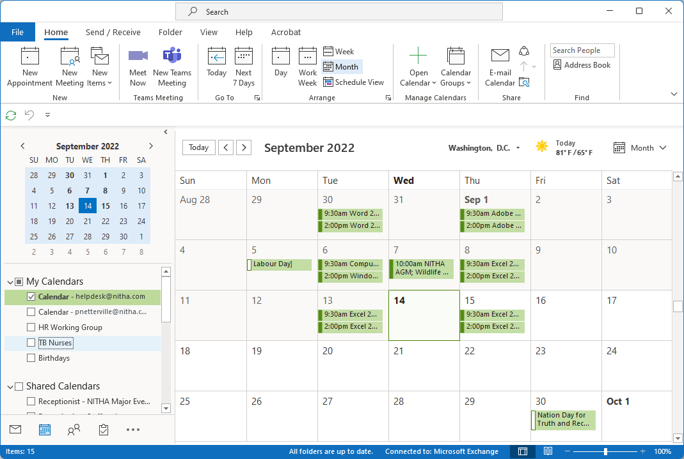
Page
The Making of a Calendar
Now that the TB Nurses calendar is made …
9
… permission needs to be assigned to those people you want to have access.
Right-click on the calendar

Slide 10
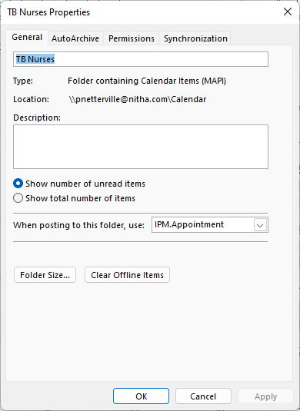
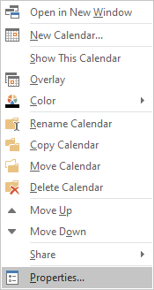
Assigning Access Rights to Others
Now that the TB Nurses calendar is made …
Page
10
Left Click on the Permissions tab.
Left Click on Properties
Notes:
Question 3: You have created a calendar. How do you set permissions for individual people to access that calendar?
Answer 2: a. Calendar module / Select calendar / Right-click on calendar / Properties
c. Calendar module / Select calendar / Home ribbon / Calendar Permissions

Slide 11
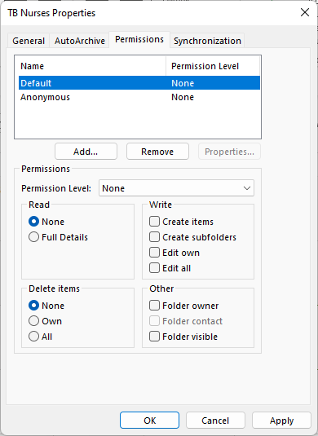
Assigning Access Rights to Others
Page
11
The panel at the top lists all those with permissions assigned.
When a name is selected from the panel above, the permissions assigned to that name are displayed and are editable in this panel.
Now click on Add…

Slide 12
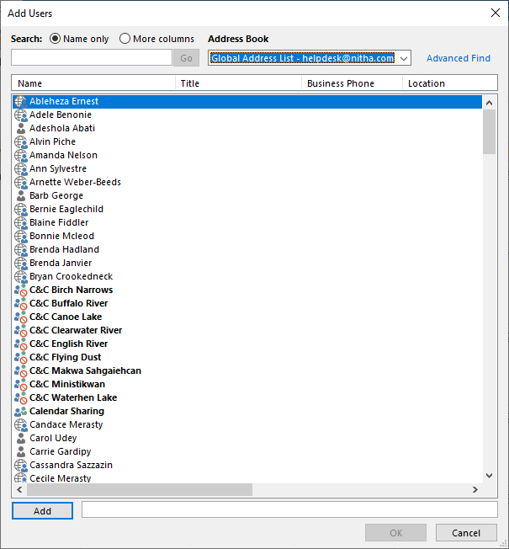
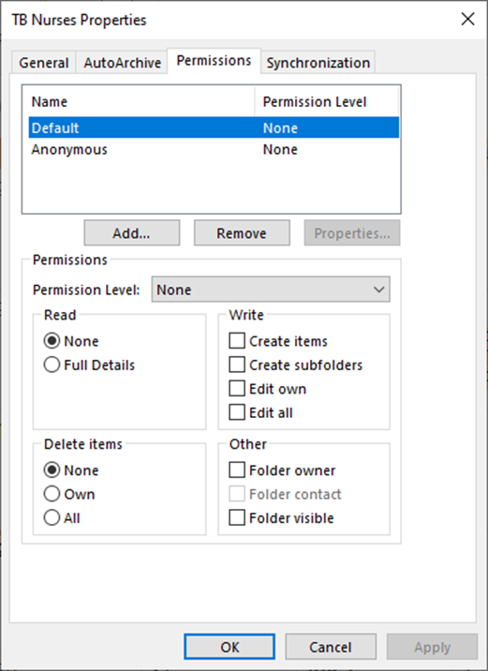
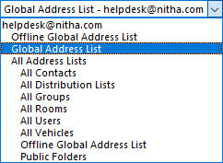
Assigning Access Rights to Others
Page
12
Select from the Address Book the Global Address List.
This Global Address List is for those in your organization.

Slide 13
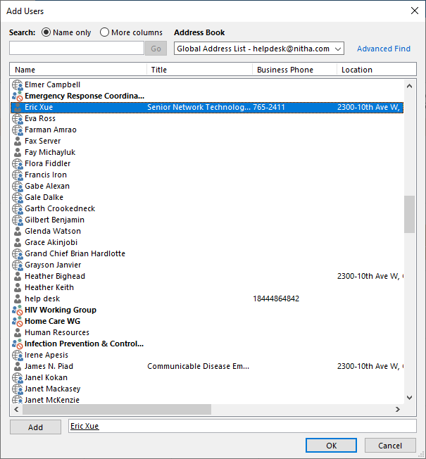
Assigning Access Rights to Others
Page
13
Select a contact to add by double-clicking on it.
Make sure to double-click to add rather than simply typing in the email address.
Click on OK.

Slide 14
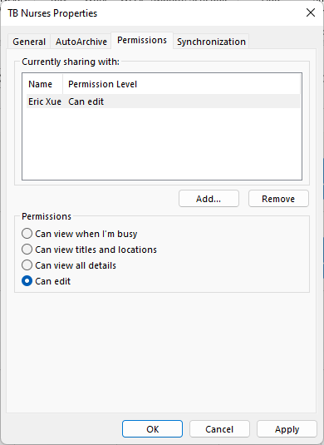
Page
14
Assigning Access Rights to Others
Select the best security option for the user you have selected.
As soon as you click OK or Apply an email is sent to the contact(s) you added in the permissions dialog.
Notes:
Question 2: If you have access to another person’s calendar, where do you find that calendar.
Answer: d. Calendar module / Folder Pane

Slide 15
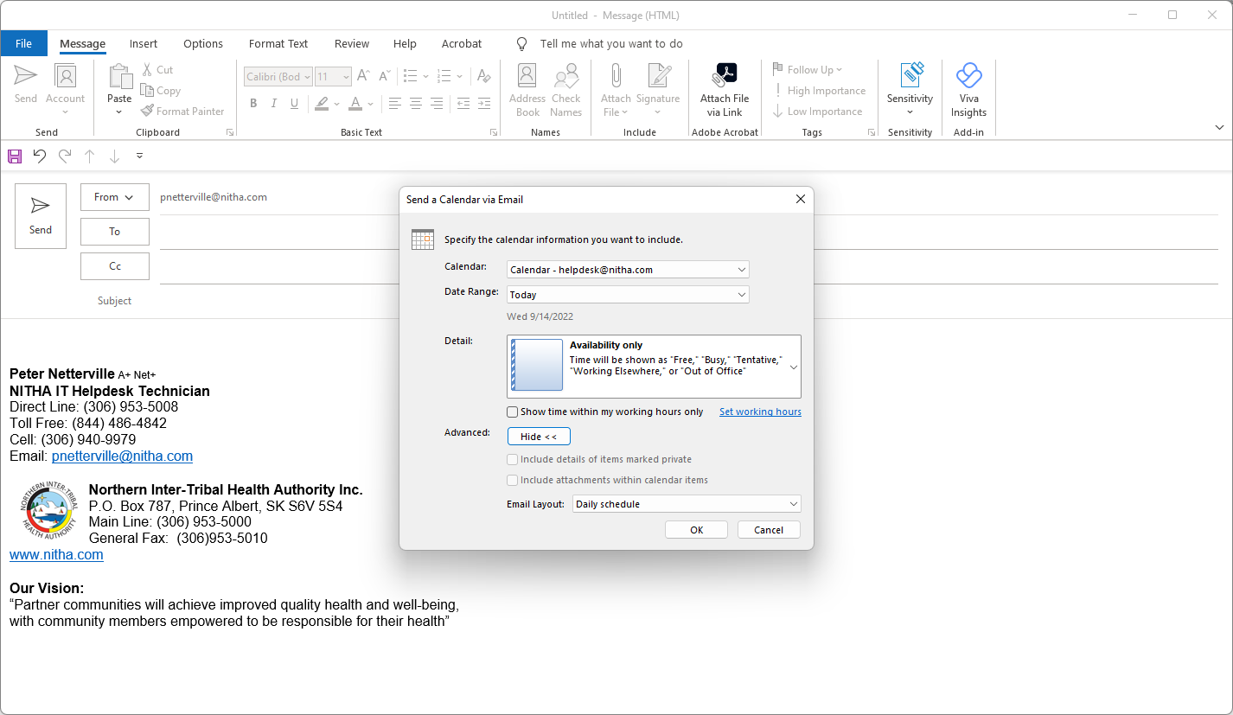
Sharing Your Calendar with Others
Page
15
With the contacts assigned to the new calendar and permissions set for each contact…
You can email more than one at a time, but make sure to group emails with the same permission level.
Finally, click on Send.
Add each of the contacts to the To field.
… the calendar now needs to be shared with the contacts.

Slide 16


Page
16
Using OneDrive to Enhance Collaboration
OneDrive is a file sharing service that when used in conjunction with the Microsoft Exchange server becomes a powerful tool for collaborative projects.
What OneDrive does for you is to allow you to share your file(s) in a secure environment where you can assign rights to others in your organization to read, read/change, or access rights to those outside your organization as well.
Another fantastic feature about OneDrive is that when sharing a file, such as a Word or Excel document from your OneDrive, multiple people can edit the file simultaneously if they were given the access rights by you to do so. This cannot be done with regular Word or Excel installed on your computer.
OneDrive can be accessed in either of two ways …
1. From the Windows File Explorer, just like you would access a document in your Documents folder.
2. From any web browser, such as Chrome, Firefox, MS Edge, and other browsers.
However, OneDrive does require an initial setup. It is easy.
First, set up OneDrive.
Notes:
Question 4: Define OneDrive
Answer: a. A file sharing service

Slide 17
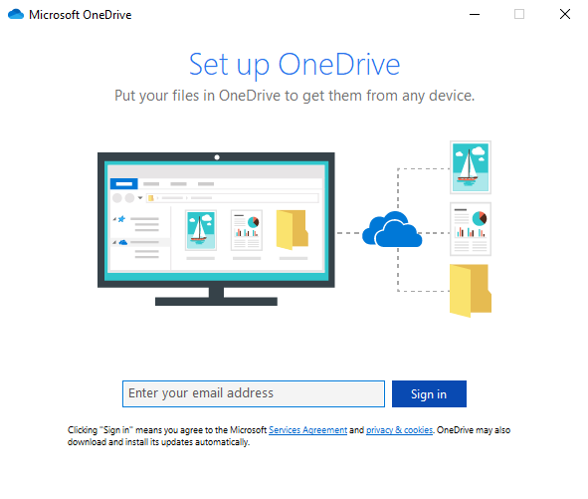
Using OneDrive to Enhance Collaboration
Setting up OneDrive
Page
17
OneDrive can be found in your
Start Menu.
Scroll down the list of programs until you find OneDrive.
The programs are sorted alphabetically.
The first screen you will see when you initiate OneDrive setup is …
Enter your work email address.

Slide 18
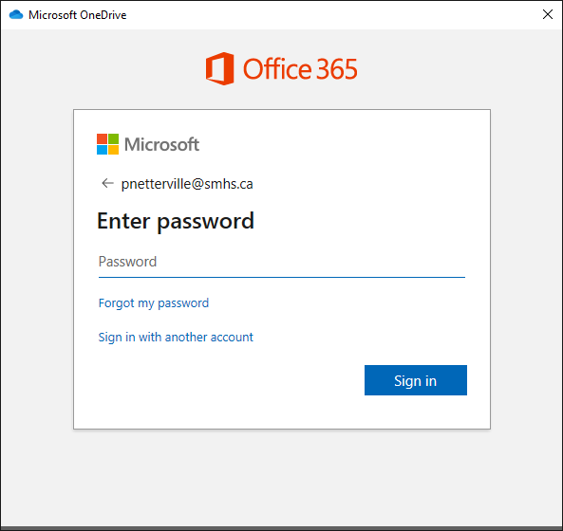
Using OneDrive to Enhance Collaboration
Setting up OneDrive
Page
18
Enter your password
If you have forgotten your password, then you can reset it by clicking here.
If you want to sign in with a different account, click here or the back arrow next to the email address listed above.
Click on Sign in

Slide 19
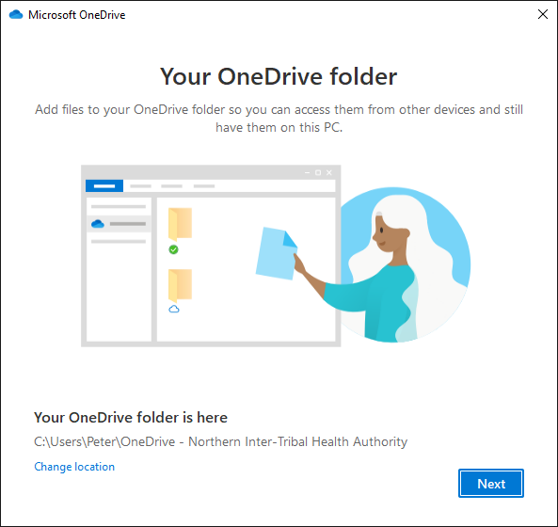
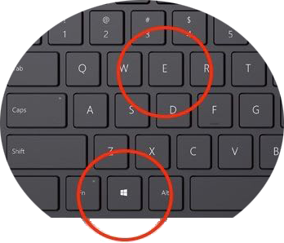
Using OneDrive to Enhance Collaboration
Setting up OneDrive
Page
19
You access this drive by opening your Windows File Explorer. The keyboard shortcut to open the File Explorer is the Windows Key + e
If you are not happy with this location, you can change it now.

Slide 20
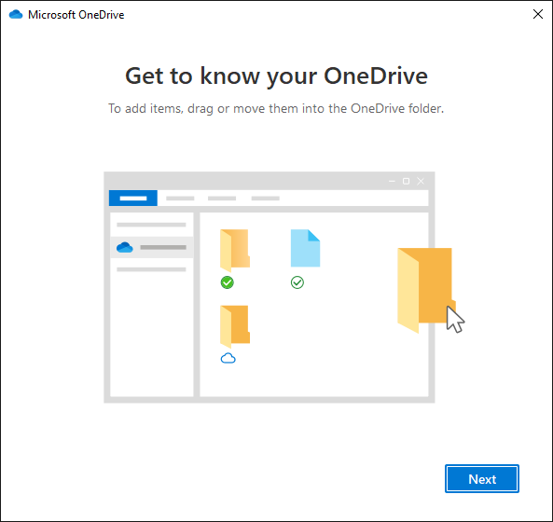
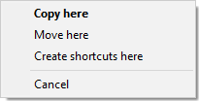
Using OneDrive to Enhance Collaboration
Setting up OneDrive
Page
20
Work with the Windows File Explorer as you would normally …
… drag and drop
OR … right-click & copy from the source
… right-click & paste on the destination
Copying Tip
When you drag and drop file(s), hold down the right mouse button not the left.
When you release the mouse button over your destination folder, you will be presented with a small menu giving you the choice to Copy, Move, Make Shortcut, or Cancel.
Choice is good.
There are a variety of ways to copy/move your files from one folder to another. Choose your favorite method.
By default, the local copy of the OneDrive folder is in your user profile.
When you copy files into the OneDrive folder, it will auto-sync with the cloud copy of your OneDrive so long as your computer has Internet access.
The other method is to use a web browser.

Slide 21
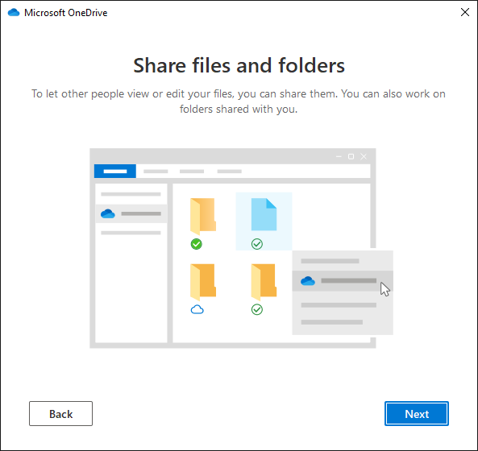
Using OneDrive to Enhance Collaboration
Setting up OneDrive
Page
21
The next setup screen shows you how to share files and folders.
The biggest item to remember here is that files in a folder also have their own access permission rights assigned.
What this means is that if you have given full rights to a user to access a folder, but have restrictions applied to that user on one or more files in that folder, the restrictions apply to that file even though the user has full access rights applied to the folder.
The opposite is also true, if the permission on the files in the folder are set to full access but the folder is set to restricted access, then all the files will also reflect that restricted status.
The more restrictive access rights always have precedence.

Slide 22
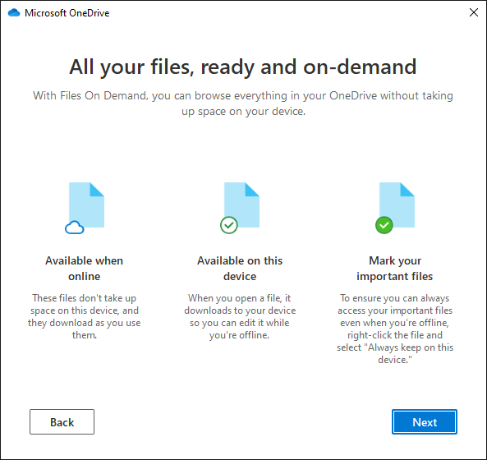
Using OneDrive to Enhance Collaboration
Setting up OneDrive
Page
22
Your files are accessible online from whatever devices you provide access.

Slide 23
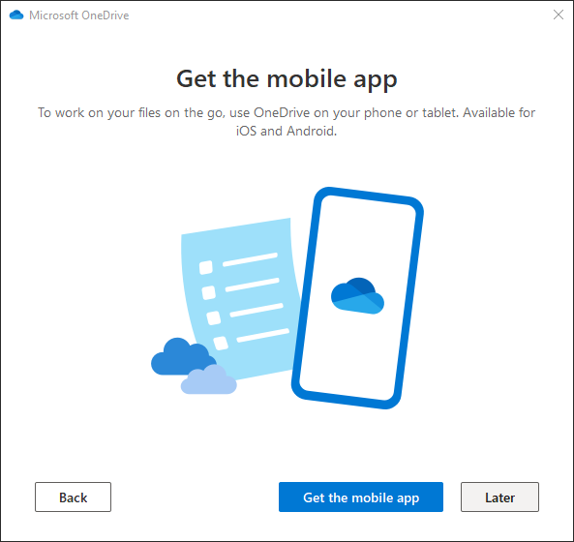
Using OneDrive to Enhance Collaboration
Setting up OneDrive
Page
23
Add your phone …
If you do not want to add the OneDrive app to your smartphone or you want to add it at another time, click on Later.

Slide 24
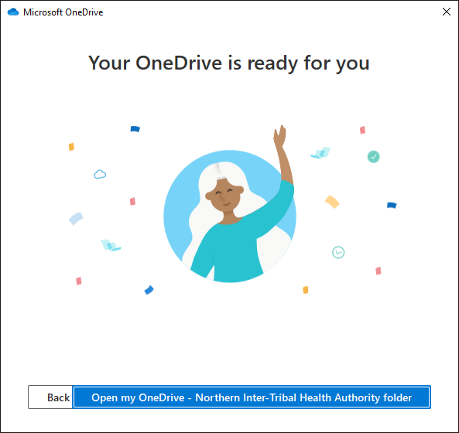
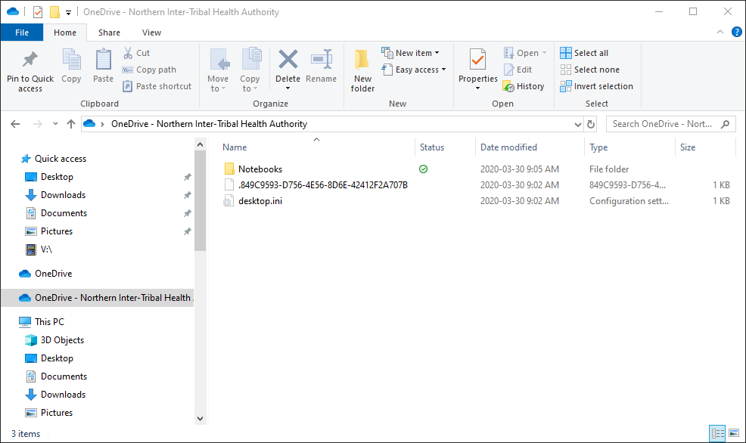
Using OneDrive to Enhance Collaboration
Setting up OneDrive
Page
24
It’s ready to go!

Slide 25
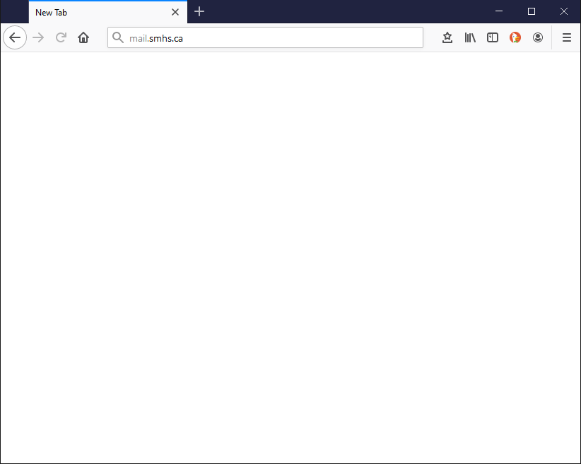
Using OneDrive to Enhance Collaboration
Logging in to OneDrive on the Cloud
Page
25
address bar
Open your favorite web browser and log in to your Office 365 account by typing into the address bar on your browser, mail.yourdomain.com
In my case it is mail.smhs.ca
Your domain is probably different, but your organization may also have a link on its home page that you can click to access your organization’s Office 365.
Once typed in, press Enter

Slide 26
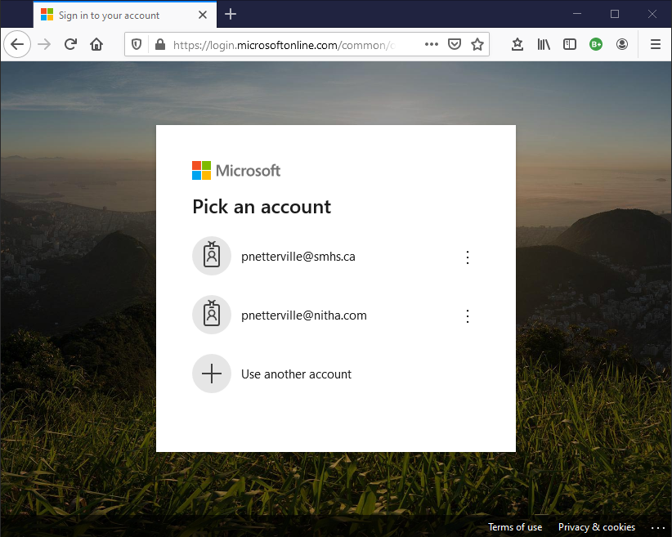
Using OneDrive to Enhance Collaboration
Logging in to OneDrive on the Cloud
Page
26
Click on your email if there are more than one listed.

Slide 27
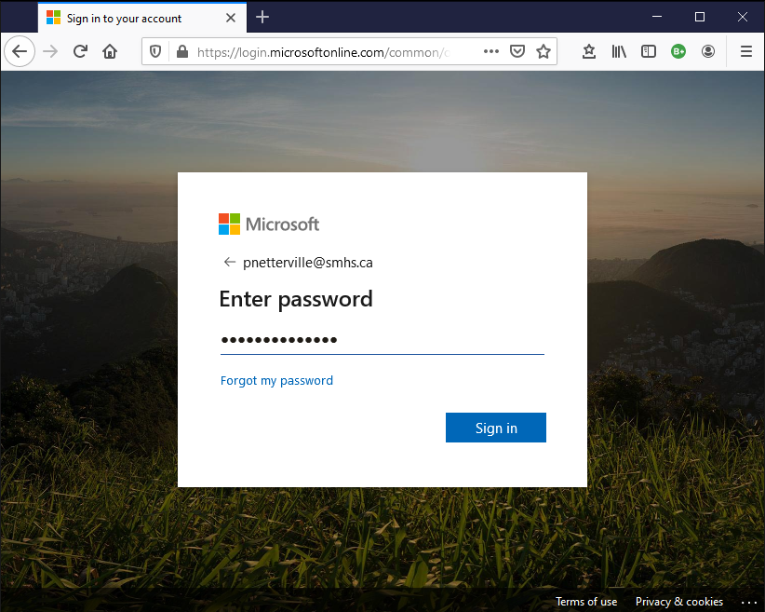
Using OneDrive to Enhance Collaboration
Logging in to OneDrive on the Cloud
Page
27
Enter your password.
Click on Sign in.

Slide 28
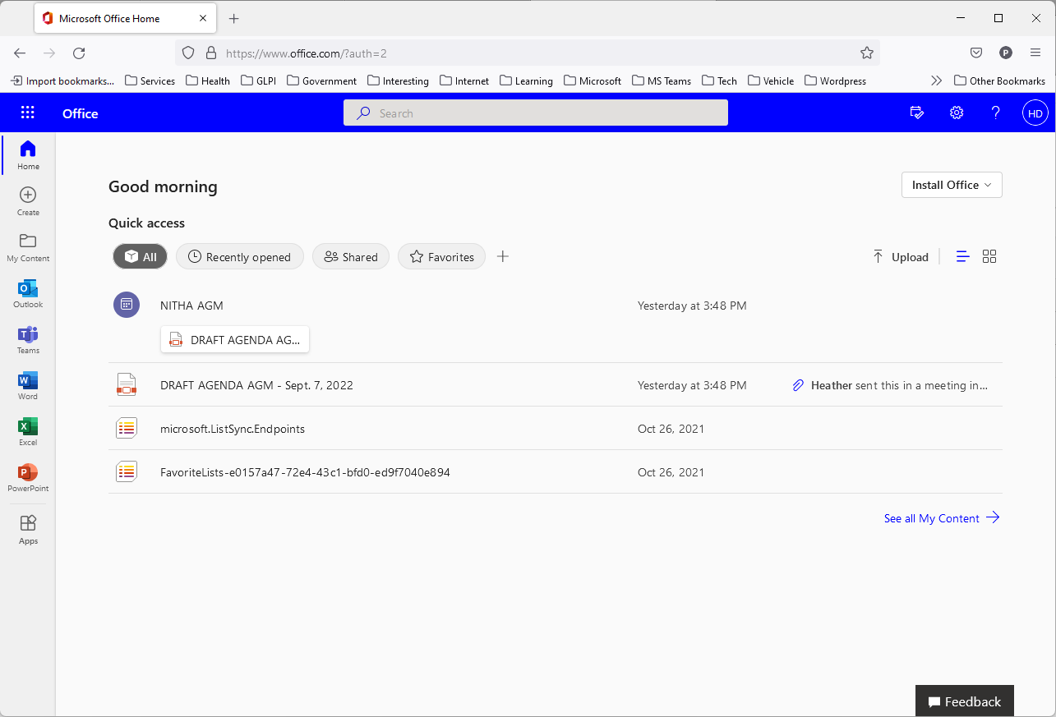
Using OneDrive to Enhance Collaboration
Managing OneDrive
Page
28
… then click on the menu along the top left of the blue bar.
This is the initial screen you will see once you have logged into your account. Your account may not look identical to this one.
If you do not see the OneDrive …

Slide 29
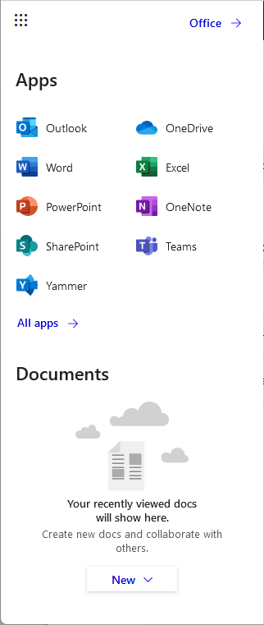
Using OneDrive to Enhance Collaboration
Managing OneDrive
Page
29
Select the OneDrive app.

Slide 30
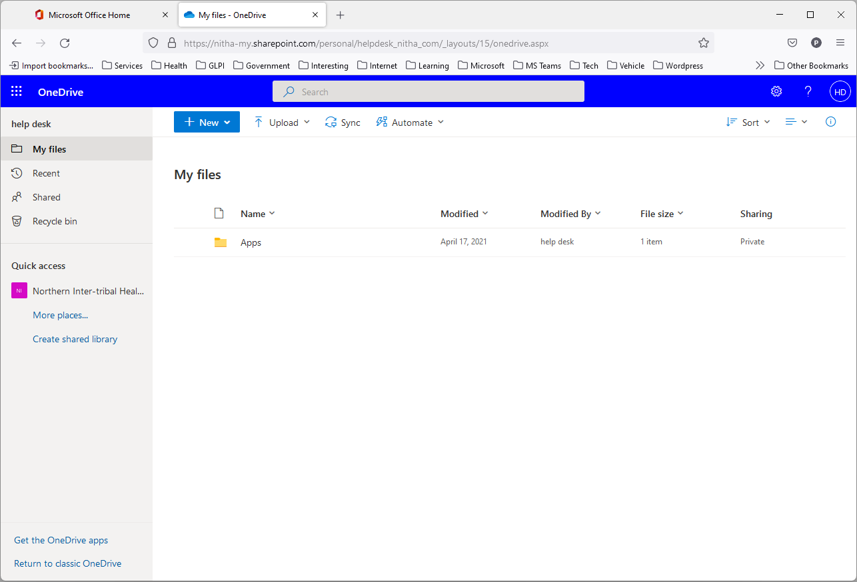
Using OneDrive to Enhance Collaboration
Managing OneDrive
Page
30

Slide 31
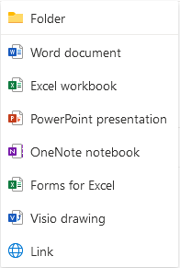
Using OneDrive to Enhance Collaboration
Managing OneDrive
Page
31
On the menu bar, click on the navigation panel icon.
My files is the default view.
These are the items you can create in your OneDrive.
Keep in mind that any documents you create here are editable by whoever you grant authorization to, alongside others.
More than one person can access and change these files at the same time.
This is where you start your collaborative project, by making a Shared Library, our goal at the moment.

Slide 32
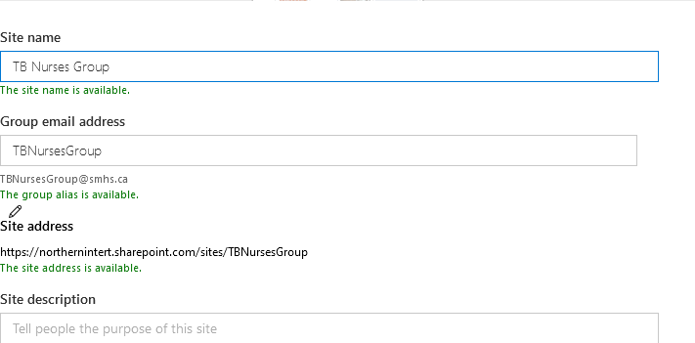
In OneDrive, a shared library is a space where teams can collaborate on files and documents, accessible to multiple users.
Using OneDrive to Enhance Collaboration
Setting up a Shared Library
Page
32
A Team has access to that team’s files and file locations inside individual channels, but the shared library allows a common file share area for more than one team.
Enter an applicable site name.
A site name is checked over your organization.
A group email address is suggested.
Scroll down on the page.
Notes:
Question 5: What is a Shared Library?
Answer: b. A space where teams can collaborate on files

Slide 33
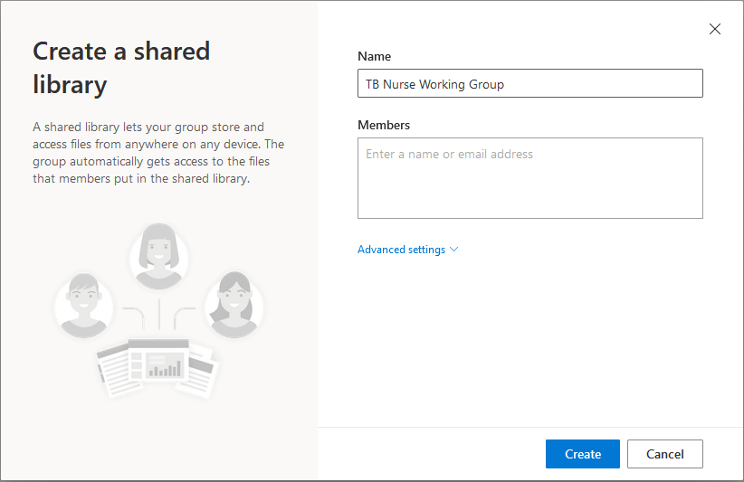

Using OneDrive to Enhance Collaboration
Setting up a Shared Library
Page
33
Name your new Shared Library
Enter all the names/email accounts of the people you wish to allow access to this new group.
Click on that link to view.
As soon as you enter a name and click on the Members box, Advanced Settings appears.

Slide 34
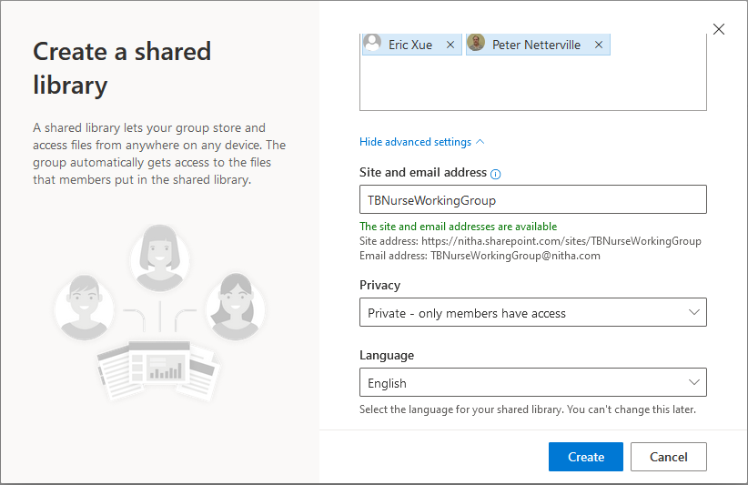

Using OneDrive to Enhance Collaboration
Setting up a Shared Library
Page
34
You can change the Site and email address name, but I do not recommend it. It is better to accept the default name.
Choose your privacy setting: just the added members, or is this group available to all in your organization
And then click on Create.

Slide 35
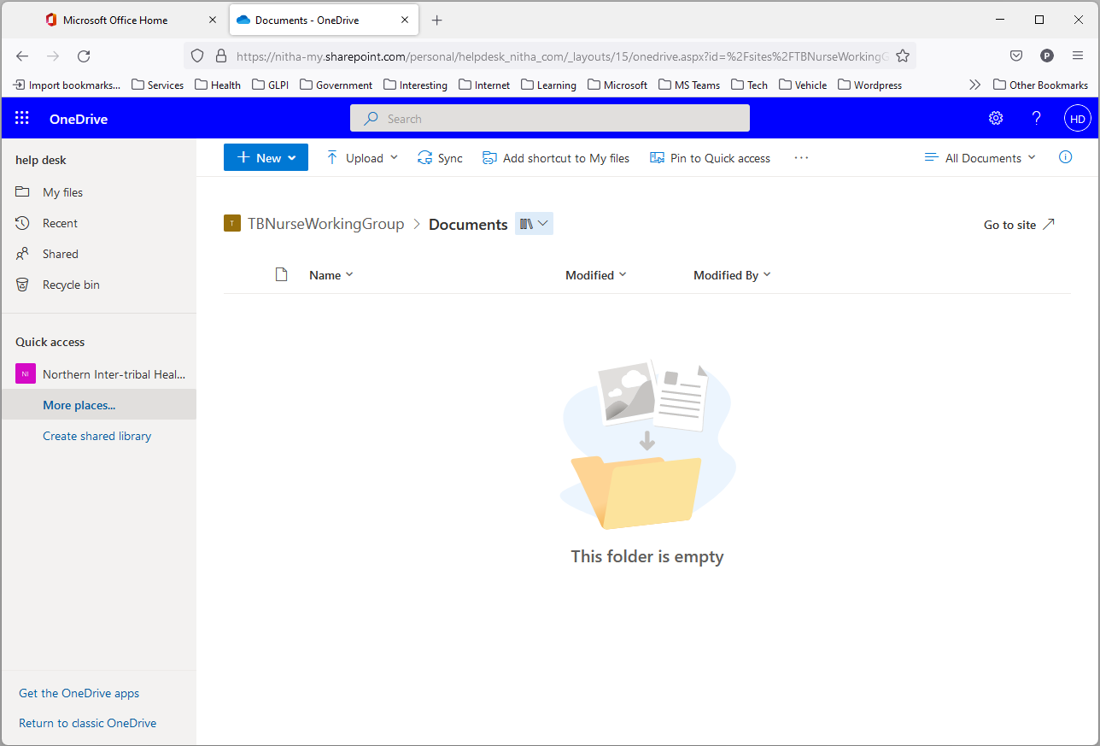
Using OneDrive to Enhance Collaboration
Managing the Shared Library
Now that the Shared Library has been created, this screen allows you to manage the group.
Page
35

Slide 36

We have covered here in this course …
Purpose of this Course
Setting up OneDrive for the First Time
The Making of a Calendar
Logging in to OneDrive on the Cloud
Assigning Access Rights to Others
Managing OneDrive
Sharing Your Calendar with Others
Setting up a Shared Library
Using OneDrive to Enhance Collaboration
Managing the Shared Library

Slide 37
NITHA IT Helpdesk
helpdesk@nitha.com
1(306)953-5008

Slide 38

Thank you

