Slide 1


Outlook 2021 Basics
Entry Level

Slide 2
NITHA IT Helpdesk
helpdesk@nitha.com
1(306)953-5008

Slide 3

What will we be covering in this course?
The BIG Picture Slide 15
Making a New Email Slide 37
Overview: What can Outlook do? Slide 16
Backstage Slide 40
Starting Outlook Slide 17
  Making a Calendar Appointment Slide 44
Where things are Slide 19
Email Options Slide 50
  The Ribbons Slide 27
  Creating a Task Slide 53
  Contacts Module Layout Slide 33
  Outlook modules work together Slide 57
Creating a New Contact Slide 34
  The Rules Slide 58

Slide 4

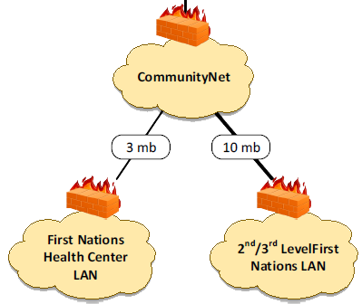



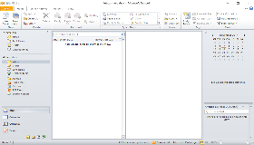

The Big Picture
The Internet
Microsoft
Where Microsoft Exchange server lives
Slide

Slide 5

What can Outlook do?
Email
Outlook is composed of five modules
Tasks
Contacts
Calendar
Notes
All five modules interact with each other.
Slide
Notes:
Question 1: What are the modules in Outlook?
Answer: c. Email, Calendar, Contacts, Tasks, Notes

Slide 6
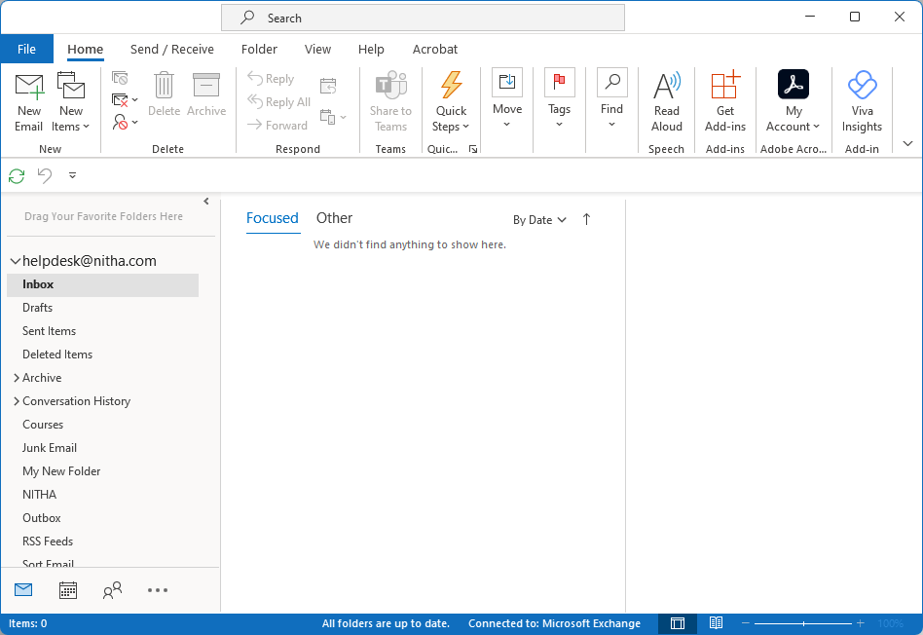
Outlook: Where thing are
This is what you should see once Outlook 2021 is running
Titlebar
Ribbon
Navigation Pane
Content Pane
Preview Pane
Status Bar
Slide

Slide 7
Outlook: Where thing are - Titlebar
The Titlebar has two items of interest …
1. Search bar
Entering text in the search bar will cause the display of a context ribbon with commands specific to searching any data in Outlook.
2. Minimize, Maximize/Restore, and Exit buttons
Minimize shrinks Outlook to the Taskbar
Maximize/Restore button maximized Outlook to the full screen or to w windowed state.
The X button closes Outlook.
Windows 11 has more options for placing your program on the screen. Just hover the mouse pointer over the Maximize/Restore icon.

Slide 8
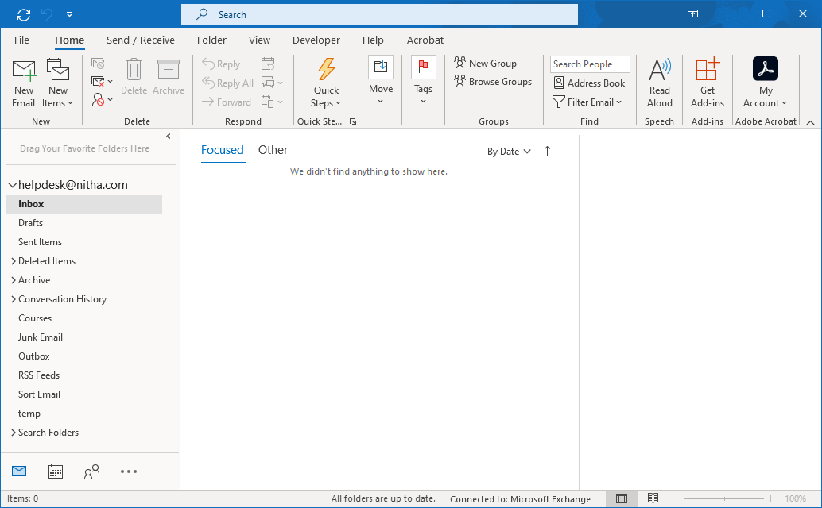
Outlook: Where thing are – Ribbon
The Ribbon has four areas of interest ...
1. Tabs – Click on the tab to open the ribbon.
The Ribbon
2. Commands – Groups of commands that relate to the current selected module.
4. Dialog Box Launcher – For extra commands not available from the ribbon.
3. Group Names – For categorizing commands in groups of like function.
Slide

Slide 9
Outlook: Where thing are – Navigation Pane
The Navigation Pane has three areas of interest ...
Navigation pane
1. Favorites – For those items you access the most, drag the item to the Favorites folder.
2. Email Folders list – Your email folders are all in this section of the Navigation pane.
In the Calendar module, this area contains the calendars.
In the Contacts module, this area contains the Contact lists and groups that you have available to you.
3. Module Icons – For quick access to the five modules in Outlook.
Slide
Notes:
Question 2: Where on the Outlook screen are the icons to select a module?
Answer: Bottom left

Slide 10
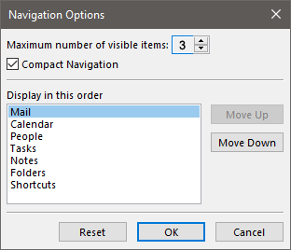
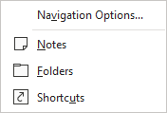
Outlook: Where thing are – Navigation Pane
The Navigation Pane has three areas of interest ...
Folders display all folders in the Navigation Pane.
Navigation Options
Max number of module icons to display (currently 3)
Compact Navigation
Change the icon display order
Reset to default
Shortcuts (favorites) display only the favorites, not the email folders.
Contacts
Notes displays the Notes module.
The notes are styled after sticky notes.
Calendar
Mail
Slide
Notes:
Question 2: Where on the Outlook screen are the icons to select a module? (Slide 11)
d. Bottom left

Slide 11
Outlook: Where thing are – Content Pane
The Content Pane lists the content applicable to the selected module.
Content Pane – Module content.
In the email module, this area lists your emails.
In the calendar module, this area displays your calendar & events.
In the Contacts (People) module, your contacts are listed here.
Slide

Slide 12
Outlook: Where thing are – Reading Pane
The Reading Pane lists the content of the item that is selected in the Content pane.
Reading Pane – Available for all modules, but may not be showing by default in every module.
Each module must have the Reading Pane enabled manually.
( View ribbon / Layout group / Reading Pane menu )
Slide

Slide 13
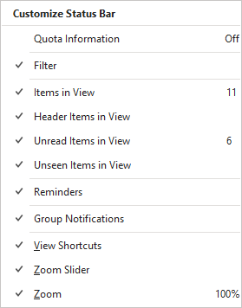
Outlook: Where thing are – Status Bar
The Status Bar shows current information.
Status Bar – Shows the current status of the items selected from the Status bar menu.
Word displays the status of the items checked in the menu when that condition becomes true, hides the information when not.
Right-click on the status bar to view the Status bar menu.
Slide

Slide 14
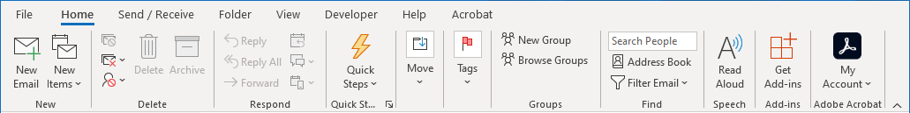
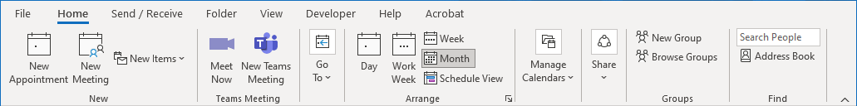
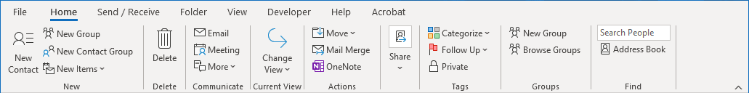
Outlook: The Ribbons – Home
Each module has an Home ribbon.
Email module - Home
Calendar module - Home
Contacts module - Home
Slide
Notes:
Question 3: Where do I go to start a new email? (Select two)
Answer: b. Calendar module, New Items
c. Email module, Home ribbon

Slide 15
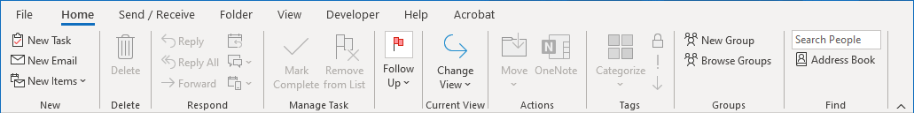
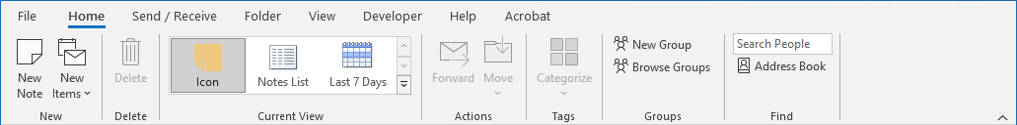
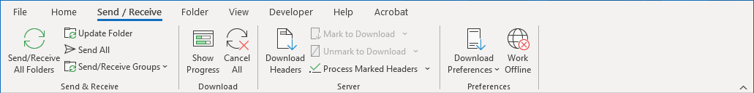
Outlook: The Ribbons – Home
Each module has an Home ribbon.
Tasks module - Home
Notes module - Home
All modules – Send/Receive
All modules have the same Send/Receive ribbon.
Slide

Slide 16
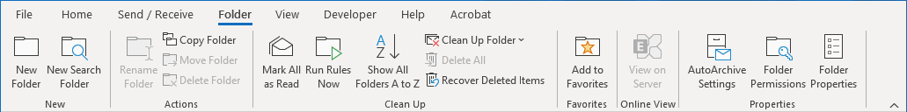
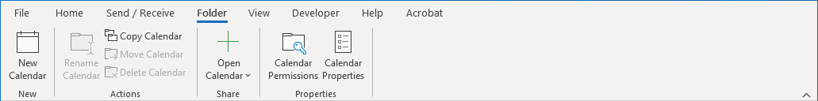
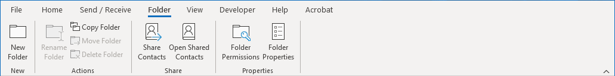
Outlook: The Ribbons – Folder
Each module has a unique Folder ribbon.
Email module – Folder
Calendar module - Folder
Contacts module – Folder
Slide

Slide 17
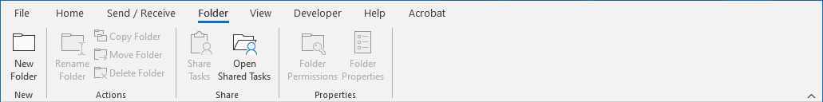
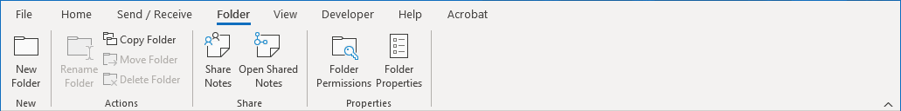
Outlook: The Ribbons – Folder
Each module has a unique Folder ribbon.
Tasks module – Folder
Notes module – Folder
Slide

Slide 18
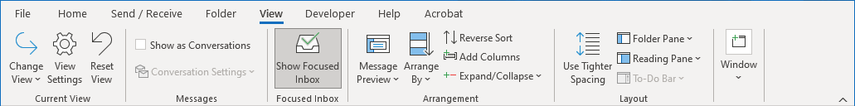
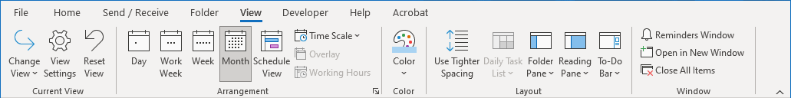
Outlook: The Ribbons – View
Each module has a unique View ribbon.
Email module – View
Calendar module – View
Contacts module - View
Slide

Slide 19
Outlook: The Ribbons – View
Each module has a unique View ribbon.
Tasks module – View
Notes module – View
Slide

Slide 20
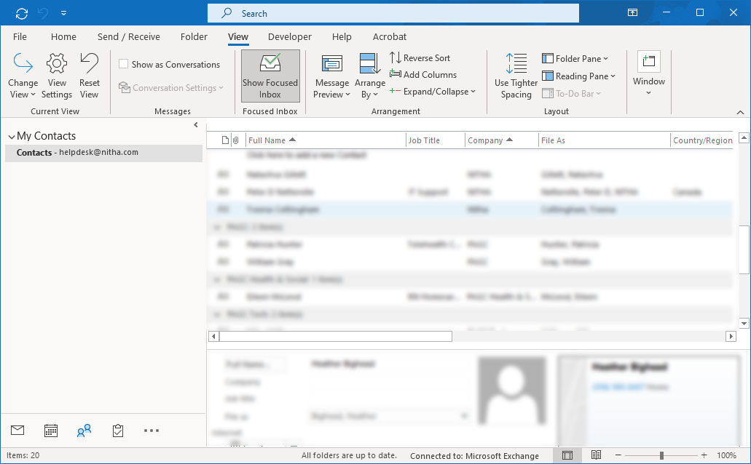
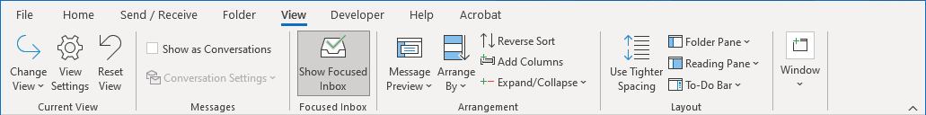
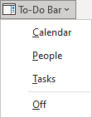
Outlook Contacts Module Layout – To-Do Bar
To enable the To-Do Bar:
Click on the View tab.
Click on the To-Do Bar button.
The To-Do Bar provides current information for today’s events, contacts, and tasks. It is available in all modules.
Which displays a drop menu
Choose any combination of the three
Calendar
People
Tasks
OR turn Off the To-Do Bar.
All three are selected in this example.
The To-Do pane gives you:
A quick view of the date, search contacts, and scheduled tasks
Easy access to the Calendar and Tasks modules.
Allows you to view today’s activities.
Slide

Slide 21
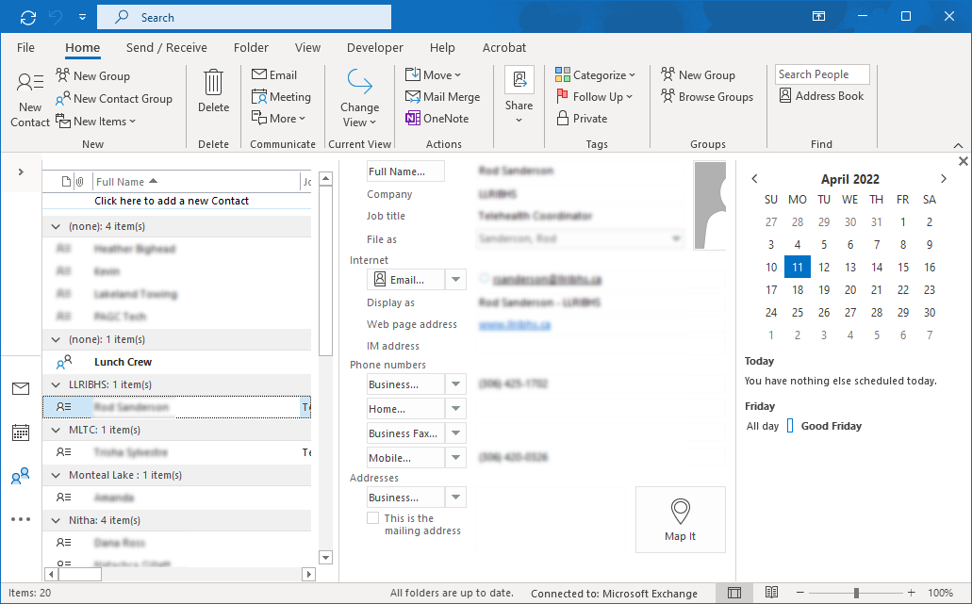

Creating a New Contact
Click on the New Contact button to create a new contact.
Collapse Navigation Pane button
Click first on the Contacts module.
or if not collapsed …
Slide

Slide 22
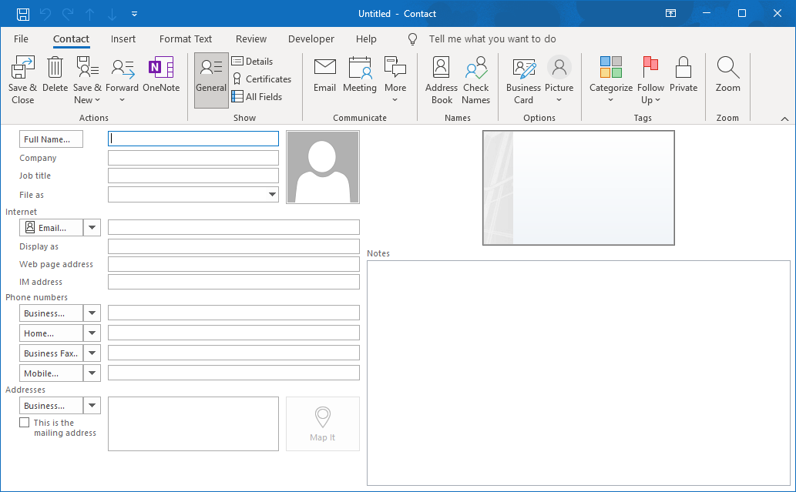
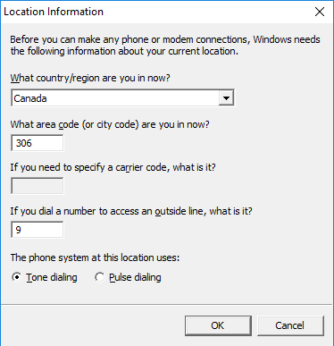
Creating a New Contact
IT Helpdesk Support
Canada
NITHA
306
Tech Guru
9
IT Helpdesk Support
helpdesk@nitha.com
NITHA
Tech Guru
helpdesk@nitha.com
www.nitha.com
www.nitha.com
1(306)953-5008
1(306)953-5008
Click on OK
PBCN Office Complex
Main Floor, 2300 10th Avenue West
Prince Albert, SK
S6V 6Z1
PBCN Office Complex
Main Floor, 2300 10th Avenue West
Prince Albert, SK
S6V 6Z1
Slide

Slide 23
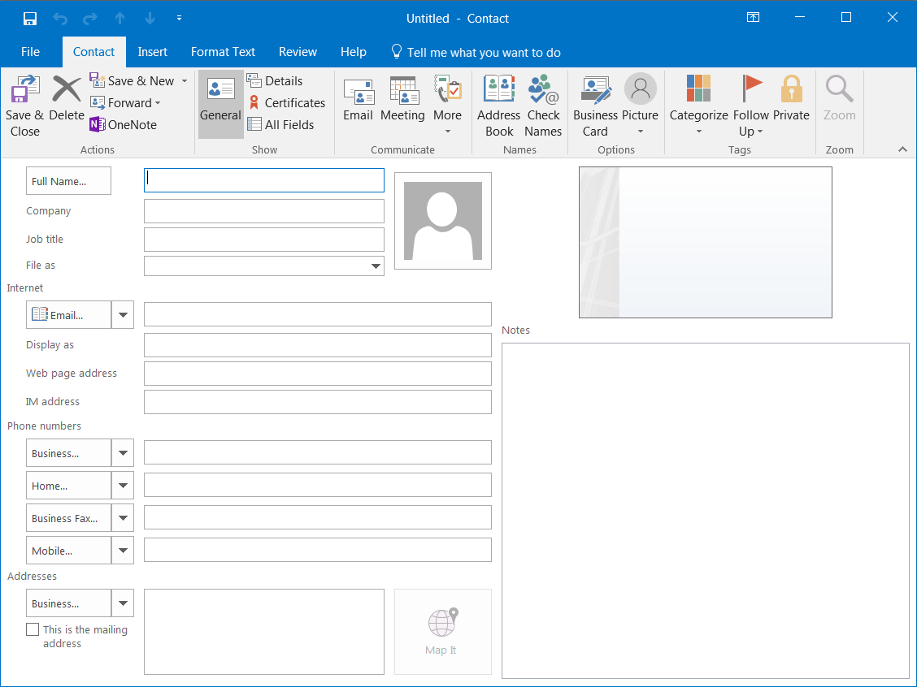
This what your contact should look like now
Click on Save & Close
IT Helpdesk Support
IT Helpdesk Support
NITHA
NITHA
Tech Guru
Tech Guru
helpdesk@nitha.com
Support, IT Helpdesk
www.nitha.com
helpdesk@nitha.com
IT Helpdesk Support (helpdesk@nitha.com)
www.nitha.com
+ 1 (844) 486-4842
PBCN Office Complex
Main Floor, 2300 10th Avenue West
Prince Albert, SK
S6V 6Z1
Slide

Slide 24
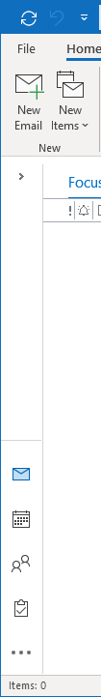

Making a New Email
Click on the New Email button to start a new email.
or if collapsed …
Select the Mail module if it is not already selected.
Slide

Slide 25
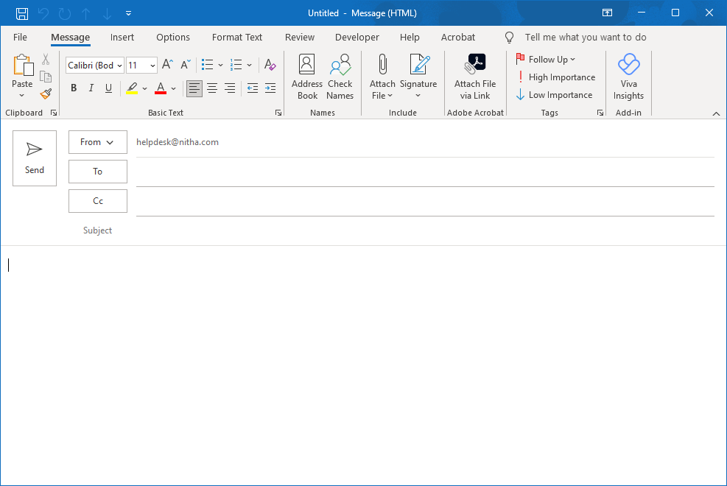
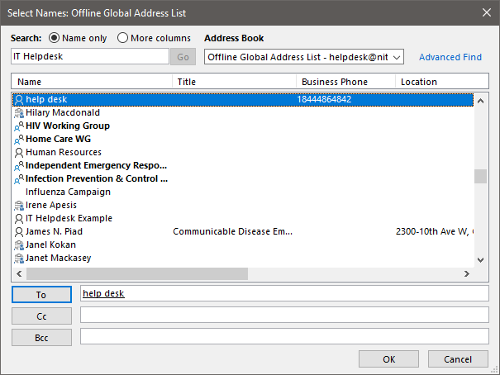
Making a New Email – Select a Contact
If you have a down arrow here, it means you have more than one email address attached to this Outlook and can choose which account from which to send the email.
Click on To… to select a contact
IT Helpdesk Support (helpdesk@nitha.com)
When you see the email(s) you want listed here, click on OK.
Slide

Slide 26
Making a New Email
IT Helpdesk Support (helpdesk@nitha.com)
IT Helpdesk Support (helpdesk@nitha.com)
Now click on Send.
IT Helpdesk Support (helpdesk@nitha.com)
In the Subject box, enter any subject, such as Tech question.
Tech question
When will computers become sentient?
Now enter the text of the email with whatever you like.
For example,
“When will computers
become sentient?”
or some other simple-to-answer question like that.
Slide

Slide 27
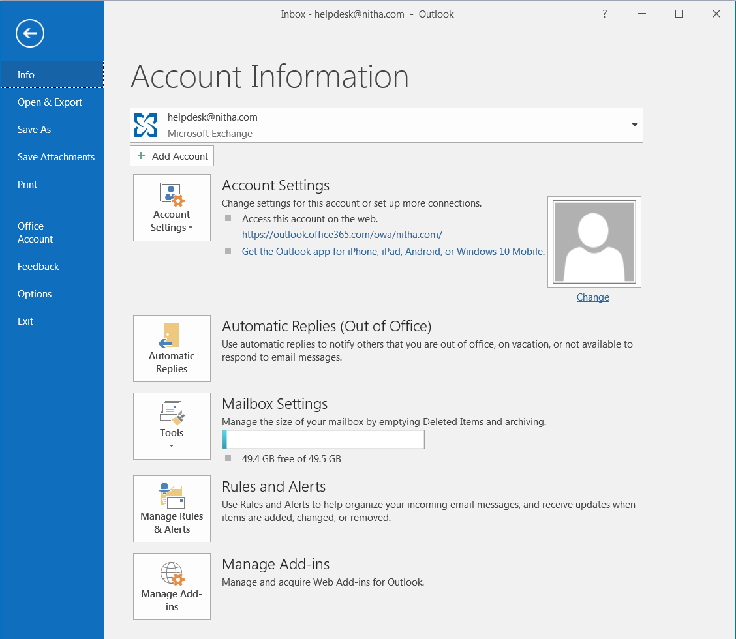
Backstage - Screen Layout - Info
When the Info screen is selected …
Choose the current account
or
Add a new one.
Account settings options:
Account Settings
Delegate access
Download global address book
Manage your mobile notifications
Change Profile
Manage Profile
This is where you enter an automatic reply to incoming emails.
You can:
Specify a date/time period
Message for inside your organization
Message for outside
Slide
Notes:
Question 4: Where do I go to set Automatic Replies?
Answer: Backstage / Info

Slide 28
Backstage - Screen Layout - Info
Tools
Mailbox Cleanup
Empty Deleted Items
Archive old emails
With Rules & Alerts, you can set a rule to do just about anything with incoming or outgoing email.
Then it can alert you by displaying a window and/or by playing a sound of your choice, sorting emails into folders and much more.
Slide

Slide 29
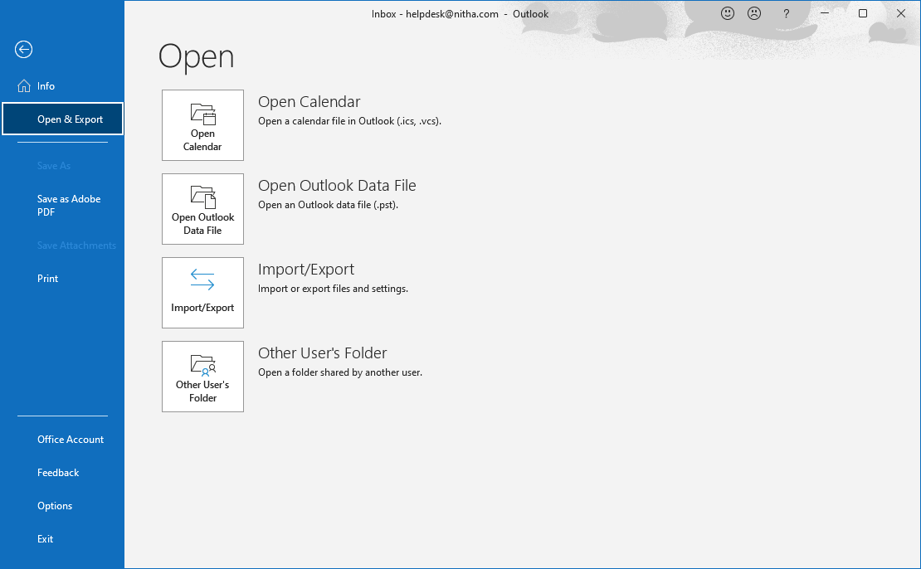
Backstage – Screens Layout - Open
When the Open & Export screen is selected
Open Calendar allows you to open a saved calendar file.
Outlook Data File is a .PST file. From this you can link other data files.
Some Import & Export functions:
RSS Feeds
vCard
iCalendar & vCalendar
Mail account settings
Mail & addresses
Open the User’s Folder option, which allows people to share their Calendars, Contacts, Inbox, Journal, and/or Tasks with others.
Slide

Slide 30
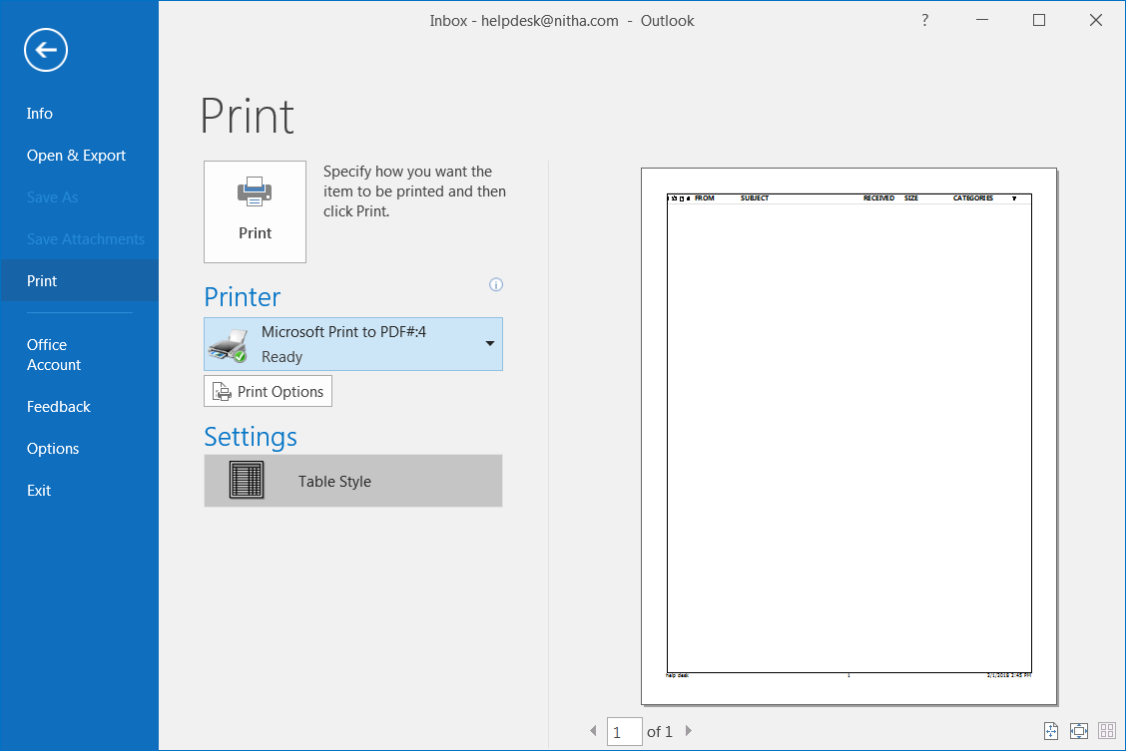
Backstage - Screens Layout - Print
When the Print screen is selected
Print – Print to paper in the print style listed below in Settings, currently set to Table Style.
Printer Select list box – Click to drop down a list of all installed printer drivers.
Settings option - allows you to choose a print style for the module you have selected.
Print Options - allows you to change the printer driver options, such as paper size, tray, etc., for the selected printer.
Slide

Slide 31
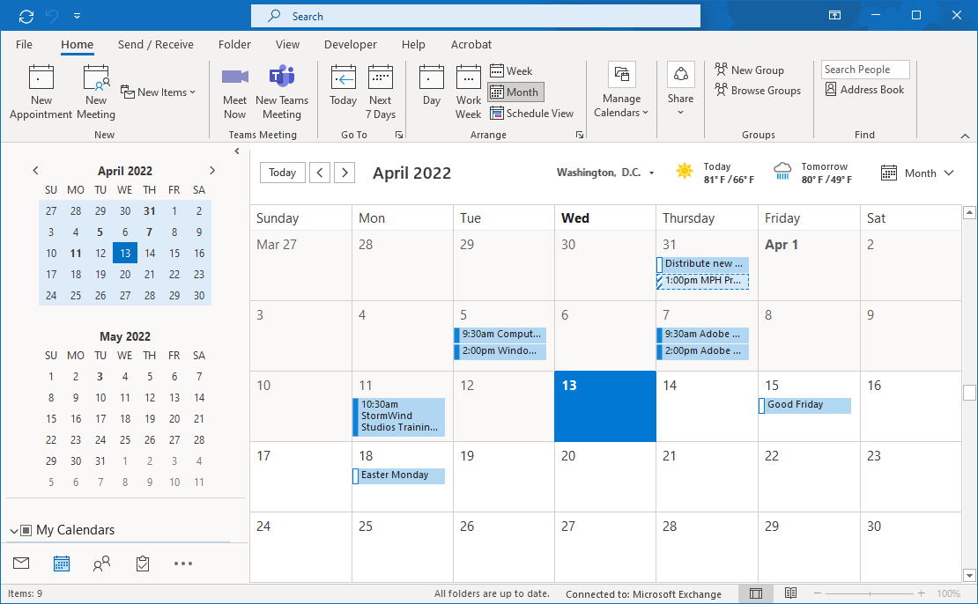
Making a Calendar Appointment
Click on the New Appointment button to start a new calendar appointment.
Select the Calendar module.
Slide

Slide 32
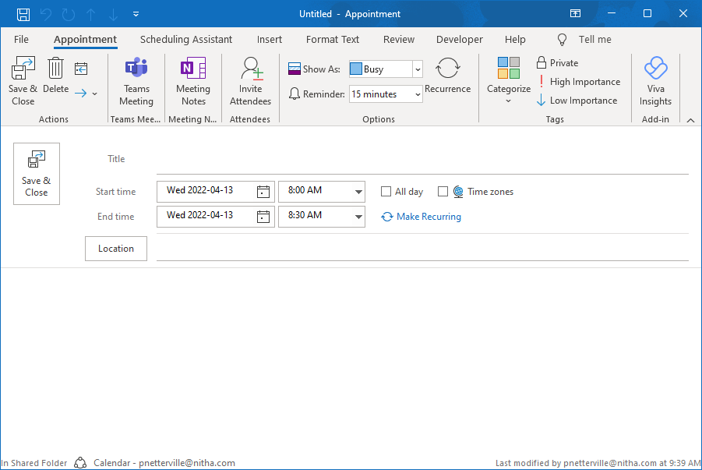

Making a Calendar Appointment
Enter the following information into a new Calendar Entry
Click on Save & Close
Outlook 2010 course from NITHA
Outlook 2021 course from NITHA
2:00 PM
2:00 PM
4:00 PM
4:00 PM
At a location near you!
Outlook training
Outlook training
At a location near you!
Slide

Slide 33
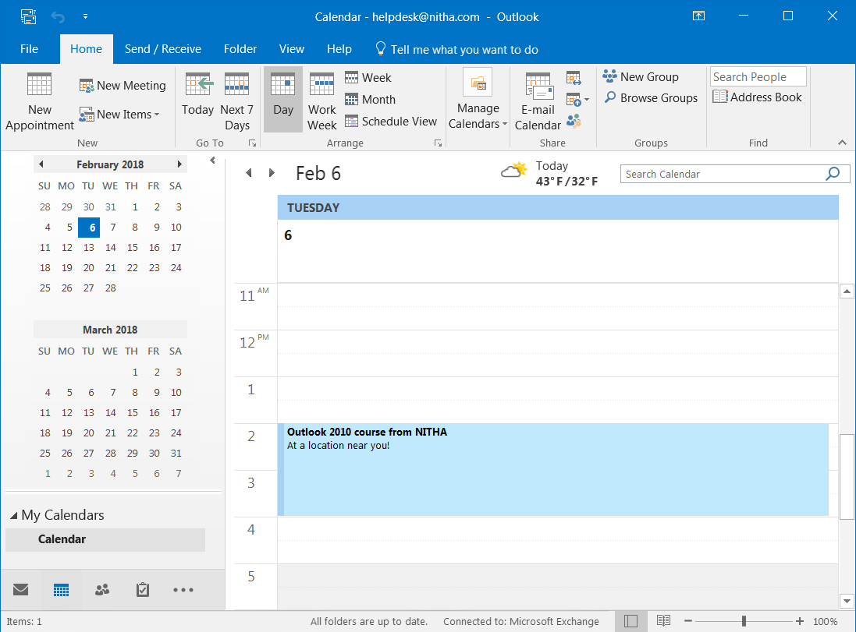
Day View
Our new appointment as viewed in Day view.
Outlook 2021 course from NITHA
At a location near you!
Slide

Slide 34
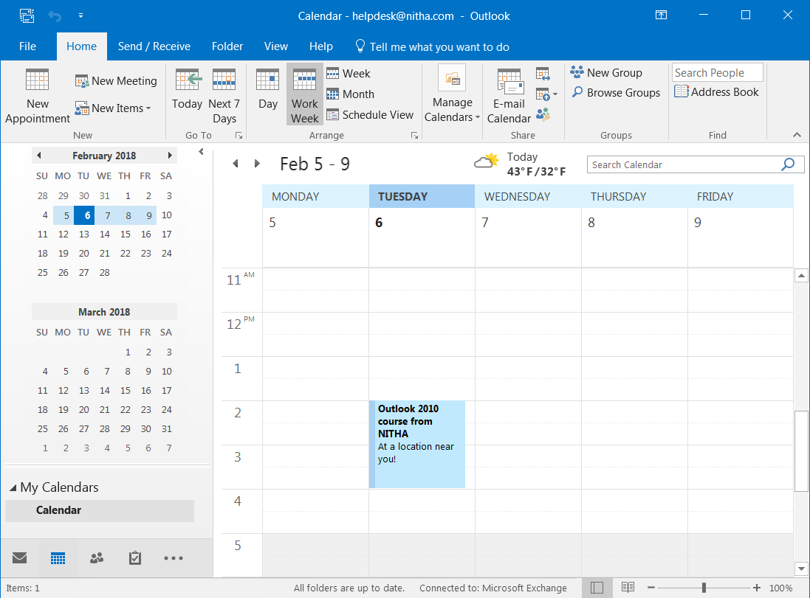
Work Week View
Our event in Work Week view
Outlook 2021 course from NITHA
At a location near you!
Slide

Slide 35
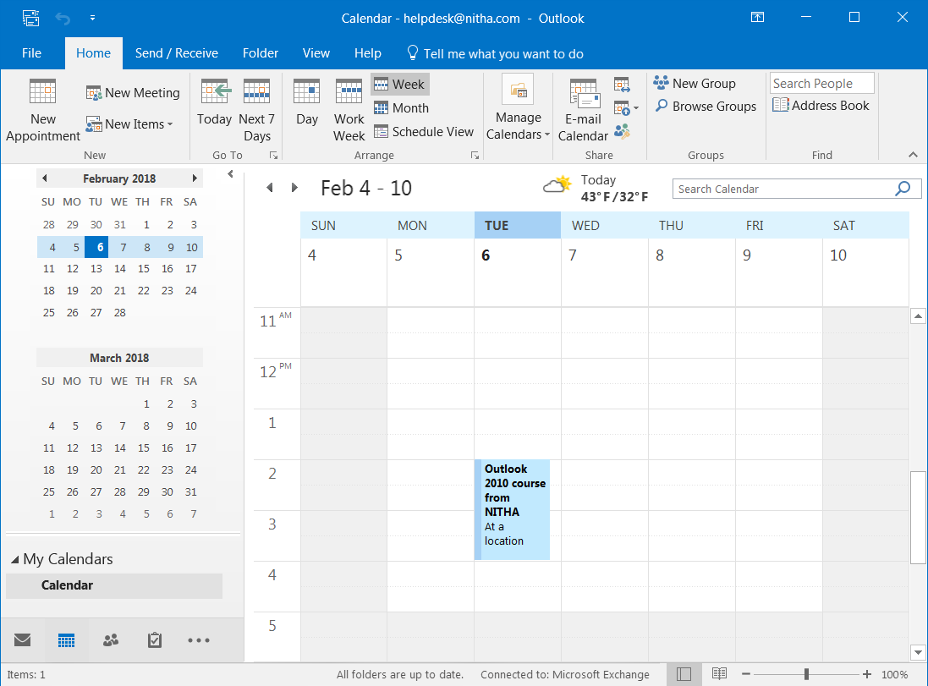
Full Week View
Our new appointment viewed in full Week view.
Outlook
2021 course from NITHA
At a
Slide

Slide 36
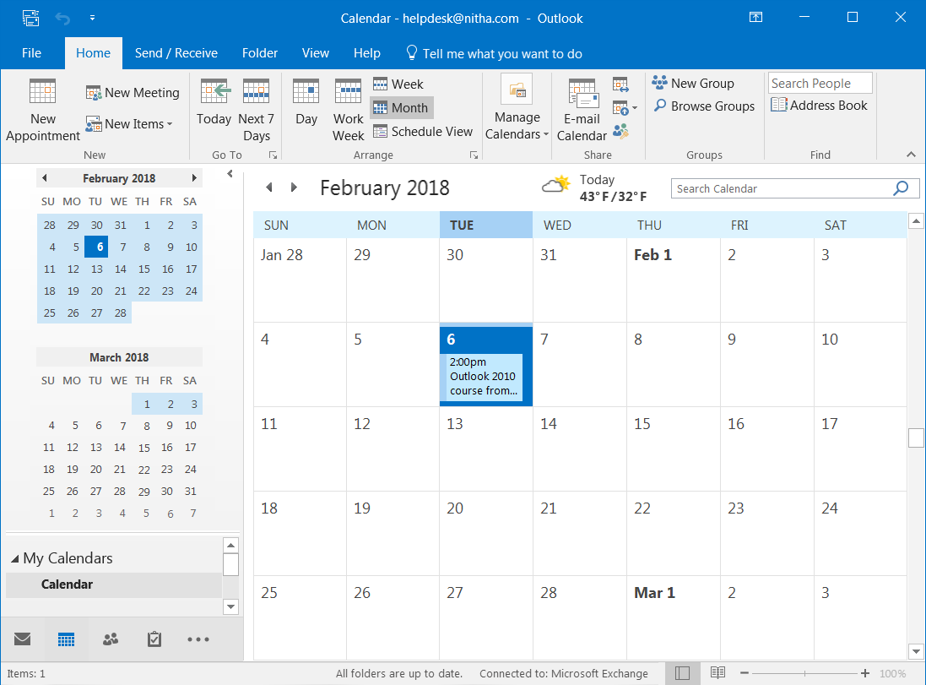
Month View
Our calendar event in Month view.
2:00pm
Outlook 2021
Slide

Slide 37
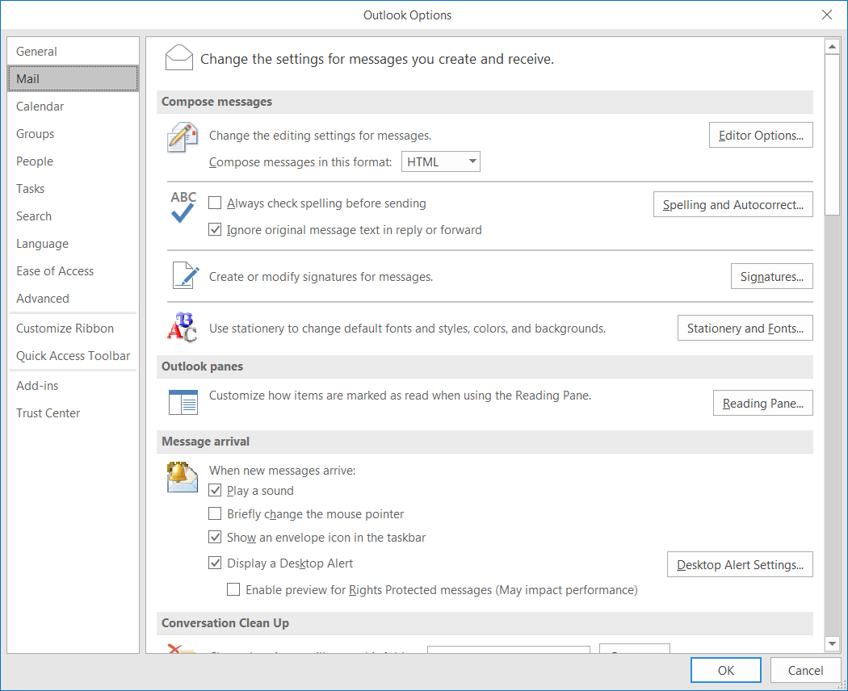
Email Options
HTML vs. Rich Text vs. Plain Text
In the Options dialog found in the Backstage tab click on Mail link.
Now click on the arrow to get the menu.
HTML – HTML is the language of
web pages. This allows most formatting that any web page can display.
Rich Text – Rich text allows formatting like HTML, but the email can only be viewed (with that formatting) in Outlook or Exchange Clients, Microsoft products.
Plain Text – No text formatting or pictures, just plain old text.
Slide

Slide 38
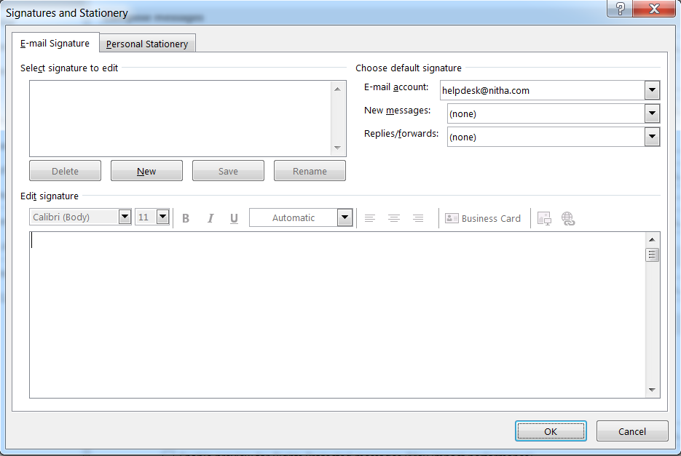
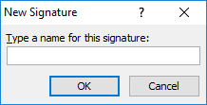
Email Options
Creating a Signature
In the Mail settings click on the Signatures… button
Which displays this dialog.
Click on the New button.
Which displays this dialog.
Type in a name, such as New Emails, for example, and click on OK.
New Emails
You should see the name in the signature box.
Now on to making the signature.
Slide
Notes:
Question 5: You need to make a signature for your emails. Where do you find this option?
Answer: b. Backstage / Options / Mail

Slide 39
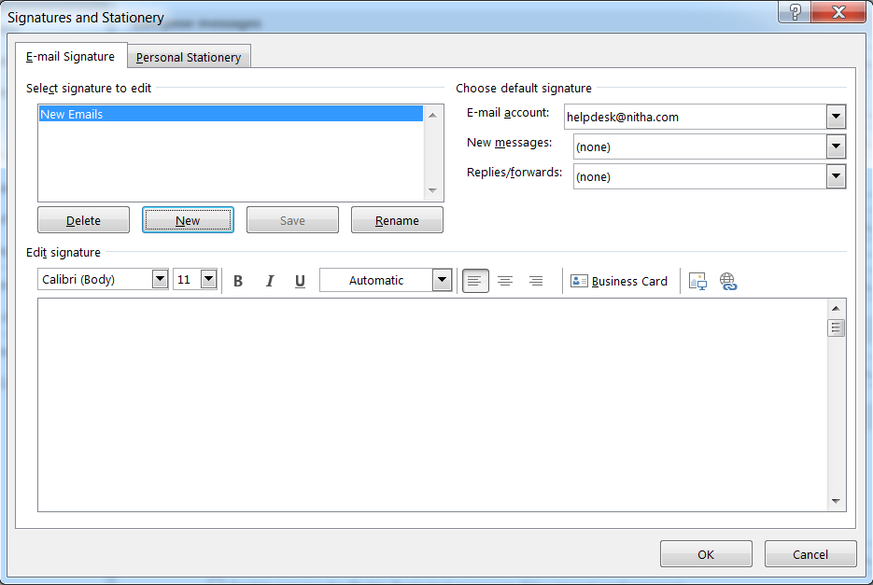
Email Options
Creating a Signature
In the Edit signatures pane, create your signature.
Now, of course you will not be entering in my signature information in the Edit signature box, but your own information.
Then select from the New messages list “New Emails”
Click on Save
New Emails
Create an email signature for all new emails you create.
Whenever you start a new email, the signature will be appended to the bottom.
Click on OK and you are done!
Slide

Slide 40
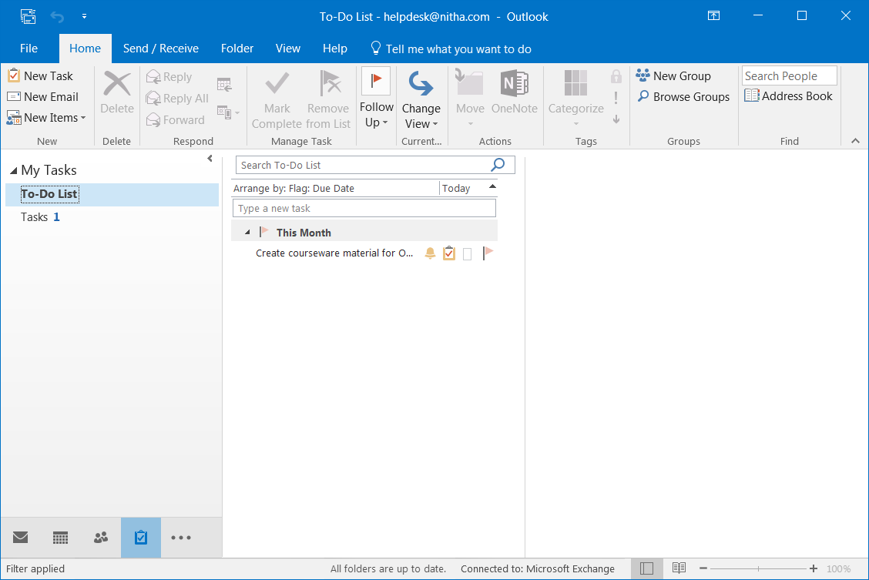
Tasks - Creating a Task
One of the best ways to keep your projects moving forward is to create and follow a scheduled timeline.
A Task can help to keep you on track until the completion of your project.
2. Click on the New Task button located in the New group on the Home tab.
1. Click on the Tasks module link.
Slide

Slide 41
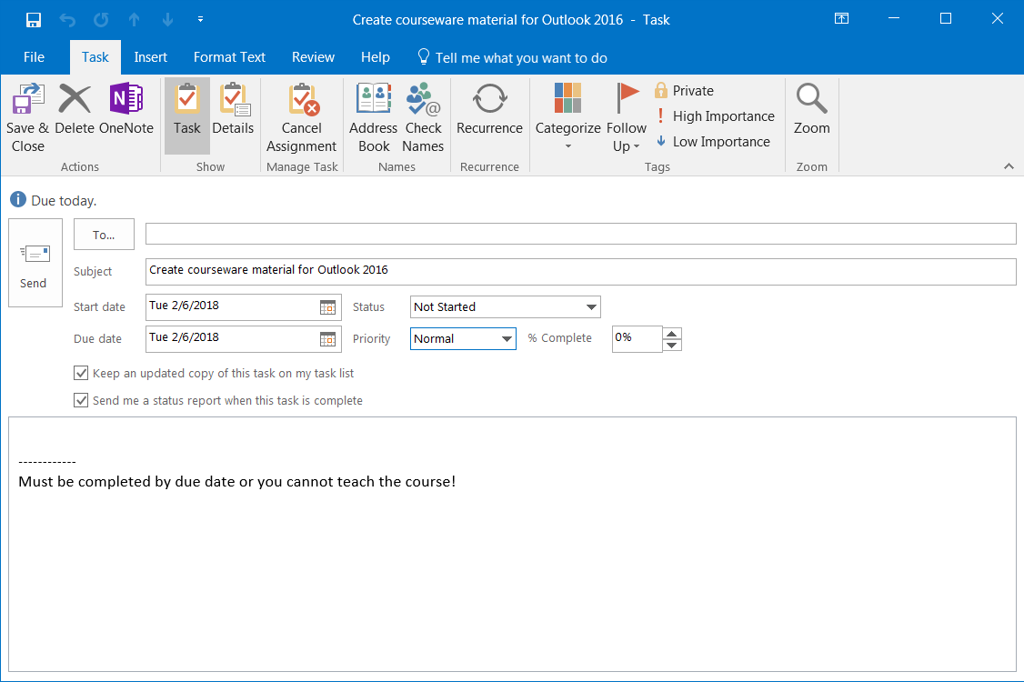
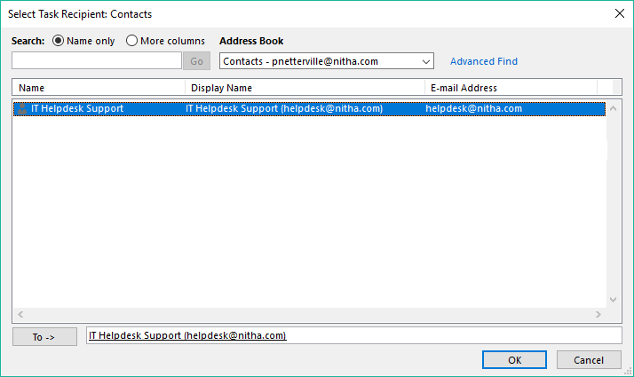
Tasks - Creating a Task
Our Purpose: To create a task and assign that task to a contact.
This is the Assign Task window. Notice the ribbon changed.
You can cancel the assignment by clicking on the Cancel Assignment button in the Manage Task group.
Click on the To… button to assign this task.
Double Click on the contact we made earlier and it will be placed in the To -> box.
Finally, click on the OK button.
Slide

Slide 42
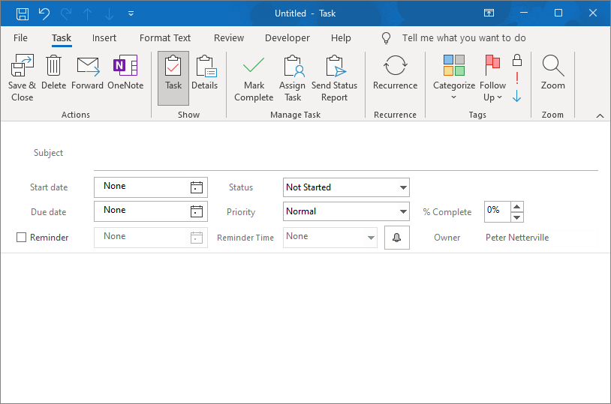

Tasks - Creating a Task
Our Purpose: To create a task and assign that task to a contact.
Type in – Create courseware material for Outlook 2021 for the Subject of the task.
Click on the calendar icon and select today’s date as the Start date.
Click on the calendar icon and choose a Due date.
Now add a reminder to the day the project completion is due by first checking the Reminder checkbox and selecting a reminder date …
... then by setting the time of the reminder.
... then add any comments, such as a log of completed sub-tasks necessary to complete the task.
Slide

Slide 43
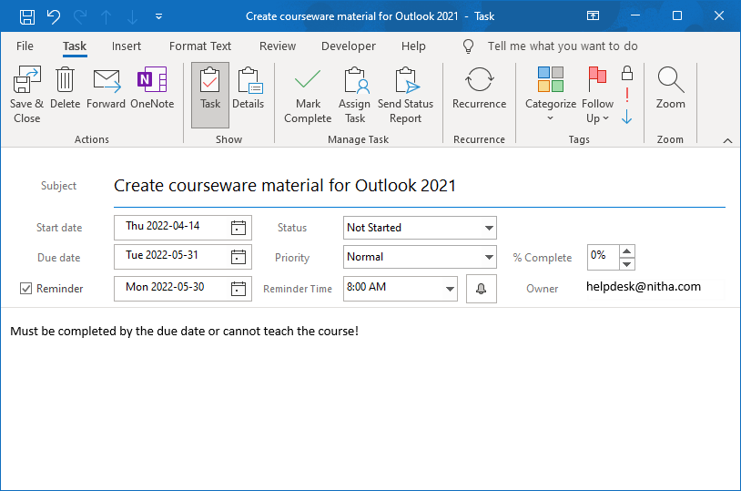
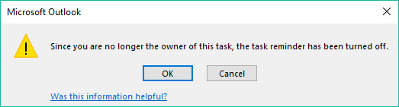
Tasks - Creating a Task
Our Purpose: To create a task and assign that task to a contact.
Click on the Save & Close button to send the assignment.
If you assigned the task to anyone other than yourself, a dialog box warning you that the reminder is turned off will appear.
Click on OK, and you are done.
Keep in mind that for the task to be useful, you should keep the progress up to date.
Slide

Slide 44

How do the Outlook modules work together?
How do the Outlook modules interact with each other?
The People / Contacts are at the hub of Outlook connectivity.
Send/receive email to/from contacts
Invite contact(s) to meetings
Forward a note to one or more contact(s)
Assign a task to one or more contact(s)
Slide

Slide 45
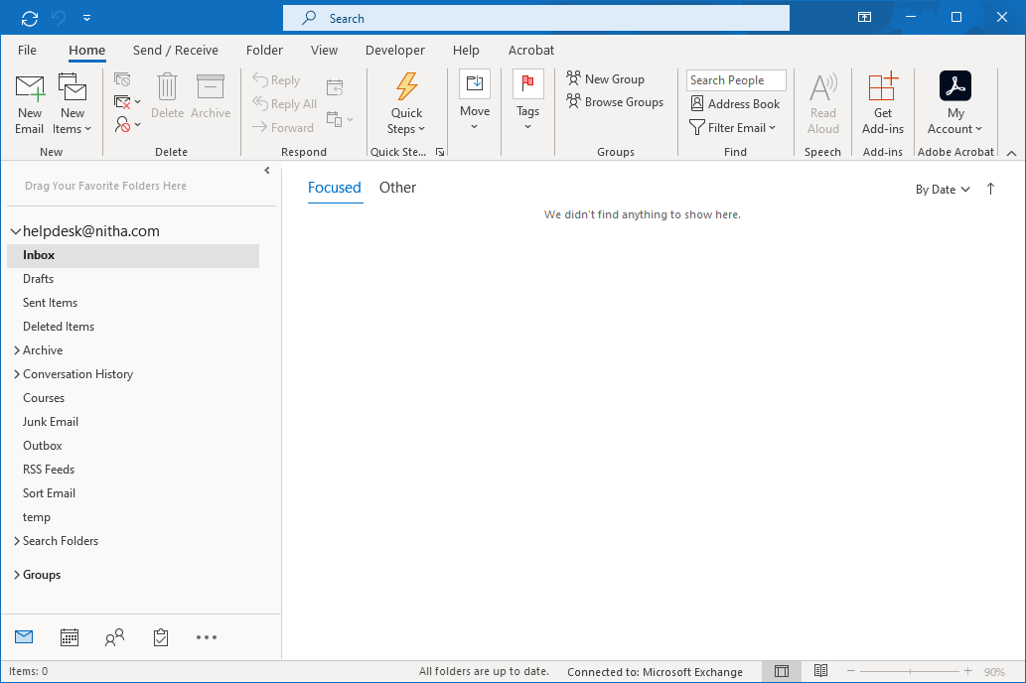


The Rules
Knowing the Rules
Click on the Home tab in the Email module if it is not already selected.
Click on the Move menu to see the options.
Click on the Rules menu.
Click on the Manage Rules & Alerts command.
First, click on the Mail button to display the Mail module.
Slide

Slide 46


The Rules
Knowing the Rules
In the dialogue box that appears, click New Rule…
You can apply a rule to incoming or outgoing messages.
Slide

Slide 47
The Rules
Knowing the Rules
Select from a few popular template rules.
OR
Select to create a blank incoming email rule.
Click on the Next button to apply filter(s) to qualify the email for selection.
Slide

Slide 48

The Rules
Knowing the Rules
Set the conditions (filters) which will narrow down the incoming emails to a qualified few.
Click on the first condition, from people or public group.
Click on this link and select a folder from the dialog that appears. You can also make folders from that dialog.
Slide

Slide 49



The Rules
Knowing the Rules
Select the folder into which the emails will be moved.
OR
Create a new folder and select it.
Slide

Slide 50
We have covered here in this course …
The BIG Picture Slide 15
Making a New Email Slide 37
Overview: What can Outlook do? Slide 16
Backstage Slide 40
Starting Outlook Slide 17
  Making a Calendar Appointment Slide 44
Where things are Slide 19
Email Options Slide 50
  The Ribbons Slide 27
  Creating a Task Slide 53
  Contacts Module Layout Slide 33
  Outlook modules work together Slide 57
Creating a New Contact Slide 34
  The Rules Slide 58

Slide 51
NITHA IT Helpdesk
helpdesk@nitha.com
1(306)953-5008

Slide 52

Thank you

