Slide 1


Outlook 2016/2019 Rules & Search
Intermediate Level

Slide 2

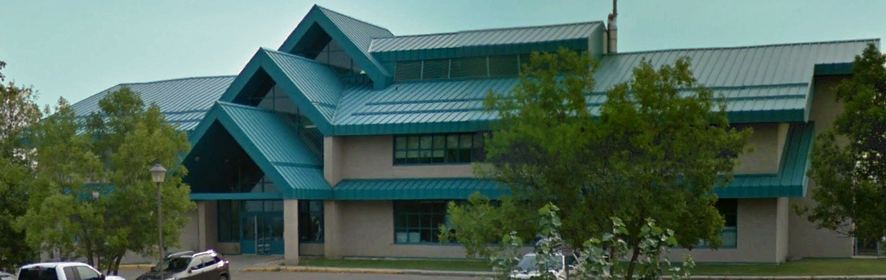

NITHA IT Helpdesk
helpdesk@nitha.com
1(306)953-5008

Slide 3

What will we be covering in this course?
What is an Outlook rule?
Pros and cons in using rules.
Methods for creating and managing rules.
Tips for working with rules
Searching for Outlook objects.
Advanced features of the Search.

Slide 4
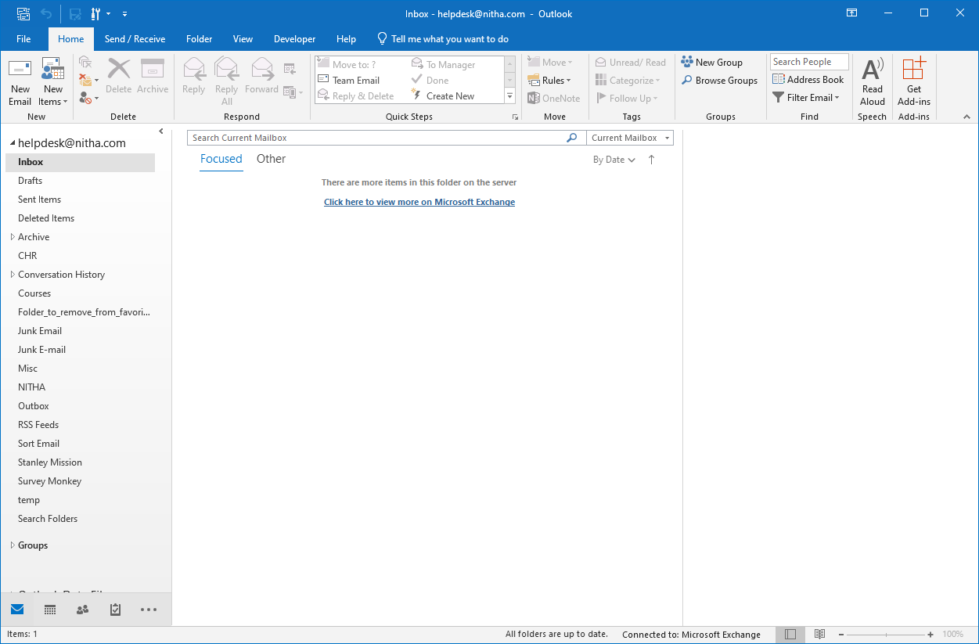
Page
An Outlook rule performs one or more actions on an incoming or outgoing email.
4
What is an Outlook rule?
OR on an incoming RSS feed.
RSS Feed (Really Simple Syndication)
- a web feed which allows users to access aggregate information, updates and other information on software, products, and business news in a standardized format.
Some of the feeds you can receive are:
update information
blog entries
news headlines
audio & video episodes
podcasts
RSS feeds are automatically updated which removes the need to go back to a website for updates.
Rules can be applied to …
Whether the rule is applied locally in Outlook on your computer (the client) or on the Exchange Server depends upon what you are getting the rule to do.
1. The Client Outlook
2. The Exchange Server
For instance …
if you are playing a sound when the mail comes in the rule must be done locally on your computer
but if the email is being sorted into a folder it is performed on the Exchange server.

Slide 5

Page
5
Pros and cons in using rules.
On the Pro side rules can:
On the Con side rules can:
help keep your emails sorted and you organized.
cause odd things to happen when there are too many, they are too complex or run in the wrong order.
remove unwanted emails automatically.
send automatic reply with specific content or template
make searching for a specific email a little more difficult if the emails are sorted to separate folders.
automatically print the incoming or outgoing email
play a sound
tend to be a bit complex to set up
Display a new item alert window
Display a Desktop Alert

Slide 6
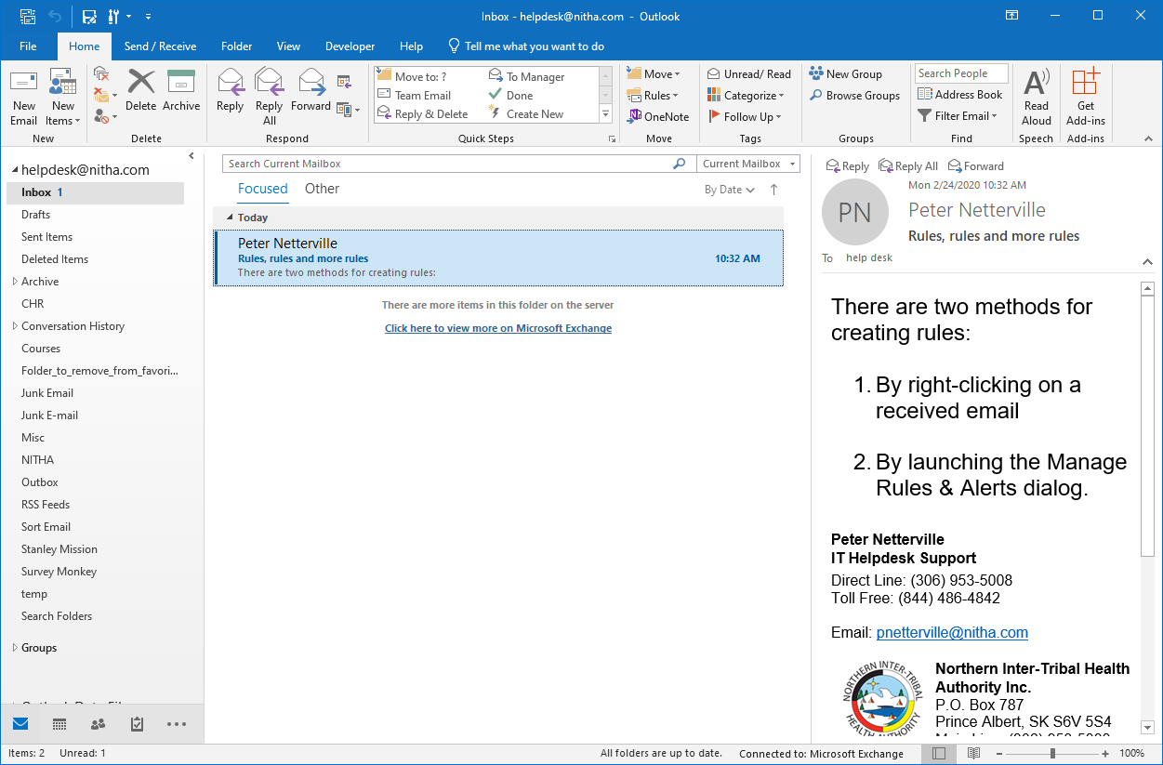
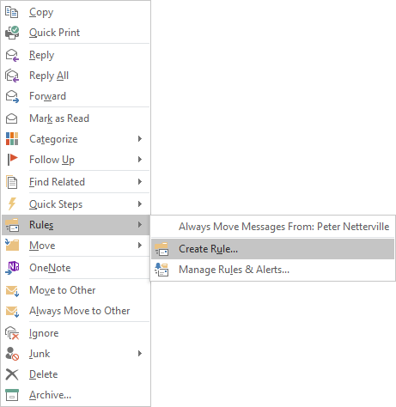
Page
6
Methods for creating and managing rules
Quick Method
Mouse over the Rules menu.
Click on Create Rule …

Slide 7
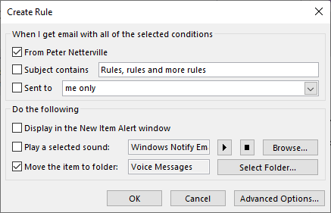
Page
7
Methods for creating and managing rules
Quick Method
When creating a rule from a specific message by right clicking on it you will see this small dialog appear.
Choose one or more from the three most common conditions
The source email address
Sent to recipient address or if the email is sent multiple people you can condition flagging the email by another’s email address.
The Subject containing the specified text

Slide 8
Page
8
Methods for creating and managing rules
Quick Method
When creating a rule from a specific message by right clicking on it you will see a smaller dialog appear.
Choose one or more from the three most common actions
Pull up an Alert window
Play a tune
Move email to a folder

Slide 9
Page
9
Methods for creating and managing rules
Quick Method
The Advanced Options presents the Rules Wizard
However, if you want the Rules Wizard you are best off launching it through the second method …
2. Manage Rules & Alerts

Slide 10
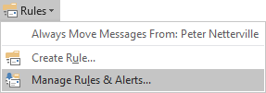
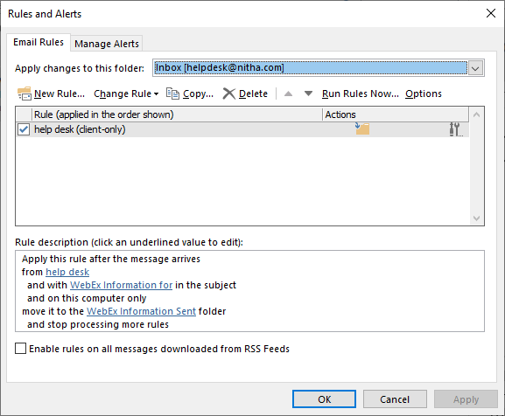
Page
10
Methods for creating and managing rules
Rules & Alert Dialog
OR by clicking on the Rules… menu found in the Move group on the Home ribbon.
Click on Manage Rules & Alerts

Slide 11
Methods for creating and managing rules
Rules & Alert Dialog
Click on the Email Rules tab
Select the email account to which you want to apply the rule(s).
To create a new rule click on New Rule… to display the Rules Wizard.
Page
11

Slide 12
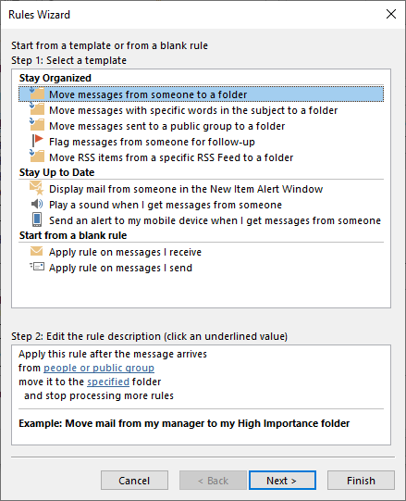
Methods for creating and managing rules
Rules & Alert Dialog
There are five Stay Organized templates from which to choose.
Three Stay Up to Date templates available.
Or start a rule from scratch for either incoming email/RSS feed or outgoing.
Click on Apply rule on message I receive
Then click Next
Page
12

Slide 13

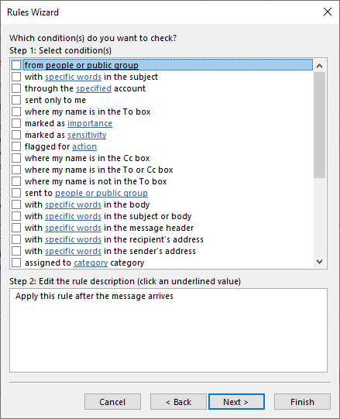
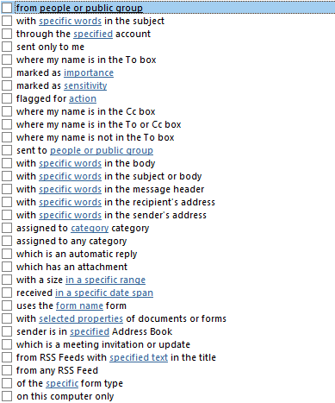
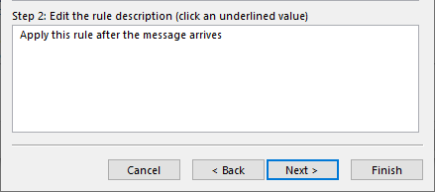
Methods for creating and managing rules
Rules & Alert Dialog
First you need to select the condition(s) that will flag the incoming email for an action you will assign later.
There are a lot of different conditions from which you can choose.
Most of those conditions require information such as:
people or public group
specific words
specified account
importance
sensitivity
flag for action
category
in a specific range
in a specified date span
form name
selected properties
Page
13

Slide 14
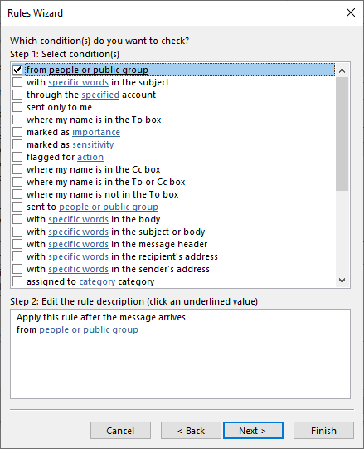
Methods for creating and managing rules
Rules & Alert Dialog
Click on the checkbox beside
from people or public group
Then click on people or public group in the Step 2 box.
In order to sort incoming emails to a different folder.
Page
14

Slide 15
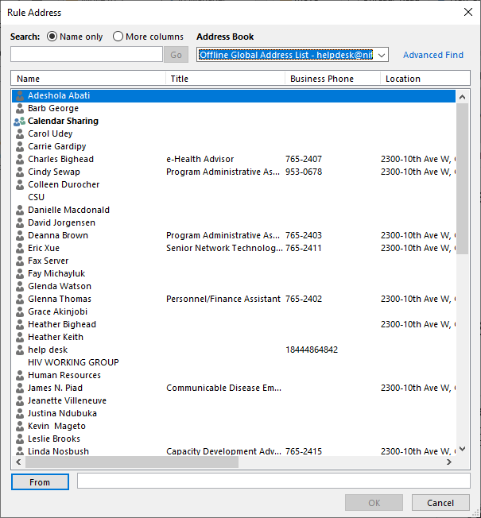
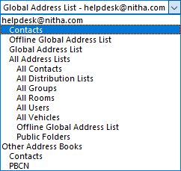
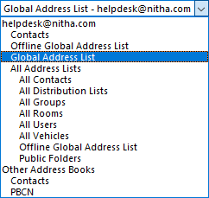
Methods for creating and managing rules
Rules & Alert Dialog
Select the contact or group of contacts.
If the contact you want does not appear in the Exchange Global Address List then click on the drop menu.
Contacts that you add to your Outlook are accessible from the top option.
By default the Exchange Global Address List will be displayed.
Page
15

Slide 16
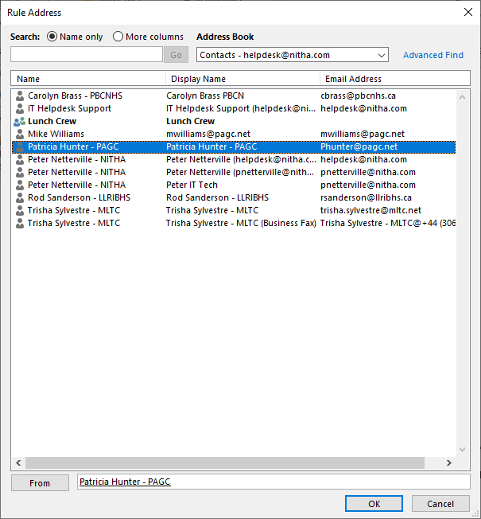
Methods for creating and managing rules
Rules & Alert Dialog
Double click on the contact you want and it will be added to the From text box at the bottom of the dialog.
Click on OK
Page
16

Slide 17
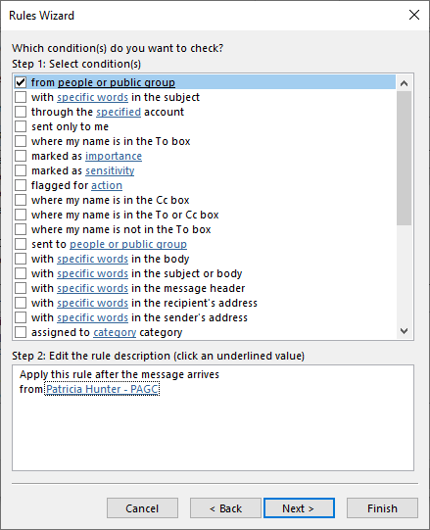
Methods for creating and managing rules
Rules & Alert Dialog
At this point you can choose more conditions that will apply to the incoming email.
Depending upon what other condition(s) you choose you can either restrict or expand the filters.
When you are done adding conditions, click on Next to go to the next panel where you choose the action(s) to apply to the incoming email.
Page
17

Slide 18
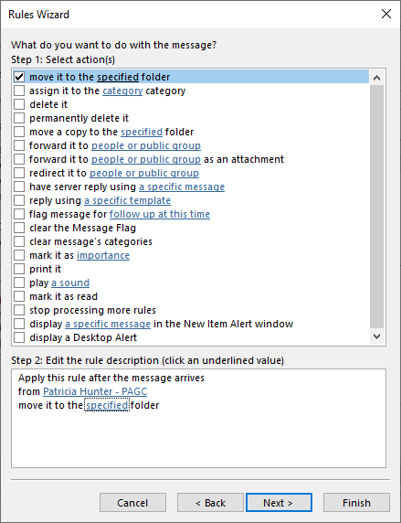
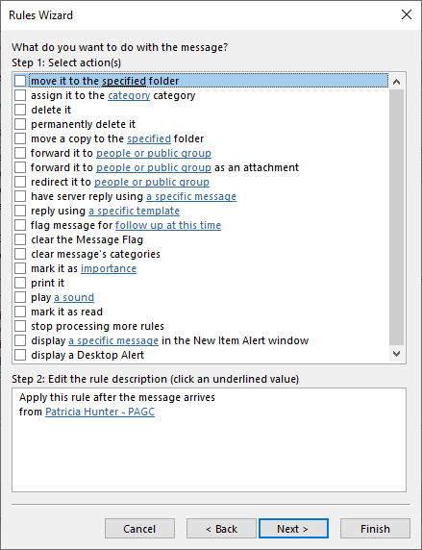
Methods for creating and managing rules
Rules & Alert Dialog
to sort the incoming email into its’ own folder, select move it to the specified folder.
Click here to specify the folder
but to continue with the exercise
A variety of actions are available from which to choose.
Page
18

Slide 19
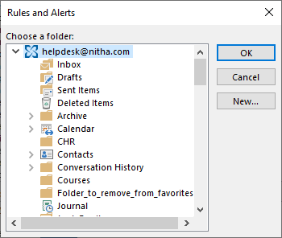
Methods for creating and managing rules
Rules & Alert Dialog
If you scroll to the top of the dialog and select the email account name, any folder you create will be placed in the root … parallel with the Inbox, Drafts, Sent Items, etc.
To make a new folder select a folder (or the root) and then click on New…
The Rules and Alerts dialog is displayed from where you can create one or more new folders.
Page
19

Slide 20
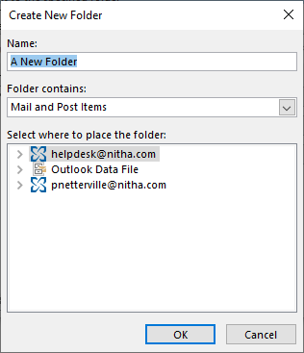
Methods for creating and managing rules
Rules & Alert Dialog
Type in the name of the folder
Page
20

Slide 21
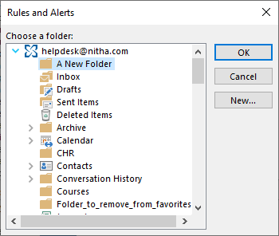
Methods for creating and managing rules
Rules & Alert Dialog
Click on OK
Page
21

Slide 22
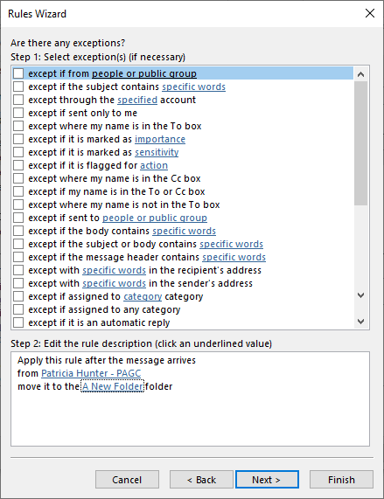
Methods for creating and managing rules
Rules & Alert Dialog
So for our example you could specify that emails that come in from the selected contact are automatically moved to the A New Folder except when it is sent only to me (no other email(s) in the TO, CC, or BCC fields).
When done click on Next
This panel lets you add any exceptions to the original condition you set up for this rule.
This list is essentially the same as the first set of conditions.
Page
22

Slide 23
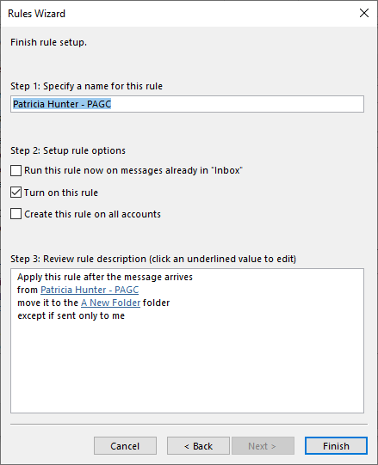
Methods for creating and managing rules
Rules & Alert Dialog
Name your new rule.
Set the rule options.
Running the rule now on the messages in the inbox can be a good way to clean up many messages automatically.
If you do not want the rule to be run now, you can opt to run it later by checking this box.
If you have more than one email account, you can have it apply this rule to all of them.
The rule summary
Page
23

Slide 24
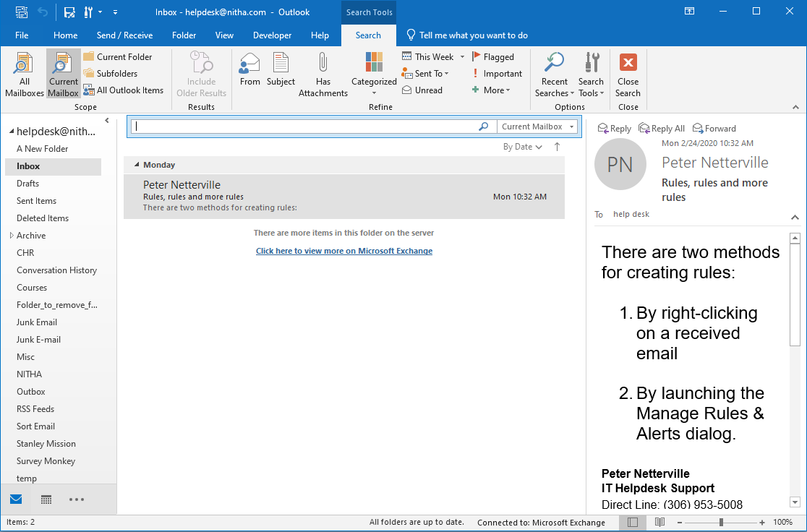
Searching for Outlook Objects
Email module
In order to start a search, click in a search box and the context Search ribbon appears.
Page
24

Slide 25
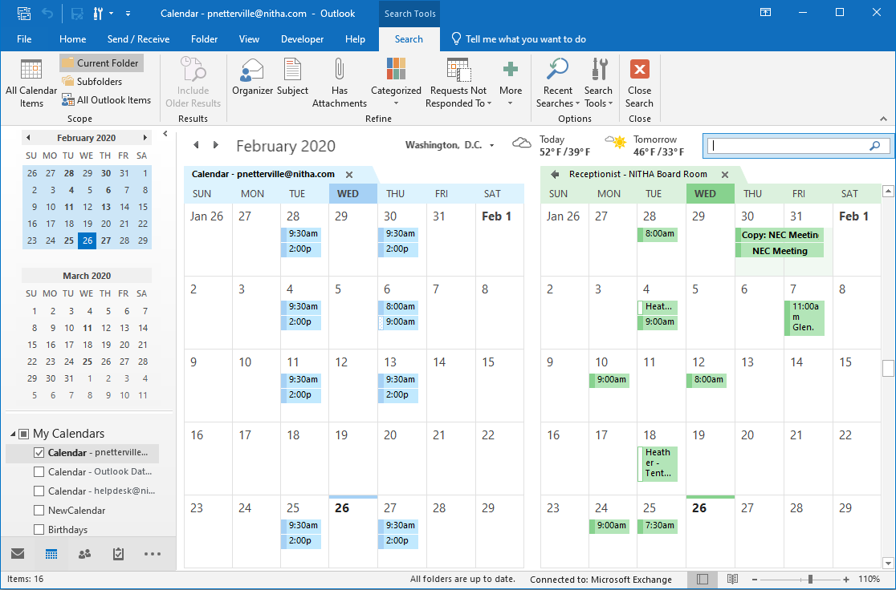
Searching for Outlook Objects
Calendar module
Calendar module
In order to start a search, click in a search box and the context Search ribbon appears.
Page
25

Slide 26
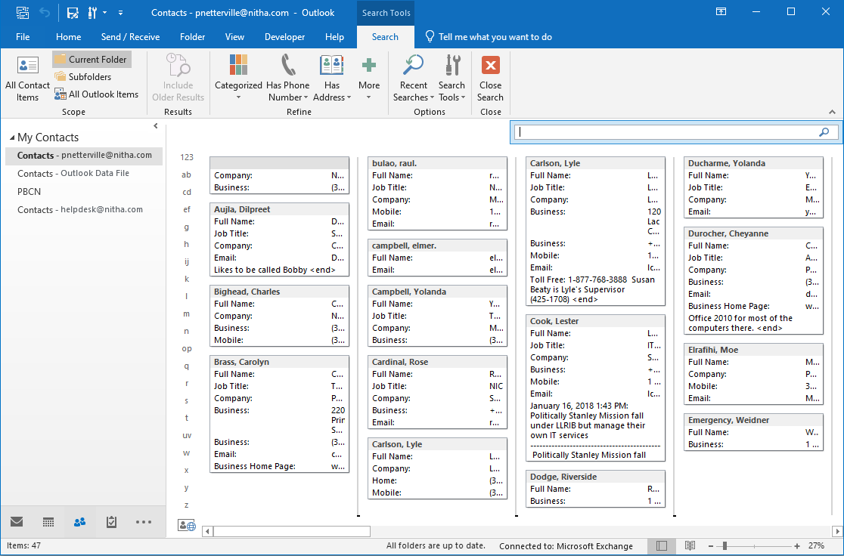
Searching for Outlook Objects
Contacts module
In order to start a search, click in a search box and the context Search ribbon appears.
Page
26

Slide 27
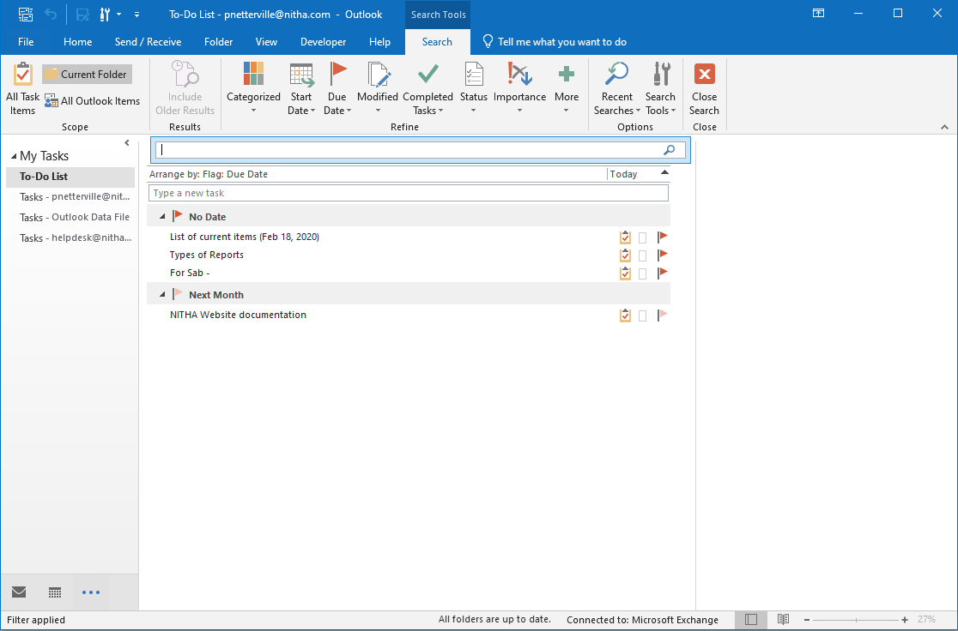
Searching for Outlook Objects
Tasks module
In order to start a search, click in a search box and the context Search ribbon appears.
Page
27

Slide 28
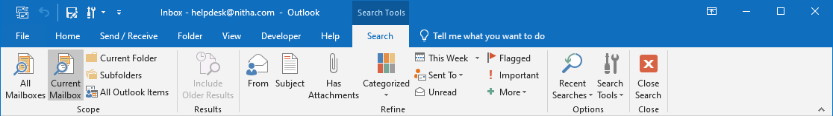
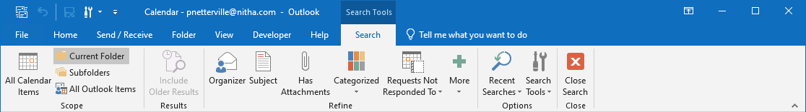
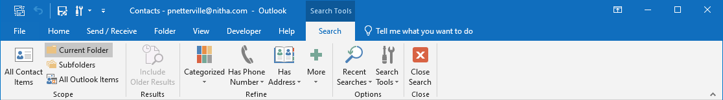
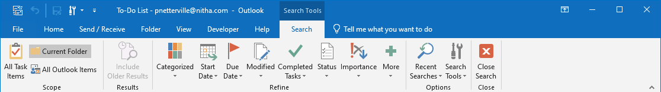
Searching for Outlook Objects
The search bars for the different modules have mostly the same search commands.
But the differences are found in the Refine group.
Page
28

Slide 29
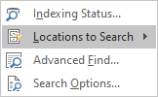

Searching for Outlook Objects - email
The Indexing Status command forces a run on indexing.
The Search Tools menu is the most useful menu of commands on the search ribbon.
The options in the Scope group are the same as the drop menu on the search bar. Where do you want Outlook to search?
The Locations to Search menu shows all Exchange server emails and any Outlook .PST files connected to your Outlook. Select the location you want to search.
Page
29

Slide 30
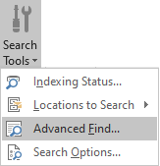
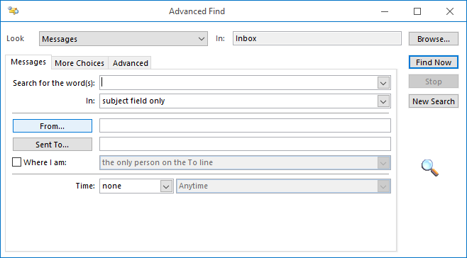
Searching for Outlook Objects – Advanced Find - Email
The Advanced Find link pulls up a dialog which will allow you to be specific in your search. You will discover the Advanced Find to be a valuable tool.
Page
30

Slide 31
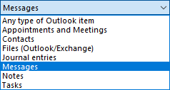
Searching for Outlook Objects – Advanced Find - Email
Look in what sub-folder?
Look in what module for your search string?
Page
31

Slide 32

Searching for Outlook Objects – Advanced Find - Email
Your search string.
Look in what field(s) for your search string?
Page
32

Slide 33
Searching for Outlook Objects – Advanced Find - Email
Search for the search words in emails from the listed in this box.
Search for the search words in emails from those listed in this box.
Page
33

Slide 34
Searching for Outlook Objects – Advanced Find - Email
Search for the search words in emails from those listed in this box.
Look in what module for your search string? Check this box to enable it.
Page
34

Slide 35
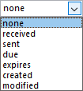
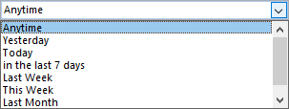
Searching for Outlook Objects – Advanced Find - Email
What is the time period?
Time period conditions.
Page
35

Slide 36
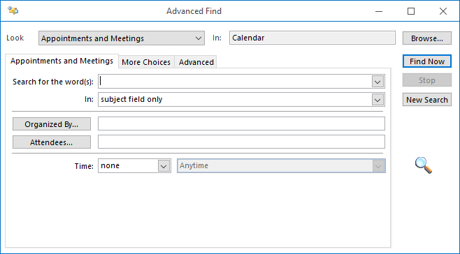
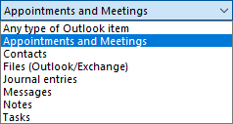
Searching for Outlook Objects – Advanced Find - Calendar
Look in what sub-folder?
Look in what module for your search string?
Page
36

Slide 37
Searching for Outlook Objects – Advanced Find - Calendar
Your search string.
Look in what field(s) for your search string?
Page
37

Slide 38
Searching for Outlook Objects – Advanced Find - Calendar
There are additional filters for the calendar appointment search, such as Organized by…
Select the email of the person who organized the meeting.
Or filter your search limiting it to those who were invited (and accepted) to attend the event.
Page
38

Slide 39

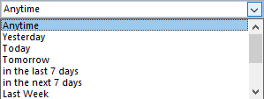
Searching for Outlook Objects – Advanced Find - Calendar
If you are also filtering your search by date/time you can specify a time period.
You can also filter by date/time.
Page
39

Slide 40
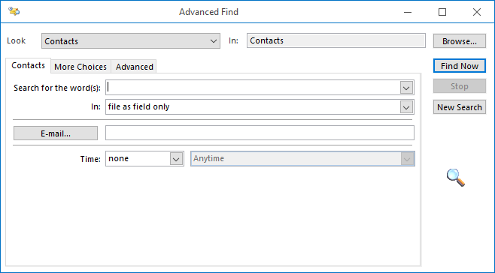
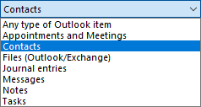
Searching for Outlook Objects – Advanced Find - Contacts
Look in what sub-folder?
Look in what module for your search string?
Page
40

Slide 41
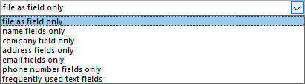
Searching for Outlook Objects – Advanced Find - Contacts
Enter a search string.
In what field do you want the search to be done?
Page
41

Slide 42
Searching for Outlook Objects – Advanced Find - Contacts
OR type in the email address or addresses. Each address is separated by a semi-colon (or leave blank, which forces a search through all contacts).
Click on this button to pull up the Contact (Address List) dialog to choose one or more contacts. By default the Exchange list is displayed.
Page
42

Slide 43

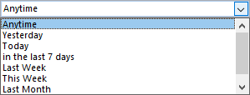
Searching for Outlook Objects – Advanced Find - Contacts
Select a time period.
Is there a time or time period in which to search the contact for the search string?
Page
43

Slide 44
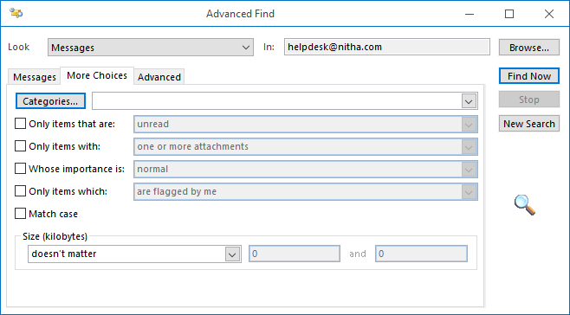
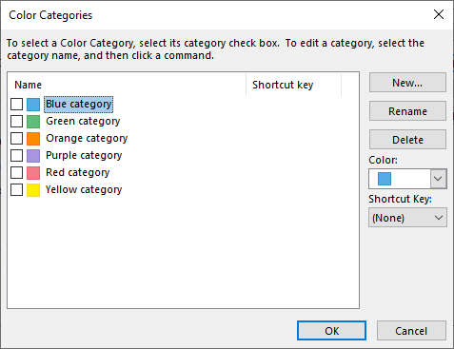
Searching for Outlook Objects – Advanced Find – Messages (More Choices Dialog)
If the message you are searching for has a Category assigned to it, this is where you can select that Category.
Page
44

Slide 45
Searching for Outlook Objects – Advanced Find – Messages (More Choices Dialog)
Check this box it you want to specify either read or unread messages are searched.
Page
45

Slide 46
Searching for Outlook Objects – Advanced Find – Messages (More Choices Dialog)
Check this box it you want to specify messages with one or more attachments or no attachments.
Page
46

Slide 47

Searching for Outlook Objects – Advanced Find – Messages (More Choices Dialog)
Check this box it you want to specify the importance the sender of the message assigned to the message.
Page
47

Slide 48

Searching for Outlook Objects – Advanced Find – Messages (More Choices Dialog)
Check this box it you want to specify messages that were previously flagged.
Page
48

Slide 49
Searching for Outlook Objects – Advanced Find – Messages (More Choices Dialog)
Check this box it you want to the search to be case sensitive.
Page
49

Slide 50
Searching for Outlook Objects – Advanced Find – Messages (More Choices Dialog)
If the size of the message (including attachments) is known, you can filter the search by specifying the lower and upper size limits.
Page
50

Slide 51
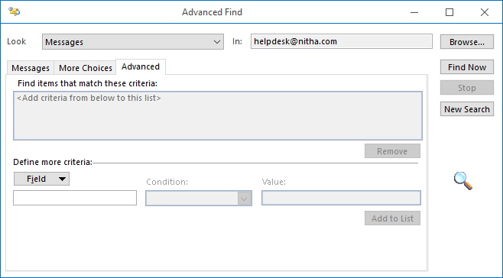
Searching for Outlook Objects – Advanced Find – Messages (More Choices Dialog)
If all the other searches fail and you can be very specific in your search.
Click on the Field drop menu and choose the precise field that you want to search using your search criteria.
The Advanced Tab of the Advanced Find dialog is a powerful tool that will allow you to search any field that exists in the Outlook software for your specified search criteria.
Page
51

Slide 52

We have covered here in this course …
What is an Outlook rule?
Pros and cons in using rules.
Methods for creating and managing rules.
Tips for working with rules
Searching for Outlook objects.
Advanced features of the Search.

Slide 53

NITHA IT Helpdesk
helpdesk@nitha.com
1(306)953-5008
Notes:
Please do not hesitate to ask any question regarding this session, and I will make sure to answer your question as soon as possible.

Slide 54


