Slide 1


Outlook 2016/2019 Calendars
Intermediate

Slide 2



NITHA IT Helpdesk
helpdesk@nitha.com
1(306)953-5008

Slide 3

What will we be covering in this course?
Purpose of this Course
Setting up OneDrive for the First Time
The Making of a Calendar
Logging in to OneDrive on the Cloud
Assigning Access Rights to Others
Managing OneDrive
Sharing Your Calendar with Others
Setting up a Shared Library
Using OneDrive to Enhance Collaboration
Managing the Shared Library

Slide 4

Page
4
The purpose of this course is to cover working with Outlook calendars and OneDrive in with a focus on using them to enhance collaboration inside and outside your organization.
Definitions:
Organization – In this usage your organization is comprised of those members of your Exchange server. Usually this includes those people who’s email addresses have the same domain name as your email address.
For example: username@llribhs.ca, username@mltc.net, username@pbcnhs.ca, username@pagc.net
OneDrive – OneDrive is a file hosting service similar to Dropbox except that OneDrive is connected to an Exchange server which allows for easy document sharing with members within and without your organization.
Security for your documents can be assigned to others in your organization from no access to full access.
When OneDrive is used in conjunction with shared Calendars collaboration is made easy and flexible.

Slide 5
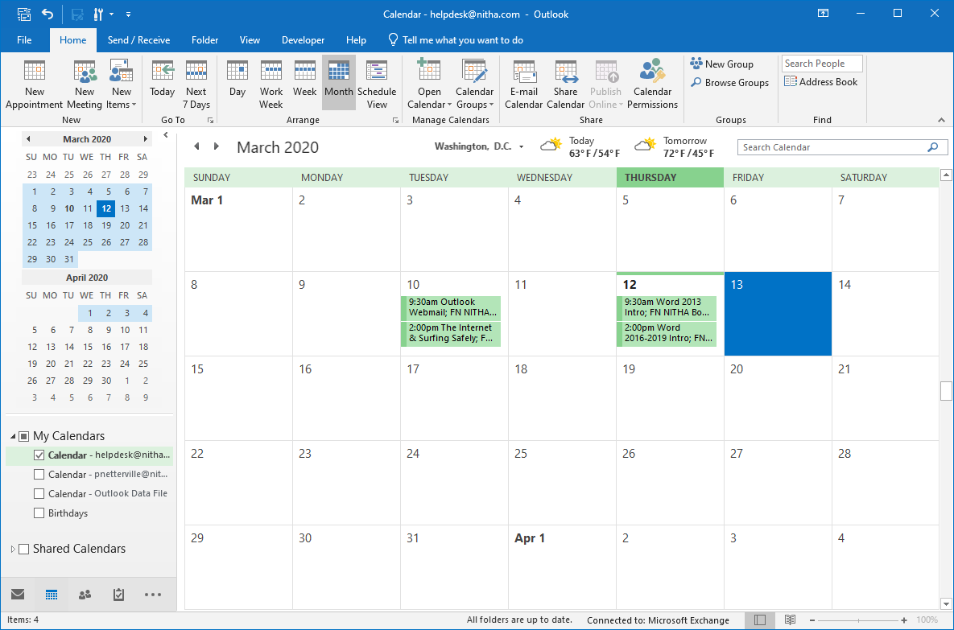
Page
5
The Making of a Calendar
If you see two calendars in the Navigation Pane …
… drag the separator handle up to display just the one calendar
Click on the Calendar module

Slide 6
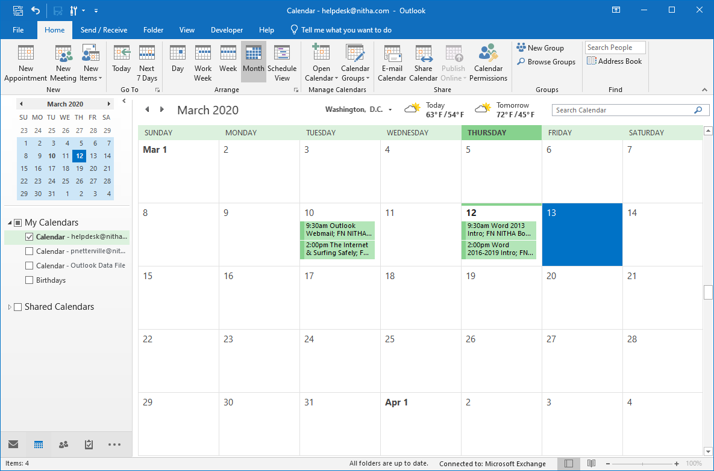
Page
Now it is easier to see the calendars
6
The Making of a Calendar
My Calendars lists one calendar for each of the following:
for each email account you have added to Outlook.
for each outlook data file (.pst). e.g. Archive.pst
for each special calendar. e.g. Birthdays, Stat Holidays
When someone shares a calendar with you, you will see it in this group.

Slide 7
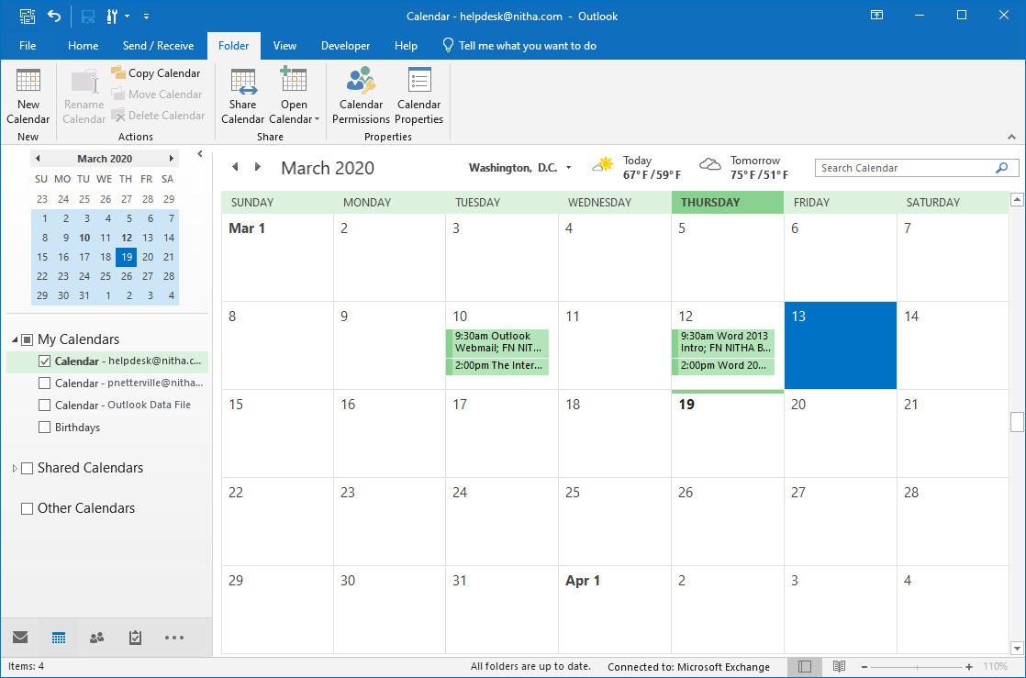

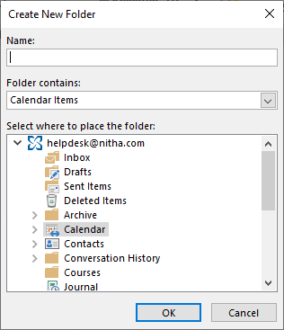
Page
Now create a new calendar.
7
The Making of a Calendar
Click on the Folder tab.
Click on New Calendar.

Slide 8
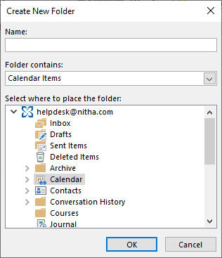
Page
Now create a new calendar.
8
The Making of a Calendar
Enter in a meaningful name for the calendar.
Click on OK

Slide 9
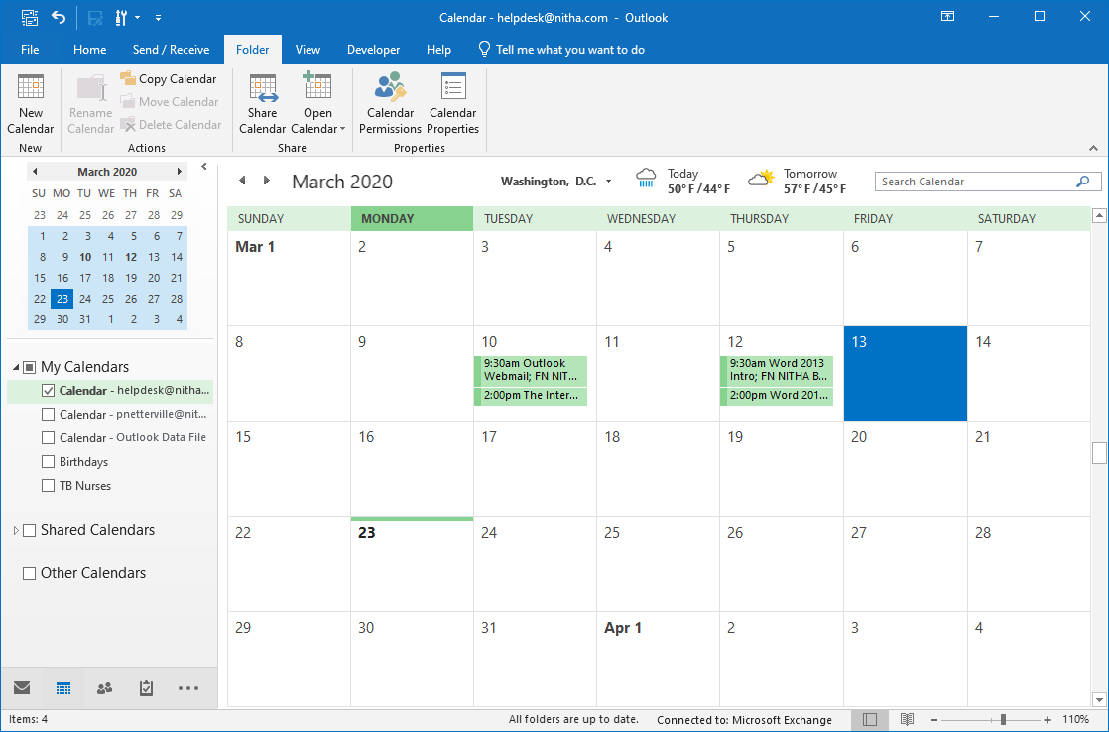
Page
Now that the create calendar is created …
9
The Making of a Calendar
… permission needs to be assigned to those people you want to have access.
Right-click on the calendar

Slide 10
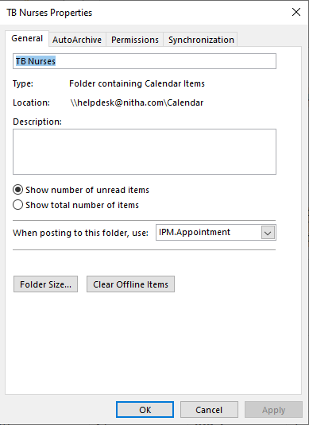
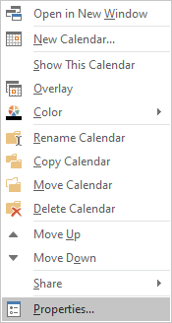
Assigning Access Rights to Others
Now that the create calendar is created …
Page
10
Left Click on the Permissions tab.
Left Click on Properties

Slide 11
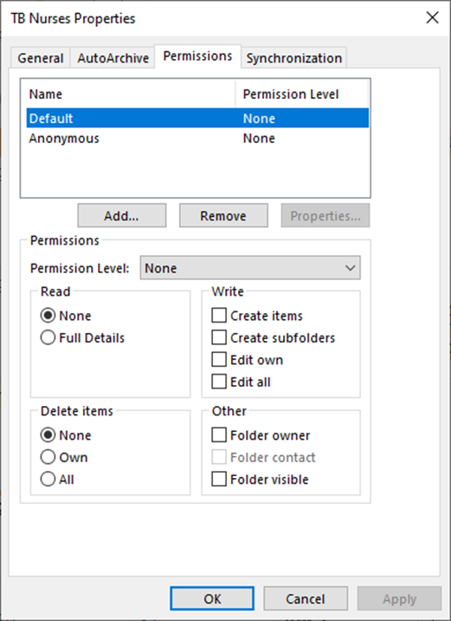
Page
11
Assigning Access Rights to Others
The panel at the top lists all those who have had permissions assigned.
When a name is selected from the panel above, the permissions assigned to that name are displayed and are editable in this panel.
Now click on Add…

Slide 12
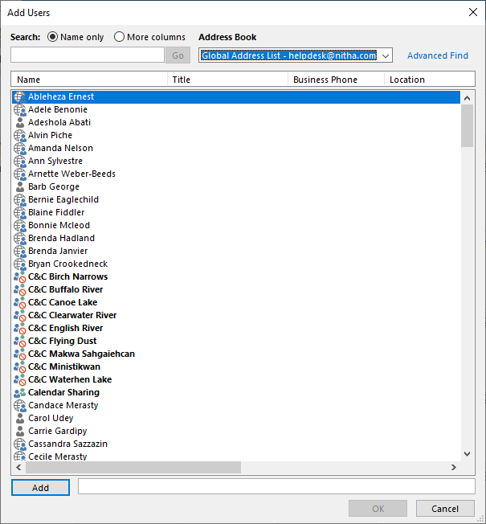
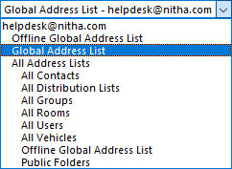
Page
12
Assigning Access Rights to Others
Select from the Address Book the Global Address List.
This Global Address List are those in your organization.

Slide 13
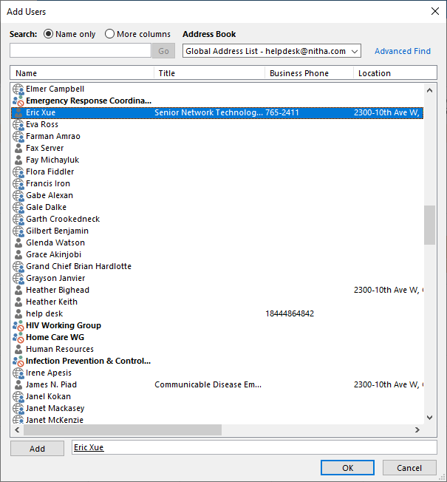
Page
13
Assigning Access Rights to Others
Select a contact to add by double-clicking on it.
This is an important step to do because if you just type in the email address, the privileges will not be applied.
Click on OK.

Slide 14
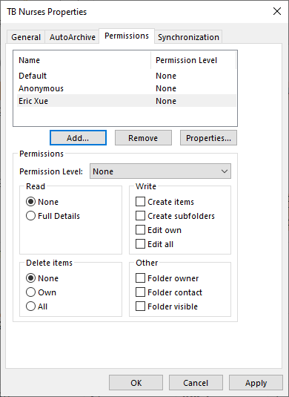
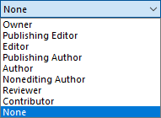
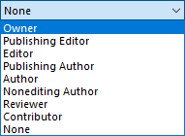
Page
14
Assigning Access Rights to Others
Click on Permissions Level to see the permissions menu.
Select a permissions level.

Slide 15
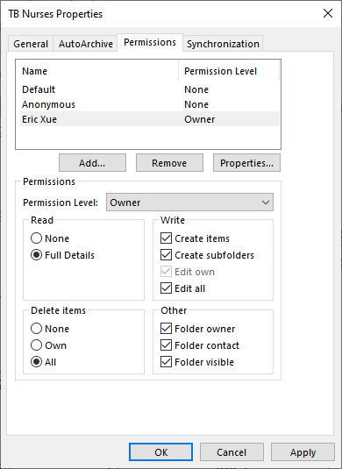
Page
15
Assigning Access Rights to Others
If you want to continue to add permissions for other contacts, first click on Apply, then click on Add.
When you select a permissions level, the permissions are displayed in the permissions panel where you can tailor them as you choose.

Slide 16
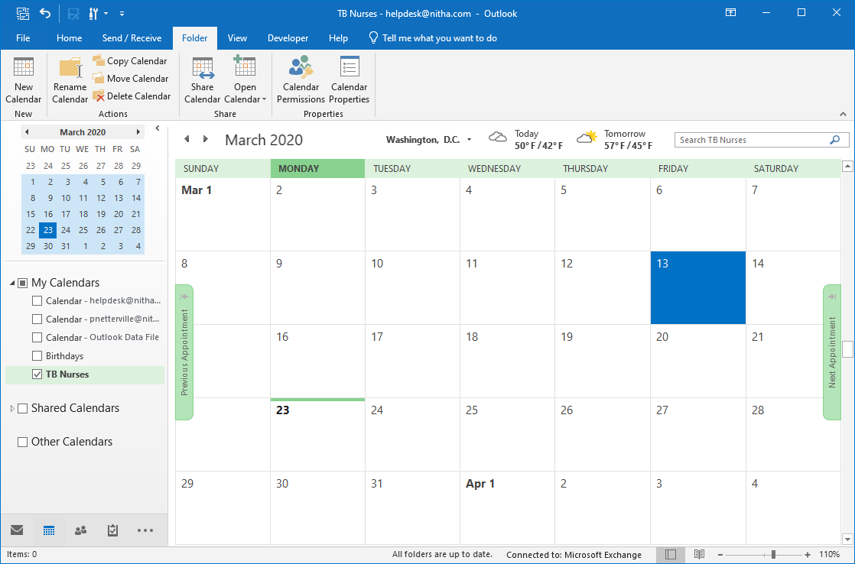

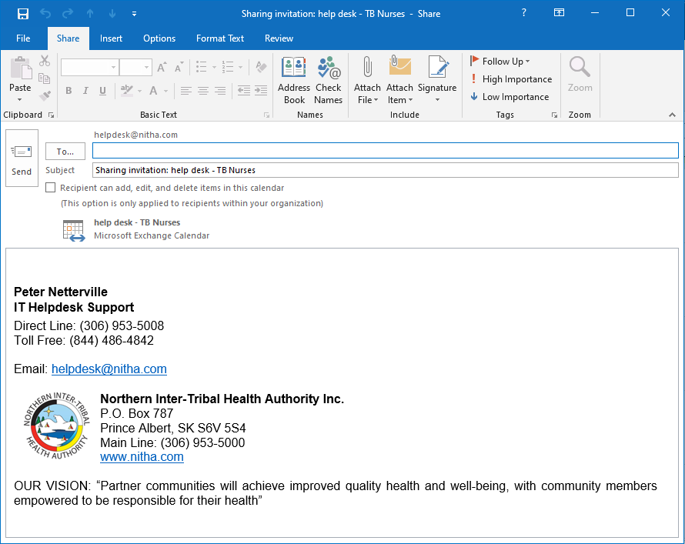
Page
16
Sharing Your Calendar with Others
With the contacts assigned to the new calendar and the permission for each contact set …
You can email more than one at a time, but make sure to group the emails that have the same permissions level.
Finally, click on Send.
… the calendar now needs to be shared with the contacts.
Check this box. Any restrictions you selected to the recipients of your calendar will be applied.
Add the contacts to the To field for each contact.

Slide 17
Page
17
Using OneDrive to Enhance Collaboration
OneDrive is a file sharing service that when used in conjunction with the Microsoft Exchange server becomes a powerful tool for collaborative projects.
What OneDrive does for you is to allow you to share your file(s) in a secure environment where you can assign rights to others in your organization to read, read/change, or ownership of your files.
OneDrive can be accessed in either of two ways …
1. From the Windows File Explorer, just like you would access a document in your Documents folder.
2. From any web browser such as Chrome, Firefox, MS Edge, and other browsers.
However, OneDrive does require an initial set up. It is easy.
First, set up OneDrive.

Slide 18
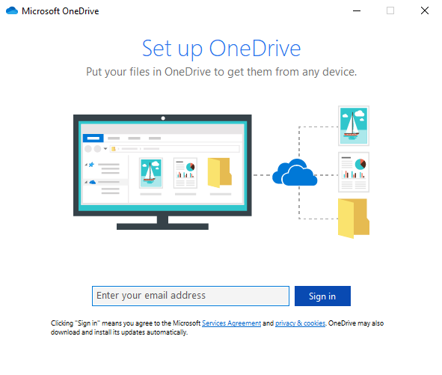
Using OneDrive to Enhance Collaboration
Setting up OneDrive
Page
18
OneDrive can be found in your Start Menu.
Scroll down the list of programs until you find OneDrive.
The programs are sorted alphabetically.
The first screen you will see when you initiate OneDrive setup is …
Enter your work email address.

Slide 19
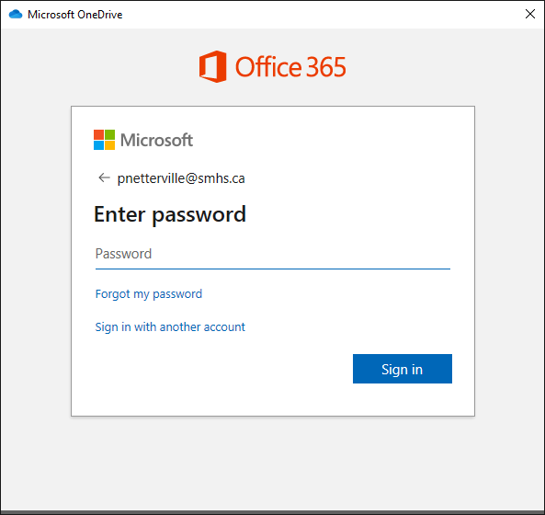
Using OneDrive to Enhance Collaboration
Setting up OneDrive
Page
19
Enter your password
If you have forgotten your password, then you can reset it by clicking here.
If you want to sign in with a different account you can click here or just click back arrow beside the email address listed above.
Click on Sign in

Slide 20
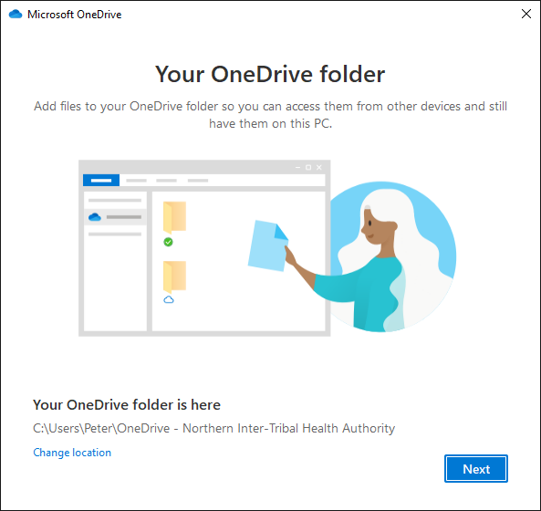
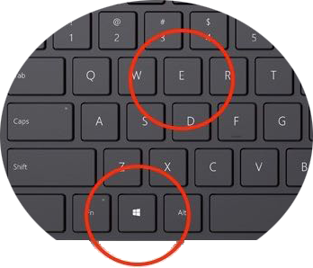
Using OneDrive to Enhance Collaboration
Setting up OneDrive
Page
20
You access this drive by opening your Windows File Explorer. The keyboard shortcut to open the File Explorer is the Windows Key + e
If you are not happy with this location, you can change it now.

Slide 21
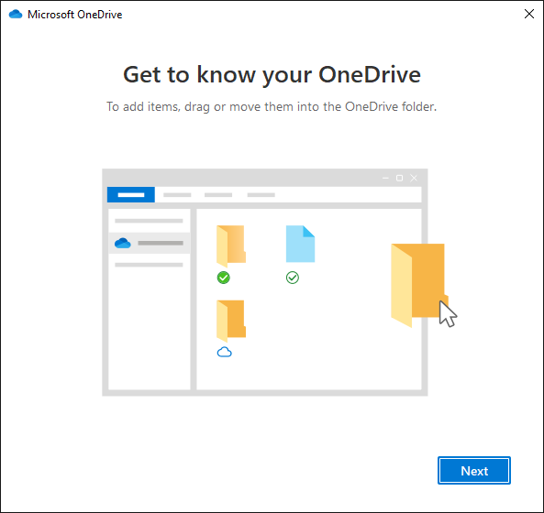
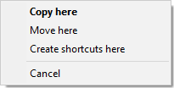
Using OneDrive to Enhance Collaboration
Setting up OneDrive
Page
21
Work with the Windows File Explorer as you would normally …
… drag and drop
OR … right-click & copy from the source
… right-click & paste on the destination
Copying Tip
When you drag and drop file(s), hold down the right mouse button not the left.
When you release the mouse button over your destination folder, you will be presented with a small menu giving you the choice to Copy, Move, Make Shortcut, or Cancel.
Choice is good.
There are a variety of ways to copy/move your files from one folder to another. Choose your favorite method
When you copy files into the OneDrive folder it will auto sync with the cloud copy of your OneDrive so long as your computer has Internet access.
The other method is to use a web browser.

Slide 22
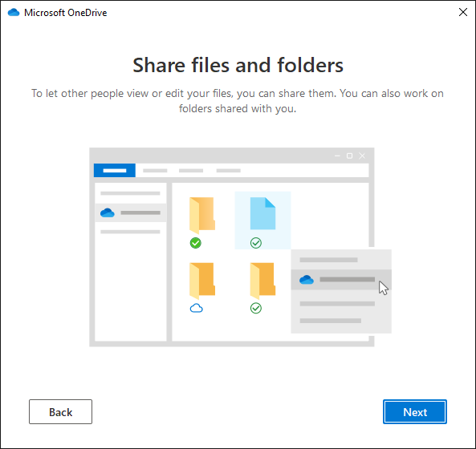
Using OneDrive to Enhance Collaboration
Setting up OneDrive
Page
22
The next setup screen shows you that you can share files and folders.
The biggest item to remember here is that files in a folder also have their own access permission rights assigned.
What this means is that if you have given full rights to a user to access a folder, but have restrictions applied to that user on one or more files in that folder, the restrictions apply to that file even though the user has full access rights applied to the folder.
The more restrictive access rights always have precedence.

Slide 23
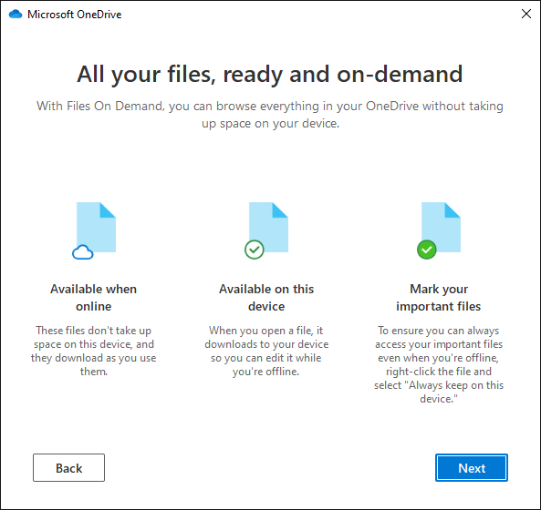
Using OneDrive to Enhance Collaboration
Setting up OneDrive
Page
23
Your files are accessible online from whatever devices you provide access.

Slide 24
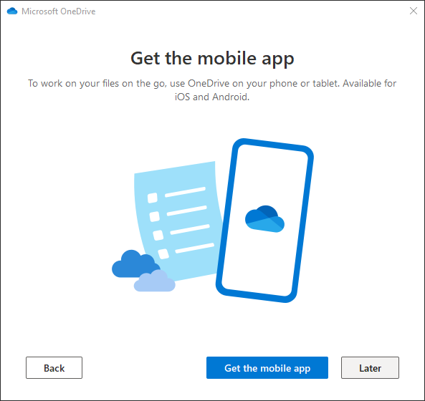
Using OneDrive to Enhance Collaboration
Setting up OneDrive
Page
24
Add your phone …
If you do not want to add the OneDrive app to your smart phone or you want to add it at another time, click on Later.

Slide 25
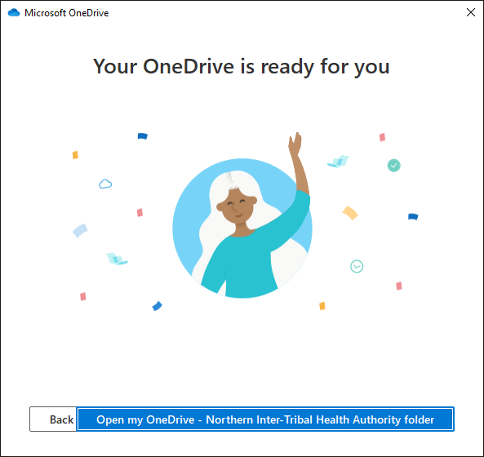
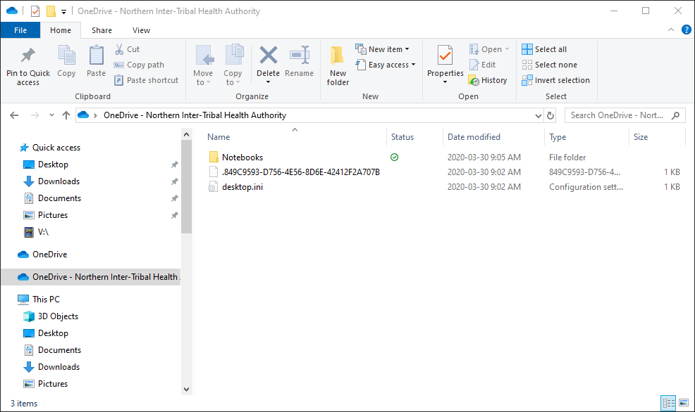
Using OneDrive to Enhance Collaboration
Setting up OneDrive
Page
25
It’s ready to go!

Slide 26
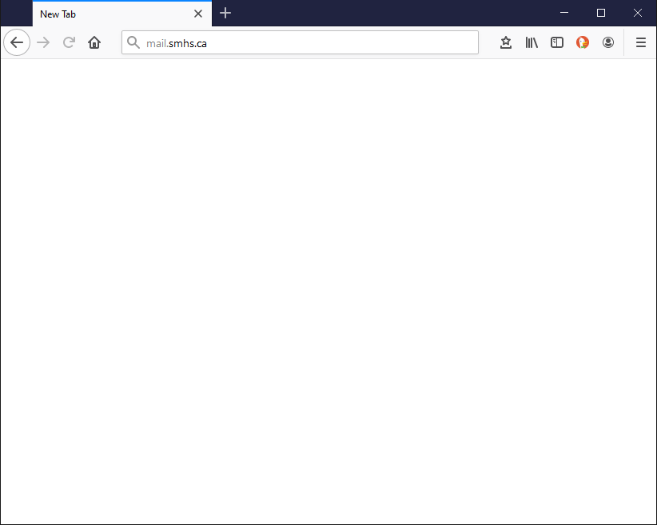
Using OneDrive to Enhance Collaboration
Logging in to OneDrive on the Cloud
Page
26
address bar
Open your favorite web browser and log in to your Office 365 account by typing into the address bar on your browser, mail.yourdomain.com
In my case it is mail.smhs.ca
You domain is probably different, but your organization may also have a link on their home page that you click on to access your organization’s Office 365.
Once typed in, press Enter

Slide 27
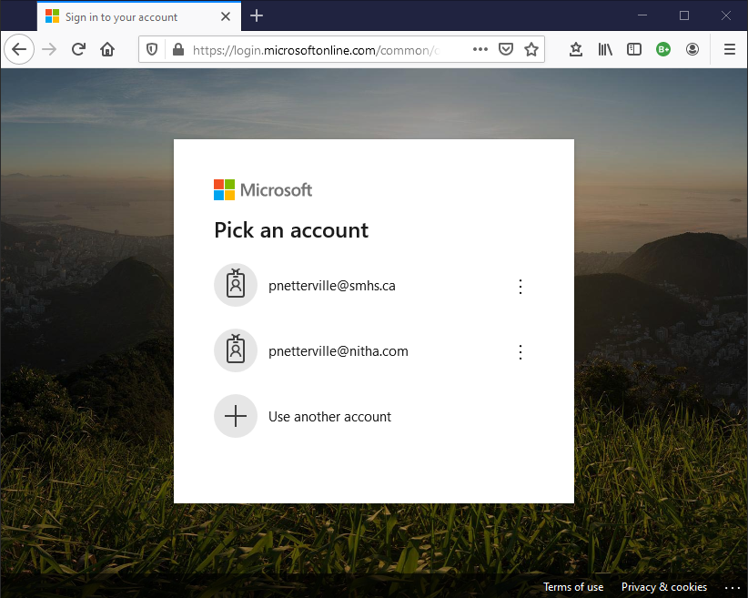
Using OneDrive to Enhance Collaboration
Logging in to OneDrive on the Cloud
Page
27
Click on your email if there are more than one listed.

Slide 28
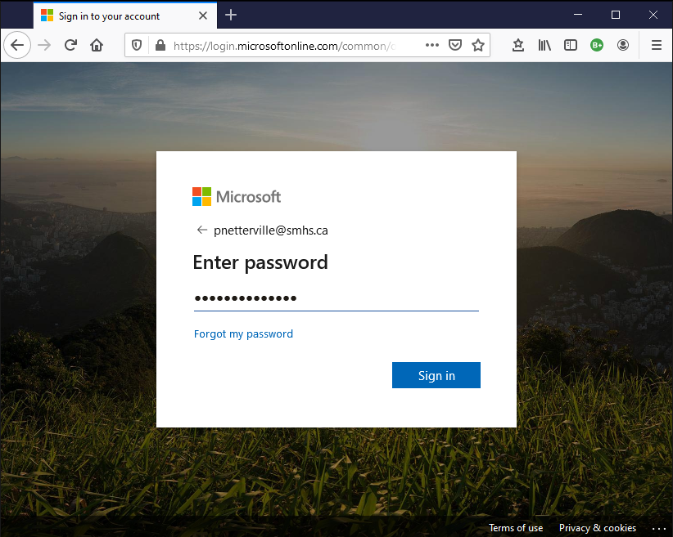
Using OneDrive to Enhance Collaboration
Logging in to OneDrive on the Cloud
Page
28
Enter your password.
Click on Sign in.

Slide 29
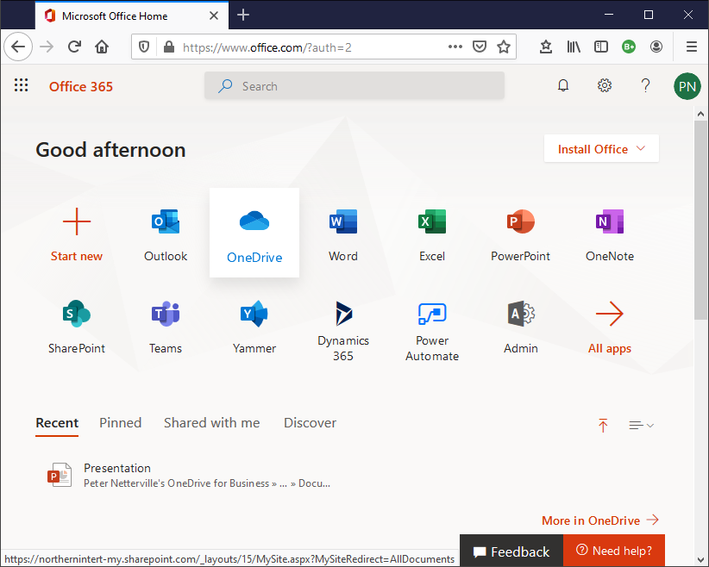
Using OneDrive to Enhance Collaboration
Managing OneDrive
Page
29
Click on the OneDrive icon to open the OneDrive folder in the web browser.

Slide 30
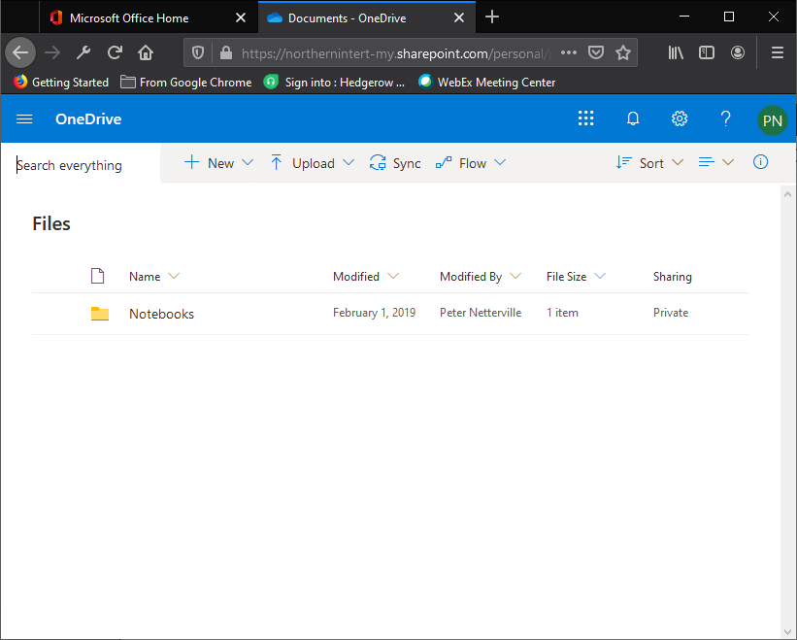
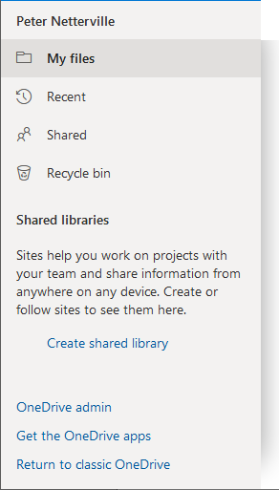
Using OneDrive to Enhance Collaboration
Managing OneDrive
Page
30
On the menu bar click on the navigation panel icon
My files is the default view.
These options are self-explanatory
This is where you start your collaborative project, by making a Shared Library.
Not yet set up by Microsoft.
(At the point when this course was created)
Install apps on your phone from your OneDrive account from your browser.
Classic OneDrive web interface.

Slide 31
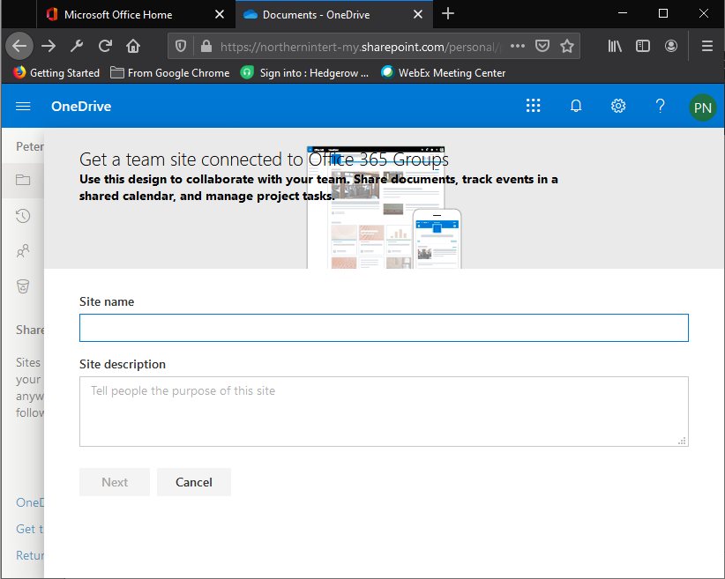
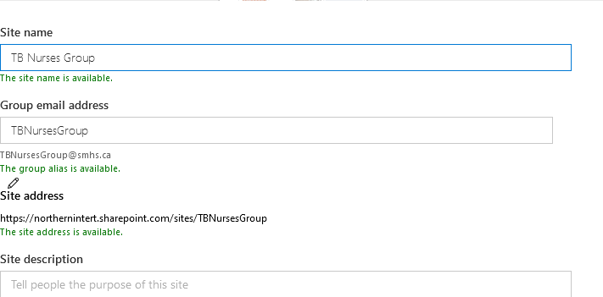
Using OneDrive to Enhance Collaboration
Setting up a Shared Library
Page
31
Enter an applicable site name.
A site name is checked over your organization.
A group email address is suggested.
Scroll down on the page.

Slide 32
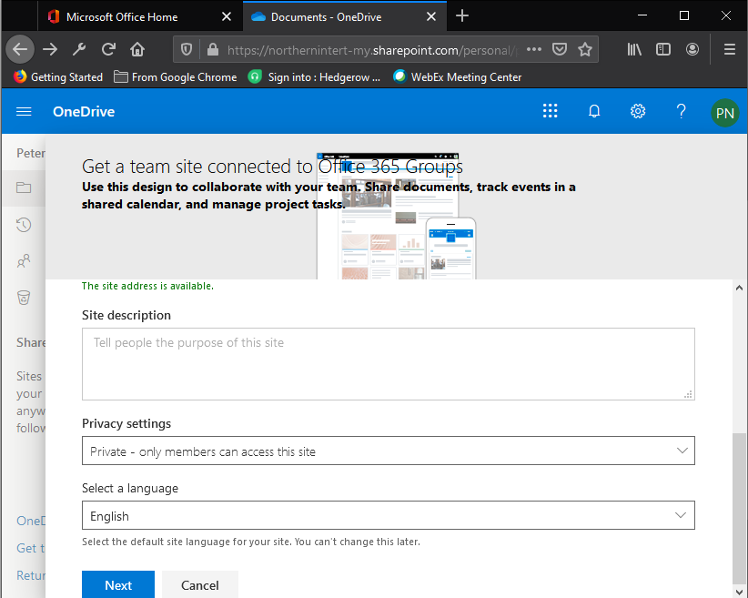
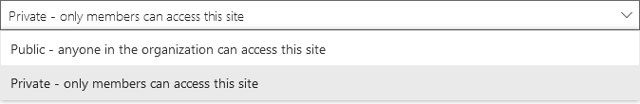
Using OneDrive to Enhance Collaboration
Setting up a Shared Library
Page
32
Describe your new Shared Library
Select who can access this Shared Library

Slide 33
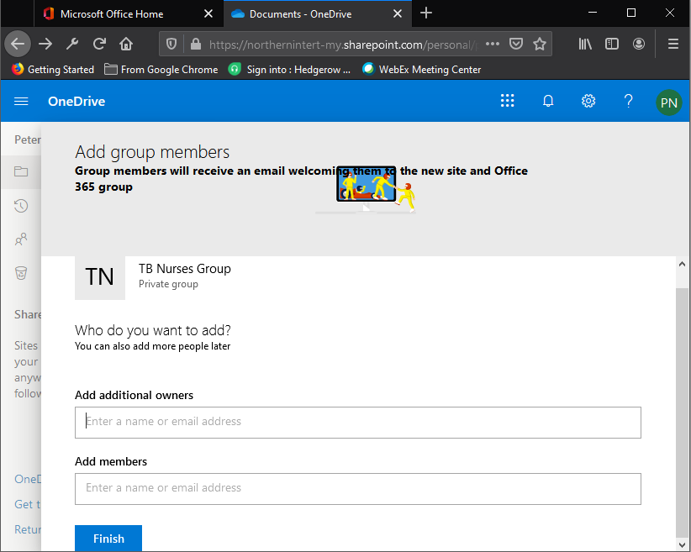
Using OneDrive to Enhance Collaboration
Setting up a Shared Library
Page
33
Add additional owners if applicable.
Add additional members if applicable.
You can add an additional owner or member later. It is not required to do that now.

Slide 34
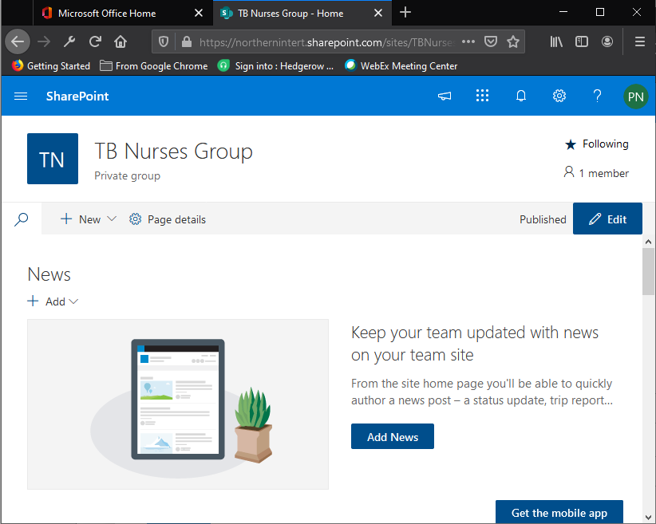
Using OneDrive to Enhance Collaboration
Managing the Shared Library
Now that the Shared Library has been created, this screen allows you to manage the group.
Page
34

Slide 35

We have covered here in this course …
Purpose of this Course
Setting up OneDrive for the First Time
The Making of a Calendar
Logging in to OneDrive on the Cloud
Assigning Access Rights to Others
Managing OneDrive
Sharing Your Calendar with Others
Setting up a Shared Library
Using OneDrive to Enhance Collaboration
Managing the Shared Library

Slide 36

NITHA IT Helpdesk
helpdesk@nitha.com
1(306)953-5008
Notes:
Please do not hesitate to ask any question regarding this session, and I will make sure to answer your question as soon as possible.

Slide 37


