Slide 1


Outlook 2013 Basics
Entry Level

Slide 2

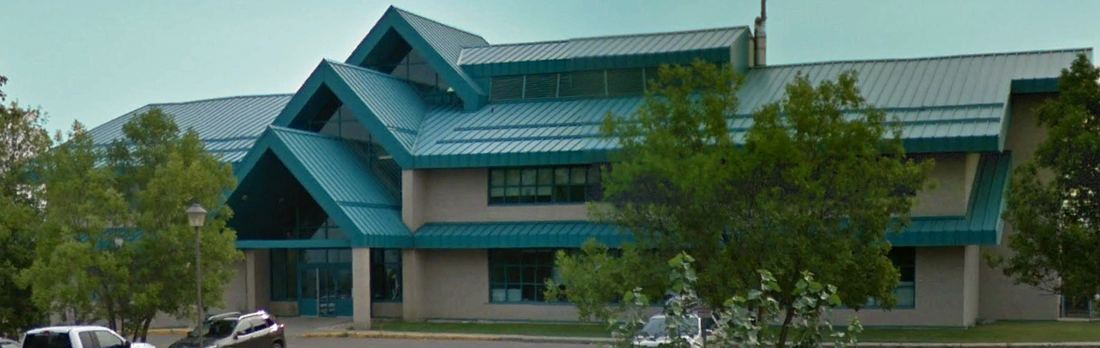

NITHA IT Helpdesk
helpdesk@nitha.com
1(844)486-4842

Slide 3
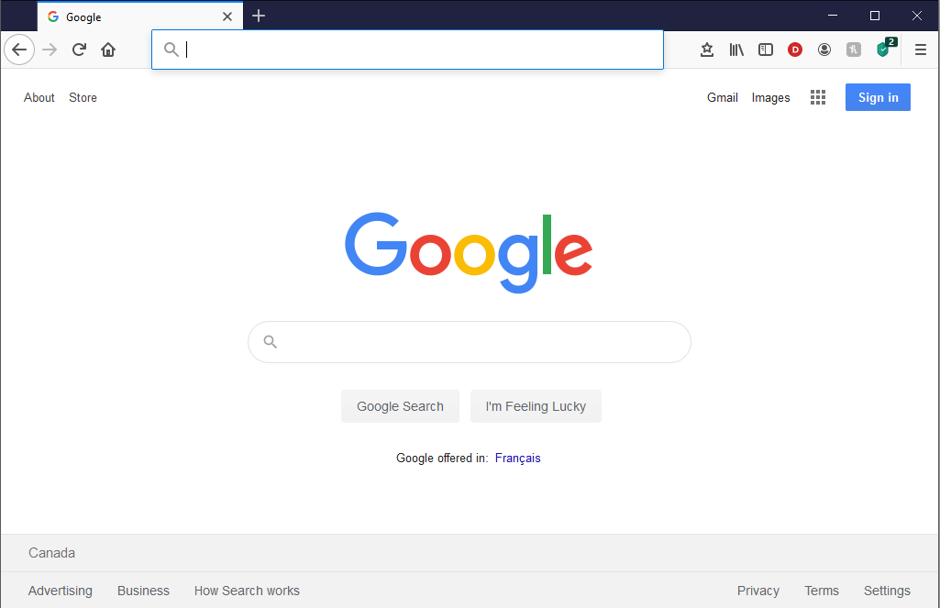
NITHA - IT Helpdesk Courses Registration Website
How do I get to the Courses Registration Website?
First, open up your favorite web browser.
Finally, press ENTER on our keyboard
Second, type in the address bar the URL, nitha.com/courses

Slide 4
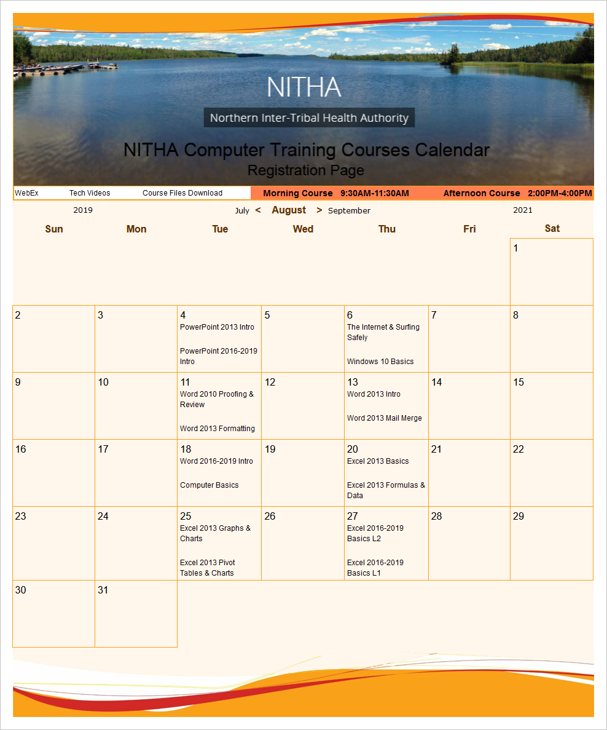
NITHA - IT Helpdesk Courses Registration Website
The NITHA Computer Training Courses Calendar
There are four sections to the
IT Helpdesk Courses Registration Website
The calendar – As seen on the right,
the calendar displays the selected month and all the course links on the appropriate days.
Morning courses 9:30 AM to 11:30 AM
Afternoon courses 2:00 PM to 4:00 PM

Slide 5
NITHA - IT Helpdesk Courses Registration Website
Cycle forward through the months by clicking on the next month
The NITHA Computer Training Courses Calendar
Cycle backward through the months by clicking on the previous month
And of course, the month in the middle is the currently displayed month.

Slide 6
NITHA - IT Helpdesk Courses Registration Website
or the next year
The NITHA Computer Training Courses Calendar
You can even click on the previous year

Slide 7
NITHA - IT Helpdesk Courses Registration Website
The NITHA Computer Training Courses Calendar
Click on the course link of your choice and you will be taken to a registration page.

Slide 8

NITHA - IT Helpdesk Courses Registration Website
The NITHA Computer Training Course Registration page
Enter your information
Select how you are going to attend the course
by WebEx
by Telehealth
Select how you want your Certificate of Completion delivered.
by Email as a PDF
by Canada Post

Slide 9
NITHA - IT Helpdesk Courses Registration Website
The NITHA Computer Training Courses WebEx Info
WebEx Information – For the WebEx connection information on how to attend the courses in the current week, click on the WebEx link.

Slide 10

NITHA - IT Helpdesk Courses Registration Website
The NITHA Computer Training Courses Calendar
These links display the WebEx information for that course
These links download the ICS file for that course so that you can add it to your Outlook calendar as an event.

Slide 11
NITHA - IT Helpdesk Courses Registration Website
The NITHA Computer Training Courses Download
Course Files Download – The courseware and the data files which are used in the courses are all available for download any time whether or not you are taking the course.
click on the Course Files Downloads link
To download the
Courseware file (A PowerPoint file)
and/or
Sample data files used in the course

Slide 12

NITHA - IT Helpdesk Courses Registration Website
The NITHA Computer Training Courses Calendar
The Course Sample File is the data file used in the course.
The PowerPoint Courseware File is the course itself.

Slide 13
NITHA - IT Helpdesk Courses Registration Website
The NITHA Computer Training Courses Calendar
Tech Videos are the fourth section of the website. As they are created, they will be placed here.
Tech Videos are short 3 to 15 minute videos featuring solutions to various tech issues.

Slide 14

What will we be covering in this course?
The BIG Picture
Overview: What can Outlook do?
Starting Outlook
Screen Layout – Contacts
Exercise: Creating a New Contact
Exercise: Making an Email
Screen Layout – Info
Screen Layout - Open
Screen Layout - Print
Exercise: Making a Calendar Appointment
Screen Layout - Options
Exercise: Changing some Options
Exercise: Creating a Signature
Exercise: Creating & Working with Tasks
How Outlook Modules Work Together
Exercise: The Rules - Making a rule

Slide 15

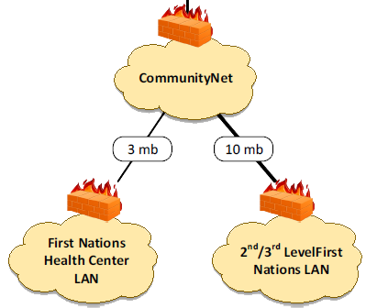



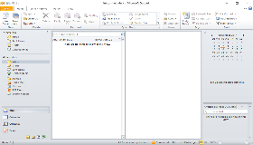

The BIG Picture
The Internet
Microsoft
Where Microsoft Exchange server lives

Slide 16

Overview: What can Outlook do?
Outlook is composed of five modules
All five modules interact with each other.

Slide 17
Starting Outlook 2010
Click on the Start Button
Windows 7 Taskbar
Click on the Start Button
Windows 10 Taskbar

Slide 18
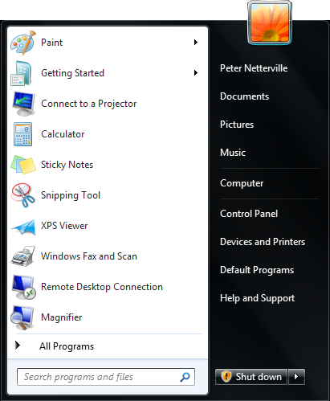
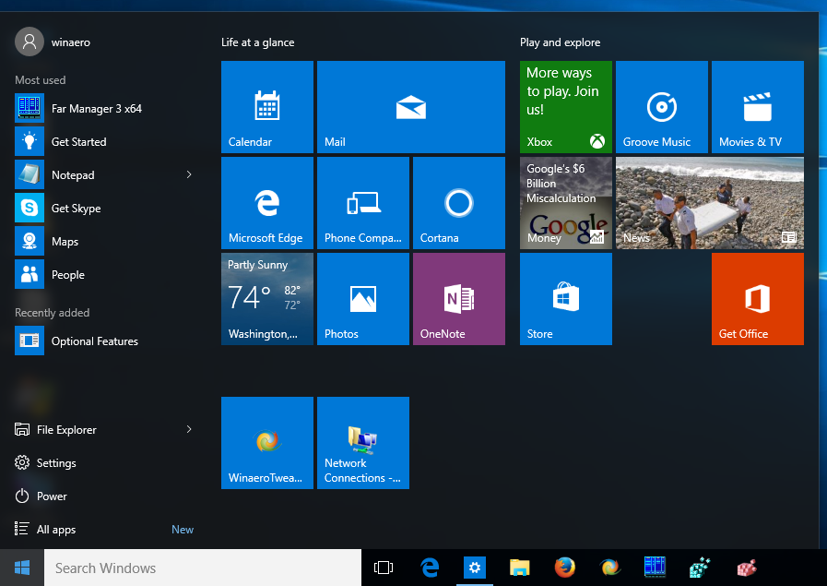
Starting Outlook
Windows 7 Start Menu
Windows 10 Start Menu
Click on All Apps if you see it there.
Click on All Programs

Slide 19
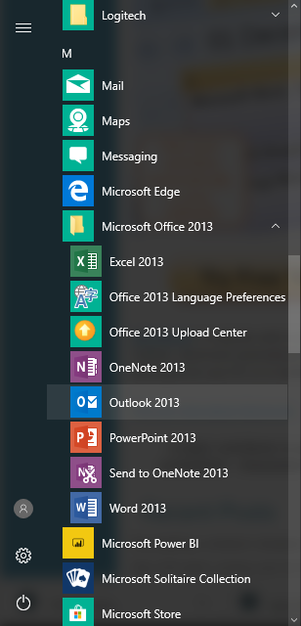
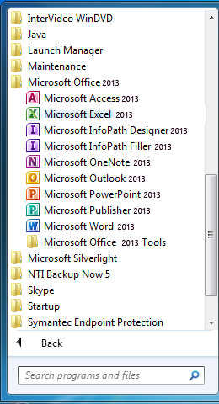
Starting Outlook
Windows 7 Start Menu
Scroll down the All Apps list until:
Microsoft Office 2013
Scroll down the All Programs list until:
Microsoft Office 2013
Now click on:
Outlook 2013
Now click on:
Outlook 2013
Be aware that Outlook 2013 will look slightly different when run in Windows 10 vs. Windows 7
Windows 10 Start Menu

Slide 20
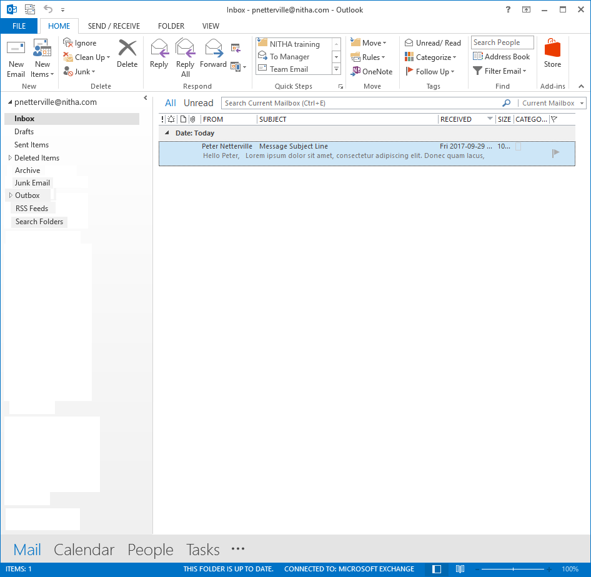
This is what you should see once Outlook 2013 is running
The five modules:
Mail
Calendar
Contacts
Tasks
Notes

Slide 21
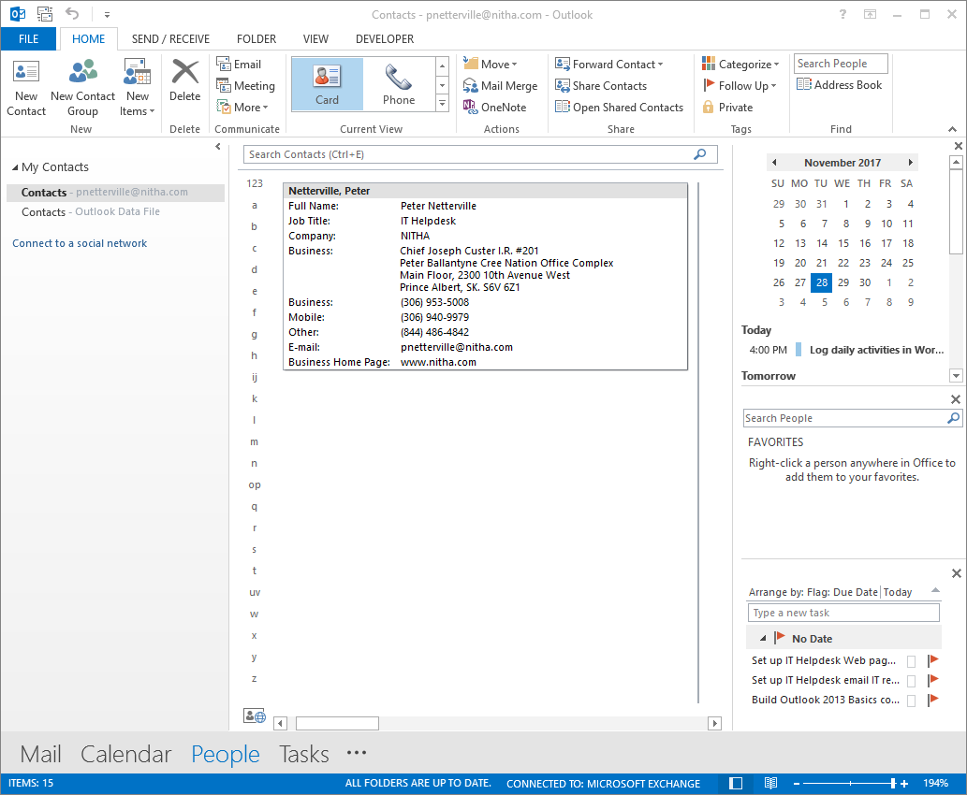
Outlook Contacts
Screen Layout
Auto-hide / Minimize/ Maximize Ribbon
Outlook Help Icon
Quick Launch Bar
Window Control icon (Alt-Spacebar)
Send/Receive Email icon
Undo icon
Customize Quick Access Toolbar icon
The Home Ribbon
New – Create new Contact items
Delete – Delete selected contact
Communicate
  Share contact(s)
  Create a meeting with contact(s)
  Assign task to contact(s)
  Create Journal entry
Current View – Change current view
Actions – Move, Mail Merge, OneNote
Share – Share contact(s)
Tags – Categorize, Follow Up, Make Contact Private
Find – Search for Contact

Slide 22
Outlook Contacts
Screen Layout
Search Bar – Search your contacts
Navigation Pane
Top of the pane – Lists your contact groups
Contact Pane – Lists the contacts in the group you have selected in the Navigation Pane.

Slide 23
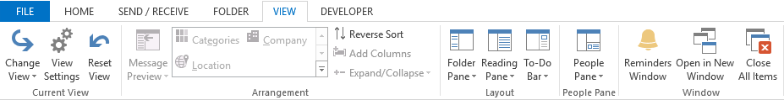
Outlook Contacts
Screen Layout
To-Do pane – By default the To-Do pane is not enabled.
To enable the To-Do pane:
Click on the View tab
Which displays the View ribbon.
Click on the To-Do Bar button.
Which displays a drop menu
Choose any combination of the three
Calendar
People
Tasks
OR turn Off the To-Do pane.
All three are selected in this example.
The To-Do pane gives you:
A quick view to the date, search contacts, and scheduled tasks
Easy access to the Calendar and Tasks modules.

Slide 24
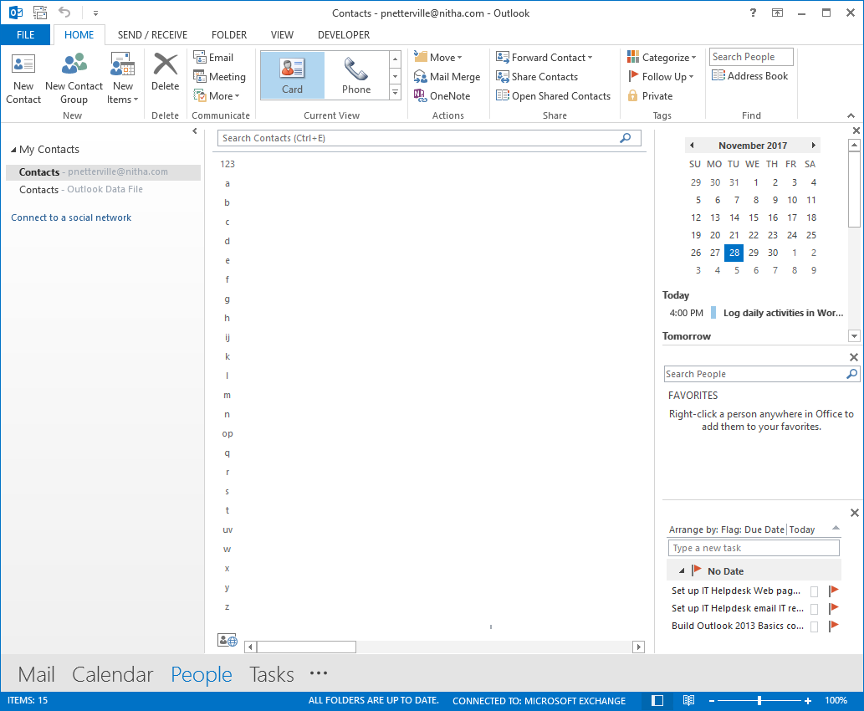
Creating a New Contact
Click on the New Contact button to create a new contact.

Slide 25
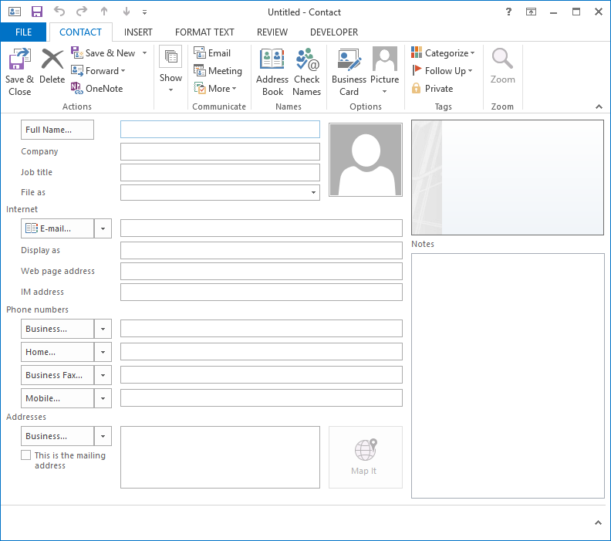
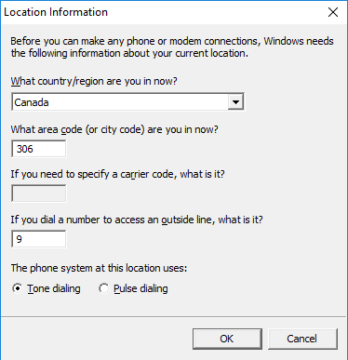
Starting a New Contact
IT Helpdesk Support
Canada
NITHA
IT Helpdesk Support
306
NITHA
Tech Guru
Tech Guru
9
helpdesk@nitha.com
helpdesk@nitha.com
www.nitha.com
www.nitha.com
1(844)486-4842
1(844)486-4842
Click on OK
PBCN Office Complex
Main Floor, 2300 10th Avenue West
Prince Albert, SK
S6V 6Z1
PBCN Office Complex
Main Floor, 2300 10th Avenue West
Prince Albert, SK
S6V 6Z1

Slide 26
This what your contact should look like now
Click on Save & Close
IT Helpdesk Support
IT Helpdesk Support
NITHA
NITHA
Tech Guru
Tech Guru
helpdesk@nitha.com
Support, IT Helpdesk
www.nitha.com
helpdesk@nitha.com
IT Helpdesk Support (helpdesk@nitha.com)
www.nitha.com
+ 1 (844) 486-4842
PBCN Office Complex
Main Floor, 2300 10th Avenue West
Prince Albert, SK
S6V 6Z1

Slide 27
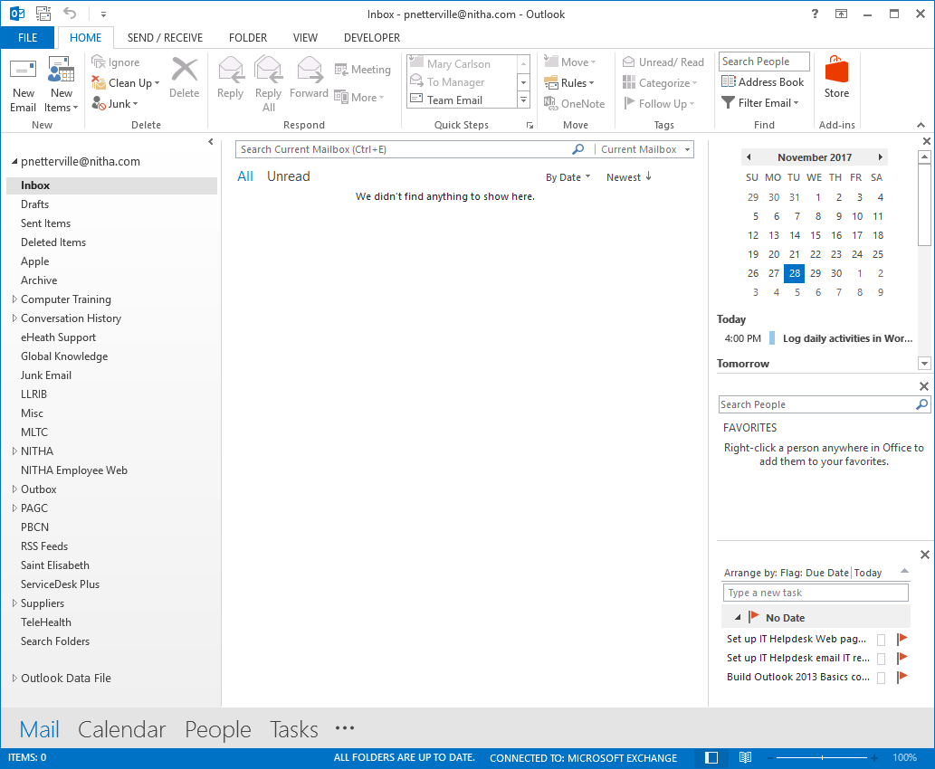
Now to make an Email
Click on the New Email button to start a new email.
Select the Mail module, if you do not have it selected already.

Slide 28
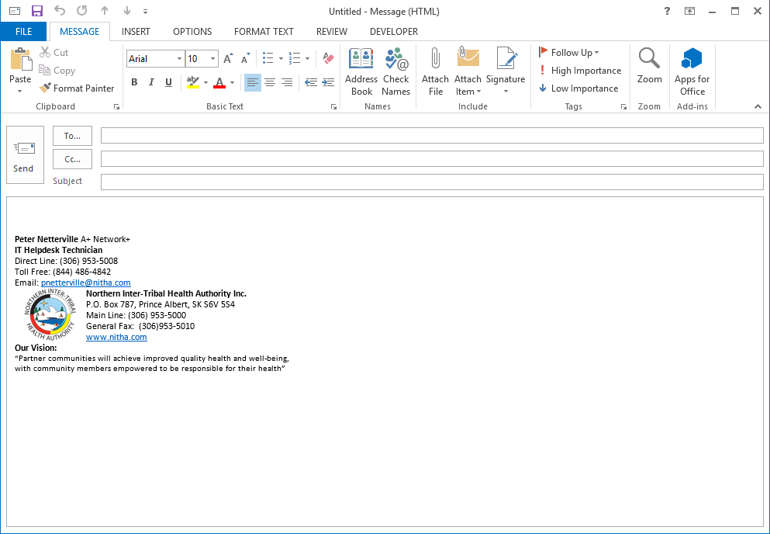
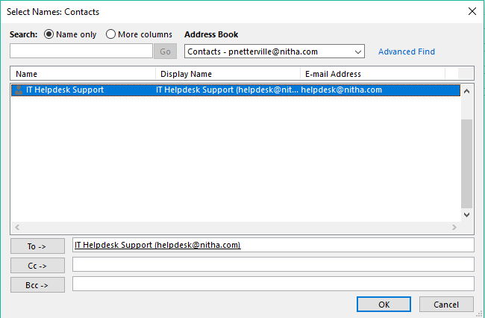
Make your email – select a contact
Click on To… to select a contact
Double Click on IT Helpdesk Support
When you see the email listed here, click on OK.

Slide 29
Make your email – select a contact
In the Subject box enter any subject, such as “Tech question”.
Now click on Send.
IT Helpdesk Support (helpdesk@nitha.com)
Tech question
Now enter the text of the email with whatever you like, for example, “Are computers just people too?” or some other simple to answer question like that.
Are computer just people too?

Slide 30
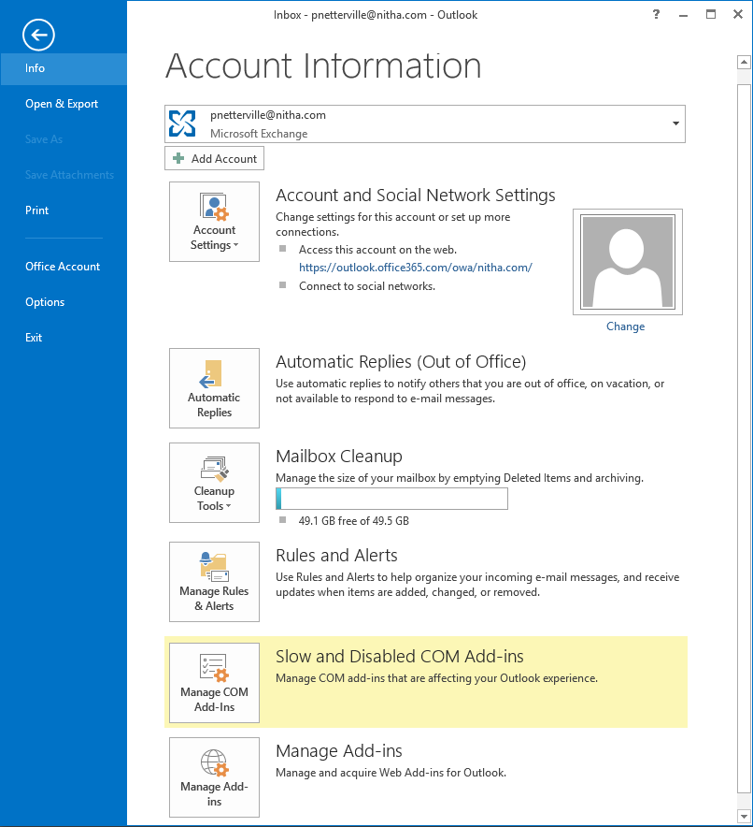
Outlook GUI
Screens Layout - Info
When the Info screen is selected
Choose the current account
or
Add a new one.
Account settings options:
Social network accounts
Delegate access
Download global address book
Manage your mobile notifications
This is where you enter an automatic reply to incoming emails.
You can:
Specify a date/time period
Message for inside your organization
Message for outside

Slide 31
Outlook GUI
Screens Layout - Info
When the Info screen is selected
Mailbox Cleanup
Empty Deleted Items
Archive old emails
With Rules & Alerts you can set a rule to do just about anything with incoming or outgoing email.
Then it can alert you by pop-up a window and/or a sound of your choice.

Slide 32
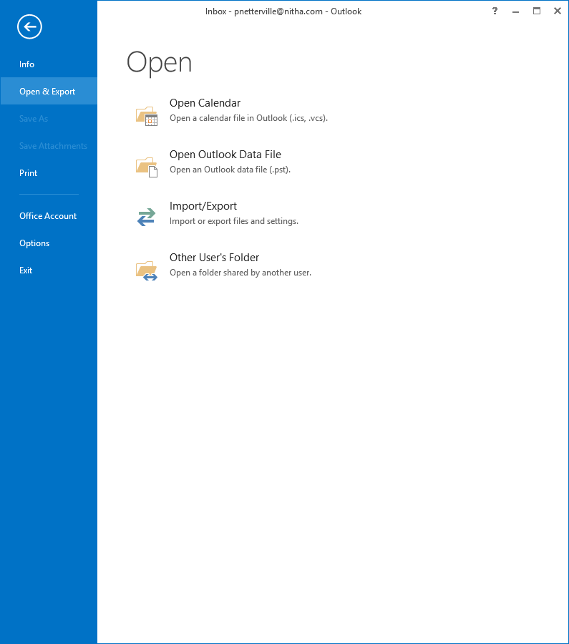
Outlook GUI
Screens Layout - Open
When the Open & Export screen is selected
Open Calendar allows you to open a saved calendar file.
Outlook Data File is a .PST file. From this you can link other data files.
Some Import & Export functions:
RSS Feeds
vCard
iCalendar & vCalendar
Mail account settings
Mail & addresses
Open User’s Folder option allows people to share their Calendars, Contacts, Inbox, Journal, and/or Tasks with others.
This option is available on a domain network.

Slide 33
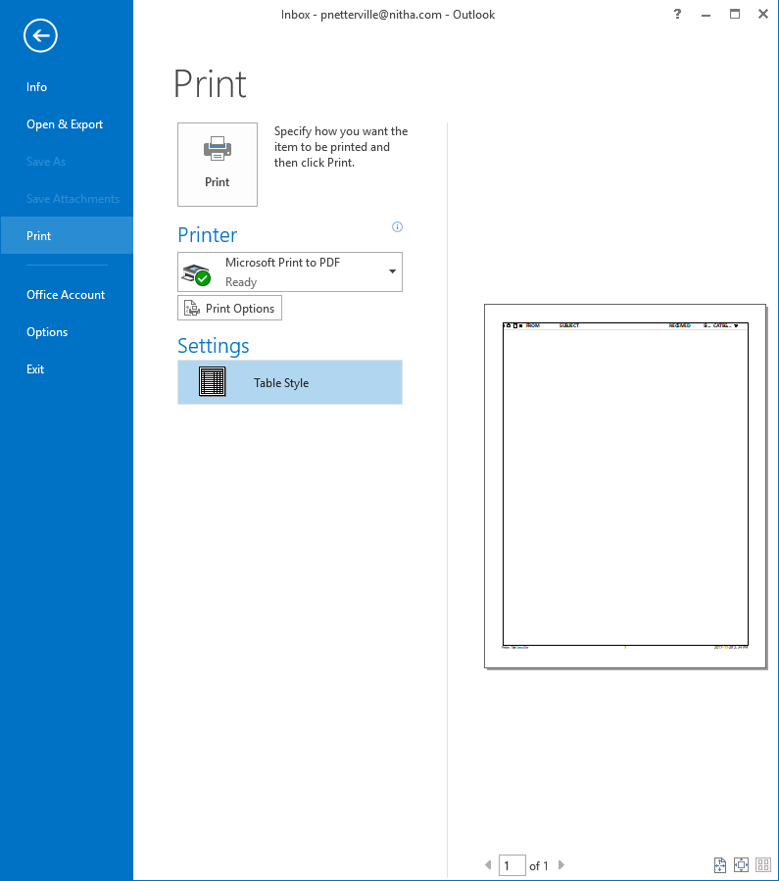
Outlook GUI
Screens Layout - Print
When the Print screen is selected
Print – Print to paper in the print style listed below in Settings, currently set to Table Style.
Printer Select list box – Click to drop down a list of all installed printer drivers.
Print Options - allows you to change the printer driver options such as paper size, tray, etc., for the selected printer.
Settings option - allows you to choose a print style for the module you have selected.

Slide 34
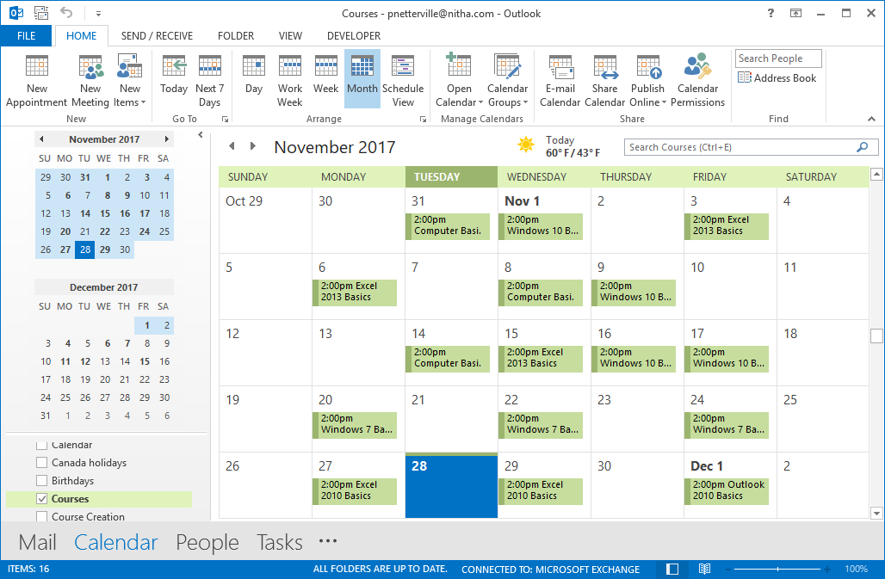
Making a Calendar Appointment
Click on the New Appointment button to start a new calendar appointment.
Select the Calendar module.

Slide 35
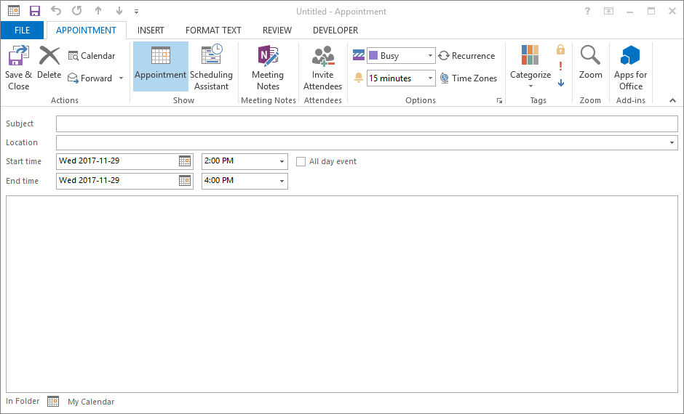
Enter the following information into a new Calendar Entry
Click on Save & Close
Outlook 2010 course from NITHA
At a location near you!
Outlook 2010 course from NITHA
2:00 PM
At a location near you!
4:00 PM
Outlook training
Outlook training

Slide 36
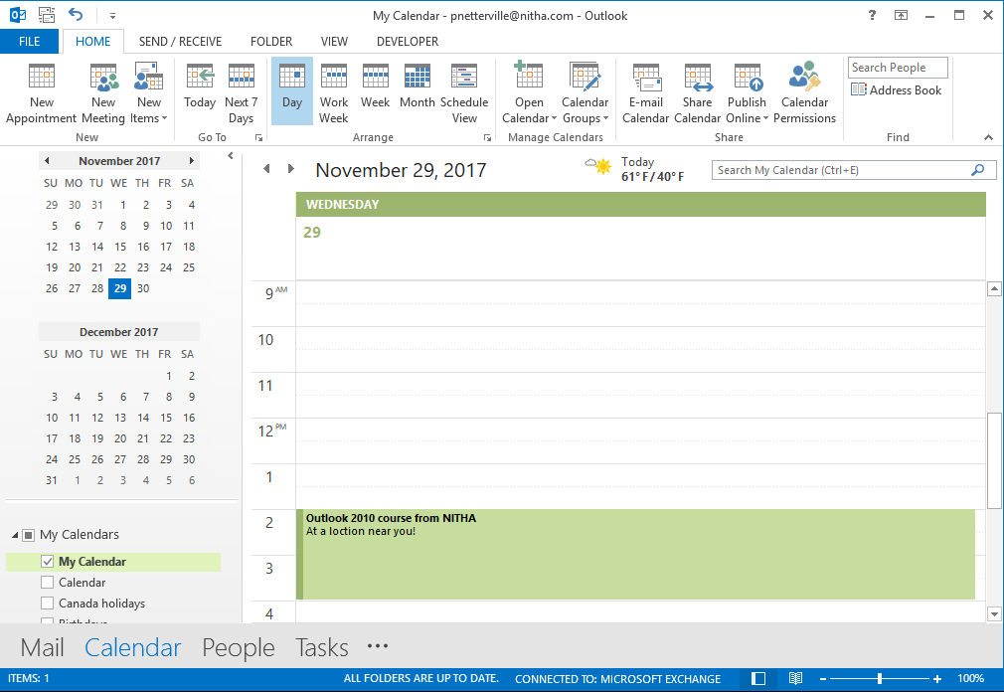
Day View
Our new appointment viewed in Day view.

Slide 37
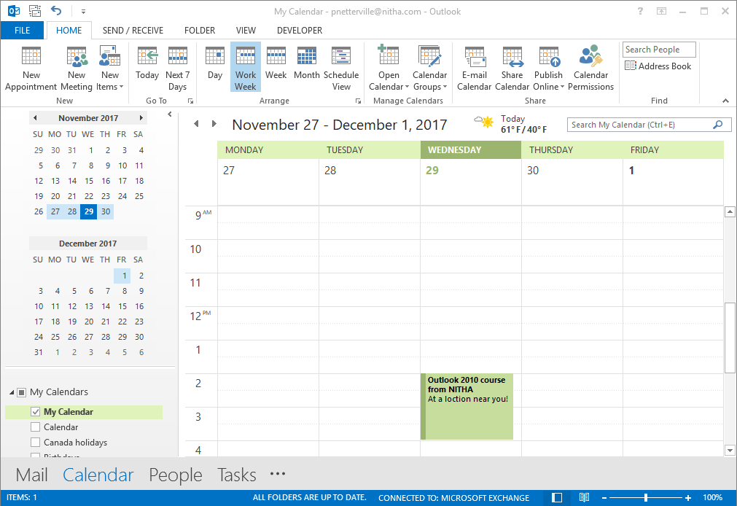
Work Week View
Our new appointment viewed in Work Week view.

Slide 38
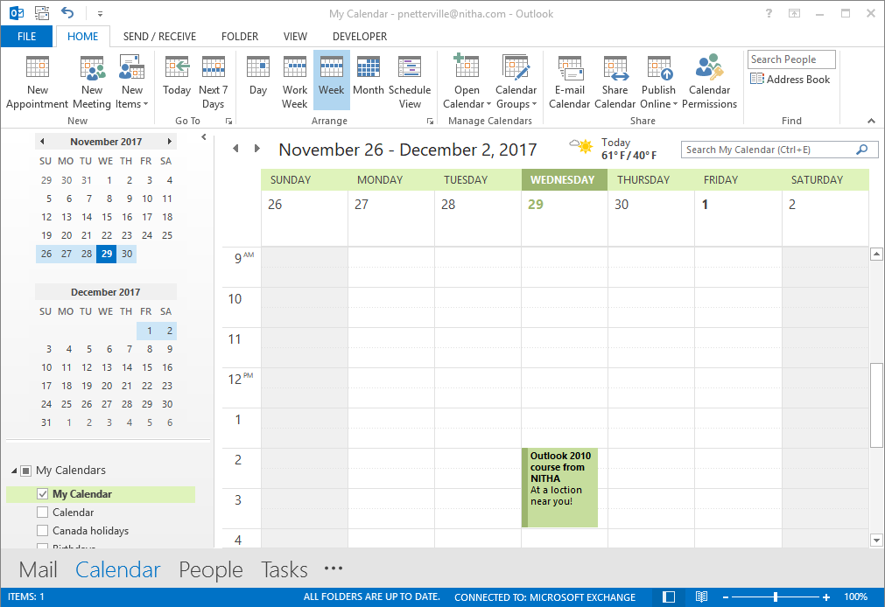
Week View
Our new appointment viewed in Week view.

Slide 39
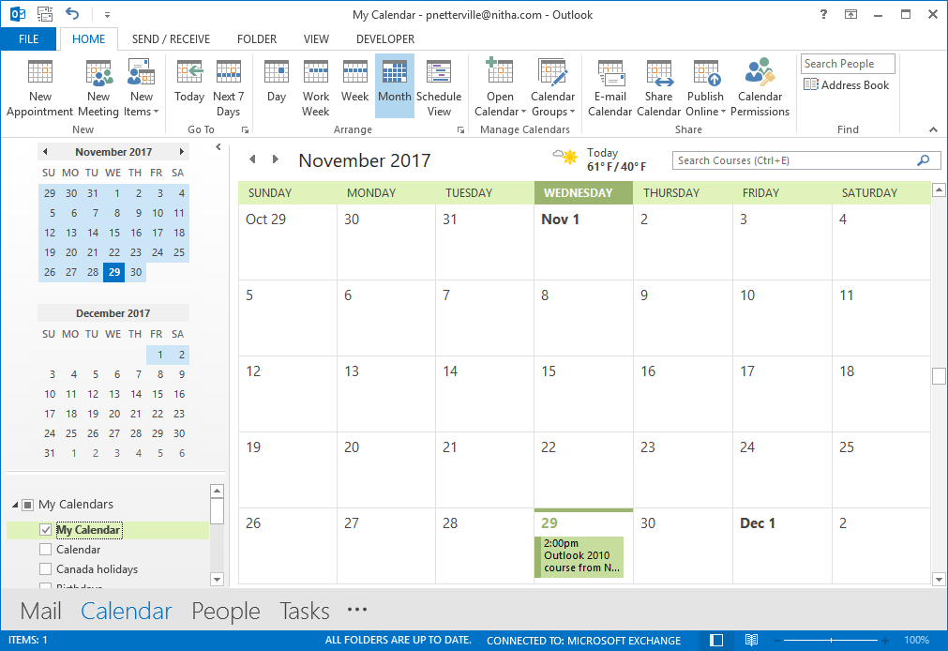
Month View
Our new appointment viewed in Month view.

Slide 40
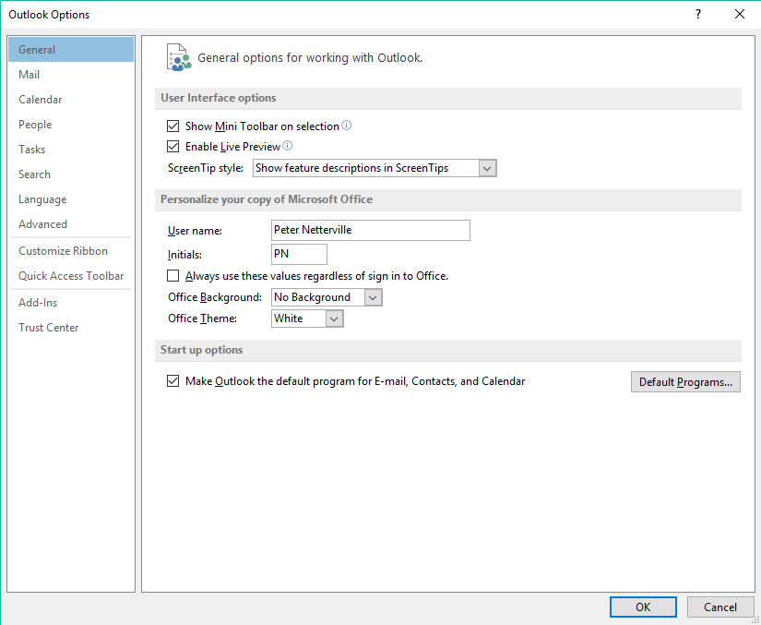
Outlook GUI
Screens Layout - Options
The Options screen contains far too many items to cover here, so we will just cover the options categories where you can find the settings you might need and some of the more common settings.
Each module has its’ own plethora of settings;
Mail
Calendar
People (Contacts)
Tasks
Search the modules and set up preferences for how Outlook automatically indexes them.
Change or add new Languages
Advanced option contains:
Outlook customizations
Auto-archiving options
Import / Export options
RRS Feeds setup options
International settings
And much more!

Slide 41
Outlook GUI
Screens Layout - Options
The Options screen contains far too many items to cover here, so we will just cover the options categories where you can find the settings you might need and some of the more common settings.
Customize Ribbon lets you add and remove items and make custom tabs.
The Quick Access Toolbar is located along the top left of Outlook on the titlebar.
Add-Ins lets you add, remove or configure third party software plug-ins for Outlook.
The Trust Center has options to:
Protect your Privacy
Security

Slide 42
Exercise
Email Options – HTML vs Rich Text vs Plain Text
Now click on the arrow to get the menu.
In the Options click on Mail.
Compose messages
HTML – HTML is the language of
web pages. This allows most formatting that any web page can display.
Rich Text – Rich text allows formatting like HTML but the email can only be viewed (with that formatting) in Outlook or Exchange Clients
Plain Text – No text formatting nor pictures, just plain old text.

Slide 43
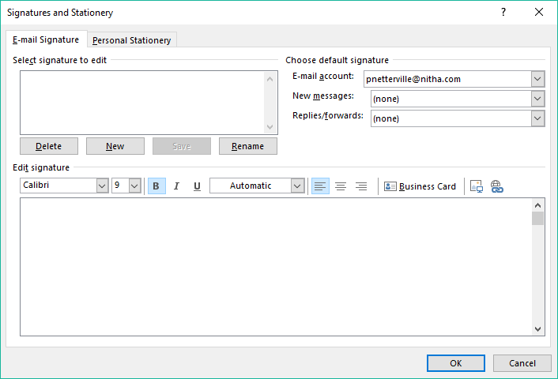
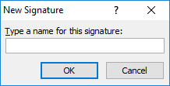
Exercise
Email Options – Creating a Signature
In the Mail settings click on the Signatures… button
Which displays this dialog.
Click on the New button.
Which displays this dialog.
Type in a name, such as “New Emails”, for example, and click on OK.
New Emails
You should see the name in the signature box.

Slide 44
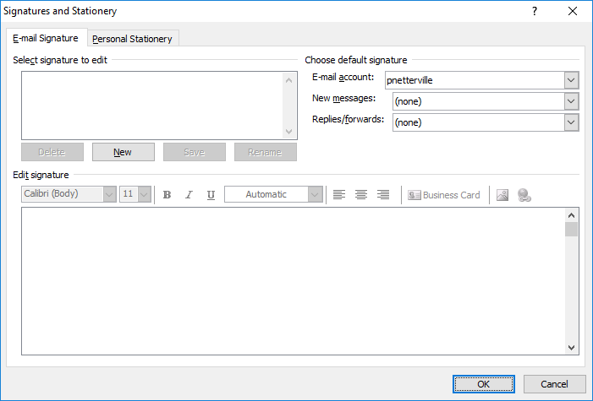
Exercise
Email Options – Creating a Signature
Create an email signature for all new emails you create.
Then select from the New messages list “New Emails”
Now, of course you will not be entering in my signature information in the Edit signature box, but your own information.
New Emails
Click on OK and you are done!
Whenever you start a new email, the signature will be appended to the bottom of it.

Slide 45
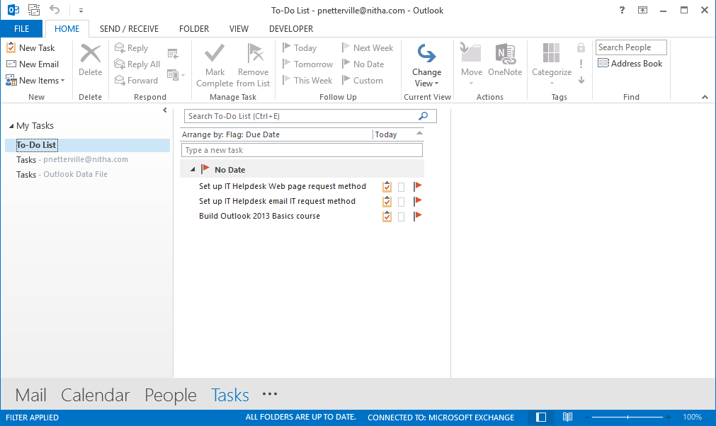
Creating and Working with Tasks
Exercise - Creating a Task
One of the best ways to keep your projects moving forward is to create and follow a scheduled timeline.
A task can help to keep you on track until completion of your project.
2. Click on the New Task button located in the New group on the Home tab.
1. Click on the Tasks module link.

Slide 46
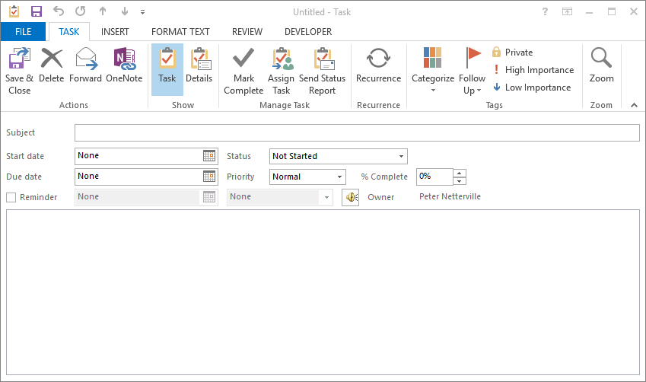
Exercise - Creating a Task
Our Purpose: To create a task and assign that task to a contact.
Create courseware material for Outlook 2010
Click on the down arrow and select today’s date. I have Mon 11/6/2017
Click on the down arrow and choose a date a couple of week in the future.
Thu 11/6/2017
Wed 11/29/2017
Now add a reminder to one day before the project completion.
Must be completed by the due date or you cannot teach the course!
Add a comment to the task, if you wish.

Slide 47
Exercise - Creating a Task
Our Purpose: To create a task and assign that task to a contact.
Click on the Assign Task button located on the Task tab in the Manage Task group.
Thu 11/6/2017
Wed 11/29/2017
Must be completed by the due date or you cannot teach the course!

Slide 48
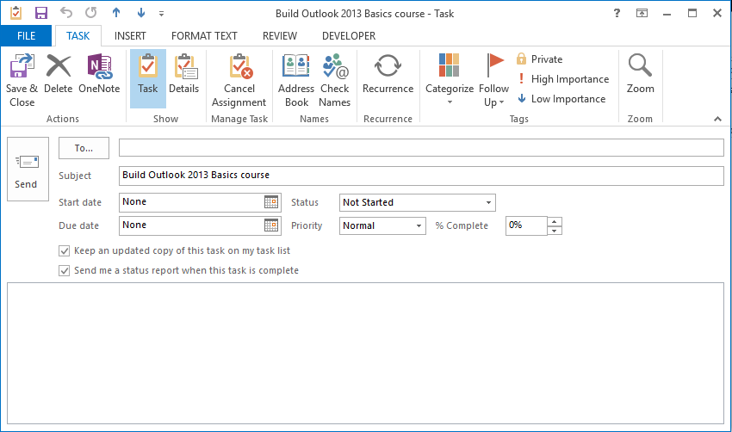
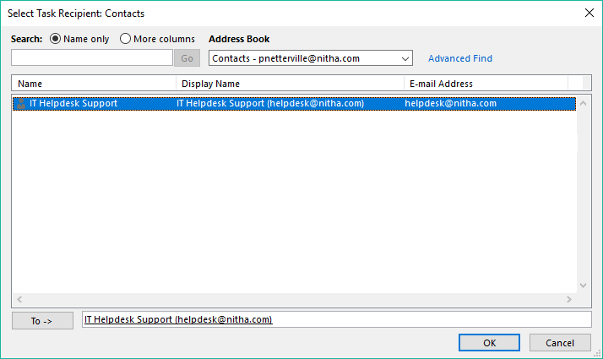
Exercise - Creating a Task
Our Purpose: To create a task and assign that task to a contact.
This is the Assign Task window. Notice the ribbon changed.
You can cancel the assignment by clicking on the Cancel Assignment button in the Manage Task group.
Click on the To… button to assign this task.
Double Click on the contact we made earlier and it will be placed in the To -> box.
Must be completed by the due date or you cannot teach the course!
Finally, click on the OK button.

Slide 49
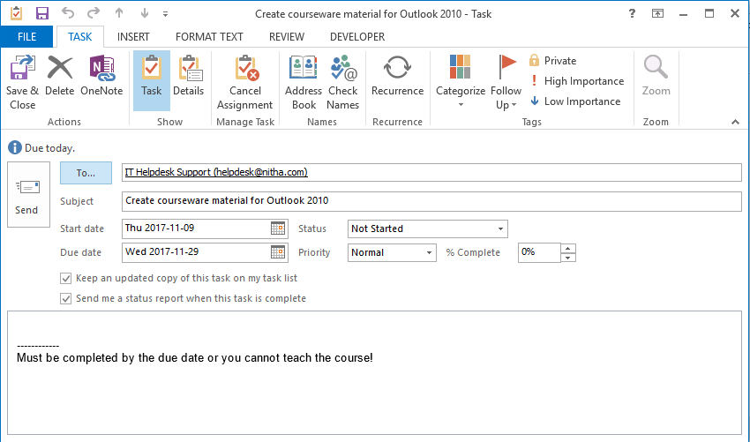
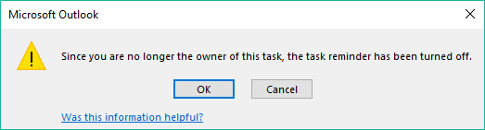
Exercise - Creating a Task
Our Purpose: To create a task and assign that task to a contact is complete.
It should look something like what is below.
Click on the send button to send the assignment.
If you assigned the task to anyone other than yourself, a dialog box warning you that the reminder is turned off will appear.
Click on OK and you are done.
Keep in mind that for the task to be useful, you should keep the progress up-to-date.

Slide 50
How do the Outlook modules work together?
How do the Outlook modules interact with each other?
The People / Contacts are at the hub of Outlook connectivity.
Send/receive email to/from contacts
Invite contact(s) to appointments/meetings
Assign a task to one or more contact(s)
Forward a note to one or more contact(s)

Slide 51

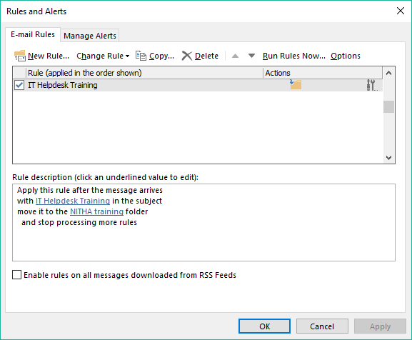
The Rules
Learning the Rules
Click on the Home tab if it is not already selected.
Click on the Rules command found in the Move group to see the menu.
Click on the Manage Rules & Alerts
On the dialog box that appears click on New Rule…
Click on the Mail button to display the Mail module.

Slide 52
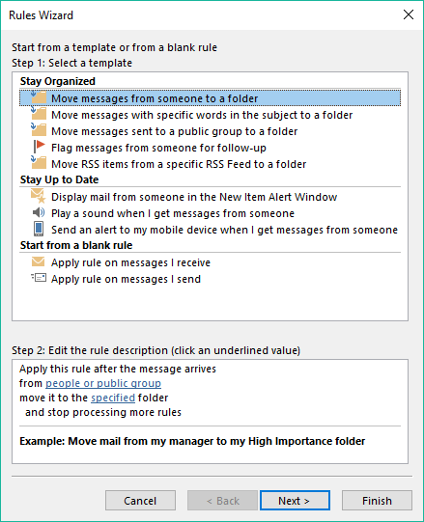
Opening up the Rules
  Which displays the Rules Wizard.

Slide 53
What are the Rules?
Rules can be applied to:
Emails in and out
RSS feeds in
Rules tell Outlook how to treat the incoming and outgoing emails.
There are three stages to an email rule.
Identifying an email
What to do with the email
How will you be notified
You can choose to:
Create a rule from a template
Create a rule from scratch

Slide 54
What are the Rules?
Creating a rule from a template
One of the most commonly used rules takes incoming emails and sorts them into folders.
That is what we will do here.
Click on Move messages from someone to a folder to select it.
Click on the people or public group link.

Slide 55
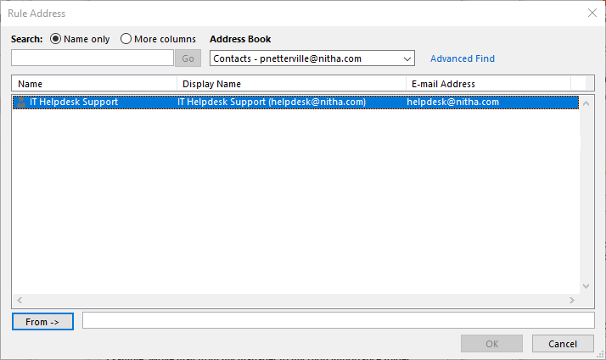
What are the Rules?
Creating a rule from a template
One of the most commonly used rules takes incoming emails and sorts them into folders.
That is what we will do here.
Which displays the select Contact dialog box.
Double click on the contact we created
Click on OK

Slide 56
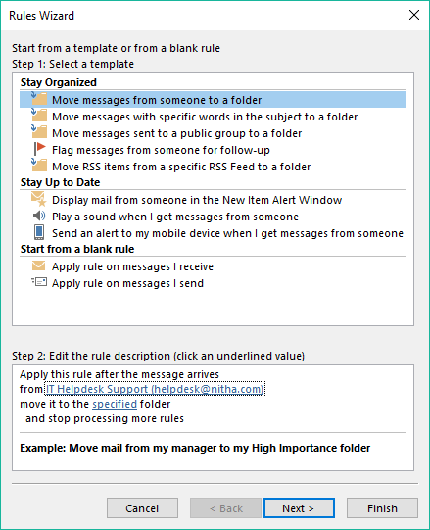
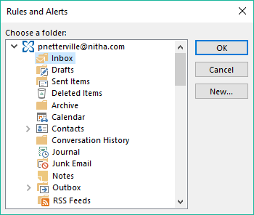
What are the Rules?
Creating a rule from a template
With the email account selected …
Click on the New button.
Which displays the Choose a folder dialog.
Click on specified to select a folder.

Slide 57
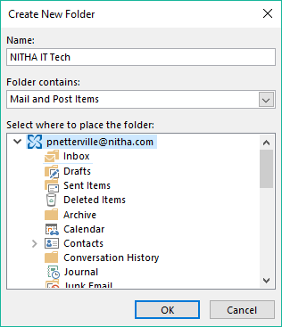
What are the Rules?
Creating a rule from a template
On the Create New Folder dialog that appears …
Click in the Name box and type NITHA IT Tech
Click on the root folder. In my case it is called helpdesk@nitha.com
Click on OK

Slide 58
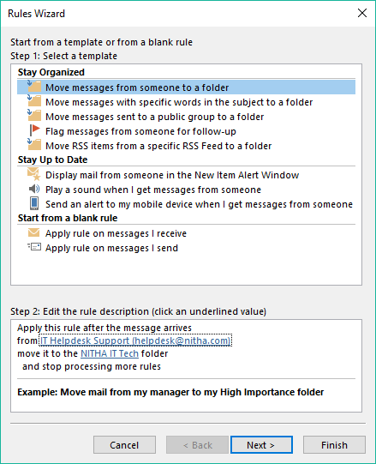
What are the Rules?
Creating a rule from a template
This rule is now complete, so you can click on Finish to close it.

Slide 59
We have covered here in this course …
The BIG Picture
Screen Layout - Print
Overview: What can Outlook do?
  Exercise: Making a Calendar Appointment
Starting Outlook
Screen Layout - Options
Screen Layout - Contacts
  Exercise: Changing some Options
  Exercise: Creating a New Contact
  Exercise: Creating a Signature
  Exercise: Making an Email
  Exercise: Creating & Working with Tasks
Screen Layout - Info
How Outlook Modules Work Together
Screen Layout - Open
Exercise: The Rules - Making a rule

Slide 60
NITHA IT HelpDesk helpdesk@nitha.com
1(844)486-4842
Notes:
Please do not hesitate to ask any question regarding this session, and I will make sure to answer your question as soon as possible.

Slide 61


