Slide 1






Office 365 Intro
Entry Level

Slide 2
NITHA IT Helpdesk
helpdesk@nitha.com
1(306)953-5008

Slide 3

What will we be covering in this course?
O365 – Pros & Cons Slide 4
O365 – Login Slide 5
Landing Page Layout Slide 7
Launch an App Slide 32

Slide 4
O365 – Pros & Cons
What are the Pros and Cons of using O365
Pros:
Cons:
Access to the latest versions of Word, Excel, PowerPoint, Outlook, and other Office apps, which are continuously updated with new features.
Controls like ActiveX controls and form toolbar controls
are not available.
External data resources cannot be used.
1 TB of OneDrive cloud storage per user, allowing you to store, share, and collaborate on files from anywhere
Macros are not available.
O365 is dependent on an Internet connection.
Tools like Microsoft Teams facilitate real-time collaboration through chat, video conferencing, and file sharing
VBA codes for command buttons not available.
Missing menus such as page layout, timeline, and draw.
No option to add extensions or add-ins.
Advanced security features, including data encryption, threat detection, and multi-factor authentication, help protect your data
Dependence on an Internet connection.
Limited storage and performance compared to desktop
Excel.
Access your apps and files from any device, whether it's a PC, Mac, tablet, or smartphone
Slide
Note: This list may change as Microsoft updates the O365 platform.

Slide 5
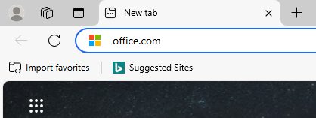
O365 - Login
All of the O365 courses require logging in to your Office 365 account since this version of Office runs in a web browser.
Open your favorite web browser and type into the address bar the URL office.com and press Enter.
Office 365 is a Software as a Service platform (SAAS)
Office running as a service runs in a web browser, unlike Office packages like 2016 or 2019 or 2021 which are installed to the PC drive and are run directly from the operating system.
Office apps installed on the PC have a greater number
of functions available, whereas the O365 apps are running
in a web browser has fewer functions for security reasons, due to running through the web browser
instead of directly on the operating system. One such example is macros. They are not available in O365
Excel or Word when running in a web browser.
There are some benefits of running the O365 apps: among other things, the best feature is that you can
have more than one person modify the same file simultaneously.
Slide

Slide 6
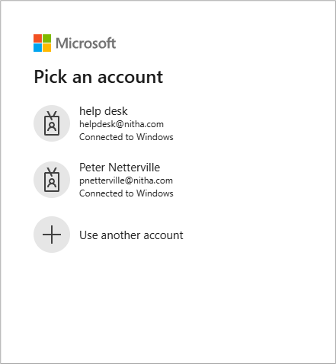

O365 - Login
This login screen will show. It will look the same except for the account names.
Select your account
The next screen you will see is where you enter the password that belongs to the email.
Slide

Slide 7
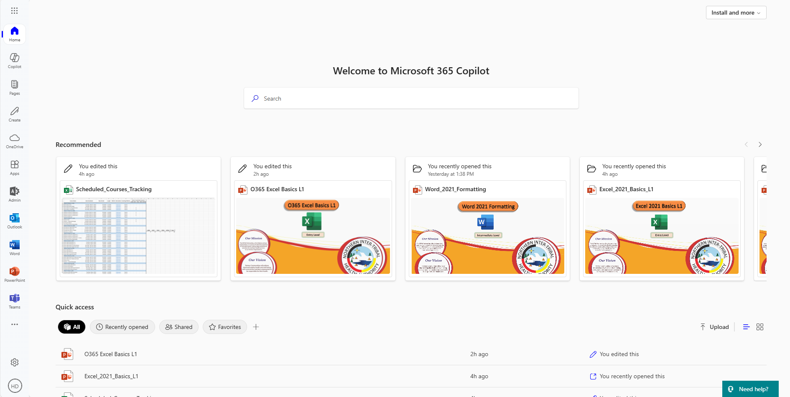
Landing Page Layout
Launch Menu Dialog
Launch Apps Nav Bar
Launch Options dialog
Open your account page.
Slide

Slide 8
Landing Page Layout
Quick Access to previously opened files.

Slide 9
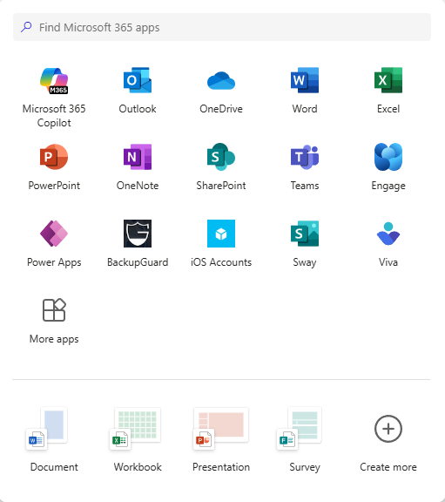
Landing Page Layout
If you do not see the program you want on the left side Nav panel then click on the menu link.
Choose from the pinned apps
OR
If you do not see the program you want of the ones shown, click on More Apps.
OR
Start a template.
Slide

Slide 10

Landing Page Layout
Microsoft Office 365 Copilot is a sophisticated AI, powered by advanced natural language processing (NLP) and a large language model.
Its’ framework enables it to understand and generate human-like text in various languages.
It processes input contextually, incorporating vast amounts of data, which provides accurate, meaningful, and engaging responses.
Displays pages created by Copilot.
Slide

Slide 11
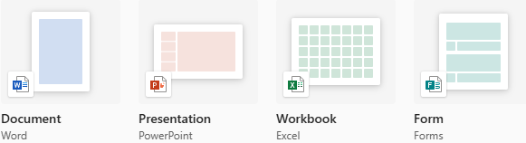
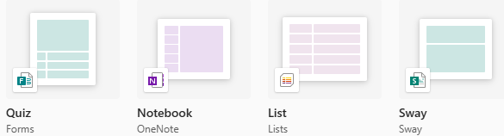
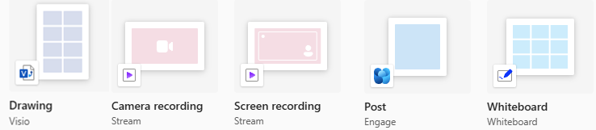
Landing Page Layout
Create a new document …
Slide

Slide 12
Landing Page Layout
Open OneDrive file storage
OneDrive is a file-sharing service similar to Dropbox, except OneDrive is tightly integrated with Office 365 and has tight security to protect your files.
Slide

Slide 13
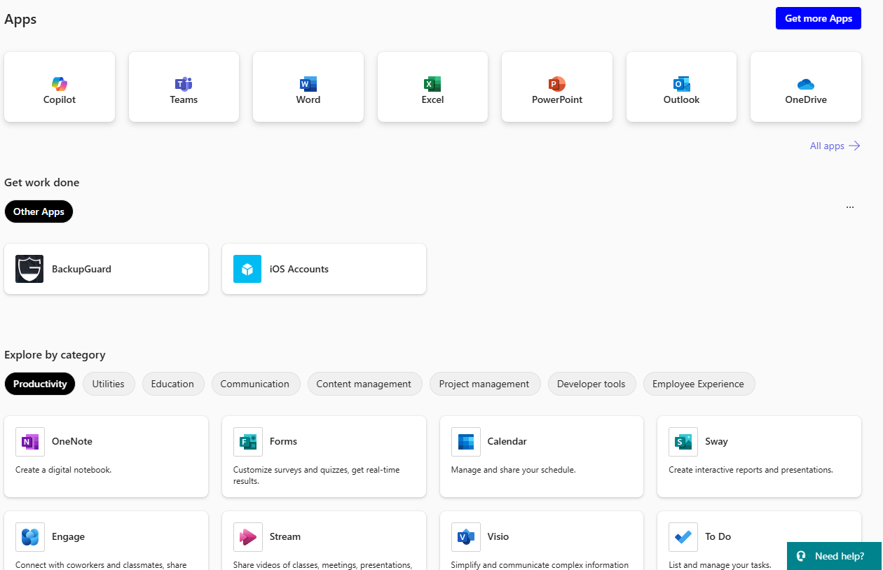
Landing Page Layout
Slide

Slide 14

Landing Page Layout
These are pinned apps.
You can pin any of the apps you add.
Slide

Slide 15
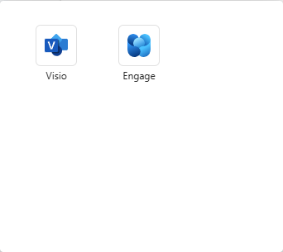
Landing Page Layout
View More Apps
Slide

Slide 16
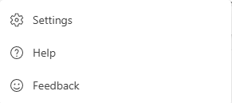
Landing Page Layout
Launch Options Dialog
Slide

Slide 17
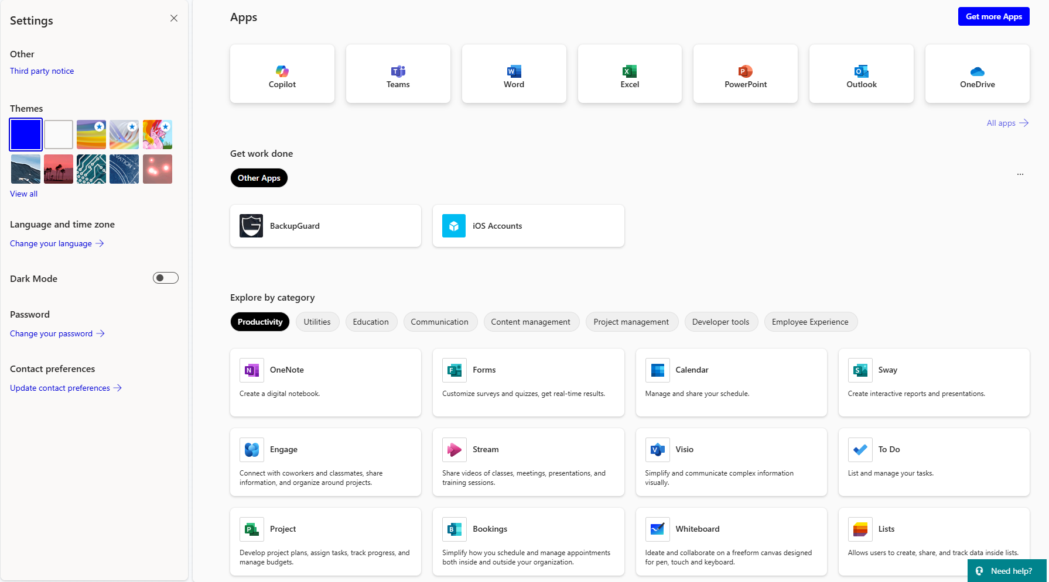
Landing Page Layout
Settings Dialog
Settings panel
Slide

Slide 18
Landing Page Layout
Settings Dialog
List of licenses for software used on the platform.
Apply a theme to your O365 platform to personalize it.
Set your language and time zone.
Set the platform to dark mode.
Slide

Slide 19
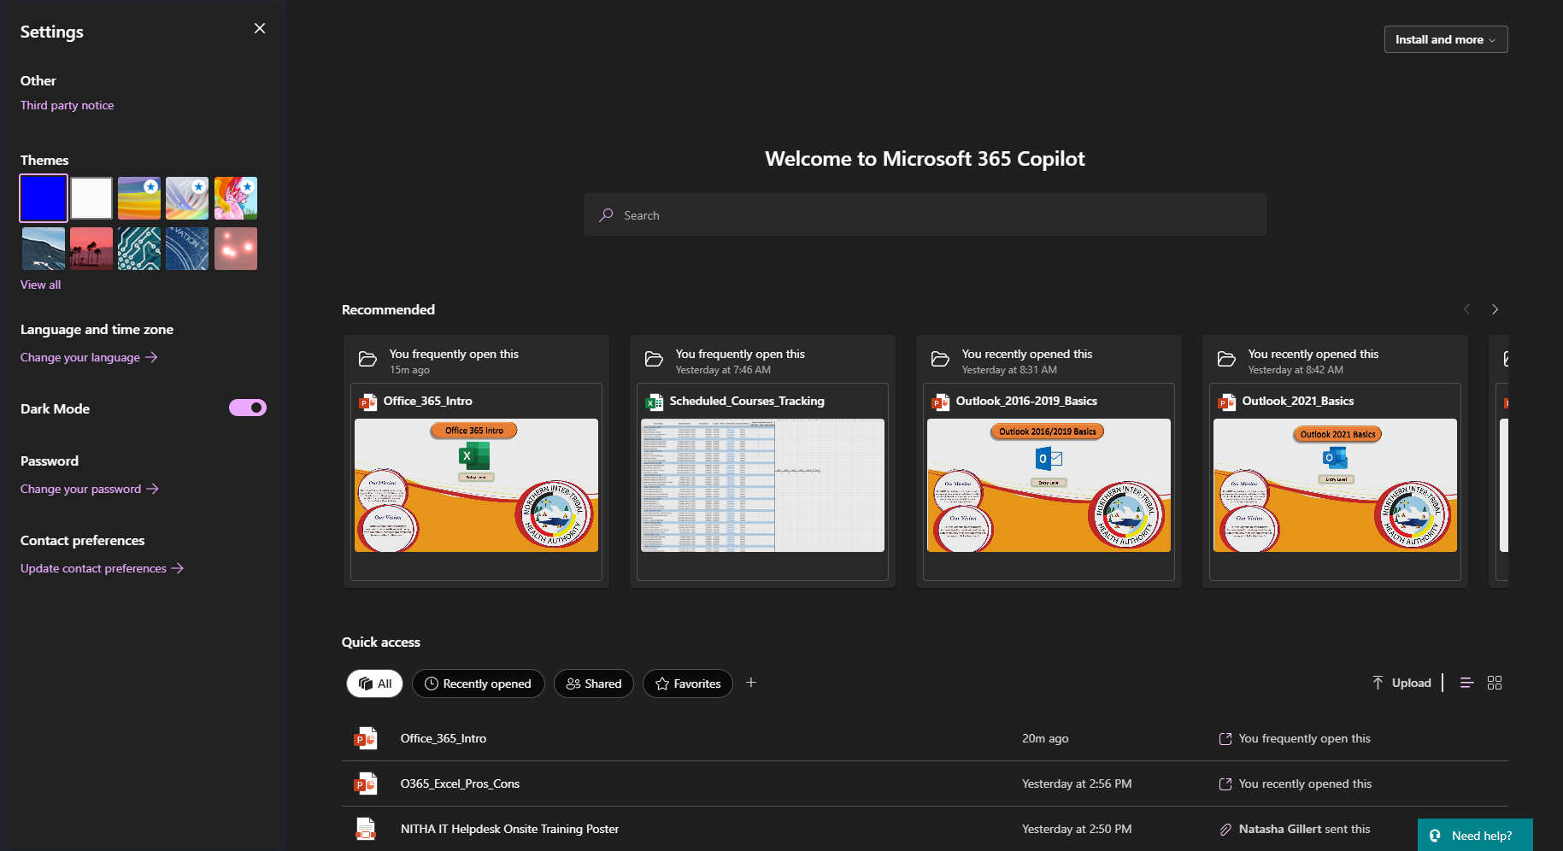
Landing Page Layout
Settings Dialog
Change your password. Make it complex; upper & lower case, symbol(s), number(s).
Clicking on this link takes you to the Settings & Privacy page.

Slide 20
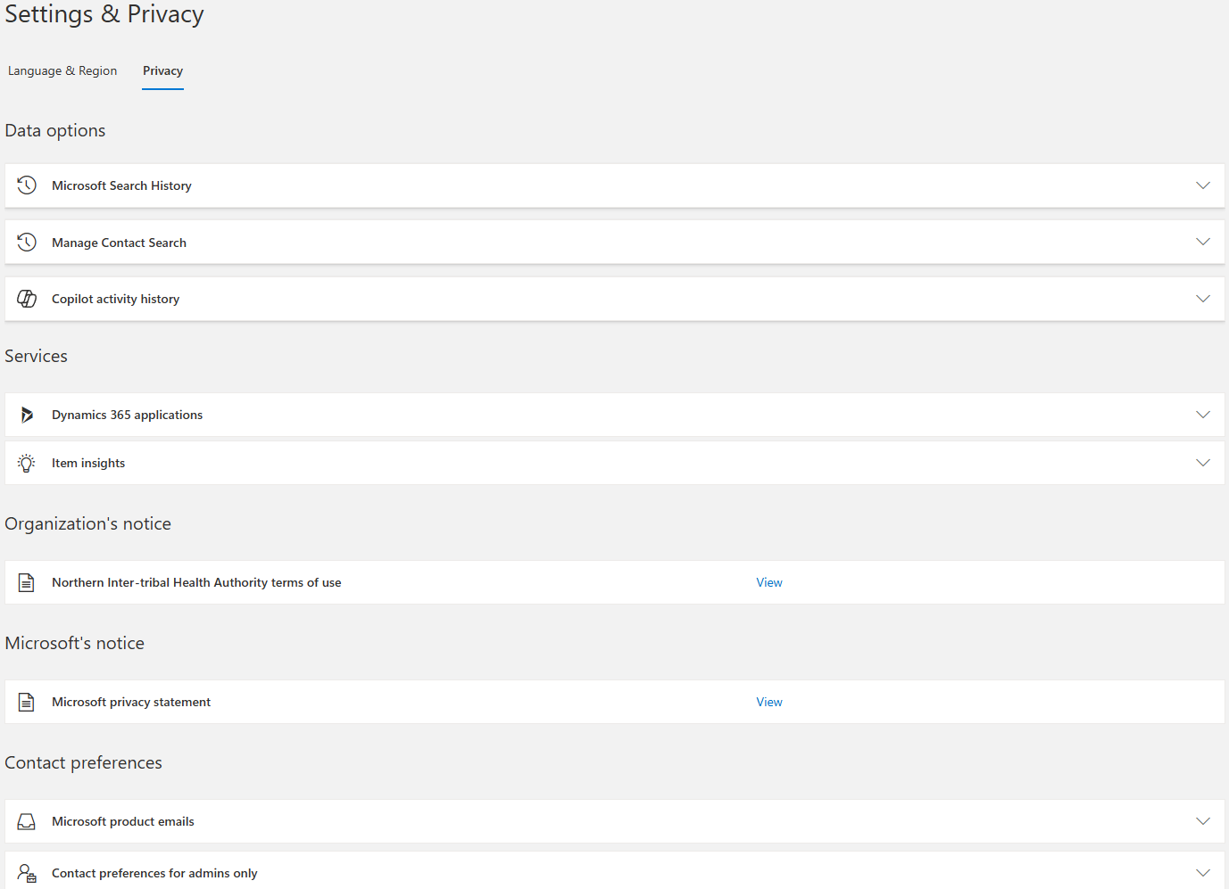
Landing Page Layout
Data Options

Slide 21
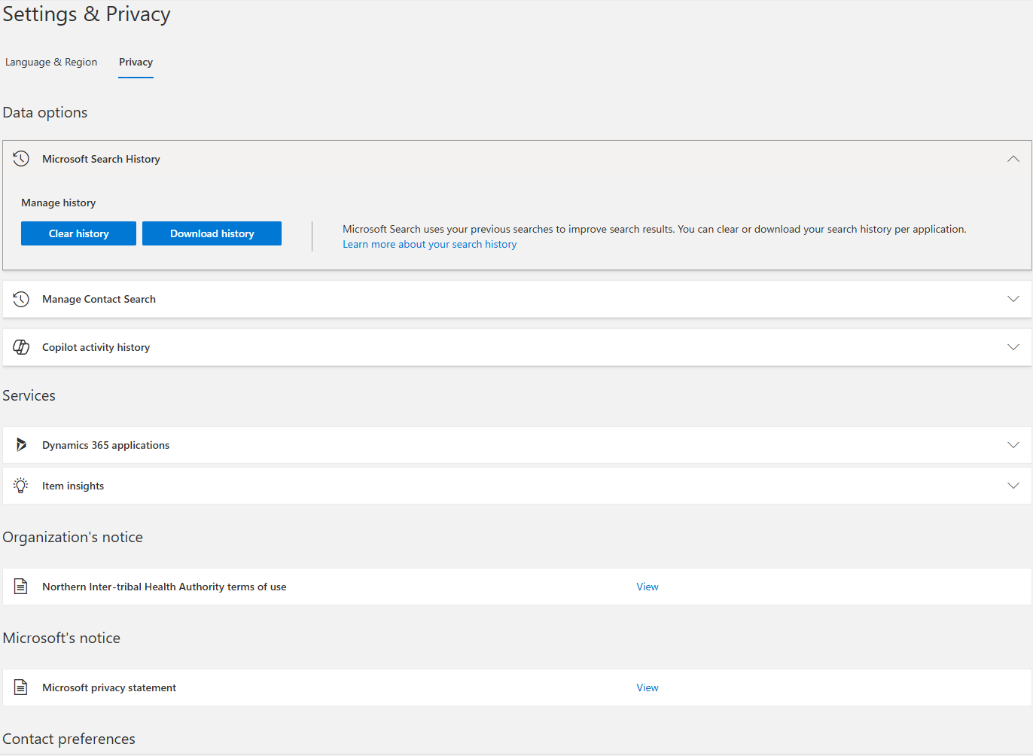
Landing Page Layout
Data Options

Slide 22
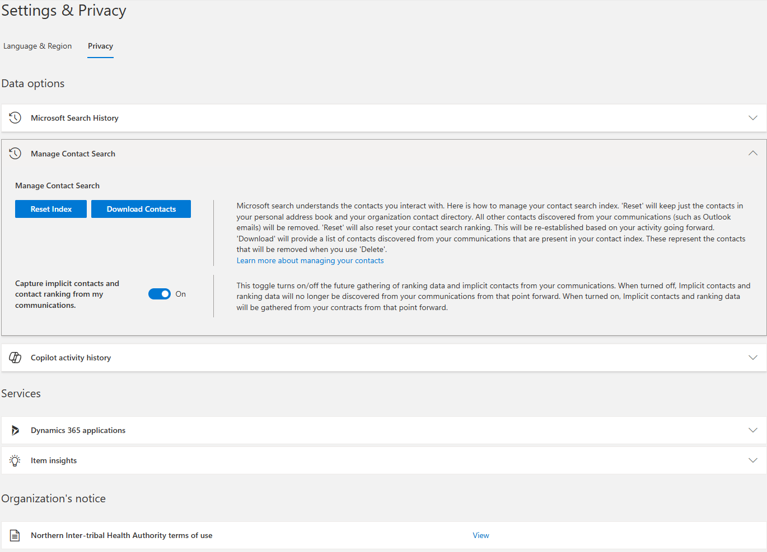
Landing Page Layout
Data Options

Slide 23
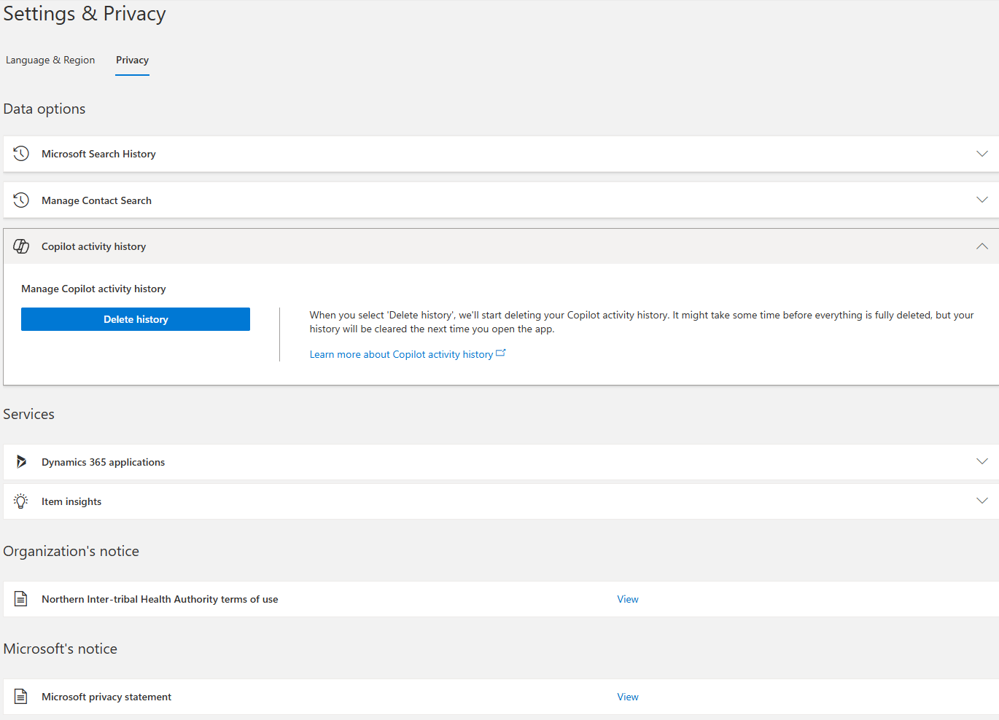
Landing Page Layout
Data Options

Slide 24
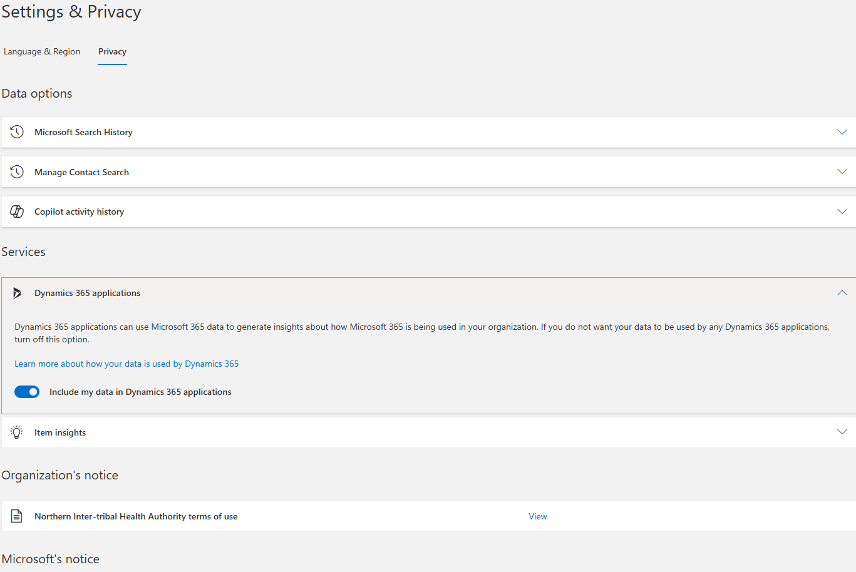
Landing Page Layout
Services

Slide 25
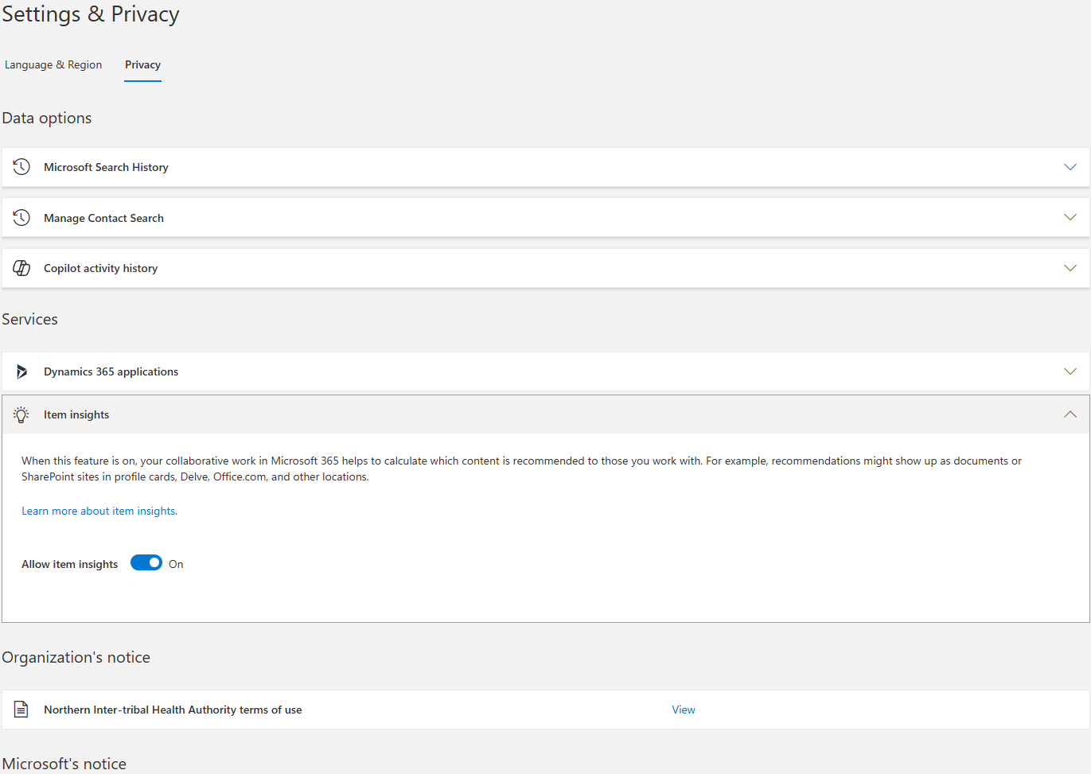
Landing Page Layout
Services

Slide 26
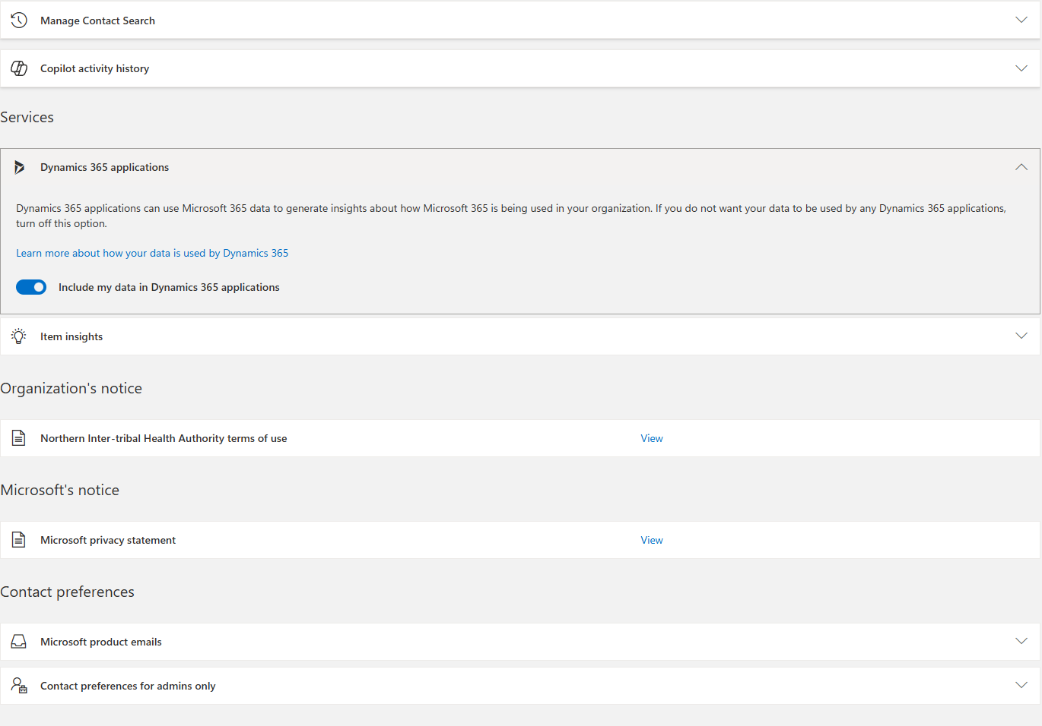
Landing Page Layout
Organization’s Notice

Slide 27
Landing Page Layout
Microsoft’s Notice

Slide 28
Landing Page Layout
Contact Preferences

Slide 29
Landing Page Layout
Contact Preferences

Slide 30
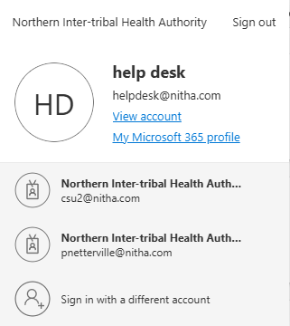
Landing Page Layout
Launch Accounts Dialog
Slide

Slide 31
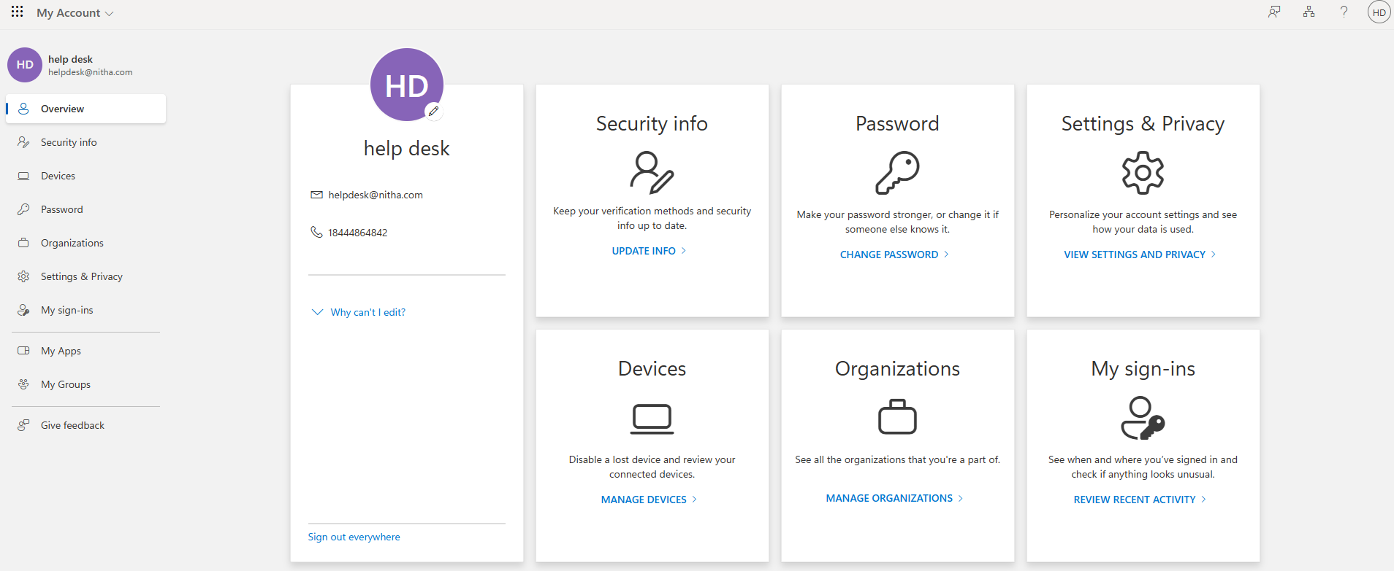
Landing Page Layout
Account Settings
Change Password
Sign Out Everywhere
Change Languages
Change Region
Account Settings
Change Password
List all sign-ins to this account.
Organizations to which your account belongs.
Device status & info
Disable device
View Bitlocker Keys
Slide

Slide 32
Launch An App
Don’t want one of these?
There are more here.
Launch an app from the Nav panel.
Slide

Slide 33
NITHA IT Helpdesk
helpdesk@nitha.com
1(306)953-5008

Slide 34

Thank you

