Slide 1


O365 Word Intro
Entry Level

Slide 2



NITHA IT Helpdesk
helpdesk@nitha.com
1(306)953-5008

Slide 3

What will we be covering in this course?
Parts of Word 365 Slide 6
Ribbons Slide 15
Navigation & Selection Slide 23
Formatting Text and More Slide 28
Working with Tables Slide 32

Slide 4
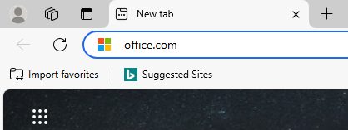
O365 - Login
All of the O365 courses require logging in to your Office 365 account since this version of Office runs in a web browser.
Open your favorite web browser and type into the address bar the URL office.com and press Enter.
Office 365 is a Software as a Service platform (SaaS)
Office running as a service runs in a web browser, unlike Office packages like 2016 or 2019 or 2021 which are installed to the PC drive and are run directly from the operating system.
Office apps installed on the PC have greater number
of functions available whereas the O365 apps running
in a web browser have less functions because of security reasons due to running through the web browser
instead of directly on the operating system. One such example is macros. They are not available in O365
Excel or Word when running in a web browser. Python scripts are used instead for Word or Excel online.
There are some benefits of running the O365 apps: among other things, the best feature is that you can
have more than one person modify the same file at the same time, in addition, limited Python scripting is
available.
Slide

Slide 5
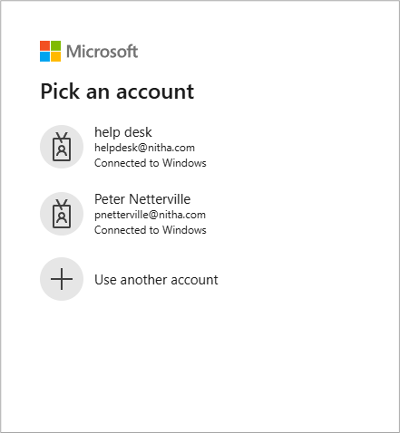

O365 - Login
This login screen will show. It will look the same for you except for the account names.
Select your account
The next screen you will see is where you enter the password that belongs to the email.
Slide

Slide 6
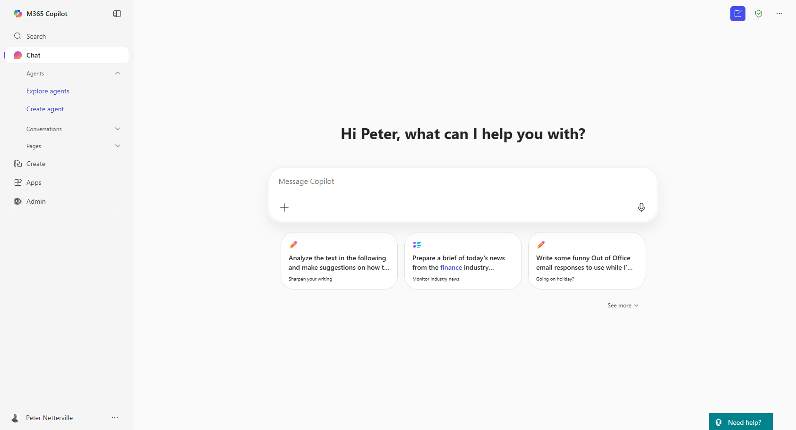
Parts of Word 365 – Launch Word
Open the Apps from the launch bar.
Slide

Slide 7
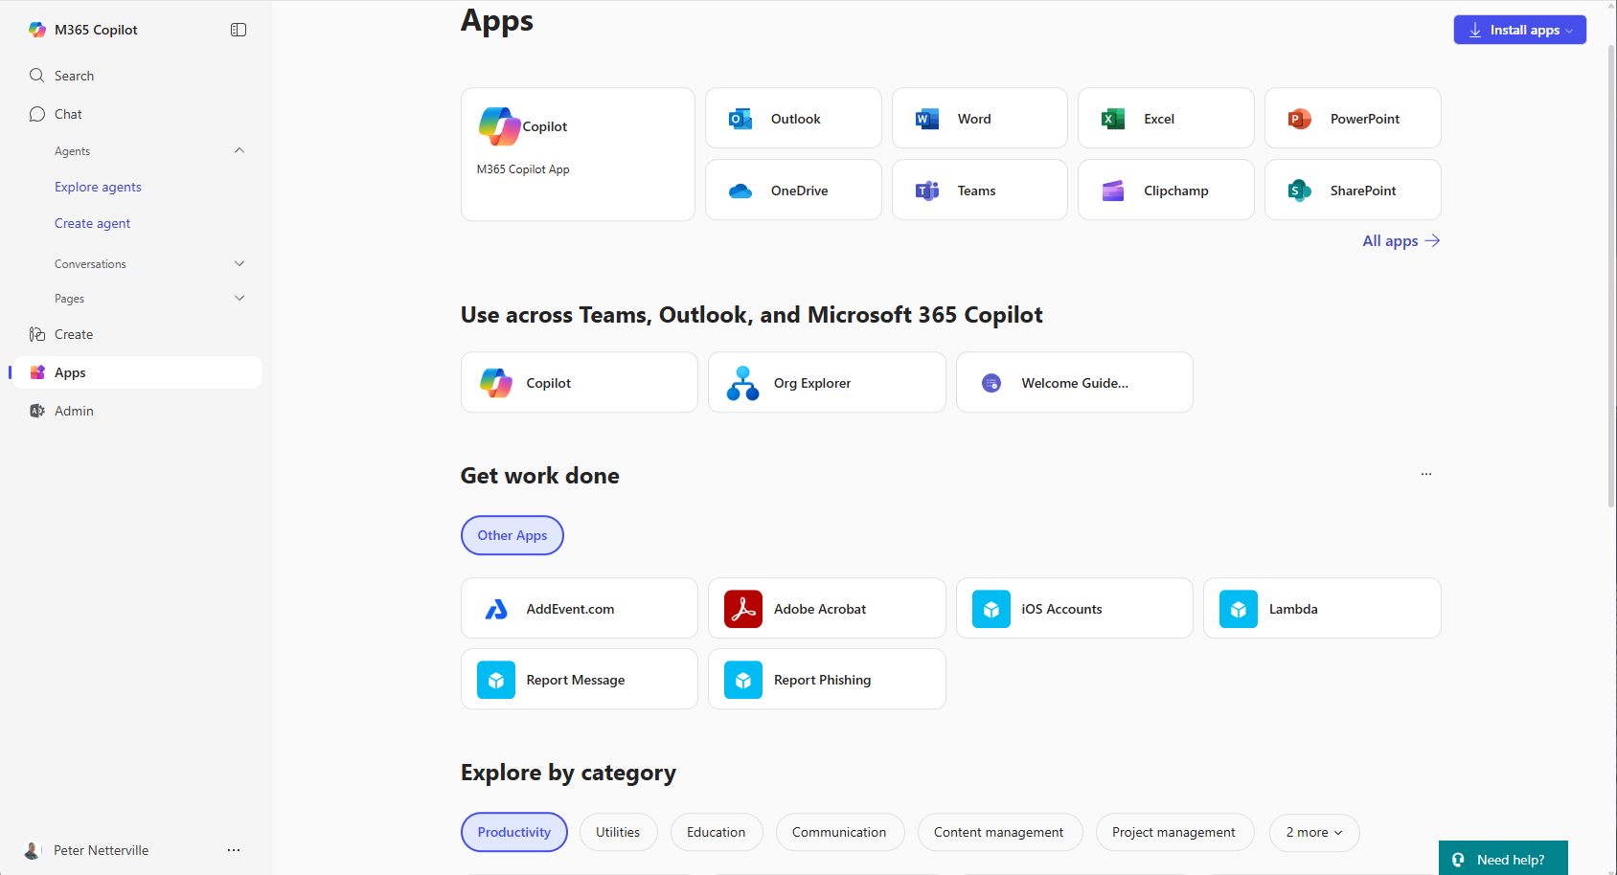
Parts of Word 365 – Launch Word
Choose an app. In our case, choose Word.
Apps to use with Teams, Outlook & Copilot.
Apps that help your productivity.
Search for an app that is not listed above.
Slide

Slide 8
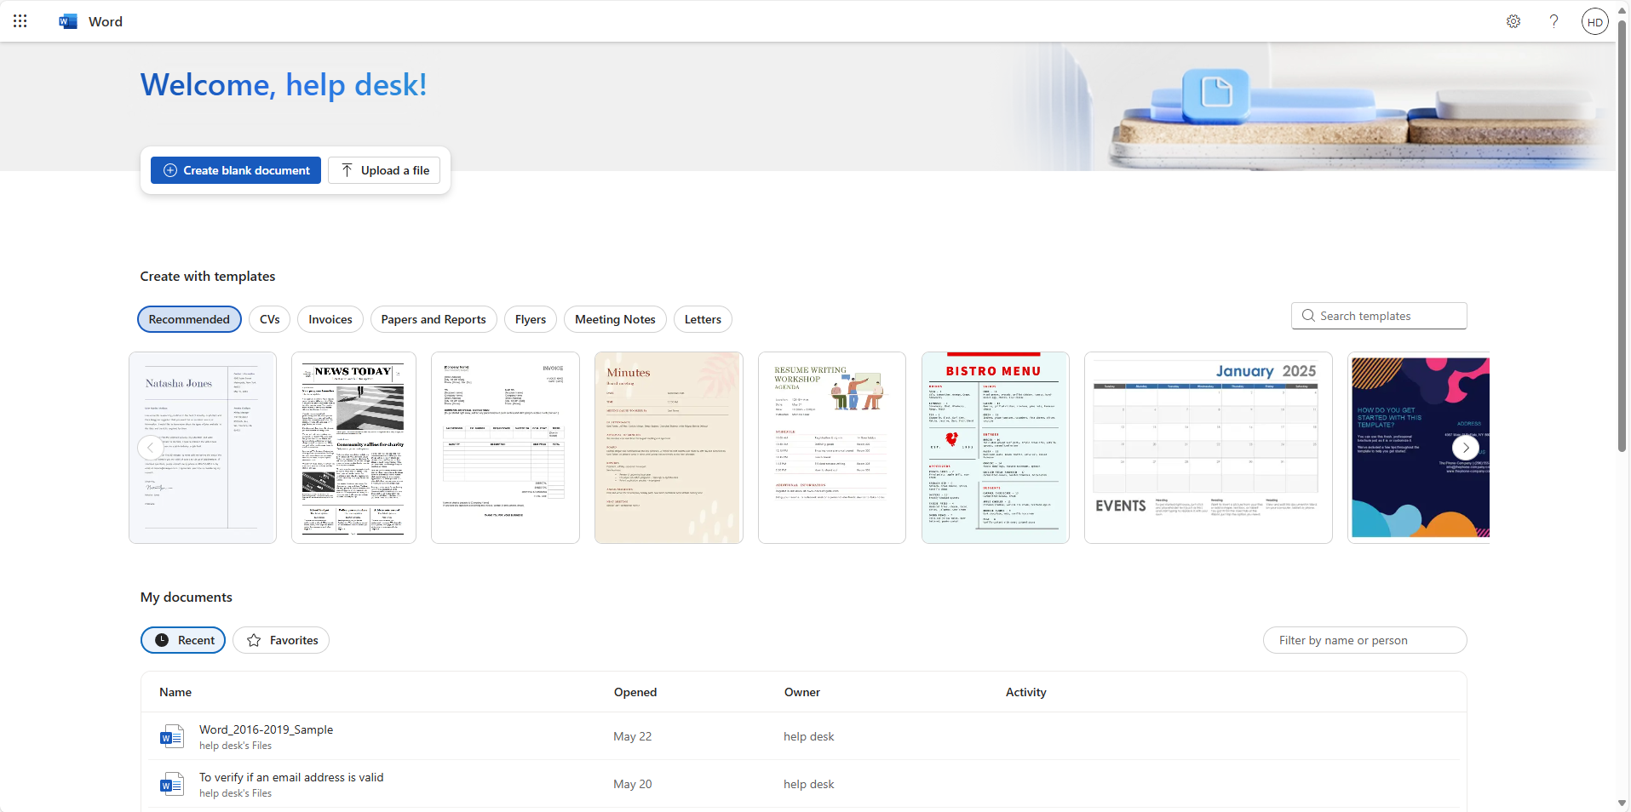
Parts of Word 365 – Word landing Page
To start with a blank page, the dreaded blank page.
Upload a Word document residing on your computer.
Click on this one to upload the Word_365_Sample.docx
Open a new Word document from a template.
Open an existing document.
Slide

Slide 9
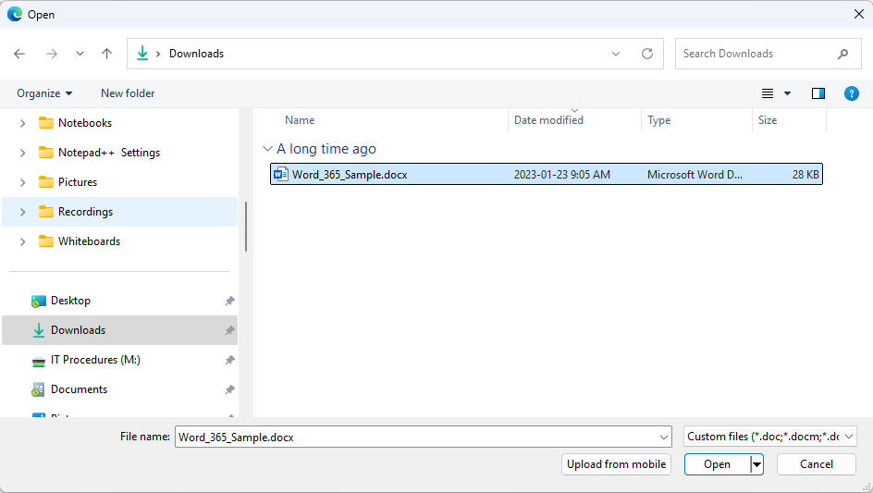
Parts of Word 365 – Uploading an Existing Document
Browse to where you have the sample document saved, possibly the downloads folder.
Slide

Slide 10
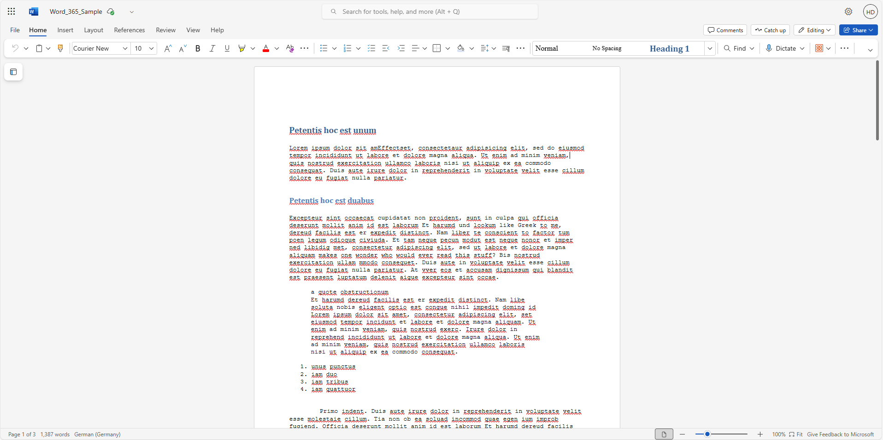
Parts of Word 365
Save the file & check the version number.
The Ribbon (simplified)
To restore the classic ribbon click here.
Document area
Status Bar
Slide

Slide 11
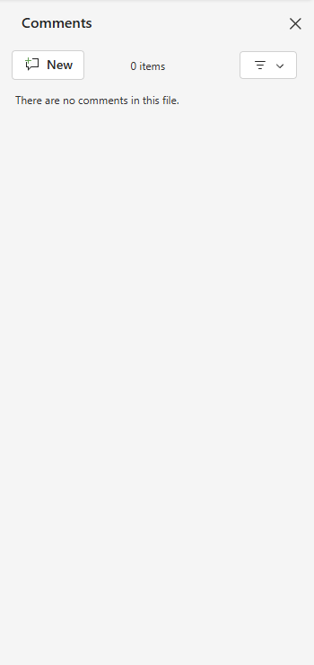
Parts of Word 365
Comments – Lists all the comments in your document for you to create new, edit or delete.
Slide

Slide 12
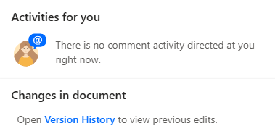
Parts of Word 365
Catch Up – A feature that helps you stay up-to-date with those working with you on your document.
They can work on your document at the same time as you do, a feature of working online.
It notifies you of any new comment activity directed at you and allows you to quickly follow up with your collaborators.
Slide

Slide 13
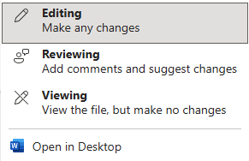
Parts of Word 365
Editing – Sets the state of the document.
Editing – It is by default set in the Editing mode
Reviewing – Sets the document in the Reviewer mode for you to review it.
Viewing – Sets the document for viewing only, no changes can be made.
Open in Desktop – Will open the document in your local installation of Word.
Slide

Slide 14
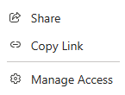
Parts of Word 365
Share – Allows you to share your document with others.
Copy Link – Copy the document link into your clipboard for you to paste elsewhere.
Manage Access – Set the level of access to the document the individuals to whom you allow access to your document.
Slide

Slide 15
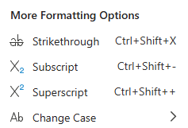
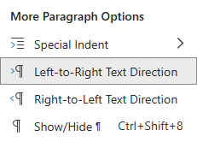
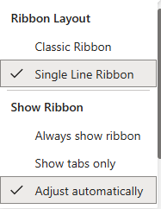
Parts of Word 365 – Home Ribbon
The Home ribbon focuses mostly on character and paragraph level formatting.
  Styles
  Search
  Speak your document to Word, transcribe.
  Add an add-in for greater functionality.
  Character formatting
  Paragraph formatting
  Launch the add-ins you added.
Undo, Redo and Format Painter commands
Classic Ribbon
Slide

Slide 16

Parts of Word 365 – Insert Ribbon
The Insert ribbon focuses on adding an object to your document.
  Insert a video.
  Insert a bookmark.
  Insert a table of contents.
  Insert an hyperlink.
  Insert an image.
  Draw your own image.
  Insert a table by:
  selecting number of cells in the row & column.
  typing the number of rows & columns.
Inserts a page break only, no other options. Section breaks do not exist in Word 365.
Slide

Slide 17
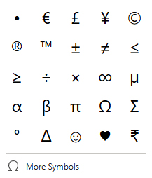
Parts of Word 365 – Insert Ribbon
The Insert ribbon focuses on adding an object to your document.
Emojis are always fun to insert.
  Add a new comment placed at the cursor.
  Insert a header or footer
  Add a page number.
  Insert your own personal equation.
  Insert a page number in a variety of formats.
  Insert a symbol.
Slide

Slide 18

Parts of Word 365 – Layout Ribbon
The Layout ribbon focuses on shaping the text on the page.
  Change the page background colour for the entire document.
  Unfortunately, an image or text cannot be set as the background in the online version of Word.
  Format the paragraphs margins.
Use these settings to shape the text on the paper.
Note that Section breaks are not available for the online version of Word.
Slide

Slide 19
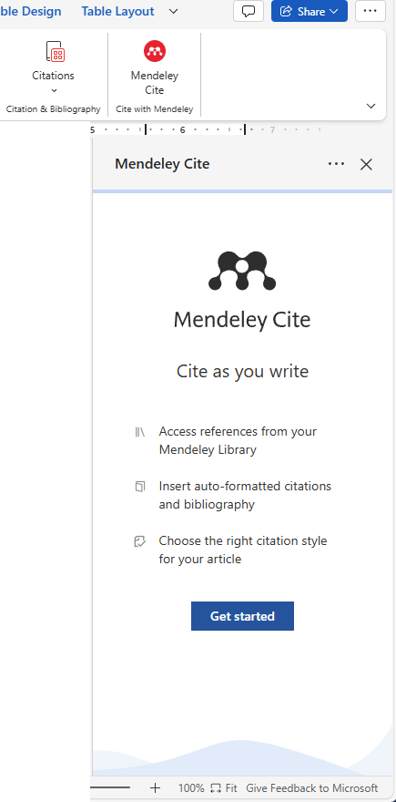

Parts of Word 365 – Layout Ribbon
The References ribbon focuses on Table of Contents, Footnotes and Endnotes.
  Add a citation from an add-in.
  If no citation add-in is installed, you will be presented with a list of available citation add-ins.
  Choose one to install, then it will be available to provide citations from the ribbon with its’ own icon.
  Insert footnotes to the page or endnotes at the end of the document.
Insert, update, or remove a Table of Contents.
Slide

Slide 20
Parts of Word 365 – Review Ribbon
The Review ribbon focuses on fixing the issues with your document.
  All things to do with comments. Usually it is the reviewer of your document that adds comments.
  Translate your document to another language.
  Check Accessibility displays the Accessibility Assistant panel on the right side which checks for Errors, offers Tips, shows Warnings, and offers Intelligent Services, which is created with the Co-Pilot AI to generate the Alt text.
  Alt text is most often used in readers for visually impaired people to describe typically, but not exclusive, images and more.
Initiate the Spelling & Grammar check, however the spelling and grammar is also checked while you are creating the document.
Slide

Slide 21
Parts of Word 365 – Review Ribbon
The Review ribbon focuses on fixing the issues with your document.
  Filter - The Filter command is used to display or hide specific types of markup, such as comments, tracked changes, or formatting changes. The filter allows you to selectively view revisions and comments, making it easier to manage the document for review and collaboration.
  Markup View – Set to either Simple Markup or All Markup.
  Track Changes – Toggle on/off. Turn this on before you review someone’s document. If your document was review by someone else then this option should already be set when you open your reviewed document.
  Accept and Reject – Specifically for your reviewed document. Do you accept the change?
  Previous and Next – Cycles back and forth between changes.
  Mark all the changes made by the reviewer of your document to marked as read.
Slide

Slide 22
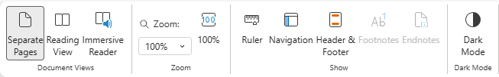
Parts of Word 365 – View Ribbon
The View ribbon focuses on fixing the issues with your document.
  Dark Mode can be easier on the eyes.
  Select the Ruler to enable it. We will be using later in the course.
  Show – Display the ruler, a nav panel on the left side, header & footers, footnotes and endnotes.
  Zoom the text on the screen only. This setting does not affect the printed page.
Change how you view your document. This make no change to the document itself.
Separate Pages – One page at a time one above the other, the default setting.
Reading View – Presents two pages together like an open book.
Immersive Read – The Immersive Reader is a tool designed to enhance reading and
comprehension by customizing the display of text and providing various
assistive features.
Immersive reading allows users to adjust text size, spacing, fonts, and background colors.
Adjusting these properties helps to improve readability and reduce visual distractions.
It also offers text-to-speech functionality, syllable breakdown, parts-of-speech highlighting, and picture dictionaries for enhanced understanding.
Slide
22
Slide

Slide 23
Parts of Word 365 – Status bar
In Word 365 online, the status bar displays information like page number, word count, and other document details. The status bar itself isn't customizable to add or remove items directly.
  The word count.
  The Language.
  Toggles your document to one long page or back to the page size that was set to previously.
  Zoom to a specific size.
  Enlarge the text 100% page width.
Maximize the document area to fit the width of the Word document area.
  Give Feedback to Microsoft – Have something to say?
Slide

Slide 24
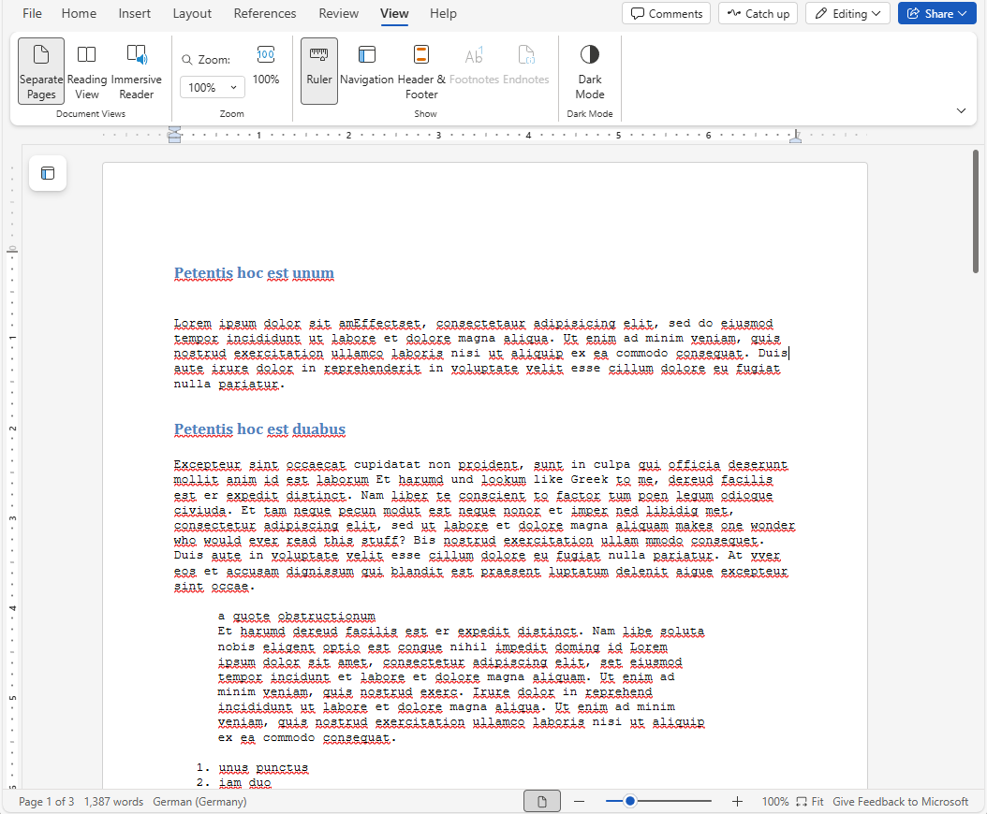
Navigation & Selection - Keyboard
Navigation and selection of text and objects in Word by keyboard & mouse.
Keyboard Shortcuts
Ctrl-Home (top of document)
Home
(beginning of line)
End
(end of line)
Page-Up
(up # of visual lines)
Page-Down
(down # visual lines)
Ctrl-Page-Up
(beginning previous
paragraph)
Ctrl-Page-Down
(beginning of next
paragraph)
Ctrl-End (end of document)
Slide

Slide 25
Navigation & Selection - Keyboard
Navigation and selection of text and objects in Word by keyboard & mouse.
Keyboard Shortcuts
Right Arrow – right one character
Left Arrow – left one character
Up Arrow – up one row
Down Arrow – down one row
Slide

Slide 26
Navigation & Selection - Keyboard
Navigation and selection of text and objects in Word by keyboard & mouse.
Keyboard Shortcuts
Ctrl - Right Arrow – to beginning of next word
Ctrl - Left Arrow – to beginning of previous
word
Up Arrow – to top of previous paragraph
Down Arrow – to top of next paragraph
Slide

Slide 27
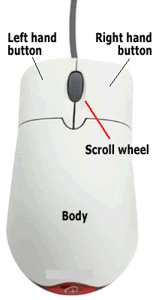
Navigation & Selection - Mouse
Select Contiguous Text Block (Option One):
Place mouse pointer at beginning of text you wish to select
Hold down the left mouse button
Drag the mouse pointer to the end of the desired text
Release the left mouse button
Select Contiguous Text Block (Option Two):
Click once at the beginning of the text you wish to select to place the cursor there
Scroll down to the end of the text you want to select using the mouse scroll button or the appropriate scroll bar but do not move the cursor
Hold down the Shift button and then click at the end of the text you wish to select
Select Non-contiguous Text Blocks
Select the first block of text just like Option One
Now to continue to select non-contiguous blocks of text to add to your selection
  Hold down the Ctrl button and then drag the mouse pointer to the end of the desired text
Keep repeating the previous step for each block of non-contiguous text you want
Slide

Slide 28
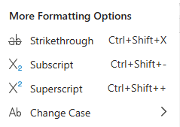
Formatting – Home Ribbon
The Home tab contains formatting options
You can apply the formatting to either the selected text, or if no text is selected, then that formatting will be applied to any new text you type.
The Font commands are where many of the options are located for formatting the text.
For more formatting options are in the More Formatting Options, clicking on the ellipsis.
From the left, these three icons are:
Undo/Redo
Options: Cut, copy, paste, paste text only, and paste with merge formatting
Format painter
Slide

Slide 29
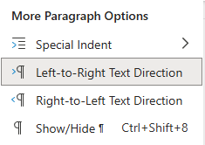
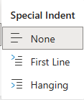
Formatting – Home Ribbon
The Home tab contains formatting options
The Paragraph menu is where more options are available.
For more paragraph options launch the More Paragraph Options menu by clicking on the ellipsis.
Slide

Slide 30
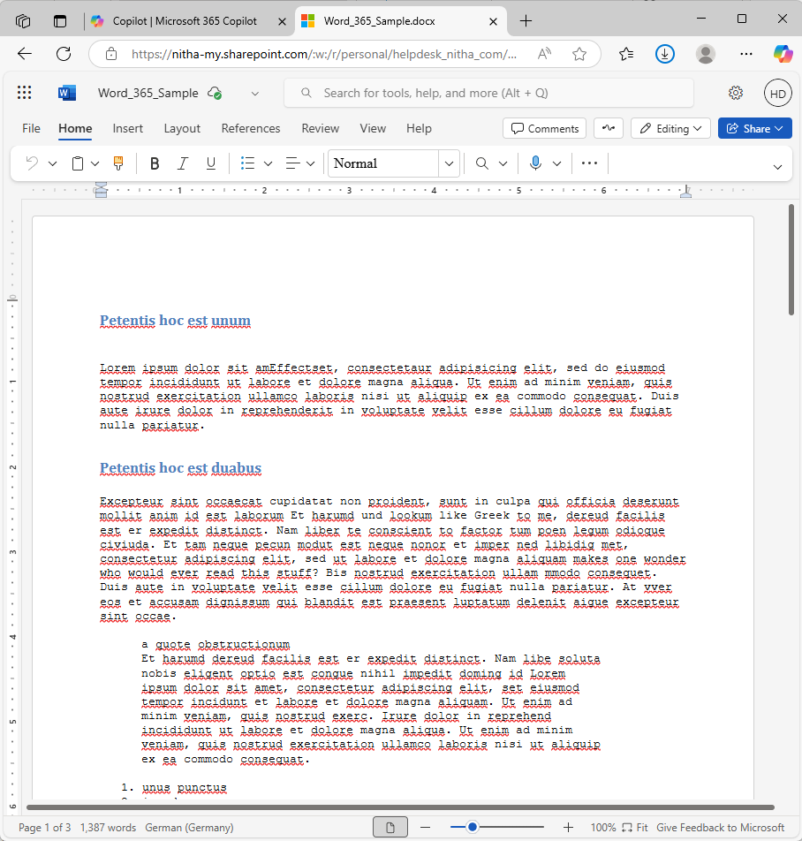
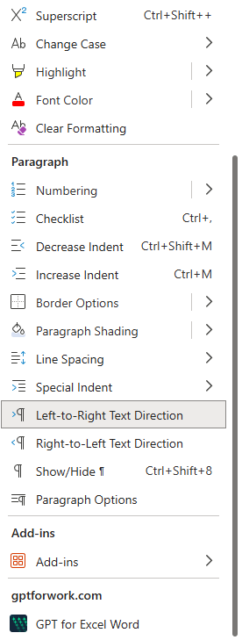
Formatting – Home Ribbon
This ellipsis opens a the Styles menu.
Character level formatting.
Paragraph level formatting.
Add some Add-ins to your document to add functionality.
GPT Chat AI bot is an excellent way to get content, formatting options. Talk to it with regular speech.
Slide

Slide 31
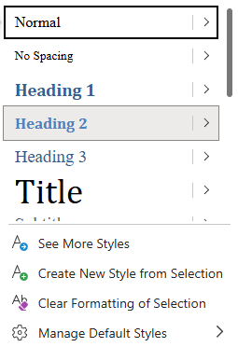
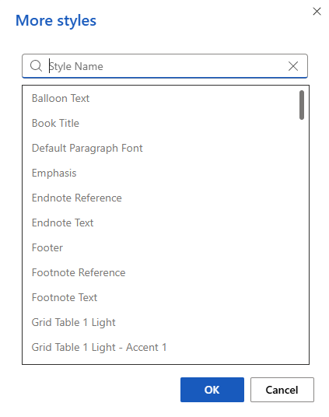
Formatting – Home Ribbon
The Styles group contains pre-made styles you can apply to selected text or a paragraph.
If you do not find the style you want in the list, check the See More Styles link.
The Styles menu launcher shows a menu on which you can choose to:
See more styles
Choose options such as Show Preview and Disable Linked Styles
Create a New Style
Inspect style (applies to selected style)
Manage Style (applies to selected style)
More Options
Slide

Slide 32
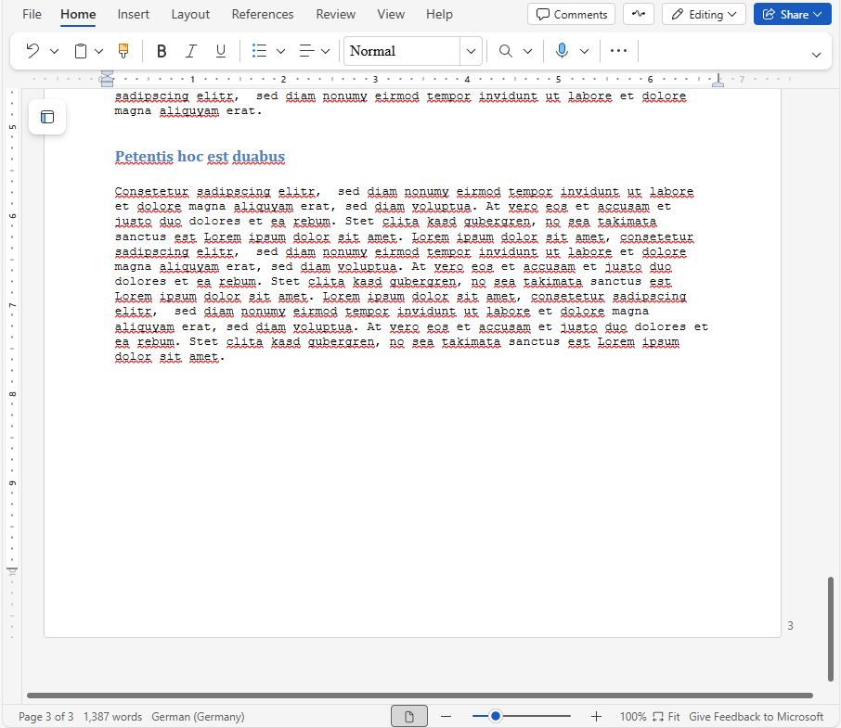
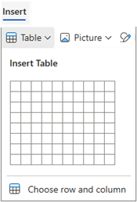
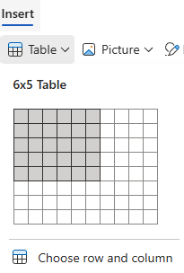
Working with Tables – Insert Ribbon
Click on the Table menu from the Insert ribbon.
There are two methods for creating a table by
Dragging your mouse over the table in the menu.
Choosing row and column.
Place the cursor where you want the table to be placed in the document.
Slide

Slide 33
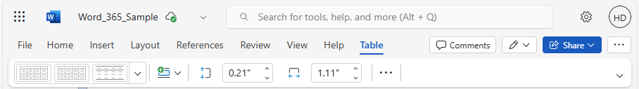
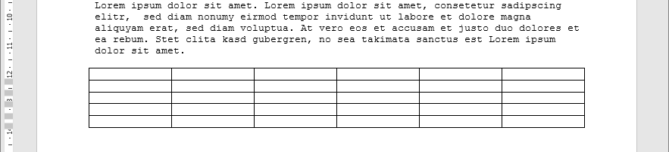
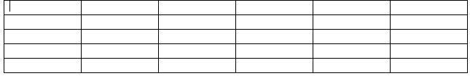
Working with Tables – Table Ribbon
When it comes to working with Word tables, they do not work entirely the same as Excel tables.
After inserting the table using the method you prefer, select the Table ribbon.
The table ribbon will only appear if you have the cursor in the table.
Slide

Slide 34
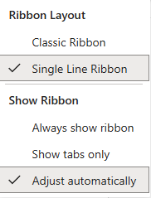
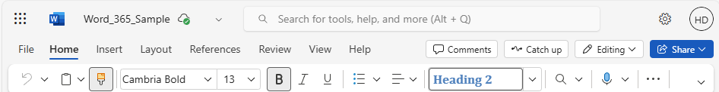
Working with Tables – Table Ribbon
First, choose to make the ribbon into the Classic ribbon so we can easily see all the commands.
Second, select the Classic Ribbon.
Slide

Slide 35
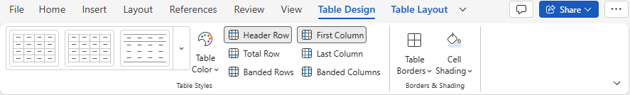
Working with Tables – Ribbon Commands
This is the full Classic Table Design Ribbon.
Select your favorite color set.
Table Borders – Set each individual border to a style from a variety of line styles and colors.
Cell Shading – Changes the background color of the selected cell(s).
Pre-set table styles.
Choose the style of your preference.
A “banded” row or column is where alternating columns are shaded with a different color or style to improve readability.
Slide

Slide 36
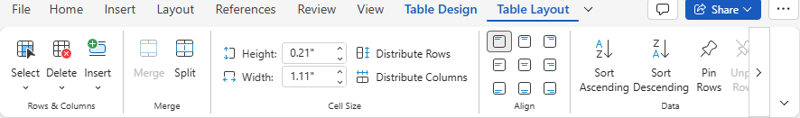
Working with Tables – Ribbon Commands
This is the full Classic Table Design Ribbon.
Merge or split cells.
Adjust the size of the cells.
Align the contents of the cell(s).
Sort the rows and/or columns
Working with the rows & columns by selecting, inserting and deleting rows and columns.
Slide

Slide 37
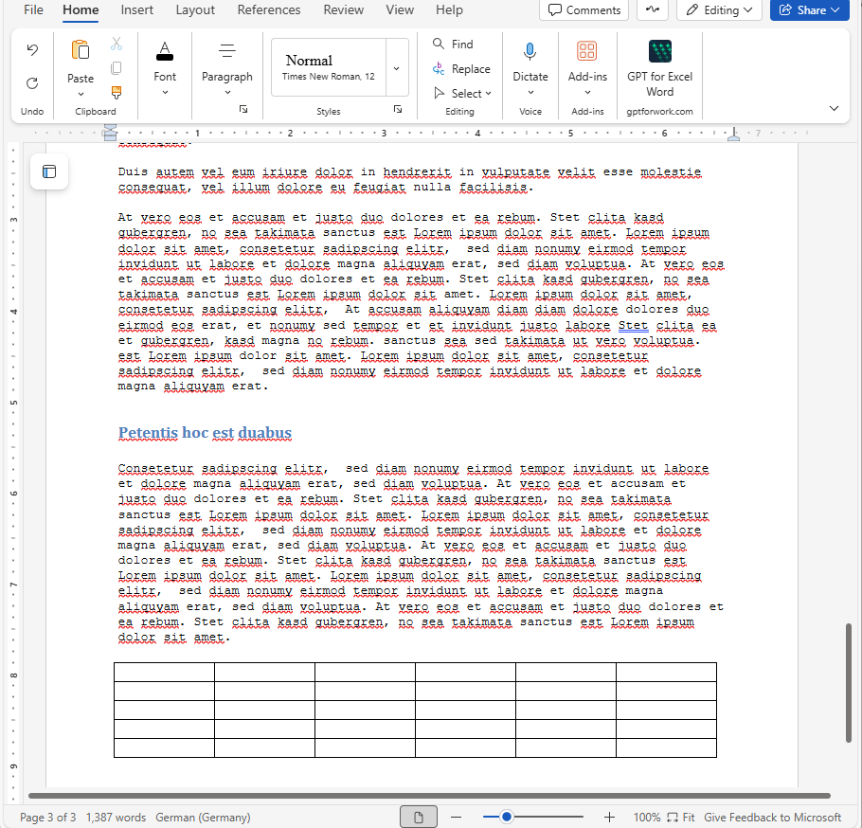
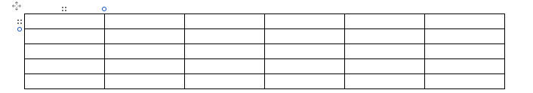
Working with Tables – Ribbon Commands
Working with tables in Word is a bit different than working with tables in Excel.
When navigating cells using the keyboard. The arrow key work best, but the TAB SHIFT/TAB key works the same as in Excel, but the ENTER key does not work the same as in Excel.
When mousing over the table icons will appear:
over the column – select column
top left corner – select table
beside the row – select row
beside the row/column line –
Add a new row or column
Slide

Slide 38
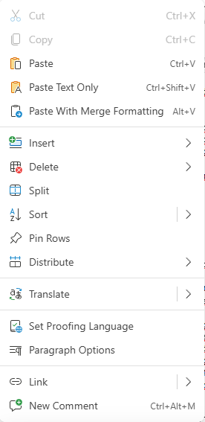
Working with Tables – Ribbon Commands
Table Right-Click Menu
Standard Copy, Cut, & Paste
Paste with Merge Formatting
Insert, Delete row(s) and/or column(s)
Split cell the cursor is in
Sort ascending or descending
Pinning a row is to freezing the row from scrolling off the screen when you scroll up or down on the table.
This is used mostly for the top row that typically has the names of the columns in them.
Slide

Slide 39
Working with Tables – Ribbon Commands
Table Right-Click Menu
Distribute will make the selected cells, either across row or column equal width. You can only do the row or column at one time.
Translate selected text to another language.
Set Proofing Language allows you to change the language for proofing and review purposes.
Slide

Slide 40
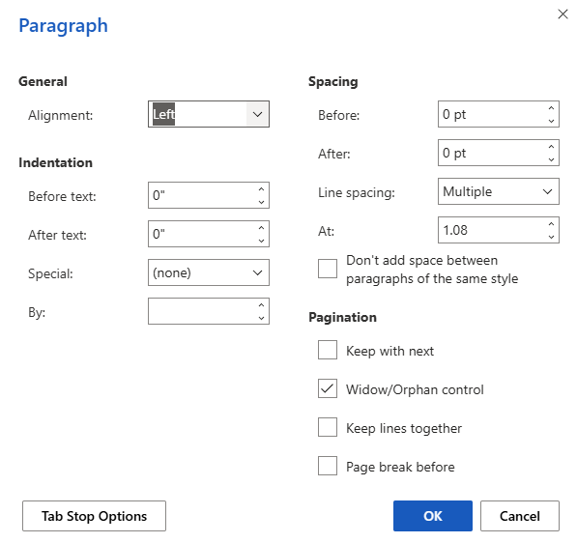
Working with Tables – Ribbon Commands
Table Right-Click Menu
Paragraph Options displays a dialog in which you can adjust the alignment, indentation, spacing, pagination, tab stops and more.
Slide

Slide 41
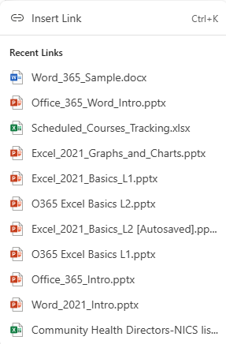
Working with Tables – Ribbon Commands
Insert Link
This displays the standard Insert Hyperlink dialog.
Table Right-Click Menu
Previous Added Links
Select from previously made links.
Slide

Slide 42
Working with Tables – Ribbon Commands
Table Right-Click Menu
New Comment
Add a new comment at the cursor location.
Slide

Slide 43


NITHA IT Helpdesk
helpdesk@nitha.com
1(306)953-5008
Notes:
Please do not hesitate to ask any question regarding this session, and I will make sure to answer your question as soon as possible.

Slide 44


