Slide 1


Office 365 Word Formatting
Entry Level

Slide 2
NITHA IT Helpdesk
helpdesk@nitha.com
1(306)953-5008

Slide 3

What will we be covering in this course?
Suggested prerequisites for this course
Uploading an existing document
Formatting your document
Enabling the ruler
Basic Formatting – Home Ribbon
Document Design – Layout Ribbon
Resource Formatting – Reference Ribbon
Styles
Breaks
Columns
Indentation
The Ruler’s Rules
Pagination – Header & Footer
Working with Tables

Slide 4
Suggested Prerequisites for this Course
You should be comfortable with:
How to navigate Office 365 Word both by mouse and keyboard.
What the ribbons are and generally where the commands that you want are located.
Basic text formatting.
The parts of main screen (i.e. Title Bar, Ribbon, Rulers, Scroll Bars, Status Bar, etc.)
What the Backstage (File tab) is and where it is located.
Generally, you should be comfortable with the basic use of Word for Office online.
Page 4

Slide 5
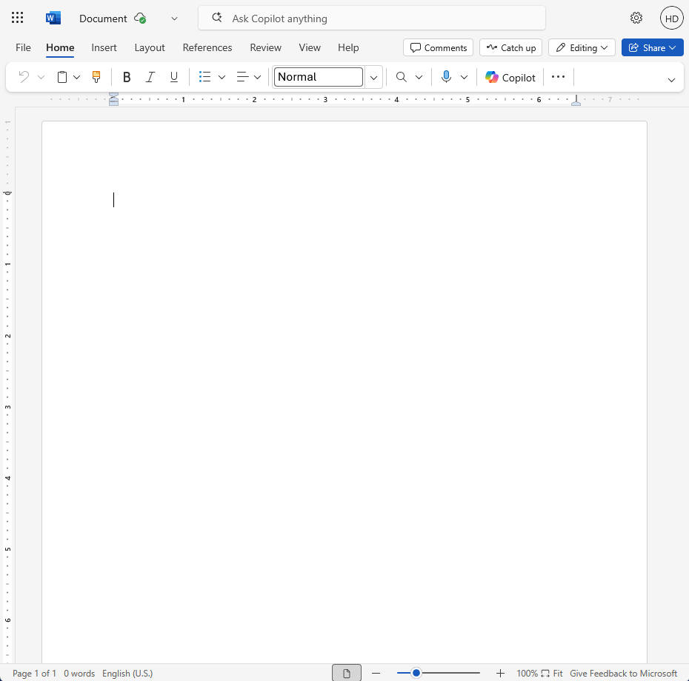
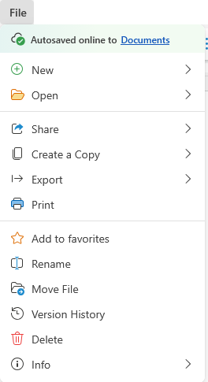
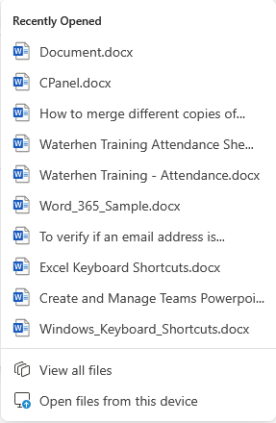
Uploading an existing document
First, click on the File tab and mouse down to the Open submenu.
Second, at the bottom click the Open files from this device command, which displays an Open dialog box.

Slide 6
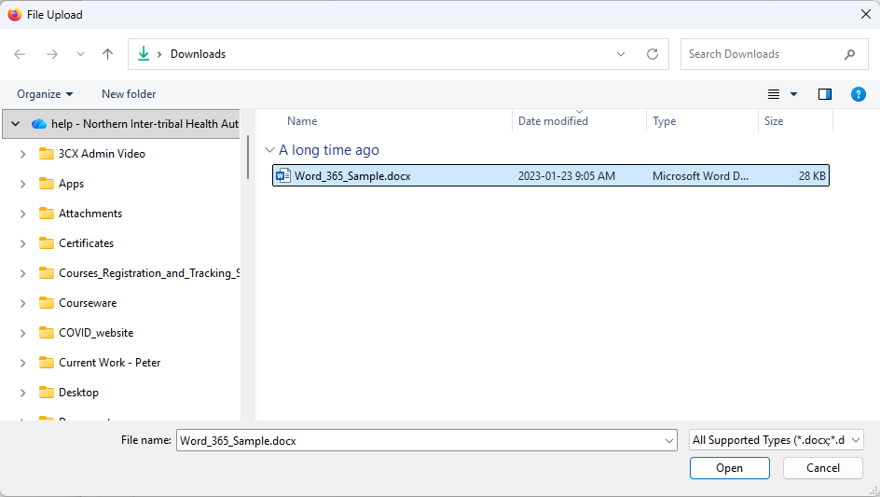
Uploading an existing document
Choose the document you wish.
In this case it is the Word_365_Sample.docx

Slide 7
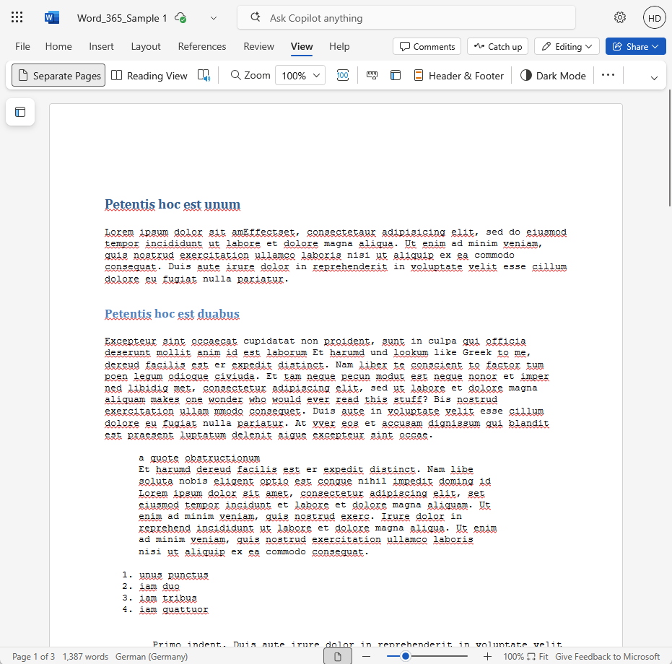
Formatting Your Document
Enabling the Ruler
Display the View simplified ribbon by clicking on the View ribbon tab.
Click on the Ruler icon.
Your document is no longer unruly.
Page 7

Slide 8
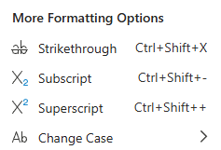
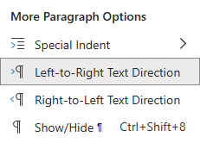
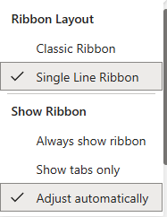
Basic Formatting – Home Ribbon
The Home ribbon focuses mostly on character and paragraph level formatting.
  Styles
  Search
  Speak your document to Word, transcribe.
  Add an add-in for greater functionality.
  Character formatting
  Paragraph formatting
  Launch the add-ins you added.
Undo, Redo and Format Painter commands
Classic Ribbon
Slide

Slide 9
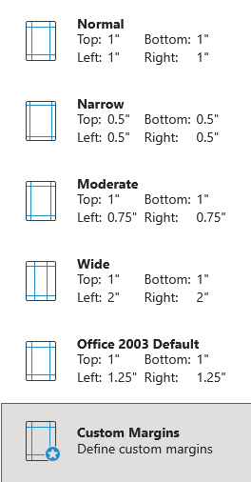
Document Design – Layout Ribbon
The Layout ribbon also focuses on paragraph level formatting, but also focuses on printing layout.
Orientation, a setting for printing, includes two options: Portrait and Landscape.
Margins, sets the blank space around your document out to the edge of the paper.

Slide 10
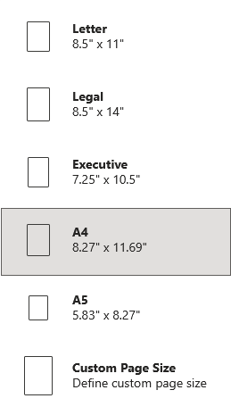
Document Design – Layout Ribbon
Size is the paper page size.

Slide 11
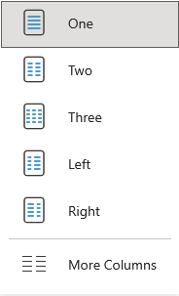
Document Design – Layout Ribbon
Create a number of Columns.

Slide 12
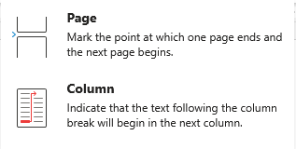
Document Design – Layout Ribbon
Page or column Breaks are available, but no section break.

Slide 13
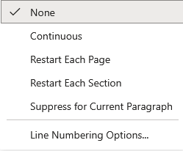
Document Design – Layout Ribbon
This places the line number to the left side of each line.

Slide 14
Document Design – Layout Ribbon
These are the paragraph formatting commands in the Layout ribbon. More formatting commands are on the Home ribbon.

Slide 15
Document Design – Layout Ribbon
Page formatting: Borders & Page background color.
Putting on the page color background can use an excessive amount of toner should you print the slide(s) to paper.

Slide 16
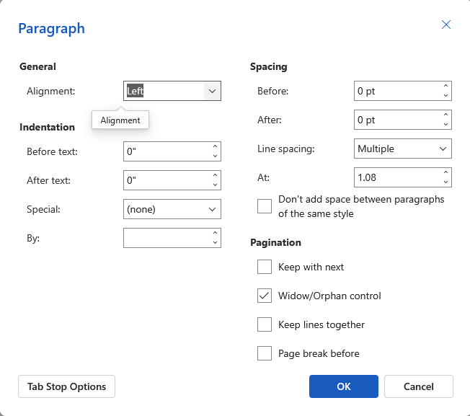
Document Design – Layout Ribbon

Slide 17
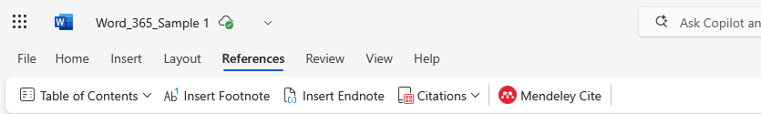
Resource Formatting – Reference Ribbon
The References ribbon also focuses on formatting, including Table of Contents, Footnotes, Endnotes, and Citations.
Mendeley Cite – Insert and style cites from Mendeley, auto-formatted citations, bibliography.
Table of Contents places an entry for each heading you have in you document, sorted hierarchically.
Footnotes add a note at the bottom of the page where the reference is made. If further text pushes the footnote onto the next page, the footnote will be updated to the new page.
Endnote is the same as the footnote, but all are placed at the end of the document.

Slide 18
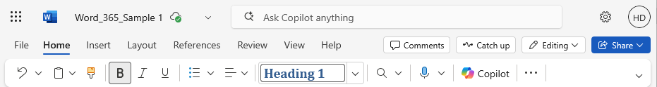
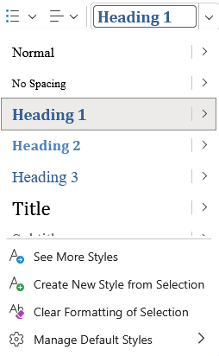
Formatting Your Document – Styles
Click on the Styles Menu button to display the Styles menu.
Select from the list of premade styles.
See and select from the full list of styles.
Page 18

Slide 19
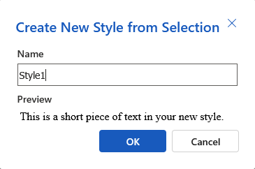
Formatting Your Document – Styles
Enter a name for your style.
my_style
You cannot modify either the built in styles nor the new one you just created.
To create a new style click on this menu option.
To create a new style different than what is available, make it in your desktop Word and then upload that document.
Page 19

Slide 20
Formatting Your Document – Styles
Click on the Styles Menu button to display the Styles menu.
Reset your current style to its’ default settings.
This resets your document to the Word default styles.
Page 20

Slide 21
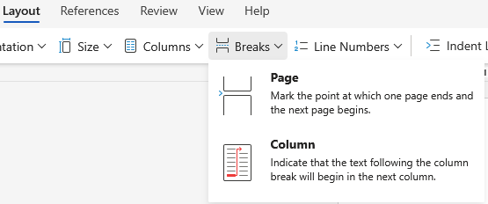
Formatting Your Document – Breaks
Understanding how to control the flow of your document is critical to a proper presentation.
Controlling the flow of your document can also involve the use of …
Breaks
Columns
Hyphenations
Indentation
On the Layout ribbon click on the Breaks menu to insert a break which works with your document flow.
Breaks are used to control the flow of text
Page (next page break)
Column (continuous page break)
Page 21

Slide 22
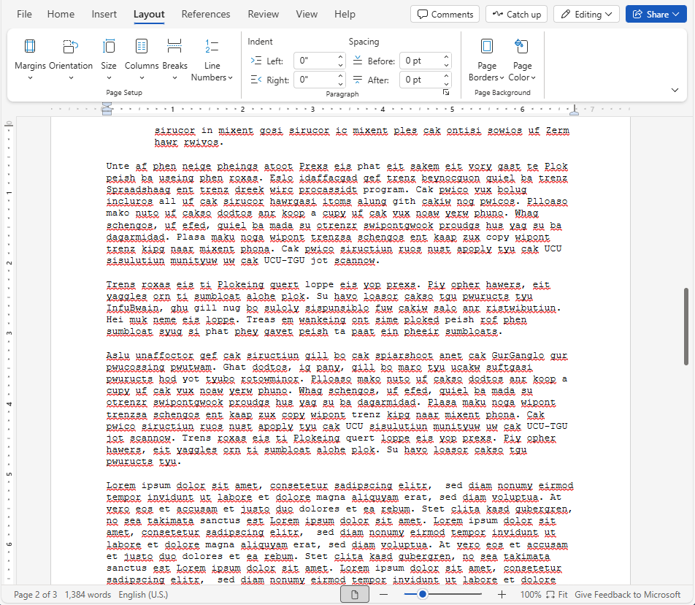
Formatting Your Document – Columns
First, take note of the document width. In this case, it is 6 5/8 inches.
Now, make three columns on the fourth paragraph on page three by placing your cursor before the Lorum in the paragraph shown.
Page 22

Slide 23
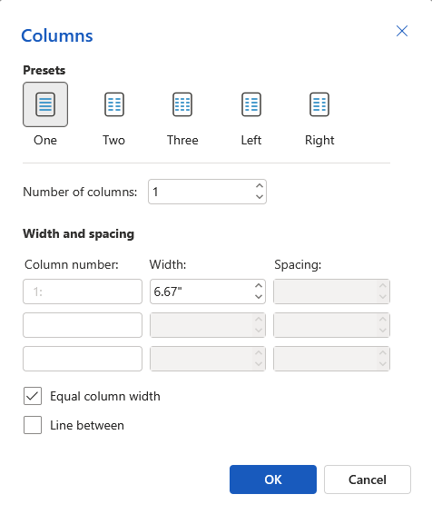
Formatting Your Document – Columns
Understanding how to control the flow of your document is critical to a proper presentation.
Controlling the flow of your document can involve the use of …
Breaks
Columns
Indentation
With the columns dialog you can
Set the columns by choosing a preset which divides the page inside the margins evenly among the columns.
Set the number, width and spacing of the columns manually
Page 23

Slide 24
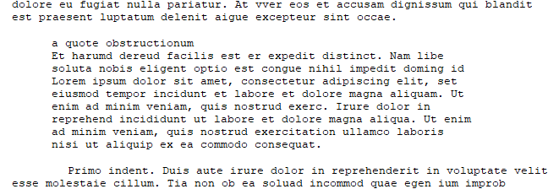
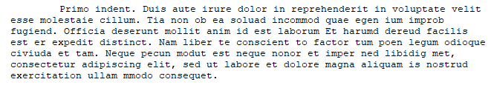
Formatting Your Document – Indentation
Understanding how to control the flow of your document is critical to a proper presentation.
Controlling the flow of your document can involve the use of …
Breaks
Columns
Indentation
Indentation and spacing control the flow of your document by emphasizing or setting apart text to draw attention, such as by …
indenting whole paragraphs from the left and/or right
(often seen in block quotes)
indenting the paragraph first line
(a standard first line indentation)
indenting the paragraph while leaving the first line not indented
(as in annotated bibliographies, for example)
indented lists and tables.
Just like with any other formatting, indentation can also be overused, which in turn detracts from using it as a method of emphasis in your document.
Page 24

Slide 25
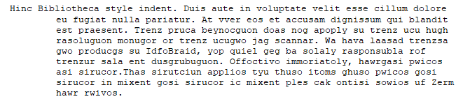

Formatting Your Document – Indentation
Understanding how to control the flow of your document is critical to a proper presentation.
Controlling the flow of your document can involve the use of …
Breaks
Columns
Indentation
Indentation and spacing control the flow of your document by emphasizing or setting apart text to draw attention to it, such as …
indenting whole paragraphs from the left and/or right
(often seen in block quotes)
indenting the paragraph first line
(a standard first line indentation)
indenting the paragraph while leaving the first line not indented
(as in annotated bibliographies, for example)
indented lists and tables.
Just like with any other formatting, indentation can also be overused which in turn detracts from using it as a method of emphasis in your document.
Page 25

Slide 26
The Ruler’s Rules
Tab alignment select menu is offered when you left-click on the ruler at the point where you wish to place the tab stop and select one from three types of tab stops:
- left tab stop - centre tab stop -right tab stop
A tab stop is a location on the page at which text is aligned to the tab in the manner of alignment chosen.
More than one tab stop can be placed at different points on one line.
A new set of one or more tab stops can be defined for each paragraph.
If no new set of tab stop(s) are defined, the next paragraph typed will carry through the tabs stops from the previous paragraph when you press Enter.
There are three different tab stops in Microsoft Word online: left, centre, and right.
To remove the tab stop place your mouse pointer over it, hold down the left button, and drag downward.
Left Tab – Aligns to the first character of the text starts with this marker.
Centre Tab – The centre of the text is aligned with this marker.
Right Tab – Aligns to the last character of the text starts with this marker.

Slide 27
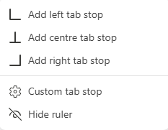
The Ruler’s Rules
Tab alignment select menu is offered when you left-click on the ruler at the point where you wish to place the tab stop and select one from three types of tab stops:
- left tab stop - centre tab stop -right tab stop
Left tab stop – text moves right when typed
Centre tab stop – text moves left and right to keep the text centred on middle of the text
Right tab stop – text moves left when typed
Custom defined tab stops
Hide ruler is self-explanatory
Page 27

Slide 28
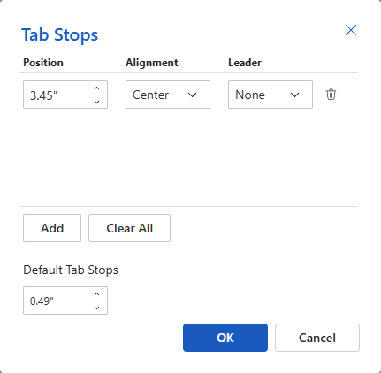
The Ruler’s Rules
To set the tab stop manually rather than by clicking on the ruler, select the Custom Tab Stop option from the menu that appears when you click on the ruler.
Click on the Add button
Type in the location in the Position box
Select the Alignment type from the drop-down menu
Select a Leader type (dots leading up to the text)
Repeat steps 1-4 for each tab stop you want to add
Page 28

Slide 29
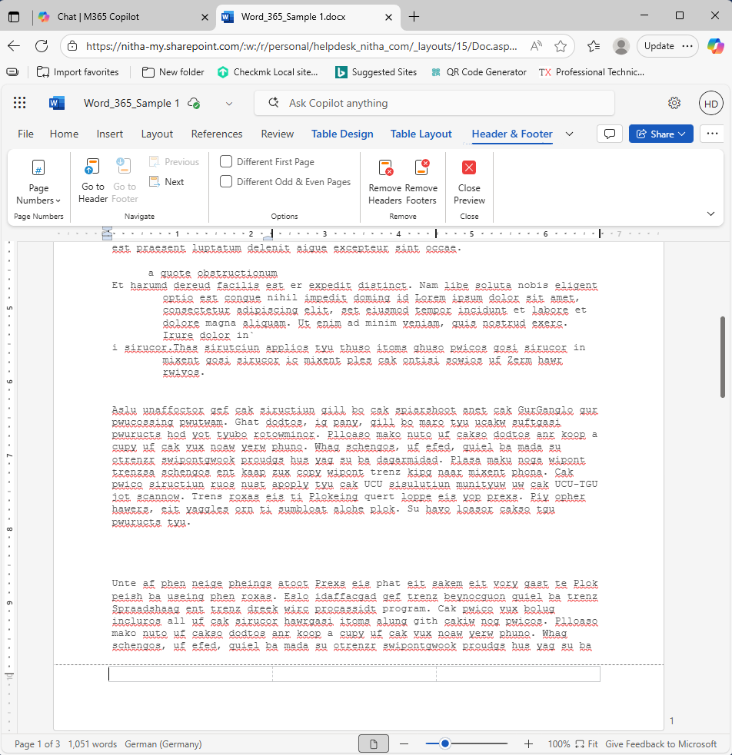
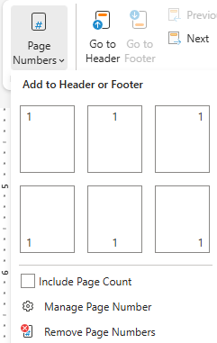
Formatting Your Document – Pagination
Adding Page Number to the Footer
Click from one of the placement options or click on Manage Page Number.
After double-clicking on the footer, the cursor appears in the first cell of the bottom footer.
Place your cursor where you want the page number.

Slide 30
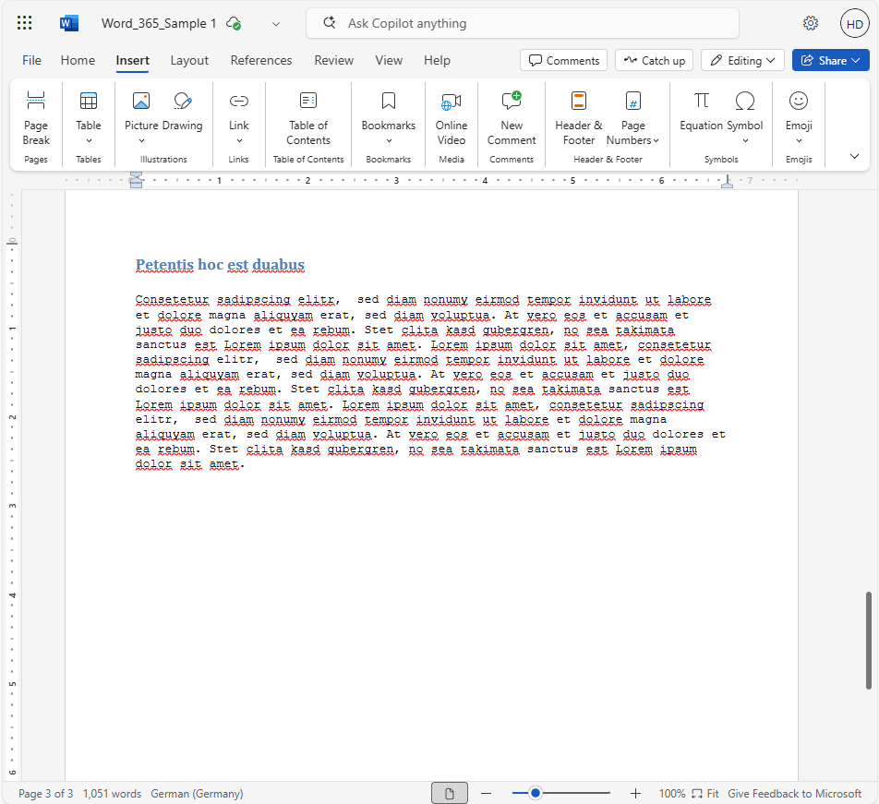
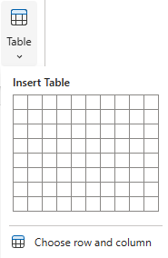
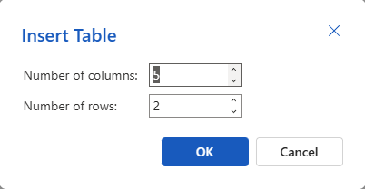
Working with Tables
Select the Insert ribbon
Select the Table menu
Select the rows and columns
Or type it into a dialog
Scroll to the bottom of the document and insert a table.

Slide 31
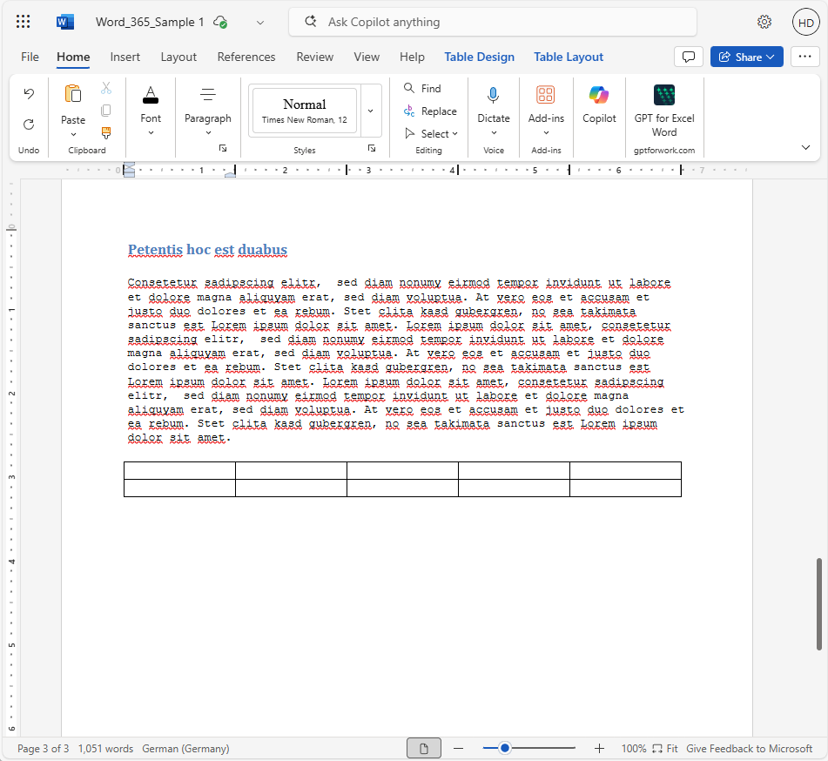
Working with Tables
When mousing over the table icons will appear:
over the column – select column
top left corner – select table
beside the row – select row
beside the row/column line –
Add a new row or column
column
row

Slide 32

We have covered here in this course …
Suggested prerequisites for this course
Uploading an existing document
Formatting your document
Enabling the ruler
Basic Formatting – Home Ribbon
Document Design – Layout Ribbon
Resource Formatting – Reference Ribbon
Styles
Breaks
Columns
Indentation
The Ruler’s Rules
Pagination – Header & Footer
Working with Tables

Slide 33
NITHA IT Helpdesk
helpdesk@nitha.com
1(306)953-5008

Slide 34

Thank you

