Slide 1


Office 365 Excel Graphs & Charts
Intermediate Level

Slide 2
NITHA IT Helpdesk
helpdesk@nitha.com
1(306)953-5008

Slide 3

What will we be covering in this course?
What is our direction in this course?
Choosing the Data You Present
Upload a Workbook
Making a Column/Bar Chart
Parts of the Chart
Making a Pie Chart
Context Ribbons - Design
Making a Doughnut Chart
Context Ribbons - Format
Tips for Formatting Your Chart

Slide 4
What is our direction in this course?
Assumption 1:
I will assume you have a basic knowledge of Excel: navigation, screen layout, etc.
Assumption 2:
You must know the following:
  What are ribbons both regular and contextual.
  What are spreadsheets, how to navigate them, and how do you create more of them.
What is a dialog box and what is a window pane.
Our goal is to work with the data so that it is represented in a chart in a meaningful way.
To accomplish our goal we will have to:
Know what we want to represent with the data.
Learn the tools to restrict and present the data so it represents what we need it to.
Tools such as:
Filter
A filter presents an arrow in the column header that lets you allow or restrict what rows you display based on the data you filter from that column.
Sort
You can sort ascending or descending, top to bottom or left to right, using one or more columns by value, cell color, font color, or cell icon.
Subtotal
Group together rows by subtotalling cells in a column using a specific function.
Group
Bind selected rows or columns together so they can be collapsed or expanded.

Slide 5
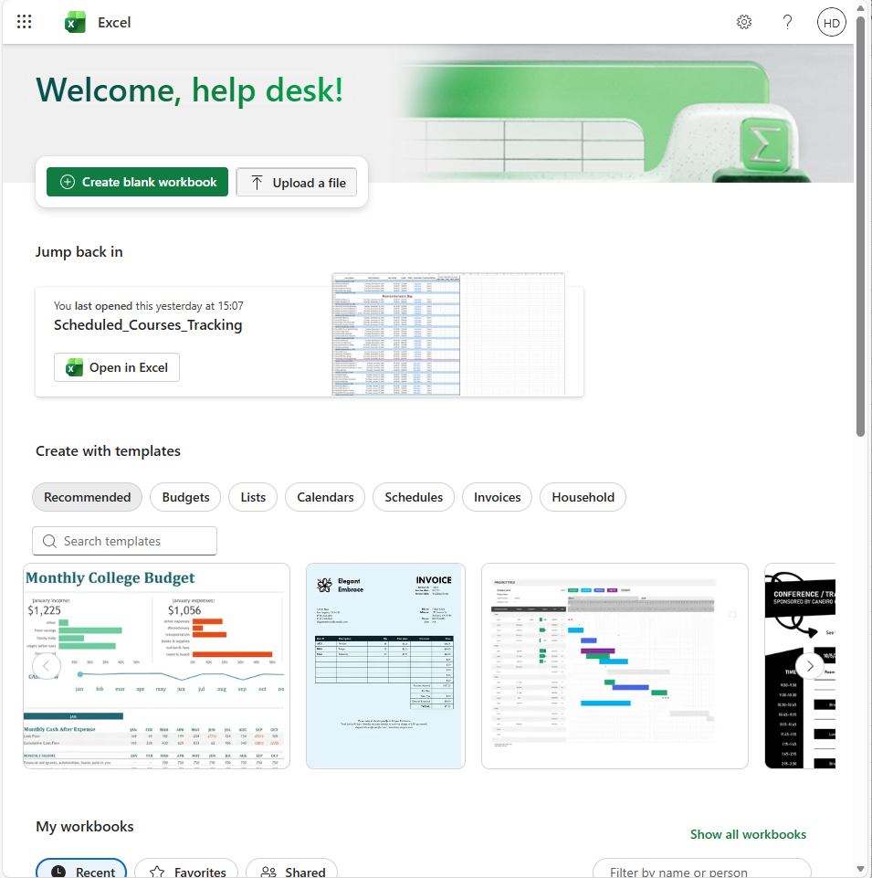
Upload a Workbook
Keep in mind that some of the features might be disabled, such as any macros, for instance.
Office Excel online does not support VBA macros, so if the workbook you are uploading has macros, they will be disabled once your workbook is uploaded to Excel online.
There is support for Python scripts, but macros are created in VBA (Visual Basic for Applications) and VBA is not supported in any Office online app.
You can upload a workbook you created in Excel installed on your PC.
You can select a workbook you opened recently.
You can select an existing template.
When you click to Upload a file, a dialog box is displayed for you to select a file.

Slide 6
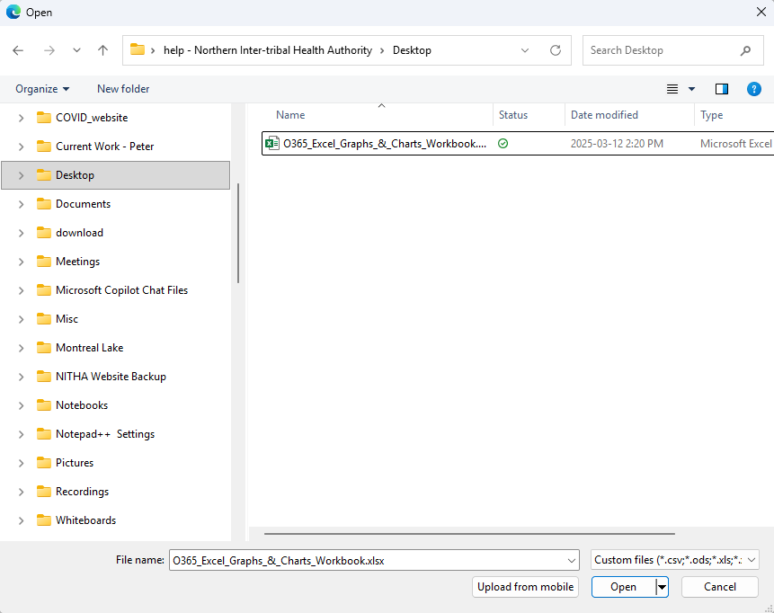
Upload a Workbook
You can upload a workbook you created in Excel on your PC.
Select the file & click on open.

Slide 7
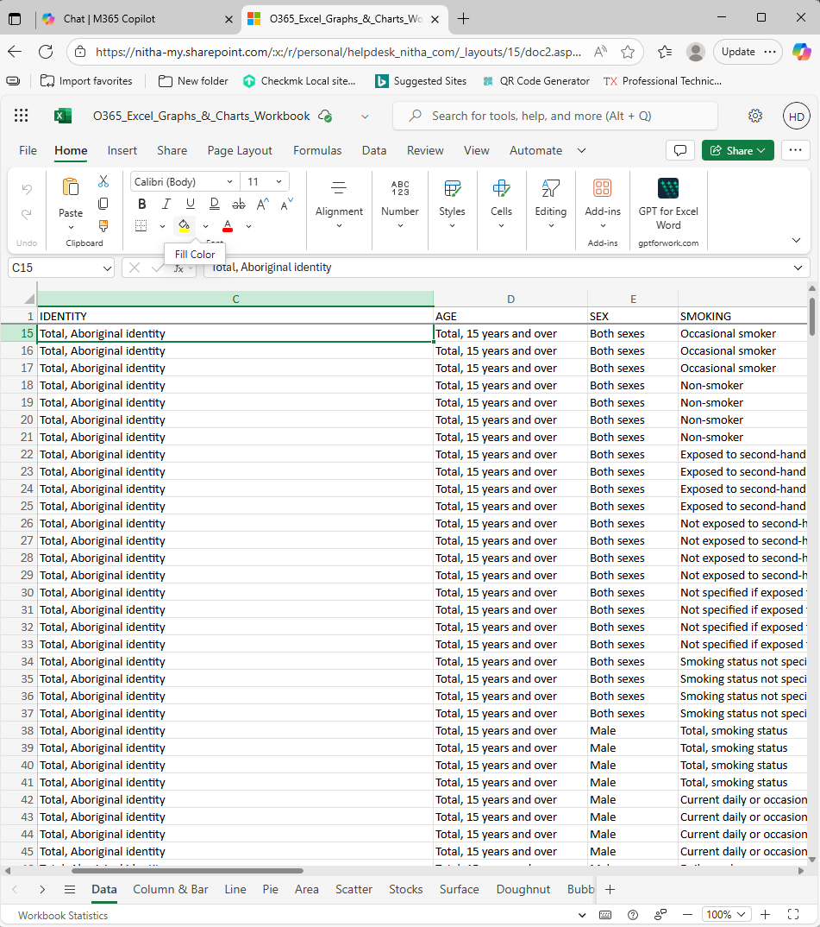
The Loaded Workbook

Slide 8
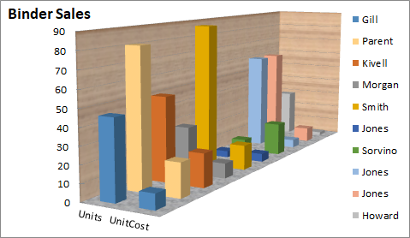
Parts of the Chart
Data Markers (or Data Points) - Symbols, in this case bars, on the chart that represent individual values from the data table.
Data Series - A group of related values. In this example, there are only two in each series; one under Units and the other under UnitCost.
Title – Chart Title.
Chart Wall
Plot Area – a graphical representation of the data selected.
Chart Area – Where the plot, axes, legend and title reside.
Vertical Axis (y-axis) - serves as a reference for plotting data.
Legend - Shows the data series name corresponding to each data marker.
Horizontal Axis (x-axis) - serves as a reference for plotting data.
Chart Floor (in 3D charts)

Slide 9
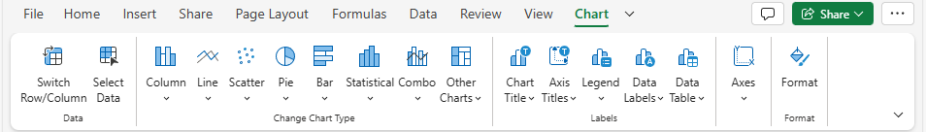
Context Ribbon - Chart
Once your data is selected, choose the chart type that best represents it.
Add a chart element.
The Axes menu provides different visual configurations for displaying X and Y axes.
Gridlines are also included to display in a variety of visual formats.
Switch Row/Column flips the x/y axes.
Select the Data to represent in the chart.

Slide 10
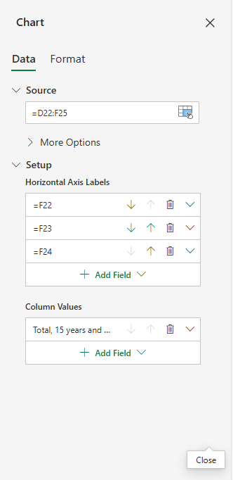
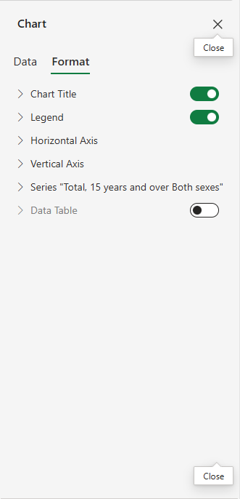
Context Ribbon - Chart
Formatting options for the various chart parts.
Change and/or update data.

Slide 11
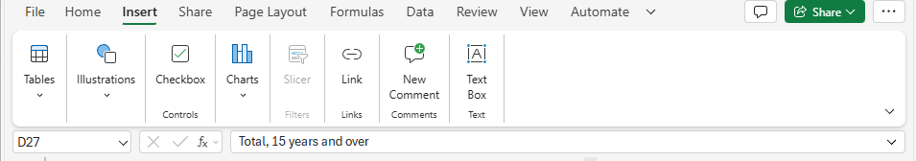
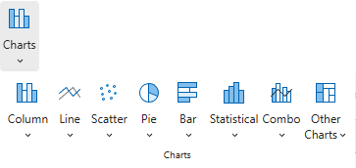

Chart Types
Clustered Column
Stacked Column
100% Stacked Column
Clustered Column
Stacked Column
100% Stacked Column
Column Charts
- Clustered Column - Uses vertical bars to compare values across categories, with subtypes like Clustered and Stacked available.
- Stacked Column - Shows the relationship of individual items to the whole, comparing the
contribution of each value to a total across categories
- 100% Stacked Column - Shows the proportion of each data category as a percentage of the total,
with each column always reaching 100%

Slide 12
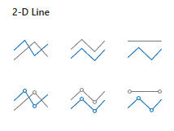
Chart Types
Line Stacked Line 100% Stacked Line
Line with Markers Stacked Line 100% Stacked Line with Markers
with Markers
Line Charts
Line Chart - Illustrates trends in continuous data over time using connected data points.
Stacked Line Chart - Each data series is added on top of the previous one, creating a cumulative effect
100% Stacked Line Chart - Shows the percentage contribution of each data series to the total
Line with Markers - Standard line chart with a distinct marker (like a dot or square) at every data point to make individual values easier to see.
100% Stacked Line with Markers - Shows how the proportion of different data series changes over time, with the added benefit of clearly identifying each individual data point on the lines.

Slide 13

Chart Types
Scatter with Scatter with Smooth Scatter with Scatter with Straight Scatter with
only Markers Lines and Markers Smooth Lines Lines and Markers Straight Lines
Scatter Charts
Scatter with only Markers – Displays individual data points as markers, with no lines connecting them.
Scatter with Smooth Lines and Markers - Each data point is connected to the next in sequence by a straight line, creating a series of linear segments.
Scatter with smooth Lines - Removes the data point markers
Scatter with Straight Lines and Markers - Connects data points with a smooth, curved line.
Scatter with Straight Lines - Same as a "Scatter with straight lines and markers" chart, but the markers themselves may be turned off

Slide 14

Chart Types
Pie & Doughnut Charts
Pie chart - Can only display one series of data. It represents data in percentages and emphasizes significant elements in the data.
Doughnut chart - Has rings, and each ring represents one set of data.

Slide 15

Chart Types
Clustered Bar Stacked Bar 100% Stacked Bar
Bar Chart
- Clustered Bar - Charts are used to show the changes in data over a period of time or to illustrate comparisons.
- Stacked Bar - Shows the relationship of individual items to the whole, with bars for each category stacked on top of each other one another.
- 100% Stacked Bar - Shows the relative percentage of each part of a whole, with each bar representing 100% of the
total.

Slide 16
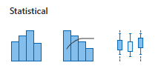
Chart Types
Histogram Pareto Box & Whisper
Statistical Charts
A Histogram shows the distribution of data grouped into bins or categories.
A Pareto chart shows the relative portion of each factor in the total and the most significant factors in the data.
Box & Whisper is used to display the variation of data in the data sets when related multiple data sets are charted.

Slide 17

Chart Types
Clustered Column – Line Column Clustered Stack Area – Column Clustered
Line on Secondary
Axis
Combo Charts
Clustered Column - Line chart is used to highlight different types of data.
- Column Clustered - Line on Secondary Axis chart displays two or more data sets on the same chart, but
with different types and scales
- Stack Area - Column Clustered chart is also used to represent mixed types.

Slide 18
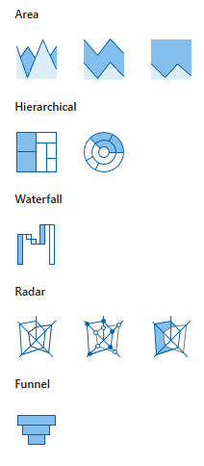
Chart Types
Area Charts
- Area chart - shows changes over time or other categories, with
the area between the axis and the line filled in.
Area Stacked Area 100% Stack Area
- Stacked Area chart - an area chart where multiple series are
stacked on top of each other, so the total
height of the stacked areas represents the
cumulative total.
100% Stack Area chart - A stacked area chart where the y-axis is a
percentage scale from 0% to 100%.

Slide 19
Chart Types
Hierarchical charts
Treemap chart - Displays hierarchical data as a set of nested
rectangles.
Treemap SunBurst
SunBurst chart - A multi-level, circular chart that displays
hierarchical data using concentric rings.

Slide 20
Chart Types
Waterfall Chart
Shows a running total with values added or subtracted, useful
for explaining changes from an initial to a final value.
Waterfall

Slide 21
Chart Types
Radar charts
Radar - Compares the aggregate values of several data series
on multiple axes radiating from a center point.
Filled Radar - Area within the polygon shape created by the
connected data points for each series are filled with a
solid color (often with some transparency if multiple
series overlap).
Radar Filled Radar Radar with Markers
Radar with Markers - Is identical to the standard Radar chart, but
adds visual emphasis to specific data points.

Slide 22
Chart Types
Funnel chart
Funnel chart - Illustrates values across different stages of a
process, typically showing a gradual decrease.
Funnel

Slide 23
Choosing the Data You Present
How to choose the proper data for your chart?
What point are you trying to make?
Choose to present restricted data and choose the chart that best represents the number of data sets.
Choose the chart which best represents the concept you are trying to represent.
  Representing percentages of a single dataset, use a pie chart.
  To present trends over time, use a line chart.
  Want to illustrate comparisons among items, use column or bar chart.
  To display the magnitude of change over time, use an area chart.
  Want to show multiple series of data, each a percentage, use a doughnut chart.
  To show values of two series compared over time or as a category, use a scatter chart.

Slide 24
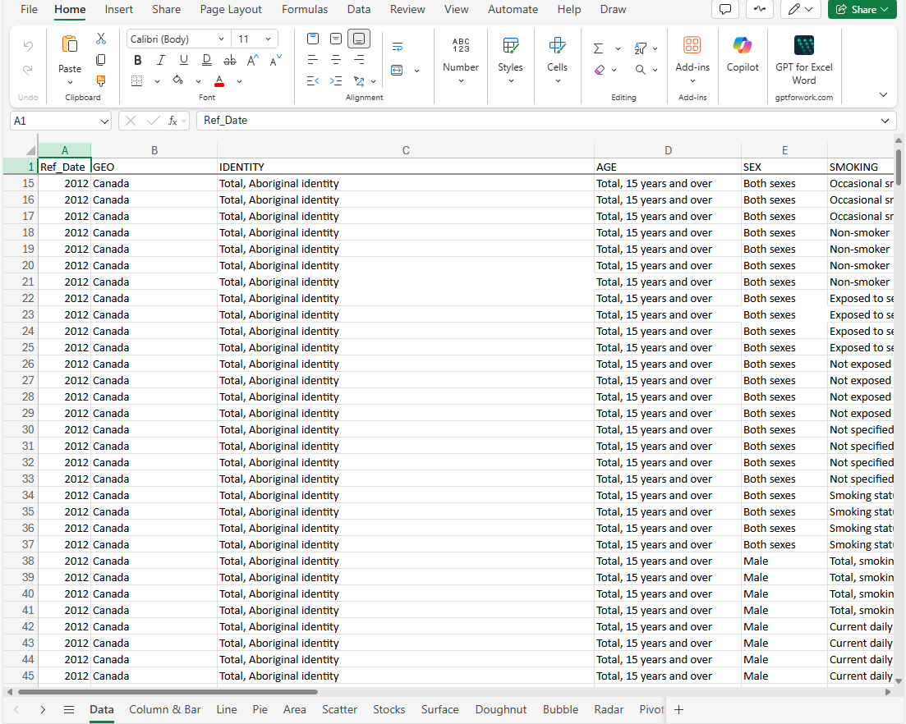
Making a Column/Bar Chart
Copy Data from the Data sheet to Column & Bar sheet
Click on any cell in table.
Press CTRL+A to select.
Press CTRL+C to copy.
OR
Home tab, Copy button.
Click on:
The Data sheet tab.

Slide 25
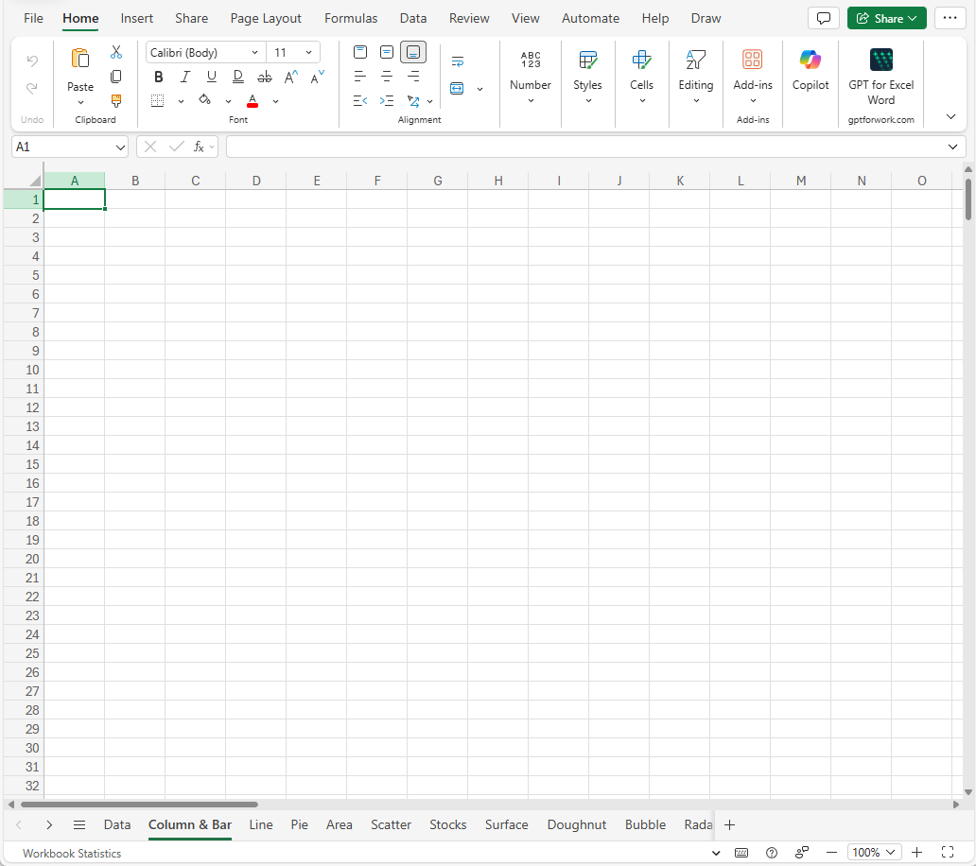
Making a Column/Bar Chart
Paste Data from the Data sheet to Column & Bar sheet
Click on cell A1 in the table.
Press CTRL+V to paste.
Click on:
The Column & Bar sheet tab.

Slide 26
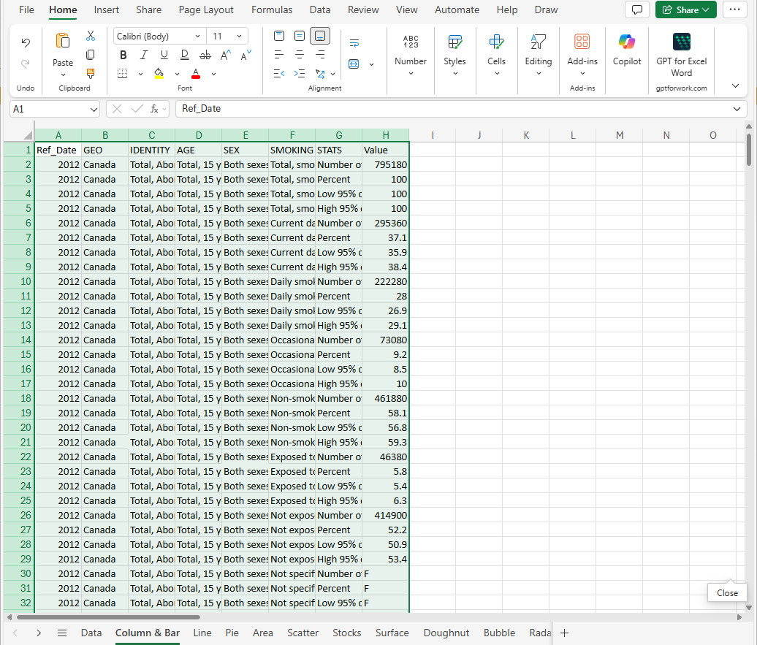
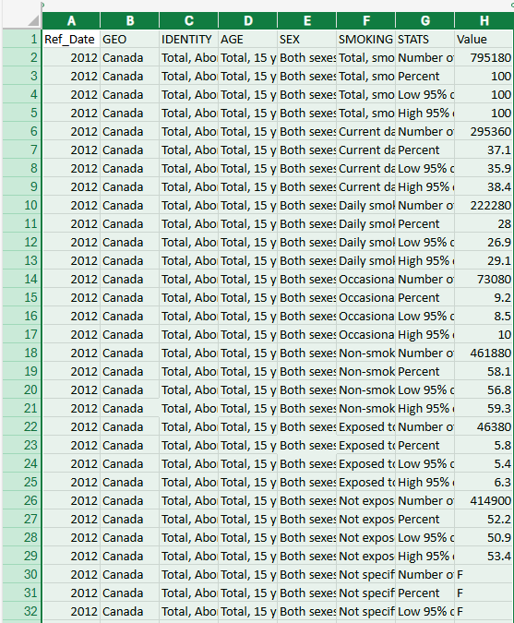
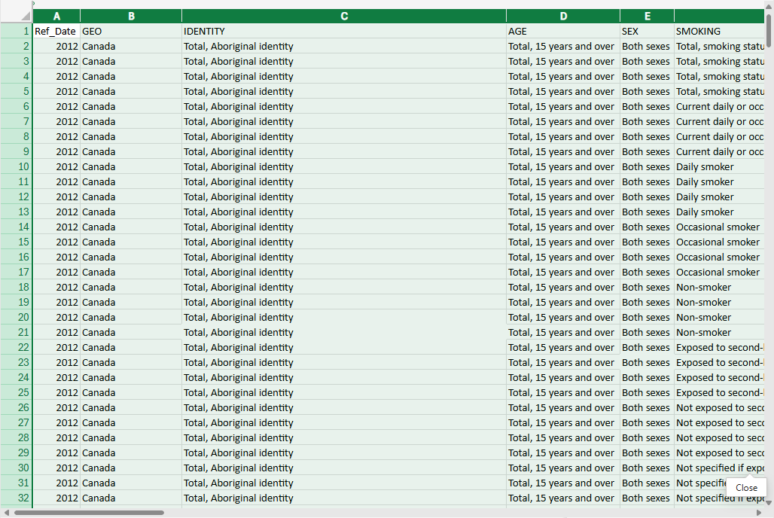
Making a Column/Bar Chart
Paste Data from the Data sheet to Column & Bar sheet
Click on cell A1 in the table.
Press CTRL+V to paste.
To expand the columns to the width of the data in the cells, do:
Drag your mouse over the A column header to the H column header to select the columns.
Now double-click on any separator line between columns.
Click on:
The Column & Bar sheet tab.

Slide 27
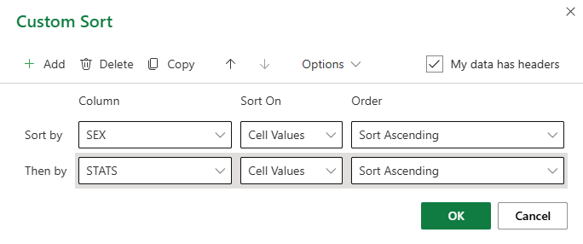
Limit the data to make it display specific information.
The tools you can use to restrict and structure the data are found on the Data ribbon.
Sort
  Click on the Custom Sort icon to launch a dialog, which allows you to apply more than one sort criteria with other useful options.
Choose sort by the Sex data field.
Choose sort by the Stats data field.

Slide 28
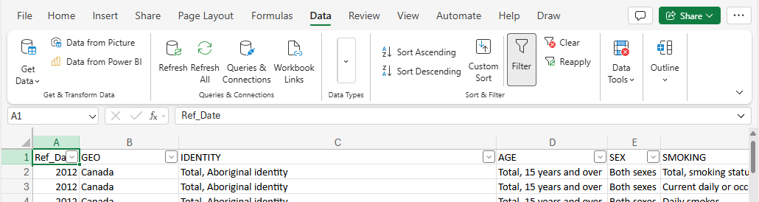
Limit the data to make it display specific information.
The tools you can use to restrict and structure the data are found on the Data ribbon.
Filter
  To narrow down the data to what you need to represent, you can filter the data in each column to display only specific information by clicking on the Filter command from the Data ribbon and then by choosing the data you wish to represent in your chart.
  Applying a filter will add an arrow to the column header, which when clicked, will drop down a list of grouped
  data. Select or deselect the data items to filter out unwanted or unnecessary information.

Slide 29
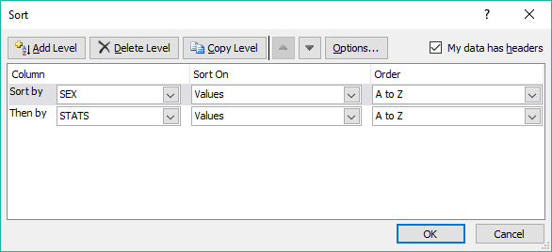
Restricting the Data
The Column chart is the first chart we will make.
Because the Column chart is used mostly to illustrate comparisons or contrasts among items, we will compare Saskatchewan First Nations Female smokers stats to Male smoker stats.
Sort by:
  Sex
  STATS

Slide 30
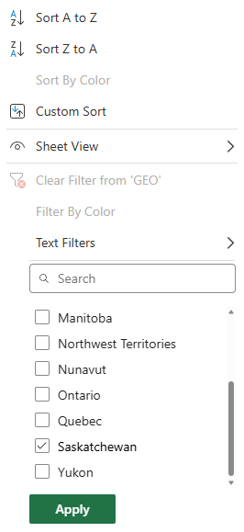
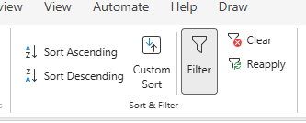
Restricting the Data
With the Filter command on the Data ribbon selected …
Filter by:
  Geo – select Saskatchewan only
Table starts with 28,513 total rows
2,592 of 28,512 rows

Slide 31

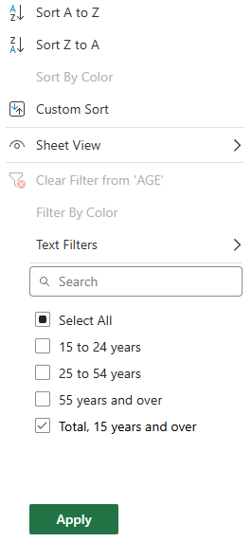
Restricting the Data
  Identity – select First Nations (North American Indian)
  Age – select Total, 15 years and over
432 of 28,512 rows
108 of 28,512 rows

Slide 32
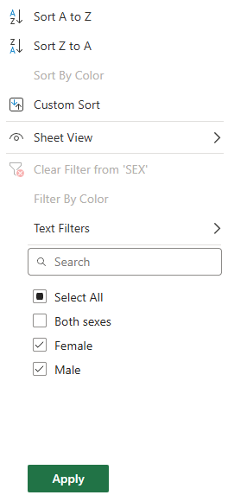
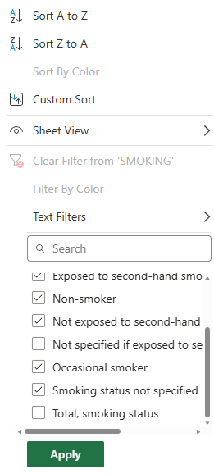
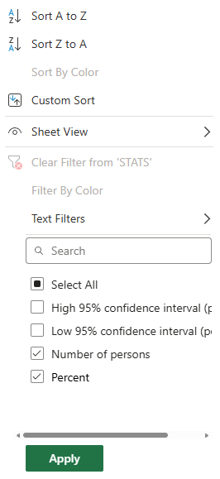
Restricting the Data
  Sex – select Female & Male
  Smoking – deselect the two below
  Stats – select the two below
72 of 28,512 rows
56 of 28,512 rows
28 of 28,512 rows

Slide 33
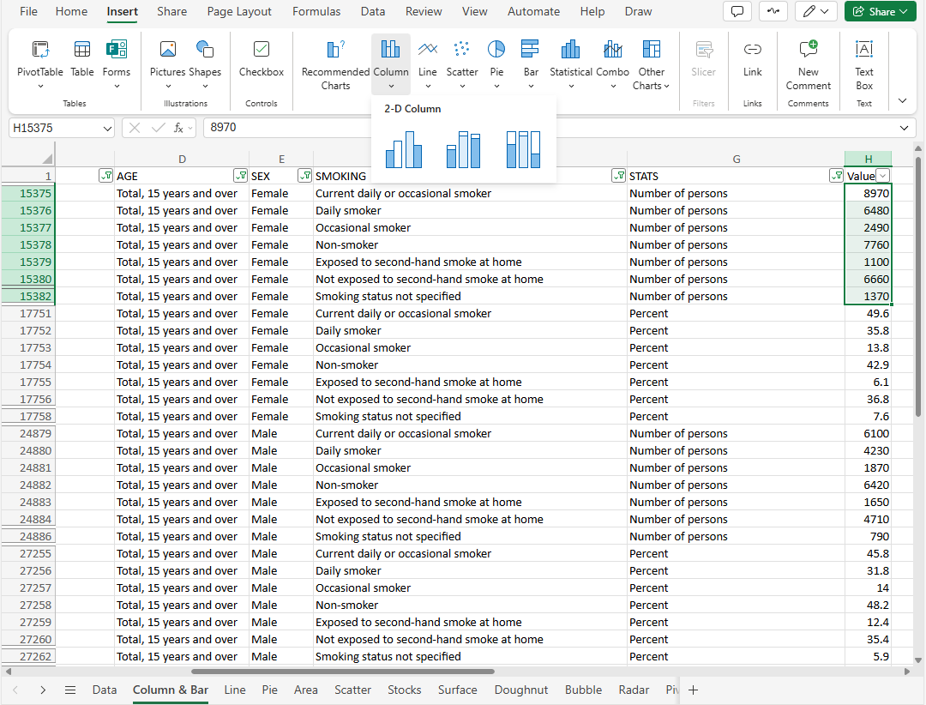
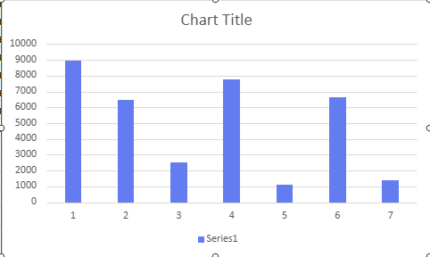
Making a Column/Bar Chart
Select the values. Add the context later.
Now insert a 2-D Column chart.
Now to work with the chart to look acceptable & show all the information we need. This will probably be named Series1.

Slide 34
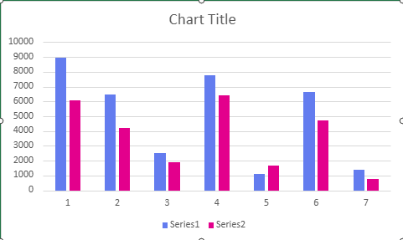
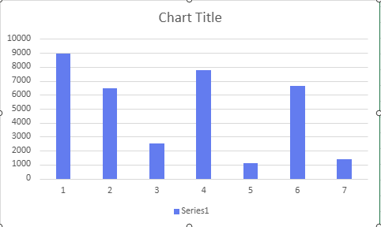
Add a second dataset
Since it is not possible to make two datasets in one selection, like in the other versions of Excel, we need to add a second dataset manually later.
Change From
To
By right-clicking on the chart to select it and click on the Select Data from the context menu that appears and follow the steps …

Slide 35
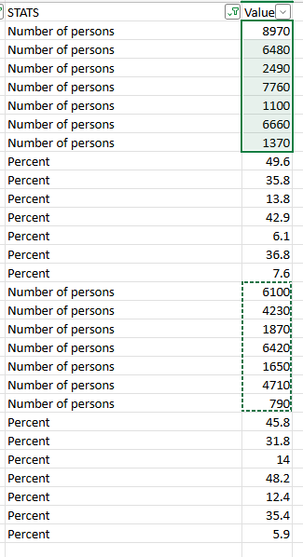
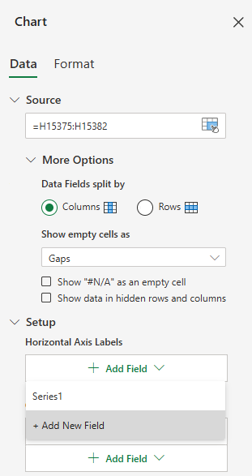
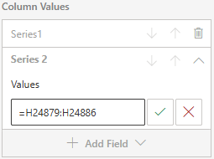
Add a second dataset
To make a second dataset after initially setting up the first dataset, do:
With the column graph selected, Add New Field from the Column Values list box
Now select the values. The dotted line represents my second dataset.
Now click on the green checkmark button, and you will have a second dataset called Series2.

Slide 36
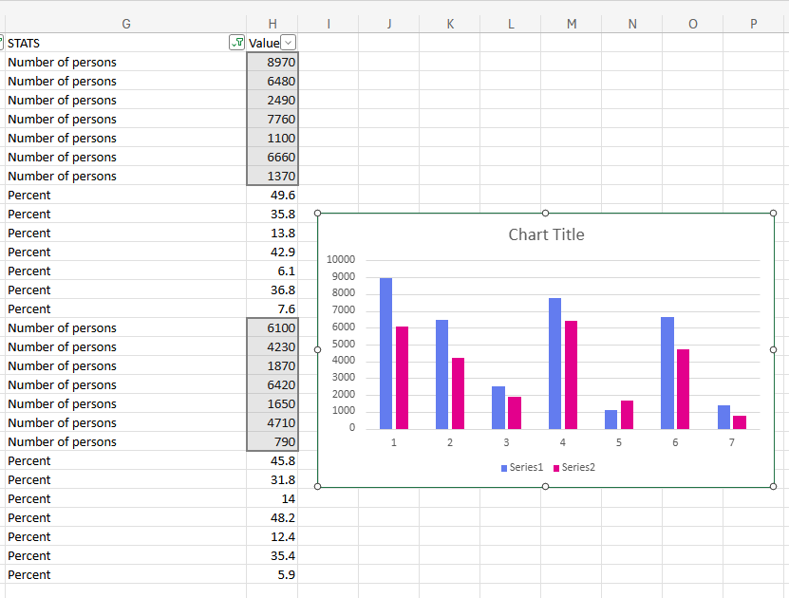
Add a second dataset
The chart displays the second dataset, but it does not display any reference to what data we are tracking, so we need to change the Chart Title, add Data Labels, and add a Legend.

Slide 37
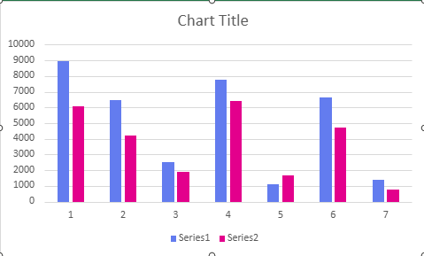
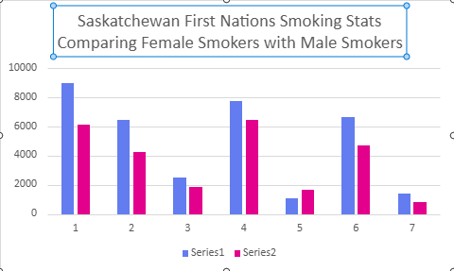
Formatting the Chart
Change the Chart Title.
Change from …
To
By double-clicking on the Chart Title box and in the dialog box that appears, replace it with
Saskatchewan First Nations Smoking Stats Comparing Female Smokers with Male Smokers

Slide 38
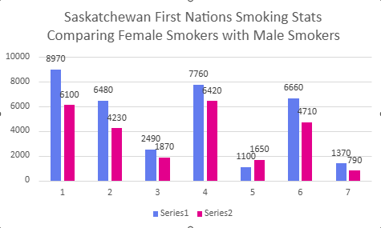
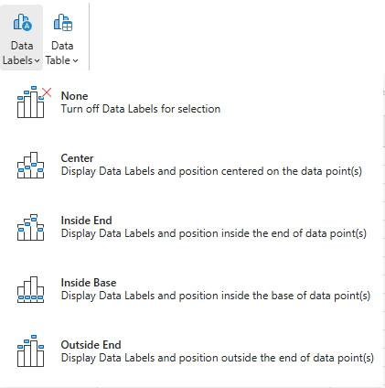
Formatting the Chart
Add Data Labels.
Change from …
To
By selecting from the Chart ribbon, and on the Data Labels menu, and choosing Outside End.

Slide 39
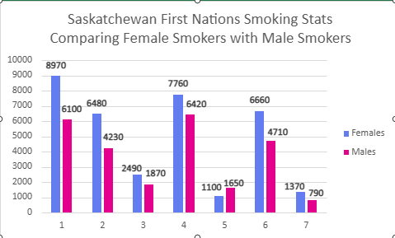
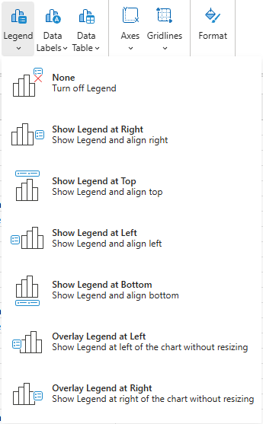
Formatting the Chart
Add a Legend.
Change from …
To
By selecting from the Chart ribbon and choosing the Show Legend at Right option.

Slide 40
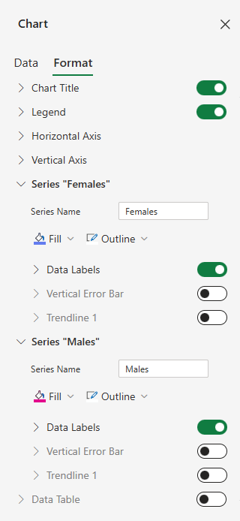
Formatting the Chart
Tidy up the chart.
Change to …
By:
Clicking once on any label, which selects all of the labels in that dataset, makes the text bold from the Home ribbon Font Group. Do this for the other dataset as well.
Move each of the individual labels around so they are visible.
Name the Series: Series 1 = Females, Series 2 = Males
The chart should look like …

Slide 41

Formatting the Chart
Many more cosmetic changes can be made. The changes we made will make your chart informative and visually appealing.
Try to make the information you want to show as clear as possible, with simple, clear formatting.
Do not over-dress your charts since it tends to draw attention away from your message.

Slide 42




Pie
&
Doughnut
Charts

Slide 43
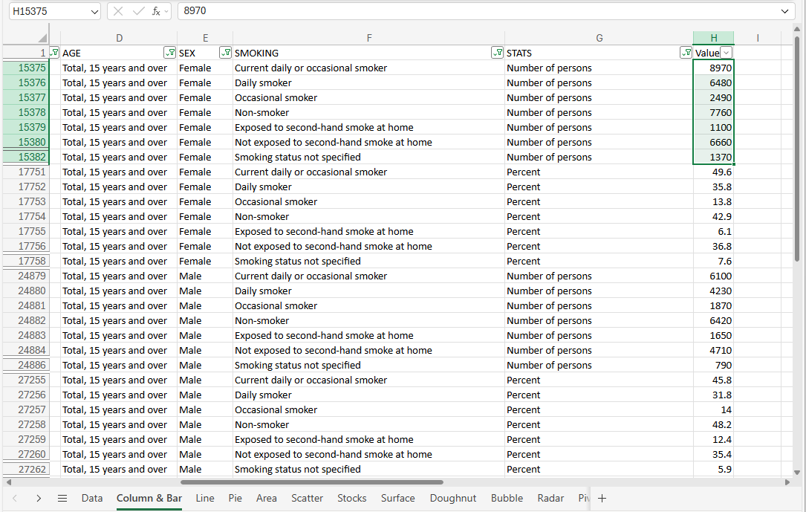
A Pie chart can only display one series of data.
Each element in the series is a percentage of the total.
Making Pie a Chart
Using the same data from the Data sheet, sorted, filtered & subtotaled the same as the Column …
Select just the data shown in the image and then choose a pie chart from the Insert ribbon, Charts group

Slide 44
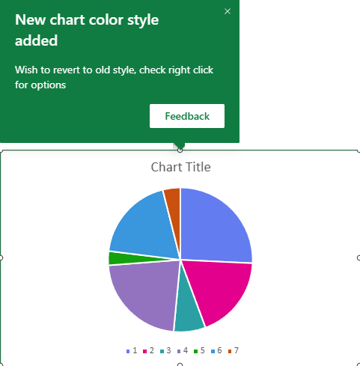
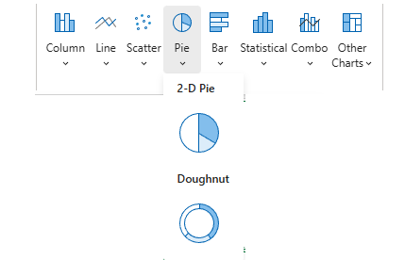
Making Pie a Chart
Click on the Pie chart option from the Insert ribbon Charts group.
Select the first 2-D Pie.
Which makes a chart like this …
A Pie chart can only display one series of data, each element in the series as a percentage of the total.

Slide 45
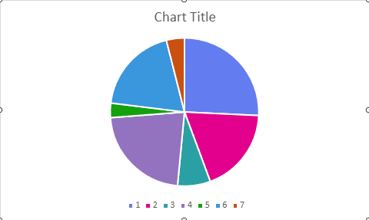
A Pie chart can only display one series of data, each element in the series as a percentage of the total.
Making Pie a Chart
This chart is for the Female Smoking Stats for First Nations.
Format the Pie chart.
Change the Chart Title, add Data Labels, and add a Legend.

Slide 46
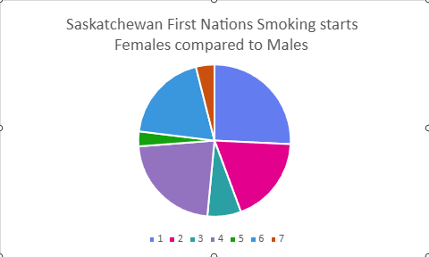
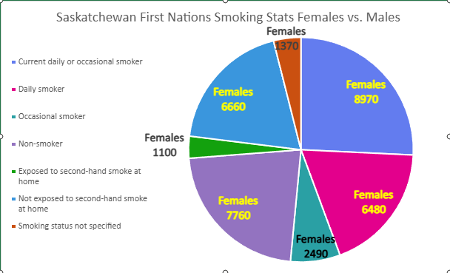
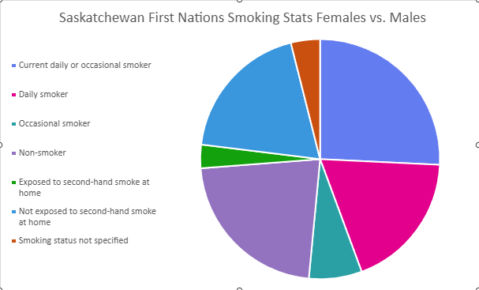
A Pie chart can only display one series of data, each element in the series as a percentage of the total.
Add Chart Title
Add Data Labels.
Add Legend to the left side.

Slide 47
A Doughnut chart can display more than one data series.
Each ring is a full dataset. Typically, present these values as percentages of the total, but this is not required.
Making a Doughnut Chart
Using the same data from the Data sheet, sorted, filtered & subtotaled the same as the Column …
Select just the data shown in the image and then choose a doughnut chart from the Insert ribbon, Charts group

Slide 48
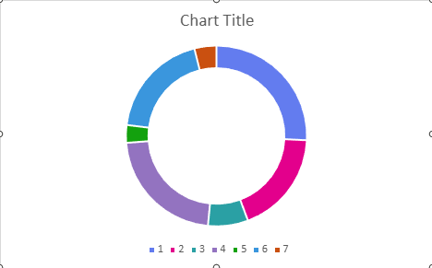
Click on the Doughnut chart option from the Insert ribbon Charts group.
Making Doughnut a Chart
Select the Doughnut.
A Doughnut chart can have more than one series of data.
Each element in the series is typically displayed as a percentage of the total. Percentage data is most often expected on doughnut and pie charts, but is not required to be shown that way.

Slide 49
A Doughnut chart can display more than one dataset.
Making Doughnut a Chart
This chart is for the Female Smoking Stats for First Nations as a Doughnut chart.
Format the Doughnut chart.
Change the Chart Title, add Data Labels, and add a Legend.

Slide 50
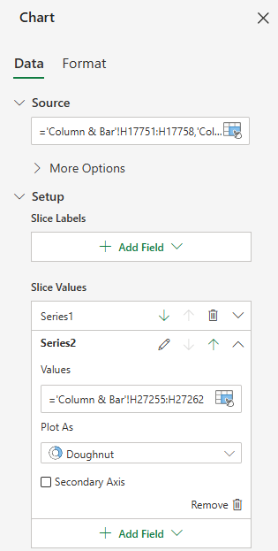

A Doughnut chart can display more than one dataset.
Making Doughnut a Chart
After adding the Males smoking data.
Before adding the Males smoking data.

Slide 51
Making Doughnut a Chart
Format the Doughnut chart.
Change the Chart Title, add Data Labels, add a Legend, shrink the doughnut hole size.

Slide 52


Add another doughnut ring with Males Smoking Stats data.
Making Doughnut a Chart
Decrease doughnut hole size (to 40%)

Slide 53
Add another doughnut ring with Males Smoking Stats data.
Making Doughnut a Chart
Add a Chart Title

Slide 54


Add another doughnut ring with Males Smoking Stats data.
Making Doughnut a Chart

Slide 55

We have covered here in this course …
What is our direction in this course?
Choosing the Data You Present
Chart Types
Making a Column/Bar Chart
Parts of the Chart
Making a Pie Chart
Context Ribbons - Design
Making a Doughnut Chart
Context Ribbons - Format
Tips for Formatting Your Chart

Slide 56
NITHA IT Helpdesk
helpdesk@nitha.com
1(306)953-5008

Slide 57

Thank you

