Slide 1


O365 Excel Basics L2
Entry Level

Slide 2



NITHA IT Helpdesk
helpdesk@nitha.com
1(306)953-5008

Slide 3
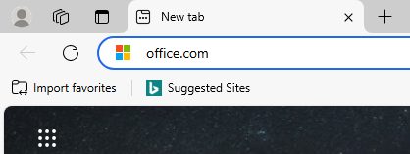
O365 - Login
All of the O365 courses require logging in to your Office 365 account since this version of Excel runs in a web browser.
Open your favorite web browser and type into the address bar the URL office.com and press Enter.
Office 365 is a Software as a Service platform (SAAS)
Office running as a service runs in a web browser, unlike Office packages like 2016 or 2019 or 2021 which are installed to the PC drive and are run directly on the operating system.
Office apps installed on the PC have greater number
of functions available whereas the O365 apps run
in a web browser do not. They have less functions because of security reasons due to running through the
web browser instead of directly on the operating system.
One such example is macros. They are not available in O365 Excel or Word. Scripts, however, are available.
There are, however, some benefits of running the O365 apps: among other things, the best feature is that you can have more than one person modify the same file at the same time.
Slide

Slide 4
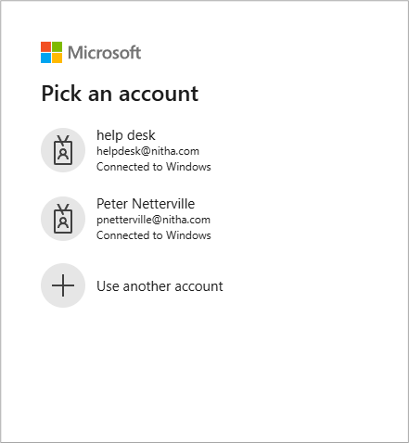

O365 - Login
This login screen will show. It will look the same except for the account names.
Select your account
The next screen you will see is where you enter the password that belongs to the account.
Slide

Slide 5

What will we be covering in this course?
  Getting around without the mouse
  Absolute vs. Relative References
  Autofill
  Data Validation
  Paste Special
  Adding Add-Ins
  Automation (Scripting)
  Worksheet Tab
  Protecting the Workbook
  Sharing the Workbook
Slide

Slide 6
Getting around without the mouse
Using the keyboard to navigate Excel will allow you to work more efficiently.
Key Combination
Navigation
CTRL+A
Select All button – Once selects data in cells, twice selects the entire worksheet
CTRL+PGUP / CTRL+PGDN
    Switch between open browser tabs, CTRL-PGUP to the right.
    CTRL+TAB / CTRL+SHIFT+TAB
    Switch between open browser tabs.
  CTRL+Right Arrow key
    Right - Jump to right column of the table.
    Left – Jump to the end of the worksheet in the direction of the arrow.
  CTRL+Left Arrow key
  ALT
    Jumps cursor to the ribbon which then allows you to navigate the ribbon by keyboard
  ESC
    Backs up one level navigating ribbon by keyboard

Slide 7
Getting around without the mouse
Using the keyboard to navigate Excel will allow you to work more efficiently.
Key Combination
Function
F2
Edit the selected cell
ALT+ENTER
Line breaks in the cell being edited
ALT, H, W
Turn on or off text wrapping for the selected cell.
NOTE: Press ALT (then release), press H (then release), press W (then release)
SHIFT+F10
Display Context Menu of selected object (right mouse button click)
CTRL+K
Insert a hyperlink into the object (text box, shape, word art, etc.)
CTRL+;
Insert current date
CTRL+SHIFT+:
Insert current time
CTRL+SHIFT+#
Change date format
CTRL+SHIFT+Arrow key
Selects all cells from the selected cell in row or column until it comes to a blank or non-number cell in the direction of the arrow key
Slide

Slide 8

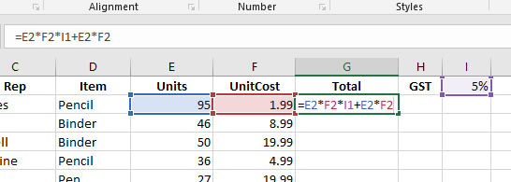
Absolute vs. Relative References
Absolute and relative references only apply when copying a formula or function from one cell to another cell.
What does this mean?
It means that when you copy a formula or function in a cell to another cell the references to the cells in the formula change relative to the cell to where it was copied.
What will happen if the formula in G2 is copied to cell G3?
Slide

Slide 9
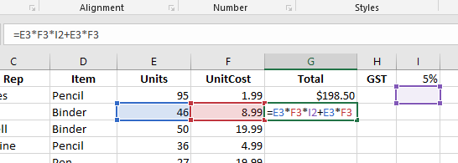
Absolute vs. Relative References
The $ is the character that stops Excel from updating the cell reference. This $ is beside the row number, so it will freeze the row in place.
Note the $
The $ beside the column letter will stop the column from being updated. (i.e. $I1) To freeze the cell in place no matter to where the formula is copied … $I$1 (i.e. =E3*F3*$I$1+E3*F3 )
=E3*F3*I$1+E3*F3
should be
Most of the cell references in the formula were properly updated, but what happened to the GST in cell I1?
Either type in the $ or you can use the F4 key.
=E3*F3*I2+E3*F3
The GST cell is now I2 where there is no value.
So how do we keep it in cell I1 when the formula is copied and pasted into another cell?
Slide

Slide 10
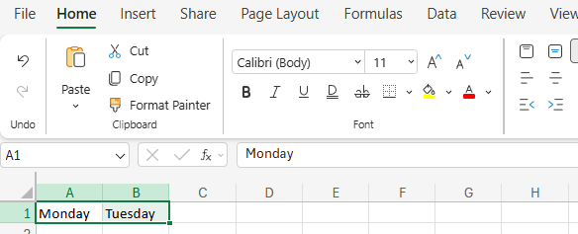
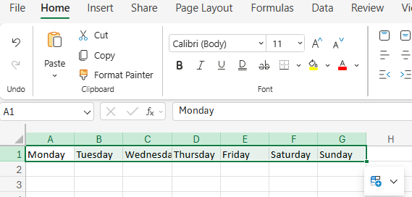
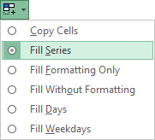
Autofill
Autofill provides an easy way to fill in cells with similar data.
drag to the right
Enter information in two cells, in the case of this example
Monday in A1
Tuesday in B1.
Pick up the Autofill handle and drag the box to the right to fill in the remaining days in the week.
Notice how Wednesday to Sunday are auto-filled.
Autofill button displays a menu of options

Slide 11
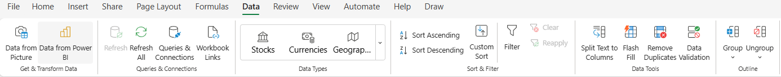
Data Validation
Data validation supplies a level of input control and professionality to your worksheet projects.
Click on the Data tab to expose the Data ribbon.
Data Validation is found in the Data Tools group.
Click on the Data Validation menu.
Page 11

Slide 12
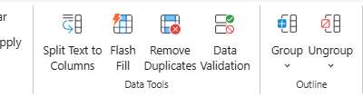
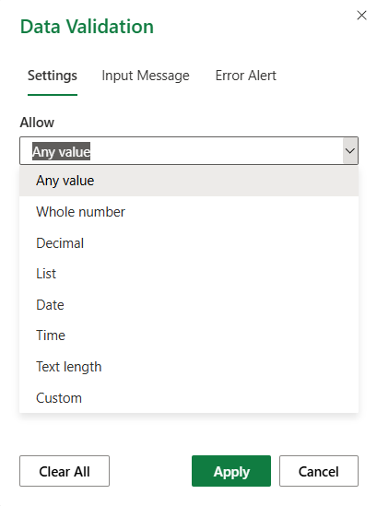
Data Validation
There are three dialogs which allow you to set the validation of one or more cells;
Settings, Input Message, and Error Alert.
Data tab
First, select the cell or cells to which you wish to apply validation.
Second, select the validation data type.
Any Value, Whole Number, Decimal – Self explanatory
List – Select a block of cells which will be put in a drop down list. You can select more than one cell to place the list.
Date – Set a date span.
Time – Set a time span.
Text Length – Set the number of characters.
Custom – Create your own formula to do the validation.
Page 12

Slide 13
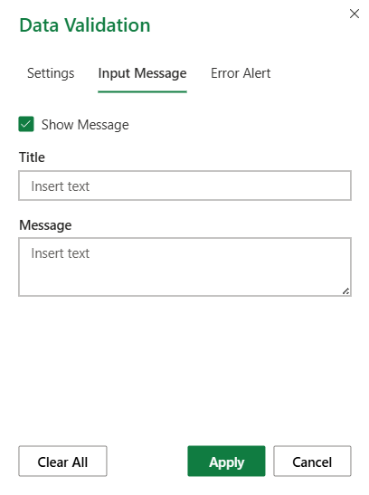

Data Validation
There are three dialogs which allow you to set the validation of one or more cells;
Settings, Input Message, and Error Alert.
Title – When you click on a cell with validation applied, a box appears with this title.
Communities List
Message – This message appears just under the title.
Please select a community from the list.

Slide 14
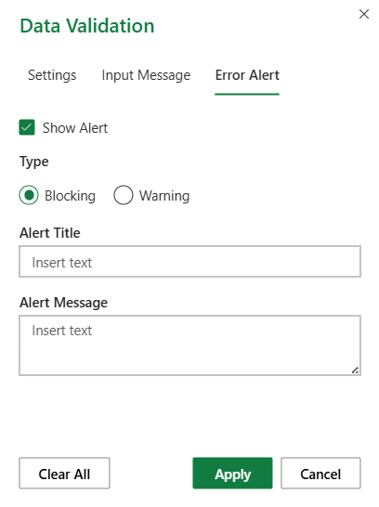
Data Validation
There are three dialogs which allow you to set the validation of one or more cells;
Settings, Input Message, and Error Alert.
Show Alert – Decide whether or not you want the error alert dialog to show when an error is detected.
Type – Select to either block errors or just issue a warning.
Invalid Community
Alert Title – Add a title to the error dialog.
You have entered an invalid community. Select one listed.
Alert Message – Your error message.

Slide 15
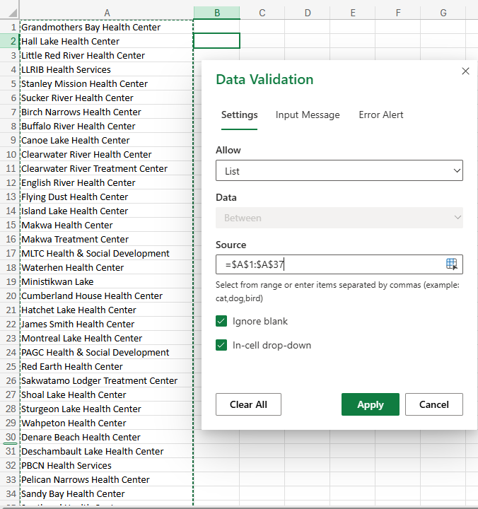
Data Validation
Second, choose List from the Allow drop box.
Now to add a drop box to the worksheet.
First, select a cell or cells into which the drop box will be placed.
If you select more than one cell, the same drop box will be placed in to each cell.
Third, select the source data, in this case the Community list.
Click on OK to apply the changes.

Slide 16
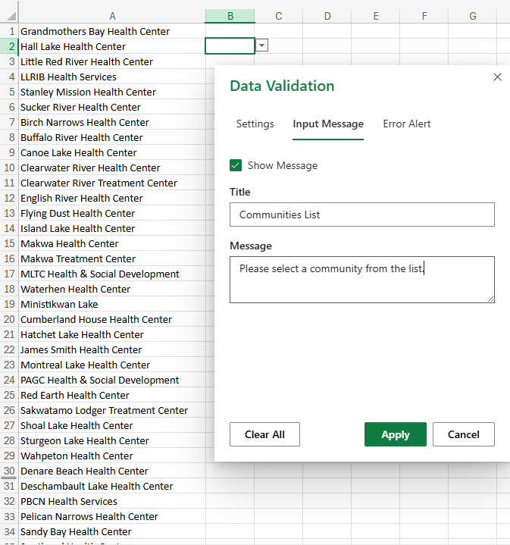
Data Validation
Fourth, type in a title for the drop list.
Now set the
Input Message
Fifth, describe the content of the list.
Click on Apply to apply the changes.

Slide 17
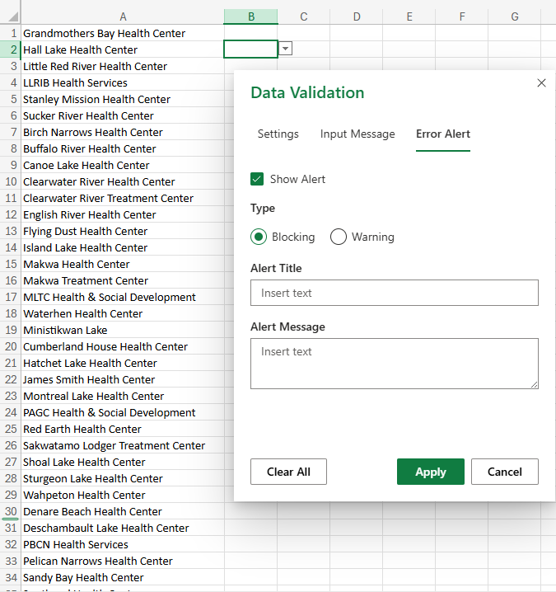
Data Validation
Sixth, select whether to even display the Error Alert dialog.
Now set the
Error Alert
Seventh, set warning or block
Eighth, add a title for the error alert.
Error Alert!
The community you have entered is an invalid community. Please choose from the list.
Ninth, Add a message to the alert.
Finally, click on Apply.

Slide 18
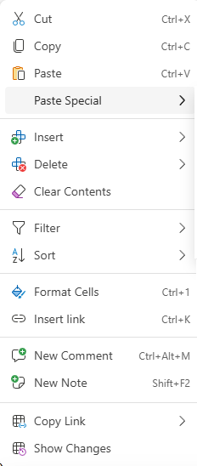
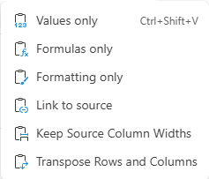
Paste Special
Values Only – Paste the values of the formula(s) only.
Formulas Only – Paste only the formula(s),
maintaining destination formatting.
Formatting Only – Paste the source formatting only.
Link to Source – Paste the hyperlink only, no formatting.
Keep Source Column Width – Keeps the column widths.
Transpose – Pastes with all formatting row data to column and vise-versa.

Slide 19
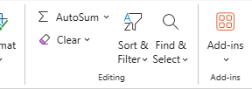
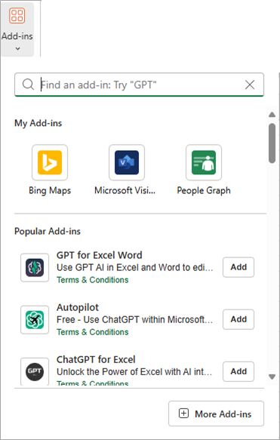
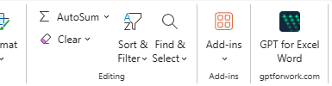
Adding Add-Ins
Click on Add-ins to launch the Add-ins dialog.
Select the add-in of your choice.
A new command is added to the ribbon for you to launch the new add-in.
Slide

Slide 20
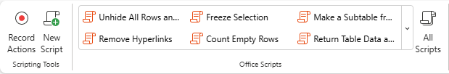
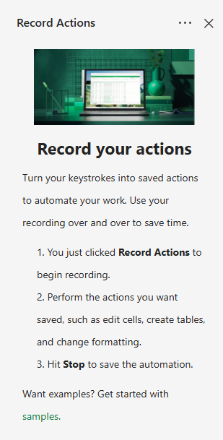
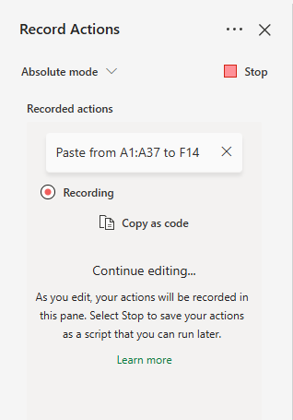
Automation (Scripting)
What is scripting about?
Set the Absolute vs. Relative cell setting.
This panel snaps in on the right side.
Now do what you want to be able to repeat.
Once done click on this stop button.
Slide

Slide 21
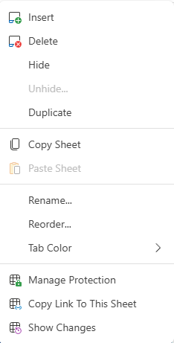
  Worksheet Tab
Right clicking on a worksheet tab exposes this dialog.
This inserts a blank worksheet to the right side of the worksheet tab you have showing.
Deletes the selected worksheet, but be aware that the worksheet cannot be undeleted.
Hide the worksheet. To unhide, select any worksheet tab and click on unhide, select the worksheet you wish to unhide, then click on OK.
Duplicates the worksheet and places it to the left side of the worksheet tab selected.
Copy each item on the worksheet into the clipboard as individual objects to work with.
Rename the worksheet.
Reorder the worksheet using a dialog box. You can use the mouse to reorder the tabs also.
Change the Tab colour.
Slide

Slide 22
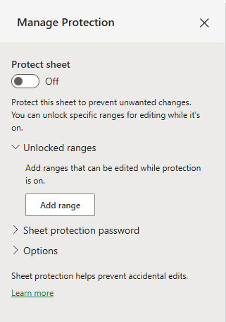
  Worksheet Tab
Right clicking on a worksheet tab exposes this dialog.
Toggle on or off protection for the entire worksheet. This is also necessary to set to on even if all you want is to lock just one cell.
Set a range instead of the whole worksheet.
Set the password to lock the selected cells.
Note: On the Review tab in the Protection group Manage Protection initiates this same function.
Slide

Slide 23
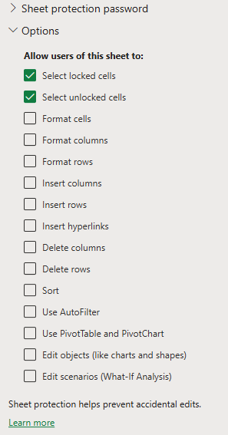
  Worksheet Tab
Right clicking on a worksheet tab exposes this dialog.
Select the condition(s) applied to the protection.
Slide

Slide 24
  Worksheet Tab
Right clicking on a worksheet tab exposes this dialog.
Copy the link to your clipboard so you can share it with others or create a shortcut to the file from your desktop, etc.
Show all changes made to the worksheet since last save.
Slide

Slide 25
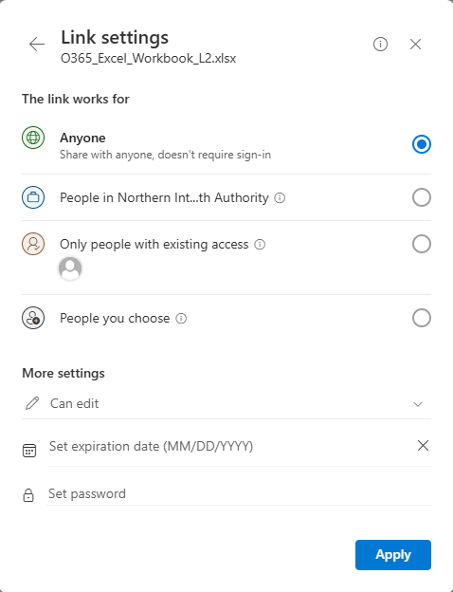
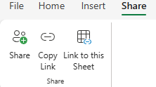
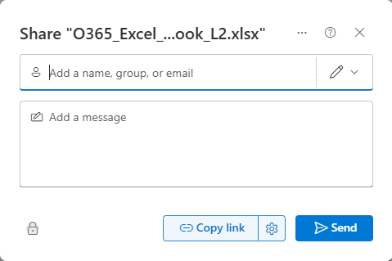
Sharing the Workbook
There are a plethora of ways to share your workbook with others.
Select the Share ribbon, share link in the Share group. Lots of sharing going on.
Slide

Slide 26
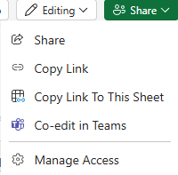
Sharing the Workbook
From the File menu choose Share.
Above the ribbon on the right side is a Share button.
Slide

Slide 27
Python
Python is a scripting programming language used to work with the contents of one or more cells.
Python is can be used, among other things, to:
1 – Data manipulation & visualization – Working with the data and graphs/charts to provide an accurate and visually appealing chart.
2 – Statistical Modeling. Statistical modeling identifies the best statistical model to uncover relationships within a given dataset. It is a mathematical relationship between random and non-random variables, providing visualizations that help data scientists identify relationships in the data to make predictions.
3 – Machine learning – Uses data preprocessing to help AI learn patterns in the data to apply to a data model which allows the AI to come to a decision without having that decision pre-programmed into it directly.
Slide

Slide 28
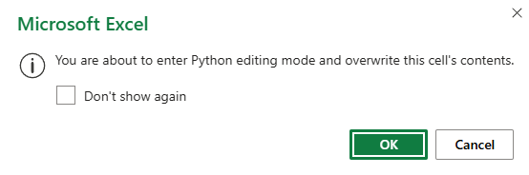
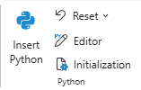
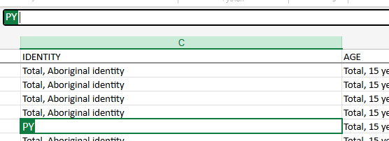
Python
The first screen you will see after you choose the cell to which you wish to apply the Python script and click on the Insert Python command.
Dismiss the warning dialog.
You can enter the Python scrip directly into the cell or by the function bar.
Notice the on the left side of the input field.
These fields are the only place Python can be entered and run.
Slide

Slide 29
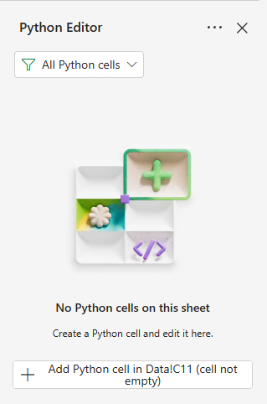
Python
The purpose of this slide is not to teach you Python, but to show you what an example looks like.
This resets the steps you have performed for the current script.
Opens the Python editor & snaps a panel on the right side.
Runs the script.
Slide

Slide 30


NITHA IT Helpdesk
helpdesk@nitha.com
1(306)953-5008
Notes:
Please do not hesitate to ask any question regarding this session, and I will make sure to answer your question as soon as possible.

Slide 31


