Slide 1


O365 Excel Basics L1
Entry Level

Slide 2



NITHA IT Helpdesk
helpdesk@nitha.com
1(306)953-5008

Slide 3

What will we be covering in this course?
O365 – Login Slide 4
O365 – Opening & Saving Tips Slide 6
Landing Page Layout Slide 7
Excel Screen Layout Slide 10
The Backstage (File Tab) Slide 28
Navigating Using the Keyboard Slide 33
Function/Formula Syntax Slide 34
Function Categories Slide 35
The Rules Slide 36
Common Functions Slide 37
Slide

Slide 4
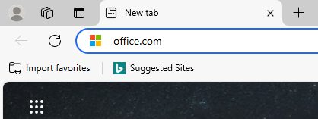
O365 - Login
All of the O365 courses require logging in to your Office 365 account since this version of Excel runs in a web browser.
Open your favorite web browser and type into the address bar the URL office.com and press Enter.
Office 365 is a Software as a Service platform (SAAS)
Office running as a service runs in a web browser, unlike Office packages like 2016 or 2019 or 2021 which are installed to the PC drive and are run directly on the operating system.
Office apps installed on the PC have greater number
of functions available whereas the O365 apps run
in a web browser do not. They have less functions because of security reasons due to running through the web
browser instead of directly on the operating system.
One such example is macros. They are not available in O365 Excel or Word. Scripts, however, are available.
There are, however, some benefits of running the O365 apps: among other things, the best feature is that you can have more than one person modify the same file at the same time.
Slide

Slide 5
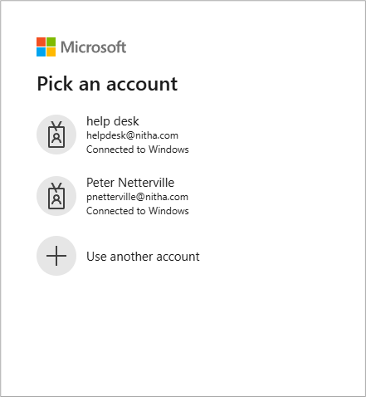

O365 - Login
This login screen will show. It will look the same except for the account names.
Select your account
The next screen you will see is where you enter the password that belongs to the email.
Slide

Slide 6
O365 – Opening & Saving Tips
Working with any software online in the web browser in Microsoft 365 (Office 365) requires a slight shift in thinking on how to open and save files. This is almost all due to the security of your files.
Opening Files:
Office 365 software defaults to opening files from the OneDrive attached to the account you logged in with. This is the first screen you will see when you start the app.
  To open a file from your PC or other device to which you have access:
From the app File menu select Open -> Open files from this device
Saving Files:
For Excel, each cell you enter data in to is immediately saved to the file when you move the cursor from that cell to another. This is how multiple people can edit the same file at the same time. There is no “Save” or “Save As” option. There is, however, an Export option.
  To save a file to your PC or other device to which you have access in another format:
From the app File menu select Export, and choose the export type: PDF, CSV or ODS.

Slide 7
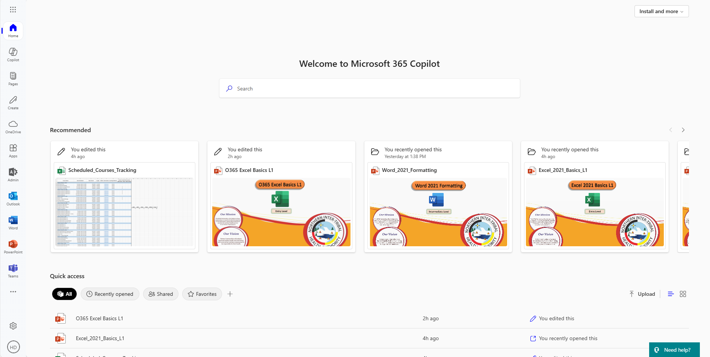
Landing Page Layout
Launch Menu Dialog
Launch Apps Nav Bar
Launch Options dialog
Open your account page.
Slide

Slide 8
Landing Page Layout
Recommended files to open
Quick Access to previously opened files.

Slide 9
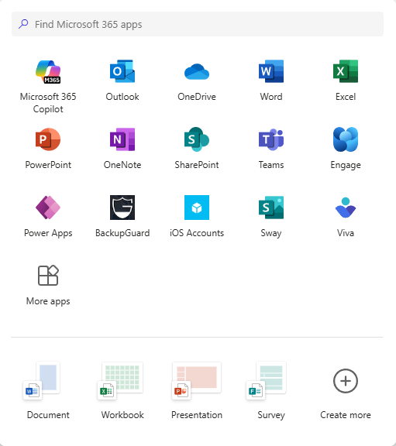
Landing Page Layout - Launch Excel
If you do not see the program you want on the left side Nav panel then click on the menu link.
Launch the Excel app.
Slide

Slide 10
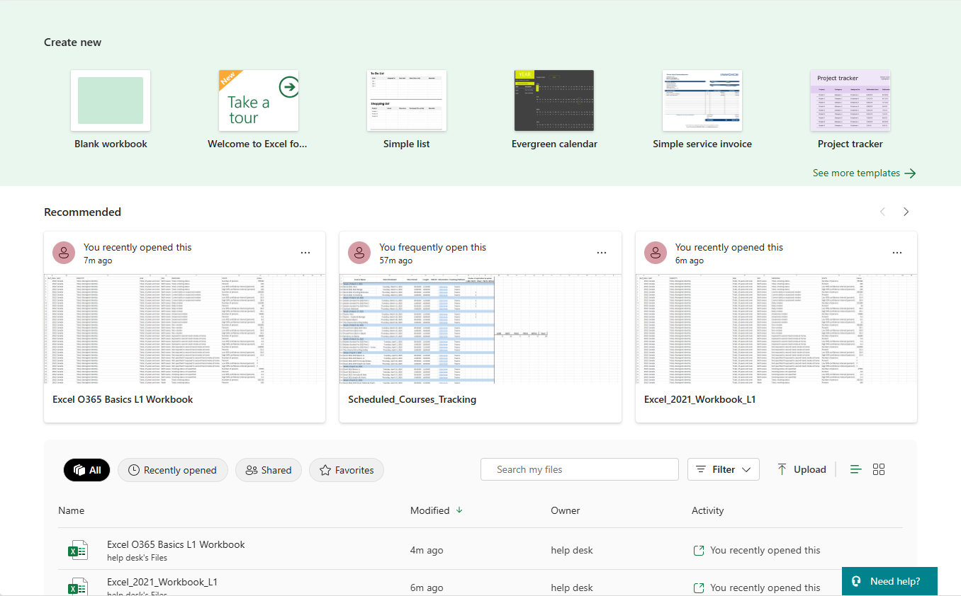
Excel Screen Layout
This is the Excel opening screen where you open a file from a save location or a new workbook template. Even the blank workbook is a template.
Create a new O365 compatible Excel workbook from template.
Open a recommended O365 compatible Excel workbook.
Open the Excel workbook below, from recently opened.
Slide

Slide 11
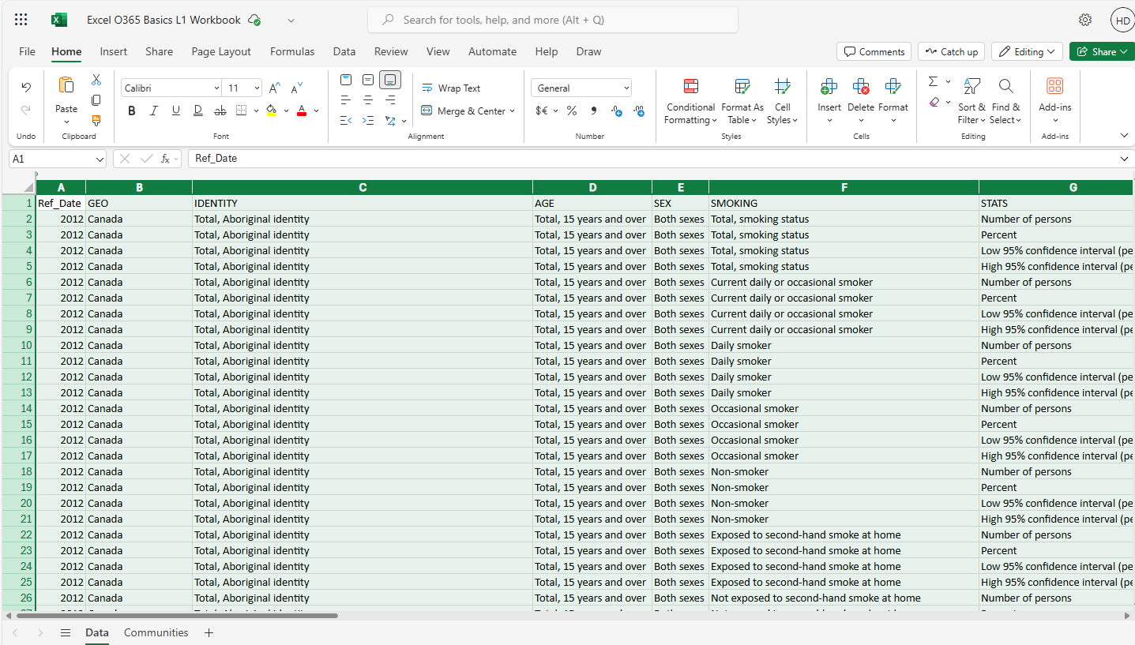
Excel Screen Layout
The workbook we will be using will look like what you see here.
Title Bar
Ribbon Tabs
Ribbon Commands
Name Box
Formula dialog
Function Bar
Slide

Slide 12
Excel Screen Layout
The workbook we will be using will look like what you see here.
Column and row headers
Document Workspace
Slide

Slide 13
Excel Screen Layout
The workbook we will be using will look like what you see here.
Worksheet tabs
Slide

Slide 14
Excel Screen Layout
Home Ribbon
Number group – Set the data type from the selected cell(s).
Editing group: AutoSum, Clear, Sort & Filter, Find & Select.
Styles group – Conditional formatting, Format as Table, Cell styles.
Alignment group – Options are left, center, right, top, middle, bottom, wrap text, merge & center.
Font group – All things text related.
Cells group: Insert, Delete, Format.
Clipboard group: Copy, Cut, Paste & Format Painter
Additional Add-ins: Displays a dialog which contains links to more add-ins, many more.
Undo & Redo commands
Slide

Slide 15
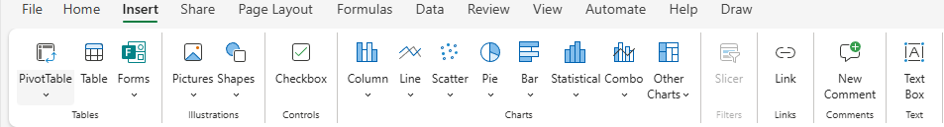
Excel Screen Layout
Insert Ribbon
Charts group: Add a chart object.
Controls group: Add a form control.
Filters group: Add Slicer filter.
Illustrations group – Add a picture or a shape object on to your worksheet.
Links group: Add an Anchor or Hyperlink.
New Comment: Insert a comment.
Add a text box object.
Tables group
Create a new PivotTable
Make a table from existing data
Create a form, edit previous form, edit selected form, send form.
Slide

Slide 16
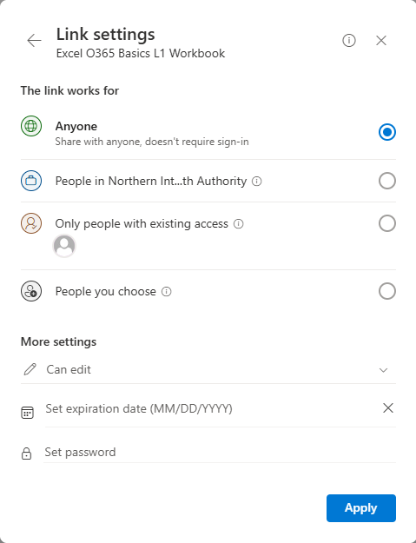
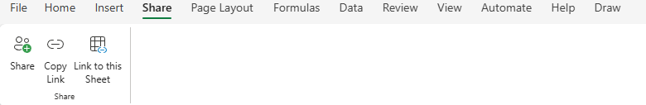
Excel Screen Layout
Share Ribbon
Share Group
Share the current workbook
Copy Link
Link to this sheet (Link settings)

Slide 17
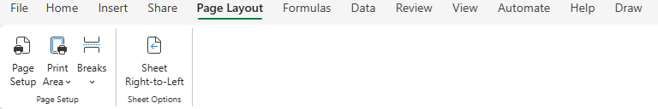
Excel Screen Layout
Page Layout Ribbon
Sheet Right to Left – Takes the columns and flips the
from left -> right
to right -> left
Page Setup – Margins, orientation, etc.
Print Area – Makes selected area the Print area.
Breaks – Various page breaks.
Slide

Slide 18
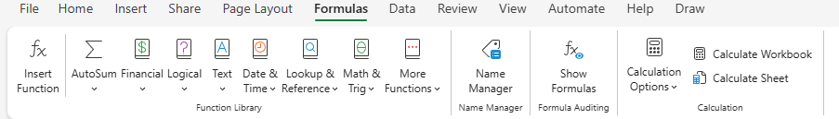
Excel Screen Layout
Formulas Ribbon
Name Manager group - Create Named groups. Select one or more cells and the name that group of cells.
Formula Auditing group – Displays your formulas on the current worksheet.
Function Library – This is where all the functions live.
Insert Function – Displays a dialog which allows you to select a function and set its’ cell references.
Calculation group –
Calculation options are automatic, partial, manual.
Calculate workbook causes all functions in the entire workbook to be run.
Calculate worksheet runs all formulas on the current worksheet.
Slide

Slide 19
Excel Screen Layout
Data Ribbon
Data Types group – Choose from Stocks, Currencies or Geography.
Queries & Connections group –
Refresh – Refreshes the current connection.
Refresh All – Any connection that has active data, such as an SQL database, will be reloaded.
Queries & Connections – Snaps in a panel on the right side which allows you to view any current queries and any connections to external data sources.
Workbook Links – List of all links to other workbooks.
Get & Transform data group –
Data from Picture uses Optical Character Recognition (OCR) on the picture to read any text.
Data from Power BI (Business Intelligence): Power Query get and transforms data in Excel.
Slide

Slide 20
Excel Screen Layout
Data Ribbon
Sort & Filter group – Sort the column which is selected either ascending or descending.
Custom Sort: Choose Column, Sort On, Order, Header options, direction of the sort
from column to row, case sensitivity.
Filter: Adds a drop box beside the column title with one listing of every unique cell.
Clear: Resets the filter.
Reapply: Sets back to the filter’s previous setting.
Data Tools group – These tools allow you to manipulate the data.
Split Text to Columns: Takes each work in a cell and makes a column for each.
Flash Fill: Fills in data based upon a recognized pattern. This is the same as autofill.
Remove Duplicates: As stated, it removes duplicate data from the selected cells.
Data Validation: Use filters to force data type compliance.
Outline group – Group into one object more than one selected object. The objects still work as they did before, but it is visually locked with other objects.
Slide

Slide 21
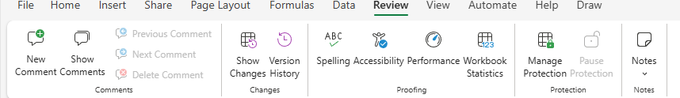
Excel Screen Layout
Review Ribbon
Notes group – Working with the notes you add to your workbook.
Proofing group – Fix various issue such as
Spelling: Check for spelling mistakes.
Accessibility: Text to describe the selected object by audio for audio impaired.
Performance: Removes excessive metadata, formatting and more to improve performance.
Workbook Statistics: Stats on your data.
Protection group – Allows you to provide security for your workbook, by workbook, or worksheet, or by cells(s).
Changes group – Work with the change(s) you have made.
Show Changes -
Comments group –
New Comment attaches your comment to the selected cell.
Show Comments displays all comments on a worksheet.
Previous, Next, Delete cycle up or down in the list of comments or delete it.
Slide

Slide 22
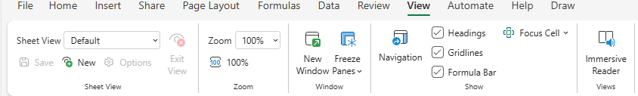
Excel Screen Layout
View Ribbon
Views group – The Immersive Reader provides options to adjust text appearance, listen to text read aloud, and utilize grammar tools.
Show group – Change your default view.
Navigation: Displays a panel on the right side which contains links to data.
Headings, Gridlines, Formula Bar are displayed or hidden.
Focus Cell: Toggles a selection where the row and cell are highlighted as well as cell.
Zoom group – Zoom to as large or small as you need.
Sheet View group – Select a block of cells to view.
Window group – Create a duplicate window that scrolls separate from the original window.
Freeze Panes -
Slide

Slide 23
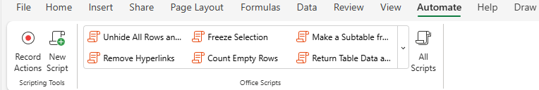
Excel Screen Layout
Automate Ribbon
Scripting Tools group – Scripts in Excel allow users to:
Automate repetitive tasks
Record, edit, and run scripts.
Scripts can be created using the Action Recorder or the Code Editor, and they can be run on different workbooks and worksheets.
Office Scripts group – Choose from prepared scripts to perform specific tasks.
Slide

Slide 24
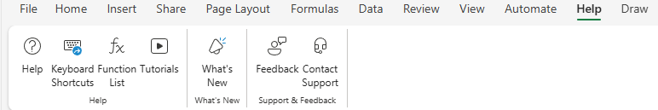
Excel Screen Layout
Help Ribbon
Support & Feedback group – Submit a suggestion or comment, or contact support to get a support ticket going.
What’s New group – See what is up and coming.
Help group – Get help from Microsoft, view the keyboard shortcuts, display the functions list, access various tutorials.
Slide

Slide 25
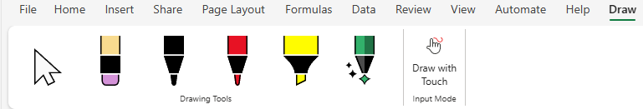
Excel Screen Layout
Draw Ribbon
Input Mode group – Changes to touch screen mode for drawing.
Drawing Tools group – Eraser, Pens, Highlighter, Action Pen (use the mouse to draw and select a group of cells).
Slide

Slide 26
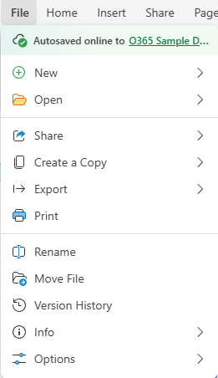
The Backstage (File Tab)
The Backstage is where things happen to your file, but not in your file.
New – Create a new workbook from template: blank or Browse for a template.
Open – Displays a list of recently opened files, view all files link, open files from this device.
Share – Displays a dialog which allows you to:
Share with people
Copy a link to the current workbook and places it into the clipboard.
Gives you the ability to select a range of cells to show, its’ appearance, how people interact with the embedded code, dimensions, the embedded code, and a preview.
Slide

Slide 27
The Backstage (File Tab)
The Backstage is where things happen to your file, but not in your file.
Create a Copy – Create a copy of the current workbook to either store online of for download.
Export – Download as a
PDF – Adobe’s Portable Document File format
ODS – Open Document Spreadsheet (LibreOffice and Apache OpenOffice)
CSV – The Comma Separated Values document is a file meant to transfer data.
Print – Print your workbook, or parts thereof, to a printer.
Slide

Slide 28
The Backstage (File Tab)
The Backstage is where things happen to your file, but not in your file.
Rename – Rename your current workbook.
Move File – Relocate your file to another folder online or download for offline.
Version History – Lists all the saves you have done to this file.
Slide

Slide 29
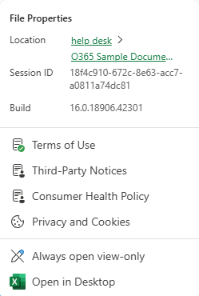
The Backstage (File Tab)
The Backstage is where things happen to your file, not in your file.
Info – File properties such as Location, Session ID, and Build.
Legal stuff
The manner in which your file is opened.
Options – Regional Settings where you can change the country/language.
You can also reset the log file. This clears the history of changes made to the workbook.
Slide

Slide 30
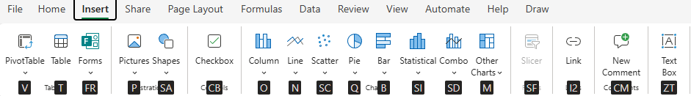
Navigating Using the Keyboard
| Shift Tab
Moves the cursor left or right
Tab |
Shift Enter
Moves the cursor up or down
Enter
PG Up
Moves the cursor up or down number of visible rows
PG Down
CRTL PG Up
Cycles through open browser tabs.
CTRL PG Down
CRTL
Moves the cursor to the furthest right/left cell
CTRL
Tap the ALT key to access the ribbon via the keyboard. You may have to touch the key twice.
Selecting the N, for example, will show the Insert ribbon as shown below. Push Esc to go back one level.
Selecting the SA will display the shapes menu, then use the arrows and Enter to select the shape you want.
Slide

Slide 31
Navigating Using the Keyboard
Tap the ALT key to access the ribbon via the keyboard. You may have to touch the key twice.
Selecting the N, for example, will show the Insert ribbon as shown below. Push Esc to go back one level.
Selecting the SA will display the shapes menu, then use the arrows and Enter to select the shape you want.
Slide

Slide 32
Function/Formula Syntax
Functions/formulas have the same syntax.
All functions start with the first character as an equal sign.
=function name(value, value, value, etc.)
These are the values, usually each referencing a cell or block of cells, all separated by a comma.
Enter the function name after the equal sign.
All functions start with the first character as an equal sign.
Slide

Slide 33
Function Categories
The function bar shown below is directly above the column headers.
Compatibility – These functions from earlier versions of Excel are provided for compatibility with functions
made in old versions of Excel.
Cube - Multidimensional sets of data providing a means to summarize information.
Database – Treating an Excel spreadsheet as a flat database, these functions return a search based on sum, variance, and standard deviation data.
Date & Time – Date and time functions allow you to work with the current time or periods of time.
Engineering – Engineering calculations: many of which relate to Bessel Functions, Complex Numbers.
Information – These functions return information about the contents and/or formatting of a cell.
Logical – Flow control, logic and error capture.
Math & Trigonometry – ABS, sine, cosine, logarithmic, Pi, Quotient, etc.
Statistical – Works with data points, deviations, and more.
Text – Use these function to manipulate text.
Web – XML and web services functions.
Slide
33
Notes:
Have them follow along in the functions dialog box if they have a computer in front of them.

Slide 34
The Rules
Like everything in life, there are rules to follow.
All formulas begin with an equal sign.
Cells when represented in a function individually or as a block are separated by a comma (union operator). eg. D14, H27, A3, B84S
Cells when represented in contiguous block are separated by a colon (cell range operator). eg. D14:D30
Excel follows the Order of Operations. Remember the PEMDAS (or BEDMAS) you might have learned in school (Brackets, Exponents, Division, Multiplication, Addition, Subtraction)
Evaluate Brackets - From the inner first to the outer last eg. =8.7334*(27.416+(12-7.3)^4)
Evaluate ranges – A range of cells such as D14:D30 (column) or D14:J14 (Row)
Evaluate intersections – Apply a function such as SUM to the overlap of two blocks of selected cells.
Evaluate unions – The union operator is the comma.
Perform negations
Convert percentage values to decimal.
Perform exponentiation – The up caret, ^, is used in a function to represent an exponent
Perform multiplication, *, and division, /. These are equal in precedence.
Perform addition, +, and subtraction, -. These are equal in precedence.
Evaluate text operators – In Excel the ampersand, &, concatenates text.
Perform comparisons – The comparison operator are: equals = not equal to <> less than <= greater than >=

Slide 35
Common Functions
Page 35
SUM – Adds all the numeric values of all the selected cells. This is probably the most common function in Excel. eg. =SUM(D2, G6:G8)
HYPERLINK – Insert a web link to a web page or resource (such as a PDF) into a cell. Hyperlinks can also jump to a name link on any spreadsheet to which it has access, even other workbook sheets (i.e. another file).
MIN & MAX – MIN returns the lowest value from the selected cells. MAX returns the highest value from the selected cells. eg. =MIN(D2, G6:G8)
NOW – Returns the current date in the format defined in Windows for a short date, short time
(Win10 – Settings/Time & Language/Date & Time/Formats/Short Date & Short Time)
eg. =NOW() Don’t forget those parenthesis!
DAYS – Returns the number of days in a date period. eg. =DAYS("January 12, 2017","February 26, 2017")
COUNT returns the number of cells in a selected range that contain numbers only. eg. =COUNT(G6:G8)
COUNTA counts all non-empty cells, including those with text, logical values, and errors eg. =COUNTA(G6:G8)
AVERAGE – Returns the arithmetic mean of its’ argument. eg. =AVERAGE(D2, G6:G8)
DSUM – Adds the numbers in the fields of records in the database that match the conditions you specify.
Notes:
( = 18.98 + 114.98 * 4 Answer is B ) ( = 12 + (3.14159 * 325) Answer is A ) ( = 187.4 * (18 + 5^3) Answer is C )

Slide 36
Exercise
Note: You may have to scroll right using the spreadsheet navigation arrows. (bottom left)
1. Enter into cell B5 the following formula:
18.98 + 114.98 * 4
Answer:
535.84
478.90
This is a basic formula you would see in commerce.
2. Enter into cell B8 the following formula:
12 + (3.14159 * 325)
Answer:
1033.01675
47.5686677281
Though syntactically not incorrect, can anyone notice anything that is unnecessary in this formula?
3. Enter into cell B11 the following formula:
187.4 * (18 + 5^3)
Answer:
3378200
8373.2
26798.2
Which is done first, the exponent or what is in parenthesis?
(Hint: trick question)
Page 36

Slide 37


NITHA IT Helpdesk
helpdesk@nitha.com
1(306)953-5008
Notes:
Please do not hesitate to ask any question regarding this session, and I will make sure to answer your question as soon as possible.

Slide 38


