Slide 1








Internet & Surfing Safety
Chrome
Firefox
Explorer
Edge
Safari
Opera
Maxthon
Entry Level

Slide 2
NITHA IT Helpdesk
helpdesk@nitha.com
1(306)953-5008

Slide 3

What will we be covering in this course?
What is the Internet?
Dangers of the Internet
Accessing the Internet
Information Security
Terminology and Basic Concepts
Backup Security
Common Services Available on the Internet
Popular free software available on the Internet
Searching the Internet (Websites & FTP)

Slide 4
What is the Internet?
The Net
Superhighway
From a technical point of view …
The Internet is a vast global interconnection of computer networks connected by cables and wireless infrastructure channelled through routers, switches, proxy servers, firewalls and other network equipment using a standardized protocol suite called TCP/IP as the mechanism to move massive amounts of data every second.
From a more useful point of view …
The Internet is a place that offers shopping, information, videos, communications, social media, stock trading, banking, connection services and much more.
Cyberspace
Hyperspace
The Cloud
Slide
Notes:
Question 1: What is the Internet? (Check all that apply) (Slide 4) – ALL 4 are correct
The Net
Superhighway
Cyberspace
Hyperspace

Slide 5
So how do we go about accessing this vast network, the Cloud?
First, get an Internet connection from an ISP.
Types of Internet services
Dial-up: Dial-up is all but gone except in some remote areas. It is too slow to be of much use. It uses an
analog modem and a standard phone line.
DSL: DSL uses a phone line for a broadband connection and can reach high speeds, but is limited to a
distance of approximately two to three kilometres as measured by the cable length.
Cable: Cable TV offers Internet access wherever cable TV is offered. These speeds can be very fast,
currently up to about 1 or maybe 1.5 Gbps. At full 1.5 Gbps speed, the download of a high-def movie of 2 1/2 hours is about 30 to 60 seconds.
Satellite: Satellite is also broadband. It can reach fairly fast speeds, generally up to around 50 Mbps, but
there is a lag due to the time it takes for the signal to get from Earth to the satellite and back.
3G, 4G/LTE, 5G, 6G: These cell phone technologies get increasingly faster. 3G is 400 Kbps. 4G is up to 100 Mbps. 5G is up to 20 Gbps, 6G will be up to 1,000 Gbps (1 Terabit/sec.)
Wireless: Wireless internet service providers set up towers to reach remote communities that often
cellular does not even reach. Speeds range up to about 50Mbps.
Slide
Notes:
Up to what speed does 6G operate? (Slide 5)
c. 1 Tbps

Slide 6




So how do we go about accessing this vast network, the Cloud?
Of course, like anything else it depends upon what you want to do. What services do you want to access?
The most commonly accessed thing on the Internet is email.
For that, you can use an email client or a web browser.
There are two methods for collecting your email
With client software
Client software is an application that installs on your computer, which allows you to access your email.
Microsoft Outlook
Mozilla Thunderbird
Opera Mail
Eudora Mail
With a web browser
Web browser-based email allows you to use almost any web browser to access your email. The email remains on the server, not on your computer.
Slide

Slide 7






So how do we go about accessing this vast network, the Cloud?
Of course, like anything else, it depends on what you want to do. What services do you want to access?
Some common web browsers
One of the ways to access the Internet, and probably the most-used app after email, is to surf the web with an Internet browser.
For that, you use a web browser.
Google Chrome
Mozilla Firefox
Internet Explorer
Some other popular Internet services (though hardly an exhaustive list) …
Microsoft Edge
Banking services
Apple Safari
Watching movies
Opera Browser
Real-time video streaming
MX5 Browser
Audio/visual communications
Shopping
And several more!
Virtual Private Network (VPN)
Remote desktop
Online gaming
Slide

Slide 8
Some Definitions
Here are some common Internet terms you will hear
Browser – Refers to a program on your computer designed to access webpages, the World Wide Web;
Chrome, Firefox, Edge, Safari, etc.
Webpage – When the browser fills up with text, images and links (URLs). That is a webpage.
URL – A Uniform Resource Locator is what you click on to go to a web page. The URL points to a resource.
The URL is often referred to as a link or web link. It is composed of several parts …
http://www.domainname.com
com is the primary domain.
http is the protocol, the vehicle used to move the data.
domainname represents the domain name.
www is the sub-domain
HTTP / HTTPS – HyperText Transport Protocol moves the webpage from the website to your computer. HTTPS does the same but does so in a secure manner because the HTML packets are encrypted.
Slide
Notes:
Question 3: Define URL. (Slide 8)
Uniform Resource Locator

Slide 9
Some Definitions
Here are some common Internet terms you will hear
IP Address – This Internet Protocol Address is the address of your computer, or your router connected to the Internet. It is similar to a building address in its function.
ISP – The Internet Service Provider is the one who connects you to the Internet.
Email – Email is the electronic equivalent of postal mail, except much faster, free, and far more reliable.
Downloading – Downloading is when you take something from the Internet to your computer.
Anti-Virus / Anti-Malware – These help protect your computer from bad people.
Slide

Slide 10
Some Definitions
Here are some common Internet terms you will hear
Social Media – Websites that are designed to allow people to interact with each other; Facebook, Twitter, Bitchute, etc.
Blog – Generally this refers to a writer’s column or article.
Cloud Computing – Refers to software resources that are Internet-based, not installed on your computer. Not only is the software located on another server on the Internet, but your data lives there as well. Cloud computing is becoming increasingly popular because users do not have to buy and maintain the hardware infrastructure.
Encryption – Encryption scrambles the data in a pattern which helps prevent unauthorized viewing. The receiving end knows how to decrypt the data.
Slide

Slide 11
Some Definitions
Here are some common Internet terms you will hear
Authentication – This is where you need to login to a service using your username and password.
Authentication also often includes the service called Two-Factor Authentication, which sends a randomly generated text, usually numbers, called a code to either your email or another mobile device, such as a smartphone. Enter the code into the box provided by the service to which you are connecting.
E-Commerce – E-commerce is the electronic method of purchasing products online. Amazon is a prime example is a prime example.
Firewall – A firewall refers to a method to block Internet traffic and allow only authorized traffic through.
Router – This is a hardware device that directs internet traffic based upon a defined set of rules. It typically resides on the edge of a network bordering the Internet and is often used to add a layer of security in addition to directing traffic.
Slide

Slide 12
The Internet is far more that just websites. Some common services available on the Internet are …
Websites – They serve web pages that can offer a variety of information and links to other resources on
the Internet. Internet Banking is included in the website services category. Protocol HTTP,
Language HTTPS.
FTP sites – They offer a repository of files of all types; software, documents and images being the most
common among those resources. Protocol FTP.
Email – The electronic equivalent of postal mail. This is the most commonly used service on the Internet.
Protocols POP, SMTP, IMAP & HTTP.
VPN – Virtual Private Networking connects your computer/network to another computer/network which
simulates a large private network. All the data that traverses the Internet is encrypted so it
remains private.
Slide

Slide 13
The Internet is far more that just websites. Some common services available on the Internet are …
Audio/Video Streaming – This can take on two forms: Protocols RTSP, RTP, RTCP & RTSP; compression
algorithms, also called a codec.
  Streaming from an AV file located on a server somewhere.
  Live AV streaming directly from AV equipment at a live event is streamed directly to your computer.
Telephony services – Standard POTS (Plain Old Telephone System) is converted to a format able to
transferred over the Internet. This is called VoIP (Voice over IP). All major phone
companies use the Internet to move their phone service from one point to another
even though you may not realize it. This is a mix of old analog POTS and digital VoIP.
Some other companies, such as cable companies, offer pure VoIP without using the
old analog phone system.
Slide

Slide 14
The Internet is far more that just websites. Some common services available on the Internet are …
News groups – This service is derived from email which allows for public debate on issues. Protocol NEWS.
For example, news://news.domain.hr
IRC sites – Internet Relay Chat offers channels, also referred to as “rooms”, where almost instantaneous text chat is
available to all those participating in the “room”.
Telnet – Telnet is not used much because it is unsecure, all data including the login is transferred in plain text and is
easily read if intercepted. SSH is the encrypted version of Telnet. It offers a command line type interface.
Slide

Slide 15
The Internet is far more that just websites. Some common services available on the Internet are …
AV Communications – As a hybrid service from other protocols, software like Skype offers bi-directional
audio/visual communications in real time.
Social Network – Although technically this is a web service, social networking can be categorized as its’
own service. It combines web pages with real-time chat, similar to an IRC server and AV communications similar to Skype to create a platform intended to be a social
meeting place.
E-Commerce – E-commerce represents online payment services coupled with web pages in a secure
encrypted environment. Services such as PayPal, along with credit card portals, are
offered as payment methods for all types of products.
Slide

Slide 16
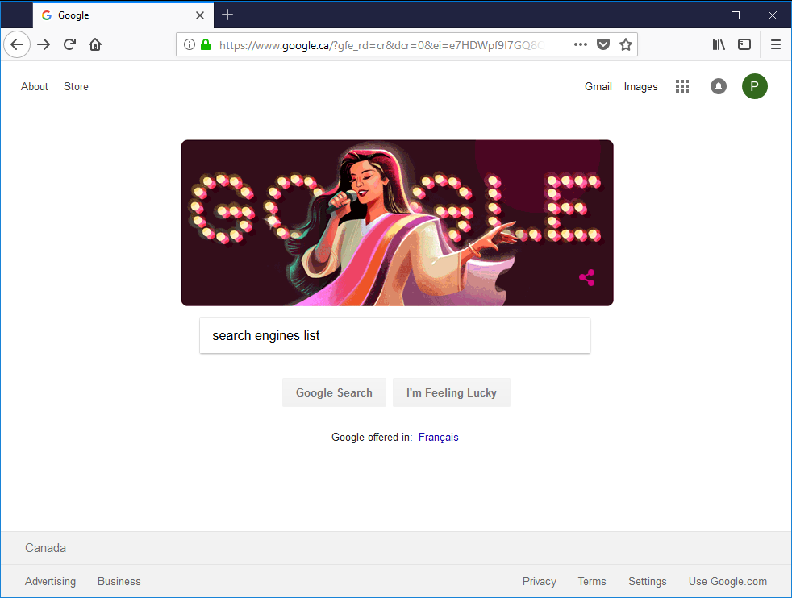
Searching the Internet
How do you go about finding what you need in this vast forest of millions of websites?
The most common method to find stuff on the Internet is to use a search engine such as:
Google – www.google.com
Yahoo – www.yahoo.com
Bing – www.bing.com
DuckDuckGo – www.duckduckgo.com
Ask – www.ask.com
AOL – www.aol.com
On your computer start your favorite web browser.
Notice what it changed to once you press Enter. It changed to:
https – encrypted
www.google.ca – country specific
Type into the Address Bar google.com and press Enter.
Slide

Slide 17
Searching the Internet
Now type into the search engine text box, search engines list and press Enter
Slide

Slide 18
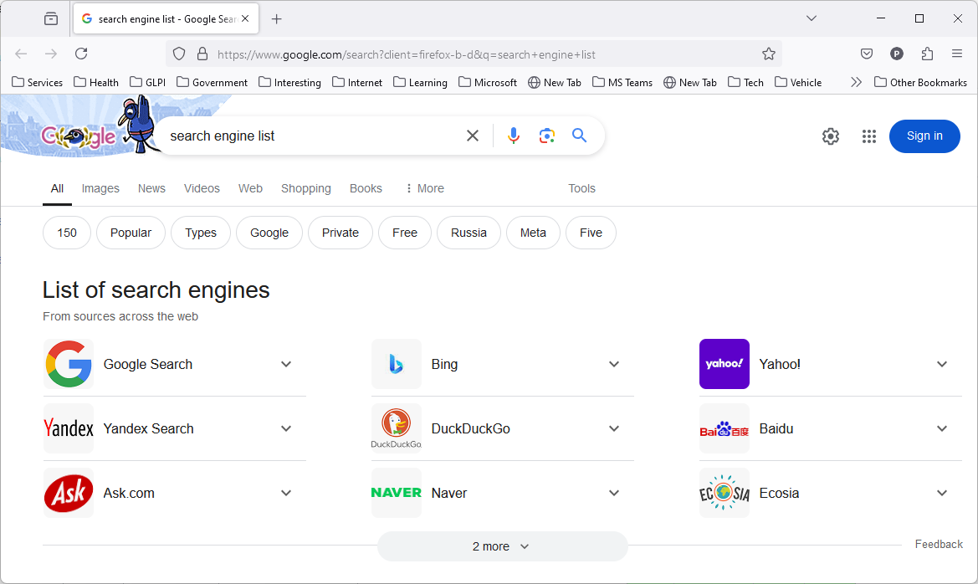
Searching the Internet
Search engine tips
You can also use logical operators to further qualify your search such as:
  AND – All linked words are included
  OR – One or the other search term
  “” – Quotation marks, exact search
  - – Remove the word from the search
  * – Wild card
  ~ – Search for all synonyms
  .. – Between two numbers indicates a
  range of numbers
The trick with search engines is to be specific, but try to avoid unnecessary words such as conjunctions and prepositions.
Slide

Slide 19
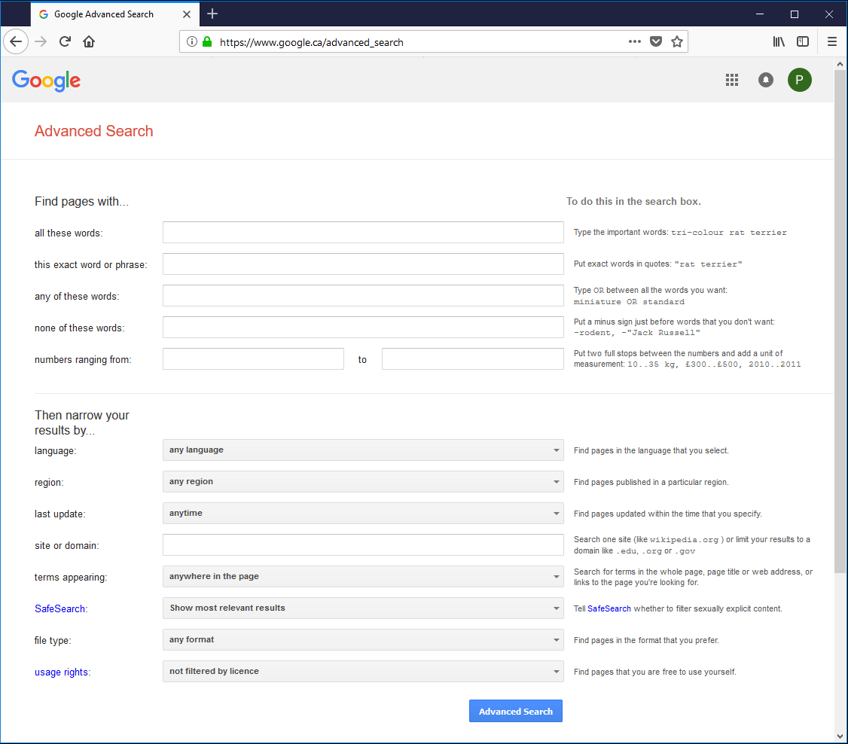
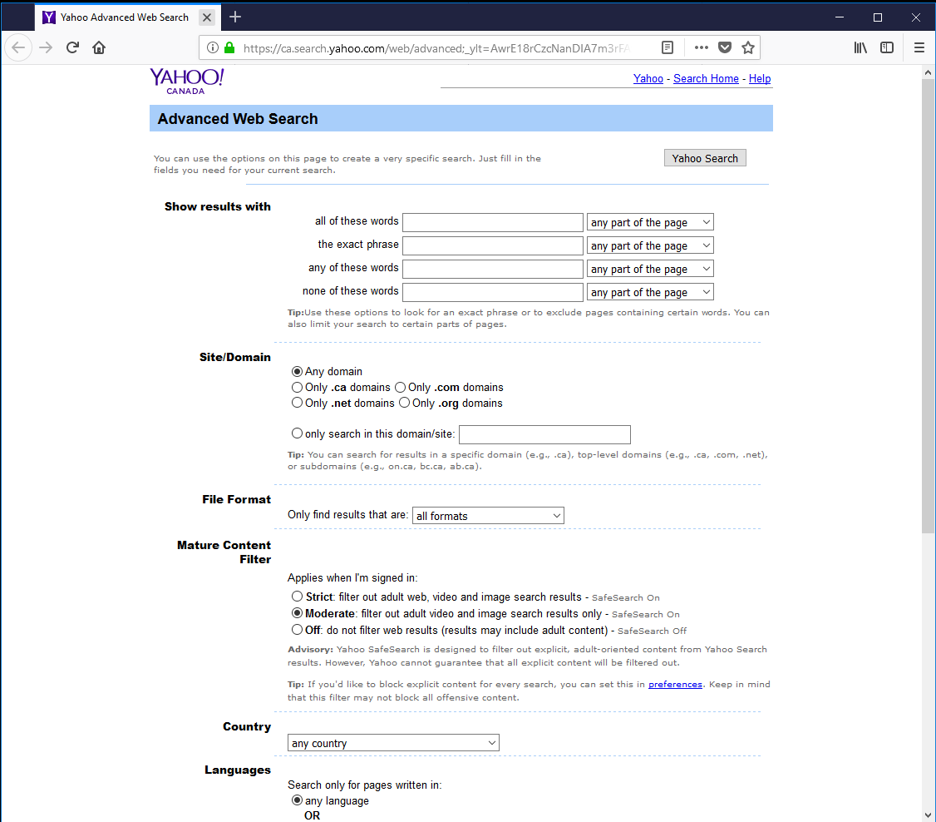
Searching the Internet
If you do not want to use the logical operators, then you can use the advanced search, which will provide the logical operators for you.
www.google.ca/advanced_search
Google and Yahoo have advanced search web pages.
ca.search.yahoo.com/web/advanced
Google advanced search
Yahoo advanced search
Slide

Slide 20
Searching the Internet
Definition:
FTP – File Transfer Protocol transfers files. It is like copying a file from your computer hard drive to your USB stick
but in this case over the Internet.
The previous mentioned search engines search websites the best, but FTP sites search for files for downloading.
Some FTP servers are: Metaftp, Global File Search, Mamont, File Searching, Napalm File Indexer, File Watcher
Archie – Archie is one of the original FTP search engines. An Archie searches FTP sites.
Be aware that when you download a file, it may contain a virus or be malware, so be cautious.
You can right-click on the newly downloaded file in your downloads folder and start a virus scan of that file.
Some browsers, such as Edge, also have a block that requires your authorization to continue with the download.
Slide

Slide 21

Dangers of the Internet – Viruses, Worms & More
Firewall Protection
A firewall can help protect your network/computer from unauthorized entry. Someone, whether actively or by using a script (automated software), attempts to access your computer from the Internet.
A firewall can take on two forms:
Software installed on your computer restricts or allows entry by monitoring installed software and ports.
Windows comes with a software firewall and virus software, called Defender.
Some Internet Anti-Virus packages also come with their own software firewall.
Hardware device, a router, restricts/allows entry mainly based on NAT (Network Address Translation) and ports.
By changing your IP address from one only accessible to the Internet, called a public IP, to an internal private IP address in itself offers some protection through your router.
Your router also filters by port number, and other technical methods using a process called packet inspection.
Slide

Slide 22
Dangers of the Internet – Viruses, Worms & More
AV Protection
A firewall can offer some limited protection against viruses, worms, Trojans and Malware, but the main protection against these is an Anti-Virus software package.
There are plenty of AV packages. Some of the more popular are (in no particular order):
Kaspersky AV
Symantec Endpoint
Bit Defender
McAfee AV
AVG
Trend Micro
Panda
Avast!
Anti-Virus programs work in two general ways:
File scan, which looks for signatures in the files identified as a virus, worm, Trojan or Malware.
Heuristics, which is a program that runs in the background on your computer that looks for virus-like activity.
Slide

Slide 23
Dangers of the Internet – Viruses, Worms & More
AV Protection
Most of the AV packages listed on the previous slide and the ones listed below have a free version you can install.
Kaspersky
usa.kaspersky.com/free-antivirus
AVG
www.avg.com/en-ca/free-antivirus-download
Trend Micro
www.trendmicro.com/en_ca/forHome/products/housecall.html
Bit Defender
www.bitdefender.com/solutions/free.html
Panda
www.pandasecurity.com/usa/homeusers/solutions/free-antivirus
McAfee
home.mcafee.com/downloads/free-virus-scan
Avast!
www.avast.com/en-ca/free-antivirus-download
When you get a notice on your computer that your AV program is updating, it is most likely downloading the latest signatures.
Heuristics work silently in the background unless some activity, such as an unexpected software installation, is detected.
Slide

Slide 24

Dangers of the Internet – Viruses, Worms & More
What are viruses, worms, Trojans, and Malware and how do I protect against them?
A virus infects a file and can be downloaded in a software package, through an email attachment, or from another infected file on your computer.
Its’ main purpose is to self-replicate.
It may have a secondary function to disrupt your computer in any number of ways.
Slide

Slide 25

Dangers of the Internet – Viruses, Worms & More
What are viruses, worms, Trojans, and Malware and how do I protect against them?
A worm is like a virus, but its’ main purpose is to infect other computers on your network. It is network-aware, where strictly speaking, a virus is not.
When a worm infects your network, all computers attached to the network must be taken off the network before scanning; the worm will simply move itself to another computer.
Slide

Slide 26
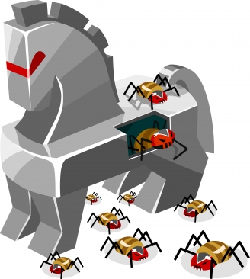
Dangers of the Internet – Viruses, Worms & More
What are viruses, worms, Trojans, and Malware and how do I protect against them?
A Trojan is also like a virus, but its’ name is characteristic of its’ delivery method ... it hides in another file, such as a software install file, and infects your computer with a virus, worm or malware when the installation file is run.
Many Trojans deliver malware and are made to lurk unnoticed in the background, creating a “backdoor” to access your computer.
Slide

Slide 27
Dangers of the Internet – Viruses, Worms & More
What are viruses, worms, Trojans, and Malware and how do I protect against them?
So as mentioned earlier, danger can come in the form of intrusions from an outside source to your network or directly to your computer but hardware and software firewalls helps to prevent this type of attack.
However a Trojan can release a malware program (virus or worm) to act as a backdoor program to allow access from the outside to your computer.
Ok, then question then arises, why should you be concerned if the firewall stops intrusion from the outside?
It is much harder to access your computer if the firewall blocks it.
Slide

Slide 28
Universal Plug and Play
So how does that same virus, worm or malware get incoming communications through the software firewall on to your computer?
UPnP – Universal Plug and Play is a feature in modern routers that typically comes enabled on the router.
UPnP allows a software package, when being installed on your computer, to automatically set itself up as a server to send outgoing and to receive incoming communication through the hardware (router) firewall.
This is handy if you are installing an app, for instance, but not so handy if it happens to be a virus, worm or malware that uses this feature.
Slide

Slide 29
Universal Plug and Play
So how does that same virus, worm or malware get incoming communications through the software firewall on to your computer?
When you install software, it is installed as an administrator, which by default grants access automatically, or if not installed as an administrator Windows presents a dialog that asks you to allow or disallow this installation, and typically you will allow its’ installation.
Either way, access is then granted to the invading software to receive communications through the software firewall.
This is how a Trojan releases viruses, worms, or malware, allowing it to set itself up as a backdoor access point to your computer.
I recommend you disable UPnP on your router.
Slide

Slide 30
Dangers of the Internet – Behaviour
Firewalls help stop intrusions from the outside.
Anti-virus software scans for infected files using signature patterns. In addition it uses heuristics to watch for virus like activity in real-time.
So I guess we are all set then … protected from all angles of attack!
Not so fast!
You also have to be aware of your actions, because you can unwittingly introduce a virus to your computer if you are not careful.
Slide
Notes:
Question 4: There are two general methods for anti-virus software to catch the bad files once they infect your computer. (Slide 30)
a. File Scan
c. Heuristics

Slide 31
Dangers of the Internet – Behaviour
Phishing – Usually appearing in the form of an email, Phishing attempts to get you to enter your sensitive
information such as username, password, credit card information, home address, phone number
and other such information by having you click on a link in the email, which then takes you to a
website that asks for this information.
Typically, it is best not to respond to any requests for information from an email. A legitimate company, bank or government agency will not send you an email that asks you to log in and enter sensitive information by a link in the email.
Software installation – When installing software, you must trust the source. If you download and install
software, make sure you trust the company from which you buy it.
Many full Anti-Virus software packages, especially the full Internet security type AV software packages, will have a method for testing the software in a “sandbox” installation to check if the software installation you downloaded is a Trojan, which isolates the Trojan to a controlled area of your computer’s memory.
Slide

Slide 32
Dangers of the Internet – Behaviour
Web Surfing Safety – Try not to visit websites that may be questionable. I’ll let you think up which ones might
be questionable.
Giving out Information – Do not give out your personal information in a chat or other online social media unless
you are certain you know who is on the other end of the conversation and that you
trust that person. This is called social engineering.
Social Engineering tactics:
Phishing – As mentioned before mostly done by email.
Pretexting – The attacker spends the time to establish a false scenario or pretext to sound credible
and gain your confidence before asking for more personal information and possibly money.
Baiting – Similar to phishing, but the baiting tactic promises some good or other item as a reward.
Slide

Slide 33
Dangers of the Internet – Behaviour
Quid Pro Quo – Offers a benefit in the exchange of information, usually in the form of services; free music,
free software, or free movies, for example.
Tailgating – When someone follows you into a secure location in order to gain access. This also applied to
looking over your shoulder before you type in your password.
Some suggestions on how you can avoid social engineering:
Do not open any emails from untrusted sources.
Do not give offers from strangers the benefit of the doubt.
Purchase anti-virus software, in particular the full Internet Security package. It is worth the price.
Be aware of your company’s privacy policy.
Slide

Slide 34
Dangers of the Internet – Protecting Your Family
Knowing the dangers of the Internet and
how to go about protecting your family?
Many hardware routers have built in content filtering which can stop website activity based upon …
Specific web site URLs entered into a list
Domain name (e.g. dirtywebsite.com)
First level domain (e.g. .com, .net, .sex, .ws, .biz, etc.)
Blacklist websites – a service that keeps a list of bad websites, often a paid subscription.
Keyword filter
Scheduled times Internet is available, often based upon computer MAC address.
If your router does not have these features, you can buy software that installs on the computer which will do all the same features and more.
Some popular software packages …
Home oriented software
Business oriented software
Net Nanny
K9
Save Squid
DansGuardian
Open DNS
Bottom Line
Slide
Notes:
Protecting your family from Internet dangers can take on the form of software. That software can be located in either of two different places. (Check all that apply) (Slide 34)
ALL 4 are correct.
Nanny software on your family’s cell phones
Nanny software that installs on your computer.
Software that in built in to your router.
Software installed on tablets and laptops.

Slide 35


Information Security
In today’s world of computer technology, keeping your information safe is absolutely required!
Considering that much of what you do on your computer is done on the Internet, keeping your information safe is critical.
So how do we protect our information while still enjoying the impressive services available online?
Steps to Maintaining your Privacy in a dangerous Internet world
Please do not write your password on a slip of paper and leave it near your desk.
Never share your password
Whenever you walk away from your computer, lock it.
(Windows Key) + L
Slide

Slide 36
Information Security
Always create a complex password:
  Use upper and lower case letters
  Use a symbol or two
  Use one or more number
  Do not use names or words
  Do not use your phone number or any number that would easily be associated with you
An example might look like
qwer5POIU*
Notice how the keyboard can be used as a mnemonic
The pattern on the keyboard, top left four keys, the 5 is near the “r”, the top right four keys are all uppercase (so hold the Shift key while typing), the * is near the “u”.
Difficult to crack passwords can also be easy to remember when you
use something like the keyboard to help you remember.
Slide

Slide 37

Information Security
Keep Windows updated
Always have installed an active Anti-Virus software package. Some common package names are:
Symantec’s Norton Anti-Virus
AVG Anti-Virus
McAfee Anti-Virus
Malwarebytes
BitDefender
Trend Micro
Some of these companies have a free basic version you can download and install.
It is still always better to buy the full
anti-virus package.
Some other suggestions …
Do not reply to emails unless you know who the sender is or you are expecting the email. Spam emails ask for you to enter your information. Don’t. A legitimate organization will not solicit your information in that way.
Do not visit questionable websites.
Keep informed of security risks. Often your anti-virus software can inform you of threats.
Slide

Slide 38
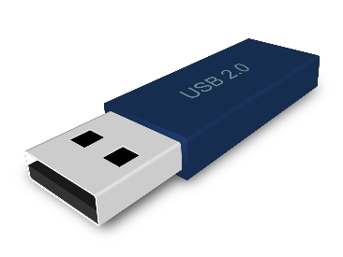
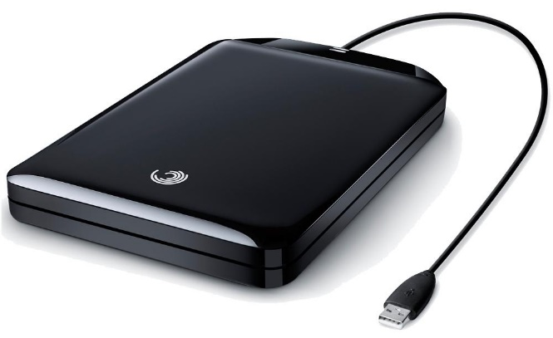

Backup Security
Slide
A USB drive is the most common method of backup today.
Though the physical size stays about the same (picture is full size), the data that it can hold ranges from 2 Gigabyte to 3,000 Gigabyte (3 Terabyte).
Backup your data!
Though this is technically not a security issue, it is an
“Oh No! Now what do I do?”
issue.
Few things are worse than losing of all your important documents.
The image above is a portable hard drive. This image is not full size.
They are about 4” X 5.5” X 0.75”
The largest capacity affordable portable hard drive (at the time of this writing) is about 2 Terabyte (2,000 Gigabyte).
Backup software
Acronis True image
Norton 360
Dropbox
Methods for backup
Copy to USB drive or to a portable hard drive.
Use backup software

Slide 39



Popular free full version software available on the Internet
Productivity Software
Most of the popular web browsers are free
openoffice.org/download/
OpenOffice™ is an excellent free alternative to Microsoft’s Office package. It contains …
OpenOffice Base – Database software (similar to Access)
OpenOffice Calc – Spreadsheet (alternative to Excel)
OpenOffice Draw – Graphics (like Paint, but far more
ability)
OpenOffice Impress – Slide Presentation (PowerPoint
alternative)
OpenOffice Math – For making math equations.
OpenOffice Writer – Document writer (Word alternative)
Google Chrome
google.ca/chrome
Mozilla Firefox
mozilla.com/firefox
Internet Explorer
Included in Windows
Microsoft Edge
Included in Windows 10
Apple Safari
safari.en.softonic.com
Opera Browser
opera.com
MX5 Browser
maxthon.com/mx5
Slide

Slide 40






Popular free full version software available on the Internet
Productivity Software
Kindle is an e-reader for reading electronic books, documents & images.
It supports files:
Mobipocket MOBI, PRC)
Text (TXT)
Adobe Reader (PDF)
Voyage & Oasis (AZW, AZW3)
Web (HTML)
MS Word (DOC, DOCX)
Images (JPG, JPEG, PNG, BMP)
Audio Touch & Oasis (AA, AAX, MP3)
Amazon (KFX, AZW3)
Irfanview is an image viewer and converter which supports many
image formats.
Intuit Mint is a handy finance program that is designed for
mobile devices to make paying bills and other money
management easy.
Paint.net is a quality product with plenty of graphic tools.
Adobe Photoshop Express is a scaled back version of Adobe Photoshop. It is an
excellent graphics tool available on iOS, Android, and
the Windows Microsoft Store.
Dropbox
Dropbox is free for the first 2 GB of storage. It stores your files in an online storage location with a cache on each device you have it installed on.
It can be used for backing up your files and/or for making your files available to you from other locations and devices.
Spotify is a music media player.
Google Earth Pro lets you roam the earth virtually in overhead view or on the ground in many places in street view.
Slide

Slide 41

We have covered here in this course …
What is the Internet?
Dangers of the Internet
Accessing the Internet
Information Security
Terminology and Basic Concepts
Backup Security
Common Services Available on the Internet
Popular free software available on the Internet
Searching the Internet (Websites & FTP)

Slide 42
NITHA IT Helpdesk
helpdesk@nitha.com
1(306)953-5008

Slide 43

Thank you

