Slide 1


Excel 2021 Pivot Tables & Charts
Intermediate Level

Slide 2
NITHA IT Helpdesk
helpdesk@nitha.com
1(306)953-5008

Slide 3

What will we be covering in this course?
Preamble and Definitions
Working with the Pivot Tables
Placing Data Fields and Filtering
Downloading and Opening the Exercise File
Working with the Pivot Tables
The Bar Chart
Creating a Pivot Table
Pivot Chart Anatomy
Working with the Pivot Tables
The Doughnut Chart
Working with the Pivot Table – Bar Chart

Slide 4
Preamble and Definitions
What are pivot tables and how do they benefit me with my projects?
Normally, when you make a chart, you massage the data using commands such as Sort, Filter, Group & SubTotal. Then you choose the chart that best represents your data and the point you are trying to make. This is okay,
Pivot tables allow you to move your data around from Column header to Row header to Filters to Values in an easy drag & drop fashion “on the fly”.
… however …
This flexibility makes it easier for you to view your data in different graph structures.
Using the traditional approach of selecting your data, filtering it and then choosing a chart can be awkward and clumsy if you do not know exactly what data you need or how you want to represent your data.
Pivot tables give you the flexibility to work with your data in real time.
A pivot chart is a visual companion to your pivot table. The graph provides a visual representation of the data.
When you sort, filter or group your data, the changes are reflected in your chart instantly.
Our Ultimate Goal
Our goal is to display a comparison of smoking statistics between males and females for Saskatchewan First Nations for all ages 15 years and up, and then we can easily switch data sets to represent Alberta vs. Saskatchewan smoking statistics for First Nations.

Slide 5
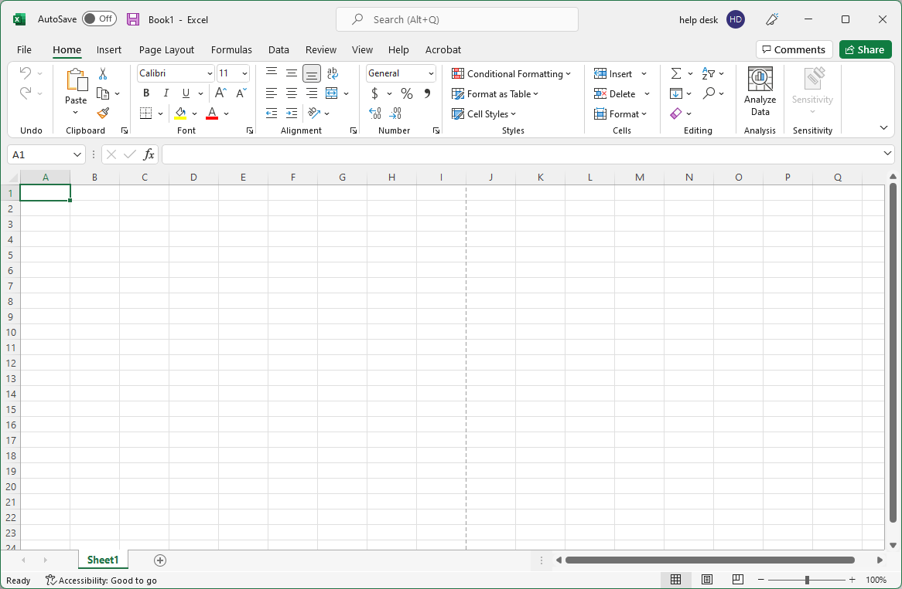
Open the Excel_2021_Pivot_Tables_Worksheet.xlsx file.
It is most likely in your Downloads, Desktop or Documents folder.
Click on the Backstage, the File tab.

Slide 6
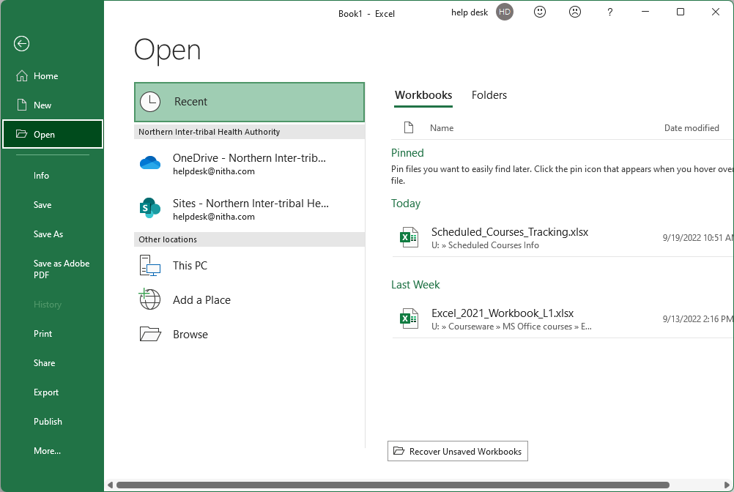
Open the Excel_2021_Pivot_Tables_Worksheet.xlsx file.
It is most likely in your Downloads, Desktop or Documents folder.
Click on the Open link which displays the Open screen.
Click on the Browse button.

Slide 7
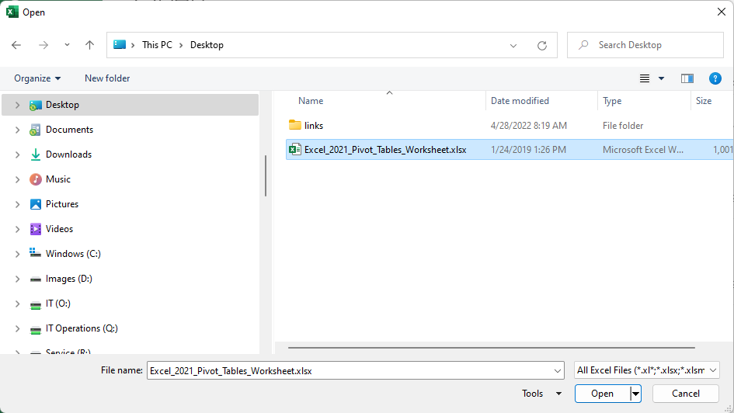
Open the Excel_2021_Pivot_Tables_Worksheet.xlsx file.
It is most likely in your Downloads, Desktop or Documents folder.
Navigate to where the course file is located on your computer.
Click on
Then click on the Open button.

Slide 8
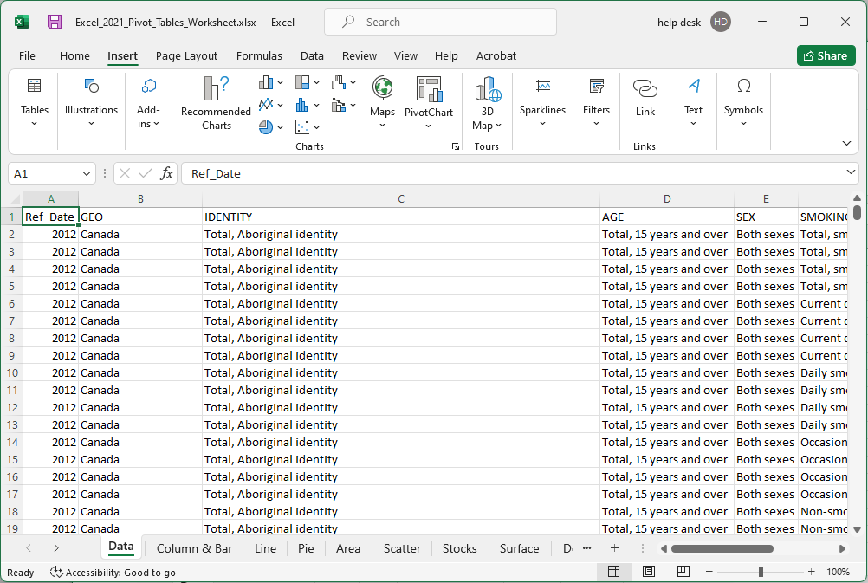
You should now have a screen that look similar to …

Slide 9
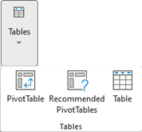

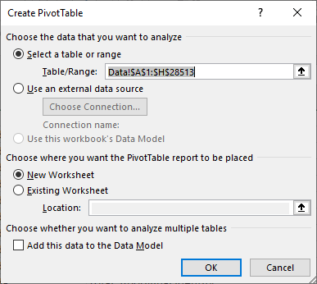
Creating a Pivot Table
Click on any cell in the table
Click on the Insert ribbon tab
On the Tables menu click on …
  PivotTable button
The Choose the data that you want to analyze option already has the entire table selected, but you can change that here.
You can also pull the data from an external data source.

Slide 10
Creating a Pivot Table
On the Choose where you want the PivotTable report to be placed option, you can choose
  New Worksheet
  Existing Worksheet
If you choose Existing Worksheet, you will need to select a cell where the report will be placed.
Click on the OK button.

Slide 11
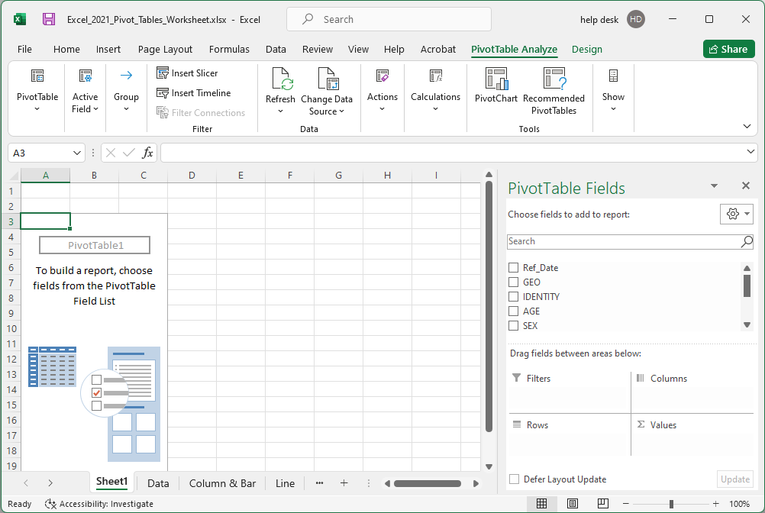
Below is what you should have on your computer
  The PivotTable box on the left
  The PivotTable Field list on the right
Pivot Chart Anatomy
When choosing what data fields to select, keep in mind what aspect of the data you are trying to emphasize.
To build a table, select the fields you want to include by dragging the field down into one of the four areas below

Slide 12
Pivot Chart Anatomy
The data in the table is represented by the PivotTable1 box on the left. Make sure to keep it selected while working on your pivot table and chart.

Slide 13
The Pivot Table Field List contains five panels:
Pivot Chart Anatomy
  Field selection
  Filters
  Columns
Field Selection
Allows you to choose what data to include in the table, which will be represented in the chart in which you have chosen to represent that data.
Filters
Allows you to focus on specific parts of the data by displaying only the data you want.
Columns
The Column label is the Y axis data.

Slide 14
The Pivot Table Field List contains five panels:
Pivot Chart Anatomy
  Rows
  Values
Rows
The Row is the X axis. It allows you to focus on specific parts of the data by displaying only the data you want.
Values
The Column label is the Y axis data.

Slide 15
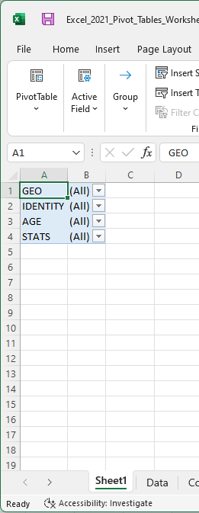
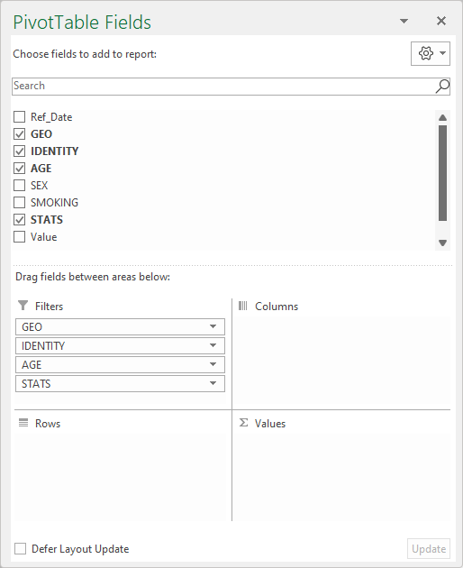
Working with the Pivot Tables
Placing Data Fields, Filtering
Now that we know the areas of the Pivot Table Field List, we need to arrange the data into the proper areas: Filters.
Sort the data fields into the following areas by dragging and dropping it.

Slide 16
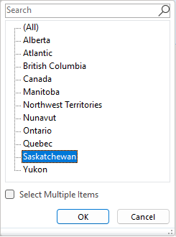
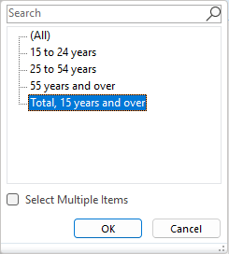
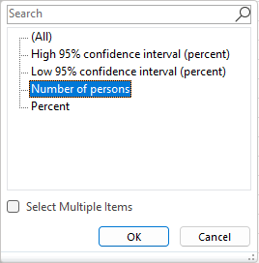
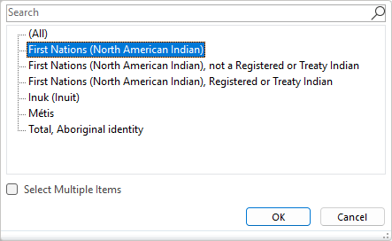
Working with the Pivot Tables
Placing Data Fields, Filtering
Now that we know the areas of the Pivot Table Field List, we need to arrange the data into the proper areas: Filters.
Set the filter for each of these four fields to restrict the data used in the table/chart.

Slide 17
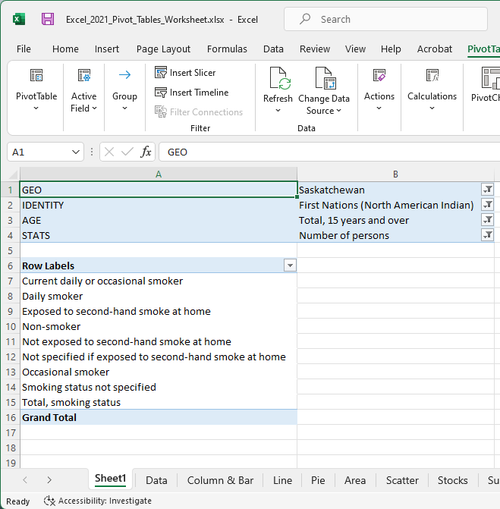
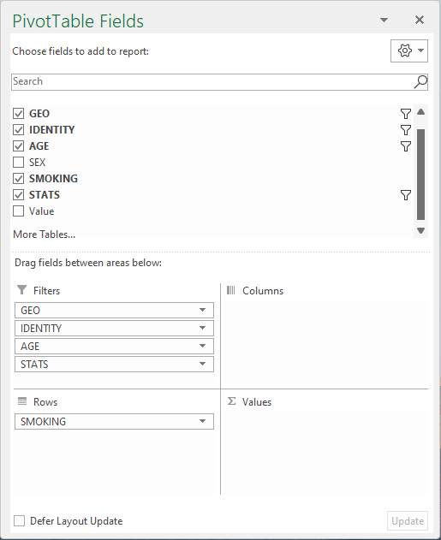
Working with the Pivot Tables
Placing Data Fields, Filtering
Now that we know the areas of the Pivot Table Field List, we need to arrange the data into the proper areas: Rows.
drag Smoking to the Rows panel.
clicking
by
Remove

Slide 18
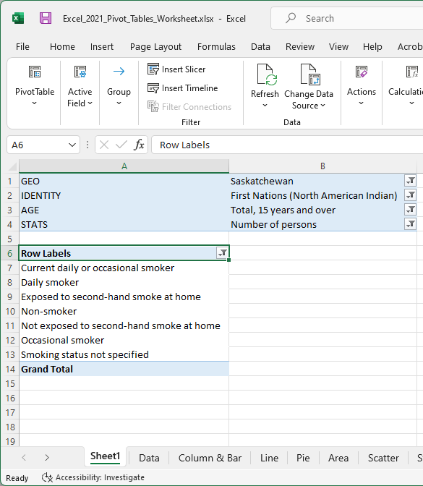
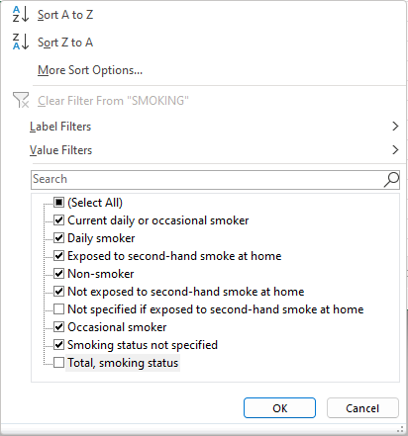
Working with the Pivot Tables
Placing Data Fields, Filtering
Now that we know the areas of the Pivot Table Field List, we need to arrange the data into the proper areas: Rows.
Result
Deselect
click OK

Slide 19
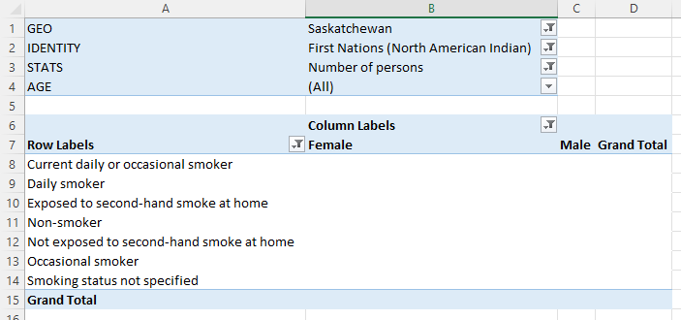
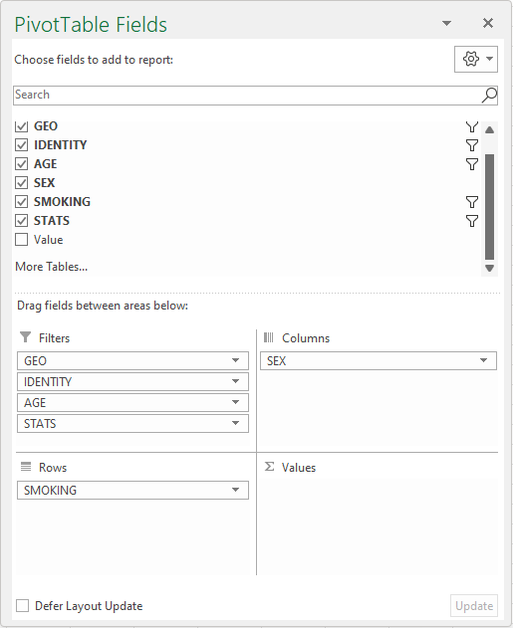
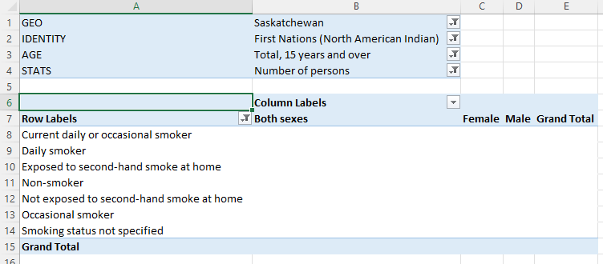
Working with the Pivot Tables
Placing Data Fields, Filtering
Now that we know the areas of the Pivot Table Field List, we need to arrange the data into the proper areas: Columns.
… by drag the SEX field …
… to the Columns box ...
to become
… by clicking on …
… then display the filter dialog …
Remove Both sexes …

Slide 20
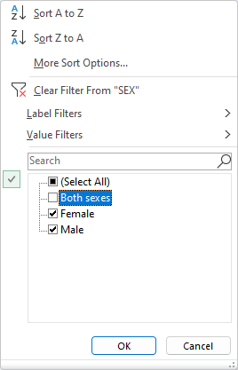
Working with the Pivot Tables
Placing Data Fields, Filtering
Now that we know the areas of the Pivot Table Field List, we need to arrange the data into the proper areas: Rows.
… by drag to it to the Columns box ...
deselect
… by clicking on …
… then display the filter dialog …
click on OK

Slide 21
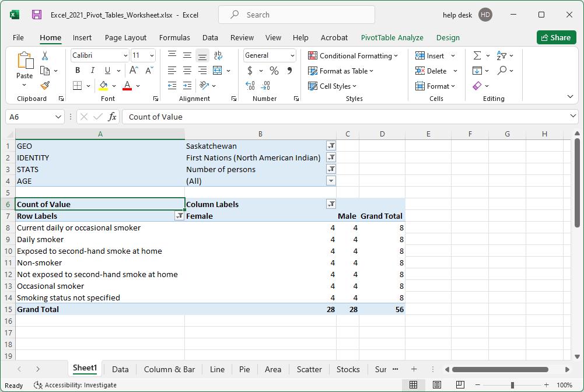
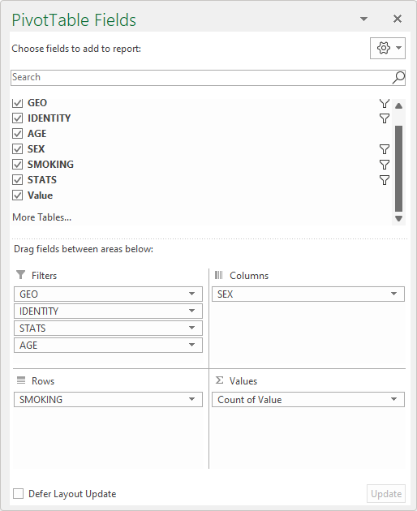
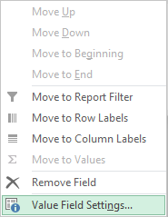
Working with the Pivot Tables
Placing Data Fields, Filtering
Now that we know the areas of the Pivot Table Field List, we need to arrange the data into the proper areas: Values.
Drag the Value field to the Values box …
… by clicking on …
… change the Count of Value to Sum of Value …
… select Value Field Settings

Slide 22
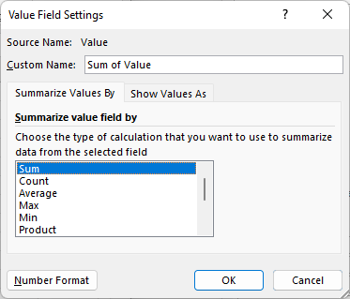
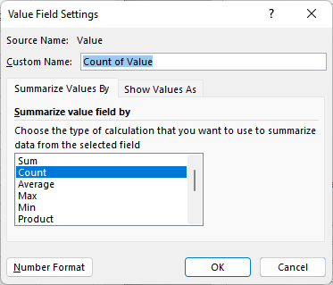
Working with the Pivot Tables
Placing Data Fields, Filtering
Now that we know the areas of the Pivot Table Field List, we need to arrange the data into the proper areas: Values.

Slide 23
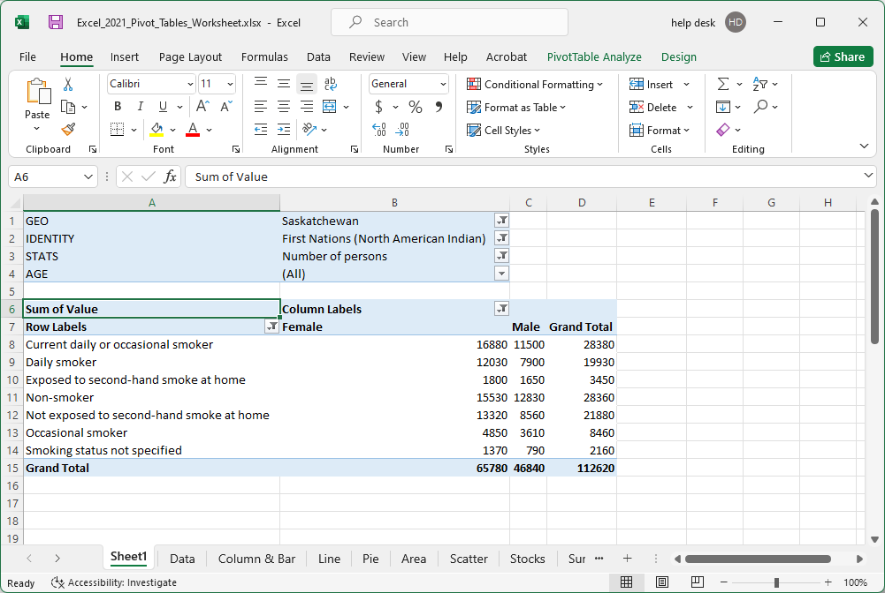

Working with the Pivot Tables
Placing Data Fields, Filtering
Now that we know the areas of the Pivot Table Field List, we need to arrange the data into the proper areas: Values.
Notice how the values have changed to something more useful.
The next step is to make a chart to display visually the selected and filtered data.
… because of the Sum function.

Slide 24
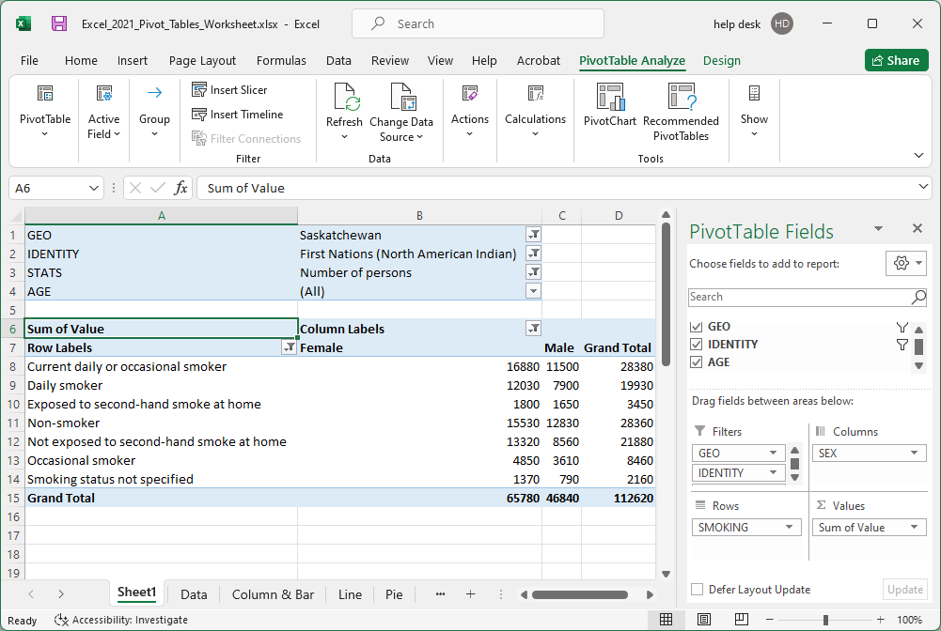
Working with the Pivot Tables - The Bar Chart
After moving the fields into their appropriate areas, applying filters, and selecting the SUM function to apply to the values field, we are finally ready to
add a Pivot Chart to display graphically what we see in the table.
Select the PivotChart command located in the Tools group on the Analyze ribbon.

Slide 25
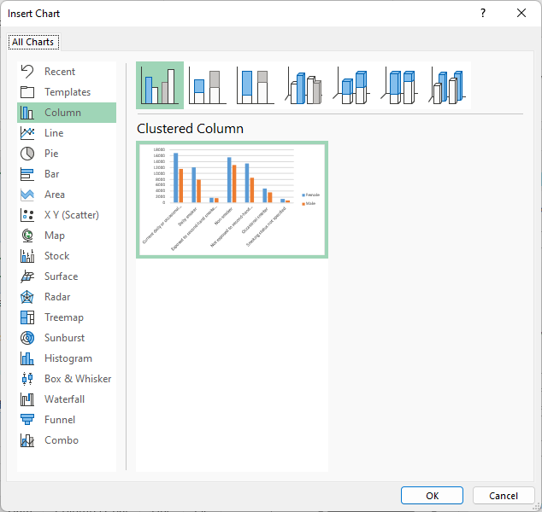
Working with the Pivot Tables - The Bar Chart
After moving the fields into their appropriate areas, applying filters, and selecting the SUM function to apply to the values field, we are finally ready to
add a Pivot Chart to display graphically what we see in the table.
Select the Column.
Click on the Clustered Column

Slide 26
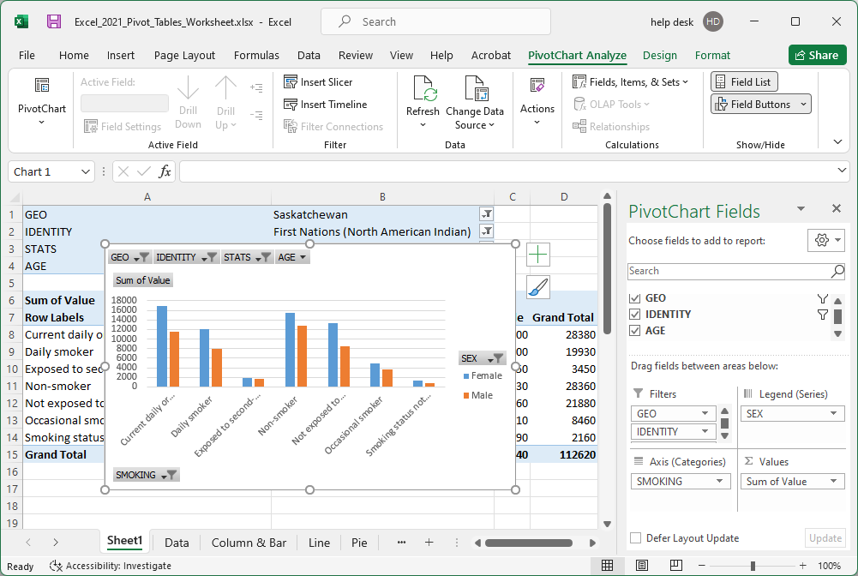
There are three PivotChart Tools contextual ribbons that will help us adjust the chart to present the data more clearly.
The PivotChart Ribbon – PivotChart Analyze
Analyze ribbon deals with …
The Active Field appears in the Legend Fields box.
Insert slicer, refresh the data or clear the filters.
Refresh or change the data source.
Actions - Clear or move the chart.
Do Calculations on Fields, Items or sets.
Show or hide a field list or field buttons.

Slide 27
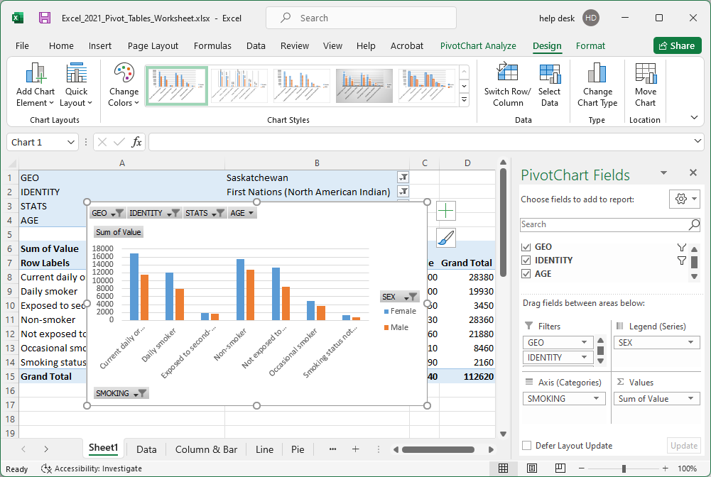
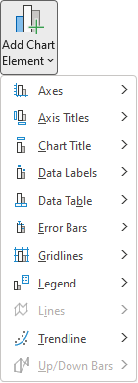
There are three PivotChart Tools contextual ribbons that will help us adjust the chart to present the data more clearly.
The PivotChart Ribbon – Design
The Chart Layouts group Add Chart Element
Design ribbon deals with …

Slide 28
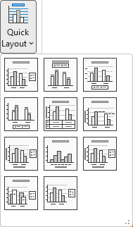
There are three PivotChart Tools contextual ribbons that will help us adjust the chart to present the data more clearly.
The PivotChart Ribbon – Design
Design ribbon deals with …
In the Chart Layouts is group Quick Layout.
If any of these chart element layout designs work for you, then click on it to select it.

Slide 29
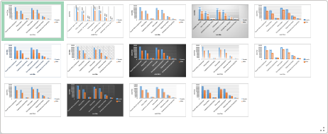
There are three PivotChart Tools contextual ribbons that will help us adjust the chart to present the data more clearly.
The PivotChart Ribbon – Design
Design ribbon deals with …
Select and/or change the chart style. Click on the more button.
Select the style you like, then adjust the colors to your liking by clicking on Change Colors.

Slide 30
There are three PivotChart Tools contextual ribbons that will help us adjust the chart to present the data more clearly.
The PivotChart Ribbon – Design
Design ribbon deals with …
Switch Row/Column. Flips the X & Y axis
Select Data allows you to add a new data set or alter existing data sets.
Change Chart Type
Move Chart to another worksheet or on the same worksheet.

Slide 31
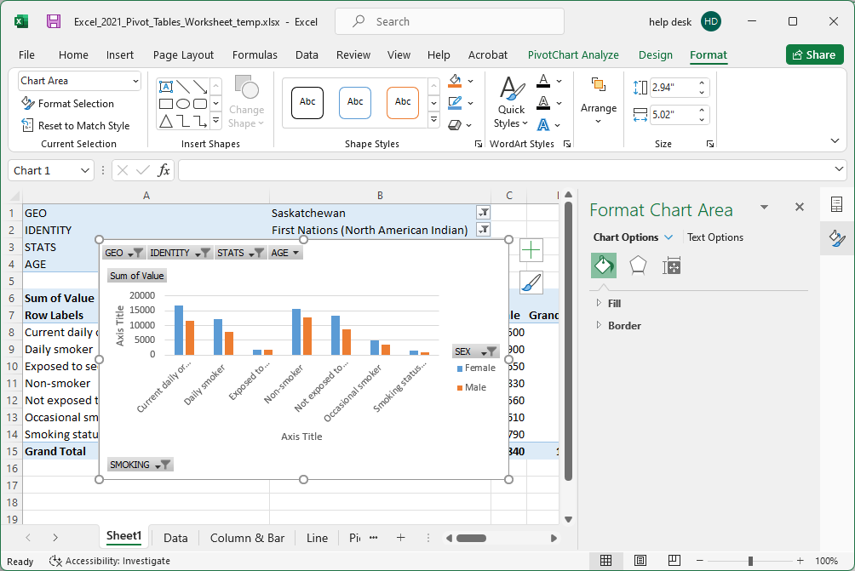
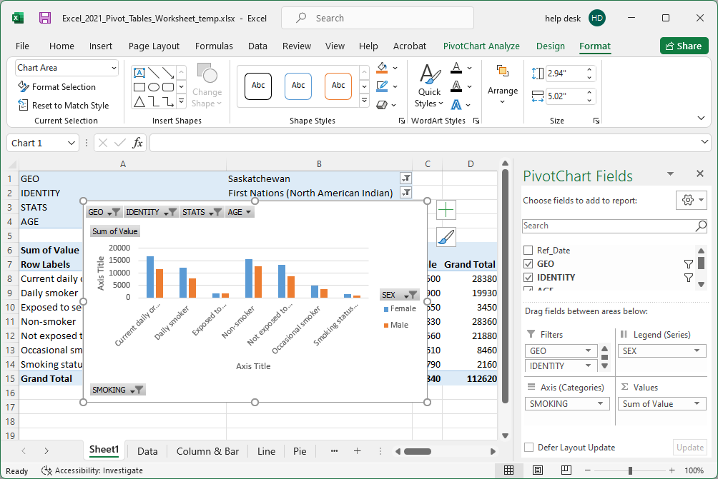
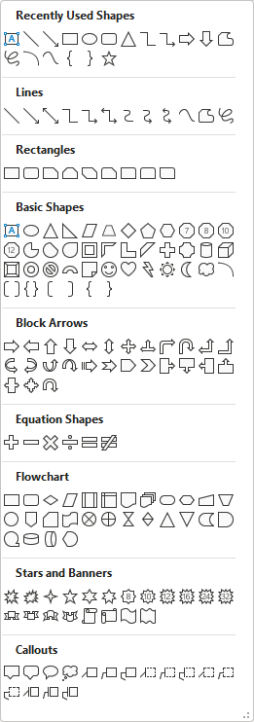
There are three PivotChart Tools contextual ribbons that will help us adjust the chart to present the data more clearly.
The PivotChart Tools Ribbon - Format
Current Selection group
Choose the chart element you want to format.
Click on Format Selection to snap the Format dialog on to the right side of the chart area.
Insert from a wide variety of different shapes.

Slide 32
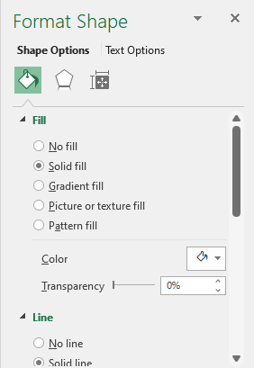
There are three PivotChart Tools contextual ribbons that will help us adjust the chart to present the data more clearly.
The PivotChart Tools Ribbon - Format
Choose from a predefined shape style and/or change the styles’ individual elements.
Choose from a predefined WordArt style and/or change the WordArts’ individual elements.
For both Shapes and WordArt there is a dialog box launcher button which snaps a formatting panel on the right side of the slide work area.

Slide 33

There are three PivotChart Tools contextual ribbons that will help us adjust the chart to present the data more clearly.
The PivotChart Tools Ribbon - Format
The Arrange group lets you manage any objects’ placement and stacking order as well as the ability to group together individual objects to be treated as one object, but can still be formatted individually.

Slide 34
There are three PivotChart Tools contextual ribbons that will help us adjust the chart to present the data more clearly.
The PivotChart Tools Ribbon - Format
Select an object and set the size here, or use the mouse and drag the edge of the object to resize it.

Slide 35
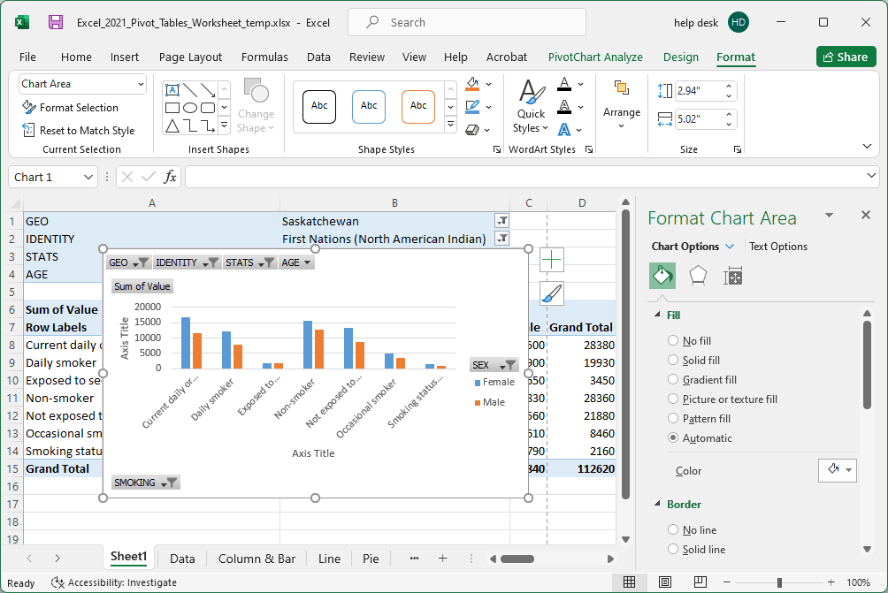
Working with the Pivot Table – Bar Chart
The Format panel and how to use it.
This is the name of the element to be formatted.
The Chart Options panel is the formatting of the container, (the chart itself), whereas the Text Options panel formats the contents of the container, (the chart content).
The paint bucket formats the chart background (fill) and border formats the line surrounding the chart.

Slide 36
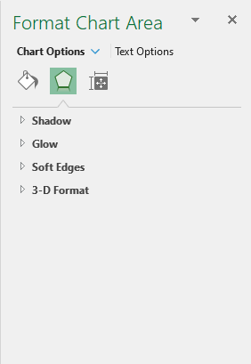
Working with the Pivot Table – Bar Chart
The Format panel and how to use it.
This is the name of the element to be formatted.
The Effects panel allows for the formatting of:
a shadow,
glow,
soft edges,
3D Formatting.

Slide 37
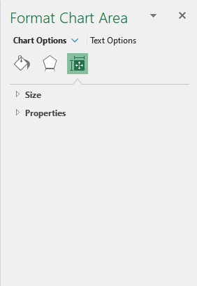
Working with the Pivot Table – Bar Chart
The Format panel and how to use it.
This is the name of the element to be formatted.
The Size & Properties panel allows for the formatting of:
The objects’ Size,
The objects’ Properties

Slide 38
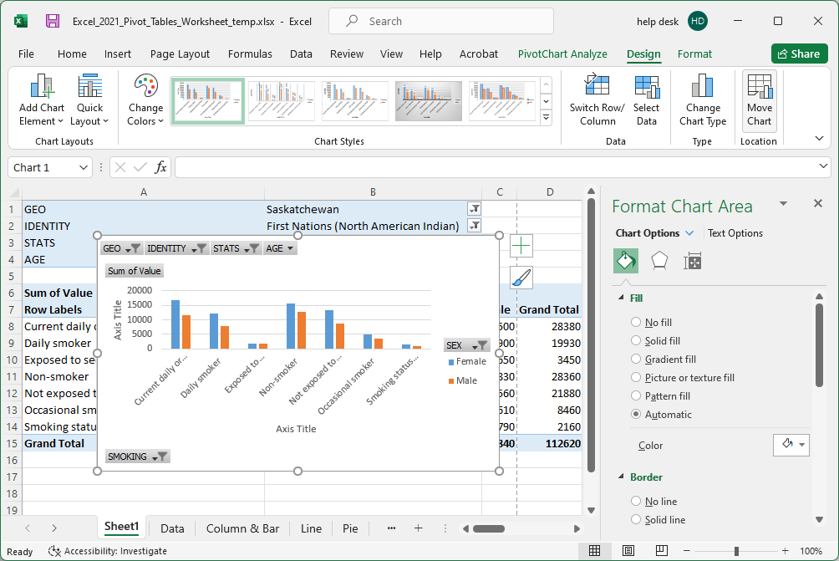
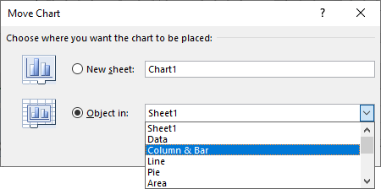
Working with the Pivot Table – Bar Chart
Move this Bar Chart to another sheet
and then format the bar chart to better represent the data.
Select the chart by clicking on it.
Now click on the Design tab, then on the Move Chart button to display the Move Chart dialog.
Then click on the Column & Bar option. Click on OK.
The chart move also moved your worksheet selection to the Column & Bar chart. Select Sheet1 again.

Slide 39
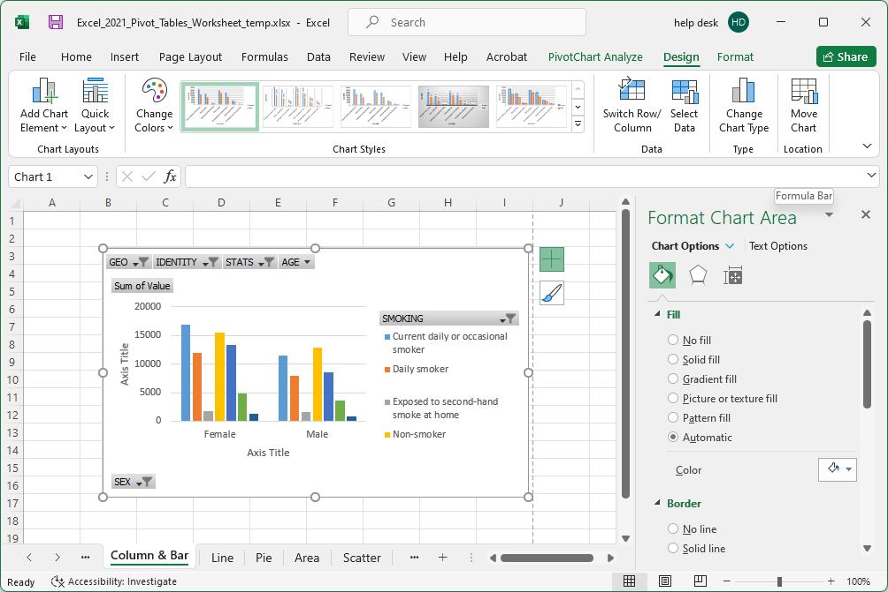
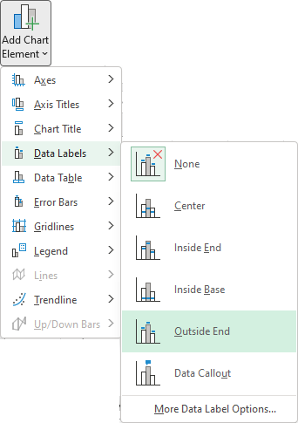
Working with the Pivot Table – Bar Chart Formatting
Click on the Design tab again, then on the Switch Row/Column button to flip the x/y axis.
Now the chart looks like this.
One more thing to add and format: the Data Labels.
On the Add Chart Element menu, choose Data Labels and then Outside End.

Slide 40
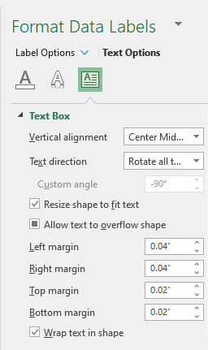
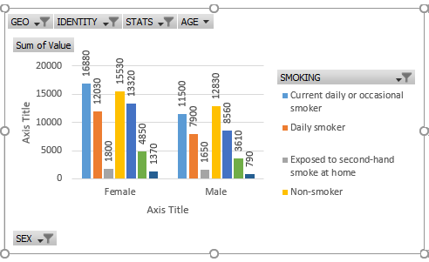
Working with the Pivot Table – Bar Chart Formatting
Make the Data Labels so they are 270°. They are more readable.
Text Direction has options for every 45°, but if you need to be more specific you can enter in a number.

Slide 41
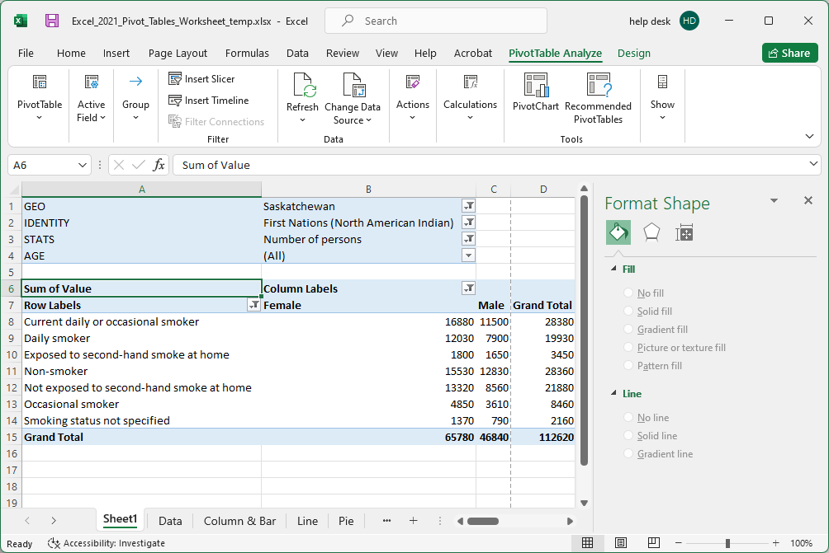

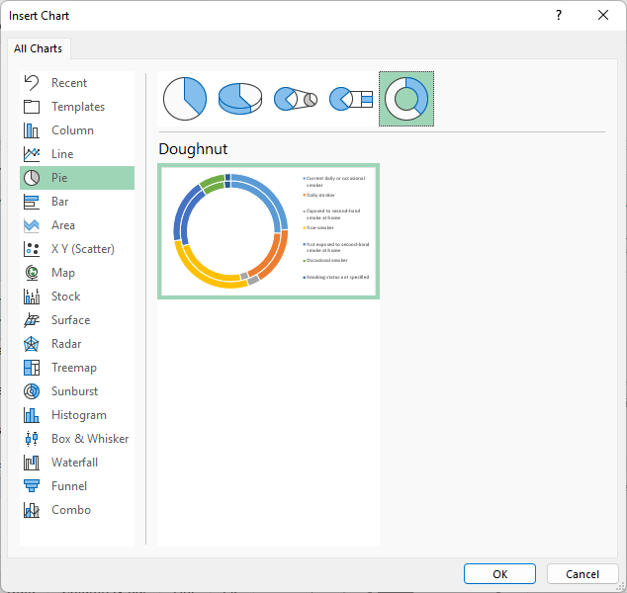
Working with the Pivot Table – Doughnut Chart
To create a doughnut chart
Select the doughnut chart by first clicking on the PivotTable Analyze tab.
Then click on the PivotChart button, which displays the Insert Chart dialog.
Finally, on the Pie charts panel select the doughnut chart.
Next, select the Pie category from the left side navigation pane.

Slide 42
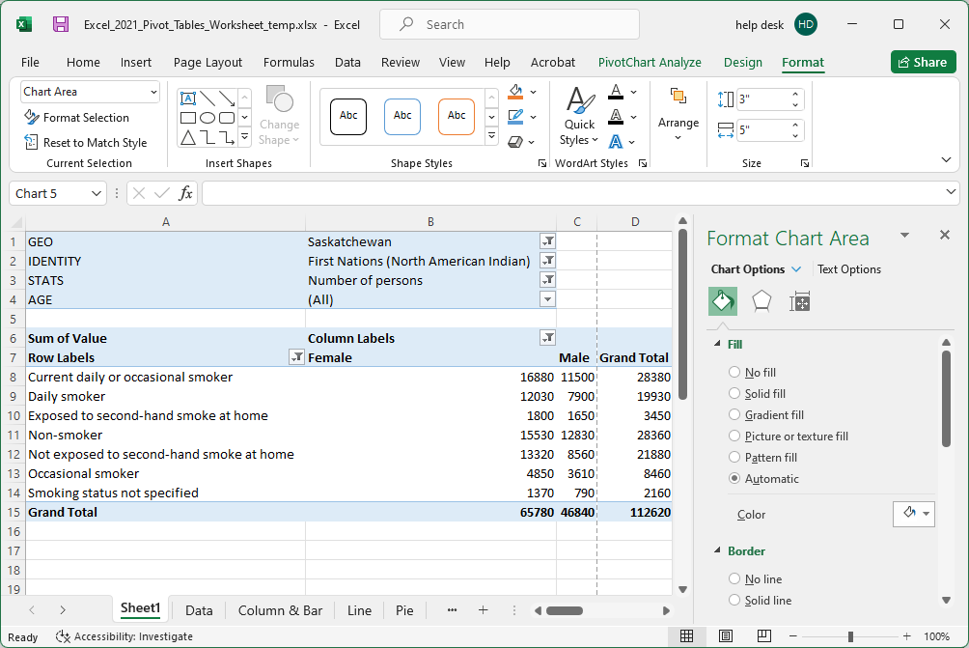


Working with the Pivot Table
Doughnut Chart
Our purpose here is to represent the data in another format, the doughnut chart, so no changes to the data will be necessary.
Click once on one of the ring segments.
One click on a doughnut segment selects all the segments in that doughnut ring.
Two clicks (not a double click, but a second click) on the same segment selects just the segment you clicked upon.
Now that all segments of the outer doughnut ring are selected, decrease the size of the doughnut hole to increase the width of the doughnut rings so the data labels can reside on each segment.

Slide 43

Working with the Pivot Table
Doughnut Chart
Our purpose here is to represent the data in another format, the doughnut chart, so no changes to the data will be necessary.
Make the doughnut hole smaller by reducing it to 25%.

Slide 44


Working with the Pivot Table
Doughnut Chart
Our purpose here is to represent the data in another format, the doughnut chart, so no changes to the data will be necessary.
With the pie segments of the outer doughnut ring still selected, add Data Labels by …
2. Clicking on Add Chart Element
1. Selecting the Design ribbon.
3. Selecting Data Labels/Show

Slide 45

Working with the Pivot Table
Doughnut Chart
Our purpose here is to represent the data in another format, the doughnut chart, so no changes to the data will be necessary.
Arrange the Data Labels so they can be seen; something like this.
Now do the same for the inner ring, the female stats.

Slide 46

Working with the Pivot Table
Doughnut Chart
Our purpose here is to represent the data in another format, the doughnut chart, so no changes to the data will be necessary.
I needed to make the chart larger to make the data labels fit.

Slide 47

Working with the Pivot Table – Doughnut Chart
Do some formatting to the doughnut to make it more informative.
Do the following alterations:
Add a Chart Title

Slide 48

We have covered here in this course …
Preamble and Definitions
Working with the Pivot Table – Bar Chart
Downloading and Opening the Exercise File
Working with the Pivot Tables
Placing Data Fields and Filtering
Creating a Pivot Table
Working with the Pivot Tables
The Bar Chart
Pivot Chart Anatomy
Working with the Pivot Tables
The Doughnut Chart

Slide 49
NITHA IT Helpdesk
helpdesk@nitha.com
1(306)953-5008

Slide 50

Thank you

