Slide 1


Excel 2021 Formulas & Data
Advanced Level

Slide 2
NITHA IT Helpdesk
helpdesk@nitha.com
1(306)953-5008

Slide 3

What will we be covering in this course?
What is the direction for this course.
Sorting, Filtering and Restricting the Data
The Ribbons & the Commands
Categories of Functions Provided By Excel
Some Relevant Definitions
Exercise in Using:
Information Functions
Connecting to MS Access Data
Logical Functions
Math Functions
Importing CSV Data
Statistical Functions
Text Functions
Database Function & an Exercise in Using Them

Slide 4
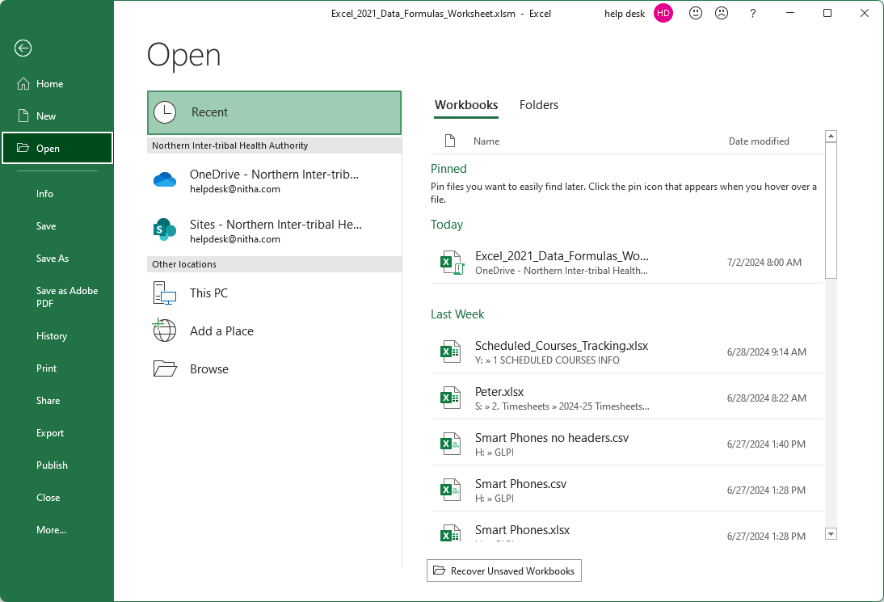
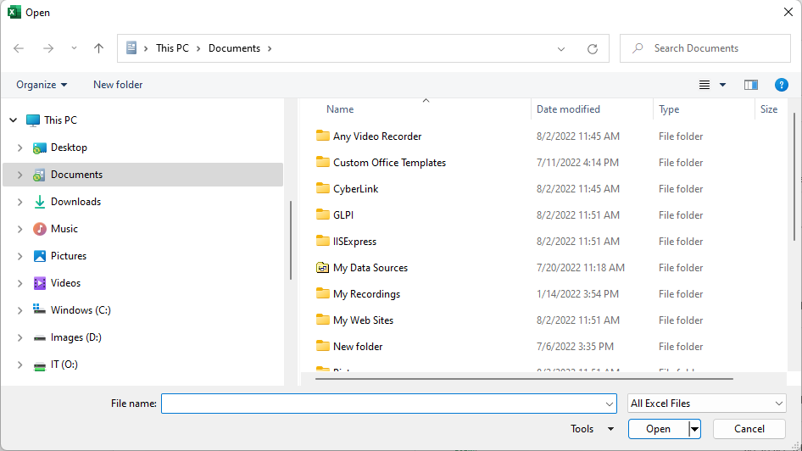
Run Excel 2021 by starting the software from the Start menu and then loading the workbook.xlsm file.
When you first start Excel 2021, the first screen you see is this …
Click on Open …
Choose the folder into which you extracted the files for this course. Select the file, then click on Open.
If the file you want is not visible in the pinned area, then click on Browse.

Slide 5
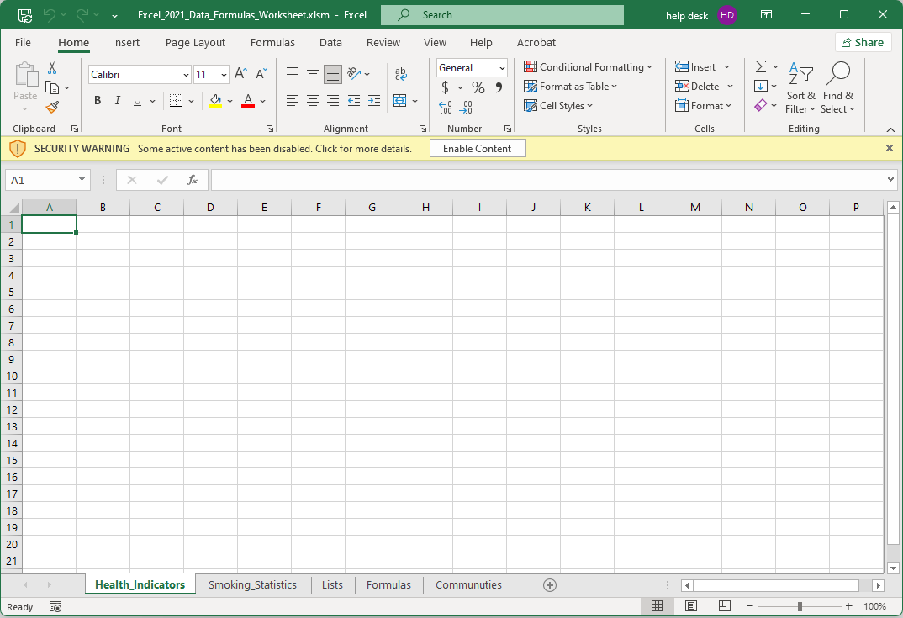
This yellow bar, Security Warning, informs you that the workbook is macro-enabled. Macros in documents can have a virus embedded into it.

Slide 6
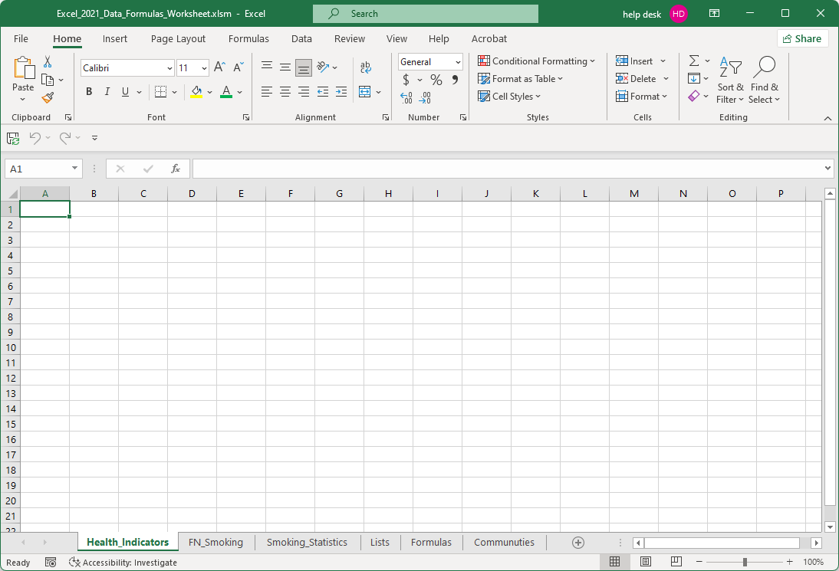
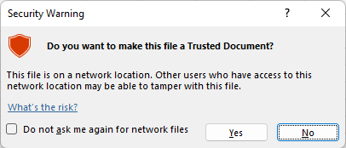
Open the sample workbook
The workbook is a macro enabled workbook. Notice the .xlsm extension on the file.
The first two spreadsheets are empty because those are the spreadsheets into which we will import data.
The “m” at the end of the file extension indicates this workbook is macro-enabled.
You might also see this dialog box. This warning is telling you this is a macro-enabled file and you need to authorize its’ use.

Slide 7
What is our direction in this course?
Assumption 1:
I will be assuming you have a basic knowledge Excel: navigation, screen layout, etc.
Assumption 2:
You must know the following:
  What are ribbons, both regular and contextual?
  What are spreadsheets, how to navigate them, and how do you create more of them.
What is a dialog box and what is a window pane.
Our goal is to import data and then use Excel provided functions to the data in our formula.
To accomplish our goal we will have to:
Learn how to connect to an outside source of data and to import data.
Know how to use the appropriate function(s) on the data to achieve our goal.
Learn how to step through our formula(s) and troubleshoot possible issues.
Definitions …
Formula – A formula is a mathematical expression telling Excel what mathematical operation(s) to perform upon
specific value(s).
Function – A function is a predefined formula available in Excel. All you need to do is plug in the appropriate data.

Slide 8
Important Caveat
The data we are going to use and the correlation between the data sets are not necessarily an accurate health data comparison.
It is the methodology of:
connecting to a database,
importing data,
restricting the data so that it is usable, and
using Excel functions to pull data from those two sources to produce a result that is the intended purpose of this course.

Slide 9
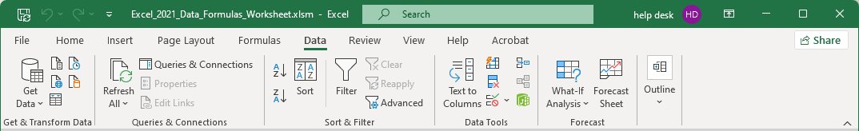
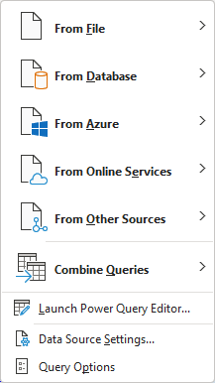
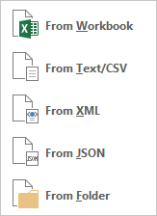
Connection Methods
From File
From Workbook – You can link to cell(s), table(s) or full spreadsheet(s) in another workbook as long as you have access to it. Be careful not to break the link if you move or rename either file.
From Text – Import text from a file. This text is separated by a delimiter.
Definition: A delimiter is a character that separates data values.
Typically, data in a text file is delimited by a comma or a tab character and each new row of data is delimited by the carriage return character.
For example, in the file you might see:
First Name, Last Name, Address1, Address2, City, Province, Country
John, Smith, Apt. 1234, 123 Street, Prince Albert, SK, Canada
From XML – eXtensible Markup Language is a text based file used for the definition, storage and transfer of data.

Slide 10
Connection Methods
From JSON – JavaScript Object Notation is a JavaScript based method for exchanging data, usually from a website to a web browser, but is not limited to that.
Excel can use JSON to transfer data, usually from a website to Excel and/or from Excel to the website.
From Folder – You can import metadata and links about other files in a folder.
Metadata is data that provides information about other data.
For example, the author name, date created, date modified, last person to access the file, tags, subject, and category are all examples of some of the metadata attached to a file.
For Excel it is the metadata in the Document Properties. (File tab, Info panel, right side of that panel).
It is this data that is imported from the files in the folder you connect to using the From Folder command.

Slide 11
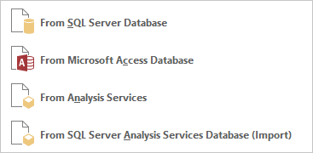
Connection Methods
From Database
From SQL Server Database – A Structured Query Language (SQL) Server Database is one of the most common types of databases for network/internet accessible data. Most modern websites use them, as do most programs that can hold vast amounts of data.
From Microsoft Access Database – Microsoft Access is a user-friendly database management system stored as an .accdb file. Excel can connect to and import entire tables or SQL query results.
From Analysis Server – A Microsoft SQL Server Analysis Services (SSAS) is an OnLine Analytical Processing (OLAP) and data mining tool as part of Microsoft SQL Server.
It offers services such as Integration Services, Reporting Services and Analysis Services.

Slide 12
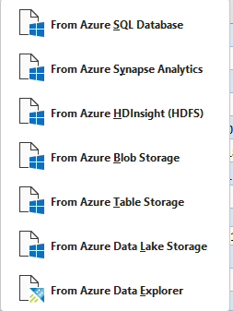
Connection Methods
From Azure
From Azure – Azure is Microsoft’s server platform, like Amazon, except the Azure platform is bound tightly with the Office 365 platform, which makes Azure even more capable than Amazon servers.
These options are for retrieving data from various iterations of the Azure platform.

Slide 13
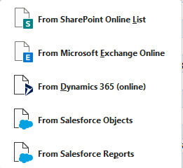
Connection Methods
From Online Services
From SharePoint Online List – SharePoint lists are designed to help you track and manage data records in a variety of ways, allowing for different formats, workflows, and access controls.
From Microsoft Exchange Online – Exchange is Microsoft’s messaging platform. You can pull data from the Exchange server.
From Dynamic 365 Online – A Dynamics 365 Online server helps enterprises to unify their workflow, gain insights into their business, and to encourage better relationships with clients.

Slide 14
Connection Methods
From Online Services
From Salesforce Objects – When a template is loaded on a Worksheet, it becomes an Excel table and is bound to a Salesforce object.
Each column in the table is bound to a Salesforce field. The table can then be used to retrieve and/or update data from Salesforce, as well as create new records in Salesforce.
From Salesforce Reports – A Salesforce report is a tool in Salesforce that helps people organize and display their data in an easily understandable way.

Slide 15
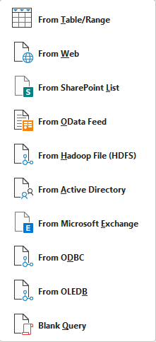
Connection Methods
From Other Sources
From Table/Range – Select a whole table or range from a table from any spreadsheet in the current workbook.
From Web – Import data, usually tabular data, from a web page.
SharePoint List – A list of available SharePoint file storage object.
From OData Feed – An OData feed is a protocol for creating and using of RESTful APIs. REST (REpresentational State Transfer) is a language-independent architectural style for developing web services by using existing web technologies.
OData is the connection, the pipe. REST is the “fluid” that flows through the pipe.

Slide 16
Connection Methods
From Other Sources
From Hadoop File (HDFS) – The Hadoop Distributed File System is an open source framework.
HDFS provides high-throughput data access to application data and is suitable for applications that have large data sets, which enables streaming access to file system data in Apache Hadoop.
From Active Directory – Import data from Active Directory, which is the main directory of users in a Microsoft domain.
From Microsoft Exchange – Pull data from an Exchange server.
From ODBC – Open DataBase Connectivity is an impressive platform in which drivers that are written to connect to a variety of database types and even different operating systems can be added and used to bridge between differing database technologies. ODBC has been with Windows since 1992, since Windows 3.1.

Slide 17
Connection Methods
From Other Sources
From OLEDB – Object Linking and Embedding DataBase is the “higher level” successor to ODBC which uses COM (Component Object Model), the core of the Windows operating system.
From Blank Query – Use Power Query software that comes with Excel to create a new query from a blank query.

Slide 18

Connection Methods
Combine Queries
Combine Queries – Merge or append queries together.

Slide 19
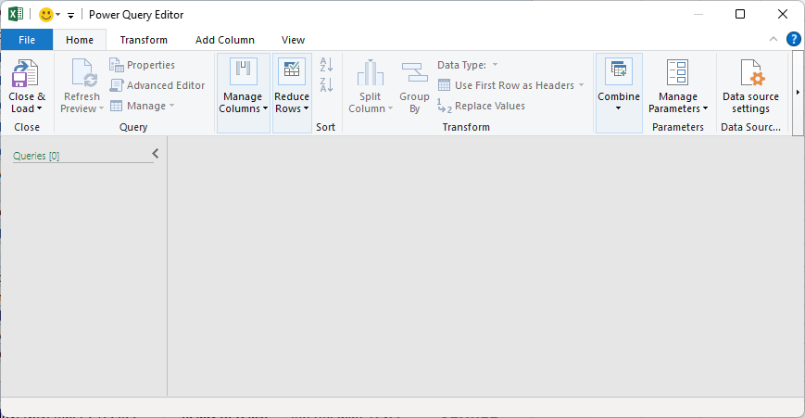
Connection Methods
Launch Power Query Editor…
Launch Power Query Editor – Launches the app shown below.

Slide 20
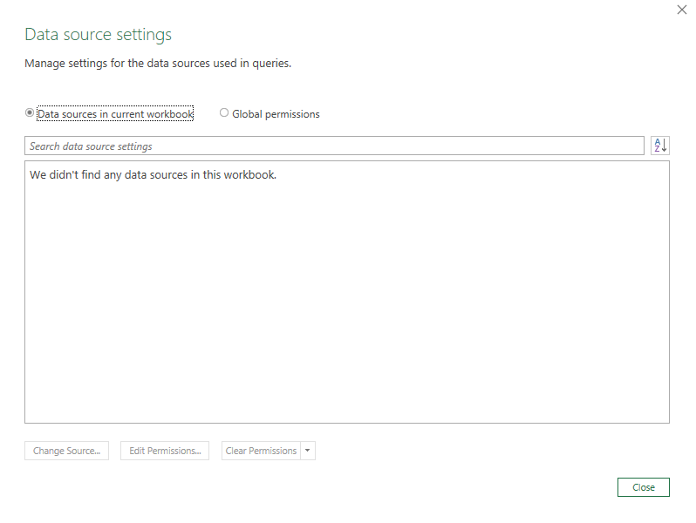
Connection Methods
Data Source Settings – Launches the dialog below.
There are no connections here now, but there will be once we add two connections:
Access database (Smoking Statistics) and
CSV file (Health Indicators).

Slide 21
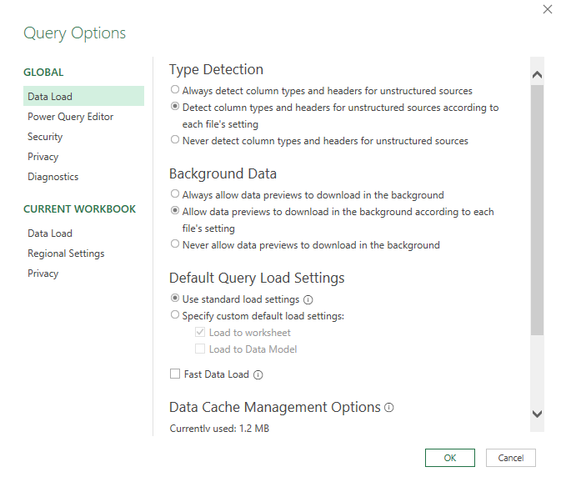
Connection Methods
Query Options – Launches the options dialog.

Slide 22
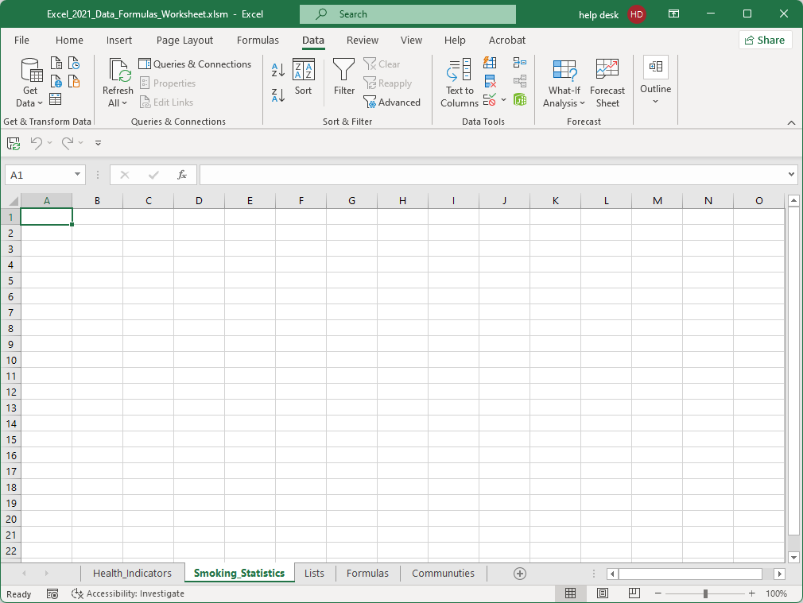
Connect to the Access database
Click on the Get Data button.
Select From Database
Select From Microsoft Access Database
Select cell A1
Select the Smoking_Statistics sheet.

Slide 23
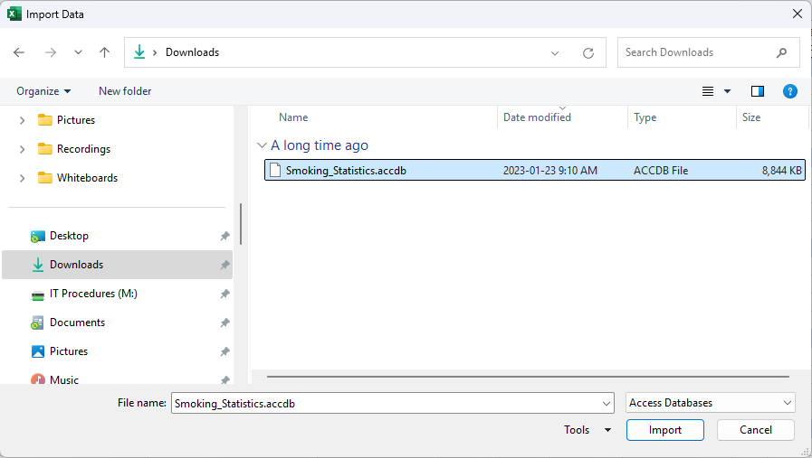
Connect to the Access database
Browse to where you have the data files for this course, in the downloads folder.
Click on Import
Select Smoking_Statistics.accdb

Slide 24
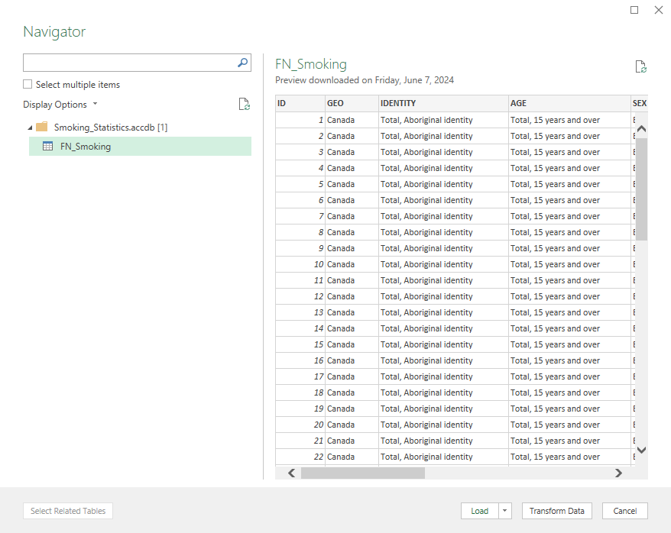
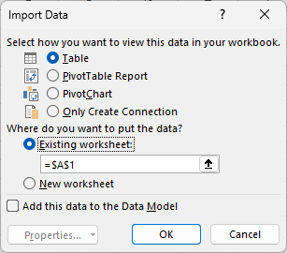

Connect to the Access database
1. Select FN_Smoking
Select from these options how you want the data imported.
Select the cell on an existing worksheet or select a new worksheet.
A data model is where two or more data tables are connected based on common fields or identifier keys.
It allows you to integrate data from multiple tables, creating a relational data source
Click on OK
2. Load to … Allows you to choose the workbook; a new worksheet will be created for the data.

Slide 25
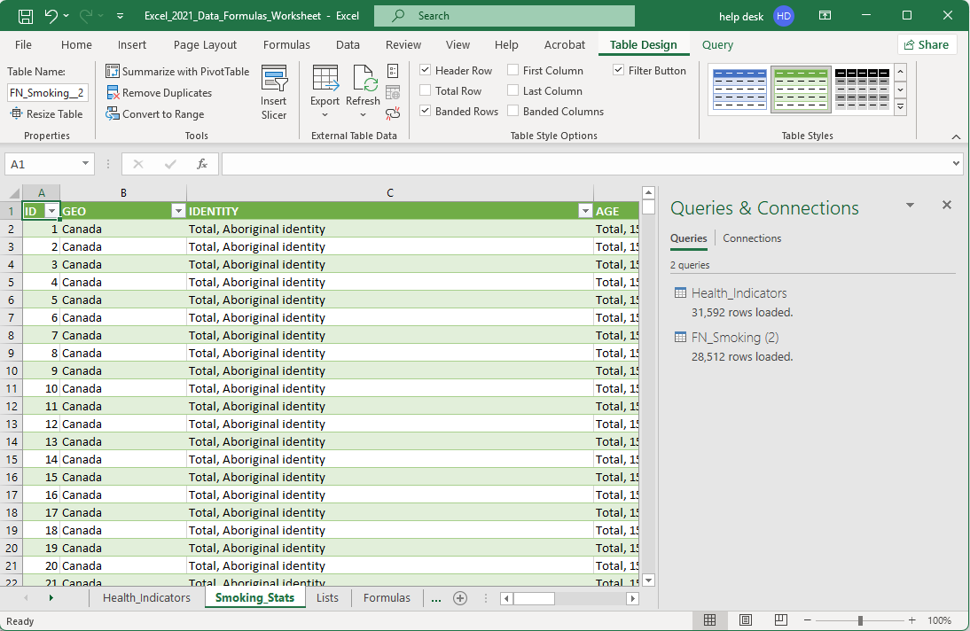
Connected to the Access database
This is what you should see now after connecting to Smoking_Stats Access database.

Slide 26
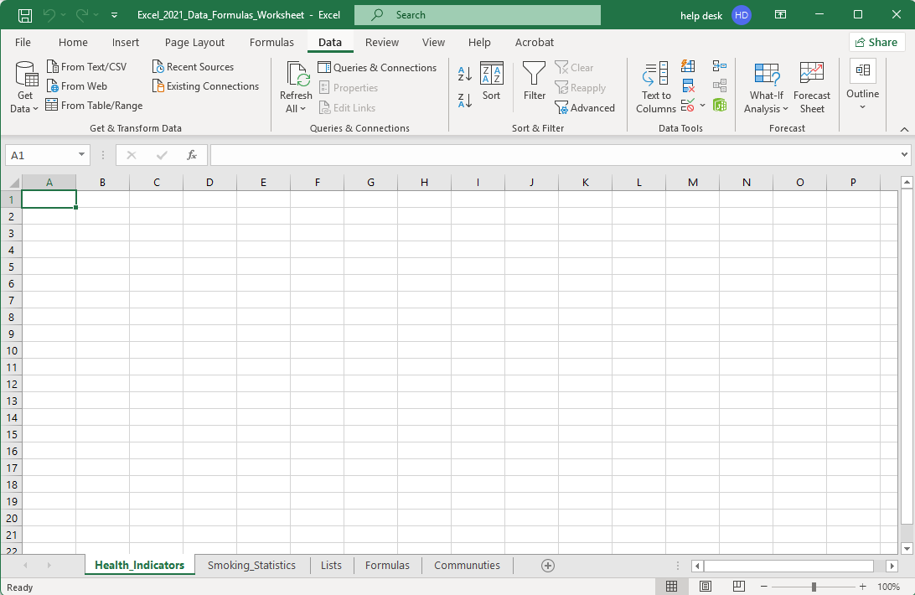
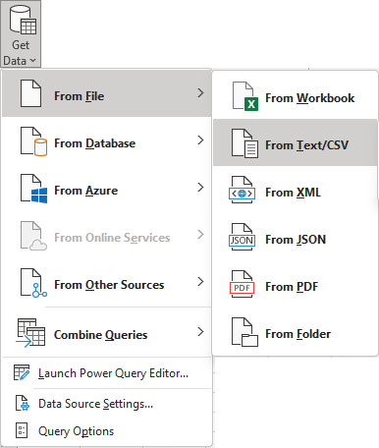
Load the CSV data
Click on the Get Data button.
Select From File.
Select From Text/CSV
Select cell A1
Select the Health_Indicators sheet.

Slide 27
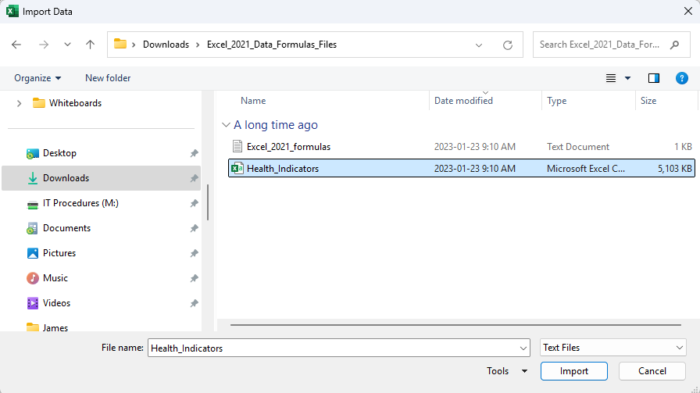
Load the CSV data
Click on the Health_Indicators button.
Click on Import

Slide 28
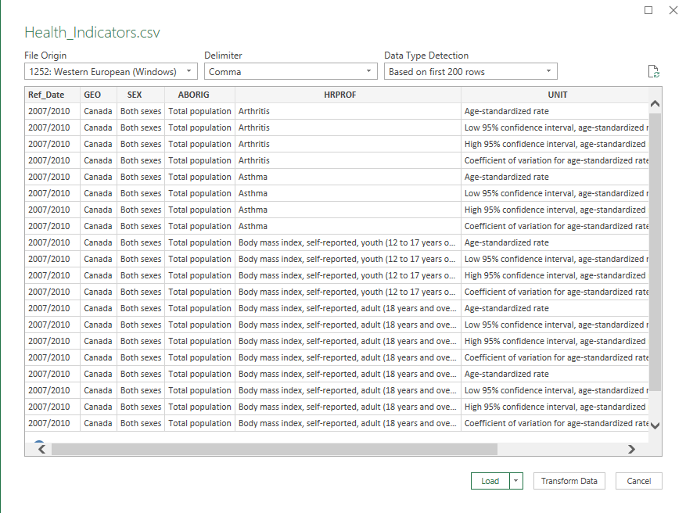

Load the CSV data
The first screen you see when you start the import process of the CSV file we just selected, Step 1 of 3, is where we have to tell Excel what character is used to separated the data.
Select the delimiter, in this case is a comma.
Select 1252: Western European (Windows)
Data Type Detection – How many rows do you need Excel to sample to automatically detect the delimiter.
Transform Data – flips rows to columns and columns to rows and places the data into a new worksheet.
Load – In the drop menu:
Load places the data into a new worksheet.
Load to places the data into the worksheet you choose.

Slide 29
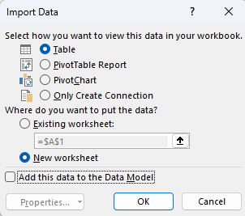
Load the CSV data
How do you want the data to appear;
in a table
as a PivotTable Report
as a PivotChart, or
only create the connection without importing the data.
Select the location of the data.
Add the data to a Data Model.
Click on OK.

Slide 30
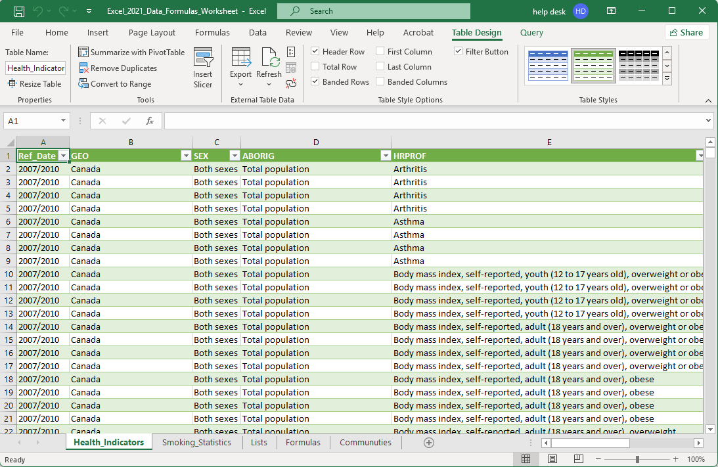
Load the CSV data
Once imported, this is what you should see.
CSV files, once imported, are no longer necessary because the import is a one-time process, unlike Access, which is a “live” connection.
When the data changes by another agent on the source database, MS Access, then when your spreadsheet connection is refreshed, your data is also updated to reflect the new data.

Slide 31
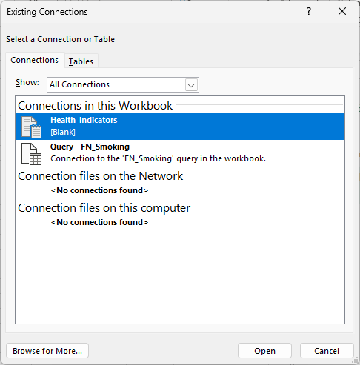
Queries & Connections
Existing Connections – Existing Connections, in the Get & Transform Data group, displays a dialog box that is divided into two tabs: Connections and Tables
Recent Sources – For any source to which you had once connected, you can connect again. That is all this command does.
The Connections panel allows you to modify existing connections and/or to add more from a file. The files have the extension of .ODC and are by default located in your documents folder in the My Data Sources sub-folder.
The Connections panel is divided into three sections:
Connections in this workbook
Connection files on the network (.odc file)
Connection files on this computer (.odc file)
The Tables panel simply allows you to choose a table in all the active connections in the current or other workbooks.

Slide 32
Queries & Connections
Existing Connections – Existing Connections, in the Get & Transform Data group, displays a dialog box that is divided into two tabs: Connections and Tables
Recent Sources – For any source to which you had once connected, you can connect again. That is all this command does.
The Connections panel allows you to modify existing connections and/or to add more from file. The files have the extension of .ODC and are by default located in your documents folder in the My Data Sources sub-folder.
The Connections panel is divided into three sections:
Connections in this workbook
Connection files on the network (.odc file)
Connection files on this computer (.odc file)
The Tables panel simply allows you to choose a table in all the active connections in the current or other workbooks.

Slide 33
Some definitions we will need to know
Database
A database, as defined in Excel, is a flat database, the simplest type of database, which includes a range of columns and rows with the column header the name of the data in that column.
Record
In Excel, a record is defined as a row of data. A typical spreadsheet has column headers which define the name of the data in that column. A row contains one item of data from each column in the row, and each row is one record.
Field
A field in Excel is typically a single cell of data, but can also refer to a cell range or a defined name of cells.
Field Name
A field name in Excel is the column header.
Data Type
A data type is the formatting applied to the column from the Format Cells / Number column. For example, number, currency, accounting, date, time, percentage, fraction, text, etc.
Criteria
Another name for criteria is condition. So, criteria are one or more conditions that have to be met for the function to return a result.
As we go through the course and use the functions, these definitions will become clearer.
Probably the most difficult one to understand is the criteria.

Slide 34

Database Functions
Parameter – A parameter is a constant or variable value. In this case, it is the data that you pass to a function.
The following is a list of database functions:
Function Parameters:
For all database functions the format is … Database_Function(Database, Field, Criteria)
Database = The range of cells you want to apply the criteria against, usually the entire table.
Field = The column in the database against which the criteria is applied to produce the result.
Criteria = The cell or range of cells that contain your criteria, the conditions.
DAVERAGE
Averages the values of the specified cells, list or database that matches the conditions you have set and returns a numeric value.
DCOUNT
Counts the number of cells containing data or records containing data that match the search criteria you provide and returns a positive integer.
DCOUNTA
Counts the number of cells containing nonblank cells or records containing nonblank cells that match the search criteria you provide and returns a positive integer.
DGET
Gets from a database a single record that matches the criteria you provide.
DMAX
Returns the largest number in the field of records in the database that matches the criteria you provide.

Slide 35
Database Functions
The following is a list of database functions (continued):
DMIN
Returns the smallest number in the field of records in the database that matches the criteria you provide.
DPRODUCT
Returns the value of the field of records in the database that matches the criteria you provide multiplied together.
DSTDEV
Estimates the standard deviation based on your section from the database.
DSTDEVP
Calculates the standard deviation based on the entire population of the selected database entries.
DSUM
Adds the numbers of your selection from the database that match the criteria you specify.
DVAR
Estimates the variance based on your selection from the database matching the criteria.
DVARP
Calculates the variance based on the entire population of the selected database entries.
We won’t be using all the database functions, just DAVERAGE, DCOUNT, DMIN, DSTDEV, DVARP

Slide 36
NOTE: There is a text file, called Excel_2021_formulas.txt, that has all of the formulas and functions already typed up for you. Just copy and paste them into the cells indicated.
For this exercise, we will use some features of Excel that you may not have used before. They are …
Make three lists of unique data values from three columns by using a macro written in Visual Basic for Applications (VBA).
Make a drop-down selection box for those lists, which will define the criteria parameter of the database function.
On the Formulas sheet enter the following database functions …
In cell A5 enter …
=DAVERAGE(Health_Indicators!A1:I31593,Health_Indicators!I1,Formulas!D2:F3)
In cell A8 enter …
=DCOUNT(Health_Indicators!A1:I31593,Health_Indicators!I1,Formulas!D2:F3)
In cell A11 enter …
=DMIN(Health_Indicators!A1:I31593,Health_Indicators!I1,Formulas!D2:F3)
In cell A14 enter …
=DSTDEV(Health_Indicators!A1:I31593,Health_Indicators!I1,Formulas!D2:F3)
In cell A17 enter …
=DVARP(Health_Indicators!A1:I31593,Health_Indicators!I1,Formulas!D2:F3)

Slide 37
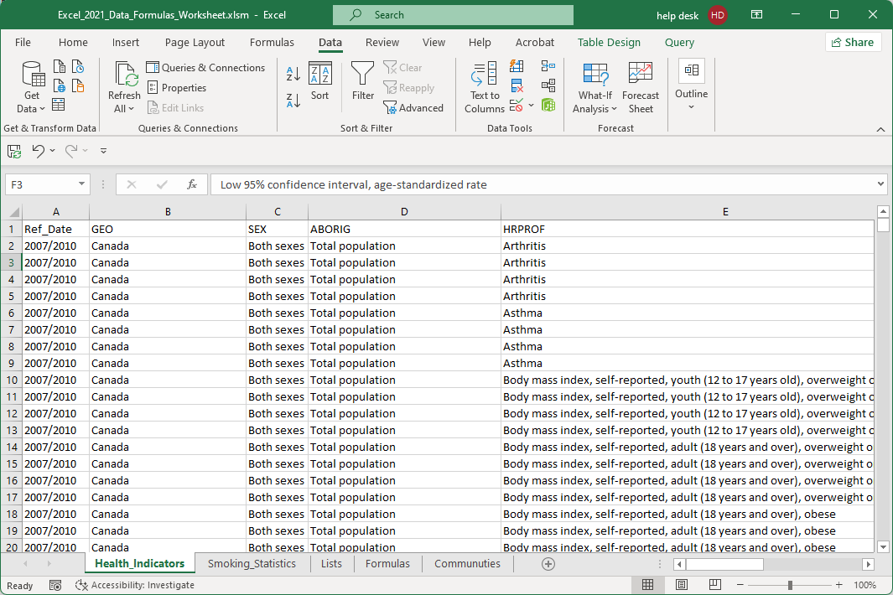
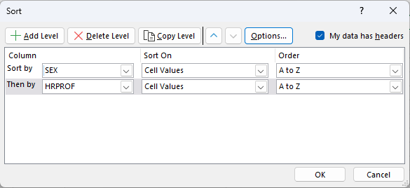
Work with the Health_Indicators to restrict the data
Sort the data by
SEX
HRPROF

Slide 38
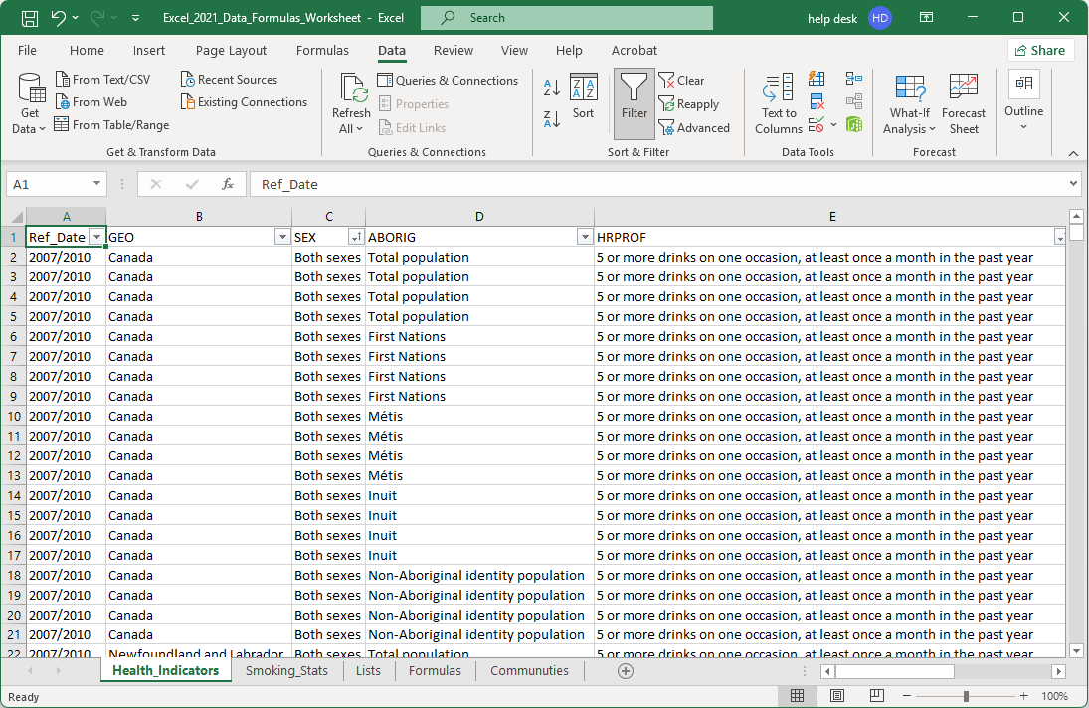
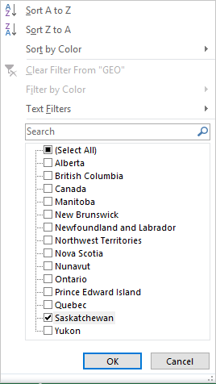
Work with the Health_Indicators to restrict the data
Click on the Filter option.
Filter by the following
GEO
Saskatchewan only
2300 of 31592 records

Slide 39
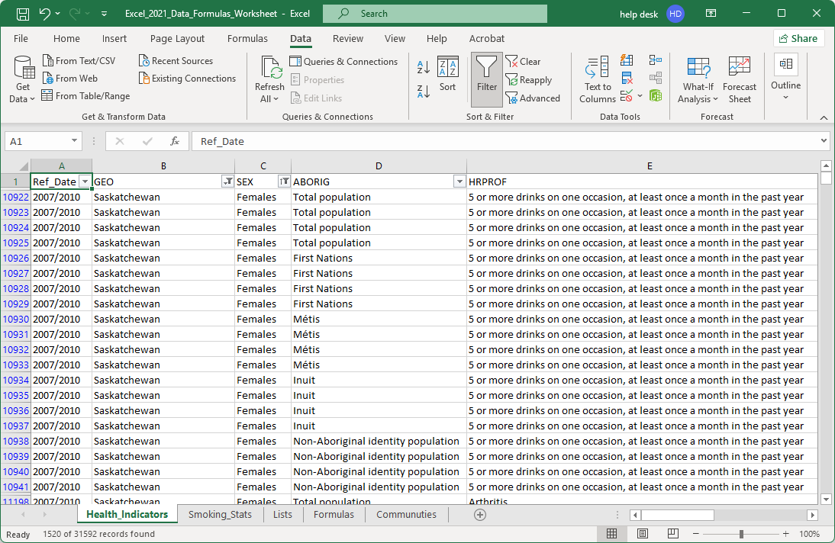
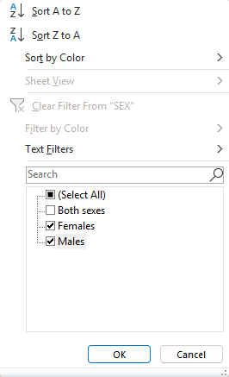
Work with the Health_Indicators to restrict the data
Filter by the following
SEX
Female & Males only
1520 of 31592 records

Slide 40
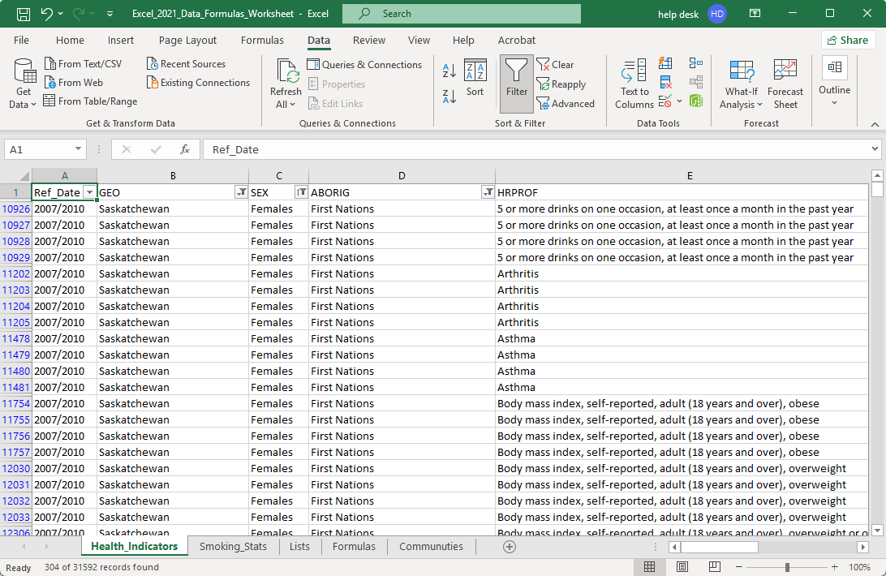
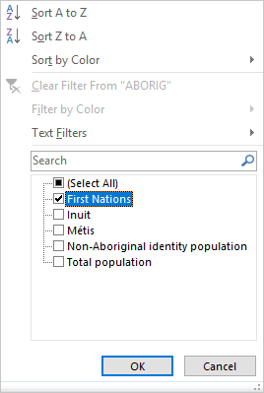
Work with the Health_Indicators to restrict the data
Filter by the following
ABORIG
First Nations only
304 of 31592 records

Slide 41
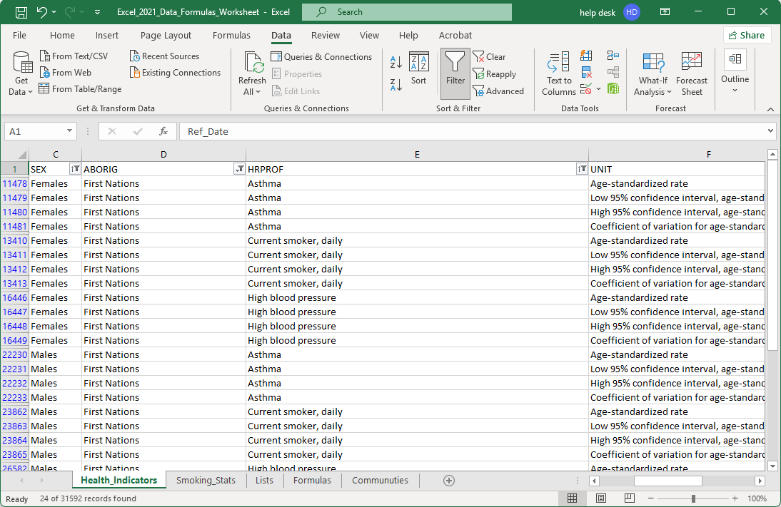
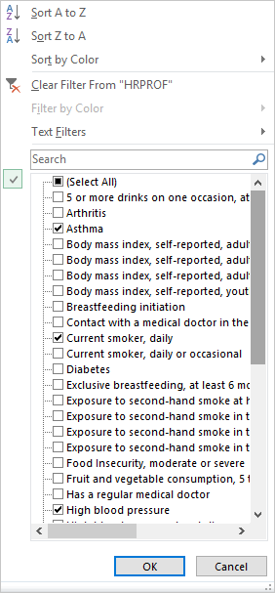
Work with the Health_Indicators to restrict the data
Filter by the following
HRPROF –
Asthma,
Current Smoker Daily,
High Blood Pressure
24 of 31592 records

Slide 42
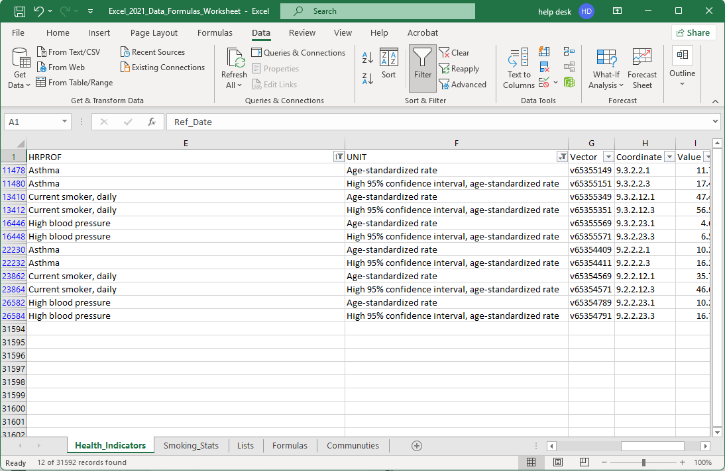
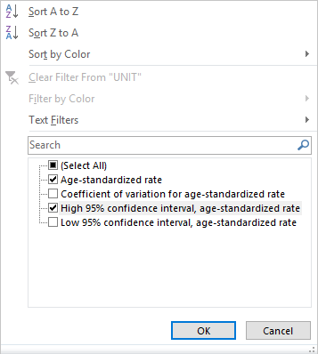
Work with the Health_Indicators to restrict the data
Filter by the following
UNIT
age-standardized rate
High 95% confidence interval,
12 of 31592 records

Slide 43
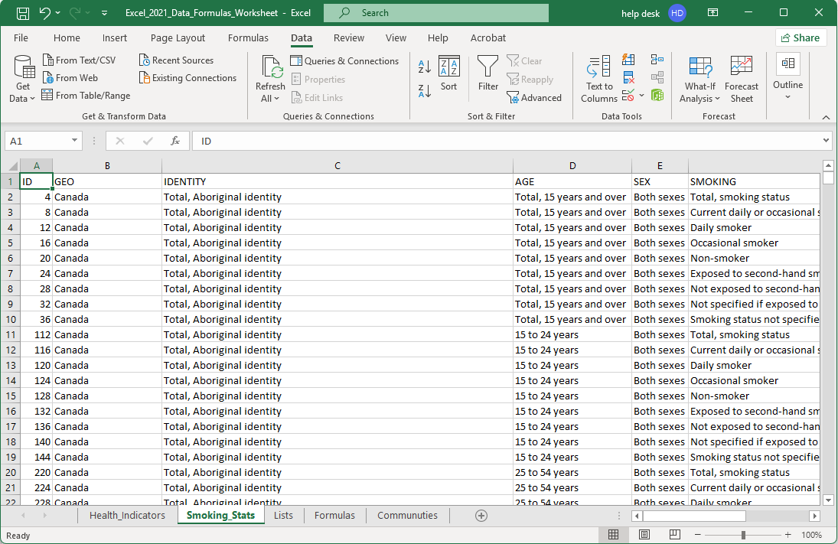
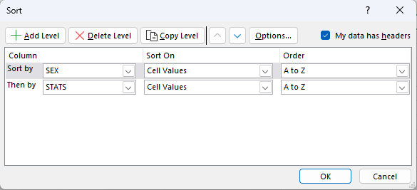
Work with the Smoking_Statistics to restrict the data
Sort the data by
SEX then STATS

Slide 44
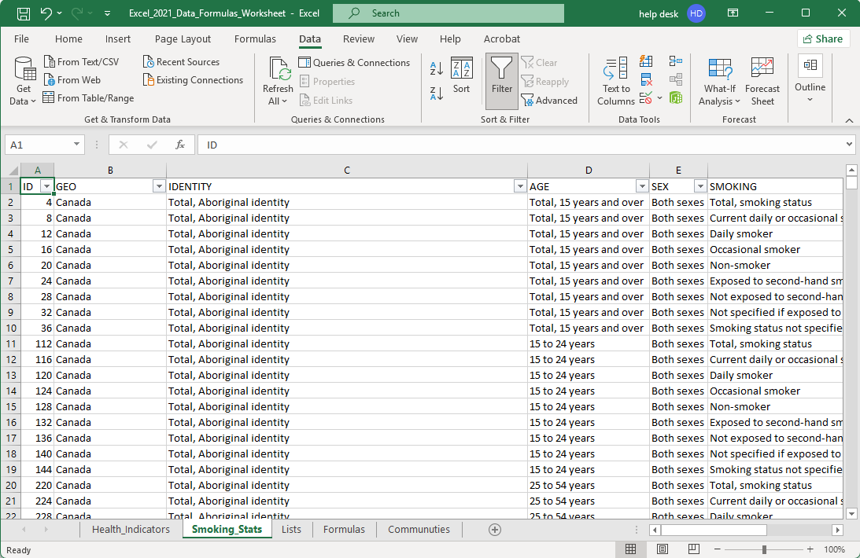
Work with the Smoking_Statistics to restrict the data
Click on Filter, if it is not already selected.

Slide 45
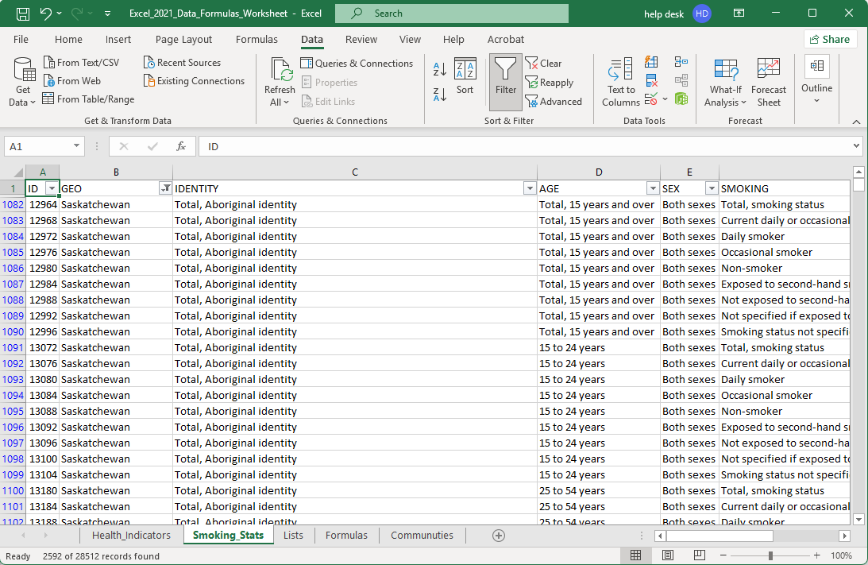
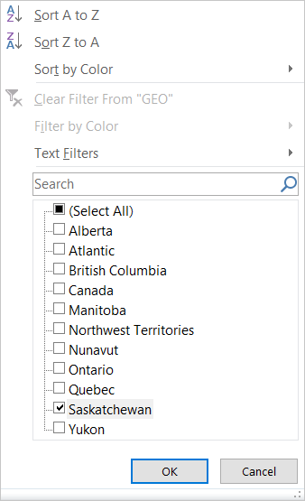
Work with the Smoking_Statistics to restrict the data
Filter by the following
GEO
  Saskatchewan only

Slide 46
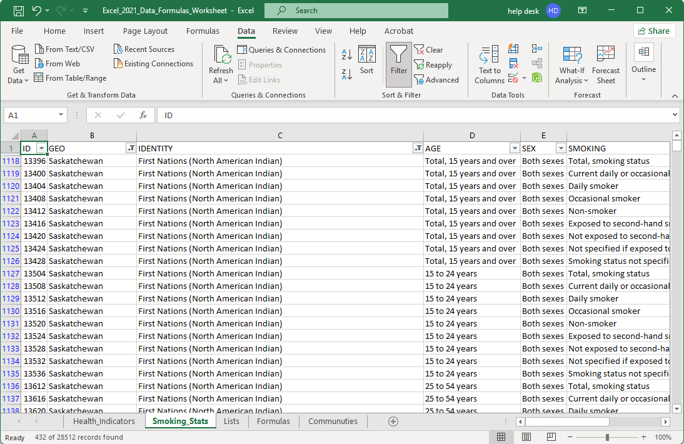
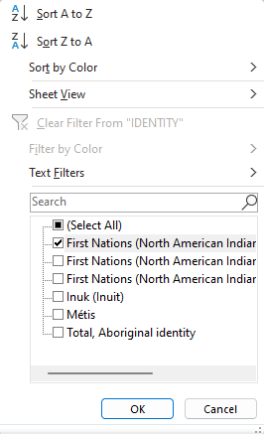
Work with the Smoking_Statistics to restrict the data
Filter by the following
IDENTITY
  First Nations (North American Indian)

Slide 47
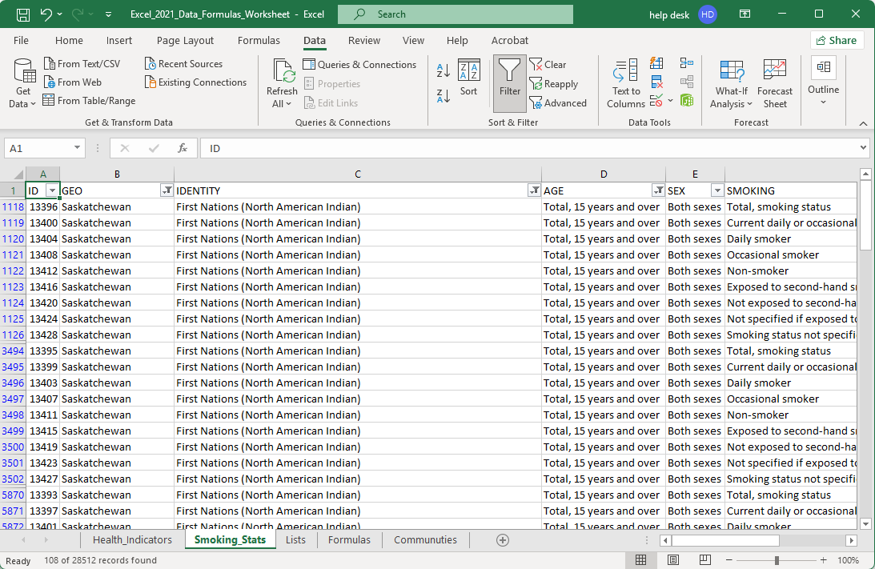
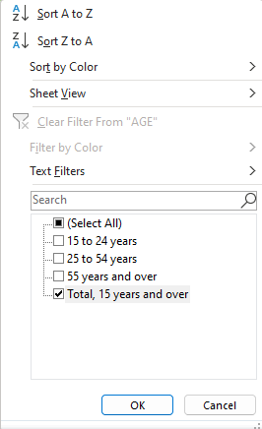
Work with the Smoking_Statistics to restrict the data
Filter by the following
AGE
Total, 15 years and over

Slide 48
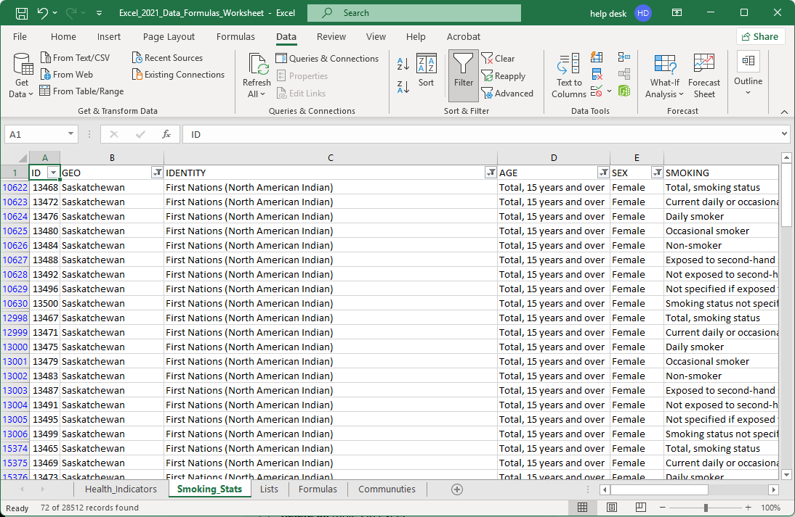
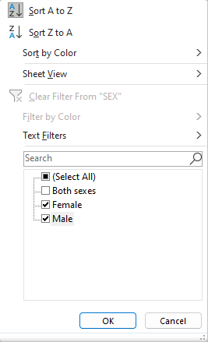
Work with the Smoking_Statistics to restrict the data
Filter by the following
SEX
Female & Male

Slide 49


Work with the Smoking_Statistics to restrict the data
Filter by the following
SMOKING
All of them except
Not Specified …
Total …

Slide 50


Work with the Smoking_Statistics to restrict the data
STATS
Number of Persons
Percent

Slide 51
Work with the Smoking_Statistics to restrict the data
The result of the filters.

Slide 52
Function Categories
The function bar shown below is directly above the column headers.
Compatibility – These functions make Excel 2025 functions compatible with older versions of Excel.
Cube - Multidimensional sets of data providing a means to summarize information based on a set of search criteria.
Database – Treating an Excel spreadsheet as a flat database, these functions return a search based on sum, variance, and standard deviation data.
Date & Time – These date and time functions allow you to work with the current time or periods of time in your functions.
Engineering – Engineering calculations: many of which relate to Bessel Functions, Complex Numbers or converting between different bases.
Information – These functions return information about the contents and/or formatting of a cell.
Logical – Flow control, logic and error capture.
Math & Trigonometry – ABS, sine, cosine, logarithmic, Pi, Quotient, etc.
Statistical – Works with data points, deviations, and more.
Text – Use these function to manipulate text.
Web – XML and web services functions.
Notes:
Have them follow along in the functions dialog box if they have a computer in front of them.

Slide 53
On the Formulas sheet, enter the following formulas …
Math
  ROUND Function (cell E40)
    =ROUND(A14,4)
  TRUNC Function (cell E43)
    =TRUNC(A14)
We will use the following Excel functions on the Formulas:
Information
  INFO Function (cell E21)
  =INFO(D21)
  ISERR Function (cell E24)
  =ISERR(E21)
  ISODD Function (cell E27)
  =ISODD(A8)
Statistical
  AVERAGE Function (cell E48)
    =AVERAGE(Health_Indicators!I7636,Health_Indicators!I7656,Smoking_Statistics!H24880,Smoking_Statistics!H27256)
  MEDIAN Function (cell E51)
    =MEDIAN(Health_Indicators!I7636,Health_Indicators!I7656,Smoking_Statistics!H24880,Smoking_Statistics!H27256)
Logical
  IF Function (cell E32)
  =IF(A5>A17,"DAVERAGE is greater than DVARP","DVARP is greater then DAVERAGE")
IFERROR Function (cell E35)
  =IFERROR(E21, "Cell E21 reports an error")

Slide 54
On the Formulas sheet enter the following formulas …
We are going to use just one formula in the Text category, but we will be embedding functions within functions.
Text
  The formula below takes the text from cell E7636 on the Health_Indicators sheet, “Current smoker, daily”, and makes a text string “Current daily smoker”.
  Why, you ask? To show you what you can do to manipulate the text as you want.
  The formula below may look complex, but it is not as bad as it looks.
  =CONCATENATE(LEFT(E7636,SEARCH(" ",E7636)-1)," ",RIGHT(E7636, LEN(E7636)-SEARCH(",", E7636)-1)," ",MID(E7636,SEARCH(" ", E7636)+1, 6))
We will be working with the following functions:
  Concatenate – Joins together text into one string.
  Search – Searches text to find one or more character strings.
  Left – Returns the left portion of a text string with the length specified.
  Mid – Returns the middle portion of a text string with the length specified starting at the position specified.
Right – Returns the right portion of a text string with the length specified.

Slide 55
We have covered here in this course …
What is the direction for this course.
Sorting, Filtering and Restricting the Data
The Ribbons & the Commands
Categories of Functions Provided By Excel
Some Relevant Definitions
Exercise in Using:
Information Functions
Connecting to MS Access Data
Logical Functions
Math Functions
Importing CSV Data
Statistical Functions
Text Functions
Database Function & an Exercise in Using Them

Slide 56
NITHA IT Helpdesk
helpdesk@nitha.com
1(306)953-5008

Slide 57

Thank you

