Slide 1


Excel 2021 Basics L2
Intermediate Level

Slide 2
NITHA IT Helpdesk
helpdesk@nitha.com
1(306)953-5008

Slide 3

What will we be covering in this course?
Getting around without the mouse Slide 4
Absolute vs. Relative References Slide 40
Tips for working with cell contents Slide 9
Data Validation Slide 42
Developer Ribbon Slide 10
Auto-correction Slide 50
Options – More Menu Slide 15
Autofill Slide 55
Backstage Slide 20
Paste Special Slide 56
Worksheet Tab Slide 37

Slide 4
Getting around without the mouse
Using the keyboard to navigate Excel will allow you to work more efficiently.
Key Combination
Navigation
CTRL+A
Select All button – Once selects data in cells, twice selects the entire worksheet
CTRL+PGUP / CTRL+PGDN
    Switch between open worksheets
    CTRL+F6 / CTRL+SHIFT+F6
    Switch between open workbooks
    CTRL + Home
    Move to the top row, column 1
    Once - Jump to edge of data in the direction of the arrow (with data on sheet)
    Twice – Jump to the end of the worksheet in the direction of the arrow
  CTRL+Arrow key
  ALT
    Jumps cursor to the ribbon which then allows you to navigate the ribbon by keyboard
  ESC
    Backs up one level navigating ribbon by keyboard
  CTRL+ALT+V
    Opens the Paste Special dialog. (If a copy cells – CTRL-C – was done)
    To navigate the Paste Special dialog (or any other dialog) via the keyboard:
    TAB / SHIFT+TAB – moves between panels in the dialog
    Arrow keys – move in the direction of the arrow within the panel
    Enter – Selects the highlighted item (or the default dialog button – usually OK)
    Spacebar – Checks or unchecks checkboxes and radio buttons
    ESC – Exits dialog without making any changes
    ALT+Down Arrow – exposes the list in drop-down lists
Notes:
Question 1: What is the Keyboard shortcut to navigate to the Row 1, Cell A?
Answer: b. CTRL + Home

Slide 5
Getting around without the mouse
Using the keyboard to access functions and features in Excel.
Key Combination
Function
F2
Edit the selected cell
ALT+ENTER
Line breaks in the cell being edited
ALT, H, W
Turn on or off text wrapping for the selected cell.
NOTE: Press ALT (then release), press H (then release), press W (then release)
SHIFT+F10
Display Context Menu of selected object (right mouse button click)
CTRL+K
Insert a hyperlink into the object (text box, shape, word art, etc.)
CTRL+;
Insert current date
CTRL+SHIFT+:
Insert current time
CTRL+SHIFT+#
Change date format
CTRL+SHIFT+Arrow key
Selects all cells from the selected cell in row or column until it comes to a blank or non-number cell in the direction of the arrow key

Slide 6
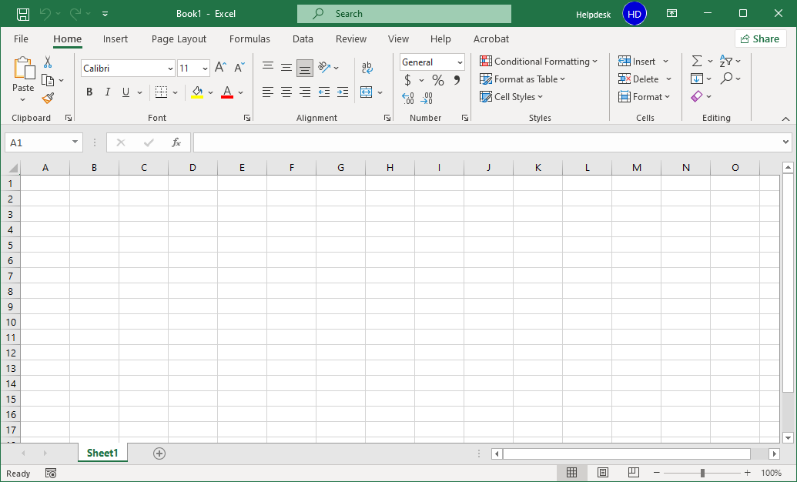
Getting around without the mouse
Navigating the ribbon using the keyboard only
Pressing the Esc on the keyboard goes back one level.
Alt – Touch the Alt key on the keyboard to gain access to the ribbon via the keyboard.
Page 6

Slide 7
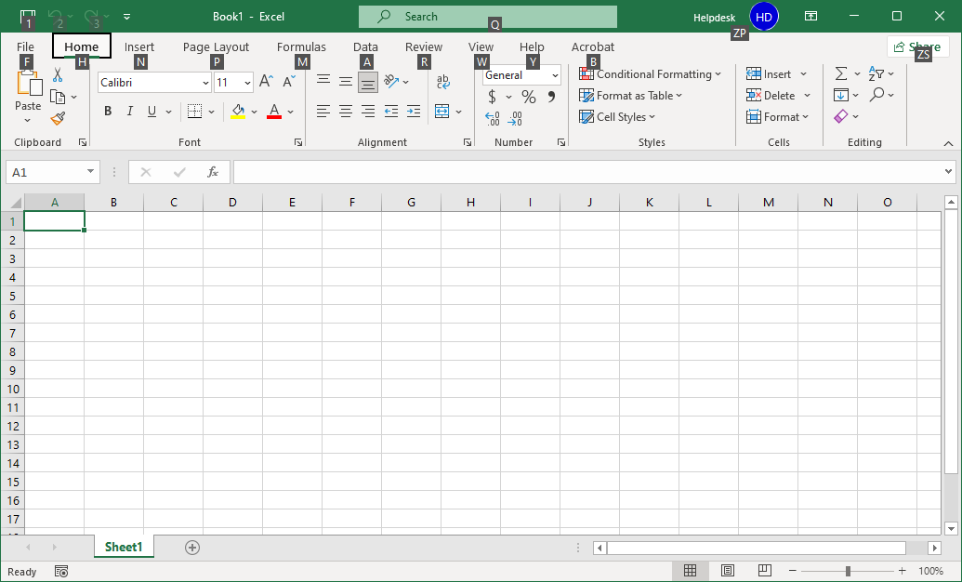
Getting around without the mouse
Navigating the ribbon using the keyboard only
Pressing the Esc key on the keyboard goes back one level.
Now touch the key that represents the ribbon you want to view.
Touch the N key to view the Insert ribbon.
Page 7

Slide 8
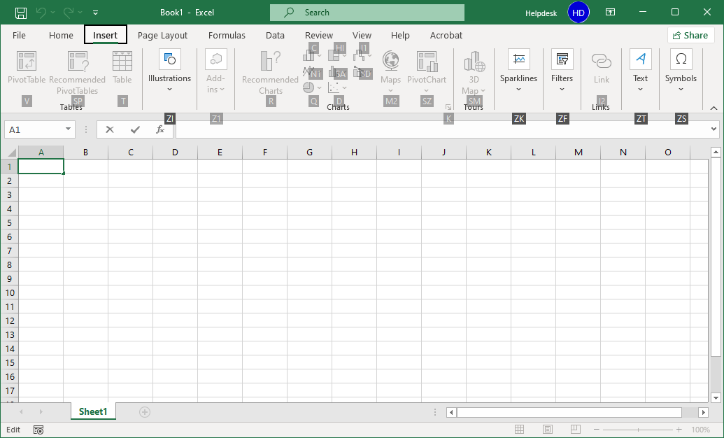
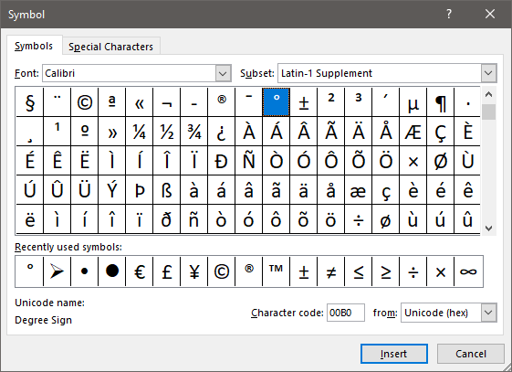

Getting around without the mouse
Navigating the ribbon using the keyboard only
Pressing the Esc on the keyboard goes back one level.
The shaded letters mean those command are not presently available.
Touch the letters ZS, Symbols, one after the other, not at the same time.
While in a menu or dialog, like the symbols dialog, you can use the up, down, left, right arrow keys and/or the Tab key navigate to the item you want.

Slide 9
Tips for working with cell contents
Miscellaneous helpful keys to know
What you want to do …
Do …
To apply a strikethrough to the text in a cell
Select the cell & then CTRL+5
To hide the current column
Select a cell in the column & then CTRL+0
To hide the current row
Select a cell in the row & then CTRL+9

Slide 10
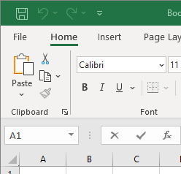
Developer Ribbon
You may not see a Developer ribbon because by default the tab is not enabled.
To see the Developer Ribbon do the following …
Click on the File tab to access the Back Stage

Slide 11
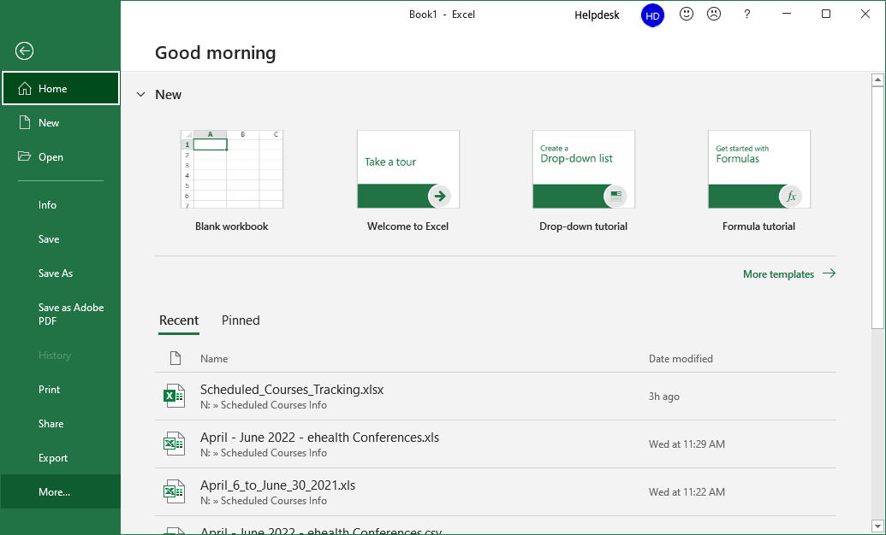
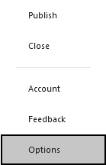
Developer Ribbon
You may not see a Developer ribbon because by default the tab is not enabled.
Click on the More… link to access a menu which provides more options.
The Options link displays a dialog that allows you to change the way Excel behaves, including adding or removing ribbons and/or commands.

Slide 12
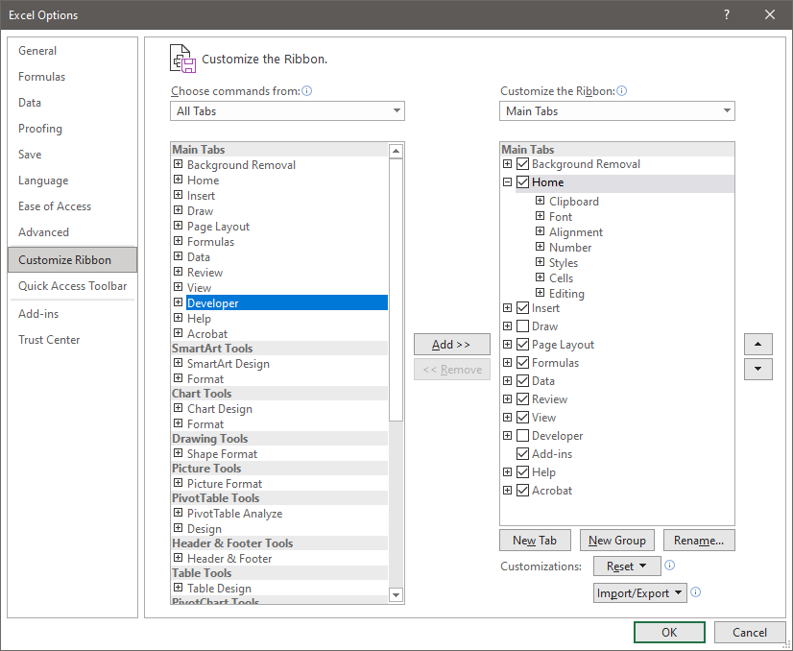
Developer Ribbon
You may not see a Developer ribbon because by default the tab is not enabled.
Select All Tabs from the Choose commands from: drop menu.
The Options link displays a dialog that allows you to change the way Excel behaves, including adding or removing ribbons and/or commands.
Select the Customize Ribbon from the navigation pane.

Slide 13
Developer Ribbon
You may not see a Developer ribbon because by default the tab is not enabled.
Click the Add >> button to place the Developer ribbon on the ribbon bar.
The Options link displays a dialog that lets you change the way Excel behaves, including adding or removing ribbons and/or commands.
The Options link displays a dialog that allows you to change the way Excel behaves.

Slide 14
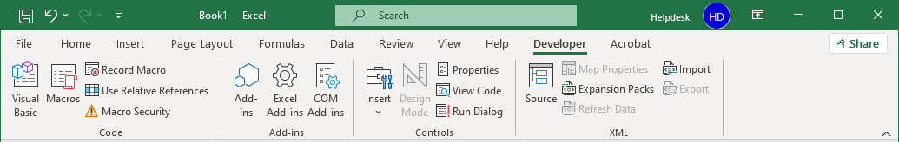
Developer Ribbon
Code – Macros and Visual Basic Editor
Add-ins – Modules that expand the abilities of Excel
XML –Work with XML source content.
Controls – Content controls that allow you to programmatically manipulate content.

Slide 15
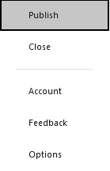
Options – More Menu
The More Menu offers some functions not displayed in the Backstage navigation pane by default.
Click on the More… link to access a menu which provides more options.
The Publish link provides commands for uploading and exporting Power BI (Business Intelligence) visual reports and dashboards.
Most Microsoft Office installations do not include Business Intelligence.

Slide 16
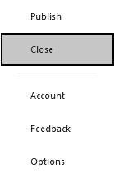
Options – More Menu
The More Menu offers some functions not displayed in the Backstage navigation pane by default.
Click on the More… link to access a menu which provides more options.
The Close link closes this workbook. Other workbooks you may have opened are not closed.

Slide 17
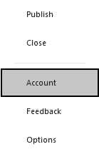
Options – More Menu
The More Menu offers some functions not displayed in the Backstage navigation pane by default.
Click on the More… link to access a menu which provides more options.
The Account link provides information which allows you to manage your account.

Slide 18
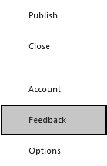
Options – More Menu
The More Menu offers some functions not displayed in the Backstage navigation pane by default.
Click on the More… link to access a menu which provides more options.
The Feedback link provides a way to complain, compliment, or offer improvement suggestions.

Slide 19
Options – More Menu
The More Menu offers some functions not displayed in the Backstage navigation pane by default.
Click on the More… link to access a menu which provides more options.
The Options link opens a dialog which allows you to change the behaviour of Excel.

Slide 20
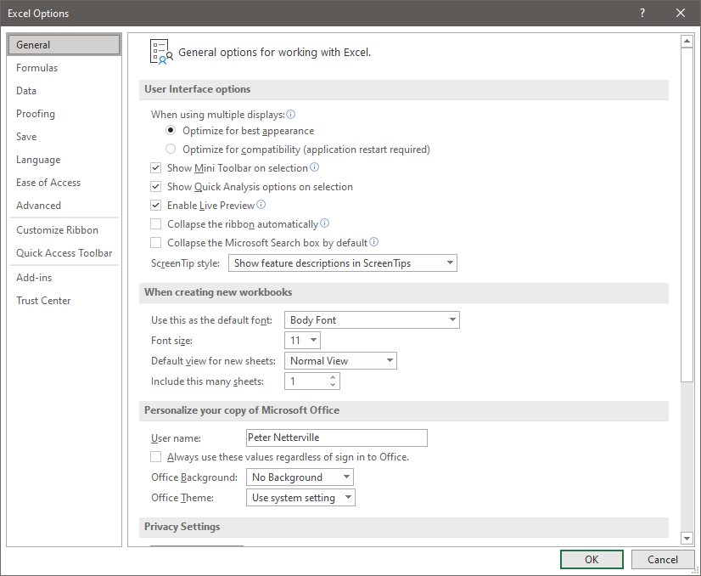
The Options dialog provide a method for changing the default behaviour of Excel.
Backstage – General Options
User interface options
Creating new workbooks
Personalizing Excel

Slide 21
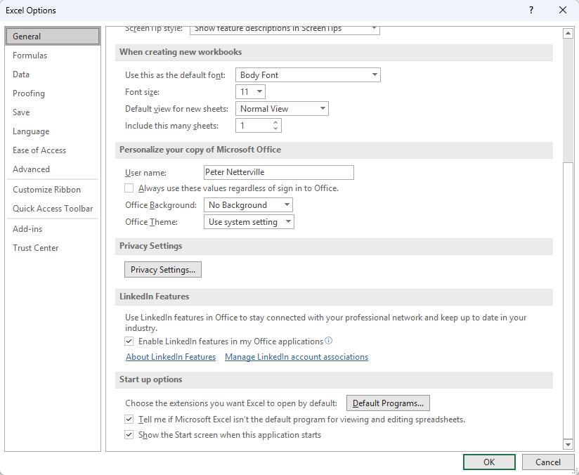
The Options dialog provide a method for changing the default behaviour of Excel.
Backstage – General Options
Privacy Settings
LinkedIn Features
Start up options

Slide 22
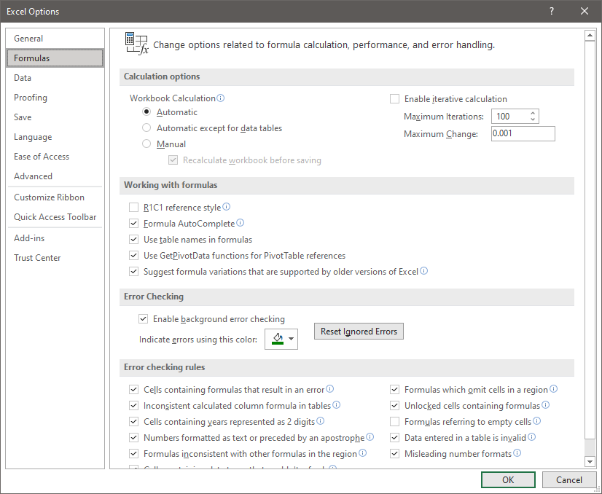
The Options dialog provide a method for changing the default behaviour of Excel.
Backstage – Formula Options
Calculation options
Working with formulas
Error checking
Error checking rules

Slide 23
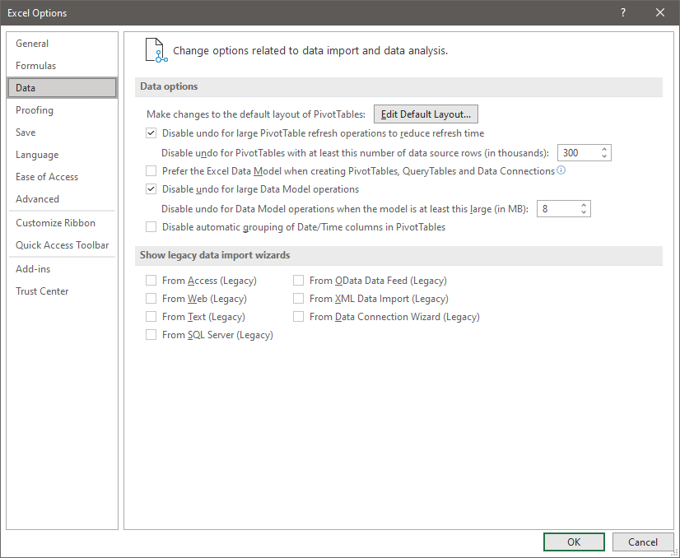
The Options dialog provide a method for changing the default behaviour of Excel.
Backstage – Data Options
Data options
Show legacy data import wizards

Slide 24
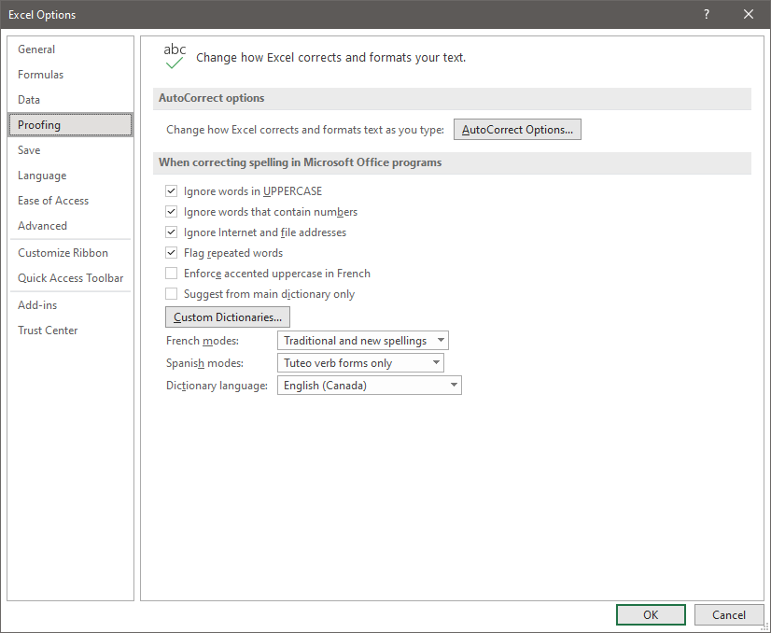
The Options dialog provide a method for changing the default behaviour of Excel.
Backstage – Proofing Options
AutoCorrect options
Spelling correction behaviour.

Slide 25
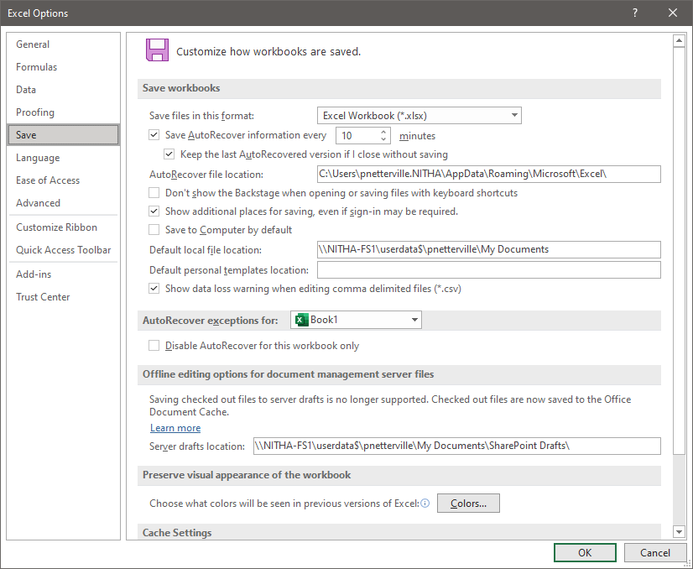
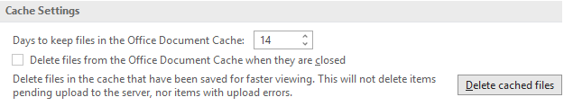
The Options dialog provide a method for changing the default behaviour of Excel.
Backstage – Save Options
Save workbook options
AutoRecover exception
Offline editing options
Preserve visual appearance
Cache settings

Slide 26
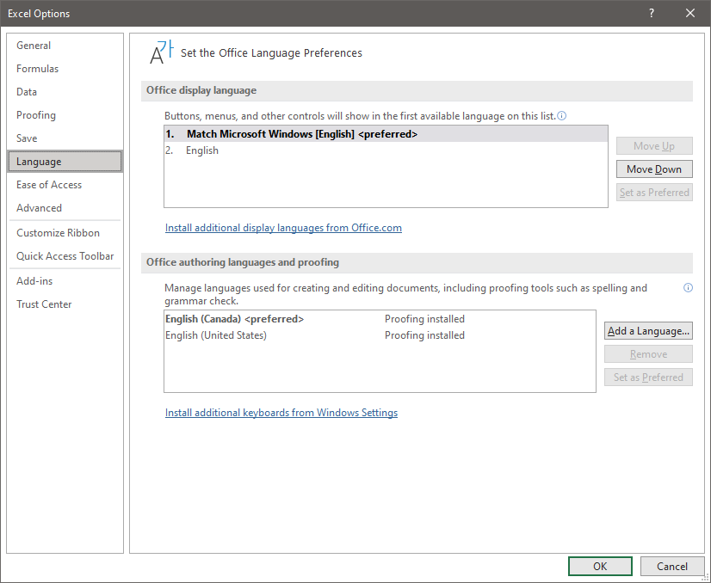
The Options dialog provide a method for changing the default behaviour of Excel.
Backstage – Language Options
Office display language
Office authoring languages and proofing

Slide 27
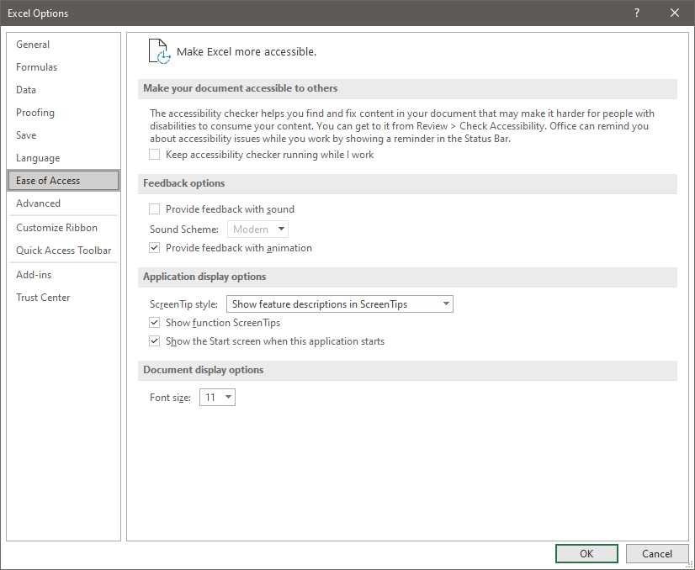
The Options dialog provide a method for changing the default behaviour of Excel.
Backstage – Ease of Access Options
Switch on accessibility
Feedback options
Applications display options
Document display options

Slide 28
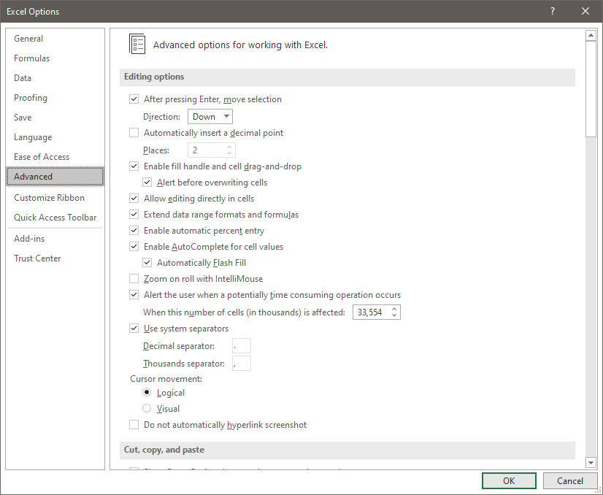
The Options dialog provide a method for changing the default behaviour of Excel.
Backstage – Advanced Options
Editing options

Slide 29
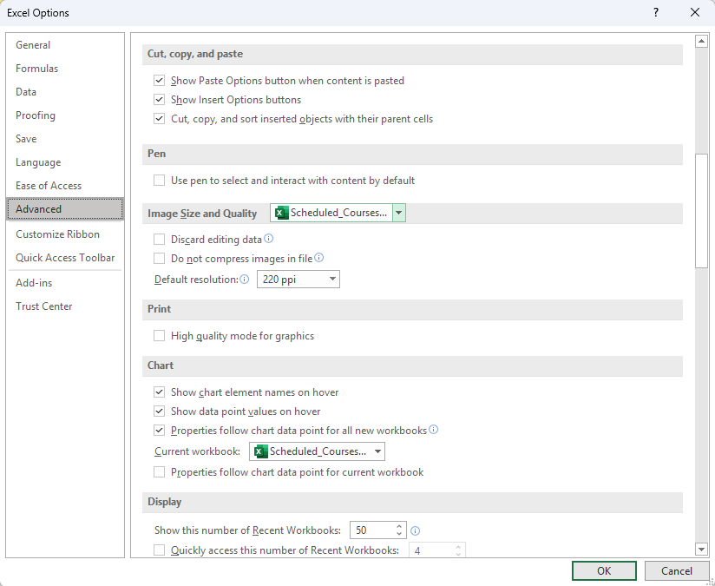
The Options dialog provide a method for changing the default behaviour of Excel.
Backstage – Advanced Options
Copy / cut / paste options
Image Size & Quality
Print
Chart

Slide 30
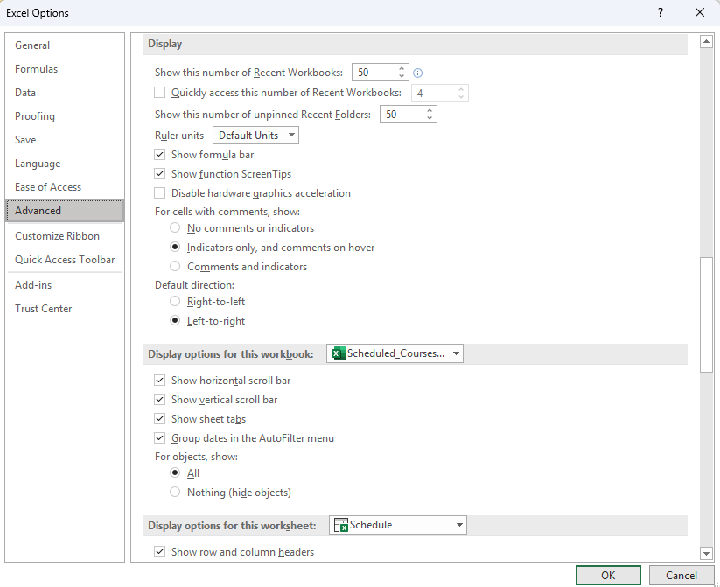
The Options dialog provide a method for changing the default behaviour of Excel.
Backstage – Advanced Options
Display
For cells with comments
Display Options

Slide 31
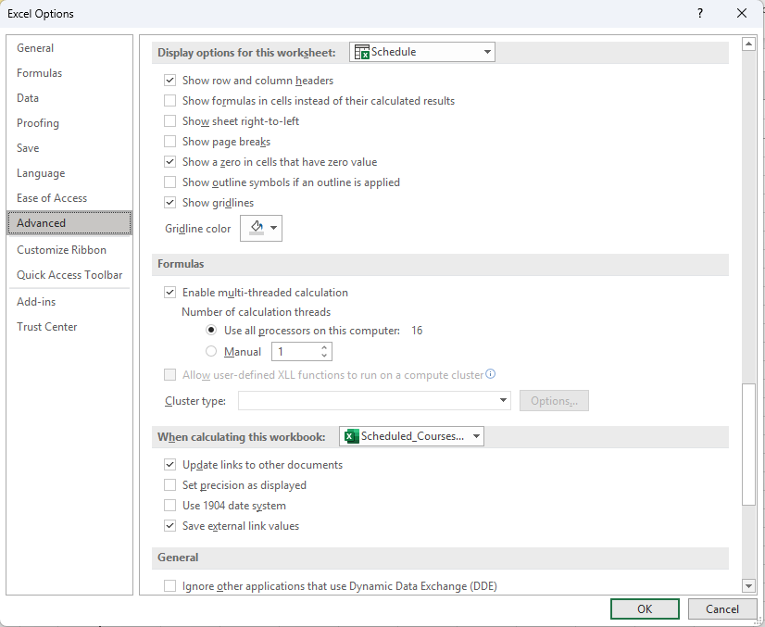
The Options dialog provide a method for changing the default behaviour of Excel.
Backstage – Advanced Options
Display Options for Workbook
Formulas
When calculating this workbook

Slide 32
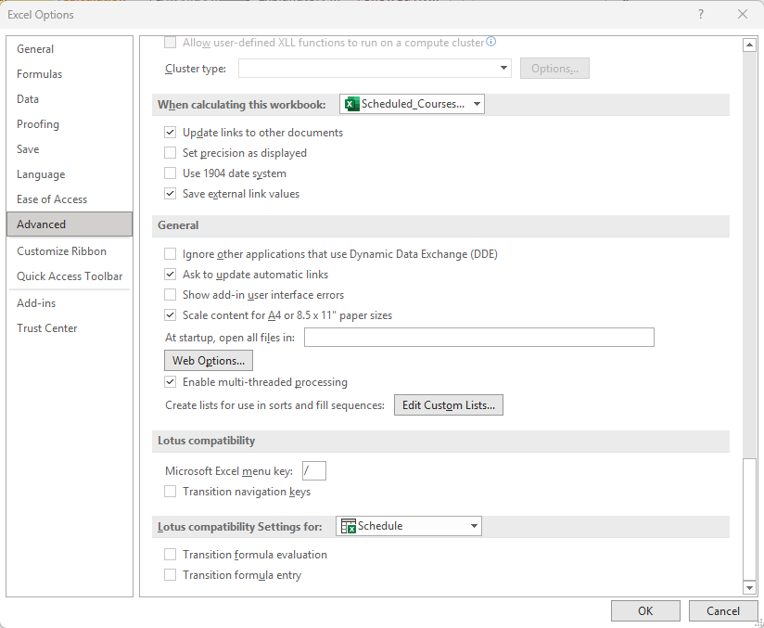
The Options dialog provide a method for changing the default behaviour of Excel.
Backstage – Advanced Options
When Calculating Workbook
General
Lotus compatibility
Lotus settings

Slide 33
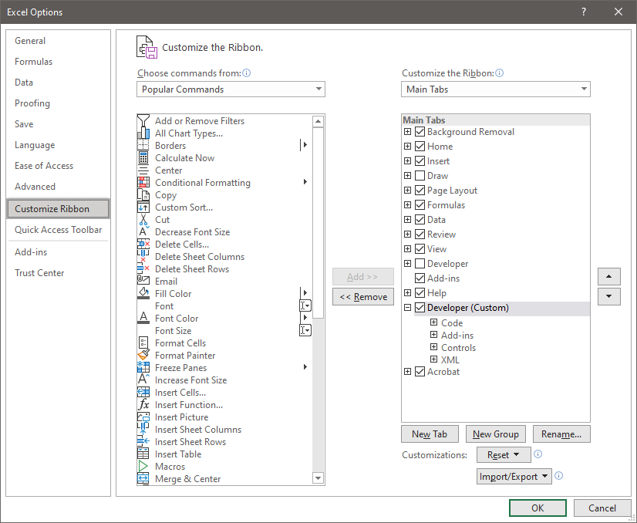
The Options dialog provide a method for changing the default behaviour of Excel.
Backstage – Customize Ribbon Options
The Customize Ribbon allows you to
Add/remove/import/export entire ribbons with all the commands for that ribbon
Change the commands on a ribbon
Create your own ribbon with all your favourite commands.

Slide 34
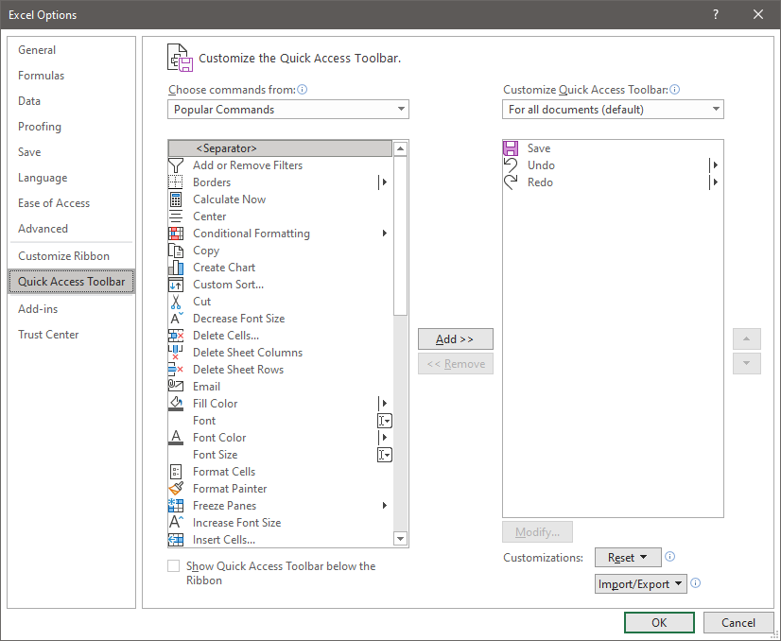
The Options dialog provide a method for changing the default behaviour of Excel.
Backstage – Quick Access Toolbar Options
The Quick Access Toolbar provides easy access to your most used commands.
Add/remove/import/export commands or menus of commands

Slide 35
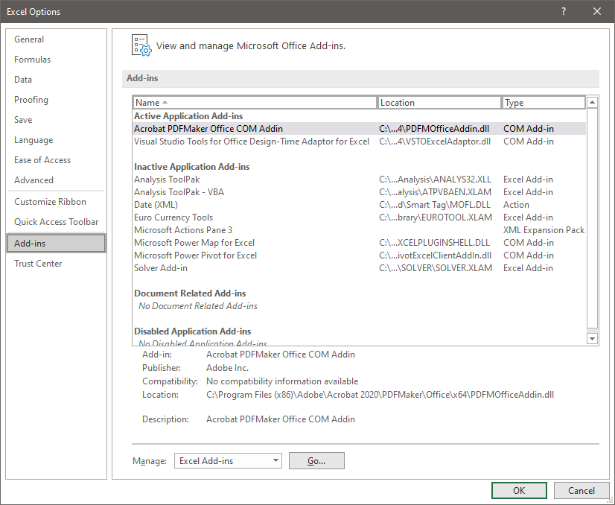
The Options dialog provide a method for changing the default behaviour of Excel.
Backstage – Add-ins Options
The Add-Ins dialog is where you can add software that is created as an addition to the functionality of Excel.

Slide 36
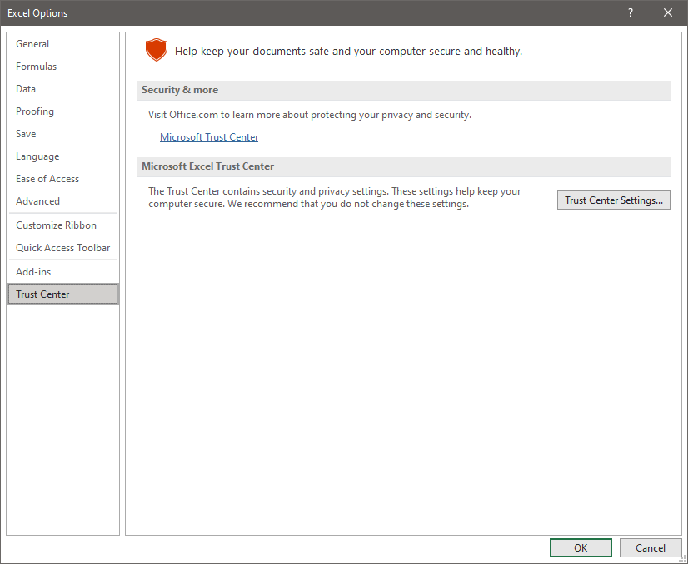
The Options dialog provide a method for changing the default behaviour of Excel.
Backstage – Trust Center Options
The Trust Center dialog is where you can
Add/remove/manage
  Trusted Publishers
  Trusted Locations
  Trusted Documents
  Trusted Add-In Catalogs
  Add-Ins
  ActiveX settings
  Macro settings
  Protected View
  Message Bar
  External Content
  File Blocking settings
  Privacy options

Slide 37
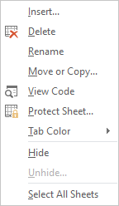
Worksheet Tab
Hide the selected worksheet(s)
Select all Sheets so you can perform the same action on all worksheets.
NOTE: You can select individual worksheets by holding down the CTRL button while left clicking on the worksheet tab of those worksheets you want to select.
Right-Click on the worksheet tab displays a menu that will allow you to change the looks and behavior of the worksheet.
The worksheet tabs are along the bottom of the worksheet just above the status bar.

Slide 38
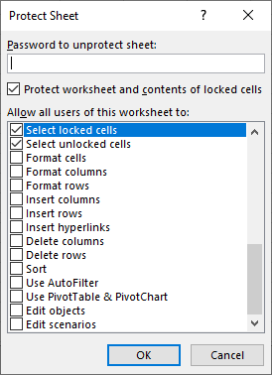
Worksheet Tab
View Code created from the macro(s) you have made, or your custom VBA coding. This opens up the Visual Basic editor.
Lock
the whole worksheet
individual cells
individual rows and/or columns
based upon different conditions such as
formatted cell(s)s, row(s), and/or column(s)
if a hyperlink exists
whether sorted or not
and much more.
Protect Sheet displays a dialog (above) which allows detailed control.
Tab Color - You can change the colour of your worksheet tabs.
Notes:
Question 2: To protect individual cells by password, where would I go to do this?
Answer 2: a. Worksheet tab / Protect Sheet…

Slide 39
Worksheet Tab
Insert a new object positioned to the right of the selected worksheet tab.
The types of available objects are:
Worksheet
Chart
Macro
Dialog box
All the worksheets in the selected template workbook.
Delete this worksheet. Keep in mind that there is no undo for deleted worksheets.
If you delete it, it is gone. The only way to get it back would be from a backup version of the worksheet in a workbook saved on a drive or USB stick.
Rename the worksheet tab.
You can move or copy the worksheet. This option displays a menu that allows you to work with the worksheets.
Alternative: You can pick up a worksheet by left-clicking and holding down the mouse button while you drag the worksheet to a new position (move).
To copy that worksheet hold down the CTRL button while dragging the tab to its’ new location.
Notes:
Question 3: You delete a spreadsheet and realize later that you should not have. How do you get it back?
Answer: b. You cannot

Slide 40

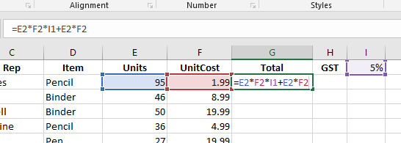
Absolute vs. Relative References
Absolute and relative references only apply when copying a formula or function from one cell to another cell.
What does this mean?
It means that when you copy a formula or function in a cell to another cell the references to the cells in the formula change relative to the cell where to where it was copied.
What will happen if the formula in G2 is copied to cell G3?

Slide 41
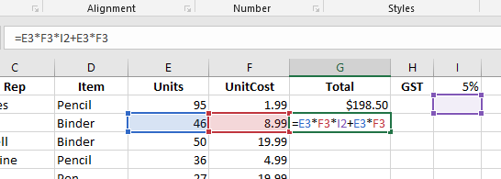
Absolute vs. Relative References
The $ character prevents Excel from updating the cell reference. This $ is beside the row number, so it will freeze the row in place.
Note the $
The $ beside the column letter will stop the column from being updated. (i.e. $I1) To freeze the cell in place no matter where the formula is copied … $I$1 (i.e. =E3*F3*$I$1+E3*F3 )
=E3*F3*I$1+E3*F3
should be
Most of the cell references in the formula were properly updated, but what happened to the GST in cell I1?
Either type in the $ or you can use the F4 key.
=E3*F3*I2+E3*F3
The GST cell is now I2, where there is no value.
So, how do we keep it in cell I1 when the formula is copied and pasted into another cell?

Slide 42
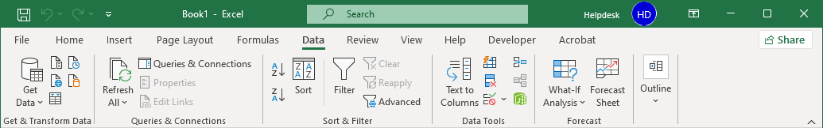
Data Validation
Data validation supplies a level of input control and professionality to your worksheet projects.
Click on the Data tab to expose the Data ribbon.
Data Validation is found in the Data Tools group.
Click on the Data Validation menu.
Page 42
Notes:
Question 4: In order to validate the data in a cell, where do I do this?
Answer 4: d. Data Ribbon / Data Tools

Slide 43

Data Validation
Data validation supplies a level of input control and professionality to your worksheet projects.
The three options in the Data Validation menu are as follows:
Data Validation… displays a dialog which we will cover later.
Circle Invalid Data – Selecting this option forced Excel to display a red circle around any cells that contain invalid data based upon the data validation criteria set in the Data Validation dialog.
Clear Validation Circles removes the red circles placed by the above command.
Page 43

Slide 44
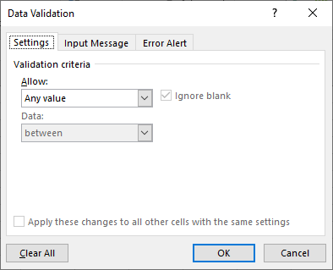
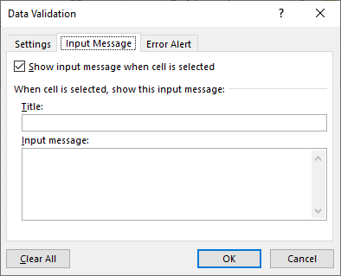
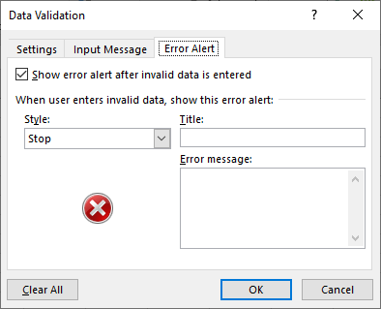
Data Validation
There are three tabs in the Data Validation dialog.
There are three tabs in the Data Validation dialog.
Note: The validation criteria applies only to the selected cell(s)
Settings – This is where you provide the condition(s) for what is necessary to validate the data that goes into the cell you have selected. This is called validation criteria.
Input Message – When the cell is selected, a message can appear. Usually, you tell the user what data is expected.
Error Alert – If incorrect data is input, this is where you specify the severity (Style), Title, and the error message.

Slide 45
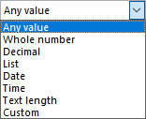
Data Validation
So, what types of data validation can be applied, and how does it help you in your projects?
Important: Before you apply a validation, you must first select the cell(s) to which you want to apply the validation.
Validation Criteria
settings panel
So, after selecting the cell(s) to which the validation will be applied:
1. Open the Data Validation dialog (from the ribbon).
2. Click on the drop arrow on the Allow menu in the settings panel.
3. Select the type of validation you want to perform on the cell(s).
Whole number, Decimal, and Text length are all self-explanatory.

Slide 46
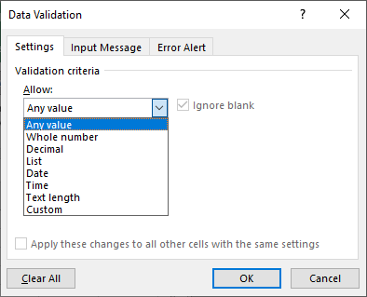
Data Validation
Important: Before you apply a validation, you must first select the cell(s) to which you want to apply the validation.
Validation Criteria
List – Creates a drop list in a cell from a selected block of cells on the same or another worksheet.
Date – Allows for the cell to accept a date only between two dates.
Time – Allows for the cell to accept a time only between two times.
Custom – Create a formula which validates input.

Slide 47
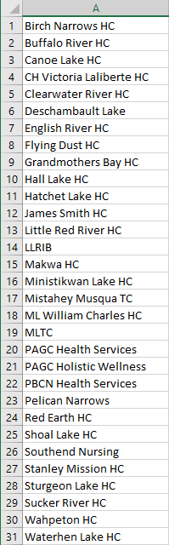
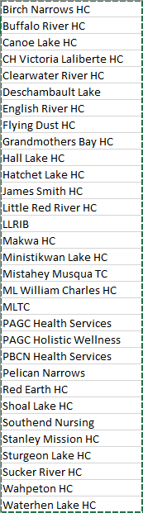
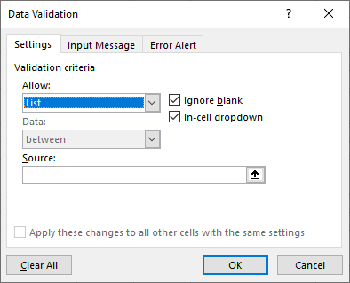
Data Validation
So, what types of data validation can be done and how does it help you in your projects?
Important: Before you apply a validation, you must first select the cell(s) to which you want to apply the validation.
List – Create a list which can then be added to a drop down list.
This type of validation forces validation by only allowing the options available in the list.
1. Select cell K2 on the Sales worksheet for this example.
3. Now select List from the Allow menu.
2. On a the communities worksheet create a list.
which will then display the selection in the source text field.
5. Finally, click on OK
4. Click on and then select the list.

Slide 48
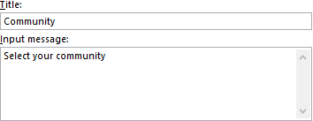
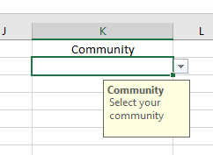
Data Validation
So, what types of data validation can be done and how does it help you in your projects?
On any cell or cells you had selected when you applied the validation criteria, you can apply an Input Message.
With the cell K2 on the Sales worksheet selected, go back into the Data Validation dialog and select the Input Message
1. Type in a title and input message.
2. Click on OK
Now when the cell is select to which you applied the Input Message you will see a message as shown below

Slide 49
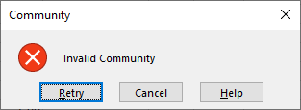
Data Validation
So, what types of data validation can be done, and how does it help you in your projects?
On any cell or cells you had selected when you applied the validation criteria, you can apply an Error Alert.
With the cell K2 on the Sales worksheet selected, go back into the Data Validation dialog and select the Error Alert tab.
1. Type in a title and an error message.
Now when incorrect data is entered into the cell, the Error Alert message will be displayed.
2. Click on OK

Slide 50
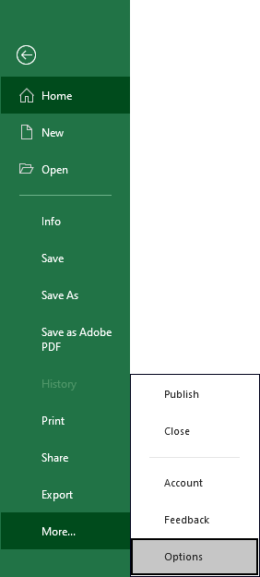
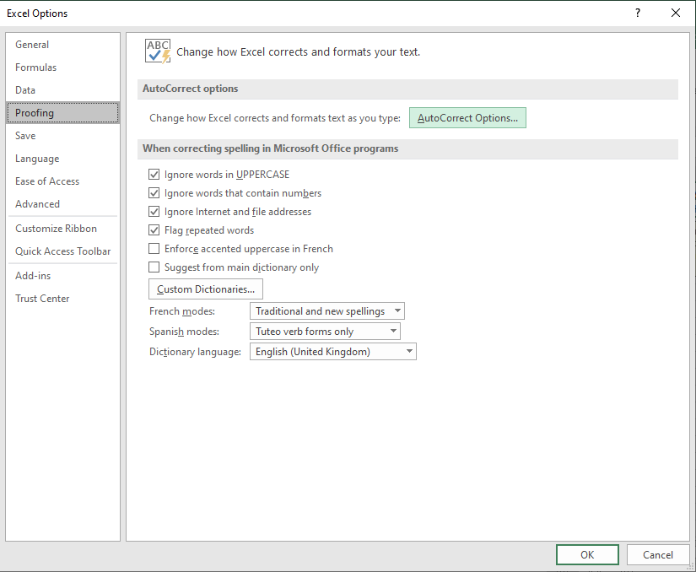
Auto-correction
Auto-correction fixes misspelled words for you.
1. Select the File tab, the Backstage.
The behaviour of auto-correction can be changed based upon the option settings.
then Autocorrect Options
then choose Proofing
2. Select Options from the Backstage.
Notes:
Question 5: Where is the AutoCorrect Options… button located?
Answer 5: c. Backstage / Proofing

Slide 51

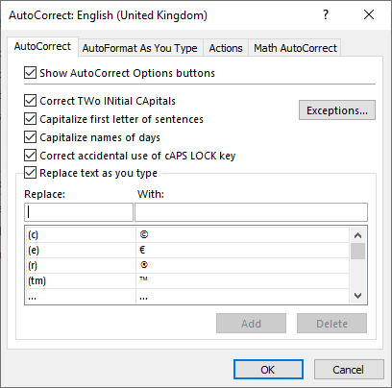
Auto-correction
AutoCorrect tab
The AutoCorrect Options button is what appears on the worksheet when an autocorrection has been made by Excel.
Self Explanatory
Replace as you type can be handy because it will fix common spelling errors, but you can also make common symbols easily such as copyright, registered, trademark, etc.
You can customize the list of autocorrect items by adding in what you want to replace with the text you type into the cell.

Slide 52

Auto-correction – AutoFormat
AutoFormat as You Type tab
AutoFormat is different from AutoCorrect in that AutoCorrect looks for one word or phrase and corrects what you have typed with text from a premade list, but …
AutoFormat, however, looks for URLs, network paths, and email addresses and replaces them with hyperlinks.
Here, you can disable this behavior.
If you enter data in a column beside other table data, or enter data in a row below other table data, AutoFormat will automatically include that data into the existing table data.
This behaviour can be disabled here by deselecting the check box.
This option causes AutoFormat to fill in formulas in a column automatically from one that you entered, like filling in the totals column.

Slide 53


Auto-correction – Actions
Actions tab
Excel provides a mechanism for adding additional actions to the right-click context menu.
Click on this checkbox to enable additional actions.
This XML formatted date can be selected but does not add the function to the right-click context menu.
Presently there are no actions that can be added to the right-click context menu until Microsoft creates some to be added.

Slide 54



Auto-correction – Math AutoCorrect
Math Auto-Correction is similar to AutoCorrect in that you have a list of text items that when typed to the cell or text box is then replaced with other text.
The difference is that in this case you can insert math symbols that you would otherwise have to go to the Equations dialog to insert.
These math symbols can also be accessed through the Equation dialog found in the Insert ribbon and in the Symbols group.

Slide 55




Autofill
Autofill provides an easy way to fill in cells with similar data.
drag to the right
Enter information in two cells, in the case of this example
Monday in A1
Tuesday in B1.
Pick up the Autofill handle and drag the box to the right to fill in the remaining days in the week.
Notice how Wednesday to Sunday are auto-filled.
Autofill button displays a menu of options

Slide 56


Paste Special
Paste - Paste all: content, formula(s) and source formatting
Formulas – Paste only the formula(s), maintaining destination formatting.
Keep Source Formatting – Paste content while maintaining the original formatting.
Formulas & Numbers Formatting – Paste both the formulas and the original formatting

Slide 57
Paste Special
No Borders - Paste all content and source formatting except borders.
Keep Source Column Width – Paste all, including the column width, from the source.
Merge Conditional Formatting – When the source and destination have conditional formatting applied, they will be merged.
Transpose – Pastes with all formatting, row data to column and vice versa.

Slide 58
Paste Special
Values - Paste the values of the formula(s) only.
Values and Numbers Formatting – Paste the values of the formula(s) and the number formatting only.
Values and Source Formatting – Pastes the values of the formula(s) and all the source formatting.

Slide 59
Paste Special
Formatting- Paste the source formatting only.
Paste Link– Paste the hyperlink only, no formatting.
Picture – Paste the picture from the source only.
Linked Picture – Pastes a link to the picture in the source.

Slide 60

Paste Special
Paste Special … - Displays the Paste Special Dialog

Slide 61

We have covered here in this course …
Getting around without the mouse Slide 4
Absolute vs. Relative References Slide 40
Tips for working with cell contents Slide 9
Data Validation Slide 42
Developer Ribbon Slide 10
Auto-correction Slide 50
Options – More Menu Slide 15
Autofill Slide 55
Backstage Slide 20
Paste Special Slide 56
Worksheet Tab Slide 37

Slide 62
NITHA IT Helpdesk
helpdesk@nitha.com
1(306)953-5008

Slide 63

Thank you

