Slide 1


Excel 2021 Basics L1
Entry Level

Slide 2
NITHA IT Helpdesk
helpdesk@nitha.com
1(306)953-5008

Slide 3

What will we be covering in this course?
Excel Intro
Basic Spreadsheet Functions
Screen layout
Navigating Using the Mouse & Keyboard
Title bar
Entering Data plus Function/Formula Syntax
Ribbons: Common and Contextual
Name Box & Formula Bar
Function Categories
Document Worksheet
The Rules
Status Bar
Commonly Used Functions
The Backstage: A Quick Overview
Exercise
Est. Time: 2h

Slide 4
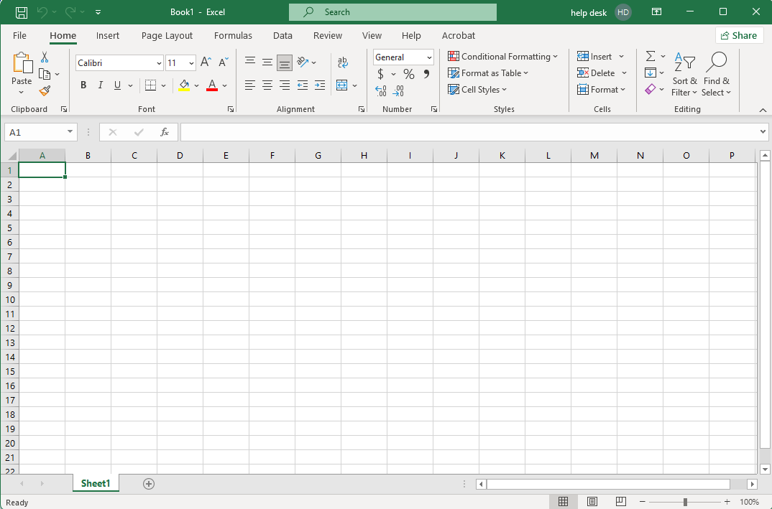
Screen Layout – Titlebar
This is the Titlebar
Ribbon state.
Account name & access.
The Titlebar has are seven items of interest …
The name of the file.
1. AutoSave
Quick Launch Toolbar
4. The Search Bar.
Minimize, Maximize/Restore, Close Window
Slide 4

Slide 5
Screen Layout – Ribbons: Common & Contextual
This is the Ribbon
Share this workbook
On the Ribbon there are five items of interest …
The Ribbon Tabs
The Ribbon Commands
Dialog Box Launcher
Group Name
Slide 5
Notes:
Question 1: In what ribbon are the settings for printing? (Slide 5)
c: Page Layout ribbon
Question 3: There are two locations you can go the Share your workbook (Slide 5 & 25)
a. Above the ribbon top right side / On the Backstage nav panel
Question 4: In what two locations can you log out of or log in to your account? (Slide 5 & 31)
d. From the Title Bar / On the Backstage Account

Slide 6
Screen Layout – Name Box & Formula Bar
This is the Name Box/Function Button/Formula Bar
Below the Ribbon there are three items of interest …
The Name Box
The Function Button
The Formula Bar
Slide 6

Slide 7
Screen Layout – Document Worksheet
The worksheet has five items …
The Column Heading
The status bar has four items …
The Select All Button
The Row Heading
Zoom Bar
The Spreadsheet
The Sheet Tabs
Horizontal & Vertical Scrollbars
Current Status Bar
Cursor State
Page View Buttons
Slide 7
Notes:
2. Where is the Page Break Preview button?
Answer – b. On the status bar

Slide 8
The Backstage: A Quick Overview
Click on the File tab ...
Slide 8

Slide 9
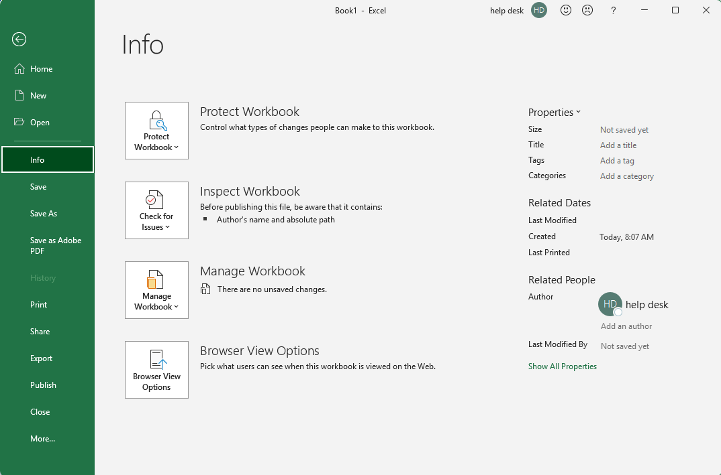
The Backstage: A Quick Overview - Info
Select the Info tab. The Home tab is the default.
… to display the Backstage
Slide 9

Slide 10
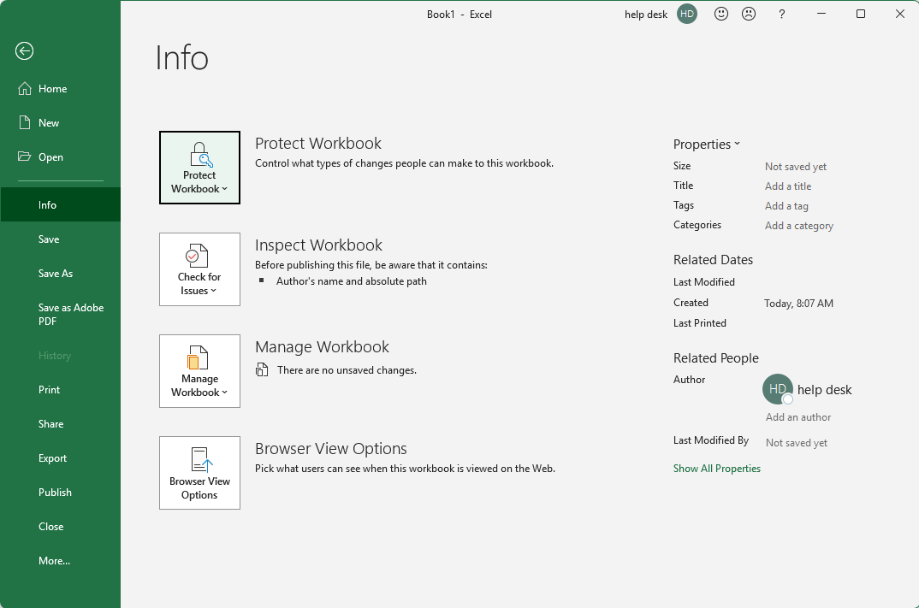

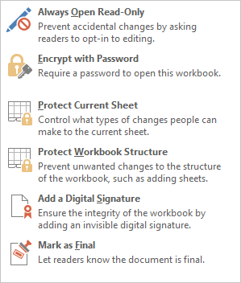
The Backstage: A Quick Overview - Info
Protecting Your Workbook
Slide 10
Always open it as a read-only document to help protect it from unwanted changes.
When you encrypt with a password, others must know the password to make any changes.
You can protect specific things on the Current Sheet. Also, do this by right-clicking on the sheet tab.
Protect only changes to the Workbook structure, such as the number of sheets.
Verify the workbook’s authenticity by adding a Digital Signature.
Mark as Final sets the document status field as Final, makes it read-only, and proofing is disabled.

Slide 11

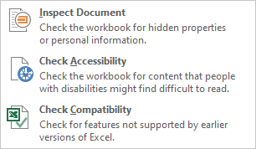
The Backstage: A Quick Overview - Info
Inspecting Your Workbook
Check and update hidden document properties and personal information.
Check your document for accessibility by people with disabilities.
Check if your workbook is compatible with earlier versions of Excel.
Slide 11

Slide 12

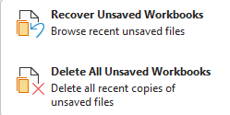
The Backstage: A Quick Overview - Info
Managing Your Workbook
If you have had any program crashes or unexpected shutdowns, you may have unsaved documents you wish to recover.
This option recovers those files or deletes them.
Slide 12

Slide 13
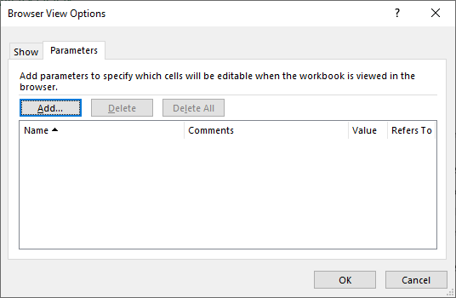
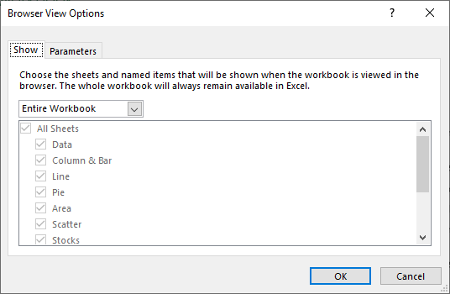

The Backstage: A Quick Overview - Info
Browser Viewing Options
The first panel of this dialog box, Show, is where you choose what is visible on the spreadsheet(s) to the web. You must use a defined name for each individual cell you wish to expose to the web page.
Browser View Options allow you to choose what will be shown on a web page, should you decide to post your workbook to a website, or an internal company Intranet website.
This second panel allows you to make specific named cells editable.
Slide 13

Slide 14
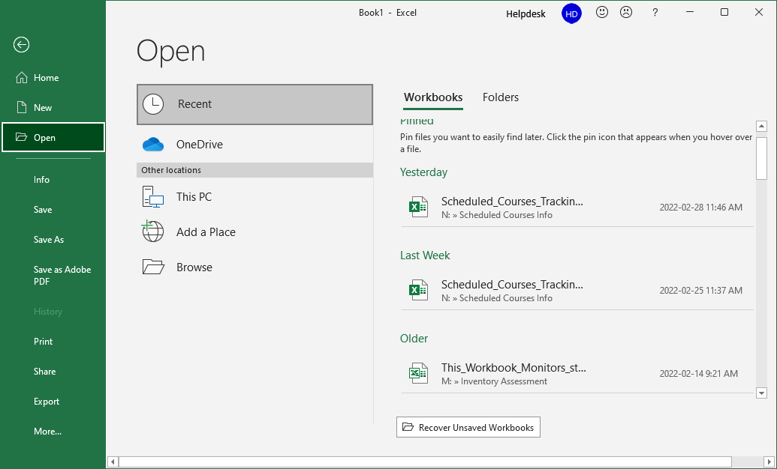
The Backstage: A Quick Overview – Open Recent
Open Workbook
Here you open an existing workbook from a storage …
Open a workbook from one you had opened before from the list that appears below.
Slide 14

Slide 15
The Backstage: A Quick Overview – Open OneDrive
Open Workbook
Open a workbook from one you had opened before from the OneDrive. OneDrive is similar to Dropbox, but is connected to the Exchange sever making it very flexible and capable.
Slide 15

Slide 16
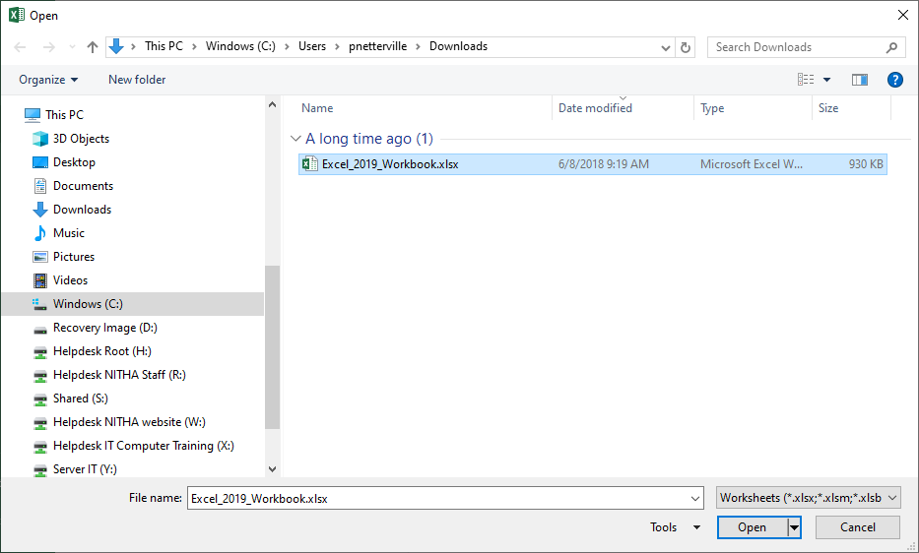
The Backstage: A Quick Overview – Open This PC
Open Workbook
Select This PC if you wish to look for a document on your computer or any network share to which you have access.
OR CLICK
… which launches an Open dialog box.
Slide 16

Slide 17
The Backstage: A Quick Overview – Open This PC
Open Workbook
Add a new location on the OneDrive from which you can open documents.
Documents stored on the OneDrive can be shared with those in your organization.
Slide 17

Slide 18
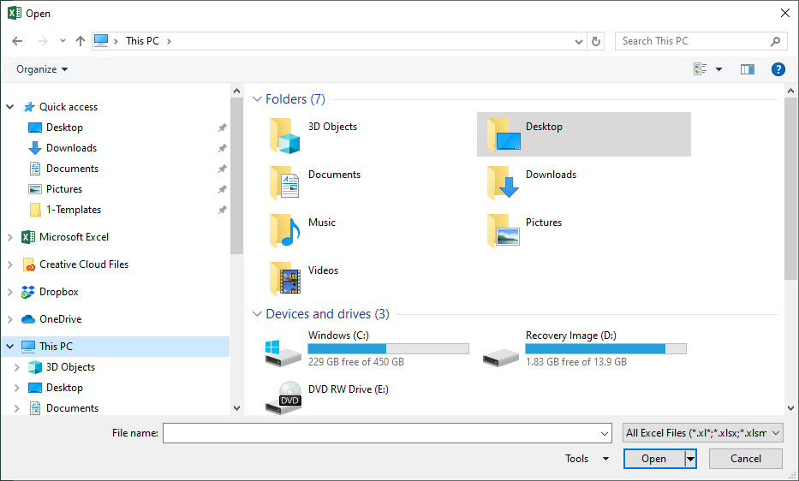
The Backstage: A Quick Overview – Browse to Open
Open Workbook
Select from the Files/Folder List the file for which you are searching.
Browse the Navigation Pane to select the location where the document resides.
Slide 18

Slide 19
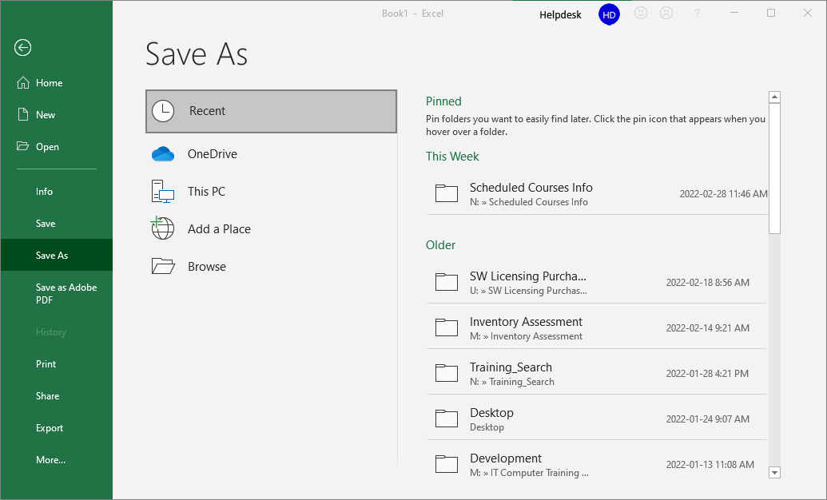
The Backstage: A Quick Overview – Save As - Recent
Save Workbook
Save a workbook to one of your recently accessed folders.
Slide 19

Slide 20
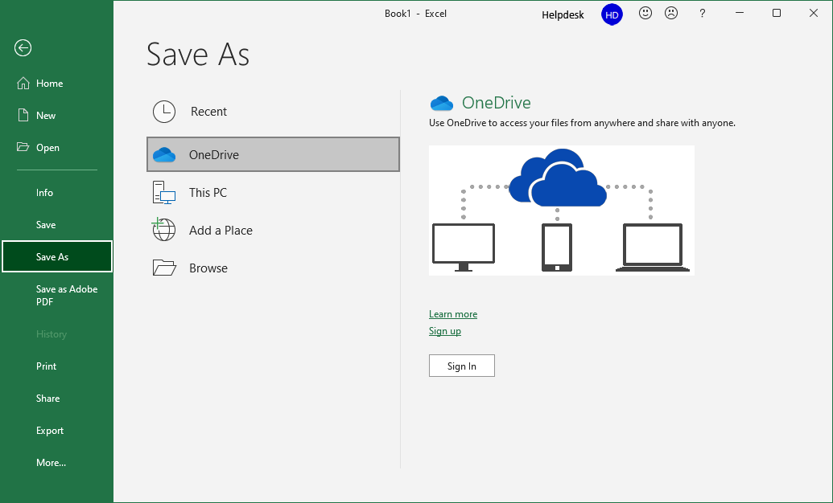
The Backstage: A Quick Overview – Save As - OneDrive
Save Workbook
Save a workbook to OneDrive for others in your organization to access should you choose to assign access to it.
Slide 20

Slide 21
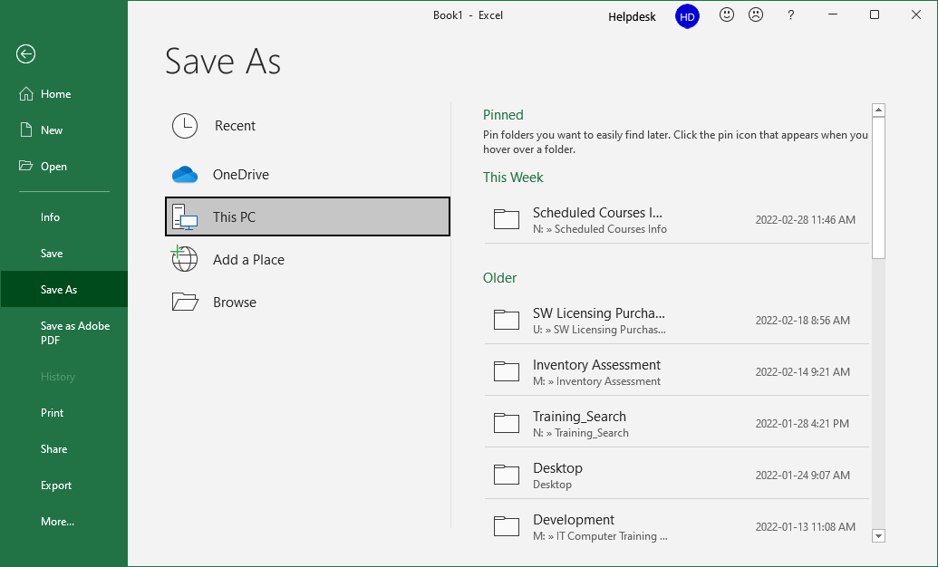
The Backstage: A Quick Overview – Save As – This PC
Save Workbook
Save a workbook your computer or a network shared location.
Slide 21

Slide 22
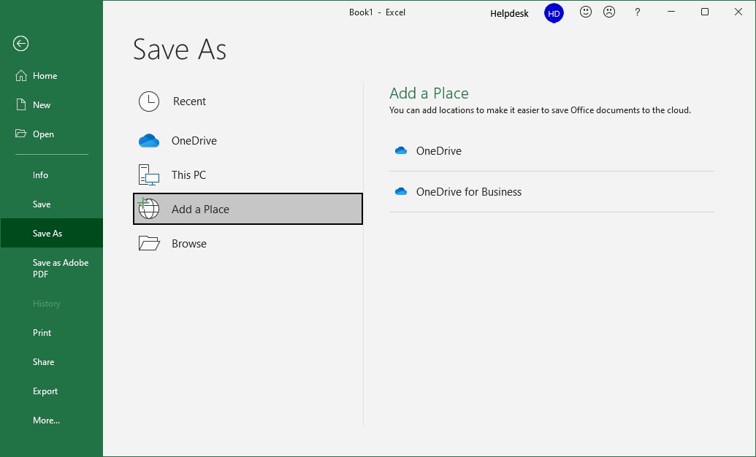
The Backstage: A Quick Overview – Save As – Add a Place
Save Workbook
Add a new Place on OneDrive so you can access it from anywhere you have access to the Internet.
You can also choose to share your workbook with people in your organization.
Slide 22

Slide 23
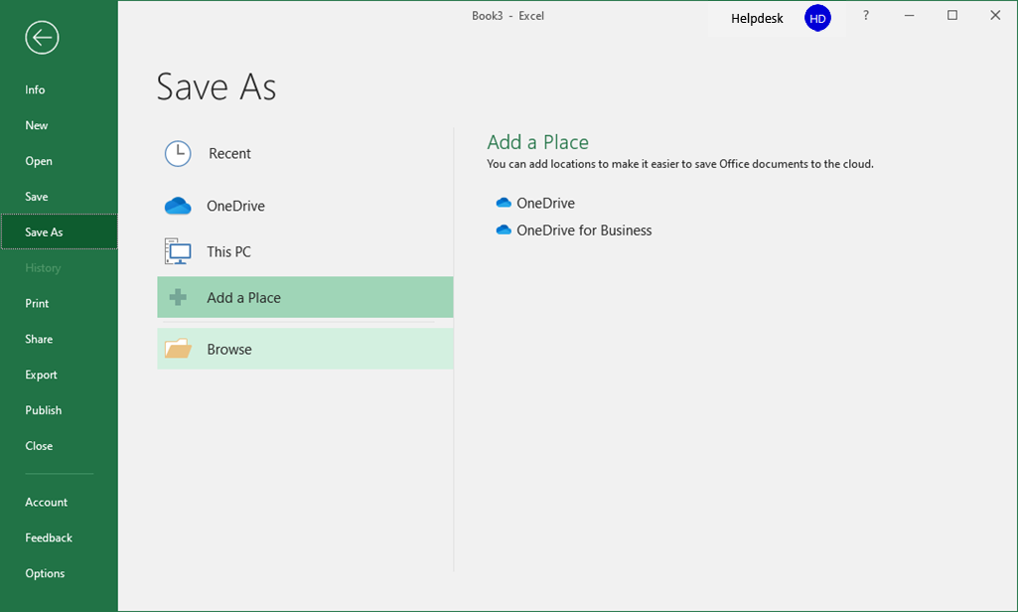
The Backstage: A Quick Overview – Save As - Browse
Save Workbook
Click on the Browse to launch a Save As dialog box.
Slide 23

Slide 24
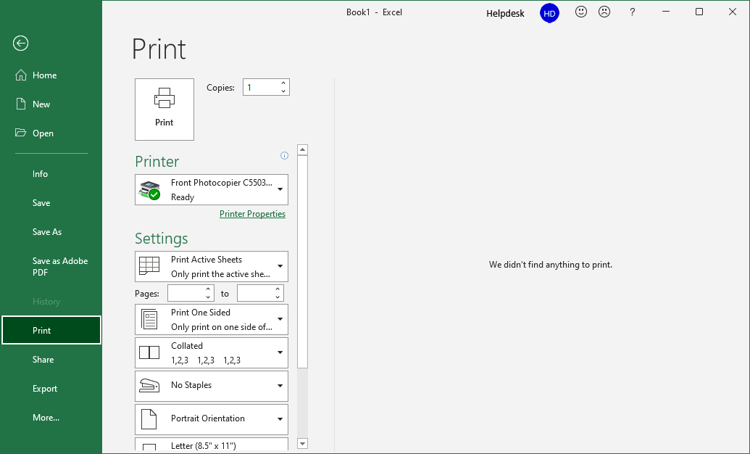
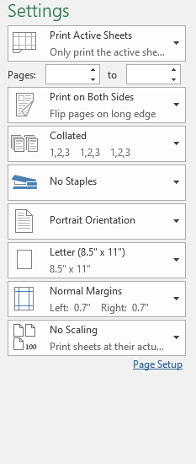
The Backstage: A Quick Overview – Print
Print Workbook
Click on Print from the navigation pane.
When you are ready to print, click here.
… or you can launch the Printer Properties dialog for the printer you have selected.
You can make some of the more common setting changes from the ones shown here …
Slide 24

Slide 25
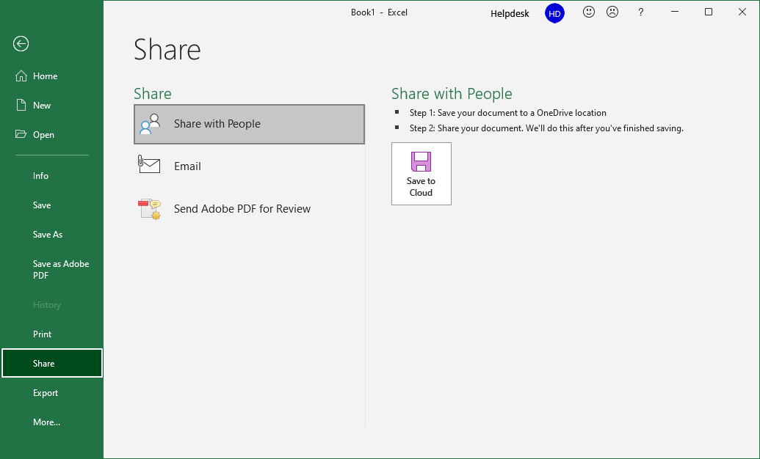
The Backstage: A Quick Overview – Share
Share Workbook
Click on Share from the navigation pane.
Share your workbook on the cloud, the OneDrive.
After saving your workbook to the OneDrive …
Slide 25
Notes:
Question 3 – There are two locations you can go the Share your workbook
a. Above the ribbon top right side / On the Backstage nav panel

Slide 26
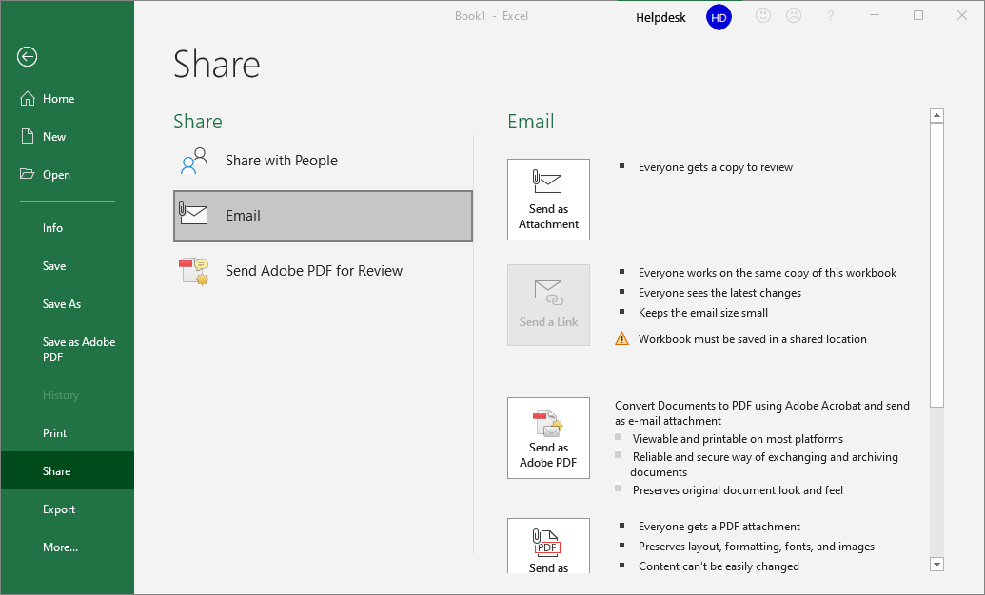
The Backstage: A Quick Overview – Share
Share Workbook
Share your workbook by email.
Send it as an attachment to an email …
Email a link to the workbook if it is shared on OneDrive. If you choose this option, you will need to assign the recipient permission to access the file. Go to your OneDrive folder on your computer or log in via a web browser and assign permissions from the web interface.
Email an Acrobat created PDF version of your workbook to others. The Adobe Acrobat printer driver is used to create the document. Most often it is best to use the Adobe Acrobat driver since the PDF is an Adobe owned file format.
Slide 26

Slide 27
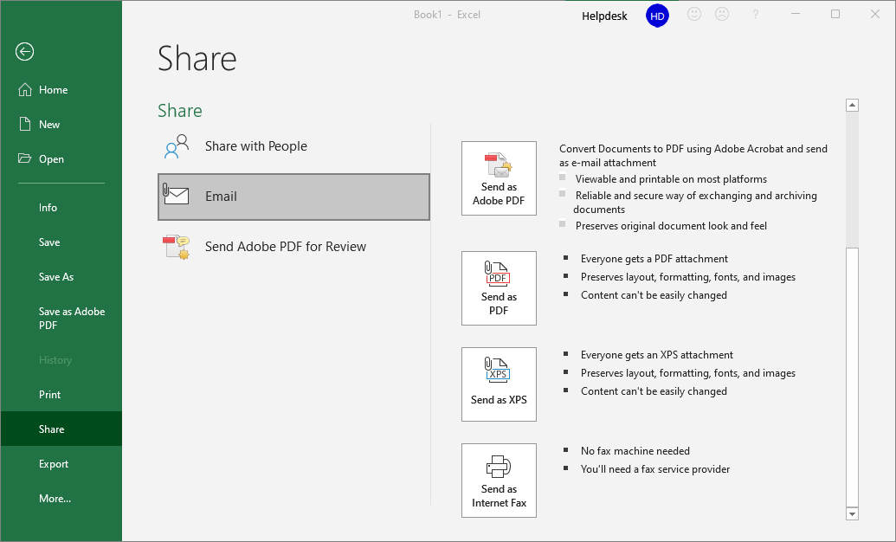
The Backstage: A Quick Overview – Share
Share Workbook
Share your workbook by email.
Send as a PDF using the Microsoft compatible PDF printer driver to create to document.
Email an XPS version of your workbook to others, Microsoft’s version of Adobe’s PDF.
Send out your workbook as a FAX, but you need a FAX service installed on your organizations’ server.
Slide 27

Slide 28
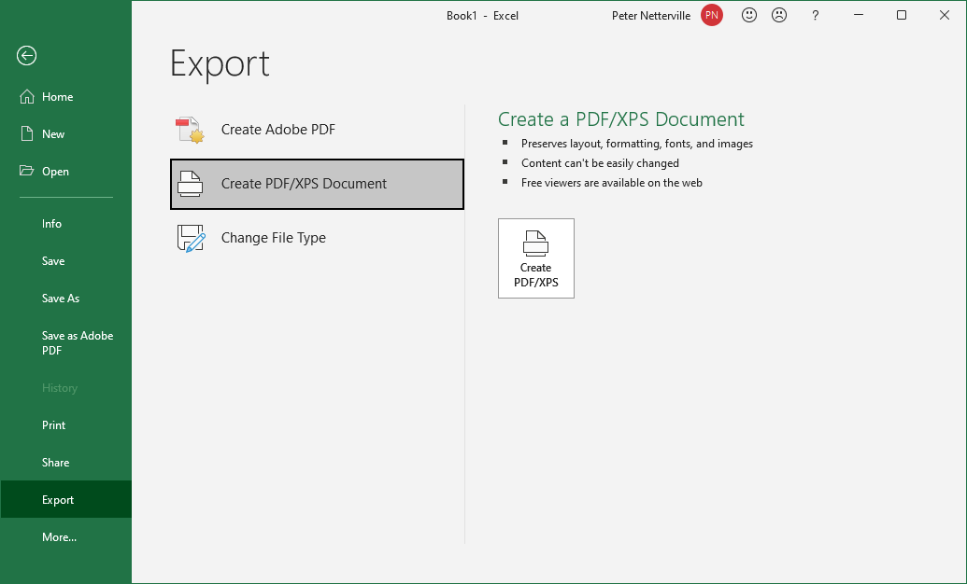
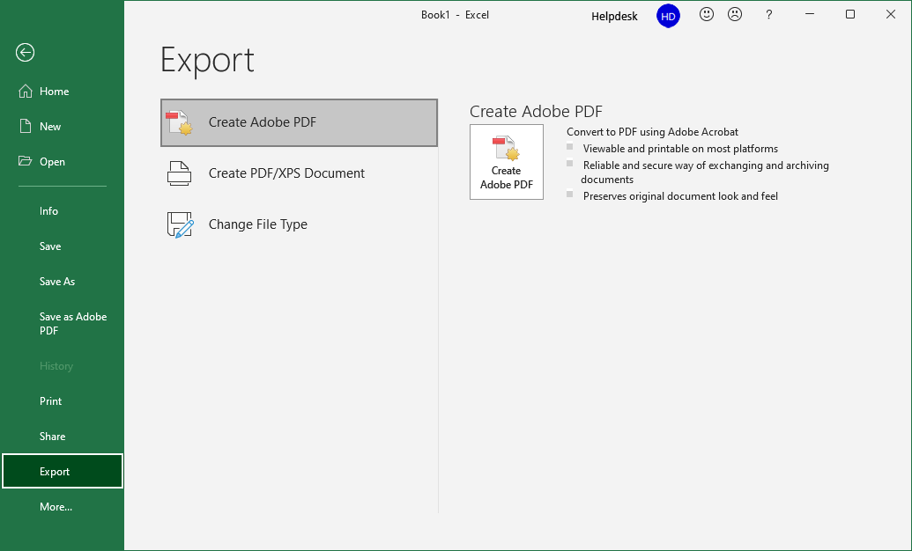
The Backstage: A Quick Overview – Export
Export Workbook
Export a PDF using the Adobe Acrobat printer driver.
Slide 28

Slide 29
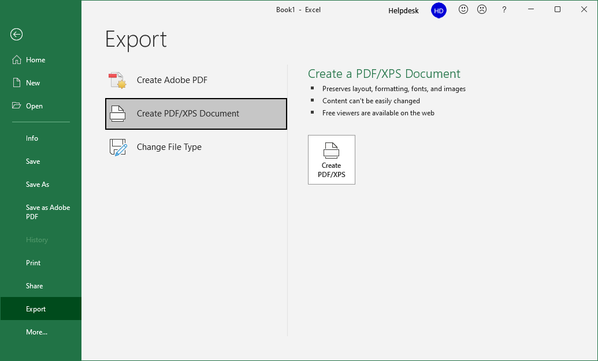
The Backstage: A Quick Overview – Export
Export Workbook
Export a PDF using the compatible Microsoft PDF driver.
Slide 29

Slide 30
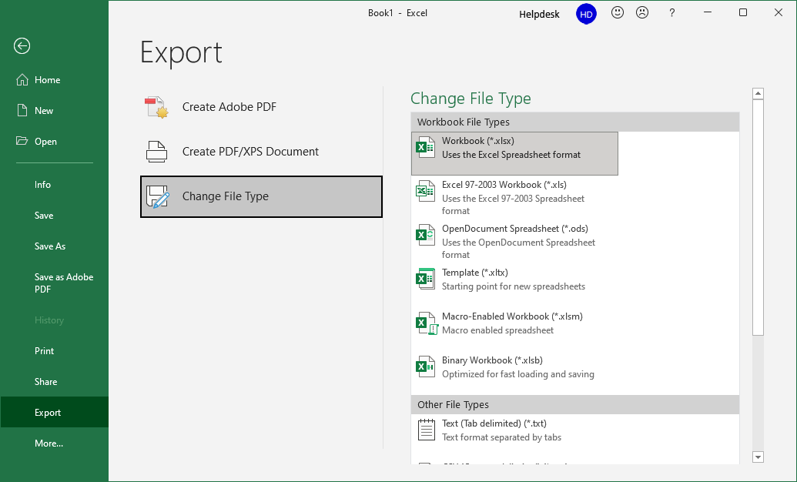
The Backstage: A Quick Overview – Export
Export Workbook
Export as a different file type.
To view the whole list of possible file types, click on Save As from the backstage (File tab).
This list offers you the most common different file types.
Slide 30

Slide 31
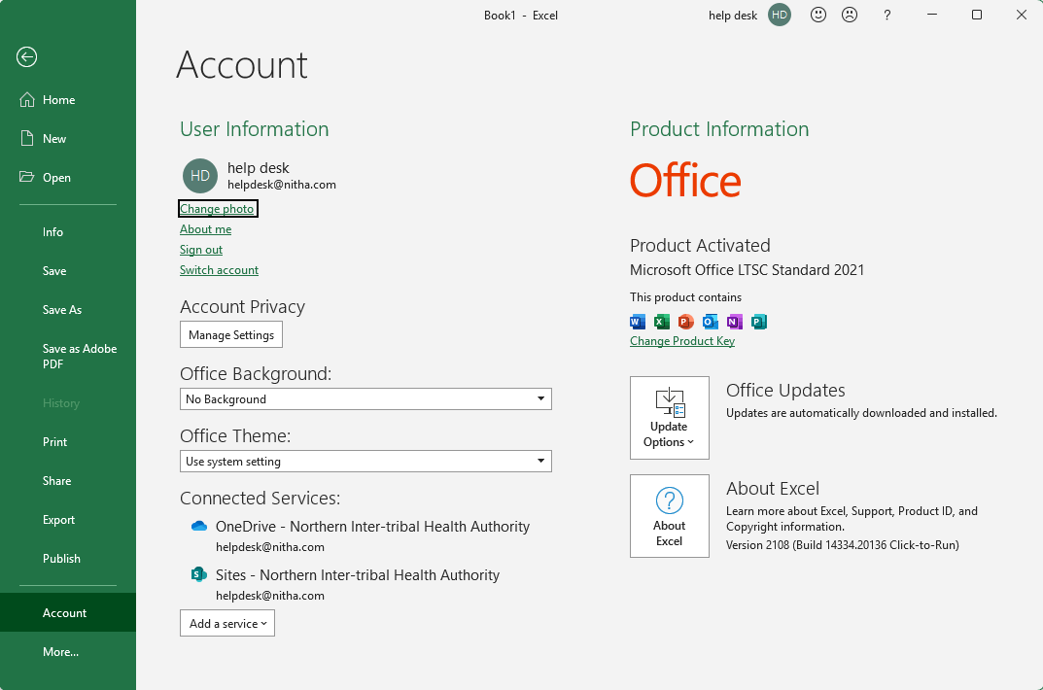
Share Workbook
The Backstage: A Quick Overview – Account
Office Information includes:
Product Activation
Changing Product Key
Forcing updates immediately (usually updated through Windows Update)
About Excel provides all the legalese.
Change personal Info, Sign out, and Switch Account.
Change your account settings regarding:
Your Privacy
Your connected experiences as Microsoft describes it.
Visuals.
How do you want Office to appear?
Connected Services include:
Storage (OneDrive)
The Office Store
Other Sites (insert content)
Slide 31
Notes:
Question 4: In what two locations can you log out of or log in to your account? (This is the second slide with a dual part question.
Answer: From the Title Bar / On the Backstage Account
Slide 5 & Slide 31

Slide 32
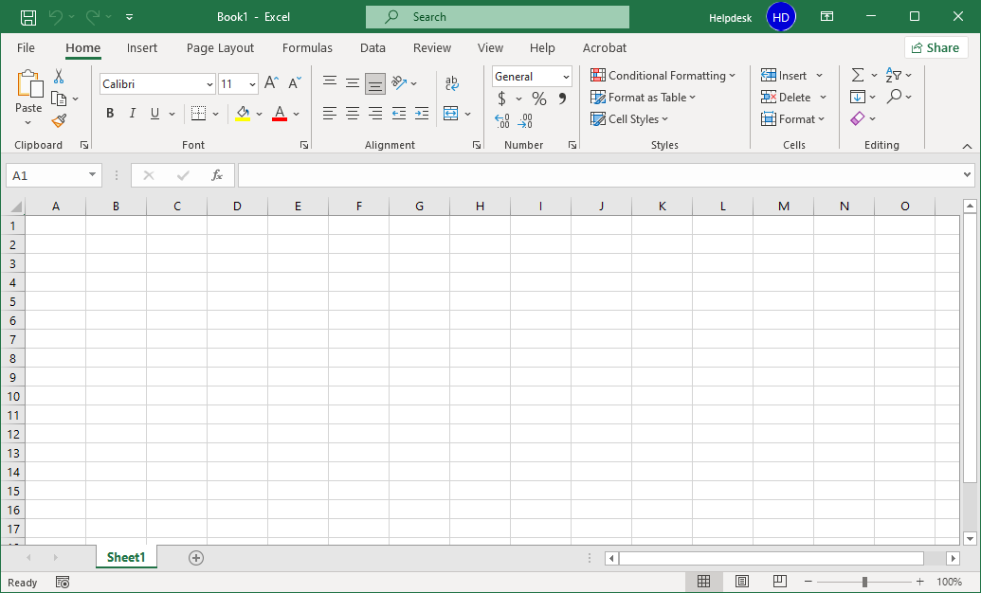
Navigating Using the Keyboard
Below is a list of the most common keyboard navigation keys and key combinations.
| Shift Tab
Moves the cursor left or right
Tab |
Shift Enter
Moves the cursor up or down
Enter
PG Up
Moves the cursor up or down number of visible rows
PG Down
CRTL PG Up
Switches between worksheets
CTRL PG Down
CRTL
Moves the cursor right one word or left one word
CTRL
HOME
Moves the to beginning of the row or to the end.
END

Slide 33
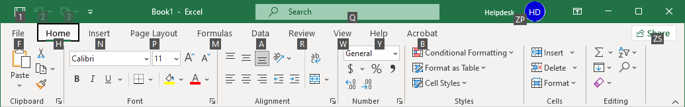
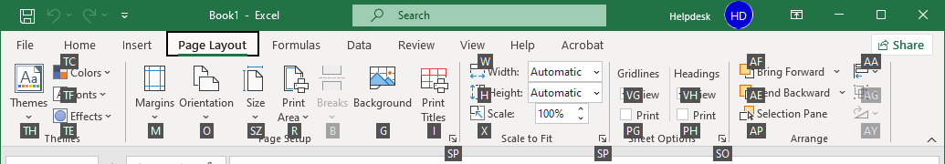
Basic Spreadsheet Functions – Ribbon Access via Keyboard
Navigating Using the Mouse & Keyboard
Alt – Touch the Alt key on the keyboard to gain access to the ribbon via the keyboard.
Touch Esc on the keyboard to go back one level.
Notice the white letters in small black boxes.
Now touch the letter of the item you want.
P for the Page Layout ribbon, for example.
Now touch another letter (or two letters in some cases) to do that command or pull down a menu.
M for the Margins menu, for example.
Slide 33

Slide 34
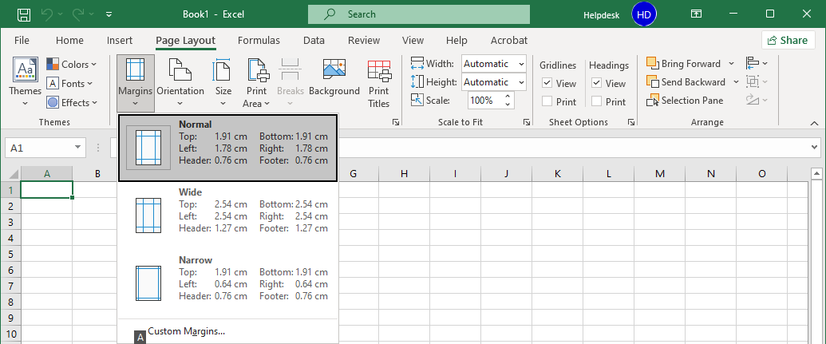
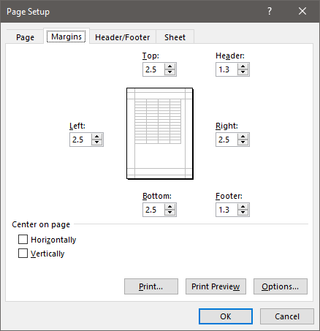
Basic Spreadsheet Functions – Ribbon Access via Keyboard
Navigating Using the Mouse & Keyboard
While in the menu, you can use the up/down arrow keys to select a command or
Touch a letter on the menu.
Touch Esc on the keyboard to go back one level.
In this example, press the letter A.
Which displays the Custom Margins dialog.
Slide 34

Slide 35
Slide 35
Basic Spreadsheet Functions
The function bar shown below is directly above the column headers.
Name Box
Insert Function box. Click on the icon to open the functions dialog.
Function/Formula bar
Compatibility – These functions from earlier versions of Excel are provided for compatibility with functions made in older versions of Excel.
Cube - Multidimensional sets of data providing a means to summarize information.
Database – Treating an Excel spreadsheet as a flat database, these functions return a search based on sum, variance, and standard deviation data.
Date & Time – Date and time functions allow you to work with the current time or time intervals.
Engineering – Engineering calculations: many of which relate to Bessel Functions, Complex Numbers.
Information – These functions return information about the contents and/or formatting of a cell.
Logical – Flow control, logic and error capture.
Math & Trigonometry – ABS, sine, cosine, logarithmic, Pi, Quotient, etc.
Statistical – Works with data points, deviations, and more.
Text – Use these functions to manipulate text.
Web – XML and web services functions.
Notes:
Have them follow along in the functions dialog box if they have a computer in front of them.

Slide 36
The Rules
Slide 36
Like everything in life, there are rules to follow.
All formulas begin with an equal sign.
Cells when represented in a function individually or as a block are separated by a comma (union operator). eg. D14, H27, A3, B84
Cells when represented in contiguous block are separated by a colon (cell range operator). eg. D14:D30
Excel follows the Order of Operations. Remember the PEMDAS (or BEDMAS) you might have learned in school (Brackets, Exponents, Division, Multiplication, Addition, Subtraction)
Evaluate Brackets - From the inner first to the outer last eg. =8.7334*(27.416+(12-7.3)^4)
Evaluate ranges – A range of cells such as D14:D30 (column) or D14:J14 (Row)
Evaluate intersections – Applies the supplied function to the overlap of two blocks of cells.
Evaluate unions – The union operator is the comma.
Perform negations
Convert percentage values to decimal.
Perform exponentiation – The up caret, ^, is used in a function to represent an exponent
Perform multiplication, *, and division, /. These are equal in precedence.
Perform addition, +, and subtraction, -. These are equal in precedence.
Evaluate text operators – In Excel the ampersand, &, concatenates text.
Perform comparisons – The comparison operator are: equals = not equal to <> less than <= greater than >=

Slide 37
Slide 37
Basic Spreadsheet Functions - Common Functions
SUM – Adds all the numeric values of all the selected cells. This is probably the most common function in Excel. eg. =SUM(D2, G6:G8)
HYPERLINK – Insert a web link to a web page or resource (such as a PDF) into a cell. Hyperlinks can also jump to a name link on any spreadsheet to which it has access, even other workbook sheets (i.e. another file).
MIN & MAX – MIN returns the lowest value from the selected cells. MAX returns the highest value from the selected cells. eg. =MIN(D2, G6:G8)
NOW – Returns the current date in the format defined in Windows for a short date, short time
(Win10 – Settings/Time & Language/Date & Time/Formats/Short Date & Short Time)
eg. =NOW() Don’t forget those parentheses!
DAYS – Returns the number of days in a date period. eg. =DAYS("January 12, 2017","February 26, 2017")
COUNT returns the number of cells in a selected range that contain numbers only. eg. =COUNT(G6:G8)
COUNTA returns the total number of cells selected regardless of content. eg. =COUNTA(G6:G8)
AVERAGE – Returns the arithmetic mean of its’ argument. eg. =AVERAGE(D2, G6:G8)
DSUM – Adds the numbers in the fields of records in the database that match the conditions you specify.
Notes:
Question 5: You want to insert the Date/Time into a cell so that when you open the workbook, that Date/Time cell display the current Date/Time. What function would I use to accomplish this?
Answer: d. =Now()

Slide 38
On the “Excel_2021_Sample_Workbook.xlsx” click on the OOP sheet tab.
Note: You may have to scroll right using the spreadsheet navigation arrows. (bottom left)
1. Enter into cell B5 the following formula:
18.98 + 114.98 * 4
Answer:
535.84
478.90
This is a basic formula you would see in commerce.
2. Enter into cell B8 the following formula:
12 + (3.14159 * 325)
Answer:
1033.01675
47.5686677281
Though syntactically not incorrect, can anyone notice anything that is unnecessary in this formula?
3. Enter into cell B11 the following formula:
187.4 * (18 + 5^3)
Answer:
3378200
8373.2
26798.2
Which is done first, the exponent or what is in parenthesis?
(Hint: trick question)
Slide 38
Notes:
( = 18.98 + 114.98 * 4 Answer is B ) ( = 12 + (3.14159 * 325) Answer is A ) ( = 187.4 * (18 + 5^3) Answer is C )

Slide 39
NITHA IT Helpdesk
helpdesk@nitha.com
1(306)953-5008

Slide 40

Thank you

