Slide 1


Excel 2016/2019 Pivot Tables & Charts
Intermediate Level

Slide 2



NITHA IT Helpdesk
helpdesk@nitha.com
1(844)486-4842

Slide 3

What will we be covering in this course?
Preamble and Definitions
Working with the Pivot Table – Bar Chart
Downloading and Opening the Exercise File
Working with the Pivot Tables
Placing Data Fields and Filtering
Creating a Pivot Table
Working with the Pivot Tables
The Bar Chart
Pivot Chart Anatomy
Working with the Pivot Tables
The Doughnut Chart

Slide 4
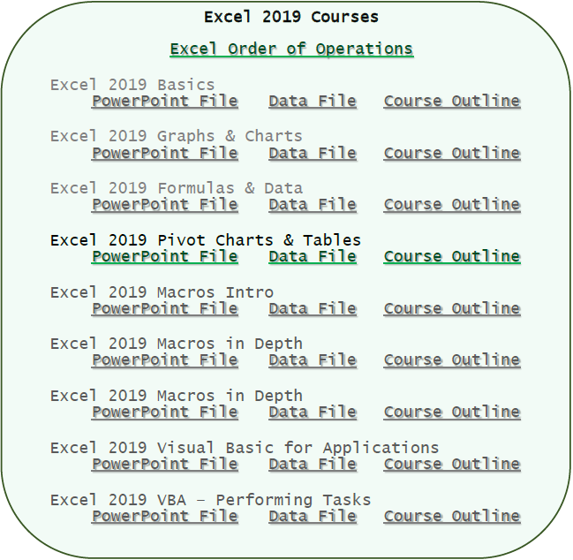
Download the files for the course.
File: Course_Downloads.PDF
The files for the course are located in a Dropbox account.
Download links for the course files were created and put into a
PDF document
which you should have had provided for you.
Open the PDF document and scroll down until you find the Excel course files.
If you do not have that file,
I will email it to you now.

Slide 5
What are pivot tables and how do they benefit me with my projects?
Normally when you make a chart, you massage the data using the commands such as Sort, Filter, Group & SubTotal.
Then you choose the chart that best represents your data and the point you are trying to make …
… however …
Pivot tables allow you to move your data around from Column header to Row header to Filters to Values in an easy drag & drop fashion “on the fly”.
This flexibility make it easier for you to view your data in different graph structures.
Using the traditional way of selecting your data, filtering it and then choosing a chart can be awkward and clumsy if you do not know exactly what data you need. Pivot tables give you the flexibility to work with your data in real time.
A pivot chart is a visual companion to your pivot table.
When you sort, filter or group your data the changes are reflected in your chart instantly.
Our Ultimate Goal
Our goal is to display the smoking statistics comparison between males and females for Saskatchewan First Nations for all ages from 15 year and up.

Slide 6
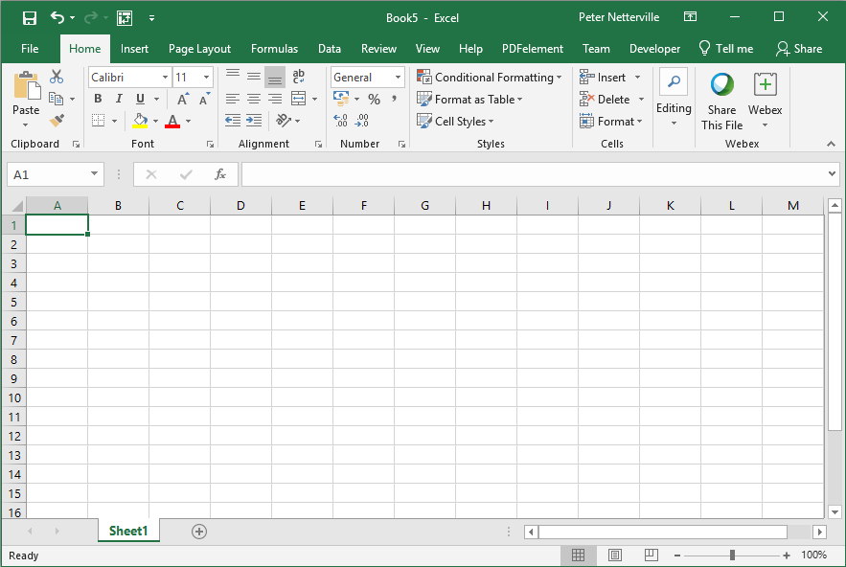
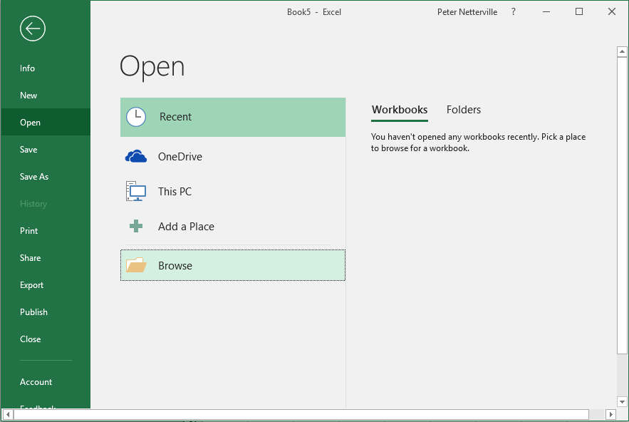
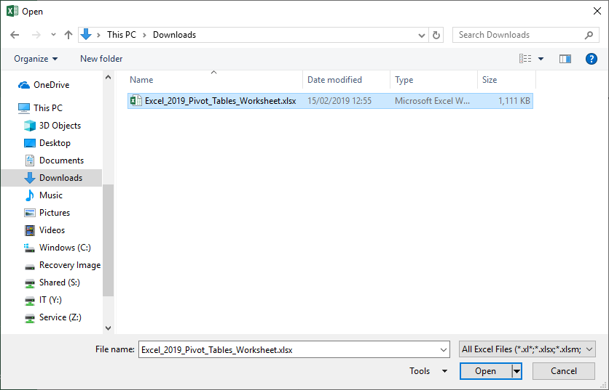
Open the Excel_2019_Pivot_Tables_Worksheet.xlsx file you just downloaded.
It is most likely in your Downloads folder.
Click on the Backstage, the File tab.
Click on the Open button which displays the Open screen.
Click on the Browse button.
Click on
Navigate to where the course file is located on your computer, probably the Downloads folder.
Then click on the Open button.

Slide 7
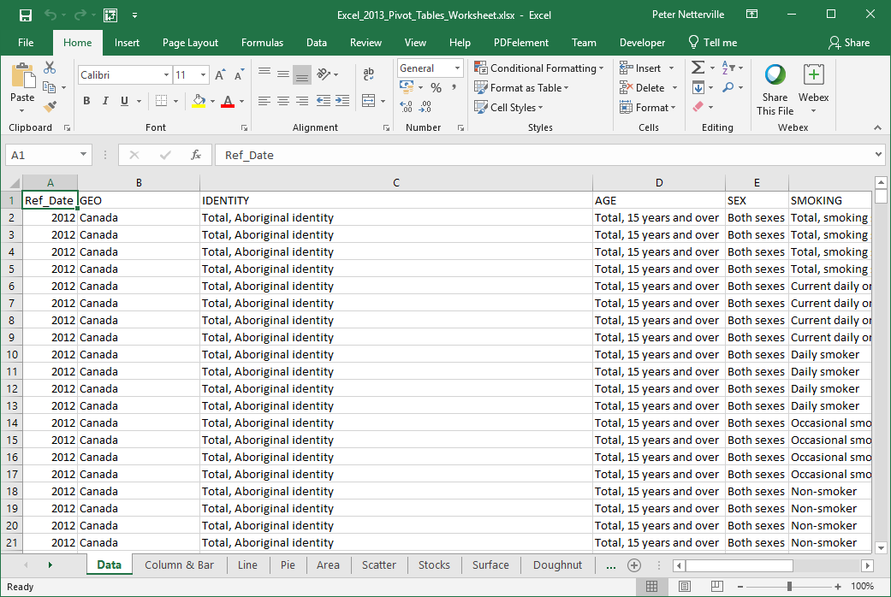
You should now have a screen that look similar to …

Slide 8
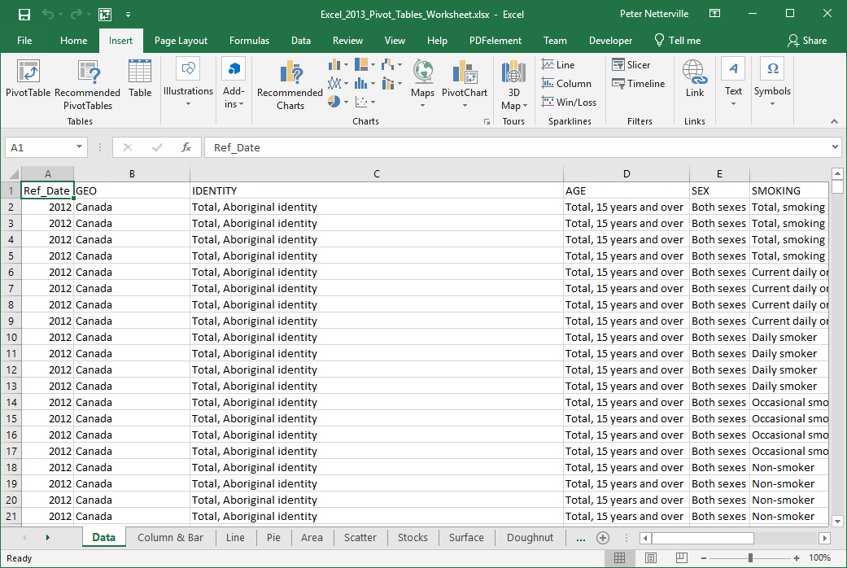

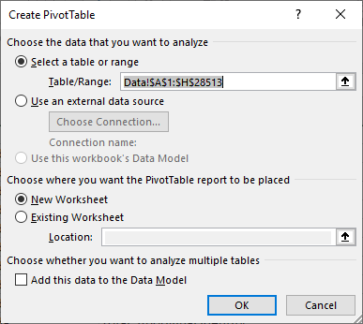
Creating a Pivot Table
Click on any cell in the table
Click on the Insert ribbon tab
In the Tables group click on …
  PivotTable button
The Choose the data that you want to analyze option already has the entire table selected, but you can change that here.
You can also pull the data from an external data source.

Slide 9
Creating a Pivot Table
On the Choose where you want the PivotTable report to be placed option you can choose
  New Worksheet
  Existing Worksheet
If you choose Existing Worksheet you will need to select a cell where the report will be placed.
Click on the OK button.

Slide 10
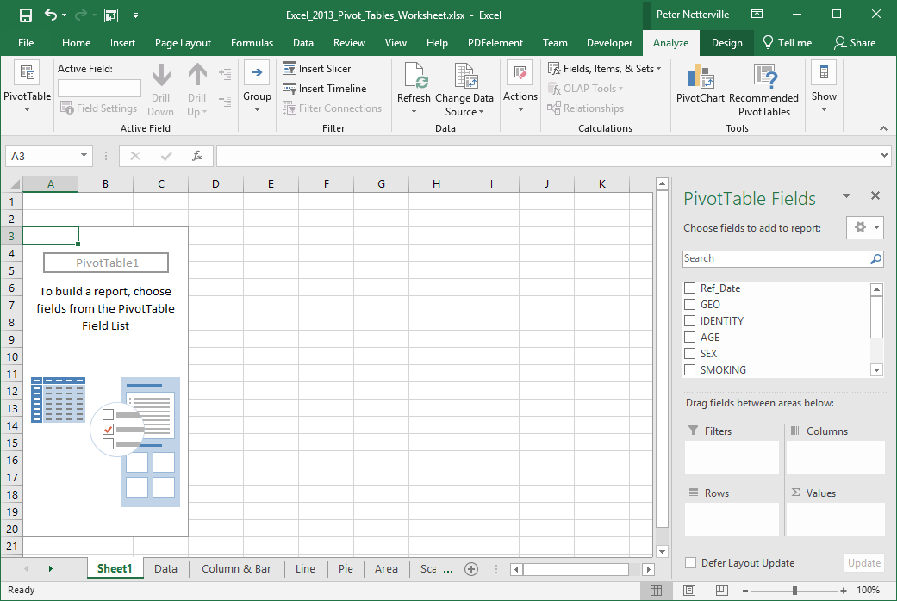
Below is what you should have on your computer
  The PivotTable box on the left
  The PivotTable Field list on the right
Pivot Chart Anatomy
When choosing what data fields to select keep in mind what aspect of the data are you trying to emphasize.
To build a table select the fields you want to include by dragging the field down into one of the four areas below

Slide 11
Pivot Chart Anatomy
The data in the table is represented by the PivotTable1 box on the left. Make sure to keep it selected while working on your pivot table and chart.

Slide 12
The Pivot Table Field List contains five panels:
Pivot Chart Anatomy
  Field selection
  Columns
  Values
Field Selection
Allows you to choose what data to include in the table, which will be represented in the chart in which you have chosen to represent that data.
  Filters
  Rows
Filters
Allows you to focus on specific parts of the data by displaying only the data you want.
Columns
The Column label is the X axis data.
Row
The Row Label is the Y axis data.
Values
The Values is the column in the table that provides context to the data record and can be represented as Sum, Count, Average, Max, Min, and more.

Slide 13
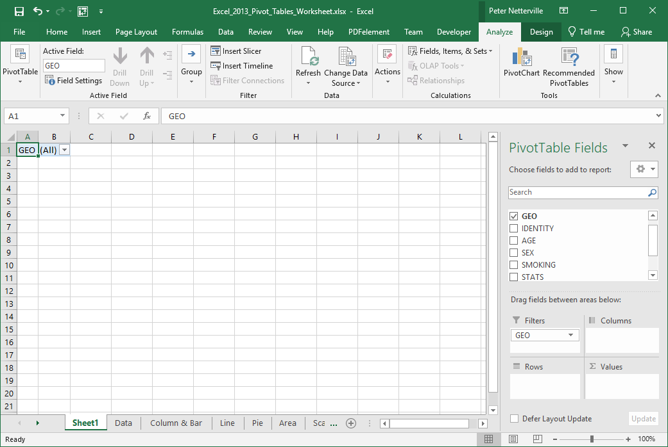
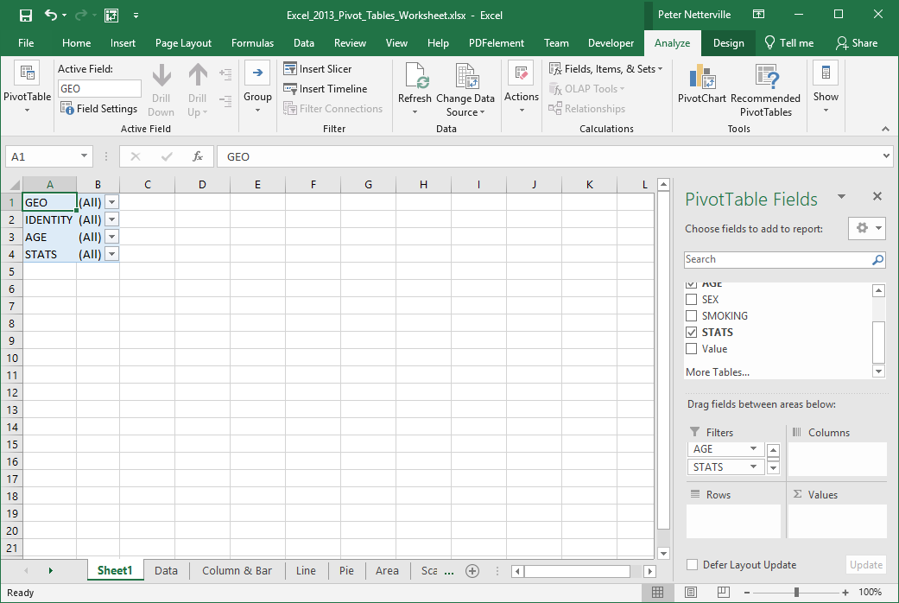
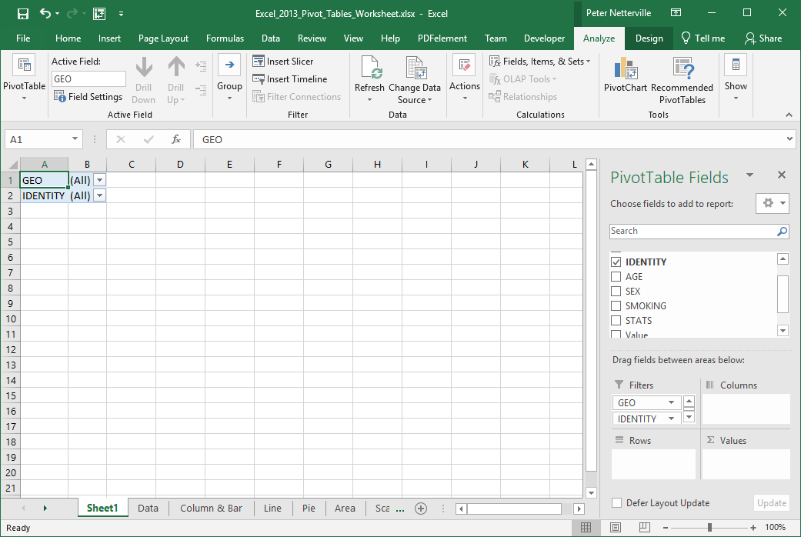
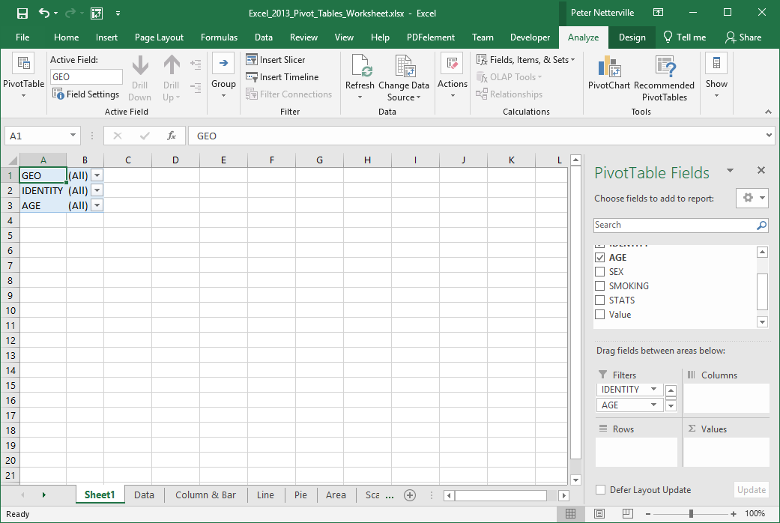
Working with the Pivot Tables
Placing Data Fields, Filtering
Now that we know the areas of the Pivot Table Field List, we need to arrange the data into the proper areas; Filters.
Sort the data fields into the following areas by dragging and dropping it.
Drag to Filters
GEO
IDENTITY
AGE
STATS

Slide 14
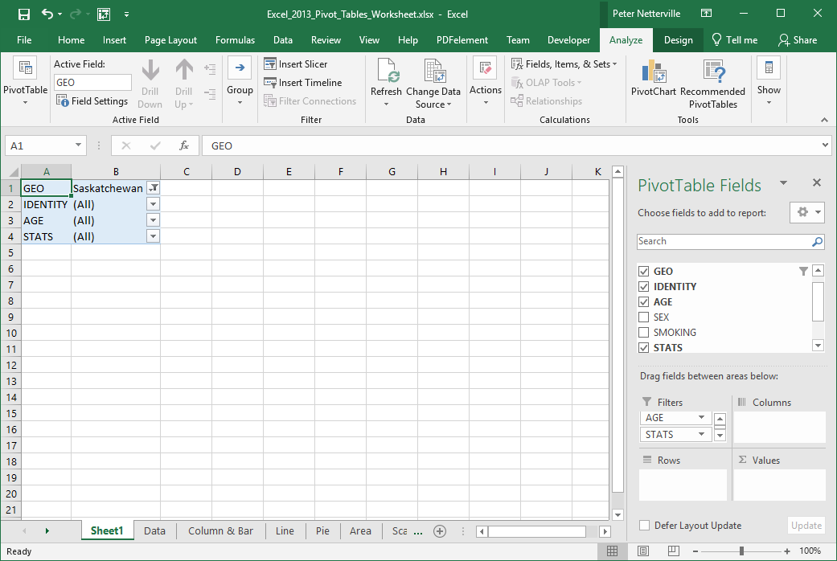
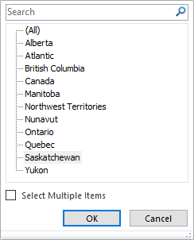
Working with the Pivot Tables
Placing Data Fields, Filtering
Now that we know the areas of the Pivot Table Field List, we need to arrange the data into the proper areas; Filters.
Now restrict the data by filtering it.
Click on the down arrow beside GEO
and select
Saskatchewan

Slide 15
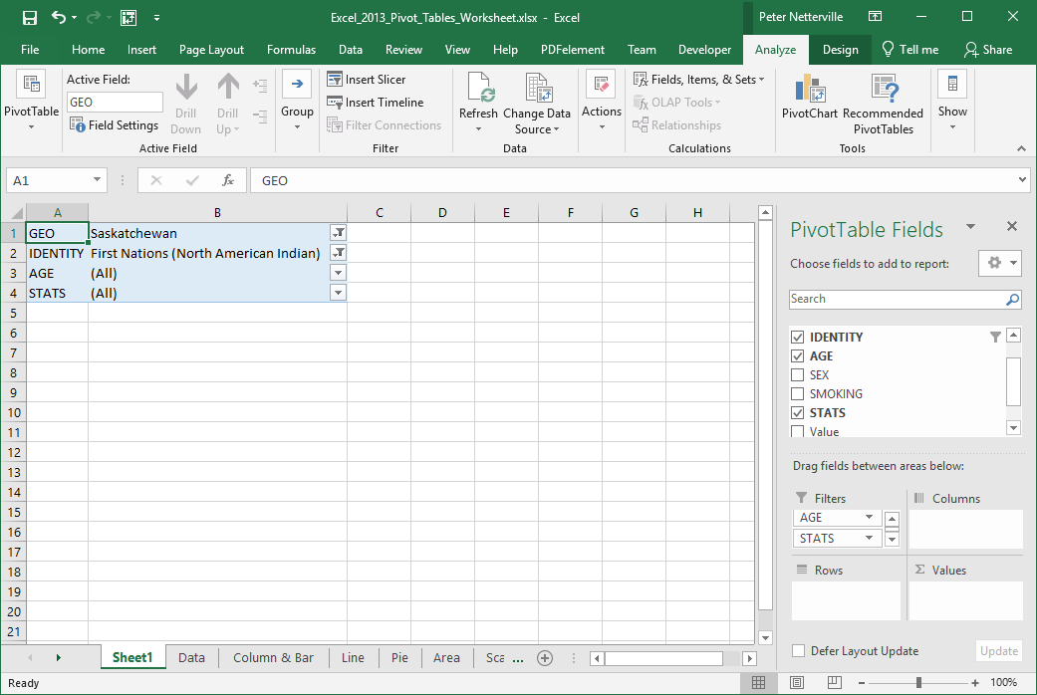
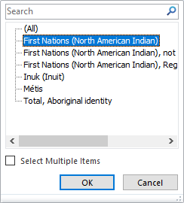
Working with the Pivot Tables
Placing Data Fields, Filtering
Now that we know the areas of the Pivot Table Field List, we need to arrange the data into the proper areas; Filters.
Now restrict the data by filtering it.
Click on the down arrow beside IDENTITY
and select
First Nations (North American Indian)

Slide 16
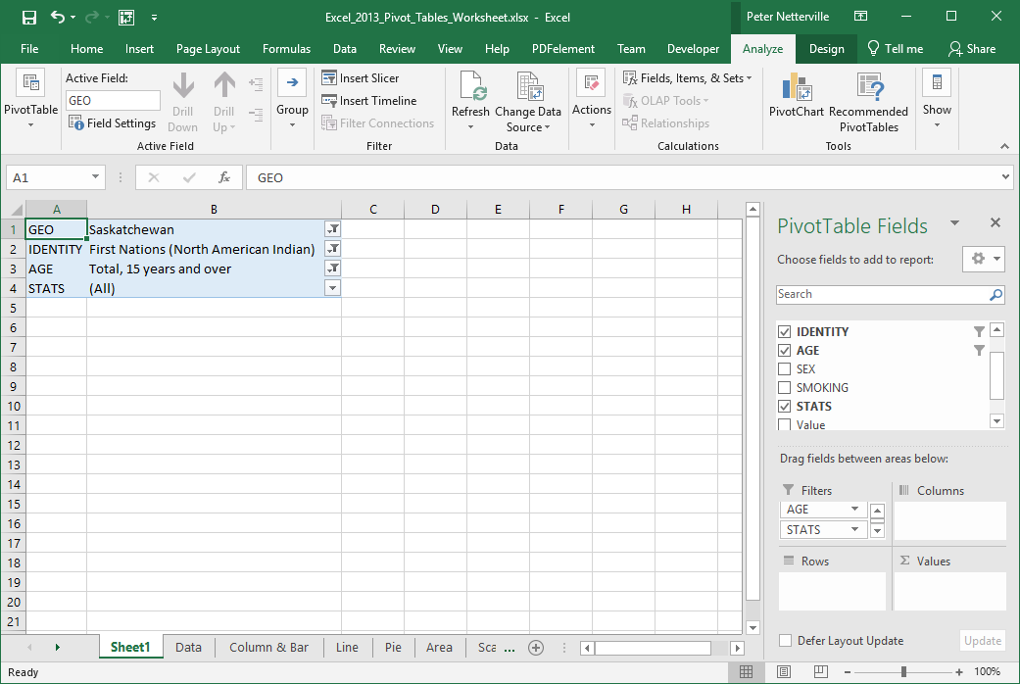
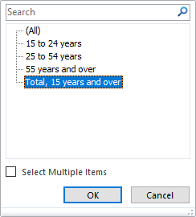
Working with the Pivot Tables
Placing Data Fields, Filtering
Now that we know the areas of the Pivot Table Field List, we need to arrange the data into the proper areas; Filters.
Now restrict the data by filtering it.
Click on the down arrow beside AGE
and select Total, 15 years and over

Slide 17
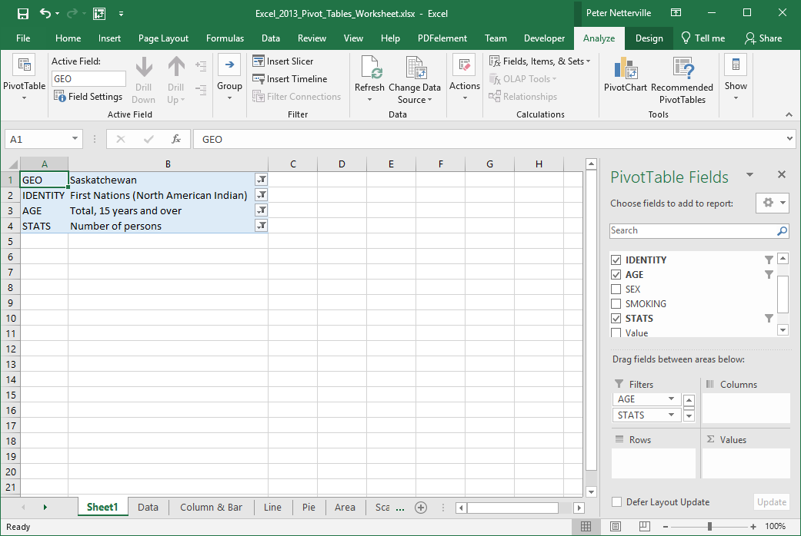
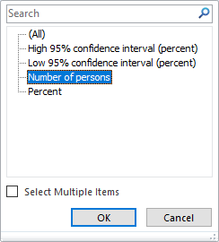
Working with the Pivot Tables
Placing Data Fields, Filtering
Now that we know the areas of the Pivot Table Field List, we need to arrange the data into the proper areas; Filters.
Now restrict the data by filtering it.
Click on the down arrow beside STATS
and select Number of Persons.

Slide 18
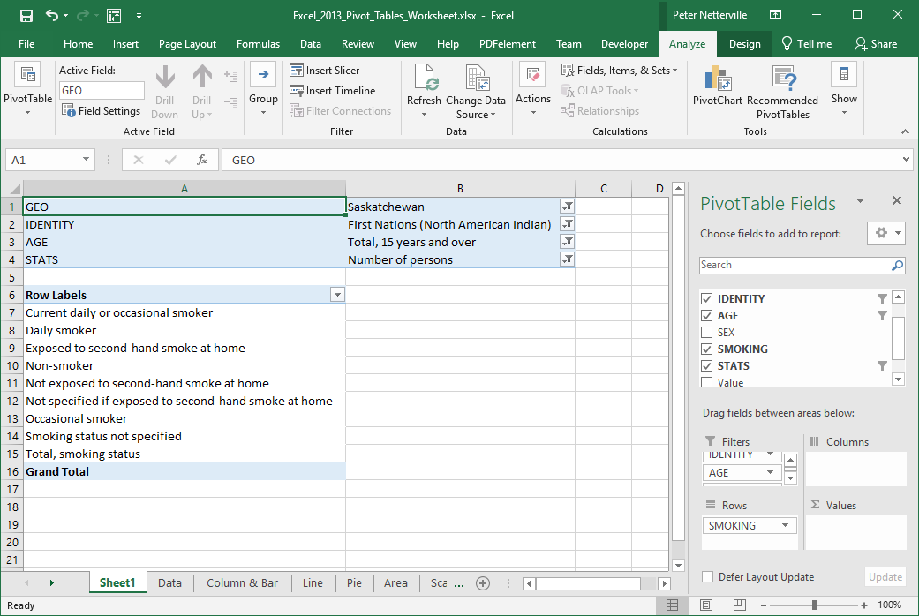
Working with the Pivot Tables
Placing Data Fields, Filtering
Now that we know the areas of the Pivot Table Field List, we need to arrange the data into the proper areas; Rows.
Now restrict the data by filtering it.
Row Labels
SMOKING

Slide 19
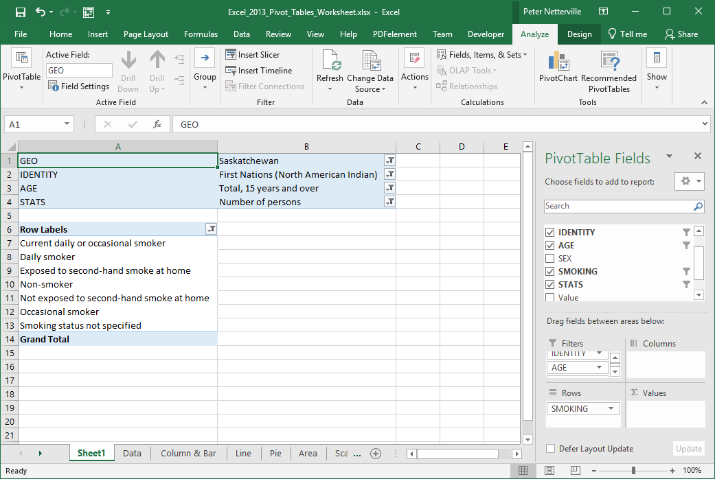
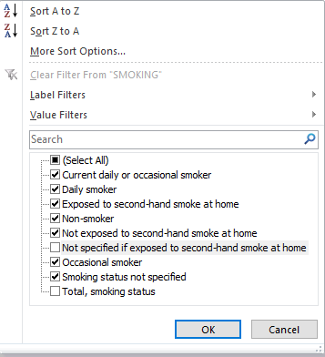
Working with the Pivot Tables
Placing Data Fields, Filtering
Now that we know the areas of the Pivot Table Field List, we need to arrange the data into the proper areas; Rows.
Now restrict the data by filtering it.
Restrict that to seven items.
Let’s also filter the Row Labels. We have nine items at the moment.

Slide 20
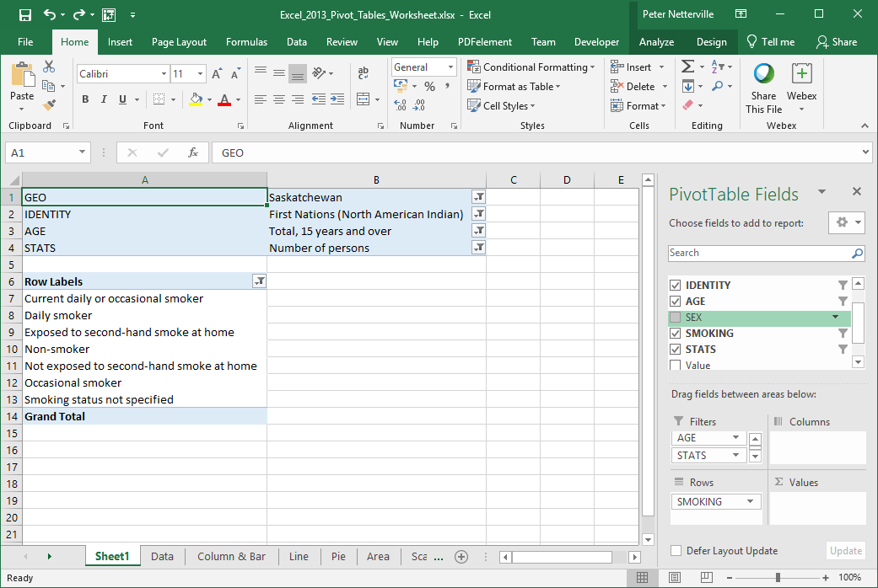
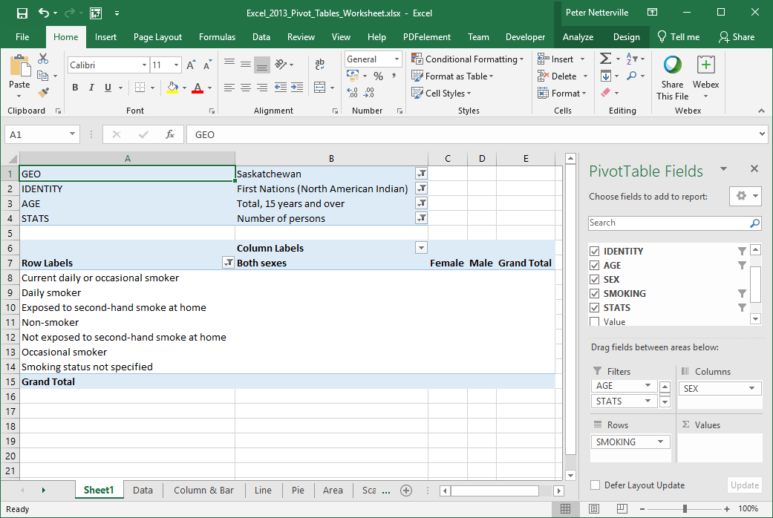
Working with the Pivot Tables
Placing Data Fields, Filtering
Now that we know the areas of the Pivot Table Field List, we need to arrange the data into the proper areas; Columns.
Now restrict the data by filtering it.
Column Labels
SEX
Notice the three columns that appeared;
Both sexes
Female
Male

Slide 21
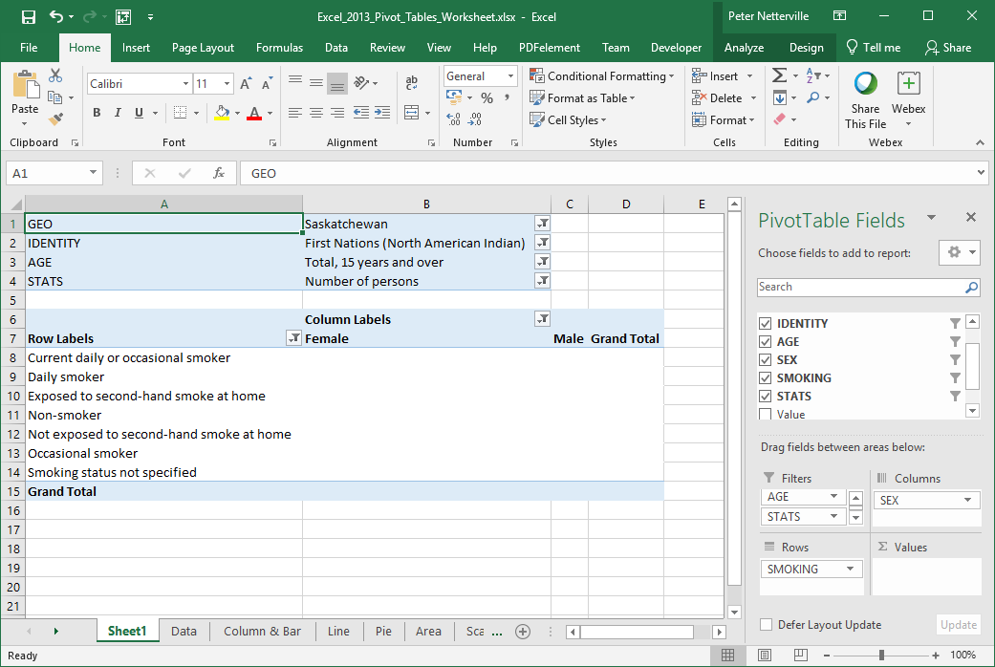
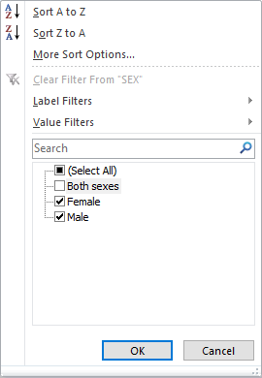
Working with the Pivot Tables
Placing Data Fields, Filtering
Now that we know the areas of the Pivot Table Field List, we need to arrange the data into the proper areas; Columns.
Now restrict the data by filtering it.
Now to filter the Sex field.
Deselect Both sexes.

Slide 22
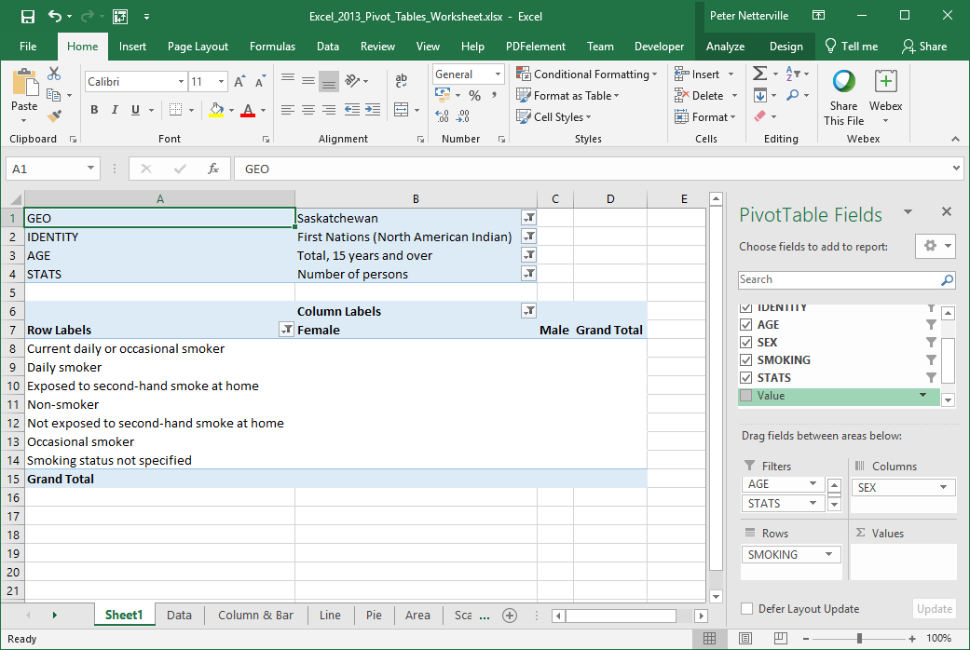
Working with the Pivot Tables
Placing Data Fields, Filtering
Now that we know the areas of the Pivot Table Field List, we need to arrange the data into the proper areas; Columns.
Now restrict the data by filtering it.
Now that we have the Sex field filtered there are two columns, just Male and Female because we are going to compare the smoking stats one against the other.

Slide 23
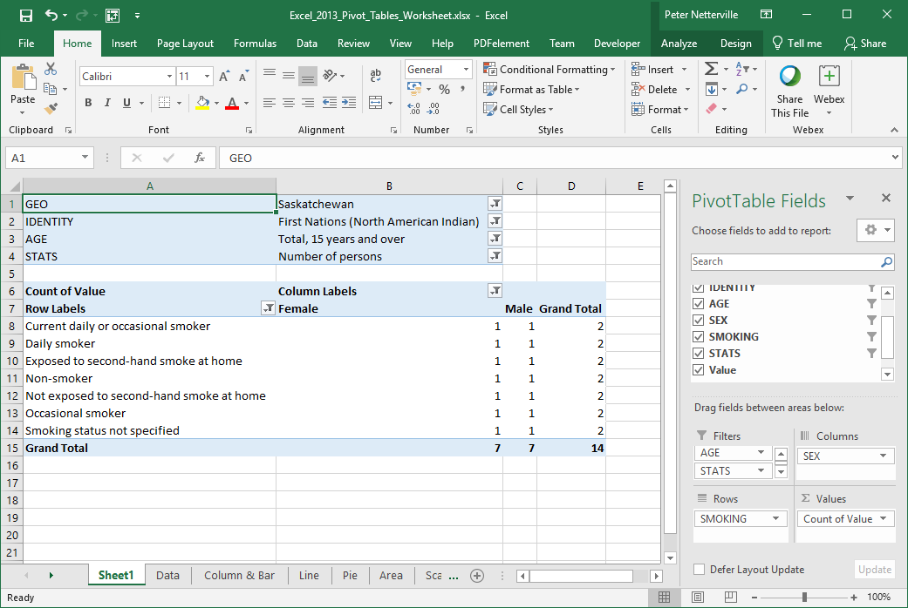
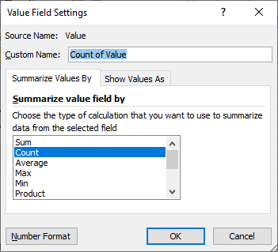
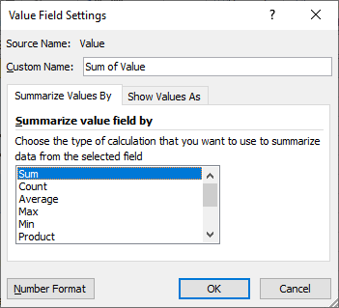
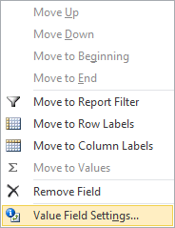
Working with the Pivot Tables
Placing Data Fields, Filtering
Now that we know the areas of the Pivot Table Field List, we need to arrange the data into the proper areas; Values.
Now restrict the data by filtering it.
Select the Sum option from the list.
The Values field is placed, oddly enough, in the Values area.
Now we need to change what function is performed on the Value field by clicking on the drop arrow.
On the menu that appears select the Value Field Settings… option.

Slide 24
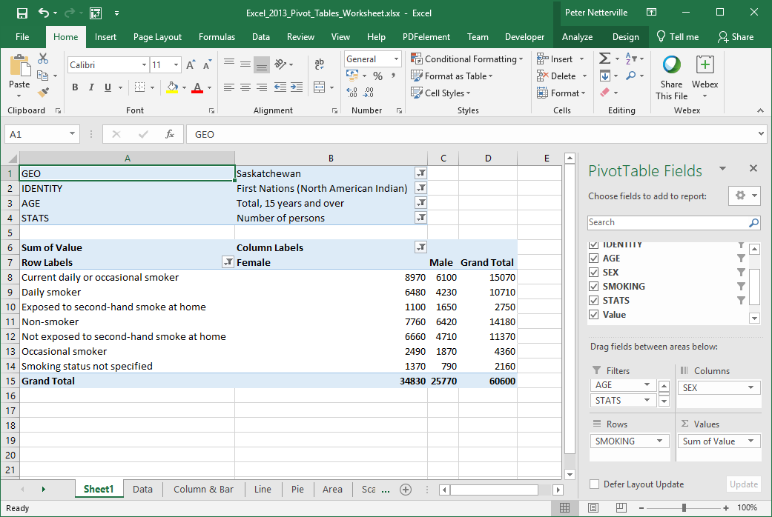
Now that we know the areas of the Pivot Table Field List, we need to arrange the data into the proper areas; Values.

Slide 25
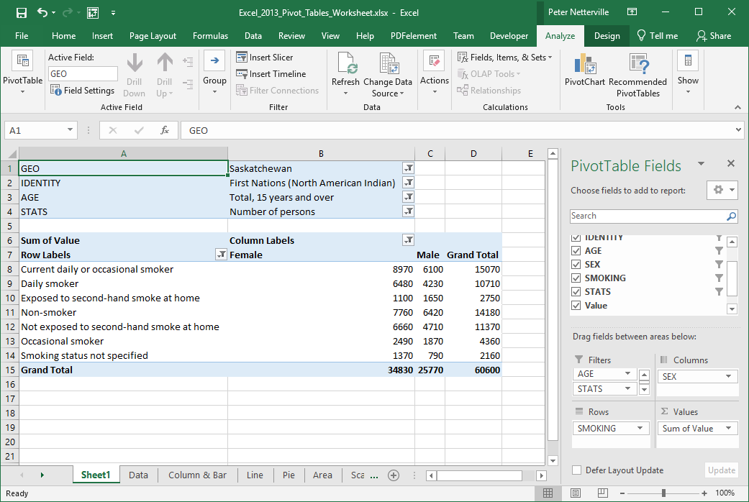
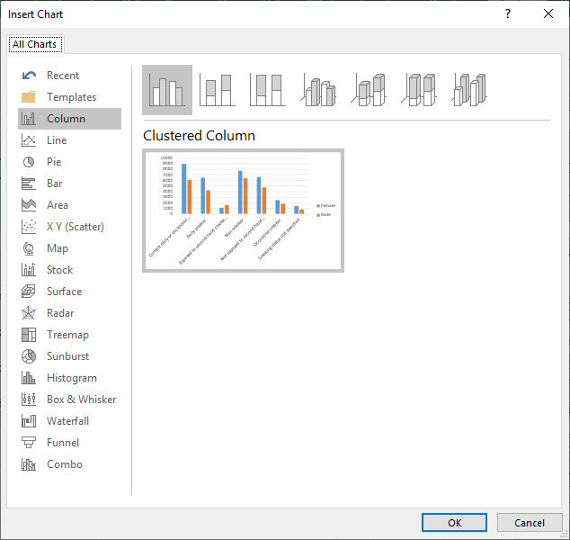
Working with the Pivot Tables
The Bar Chart
After moving the fields into their appropriate areas, applying filters, and selecting the function to apply to the values field, we are finally ready to add a Pivot Chart to display graphically what we see in the table.
Select the PivotChart command located in the Tools group on the Analyze ribbon.
Select the Column.
Click on the Clustered Column

Slide 26
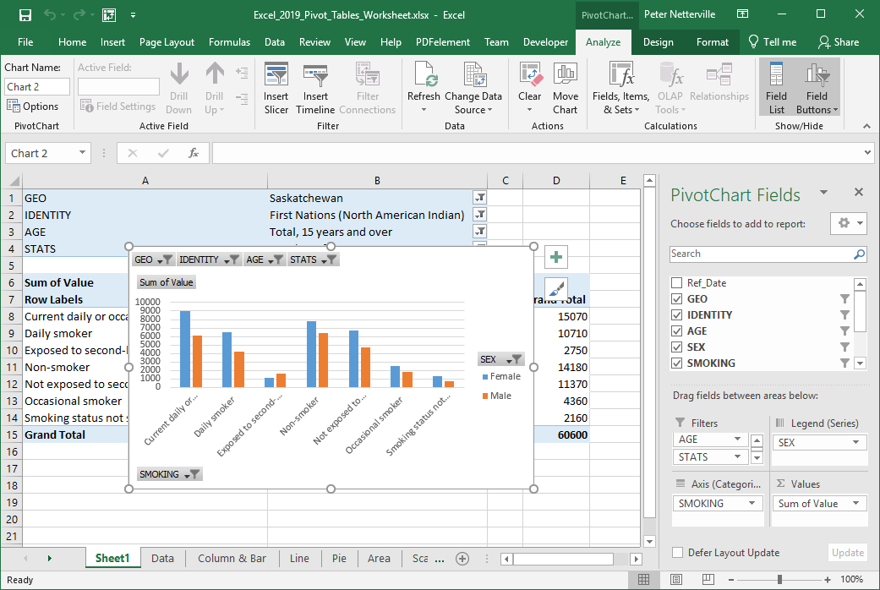
There are three PivotChart Tools contextual ribbons that will help us adjust the chart so that it presents the data more clearly.
The PivotChart Tools Ribbon - Analyze
Analyze ribbon deals with …
Select the chart element
The Active Field appears in the Legend Fields box.
Insert slicer, refresh the data or clear the filters.
Refresh or change the data source.
Clear the data or change the Data Source
Do Calculations on Fields, Items or sets.
Show of hide a field list or field buttons.

Slide 27
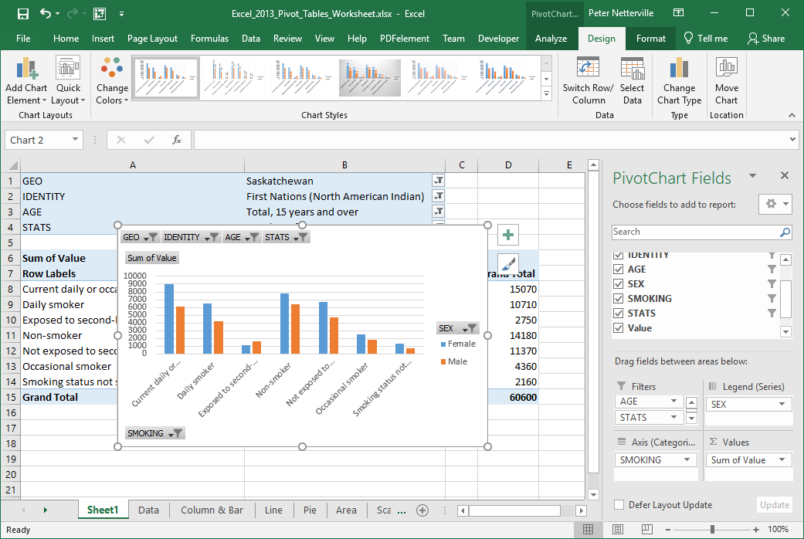
There are three PivotChart Tools contextual ribbons that will help us adjust the chart so that it presents the data more clearly.
The PivotChart Tools Ribbon - Design
Design ribbon deals with …
Adding/editing elements & apply a quick layout.
Chart styles and colours.
Selection of the data & the x, y axis layout.
Change the chart type to another chart.
The placement of the chart on this or another spreadsheet.

Slide 28
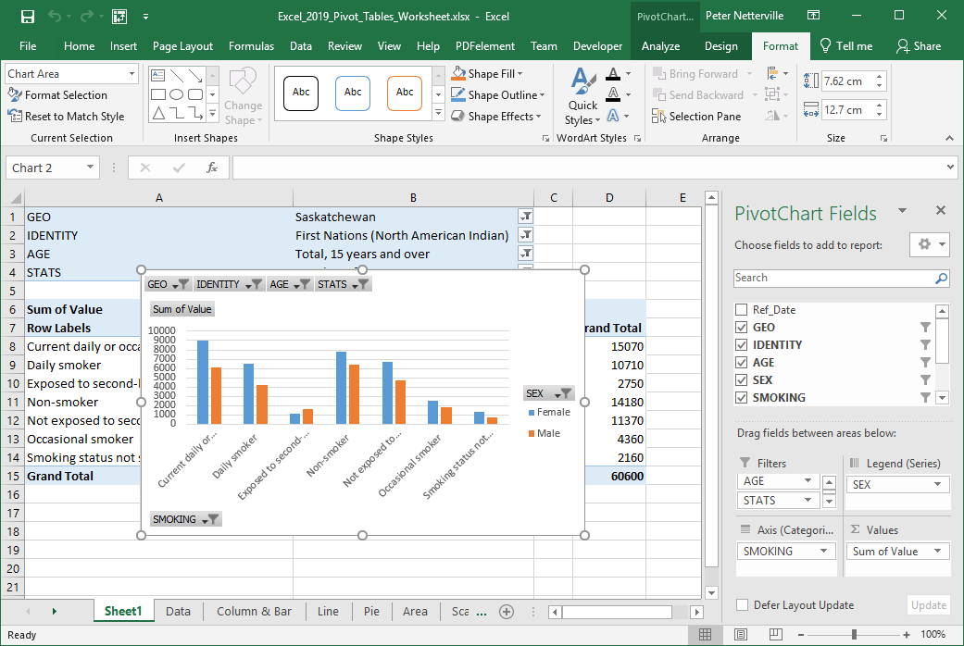
There are three PivotChart Tools contextual ribbons that will help us adjust the chart so that it presents the data more clearly.
The PivotChart Tools Ribbon - Format
Format ribbon deals with …
Selecting parts of the chart to format.
Change the shape by choosing a style or individual elements.
Change WordArt styles or individual elements.
You can manage the objects on the spreadsheet from here.
Change the shape of the selected object

Slide 29

Working with the Pivot Table – Bar Chart
Now to adjust the Bar Chart so it better represents the data.
Switch the X and Y axis.
Select the Design ribbon.
Click on the Switch Row/Column command.

Slide 30
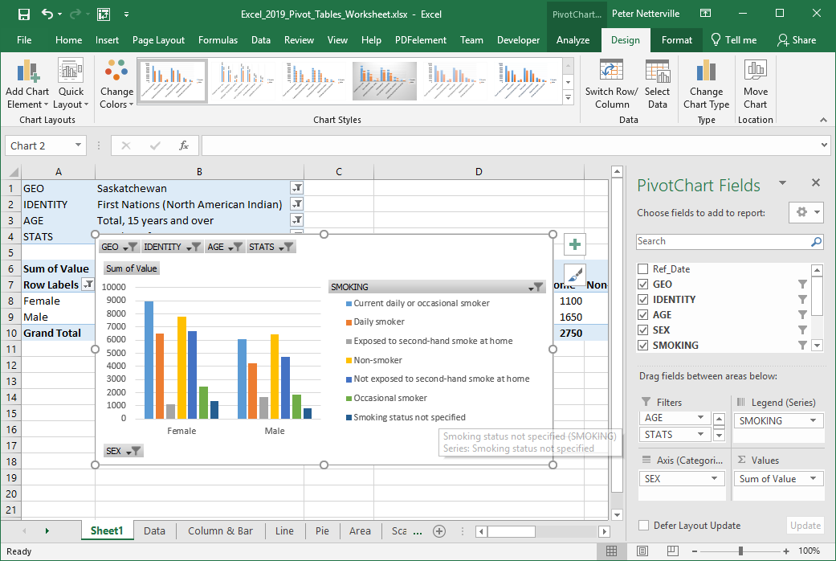
Working with the Pivot Table – Bar Chart
The column chart now displays the field Sex along the bottom on the Axis and Smoking field in the Legend.
Now that the column chart shows the comparison of smoking data between female and males, the chart even would look even better if …
1. We could see the whole legend

Slide 31
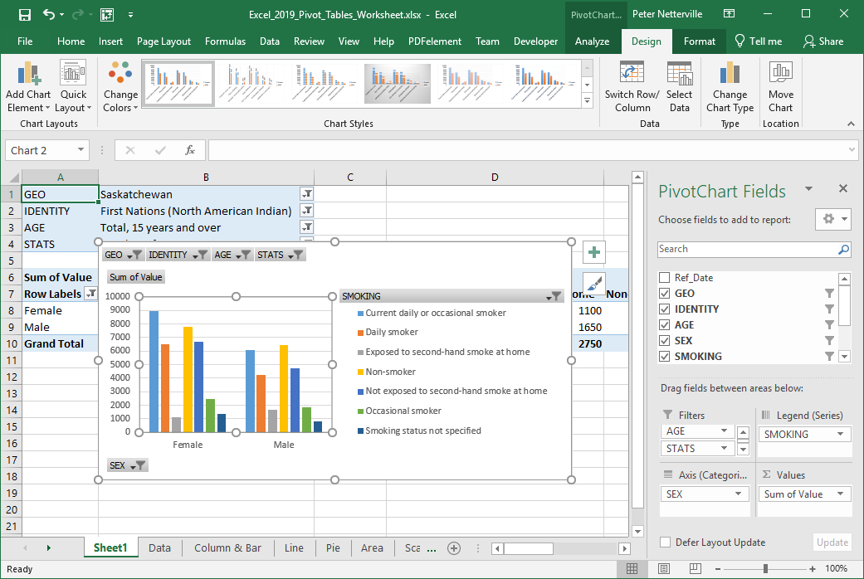
Working with the Pivot Table – Bar Chart
The column chart now displays the field Sex along the bottom on the Axis and Smoking field in the Legend.
Now that the column chart shows the comparison of smoking data between female and males, the chart even would look even better if …
2. Had values assigned to the bars in the chart.
Select the Add Chart Element menu from the Chart Layouts group on the Design ribbon.

Slide 32
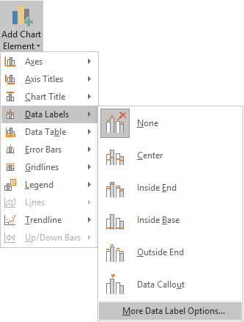
Working with the Pivot Table – Bar Chart
The column chart now displays the field Sex along the bottom on the Axis and Smoking field in the Legend.
Now that the column chart shows the comparison of smoking data between female and males, the chart even would look even better if …
2. Had values assigned to the bars in the chart.
Select From the Data Labels menu the More Data Labels Options …

Slide 33
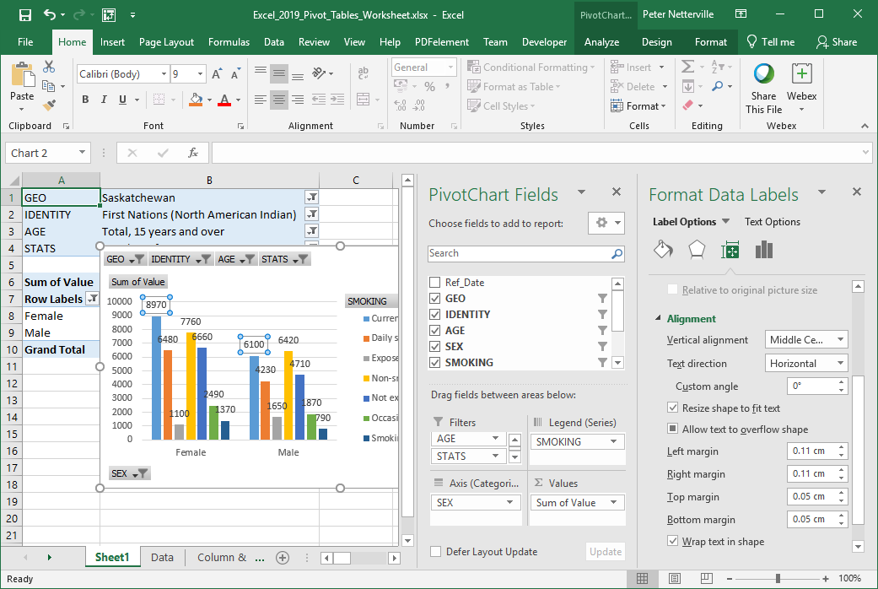
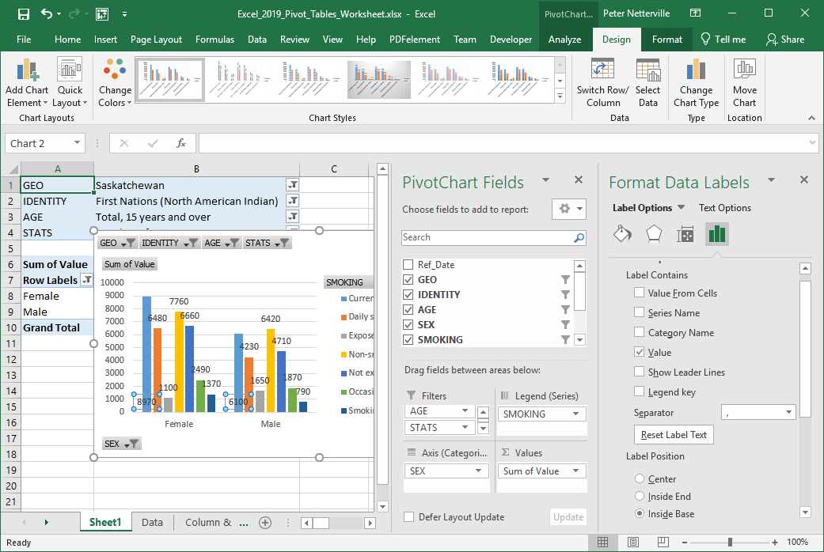
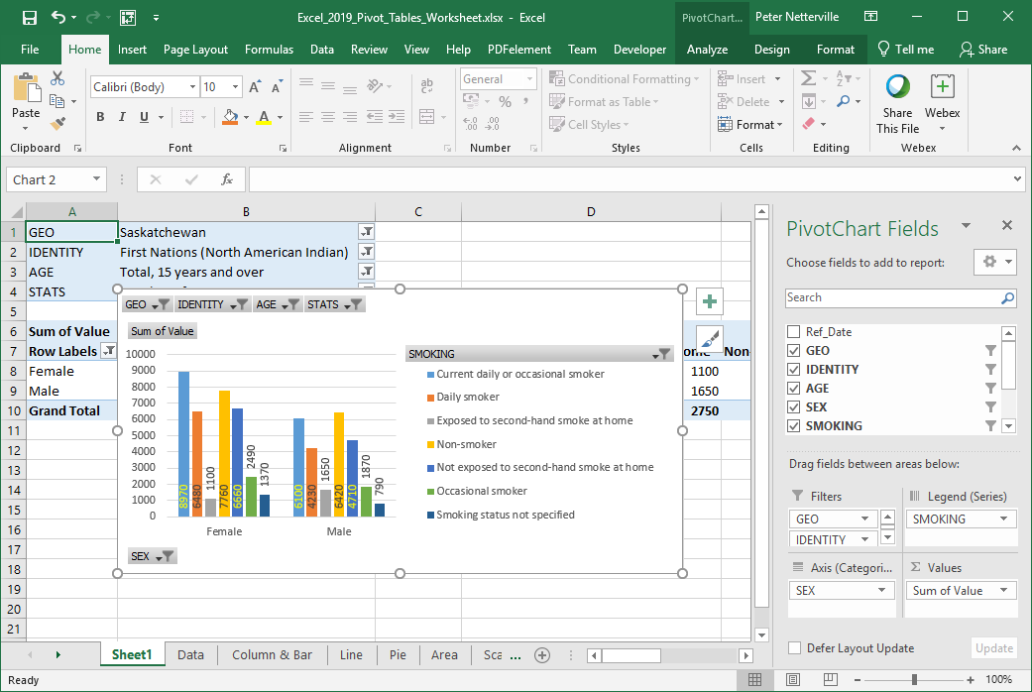
Working with the Pivot Table – Bar Chart
Add some numbers to the data so that it has meaning.
On the Label Options group
Select the Label Options panel
Select Value
Select Inside Base or Outside End
Select 270 degrees from the Size & Properties panel Text Direction menu
Do steps 1, 2 & 3 for each label

Slide 34
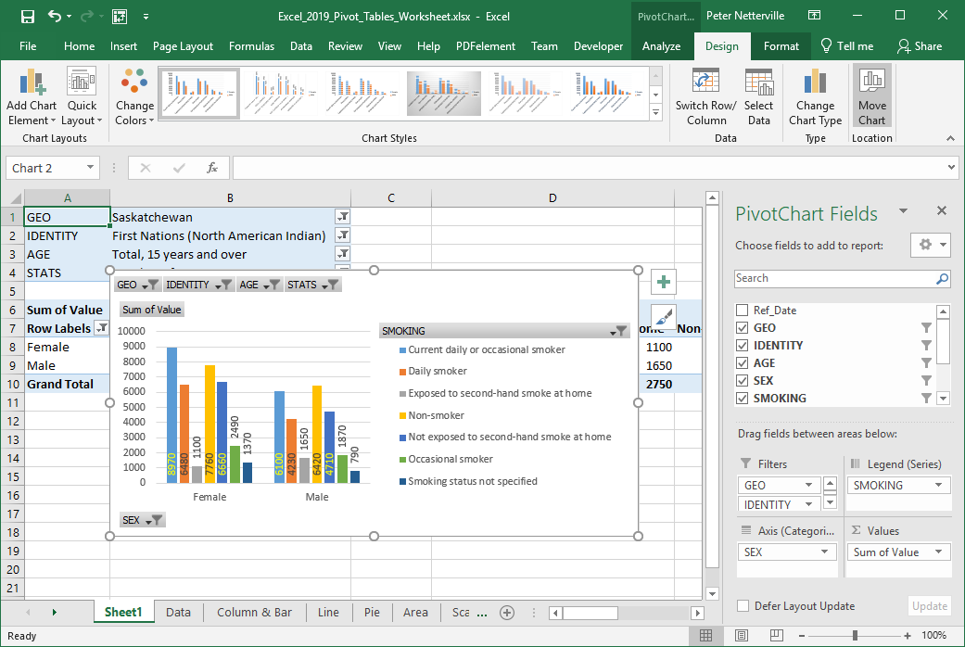
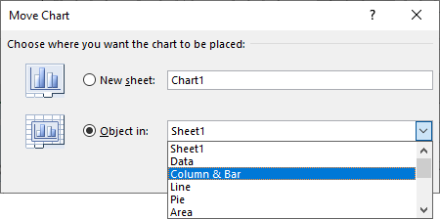
Working with the Pivot Table – Doughnut Chart
Move this Bar Chart to another sheet and make a doughnut chart
Click on Move Chart, then on the Column & Bar sheet, then on then OK button.

Slide 35
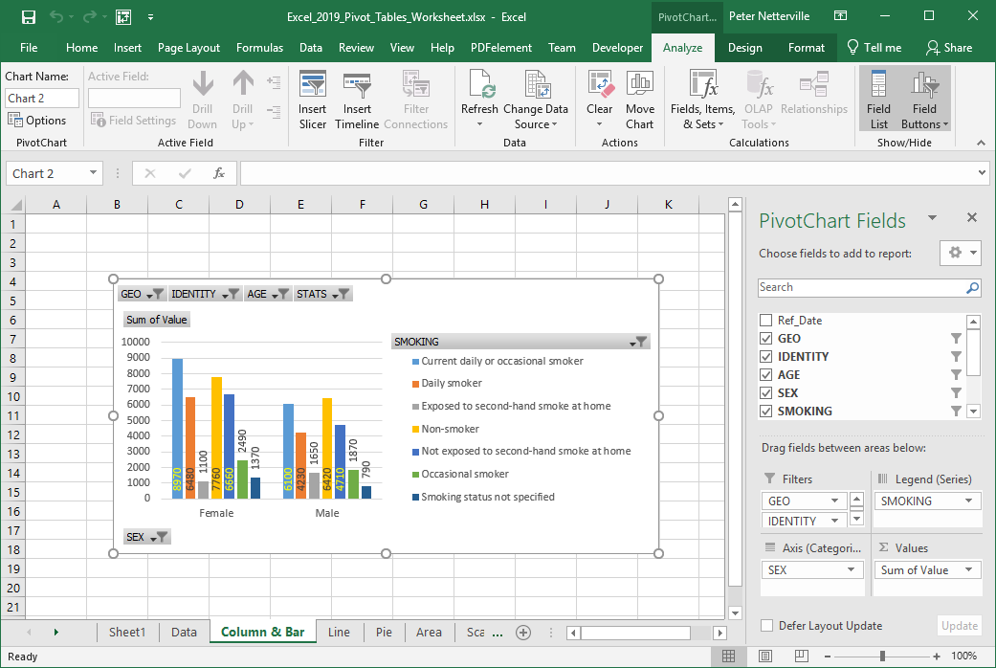
Now the column chart is out of the way on its’ own sheet, the Column & Bar sheet.
Working with the Pivot Table – Bar Chart
Select the Sheet1 sheet and make a Doughnut chart on it using the same data filtered as it was for the column chart.

Slide 36
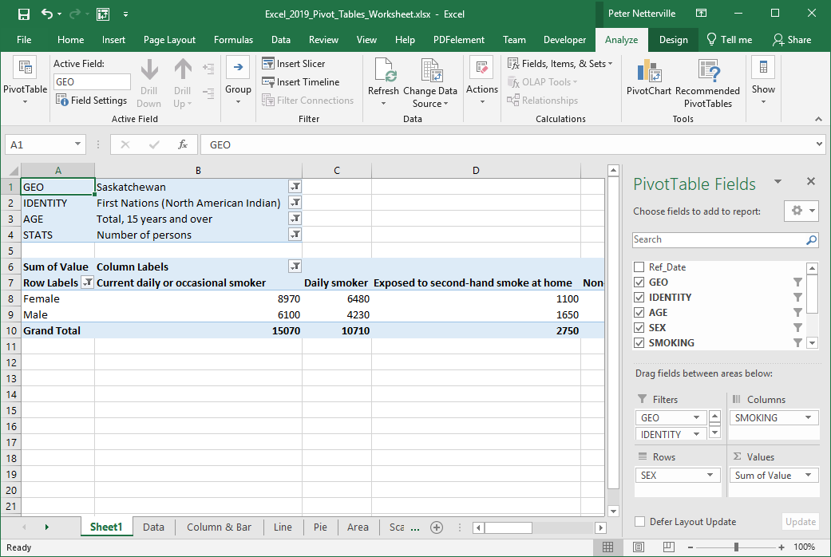
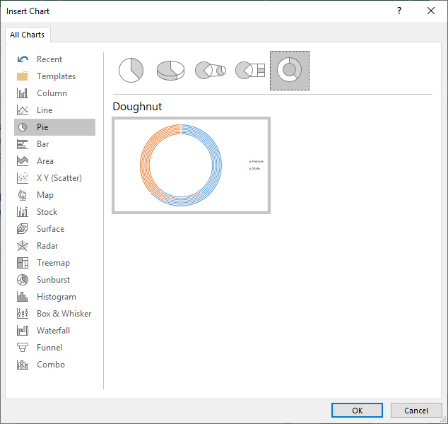

Working with the Pivot Table – Doughnut Chart
Our purpose here is to represent the data in another format, the doughnut chart, so no changes to the data will be necessary.
Select the Analyze ribbon
Click on the PivotChart option
Click on Pie
Click on Doughnut
Click on OK

Slide 37
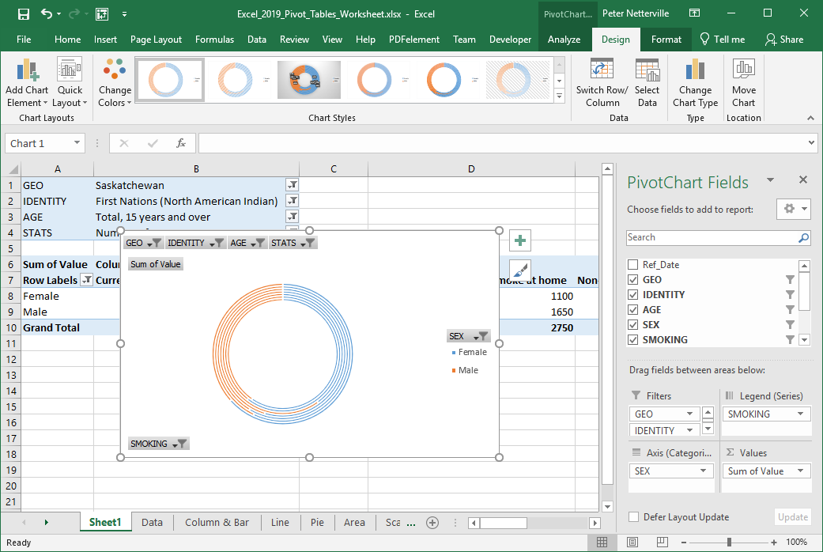
Working with the Pivot Table – Doughnut Chart
This doughnut does not look too appealing, so we will need to adjust it into two rings, not seven.
That is accomplished by switching the X and Y axis back again.
On the Design ribbon click on the Switch Row/Column.

Slide 38


Working with the Pivot Table – Doughnut Chart
Do some formatting to the doughnut to make it more informative.
Do the following alterations:
Resize the chart larger.

Slide 39

Working with the Pivot Table – Doughnut Chart
Do some formatting to the doughnut to make it more informative.
Do the following alterations:
Make the legend display all the smoking stats each on one line.
Make the doughnut as large as possible in the space available.

Slide 40

Working with the Pivot Table – Doughnut Chart
Do some formatting to the doughnut to make it more informative.
Do the following alterations:
Shrink the doughnut hole size to 10% from 75% which in turn makes the segments thicker for the data labels.

Slide 41


Working with the Pivot Table – Doughnut Chart
Do some formatting to the doughnut to make it more informative.
Do the following alterations:
Add the Data Labels from the Chart Layouts group on the design ribbon.

Slide 42

Working with the Pivot Table – Doughnut Chart
Do some formatting to the doughnut to make it more informative.
Do the following alterations:
Now format the Data Labels so that they are readable.

Slide 43

Working with the Pivot Table – Doughnut Chart
Do some formatting to the doughnut to make it more informative.
Do the following alterations:
Add a Chart Title

Slide 44

We have covered here in this course …
Preamble and Definitions
Working with the Pivot Table – Bar Chart
Downloading and Opening the Exercise File
Working with the Pivot Tables
Placing Data Fields and Filtering
Creating a Pivot Table
Working with the Pivot Tables
The Bar Chart
Pivot Chart Anatomy
Working with the Pivot Tables
The Doughnut Chart

Slide 45

NITHA IT Helpdesk helpdesk@nitha.com
1(844)486-4842
Notes:
Please do not hesitate to ask any question regarding this session, and I will make sure to answer your question as soon as possible.

Slide 46


