Slide 1


Excel 2016/2019 Graphs & Charts
Intermediate Level

Slide 2



NITHA IT Helpdesk
helpdesk@nitha.com
1(306)953-5008

Slide 3

What will we be covering in this course?
What is our direction in this course?
Choosing the Data You Present
Chart Types
Parts of the Chart
Context Ribbons - Design
Context Ribbons - Format
Making a Column/Bar Chart
Making a Pie Chart
Making a Doughnut Chart
Tips for Formatting Your Chart

Slide 4
What is our direction in this course?
Assumption 1:
I will be assuming you have a basic knowledge Excel: navigation, screen layout, etc.
Assumption 2:
You must know the following:
  What are ribbons both regular and contextual.
  What are spreadsheets, how to navigate them, and how do you create more of them.
What is a dialog box and what is a window pane.
Our goal is to work with the data so that it is represented in a chart in a meaningful way.
To accomplish our goal we will have to:
Know what we want to represent with the data.
Learn the tools to restrict and present the data so it represents what we need it to.
Tools such as:
Filter –
A filter presents an arrow in the column header which lets you allow or restrict what rows you display based upon the data you filter from that column.
Sort –
You can sort ascending or descending, top to bottom or left to right, using one or more columns by value, cell color, font color, or cell icon.
Subtotal –
Group together rows by subtotalling cells in a column using a specific function.
Group –
Bind selected rows or columns together so they can be collapsed or expanded.

Slide 5
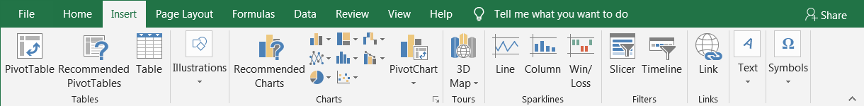
Chart Types
Column & Bar Charts
Column and Bar charts are used to show the changes in data over a period of time or to illustrate comparisons.
Line & Area Charts
The Line chart uses lines to plot trends and changes in data over time.
An Area chart displays the magnitude of change over time.
Pie & Doughnut Charts
A Pie chart can only display one series of data. It represents data in percentages and emphasizes significant elements in the data.
A Doughnut chart has rings and each ring represents one set of data.
Scatter & Bubble Charts
Scatter chart observes how the values of two series compares over time or other category
Bubble chart is similar to scatter chart, except it compares sets of three values instead of two.
Histogram, Pareto, & Box and Whisper Charts
A Histogram shows the distribution of data grouped into bins or categories.
A Pareto chart shows the relative portion of each factor in the total and the most significant factors in the data.
Box and Whisper is used to display the variation of data in the data sets when related multiple data sets are charted.

Slide 6
Chart Types
Hierarchy Charts
Treemap chart compares values across hierarchy levels and shows proportions within hierarchal levels as rectangles
Sunburst chart also compares values across hierarchy levels but shows proportions within hierarchal levels as rings.
Other Charts
Waterfall chart shows the cumulative effect of a series of positive and negative values as in the inflows and outflows of financial data.
Stocks chart shows the trend od stock performance over time.
Surface charts display trends in values across a two dimensional plane in a continuous curve.
Radar shows values relative to a center point.
Combo Charts
Combo charts allow you to represent multiple data series in one chart when the data is of mixed types.
Clustered Column-Line chart is used to highlight different types of data.
Stack Area – Clustered Column chart is also used to represent mixed types.

Slide 7
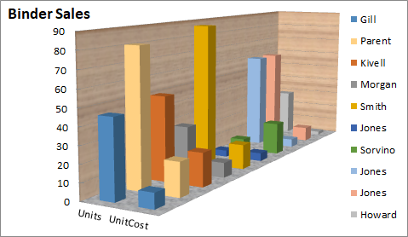
Parts of the Chart
Data Markers (or Data Points) - Symbols, in this case bars, on the chart that represents individual values from the data table.
Data Series - A group of related values. In this example there are only two in each series; one under Units and the other under UnitCost.
Title – Chart Title.
Chart Wall
Plot Area – a graphical representation of the data selected.
Chart Area – Where the plot, axes, legend and title reside.
Vertical Axis (y-axis) - serves as a reference for plotting data.
Legend - Shows the data series name corresponding to each data marker.
Horizontal Axis (x-axis) - serves as a reference for plotting data.
Chart Floor (in 3D charts)

Slide 8
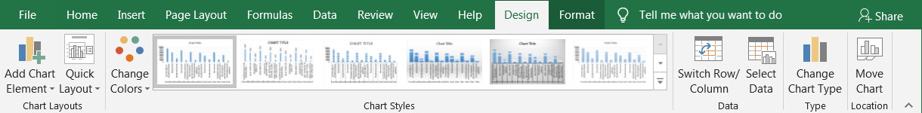
Quick Chart Layouts
Choose from different layouts for your chart.
Context Ribbons – Chart Design
Add Chart Element
You can add …
Axis
Axis Titles
Chart Title
Data Label
Data Table
Error Bars
Gridlines
Legend
Lines
Trendlines
Up/Down Bars
Chart Styles
Chart styles deal with the color of the data points or data series.
Data
Switch Row/Column
Flips the column and row.
Select Data
Choose the data to be represented in the chart.
Type
Change Chart Type
From bar to pie or to any other chart type. A chart type is the graphical representation of the data points.
Location
When you Move Chart you can relocate it to:
Another sheet
As an object on the same sheet.
You must also change the chart type if you insert another chart on to the same sheet when it is based on the same data.

Slide 9
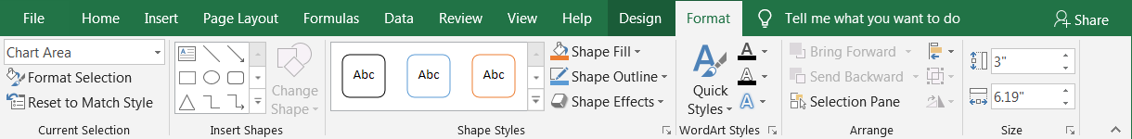
Context Ribbons - Format
Current Selection drop box
Select the object on the chart you want to format.
Format Selection
Will display a dialog box with the formatting options.
Reset to Match Style
Resets the style back to the default.
Shape Styles
For the selected object you can:
Choose from a Shape quick style
Alter individual elements of the object by using the Shape Fill, Shape Outline, and Shape Effects menus.
WordArt Styles
For the selected WordArt object you can:
Choose from a Word Art quick style
Alter individual elements of the object by using the Shape Fill, Shape Outline, and Shape Effects menus.
Insert Shapes
You can add a new shape to your spreadsheet from here or change one you have already placed.

Slide 10
Context Ribbons - Format
Arrange
Objects on the spreadsheet can be arranged like cards laying on a desk.
If you have more than one object on the spreadsheet, you can use the Bring Forward and Send Backward options to move the object up or down on the stack.
Size
Manually set the size of the chart measured in centimeters. Must have the chart selected, not an object on the chart.

Slide 11
Choosing the Data You Present
How to choose the proper data for your chart?
What point are you trying to make?
Choose to present restricted data and choose the chart that best represents the number of data sets.
Choose the chart which best represents the concept you are trying to represent.
  Representing percentages of a whole, use a pie chart.
  To present trends over time, use a line chart.
  Want to illustrate comparisons among items, use column or bar chart.
  To display the magnitude of change over time, use an area chart.
  Want to show a multiple series of data each a percentage, use a doughnut chart.
  To show values of two series compared over time or as a category, use a scatter chart.

Slide 12
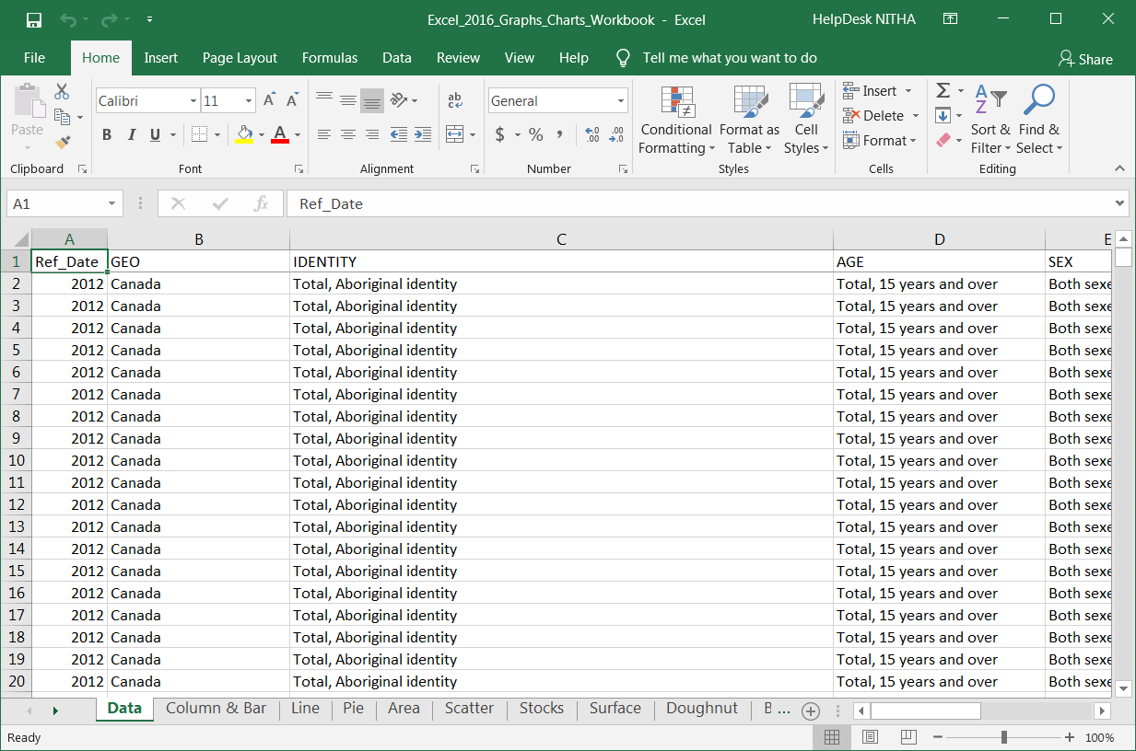
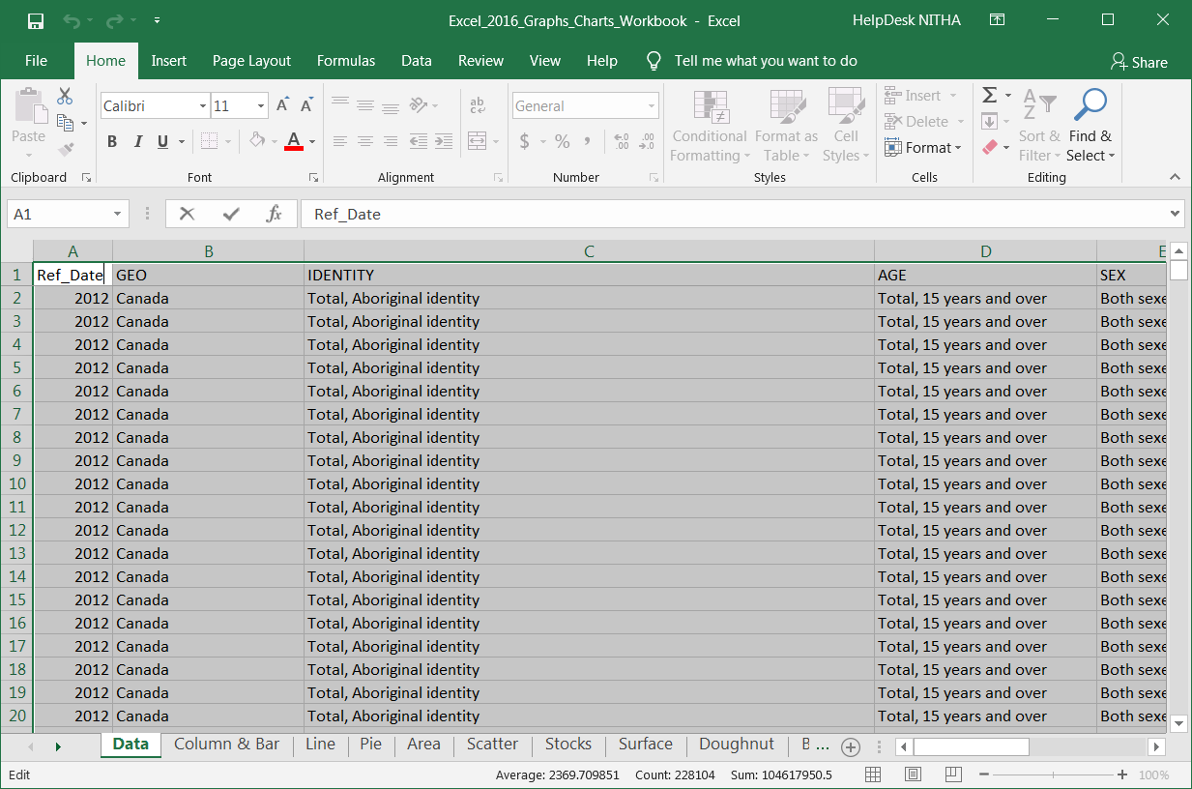
Copy Data from the Data sheet to Column & Bar sheet
Making a Column/Bar Chart
2. Click on:
The Select All button
Press CTRL+C to copy
OR
Home tab, Copy button
1. Click on:
The Data sheet tab

Slide 13
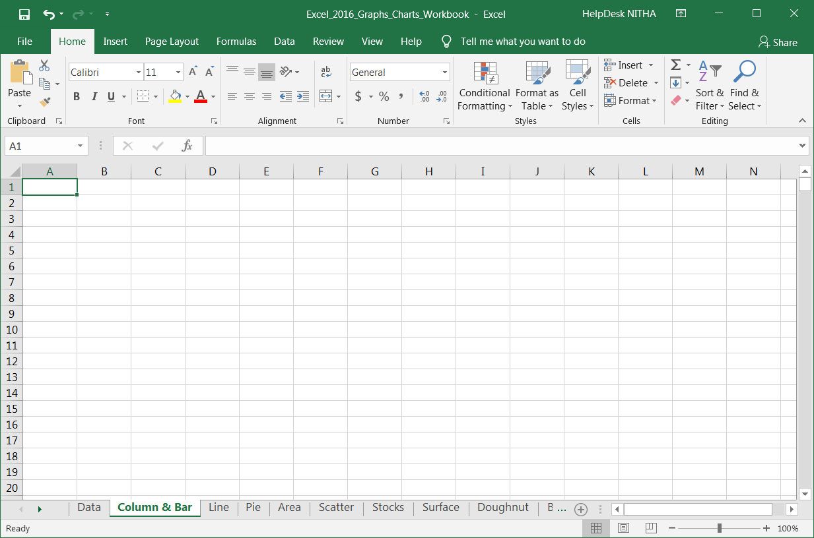
Copy Data from the Data sheet to Column & Bar sheet
Making a Column/Bar Chart
4. Click on:
Cell A1
Press CTRL+V to paste
OR
Home tab, Paste button
3. Click on:
The Column & Bar tab
We will copy this data for each chart type we create; column, pie & doughnut.

Slide 14
Limit the data to make it display specific information.
The tools you can use to restrict and structure the data are found on the Data tab.
Sort
  You can sort the data in column(s) by one or more sort criteria.
  Options allow you to sort by case sensitive or to change the sort orientation from top to bottom or left to right
  If the data does not have headers, deselecting My data has headers will force Excel to add its’ own column headers
Filter
  To narrow down the data to what you need to represent, you can filter the data in each column to display only specific information.
  Applying a filter will add an arrow to the column header which when clicked will drop down a list of grouped data. Select or deselect the data items to filter out unwanted or unnecessary information.
Group
  You can manually group together cells so they can be collapsed or expanded as needed.
  Group by row or column.
Subtotal
  Total two or more rows of related data
  Subtotal is applied to a column with numbers using one of the following functions:
    Sum, Count, Average, Max, Min, Product, StdDev, StdDevp, Var, and Varp.
  One column is assigned as the data changes each subtotal is applied. (Thus, a Sort should be applied to that column before subtotaling using that column as the At each change in: field)

Slide 15
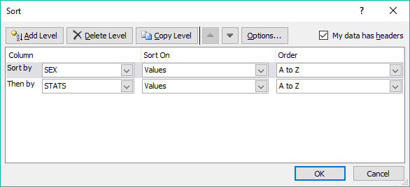
Steps to restrict the data
Because the Column chart is used to illustrate comparisons among items, we will compare smokers between females verses males.
Sort by:
  Sex
  STATS

Slide 16
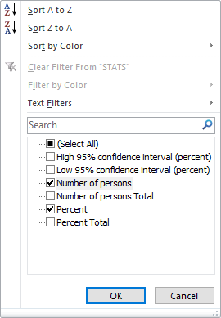
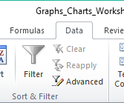
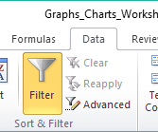
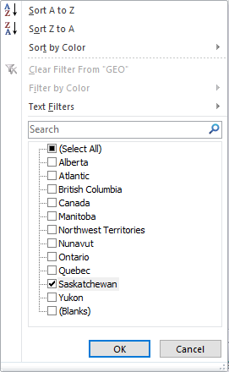
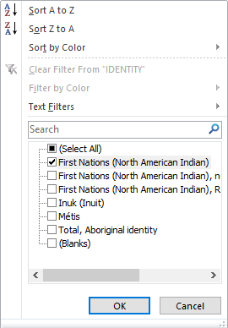
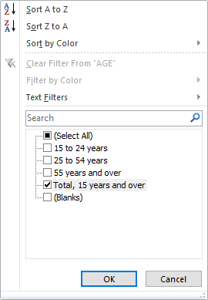
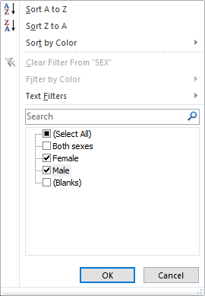
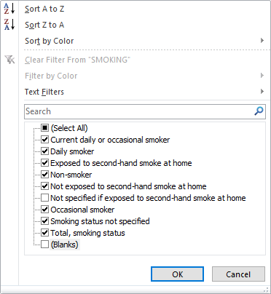
Steps to restrict the data
In the
Data ribbon
Sort & Filter group
Click on the Filter command
Click on the Filter command
Filter by:
  Geo – select Saskatchewan only
  Identity – select First Nations (North American Indian)
  Age – select Total, 15 years and over
  Sex – select Male and Female
  Smoking – deselect Not specified if exposed to second-hand smoke at home and Blanks
  Stats – select Number of persons and Percent

Slide 17
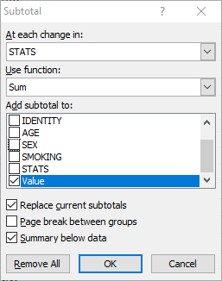
Steps to restrict the data
Subtotal by:
At each change in STATS
Use function Sum
Add subtotal to Value
Replace current subtotals is checked
Page break between groups is unchecked
Summary below data is checked

Slide 18
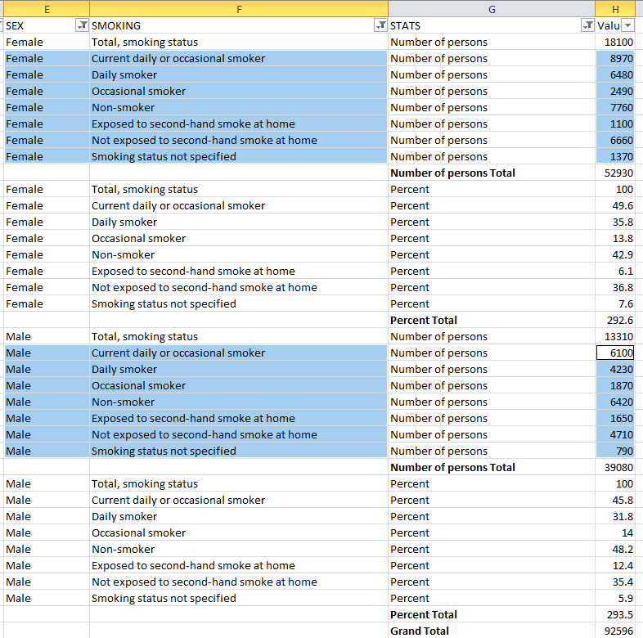
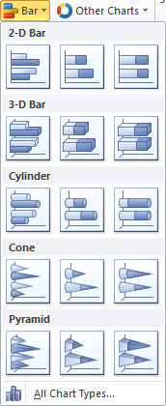
Select the data and inserting the chart
Use the Ctrl button on the keyboard in conjunction with the mouse to select the blocks of data shown here.
Now insert a 2-D Column chart.

Slide 19
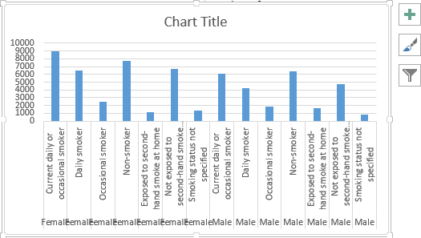
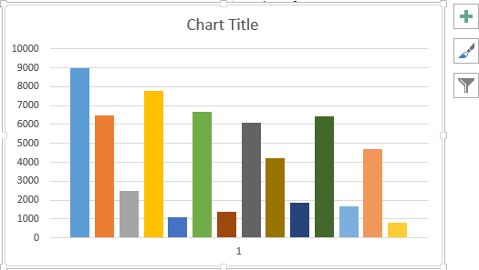
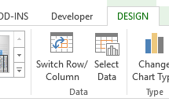
Change the chart’s Row/Column
From
To
By clicking on the
Switch Row/Column
button
located on the
Chart Tools/Design tab in the Data group

Slide 20
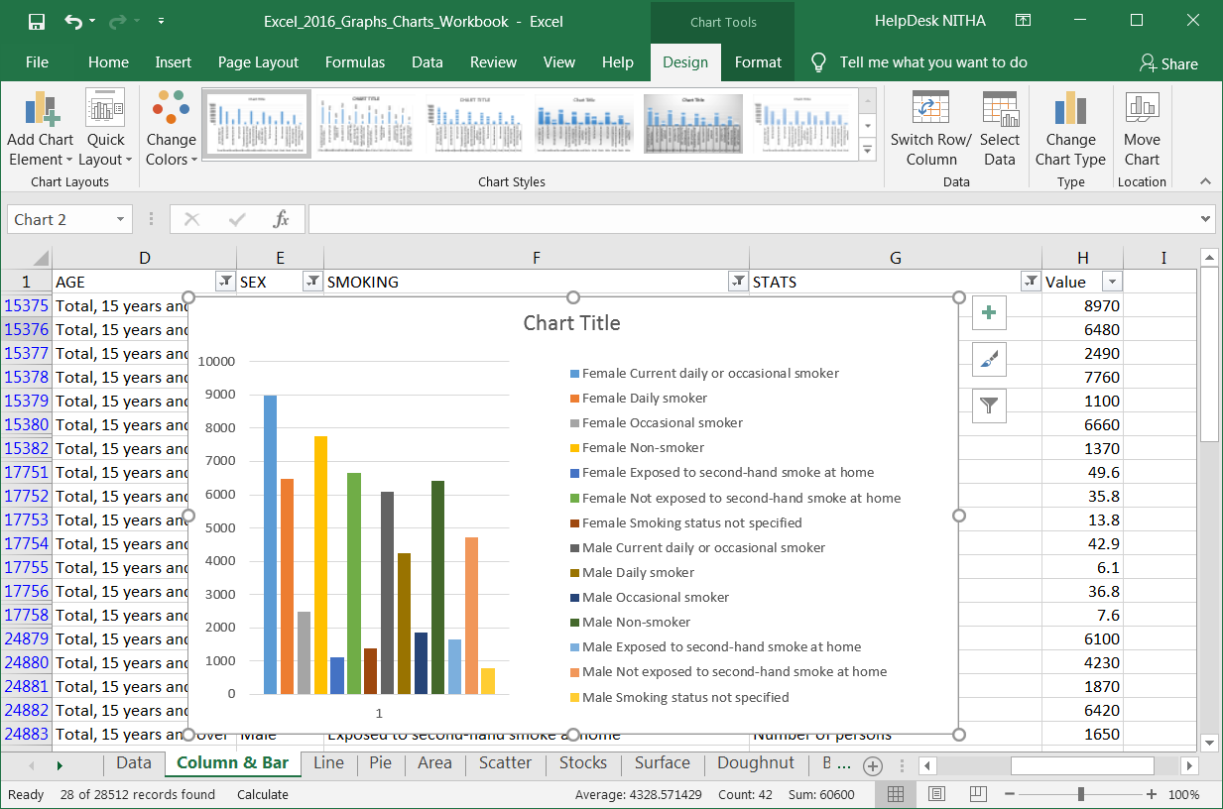
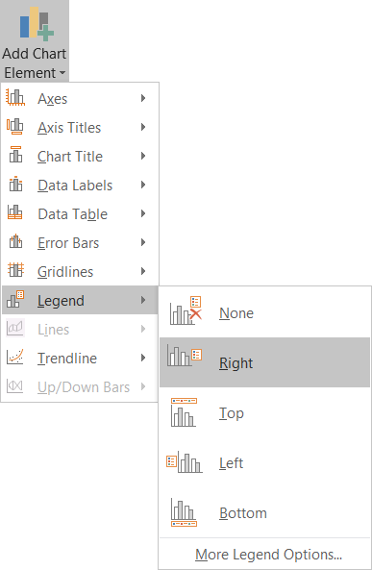
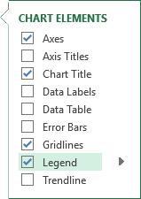
The end result is that we have a column chart representing the contrasting Female/Male smoking statistics for First Nations people in Saskatchewan for the year 2012 counted by number of persons.
Making a Column/Bar Chart
Now take a few minutes and select the individual objects in the chart.
Resize them, along with the chart size, to make it show all the legend data as it is represented in this chart.
First thing is to resize the chart to be smaller to fit.
Second, click on either of the Add Chart Elements button and add a legend.
The resize the legend.

Slide 21
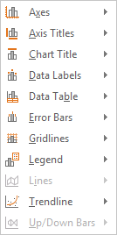
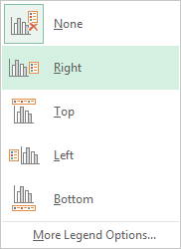
Spend some time formatting your chart to make it look as you prefer.
Making a Column/Bar Chart
You may wish to add a Legend or other element.
To add another element, such as a legend go to …
Chart Tools/Design ribbon
Chart Layouts group
Add Chart Element menu
Choose the Element from the sub-menu items
Choose the position
You may wish to resize the legend so it shows the data names for all 14 data points.

Slide 22




Pie
&
Doughnut
Charts

Slide 23
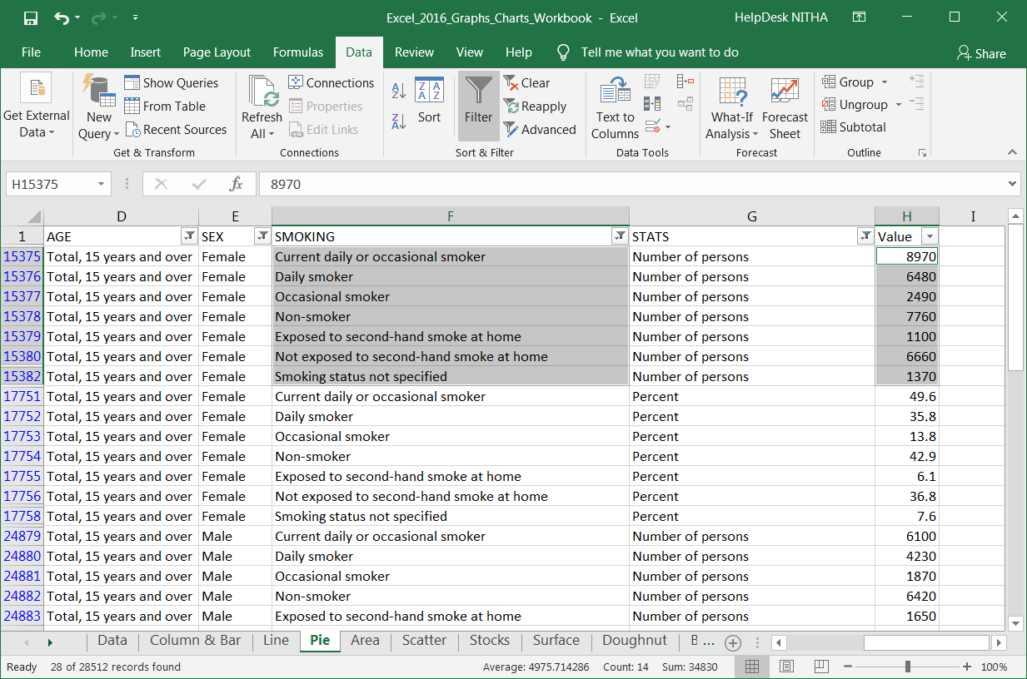
A Pie chart can only display one series of data, each element in the series as a percentage of the total.
Making Pie a Chart
Using the same data from the Data sheet; sorted, filtered & subtotaled the same as the Column …
Select just the data shown in the image and then choose a pie chart.

Slide 24
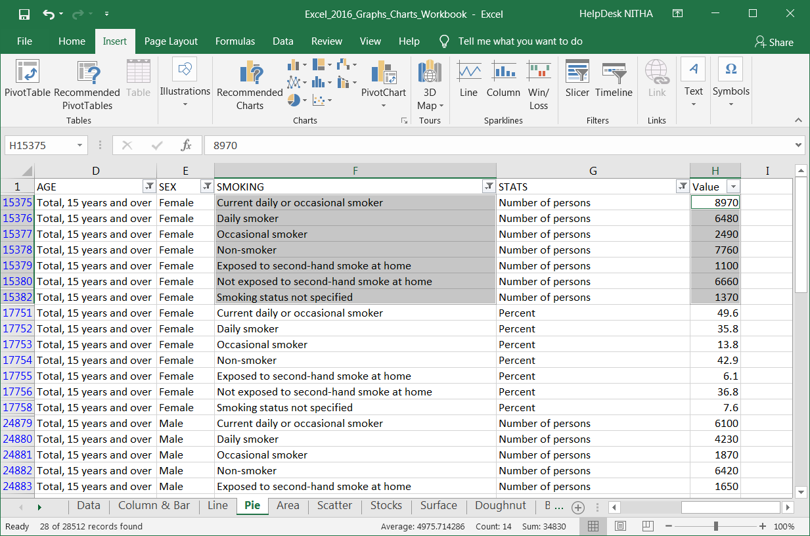
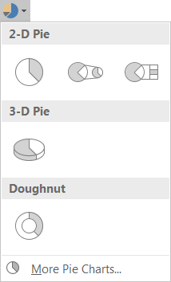
A Pie chart can only display one series of data, each element in the series as a percentage of the total.
Making Pie a Chart
Click on the Pie chart option from the Insert ribbon Charts group.
Select the first 2D Pie.

Slide 25
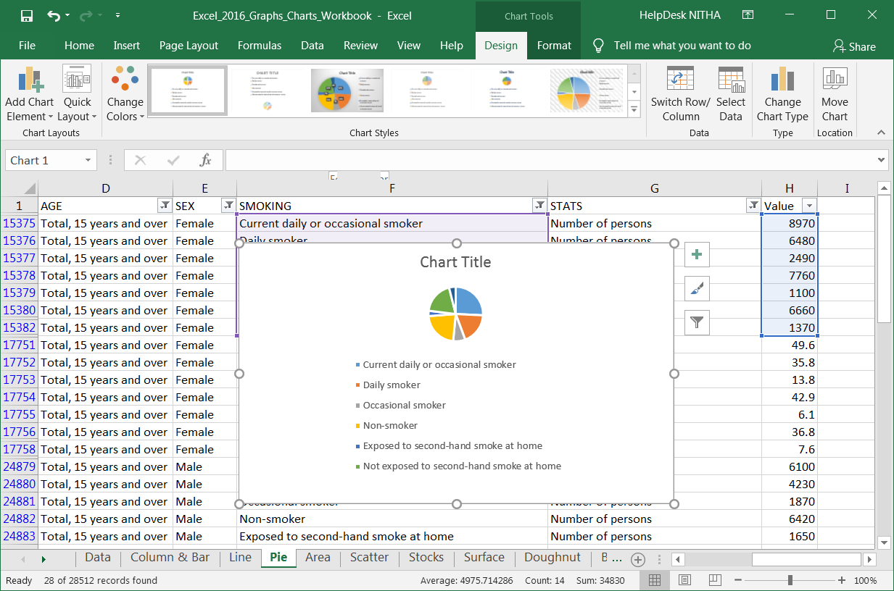
A Pie chart can only display one series of data, each element in the series as a percentage of the total.
Making Pie a Chart
This chart is for the Female Smoking Stats for First Nations.
Now redo the chart elements so that they look like …

Slide 26
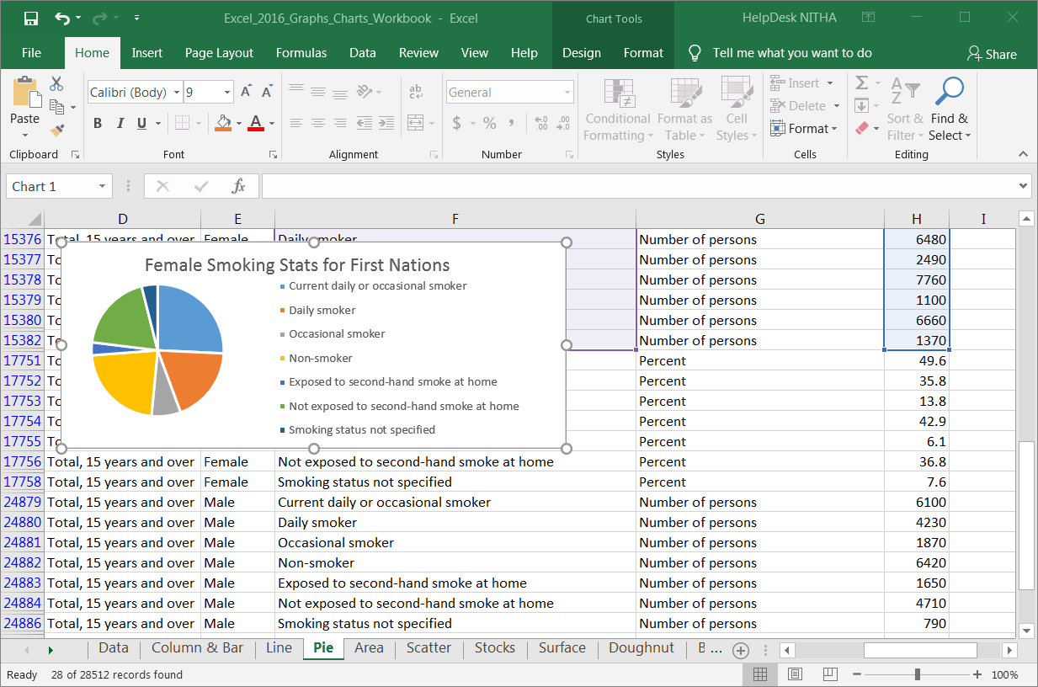
Making Pie a Chart
… looks like this.

Slide 27
Making Pie a Chart
The Pie chart shows the seven smoking statistics for females.
Now make a chart for the male smokers and display it on the same sheet.

Slide 28
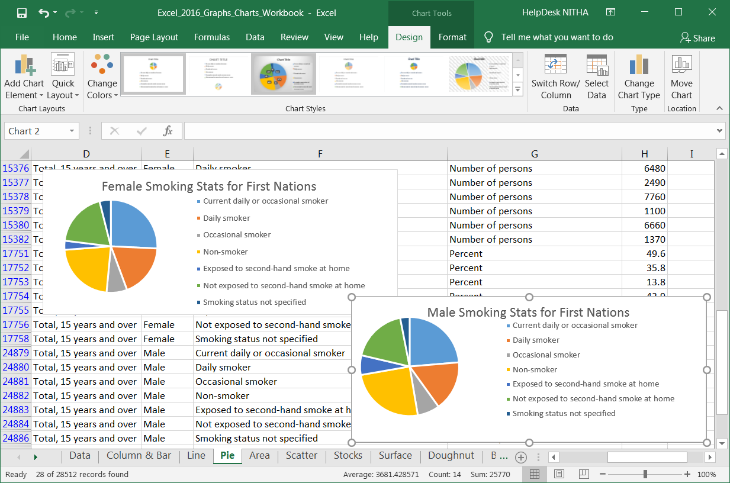
Making Pie a Chart
Here is what the two pie charts on the one sheet looks like.
Notice that you will have had to resize both charts to fit on the one page.
On the other hand, you can place one or both of those charts on separate spreadsheets.
To do this:
Select one of them.
Select the Design ribbon.
Click on Move Chart

Slide 29
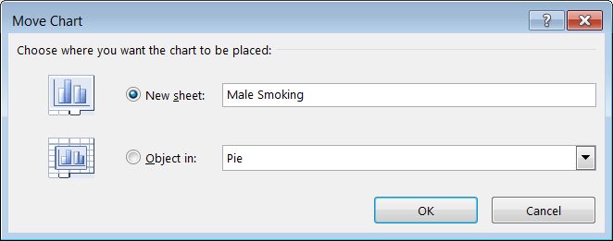
Which displays the Move Chart dialog box.
Making Pie a Chart
Click on New Sheet and then name the new sheet.
I called it Male Smoking.
Click on the OK.

Slide 30
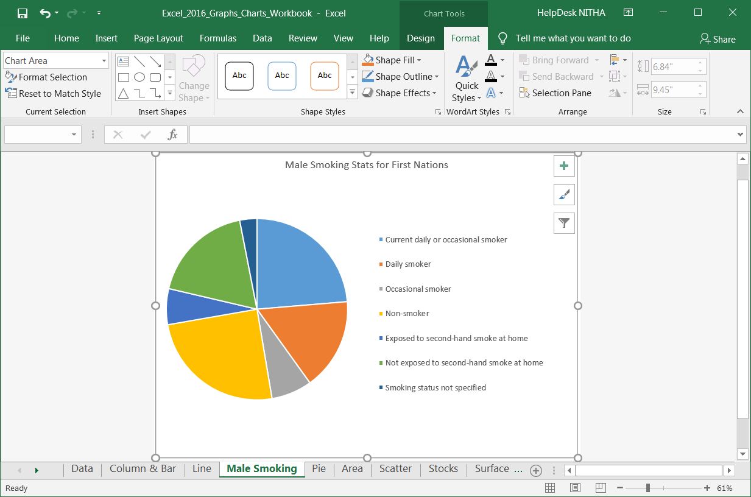
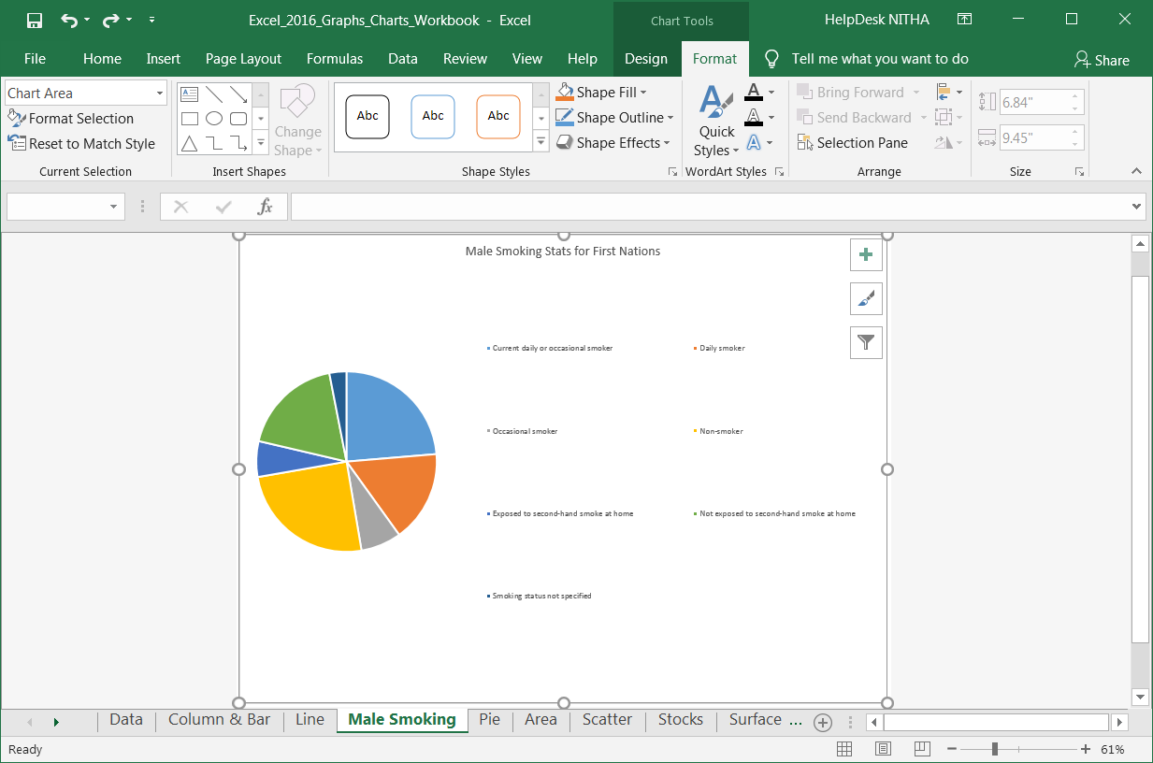
Making Pie a Chart
Excel did not do a good job formatting that.
It looks ugly, so let’s change that to look better.
Change it to look like …

Slide 31
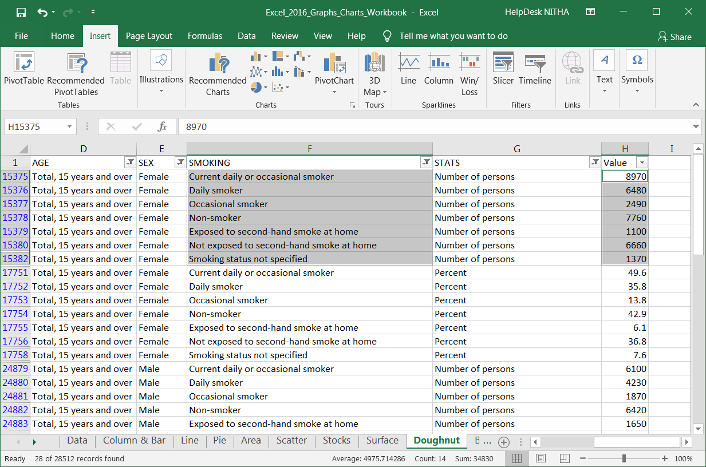
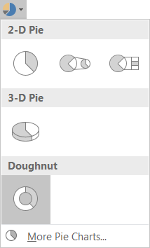
Creating a doughnut chart to represent smoking stats for both Female and Male for a doughnut chart involves a little bit more work than just selecting the necessary data.
Making a Doughnut Chart
Select just the seven smoking stats for females and the associated numbers as seen in the image to the right.
Click on:
Insert tab
Pie/Doughnut Chart
Doughnut chart
Which should create a doughnut chart with just one ring.

Slide 32
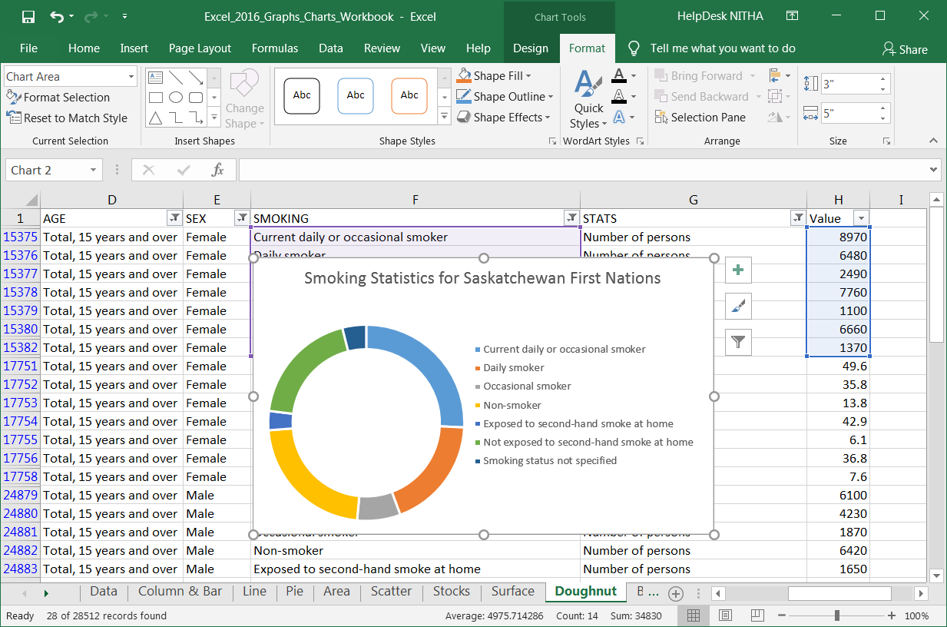
Format the chart to look like the image below.
Making a Doughnut Chart

Slide 33
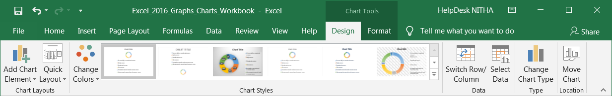
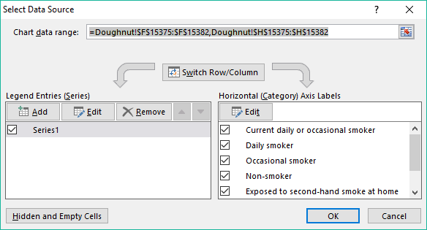
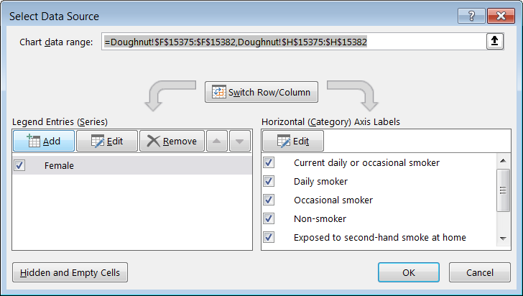
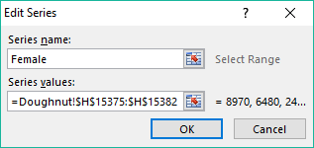
Now we need to label the female series data as Female.
Making a Doughnut Chart
Click on the Select Data button.
Which displays the
Select Data Source dialog.
Click on Series1
Click on the Edit button.
Which displays the
Edit Series dialog.
Type into the Series Name box, Female
Click on the OK button.

Slide 34
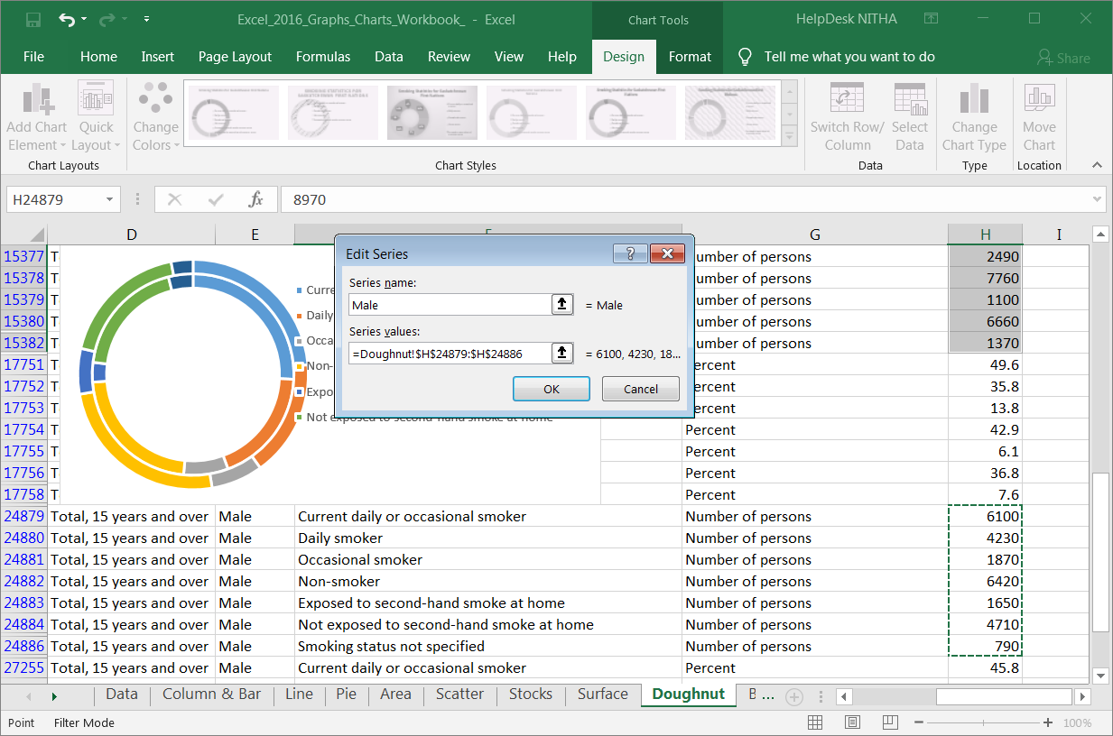
Now that the Female series of data is labeled, we need to add the data for the males and label that data series as Male.
Making a Doughnut Chart
Click on Add in the Legend Entries (Series).
Type Male in the Series name field.
Click on the Select Data Series button.
Select the Male Smoking data as shown, only the numbers.
You may have to move the Female chart out of the way and scroll down on the table to find that data.

Slide 35
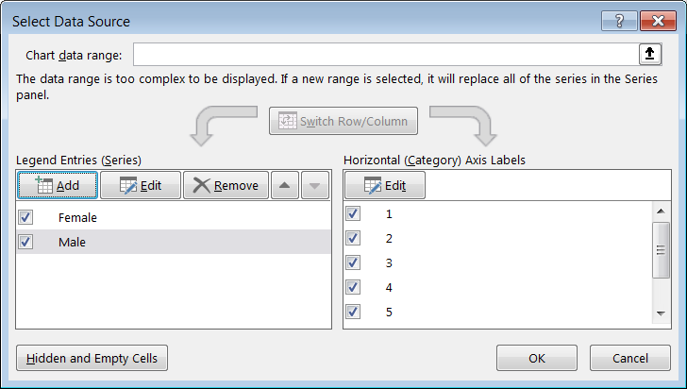
Now that the Female series of data is labeled, we need to add the data for the males and label that data series as Male.
Making a Doughnut Chart
Click on the OK button to complete the addition to the doughnut chart.

Slide 36
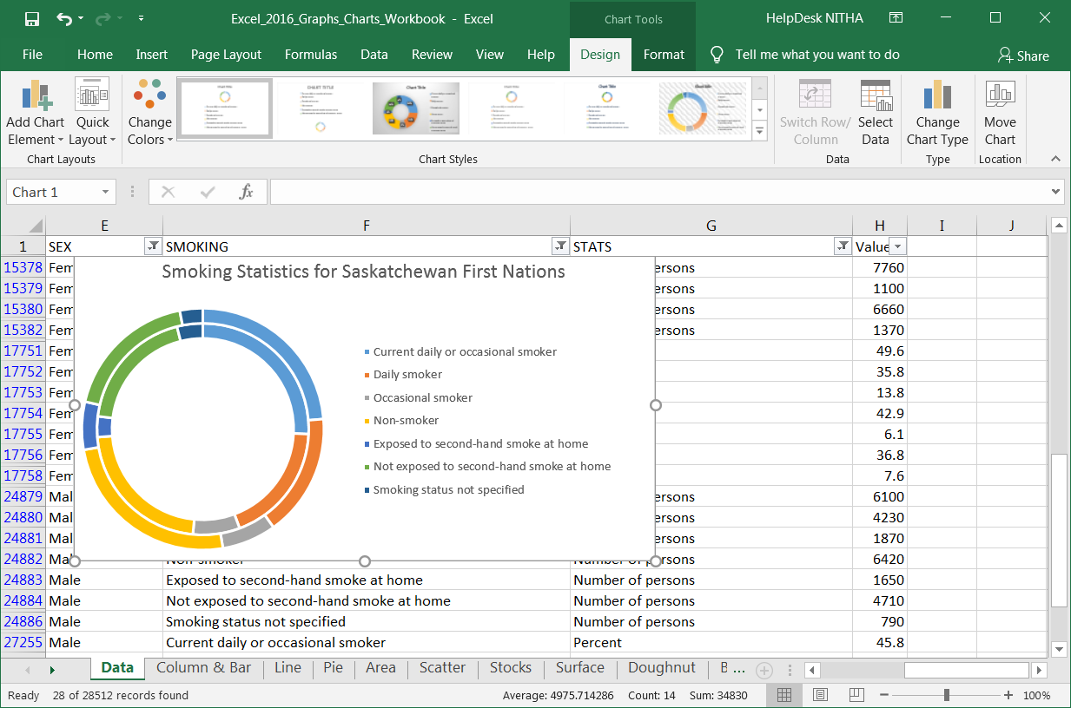
We have a doughnut chart with both the Female and Male smokers data in two rings, but the chart is poorly formatted and does not give us much information.
Making a Doughnut Chart
So let’s rearrange it so it looks like this to begin with. We will add more formatting to describe the doughnut segments.

Slide 37
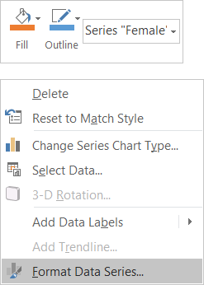
The doughnut segments do not tell us:
which ring represents females or males
the values associate with each of segments
Making a Doughnut Chart
To fix this problem …
We will need to add Data Labels and place those labels on top of the segments.
First thing to do is make space on the segments to place the labels by reducing the size of the doughnut hole thereby increasing the thickness of the segment rings
Right click on one of the segments on the inner ring
Left click on Format Data Series.

Slide 38
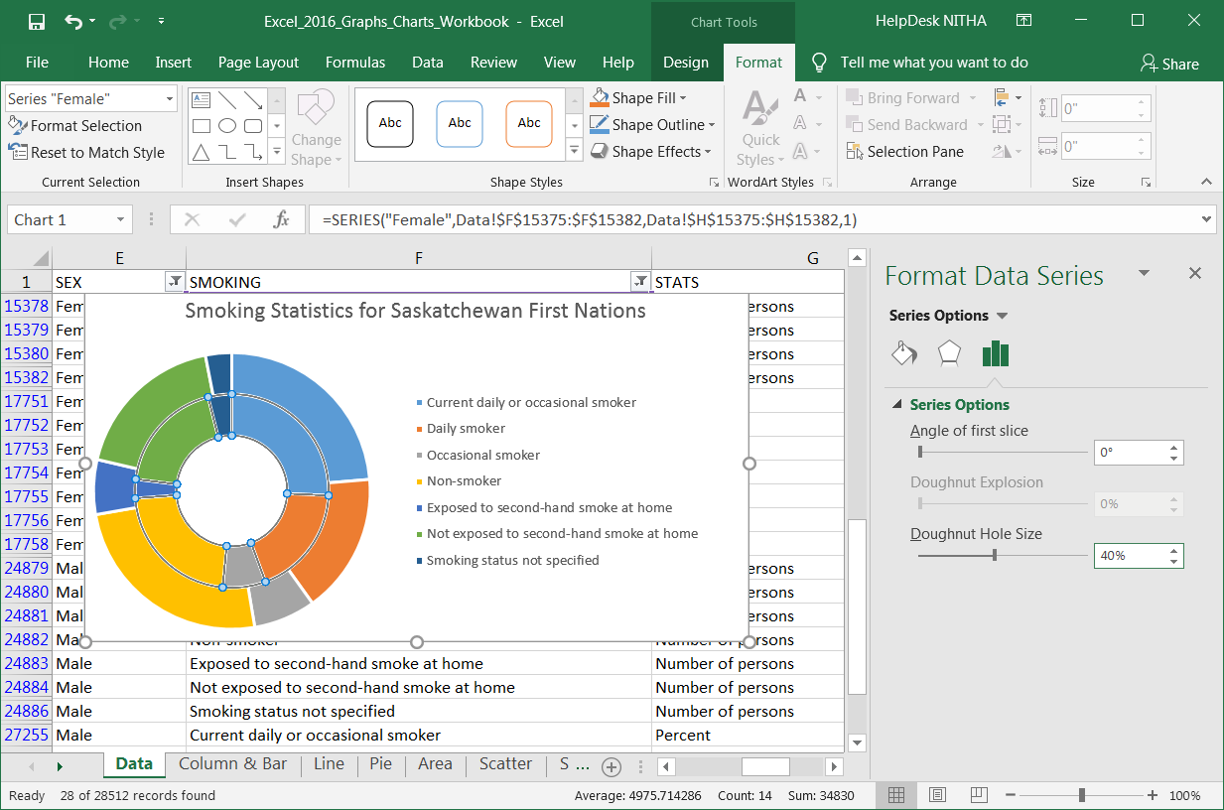
The doughnut segments do not tell us:
which ring represents females or males
the values associate with each of segments
Making a Doughnut Chart
Change the value for the size of the doughnut hole from 75% to 40%.
Which makes the segments thicker

Slide 39
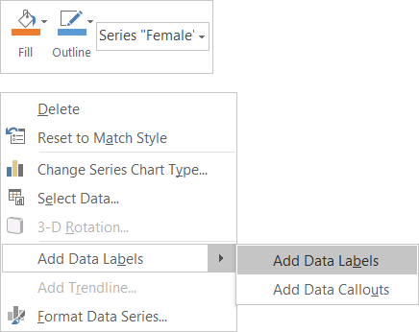
The doughnut segments do not tell us:
which ring represents females or males
the values associate with each of segments
Once again, Right Click on one of the inner ring segments and select Add Data Labels from the Add Data Labels sub-menu.

Slide 40


The doughnut segments do not tell us:
which ring represents females or males
the values associate with each of segments
The default selected items are Value and Show Leader Lines.
Change those options to:
Series Name
Value
Separator: New Line
Which create data labels like this
You can pick up each data label individually and reposition it so that it is readable.

Slide 41
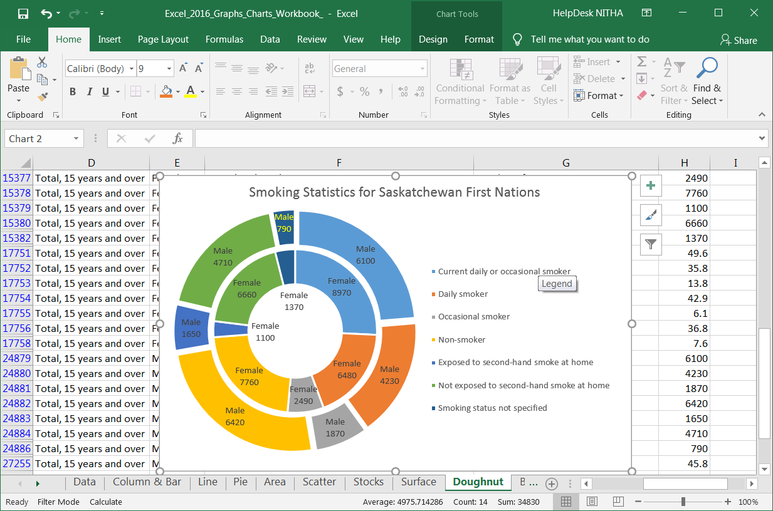
Do the same to the outer ring, Male Smoking Stats, as you did to the inner ring.
Then move and format the data labels so that they are all readable.

Slide 42

We have covered here in this course …
What is our direction in this course?
Choosing the Data You Present
Chart Types
Parts of the Chart
Context Ribbons - Design
Context Ribbons - Format
Making a Column/Bar Chart
Making a Pie Chart
Making a Doughnut Chart
Tips for Formatting Your Chart

Slide 43


NITHA IT Helpdesk
helpdesk@nitha.com
1(306)953-5008
Notes:
Please do not hesitate to ask any question regarding this session, and I will make sure to answer your question as soon as possible.

Slide 44


