Slide 1


Excel 2016/2019 Formulas & Data
Advanced Level

Slide 2



NITHA IT Helpdesk
helpdesk@nitha.com
1(306)953-5008

Slide 3

What will we be covering in this course?
What is the direction for this course.
Categories of Functions Provided By Excel
The Ribbons & the Commands
Exercise in Using:
Information Functions
Some Relevant Definitions
Logical Functions
Math Functions
Connecting to MS Access Data
Statistical Functions
Text Functions
Importing CSV Data
Database Function & an Exercise in Using Them

Slide 4
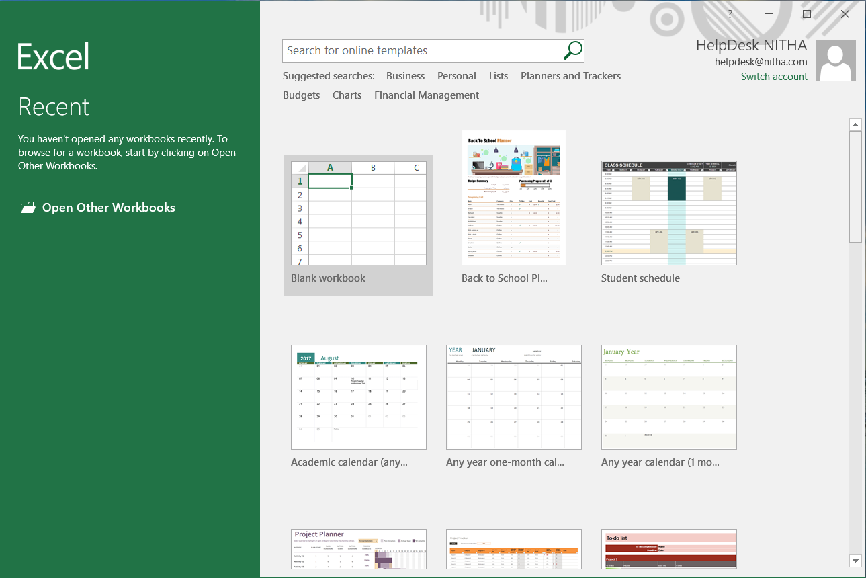
Start Excel & load macro enabled workbook
When you first start Excel 2016 or 2019 the first screen you see is this …
Click on Open Other Workbooks …

Slide 5
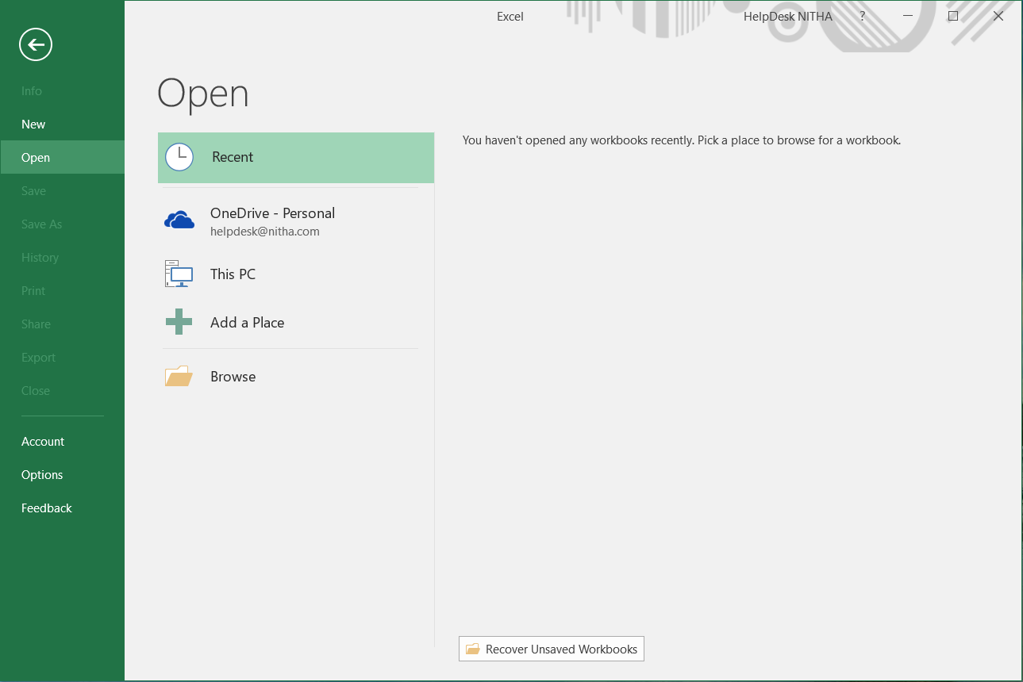
Start Excel & load macro enabled workbook
Click on Browse

Slide 6
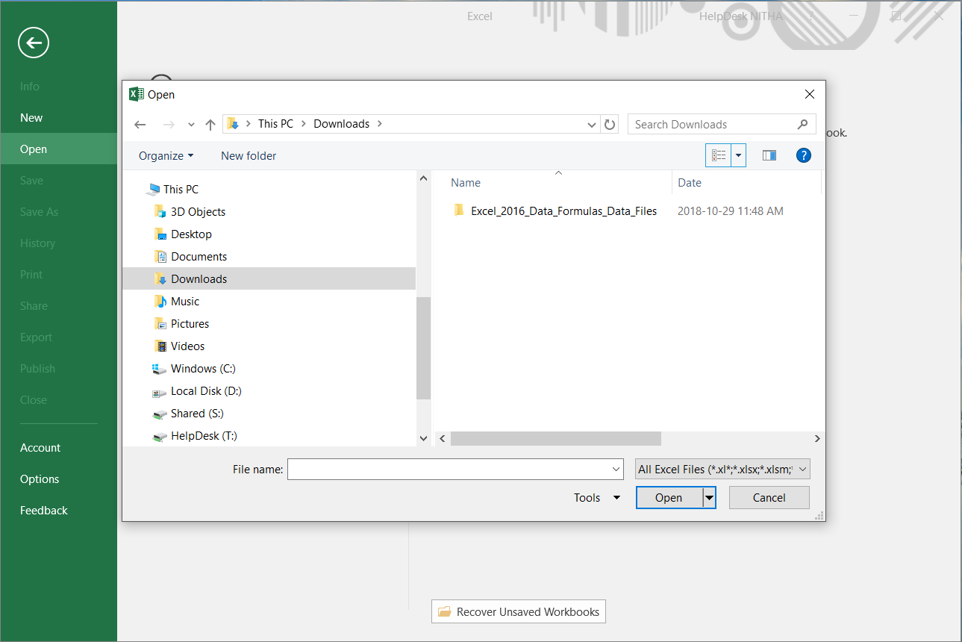
Start Excel & load macro enabled workbook
Select Excel_2016_Data_Formulas_Data_Files folder and open it.
Select the …
downloads folder (or whatever folder in to which you downloaded the file)
After opening the folder which contains the data files, select the .XLSM workbook and click on Open.

Slide 7
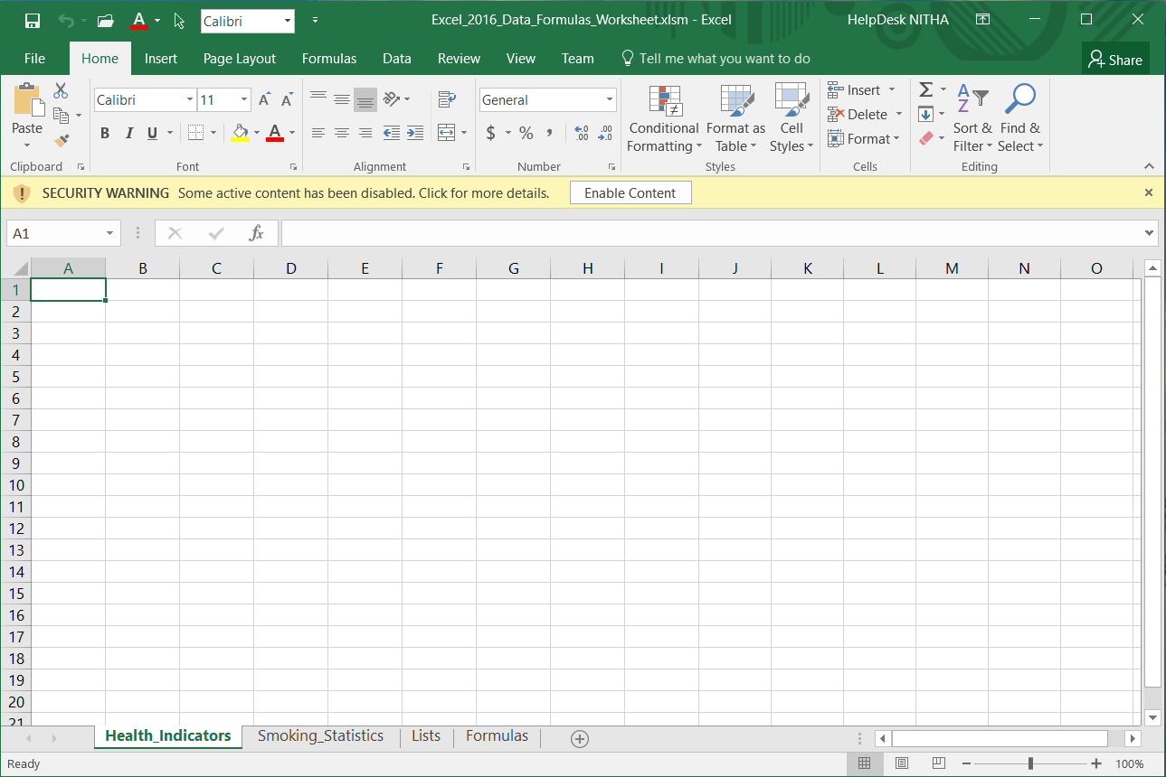
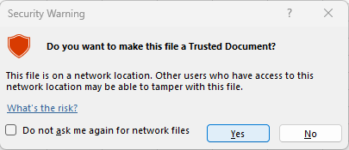
Start Excel & load macro enabled workbook
Click on Enable Content

Slide 8
What is our direction in this course?
Assumption 1:
I will be assuming you have a basic knowledge Excel: navigation, screen layout, etc.
Assumption 2:
You must know the following:
  What are ribbons both regular and contextual.
  What are spreadsheets, how to navigate them, and how do you create more of them.
What is a dialog box and what is a window pane.
Our goal is to import data and then use Excel provided functions to the data in our formula.
To accomplish our goal we will have to:
Learn how to connect to an outside source of data and to import data.
Know how to use the appropriate function(s) on the data to achieve our goal.
Learn how to step through our formula(s) and troubleshoot possible issues.
Definitions …
Formula – A formula is a mathematical expression telling Excel what mathematical operation(s) to perform upon
specific value(s).
Function – A function is a predefined formula available in Excel. All you need to do is plug in the appropriate
data.

Slide 9
Important Caveat
The data we are going to use and the correlation between that data is not necessarily an accurate health data comparison.
It is the methodology of connecting to a database, importing data, restricting the data so that it is usable, and using Excel functions to pull data from those two sources to produce a result that is the intended purpose of this course.

Slide 10
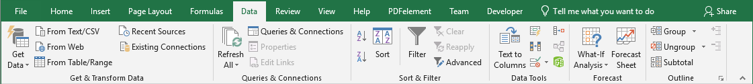
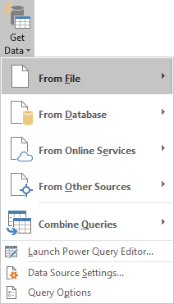
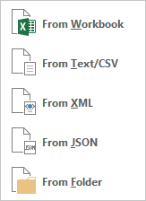
First we will need to go through the methods for connecting and/or importing data
From File
From Workbook – You can link to cell(s), table(s) or full spreadsheet(s) in another workbook as long as you have access to it. Be careful of breaking a linkage if you move or rename either file.
From Text – Import text from a file. This text is separated by a delimiter.
Definition: A delimiter is a character that separates data values.
Typically data in a text file is delimited by a comma or a tab character and each new row of data is delimited by the carriage return character.
For example, in the file you might see:
First Name, Last Name, Address1, Address2, City, Province, Country
John, Smith, Apt. 1234, 123 Street, Prince Albert, SK, Canada
From XML – eXtensible Markup Language is a text based file used for the definition, storage and transfer of data.

Slide 11
First we will need to go through the methods for connecting and/or importing data
From JSON – JavaScript Object Notation is a JavaScript based method for exchanging data, usually from a website to a web browser, but is not limited to that.
Excel can use JSON as a means of transferring data, usually from a website to Excel.
From Folder – You can import metadata and links about other files in a folder.
Metadata is data that provides information about other data.
For example, the author name, date created, date modified, last person to access the file, tags, subject, and category are all examples of some of the metadata attached to a file. For Excel it is the metadata in the Document Properties.
(File tab, Info panel, right side of that panel).
It is this data that is imported from the files in the folder to which you connect using the From Folder command.

Slide 12
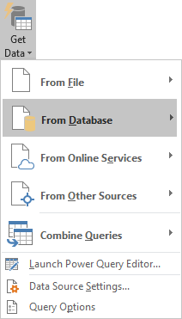
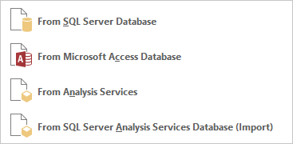
First we will need to go through the methods for connecting and/or importing data
From Database
From SQL Server Database – A Structured Query Language (SQL) Server Database is one of the most common types of databases for network/internet accessible data. Most modern websites use them along with most programs that can hold vast amounts of data.
From Microsoft Access Database – Microsoft Access is an user friendly database management system stored as an .accdb file. Excel can connect to and import whole tables or SQL query data sets.
From Analysis Server – A Microsoft SQL Server Analysis Services (SSAS) is an OnLine Analytical Processing (OLAP) and data mining tool as part of Microsoft SQL Server.
It offers services such as Integration Services, Reporting Services and Analysis Services.

Slide 13
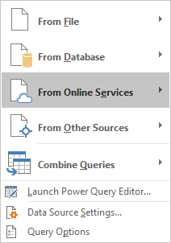

First we will need to go through the methods for connecting and/or importing data
From Online Services
From Facebook – Excel uses Get & Transform (Power Query) to connect to Facebook and retrieve information about selected categories, like friends and/or comments. You must have the password for the account in order to retrieve this data.

Slide 14
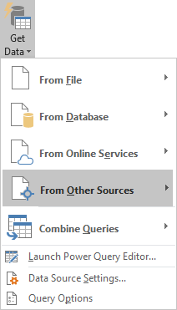
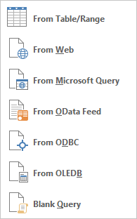
First we will need to go through the methods for connecting and/or importing data
From Online Services
From Table/Range – Select a whole table or range from a table from any spreadsheet in the current workbook.
From Web – Import data, usually tabular data, from a web page.
From Microsoft Query – A Microsoft Query is graphical method for constructing a query. It generated an SQL query.
From OData Feed – An OData feed is a protocol for the creation and use of RESTful APIs. REST (REpresentational State Transfer) is a language-independent architectural style for developing web services by using existing web technologies.
OData is the connection, the pipe. REST is the “fluid” that flows through the pipe.

Slide 15
First we will need to go through the methods for connecting and/or importing data
From Online Services
From ODBC – Open DataBase Connectivity is an impressive platform in which drivers that are written to connect to a variety of database types and even different operating systems can be added and used to bridge between differing database technologies. ODBC has been with Windows since 1992, since Windows 3.1.
From OLEDB – Object Linking and Embedding DataBase is the “higher level” successor to ODBC which uses COM (Component Object Model), the core of the Windows operating system.
From OData Feed – An OData feed is a protocol for the creation and use of RESTful APIs. REST (REpresentational State Transfer) is a language-independent architectural style for developing web services by using existing web technologies.

Slide 16
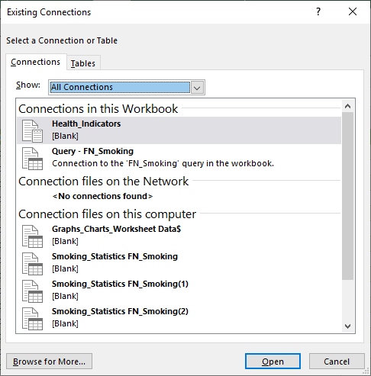
First we will need to go through the methods for connecting and/or importing data
Existing Connections – Existing Connections displays a dialog box that is divided into two tabs: Connections and Tables
In Excel 2019 there are four commands for creating and inspecting your connection of which you should be aware.
Recent Sources – For any source to which you had once connected, you can connect again. That is all this command does.
The Connections panel allows you to modify existing connections and/or to add more from file. The files have the extension of .ODC and are by default located in your documents folder in the My Data Sources sub-folder.
The Connections panel is divided into three sections:
Connections in this workbook
Connection files on the network (.odc file)
Connection files on this computer (.odc file)
The Tables panel simply allows you to choose a table in all the active connections in the current or other workbooks.

Slide 17
First we will need to go through the methods for connecting and/or importing data

Slide 18
Some definitions we will need to know
Database
A database as defined in Excel is a flat database, the simplest type of database, includes a range of columns and rows with the column header the name of the data in that column.
A record in Excel is defined as a row of data. A typical spreadsheet has column headers which define the name of the data in that column. A row of data has one item of data from each column in the row, and each row is one record.
Record
Field
A field in Excel is typically one cell of data, but can also refer to a cell range, or a defined name of cells.
Field Name
A field name in Excel is the column header.
A data type is the formatting applied to the column done from the Format Cells / Number column. For example, number, currency, accounting, date, time, percentage, fraction, text, etc.
Data Type
Another name for criteria is condition. So, criteria is one or more conditions that has to be met for the function to return a result.
Criteria
As we go through the course and use the functions these definitions will become clearer.
Probably the most difficult one to understand is criteria.

Slide 19

Select the Formulas sheet. If you don’t have it opened, then please open it up at this time.
Parameter – A parameter is a constant or variable value. In this case, it is the data that you pass to a function.
The following is a list of database functions:
Function Parameters:
For all database functions the format is … Database_Function(Database, Field, Criteria)
Database = The range of cells you want to apply the criteria against, usually the entire table.
Field = The column in the database against which the criteria is applied to produce the result.
Criteria = The cell or range of cells that contain your criteria, the conditions.
Database functions
Averages the values of the specified cells, list or database that matches the conditions you have set and returns a numeric value.
DAVERAGE
Counts the number of cells containing data or records containing data that match the search criteria you provide and returns a positive integer.
DCOUNT
Counts the number of cells containing nonblank cells or records containing nonblank cells that match the search criteria you provide and returns a positive integer.
DCOUNTA

Slide 20
Select the Formulas sheet. If you don’t have it opened, then please open it up at this time.
Parameter – A parameter is a constant or variable value. In this case, it is the data that you pass to a function.
The following is a list of database functions:
Function Parameters:
For all database functions the format is … Database_Function(Database, Field, Criteria)
Database = The range of cells you want to apply the criteria against, usually the entire table.
Field = The column in the database against which the criteria is applied to produce the result.
Criteria = The cell or range of cells that contain your criteria, the conditions.
Database functions
DAVERAGE
Averages the values of the specified cells, list or database that matches the conditions you have set and returns a numeric value.
DCOUNT
Counts the number of cells containing data or records containing data that match the search criteria you provide and returns a positive integer.
DCOUNTA
Counts the number of cells containing nonblank cells or records containing nonblank cells that match the search criteria you provide and returns a positive integer.
DGET
Gets from a database a single record that matches the criteria you provide.
DMAX
Returns the largest number in the field of records in the database that matches the criteria you provide.

Slide 21
The following is a list of database functions (continued):
Database functions
DMIN
Returns the smallest number in the field of records in the database that matches the criteria you provide.
DPRODUCT
Returns the value of the field of records in the database that matches the criteria you provide multiplied together.
DSTDEV
Estimates the standard deviation based on your section from the database.
DSTDEVP
Calculates the standard deviation based on the entire population of the selected database entries.
DSUM
Adds the numbers of your selection from the database that match the criteria you specify.
DVAR
Estimates the variance based upon the your selection from the database matching the criteria.
DVARP
Calculates the variance based upon the entire population of the selected database entries.
We won’t be using all the database functions, just DAVERAGE, DCOUNT, DMIN, DSTDEV, DVARP

Slide 22
NOTE: There is a text file provided called Excel_2016_formulas.txt that has all of the formulas
and functions already typed up for you. Just copy and paste them into the cells indicated.
For this exercise, we will use some features of Excel that you may not have used before. They are …
Make three lists of unique data values from three columns by using a macro written in Visual Basic for Applications (VBA).
Make a drop down selection box for those lists which will define the criteria parameter of the database function.
On the Formulas sheet enter the following database functions …
In cell A5 enter …
=DAVERAGE(Health_Indicators!A1:I31593,Health_Indicators!I1,Formulas!D2:F3)
In cell A8 enter …
=DCOUNT(Health_Indicators!A1:I31593,Health_Indicators!I1,Formulas!D2:F3)
In cell A11 enter …
=DMIN(Health_Indicators!A1:I31593,Health_Indicators!I1,Formulas!D2:F3)
In cell A14 enter …
=DSTDEV(Health_Indicators!A1:I31593,Health_Indicators!I1,Formulas!D2:F3)
In cell A17 enter …
=DVARP(Health_Indicators!A1:I31593,Health_Indicators!I1,Formulas!D2:F3)

Slide 23
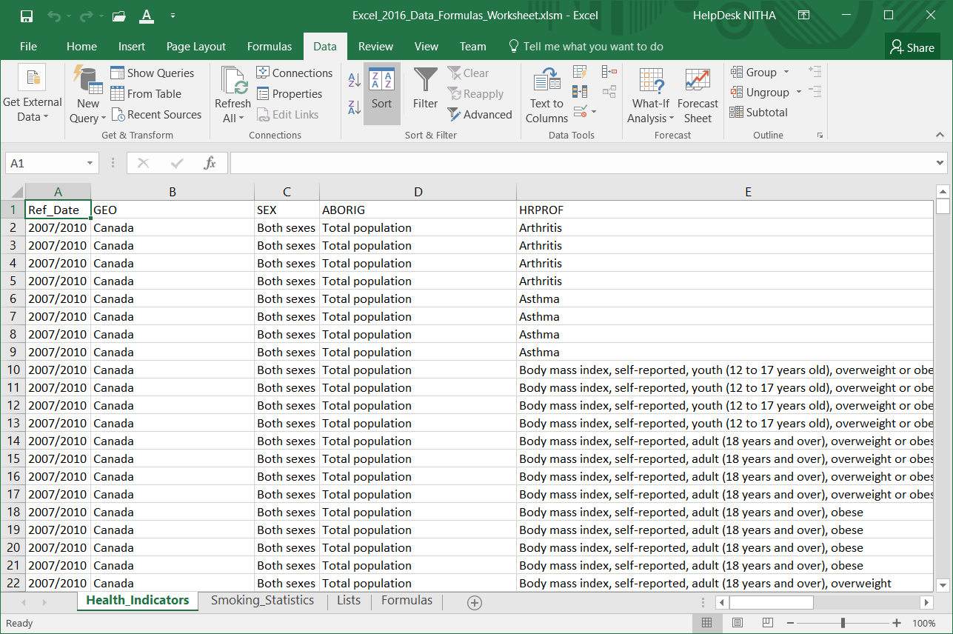
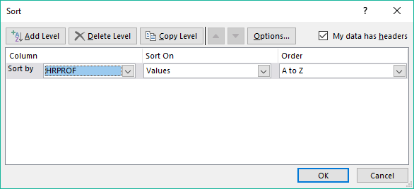
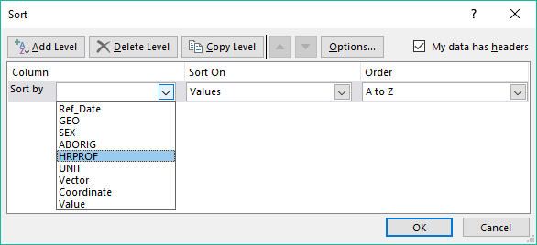
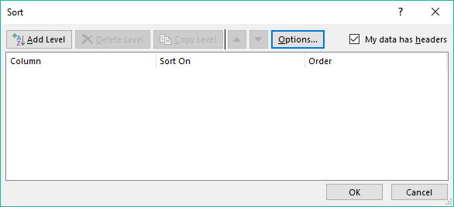
Work with the Health_Indicators (CSV imported data) to restrict the data
Sort the data by HRPROF
Click on Add Level

Slide 24
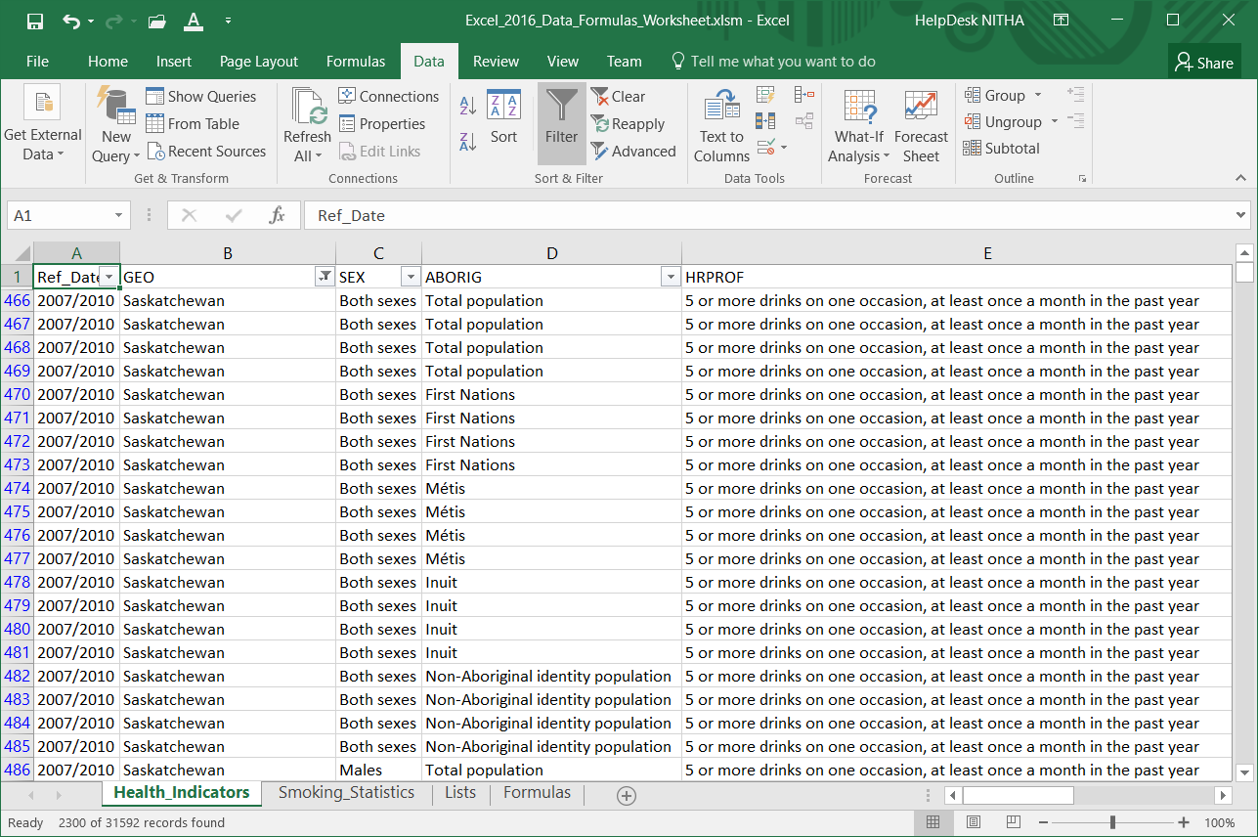
Work with the Health_Indicators (CSV imported data) to restrict the data
Click on the Filter button.

Slide 25
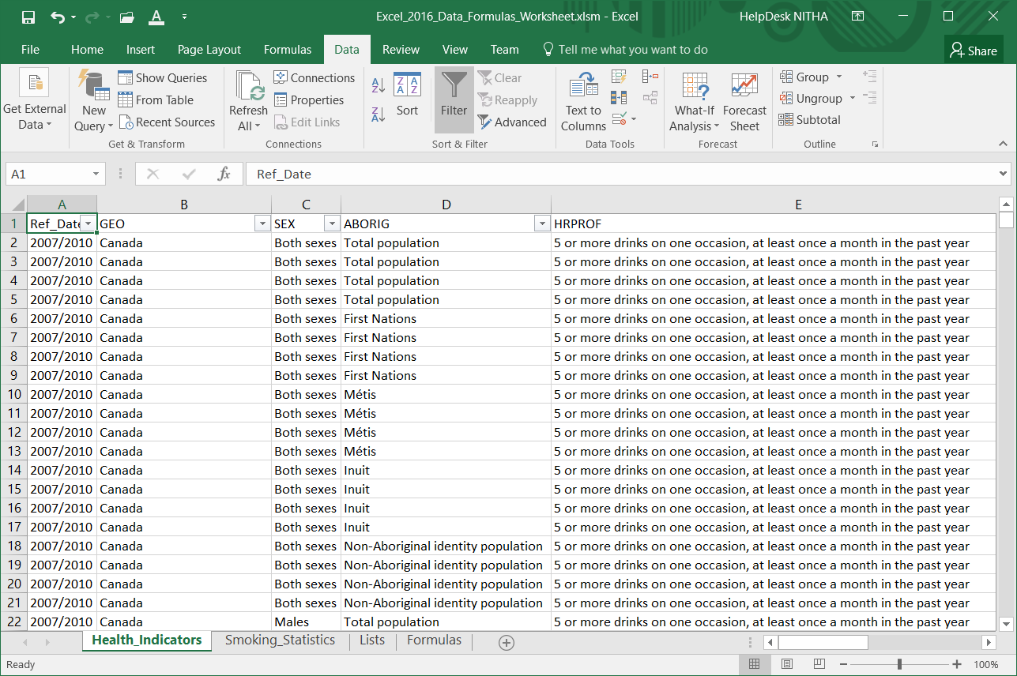
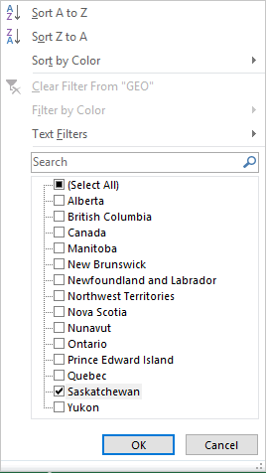
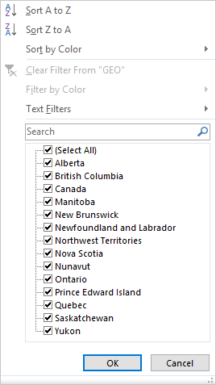
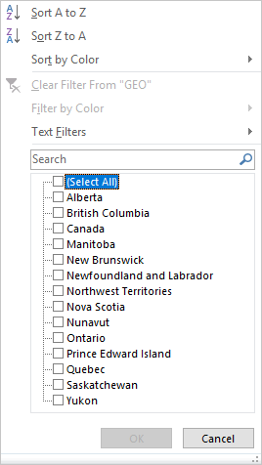
Work with the Health_Indicators (CSV imported data) to restrict the data
Filter by the following
GEO
Saskatchewan only
Click on the (Select All) check box to deselect all the options.
Then click on Saskatchewan to select in only.
Notice that when you clicked on Filter down-arrows appeared to the right side of the header names for each column.
2300 of 31592 records

Slide 26
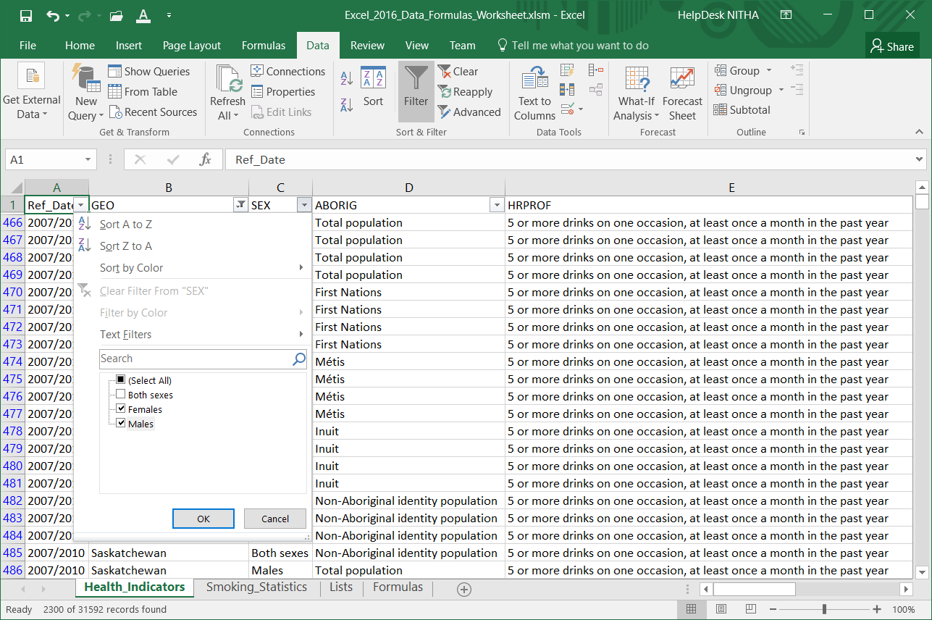
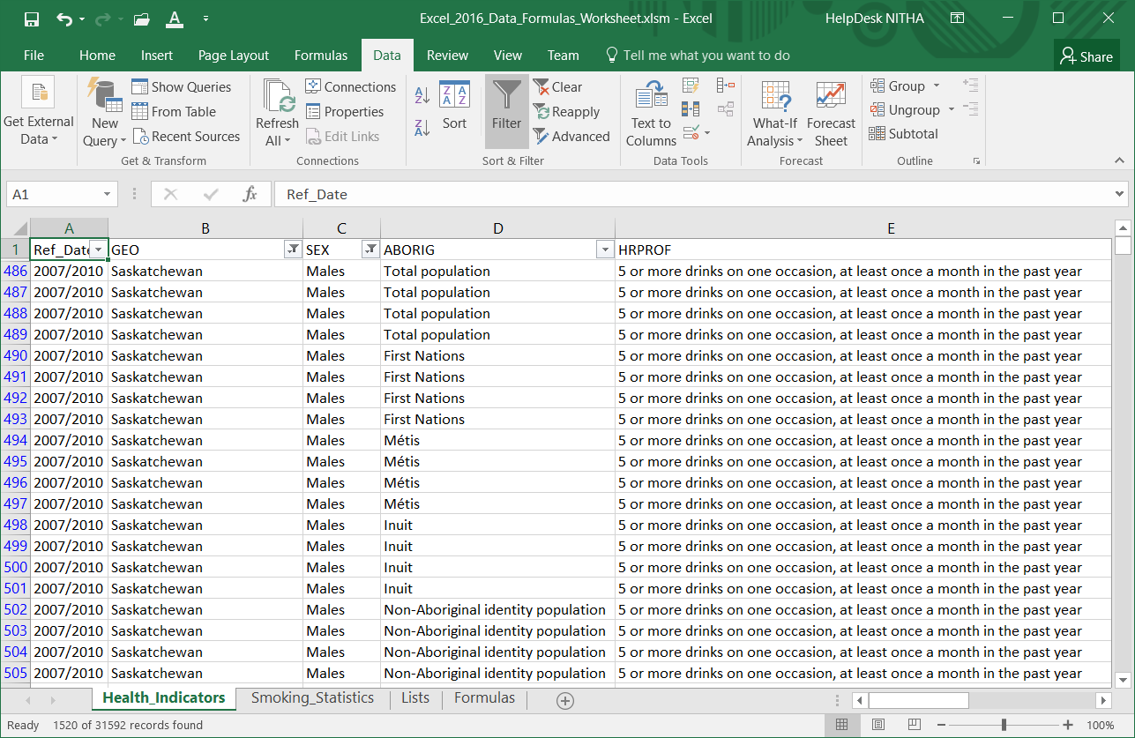
Work with the Health_Indicators (CSV imported data) to restrict the data
Filter by the following
SEX
Female & Males only
1520 of 31592 records

Slide 27
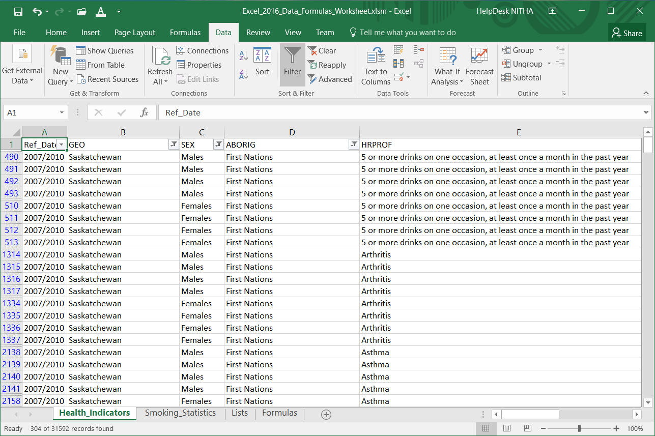
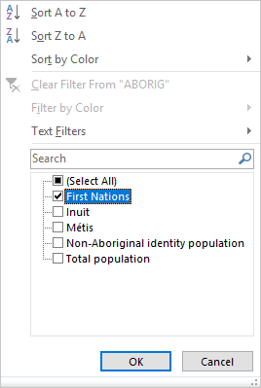
Work with the Health_Indicators (CSV imported data) to restrict the data
Filter by the following
ABORIG
First Nations only
304 of 31592 records

Slide 28
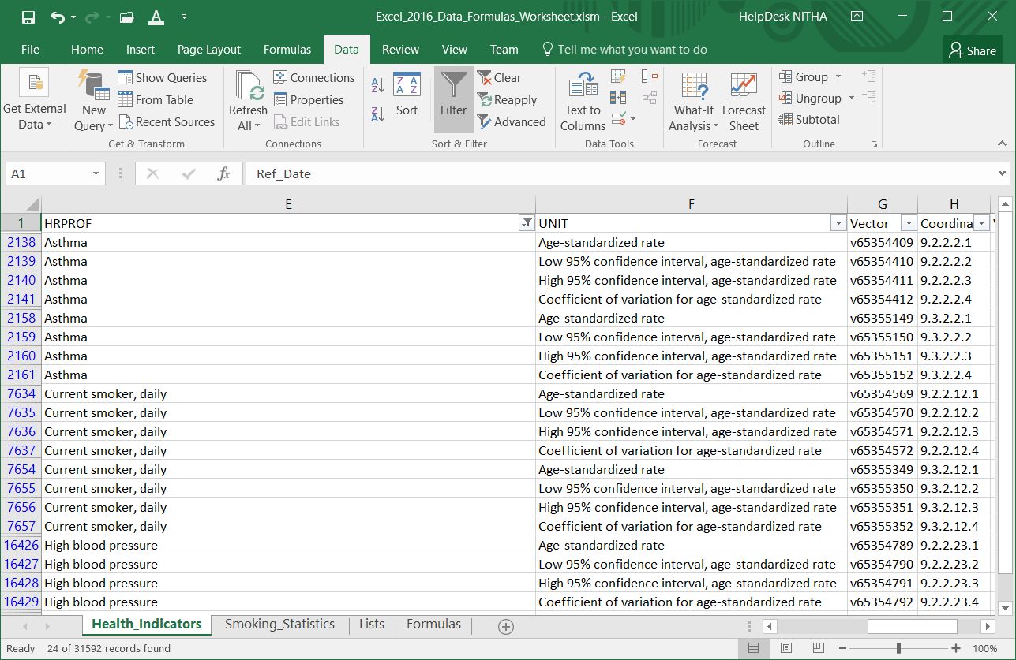
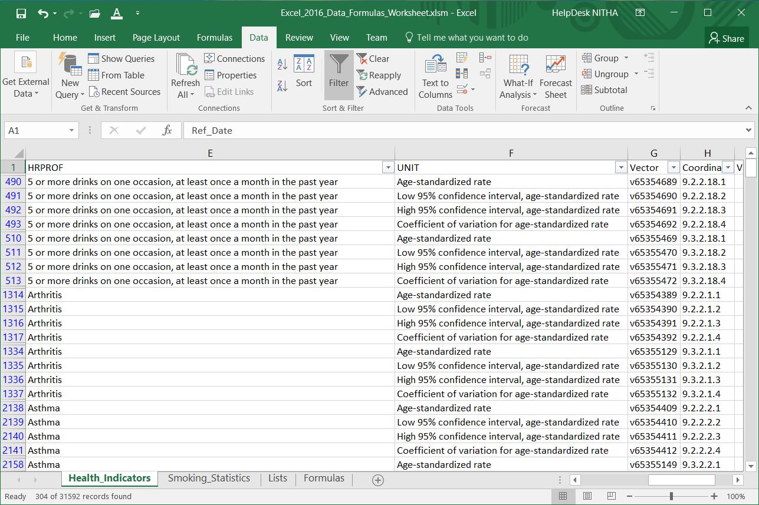
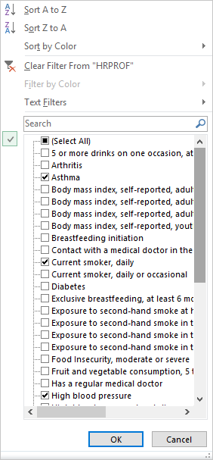
Work with the Health_Indicators (CSV imported data) to restrict the data
Click on HRPROF to filter.
Filter by the following
HRPROF –
Asthma,
Current Smoker Daily,
High Blood Pressure
24 of 31592 records

Slide 29
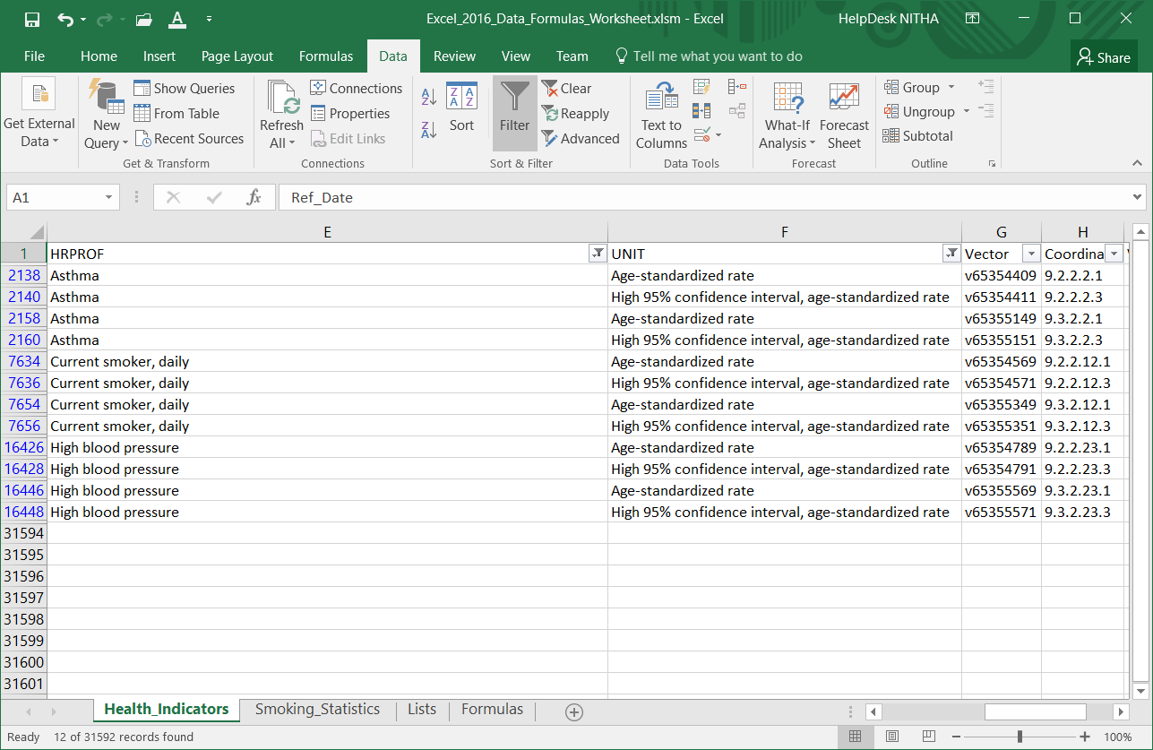
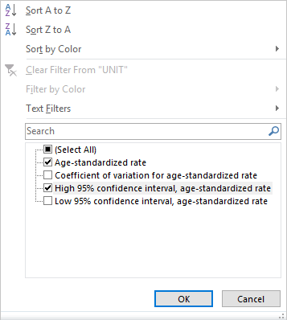
Work with the Health_Indicators (CSV imported data) to restrict the data
Filter by the following
UNIT
High 95% confidence interval,
age-standardized rate
12 of 31592 records

Slide 30
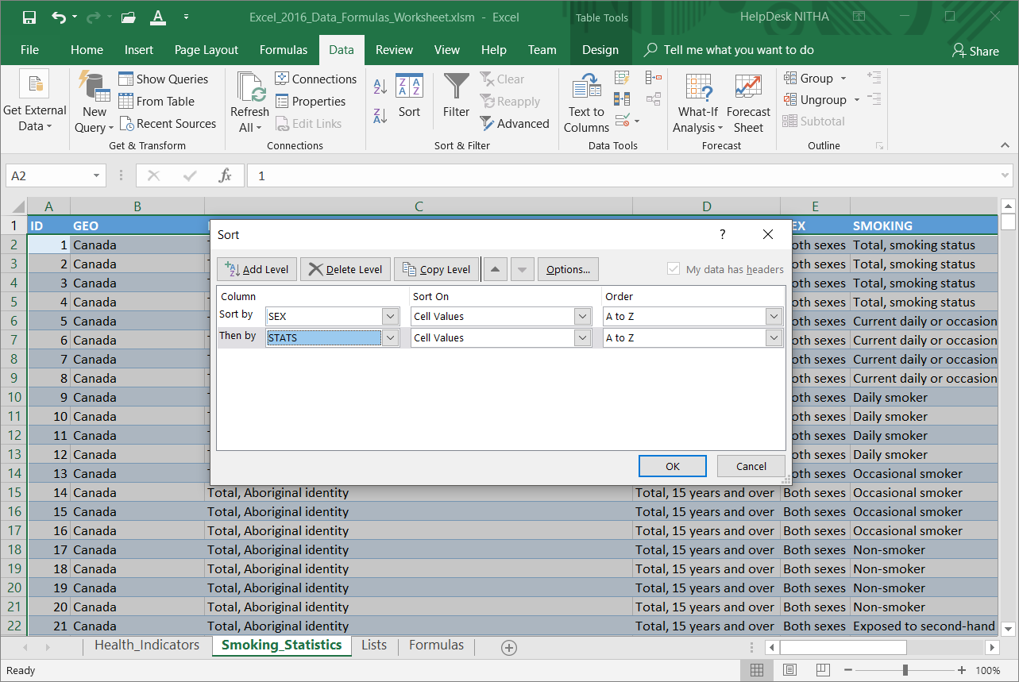
Work with the Smoking Statistics (Access data) to restrict the data
Sort the data by
SEX then STATS

Slide 31
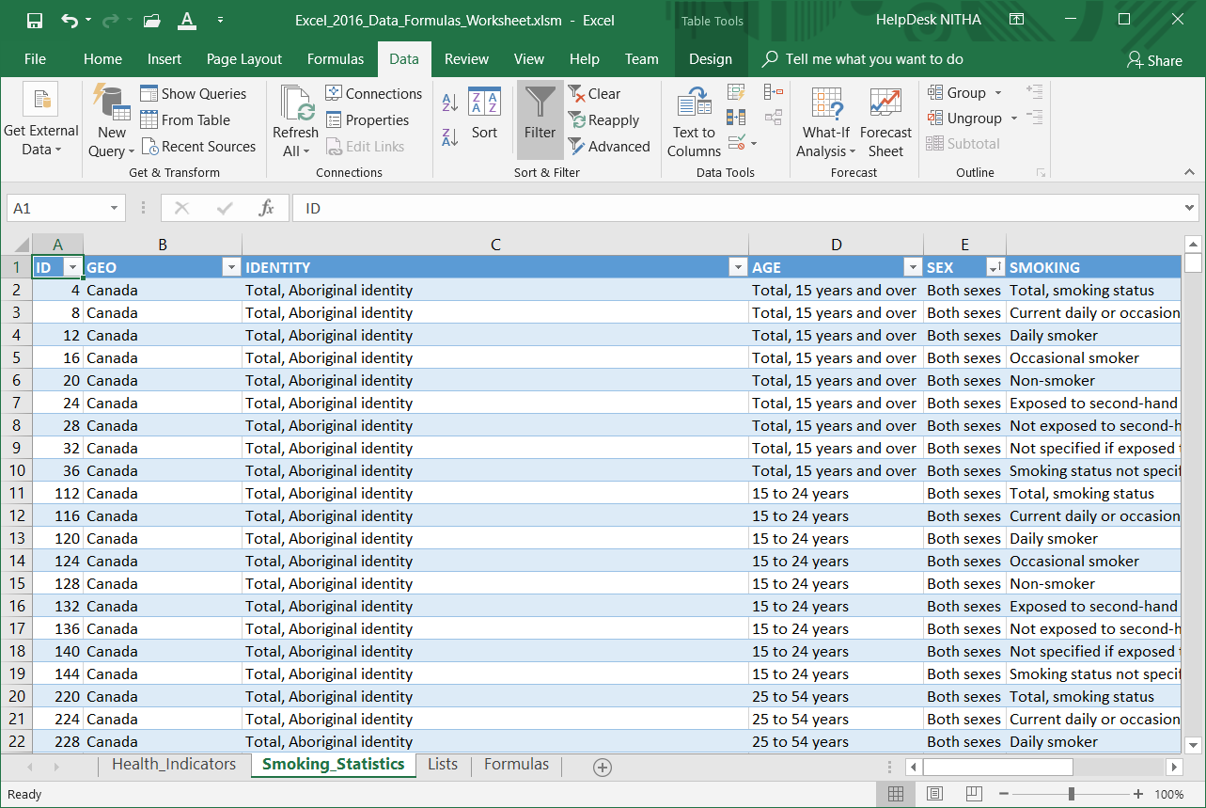
Work with the Smoking Statistics (Access data) to restrict the data
Click on Filter

Slide 32
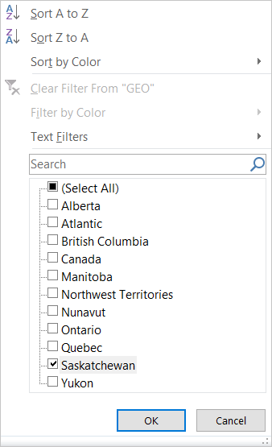
Work with the Smoking Statistics (Access data) to restrict the data
Filter by the following
GEO
  Saskatchewan only

Slide 33
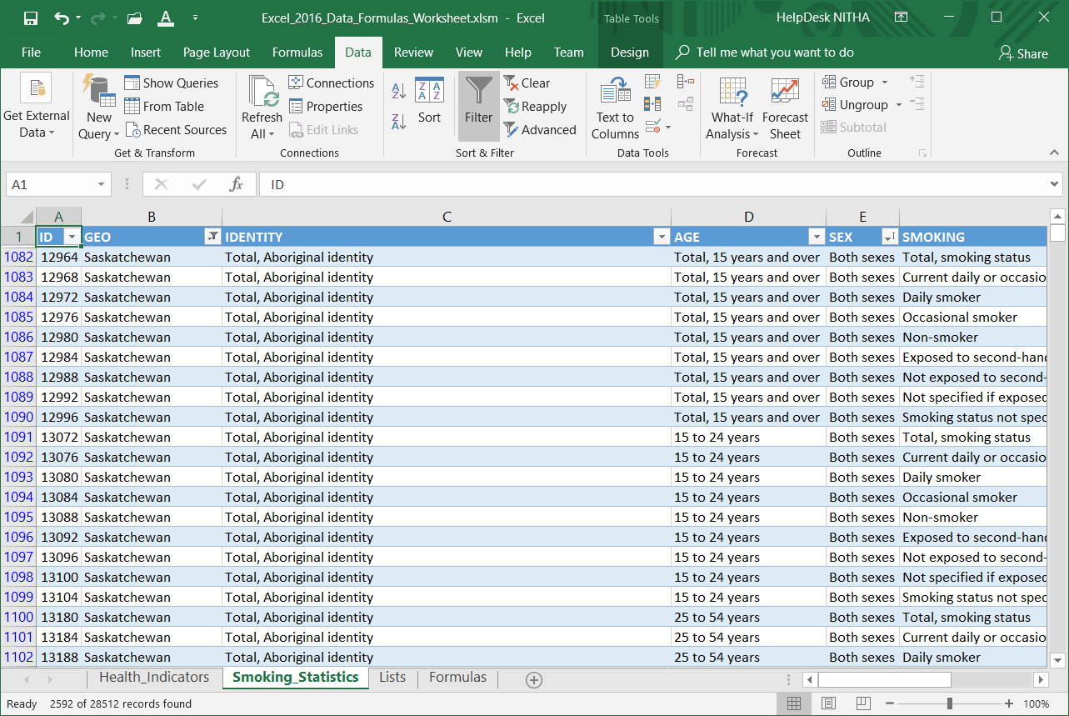
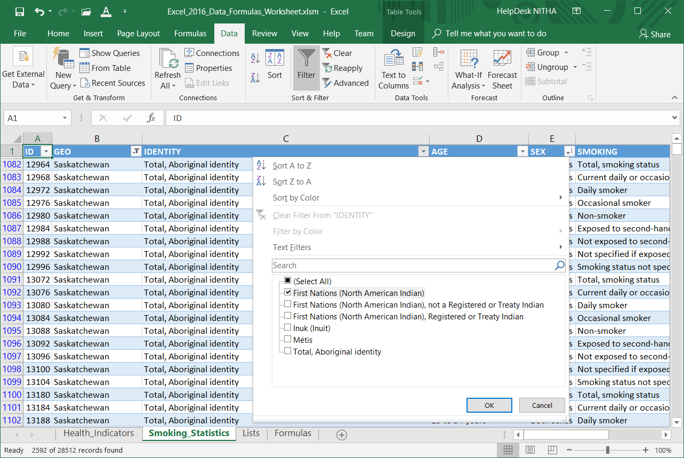
Work with the Smoking Statistics (Access data) to restrict the data
Filter by the following
IDENTITY
  First Nations
  (North American Indian)

Slide 34
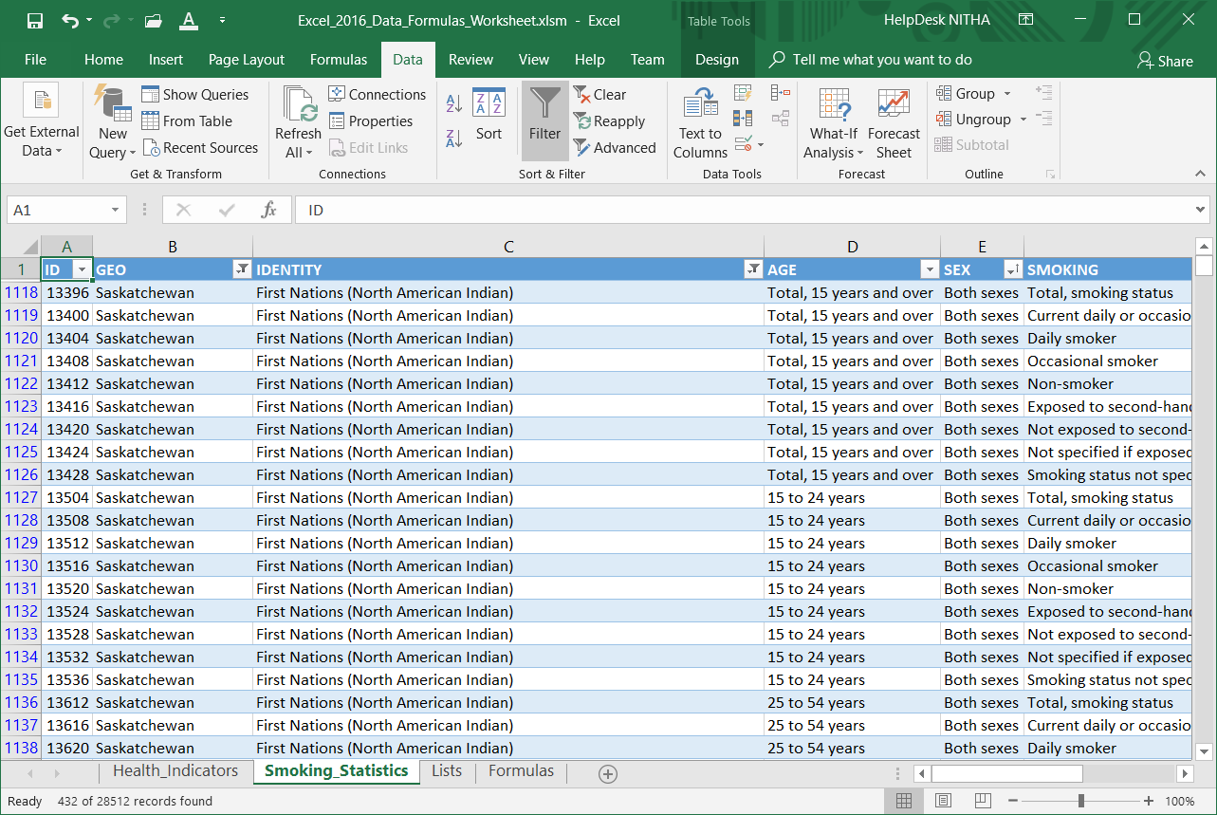
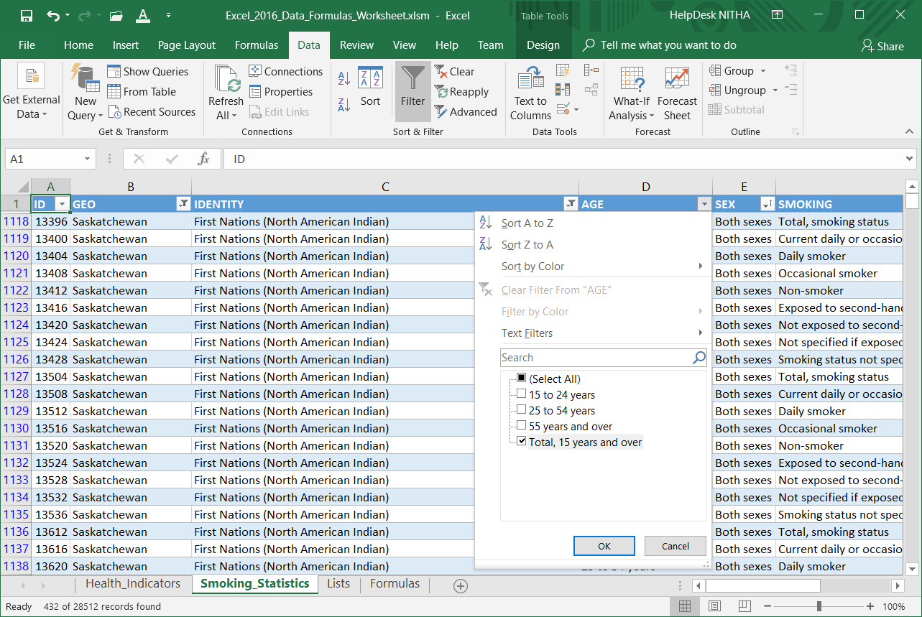
Work with the Smoking Statistics (Access data) to restrict the data
Filter by the following
AGE
Total, 15 years and over

Slide 35
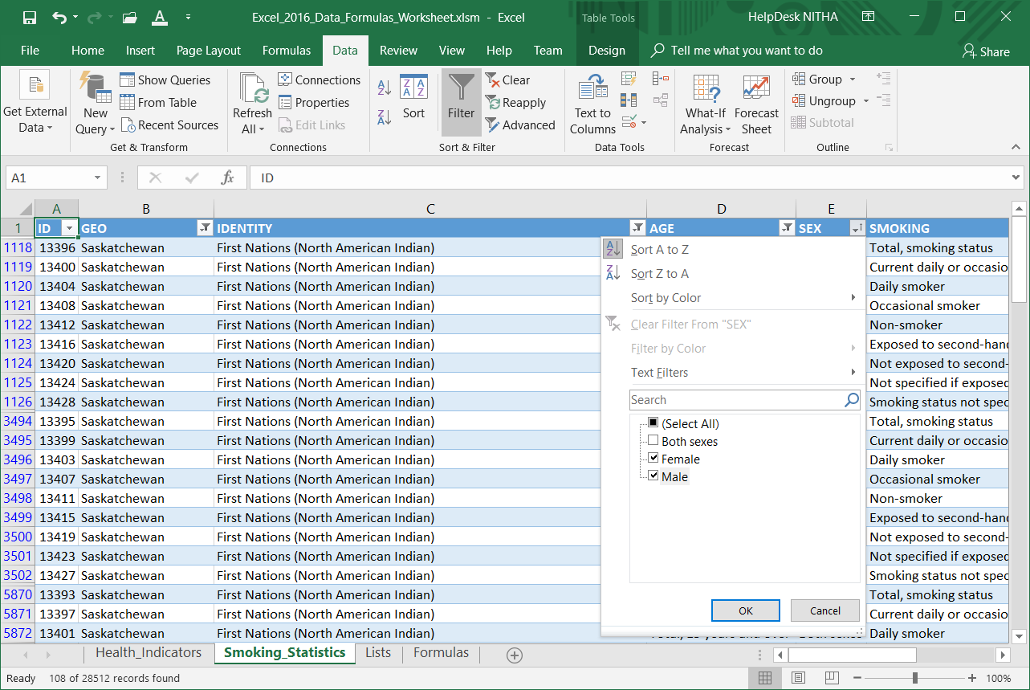
Work with the Smoking Statistics (Access data) to restrict the data
Filter by the following
SEX
Female & Male only

Slide 36
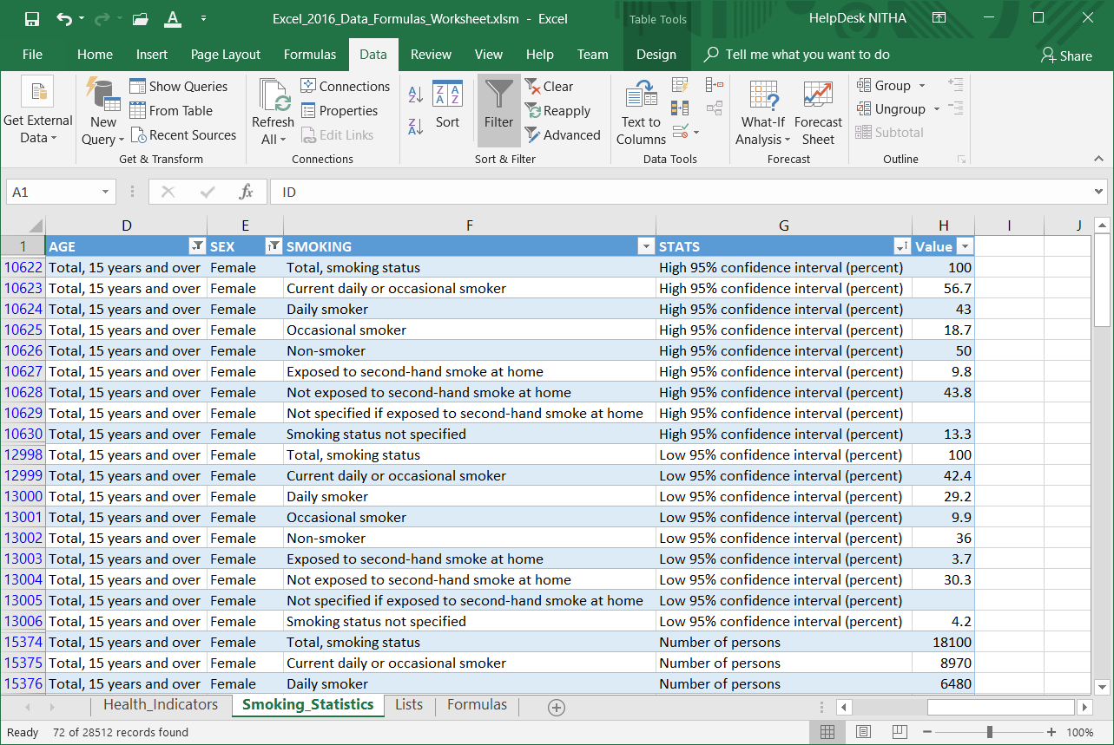
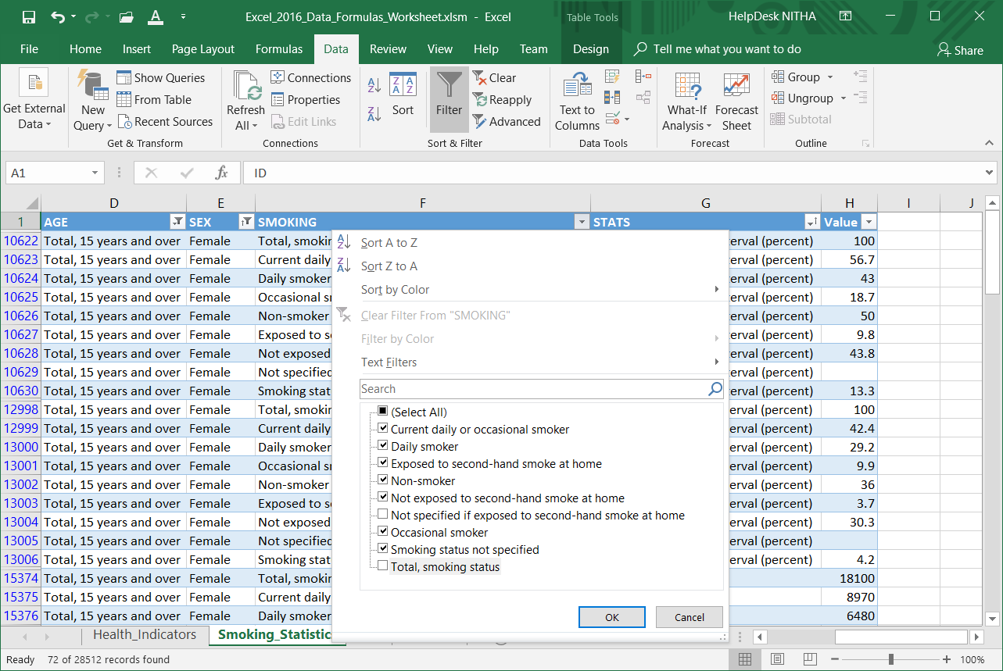
Work with the Smoking Statistics (Access data) to restrict the data
Filter by the following
SMOKING
All except
Not Specified …
Total …

Slide 37
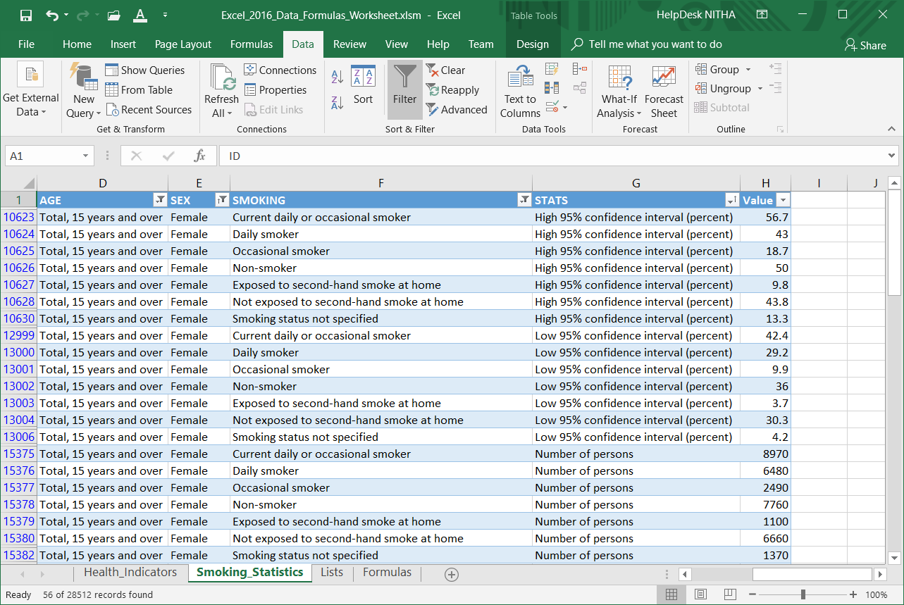
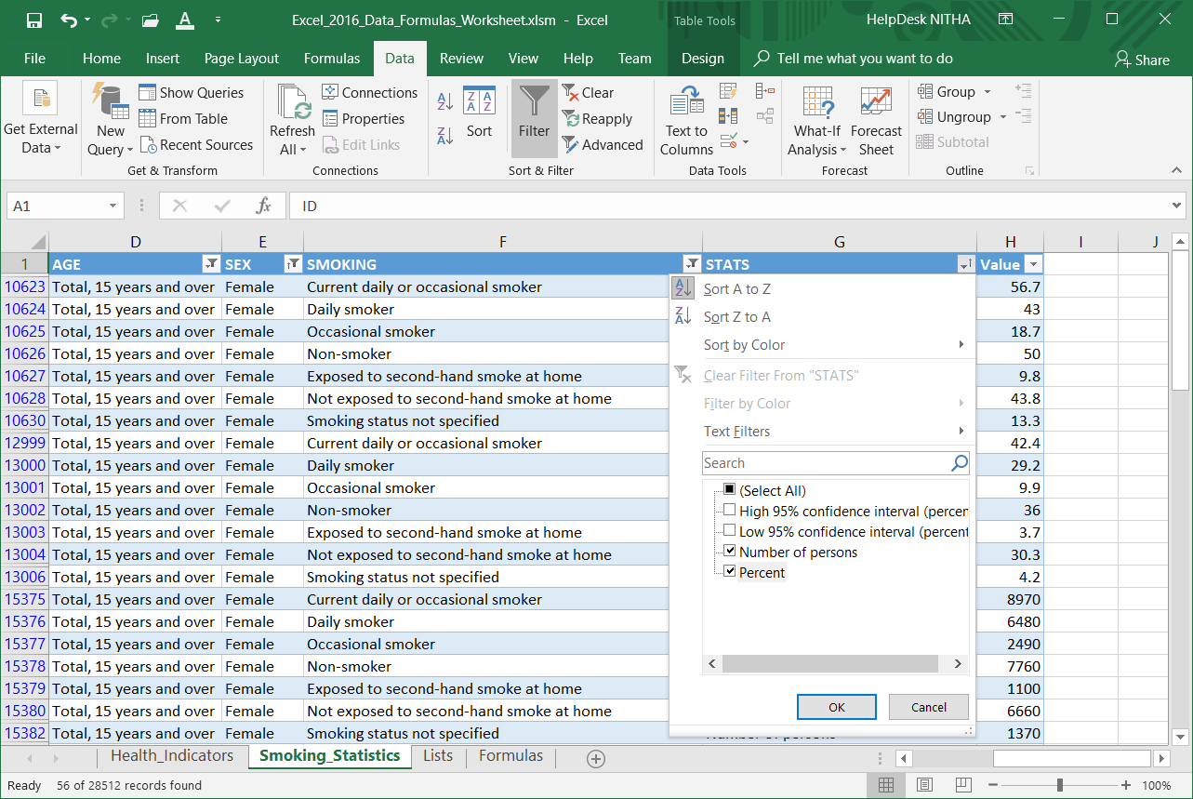
Work with the Smoking Statistics (Access data) to restrict the data
STATS
Number of Persons Percent

Slide 38
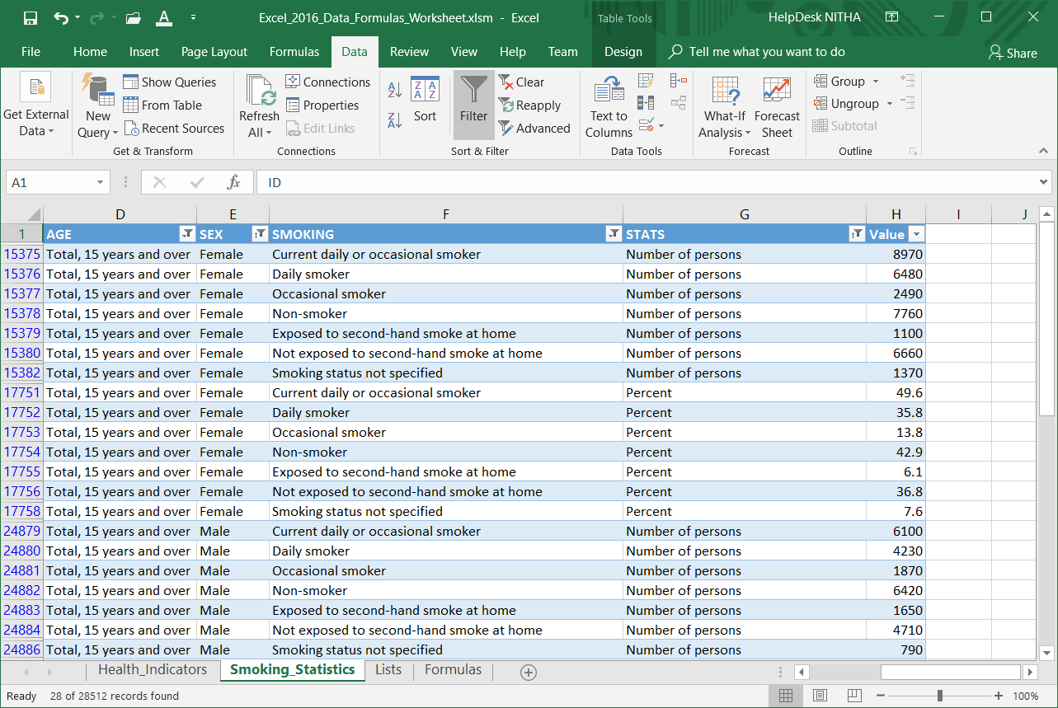
Work with the Smoking Statistics (Access data) to restrict the data
The result of the filtering.

Slide 39
Function Categories
The function bar shown below is directly above the column headers.
Name Box
Insert Function box. Click on the icon to open the functions dialog.
Function/Formula bar
Formula Categories
Compatibility – These functions make Excel 2010 functions compatibility with older versions of Excel.
Cube - Multidimensional sets of data providing a means to summarize information based on a set of search criteria.
Database – Treating an Excel spreadsheet as a flat database, these functions return a search based on sum, variance, and standard deviation data.
Date & Time – These date and time functions allow you to work with the current time or periods of time in your functions.
Engineering – Engineering calculations: many of which relate to Bessel Functions, Complex Numbers or converting between different bases.
Information – These functions return information about the contents and/or formatting of a cell.
Logical – Flow control, logic and error capture.
Math & Trigonometry – ABS, sine, cosine, logarithmic, Pi, Quotient, etc.
Statistical – Works with data points, deviations, and more.
Text – Use these function to manipulate text.
Web – XML and web services functions.
Notes:
Have them follow along in the functions dialog box if they have a computer in front of them.

Slide 40
On the Formulas sheet enter the following formulas …
Math
  ROUND Function (cell E40)
    =ROUND(A14,4)
  TRUNC Function (cell E43)
    =TRUNC(A14)
We will use the following Excel functions on the Formulas:
Information
  INFO Function (cell E21)
  =INFO(D21)
  ISERR Function (cell E24)
  =ISERR(E21)
  ISODD Function (cell E27)
  =ISODD(A8)
Statistical
  AVERAGE Function (cell E48)
    =AVERAGE(Health_Indicators!I7636,Health_Indicators!I7656,Smoking_Statistics!H24880,Smoking_Statistics!H27256)
  MEDIAN Function (cell E51)
    =MEDIAN(Health_Indicators!I7636,Health_Indicators!I7656,Smoking_Statistics!H24880,Smoking_Statistics!H27256)
Logical
  IF Function (cell E32)
  =IF(A5>A17,"DAVERAGE is greater than DVARP","DVARP is greater then DAVERAGE")
IFERROR Function (cell E35)
  =IFERROR(E21, "Cell E21 reports an error")
Take notice that the values for all the statistical functions are separated by a comma, not a colon.
Why is that important?

Slide 41
On the Formulas sheet enter the following formulas …
We are going to do just one formula in the Text category, but we will be embedding functions within functions.
Text
  The formula below takes the text from cell E7636 on the Health_Indicators sheet, “Current smoker, daily”, and makes a text string “Current daily smoker”.
  Why, you ask? To show you what you can do to manipulate the text as you want.
  The formula below looks complex, but it is not as bad as it looks.
  =CONCATENATE(LEFT(E7636,SEARCH(" ",E7636)-1)," ",RIGHT(E7636, LEN(E7636)-SEARCH(",", E7636)-1)," ",MID(E7636,SEARCH(" ", E7636)+1, 6))
We will be working with the following functions:
  Concatenate – Joins together text into one string.
  Search – Searches text to find a one or more character string.
  Left – Returns the left portion of a text string with the length specified.
  Mid – Returns the middle portion of a text string with the length specified starting at the position specified.
Right – Returns the right portion of a text string with the length specified.

Slide 42
Like all other formulas, the function is the following structure:
Function_Name(parameter1, parameter2, etc., etc.)
On the Formulas sheet enter the following formulas …
=CONCATENATE(LEFT(E7636,SEARCH(" ",E7636)-1)," ",RIGHT(E7636, LEN(E7636)-SEARCH(",", E7636)-1),
" ",MID(E7636,SEARCH(" ", E7636)+1, 6))
Concatenate can have as many strings (text) to join as you like, each separated by a comma. I have five for this formula.
=CONCATENATE(
LEFT(
E7636,
SEARCH(" ",E7636)-1
),
" ",
RIGHT(
E7636,
LEN(E7636)-SEARCH(",", E7636)-1
),
" ",
MID(
E7636,
SEARCH(" ", E7636)+1,
6
)
)
LEFT requires two parameters:
The text from which to take a slice (either static text or a cell).
The length of the slice to take measure in characters.
LEN requires one parameter:
A cell or static text.
It returns the length on the supplied parameter.
SEARCH requires two parameters, the third is optional:
The text to search for
The text to search in
The starting character number
SEARCH finds a one or more character string in the text supplied in parameter two and returns the starting position character number.
If you leave the third parameter empty, character position one is assumed.
five
RIGHT requires two parameters:
The text from which to take a slice (either static text or a cell).
The length of the slice to take measure in characters.
MID requires three parameters:
The text from which to take a slice (either static text or a cell).
Starting character.
The length of the slice to take measure in characters.

Slide 43

We have covered here in this course …
What is the direction for this course.
Sorting, Filtering and Restricting the Data
The Ribbons & the Commands
Categories of Functions Provided By Excel
Some Relevant Definitions
Exercise in Using:
Information Functions
Connecting to MS Access Data
Logical Functions
Math Functions
Statistical Functions
Importing CSV Data
Text Functions
Database Function & an Exercise in Using Them

Slide 44


NITHA IT Helpdesk
helpdesk@nitha.com
1(306)953-5008
Notes:
Please do not hesitate to ask any question regarding this session, and I will make sure to answer your question as soon as possible.

Slide 45


