Slide 1


Excel 2016/2019 Basics L2
Intermediate Level

Slide 2



NITHA IT Helpdesk
helpdesk@nitha.com
1(306)953-5008

Slide 3

What will we be covering in this course?
Getting around without the mouse.
Data Validation
Tips working with cell contents
Auto-correction
Developer Ribbon
Autofill
Worksheet Tab
Paste Special
Absolute vs. Relative References

Slide 4
Getting around
without the mouse
Using the keyboard to navigate Excel will allow you to work more efficiently.
Key Combination
Navigation
CTRL+A
Select All button – Once selects data in cells, twice selects the entire worksheet
CTRL+PGUP / CTRL+PGDN
    Switch between open worksheets
    CTRL+TAB / CTRL+SHIFT+TAB
    CTRL+F6 / CTRL+SHIFT+F6
    Switch between open workbooks
    Once - Jump to edge of data in the direction of the arrow (with data on sheet)
    Twice – Jump to the end of the worksheet in the direction of the arrow
  CTRL+Arrow key
  ALT
    Jumps cursor to the ribbon which then allows you to navigate the ribbon by keyboard
  ESC
    Backs up one level navigating ribbon by keyboard
  CTRL+ALT+V
    Opens the Paste Special dialog. (If a copy cells – CTRL-C – was done)
    To navigate the Paste Special dialog (or any other dialog) via the keyboard:
    TAB / SHIFT+TAB – moves between panels in the dialog
    Arrow keys – moves in the direction of the arrow within the panel
    Enter – Selects the highlighted item (or the default dialog button – usually OK)
    Spacebar – Checks or unchecks checkboxes and radio buttons
    ESC – Exits dialog without making any changes
    ALT+Down Arrow – exposes the list on drop down lists

Slide 5
Getting around
without the mouse
Using the keyboard to access functions and features in Excel.
Key Combination
Function
F2
Edit the selected cell
ALT+ENTER
Line breaks in the cell being edited
ALT, H, W
Turn on or off text wrapping for the selected cell.
NOTE: Press ALT (then release), press H (then release), press W (then release)
SHIFT+F10
Display Context Menu of selected object (right mouse button click)
CTRL+K
Insert a hyperlink into the object (text box, shape, word art, etc.)
CTRL+;
Insert current date
CTRL+SHIFT+:
Insert current time
CTRL+SHIFT+#
Change date format
CTRL+SHIFT+Arrow key
Selects all cells from the selected cell in row or column until it comes to a blank or non-number cell in the direction of the arrow key

Slide 6
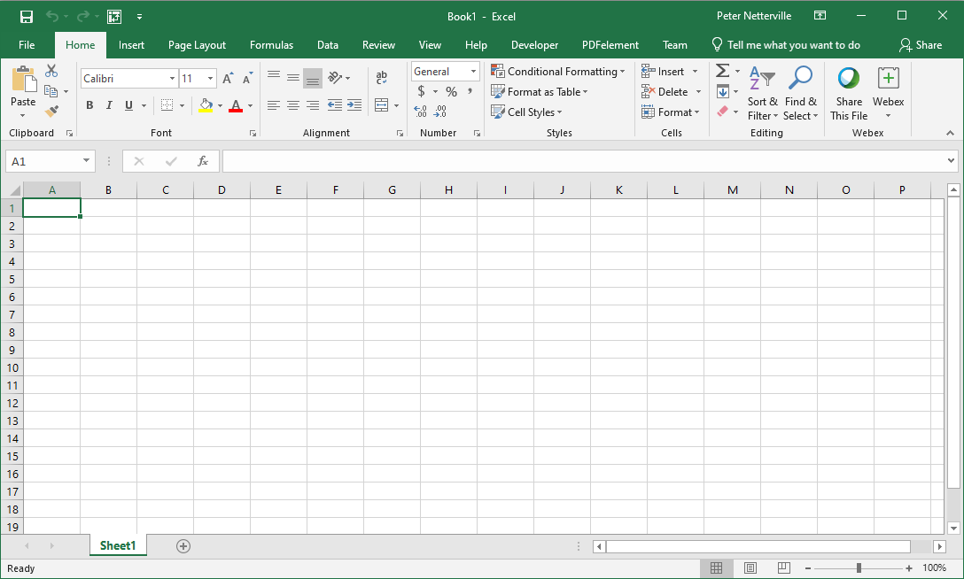
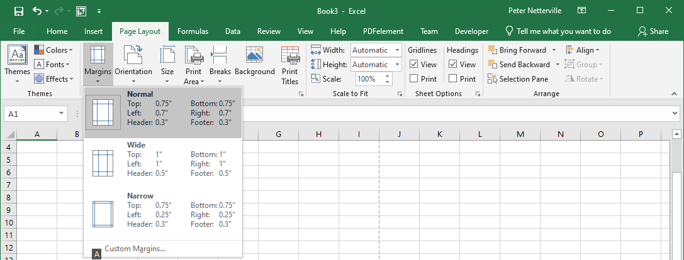
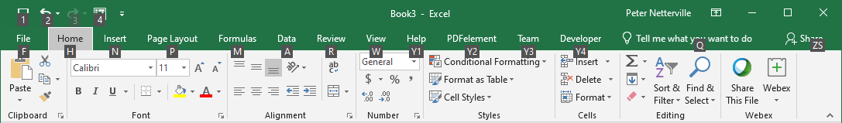
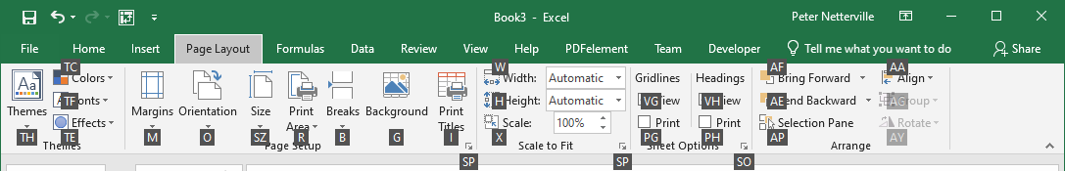
Getting around without the mouse
Navigating the ribbon using the keyboard only
Notice the white letters in small black boxes.
Now touch the letter of the item you want.
P for the Page Layout ribbon, for example.
Alt – Touch the Alt key to gain access to the ribbon via the keyboard.
Touch Esc on the keyboard to go back each level.
Now touch another letter (or two letters in some cases) to do that command or pull down a menu.
M for the Margins menu, for example.
While in the menu you can use the up/down arrow keys to select a command or
Touch a letter on the menu.

Slide 7
Tips working with cell contents
Miscellaneous helpful keys to know
What you want to do …
Do …
To apply a strikethrough to the text in a cell
Select the cell & then CTRL+5
To hide the current column
Select a cell in the column & then CTRL+0
To hide the current row
Select a cell in the row & then CTRL+9

Slide 8
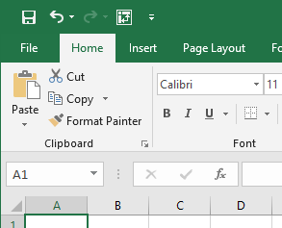
Developer Ribbon
You may not see a Developer ribbon because by default the tab is not enabled.
The Developer ribbon provides functions such as:
Code – Macros and Visual Basic Editor
Add-ins – Modules that expand the abilities of Excel
Content Controls – Controls that allow you to programmatically manipulate content.
XML Content – Work with XML source.
To see the Developer Tab do the following …
Click on the File tab to access the Back Stage

Slide 9
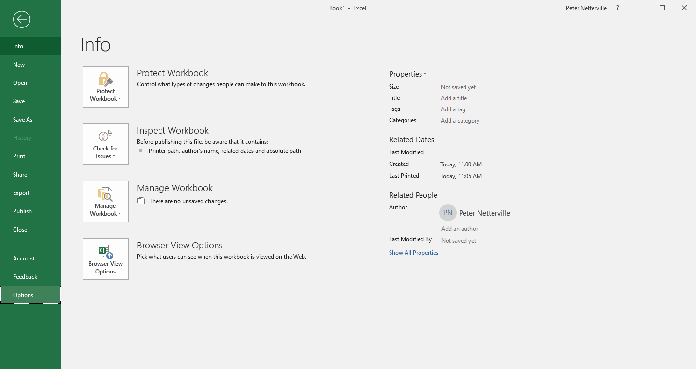
Developer Ribbon
Enable the Developer ribbon from Options accessed from the Backstage.
Click on Options

Slide 10
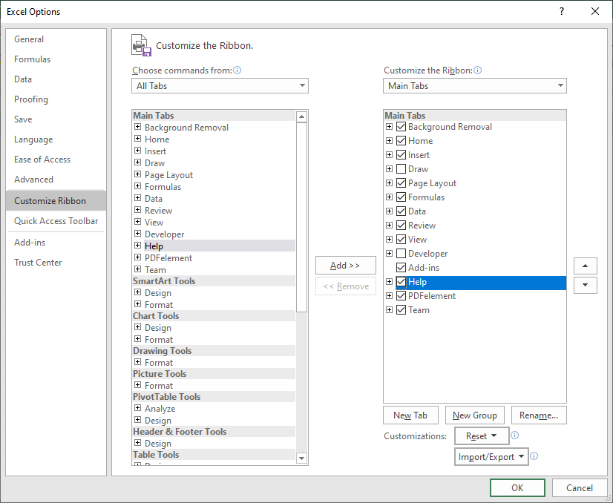
Developer Ribbon
Click on the drop arrow to change from where you select your commands
Select Custom Ribbon

Slide 11
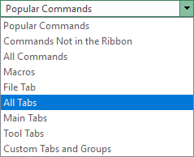
Developer Ribbon
Click on All Tabs

Slide 12
Developer Ribbon
1. Select the Developer ribbon
2. The Developer tab will be placed to the right of the tab you select.
I like the Developer tab after the Help tab, so I selected the Help tab.
3. Click on the Add button

Slide 13
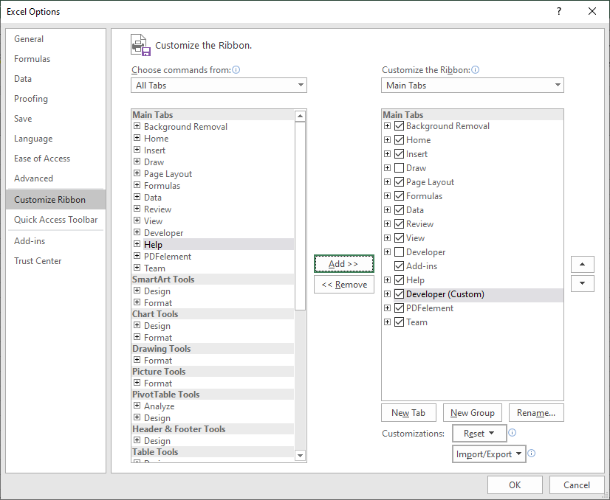
Developer Ribbon
With the Developer ribbon added …
Click on OK

Slide 14
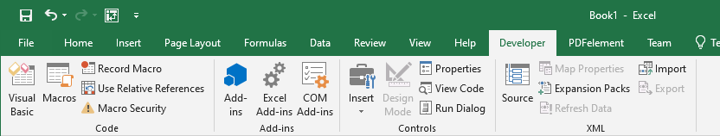
Developer Ribbon
Code – Macros and Visual Basic Editor
Add-ins – Modules that expand the abilities of Excel
XML –Work with XML source content.
Controls – Content controls that allow you to programmatically manipulate content.

Slide 15
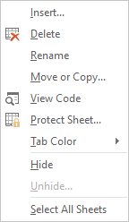
Worksheet Tab
Hide the selected worksheet(s)
Select all Sheets so you can perform the same action on all worksheets.
NOTE: You can select individual worksheets by holding down the CTRL button while left clicking on the worksheet tab of those worksheets you want to select.
Right-Click on the worksheet tab displays a menu that will allow you to change the looks and behavior of the worksheet.
The worksheet tabs are along the bottom of the worksheet just above the status bar.

Slide 16
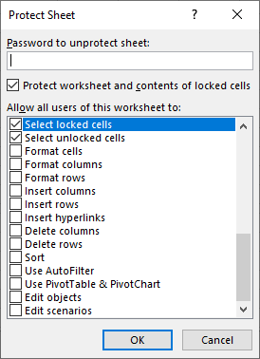
Worksheet Tab
View Code created from the macro(s) you have made, or your custom VBA coding. This opens up the Visual Basic editor.
Lock
the whole worksheet
individual cells
individual rows and/or columns
based upon different conditions such as
formatted cell(s)s, row(s), and/or column(s)
if a hyperlink exists
whether sorted or not
and much more.
Protect Sheet displays a dialog (above) which allows detailed control.
Tab Color - You can change the colour of your worksheet tabs.

Slide 17
Insert a new object positioned to the right of the selected worksheet tab.
The type of available objects are:
Worksheet
Chart
Macro
Dialog box
All the worksheets in the selected template workbook.
Worksheet Tab
Delete this worksheet. Keep in mind that there is no undo for deleted worksheets.
If you delete it, it is gone. The only way to get it back would be from a backed up version of the worksheet in a workbook saved on a drive or USB stick.
Rename the worksheet tab.
You can Move or Copy the worksheet. This option displays a menu that allows you to work with the worksheets.
Alternative: You can pickup a worksheet by left clicking and holding down the mouse button while you drag the worksheet to a new position (move).
To copy that worksheet hold down the CTRL button while dragging the tab to its’ new location.

Slide 18

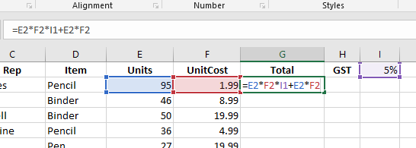
Absolute vs. Relative References
Absolute and relative references only apply when copying a formula or function from one cell to another cell.
What does this mean?
It means that when you copy a formula or function in a cell to another cell the references to the cells in the formula change relative to the cell where it was copied.
What will happen if the formula in G2 is copied to cell G3?

Slide 19
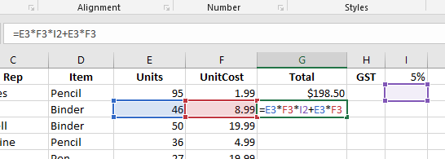
Absolute vs. Relative References
The $ is the character that stops Excel from updating the cell reference. This $ is beside the row number, so it will freeze the row in place.
Note the $
The $ beside the column letter will stop the column from being updated. (i.e. $I1) To freeze the cell in place no matter to where the formula is copied … $I$1 (i.e. =E3*F3*$I$1+E3*F3 )
=E3*F3*I$1+E3*F3
should be
Most of the cell references in the formula were properly updated, but what happened to the GST in cell I1?
Either type in the $ or you can use the F4 key.
=E3*F3*I2+E3*F3
The GST cell is now I2 where there is no value.
So how do we keep it in cell I1 when the formula is copied and pasted into another cell?

Slide 20
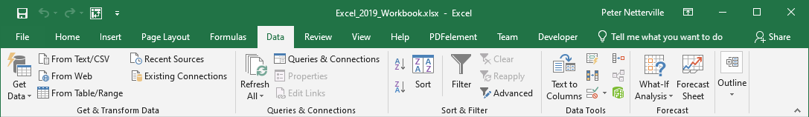
Data Validation
Data validation supplies a level of input control and professionality to your worksheet projects.
Click on the Data tab to expose the Data ribbon.
Data Validation is found in the Data Tools group.
Click on the Data Validation menu.

Slide 21

Data Validation
Data validation supplies a level of input control and professionality to your worksheet projects.
The three options in the Data Validation menu are as follows:
Data Validation… displays a dialog which we will cover later.
Circle Invalid Data – Selecting this option forced Excel to display a red circle around any cells that contain invalid data based upon the data validation criteria set in the Data Validation dialog.
Clear Validation Circles removes the red circles placed by the above command.

Slide 22
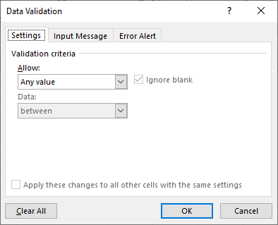
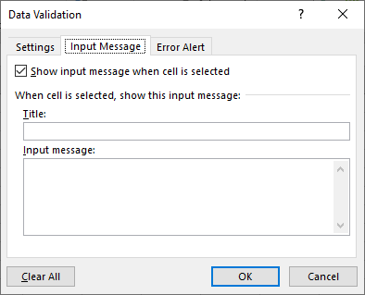
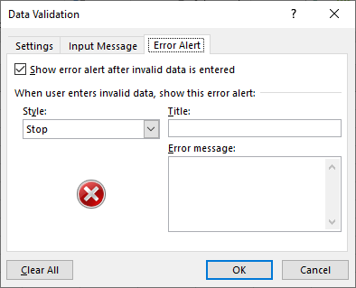
Data Validation
There are three tabs in the Data Validation dialog.
There are three tabs in the Data Validation dialog.
Note: The validation criteria applies only to the selected cell(s)
Settings – This is where you provide the condition(s) for what is necessary to validate the data that goes into the cell you have selected. This is call validation criteria.
Input Message – When the cell is selected a message can appear. Usually you tell the user what data is expected.
Error Alert – If incorrect data is input, this is where you specify the severity (Style), Title, and the error message.

Slide 23
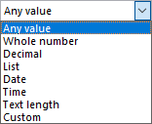
Data Validation
So, what types of data validation can be applied and how does it help you in your projects?
Important: Before you apply a validation, you must first select the cell(s) to which you want to apply the validation.
Validation Criteria
settings panel
So, after selecting the cell(s):
1. Open the Data Validation dialog (from the ribbon).
2. Click on the drop arrow on the Allow menu in the settings panel.
3. Select the type of validation you want to perform on the cell(s).
Whole number, Decimal, and Text length are all self-explanatory.

Slide 24
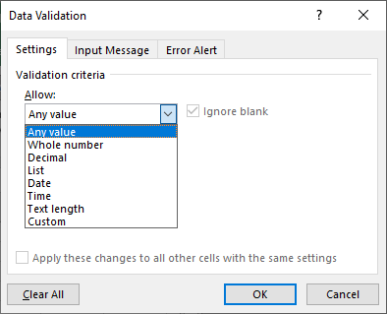
Data Validation
Important: Before you apply a validation, you must first select the cell(s) to which you want to apply the validation.
Validation Criteria
List – Creates a drop list in a cell from a selected block of cells on the same or another worksheet.
Date – Allows for the cell to accept a date only between two dates.
Time – Allows for the cell to accept a time only between two times.
Custom – Create a formula which validates input.

Slide 25
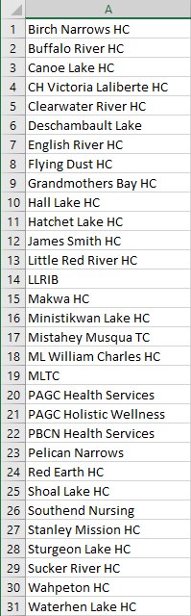
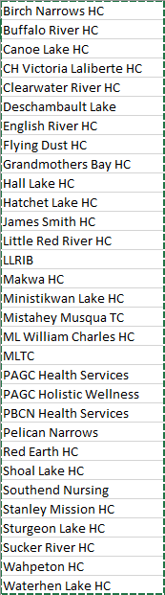
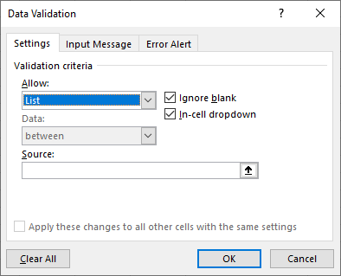
Data Validation
So, what types of data validation can be done and how does it help you in your projects?
Important: Before you apply a validation, you must first select the cell(s) to which you want to apply the validation.
List – Create a list which can then be added to a drop down list.
This type of validation forces validation by only allowing the options available in the list.
1. Select cell K2 on the Sales worksheet for this example.
3. Now select List from the Allow menu.
2. On a the communities worksheet create a list.
which will then display the selection in the source text field.
5. Finally, click on OK
4. Click on and then select the list.

Slide 26
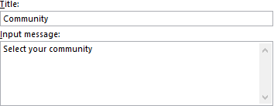
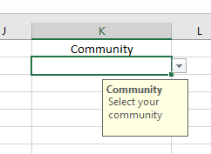
Data Validation
So, what types of data validation can be done and how does it help you in your projects?
On any cell or cells you had selected when you applied the validation criteria, you can apply an Input Message.
With the cell K2 on the Sales worksheet selected, go back into the Data Validation dialog and select the Input Message
1. Type in a title and input message.
2. Click on OK
Now when the cell is select to which you applied the Input Message you will see a message as shown below

Slide 27
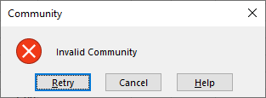
Data Validation
So, what types of data validation can be done and how does it help you in your projects?
On any cell or cells you had selected when you applied the validation criteria, you can apply an Error Alert.
With the cell K2 on the Sales worksheet selected, go back into the Data Validation dialog and select the Error Alert tab.
1. Type in a title and an error message.
Now when incorrect data is entered into the cell, the Error Alert message will be displayed.
2. Click on OK

Slide 28
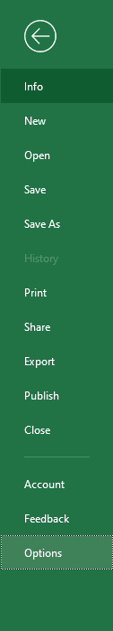
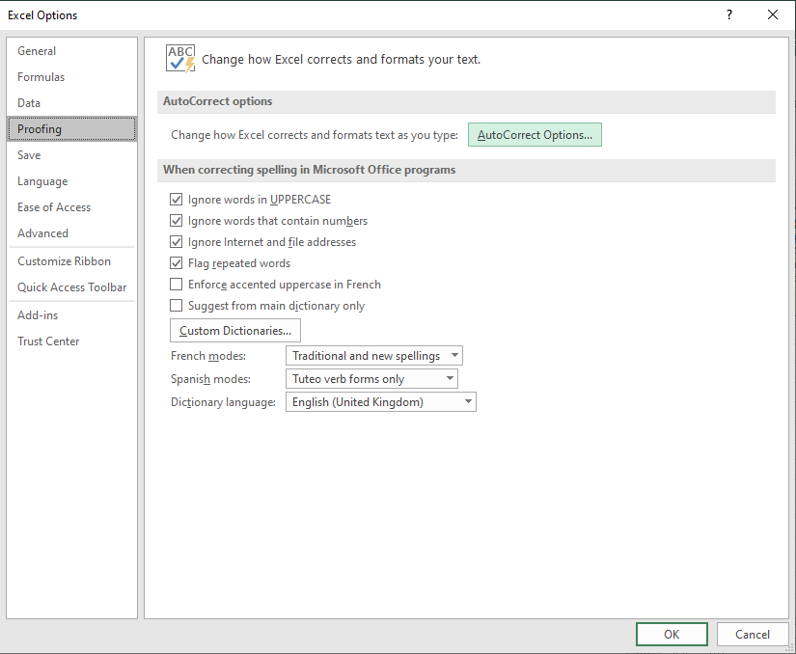
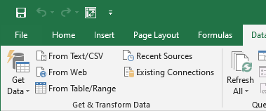
Auto-correction
Auto-correction fixes misspelled words for you.
The behaviour of auto-correction can be changed based upon the option settings.
1. Select the File tab, the Backstage.
then Autocorrect Options
then choose Proofing
2. Select Options from the Backstage.

Slide 29

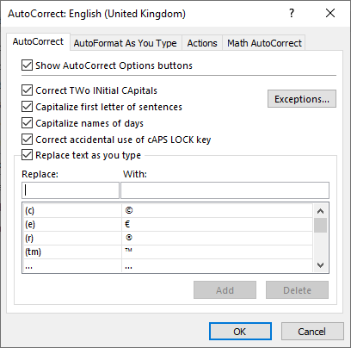
Auto-correction
AutoCorrect tab
The AutoCorrect Options button is what appears on the whorsheet when an autocorrection has been made by Excel.
Self Explanatory
Replace as you type can be handy because it will fix common spelling errors, but you can also make common symbols easily such as copyright, registered, trademark, etc.
You can customize the list of autocorrect items by adding in what you want to replace with the text you type into the cell.

Slide 30
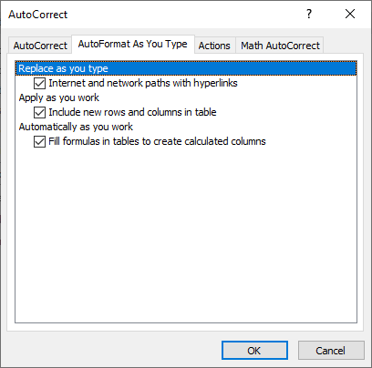
Auto-correction – AutoFormat
AutoFormat as You Type tab
AutoFormat is different from AutoCorrect in that AutoCorrect looks for one word or phrase and corrects what you have typed with text from a premade list but …
AutoFormat, however, looks for URLs, network paths, and email addresses and replaces them with hyperlinks.
It is here that you can disable this behavior.
If you enter data in a column beside other table data, or enter data in a row below other table data, AutoFormat will automatically includes that data into the existing table data.
This behaviour can be disabled here by deselecting the check box.
This option causes AutoFormat to fill in a formulas in a column automatically from one that you entered, like filling in the totals column.

Slide 31
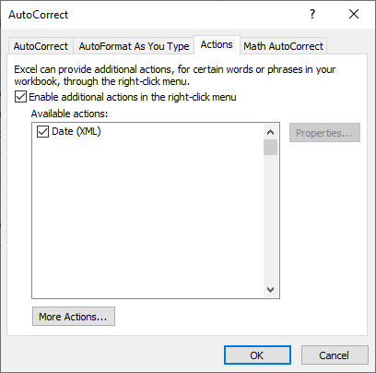
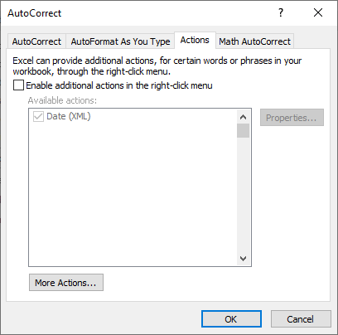
Auto-correction – Actions
Actions tab
Excel provides a mechanism for adding additional actions to the right-click context menu.
Click on this checkbox to enable additional actions.
This XML formatted date can be selected but does not add the function to the right-click context menu.
Presently there are no actions that can be added to the right-click context menu until Microsoft creates some to be added.

Slide 32
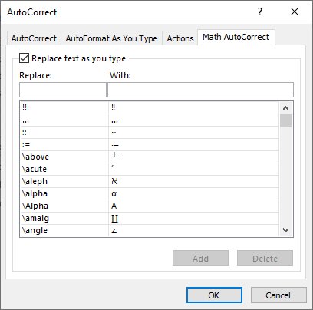
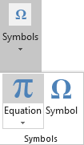
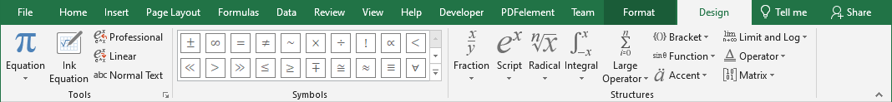
Auto-correction – Math AutoCorrect
Math Auto-Correction is similar to AutoCorrect in that you have a list of text items that when typed to the cell or text box is then replaced with other text.
The difference is that in this case you can insert math symbols that you would otherwise have to go to the Equations dialog to insert.
These math symbols can also be accessed through the Equation dialog found in the Insert ribbon and in the Symbols group.

Slide 33
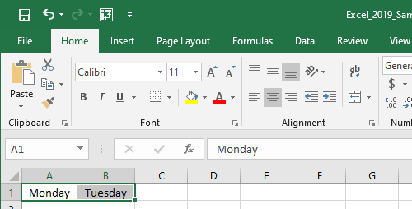
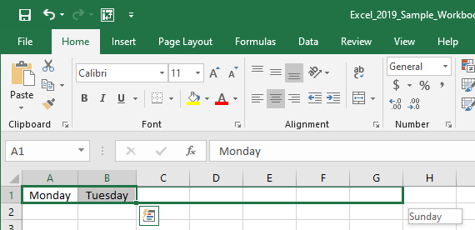
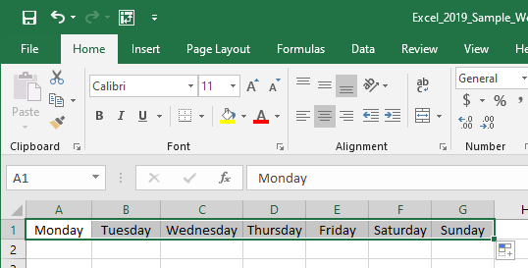
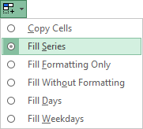
Autofill
Autofill provides an easy way to fill in cells with similar data.
drag to the right
Enter information in two cells, in the case of this example
Monday in A1
Tuesday in B1.
Pick up the Autofill handle and drag the box to the right to fill in the remaining days in the week.
Notice how Wednesday to Sunday are auto-filled.
Autofill button displays a menu of options

Slide 34
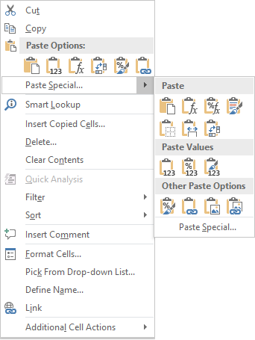
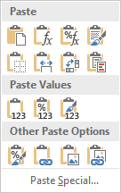
Paste Special
Paste - Paste all: content, formula(s) and source formatting
Formulas – Paste only the formula(s), maintaining destination formatting.
Keep Source Formatting – Paste content while maintaining the original formatting.
Formulas & Numbers Formatting – Paste both the formulas and the original formatting

Slide 35
Paste Special
No Borders - Paste all content and source formatting except borders.
Keep Source Column Width – Paste all including the column width from the source.
Merge Conditional Formatting – In instances where the source and destination have conditional formatting applied, they will be merged.
Transpose – Pastes with all formatting row data to column and vise-versa.

Slide 36
Paste Special
Values - Paste the values of the formula(s) only.
Values and Numbers Formatting – Paste the values of the formula(s) and the number formatting only.
Values and Source Formatting – Pastes the values of the formula(s) and all he source formatting.

Slide 37
Paste Special
Formatting- Paste the source formatting only.
Paste Link– Paste the hyperlink only, no formatting.
Picture – Paste the picture from the source only.
Linked Picture – Pastes a link to the picture in the source.

Slide 38
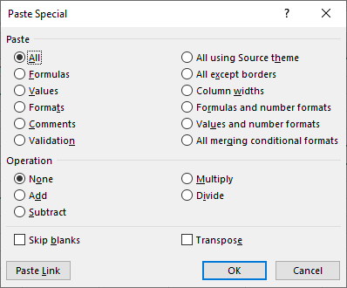
Paste Special
Paste Special … - Displays the Paste Special Dialog

Slide 39

We have covered here in this course …
Getting around without the mouse.
Data Validation
Tips working with cell contents
Auto-correction
Developer Ribbon
Autofill
Worksheet Tab
Paste Special
Absolute vs. Relative References

Slide 40


NITHA IT Helpdesk
helpdesk@nitha.com
1(306)953-5008
Notes:
Please do not hesitate to ask any question regarding this session, and I will make sure to answer your question as soon as possible.

Slide 41


