Slide 1


Excel 2016/2019 Basics L1
Entry Level

Slide 2



NITHA IT Helpdesk
helpdesk@nitha.com
1(844)486-4842

Slide 3
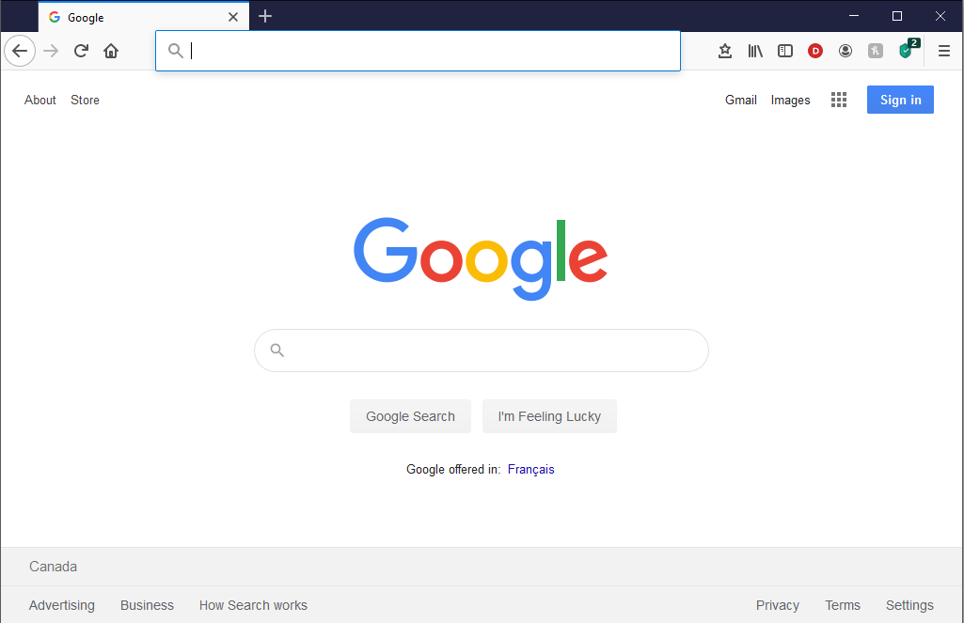
NITHA - IT Helpdesk Courses Registration Website
How do I get to the Courses Registration Website?
First, open up your favorite web browser.
Finally, press ENTER on our keyboard
Second, type in the address bar the URL, nitha.com/courses

Slide 4

NITHA - IT Helpdesk Courses Registration Website
The NITHA Computer Training Courses Calendar
There are four sections to the
IT Helpdesk Courses Registration Website
The calendar – As seen on the right,
the calendar displays the selected month and all the course links on the appropriate days.
Morning courses 9:30 AM to 11:30 AM
Afternoon courses 2:00 PM to 4:00 PM

Slide 5
NITHA - IT Helpdesk Courses Registration Website
Cycle forward through the months by clicking on the next month
The NITHA Computer Training Courses Calendar
Cycle backward through the months by clicking on the previous month
And of course, the month in the middle is the currently displayed month.

Slide 6
NITHA - IT Helpdesk Courses Registration Website
or the next year
The NITHA Computer Training Courses Calendar
You can even click on the previous year

Slide 7
NITHA - IT Helpdesk Courses Registration Website
The NITHA Computer Training Courses Calendar
Click on the course link of your choice and you will be taken to a registration page.

Slide 8

NITHA - IT Helpdesk Courses Registration Website
The NITHA Computer Training Course Registration page
Enter your information
Select how you are going to attend the course
by WebEx
by Telehealth
Select how you want your Certificate of Completion delivered.
by Email as a PDF
by Canada Post

Slide 9
NITHA - IT Helpdesk Courses Registration Website
The NITHA Computer Training Courses WebEx Info
WebEx Information – For the WebEx connection information on how to attend the courses in the current week, click on the WebEx link.

Slide 10

NITHA - IT Helpdesk Courses Registration Website
The NITHA Computer Training Courses Calendar
These links display the WebEx information for that course
These links download the ICS file for that course so that you can add it to your Outlook calendar as an event.

Slide 11
NITHA - IT Helpdesk Courses Registration Website
The NITHA Computer Training Courses Download
Course Files Download – The courseware and the data files which are used in the courses are all available for download any time whether or not you are taking the course.
click on the Course Files Downloads link
To download the
Courseware file (A PowerPoint file)
and/or
Sample data files used in the course

Slide 12

NITHA - IT Helpdesk Courses Registration Website
The NITHA Computer Training Courses Calendar
The Course Sample File is the data file used in the course.
The PowerPoint Courseware File is the course itself.

Slide 13
NITHA - IT Helpdesk Courses Registration Website
The NITHA Computer Training Courses Calendar
Tech Videos are the fourth section of the website. As they are created, they will be placed here.
Tech Videos are short 3 to 15 minute videos featuring solutions to various tech issues.

Slide 14

What will we be covering in this course?
Excel Intro
Basic Spreadsheet Functions
Overview: What can Excel do?
Navigating Using the Mouse & Keyboard
Screen layout
Entering Data plus Function/Formula Syntax
Title bar
Function Categories
Ribbons: Common and Contextual
The Rules
Name Box & Formula Bar
Document Worksheet
Commonly Used Functions
Status Bar
Exercise
The Backstage: A Quick Overview
Est. Time: 2h

Slide 15
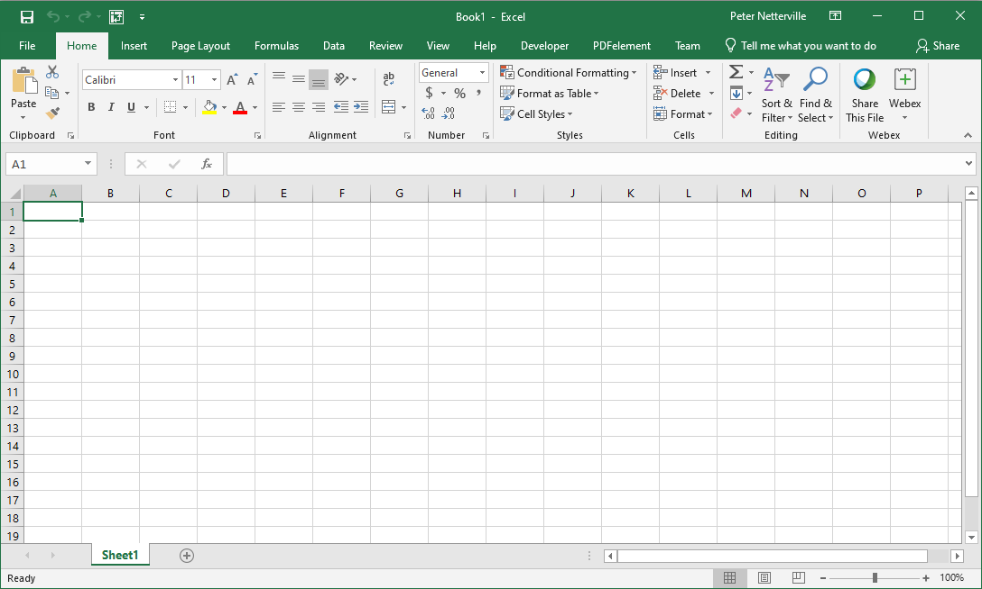
Screen Layout – Titlebar
This is the Titlebar
Ribbon Display Options
Account name & access.
On the Titlebar there are five items of interest …
1. The Quick Access Toolbar.
The name of the file.
Minimize, Maximize/Restore, Close Window

Slide 16
Screen Layout – Ribbons: Common & Contextual
This is the Ribbon
Share this workbook
On the Ribbon there are six items of interest …
Search Online Help
The Ribbon Tabs
The Ribbon Commands
Dialog Box Launcher
Group Name

Slide 17
Screen Layout – Name Box & Formula Bar
This is the Name Box/Formula Bar
Below the Ribbon there are two items of interest …
The Name Box
The Formula Bar

Slide 18
Screen Layout – Document Worksheet
Screen Layout – Status Bar
The worksheet has five items …
The Column Heading
The status bar has four items …
The Select All Button
The Row Heading
Zoom Bar
The Spreadsheet
The Sheet Tabs
Horizontal & Vertical Scrollbars
Current Status Bar
Cursor State
Page View Buttons

Slide 19
The Backstage: A Quick Overview
Click on the File tab ...

Slide 20
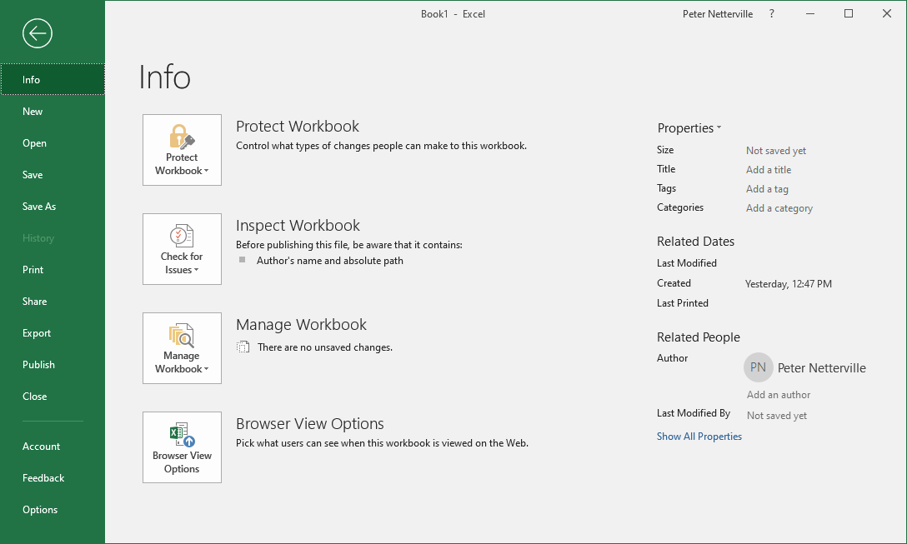
The Backstage: A Quick Overview - Info
Select the Info tab if it is not already there.
… to display the Backstage

Slide 21

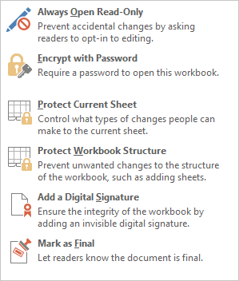
The Backstage: A Quick Overview - Info
Protecting Your Workbook
Always Open as a Read Only document will help to protect it from unwanted changes.
When you Encrypt with a Password others must know the password to make any changes.
You can Protect specific things on the Current Sheet. Also, do this by right-clicking on the sheet tab.
Protect only changes to the Workbook structure such as the number of sheets.
Verify that the workbook is authentic by Adding a Digital Signature.
Mark as Final sets the document status field as Final, makes it read-only, proofing is disabled.

Slide 22

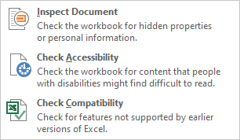
The Backstage: A Quick Overview - Info
Inspecting Your Workbook
Check and update hidden document properties and personal information.
Check your document for accessibility by those people with disabilities.
Check if your workbook is compatible with earlier versions of Excel.

Slide 23


The Backstage: A Quick Overview - Info
Managing Your Workbook
If you have had any program crashes or unexpected shutdowns you may have unsaved documents you wish to recover. This option searches for those files.

Slide 24
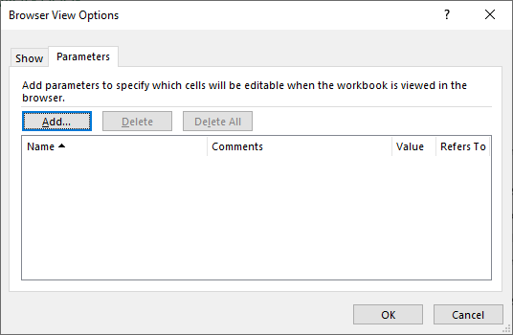
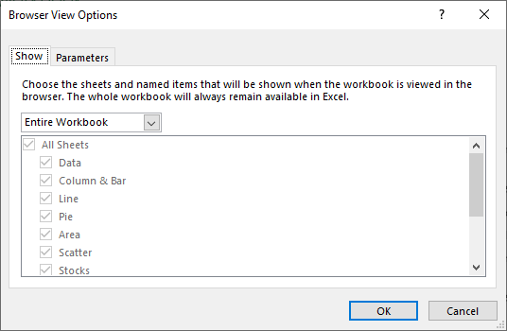

The Backstage: A Quick Overview - Info
Browser Viewing Options
The first panel of this dialog box, Show, is where you choose what is visible on the spreadsheet(s) to the web. You must use a defined name for each individual cell you wish to expose to the web page.
Browser View Options allow you to choose what will be shown on a web page should you decide to post your workbook to a website, or an internal company Intranet website.
This second panel allows you to make specific cells named cells editable.

Slide 25
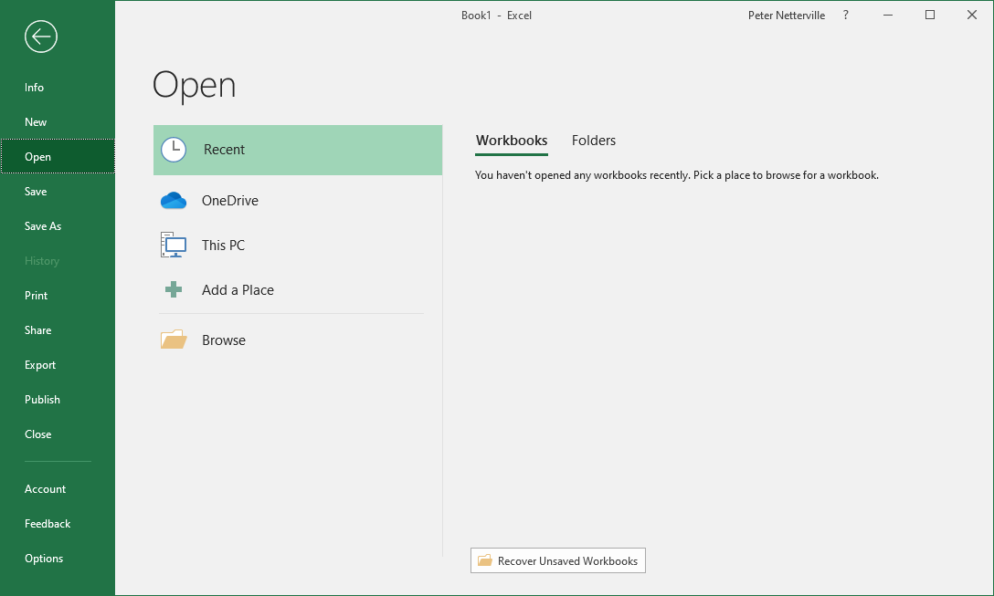
The Backstage: A Quick Overview – Open Recent
Open Workbook
Here you open an existing workbook from a storage …
Open a workbook from one you had opened before from the list that appears below.

Slide 26
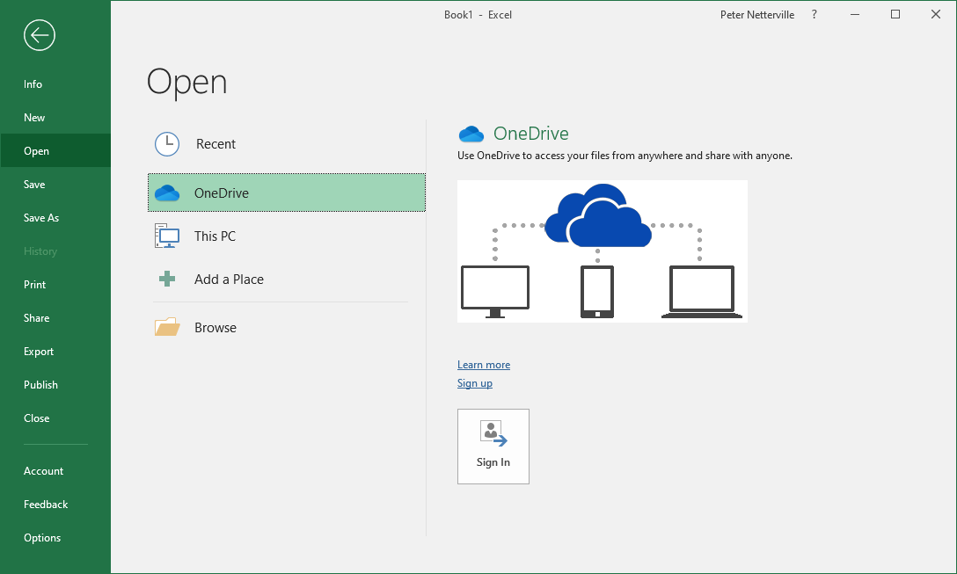
The Backstage: A Quick Overview – Open OneDrive
Open Workbook
Open a workbook from one you had opened before from the OneDrive. OneDrive is similar to Dropbox, but is connected to the Exchange sever making it very flexible and capable.

Slide 27
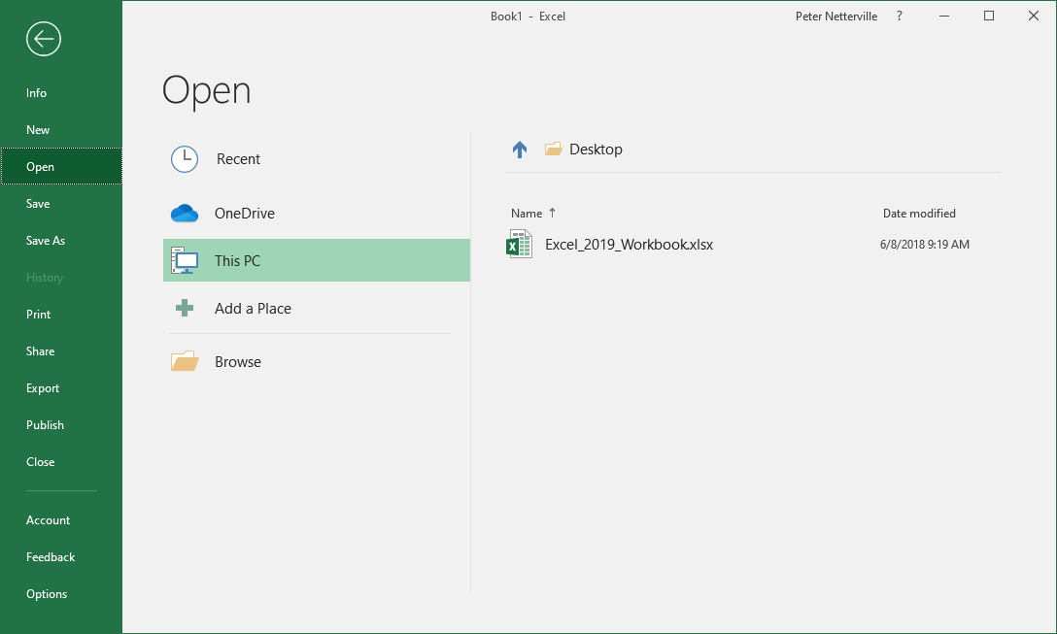
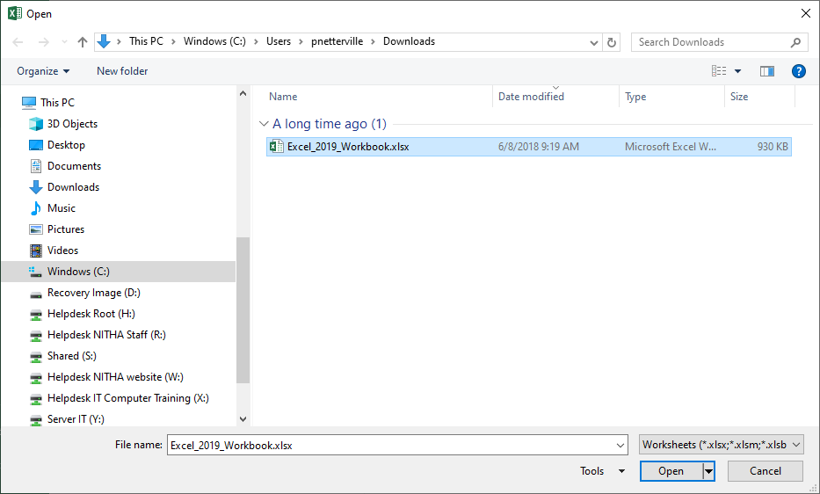
The Backstage: A Quick Overview – Open This PC
Open Workbook
Select This PC if you wish to look for a document on your computer or any network share to which you have access.
OR CLICK
… which launches an Open dialog box.

Slide 28
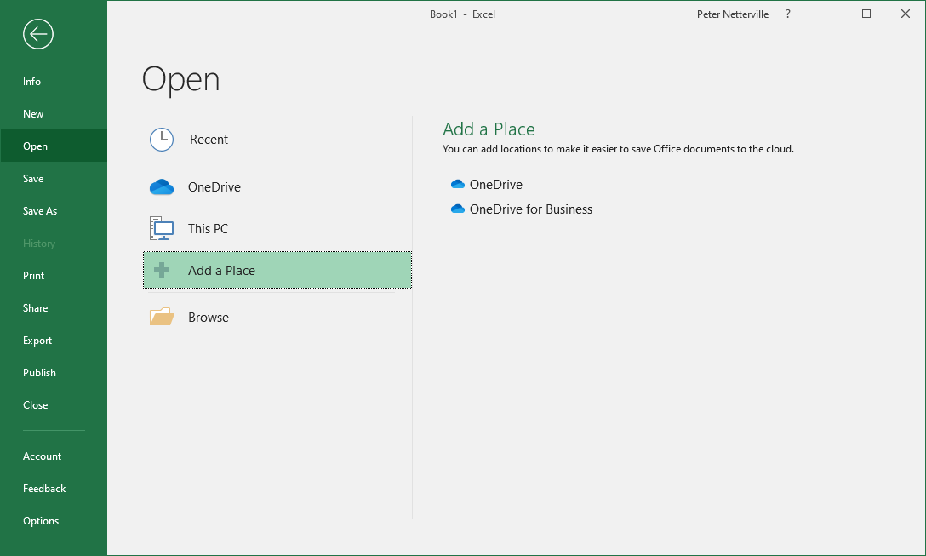
The Backstage: A Quick Overview – Open This PC
Open Workbook
Add a new location on the OneDrive from which you can open documents.
Documents stored on the OneDrive can be shared with those in your organization.

Slide 29
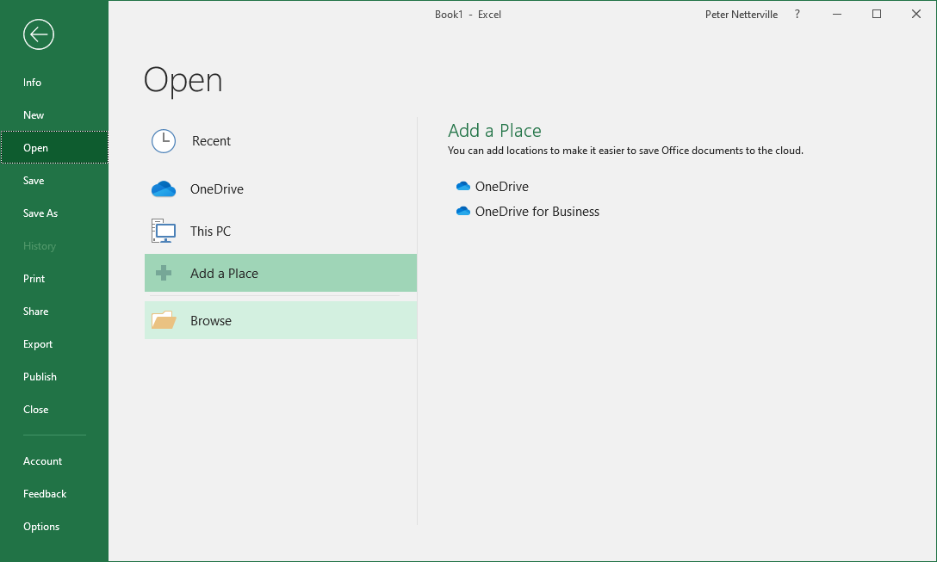
The Backstage: A Quick Overview – Browse to Open
Open Workbook
Click on Browse to launch an Open dialog so you can search for the file you want from your local computer or from any network drive to which you have access.

Slide 30
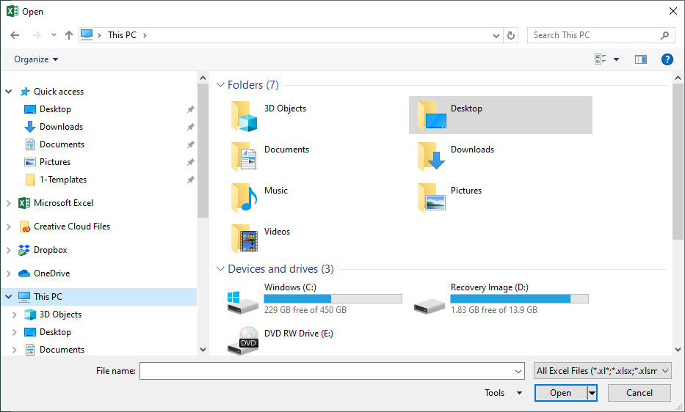
The Backstage: A Quick Overview – Browse to Open
Open Workbook
Select from the Files/Folder List the file for which you are searching.
Browse the Navigation Pane to select the location where the document resides.

Slide 31
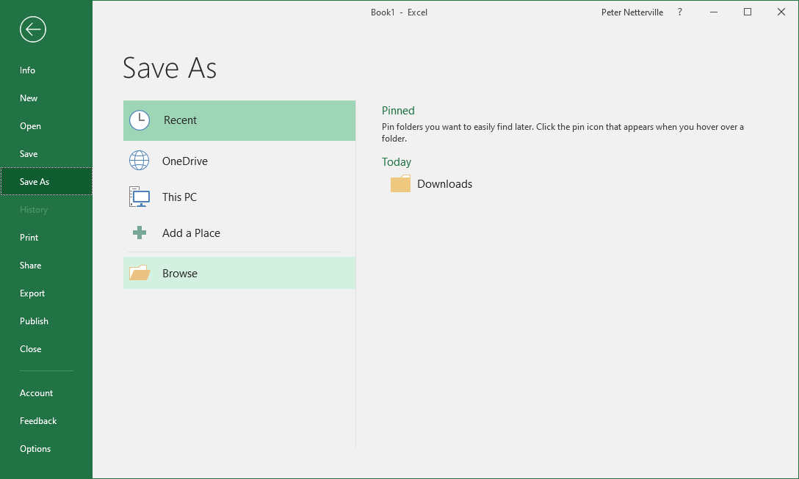
The Backstage: A Quick Overview – Save As - Recent
Save Workbook
Save a workbook to one of your recently accessed folders.

Slide 32
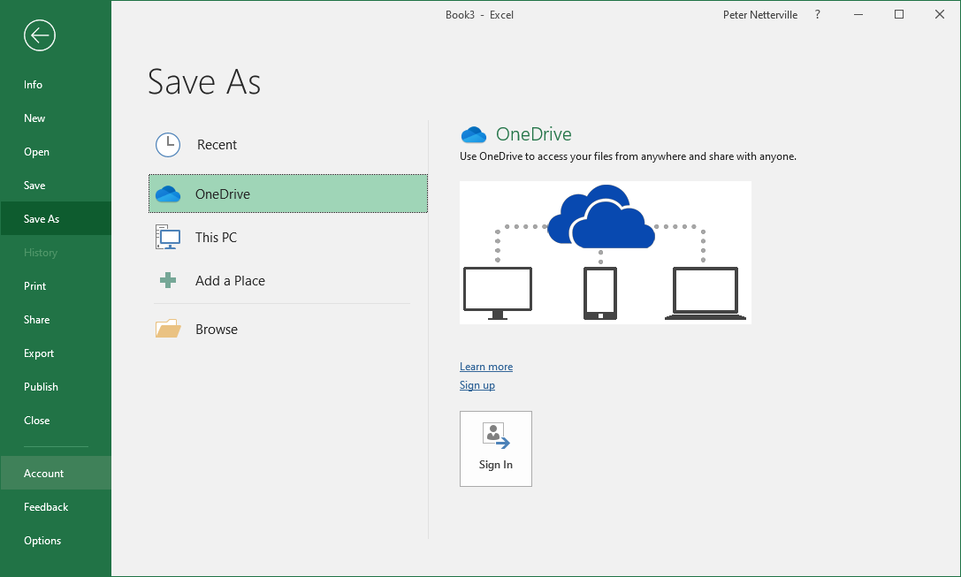
The Backstage: A Quick Overview – Save As - OneDrive
Save Workbook
Save a workbook to OneDrive for others in your organization to access should you choose to assign access to it.

Slide 33
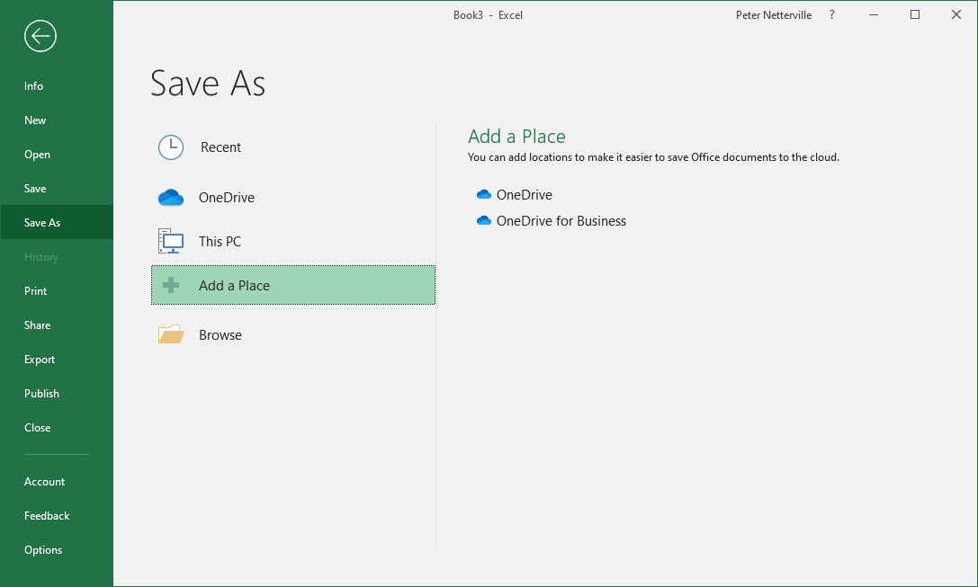
The Backstage: A Quick Overview – Save As – Add a Place
Save Workbook
Add a new Place on OneDrive so you can access it from anywhere you have access to the Internet.
You can also choose to share your workbook with people in your organization.

Slide 34
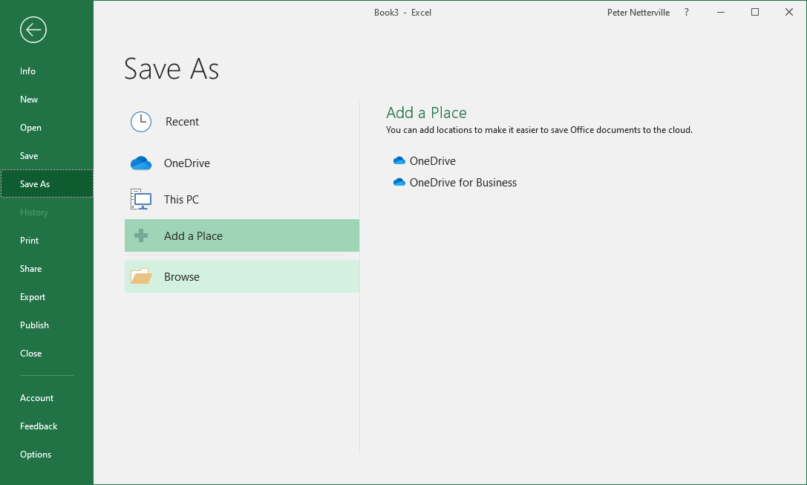
The Backstage: A Quick Overview – Save As - Browse
Save Workbook
Click on the Browse to launch a dialog box.

Slide 35
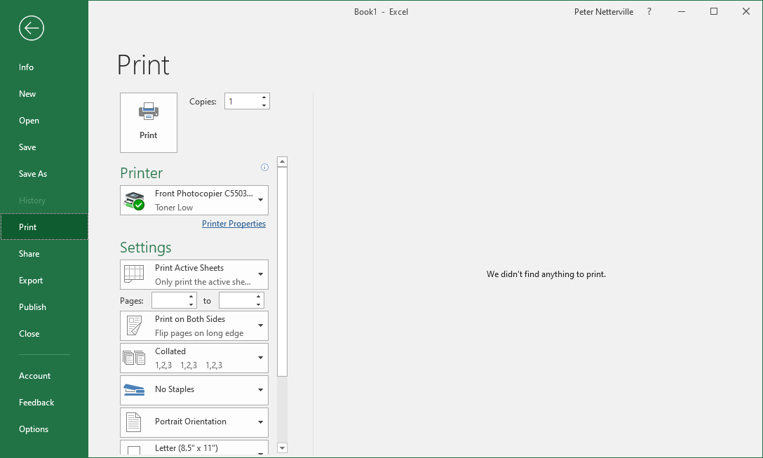
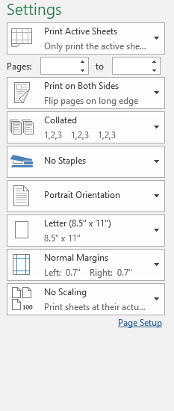
The Backstage: A Quick Overview – Print
Print Workbook
Click on Print from the navigation pane.
When you are ready to print, click here.
… or you can launch the Printer Properties dialog for the printer you have selected.
You can make some of the more common setting changes from the ones shown here …

Slide 36
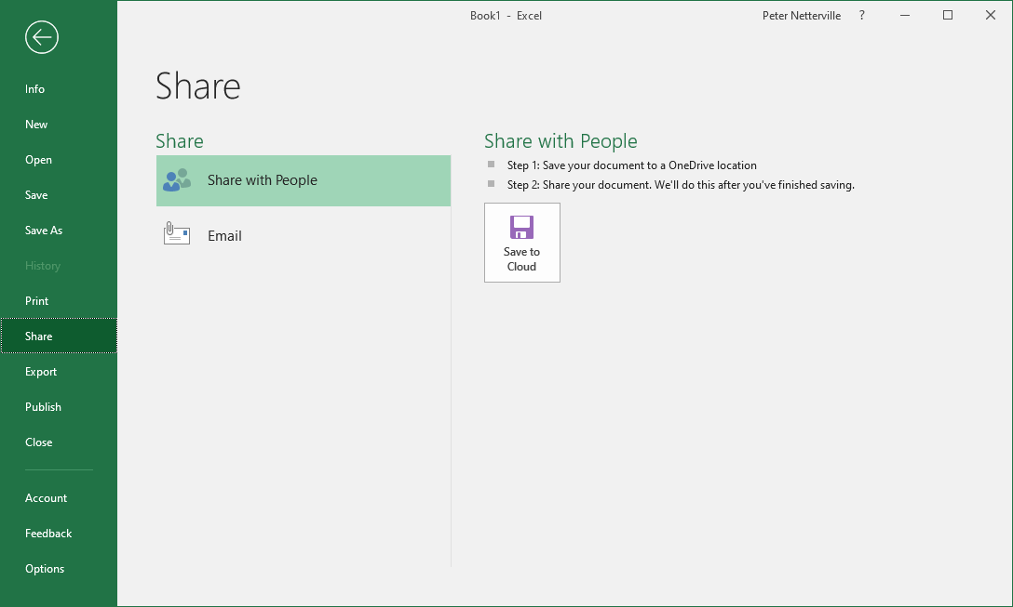
The Backstage: A Quick Overview – Share
Share Workbook
Click on Share from the navigation pane.
Share your workbook on the cloud, the OneDrive.
After saving your workbook to the OneDrive …

Slide 37
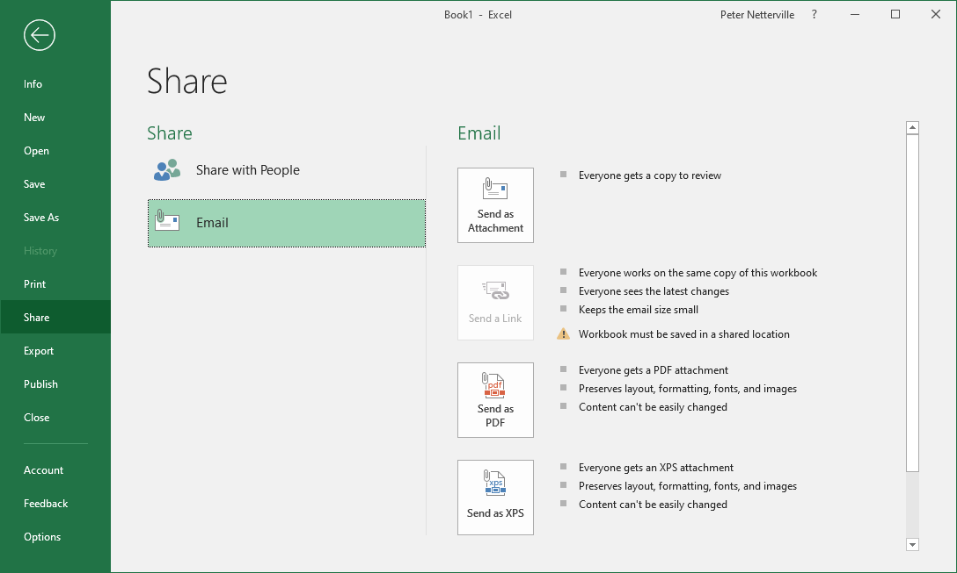
The Backstage: A Quick Overview – Share
Share Workbook
Share your workbook by email.
Send it as an attachment to an email …
Email a link to the workbook if it is shared on OneDrive.
Email a PDF version of your workbook to others.
Email an XPS version of your workbook to others, Microsoft’s version of Adobe’s PDF.

Slide 38
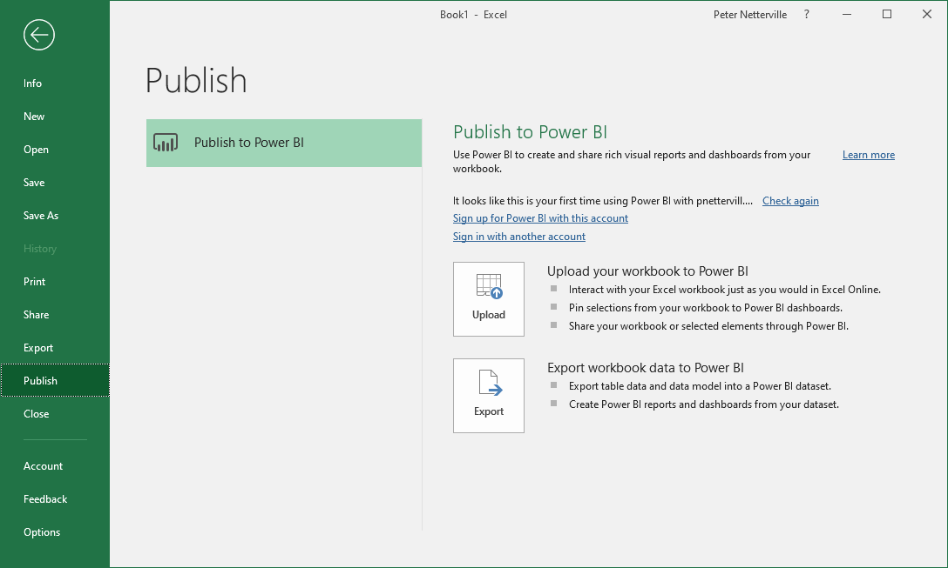
The Backstage: A Quick Overview – Share
Share Workbook
Click on Publish from the navigation pane.
Publish your workbook to Microsoft’s Business Intelligence (BI) service.
Upload your entire workbook to BI.
Export tables and datasets to a Power BI dataset.

Slide 39
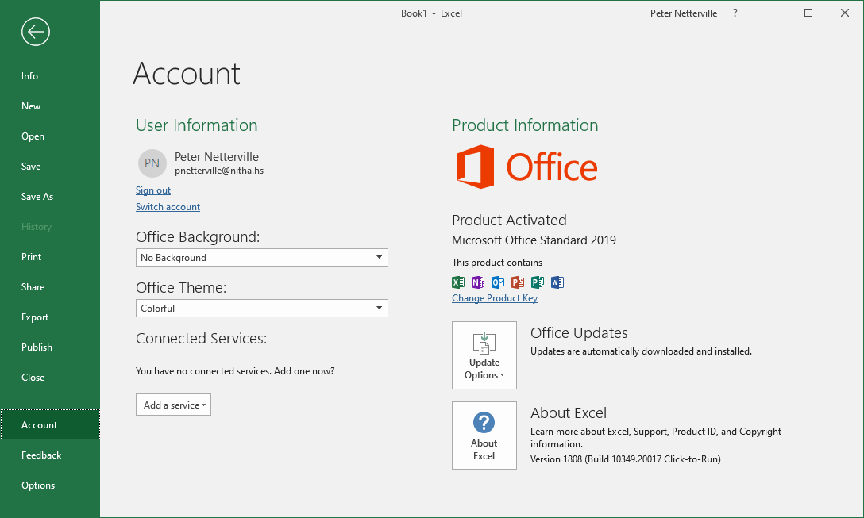
The Backstage: A Quick Overview – Share
Share Workbook
Click on Account from the navigation pane.
This lists:
the user account name
the email attached to the account
a sign out link
a switch account link.
Change the appearance of Excel.
Export tables and datasets to a Power BI dataset.

Slide 40
The Backstage: A Quick Overview – Share
Share Workbook
Update Office from here, but is normally updated automatically.
Information about this version of Excel.

Slide 41
Navigating Using the Keyboard
Below is a list of the most common keyboard navigation keys and key combinations.
| Shift Tab
Moves the cursor left or right
Tab |
Shift Enter
Moves the cursor up or down
Enter
PG Up
Moves the cursor up or down number of visible rows
PG Down
CRTL PG Up
Moves the cursor up to the top or to the bottom
CTRL PG Down
CRTL
Moves the cursor right one word or left one word
CTRL
HOME
Moves the to beginning of the row or to the end.
END

Slide 42
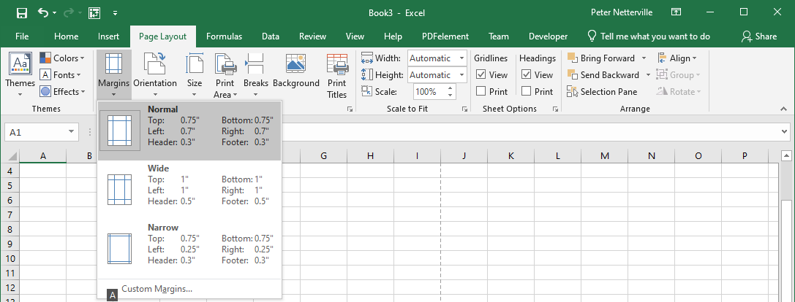
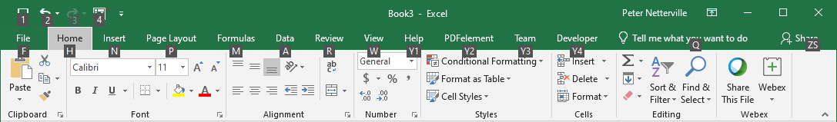
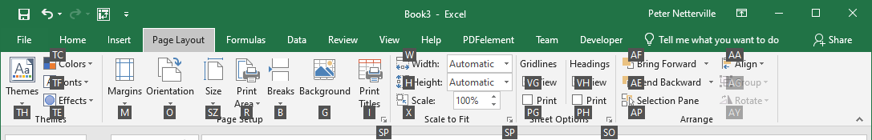
Basic Spreadsheet Functions – Ribbon Access via Keyboard
Navigating Using the Mouse & Keyboard
Alt – Touch the Alt key to gain access to the ribbon via the keyboard.
Notice the white letters in small black boxes.
Now touch the letter of the item you want.
P for the Page Layout ribbon, for example.
Touch Esc on the keyboard to go back one level.
Now touch another letter (or two letters in some cases) to do that command or pull down a menu.
M for the Margins menu, for example.
While in the menu you can use the up/down arrow keys to select a command or
Touch a letter on the menu.

Slide 43
Basic Spreadsheet Functions
Function Categories
The function bar shown below is directly above the column headers.
Name Box
Insert Function box. Click on the icon to open the functions dialog.
Function/Formula bar
Formula Categories
Compatibility – These functions from earlier versions of Excel are provided for compatibility with functions made in old versions of Excel.
Cube - Multidimensional sets of data providing a means to summarize information based on a set of search criteria.
Database – Treating an Excel spreadsheet as a flat database, these functions return a search based on sum, variance, and standard deviation data.
Date & Time – These date and time functions allow you to work with the current time or periods of time in your functions.
Engineering – Engineering calculations: many of which relate to Bessel Functions, Complex Numbers or converting between different bases.
Information – These functions return information about the contents and/or formatting of a cell.
Logical – Flow control, logic and error capture.
Math & Trigonometry – ABS, sine, cosine, logarithmic, Pi, Quotient, etc.
Statistical – Works with data points, deviations, and more.
Text – Use these function to manipulate text.
Web – XML and web services functions.
Notes:
Have them follow along in the functions dialog box if they have a computer in front of them.

Slide 44
Basic Spreadsheet Functions
The Rules
Like everything in life, there are rules to follow.
All formulas begin with an equal sign.
Cells when represented in a function individually or as a block are separated by a comma (union operator). eg. D14, H27, A3, B84
Cells when represented in contiguous block are separated by a colon (cell range operator). eg. D14:D30
Blocks of contiguous cells and/or single cells are separated by a comma. eg. D14:D30, B24, H27:J34, A3:H3, J38, B84:D84
Excel follows the Order of Operations. Remember the PEMDAS (or BEDMAS) you might have learned in school
(Parenthesis, Exponent, Multiplication, Division, Addition, Subtraction) or (Brackets, Exponents, Division, Multiplication, Addition, Subtraction)
Evaluate Parenthesis - From the inner first to the outer last eg. =8.7334*(27.416+(12-7.3)^4)
Evaluate ranges – A range of cells such as D14:D30 (column) or D14:J14 (Row)
Evaluate intersections – Using the space in a formula to separate ranges of cells tell Excel to intersect where the two ranges overlap.
- If one cell is overlapped, the value or calculated value in the overlap cell will be inserted into the formula.
- If more than one cell is overlapped, a #VALUE error will be returned. Why? Because the cell cannot display more that one value. So run a function
on it, such as SUM, MIN, MAX, etc., a function that can deal with multiple cells.
Evaluate unions – The union operator is the comma.
Perform negations
Convert percentage values to decimal.
Perform exponentiation – The up caret, ^, is used in a function to represent an exponent. ex. 4^3 equals 64
In Excel entering an e character between two numbers will with no spaces perform the n * 10^n. ex. 4e3 equals 4000.
Perform multiplication, *, and division, /. These are equal in precedence, so whichever comes first is evaluated first.
Perform addition, +, and subtraction, -. These are equal in precedence, so whichever come first is evaluated first.
Evaluate text operators – In Excel the ampersand, &, concatenates text.
Perform comparisons – The comparison operator are: equals = not equal to <> less than <= greater than >=
Fear not! I have this list created in a PDF document for you to download and view.
ftp://172.27.0.4/CSU/IT_Helpdesk/Computer_Training/Excel_Order_Of_Operations.pdf

Slide 45
Basic Spreadsheet Functions
Common Functions
SUM – Adds all the numeric values of all the selected cells. This is probably the most common function in Excel. eg. =SUM(D2, G6:G8)
HYPERLINK – Insert a web link to a web page or resource (such as a PDF) into a cell. Hyperlinks can also jump to a name link on any spreadsheet to which it has access, even other workbook sheets (i.e. another file).
MIN & MAX – MIN returns the lowest value from the selected cells. MAX returns the highest value from the selected cells. eg. =MIN(D2, G6:G8)
NOW – Returns the current date in the format defined in Windows for a short date, short time
(Win10 – Settings/Time & Language/Date & Time/Formats/Short Date & Short Time) eg. =NOW() Don’t forget those parenthesis!
DAYS – Returns the number of days in a date period. eg. =DAYS("January 12, 2017","February 26, 2017")
COUNT & COUNTA – COUNT returns the number of cells in a selected range that contain number only. eg. =COUNT(D2, G6:G8)
COUNTA returns the number of cells in a selected range that are empty. eg. =COUNTA(D2, G6:G8)
AVERAGE – Returns the arithmetic mean of its’ argument. eg. =AVERAGE(D2, G6:G8)
DSUM – Adds the numbers in the fields of records in the database that match the conditions you specify.
Notes:
( = 18.98 + 114.98 * 4 Answer is B ) ( = 12 + (3.14159 * 325) Answer is A ) ( = 187.4 * (18 + 5^3) Answer is C )

Slide 46
Exercise Two
On the “Excel_2016_Sample_Workbook.xlsx” click on the OOP sheet tab.
Note: You may have to scroll right using the spreadsheet navigation arrows. (bottom left)
1. Enter into cell B5 the following formula:
18.98 + 114.98 * 4
Answer:
535.84
This is a basic formula you would see in commerce.
478.90
2. Enter into cell B8 the following formula:
12 + (3.14159 * 325)
Answer:
1033.01675
47.5686677281
Though syntactically not incorrect, can anyone notice anything that is unnecessary in this formula?
3. Enter into cell B11 the following formula:
187.4 * (18 + 5^3)
Answer:
3378200
8373.2
26798.2
Which is done first, the exponent or what is in parenthesis? (Hint: trick question)

Slide 47

NITHA IT HelpDesk helpdesk@nitha.com
1(844)486-4842
Notes:
Please do not hesitate to ask any question regarding this session, and I will make sure to answer your question as soon as possible.

Slide 48


