Slide 1


Excel 2013 Pivot Tables & Charts
Intermediate Level

Slide 2



NITHA IT Helpdesk
helpdesk@nitha.com
1(844)486-4842

Slide 3

NITHA - IT Helpdesk Courses Registration Website
How do I get to the Courses Registration Website?
First, open up your favorite web browser.
Finally, press ENTER on our keyboard
Second, type in the address bar the URL, nitha.com/courses

Slide 4

NITHA - IT Helpdesk Courses Registration Website
The NITHA Computer Training Courses Calendar
There are four sections to the
IT Helpdesk Courses Registration Website
The calendar – As seen on the right,
the calendar displays the selected month and all the course links on the appropriate days.
Morning courses 9:30 AM to 11:30 AM
Afternoon courses 2:00 PM to 4:00 PM

Slide 5
NITHA - IT Helpdesk Courses Registration Website
Cycle forward through the months by clicking on the next month
The NITHA Computer Training Courses Calendar
Cycle backward through the months by clicking on the previous month
And of course, the month in the middle is the currently displayed month.

Slide 6
NITHA - IT Helpdesk Courses Registration Website
or the next year
The NITHA Computer Training Courses Calendar
You can even click on the previous year

Slide 7
NITHA - IT Helpdesk Courses Registration Website
The NITHA Computer Training Courses Calendar
Click on the course link of your choice and you will be taken to a registration page.

Slide 8

NITHA - IT Helpdesk Courses Registration Website
The NITHA Computer Training Course Registration page
Enter your information
Select how you are going to attend the course
by WebEx
by Telehealth
Select how you want your Certificate of Completion delivered.
by Email as a PDF
by Canada Post

Slide 9
NITHA - IT Helpdesk Courses Registration Website
The NITHA Computer Training Courses WebEx Info
WebEx Information – For the WebEx connection information on how to attend the courses in the current week, click on the WebEx link.

Slide 10

NITHA - IT Helpdesk Courses Registration Website
The NITHA Computer Training Courses Calendar
These links display the WebEx information for that course
These links download the ICS file for that course so that you can add it to your Outlook calendar as an event.

Slide 11
NITHA - IT Helpdesk Courses Registration Website
The NITHA Computer Training Courses Download
Course Files Download – The courseware and the data files which are used in the courses are all available for download any time whether or not you are taking the course.
click on the Course Files Downloads link
To download the
Courseware file (A PowerPoint file)
and/or
Sample data files used in the course

Slide 12

NITHA - IT Helpdesk Courses Registration Website
The NITHA Computer Training Courses Calendar
The Course Sample File is the data file used in the course.
The PowerPoint Courseware File is the course itself.

Slide 13
NITHA - IT Helpdesk Courses Registration Website
The NITHA Computer Training Courses Calendar
Tech Videos are the fourth section of the website. As they are created, they will be placed here.
Tech Videos are short 3 to 15 minute videos featuring solutions to various tech issues.

Slide 14

What will we be covering in this course?
Preamble and Definitions
Working with the Pivot Table – Bar Chart
Downloading and Opening the Exercise File
Working with the Pivot Tables
Placing Data Fields and Filtering
Creating a Pivot Table
Working with the Pivot Tables
The Bar Chart
Pivot Chart Anatomy
Working with the Pivot Tables
The Doughnut Chart

Slide 15
What are pivot tables and how do they benefit me with my projects?
Normally when you make a chart, you massage the data using the commands such as Sort, Filter, Group & SubTotal.
Then you choose the chart that best represents your data and the point you are trying to make …
… however …
Pivot tables allow you to move your data around from Column header to Row header to Filters to Values in an easy drag & drop fashion “on the fly”.
This flexibility make it easier for you to view your data in different graph structures.
Using the traditional way of selecting your data, filtering it and then choosing a chart can be awkward and clumsy if you do not know exactly what data you need. Pivot tables give you the flexibility to work with your data in real time.
A pivot chart is a visual companion to your pivot table.
When you sort, filter or group your data the changes are reflected in your chart instantly.
Our Ultimate Goal
Our goal is to display the smoking statistics comparison between males and females for Saskatchewan First Nations for all ages from 15 year and up.

Slide 16
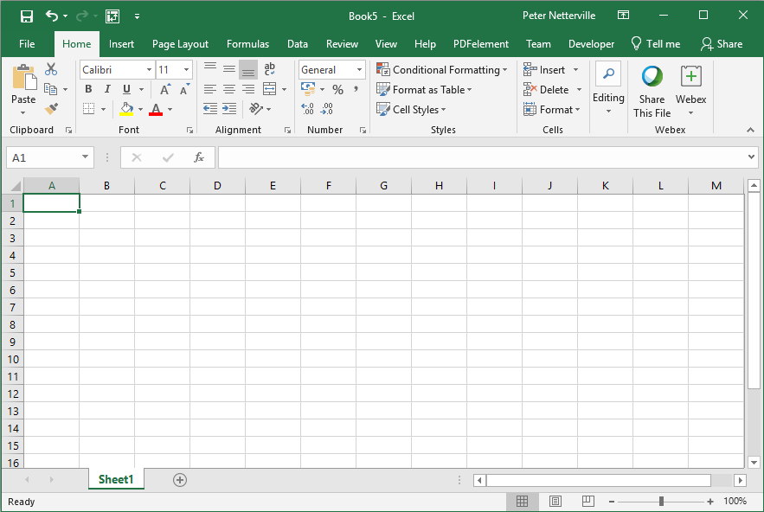
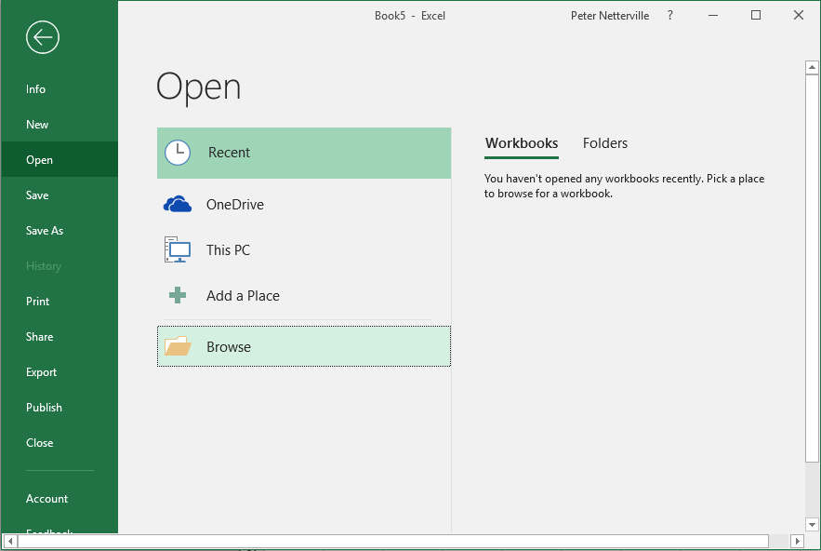
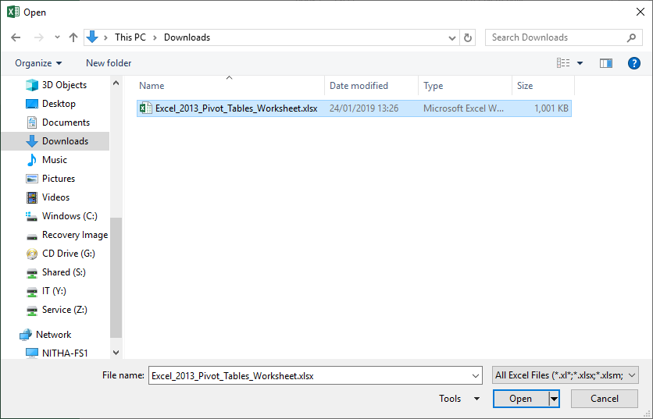
Open the Excel_2013_Pivot_Tables_Worksheet.xlsx file you just downloaded.
It is most likely in your Downloads folder.
Click on the Backstage, the File tab.
Click on the Open button which displays the Open screen.
Click on
Click on the Browse button.
Navigate to where the course file is located on your computer, probably the Downloads folder.
Then click on the Open button.

Slide 17
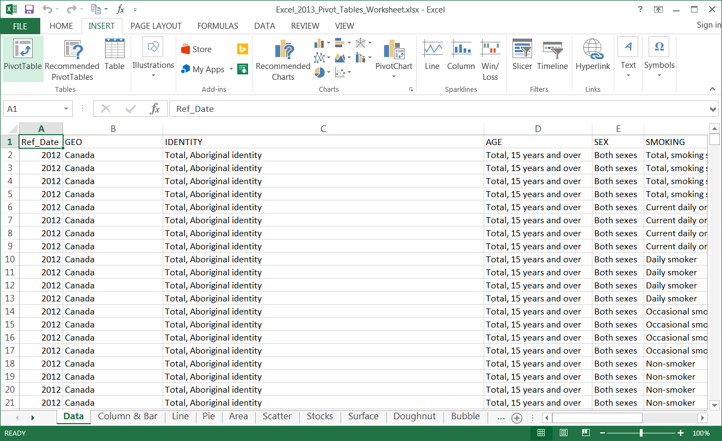
You should now have a screen that look similar to …

Slide 18
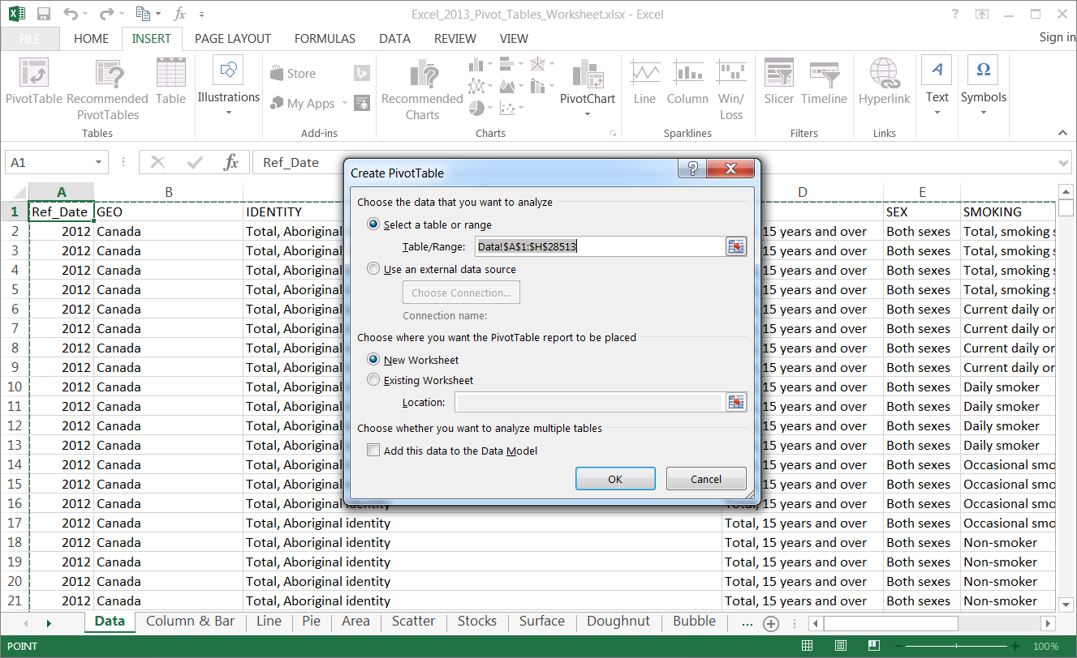

Creating a Pivot Table
Click on any cell in the table
Click on the Insert ribbon tab
In the Tables group click on …
  PivotTable button
The Choose the data that you want to analyze option already has the entire table selected, but you can change that here.
You can also pull the data from an external data source.

Slide 19
Creating a Pivot Table
On the Choose where you want the PivotTable report to be placed option you can choose
  New Worksheet
  Existing Worksheet
If you choose Existing Worksheet you will need to select a cell where the report will be placed.
Click on the OK button.

Slide 20
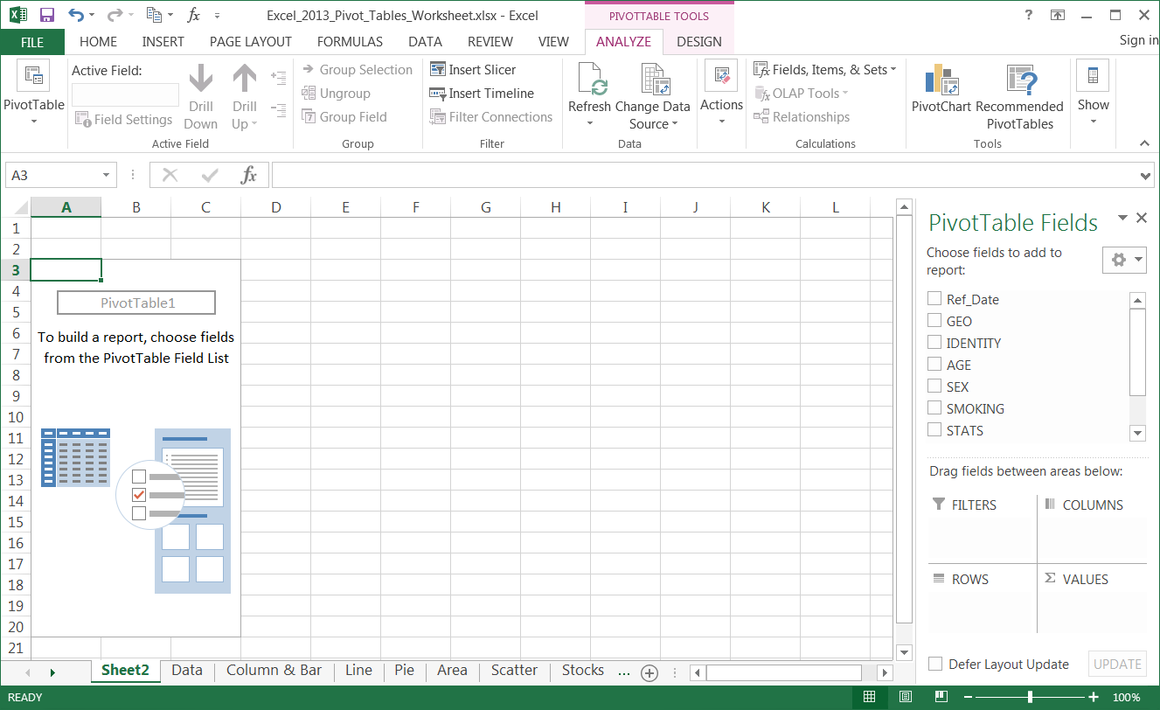
Below is what you should have on your computer
  The PivotTable box on the left
  The PivotTable Field list on the right
Pivot Chart Anatomy
When choosing what data fields to select keep in mind what aspect of the data are you trying to emphasize.
To build a table select the fields you want to include by dragging the field down into one of the four areas below

Slide 21
Pivot Chart Anatomy
The data in the table is represented by the PivotTable1 box on the left. Make sure to keep it selected while working on your pivot table and chart.

Slide 22
The Pivot Table Field List contains five panels:
Pivot Chart Anatomy
  Field selection
  Columns
  Values
Field Selection
Allows you to choose what data to include in the table, which will be represented in the chart in which you have chosen to represent that data.
  Filters
  Rows
Filters
Allows you to focus on specific parts of the data by displaying only the data you want.
Columns
The Column label is the X axis data.
Rows
The Row Label is the Y axis data.
Values
The Values is the column in the table that provides context to the data record and can be represented as Sum, Count, Average, Max, Min, and more.

Slide 23
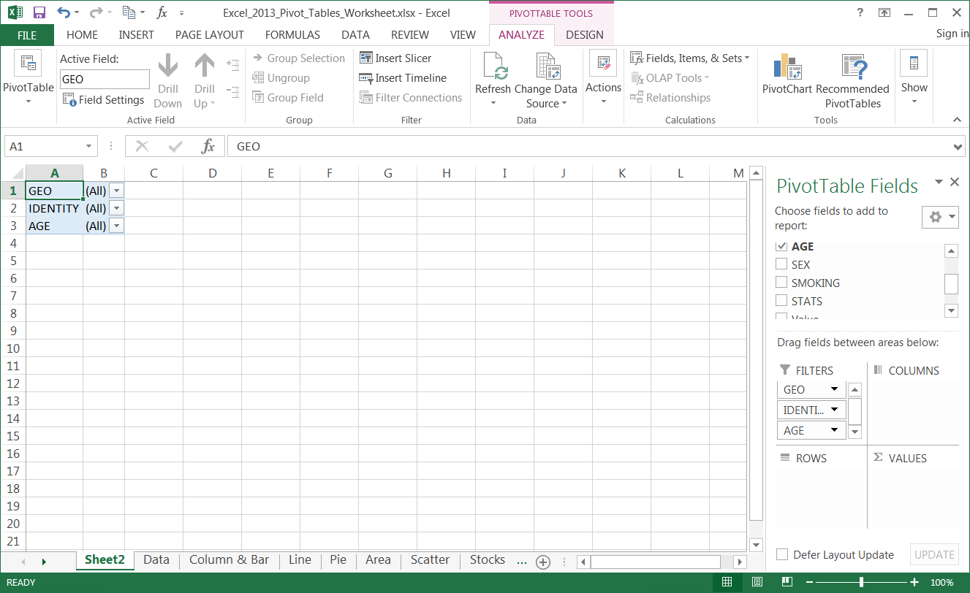
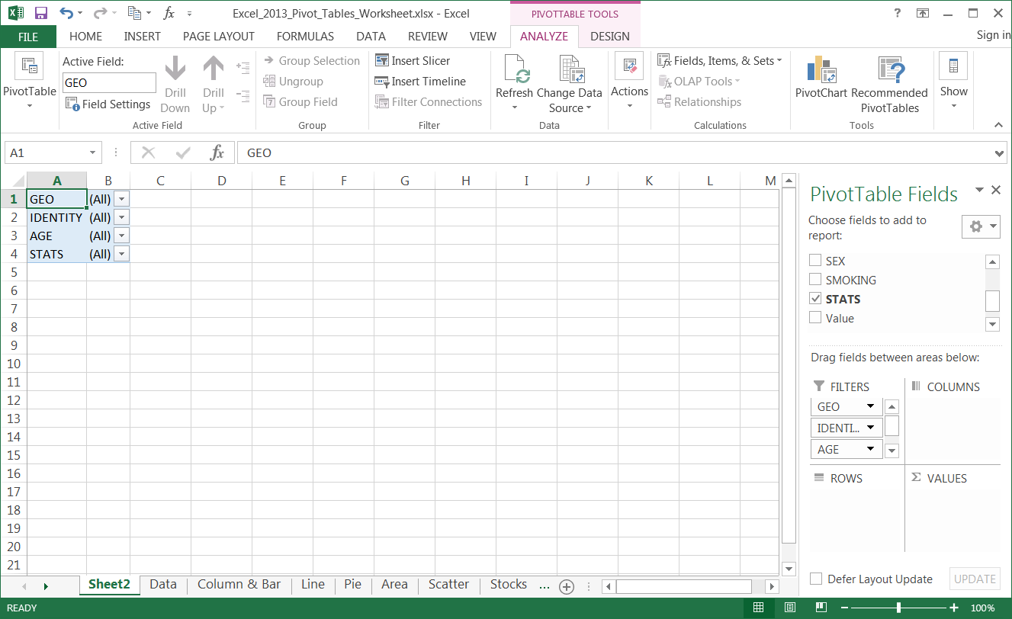
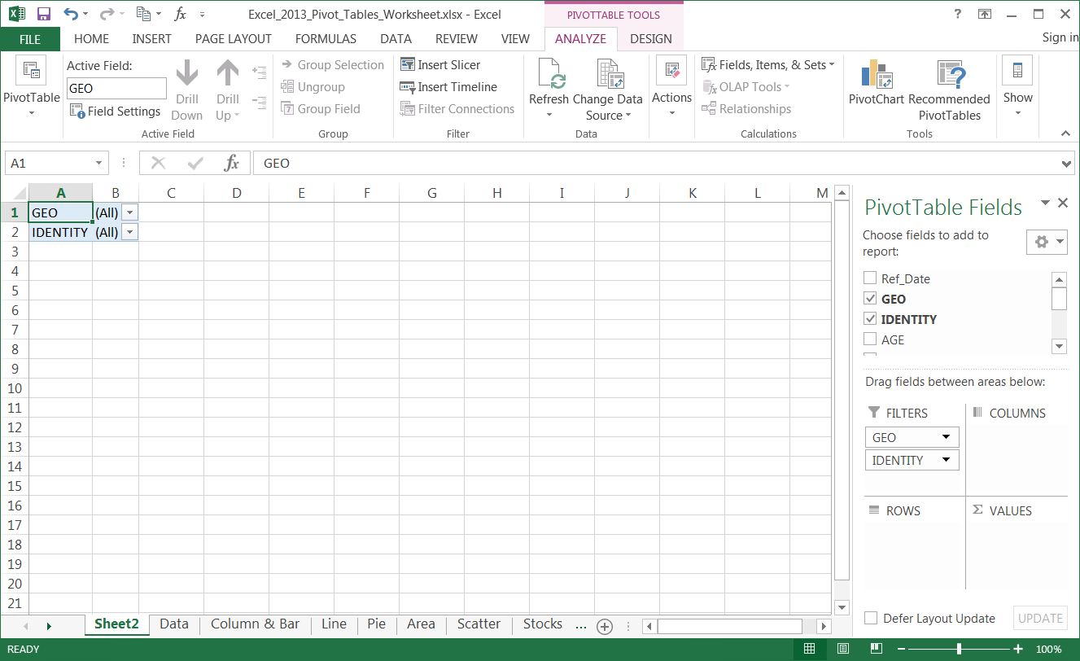
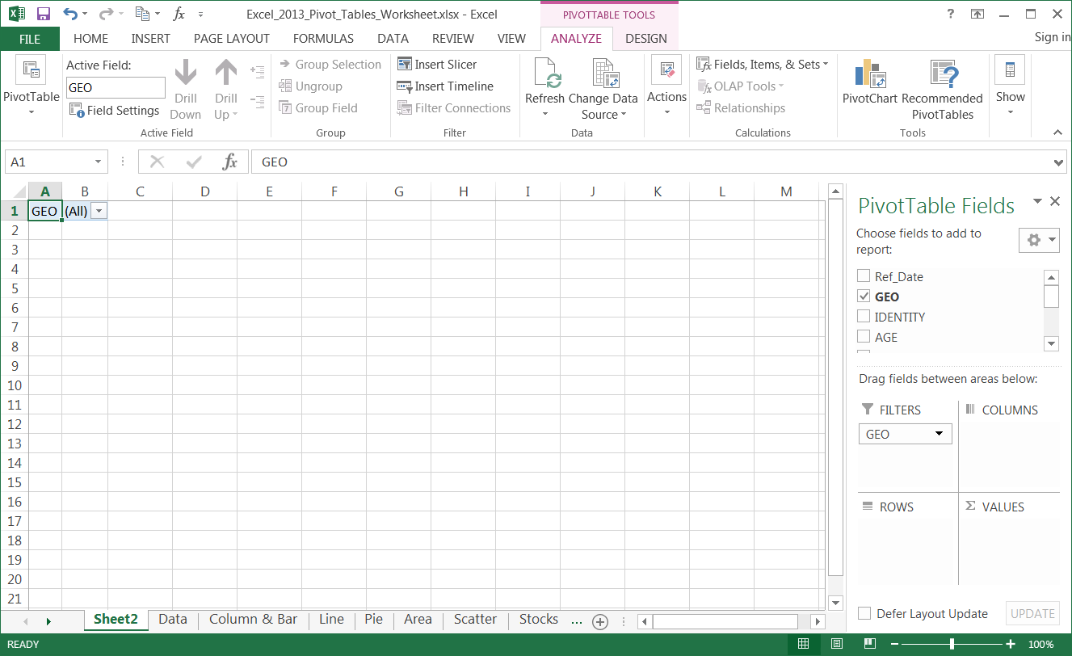
Working with the Pivot Tables
Placing Data Fields, Filtering
Now that we know the areas of the Pivot Table Field List, we need to arrange the data into the proper areas; Filters.
Sort the data fields into the following areas by dragging and dropping it.
Drag to Filters
GEO
IDENTITY
AGE
STATS

Slide 24
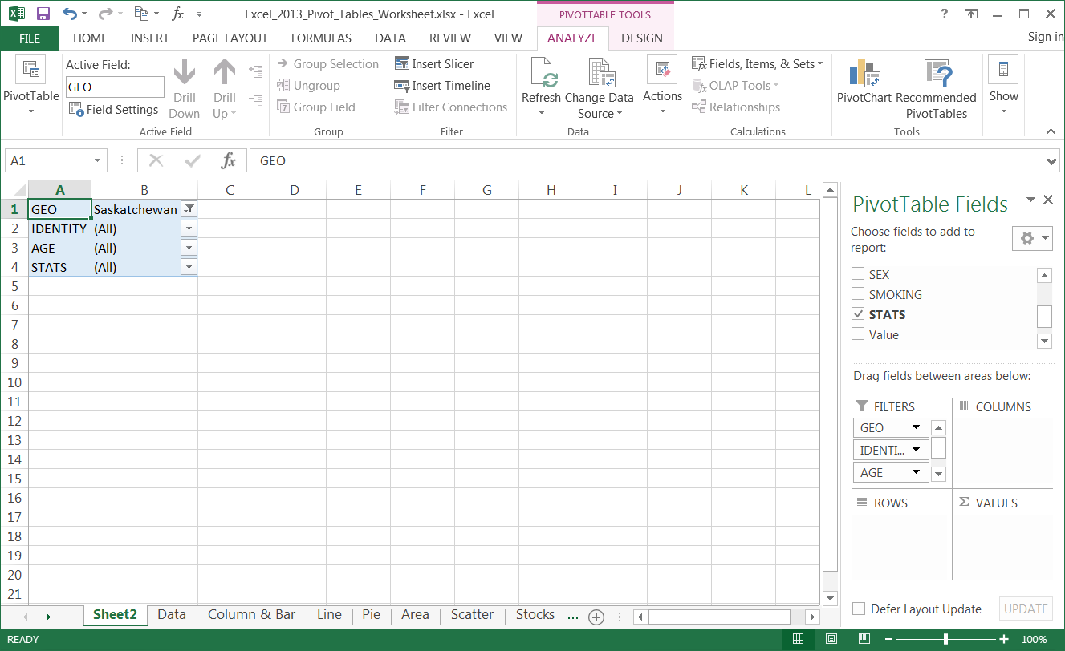
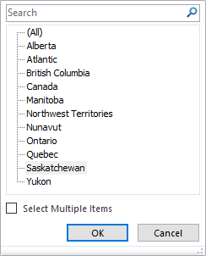
Working with the Pivot Tables
Placing Data Fields, Filtering
Now that we know the areas of the Pivot Table Field List, we need to arrange the data into the proper areas; Filters.
Now restrict the data by filtering it.
Click on the down arrow beside GEO
and select
Saskatchewan

Slide 25
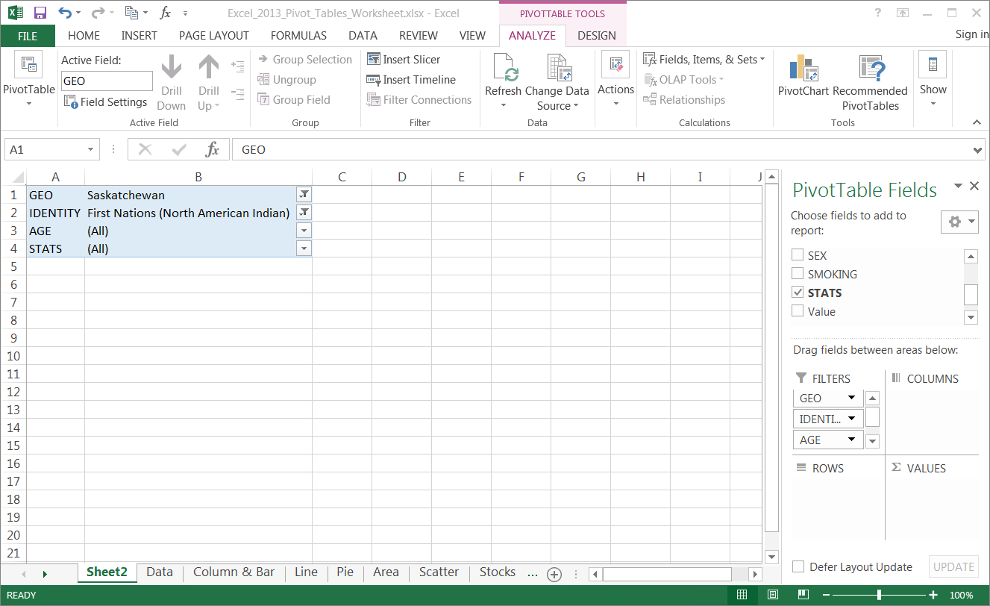
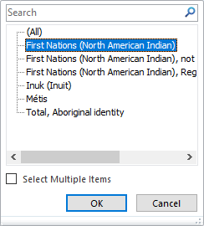
Working with the Pivot Tables
Placing Data Fields, Filtering
Now that we know the areas of the Pivot Table Field List, we need to arrange the data into the proper areas; Filters.
Now restrict the data by filtering it.
Click on the down arrow beside IDENTITY
and select
First Nations (North American Indian)

Slide 26
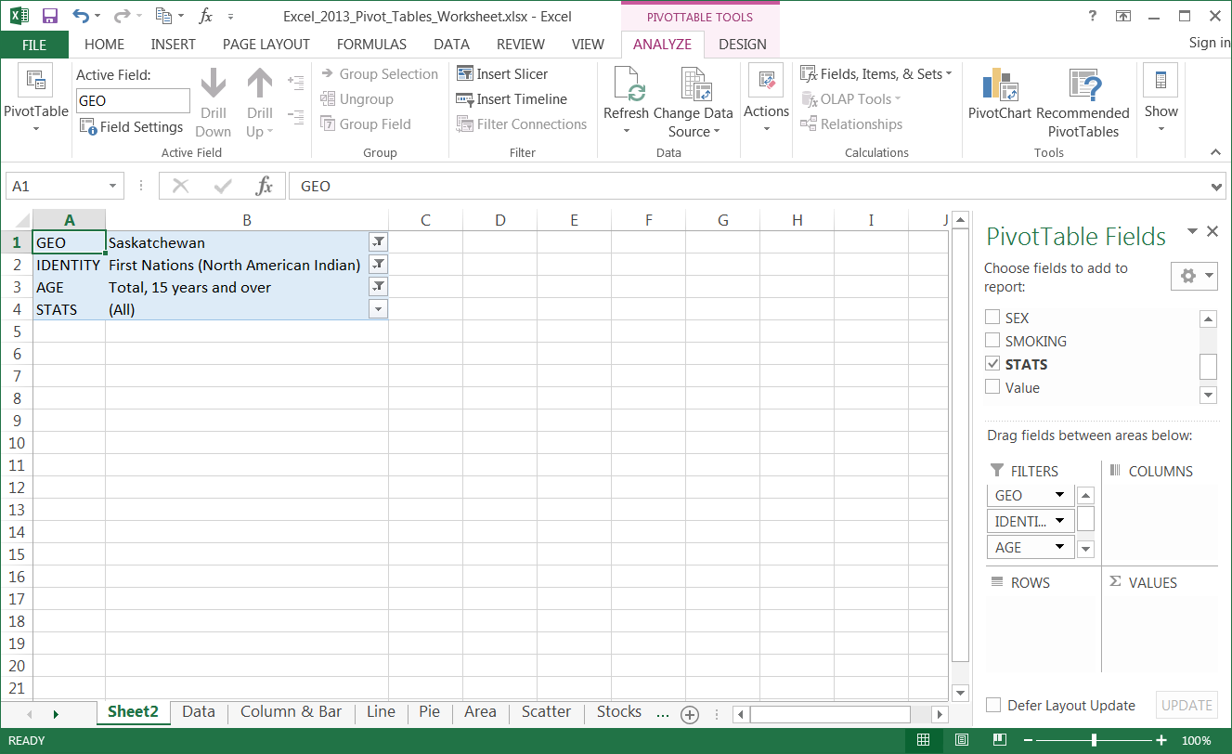
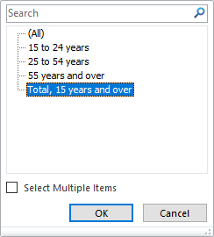
Working with the Pivot Tables
Placing Data Fields, Filtering
Now that we know the areas of the Pivot Table Field List, we need to arrange the data into the proper areas; Filters.
Now restrict the data by filtering it.
Click on the down arrow beside AGE
and select Total, 15 years and over

Slide 27
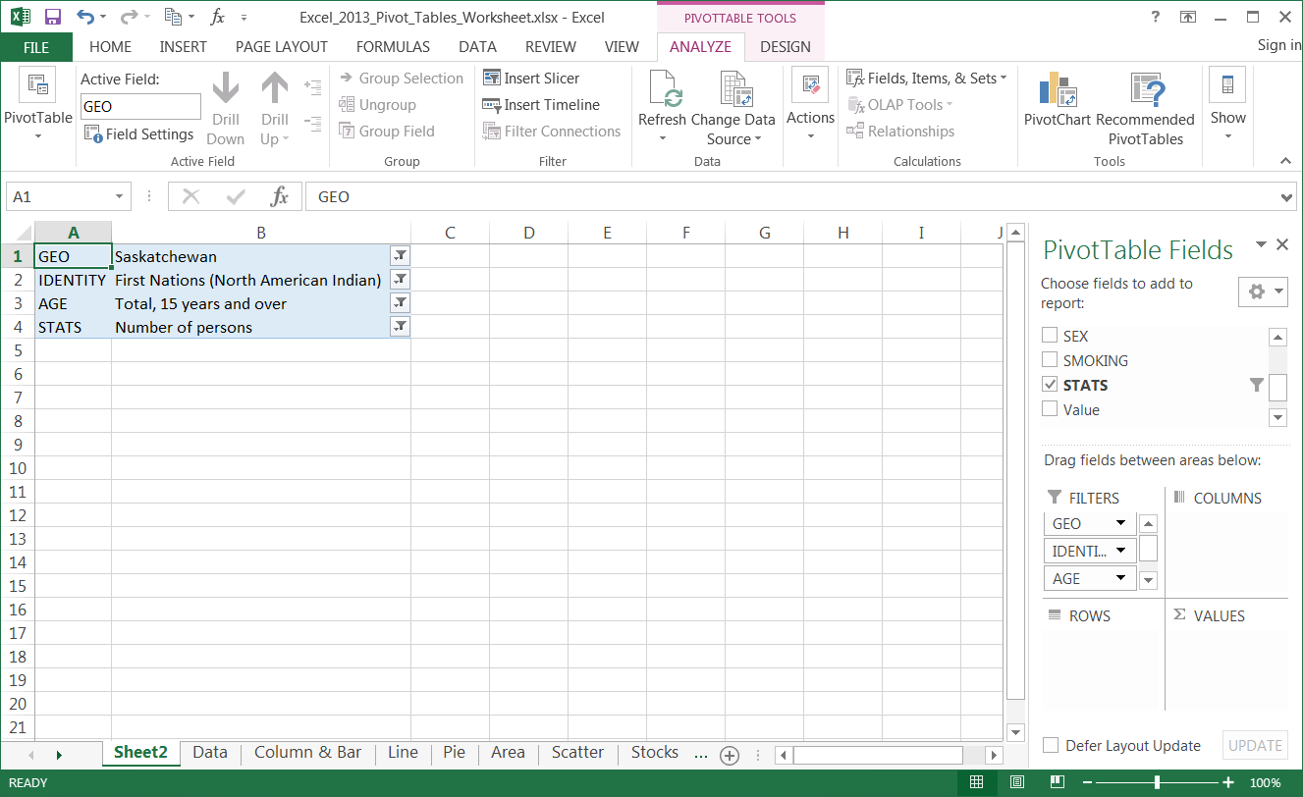
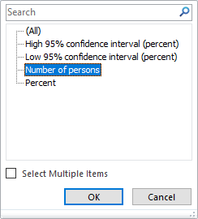
Working with the Pivot Tables
Placing Data Fields, Filtering
Now that we know the areas of the Pivot Table Field List, we need to arrange the data into the proper areas; Filters.
Now restrict the data by filtering it.
Click on the down arrow beside STATS
and select Number of Persons.

Slide 28
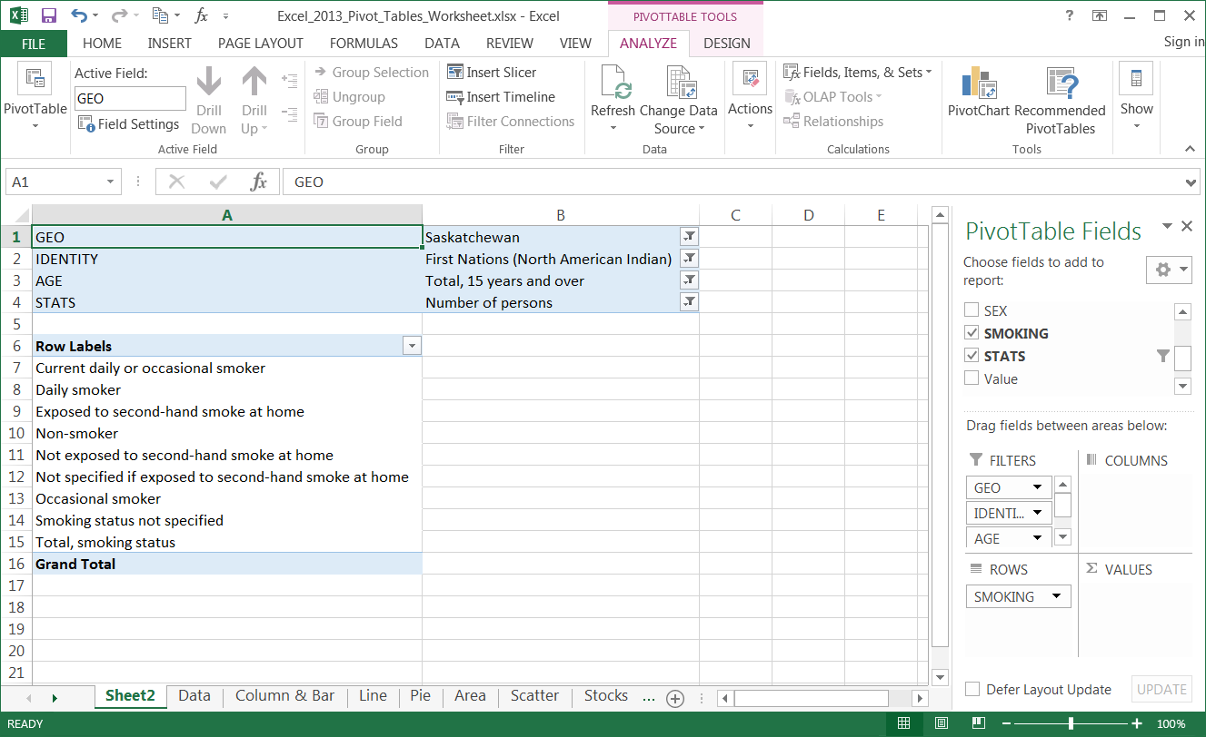
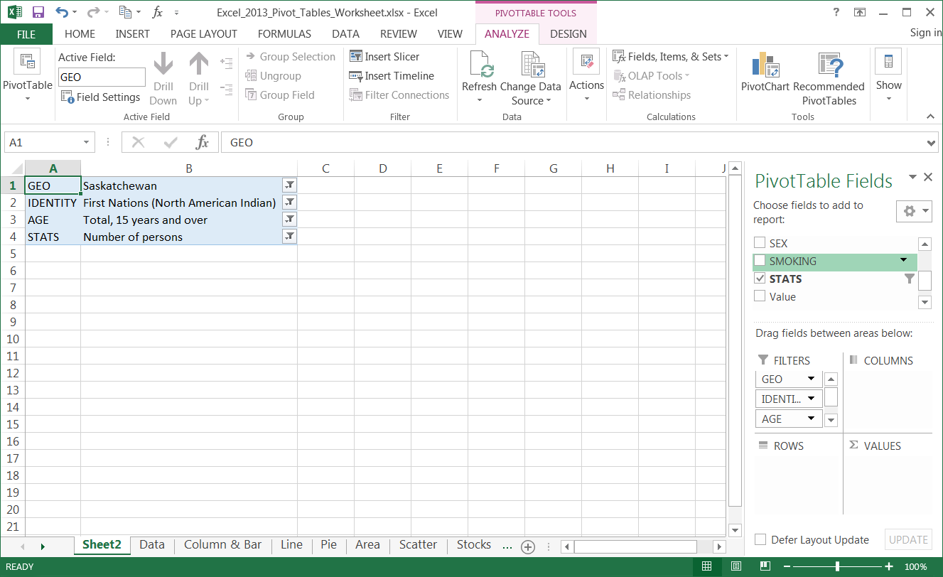
Working with the Pivot Tables
Placing Data Fields, Filtering
Now that we know the areas of the Pivot Table Field List, we need to arrange the data into the proper areas; Rows.
Now restrict the data by filtering it.
Row Labels
SMOKING

Slide 29
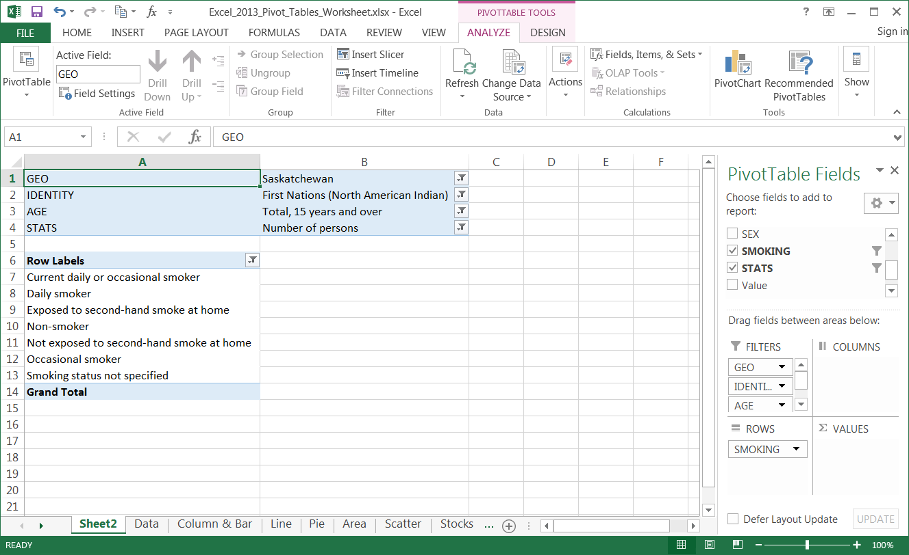
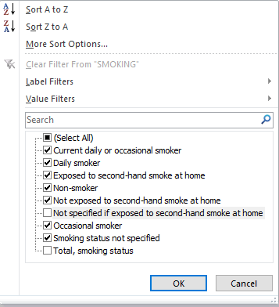
Working with the Pivot Tables
Placing Data Fields, Filtering
Now that we know the areas of the Pivot Table Field List, we need to arrange the data into the proper areas; Rows.
Now restrict the data by filtering it.
Restrict that to seven items.
Let’s also filter the Row Labels. We have nine items at the moment.

Slide 30
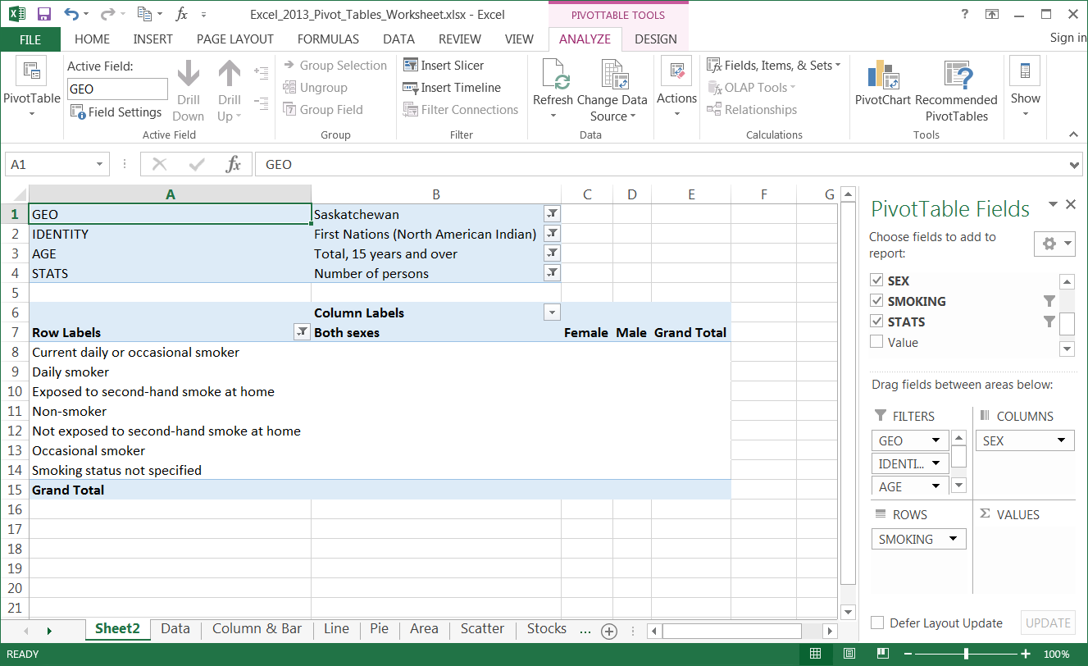
Working with the Pivot Tables
Placing Data Fields, Filtering
Now that we know the areas of the Pivot Table Field List, we need to arrange the data into the proper areas; Columns.
Now restrict the data by filtering it.
Column Labels
SEX
Notice the three columns that appeared;
Both sexes
Female
Male

Slide 31
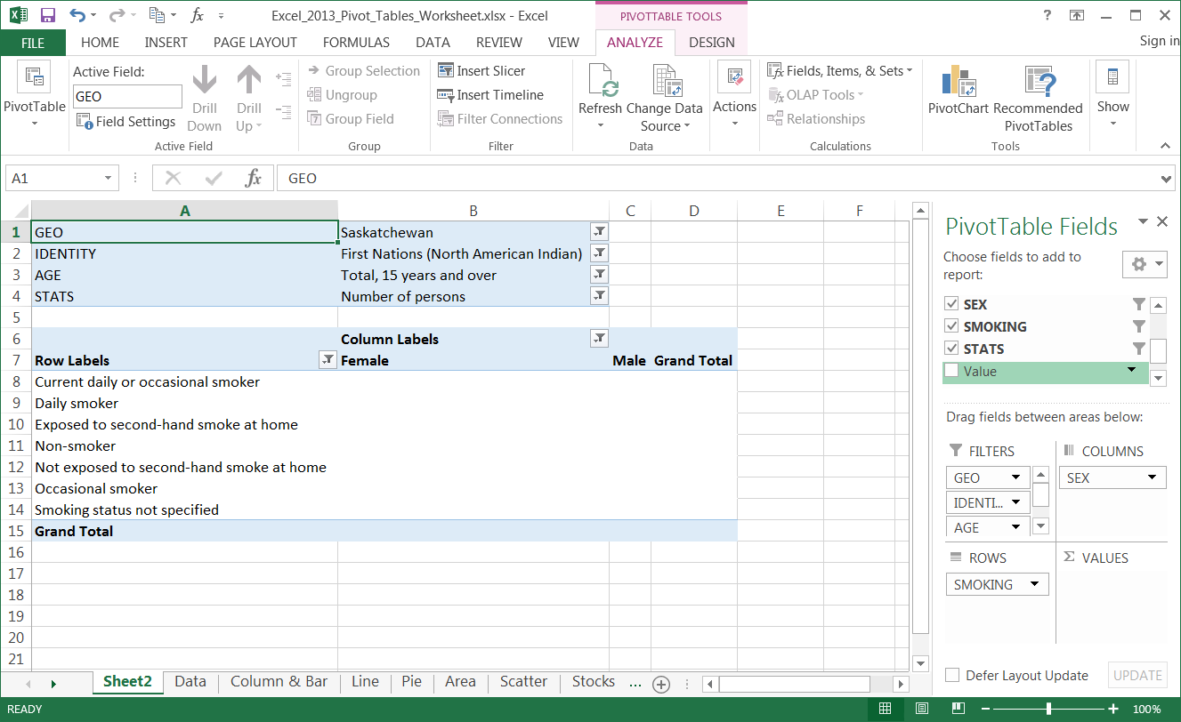
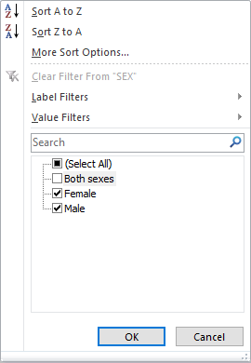
Working with the Pivot Tables
Placing Data Fields, Filtering
Now that we know the areas of the Pivot Table Field List, we need to arrange the data into the proper areas; Columns.
Now restrict the data by filtering it.
Now to filter the Sex field.
Deselect Both sexes.

Slide 32
Working with the Pivot Tables
Placing Data Fields, Filtering
Now that we know the areas of the Pivot Table Field List, we need to arrange the data into the proper areas; Columns.
Now restrict the data by filtering it.
Now that we have the Sex field filtered there are two columns, just Male and Female because we are going to compare the smoking stats one against the other.

Slide 33
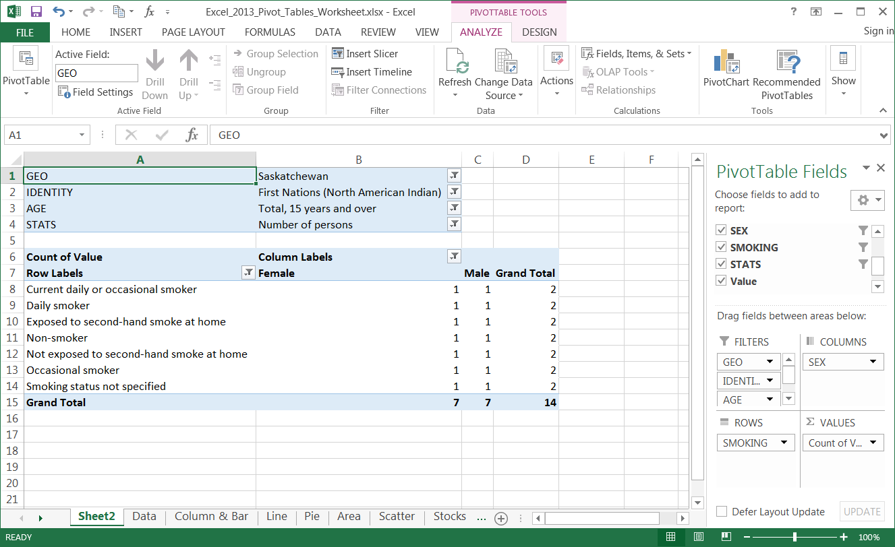
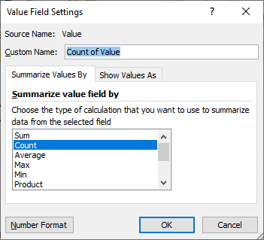
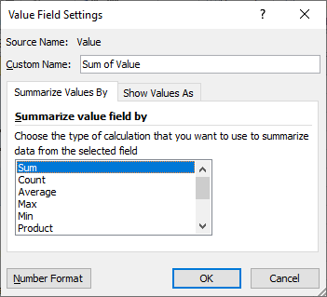
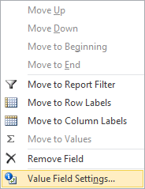
Working with the Pivot Tables
Placing Data Fields, Filtering
Now that we know the areas of the Pivot Table Field List, we need to arrange the data into the proper areas; Values.
Now restrict the data by filtering it.
Select the Sum option from the list.
The Values field is placed, oddly enough, in the Values area.
Now we need to change what function is performed on the Value field by clicking on the drop arrow.
On the menu that appears select the Value Field Settings… option.

Slide 34
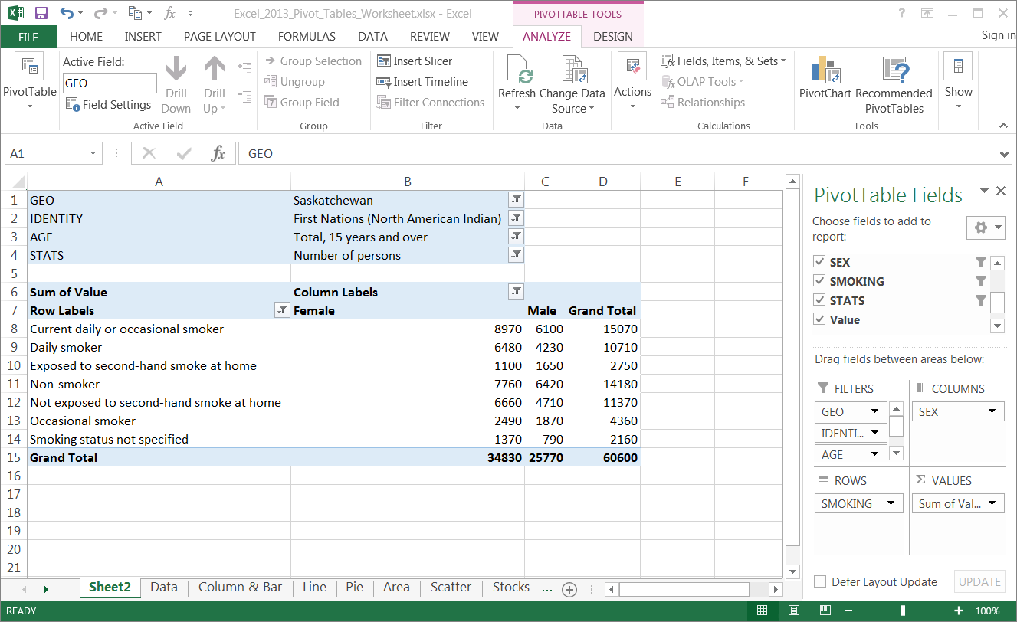
Now that we know the areas of the Pivot Table Field List, we need to arrange the data into the proper areas; Values.

Slide 35
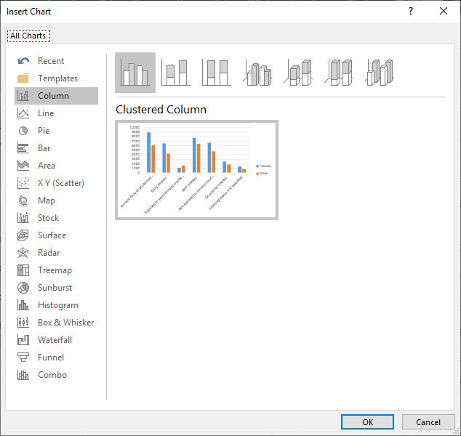
Working with the Pivot Tables
The Bar Chart
After moving the fields into their appropriate areas, applying filters, and selecting the function to apply to the values field, we are finally ready to add a Pivot Chart to display graphically what we see in the table.
Select the PivotChart command located in the Tools group on the Analyze ribbon.
Select the Column.
Click on the Clustered Column

Slide 36
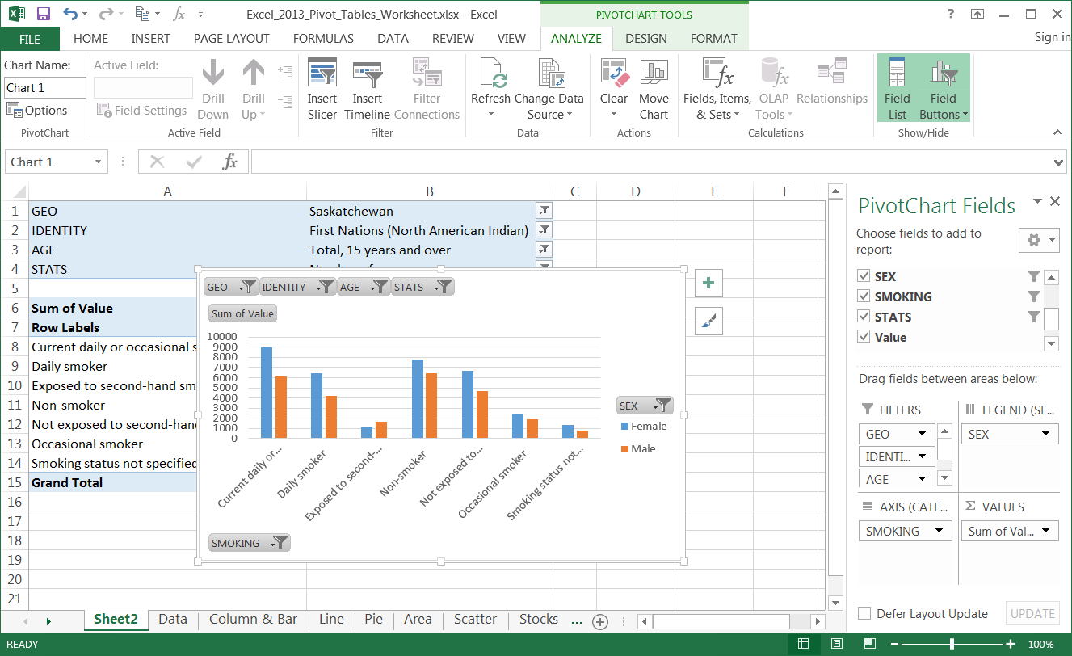
There are three PivotChart Tools contextual ribbons that will help us adjust the chart so that it presents the data more clearly.
The PivotChart Tools Ribbon - Analyze
Design ribbon deals with …
Name the chart in this field and change options.
Select the active field and move it up or down.
Insert a slicer, a timeline or filter.
Connect to a data source and refresh the connection.
Clear or move the chart.
Choose the Field(s), Item(s) & Set(s) upon which to perform calculations.
Show and hide fields.

Slide 37
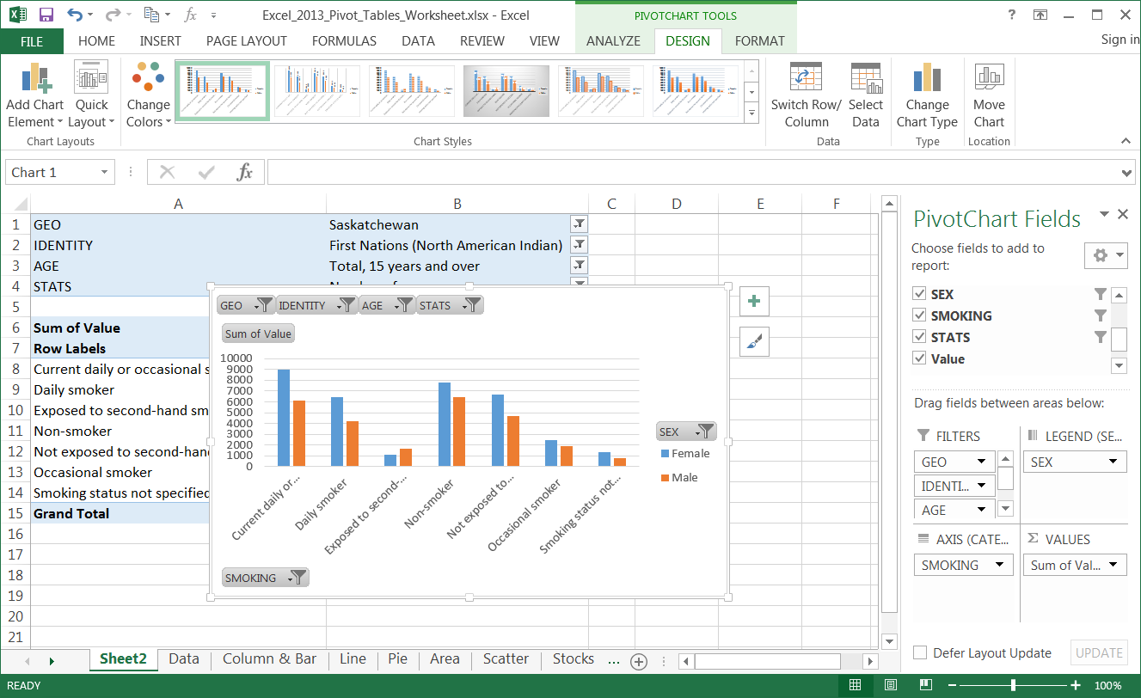
There are three PivotChart Tools contextual ribbons that will help us adjust the chart so that it presents the data more clearly.
The PivotChart Tools Ribbon - Design
Design ribbon deals with …
Add elements to the chart or choose a quick layout.
Select a chart style which colours the data points.
Switch the Row and column or Select new data.
Change the chart type.
The placement of the chart on this or another spreadsheet.

Slide 38
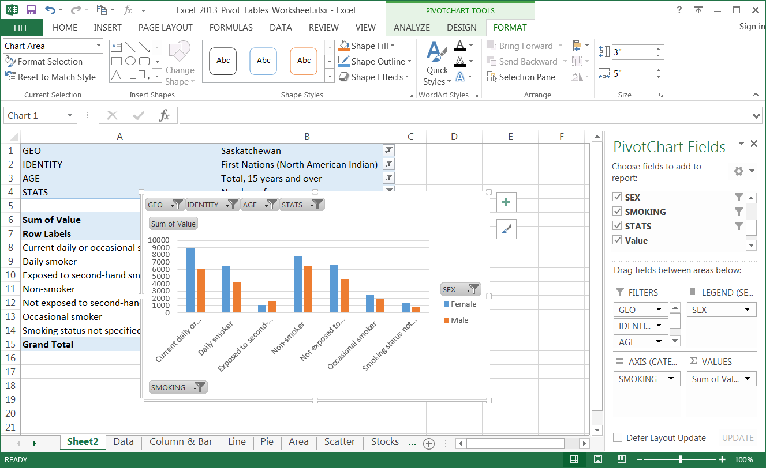
There are three PivotChart Tools contextual ribbons that will help us adjust the chart so that it presents the data more clearly.
The PivotChart Format Ribbon
Format ribbon deals with …
Selecting parts of the chart to format that part.
Insert and modify shapes.
Change the shape by choosing a style or individual elements.
Change WordArt styles or individual elements.
You can manage the objects on the spreadsheet from here.
Change the shape of the selected object

Slide 39
Working with the Pivot Table – Bar Chart
Now to adjust the Bar Chart so it better represents the data.
Switch the X and Y axis.
Select the Design ribbon.
Click on the Switch Row/Column command.

Slide 40
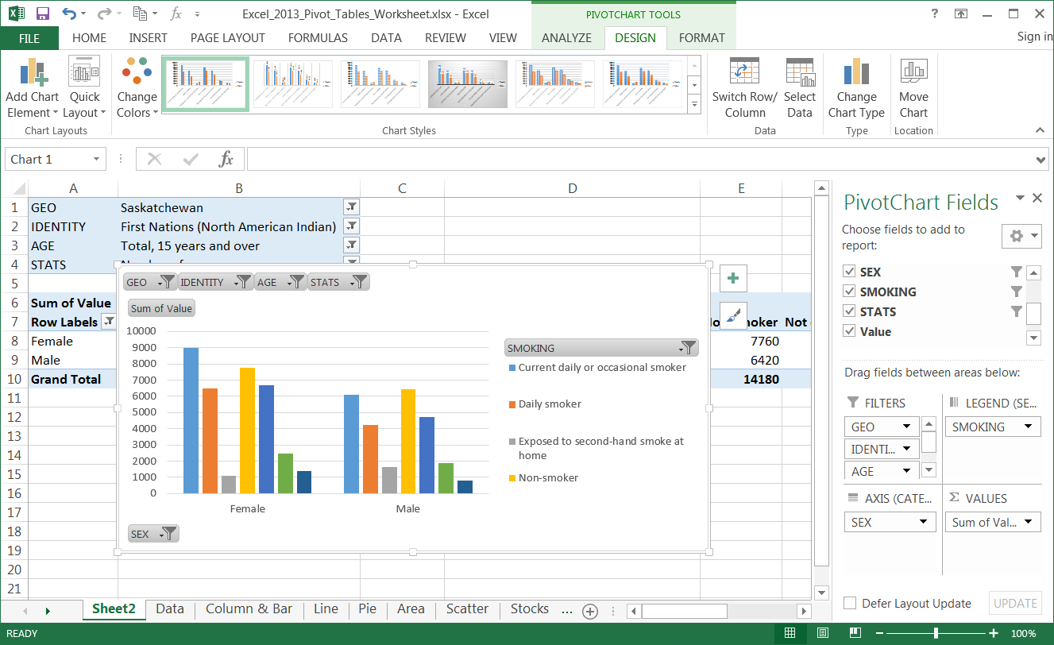
Working with the Pivot Table – Bar Chart
The column chart now displays the field Sex along the bottom on the Axis and Smoking field in the Legend.
Now that the column chart shows the comparison of smoking data between female and males, the chart even would look even better if …
1. We could see the whole legend

Slide 41
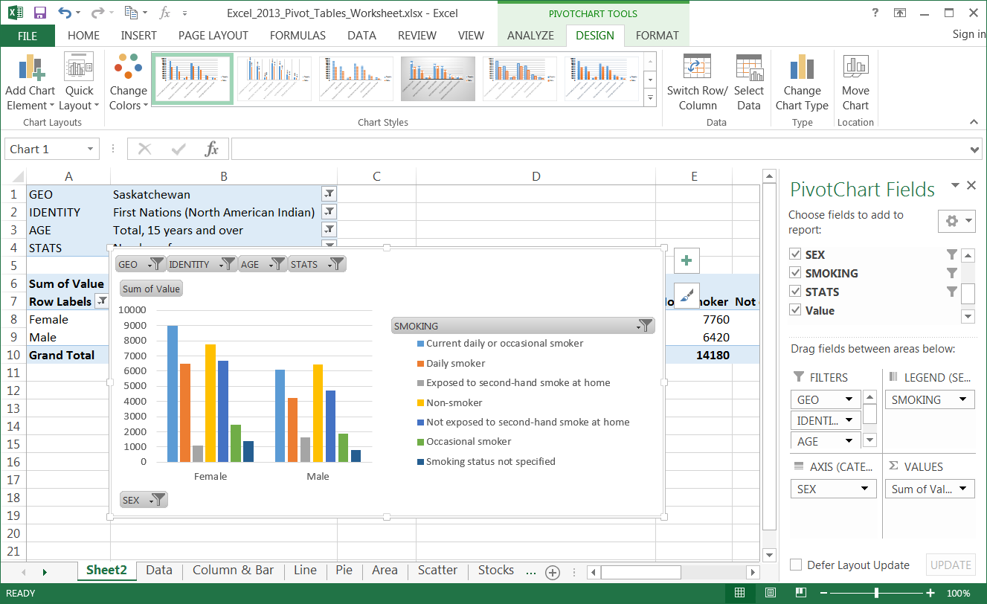
Working with the Pivot Table – Bar Chart
The column chart now displays the field Sex along the bottom on the Axis and Smoking field in the Legend.
Now that the column chart shows the comparison of smoking data between female and males, the chart even would look even better if …
Now the entire legend is visible.

Slide 42
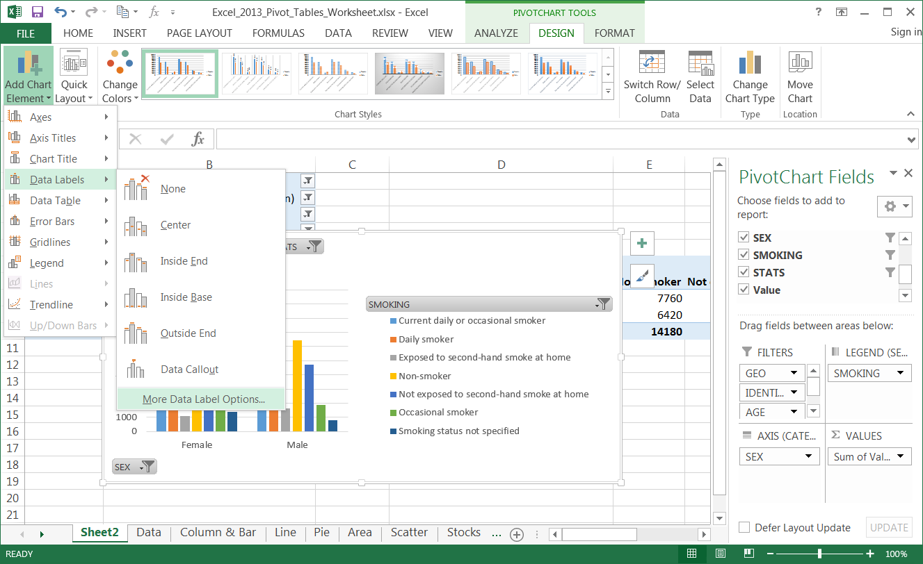
Working with the Pivot Table – Bar Chart
The column chart now displays the field Sex along the bottom on the Axis and Smoking field in the Legend.
Now that the column chart shows the comparison of smoking data between female and males, the chart would look even better if …
values were assigned to the bars in the chart.
Data Labels
Menu
Select the Add Chart Element menu.
More Data
Label Options

Slide 43
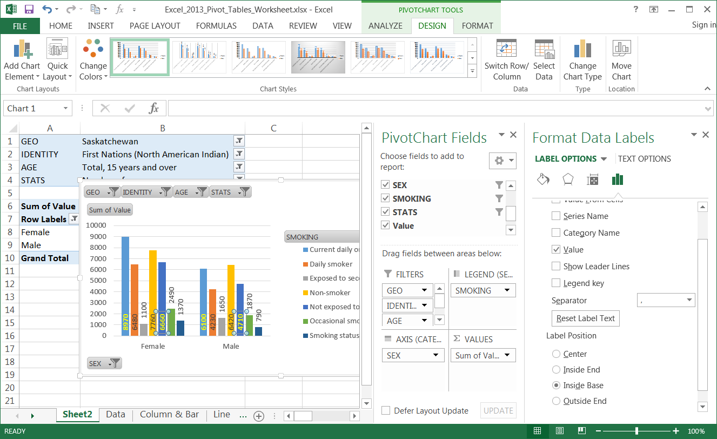
Working with the Pivot Table – Bar Chart
The column chart now displays the field the two sexes along the bottom on the Axis and Smoking field in the Legend.
So how do we go about …
adding labels
orienting them on end
positioning some on the data bar and some not
coloring them different
Now add data labels to make it look like it is in this picture.

Slide 44
Working with the Pivot Table – Bar Chart
The column chart now displays the field the two sexes along the bottom on the Axis and Smoking field in the Legend.
Adding labels
  Label Options
  Show Values only

Slide 45
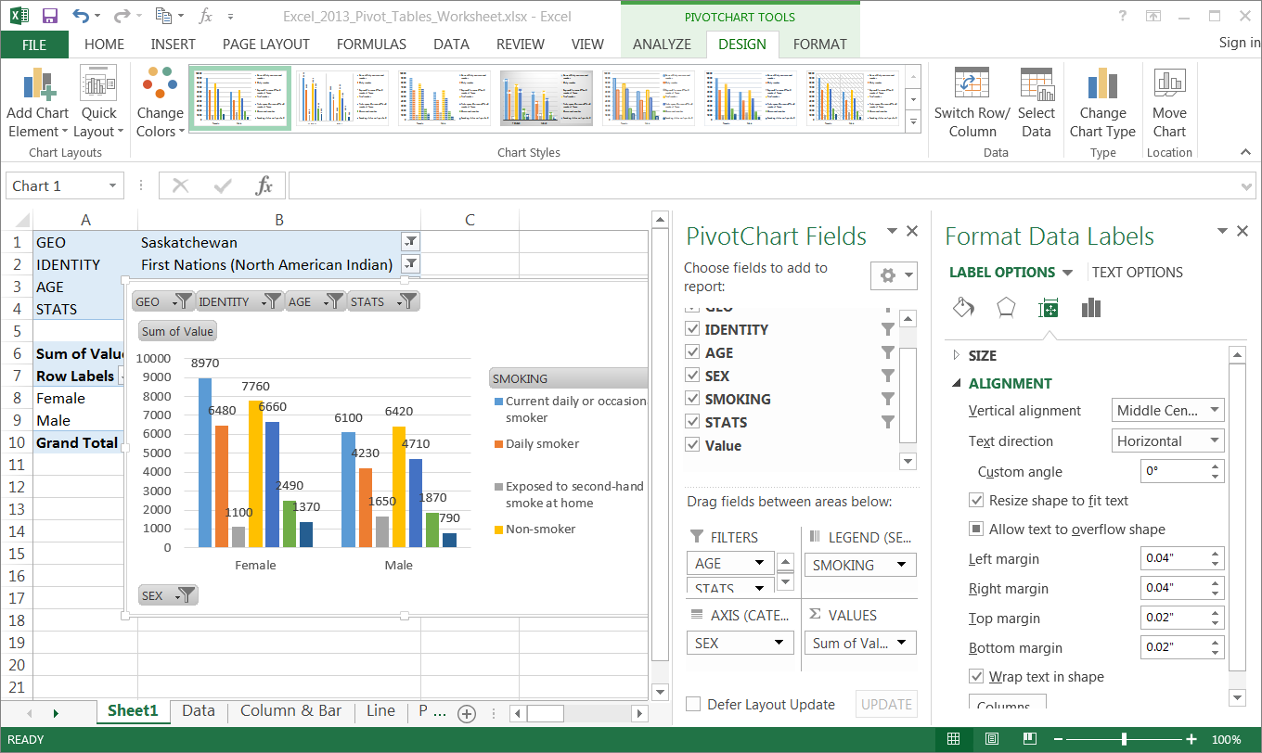
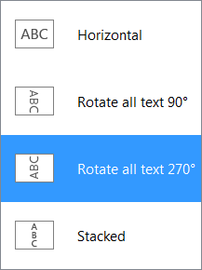
Working with the Pivot Table – Bar Chart
The column chart now displays the field the two sexes along the bottom on the Axis and Smoking field in the Legend.
Formatting the labels
  Label Options
  Size & Properties
    Alignment
    Text Direction
      270°

Slide 46
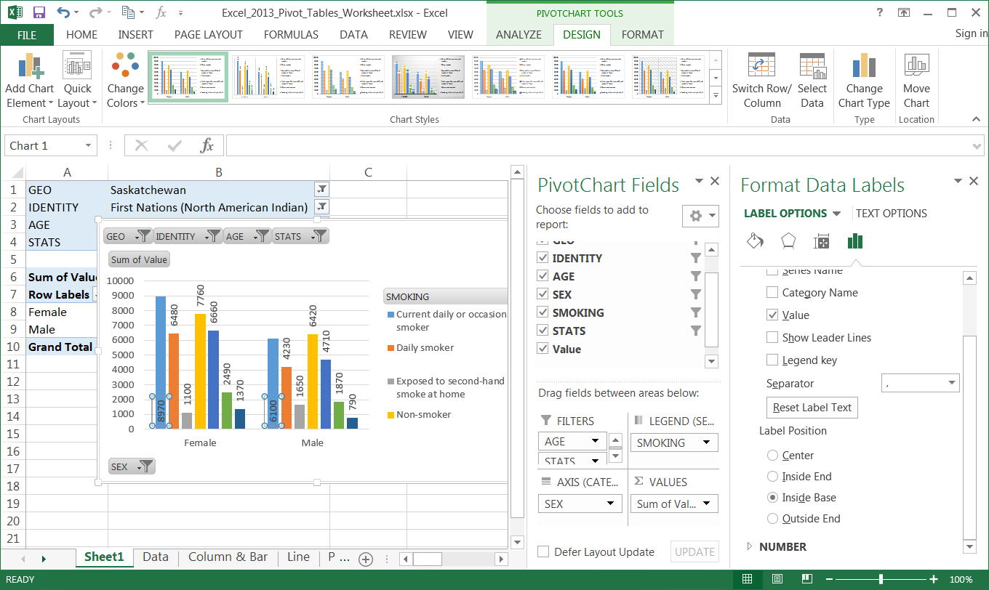
Working with the Pivot Table – Bar Chart
The column chart now displays the field the two sexes along the bottom on the Axis and Smoking field in the Legend.
Formatting the labels
  Back to Label Options
  Inside Base
    Do this for each data label for either the female or male.
    The same stat for both female and male are changed at the same time.

Slide 47
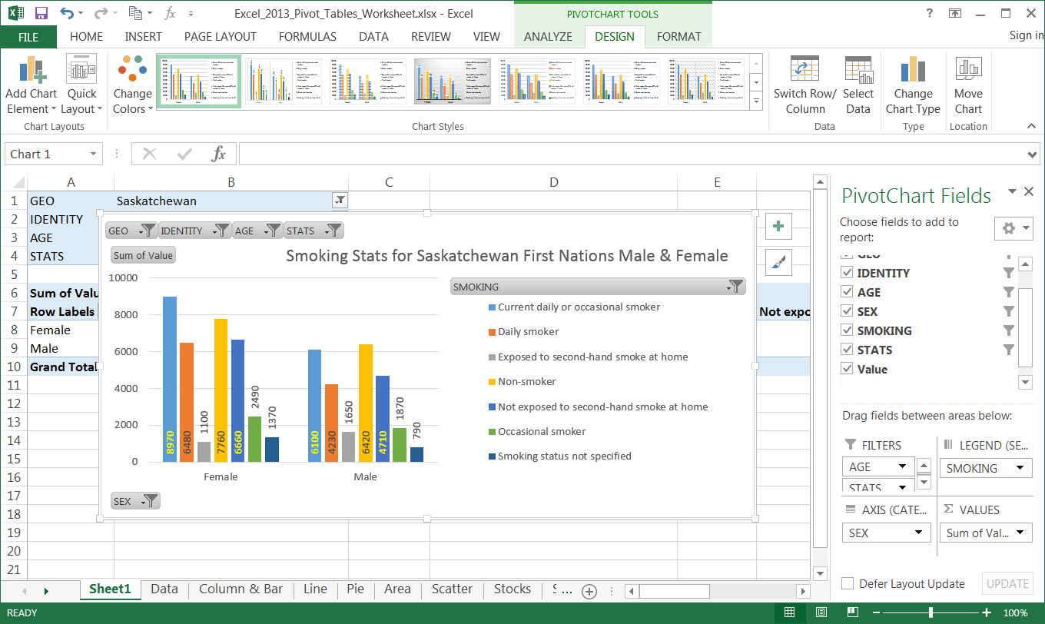
Working with the Pivot Table – Bar Chart
The column chart now displays the field the two sexes along the bottom on the Axis and Smoking field in the Legend.
Formatting the chart
  Resize the chart larger
  Add a chart title
  Resize the legend so we can see all the stats

Slide 48
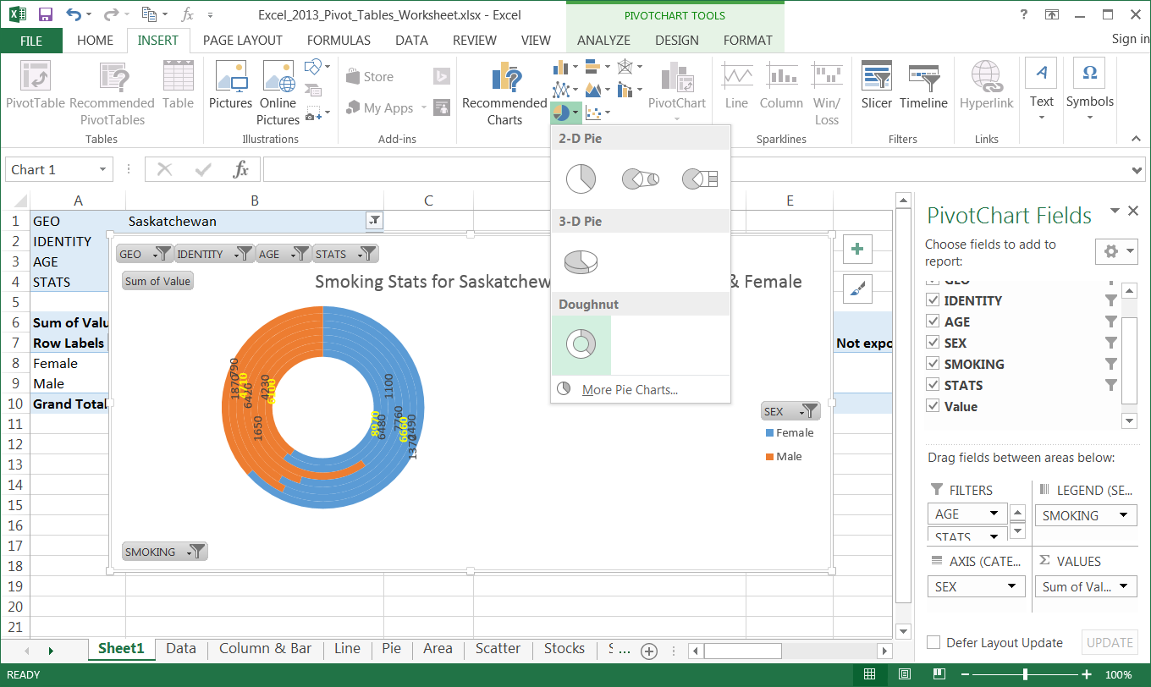
Working with the Pivot Table – Doughnut Chart
Now switch the current bar chart for a doughnut chart.
It must be a doughnut chart, not a pie chart, because there are two data sets and a pie chart can only have one data set.
Be sure to select the bar chart.
Click on the tab of the Insert ribbon.
With the bar chart selected, select the Doughnut from Pie/Doughnut Chart menu.
We will have to work with this doughnut chart to make it more useful.

Slide 49
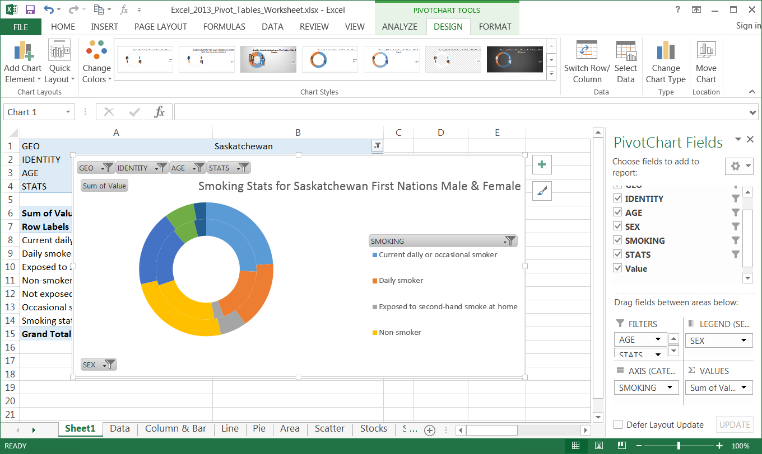
Working with the Pivot Table – Doughnut Chart
This doughnut does not look too appealing, so we will need to adjust it into two rings, not seven.
That is accomplished by switching the X and Y axis back again.
On the Design ribbon click on the Switch Row/Column.

Slide 50
Working with the Pivot Table – Doughnut Chart
This doughnut does not look too appealing, so we will need to adjust it into two rings, not seven.
That is accomplished by switching the X and Y axis back again.
Now rearrange the doughnut, legend, and data labels to too like …

Slide 51
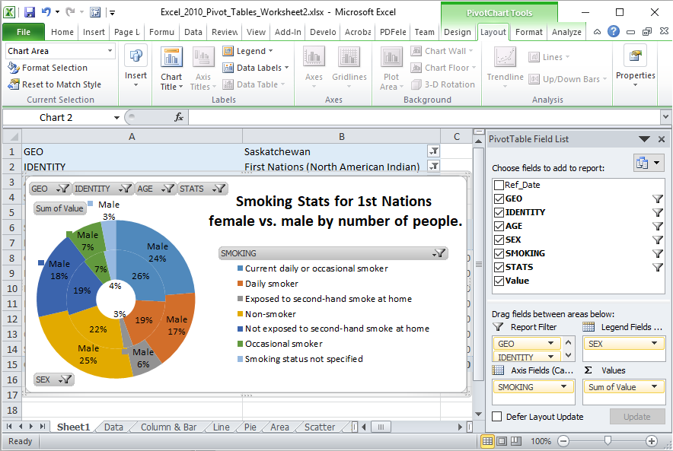
Working with the Pivot Table – Doughnut Chart
With a bit of adjustment to the doughnut chart, it is now more readable
I did the following to this doughnut chart:
Resized it larger to accommodate the text.
Shrunk the doughnut hole size to increase the size of the rings.
Added data labels
  Added the series name to the outside doughnut, Male, because there is more room. No need for adding the label to the inside doughnut.
  Adjusted the positioning of each individual label so that it can be best read.
Can you make your chart look the same?

Slide 52

We have covered here in this course …
Preamble and Definitions
Working with the Pivot Table – Bar Chart
Downloading and Opening the Exercise File
Working with the Pivot Tables
Placing Data Fields and Filtering
Creating a Pivot Table
Working with the Pivot Tables
The Bar Chart
Pivot Chart Anatomy
Working with the Pivot Tables
The Doughnut Chart

Slide 53

NITHA IT Helpdesk helpdesk@nitha.com
1(844)486-4842
Notes:
Please do not hesitate to ask any question regarding this session, and I will make sure to answer your question as soon as possible.

Slide 54


