Slide 1


Excel 2013 Graphs and Charts
Intermediate Level

Slide 2



NITHA IT Helpdesk
helpdesk@nitha.com
1(844)486-4842

Slide 3

NITHA - IT Helpdesk Courses Registration Website
How do I get to the Courses Registration Website?
First, open up your favorite web browser.
Finally, press ENTER on our keyboard
Second, type in the address bar the URL, nitha.com/courses

Slide 4
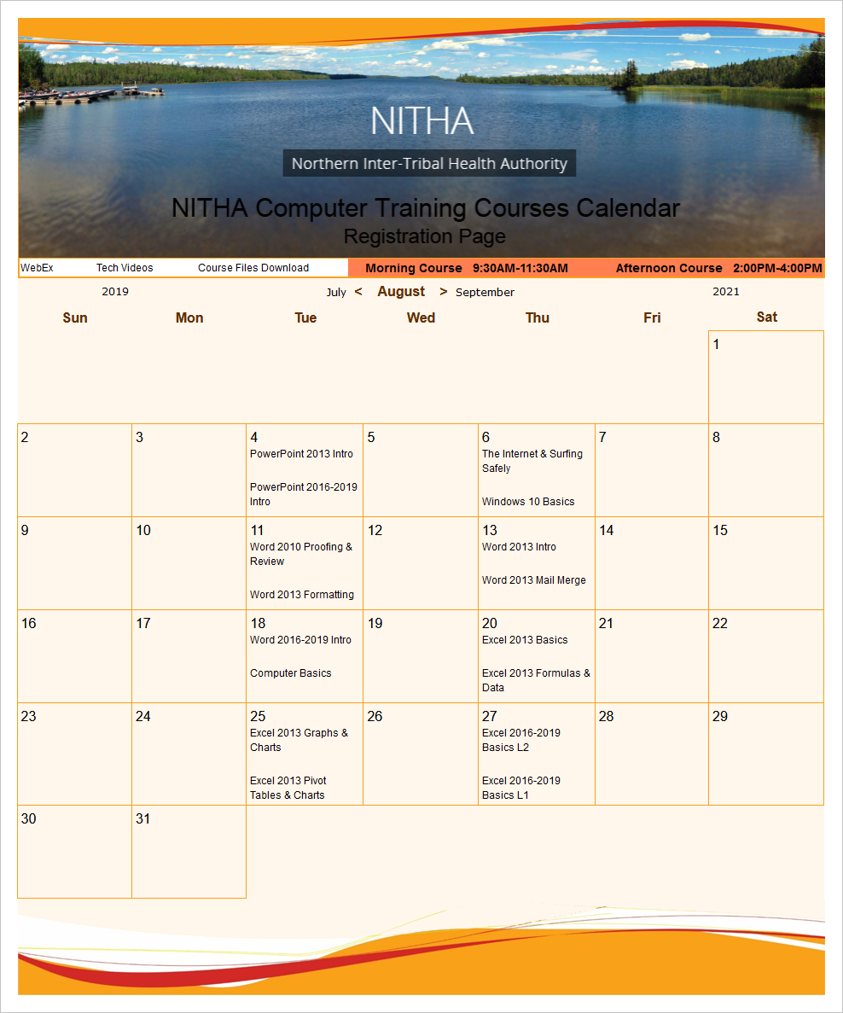
NITHA - IT Helpdesk Courses Registration Website
The NITHA Computer Training Courses Calendar
There are four sections to the
IT Helpdesk Courses Registration Website
The calendar – As seen on the right,
the calendar displays the selected month and all the course links on the appropriate days.
Morning courses 9:30 AM to 11:30 AM
Afternoon courses 2:00 PM to 4:00 PM

Slide 5
NITHA - IT Helpdesk Courses Registration Website
Cycle forward through the months by clicking on the next month
The NITHA Computer Training Courses Calendar
Cycle backward through the months by clicking on the previous month
And of course, the month in the middle is the currently displayed month.

Slide 6
NITHA - IT Helpdesk Courses Registration Website
or the next year
The NITHA Computer Training Courses Calendar
You can even click on the previous year

Slide 7
NITHA - IT Helpdesk Courses Registration Website
The NITHA Computer Training Courses Calendar
Click on the course link of your choice and you will be taken to a registration page.

Slide 8

NITHA - IT Helpdesk Courses Registration Website
The NITHA Computer Training Course Registration page
Enter your information
Select how you are going to attend the course
by WebEx
by Telehealth
Select how you want your Certificate of Completion delivered.
by Email as a PDF
by Canada Post

Slide 9
NITHA - IT Helpdesk Courses Registration Website
The NITHA Computer Training Courses WebEx Info
WebEx Information – For the WebEx connection information on how to attend the courses in the current week, click on the WebEx link.

Slide 10

NITHA - IT Helpdesk Courses Registration Website
The NITHA Computer Training Courses Calendar
These links display the WebEx information for that course
These links download the ICS file for that course so that you can add it to your Outlook calendar as an event.

Slide 11
NITHA - IT Helpdesk Courses Registration Website
The NITHA Computer Training Courses Download
Course Files Download – The courseware and the data files which are used in the courses are all available for download any time whether or not you are taking the course.
click on the Course Files Downloads link
To download the
Courseware file (A PowerPoint file)
and/or
Sample data files used in the course

Slide 12

NITHA - IT Helpdesk Courses Registration Website
The NITHA Computer Training Courses Calendar
The Course Sample File is the data file used in the course.
The PowerPoint Courseware File is the course itself.

Slide 13
NITHA - IT Helpdesk Courses Registration Website
The NITHA Computer Training Courses Calendar
Tech Videos are the fourth section of the website. As they are created, they will be placed here.
Tech Videos are short 3 to 15 minute videos featuring solutions to various tech issues.

Slide 14

What will we be covering in this course?
What is our direction in this course?
Choosing the Data You Present
Chart Types
Making a Column/Bar Chart
Parts of the Chart
Making a Pie Chart
Context Ribbons - Design
Making a Doughnut Chart
Context Ribbons - Layout
Tips for Formatting Your Chart
Context Ribbons - Format

Slide 15
What is our direction in this course?
Assumption 1:
I will be assuming you have a basic knowledge Excel: navigation, screen layout, etc.
Assumption 2:
You must know the following:
  What are ribbons both regular and contextual.
  What are spreadsheets, how to navigate them, and how do you create more of them.
What is a dialog box and what is a window pane.
Our goal is to work with the data so that it is represented in a chart in a meaningful way.
To accomplish our goal we will have to:
Know what we want to represent with the data.
Learn the tools to restrict and present the data so it represents what we need it to.
Tools such as:
Filter –
A filter presents an arrow in the column header which lets you allow or restrict what rows you display based upon the data you filter from that column.
Sort –
You can sort ascending or descending, top to bottom or left to right, using one or more columns by value, cell color, font color, or cell icon.
Subtotal –
Group together rows by subtotalling cells in a column using a specific function.
Group –
Bind selected rows or columns together so they can be collapsed or expanded.

Slide 16
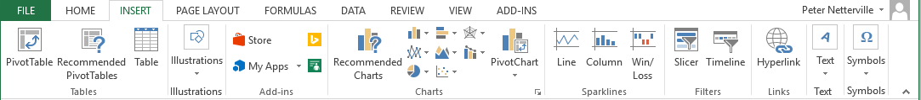
Chart Types
Column & Bar – Used to show the changes in data over a period of time or to illustrate comparisons among items.
Line – Uses lines to plot trends and changes in data over time.
Pie & Doughnut – A Pie chart can only display one series of data. It represents data in percentages and emphasizes
significant elements in the data. A Doughnut chart has rings and each ring represents one set of data.
Area – Displays the magnitude of change over time.
Scatter – Observes how the values of two series compares over time or other category.
Other Charts
Stocks – Shows opening and closing prices and the volume of shares traded during a certain period of time.
Surface – Used to determine the optimum combination between two sets of data.
Doughnut – Similar to pie charts but can show a multiple series of data.
Bubble – Similar to scatter chart, except it compares sets of three values instead of two.
Radar – Displays data relative to a center point.

Slide 17
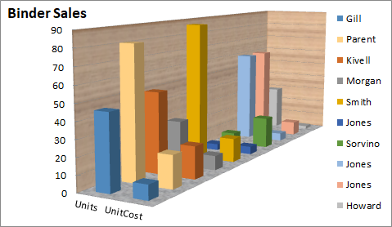
Parts of the Chart
Data Markers (or Data Points) - Symbols, in this case bars, on the chart that represents individual values from the data table.
Data Series - A group of related values. In this example there are only two in each series; one under Units and the other under UnitCost.
Title – Chart Title.
Chart Wall
Plot Area – a graphical representation of the data selected.
Chart Area – Where the plot, axes, legend and title reside.
Vertical Axis (y-axis) - serves as a reference for plotting data.
Legend - Shows the data series name corresponding to each data marker.
Horizontal Axis (x-axis) - serves as a reference for plotting data.
Chart Floor (in 3D charts)
Notes:
At the end of this slide before going on
load the workbook,
Select the table
Create a quick bar chart
Show how the context ribbons work

Slide 18
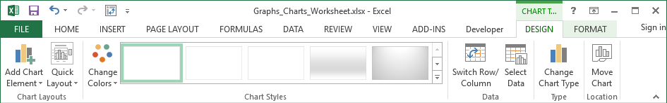
Context Ribbons – Chart Design
Chart Styles
Chart styles deal with the color of the data points or data series.
Data
Switch Row/Column
Flips the column and row.
Select Data
Choose the data to be represented in the chart.
Type
Change Chart Type
From bar to pie or to any other chart type. A chart type is the graphical representation of the data points.
Add Chart Element
You can add …
Axis
Axis Titles
Chart Title
Data Label
Data Table
Error Bars
Gridlines
Legend
Lines
Trendlines
Up/Down Bars
Chart Layouts
Choose from different layouts for your chart.
Location
When you Move Chart you can relocate it to:
Another sheet
As an object on the same sheet.
You must also change the chart type if you insert another chart on to the same sheet when it is based on the same data.

Slide 19
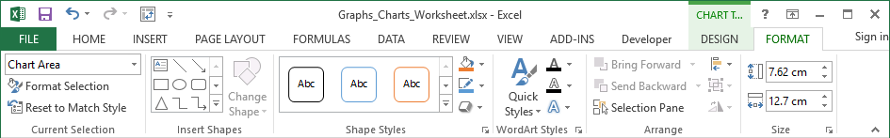
Context Ribbons - Format
Current Selection drop box
Select the object on the chart you want to format.
Format Selection
Will display a dialog box with the formatting options.
Reset to Match Style
Resets the style back to the default.
Shape Styles
For the selected object you can:
Choose from a quick style
Alter individual elements of the object by using the Shape Fill, Shape Outline, and Shape Effects menus.
WordArt Styles
For the selected WordArt object you can:
Choose from a quick style
Alter individual elements of the object by using the Shape Fill, Shape Outline, and Shape Effects menus.
Insert Shapes
You can add a new shape to your spreadsheet from here or change one you have already placed.

Slide 20
Context Ribbons - Format
Arrange
Objects on the spreadsheet can be arranged like cards laying on a desk.
If you have more than one object on the spreadsheet, you can use the Bring Forward and Send Backward options to move the object up or down on the stack.
Size
Manually set the size of the chart measured in centimeters. Must have the chart selected, not an object on the chart.

Slide 21
Choosing the Data You Present
How to choose the proper data for your chart?
What point are you trying to make?
Choose to present only one data set in one chart, or maybe two if they are related, complement or contrast.
Choose the chart which best represents the concept you are trying to represent.
  Representing percentages of a whole, use a pie chart.
  To present trends over time, use a line chart.
  Want to illustrate comparisons among items, use column or bar chart.
  To display the magnitude of change over time, use an area chart.
  Want to show a multiple series of data each a percentage, use a doughnut chart.
  To show values of two series compared over time or as a category, use a scatter chart.

Slide 22
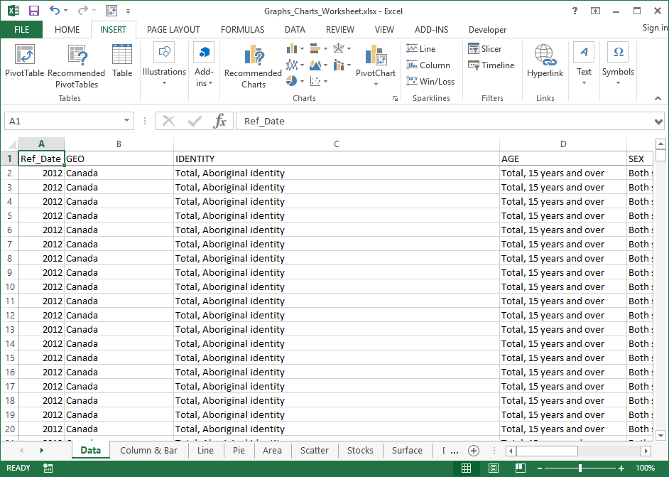
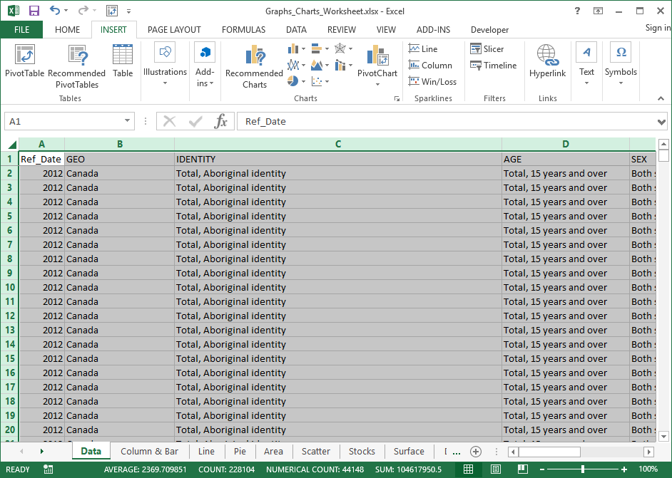
Copy Data from the Data sheet to Column & Bar sheet
Making a Column/Bar Chart
2. Click on:
The Select All button
Press CTRL+C to copy
OR
Home tab, Copy button
1. Click on:
The Insert ribbon tab
The Data sheet tab

Slide 23
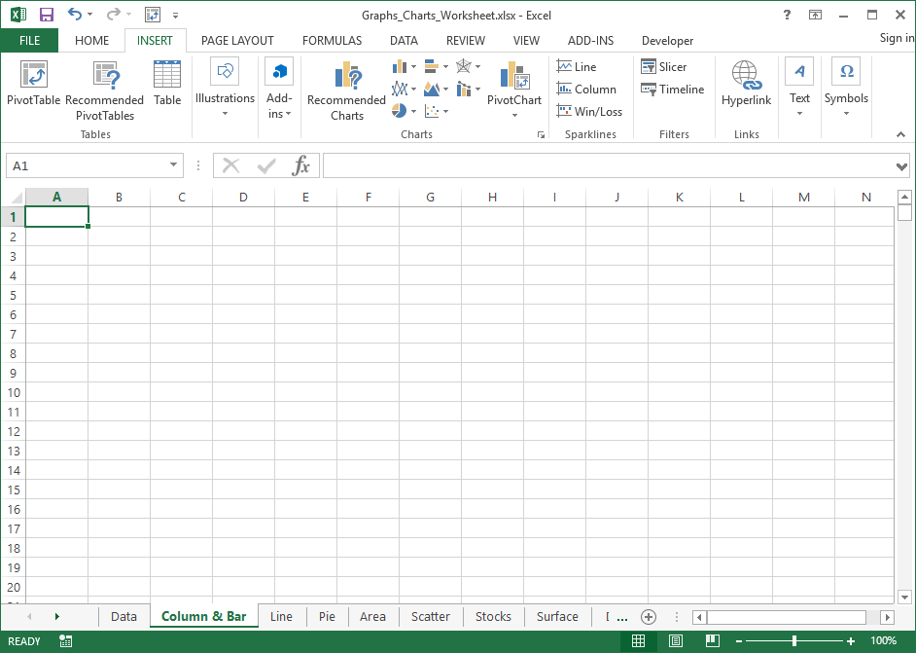
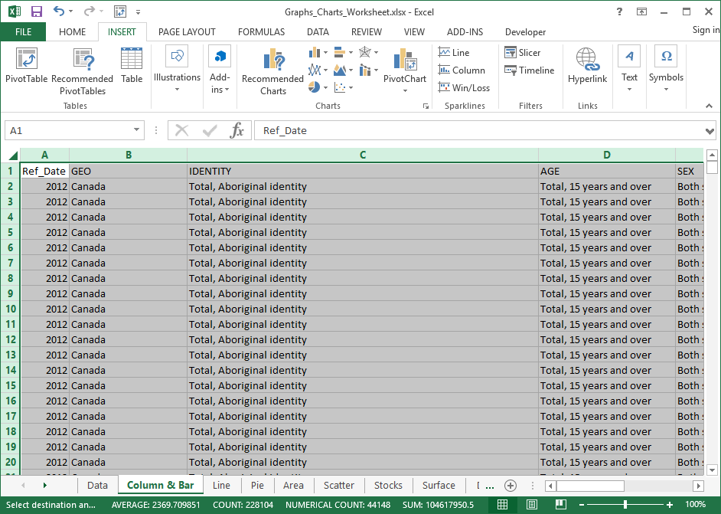
Copy Data from the Data sheet to Column & Bar sheet
Making a Column/Bar Chart
4. Click on:
Cell A1
Press CTRL+V to paste
OR
Home tab, Paste button
3. Click on:
The Column & Bar tab
We will copy this data for each chart type we create; column, pie, doughnut & pivot.

Slide 24
Limit the data to make it display specific information.
The tools you can use to restrict and structure the data are found on the Data tab.
Sort
  You can sort the data in column(s) by one or more sort criteria.
  Options allow you to sort by case sensitive or to change the sort orientation from top to bottom or left to right
  If the data does not have headers, deselecting My data has headers will force Excel to add its’ own column headers
Filter
  To narrow down the data to what you need to represent, you can filter the data in each column to display only specific information.
  Applying a filter will add an arrow to the column header which when clicked will drop down a list of grouped data. Select or deselect the data items to filter out unwanted or unnecessary information.
Group
  You can manually group together cells so they can be collapsed or expanded as needed.
  Group by row or column.
Subtotal
  Total two or more rows of related data
  Subtotal is applied to a column with numbers using one of the following functions:
    Sum, Count, Average, Max, Min, Product, StdDev, StdDevp, Var, and Varp.
  One column is assigned as the data changes each subtotal is applied. (Thus, a Sort should be applied to that column before subtotaling using that column as the At each change in: field)

Slide 25
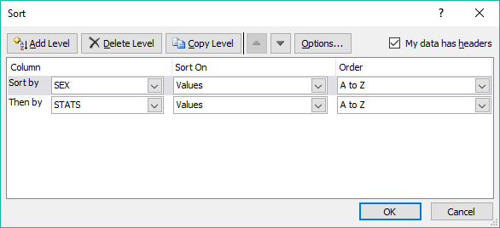
Steps to restrict the data
Because the Column chart is used to illustrate comparisons among items, we will compare smokers between females verses males.
Sort by:
  Sex
  STATS

Slide 26
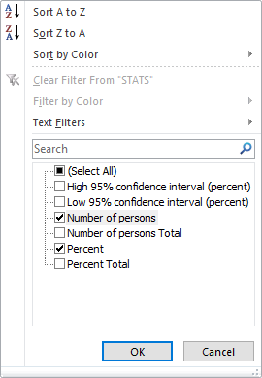
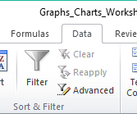
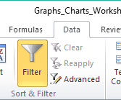
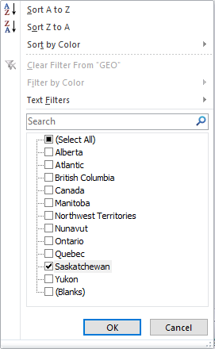
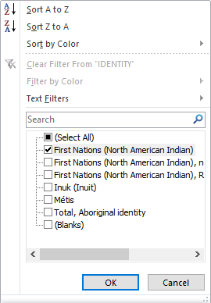
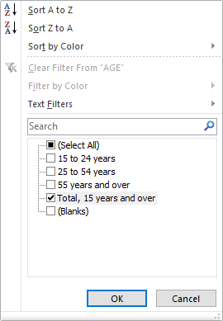
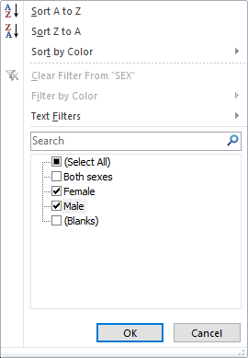
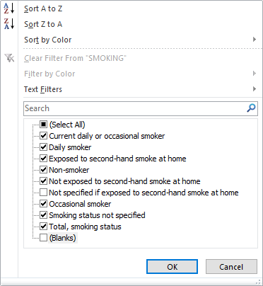
Steps to restrict the data
In the
Data ribbon
Sort & Filter group
Click on the Filter command
Click on the Filter command
Filter by:
  Geo – select Saskatchewan only
  Identity – select First Nations (North American Indian)
  Age – select Total, 15 years and over
  Sex – select Male and Female
  Smoking – deselect Not specified if exposed to second-hand smoke at home and Blanks
  Stats – select Number of persons and Percent

Slide 27
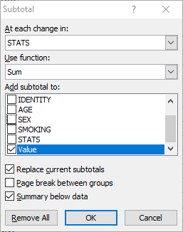
Steps to restrict the data
Subtotal by:
At each change in STATS
Use function Sum
Add subtotal to Value
Replace current subtotals is checked
Page break between groups is unchecked
Summary below data is checked

Slide 28
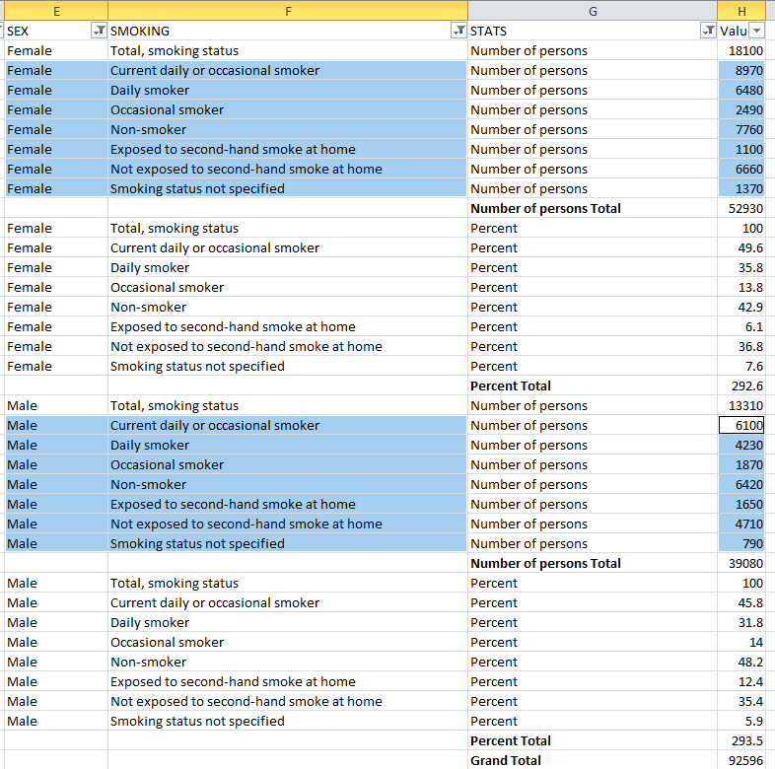
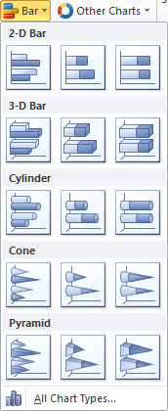
Select the data and inserting the chart
Use the Ctrl button on the keyboard in conjunction with the mouse to select the blocks of data shown here.
Now insert a 2-D Column chart.

Slide 29
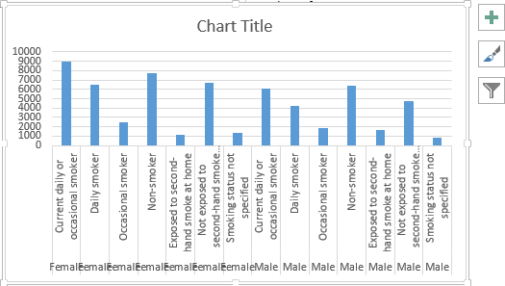
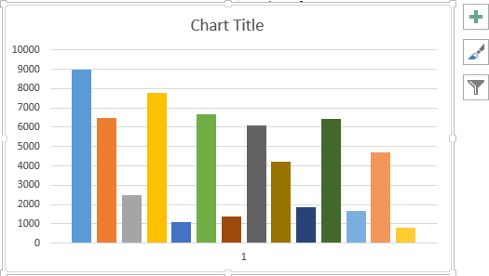
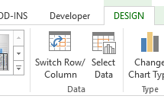
Change the chart’s Row/Column
From
To
By clicking on the
Switch Row/Column
button
located on the
Chart Tools/Design tab in the Data group

Slide 30
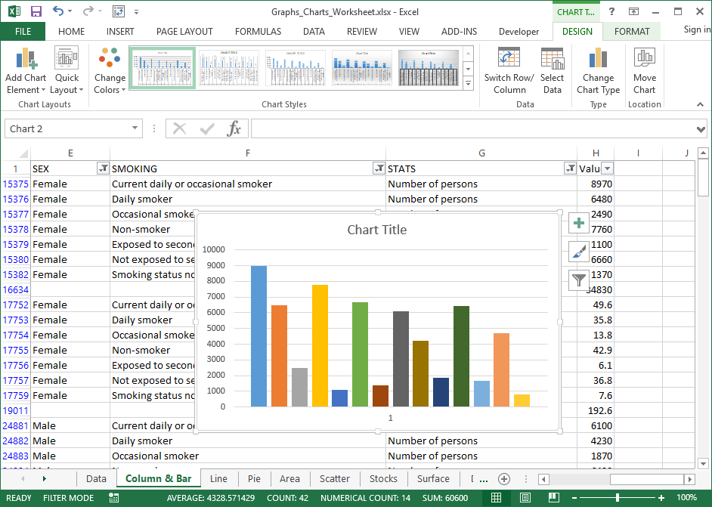
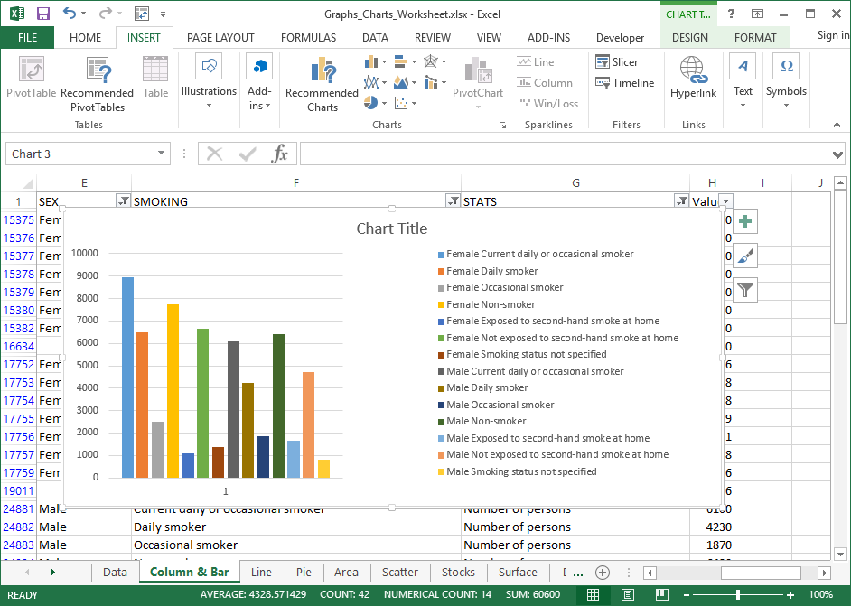
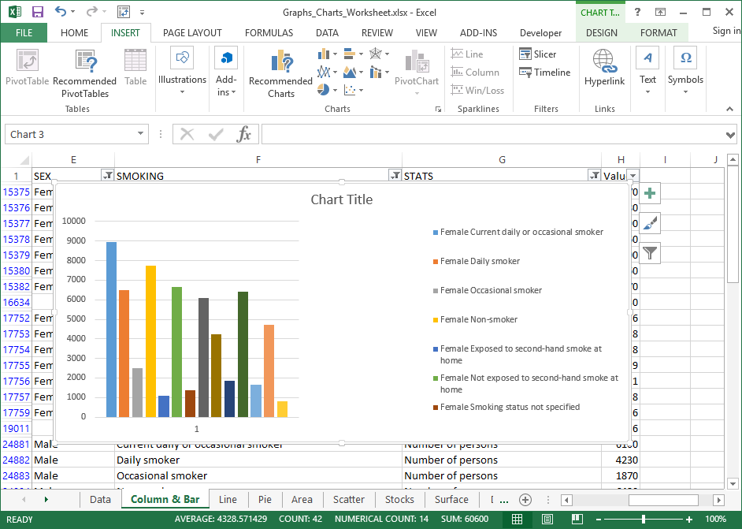
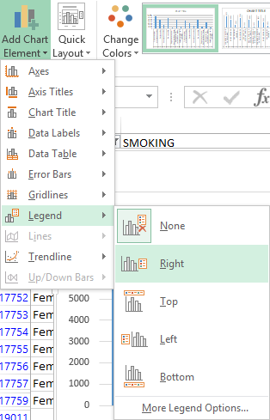
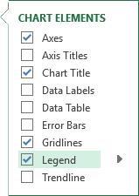
The end result is that we have a column chart representing the contrasting Female/Male smoking statistics for First Nations people in Saskatchewan for the year 2012 counted by number of persons.
Making a Column/Bar Chart
Now take a few minutes and select the individual objects in the chart.
Resize them, along with the chart size, to make it show all the legend data as it is represented in this chart.
First thing is to resize the chart to be smaller to fit th.
Second, click on either of the Add Chart Elements button and add a legend.
The resize the legend.

Slide 31
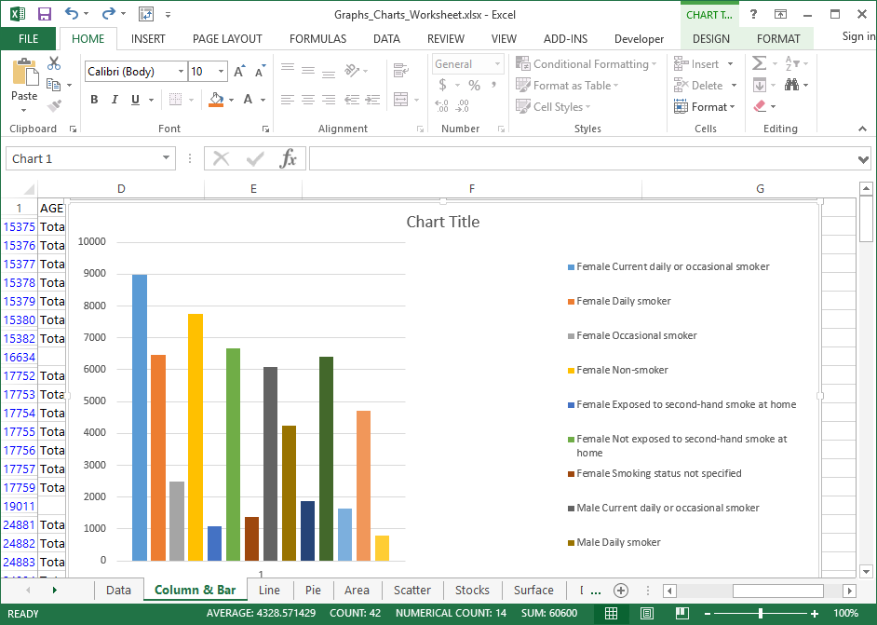
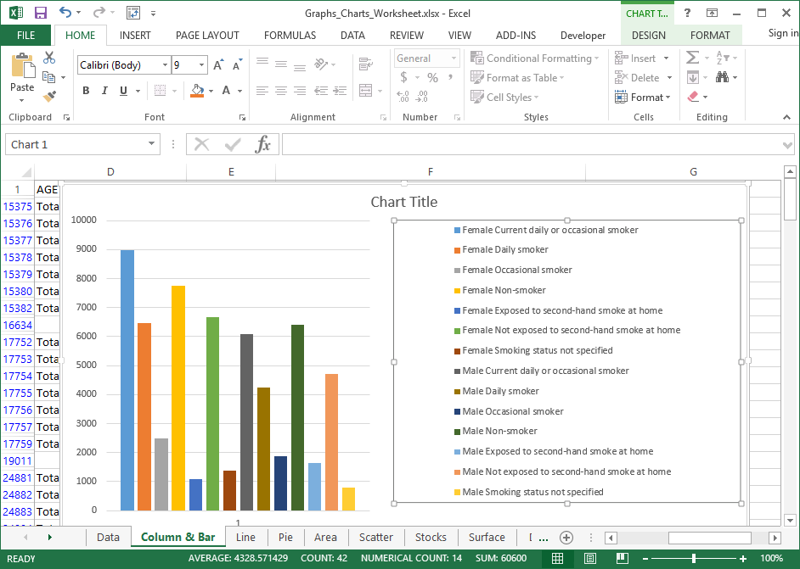
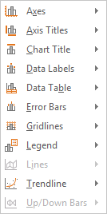
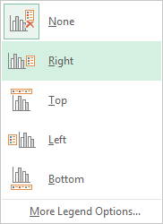
Spend some time formatting your chart to make it look as you prefer.
Making a Column/Bar Chart
You may wish to add a Legend or other element.
To add another element, such as a legend go to …
Chart Tools/Design ribbon
Chart Layouts group
Add Chart Element menu
Choose the Element from the sub-menu items
Choose the position
You may wish to resize the legend so it shows the data names for all 14 data points.

Slide 32




Pie
&
Doughnut
Charts

Slide 33
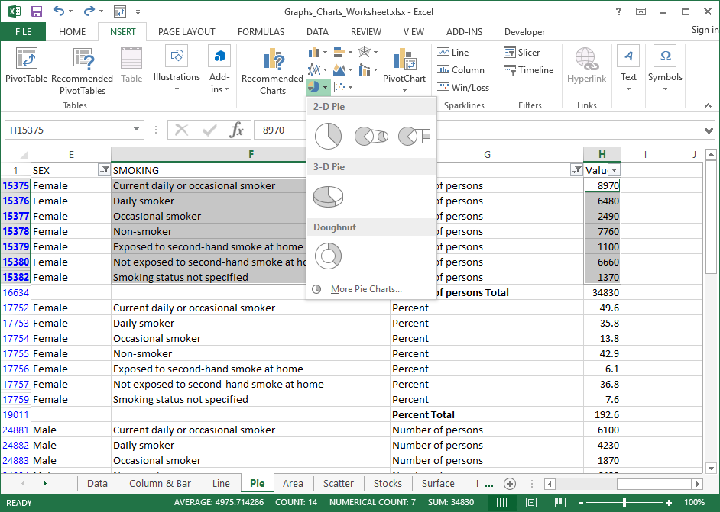
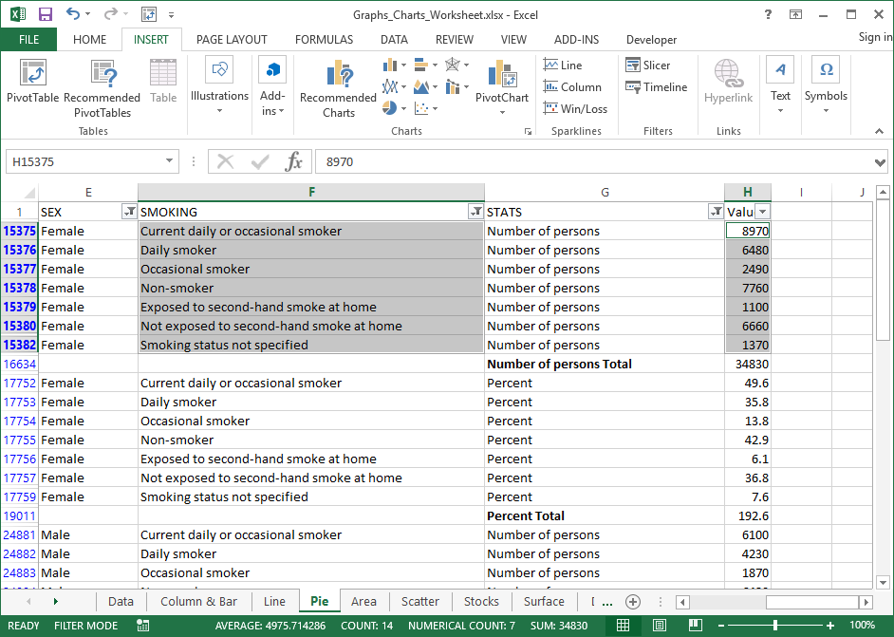
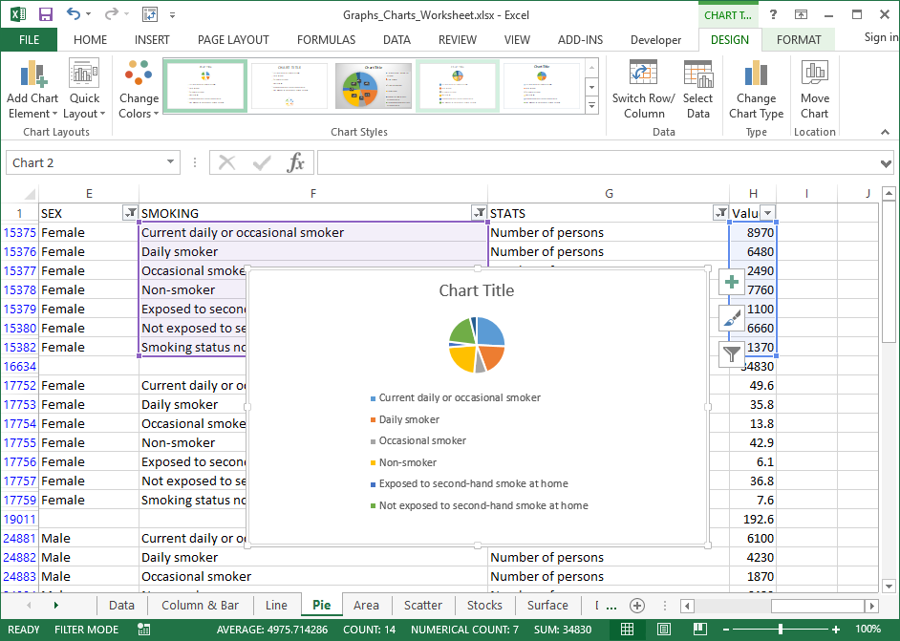
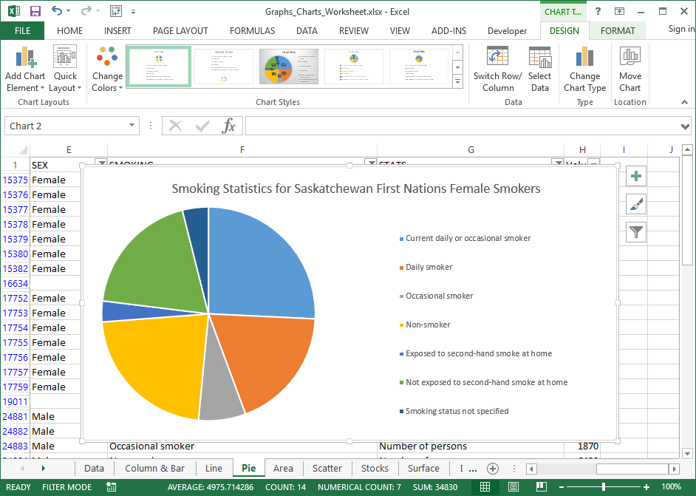
A Pie chart can only display one series of data, each element in the series as a percentage of the total.
Making Pie a Chart
Using the same data from the Data sheet; sorted, filtered & subtotaled the same as the Column …
Select just the data shown in the image and then choose a pie chart.
Click on the Pie chart option from the Insert ribbon Charts group.
Select the first 2D Pie.
Now reorganize the chart elements to look like …

Slide 34
Making Pie a Chart
The Pie chart shows the seven smoking statistics for females.
Now make a chart for the male smokers and display it on the same sheet.

Slide 35
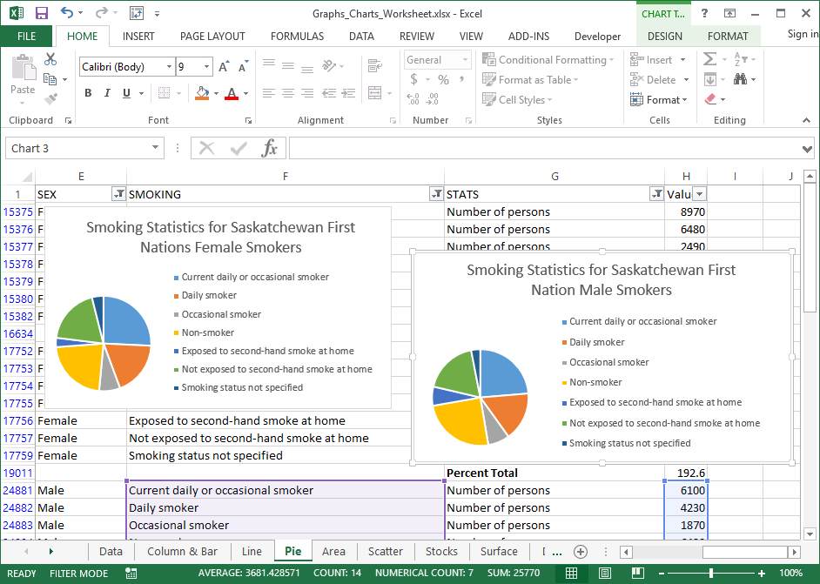
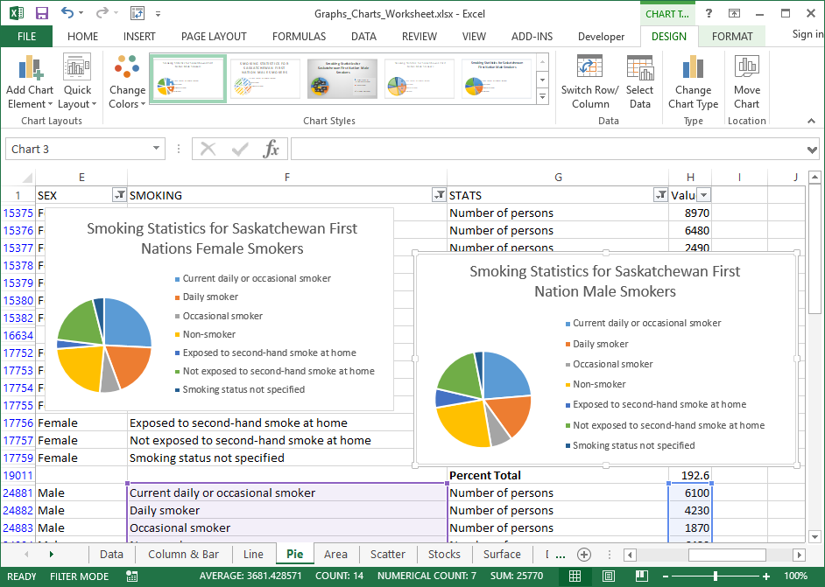
Making Pie a Chart
Here is what the two pie charts on the one sheet looks like.
Notice that you will have had to resize both charts to fit on the one page.
On the other hand, you can place one or both of those charts on separate spreadsheets.
To do this:
Select one of them.
Select the Design ribbon.
Click on Move Chart

Slide 36
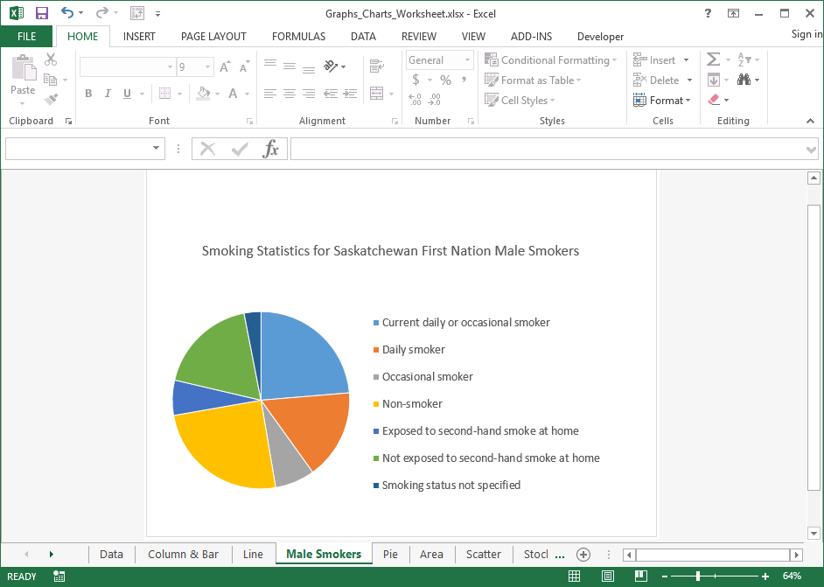
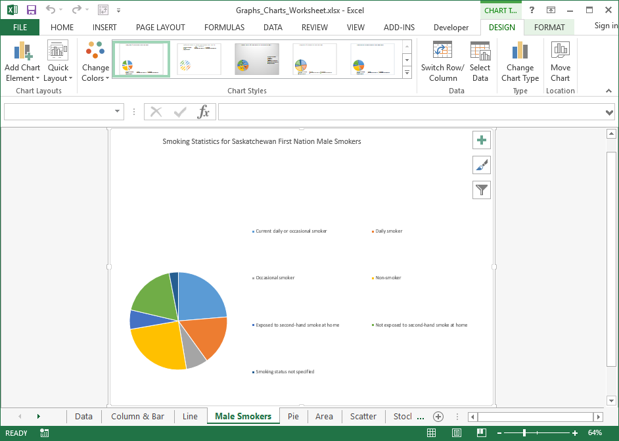
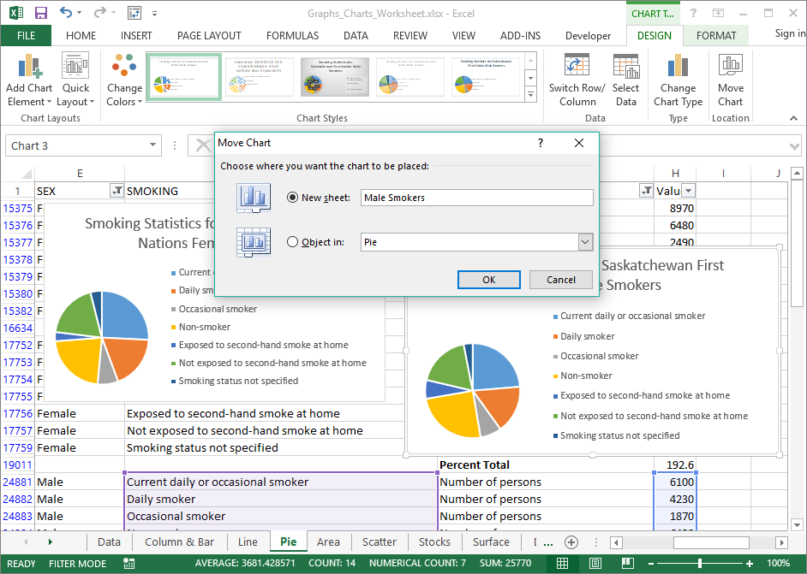
Which displays the Move Chart dialog box.
Making Pie a Chart
Click on New Sheet and then name the new sheet.
I called it Male Smokers.
Click on the OK.
Excel did not do a good job formatting that so it looks good, so let’s change that to look better.
Change it to look like …

Slide 37
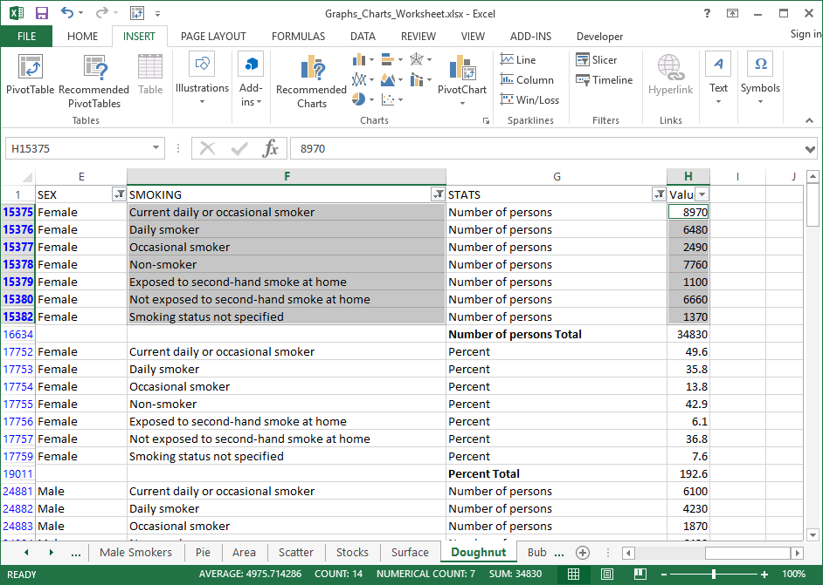
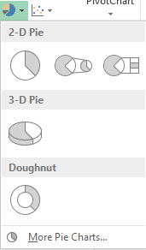
Creating a doughnut chart to represent smoking stats for both Female and Male for a doughnut chart involves a little bit more work than just selecting the necessary data.
Making a Doughnut Chart
Select just the seven smoking stats for females and the associated numbers as seen in the image to the right.
Click on:
Insert tab
Pie or Doughnut Chart
Doughnut chart
Which should create a doughnut chart with just one ring.

Slide 38
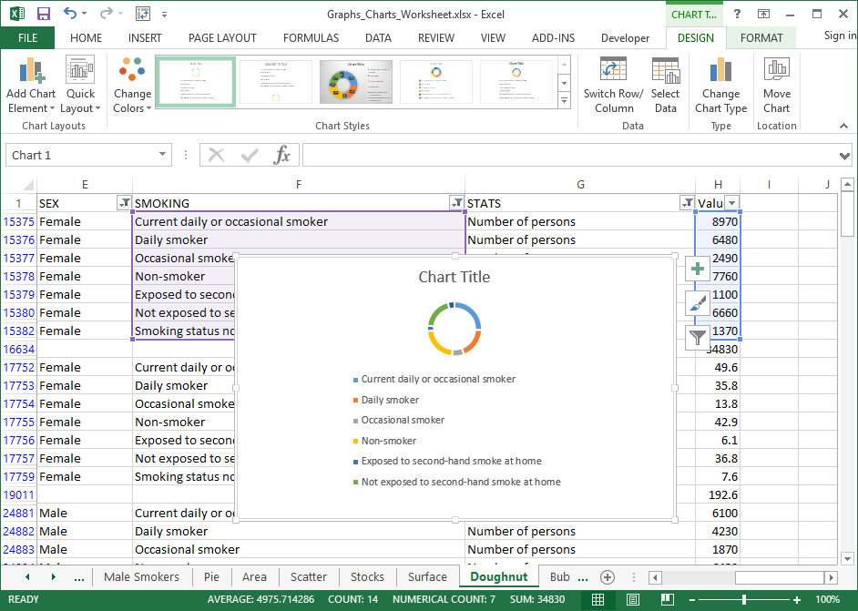
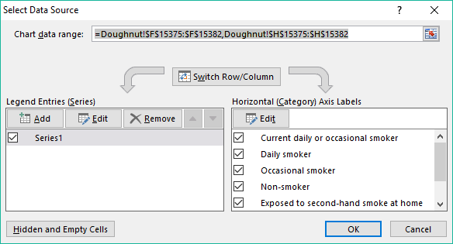
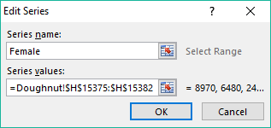
Now we need to label the female series data as Female.
Making a Doughnut Chart
Click on the Select Data button.
Which displays the
Select Data Source dialog.
Click on Series1
Click on the Edit button.
Which displays the
Edit Series dialog.
Type into the Series Name box, Female
Click on the OK button.

Slide 39
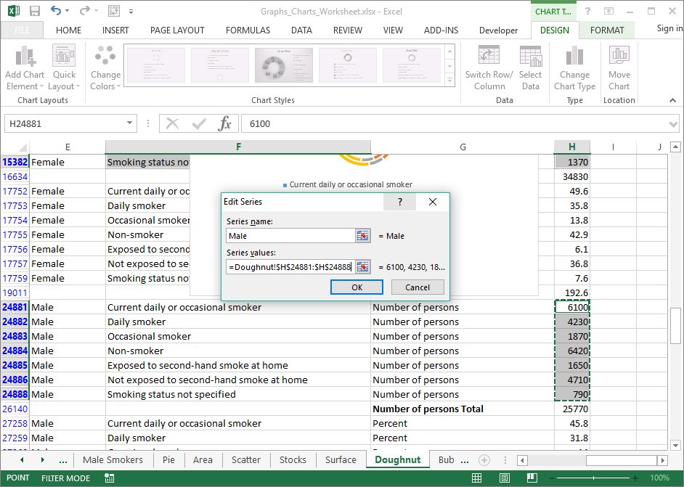
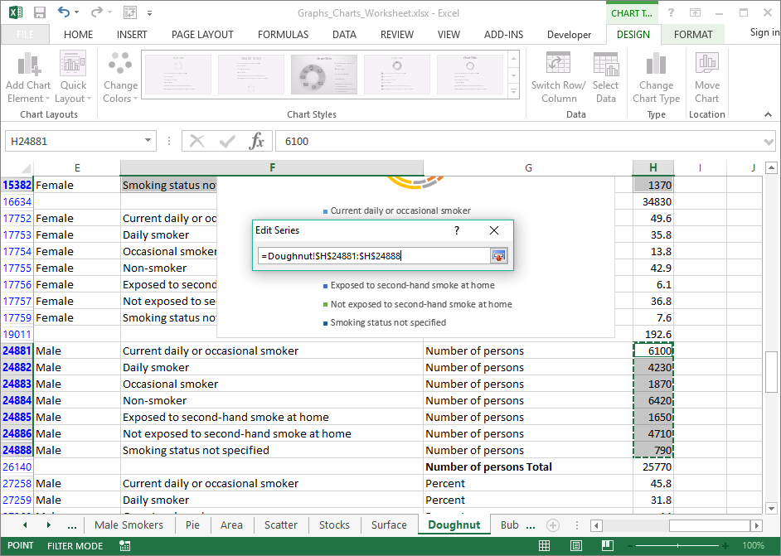
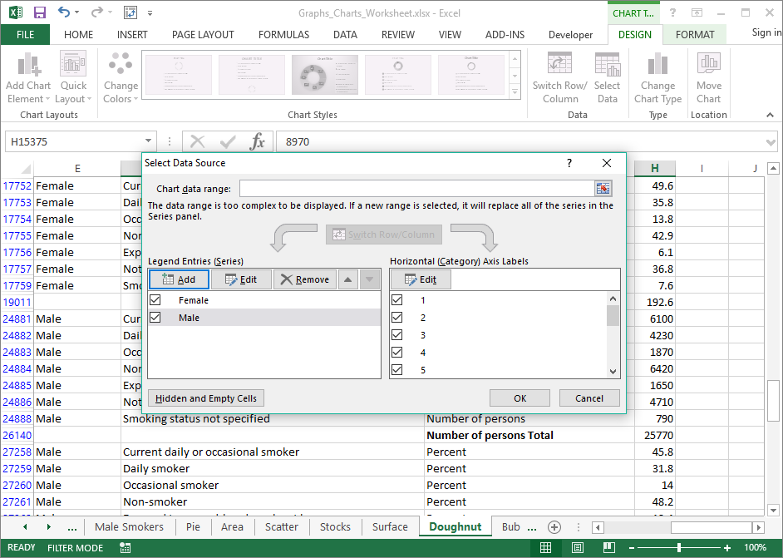




Now that the Female series of data is labeled, we need to add the data for the males and label that data series as Male.
Making a Doughnut Chart
Click on Add in the Legend Entries (Series).
Now click on the Select Data Series button again to expand the dialog box.
Type Male in the Series name field.
Now click on the OK button.
Click on the Select Data Series button.
to get
Select the Male Smoking data as shown, only the numbers.
You may have to move the Female chart out of the way and scroll down on the table to find that data.
Click once again on the OK button.

Slide 40

Making a Doughnut Chart
We have a doughnut chart with both the Female and Male smokers data in two rings, but the chart is poorly formatted and does not give us much information.
So let’s rearrange it so it looks better and tells us more.

Slide 41

Making a Doughnut Chart
This is how the doughnut chart should appear after we add some labels & resize the chart objects.

Slide 42

Tips for Formatting Your Chart.
Make sure the object you want to format is selected.
Although 3D might look nicer, does it fit the chart you have chosen and the data you are presenting?
You can right click the object to select it or select it from the format ribbon.
Don’t over format your chart, you want it to emphasis the data, not detract from it.
Changes you make are presented as soon as you make them so you can see the result “real time”.
Don’t clutter your chart with over-labelling.
A reminder of the parts of the chart
Chart Area
Plot Area
Legend
Data Markers
Chart Wall
Data Series
Chart Title
Chart Area
Plot Area
Vertical Axis
Legend
Horizontal Axis
Chart Floor

Slide 43

We have covered here in this course …
What is our direction in this course?
Choosing the Data You Present
Chart Types
Making a Column/Bar Chart
Parts of the Chart
Making a Pie Chart
Context Ribbons - Design
Making a Doughnut Chart
Context Ribbons - Layout
Tips for Formatting Your Chart
Context Ribbons - Format

Slide 44

NITHA IT HelpDesk helpdesk@nitha.com
1(844)486-4842
Notes:
Please do not hesitate to ask any question regarding this session, and I will make sure to answer your question as soon as possible.

Slide 45


