Slide 1


Excel 2013 Formulas & Data
Advanced Level

Slide 2



NITHA IT Helpdesk
helpdesk@nitha.com
1(844)486-4842

Slide 3

NITHA - IT Helpdesk Courses Registration Website
How do I get to the Courses Registration Website?
First, open up your favorite web browser.
Finally, press ENTER on our keyboard
Second, type in the address bar the URL, nitha.com/courses

Slide 4

NITHA - IT Helpdesk Courses Registration Website
The NITHA Computer Training Courses Calendar
There are four sections to the
IT Helpdesk Courses Registration Website
The calendar – As seen on the right,
the calendar displays the selected month and all the course links on the appropriate days.
Morning courses 9:30 AM to 11:30 AM
Afternoon courses 2:00 PM to 4:00 PM

Slide 5
NITHA - IT Helpdesk Courses Registration Website
Cycle forward through the months by clicking on the next month
The NITHA Computer Training Courses Calendar
Cycle backward through the months by clicking on the previous month
And of course, the month in the middle is the currently displayed month.

Slide 6
NITHA - IT Helpdesk Courses Registration Website
or the next year
The NITHA Computer Training Courses Calendar
You can even click on the previous year

Slide 7
NITHA - IT Helpdesk Courses Registration Website
The NITHA Computer Training Courses Calendar
Click on the course link of your choice and you will be taken to a registration page.

Slide 8

NITHA - IT Helpdesk Courses Registration Website
The NITHA Computer Training Course Registration page
Enter your information
Select how you are going to attend the course
by WebEx
by Telehealth
Select how you want your Certificate of Completion delivered.
by Email as a PDF
by Canada Post

Slide 9
NITHA - IT Helpdesk Courses Registration Website
The NITHA Computer Training Courses WebEx Info
WebEx Information – For the WebEx connection information on how to attend the courses in the current week, click on the WebEx link.

Slide 10

NITHA - IT Helpdesk Courses Registration Website
The NITHA Computer Training Courses Calendar
These links display the WebEx information for that course
These links download the ICS file for that course so that you can add it to your Outlook calendar as an event.

Slide 11
NITHA - IT Helpdesk Courses Registration Website
The NITHA Computer Training Courses Download
Course Files Download – The courseware and the data files which are used in the courses are all available for download any time whether or not you are taking the course.
click on the Course Files Downloads link
To download the
Courseware file (A PowerPoint file)
and/or
Sample data files used in the course

Slide 12

NITHA - IT Helpdesk Courses Registration Website
The NITHA Computer Training Courses Calendar
The Course Sample File is the data file used in the course.
The PowerPoint Courseware File is the course itself.

Slide 13
NITHA - IT Helpdesk Courses Registration Website
The NITHA Computer Training Courses Calendar
Tech Videos are the fourth section of the website. As they are created, they will be placed here.
Tech Videos are short 3 to 15 minute videos featuring solutions to various tech issues.

Slide 14

What will we be covering in this course?
What is the direction for this course.
Sorting, Filtering and Restricting the Data
The Ribbons & the Commands
Categories of Functions Provided By Excel
Some Relevant Definitions
Exercise in Using:
Information Functions
Connecting to MS Access Data
Logical Functions
Math Functions
Statistical Functions
Importing CSV Data
Text Functions
Database Function & an Exercise in Using Them

Slide 15
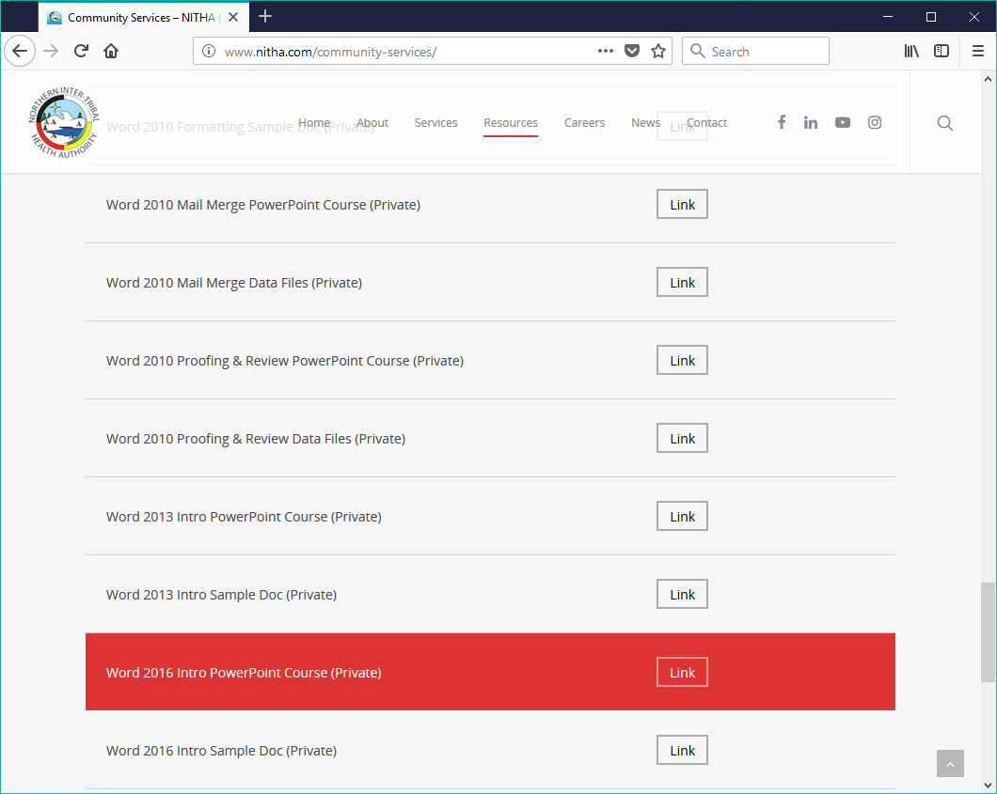
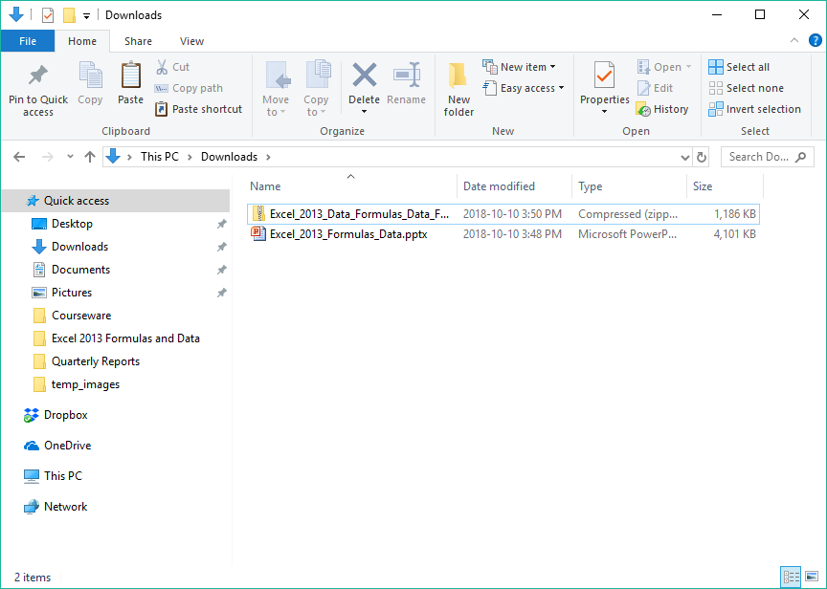
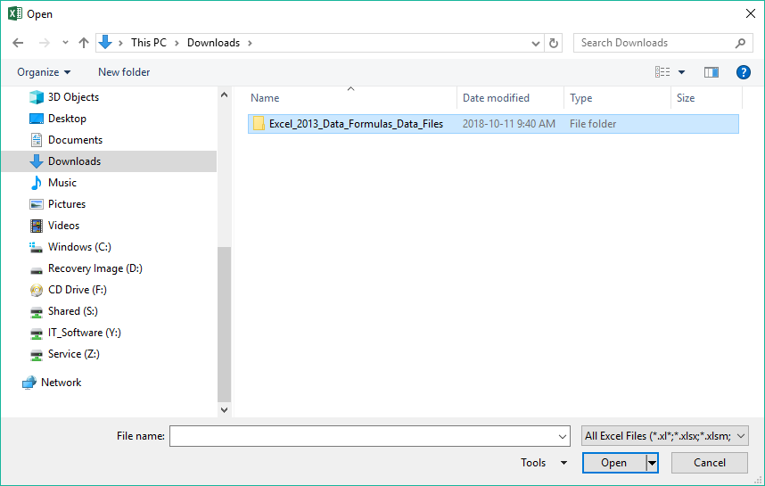
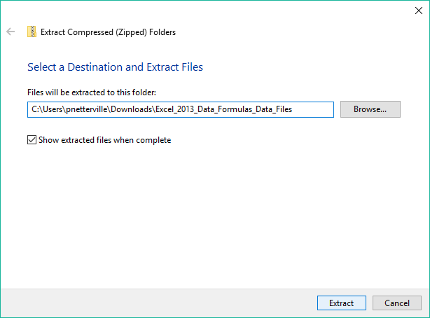
Exercise One
Browsing for the course file
Download the course data file from NITHA’s website
Open the folder which contains the Excel_2013_Data_Formulas_Data_Files file.
This will probably be the Downloads folder.
You will need to extract the files because they are in a compressed ZIP format …
Right-click on the Excel_2013_Data_Formulas_Data_Files file which will display this dialog …
Click on Extract.
Which makes a folder where the extracted files live.

Slide 16
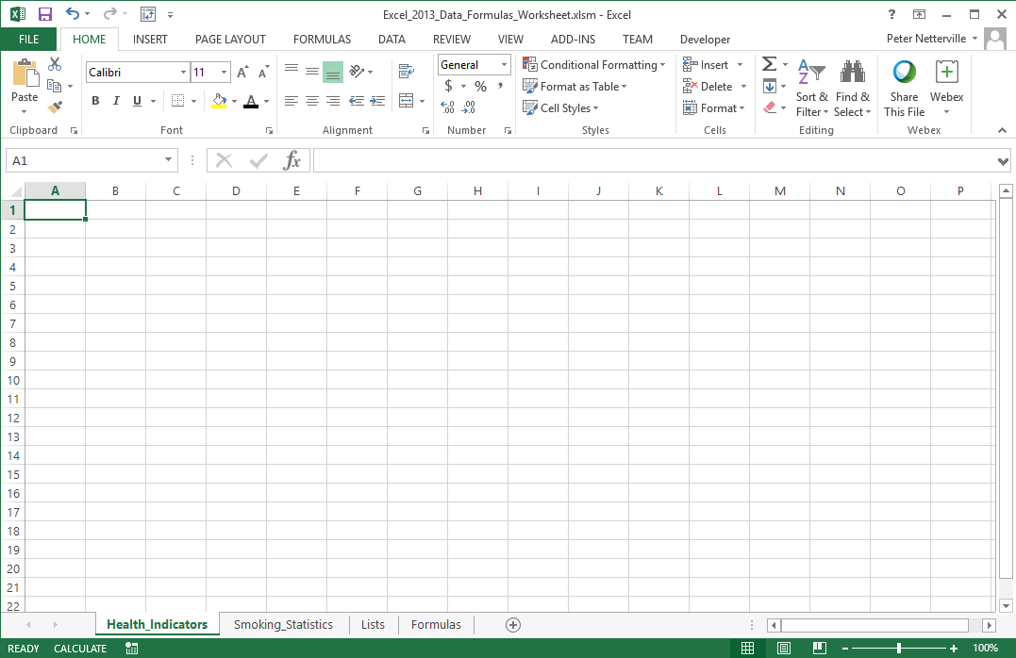
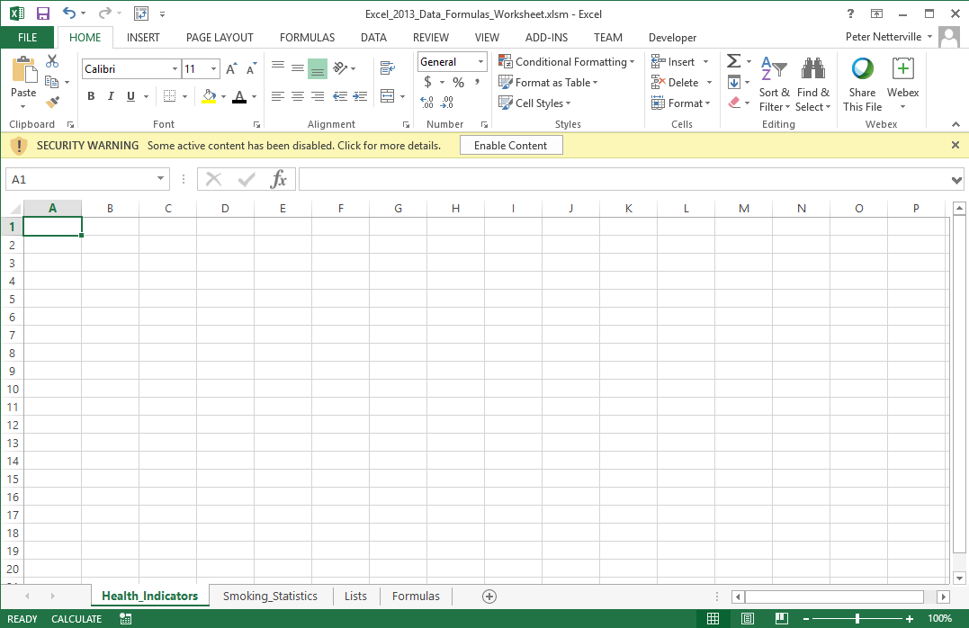
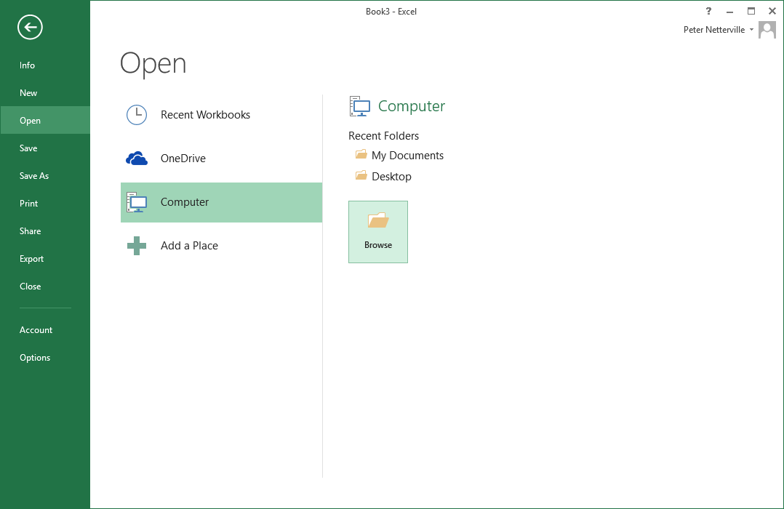
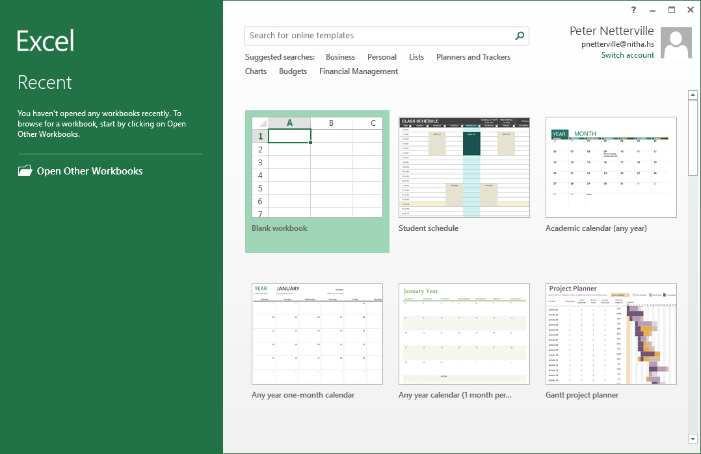
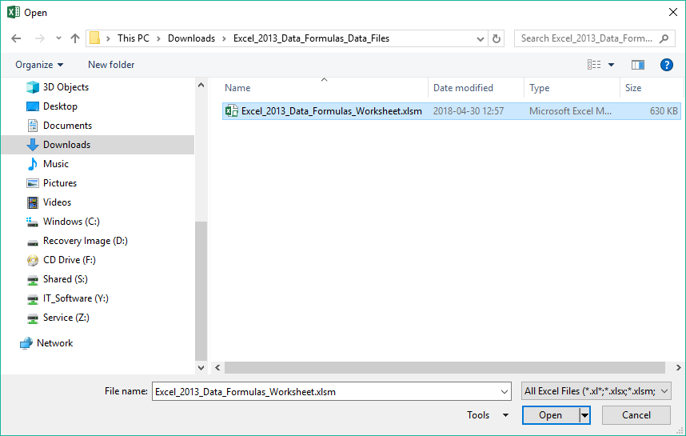
Exercise One
Run Excel 2013 and load the workbook .xlsm file
When you first start Excel 2013 the first screen you see is this …
Click on Open Other Workbook …
Click on Computer
Click on Browse
Now, click on Enable Content
After browsing for the folder with the data files in the downloads folder…
Select the .XLSM workbook

Slide 17
What is our direction in this course?
Assumption 1:
I will be assuming you have a basic knowledge Excel: navigation, screen layout, etc.
Assumption 2:
You must know the following:
  What are ribbons both regular and contextual.
  What are spreadsheets, how to navigate them, and how do you create more of them.
What is a dialog box and what is a window pane.
Our goal is to import data and then use Excel provided functions to the data in our formula.
To accomplish our goal we will have to:
Learn how to connect to an outside source of data and to import data.
Know how to use the appropriate function(s) on the data to achieve our goal.
Learn how to step through our formula(s) and troubleshoot possible issues.
Definitions …
Formula – A formula is a mathematical expression telling Excel what mathematical operation(s) to perform upon
specific value(s).
Function – A function is a predefined formula available in Excel. All you need to do is plug in the appropriate data.

Slide 18
Important Caveat
The data we are going to use and the correlation between that data is not necessarily an accurate health data comparison.
It is the methodology of connecting to a database, importing data, restricting the data so that it is usable, and using Excel functions to pull data from those two sources to produce a result that is the intended purpose of this course.

Slide 19
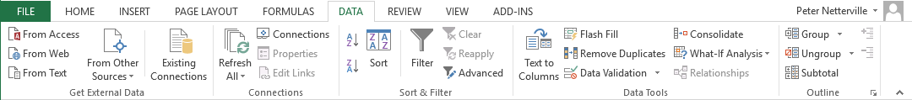
First we will need to go through the methods for connecting and/or importing data. – Get External Data
From Access – Access is a relational database application provided in the professional
version of MS Office. You can either connect to entire tables or pull specific data using an Structured Query Language (SQL) call.
From Web – Imports the contents of the webpage. Be cognisant of the copyright of the data
you are importing.
From Text – Import text from a file. This text is separated by a delimiter.
Definition: A delimiter is a character that separates data values.
Typically data in a text file is delimited by a comma or a tab character and each new row of data is delimited by the carriage return character.
For example, in the file you might see:
First Name, Last Name, Address1, Address2, City, Province, Country
John, Smith, Apt. 1234, 123 Street, Prince Albert, SK, Canada

Slide 20
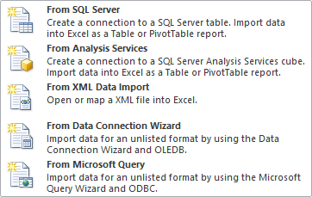
First we will need to go through the methods for connecting and/or importing data. – Get External Data
Click on the From Other Sources button.
From SQL Server – With the proper connection, database, table(s), and field(s)
information you can pull data from an SQL (Structured Query Language) server.
From Analysis Services – From an SQL server, this data is represented as
data cube.
Definition: A data cube is the data structure provided by an SQL Server Analysis
Service (SSAS) data server which provides users with rapid access searchable data from any data point in the cube. This is the next software evolution of databases after relational databases.
This allows the user to present the data in the cube from multiple perspectives.

Slide 21
First we will need to go through the methods for connecting and/or importing data. – Get External Data
From XML Data Import – Extensible Markup Language (XML) is a language which
self defines the data. All data is textual, so all XML files are standard text. When importing XML data, the data field name is defined and accompanied by the data.
From Data Connection Wizard – In addition to the first two connection options,
From SQL Server and From Analysis Services, you can connect to …
ODBC DSN – From Open DataBase Connectivity Data Source Name dialog
found in the Administrative Tools you can connect to a variety of other sources such as dBase files so long as you have the driver for it.
OLE DB – Object Linking and Embedding DataBase connections use the low
level Component Object Model (COM) system of Windows to connect to COM object databases. This is a very powerful function that we will not be covering in this course.

Slide 22
First we will need to go through the methods for connecting and/or importing data. – Get External Data
From Microsoft Query – This function allows you to build a data query on any
existing database connections you have created. If none are created, then you can connect to a new data source from this dialog.

Slide 23
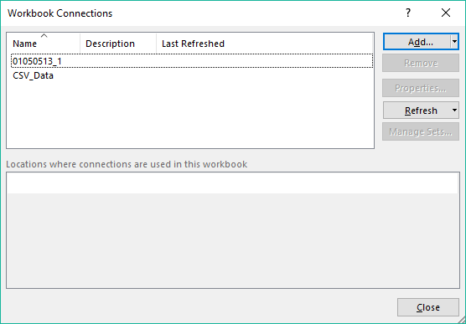
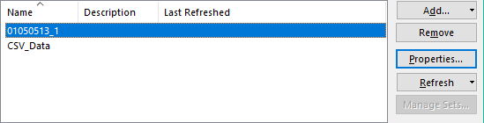
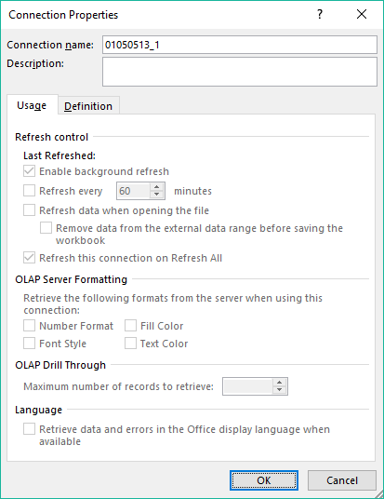
First we will need to go through the methods for connecting and/or importing data. – Connections
In the Connections group
Connections – This allows you to add a database connection to
your workbook.
If the connection exists you can …
select it from the list to add it to the workbook
check its’ properties
remove it either as added to the workbook or entirely from the list
refresh it in case the data source has changed
If a connection does not exist, you can add a new connection from the Connections dialog.
Refresh All – Refreshes all database connections added to the workbook.

Slide 24
Some definitions we will need to know
Database
A database as defined in Excel is a flat database, the simplest type of database, includes a range of columns and rows with the column header the name of the data in that column.
Record
A record in Excel is defined as a row of data. A typical spreadsheet has column headers which define the name of the data in that column. A row of data has one item of data from each column in the row, and each row is one record.
Field
A field in Excel is typically one cell of data, but can also refer to a cell range, or a defined name of cells.
Field Name
A field name in Excel is the column header.
Data Type
A data type is the formatting applied to the column done from the Format Cells / Number column. For example, number, currency, accounting, date, time, percentage, fraction, text, etc.
Criteria
Another name for criteria is condition. So, criteria is one or more conditions that has to be met for the function to return a result.
As we go through the course and use the functions these definitions will become clearer.
Probably the most difficult one to understand is criteria.

Slide 25
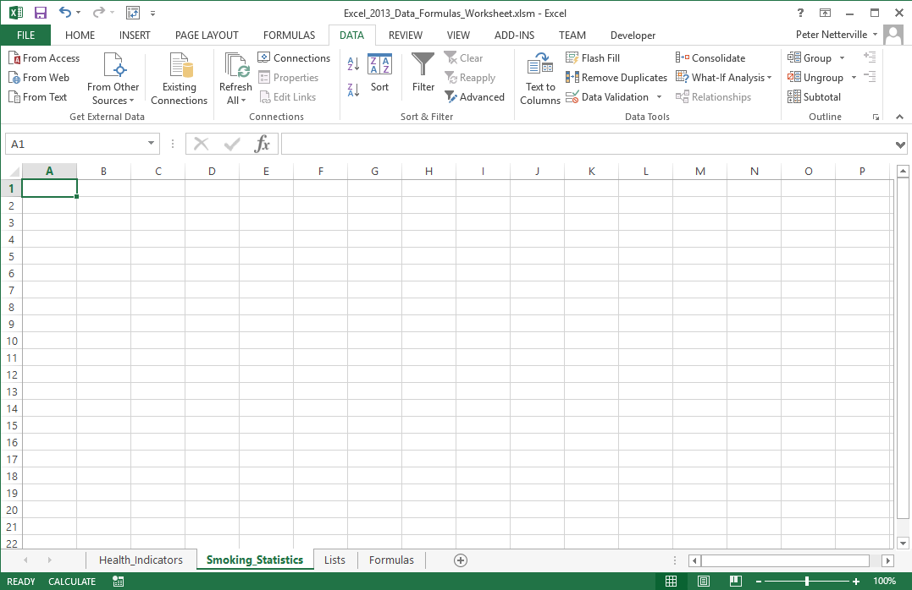
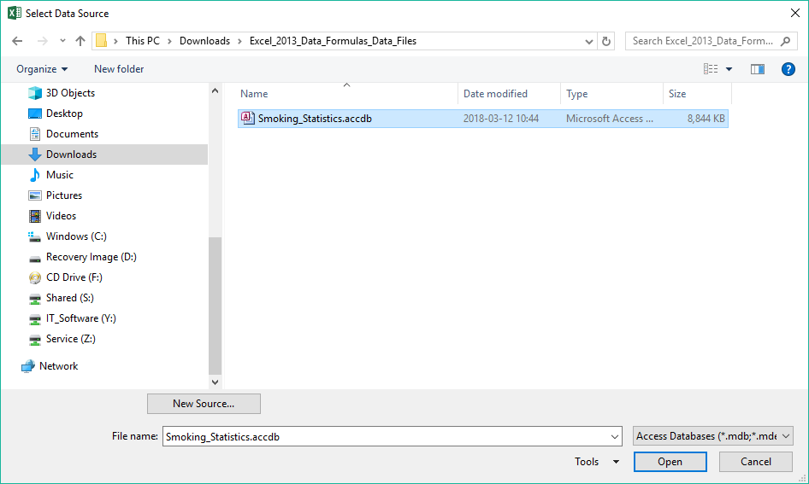
First step … Connect to the Access database.
Click on the From Access command
Browse to where you have the data files for this course, in the downloads folder.
Select the Smoking_Statistics.accdb file
Click on Open
Select the Smoking_Statistics sheet.

Slide 26
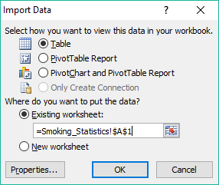
First step … Connect to the Access database.
Click on Table
Click on Existing worksheet
We want to place the data on to its’ own spreadsheet, so make sure the text box has in it, =Smoking_Statistics!$A$1
It is easiest to do this by clicking on button
Click once on the Smoking_Statistics sheet tab
Click once on cell A1
Click on the button again
Click on OK

Slide 27
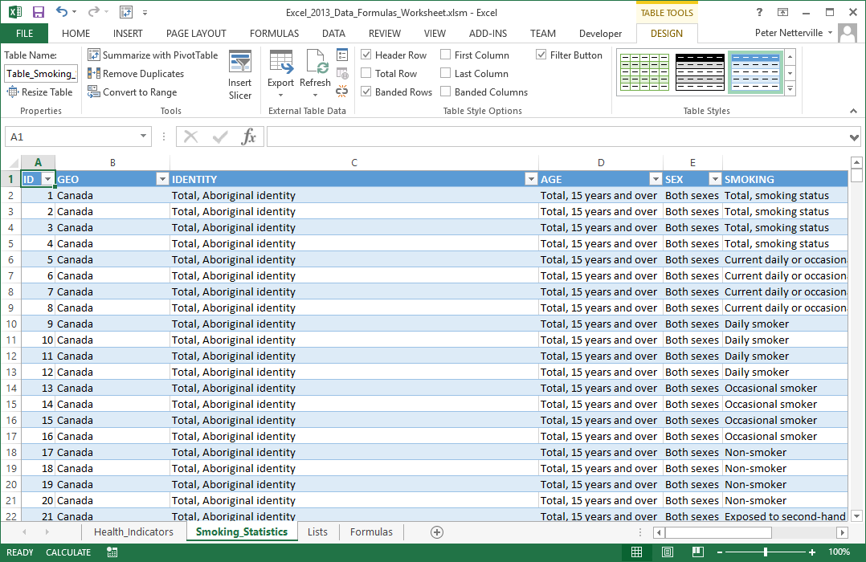
The Smoking_Statistics sheet should look like this now.
Next, click on the Health_Indicators sheet tab.

Slide 28
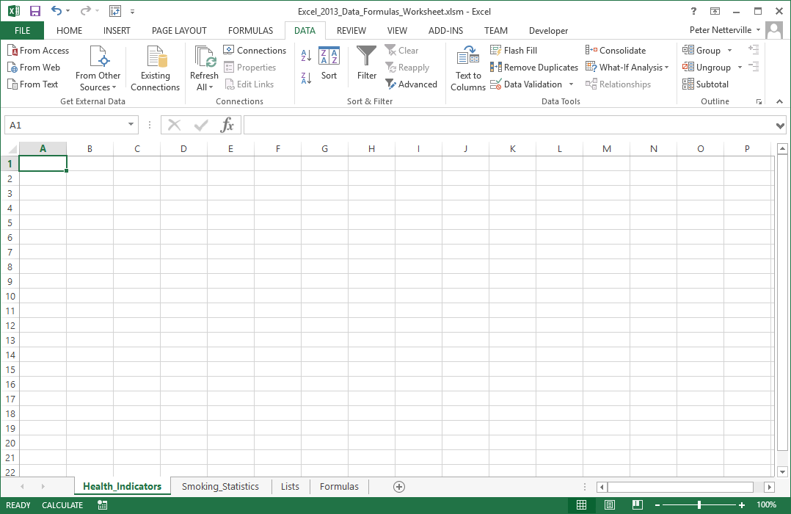
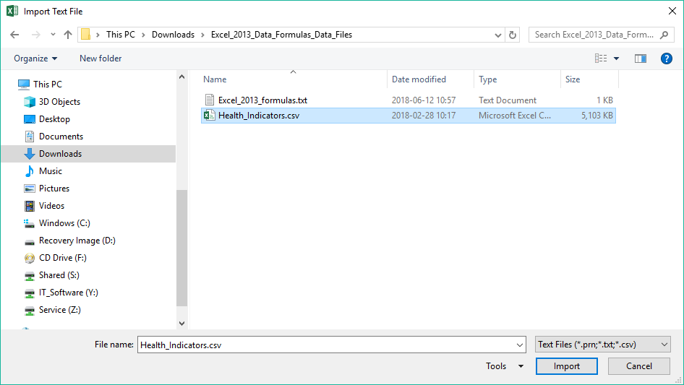
Next step … Import the CSV data.
Note: This button says Import whereas with the Access database the button said Open.
For the Access database Excel …
connects to the Access database,
reads the data from the database, and
remains connected to the file.
Click on the From Text command
For the CSV text file…
the data is imported, then
the file is closed, disconnecting it from Excel.
Browse to where you have the data files for this course
This is important to know because that means any changes in the Access file will mean the data changes in the Excel file too, though you might need to refresh the data connection in Excel. The connection to the Access file is live.
The same in not true for the CSV file. It is a one time import.
So, import means a one time retrieve the data, and open means connect to the source and keep the connection live.
Select Health_Indicators.csv file
Click on Import.

Slide 29
Next step … Import the CSV data.
Make sure the File Origin field says 28593: Latin 3 (ISO)
Click on Delimited
Click on Next

Slide 30
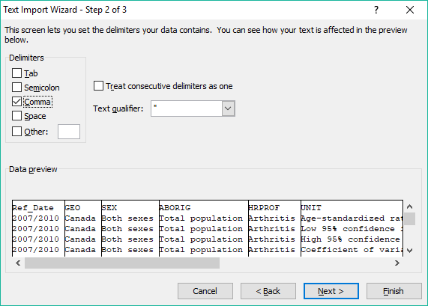
Next step … Import the CSV data.
this is a CSV (Comma Separated Values) file.
Uncheck Tab
Check Comma
because
Click on Next

Slide 31
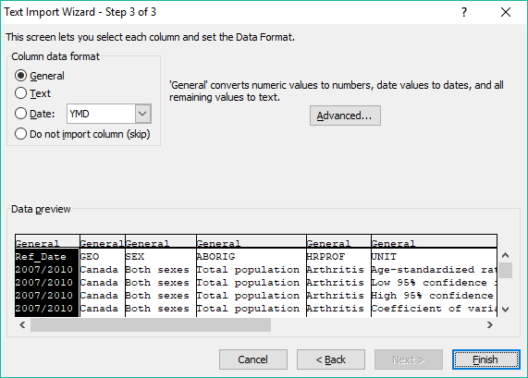
Next step … Import the CSV data.
With the Column data format group you can choose the data format (also called data type) of the selected column.
Since the Ref_Date column is selected, then the data format selection would be applied to that column.
Since this is not a valid date format, we can leave it at General.
In fact no column needs to have its’ data format set. They can all be left at General.
Click on Finish

Slide 32
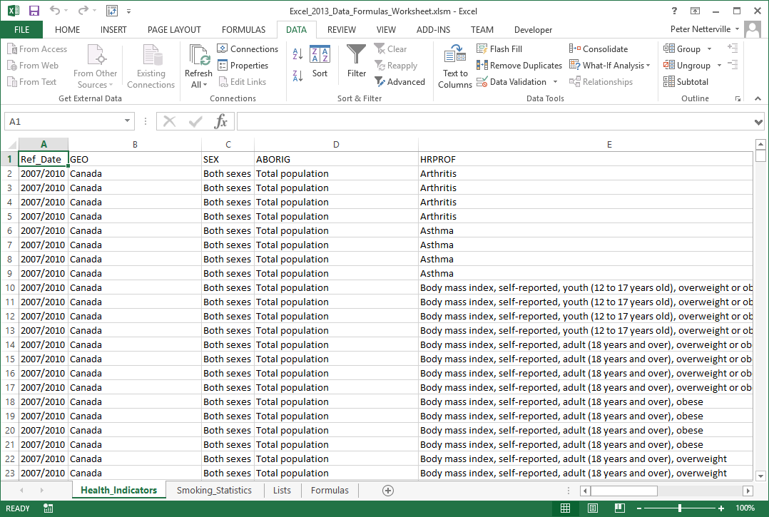
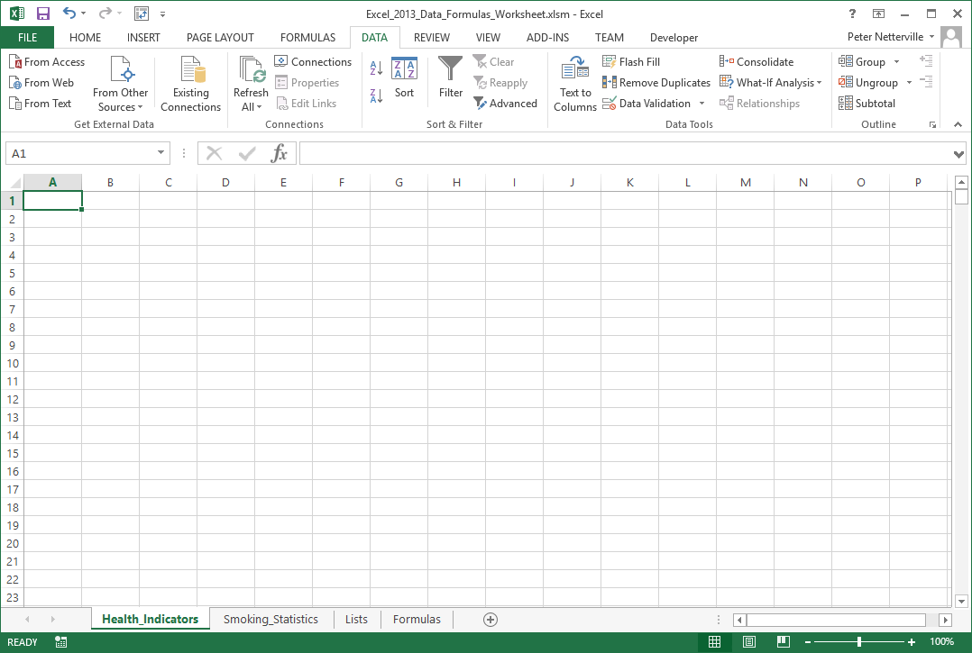
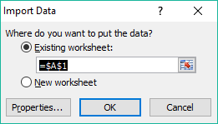
Next step … Import the CSV data.
Place the data on the Data sheet in cell A1
Now we have all the data for both spreadsheets.

Slide 33

Select the Formulas sheet. If you don’t have it opened, then please open it up at this time.
Parameter – A parameter is a constant or variable value. In this case, it is the data that you pass to a function.
The following is a list of database functions:
Function Parameters:
For all database functions the format is … Database_Function(Database, Field, Criteria)
Database = The range of cells you want to apply the criteria against, usually the entire table.
Field = The column in the database against which the criteria is applied to produce the result.
Criteria = The cell or range of cells that contain your criteria, the conditions.
Database functions
DAVERAGE
Averages the values of the specified cells, list or database that matches the conditions you have set and returns a numeric value.
DCOUNT
Counts the number of cells containing data or records containing data that match the search criteria you provide and returns a positive integer.
DCOUNTA
Counts the number of cells containing nonblank cells or records containing nonblank cells that match the search criteria you provide and returns a positive integer.
DGET
Gets from a database a single record that matches the criteria you provide.
DMAX
Returns the largest number in the field of records in the database that matches the criteria you provide.

Slide 34
The following is a list of database functions (continued):
Database functions
DMIN
Returns the smallest number in the field of records in the database that matches the criteria you provide.
DPRODUCT
Returns the value of the field of records in the database that matches the criteria you provide multiplied together.
DSTDEV
Estimates the standard deviation based on your section from the database.
DSTDEVP
Calculates the standard deviation based on the entire population of the selected database entries.
DSUM
Adds the numbers of your selection from the database that match the criteria you specify.
DVAR
Estimates the variance based upon the your selection from the database matching the criteria.
DVARP
Calculates the variance based upon the entire population of the selected database entries.
We won’t be using all the database functions, just DAVERAGE, DCOUNT, DMIN, DSTDEV, DVARP

Slide 35
NOTE: There is a text file provided called Excel_2013_formulas.txt that has all of the formulas
and functions already typed up for you. Just copy and paste them into the cells indicated.
For this exercise, we will use some features of Excel that you may not have used before. They are …
Make three lists of unique data values from three columns by using a macro written in Visual Basic for Applications (VBA).
Make a drop down selection box for those lists which will define the criteria parameter of the database function.
On the Formulas sheet enter the following database functions …
In cell A5 enter …
=DAVERAGE(Health_Indicators!A1:I31593,Health_Indicators!I1,Formulas!D2:F3)
In cell A8 enter …
=DCOUNT(Health_Indicators!A1:I31593,Health_Indicators!I1,Formulas!D2:F3)
In cell A11 enter …
=DMIN(Health_Indicators!A1:I31593,Health_Indicators!I1,Formulas!D2:F3)
In cell A14 enter …
=DSTDEV(Health_Indicators!A1:I31593,Health_Indicators!I1,Formulas!D2:F3)
In cell A17 enter …
=DVARP(Health_Indicators!A1:I31593,Health_Indicators!I1,Formulas!D2:F3)

Slide 36
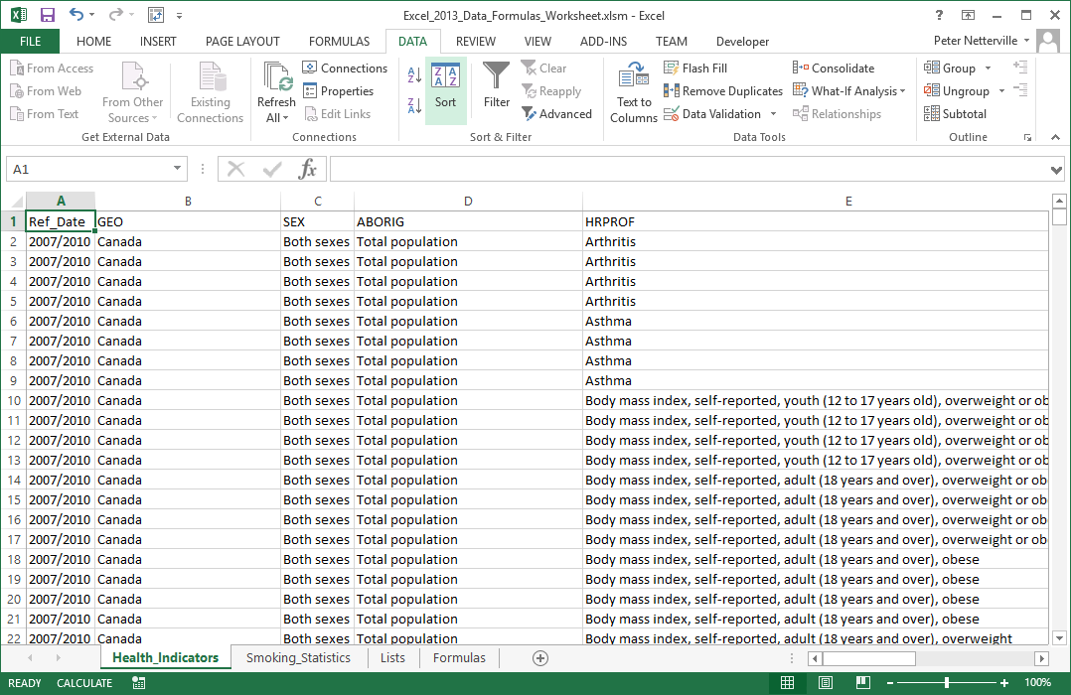
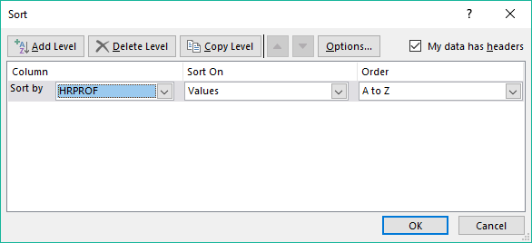
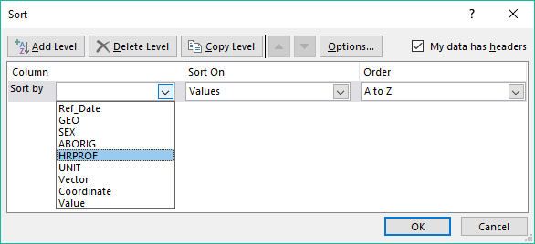
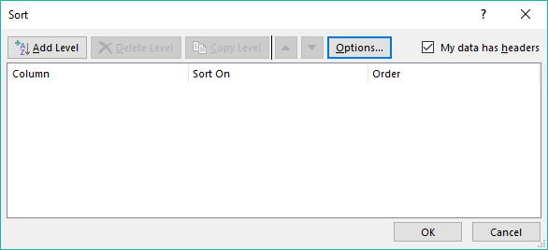
Work with the Health_Indicators (CSV imported data) to restrict the data
Sort the data by HRPROF
Click on Add Level

Slide 37
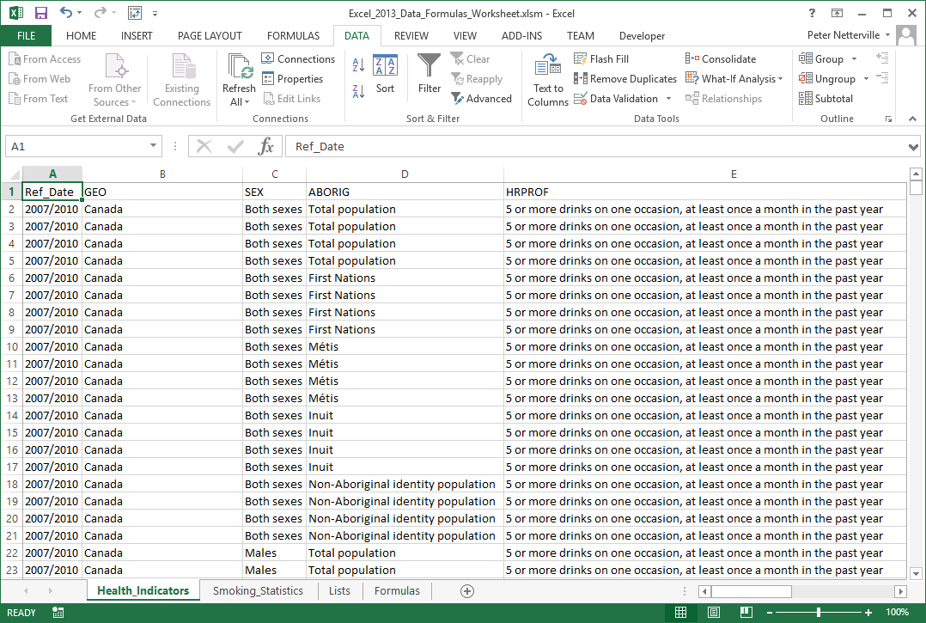
Work with the Health_Indicators (CSV imported data) to restrict the data
Click on the Filter button.

Slide 38
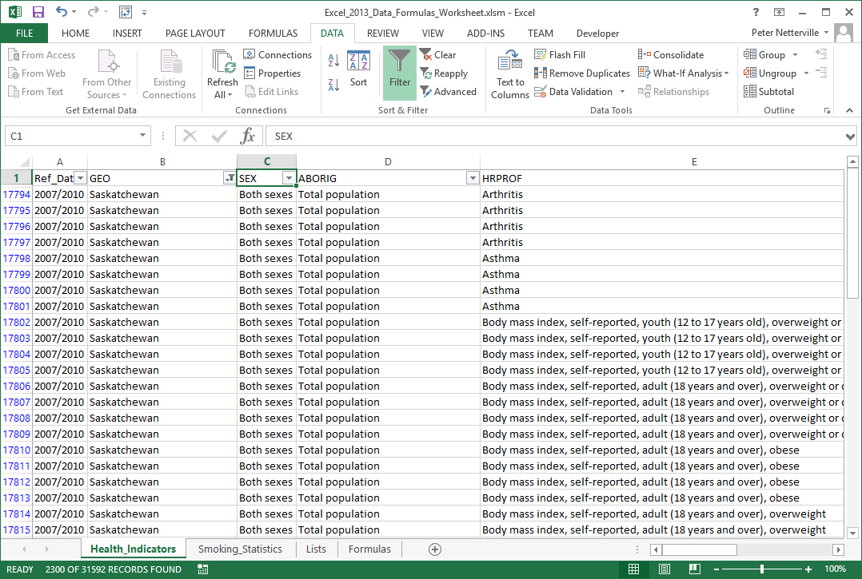
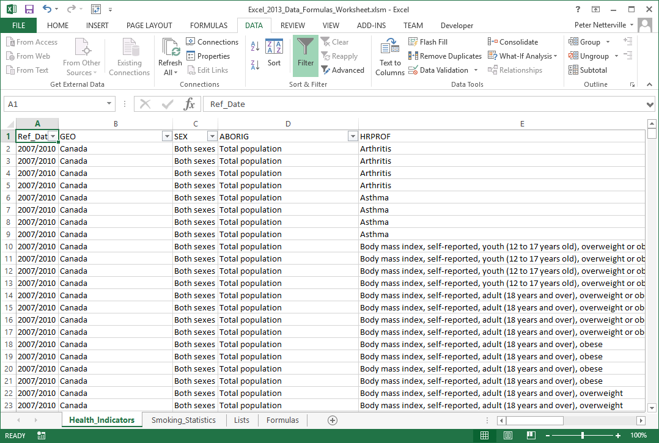
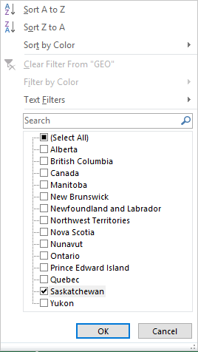
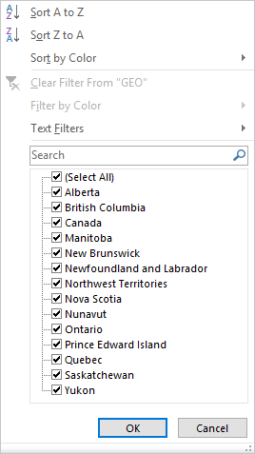
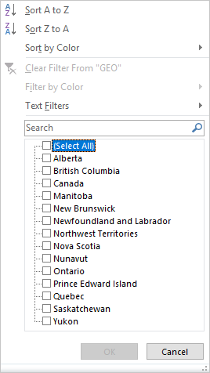
Work with the Health_Indicators (CSV imported data) to restrict the data
Filter by the following
GEO
Saskatchewan only
Click on the (Select All) check box to deselect all the options.
Then click on Saskatchewan to select in only.
Notice that when you clicked on Filter down-arrows appeared to the right side of the header names for each column.
2300 of 31592 records

Slide 39
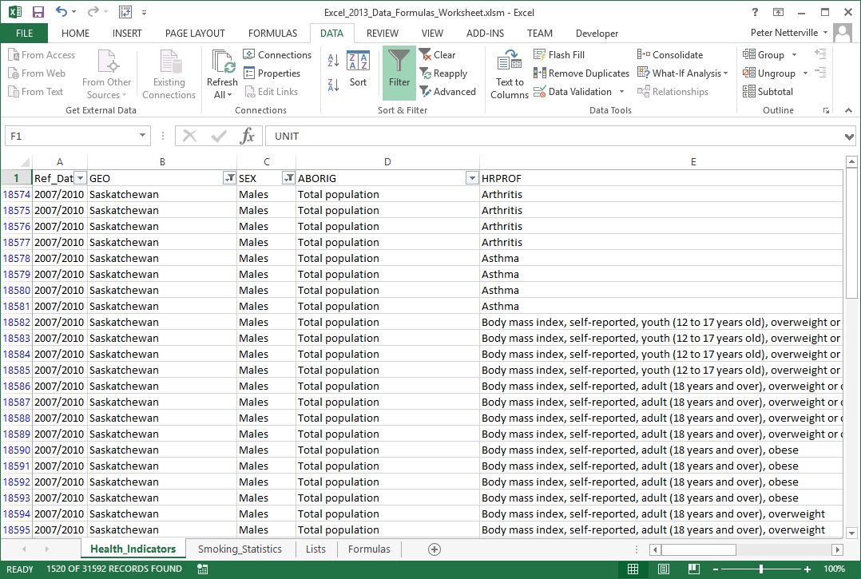
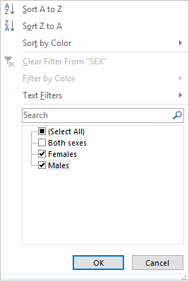
Work with the Health_Indicators (CSV imported data) to restrict the data
Filter by the following
SEX
Female & Males only
1520 of 31592 records

Slide 40
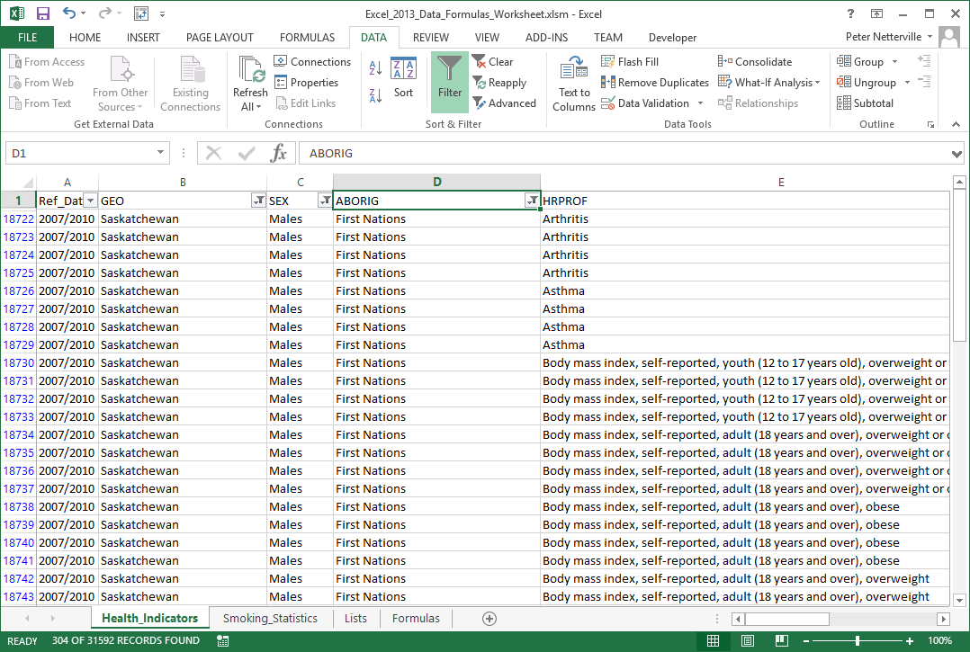
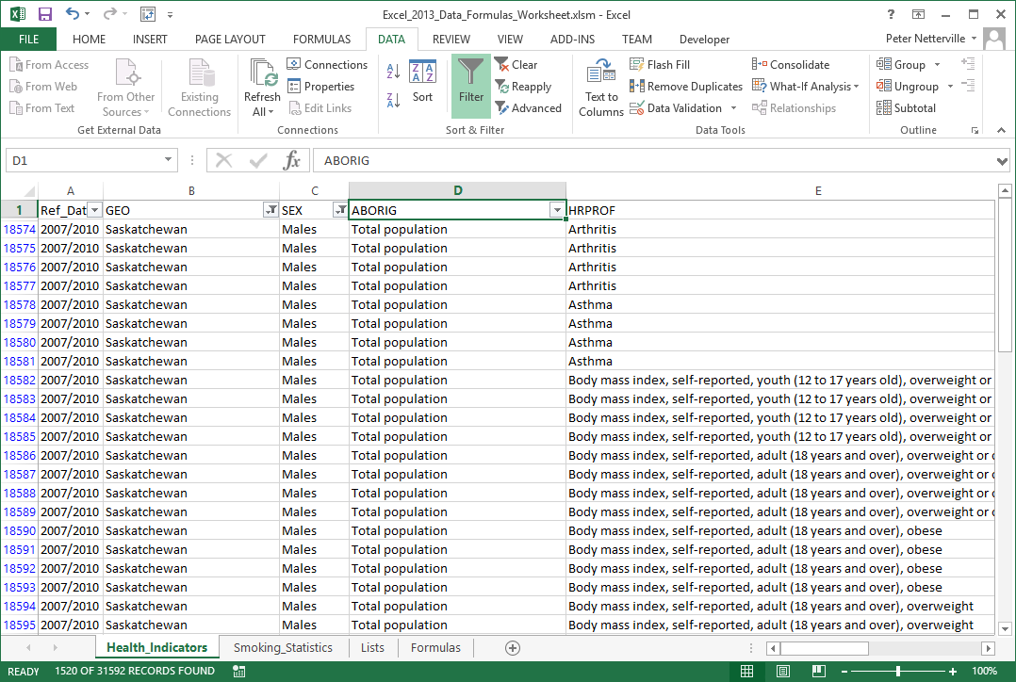
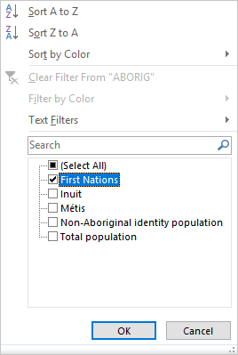
Work with the Health_Indicators (CSV imported data) to restrict the data
Filter by the following
ABORIG
First Nations only
304 of 31592 records

Slide 41
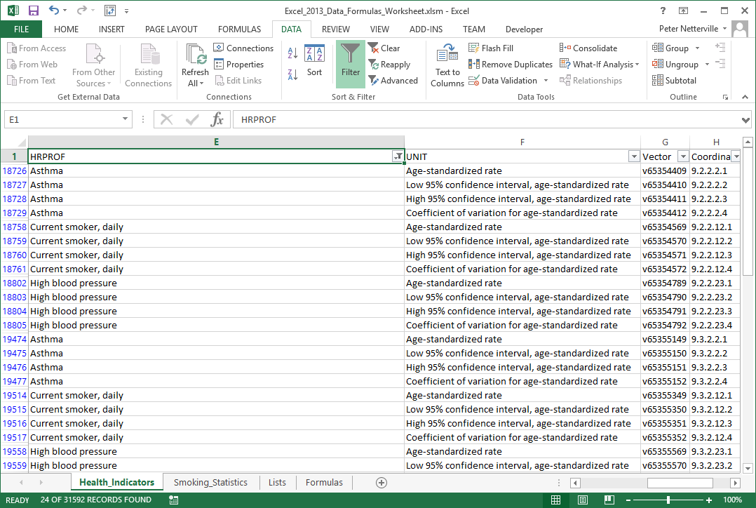
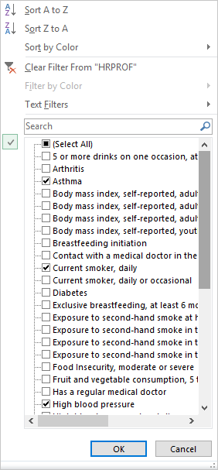
Work with the Health_Indicators (CSV imported data) to restrict the data
Filter by the following
HRPROF –
Asthma,
Current Smoker Daily,
High Blood Pressure
24 of 31592 records

Slide 42
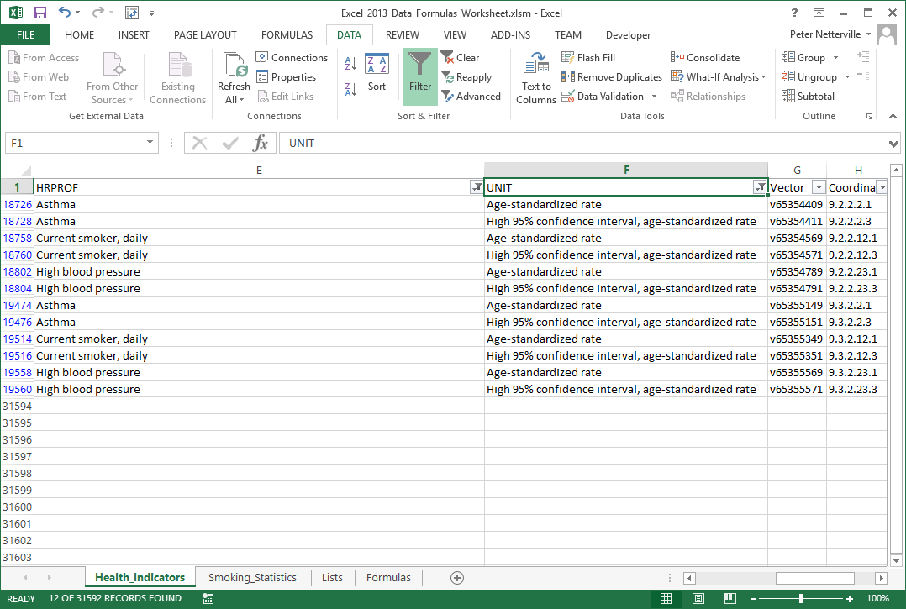
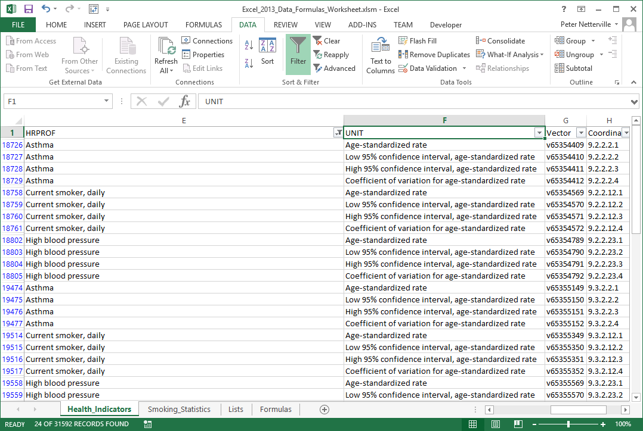
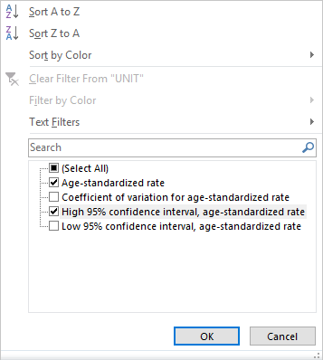
Work with the Health_Indicators (CSV imported data) to restrict the data
Filter by the following
UNIT
High 95% confidence interval,
age-standardized rate
12 of 31592 records

Slide 43
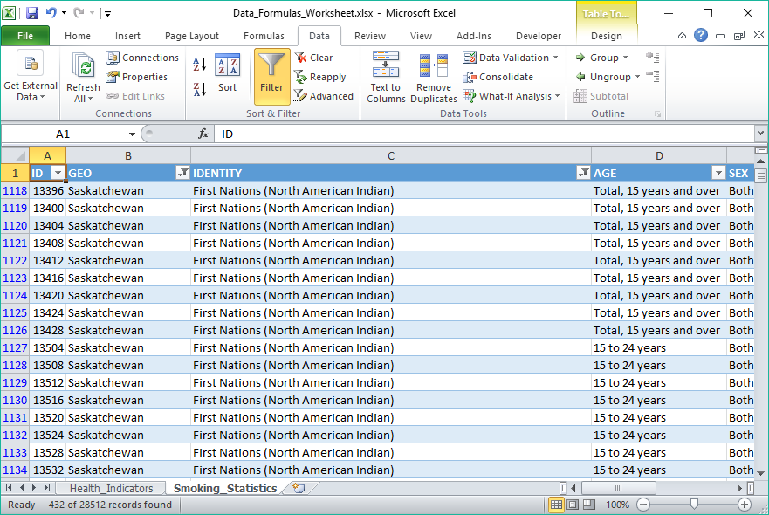
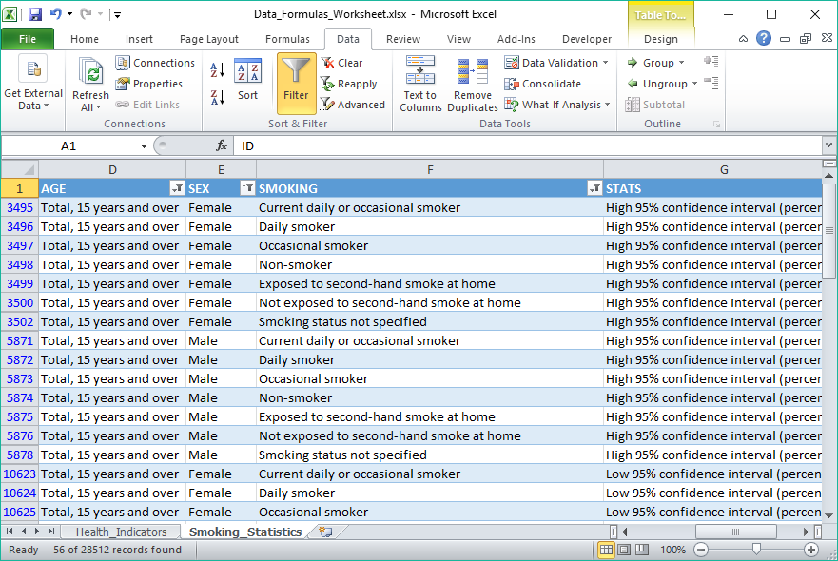
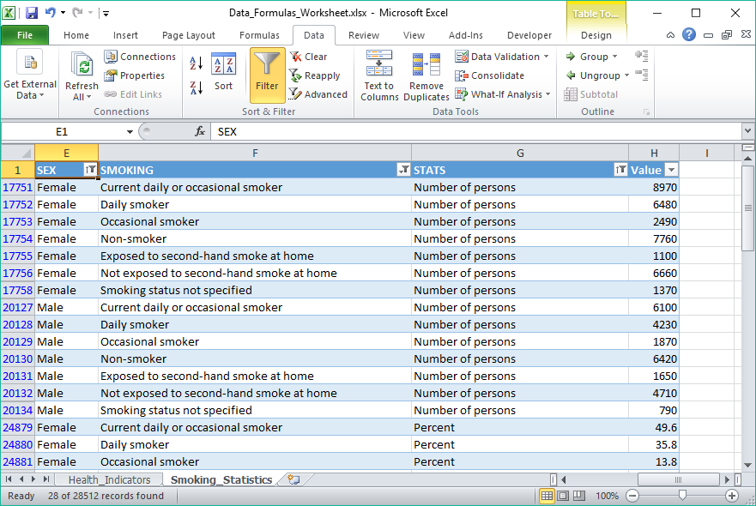
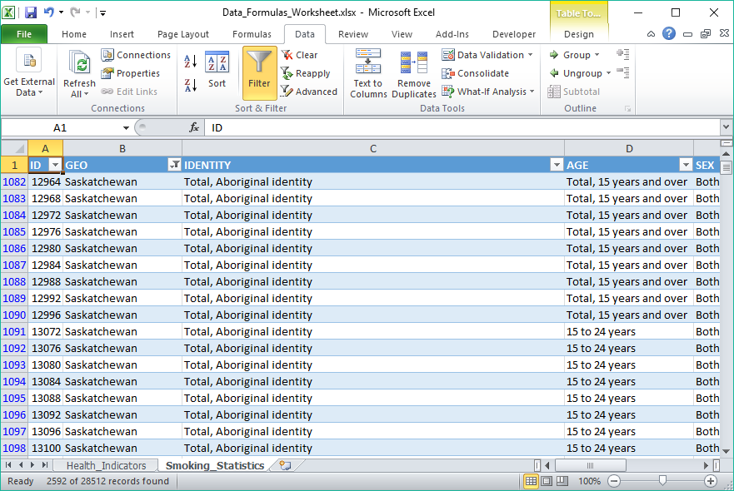
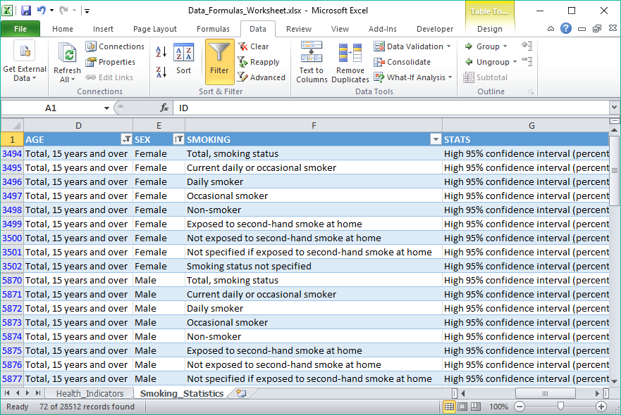



Work with the Smoking Statistics (Access data) to restrict the data
Sort the data by STATS then SEX
Filter by the following
GEO – Saskatchewan only
IDENTITY – First Nations
(North American Indian)
AGE – Total, 15 years and over
SEX – Female & Male only
SMOKING – All except
Not Specified … and Total …
STATS – Number of Persons and
Percent
We should have twenty eight rows of data now.

Slide 44
Function Categories
The function bar shown below is directly above the column headers.
Name Box
Insert Function box. Click on the icon to open the functions dialog.
Function/Formula bar
Formula Categories
Compatibility – These functions make Excel 2010 functions compatibility with older versions of Excel.
Cube - Multidimensional sets of data providing a means to summarize information based on a set of search criteria.
Database – Treating an Excel spreadsheet as a flat database, these functions return a search based on sum, variance, and standard deviation data.
Date & Time – These date and time functions allow you to work with the current time or periods of time in your functions.
Engineering – Engineering calculations: many of which relate to Bessel Functions, Complex Numbers or converting between different bases.
Information – These functions return information about the contents and/or formatting of a cell.
Logical – Flow control, logic and error capture.
Math & Trigonometry – ABS, sine, cosine, logarithmic, Pi, Quotient, etc.
Statistical – Works with data points, deviations, and more.
Text – Use these function to manipulate text.
Web – XML and web services functions.
Notes:
Have them follow along in the functions dialog box if they have a computer in front of them.

Slide 45
On the Formulas sheet enter the following formulas …
Math
  ROUND Function (cell E40)
    =ROUND(A14,4)
  TRUNC Function (cell E43)
    =TRUNC(A14)
We will use the following Excel functions on the Formulas:
Information
  INFO Function (cell E21)
  =INFO(D21)
  ISERR Function (cell E24)
  =ISERR(E21)
  ISODD Function (cell E27)
  =ISODD(A8)
Statistical
  AVERAGE Function (cell E48)
    =AVERAGE(Health_Indicators!I7636,Health_Indicators!I7656,Smoking_Statistics!H24880,Smoking_Statistics!H27256)
  MEDIAN Function (cell E51)
    =MEDIAN(Health_Indicators!I7636,Health_Indicators!I7656,Smoking_Statistics!H24880,Smoking_Statistics!H27256)
Logical
  IF Function (cell E32)
  =IF(A5>A17,"DAVERAGE is greater than DVARP","DVARP is greater then DAVERAGE")
IFERROR Function (cell E35)
  =IFERROR(E21, "Cell E21 reports an error")
Take notice that the values for all the statistical functions are separated by a comma, not a colon.
Why is that important?

Slide 46
On the Formulas sheet enter the following formulas …
We are going to do just one formula in the Text category, but we will be embedding functions within functions.
Text
  The formula below takes the text from cell E7636 on the Health_Indicators sheet, “Current smoker, daily”, and makes a text string “Current daily smoker”.
  Why, you ask? To show you what you can do to manipulate the text as you want.
  The formula below looks complex, but it is not as bad as it looks.
  =CONCATENATE(LEFT(E7636,SEARCH(" ",E7636)-1)," ",RIGHT(E7636, LEN(E7636)-SEARCH(",", E7636)-1)," ",MID(E7636,SEARCH(" ", E7636)+1, 6))
We will be working with the following functions:
  Concatenate – Joins together text into one string.
  Search – Searches text to find a one or more character string.
  Left – Returns the left portion of a text string with the length specified.
  Mid – Returns the middle portion of a text string with the length specified starting at the position specified.
Right – Returns the right portion of a text string with the length specified.

Slide 47
Like all other formulas, the function is the following structure:
Function_Name(parameter1, parameter2, etc., etc.)
On the Formulas sheet enter the following formulas …
=CONCATENATE(LEFT(E7636,SEARCH(" ",E7636)-1)," ",RIGHT(E7636, LEN(E7636)-SEARCH(",", E7636)-1),
" ",MID(E7636,SEARCH(" ", E7636)+1, 6))
Concatenate can have as many strings (text) to join as you like, each separated by a comma. I have five for this formula.
=CONCATENATE(
LEFT(
E7636,
SEARCH(" ",E7636)-1
),
" ",
RIGHT(
E7636,
LEN(E7636)-SEARCH(",", E7636)-1
),
" ",
MID(
E7636,
SEARCH(" ", E7636)+1,
6
)
)
LEFT requires two parameters:
The text from which to take a slice (either static text or a cell).
The length of the slice to take measure in characters.
LEN requires one parameter:
A cell or static text.
It returns the length on the supplied parameter.
SEARCH requires two parameters, the third is optional:
The text to search for
The text to search in
The starting character number
SEARCH finds a one or more character string in the text supplied in parameter two and returns the starting position character number.
If you leave the third parameter empty, character position one is assumed.
five
RIGHT requires two parameters:
The text from which to take a slice (either static text or a cell).
The length of the slice to take measure in characters.
MID requires three parameters:
The text from which to take a slice (either static text or a cell).
Starting character.
The length of the slice to take measure in characters.

Slide 48

We have covered here in this course …
What is the direction for this course.
Sorting, Filtering and Restricting the Data
The Ribbons & the Commands
Categories of Functions Provided By Excel
Some Relevant Definitions
Exercise in Using:
Information Functions
Connecting to MS Access Data
Logical Functions
Math Functions
Statistical Functions
Importing CSV Data
Text Functions
Database Function & an Exercise in Using Them

Slide 49

NITHA IT Helpdesk helpdesk@nitha.com
1(844)486-4842
Notes:
Please do not hesitate to ask any question regarding this session, and I will make sure to answer your question as soon as possible.

Slide 50


