Slide 1


Excel 2013 Basics
Entry Level

Slide 2



NITHA IT Helpdesk
helpdesk@nitha.com
1(844)486-4842

Slide 3

NITHA - IT Helpdesk Courses Registration Website
How do I get to the Courses Registration Website?
First, open up your favorite web browser.
Finally, press ENTER on our keyboard
Second, type in the address bar the URL, nitha.com/courses

Slide 4

NITHA - IT Helpdesk Courses Registration Website
The NITHA Computer Training Courses Calendar
There are four sections to the
IT Helpdesk Courses Registration Website
The calendar – As seen on the right,
the calendar displays the selected month and all the course links on the appropriate days.
Morning courses 9:30 AM to 11:30 AM
Afternoon courses 2:00 PM to 4:00 PM

Slide 5
NITHA - IT Helpdesk Courses Registration Website
Cycle forward through the months by clicking on the next month
The NITHA Computer Training Courses Calendar
Cycle backward through the months by clicking on the previous month
And of course, the month in the middle is the currently displayed month.

Slide 6
NITHA - IT Helpdesk Courses Registration Website
or the next year
The NITHA Computer Training Courses Calendar
You can even click on the previous year

Slide 7
NITHA - IT Helpdesk Courses Registration Website
The NITHA Computer Training Courses Calendar
Click on the course link of your choice and you will be taken to a registration page.

Slide 8

NITHA - IT Helpdesk Courses Registration Website
The NITHA Computer Training Course Registration page
Enter your information
Select how you are going to attend the course
by WebEx
by Telehealth
Select how you want your Certificate of Completion delivered.
by Email as a PDF
by Canada Post

Slide 9
NITHA - IT Helpdesk Courses Registration Website
The NITHA Computer Training Courses WebEx Info
WebEx Information – For the WebEx connection information on how to attend the courses in the current week, click on the WebEx link.

Slide 10

NITHA - IT Helpdesk Courses Registration Website
The NITHA Computer Training Courses Calendar
These links display the WebEx information for that course
These links download the ICS file for that course so that you can add it to your Outlook calendar as an event.

Slide 11
NITHA - IT Helpdesk Courses Registration Website
The NITHA Computer Training Courses Download
Course Files Download – The courseware and the data files which are used in the courses are all available for download any time whether or not you are taking the course.
click on the Course Files Downloads link
To download the
Courseware file (A PowerPoint file)
and/or
Sample data files used in the course

Slide 12

NITHA - IT Helpdesk Courses Registration Website
The NITHA Computer Training Courses Calendar
The Course Sample File is the data file used in the course.
The PowerPoint Courseware File is the course itself.

Slide 13
NITHA - IT Helpdesk Courses Registration Website
The NITHA Computer Training Courses Calendar
Tech Videos are the fourth section of the website. As they are created, they will be placed here.
Tech Videos are short 3 to 15 minute videos featuring solutions to various tech issues.

Slide 14

What will we be covering in this course?
Excel Intro
Basic Spreadsheet Functions
Starting Excel
Downloading a workbook from NITHA
Opening the workbook in Excel
Navigating the Spreadsheet & Entering Data
Overview: What can Excel do?
Ribbons: Common and Contextual
Function Categories
The Rules
Common Used Functions

Slide 15
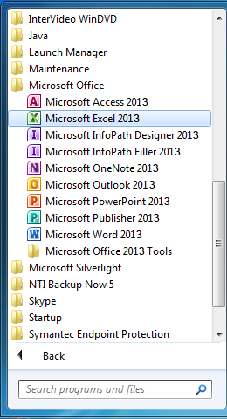

Exercise One
Let’s open the Excel program
If you are using a computer in this course, then follow along with what I do.
Goal: To start Excel, download a data file, and to open a workbook (Windows 7)
Click on your Start Button (Windows 7)
  Click on All Programs
Scroll down the program list and find MS Office 2013
  Then click on Excel 2013
Windows 7 start button

Slide 16
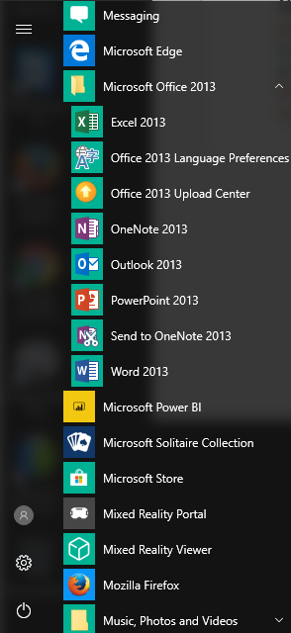
Exercise One
Let’s open the Excel program
If you are using a computer in this course, then follow along with what I do.
Goal: To start Excel, download a data file, and to open a workbook (Windows 10)
Click on your Start Button (Windows 10)
Scroll down the program list and find MS Office 2013
  Then click on Excel 2013
Windows 10 start button

Slide 17
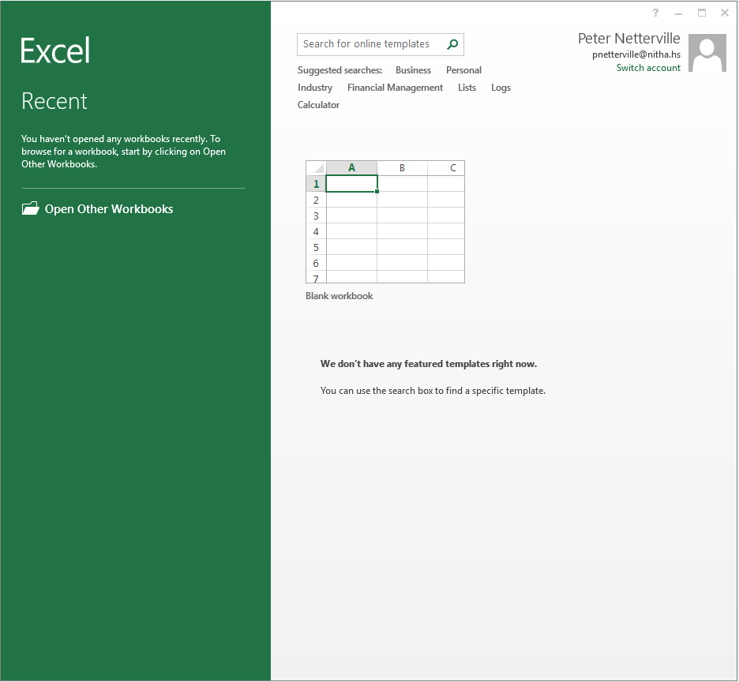
The Excel GUI
Screens Layout – Start
This is the first screen you see when you start the program directly, not by double clicking on an Excel worksheet. It is called the Start screen.
You can search online for a template among hundreds free for download. These templates are on the Microsoft site so they should be free from any macro viruses.
Top of the left panel is where the Recent files are listed.
This information lists the user account on Microsoft. Previously this was called a Windows Live ID but is now called a Microsoft account.
It is not required that you have a Microsoft account in order to use Excel 2013.
You can switch accounts from here should you have the wrong one or have another one you wish to work in.
When you click on Open Other Workbooks the Open screen appears.
You can start a new workbook from here.
If Microsoft has any featured templates, they will be listed here.
Now click on new workbook.

Slide 18
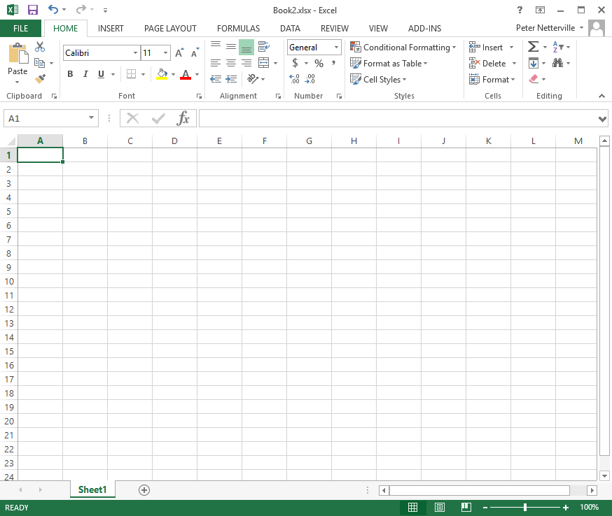
The Ribbon – All commands are located in the ribbons. They are:
Home – Deals with formatting the cells.
Insert – Provides objects to insert on to the spreadsheet.
Page Layout – These commands provide formatting for printing.
Formulas – The main power of Excel, the formulas.
Data – Functions for inserting and manipulating data from one or many sources.
Review – Commands to help you proof your workbook
View – These commands deal with how you view the spreadsheet on the screen, but not for printing.
Add-Ins – Allows you to access functions of custom add-ins and to manage them.
Some of the context ribbons available are:
Chart Tools – Design, Format & Layout
Drawing Format Tools – WordArt and Shapes
Picture Format Tools – Images and clipart.
Pivot Table Tools – Design and Format.
Smart Art Tools – Design and Format.
The Excel GUI
Screens Layout – Ribbon Tabs
It should look like this

Slide 19
The Excel GUI
Screens Layout – Ribbon Groups
The Ribbon Commands – All commands are located in groups on the ribbons. Groups are a collection of similar commands.
The groups listed here are found on the Home tab.
Clipboard – Copy text or objects and provides format duplicating.
Font – Provides formatting of true-type text.
Alignment – Aligns the contents of the cell within the cell.
Number – Formatting for numbers such as currency, percentage and more.
Styles – A style applies all types of visual formatting to text in one application of a style.
Cells – Commands to manipulate the contents of a cell.
Editing – The editing group is almost a miscellaneous category including adding quick access to most the common functions, Sort and Filter, Fill, Search and Replace, and clearing the cell.

Slide 20
The Excel GUI
Screens Layout – Ribbon Dialog Launch Button
Notice that some groups have in the bottom right corner this icon.
Clicking on this icon displays either a dialog box or a panel which offers further options, functions, and control of the commands in that group.
Notes:
Stop here and show them on the blank workbook the ribbons, dialog launchers, and commands.

Slide 21
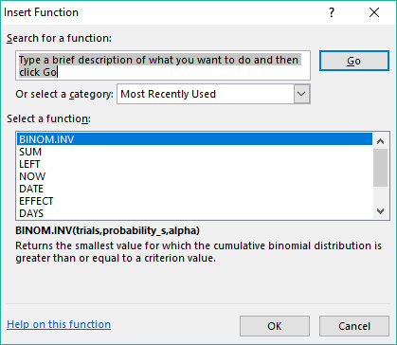
Formula Bar – This bar is where the contents of the cell are displayed.
This bar does not display the results of any formula or function, but the actual contents of the selected cell.
You can edit the cell contents from this bar or from the cell itself.
The Excel GUI
Screens Layout – Blank Workbook
Function Button – The Function button displays a dialog box which allows you to search for and select a function.
Name Box – The Name Box shows the cell in which the cursor is located.
The cursor is the selected cell.
If more than one cell is selected, the Name Box contains the cell name at which point the selection of cells was started.
You can type in a name meaningful to you for a cell or selection of cells and then refer to that name in your functions, etc. It is not case sensitive. No spaces.
You can also use that Name Box to navigate to a cell or another custom name by typing it in.
  NOTE: If Excel finds the name you typed it navigates to that name on the spreadsheet otherwise it will name the current cell what you just typed.
You cannot name a cell the same as another cell on that spreadsheet, they must be all be unique for that spreadsheet.

Slide 22
The bar along the bottom of the workbook contains (left to right):
Spreadsheet navigation arrows
Spreadsheet tabs
Create new spreadsheet button
Horizontal scroll bar
Resize handle
This resize handle allows you to increase or decrease the size of the horizontal scroll bar or the space for the spreadsheet tabs.
Status Bar
Normal View Icon
Page Layout View Icon
Page Break Preview
The zoom bar increases or decreases the spreadsheet view but does not change how it will be printed. This magnification is just for the screen only.

Slide 23
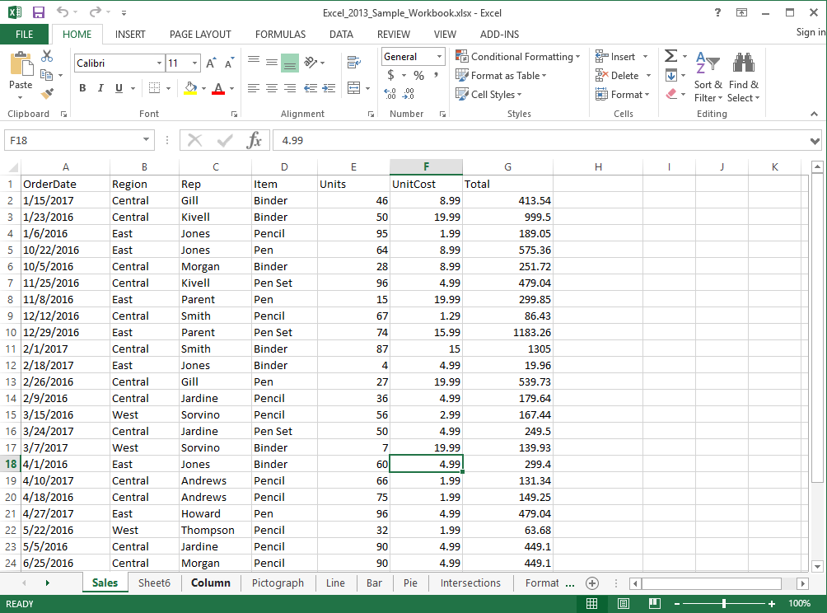
Exercise One
Working with the workbook
If you are using a computer in this course, then follow along with what I do.
Goal: Learn to navigate around in
a workbook and enter data.
So now we have:
Started Excel 2013 from the Start Menu.
Downloaded a workbook file from the NITHA server.
Opened that file in Excel by using Excel‘s Open dialog, not by double-clicking on the file.
Now let’s learn how to navigate around and to enter data in a workbook.

Slide 24


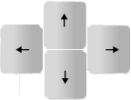
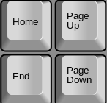
Navigating in Excel
Navigating the Spreadsheet & Entering Data
When not editing the cell …
When editing the cell …
Tab
Shift-Tab
Moves right across the screen (down the row)
Moves left across the screen (up the row)
Tab
Shift-Tab
Jumps out of editing and moves right
Jumps out of editing and moves left
Enter
Shift-Enter
Moves down the column
Moves up the column
Enter
Shift-Enter
Jumps out of editing and moves down
Jumps out of editing and moves up
Right Arrow
Left Arrow
Up Arrow
Down Arrow
Moves down the row
Moves up the row
Moves up the column
Moves down the column
Right Arrow
Left Arrow
Up Arrow
Down Arrow
Moves the cursor right in the edited cell
Moves the cursor left in the edited cell
Jumps back to where cursor was before right arrow
Jumps to the end of the text in the edited cell
Home
End
Page Up
Page Down
Beginning of the row
Furthest right populated cell (press twice)
Pages up one screen of visible cells
Pages down one screen of visible cells
Home
End
Page Up
Page Down
Beginning of text in edited cell
End of text in edited cell
Jumps up one page in select cell mode
Jumps down one page in select cell mode

Slide 25
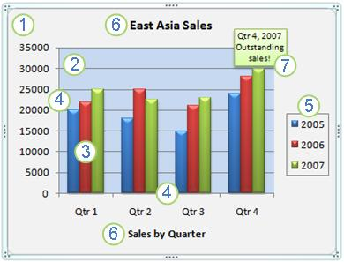
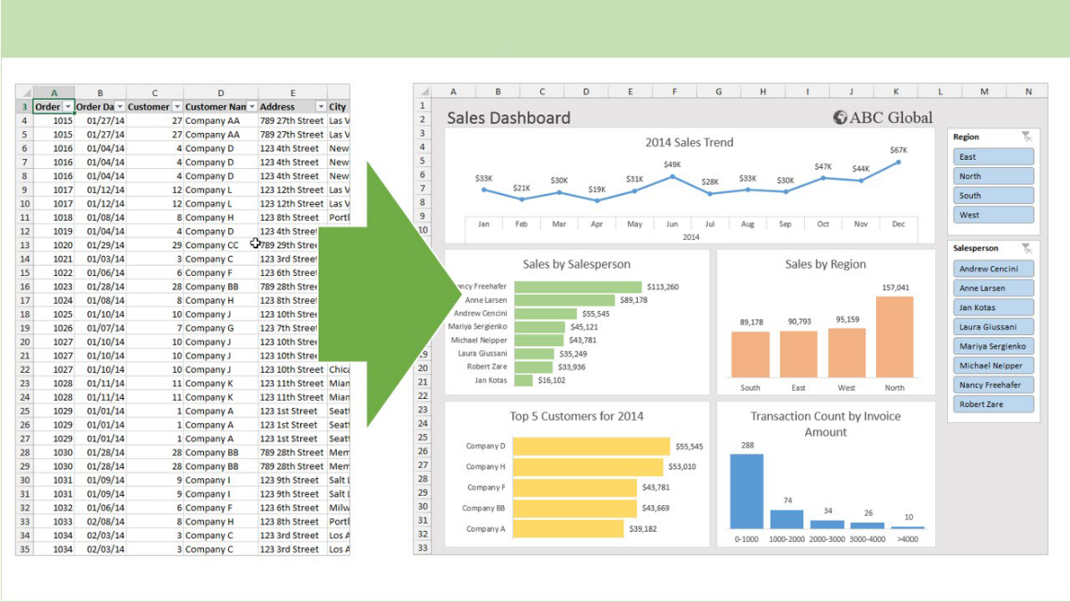
The Excel GUI
What can Excel do?
You can enter basic or complex functions and calculations in Excel.
From the simple
=16.83 + 127.42
To the complex
=IF(IF(INDEX(temp.xls!A:F;SUM(MATCH("EENU";temp.xls!A:A;0);MATCH("BF304";OFFSET(temp.xls!A1;MATCH("EENU";temp.xls!A:A;0)-1;0;MATCH("FCLI";temp.xls!A:A;0)-MATCH("EENU";temp.xls!A:A;0)+1;1);0))-1;5)<>0;5;6)=5;INDEX(temp.xls!A:F;SUM(MATCH("EENU";temp.xls!A:A;0);MATCH("BF304";OFFSET(temp.xls!A1;EQUIV("EENU";temp.xls!A:A;0)-1;0;MATCH("FCLI";temp.xls!A:A;0)-MATCH("EENU";temp.xls!A:A;0)+1;1);0))-1;IF(INDEX(temp.xls!A:F;SUM(MATCH("EENU";temp.xls!A:A;0);MATCH("BF304";OFFSET(temp.xls!A1;MATCH("EENU";temp.xls!A:A;0)-1;0;MATCH("FCLI";temp.xls!A:A;0)-MATCH("EENU";temp.xls!A:A;0)+1;1);0))-1;5)<>0;5;6));-INDEX(temp.xls!A:F;SUM(MATCH("EENU";temp.xls!A:A;0);MATCH("BF304";OFFSET(temp.xls!A1;MATCH("EENU";temp.xls!A:A;0)-1;0;MATCH("FCLI";temp.xls!A:A;0)-MATCH("EENU";temp.xls!A:A;0)+1;1);0))-1;IF(INDEX(temp.xls!A:F;SUM(MATCH("EENU";temp.xls!A:A;0);MATCH("BF304";OFFSET(temp.xls!A1;MATCH("EENU";temp.xls!A:A;0)-1;0;MATCH("FCLI";temp.xls!A:A;0)-MATCH("EENU";temp.xls!A:A;0)+1;1);0))-1;5)<>0;5;6)))
Yes, that is a real function.
You can create professional reports and dashboards with nice looking charts and visualizations
You can create Pivot Tables
A pivot table processes data from
One or more spreadsheet(s),
table(s), and/or database(s)
using a query and then organizes
and summarizes that data into
a visual chart, graph or report.
The example here is called a
Dashboard. We will briefly cover
A typical Dashboard later in the
course.

Slide 26
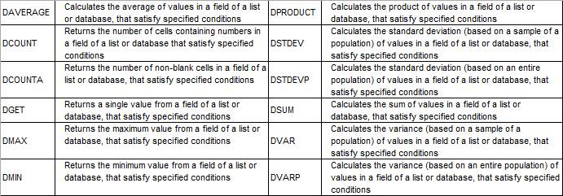
The Excel GUI
What can Excel do?
You can write code in Excel with VBA (Visual Basic for Applications)
Set objExcel = CreateObject("Excel.Application")
objExcel.Workbooks.Add
Sheet = 1
Set objSheet = objExcel.ActiveWorkbook.Worksheets(Sheet)
objSheet.Name = "VBS_Excel_Example"
strExcelPath = "d:\Vbs_Excel_Example.xlsx"
objSheet.Cells(row, column).Value = "Whatever"
objSheet.Cells(1, 1).Value = "Name" 'Row 1 Column 1 (A)
objSheet.Cells(1, 2).Value = "Description" 'Row 1 Column 2 (B)
objSheet.Cells(1, 3).Value = "Something Else" 'Row 1 Column 3 (C)
For row = 2 to 10
objSheet.Cells(row, 1).Value = "Item " & row & " Name"
objSheet.Cells(row, 2).Value = "Item " & row & " Description"
objSheet.Cells(row, 3).Value = "Item " & row & " Something Else“
You can program your own scripts, or even download them from the Internet, but if you do that you must be careful otherwise you could possibly introduce a security risk to your computer.
You can solve optimization problems and make statistical analysis (data analysis)
Some of the more common statistical functions:
ABS | The absolute value of a number
AVERAGE | The average or arithmetic mean for a group of numbers
COUNT | The number of cell locations in a range that contain a numeric character
COUNTA | The number of cell locations in a range that contain a text or numeric character
MAX | The highest numeric value in a group of numbers
MEDIAN | The middle number in a group of numbers (half the numbers in the group are higher than the median and half the numbers in the group are lower than the median)
MIN | The lowest numeric value in a group of numbers
MODE | The number that appears most frequently in a group of numbers
PRODUCT | The result of multiplying all the values in a range of cell locations
SQRT | The positive square root of a number
STDEV.S | The standard deviation for a group of numbers based on a sample
SUM | The total of all numeric values in a group
You can collect information, make data entries and create lists
This not a full list, but the more common database functions.

Slide 27
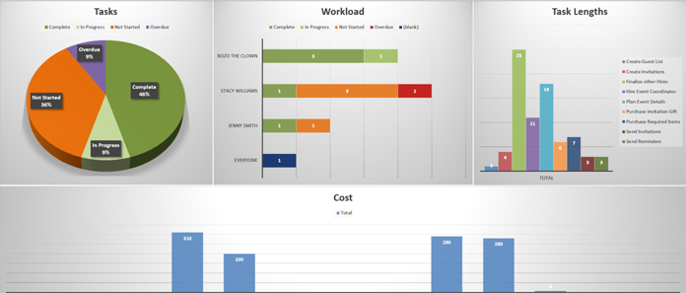
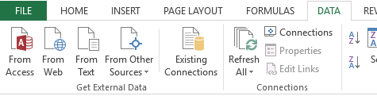
The Excel GUI
What can Excel do?
You can use Excel for educational purposes with interactive features
You can create games in Excel
  Monopoly
  3D Maze
  Writer’s Block
  3D Tic Tac Toe
Much more! Just Google
“Excel games” and check it out.
You can connect an Excel spreadsheet to a web page just by saving it to a folder
I have no specific example to show you, but through a variety of technologies an Excel Spreadsheet can be made immediately available to a web page simply by saving it to a specific folder.
You can fetch live data from the web into Excel.
The Data ribbon has all sorts of cool things. One of them is the Get External Data group.
You can import live Access databases, web pages, plain old boring text, and much more.
You can prepare Diagrams, Mockups and Gantt Charts

Slide 28
Basic Spreadsheet Functions
Function Categories
The function bar shown below is directly above the column headers.
Name Box
Insert Function box. Click on the icon to open the functions dialog.
Function/Formula bar
Formula Categories
Compatibility – These functions from earlier versions of Excel are provided for compatibility with functions made in old versions of Excel.
Cube - Multidimensional sets of data providing a means to summarize information based on a set of search criteria.
Database – Treating an Excel spreadsheet as a flat database, these functions return a search based on sum, variance, and standard deviation data.
Date & Time – These date and time functions allow you to work with the current time or periods of time in your functions.
Engineering – Engineering calculations: many of which relate to Bessel Functions, Complex Numbers or converting between different bases.
Information – These functions return information about the contents and/or formatting of a cell.
Logical – Flow control, logic and error capture.
Math & Trigonometry – ABS, sine, cosine, logarithmic, Pi, Quotient, etc.
Statistical – Works with data points, deviations, and more.
Text – Use these function to manipulate text.
Web – XML and web services functions.
Notes:
Have them follow along in the functions dialog box if they have a computer in front of them.

Slide 29
Basic Spreadsheet Functions
The Rules
Like everything in life, there are rules to follow.
All formulas begin with an equal sign.
Cells when represented in a function individually or as a block are separated by a comma (union operator). eg. D14, H27, A3, B84
Cells when represented in contiguous block are separated by a colon (cell range operator). eg. D14:D30
Blocks of contiguous cells and/or single cells are separated by a comma. eg. D14:D30, B24, H27:J34, A3:H3, J38, B84:D84
Excel follows the Order of Operations. Remember the PEMDAS (or BEDMAS) you might have learned in school
(Parenthesis, Exponent, Multiplication, Division, Addition, Subtraction) or (Brackets, Exponents, Division, Multiplication, Addition, Subtraction)
Evaluate Parenthesis - From the inner first to the outer last eg. =8.7334*(27.416+(12-7.3)^4)
Evaluate ranges – A range of cells such as D14:D30 (column) or D14:J14 (Row)
Evaluate intersections – Using the space in a formula to separate ranges of cells tell Excel to intersect where the two ranges overlap.
- If one cell is overlapped, the value or calculated value in the overlap cell will be inserted into the formula.
- If more than one cell is overlapped, a #VALUE error will be returned. Why? Because the cell cannot display more that one value. So run a function
on it, such as SUM, MIN, MAX, etc., a function that can deal with multiple cells.
Evaluate unions – The union operator is the comma.
Perform negations
Convert percentage values to decimal.
Perform exponentiation – The up caret, ^, is used in a function to represent an exponent. ex. 4^3 equals 64
In Excel entering an e character between two numbers will with no spaces perform the n * 10^n. ex. 4e3 equals 4000.
Perform multiplication, *, and division, /. These are equal in precedence, so whichever comes first is evaluated first.
Perform addition, +, and subtraction, -. These are equal in precedence, so whichever come first is evaluated first.
Evaluate text operators – In Excel the ampersand, &, concatenates text.
Perform comparisons – The comparison operator are: equals = not equal to <> less than <= greater than >=
Fear not! I have this list created in a PDF document for you to download and view.
ftp://172.27.0.4/CSU/IT_Helpdesk/Computer_Training/Excel_Order_Of_Operations.pdf

Slide 30
Basic Spreadsheet Functions
Common Functions
SUM – Adds all the numeric values of all the selected cells. This is probably the most common function in Excel. eg. =SUM(D2, G6:G8)
HYPERLINK – Insert a web link to a web page or resource (such as a PDF) into a cell. Hyperlinks can also jump to a name link on any spreadsheet to which it has access, even other workbook sheets (i.e. another file).
MIN & MAX – MIN returns the lowest value from the selected cells. MAX returns the highest value from the selected cells. eg. =MIN(D2, G6:G8)
NOW – Returns the current date in the format defined in Windows for a short date, short time
(Win10 – Settings/Time & Language/Date & Time/Formats/Short Date & Short Time) eg. =NOW() Don’t forget those parenthesis!
DAYS – Returns the number of days in a date period. eg. =DAYS("January 12, 2017","February 26, 2017")
COUNT & COUNTA – COUNT returns the number of cells in a selected range that contain number only. eg. =COUNT(D2, G6:G8)
COUNTA returns the number of cells in a selected range that are empty. eg. =COUNTA(D2, G6:G8)
AVERAGE – Returns the arithmetic mean of its’ argument. eg. =AVERAGE(D2, G6:G8)
DSUM – Adds the numbers in the fields of records in the database that match the conditions you specify.
Notes:
( = 18.98 + 114.98 * 4 Answer is B ) ( = 12 + (3.14159 * 325) Answer is A ) ( = 187.4 * (18 + 5^3) Answer is C )

Slide 31
Exercise Two
On the “Excel_2013_Sample_Workbook.xlsx” click on the OOP sheet tab.
Note: You may have to scroll right using the spreadsheet navigation arrows. (bottom left)
1. Enter into cell B5 the following formula:
18.98 + 114.98 * 4
Answer:
535.84
This is a basic formula you would see in commerce.
478.90
2. Enter into cell B8 the following formula:
12 + (3.14159 * 325)
Answer:
1033.01675
47.5686677281
Though syntactically not incorrect, can anyone notice anything that is unnecessary in this formula?
3. Enter into cell B11 the following formula:
187.4 * (18 + 5^3)
Answer:
3378200
8373.2
26798.2
Which is done first, the exponent or what is in parenthesis? (Hint: trick question)

Slide 32
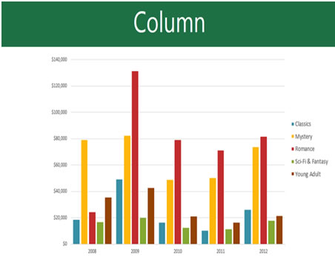
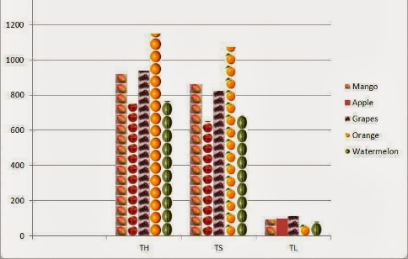
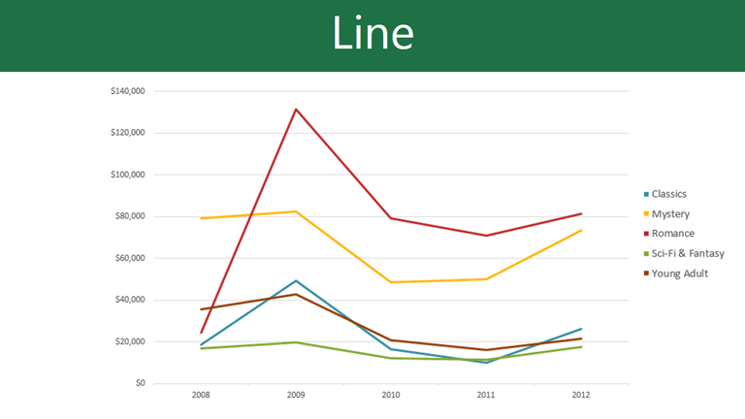
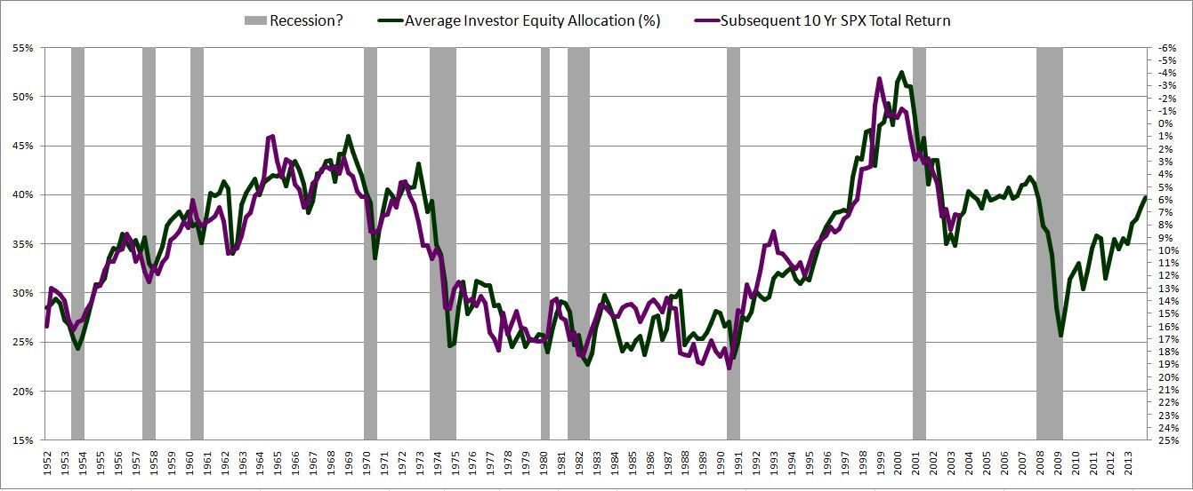
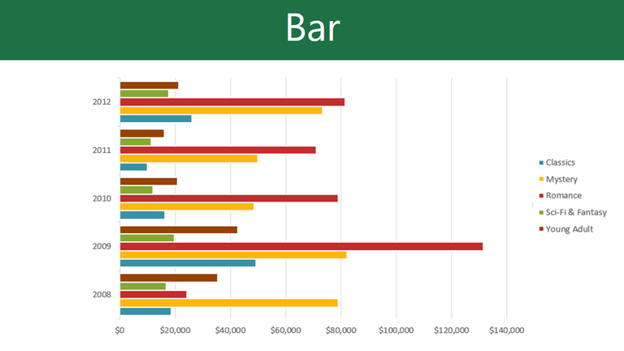
Basic Spreadsheet Functions
Intro to Charts and Pivot Tables
We will only be covering the most basic information here in this course. The course Excel 2013 Pivot Tables & Graphs will be covering this is detail.
An Excel chart is a visual representation of tabular data.
Below are the more common types of charts available in Excel.
Column chart (or Bar graph) is used to show a comparison between two items.
The Pie chart
Shows percentages
A Pictograph (or Pictogram) is a column chart that uses pictures to represent the data instead of the standard colored columns.
The Line chart is used to show trends over time.
A Bar chart’s columns run horizontally along the page rather than vertically.
A Stock Market chart shows stocks and shares information in their opening and closing prices over a time period.

Slide 33
NITHA IT HelpDesk helpdesk@nitha.com
1(844)486-4842
Notes:
Please do not hesitate to ask any question regarding this session, and I will make sure to answer your question as soon as possible.

Slide 34


