Slide 1


Excel 2010 Pivot Tables & Charts
Intermediate Level

Slide 2



NITHA IT Helpdesk
helpdesk@nitha.com
1(844)486-4842

Slide 3

NITHA - IT Helpdesk Courses Registration Website
How do I get to the Courses Registration Website?
First, open up your favorite web browser.
Finally, press ENTER on our keyboard
Second, type in the address bar the URL, nitha.com/courses

Slide 4

NITHA - IT Helpdesk Courses Registration Website
The NITHA Computer Training Courses Calendar
There are four sections to the
IT Helpdesk Courses Registration Website
The calendar – As seen on the right,
the calendar displays the selected month and all the course links on the appropriate days.
Morning courses 9:30 AM to 11:30 AM
Afternoon courses 2:00 PM to 4:00 PM

Slide 5
NITHA - IT Helpdesk Courses Registration Website
Cycle forward through the months by clicking on the next month
The NITHA Computer Training Courses Calendar
Cycle backward through the months by clicking on the previous month
And of course, the month in the middle is the currently displayed month.

Slide 6
NITHA - IT Helpdesk Courses Registration Website
or the next year
The NITHA Computer Training Courses Calendar
You can even click on the previous year

Slide 7
NITHA - IT Helpdesk Courses Registration Website
The NITHA Computer Training Courses Calendar
Click on the course link of your choice and you will be taken to a registration page.

Slide 8

NITHA - IT Helpdesk Courses Registration Website
The NITHA Computer Training Course Registration page
Enter your information
Select how you are going to attend the course
by WebEx
by Telehealth
Select how you want your Certificate of Completion delivered.
by Email as a PDF
by Canada Post

Slide 9
NITHA - IT Helpdesk Courses Registration Website
The NITHA Computer Training Courses WebEx Info
WebEx Information – For the WebEx connection information on how to attend the courses in the current week, click on the WebEx link.

Slide 10

NITHA - IT Helpdesk Courses Registration Website
The NITHA Computer Training Courses Calendar
These links display the WebEx information for that course
These links download the ICS file for that course so that you can add it to your Outlook calendar as an event.

Slide 11
NITHA - IT Helpdesk Courses Registration Website
The NITHA Computer Training Courses Download
Course Files Download – The courseware and the data files which are used in the courses are all available for download any time whether or not you are taking the course.
click on the Course Files Downloads link
To download the
Courseware file (A PowerPoint file)
and/or
Sample data files used in the course

Slide 12

NITHA - IT Helpdesk Courses Registration Website
The NITHA Computer Training Courses Calendar
The Course Sample File is the data file used in the course.
The PowerPoint Courseware File is the course itself.

Slide 13
NITHA - IT Helpdesk Courses Registration Website
The NITHA Computer Training Courses Calendar
Tech Videos are the fourth section of the website. As they are created, they will be placed here.
Tech Videos are short 3 to 15 minute videos featuring solutions to various tech issues.

Slide 14

What will we be covering in this course?
Preamble and Definitions
Working with the Pivot Table – Bar Chart
Downloading and Opening the Exercise File
Working with the Pivot Tables
Placing Data Fields and Filtering
Creating a Pivot Table
Working with the Pivot Tables
The Bar Chart
Pivot Chart Anatomy
Working with the Pivot Tables
The Doughnut Chart

Slide 15
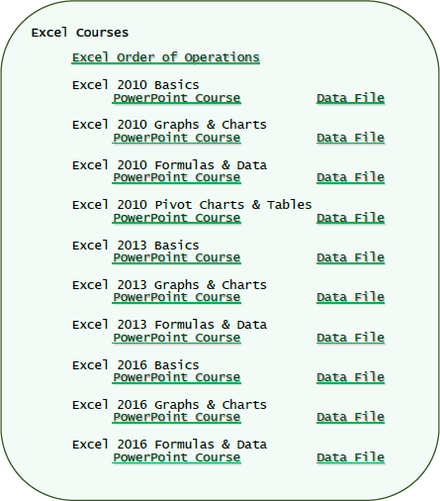
Download the files for the course.
File: Course_Downloads.PDF
The files for the course are located in a Dropbox account.
Download links for the course files were created and put into a
PDF document
which you should have had provided for you.
Open the PDF document and scroll down until you find the Excel course files.
If you do not have that file,
I will email it to you now.

Slide 16
What are pivot tables and how do they benefit me with my projects?
Normally when you make a chart, you massage the data using the commands such as Sort, Filter, Group & SubTotal.
Then you choose the chart that best represents your data and the point you are trying to make …
… however …
Pivot tables allow you to move your data around from Column header to Row header to Filters to Values in an easy drag & drop fashion “on the fly”.
This flexibility make it easier for you to view your data in different graph structures.
Using the traditional way of selecting your data, filtering it and then choosing a chart can be awkward and clumsy if you do not know exactly what data you need. Pivot tables give you the flexibility to work with your data in real time.
A pivot chart is a visual companion to your pivot table.
When you sort, filter or group your data the changes are reflected in your chart instantly.
Our Ultimate Goal
Our goal is to display the smoking statistics comparison between males and females for Saskatchewan First Nations for all ages from 15 year and up.

Slide 17
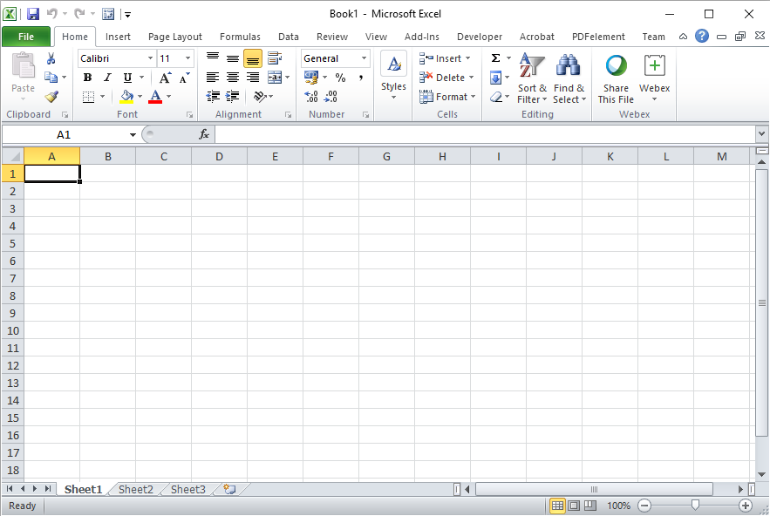
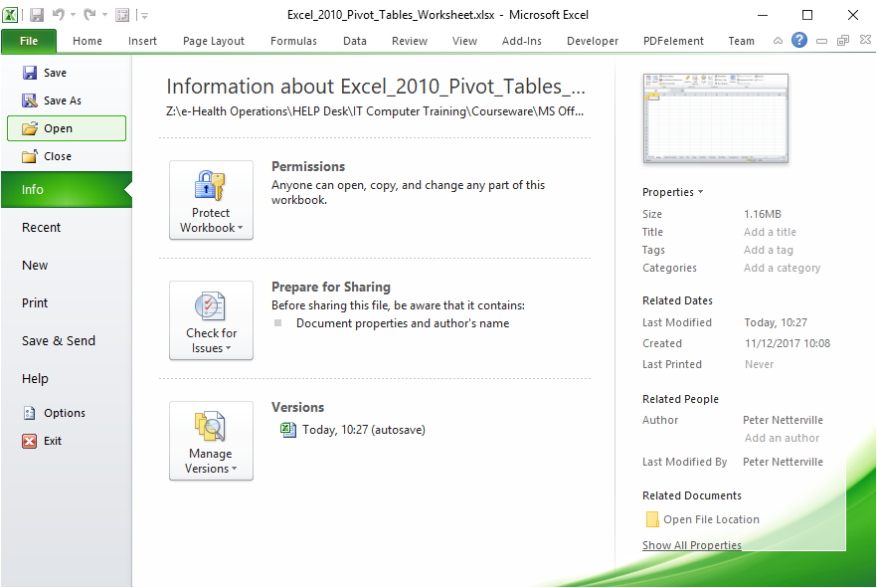
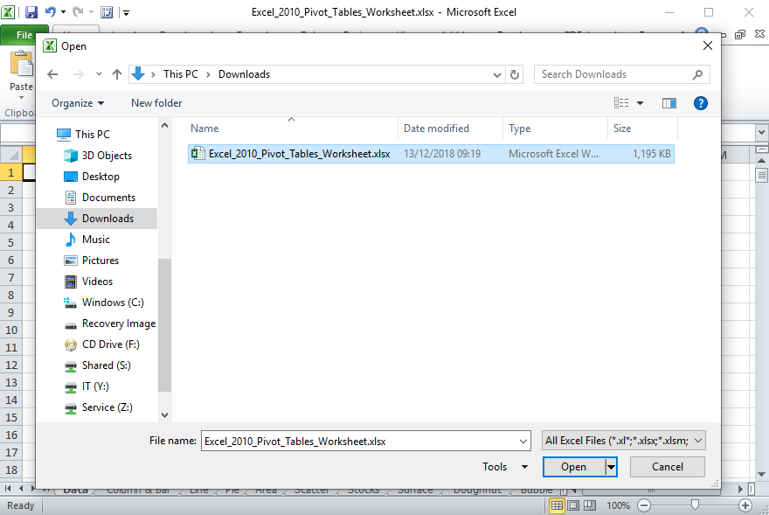
Open the Excel_2010_Pivot_Tables_Worksheet.xlsx file you just downloaded.
It is most likely in your Downloads folder.
Click on the Backstage, the File tab.
Click on the Open button which displays an Open dialog box.
Navigate to where the course file is located on your computer, probably the Downloads folder.
Click on
Then click on the Open button.

Slide 18
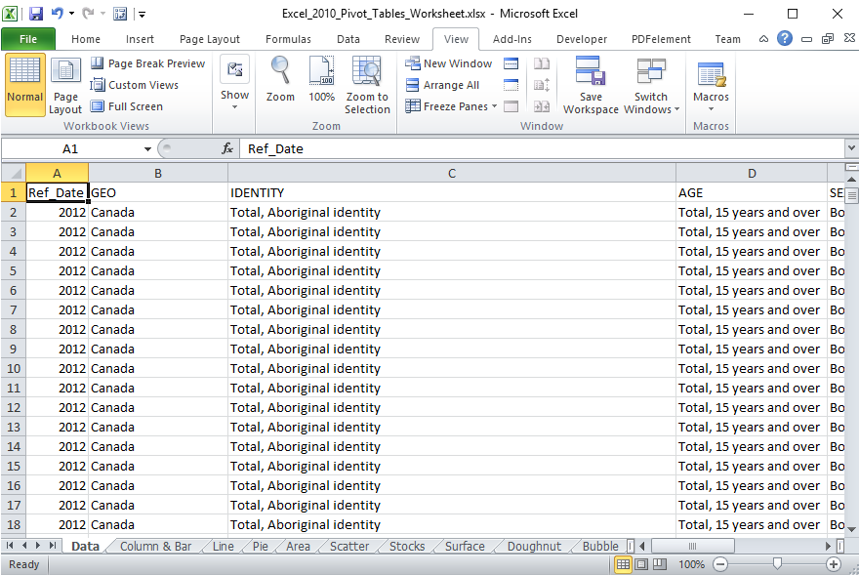
You should now have a screen that look similar to …

Slide 19
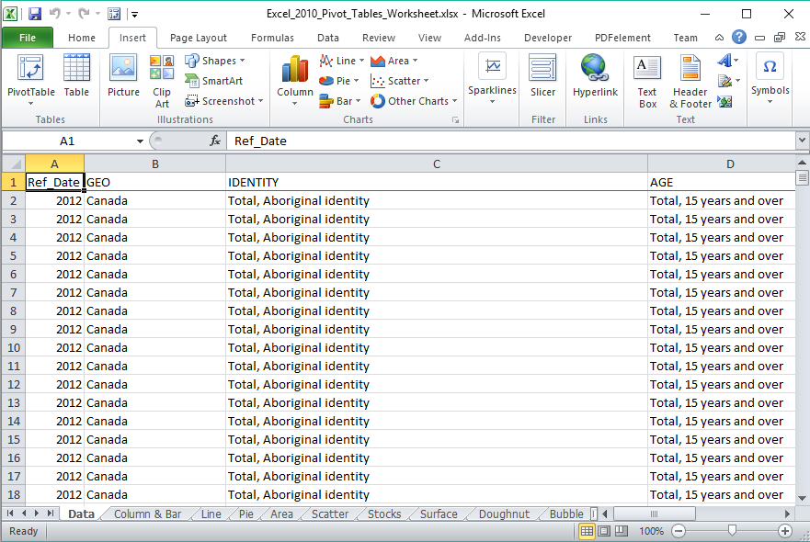
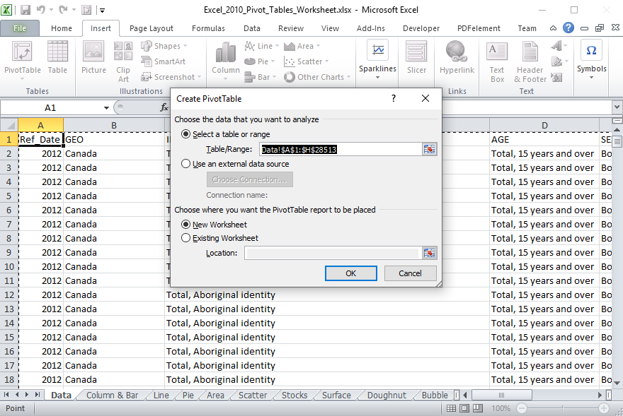
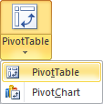
Creating a Pivot Table
Click on any cell in the table
Click on the Insert ribbon tab
In the Tables group click on …
  PivotTable menu
  Click on PivotTable
The Choose the data that you want to analyze option already has the entire table selected, but you can change that here.
You can also pull the data from an external data source.

Slide 20
Creating a Pivot Table
On the Choose where you want the PivotTable report to be placed option you can choose
  New Worksheet
  Existing Worksheet
If you choose Existing Worksheet you will need to select a cell where the report will be placed.
Click on the OK button.

Slide 21
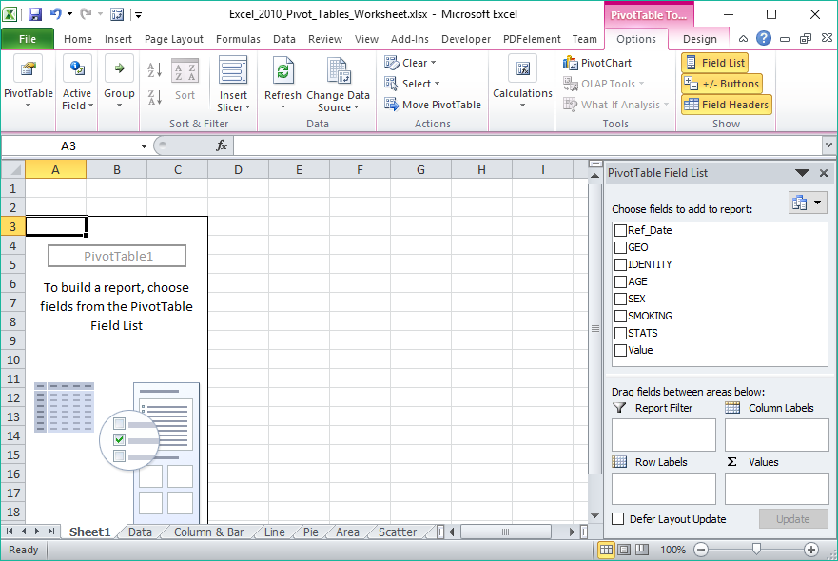
Pivot Chart Anatomy
Below is what you should have on your computer
  The PivotTable box on the left
  The PivotTable Field list on the right
When choosing what data fields to select keep in mind what aspect of the data are you trying to emphasize.
To build a table select the fields you want to include by dragging the field down into one of the four areas below

Slide 22
Pivot Chart Anatomy
The data in the table is represented by the PivotTable1 box on the left. Make sure to keep it selected while working on your pivot table and chart.

Slide 23
The Pivot Table Field List contains five panels:
Pivot Chart Anatomy
  Field selection
  Column Labels
  Values
  Report Filter
  Row Labels
Field Selection
Allows you to choose what data to include in the table, which will be represented in the chart in which you have chosen to represent that data.
Report Filter
Allows you to focus on specific parts of the data by displaying only the data you want.
Column Labels
The Column label is the X axis data.
Row Labels
The Row Label is the Y axis data.
Values
The Values is the column in the table that provides context to the data record and can be represented as Sum, Count, Average, Max, Min, and more.

Slide 24
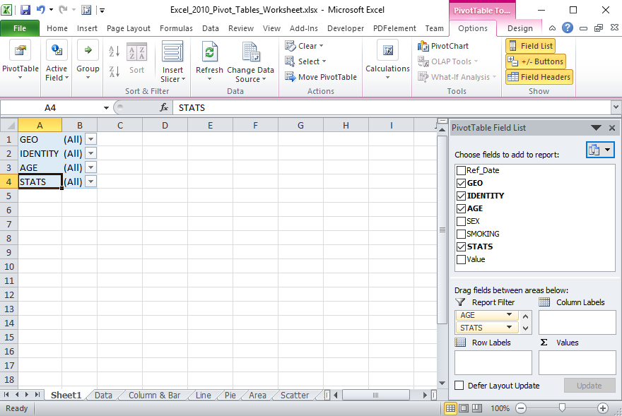
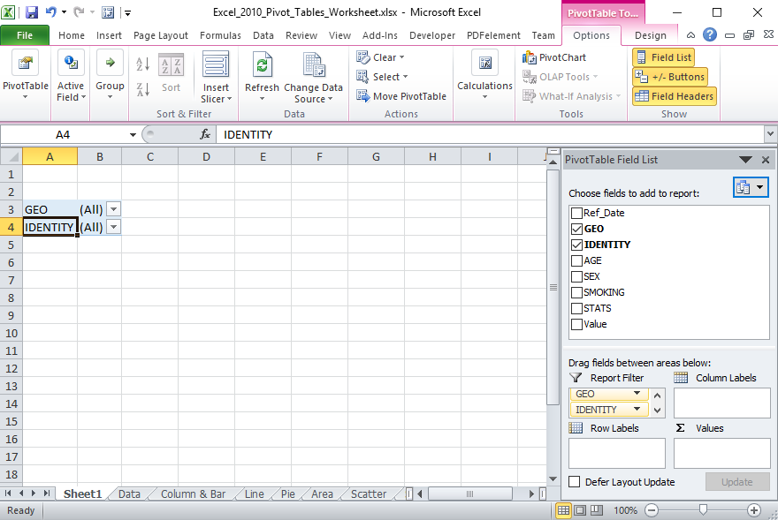
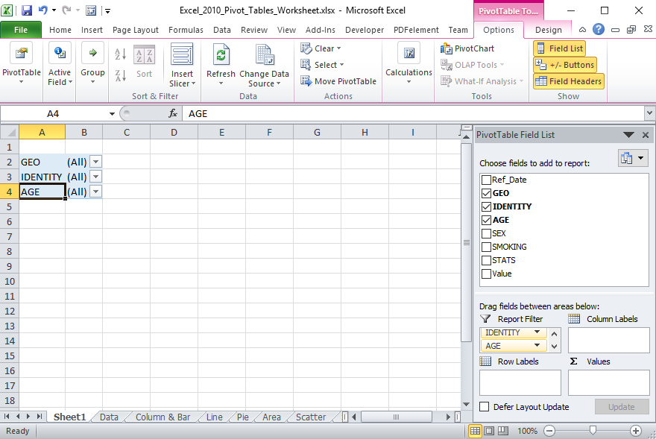
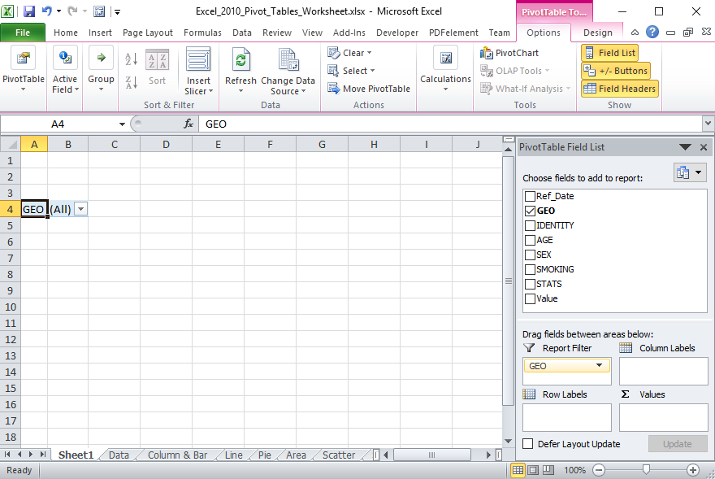
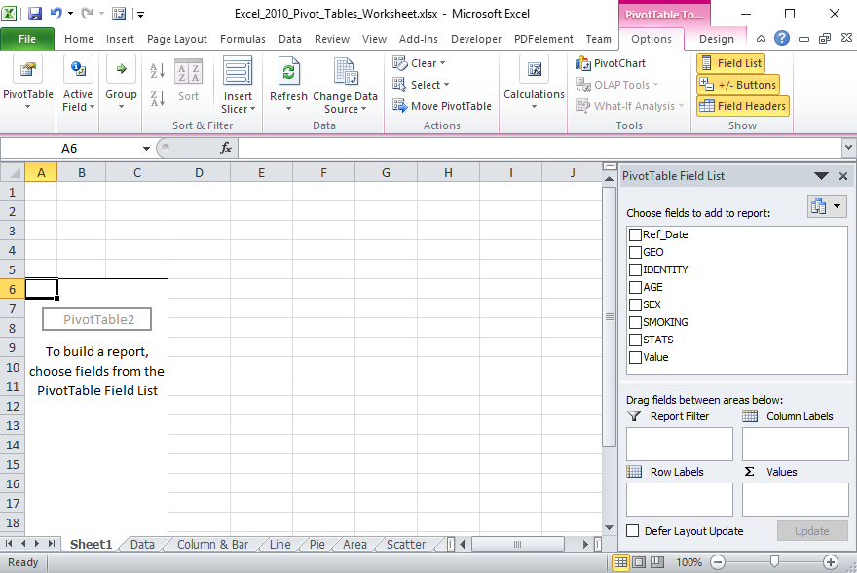
Working with the Pivot Tables
Placing Data Fields, Filtering
Now that we know the areas of the Pivot Table Field List, we need to arrange the data into the proper areas; Report Filters.
Sort the data fields into the following areas by dragging and dropping it.
Drag to Filters
GEO
IDENTITY
AGE
STATS

Slide 25
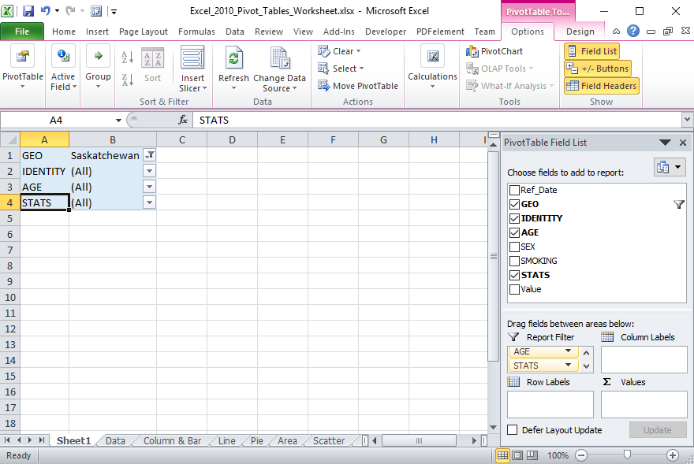
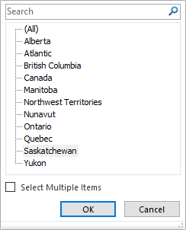
Working with the Pivot Tables
Placing Data Fields, Filtering
Now that we know the areas of the Pivot Table Field List, we need to arrange the data into the proper areas; Report Filters.
Now restrict the data by filtering it.
Click on the down arrow beside GEO
and select Saskatchewan

Slide 26
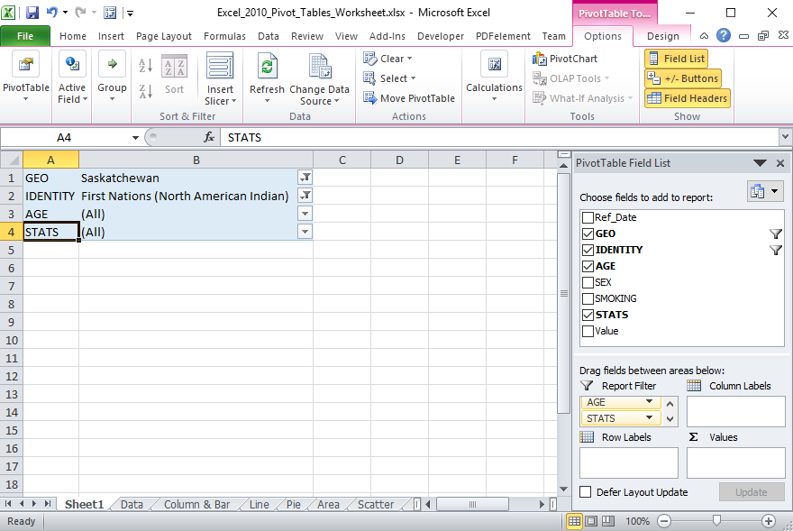
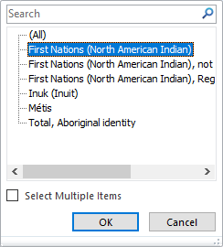
Working with the Pivot Tables
Placing Data Fields, Filtering
Now that we know the areas of the Pivot Table Field List, we need to arrange the data into the proper areas; Report Filters.
Now restrict the data by filtering it.
Click on the down arrow beside IDENTITY
and select
First Nations (North American Indian)

Slide 27
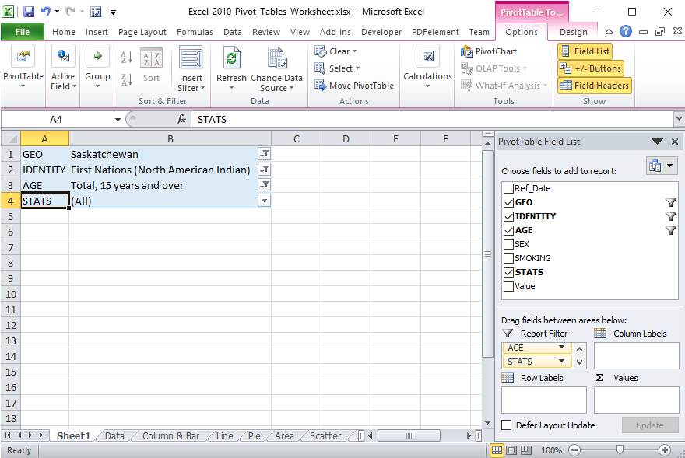
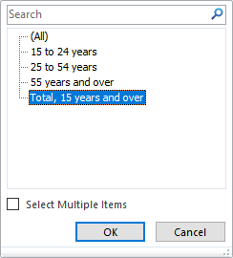
Working with the Pivot Tables
Placing Data Fields, Filtering
Now that we know the areas of the Pivot Table Field List, we need to arrange the data into the proper areas; Report Filters.
Now restrict the data by filtering it.
Click on the down arrow beside AGE
and select Total, 15 years and over

Slide 28
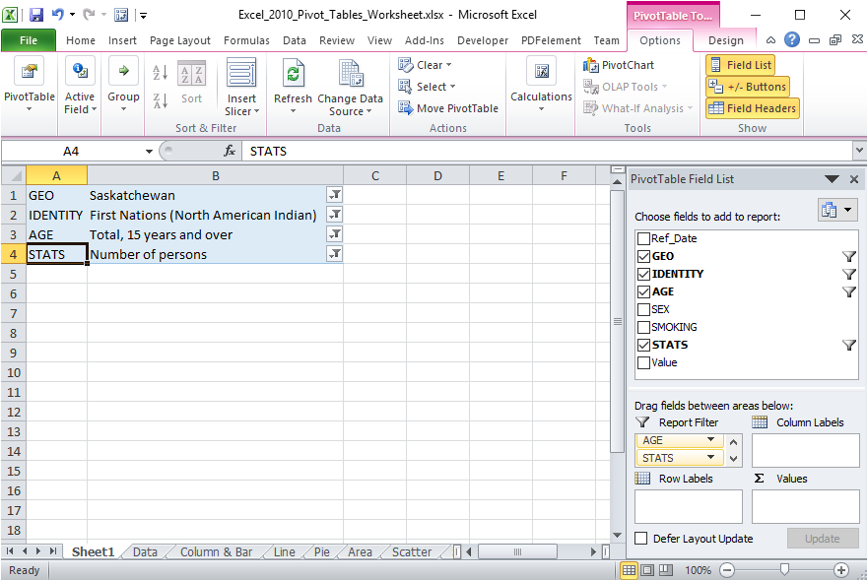
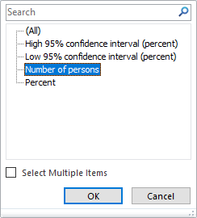
Working with the Pivot Tables
Placing Data Fields, Filtering
Now that we know the areas of the Pivot Table Field List, we need to arrange the data into the proper areas; Report Filters.
Now restrict the data by filtering it.
Click on the down arrow beside STATS
and select Number of Persons.

Slide 29
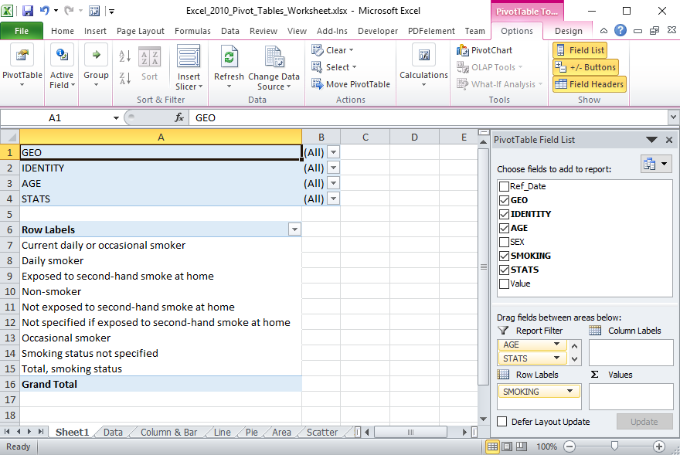
Working with the Pivot Tables
Placing Data Fields, Filtering
Now that we know the areas of the Pivot Table Field List, we need to arrange the data into the proper areas; Row Labels.
Now restrict the data by filtering it.
Row Labels
SMOKING

Slide 30
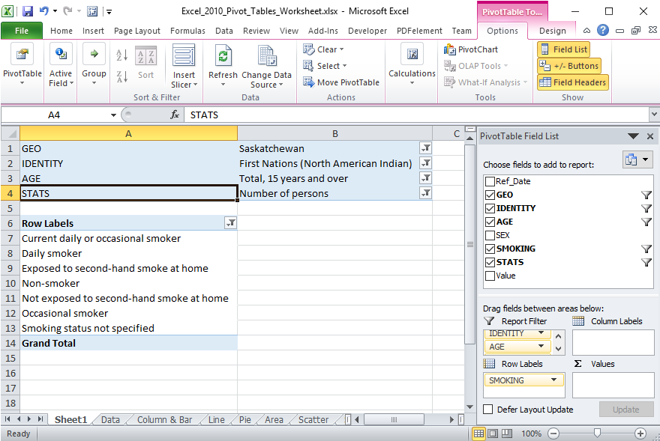
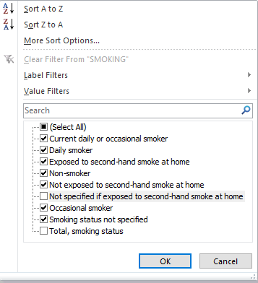
Working with the Pivot Tables
Placing Data Fields, Filtering
Now that we know the areas of the Pivot Table Field List, we need to arrange the data into the proper areas; Row Labels.
Now restrict the data by filtering it.
Restrict that to seven items.
Let’s also filter the Row Labels. We have nine items at the moment.

Slide 31
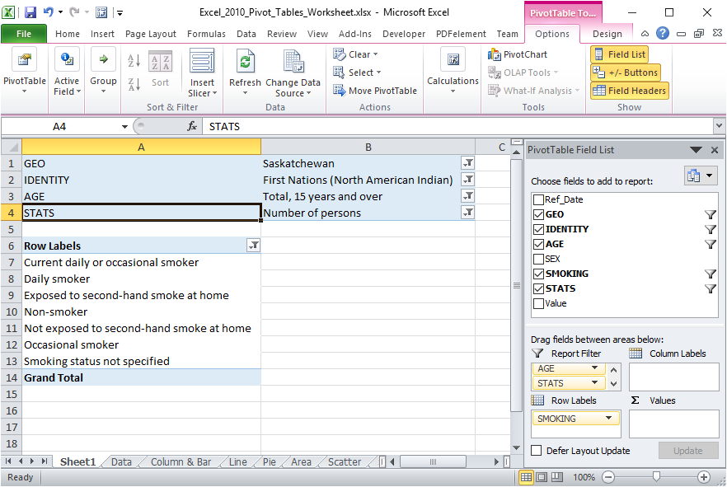
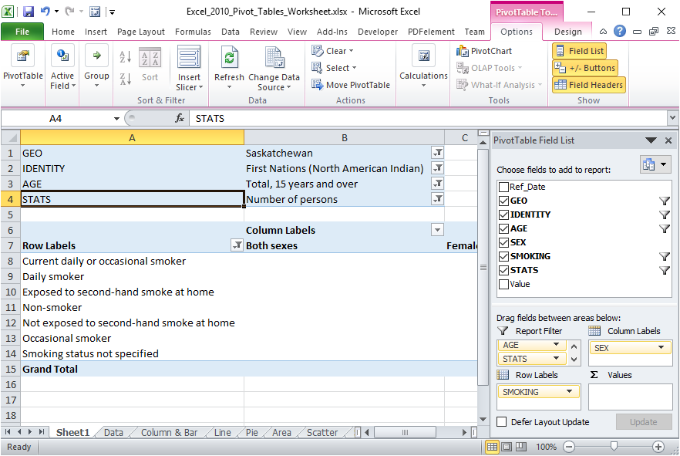
Working with the Pivot Tables
Placing Data Fields, Filtering
Now that we know the areas of the Pivot Table Field List, we need to arrange the data into the proper areas; Column Labels.
Now restrict the data by filtering it.
Column Labels
SEX
Notice the three columns that appeared;
Both sexes
Female
Male (cannot see at the moment)

Slide 32
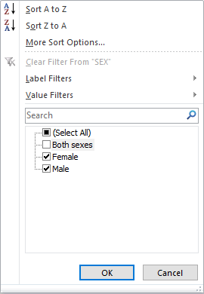
Working with the Pivot Tables
Placing Data Fields, Filtering
Now that we know the areas of the Pivot Table Field List, we need to arrange the data into the proper areas; Column Labels.
Now restrict the data by filtering it.
Now to filter the Sex field.
Click on the arrow.
Deselect Both sexes.

Slide 33

Working with the Pivot Tables
Placing Data Fields, Filtering
Now that we know the areas of the Pivot Table Field List, we need to arrange the data into the proper areas; Column Labels.
Now restrict the data by filtering it.
Now that we have the Sex field filtered there are two columns, just Male and Female because we are going to compare the smoking stats one against the other.
Make the Female column smaller by dragging the column divider to the left.

Slide 34
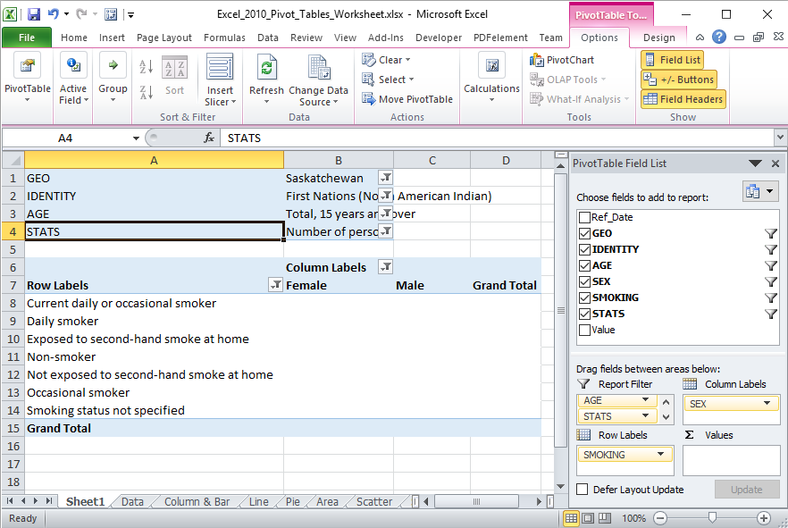
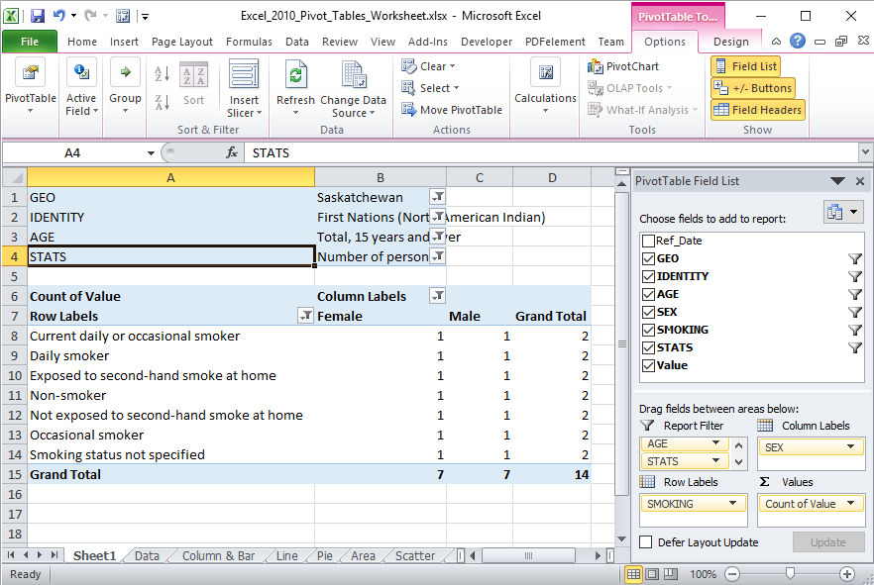
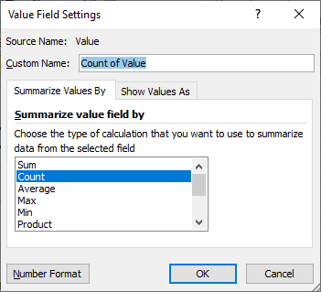
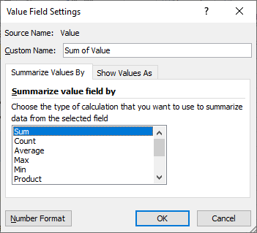
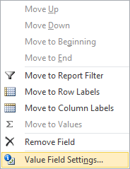
Working with the Pivot Tables
Placing Data Fields, Filtering
Now that we know the areas of the Pivot Table Field List, we need to arrange the data into the proper areas; Values.
Now restrict the data by filtering it.
Select the Sum option from the list.
The Values field is placed, oddly enough, in the Values area.
Now we need to change what function is performed on the Value field by clicking on the drop arrow.
On the menu that appears select the Value Field Settings… option.
You will need to rearrange the column widths again because Excel auto-adjusts the column widths when a field is added to one of the boxes.

Slide 35
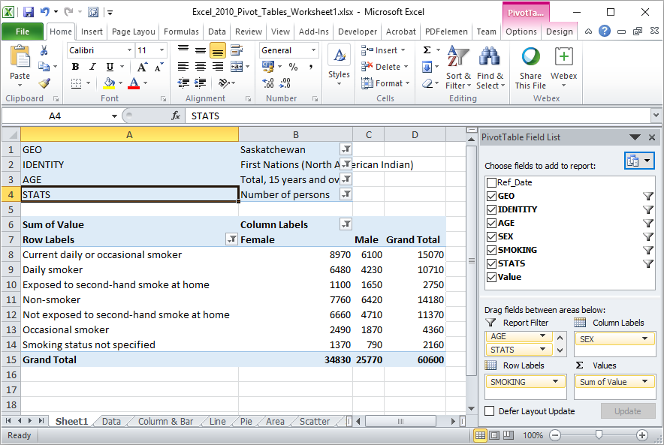
Now that we know the areas of the Pivot Table Field List, we need to arrange the data into the proper areas; Values.

Slide 36
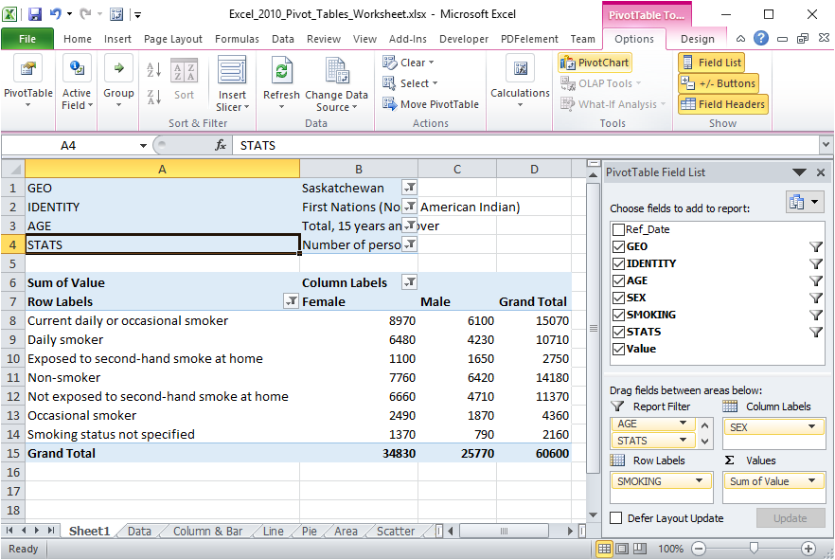
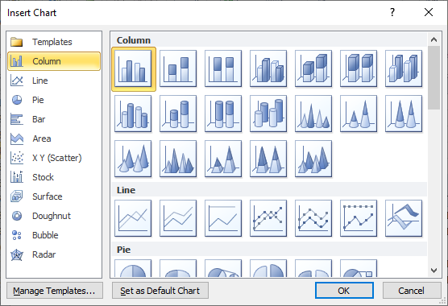
Working with the Pivot Tables
The Bar Chart
After moving the fields into their appropriate areas, applying filters, and selecting the function to apply to the values field, we are finally ready to add a Pivot Chart to display graphically what we see in the table.
Select the PivotChart command located in the Tools group on the PivotTable Tools Options ribbon.
Select the first one, the Clustered Column because we are going to compare the female smoking stats against the male smoking stats.

Slide 37
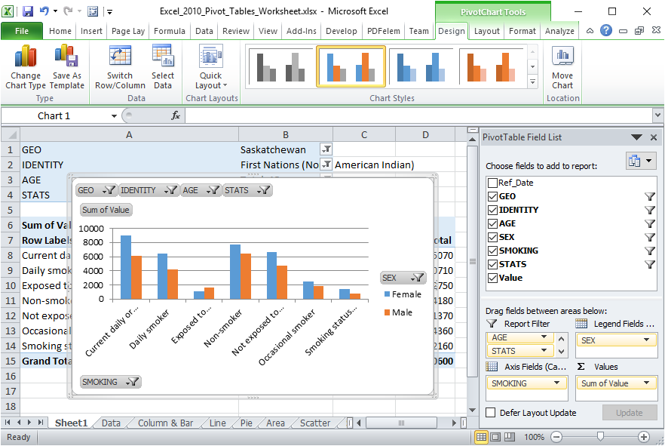
The PivotChart Tools Ribbon
There are four PivotChart Tools contextual ribbons that will help us adjust the chart so that it presents the data more clearly.
Design ribbon deals with …
the type of chart, column, pie, Line, etc.
The selection and placement of the data.
The layout of the data in the chart
The colour styles of the chart data points
The placement of the chart on this or another spreadsheet.

Slide 38
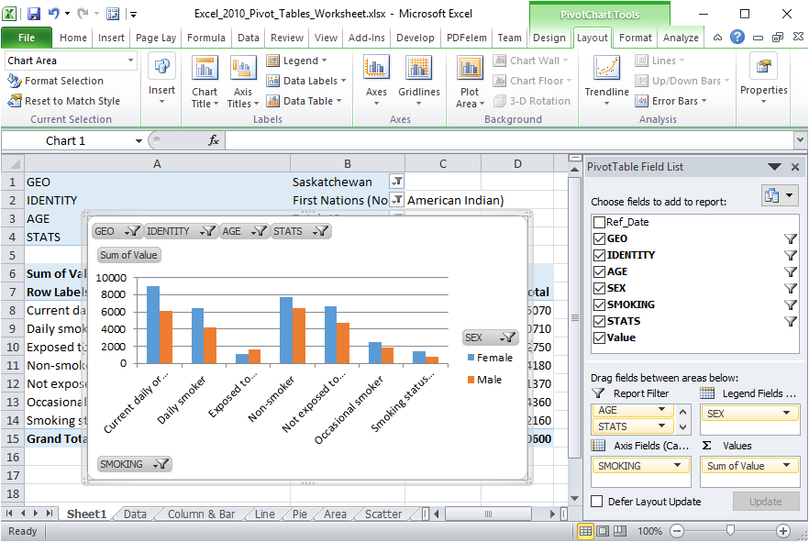
The PivotChart Layout Ribbon
There are four PivotChart Tools contextual ribbons that will help us adjust the chart so that it presents the data more clearly.
Layout ribbon deals with …
Selecting parts of the chart to format that part.
Insert a picture, shape or textbox
Add and format titles for the parts of the chart
Add and format axes and grid lines.
Format the plot area, chart wall, floor, and 3D rotation
Insert trendlines, lines, up/down bars and error bars
Properties of the selected chart part

Slide 39
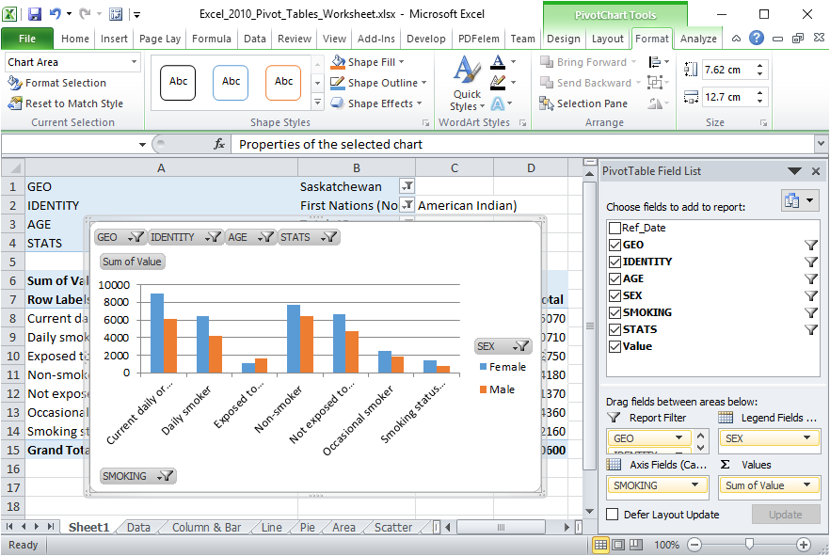
The PivotChart Format Ribbon
There are four PivotChart Tools contextual ribbons that will help us adjust the chart so that it presents the data more clearly.
Format ribbon deals with …
Selecting parts of the chart to format that part.
Change the shape by choosing a style or individual elements.
Change WordArt styles or individual elements.
You can manage the objects on the spreadsheet from here.
Change the shape of the selected object

Slide 40
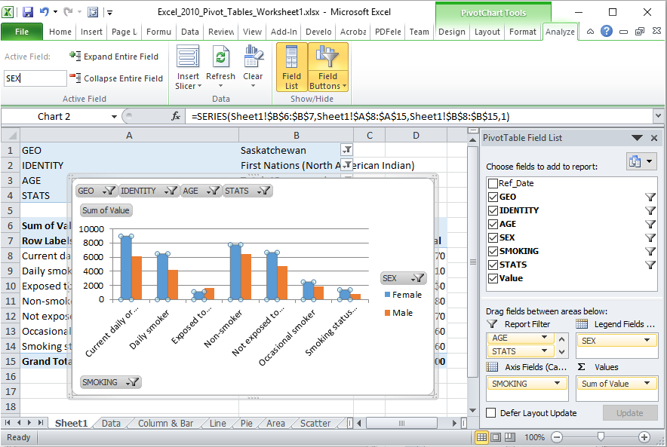
The PivotChart Analysis Ribbon
There are four PivotChart Tools contextual ribbons that will help us adjust the chart so that it presents the data more clearly.
Format ribbon deals with …
The Active Field appears in the Legend Fields box.
Insert slicer, refresh the data or clear the filters.
Toggle on or off the Fields List or selected Field Buttons.

Slide 41
Working with the Pivot Table – Bar Chart
Now to adjust the Bar Chart so it better represents the data.
Switch the X and Y axis.
Select the Design ribbon.
Click on the Switch Row/Column command.

Slide 42
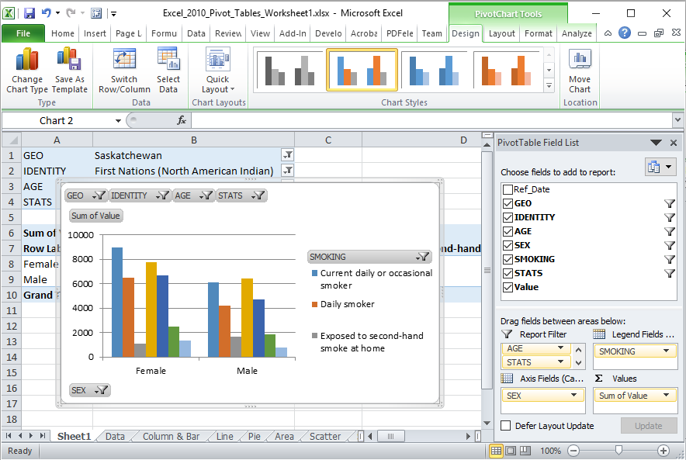
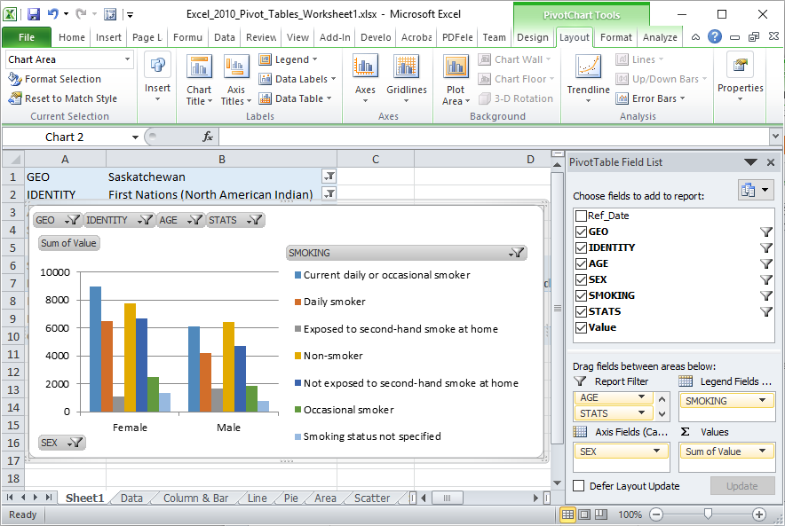
Working with the Pivot Table – Bar Chart
The column chart now displays the field Sex along the bottom on the Axis and Smoking field in the Legend.
Now that the column chart shows the comparison of smoking data between female and males, the chart even would look even better if …
1. We could see the whole legend

Slide 43
Working with the Pivot Table – Bar Chart
The column chart now displays the field Sex along the bottom on the Axis and Smoking field in the Legend.
Now that the column chart shows the comparison of smoking data between female and males, the chart even would look even better if …
1. We could see the whole legend
2. Had values assigned to the bars in the chart.
Select the Data Labels menu.

Slide 44
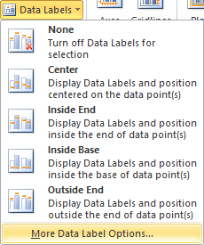
Working with the Pivot Table – Bar Chart
The column chart now displays the field Sex along the bottom on the Axis and Smoking field in the Legend.
Now that the column chart shows the comparison of smoking data between female and males, the chart even would look even better if …
1. We could see the whole legend
2. Had values assigned to the bars in the chart.
Select the Data Labels menu.
Select More Data Label Options

Slide 45
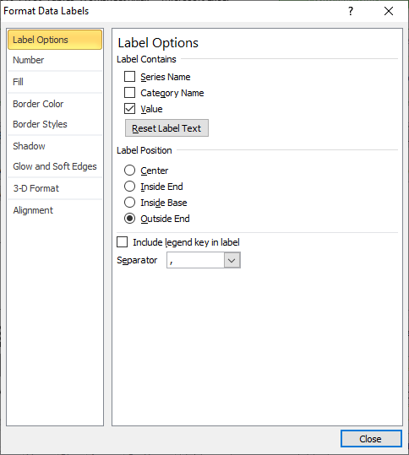
Working with the Pivot Table – Bar Chart
The column chart now displays the field Sex along the bottom on the Axis and Smoking field in the Legend.
Now that the column chart shows the comparison of smoking data between female and males, the chart even would look even better if …
1. We could see the whole legend
2. Had values assigned to the bars in the chart.
Select the Data Labels menu.
On the dialog that appears work with the …
Label Options – Positions for each data point label ...
and

Slide 46
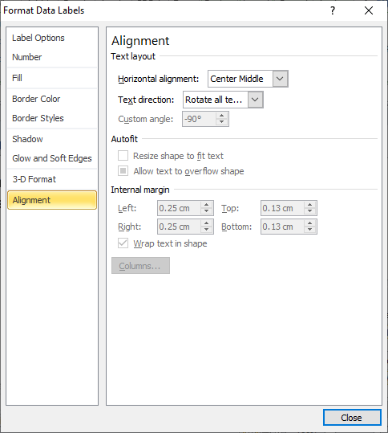
Working with the Pivot Table – Bar Chart
The column chart now displays the field Sex along the bottom on the Axis and Smoking field in the Legend.
Now that the column chart shows the comparison of smoking data between female and males, the chart even would look even better if …
1. We could see the whole legend
2. Had values assigned to the bars in the chart.
Select the Data Labels menu.
On the dialog that appears work with the …
Alignment – Text Layout
of each data label.
Until you get

Slide 47
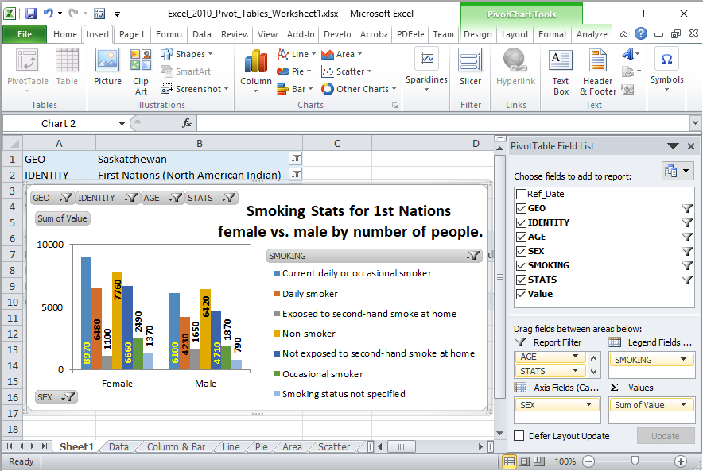
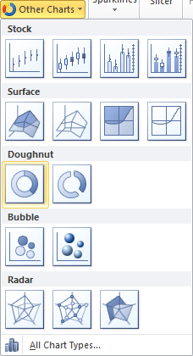
Working with the Pivot Table – Bar Chart
The final result should look like the image below.
Since we have two data sets, male & female, we can make doughnut chart.
Be sure to select the chart.
Click on the tab of the Insert ribbon.
Select the Doughnut from Other Charts

Slide 48
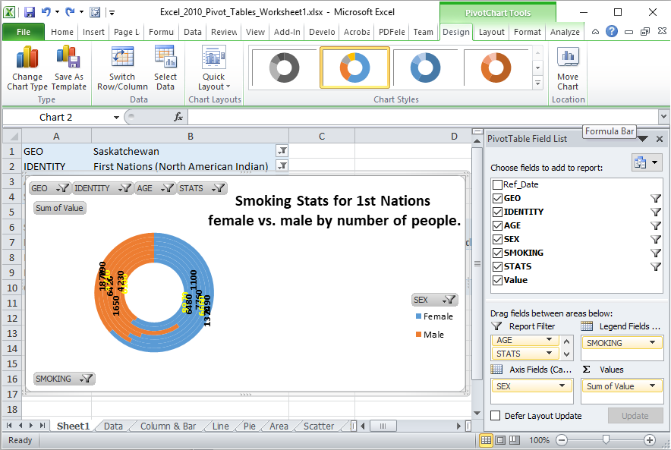
Working with the Pivot Table – Doughnut Chart
This doughnut does not look too appealing, so we will need to adjust it into two rings, not seven.
That is accomplished by switching the X and Y axis back again.
On the Design ribbon click on the Switch Row/Column.

Slide 49
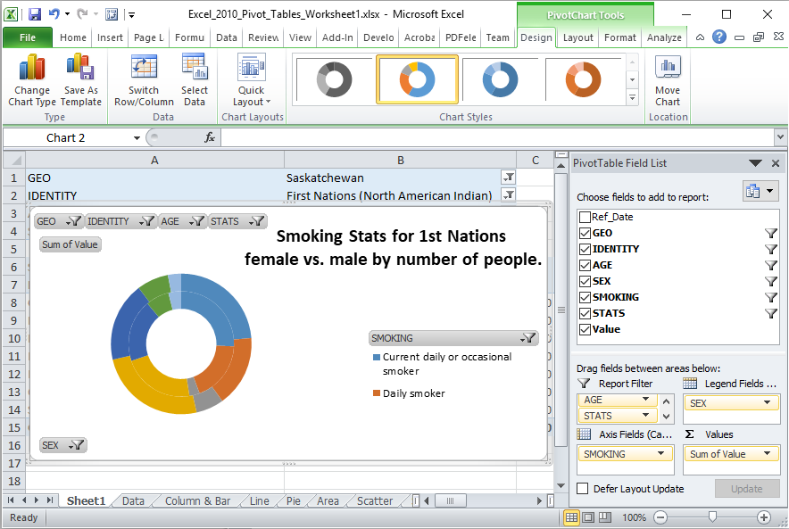
Working with the Pivot Table – Doughnut Chart
This doughnut does not look too appealing, so we will need to adjust it into two rings, not seven.
That is accomplished by switching the X and Y axis back again.
Now rearrange the doughnut, legend, and data labels to too like …

Slide 50
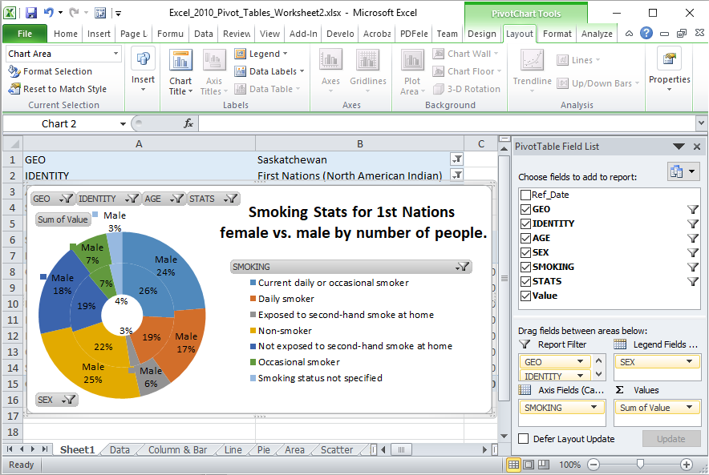
Working with the Pivot Table – Doughnut Chart
With a bit of adjustment to the doughnut chart, it is now more readable
I did the following to this doughnut chart:
Resized it larger to accommodate the text.
Shrunk the doughnut hole size to increase the size of the rings.
Added data labels
  Added the series name to the outside doughnut, Male, because there is more room. No need for adding the label to the inside doughnut.
  Adjusted the positioning of each individual label so that it can be best read.
Can you make your chart look the same?

Slide 51

We have covered here in this course …
Preamble and Definitions
Working with the Pivot Table – Bar Chart
Downloading and Opening the Exercise File
Working with the Pivot Tables
Placing Data Fields and Filtering
Creating a Pivot Table
Working with the Pivot Tables
The Bar Chart
Pivot Chart Anatomy
Working with the Pivot Tables
The Doughnut Chart

Slide 52

NITHA IT Helpdesk helpdesk@nitha.com
1(844)486-4842
Notes:
Please do not hesitate to ask any question regarding this session, and I will make sure to answer your question as soon as possible.

Slide 53


