Slide 1


Excel 2010 Basics
Entry Level

Slide 2



NITHA IT Helpdesk
helpdesk@nitha.com
1(844)486-4842

Slide 3

NITHA - IT Helpdesk Courses Registration Website
How do I get to the Courses Registration Website?
First, open up your favorite web browser.
Finally, press ENTER on our keyboard
Second, type in the address bar the URL, nitha.com/courses

Slide 4

NITHA - IT Helpdesk Courses Registration Website
The NITHA Computer Training Courses Calendar
There are four sections to the
IT Helpdesk Courses Registration Website
The calendar – As seen on the right,
the calendar displays the selected month and all the course links on the appropriate days.
Morning courses 9:30 AM to 11:30 AM
Afternoon courses 2:00 PM to 4:00 PM

Slide 5
NITHA - IT Helpdesk Courses Registration Website
Cycle forward through the months by clicking on the next month
The NITHA Computer Training Courses Calendar
Cycle backward through the months by clicking on the previous month
And of course, the month in the middle is the currently displayed month.

Slide 6
NITHA - IT Helpdesk Courses Registration Website
or the next year
The NITHA Computer Training Courses Calendar
You can even click on the previous year

Slide 7
NITHA - IT Helpdesk Courses Registration Website
The NITHA Computer Training Courses Calendar
Click on the course link of your choice and you will be taken to a registration page.

Slide 8

NITHA - IT Helpdesk Courses Registration Website
The NITHA Computer Training Course Registration page
Enter your information
Select how you are going to attend the course
by WebEx
by Telehealth
Select how you want your Certificate of Completion delivered.
by Email as a PDF
by Canada Post

Slide 9
NITHA - IT Helpdesk Courses Registration Website
The NITHA Computer Training Courses WebEx Info
WebEx Information – For the WebEx connection information on how to attend the courses in the current week, click on the WebEx link.

Slide 10

NITHA - IT Helpdesk Courses Registration Website
The NITHA Computer Training Courses Calendar
These links display the WebEx information for that course
These links download the ICS file for that course so that you can add it to your Outlook calendar as an event.

Slide 11
NITHA - IT Helpdesk Courses Registration Website
The NITHA Computer Training Courses Download
Course Files Download – The courseware and the data files which are used in the courses are all available for download any time whether or not you are taking the course.
click on the Course Files Downloads link
To download the
Courseware file (A PowerPoint file)
and/or
Sample data files used in the course

Slide 12

NITHA - IT Helpdesk Courses Registration Website
The NITHA Computer Training Courses Calendar
The Course Sample File is the data file used in the course.
The PowerPoint Courseware File is the course itself.

Slide 13
NITHA - IT Helpdesk Courses Registration Website
The NITHA Computer Training Courses Calendar
Tech Videos are the fourth section of the website. As they are created, they will be placed here.
Tech Videos are short 3 to 15 minute videos featuring solutions to various tech issues.

Slide 14

What will we be covering in this course?
Excel Intro
Basic Spreadsheet Functions
Starting Excel
Downloading a workbook from NITHA
Opening the workbook in Excel
Navigating the Spreadsheet & Entering Data
Overview: What can Excel do?
Ribbons: Common and Contextual
Function Categories
The Rules
Common Functions

Slide 15
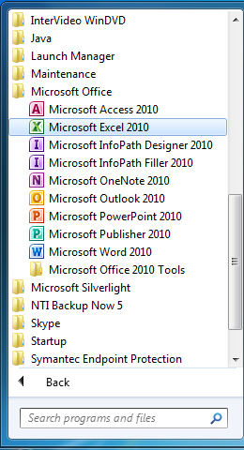

Exercise One
Let’s open the Excel program
If you are using a computer in this course, then follow along with what I do.
Goal: To start Excel, download a data file, and to open a workbook (Windows 7)
Click on your Start Button (Windows 7)
  Click on All Programs
Scroll down the program list and find MS Office 2010
  Then click on Excel 2010
Windows 7 start button

Slide 16
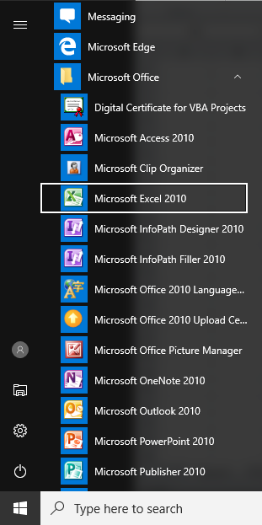
Exercise One
Let’s open the Excel program
If you are using a computer in this course, then follow along with what I do.
Goal: To start Excel, download a data file, and to open a workbook (Windows 10)
Click on your Start Button (Windows 10)
Scroll down the program list and find MS Office 2010
  Then click on Excel 2010
Windows 10 start button

Slide 17
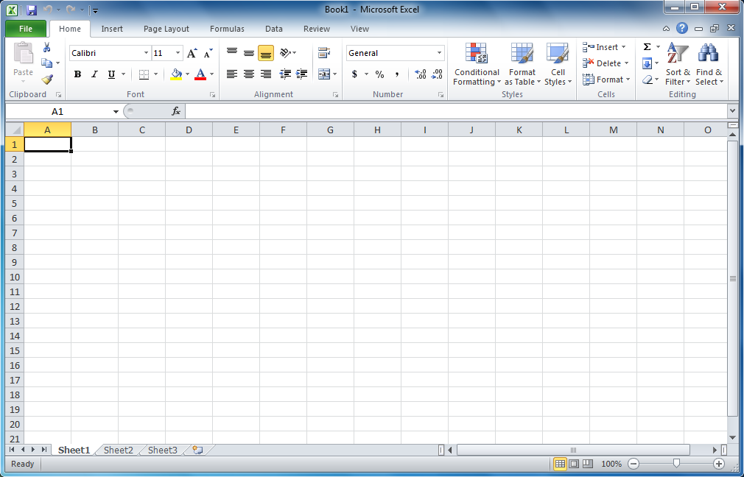
This is the first screen you see when you start the program directly (not by double clicking on an Excel worksheet). You are immediately put into a new blank workbook with three blank spreadsheets.
The Excel GUI
Screens Layout – Blank Workbook
Quick Launch - Much like a customizable toolbar, but it lives on the titlebar.
The window controls: Minimize, Maximize, Exit.
The Workbook window controls.
- Minimize the ribbon. Hides the ribbon
but not the ribbon names.
- Excel help.
- Minimize the workbook only.
- Maximize the workbook inside the
Excel program. Does not maximize
Excel to the screen.
- Closes the workbook, not the Excel
program.

Slide 18
The Ribbon – All commands are located in the ribbons.
They are:
Home – Deals with formatting the cells.
Insert – Provides objects to insert on to the spreadsheet.
Page Layout – These commands provide formatting for printing.
Formulas – The main power of Excel, the formulas.
Data – Functions for inserting and manipulating data from one or
many sources.
Review – Commands to help you proof your spreadsheet
View – These commands deal with how you view the spreadsheet
on the screen, but not for printing.
The Excel GUI
Screens Layout – Ribbon Tabs
Some of the context ribbons available are:
Chart Tools – Design, Format & Layout
Drawing Format Tools – Format ribbon WordArt and Shapes
Picture Format Tools – Format ribbon for images and clipart.
Pivot Table Tools – Design and Format.
Smart Art Tools – Design and Format.

Slide 19
The Ribbon – All commands are located in the ribbons. The commands are grouped. The group names are:
Clipboard – Stores up to 24 items to insert.
Font – Formatting the text in the selected cell(s).
Alignment – Align the text in the selected cell(s).
Number – Formatting numbers in the cell(s).
Styles – Apply styling and/or conditional formatting to the selected cell(s).
Cells – Insert, delete and apply formatting to cell(s).
Editing – Most used functions, clear data, sort & filter,
and search functions.
The Excel GUI
Screens Layout – Ribbon Groups

Slide 20
The Excel GUI
Screens Layout – Ribbon Dialog Launch Button
Notice that some groups have in the bottom right corner this icon.
Clicking on this icon displays either a dialog box or a panel which offers further options, functions, and control of the commands in that group.

Slide 21
The Excel GUI
Screens Layout – Blank Workbook
Formula Bar – The button pulls up a Functions dialog box.
The rest of the bar is where the contents of the cell are displayed.
You can edit the cell contents from this bar or from the cell itself.
Name Box – The Name Box shows the cell in which the cursor is located.
The cursor is the selected cell.
If more than one cell is selected, the Name Box contains the cell name at which point the selection of cells was started.
You can type in a name meaningful for a cell or selection of cells and then refer to that name in your functions, etc.
You can also use that Name Box to navigate to a cell or another custom name by typing it in.
  If Excel finds the name you typed it navigates to that name on the spreadsheet otherwise it will name the current cell what you just typed.
You cannot name a cell the same as another cell on that spreadsheet, they must be all be unique for that spreadsheet.

Slide 22
The bar along the bottom of the workbook contains:
Spreadsheet navigation arrows
Spreadsheet tabs
Create new spreadsheet button
Horizontal scroll bar
Resize handle / Split screen handle
The one on the left side of the horizontal scroll bar (the resize handle) increases or decreases the size of the horizontal scroll bar, and conversely the room for spreadsheet tabs.
The one on the right side of the horizontal scroll bar (the split screen handle) splits the screen, the same workbook, into two panels so you can compare different parts of the same workbook.
The Excel GUI
Screens Layout – Blank Workbook
Status Bar
Normal View Icon
Page Layout View Icon
Page Break Preview
The zoom bar increases or decreases the spreadsheet view but does not change how it will be printed. This magnification is just for the screen only.

Slide 23
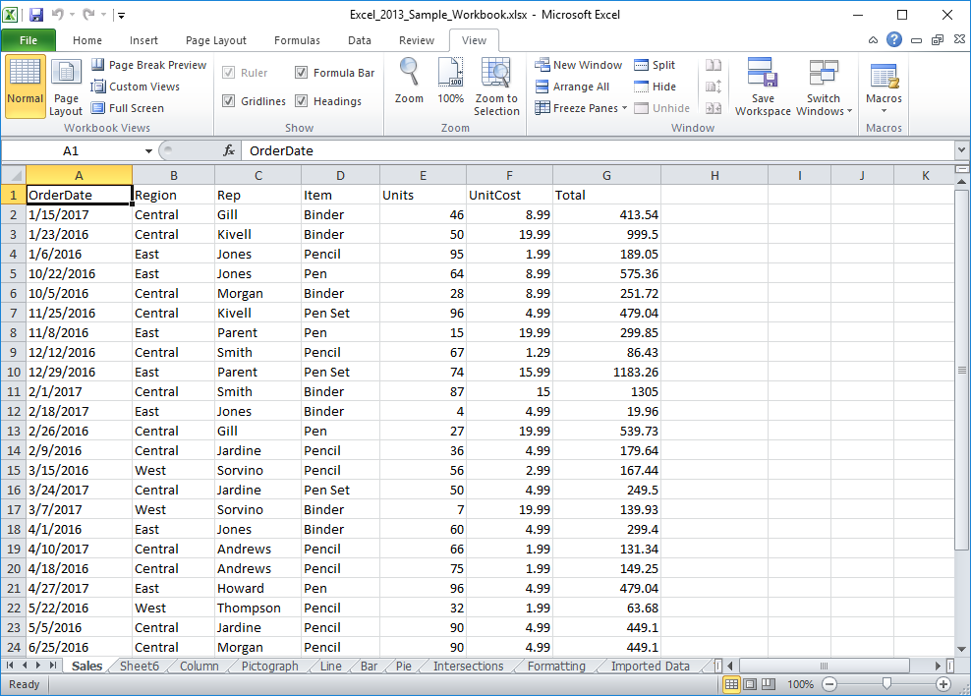
Exercise One
Working with the workbook
If you are using a computer in this course, then follow along with what I do.
Goal: Learn to navigate around in
a workbook and enter data.
So now we have:
Started Excel from the Start Menu.
Downloaded a workbook file from the NITHA server.
Opened that file in Excel by using Excel‘s Open dialog, not by double-clicking on the file.
Now let’s learn how to navigate around and to enter data in a workbook.

Slide 24


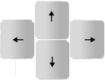
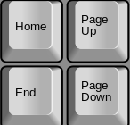
The Excel GUI
Navigating the Spreadsheet & Entering Data
When not editing the cell …
When editing the cell …
Tab
Shift-Tab
Moves right across the screen (down the row)
Moves left across the screen (up the row)
Tab
Shift-Tab
Jumps out of editing and moves right
Jumps out of editing and moves left
Enter
Shift-Enter
Moves down the column
Moves up the column
Enter
Shift-Enter
Jumps out of editing and moves down
Jumps out of editing and moves up
Right Arrow
Left Arrow
Up Arrow
Down Arrow
Moves down the row
Moves up the row
Moves up the column
Moves down the column
Right Arrow
Left Arrow
Up Arrow
Down Arrow
Moves the cursor right in the edited cell
Moves the cursor left in the edited cell
Jumps back to where cursor was before right arrow
Jumps to the end of the text in the edited cell
Home
End
Page Up
Page Down
Beginning of the row
Furthest right populated cell (press twice)
Pages up one screen of visible cells
Pages down one screen of visible cells
Home
End
Page Up
Page Down
Beginning of text in edited cell
End of text in edited cell
Jumps up one page in select cell mode
Jumps down one page in select cell mode

Slide 25
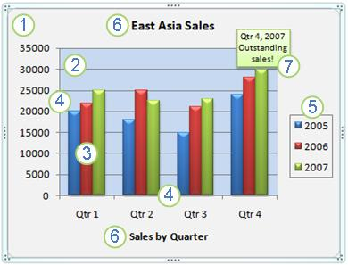
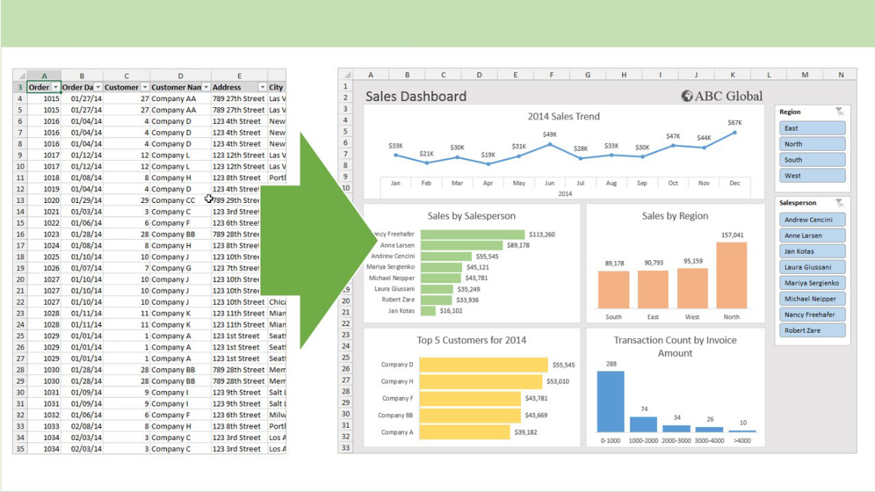
The Excel GUI
So, what can Excel do?
You can enter basic or complex functions and calculations in Excel.
From the simple
=16.83 + 127.42
To the complex
=IF(IF(INDEX(temp.xls!A:F;SUM(MATCH("EENU";temp.xls!A:A;0);MATCH("BF304";OFFSET(temp.xls!A1;MATCH("EENU";temp.xls!A:A;0)-1;0;MATCH("FCLI";temp.xls!A:A;0)-MATCH("EENU";temp.xls!A:A;0)+1;1);0))-1;5)<>0;5;6)=5;INDEX(temp.xls!A:F;SUM(MATCH("EENU";temp.xls!A:A;0);MATCH("BF304";OFFSET(temp.xls!A1;EQUIV("EENU";temp.xls!A:A;0)-1;0;MATCH("FCLI";temp.xls!A:A;0)-MATCH("EENU";temp.xls!A:A;0)+1;1);0))-1;IF(INDEX(temp.xls!A:F;SUM(MATCH("EENU";temp.xls!A:A;0);MATCH("BF304";OFFSET(temp.xls!A1;MATCH("EENU";temp.xls!A:A;0)-1;0;MATCH("FCLI";temp.xls!A:A;0)-MATCH("EENU";temp.xls!A:A;0)+1;1);0))-1;5)<>0;5;6));-INDEX(temp.xls!A:F;SUM(MATCH("EENU";temp.xls!A:A;0);MATCH("BF304";OFFSET(temp.xls!A1;MATCH("EENU";temp.xls!A:A;0)-1;0;MATCH("FCLI";temp.xls!A:A;0)-MATCH("EENU";temp.xls!A:A;0)+1;1);0))-1;IF(INDEX(temp.xls!A:F;SUM(MATCH("EENU";temp.xls!A:A;0);MATCH("BF304";OFFSET(temp.xls!A1;MATCH("EENU";temp.xls!A:A;0)-1;0;MATCH("FCLI";temp.xls!A:A;0)-MATCH("EENU";temp.xls!A:A;0)+1;1);0))-1;5)<>0;5;6)))
Yes, that is a real function.
You can create professional reports and dashboards with nice looking charts and visualizations
You can create Pivot Tables
A pivot table processes data from
One or more spreadsheet(s),
table(s), and/or database(s)
using a query and then organizes
and summarizes that data into
a visual chart, graph or report.
The example here is called a
Dashboard. We will briefly cover
A typical Dashboard later in the
course.

Slide 26
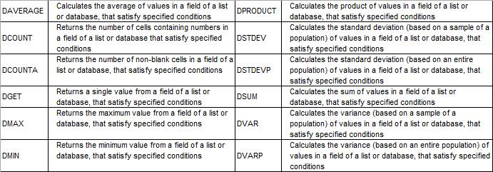
The Excel GUI
So, what can Excel do?
You can write code in Excel with VBA (Visual Basic for Applications)
Set objExcel = CreateObject("Excel.Application")
objExcel.Workbooks.Add
Sheet = 1
Set objSheet = objExcel.ActiveWorkbook.Worksheets(Sheet)
objSheet.Name = "VBS_Excel_Example"
strExcelPath = "d:\Vbs_Excel_Example.xlsx"
objSheet.Cells(row, column).Value = "Whatever"
objSheet.Cells(1, 1).Value = "Name" 'Row 1 Column 1 (A)
objSheet.Cells(1, 2).Value = "Description" 'Row 1 Column 2 (B)
objSheet.Cells(1, 3).Value = "Something Else" 'Row 1 Column 3 (C)
For row = 2 to 10
objSheet.Cells(row, 1).Value = "Item " & row & " Name"
objSheet.Cells(row, 2).Value = "Item " & row & " Description"
objSheet.Cells(row, 3).Value = "Item " & row & " Something Else“
You can program your own scripts, or even download them from the Internet, but if you do that you must be careful otherwise you could possibly introduce a security risk to your computer.
You can solve optimization problems and make statistical analysis (data analysis)
Some of the more common statistical functions:
ABS | The absolute value of a number
AVERAGE | The average or arithmetic mean for a group of numbers
COUNT | The number of cell locations in a range that contain a numeric character
COUNTA | The number of cell locations in a range that contain a text or numeric character
MAX | The highest numeric value in a group of numbers
MEDIAN | The middle number in a group of numbers (half the numbers in the group are higher than the median and half the numbers in the group are lower than the median)
MIN | The lowest numeric value in a group of numbers
MODE | The number that appears most frequently in a group of numbers
PRODUCT | The result of multiplying all the values in a range of cell locations
SQRT | The positive square root of a number
STDEV.S | The standard deviation for a group of numbers based on a sample
SUM | The total of all numeric values in a group
You can collect information, make data entries and create lists
This not a full list, but the more common database functions.

Slide 27
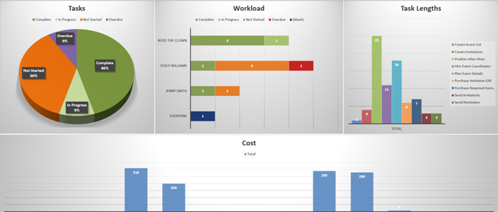
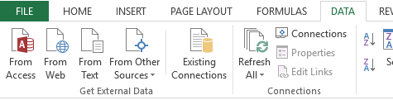
The Excel GUI
So, what can Excel do?
You can use Excel for educational purposes with interactive features
You can create games in Excel
  Monopoly
  3D Maze
  Writer’s Block
  3D Tic Tac Toe
Much more! Just Google
“Excel games” and check it out.
You can connect an Excel spreadsheet to a web page just by saving it to a folder
I have no specific example to show you, but through a variety of technologies an Excel Spreadsheet can be made immediately available to a web page simply by saving it to a specific folder.
You can fetch live data from the web into Excel.
The Data ribbon has all sorts of cool things. One of them is the Get External Data group.
You can import live Access databases, web pages, plain old boring text, and much more.
You can prepare Diagrams, Mockups and Gantt Charts

Slide 28
Basic Spreadsheet Functions
Function Categories
The function bar shown below is directly above the column headers.
Name Box
Insert Function box. Click on the icon to open the functions dialog.
Function/Formula bar
Formula Categories
Compatibility – These functions from earlier versions of Excel are provided for compatibility with functions made in old versions of Excel.
Cube - Multidimensional sets of data providing a means to summarize information based on a set of search criteria.
Database – Treating an Excel spreadsheet as a flat database, these functions return a search based on sum, variance, and standard deviation data.
Date & Time – These date and time functions allow you to work with the current time or periods of time in your functions.
Engineering – Engineering calculations: many of which relate to Bessel Functions, Complex Numbers or converting between different bases.
Information – These functions return information about the contents and/or formatting of a cell.
Logical – Flow control, logic and error capture.
Math & Trigonometry – ABS, sine, cosine, logarithmic, Pi, Quotient, etc.
Statistical – Works with data points, deviations, and more.
Text – Use these function to manipulate text.
Web – XML and web services functions.
Notes:
Have them follow along in the functions dialog box if they have a computer in front of them.

Slide 29
Basic Spreadsheet Functions
The Rules
Like everything in life, there are rules to follow.
All formulas begin with an equal sign.
Cells when represented in a function individually or as a block are separated by a comma (union operator). eg. D14, H27, A3, B84
Cells when represented in contiguous block are separated by a colon (cell range operator). eg. D14:D30
Blocks of contiguous cells and/or single cells are separated by a comma. eg. D14:D30, B24, H27:J34, A3:H3, J38, B84:D84
Excel follows the Order of Operations. Remember the PEMDAS (or BEDMAS) you might have learned in school
(Parenthesis, Exponent, Multiplication, Division, Addition, Subtraction) or (Brackets, Exponents, Division, Multiplication, Addition, Subtraction)
Evaluate Parenthesis - From the inner first to the outer last eg. =8.7334*(27.416+(12-7.3)^4)
Evaluate ranges – A range of cells such as D14:D30 (column) or D14:J14 (Row)
Evaluate intersections – Using the space in a formula to separate ranges of cells tell Excel to intersect where the two ranges overlap.
- If one cell is overlapped, the value or calculated value in the overlap cell will be inserted into the formula.
- If more than one cell is overlapped, a #VALUE error will be returned. Why? Because the cell cannot display more that one value. So run a function
on it, such as SUM, MIN, MAX, etc., a function that can deal with multiple cells.
Evaluate unions – The union operator is the comma.
Perform negations
Convert percentage values to decimal.
Perform exponentiation – The up caret, ^, is used in a function to represent an exponent. ex. 4^3 equals 64
In Excel entering an e character between two numbers will with no spaces perform the n * 10^n. ex. 4e3 equals 4000.
Perform multiplication, *, and division, /. These are equal in precedence, so whichever comes first is evaluated first.
Perform addition, +, and subtraction, -. These are equal in precedence, so whichever come first is evaluated first.
Evaluate text operators – In Excel the ampersand, &, concatenates text.
Perform comparisons – The comparison operator are: equals = not equal to <> less than <= greater than >=
Fear not! I have this list created in a PDF document for you to download and view.
ftp://172.27.0.4/CSU/IT_Helpdesk/Computer_Training/Excel_Order_Of_Operations.pdf

Slide 30
Basic Spreadsheet Functions
Common Functions
SUM – Adds all the numeric values of all the selected cells. This is probably the most common function in Excel. eg. =SUM(D2, G6:G8)
HYPERLINK – Insert a web link to a web page or resource (such as a PDF) into a cell. Hyperlinks can also jump to a name link on any spreadsheet to which it has access, even other workbook sheets (i.e. another file).
MIN & MAX – MIN returns the lowest value from the selected cells. MAX returns the highest value from the selected cells. eg. =MIN(D2, G6:G8)
NOW – Returns the current date in the format defined in Windows for a short date, short time
(Win10 – Settings/Time & Language/Date & Time/Formats/Short Date & Short Time) eg. =NOW() Don’t forget those parenthesis!
DAYS – Returns the number of days in a date period. eg. =DAYS("January 12, 2017","February 26, 2017")
COUNT & COUNTA – COUNT returns the number of cells in a selected range that contain number only. eg. =COUNT(D2, G6:G8)
COUNTA returns the number of cells in a selected range that are empty. eg. =COUNTA(D2, G6:G8)
AVERAGE – Returns the arithmetic mean of its’ argument. eg. =AVERAGE(D2, G6:G8)
DSUM – Adds the numbers in the fields of records in the database that match the conditions you specify.
Notes:
( = 18.98 + 114.98 * 4 Answer is B ) ( = 12 + (3.14159 * 325) Answer is A ) ( = 187.4 * (18 + 5^3) Answer is C )

Slide 31
Exercise Two
On the “Excel_2013_Sample_Workbook.xlsx” click on the OOP sheet tab.
Note: You may have to scroll right using the spreadsheet navigation arrows. (bottom left)
1. Enter into cell B5 the following formula:
18.98 + 114.98 * 4
Answer:
535.84
This is a basic formula you would see in commerce.
478.90
2. Enter into cell B8 the following formula:
12 + (3.14159 * 325)
Answer:
1033.01675
47.5686677281
Though syntactically not incorrect, can anyone notice anything that is unnecessary in this formula?
3. Enter into cell B11 the following formula:
187.4 * (18 + 5^3)
Answer:
3378200
8373.2
26798.2
Which is done first, the exponent or what is in parenthesis? (Hint: trick question)

Slide 32
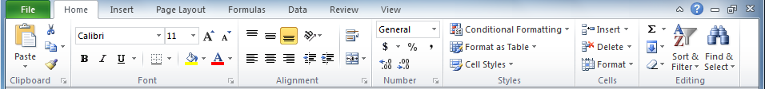
Navigating in Excel
Ribbon - Home
Notice the icon. This opens up a dialog box or panel which allows you further control of the commands in that group.
Clipboard – Allows you to copy cut and paste cell contents, graphs, pictures and more.
Font – You can modify the text of the cells.
Alignment - Positions the content of the cells in the cells.
Number – Allows you to format numbers as monetary, percentage and more.
Styles – You can apply all the formatting into a single style and apply that instead of applying each format separately.
Cells – Gives you the ability to insert, delete and format individual cells or as a selected group of cells.
Editing – Sort, filter, search and selection functions.

Slide 33
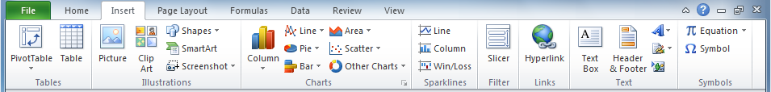
Navigating in Excel
Ribbon - Insert
Tables – You can insert regular tables and pivot tables. A pivot table processes data from one or more spreadsheet(s), table(s), and/or database(s) using a query and then organizes and summarizes that data into a visual chart, graph or report.
Illustrations – You can insert pictures, pictures from the web, shapes, Smart Art graphics, or screen shots.
Charts – Column, line, pie, donut, bar, area, scatter, stock, and radar charts are just some of the types of charts you can create.
Sparklines – Sparklines are mini-charts placed in single cells, each representing a single row of data in your selection. You can make a Line Sparkline, Column Sparkline, or Win/Loss Sparkline.
Filters – A Slicer allows you to filter the data visually. Timeline allow you to filter data by a time periods for Pivot tables, Pivot charts, and cube data.
Links – You can insert hypertext links, also known as URLs. You can also make a link to another cell even on another spreadsheet.
Text – You can also add text boxes, headers and footers, Word Art, a Signature line, and an object. An object can be a lot of things, but as an example; Adobe PDF, Illustrator, Photoshop, Bitmap, Encapsulated Postscript, Flash document, PowerPoint, Word, and much more.
Symbols – If all that isn’t enough, you can also insert equations, symbols, and special characters.

Slide 34
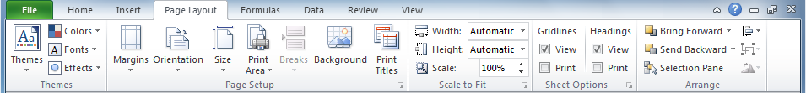
Navigating in Excel
Ribbon – Page Layout
Themes – The elements of a Theme include colors, fonts, and effects. You can choose from pre-set themes, browse for a saved theme, or save the current theme.
Page Setup – Page setup includes; margins, page orientation, page size, set or clear the selected print area, page breaks, background and print titles. The button opens a dialog box with yet more options for page set up such as margins and specialize print options.
Scale to Fit – Scale to fit will force a large spreadsheet into a smaller area or vise-versa. Since Windows uses vector fonts (true-type) then the text remains clear and easy to read.
Sheet Options – Sheet options, also the fourth tab on the Page Setup dialog box, lets you set grid lines and Heading to just on-screen view or printed as well. The Setup dialog box allows even more options.
Arrange – Any time an object such as a chart, picture, PDF, or any object, those objects can be layered like cards on the surface of a desk. The arrange layers those objects forward or backward, align them to the top, bottom, left or right side of the spreadsheet, or snap to grid. You can group the objects so several can be handled as one, rotate them one by one or as a group. Plenty of ways to arrange the objects on the spreadsheet.

Slide 35
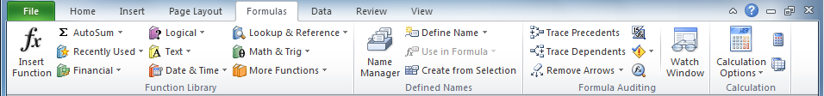
Navigating in Excel
Ribbon – Formulas
Function Library – The Function Library is by far the main feature and power of Excel. From the simple AutoSum function which totals the values in a selected block of cells to the more advanced Math, Statistical, Trigonometric and Engineering functions, the formulas cover most any operation you will need. If not, you can always write your own formula. Excel follows the Order of Operations.
Defined Names – When you define a name for a cell or selected block of cells, you are applying a name by which you can reference in a formula. In this group are the commands; Define Name, Use in Formula, Create from Selection, and the Name manager.
Formula Auditing – The more complex a formula the more prone to entry errors it becomes. Formula auditing allows you to track down errors by:
Tracing - Allowing you to follow the path of execution by tracing precedent and dependant cells(s). Which cells affect the value in the current cell (precedent) and which cells are affected by the value in the current cell (dependant).
Exposing the formula - Displays the formula in the cell instead of the calculated value
Error Checking – Checks mainly for syntactical errors.
Formula Evaluation – Allows you to step through each part of a formula individually so you can evaluate the results as they progress.
Watch Window – Will display the value of the cells you choose to include in the watch as you step through or run the formula even if those cells are on different spreadsheets.
Calculation – You can have Excel automatically or manually calculate the formulas on the spreadsheet.
Set it to manual if, for example, you want a button to execute the formula.
Or, if you do not bind your formula to a button inserted on to the spreadsheet, you can use one of the commands located beside the Calculation Options button, calculate all formulas on the entire workbook or on the current selected spreadsheet.

Slide 36
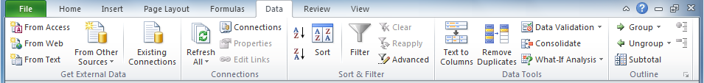
Navigating in Excel
Ribbon – Data
Get External Data – You can import data from a Microsoft Access file, Web page, Text file, SQL server, SQL server analysis services cube,
Window Azure Data Market feed, OData data feed, XML file, and other data sources such as OLEDB and ODBC.
Connections – The connections group contains commands that allow you to add, edit and manage your data connection to the various sources listed above.
Sort & Filter – You can:
Sort your data by the data type in that column
Filter the data in a column by selecting a data type from the drop down arrow in the column header beside the header name
Advanced criteria for filtering the data in a column
Data Tools
Text to columns – Parse text data by a delimiter or by a fixed character length into a column
Flash Fill – Enter a couple of cells containing the pattern of data and Flash Fill will extrapolate and fill the remaining selected cells.
Remove Duplicates – Will remove duplicate data in the selected block of cells, or the entire spreadsheet if no cells are selected.
Data Validation – Data validation sets condition(s) to the data that can be entered into that cell and will display a custom message and/or alert if the data attempted to be entered was incorrect.
Consolidate – Collates data from separate selected ranges of cell into a single output range.
What-If-Analysis – Allows you to run a formula using different input criteria so you can view the results.
Relationships – You can create a relationship between two tables of data, based on matching data in each table and then create Power View sheets, build PivotTables and other reports with fields from each table, even when the tables are from different sources.
Outline – Group rows and/or columns or related data. Then subtotal the data automatically.

Slide 37
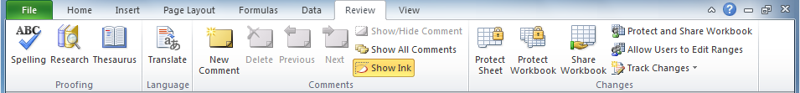
Navigating in Excel
Ribbon – Review
Proofing – Proof read your workbook by checking for spelling mistakes, by using a thesaurus to replace all those boring simple words with complex words, and do research with online dictionaries, encyclopedias, language translation and more.
Language – The translate button will display the research panel so you can enter the search text. You can translate between 49 different languages.
Comments
Add a Comment - Add a post-it style note attached to a cell, but not in the cell contents. It is represented by a small red triangle in the upper right corner of the cell. Hover over it to see the comment. When the cell is selected and a comment is attached, the Add a Comment button is changed to Edit a Comment.
Delete – You can delete a comment attached to a cell by first selecting the cell, the clicking on Delete.
Previous and Next – Cycle through all the comments on the spreadsheet.
Show/Hide Comment – Displays the comment attached to the selected cell.
Show All Comments – Display all the comments on the selected spreadsheet.
Show Ink - Shows or hides the small red triangular mark which indicates a comment is attached to a cell.
Changes
Protect Sheet – Select ranges of cells to lock and some to leave unlocked and then password protect the spreadsheet.
Protect Workbook – Prevent structural changes to your workbook, such as moving, adding or deleting spreadsheets by applying a password to the workbook.
Share Workbook – Options which apply to sharing your workbook with others, such as enable tracking changes.
Protect Shared Workbook – Apply a password to the workbook.
Allow Users to Edit Ranges – When selected a dialog box appears in which you can add cell ranges and allow selected users permissions to read-only or edit that range. If your computer is part of a domain, the you can select the from the domain users. If your computer is stand alone, then you can add from used accounts on the local computer only.
Track Changes – Keep track of all the changes to the document. When a workbook is sent to others for review, this option keeps track of any changes they make by highlighting the changes.

Slide 38
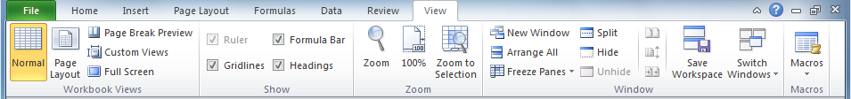
Navigating in Excel
Ribbon – View
Workbook Views
Normal View – This is the regular way to view the workbook.
Page Break Preview – When selected this will divide your spreadsheet into printable pages based upon the paper size type setting fount on the Page Layout tab, Page Setup group, Size setting. After clicking on this command the spreadsheet visually show how the data is divided and how the pages will be printed. And when you break out of this view by clicking on the Normal button dotted lines showing where the pages are separated will remain on the spreadsheet.
Page Layout – Will display the pages similar to the Page Break Preview mode but more like sheets of paper with the data shown full size.
Custom Views – Custom views allows you to select specific cells to highlight for specific views. Apply a label or name to each view.
Show
Ruler – You can show or hide the horizontal ruler at the top of the spreadsheet. Appears in Page Layout mode.
Gridlines – Show or hide the lines between the cells on the screen. To hide the grid lines on paper is another setting found on the Page Layout Tab, Sheet Options, Gridlines Print check box.
Formula Bar – Shows or hides the formula bar.
Heading – This shows or hides the A, B, C column headings and the 1, 2, 3 row headings.
Zoom – Zoom in and out by percentage or zoom to a selected area of cells.
Window
New Window – Opens another window on the current workbook
Arrange All – By Tiles, Horizontal, Vertical, Cascade
Freeze Panes – Freezes the cells left of the selected cell and above the selected cell allowing for only the remaining cells to scroll vertically and horizontally. You can freeze the top row and first column in this fashion as well, the purpose is assuming the first column and row are headers.
Split – You can split the window into four panes all scrolling independent of each other.
Hide –Hide and unhide spreadsheets.
Macros – You can record, view and play macros using this command.

Slide 39
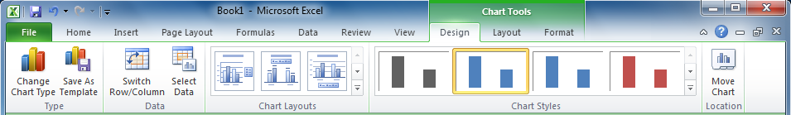
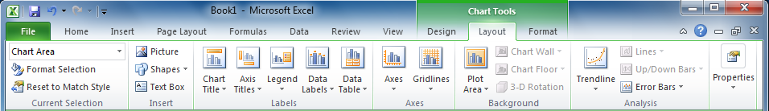
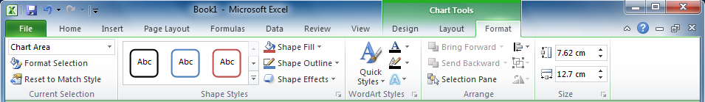
Navigating in Excel
Contextual Ribbons
Contextual ribbons are special types of ribbons that appear only when a particular object is selected, such as a chart or a shape.
These Contextual Ribbons or Contextual Tabs contain commands specific to whatever object you are currently working on.
Below are a few of the many available Contextual ribbons.
Chart Tools
Chart design tools
Chart layout tools
Chart formatting tools

Slide 40
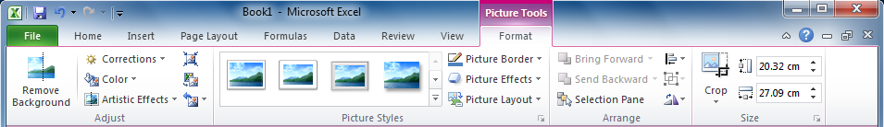
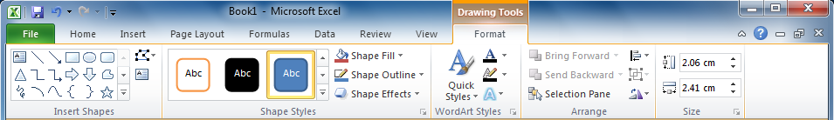
Navigating in Excel
Contextual Ribbons
Contextual ribbons are special types of ribbons that appear only when a particular object is selected, such as a chart or a shape.
These Contextual Ribbons or Contextual Tabs contain commands specific to whatever object you are currently working on.
Below are a few of the many available Contextual ribbons.
Picture Tools
Picture formatting tools
Drawing Tools
Drawing formatting tools

Slide 41
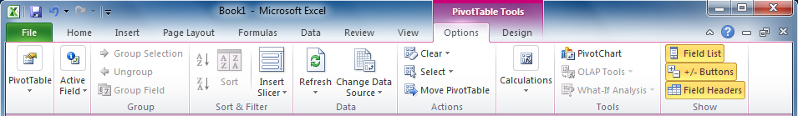
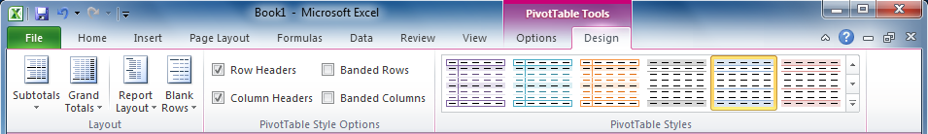
Navigating in Excel
Contextual Ribbons
Contextual ribbons are special types of ribbons that appear only when a particular object is selected, such as a chart or a shape.
These Contextual Ribbons or Contextual Tabs contain commands specific to whatever object you are currently working on.
Below are a few of the many available Contextual ribbons.
PivotTable Tools
PivotTable options tools
PivotTable design tools

Slide 42
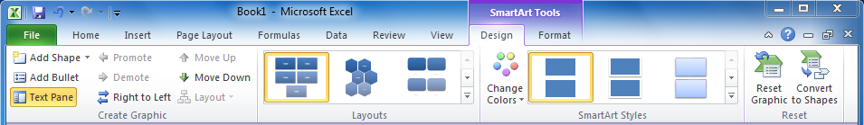
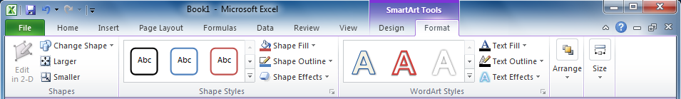
Navigating in Excel
Contextual Ribbons
Contextual ribbons are special types of ribbons that appear only when a particular object is selected, such as a chart or a shape.
These Contextual Ribbons or Contextual Tabs contain commands specific to whatever object you are currently working on.
Below are a few of the many available Contextual ribbons.
SmartArt / WordArt Tools
SmartArt / WordArt design tools
SmartArt / WordArt formatting tools

Slide 43
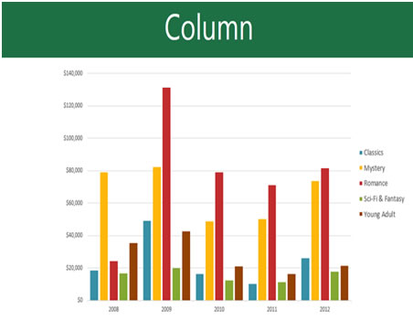
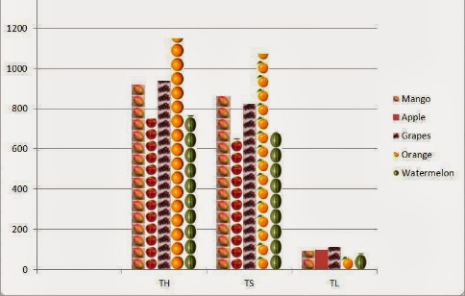
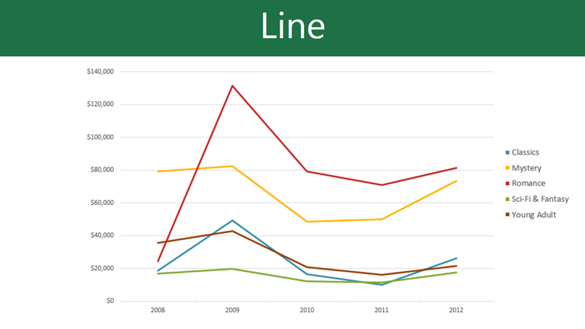
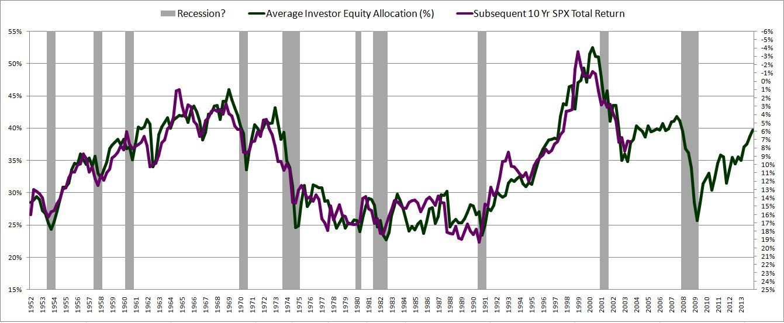
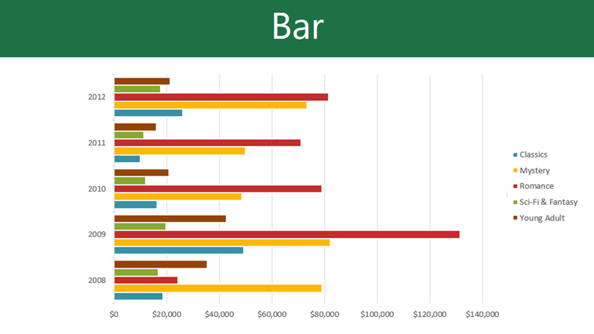
Basic Spreadsheet Functions
Intro to Charts and Pivot Tables
We will only be covering the most basic information here in this course. The course Excel 2013 Pivot Tables & Graphs will be covering this is detail.
An Excel chart is a visual representation of tabular data.
Below are the more common types of charts available in Excel.
Column chart (or Bar graph) is used to show a comparison between two items.
The Pie chart
Shows percentages
A Pictograph (or Pictogram) is a column chart that uses pictures to represent the data instead of the standard colored columns.
The Line chart is used to show trends over time.
A Bar chart’s columns run horizontally along the page rather than vertically.
A Stock Market chart shows stocks and shares information in their opening and closing prices over a time period.

Slide 44
NITHA IT HelpDesk helpdesk@nitha.com
1(844)486-4842
Notes:
Please do not hesitate to ask any question regarding this session, and I will make sure to answer your question as soon as possible.

Slide 45


