Slide 1


Computer Basics
Entry Level

Slide 2
NITHA IT Helpdesk
helpdesk@nitha.com
1(306)953-5008

Slide 3

What will be covered in this course
Computer Hardware
  Computer Types, Computer Parts
  Monitors, Keyboards & Mice
  Printer Types
  Plugs & Ports
Computer Software
  Bits & Bytes
  Basic Intro to Programs (Excel, Word, Email, etc.)
  Information Security
  Backup Security
  Buying a Computer

Slide 4
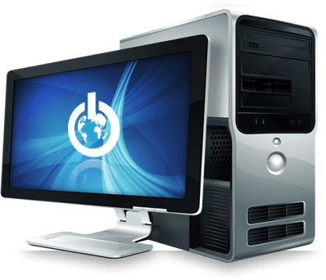
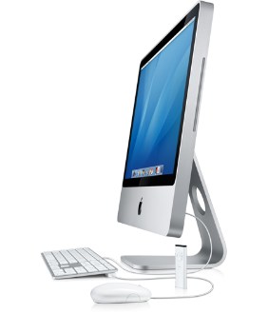
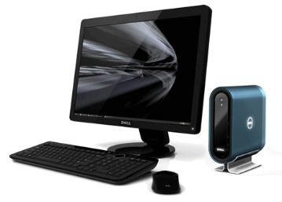
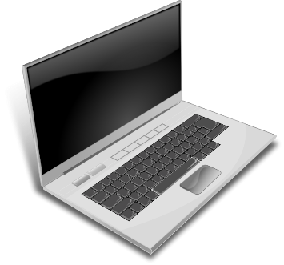
Computer Hardware
The Personal Computer (PC) comes in four general types
The Personal Computer (PC) can be:
Built into the monitor
A tower computer
The laptop PC
Desktop PC

Slide 5
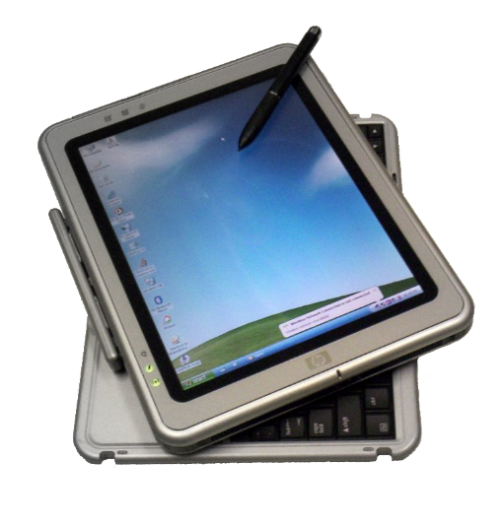
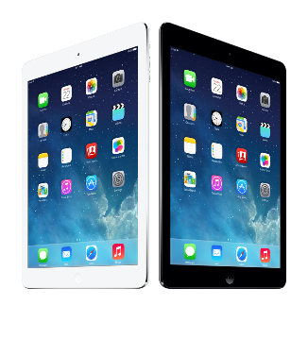
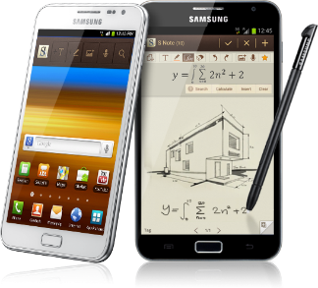
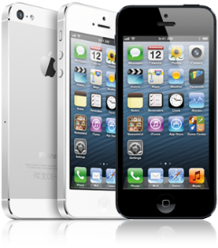
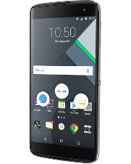
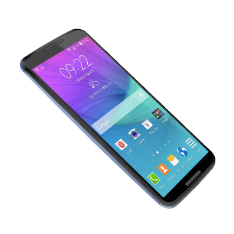
Computer Hardware
Portable Computers Types
The Tablet PC
iPhone, Android, & Blackberry phones
Apple iPad Samsung sNote

Slide 6
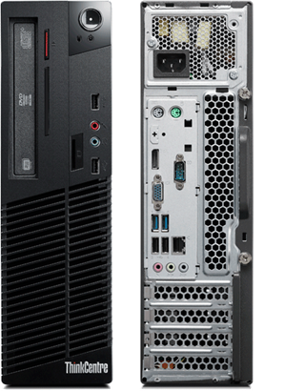
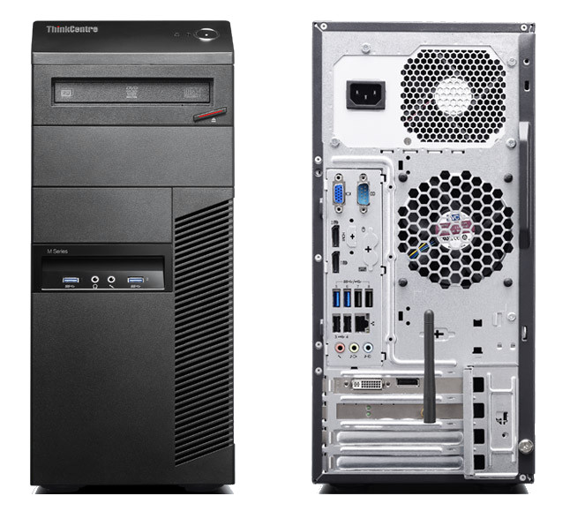
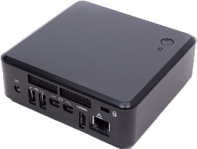
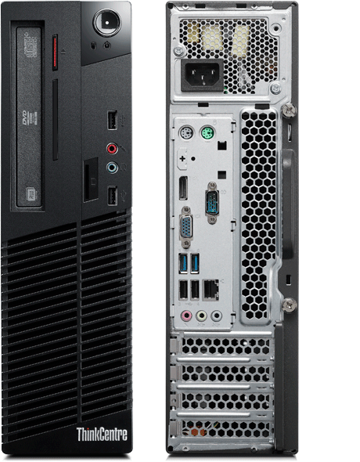
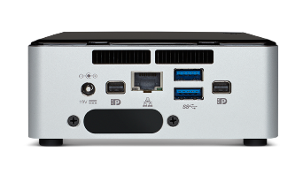
Computer Hardware
The Computer Chassis
Tower
Micro PC
Desktop
23 cm
35 cm
10 cm
45 cm
20cm
6 cm

Slide 7
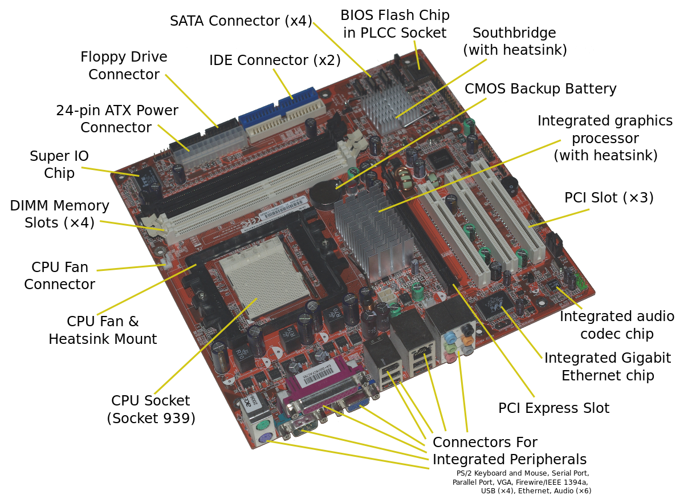
Computer Hardware
The guts of the computer
The Motherboard
The motherboard is the heart of the computer. All hardware plugs into it.
Without a good quality motherboard, the even the best components would be hindered.

Slide 8
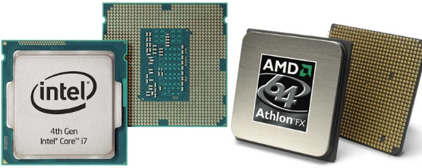
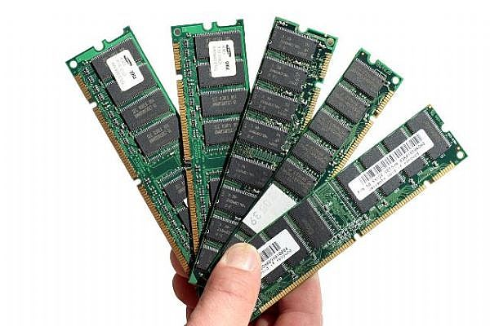
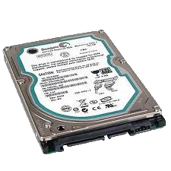
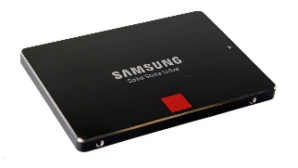
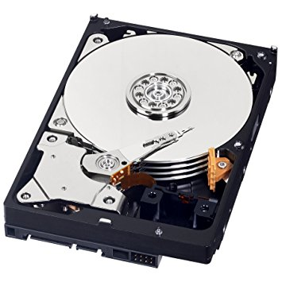
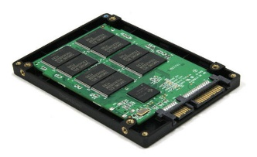
Computer Hardware
The guts of the computer
The CPU (Central Processing Unit) is the brain of the computer. Intel and AMD are the leading CPU competitors in the PC market. Its’ speed is generally the measure of how fast the computer is, measured in Gigahertz (Ghz).
RAM (Random Access Memory) is like the computer’s desk. Any file that the computer has open is on its’ “desk”. The bigger the desk (more RAM), the more it can have open.
RAM capacity is measured in Gigabytes (GB)
The computer’s storage is like a filing cabinet. The computer cannot work on it until it is on its’ desk.
The HDD is the older mechanical storage, as seen on the left.
The SSD is newer and more expensive than SRAM memory storage.
Measured in Gigabytes (GB)

Slide 9

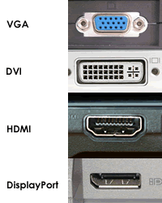
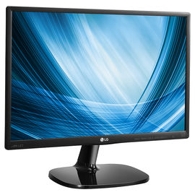
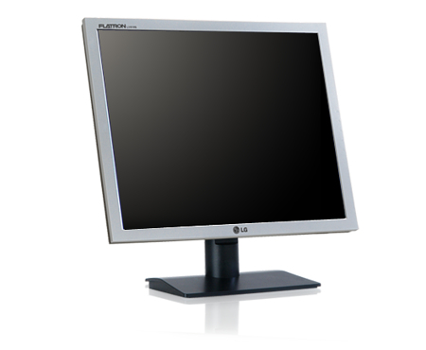
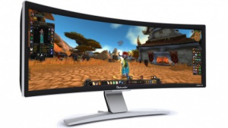
DVI-I Single link
DVI-I Dual link
Monitors
DVI-D Single link
DVI-D Dual link
DVI-A Analog Only
3440 X 1440
Ultra Wide 21 x 9
Wide Screen 16 x 9
1920 X 1080
16 X 10 = 1920 X 1200
Standard 4 x 3
1024 X 768

Slide 10
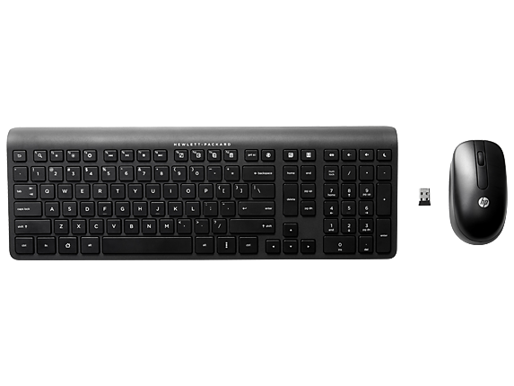
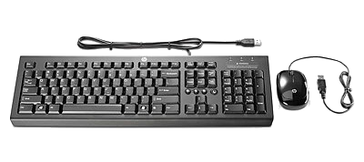
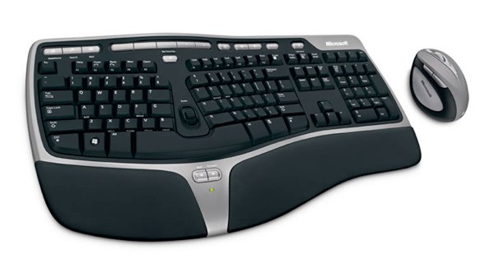
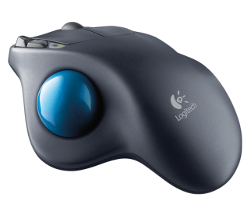
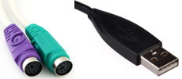
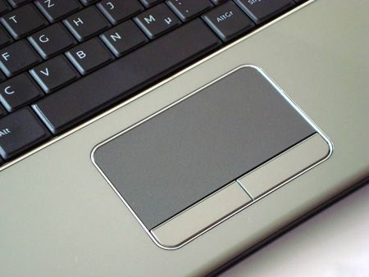
Keyboards and Mice
Basic wireless keyboard and mouse
Basic wired keyboard and mouse
Trackball
Touchpad
PS/2 Keyboard
PS/2 Mouse
USB Plug
Wireless Ergonomic Keyboard and Mouse

Slide 11
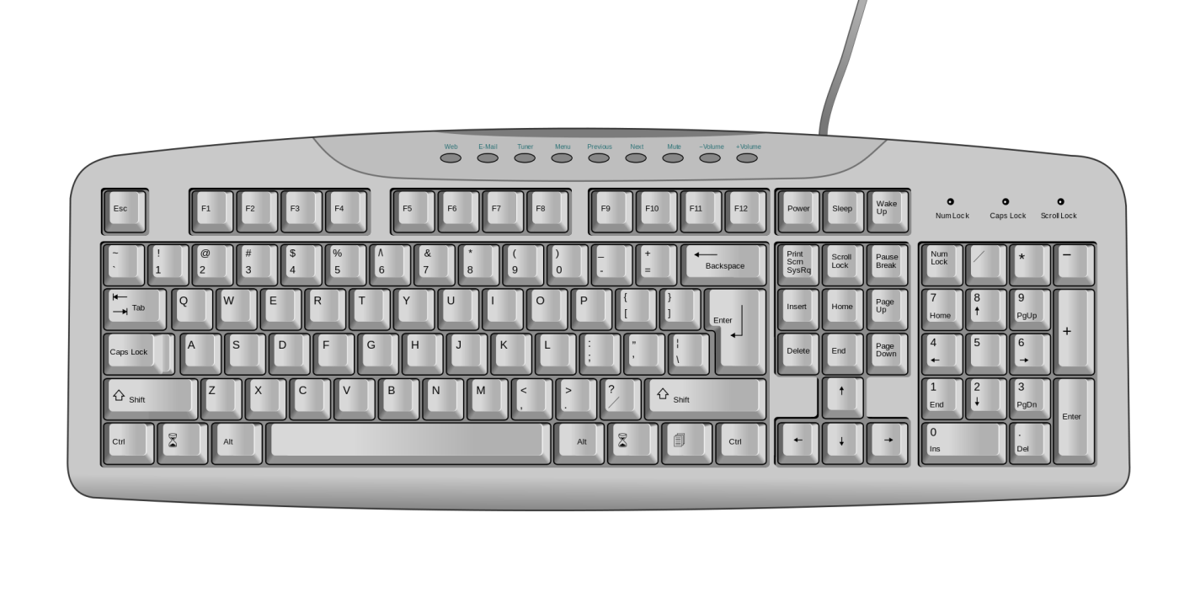
Getting Around in Windows
Using the Mouse
Insert/Delete
Home/End
Page Up/Page Down
Print Screen
Scroll Lock
Pause
Escape key
Programmable Function Keys
Standard typewriter
keyboard
Numeric Key Pad
Arrow Keys
Standard keyboard

Slide 12
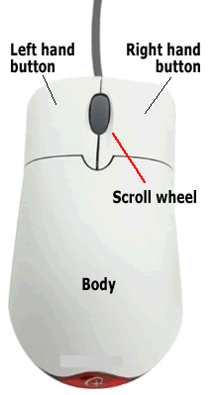
The typical mouse has two larger buttons that can be configured either:
left / right
right / left
The scroll wheel is also a button.
Getting Around in Windows
Using the Mouse
Some basic rules
1. Don't double click in a Web browser.
Links, buttons, tabs, toolbar icons, and everything else you will find in your web browser usually require only one click.
2. Don't double click the Quick Launch program icons on your Taskbar
3. Double-click program icons on your desktop and files/folders you want to open.
4. You can right-click almost any item (icon, link, desktop, taskbar, etc.) and get a context menu of things you can do with that item.
Rule of thumb – If you are unsure whether to single or double-click, click once. If it does not work, double click.
When do you left click, right click or double click, you ask?
You left click to:
Select an object such as a desktop icon,
a file or a file folder.
Start a program or open a document link.
When you right click something, you quickly press and release the button that is configured as the right mouse button.
When you left click something you do the same as a “right click” except using the left button.
When you “double click” you press and release the left mouse button two times in rapid succession.

Slide 13
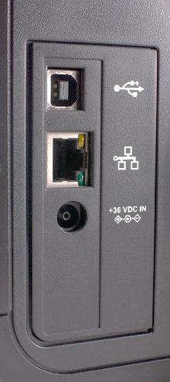
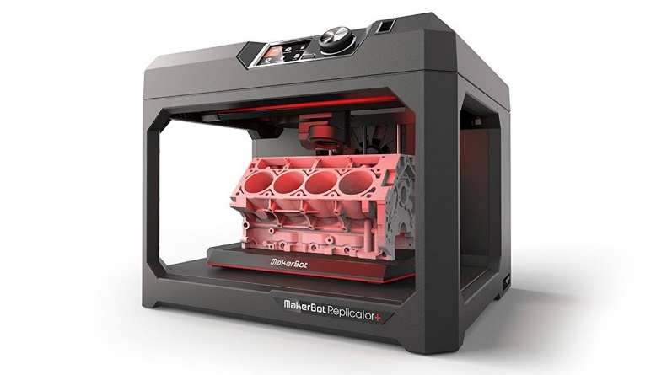
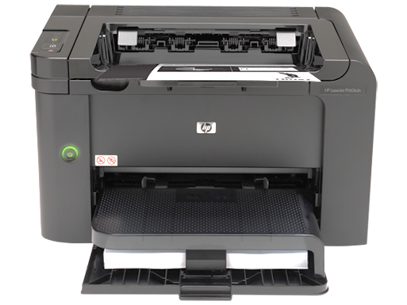
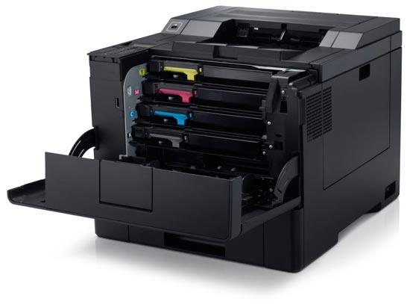
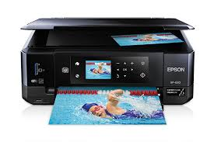
Printer Connector Types
Types of Printers
The 3D Printer
USB ➔
Network ➔
Laser or LED Printer
3D printing is also called additive manufacturing because it builds a three dimensional model in almost any shape using polymers, plastic.
Designed with 3D CAD software, the head moves across the model and builds the design minuscule drop by minuscule drop of hot plastic.
An engine block model as seen above would take several hours to build.
Inkjet Printer
with Flatbed Scanner
Color Laser Printer

Slide 14
Plugs & Ports
Power Plugs and Ports
USB Types
Audio Connectors
Network
Legacy (really old plugs and ports)

Slide 15
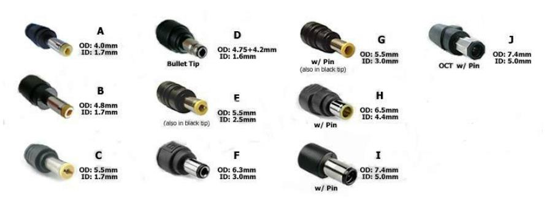
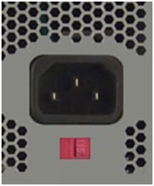
1. Power Plugs and Ports
Laptop and most other hardware plugs
    direct current power
    mostly attached to a power adapter
Computer Desktop and Tower
115 volts alternating current power
Switchable to 230 volt AC power

Slide 16
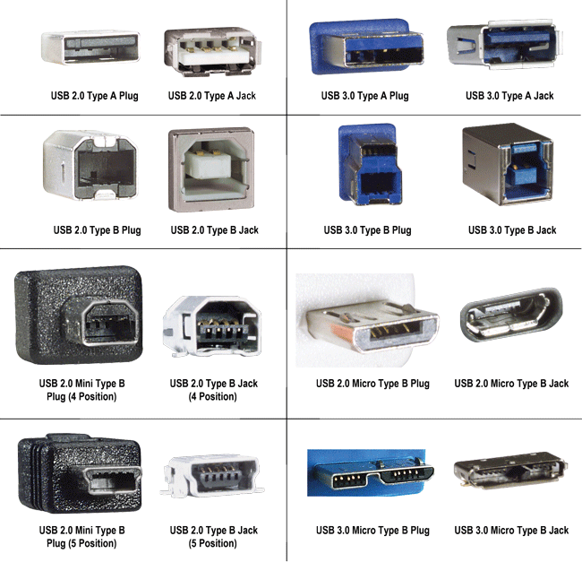
USB Types
The computer industry has changed the terminology for plugs and jacks.
The Type A jack and plug is rectangular.
Type B is square for the regular and mini jacks and plugs, but changes to be rectangular for the micro size.
Notice that the USB 2.0 is black, USB 3.0 is blue and the red ports (not shown here) have increased power output, still USB 3.0.

Slide 17
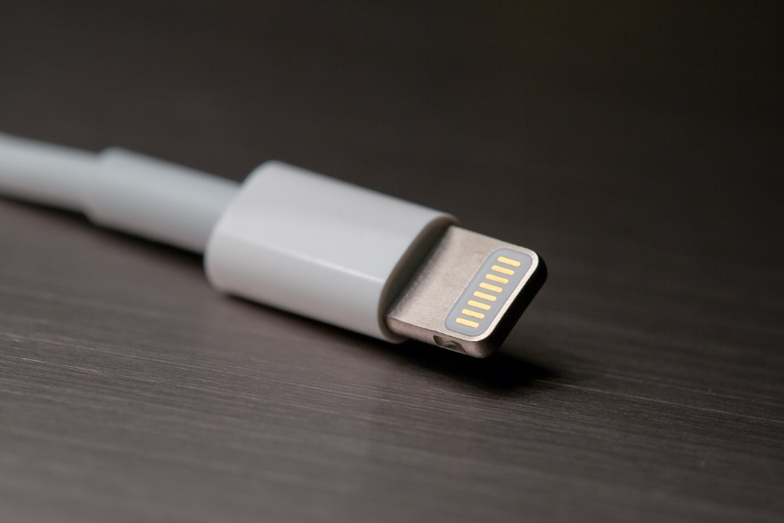
USB Types
This is a USB-C plug, which is found on Apple iPhones, called “Lightning” by Apple.
USB C transfers at the same speed as USB 3.1, up to 10 Gbps.

Slide 18
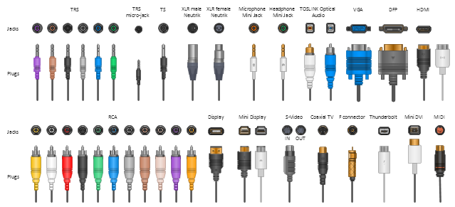
Audio Connectors
The audio connector is used less today because USB audio devices have largely replaced it, but most computers still come with the standard analog audio connections.
 | black TRS 3.5 mm | stereo output, rear channels
 | grey TRS 3.5 mm | stereo output, side channels
 | gold TRS 3.5 mm | dual output, center and subwoofer
 | blue TRS 3.5 mm | stereo input, line level
 | pink TRS† 3.5 mm | mono microphone input
Here is a fairly comprehensive chart of the plugs and jacks. Some are not audio-related.
The top row, far left, six plugs, and ports are the most common seen on tower, desktop, and micro PCs. This is where you would hook up your 7.1 and 8.1 surround sound system designed for computers.
The mini-jack top middle is common on laptops and portable computers.

Slide 19
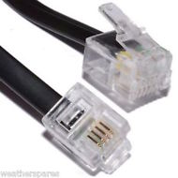
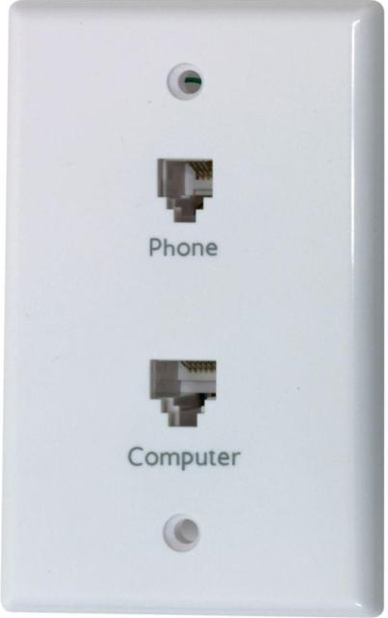
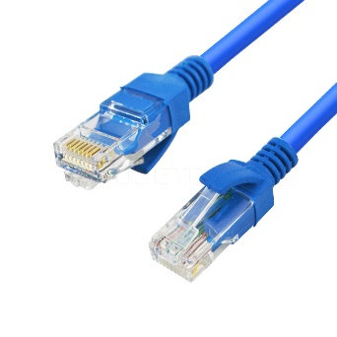
Network
Here is a comparison between the phone jack and the network (Ethernet) jack. They look similar, but serve very different functions. Do not confuse the two.
Phone jack – RJ11
Phone plug – 4 wires
RJ9 is the headset jack, 4 wires but smaller that a RJ11
Ethernet jack – RJ45
Ethernet plug – 8 wires

Slide 20
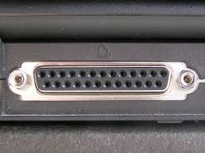
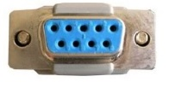
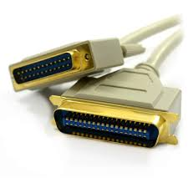


Legacy Plugs and Ports
Included here are a few old plugs and ports that you might still come across. You should be able to identify them when you see them so you know what they are.
Parallel port - 25 pin
Serial port - 9 pin
The serial port and cable was mostly used for transferring data, but was also use for the mouse in days old.
Old printer port and plug
Centronics port
Notes:
Audio ports
They can be found in the back of your desktop, and they are usually colored code.
Green is for speaker
Pink is for Microphone
Other colors are used for professional purposes
Sometimes they can be found in front face of your desktop as well, however I highly recommend you to use back one as it has better quality. There are technical reason that makes back ports more reliable.
You can also find similar ports on laptop, they are not colored code but usually you can see a sign of microphone and speakers near those ports.

Slide 21

The Back of a Typical PC
Power Port
Power Switch
Keyboard Port
PS2 Mouse Port
Sony / Phillips Digital Interface Format uses a coaxial cable with a specialized plug to carry audio over short distances. The yellow round plug is the video.
S/PDIF Out
USB 2.0 Ports
USB 2.0 Ports
eSATA Ports
External Serial Advanced Technology Attachment extends the internal SATA so hard drives can be connected external.
Audio Ports
Ethernet Port
High Definition Media Interface is used to transmit video and/or audio through the cable for up to 15 meters (49 feet).
Analog Video Port
DVI Video Port
HDMI Port

Slide 22

Some Basic Terminology
The Techie Speak
Bits and Bytes and all things nice
Bit
A bit is a binary digit
Think of a byte as a container that holds a value ranging from 0 to 255.
A Bit is, well, just a wee little bit of a Byte.
A byte is eight binary digits
Byte
256 128 64 32 16 8 4 2
A bit is like a light switch: Two states, on or off, 1 or 0.
A byte is a container with eight “light switches” … bits.

Slide 23
So now that you know what a bit and a byte is, why should you care?
All files and programs in a computer are made of bytes.
Any file of any type is a series of bytes, numbers ranging from the value of 0 to the value of 255.
So then, how does the computer know the difference between Excel and the spreadsheet?
In Windows, it is the file extension that tells the difference.
In Macintosh, it is the first part of the file that tells the difference.

Slide 24



Computer Software
The diagram below shows the flow of activity between the user and the computer and back again.
The user is you
The program can be anything, from Excel to Word, Internet to Email, to fancy stuff like photo editing and albums.
You can run many programs at once, such as browsing the Internet while writing up an email to your friend. In fact, even if you do not start any programs, Windows runs many programs in the background, and all of them simultaneously.
There are several operating systems: Windows, Mac, Linux, and UNIX are the most common.
We will focus on Windows as it is the most widely used operating system and is the one you are most likely to use.
The hardware we have already covered in general.
Windows runs on the desktop, tower, tablet and Surface PCs.
The operating system Android runs on the smaller sNote, Android phones, while Apple IOS runs on iPad, and iPhone.

Slide 25






















Software provides many different functions
Here are a few popular programs of the many thousands available to do just about any function you can imagine.
Productivity:
- Microsoft Word, Excel and PowerPoint
- PhotoShop, Premiere, Corel Draw, Sound Forge, Amadeus Pro
Entertainment:
- Media Player, VLC Media Player, Real Player, iTunes
- Games such as Guild Wars, World of Warcraft, SIMs
Internet:
- Web browsers such as Chrome, Firefox, MSIE, Safari, Edge
- Email software such as Microsoft Outlook and GMail

Slide 26


Information Security
In today’s world of computer technology, keeping your information safe is absolutely required!
With our information being recorded in government computers, on social networking, and on banking, and while your information is conveniently available for you to use, it can also be available to anyone else if the proper steps are not taken to secure it.
Steps to Privacy
Please do not write your password on a slip of paper and leave it near your desk.
2. Never share your password
Create a complex password
  Use upper and lower case letters
  Use a symbol or two
  Use one or more number
  Do not use names or words
  Do not use your phone number or any number that would easily be associated with you
Notice how the keyboard can be used as a mnemonic?
The pattern on the keyboard, top left four keys, the 5 is near the “r”, the top right four keys all uppercase (so hold the Shift key while typing), the * is near the “u”.
Difficult to crack passwords can also be easy to remember when you
use something like the keyboard to help you remember.
An example might look like
qwer5POIU*
Whenever you walk away from your computer, lock it.
(Windows Key) + L

Slide 27


Information Security
4. Keep Windows updated
5. Always have installed an active Anti-Virus software package. Some common package names are:
Symantec’s Norton Anti-Virus
AVG Anti-Virus
McAfee Anti-Virus
Malwarebytes
BitDefender
Trend Micro
Some of these companies have a free basic version you can download and install.
But it is still always better to buy the full anti-virus package.
6.
Do not reply to emails unless you know who the sender is or you are expecting the email. Spam emails can ask you to enter your information. Don’t. A legitimate organization will not solicit your information in that way.
Do not visit questionable websites.
Keep informed of security risks. Often your anti-virus software can inform you of threats.

Slide 28



Backup Security
A USB drive is the most common backup method today.
Though the physical size stays about the same (picture is full size), the data that it can hold up to around 16 Terabyte.
Backup your data!
Though this is technically not a security issue, it is an “Oh No! Now what do I do?” issue.
Few things are worse than losing of all your important documents.
The image above is a portable hard drive. This image is not full size.
They are about 4” X 5.5” X 0.75”
The largest capacity affordable portable hard drive (at the time of this writing) is about 16 Terabyte (16,000 Gigabyte).
- Backup software
Acronis True image
Norton 360
Dropbox
Methods for backup
Copy to USB drive or to a portable hard drive.
Use backup software

Slide 29
What computer do I buy?
Well, it depends upon what you want to do with it.
Do you need to be able to pick it up and go?
Do you need it to do business stuff?
Do you need it for gaming?
Do you need it to just send emails, browse the Internet and maybe the occasional letter, maybe a spreadsheet or two?
Do you need huge storage for lots of data?
Some Popular Brands
Dell
Apple
Hewlett-Packard
Asus
Acer
Lenovo
Alienware
Sony
Toshiba
Samsung
Compaq
Microsoft
IBM
Gateway
If you want portability, a laptop might be the best option, but it can still be a bit cumbersome and can be pricey.
A tablet PC or an even smaller Samsung sNote or Apple iPad is excellent for reading electronic books, sending and receiving emails and browsing the Internet (among other functions).
The sNote or iPad does not have a separate keyboard, unlike the Tablet PC.
If having portability is not an issue, then a desktop or tower PC gives you the best “bang for the buck”. You can get a faster computer with more storage capacity for less with a desktop or tower.
However, they tend not to have built-in wireless like portable computers because they are stationary.

Slide 30
Computer Specs
Here is some techie speak, some specifications you can give to the computer salesman, should you go buy a computer.
 | CPU | RAM | STORAGE | CHASSIS
Business | Intel i5 | 16 GB | 1 TB HDD | Desktop or tower
Home | Intel i7 | 16 GB | 2 TB HDD | Desktop, tower or Laptop
Gaming | Intel i7 | 32 GB | 512 GB SSD + 2 TB HDD | Tower
The CPU is the brain of the computer, and its’ speed is usually considered the measure of how fast the computer is.
The RAM is the temporary memory of the computer, something like your desk is a temporary spot to work with your paper documents.
Typically, more memory is better, but too much can be an unnecessary and extra expense.
The STORAGE is the permanent memory, which is similar to your filing cabinet.
  A business computer does not always need a lot of storage because most often documents are stored on a separate file server.
  A home computer needs more storage. 2 terabytes is a decent size to hold pictures, movies and all your other documents.
  A gaming computer needs the fastest speed, memory and storage. Many of the newer games require a lot of “horsepower”.
The CHASSIS is the box which contains the computer.

Slide 31
NITHA IT Helpdesk
helpdesk@nitha.com
1(306)953-5008

Slide 32

Thank you

