Slide 1


Adobe Acrobat Pro 2020 Part 3
Advanced Level

Slide 2
NITHA IT Helpdesk
helpdesk@nitha.com
1(306)953-5008

Slide 3

What will we be covering in this course?
Understanding Adobe Forms
Procedure to embed custom fonts into the PDF
Adobe File Types
The Form Elements in Detail
Add Text
Add Text Box
Add Checkbox
Add Radio Button
Add List Box
Add Dropdown List
Add Button
Add Image
Add Date
Add Signature
Add Barcode
Making a Form
From Scratch
From a Word Document

Slide 4
Page
Understanding Adobe Forms
Types of PDF file formats (6 types)
4
PDF (Portable Document Format) is part of a suite of file formats:
XML
Static PDF
Dynamic PDF
Traditional PDF
Acroform
PDF/A
1. XML Forms Architecture PDF(XFA PDF) - Adobe uses the term XFA PDF form to refer to the interactive
and dynamic forms.
This well-structured and flexible format enables an AEM Forms Server to transform your Designer files into different formats, including traditional PDF, PDF/A, and HTML.
Definition: XFA stands for XML Forms Architecture. While XFA is proprietary, XML is a universal standard.
2. Static PDF - Static XFA PDF forms layout never changes at runtime, but they can be interactive for the
user. The following are a few advantages of static XFA PDF forms:
Static XFA PDF format layout never changes when opened, yet it can also be interactive for the user.
Static Forms support the Comment and Markup tools.
Static Forms allow you to be able to import and/or export inserted comments.
Static Forms support font sub-setting, which is a technique that can be done on an AEM Forms Server.
Static Forms can be rendered using the built-in PDF viewer that comes with modern browsers.
Notes:
AEM provides a customizable Forms Portal that ensures that customers find and access forms they need across both web and mobile channels. AEM Forms provides forms management tools that not only lets you manage adaptive form, but XFA forms, PDF forms, and related assets as well.
subsetting is the process of retrieving just the parts (a subset) of large files which are of interest for a specific purpose

Slide 5
Page
Understanding Adobe Forms
Types of PDF file formats (6 types)
5
3. Dynamic PDF - Commenting and markup are not supported with the Dynamic XFA PDF. They can change
their layout at runtime. Dynamic XFA PDFs do offer the following advantages:
Dynamic forms support client-side scripts that modify the form’s layout and pagination. Form fields and data are expanded and paginated to accommodate an endless amount of data if you save it as a dynamic form.
Dynamic forms support all the properties of your form at runtime, whereas static forms support only a subset.
4. Traditional PDF – It is a certified document providing PDF document and form recipients with added
assurances of its authenticity and integrity.
The most popular and pervasive PDF format is the traditional PDF file.

Slide 6
Page
Understanding Adobe Forms
Types of PDF file formats (6 types)
6
5. Acroform - Acroforms are Adobe’s older interactive form technology.
Acroforms is a traditional PDF that defines the static layout and graphics of the form.
Interactive form fields that are bolted on top with the form tools of the Adobe Acrobat program. These form tools are a small subset of what’s available in AEM Forms Designer.
6. PDF/A – PDF/A (PDF for Archives) builds on the document storage benefits of traditional PDFs with many
specific details that enhance long-term archiving.
This file format is specifically designed for compressing and archiving the PDF to its’ minimum size for storage.
We will be working with the traditional PDF file type, #4.

Slide 7
Procedures to embed custom fonts into the PDF
Embed the font using "Save As Optimized PDF" (Acrobat Pro)
Open the PDF in Adobe Acrobat Pro.
Go to File > Save As Other > Optimized PDF.
  In the dialog box, click the Fonts tab on the left.
  Ensure all the fonts you want to embed are listed.
  Check the box for Embed all fonts.
  Save the optimized PDF.

Slide 8
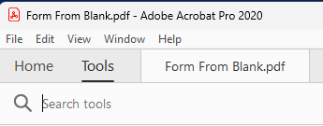
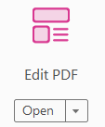
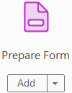
The Form Elements in Detail
Basic Procedures for Adding New Objects & Editing Existing Objects
** The way Adobe works is a bit different from the way Microsoft Office products work in that you must
select the tool you want to work with first before working with the object you have selected on your PDF.
For every new object you add to your PDF:
1. Select the tool group from the Tools link on the menu bar.
2. Select the tool you need from the sub-menu tool group.
3. Draw a box on the document to place the new object.
There are more sub-menu tool groups than the two shown below, however we will only be working with the two below.
Edit sub-menu tool group
Forms sub-menu tool group

Slide 9
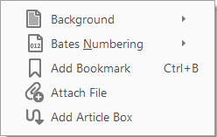
Page
The Form Elements in Detail
General Description - Edit Submenu
9
Add Text -
This control adds a text label but has no active input field, it is only a label.
Add Image -
Add an image to PDF. Be sure to size the image first before adding it to the PDF.
Add Hyperlink -
Add a URL (Uniform Resource Locator) to a file or webpage.
Crop Pages -
Reduces the page to a rectangular section defined by you.
Header & Footer -
Add a date/time, page number or text to left, middle, right.
Watermark -
Add a watermark fastened to the “paper”.
More -
Background – Add a background image or text behind the document content.
Bates Numbering – Add a numbering system to your document used in legal documents.
Add Bookmark - Add a bookmark at the object you have selected in your document.
Attach File – This adds any file you want to your PDF.
Add Article Box – Add a magazine style article to your document.

Slide 10
Page
The Form Elements in Detail
General Description - Forms Submenu
10
Add Text -
This control adds a text label but has no active input field, it is only a label.
Add Text Box -
This control allows for text entry.
Add Checkbox -
The checkbox is an independent control, it is not part of a set as is the radio button.
Add Radio Button -
The radio button is part of a set of two or more buttons where only one can be selected at a time.
Add List Box -
The List Box shows a user selected number of rows of selectable items.
Add Dropdown List -
The Dropdown List Box shows only one row. All other rows are selectable from the drop list.
Add Button -
This adds a clickable button that has an action attached to it.
Add Date -
The Date object is represented as a mini calendar that is selected by clicking on it.
Add Image -
Add an image to PDF. Be sure to size the image first before adding it to the PDF.
Add Signature -
Adds a digital signature to your PDF which encrypts your signature.
Add Barcode -
Adds a bar code for an hand scanner to read.

Slide 11
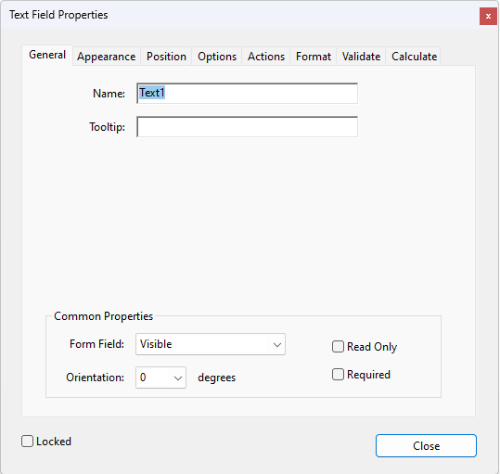
Page
11
Customize – Control Properties
Control Properties Dialogs
General Tab
Name:
Name must be a unique name. The names of the controls must each be different.
Tooltip:
Show text describing the control.
Common Properties
Form Field:
Visible – Visible on screen and printed.
Hidden – Control not visible at any time.
Visible but does not Print – Visible on screen only
Hidden but is Printable - Visible on paper only.
Read Only:
Cannot change form field content.
Orientation:
Change the orientation to the degree.
Required:
Makes the field data entry mandatory.
Locked:
Fixes the control so that it is unchangeable.

Slide 12
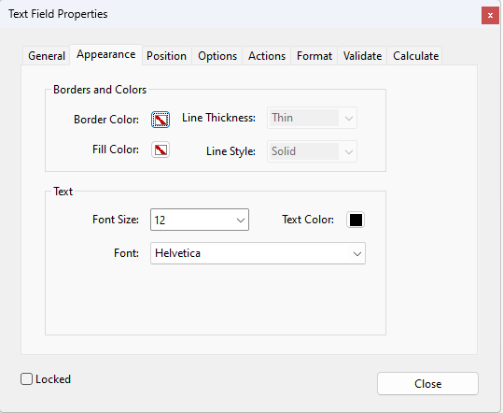
Page
12
Customize – Control Properties
Control Properties Dialogs
Appearance Tab
Borders and Colors
Border Color:
Color of the control’s border.
Fill Color:
Fill the control with the selected color.
Line Thickness:
Thickness of line, measured in pixels.
Line Style:
Choose a line style.
Text
Font Size:
Size of the font, measured in points.
Text Color:
Text appears with selected color.
Font:
Select the font type.
Locked:
Fixes the control so that it is unchangeable.

Slide 13
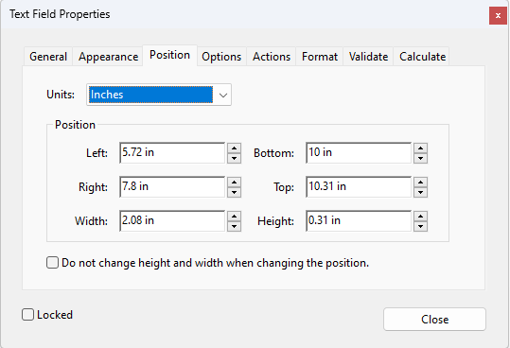
Page
13
Customize – Control Properties
Control Properties Dialogs
Position Tab
Units:
Points – Points are small measurements used to measure both the type, size and the space between the lines of text.
Picas – Picas, which are the larger unit, are used to measure the length of a line of type.
Millimeters – Units measured by millimeters.
Centimeters – Units measured by centimeters.
Inches – Units measured by inches.
Position:
By default, the position fields use the measurement system set up in Windows: Metric or Imperial, however can change that on the fly by selecting the measurement type above, from the Units field.
A checkbox allows you to force text to the size you have specified: height and width.
Locked:
Fixes the control so that it is unchangeable.

Slide 14
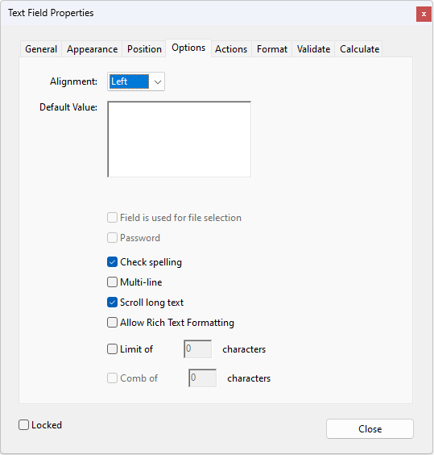
Page
14
Customize – Control Properties
Control Properties Dialogs
Options Tab
Alignment:
Align the text left, center, or right.
Default Value:
If you have default text for this control, enter it in this field.
Field is used for file Selection:
When used in conjunction with
the field’s object browseForFileToSubmit method. It allows the user to attach a file to the form field.
Password:
Password protect the data that is typed into the field.
Check Spelling:
Self-explanatory.

Slide 15
Page
15
Customize – Control Properties
Control Properties Dialogs
Options Tab
Multi-line:
Allow multiple lines in the control.
Scroll long text:
Allows text in the control to be greater than what can be displayed in the control.
Allow Rich Text Formatting:
Allows text in the control to be
formatted in the Microsoft Rich Text Format.
Limit of:
Only allows max number of characters.
Comb of:
Spreads the user-entered text evenly across the width of the text field. In MS Word this is called Expanded Spacing (located in the Font dialog / advanced tab / Character Spacing group.)

Slide 16
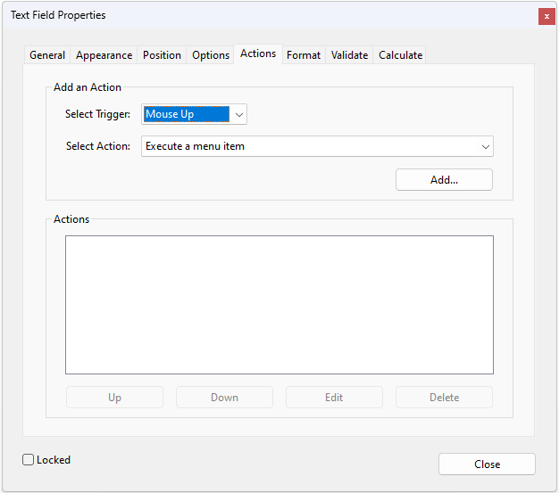
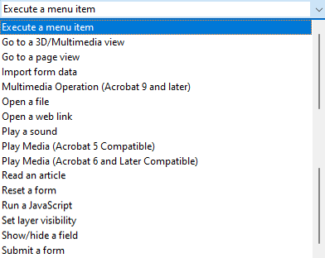
Page
16
Customize – Control Properties
Control Properties Dialogs
Actions Tab
Add an Action -
Select Trigger:
Mouse Up Mouse Enter On Blur
Mouse Down Mouse Exit On Focus
The mouse action is initiated when …
Mouse Up - the mouse button is released over the form field
Mouse Down - the mouse button is moved over the form field, without waiting for the release
Mouse Enter - the mouse pointer enters the boundary or area of the form field
Mouse Exit - the mouse pointer leaves the boundary or area of the form field
On Blur - a form field loses keyboard focus
On Focus - the form field receives keyboard focus, either by a user clicking on it with the mouse or navigating to it using the Tab key

Slide 17
Page
17
Customize – Control Properties
Control Properties Dialogs
Actions Tab
Add an Action -
Select Trigger:
Mouse Up Mouse Enter On Blur
Mouse Down Mouse Exit On Focus
Select Actions:
Listed below are the descriptions of all the actions available for you to apply to a control.
Execute a menu item -
This selection offers a lot of flexibility for your document.
Go to a 3D/Multimedia view -
Pulls up a video player.
Go to page view -
Switches to single page view.
Import form data -
Imports data to populate a form in your PDF.

Slide 18
Page
18
Customize – Control Properties
Control Properties Dialogs
Actions Tab
Multimedia Operation:
Executes an action for a multimedia
object in the file, for example, playing a sound file.
Open a File:
This opens a file dialog box for you
to select from. Adobe Acrobat Reader needs the native application of the linked file to open it successfully.
Open a web link:
This opens the web page you specify.
Plays a sound:
Play the embedded sound file.
Plays Media:
Two selections for this media option;
Acrobat 5 and earlier, Acrobat 6 and later.
Read an Article:
Define sections of content from
different spots in your PDF that flow one to another, similar to magazine articles that flow through the magazine.

Slide 19
Page
19
Customize – Control Properties
Control Properties Dialogs
Actions Tab
Reset a form:
Reset the form fields to their defaults. You can choose the specific form fields to reset.
Run a JavaScript:
Write your own JavaScripts and run them.
Set Layer Visibility:
You can set the control to visible or invisible.
Show/Hide Field:
Two selections for this media option;
Acrobat 5 and earlier, Acrobat 6 and later.
Submit a Form:
This submits the form to: Print or Export.

Slide 20
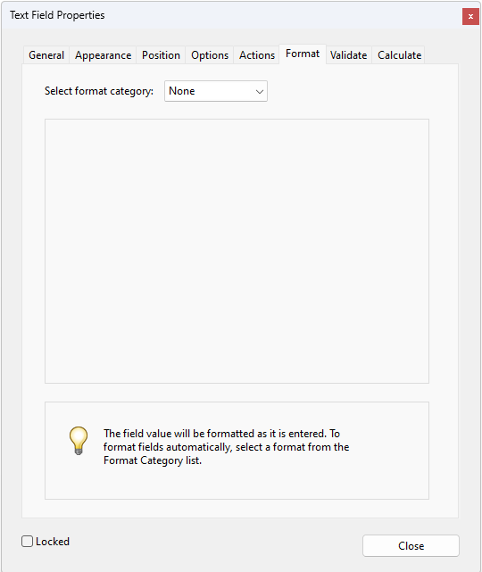
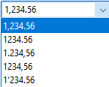
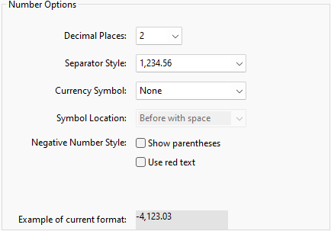
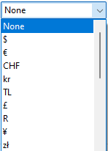
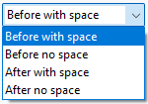
Page
20
Customize – Control Properties
Control Properties Dialogs
Format Tab
Select Format Category:
The format categories are data types.
Number:
Set the form control to a number format with the following options.
Negative Number Style: Self-explanatory.

Slide 21
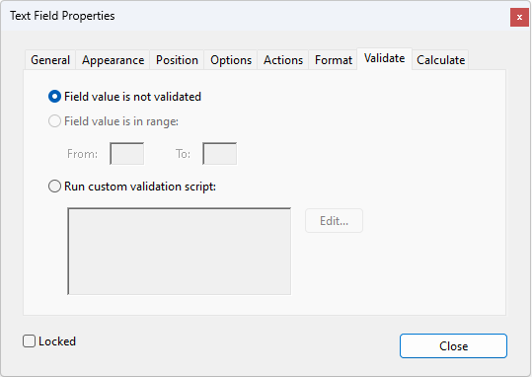
Page
21
Customize – Control Properties
Control Properties Dialogs
Validate Tab
Field value is in range:
Set the top and bottom values.
Run custom validation script:
Make your own custom script,
created in JavaScript, to validate the form field you have selected.

Slide 22
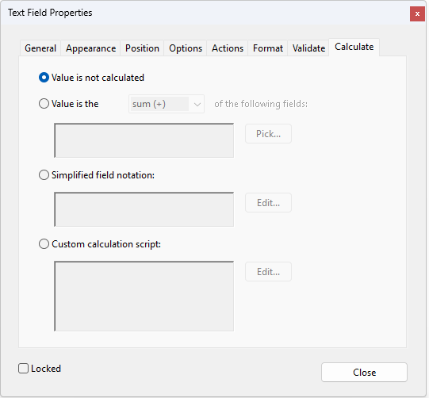
Page
22
Customize – Control Properties
Control Properties Dialogs
Calculate Tab
Select one of the following:
Value is the:
Select from the Pick… dialog the field(s) to which to apply the calculation.
Simplified field notation:
Click on the Edit… to get the
JavaScript dialog. Enter your formula here.
Simplified Field Notation allows the creation of much more
complex calculations.
It uses a notation similar to how a calculation would normally be written, that is, using the regular math symbols, addition, subtraction, multiplication and division. Field names are used as operands. (quote from Adobe Help)
Custom calculation script:
Enter your formula using full
JavaScript to calculate the field you have selected.
Notes:
Calculated fields can be used for any scenario where the document needs to be dynamically updated at time of signing.
Below are a few sample use cases where calculated fields can be used. These use cases are for illustration purpose only.
1. Setting up an Order Form—Calculated fields can be used to set up an order form in which the signer has the option to select from a list of available items and specify a quantity.
2. Automatically populating contract term expiration date—For agreements that allow customers to choose the length of term of the contract at time of signing (6 months, 12 months, 24 months, etc.), a calculated field can be used to automatically populate the end date for the contract based on the selection made by the customer at time of signing the contract.
3. Sign up forms with multiple choices—A calculated field can be used to set up sign-up forms (such as membership forms) where the person signing the form can choose from a set of available options. The choices made by the signer can drive other dynamic aspects of forms, such as the terms the signer is agreeing to, the duration of the contract, and also the total cost.

Slide 23
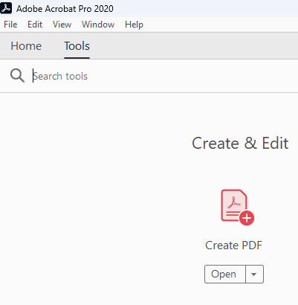
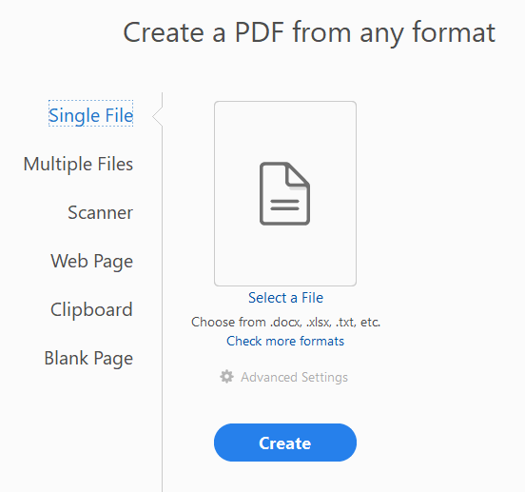
Page
Making a Form
From Scratch
23
Creating from scratch means we first need to create a blank PDF document.

Slide 24
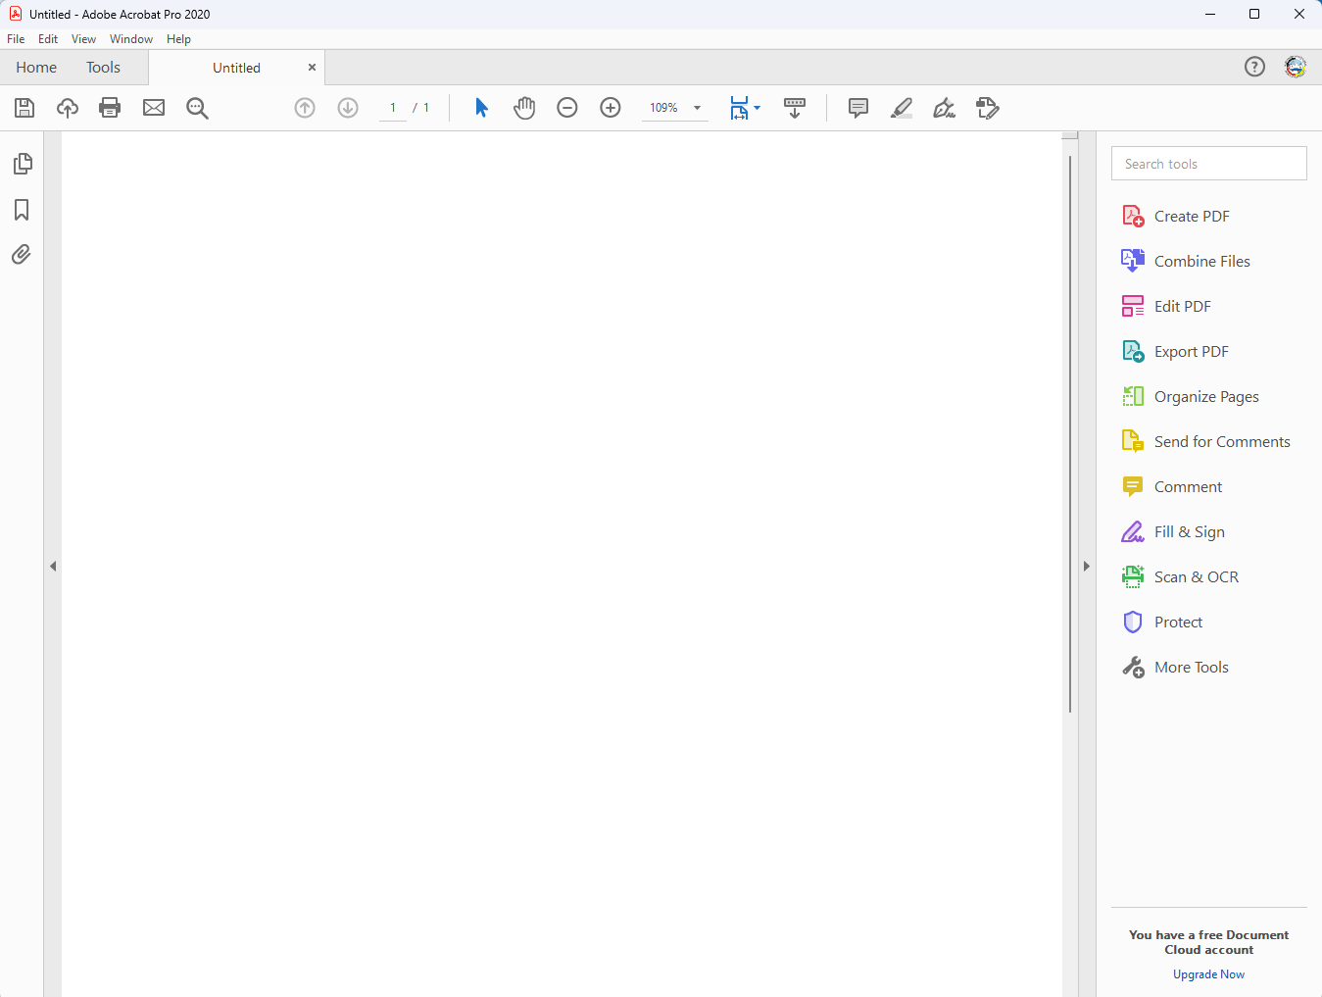
Page
Making a Form
24
The dreaded blank screen.
Add and configure the following fields:
Text
Text Box
Checkbox
Add Image
Add Signature
Add Radio Button
Add Date
Add Dropdown List
Add List Box
Add Button

Slide 25
Page
25
All demonstrations adding fields to the PDF will be done during the course.

Slide 26
What we have covered in this course?
Understanding Adobe Forms
Procedure to embed custom fonts into the PDF
Adobe File Types
The Form Elements in Detail
Add Text
Add Text Box
Add Checkbox
Add Radio Button
Add List Box
Add Dropdown List
Add Button
Add Image
Add Date
Add Signature
Add Barcode
Making a Form
From Scratch
From a Word Document

Slide 27
NITHA IT Helpdesk
helpdesk@nitha.com
1(306)953-5008

Slide 28

Thank you

