Slide 1


Adobe Acrobat Pro 2020 Part 1
Entry Level

Slide 2
NITHA IT Helpdesk
helpdesk@nitha.com
1(306)953-5008

Slide 3

What will we be covering in this course?
Where to find Acrobat 2020 help online
Editing a PDF
Adobe Acrobat Pro Tutorials
Edit, Add Text, Add Image, Add Hyperlink
Adobe Acrobat Pro User Guide
Add Watermark, Watermark vs. Background
Export PDF
Creating a PDF
From a Blank Page
Organizing Pages
From a Single or Multiple Files
Rotate a Page, Delete a Page, Extract a Page
From the Clipboard
Insert a Page, Split the Document, Print Pages

Slide 4
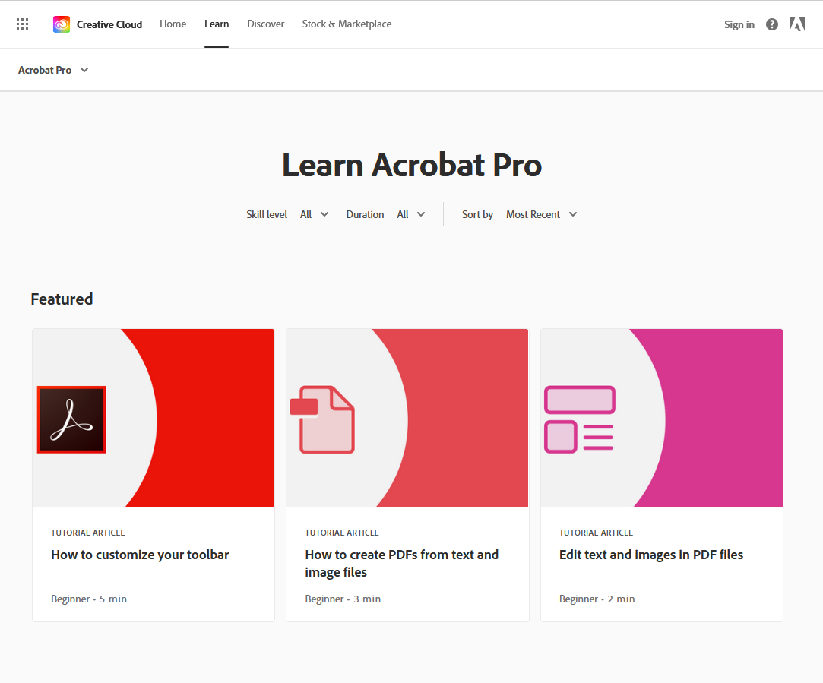
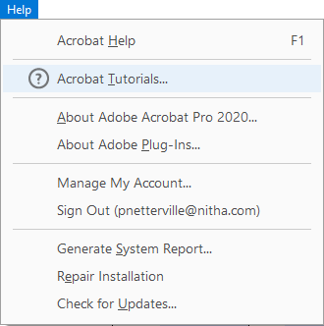
Page
Go to the link
4
Adobe Acrobat Pro Tutorials
https://creativecloud.adobe.com/learn/app/acrobat#fundamentals
OR
displays
Choose a skill level and the length of the help video clips. Generally, the longer the video length, the more detailed the help provided.
OR
Select from one of the featured videos.

Slide 5
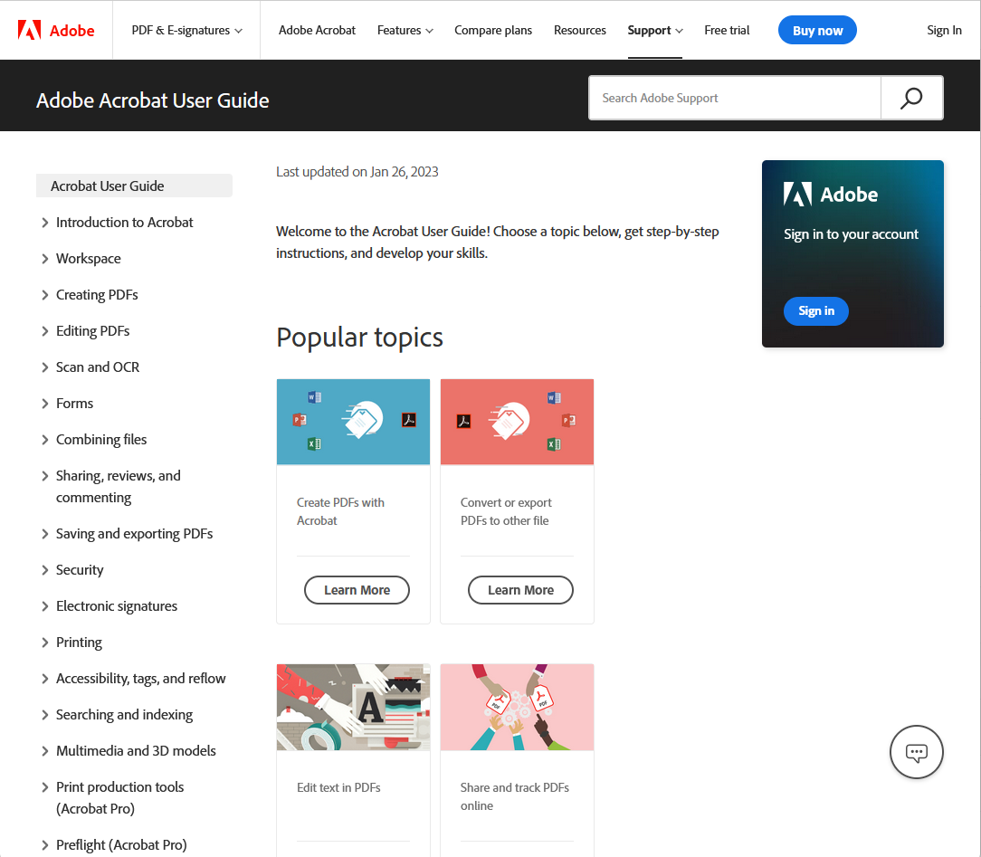
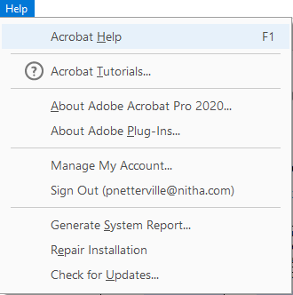
Page
Go to the link
https://helpx.adobe.com/acrobat/user-guide.html
5
Adobe Acrobat Pro User Guide
OR
Displays
Search for a help topic or
… on the panel to the right
Select a category from this list which displays available articles & videos …

Slide 6
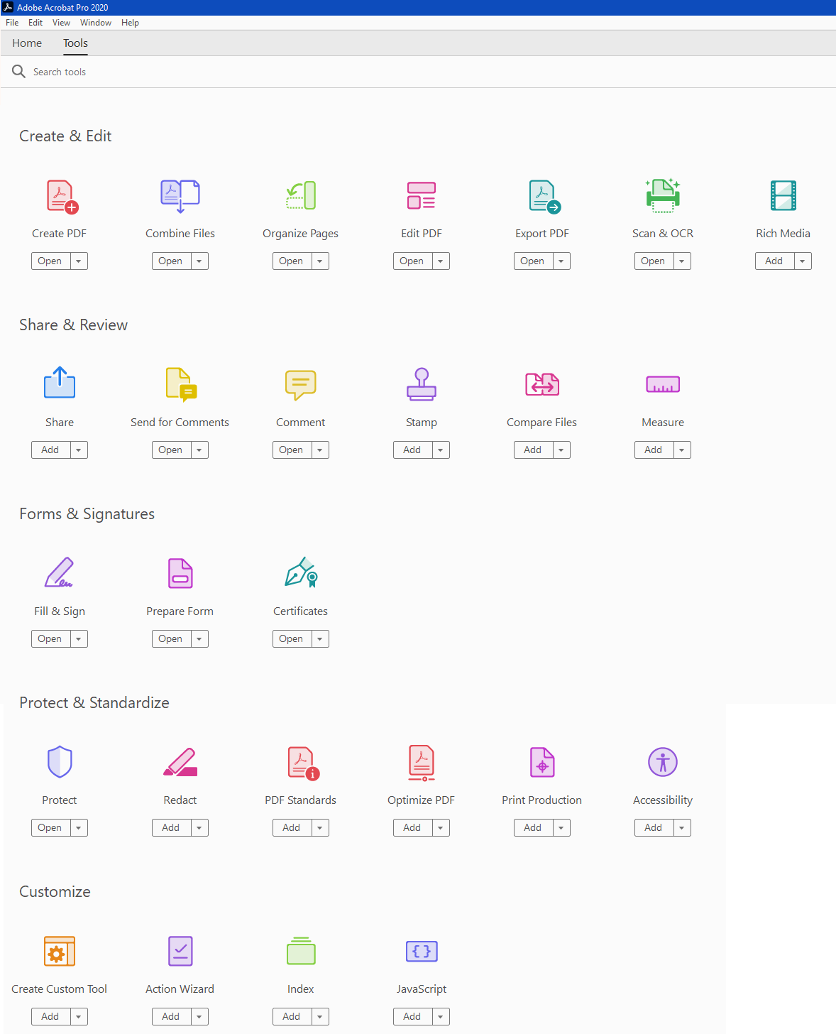
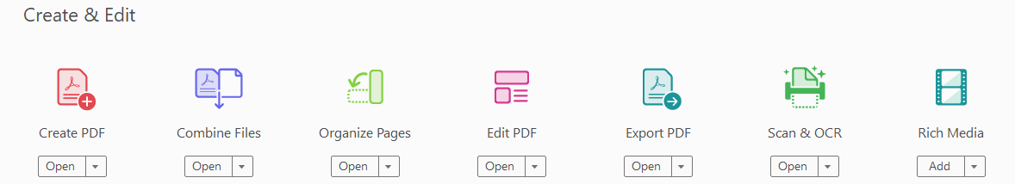
Adobe Acrobat Pro Screen Layout

Slide 7
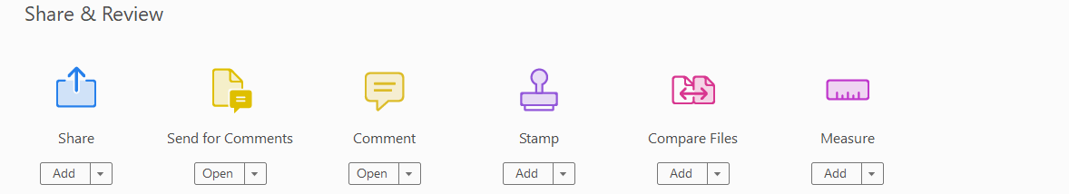
Adobe Acrobat Pro Screen Layout

Slide 8

Adobe Acrobat Pro Screen Layout

Slide 9
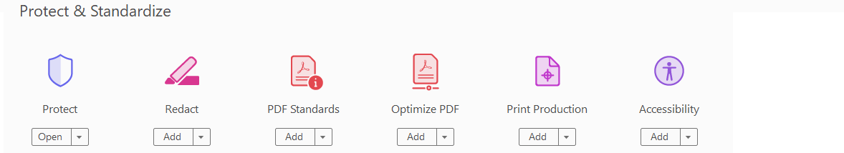
Adobe Acrobat Pro Screen Layout

Slide 10
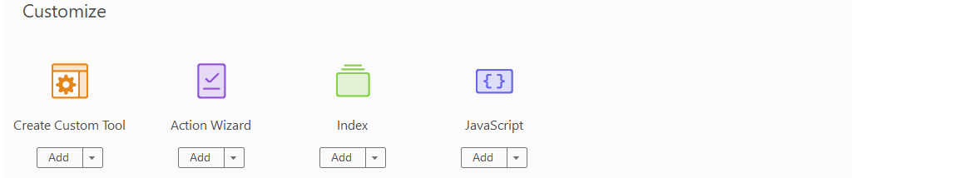
Adobe Acrobat Pro Screen Layout

Slide 11
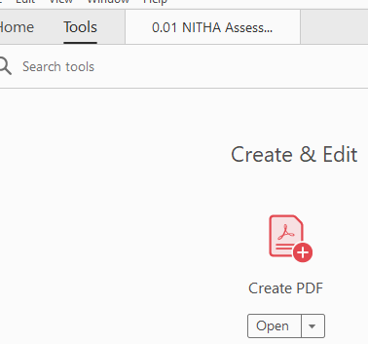
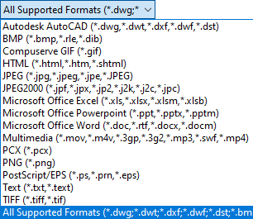
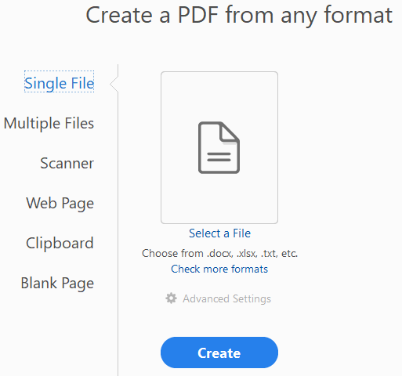
Page
11
Creating a PDF from a Single File
From the Tools screen …
Click on the Create PDF icon.
click
Adobe supports importing many types of files.
click
This displays an Open file dialogue box so you can select your file.

Slide 12
Page
12
Creating a PDF from a Multiple Files
From the Tools screen …
Click on the Create PDF icon.
click
… of the following selection file types.
click
Which displays an Open file dialog box so you can select one or more files …

Slide 13
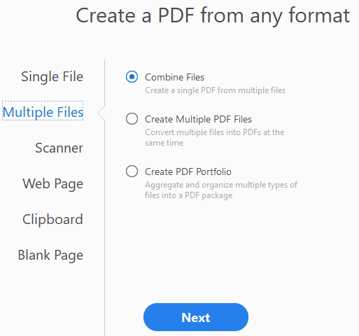
Page
Creating a PDF from a Multiple Files
13
From the Tools screen …
Choose Multiple Files
Click on the Create PDF icon.
Combine Files – Each file is imported into one or more separate pages appended to the bottom of the document sequentially for each file opened.
Multiple PDF Files – Each file is imported into one or more separate pages, and each file is made into a separate PDF document.
Create PDF Portfolio - A PDF Portfolio contains multiple files assembled into an integrated PDF unit, which can have many different file types.
What makes this different is that each file retains its individual identity, so you can open, read, edit, and format each component file independently of the other component files in the PDF Portfolio.
Notes:
Question 1: Where do you go to start a blank PDF?
Answer 1: d. Tools / Create PDF / Blank Page

Slide 14
Page
Creating a PDF from Multiple Files – Advantages of a PDF Portfolio
14
Add or remove files easily, without having to find and select all the pages that originated in that file.
Drag files to rearrange, and drop files to folders, or folder to another folder at the same level in the navigation pane of the PDF Portfolio.
Quickly preview component files without opening them in their native applications.
Change individual files within the PDF Portfolio without affecting the other files. For example, you can renumber pages in one document without renumbering other documents in the PDF Portfolio. You can also edit non-PDF files in their native applications from within a PDF Portfolio. Any changes you make are saved to the file within the PDF Portfolio, not to the original file.
Share a PDF Portfolio with others and ensure they receive all the portfolio components.
Publish a PDF Portfolio on a website for others to view.
Sort component files by categories that you can add to, delete, hide, and customize. Simply click a column name to sort the list.
Print all the PDFs in a PDF Portfolio, or selected component PDFs.
Search one or all files in a PDF Portfolio. You can even search non-PDF component files.
Add non-PDF files to an existing PDF Portfolio without converting them to PDF.
The source files of a PDF Portfolio—even existing files you add to the PDF Portfolio—are not changed when you create a PDF Portfolio. Changes you make to the component files within a PDF Portfolio do not change the original files from which you created the PDF Portfolio.
Notes:
Question 2: What is a PDF Portfolio? (Select three) (Slide 14)
Answer 2:
a. Multiple files assembled into an integrated PDF unit
c. Allows you to edit each file individually in original app
d. Can add non-PDF files to portfolio

Slide 15
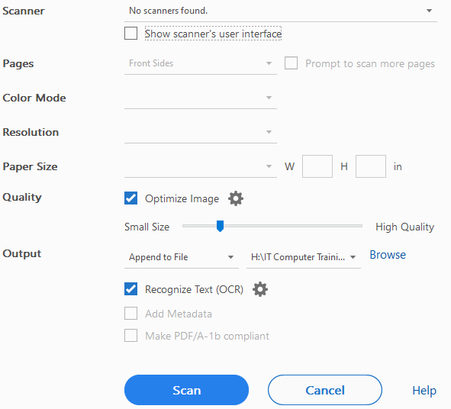
Page
15
Creating a PDF from a Scanner
If you have a scanner you can set:
Side of Page – Front, back or both.
Color Mode – RGB (millions of colors)
– CMYK (four-printed colors)
– Greyscale (256 shades of gray)
Resolution – pixels/dots per inch.
Paper Size – 8 ½ X 11, for example
Image Quality – Make smaller using compression but lose quality: lossy format.
Output Location - Local, network or OneDrive.

Slide 16
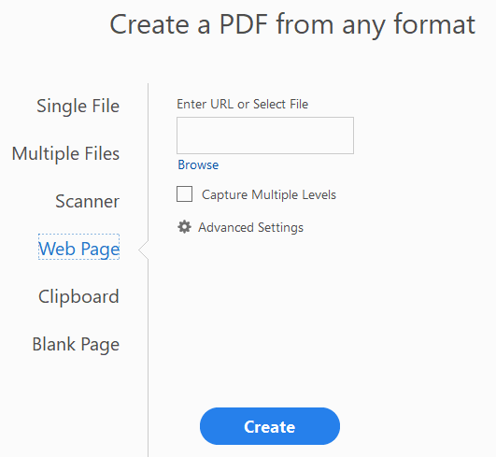
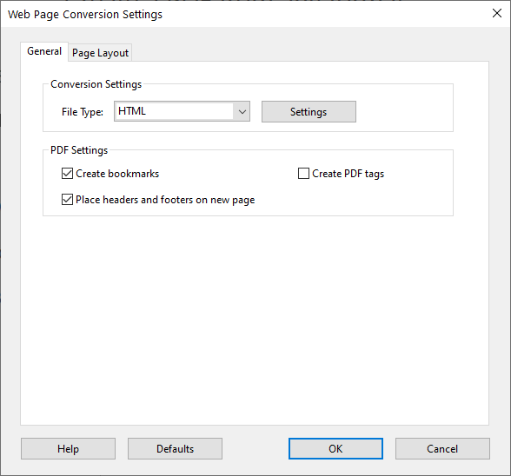
Creating a PDF from a Web Page
Type in or copy and paste a hyperlink (URL), or choose a web page saved as a file.
Reads in one or more web pages and converts each web page to a PDF page.
Is this the first level only or should Adobe open recursive levels through hyperlinks on the web page(s).
i.e. NITHA.COM and all its’ pages, but no pages that access pages outside of NITHA.COM.
Page
16

Slide 17
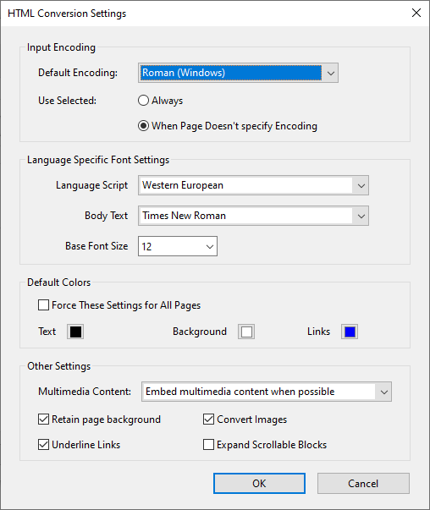

Page
17
Creating a PDF from a Web Page
HTML Conversion Settings
Choose between HTML or Text.
HTML is the language of web pages.

Slide 18
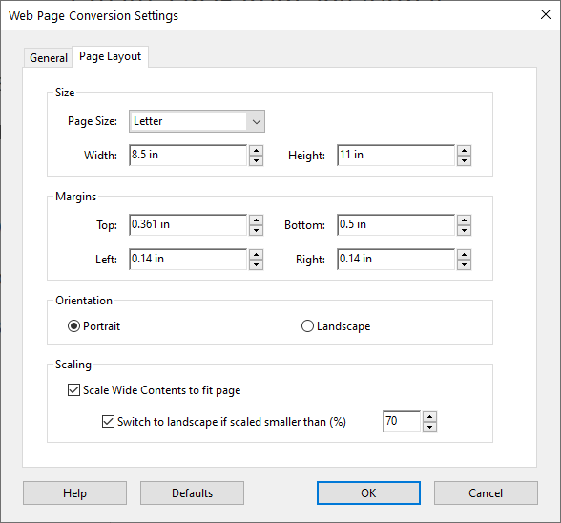
Page
18
Creating a PDF from a Web Page
Change the paper size.
Change the margins.
Change the paper orientation.
Scale large web pages to fit the paper.

Slide 19
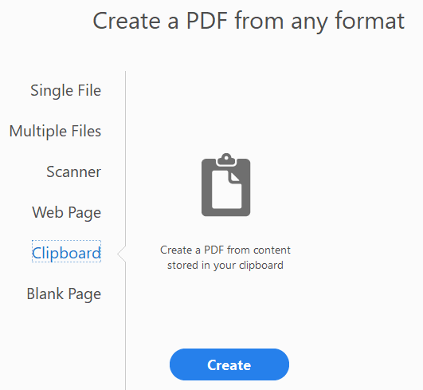
Creating a PDF from the Clipboard
Any content you have in the clipboard will be converted to a PDF page or pages, so long as the content is of an appropriate type which can be converted to a PDF format.
For example, if you copy a file using File Explorer and then try to make a PDF from the file you copied to the clipboard, you will not be successful.
However, if you open up the file in the program that will support that file, such as a DOCX document in MS Word or an XLSX workbook in Excel, and then copy the contents of the opened file into the clipboard, you will be successful.
Page
19

Slide 20
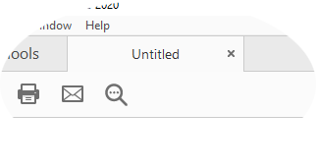
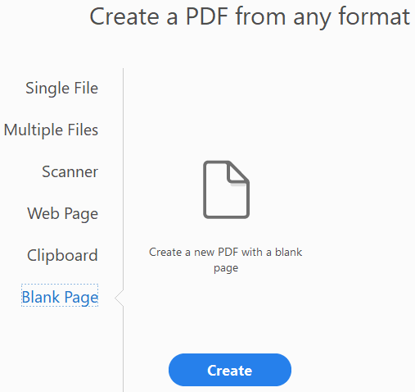
Page
20
Creating a PDF from a Blank Page
From the Tools screen …
Click on the Create PDF icon.
which creates an Untitled PDF
click
click
Notes:
Question 2: Where do you go to start a blank PDF?
Answer 2: d. Tools / Create PDF / Blank Page

Slide 21
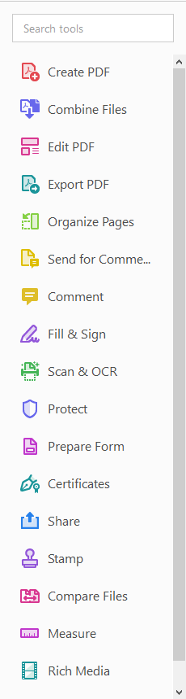
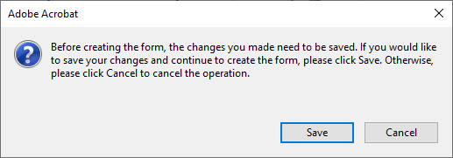
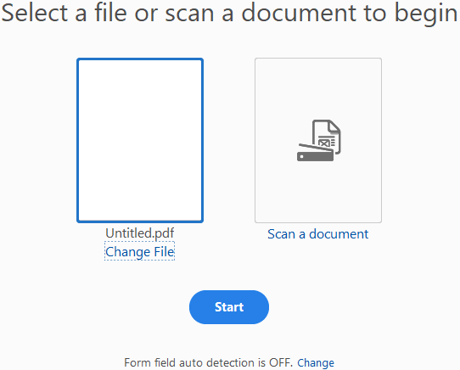
Page
21
Creating a PDF from a Blank Page
Once you have created a blank page …
… you need to figure out what you want to put on the page and then choose the correct tool set.
to add pictures & text select the Edit PDF toolset.
edit toolbar
to create a fillable form select the Prepare Form toolset.
Select Untitled.pdf
Save your PDF to a folder with the name of your choice.
Prepare Form toolbar

Slide 22
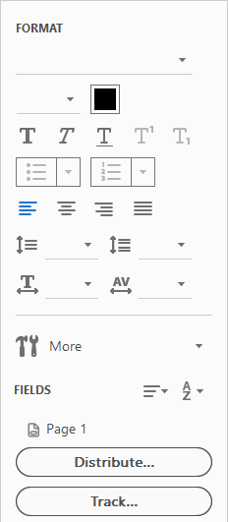
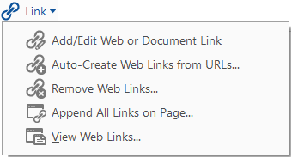
Page
22
Creating a PDF from a Blank Page – Edit PDF Toolbar overview
Click on Link to view the link menu.
Click the Edit tool to select an existing text, image, link, or other object on the page so that you can change it or delete it.
Click the Add Text tool to add text using the panel below.
When Add Image is selected a file Open dialog appears for you to select an image from your drive or OneDrive.
NOTE: To keep your PDF file size as small as possible, resize and optimize the image first.
F
Do not insert a large image and
size it smaller in the PDF document because that only makes it visually smaller. The image byte size remains the same.

Slide 23
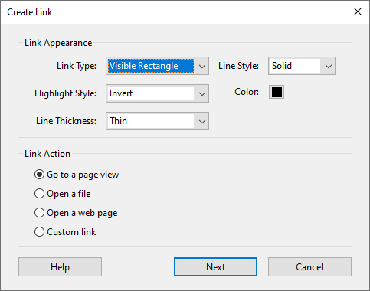
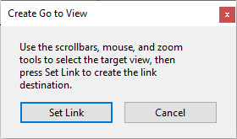
Page
23
Creating a PDF from a Blank Page – Edit PDF
Creating a PDF from a Blank Page – Edit PDF Toolbar overview
draw a rectangle on the page where you want the link to be then this dialog appears.
TIP: The link rectangle is nothing more that place to click. There is no text or image in the link box. The link box is simply an overlay.
Selecting Open a File displays an Open Dialog when the Next button is clicked at which point you can select a file to open.
Selecting Open a webpage opens the default web browser and displays the requested web page.

Slide 24
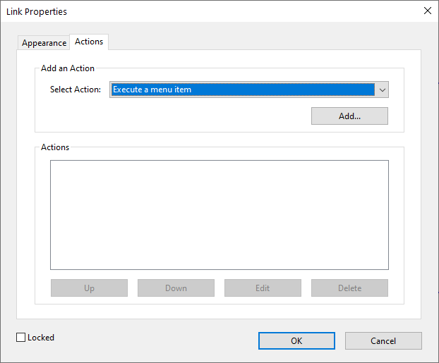
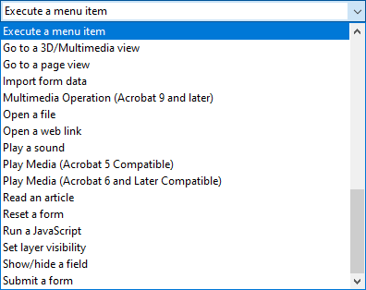
Page
24
Creating a PDF from a Blank Page – Edit PDF
Creating a PDF from a Blank Page – Edit PDF Toolbar overview
1. Click on the Actions tab.
The Custom link allows for the most options.
2. Click on the arrow to see all the options.
There is a wide variety of actions that can be applied to the link overlay box from executing a menu to playing media to resetting a form to blank and much more.

Slide 25
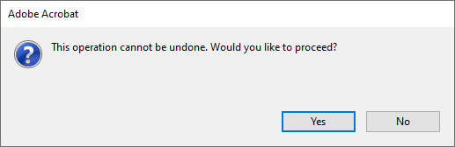
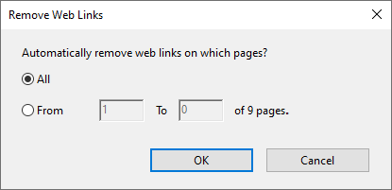
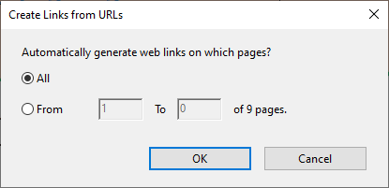
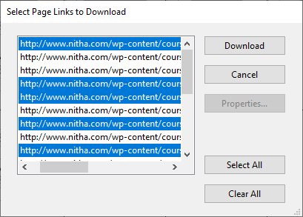
Page
25
Creating a PDF from a Blank Page – Edit PDF Toolbar overview
=
This option finds all the hyperlinks on a page and make a bookmark for each.
Adobe downloads each webpage from the links you have selected and makes them into a page in the document append to the bottom of the document and makes a bookmark to the page.

Slide 26
Page
26
Creating a PDF from a Blank Page – Edit PDF Toolbar overview
Cropping a page means: to adjust the visible area of a page.
A watermark is a stamp that is composed of text.
It appears either in front or behind existing document content.
Cropping pages can help you create consistency in a PDF with pages of different sizes.
Headers and footers in Adobe are similar to those in MS Word or Excel, with three sections: left, middle, and right. However, only the following can be added.
text
date field
page number
A watermark is integrated into the PDF pages as a fixed element.
The background is not fixed to the page, but it is behind the content.
Notes:
Question 3: Where do you go to add a Watermark.
Answer 3: c. Tools / Edit / Watermark

Slide 27
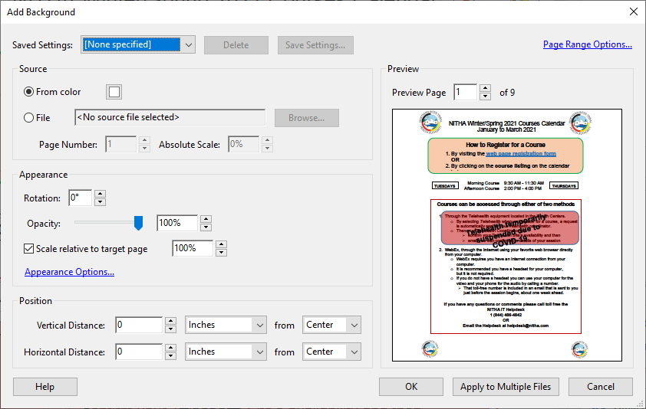
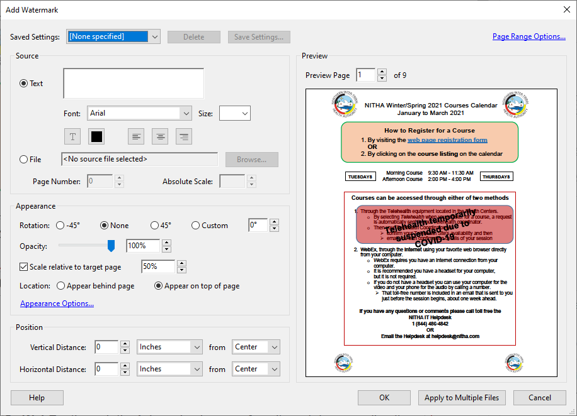
Page
27
Creating a PDF from a Blank Page – Edit PDF Toolbar overview
Background
Watermark
The Add Background and the Add Watermark dialogs are almost identical except that which is highlighted above.

Slide 28
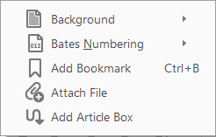
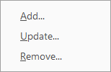

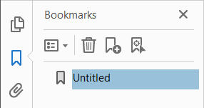
Page
28
Creating a PDF from a Blank Page – Edit PDF Toolbar overview
Bate Numbering is the process of assigning a unique sequential identification number to each page.
Attach File opens a file dialog box.
Keep in mind that for every file you attach to the PDF, the your PDF size increases the exact size of the file you attached.
Adding a Bookmark adds to the Bookmark panel that is displayed on the left side.
The article feature enables you to guide your readers through material presented in multiple columns and across a series of pages, just like in magazines and newspapers.
You create an article by defining a series of boxes around the content in the order in which you want the content to be read.

Slide 29
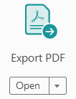

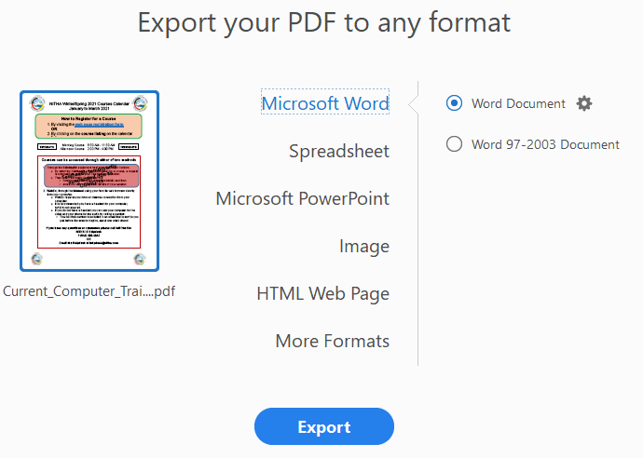
Page
29
Create & Edit - Export PDF
In order to create a file different from the default PDF, use the Export PDF function found on the Tools page …
1
2
3
4
5
… where you will find 11 different file formats …
Rich Text Format
Encapsulated Postscript
Postscript
Text (Accessibility)
Text (Plain)
XML 1.0
6 to 11
Notes:
Question 4: To what formats can you export your PDF? (Select all that apply)
Answer 4: (All)
Rich Text Format
Encapsulated Postscript
Postscript
Spreadsheet

Slide 30
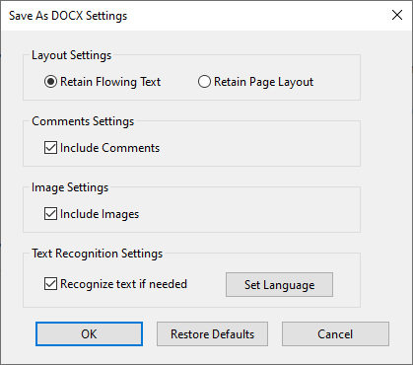
Page
30
Create & Edit - Export PDF
The first export type is to MS Word …
… to the new format (.docx) of version 2007, 2010, 2013, 2016, 2019, 365.
… to the older proprietary format (.doc) of versions 97 to 2003.
Don’t expect the export to be the best for these old formats. You will most likely have to do some fixing in Word.

Slide 31
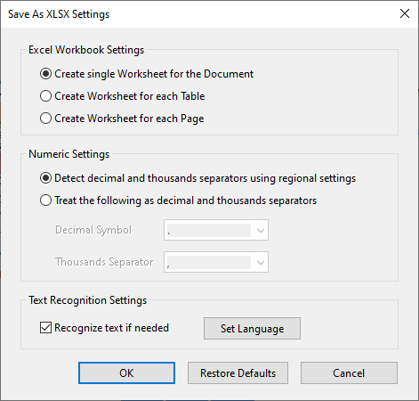
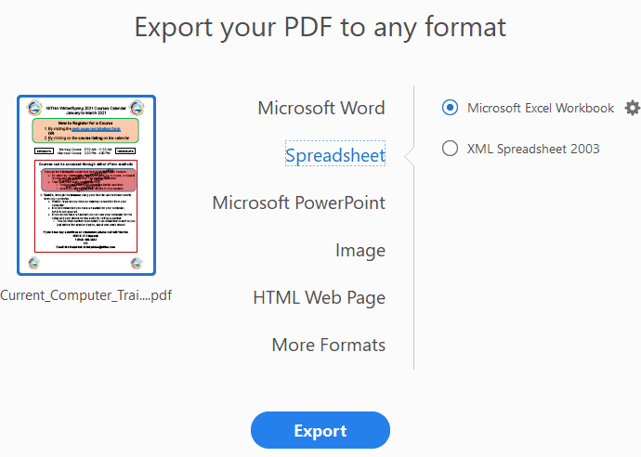
Page
31
Create & Edit - Export PDF
The second export type is to MS Excel …
… to the new format (.xlsx) of version 2007, 2010, 2013, 2016, and 2019.
… to the universal XML standard.
You will then need to run Excel 2003 to import the XML file.

Slide 32
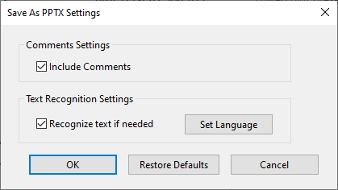
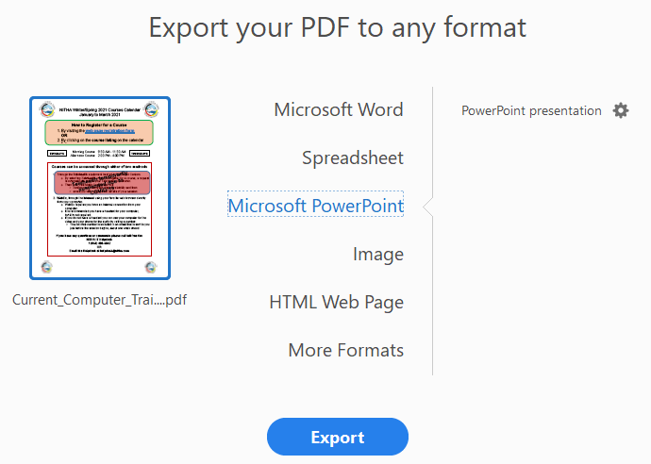
Page
32
Create & Edit - Export PDF
The third export type is to MS PowerPoint…
… each page in the Adobe PDF document will be converted to a PowerPoint slide.

Slide 33
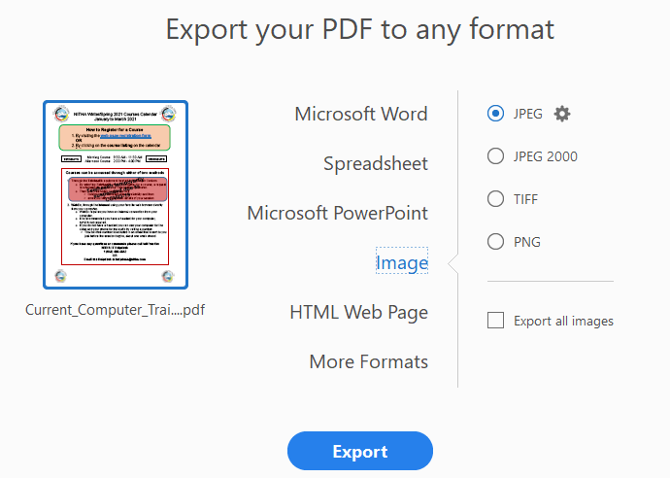
Page
33
Create & Edit - Export PDF
The fourth export type is to an image …
… four different raster graphic file formats are supported.
JPEG/2000 – Lossy compression format, file size can be made small by loss of image quality.
TIFF – A flexible, adaptable file format for handling images and data within a single file
PNG – Uses a lossless data compression supporting palette-based images & transparency layers, supporting even partial transparency.

Slide 34
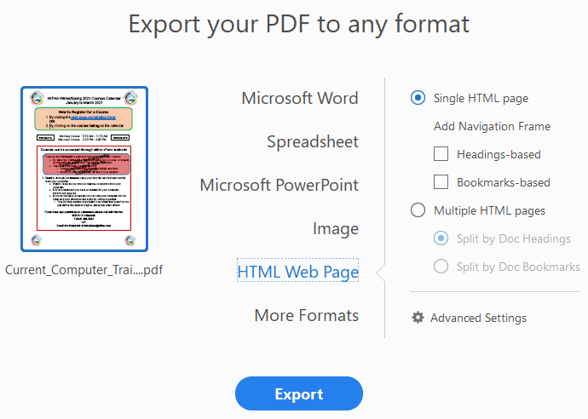
Page
34
Create & Edit - Export PDF
The fifth export type is to an HTML web page …
Regardless of how many pages you have, this option will create one web page tacking each page below the previous in one long web page.
This option will add headers and/or bookmarks in the web page to provide a method to navigate the web page content.
If you want multiple web pages, one for each page from your PDF document, then you can choose to separate each page by using:
Your document’s headings
Your document’s bookmarks

Slide 35
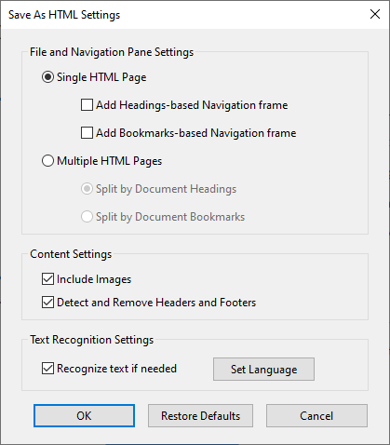
Page
35
Create & Edit - Export PDF
The fifth export type is to an HTML web page …

Slide 36

Page
36
Create & Edit - Export PDF
Rich Text Format (RTF) is a Microsoft centric format which allows for fonts & other formatting.
The sixth through eleventh export types …
Encapsulated Postscript (EPS) is a self-contained graphics program used mostly for printers.
Postscript (PS) is a page description language used in desktop publishing.
Text Accessibility (txt) is simple characters with no formatting information, but includes any text used for visually impaired individuals.
Text (txt) is simple characters with no formatting information.
XML 1.0 (XML) is a universal standard that contains data and the tags to define that data in text.

Slide 37
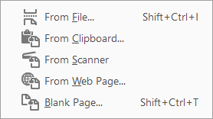
Page
37
Organize Pages - Extract
Insert page(s) displays a menu that has the following functions:
Replace opens an Open dialogue that lets you choose one file from a list of many file types to replace the selected page(s).
Rotating pages allows you to position the page at any angle.
Extract pages displays a thumbnail of each page in the document.
Select one or more pages, and the toolbar below becomes available.
If you do not check Extract pages as separate files, then the selected pages are all made into one new PDF.
Notes:
Question 5: When you scanned in a page it ended up upside-down. How do you correct that in Adobe?
Answer 5: d. Go to the Tools, Organize Pages and rotate it from there

Slide 38


Page
38
Organize Pages - Split
Selecting Split will display another toolbar …

Slide 39


Organize Pages – Print Pages …

Slide 40

Organize Pages – Print Pages …

Slide 41


We have covered here in this course …
Where to find Acrobat 2020 help online
Editing a PDF
Adobe Acrobat Pro Tutorials
Edit, Add Text, Add Image, Add Hyperlink
Adobe Acrobat Pro User Guide
Add Watermark, Watermark vs. Background
Export PDF
Creating a PDF
From a Blank Page
Organizing Pages
From a Single or Multiple Files
Rotate a Page, Delete a Page, Extract a Page
From the Clipboard
Insert a Page, Split the Document, Print Pages

Slide 42
NITHA IT Helpdesk
helpdesk@nitha.com
1(306)953-5008

Slide 43

Thank you

